Slide 1
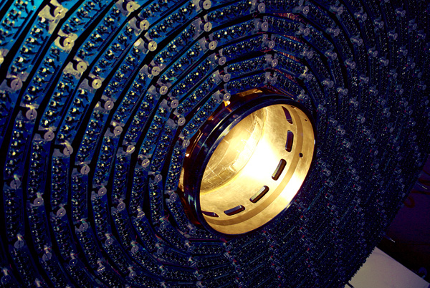
Detector Technology and Systems Platform Berlin Workshop Plans 2013 - 2019
Christiane Buchwald

Slide 2
Research Fields of the Helmholtz Association
Energy
Earth and Environment
Health
Key Technologies
Structure of Matter
Aeronautics, Space and Transport

Slide 3
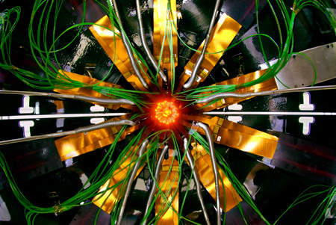
Program Oriented Funding (POF)
POF II: will end 2014
POF III: will start in 2015
Funding Period: 5 years

Slide 4
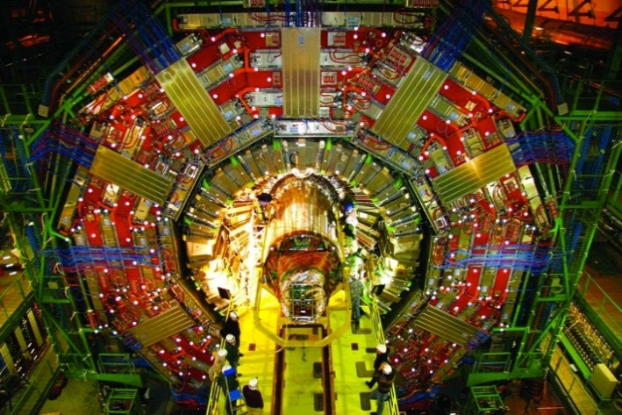
From Portfolio to POF III
The portfolio extension will become a new program topic 3.2 „Detector Technology and -Systems“ in the program „Matter and Technology“
The funding of the portfolio will thus be continued beyond 2015.
Deadline for funding proposals in the reseach field „Matter“ is 1st November 2013.
BUT: The outline of the proposal is required at 19th June 2013.

Slide 5
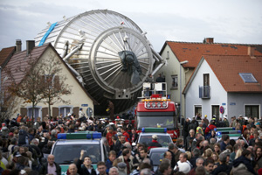
POF II: „Structure of Matter“
Elementary Particle Physics
Astroparticle Physics
Hadrons and Nuclear Physics
Research with Photons, Neutrons and Ions (PNI)

Slide 6
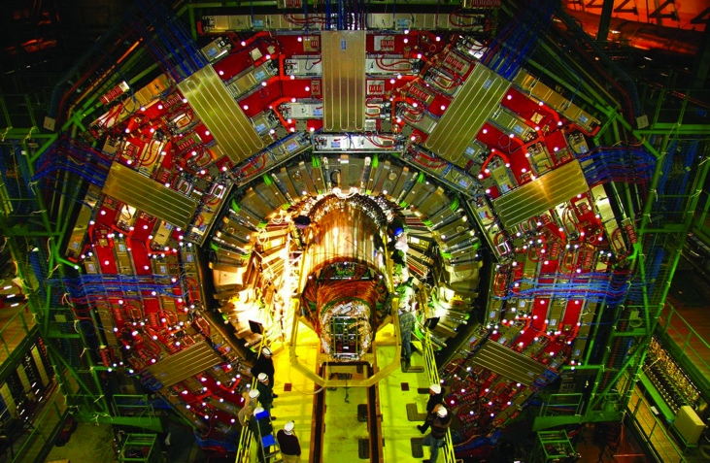
„Structure of Matter“ becomes „Matter“
Program 1: Matter and Universe
Program 2: From Matter to Materials and Life
Program 3: Matter and Technology
3.1. Accelerator Research and Development
3.2. Detector Technology and -Systems

Slide 7
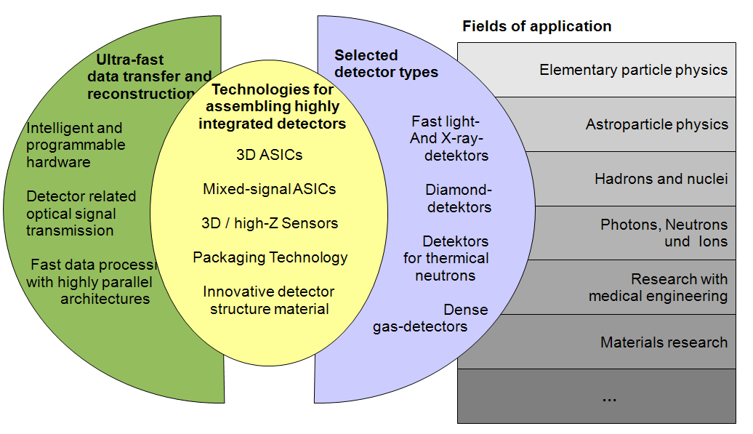
This is the structure of the current platform

Slide 8
Work packages in program topic 3.2 (preliminary)

Slide 9
What should be the structure in POF III?
Example A:
Ultrafast data transfer and reconstruction
Technologies for assembling highly integrated detectors
Selected detector types
Example B:
Enabling Technologies
Interfacing detector and user
Demonstrating technologies
Example C:
…

Slide 10
Questions for Discussion I
General organization of pillars and work packages?
Matrix of technologies and applications
Key topics for the proposal?
Review of the existing work packages for PoF III?
Additional (ground breaking) topics?
Personal effort / Milestones
Are there new technologies?
What results can be expected until 2019? (especially for 3D technologies)
What are key contributions to applications and further experiments?
Do we cover all technologies needed for the next generation of sources and accelerators?

Slide 11
Questions for Discussion (cont.)
Overlap / Interface to programme „SuperComputing and Big Data“?
What is our potential for collaboration with industry / Spin-offs?
Helmholtz likes women in executive positions
Proposals are most welcome
Further candidates for work packages?

Slide 12
„Benchmarks from Prof. Mlynek“
Standing
International reputation of collaboration? Is the science/topics world leading?
Balance
Why do we choose these topics?
Priorities and posteriorities
Potential (opportunities)
Think big, act big
What do we want to achieve in five years?
Where do we make a difference?

Slide 13
„Suggestions for parallel sessions
Check why this research is crucial and indispensible for your future experiment
Why can this technology not be bought or better be developed elsewhere?
Consider what not do and why not.
Which demonstrator do you need?
Where are opportunities for spin-offs outside of „Matter“?
Always be as specific as possible!

Slide 14
„Requirements from BMBF
(„Forschungspolitische Vorgaben“)
No blue skies research !
Detectors must serve specific needs of science of (future) accelerators and sources

Slide 15
Matrix: Technologies vs. Applications?

Slide 16
Evaluation of work packages (initial guess)

Slide 17
Material for parallel sessions

Slide 18
POF II
Period 2013 - 2014
Goals
Milestones
Results
Please keep POF III in mind, when planning POF II

