Slide 1
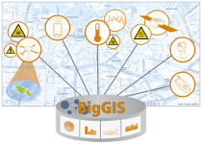
BigGIS –
Stream Enrichment with Temperature Data
BDAHM/SDIC 2017, 11.10.2017
Julian Bruns
Matthias Frank
Dr. Viliam Simko
Prof. Jens Nimis
Prof. Thomas Setzer
Patrick Wiener
Notes:
<number>

Slide 2
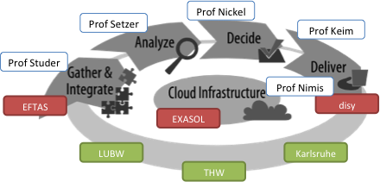
Project Goal -
Overview
Development of a GIS to model complex relationships and developments for big, unreliable and high-dimensional as well as the development of new analytical mechanism for decision support in real time.
12.05.2016
<number>
Notes:
<number>

Slide 3

Goal –
Infrastructure
Leveraging the continuous refinement model in BigGIS (Wiener et al. 2016) to address heterogeneity and uncertainty.
Integrated and unified approach that „tames“ the evolution in big data and its technologies, by using the established pipes and filters (Buschmann et al. 1996) software architecture pattern.
Heterogeneity ...
... in data,
... in use cases,
... in big data technologies
... still not properly addressed.
... are addressed in BigGIS.
Central idea in BigGIS:
Decomposing complex processing tasks into a series of discrete and reusable components.
12.05.2016
<number>
Notes:
<number>

Slide 4
Infrastructure –
Requirements
Spatial and Temporal Analytics Support
  Provide map algebra operations in a distributed fashion on raster data.
  Allow integrated processing of vector/raster data.
  Allow to perform spatio-temporal analysis.
Heterogeneity-Awareness
  Easy integration of heterogeneous data sources through defined wrappers and transformations.
  Extending the pool of possible data sources.
Uncertainty-Awareness
  Allow to annotate semantic information of data sources to model inherent uncertainties.
User Integration
  Allowing experts to visually explore and analyze results.
  Provide mechanism to manipulate the analysis at arbitrary stages in the processing pipeline.
Technology-Agnosticism
  Leverage multiple underlying big data technologies for batch/stream processing, machine learning etc.
<number>
Notes:
<number>

Slide 5

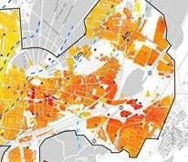
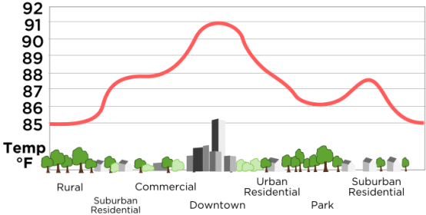
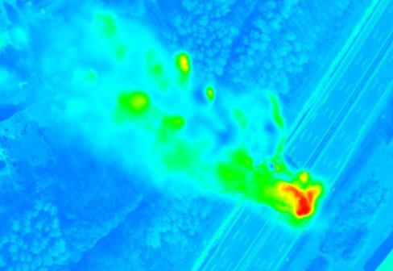
Overview –
Scenario
Environment –
Modelling the spread of invasive species
Smart City:
Understanding
Urban Heat
Islands
BOS –Decision support for civilian protection
12.05.2016
<number>
Notes:
<number>

Slide 6
Motivation –
Why temperatures?
Heat risks
Impact on invasive Species
  Young and elderly more vulnerable
  Impacts several illnesses and increases detoriation in some cases
  E.g. Asian Tiger Mosquioto
    Only survives above 10°C
    And: Fertile up to 30°C
© UCaHS Projekt (Urban Climate and Heat Stress)
10/24/17
© FZI Forschungszentrum Informatik
<number>
Notes:
<number>

Slide 7
Goal –
Graphical
Raw Temperature
Highest Quantiles
Goal :
Model heat distribution and the underlying causes
Hot Spot Analysis
10/24/17
© FZI Forschungszentrum Informatik
<number>
Notes:
Thermalflug -> one-time event 26.9.2008
<number>

Slide 8
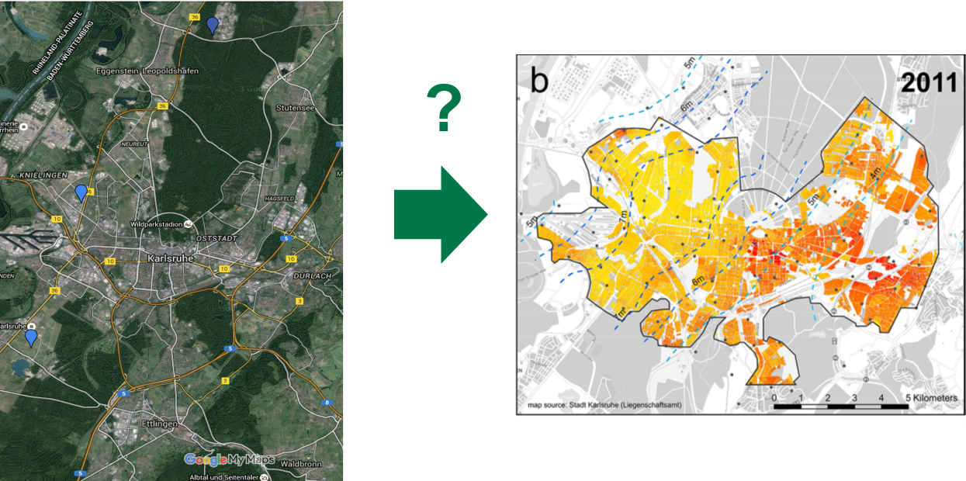
Goal –
Challenge
10/24/17
© FZI Forschungszentrum Informatik
<number>

Slide 9
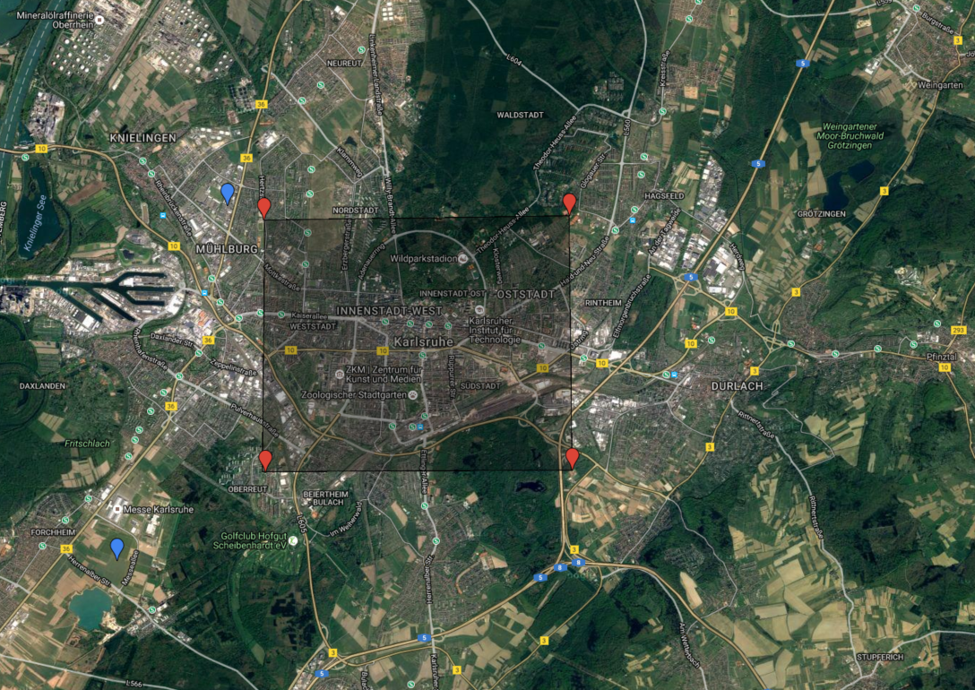
Challenge –
Available Data
?
See also: Bernsdorf, Bodo, and Julian Bruns. "Big-Data und Data-Mining im Umfeld städtischer Nutzungskartierung."
10/24/17
© FZI Forschungszentrum Informatik
<number>
Notes:
<number>

Slide 10

Continuous Refinement Model in BigGIS –
Vision
Domain Expert Knowledge
Direct Expert
Support
Sources
Human
Archive
Indirect Expert Support
Remote Sensing
Action
Visualization
Data
Continuous
Refinement
User
VGI
Model
Finding
Sensors
...
Indirect Semantic Support
System
Smart Semantic Web Services
Direct Semantic
Support
Veracity (Uncertainty)
Value (Knowledge)
BigGIS: a continuous refinement approach to master heterogeneity and uncertainty in spatio-temporal big data (vision paper), Proceedings of the 24th ACM SIGSPATIAL International Conference on Advances in Geographic Information Systems
Notes:
<number>

Slide 11
Architecture –
Architectural Elements Defining BigGIS
(BigGIS). The conceptual architectural framework of BigGIS is formally described as a tuple (P,S,R,A), where:
P is a set of pipelines
S is a set of services
R is a set of repositories
A is a set of user actions
Pipelines
Leverages the pipes and filters pattern and are composed of queues (pipes) & consecutive nodes (filters) that form a use case-specific processing chain.
Services
Self-sustained units of functionalities for a given task, e.g., (1) provider (2) integrator or (3) manager that expose a distinct interface for interaction.
Repositories
Dedicated storages for (1) metadata information of various elements (2) software artifacts, e.g., packaged nodes.
User actions
Allow various types of user interaction with the system, e.g., (1) non-interactive or (2) interactive user action.
<number>
Notes:
Designing a conceptual architectural framework, which accounts for the aforementioned requirements, involves decomposing the design in various architectural elements.
<number>

Slide 12
Architecture –
Conceptual Architectural Framework of BigGIS
Wiener, P., Simko, V., & Nimis, J. (2017). Taming the Evolution of Big Data and its Technologies in BigGIS - A Conceptual Architectural Framework for Spatio-Temporal Analytics at Scale. In Proceedings of the 3rd International Conference on Geographical Information Systems Theory, Applications and Management. SCITEPRESS - Science and Technology
<number>
Notes:
User action triggers the cognitive app service to deploy the nodes on the underlying big data frameworks.
Furthermore, the cognitive app service triggers the linked API service to start the smart data integration process thereby leveraging the semantic annotation and the rules of conversion from the data source repository.
Output of the data integration process is published to specified queues from where it gets consumed, continuously analyzed, refined and further distributed to the selected data sinks
<number>

Slide 13

Use Case –
Stream Enrichment
receive measurements
find neighbour ENVISAT pixels
find intersection with ATKIS polygons
pick top k land use classes per pixel
generate enriched output vector
pull measurements
id,
ts,
lat,
lon,
measures,
lst₁,
pdist₁,
c₁₁,
a₁₁,
...
c_{1k},
a_{1k},
lst₂,
pdist₂,
...
id,
ts,
lat,
lon,
measures
<number>

Slide 14
Use Case –
Stream Enrichment Formalization
(SEP). A stream enrichment pipeline is formally described as a tuple (N,Q), where:
N is a set of 3 nodes
Q is a set of 7 queues
<number>

Slide 15
Use Case –
Stream Combination
Semantic technologies to transfer the heterogenous data
The StreamPipes technology is used as connector between each node
  Uses the semantic informations to connect the components
10/24/17
© FZI Forschungszentrum Informatik
<number>
Notes:
Hier referenzen Stream Pipes
<number>

Slide 16
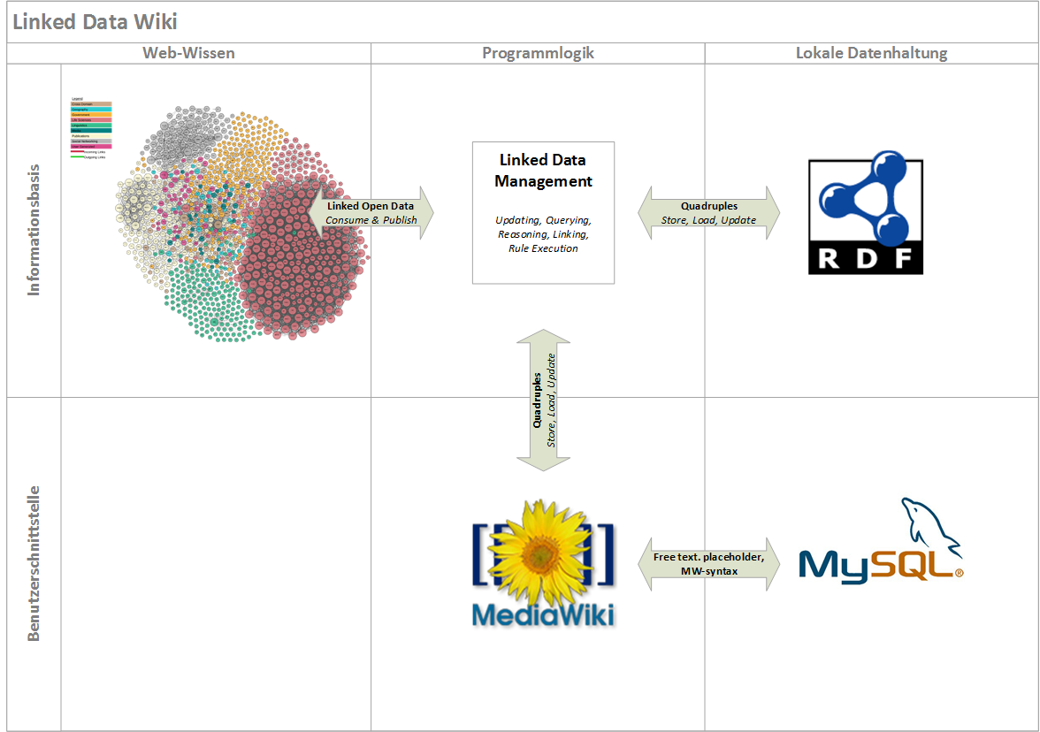
Smart Data Integration –
Technologies
Frank, Matthias, and Stefan Zander. "Pushing the CIDOC-Conceptual Reference Model towards LOD by Open Annotations." Modellierung. 2016.
10/24/17
© FZI Forschungszentrum Informatik
<number>
Notes:
Wiki to register meta data of nodes at central RDF repository
Interlink entities with Linked Open Data for context understanding
<number>

Slide 17
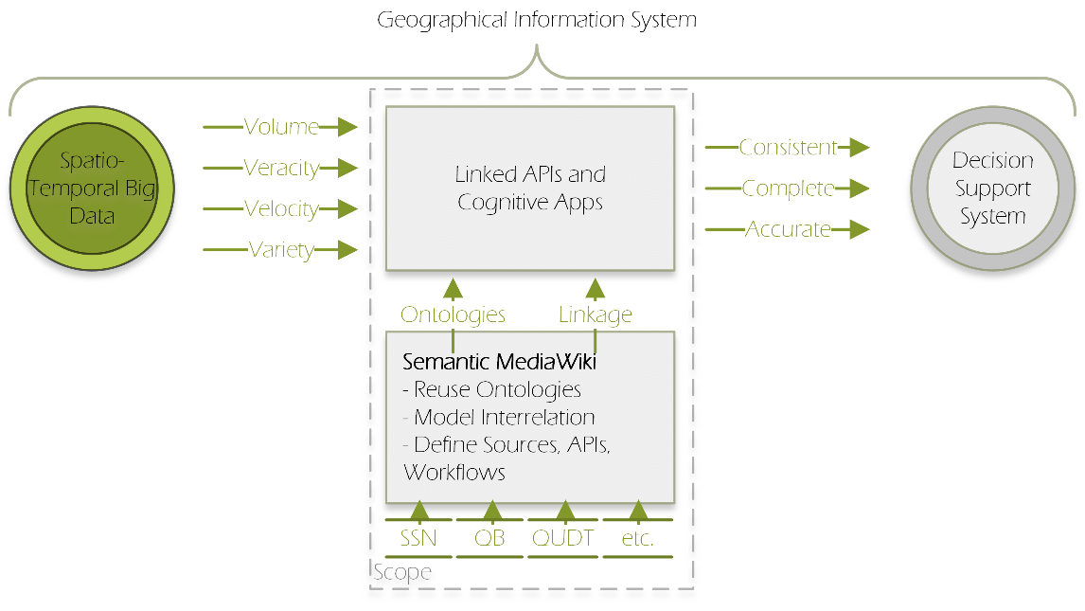
Smart Data Integration –
Goal
Frank, Matthias, and Stefan Zander. "Smart Web Services for Big Spatio-Temporal Data in Geographical Information Systems." SALAD@ ESWC. 2016.
APIs empowered with semantic context information to overcome data heterogeneity
10/24/17
© FZI Forschungszentrum Informatik
<number>
Notes:
<number>

Slide 18
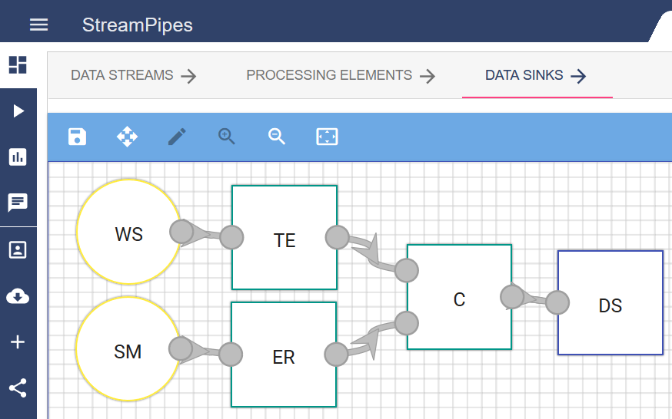
Smart Data Integration –
Example with StreamPipes
Yellow: Source Nodes → Green: Processing Nodes → Blue: Sink Node
10/24/17
© FZI Forschungszentrum Informatik
<number>

Slide 19
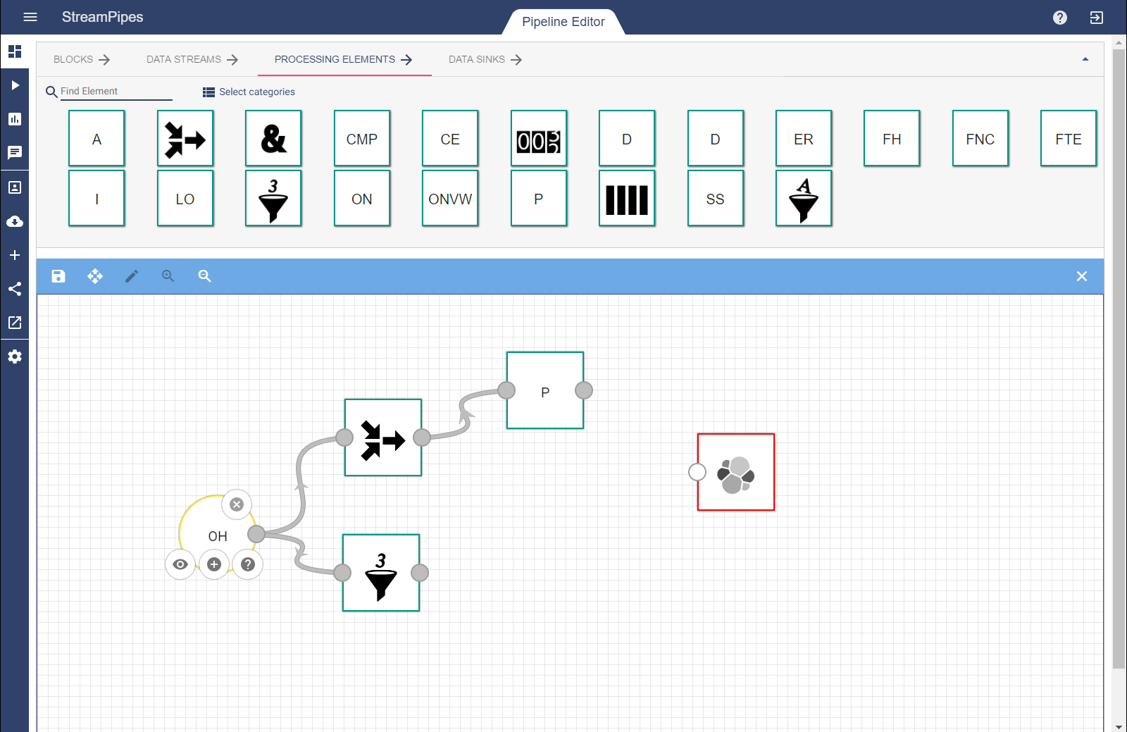
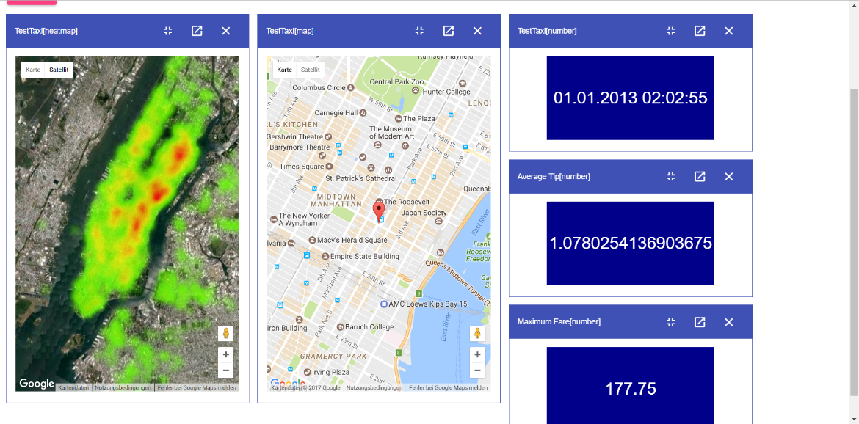





StreamPipes
Flexible Modeling of Real-Time Big Data Pipelines
Features
Graphical modeling of data pipelines
Semantics-based verification
Arbitrary data formats and protocols
Distributed runtime
Multiple runtime wrappers (Flink, Spark, …)
http://streampipes.fzi.de

Slide 20
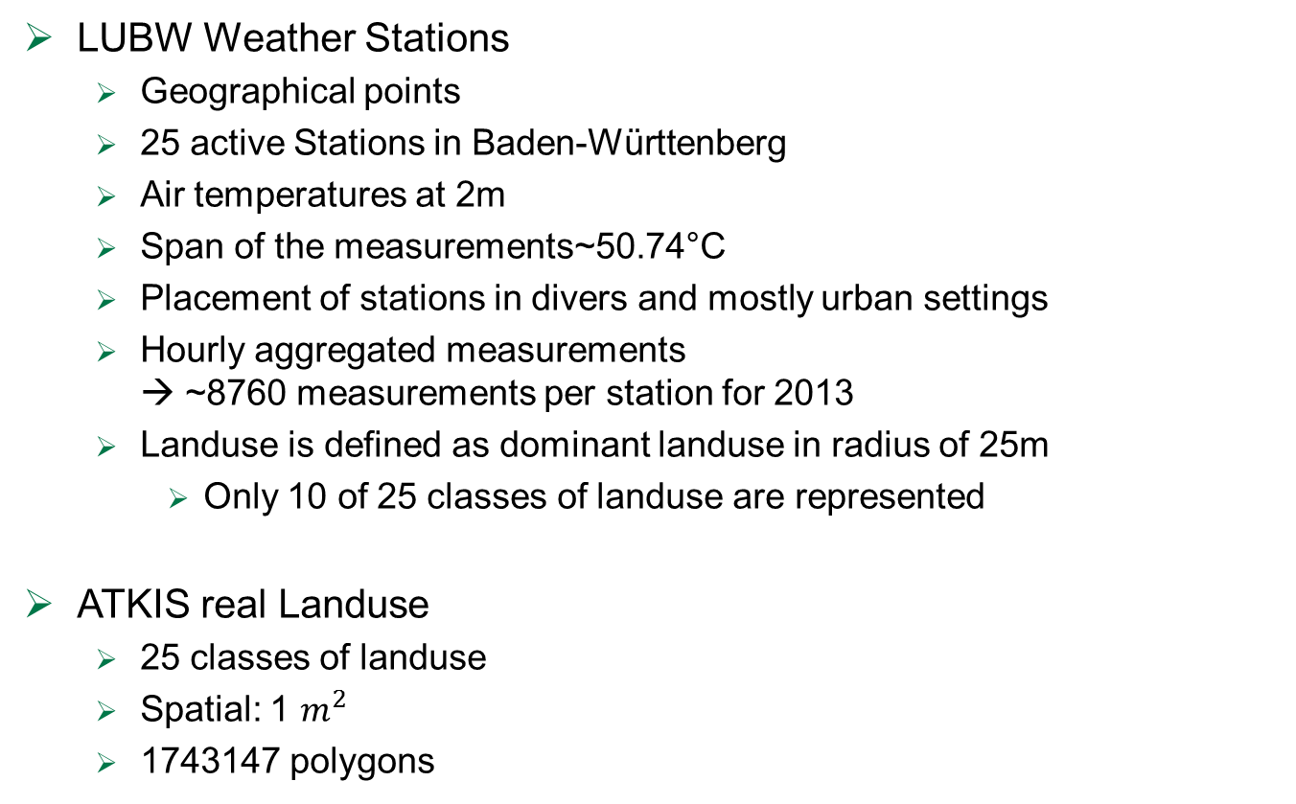
BHM Model –
Data Description
LUBW Weather Stations
  Geographical points
  25 active Stations in Baden-Württenberg
  Air temperatures at 2m
  Span of the measurements~50.74°C
  Placement of stations in divers and mostly urban settings
  Hourly aggregated measurements
  → ~8760 measurements per station for 2013
  Landuse is defined as dominant landuse in radius of 25m
    Only 10 of 25 classes of landuse are represented
ATKIS real Landuse
  25 classes of landuse
  Spatial: 1
  1743147 polygons
10/24/17
© FZI Forschungszentrum Informatik
<number>
Notes:
Model: BHM Model, Under Work for publication
<number>

Slide 21
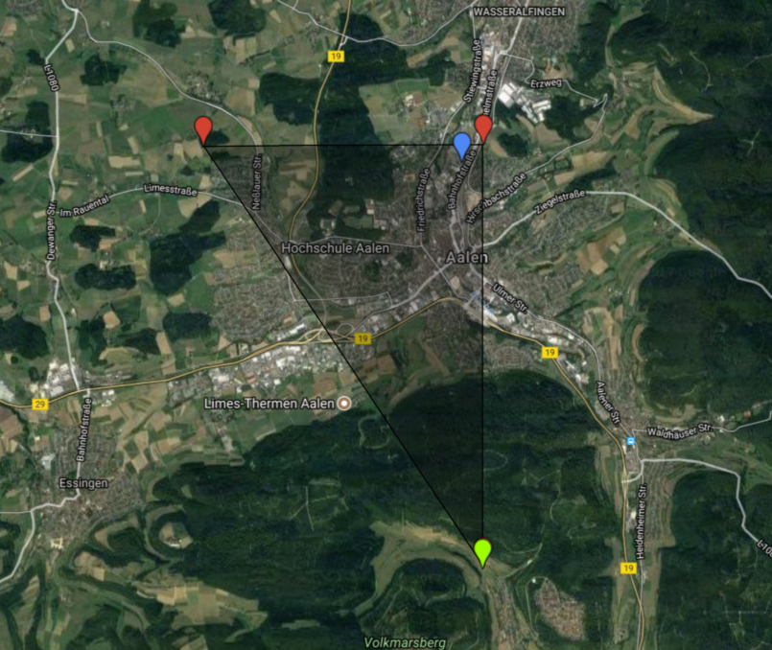
Example –
Aalen
10/24/17
© FZI Forschungszentrum Informatik
<number>

Slide 22
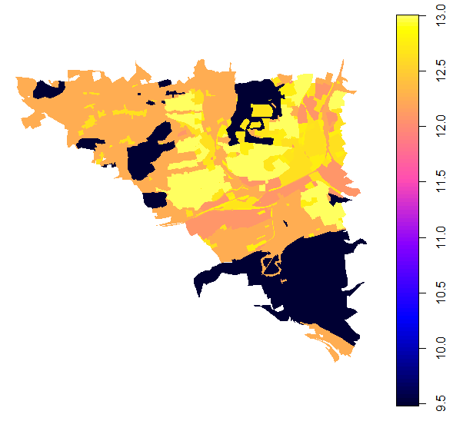
Prediction –
Aalen
10/24/17
© FZI Forschungszentrum Informatik
<number>
Notes:
Referenztemp: 12.3; 13h
<number>

Slide 23
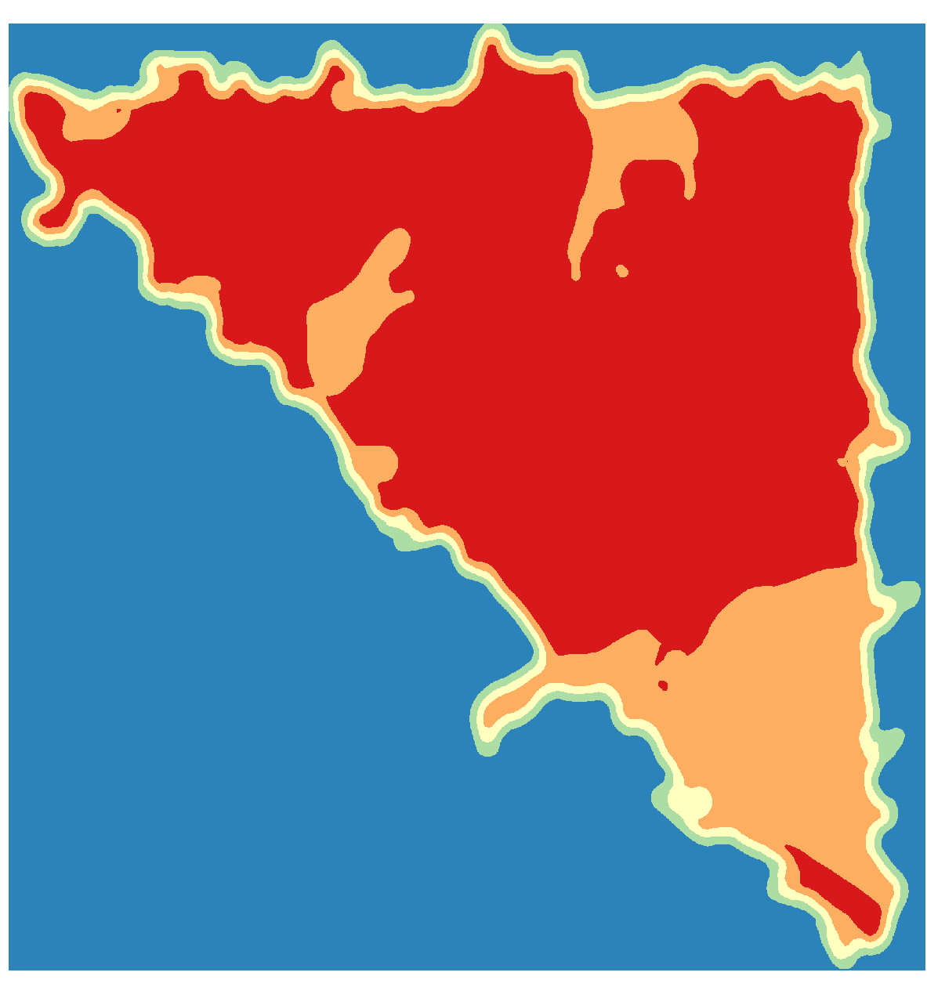
Future Steps –
HotSpot Analyse
Bruns, Julian, and Viliam Simko. "Stable Hotspot Analysis for Intra-Urban Heat Islands." GI_Forum 2017, 1: 79-92
Additional work in progress
10/24/17
© FZI Forschungszentrum Informatik
<number>

Slide 24
Future Steps -
Heat stress minimizing routing
Heat exposure could be reduced by
Heat exposure could be reduced in about 70 % of the cases
Rußig, Joachim, and Julian Bruns. "Reducing Individual Heat Stress Through Path Planning." GI_Forum 2017, 1: 327-340.
10/24/17
© FZI Forschungszentrum Informatik
<number>

Slide 25
Thank you
Acknowledgements:
  Marc Gassenschmidt
  Joachim Rußig
  Bowen Wang
  Till Riedel
  Matthias Budde
  Manuel Stein
  Daniel Seebacher
10/24/17
© FZI Forschungszentrum Informatik
<number>

Slide 26
Back Up 1
10/24/17
© FZI Forschungszentrum Informatik
<number>

Slide 27
Pipes and Filter Pattern
(Buschmann et al. 1996)
Back Up 2
(Pipeline). A pipeline p is formally described as a tuple (F,P), where:
F is a set of filters
P is a set of pipes
pipeline
pipe
Filter
pipe
Filter
pipe
Source
Sink
pipe
pipe
Filter
Filter
pipe
Source
pipe
Sink
pipe
Unix pipes wordcount example: Count the words in a given document.
cat example.txt | wc -w
<number>
Notes:
simple & powerful software architecture pattern
Consists of any number of components (filter) that process data (transform, filter, enrich,...) , before passing it on via connectors (pipes) to other components.
Architecture is often used as a simple sequence, but may be also used for very complex structures.
Source=Initial data producers, e.g. static files, DB
Sink=Final data consumers is the data target, e.g. another DB, web dashboard
<number>

