Slide 1
CMS tracker operation
Ivan Shvetsov

Slide 2
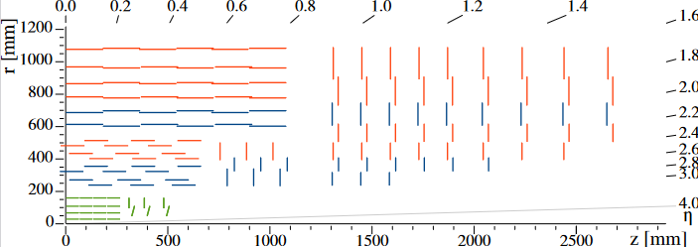
CMS tracker
CMS tracker has two sub-detectors:
Pixel detector (phase 1 detector, installed in 2017)
Silicon strips (phase 0 detector, installed in 2007)

Slide 3
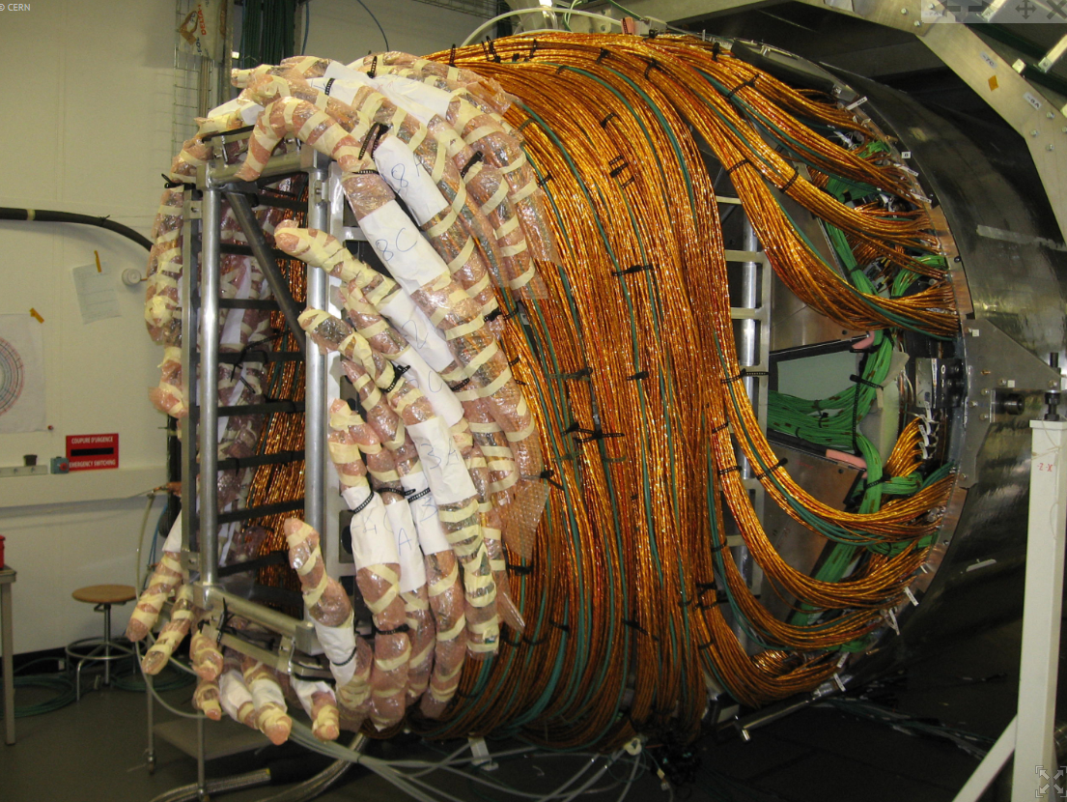
CMS tracker at TIF

Slide 4
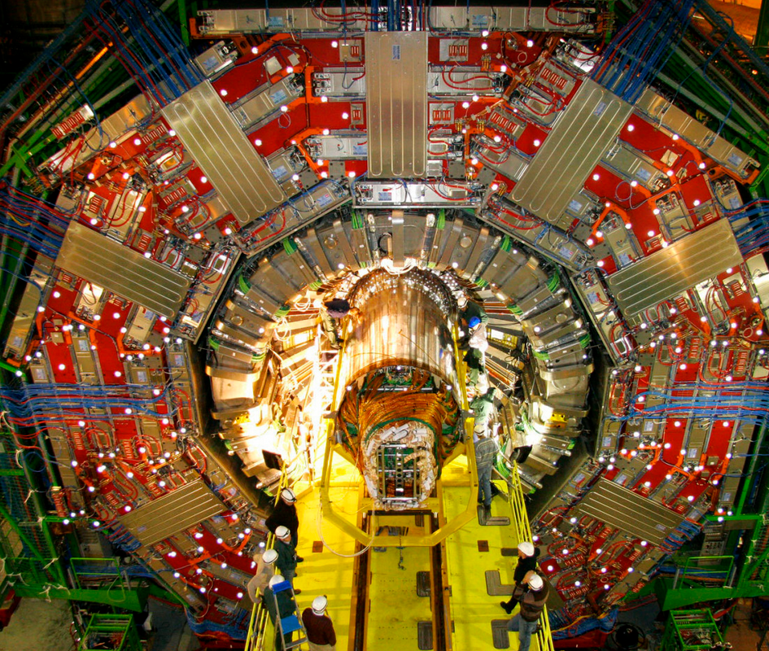
Installation inside CMS

Slide 5
Operation of the CMS tracker
CMS tracker has been installed in CMS more than 10 years ago
The detector has been operated successfully since then
What makes this detector special?
Most of the detector is not accessible since installation in 2008
The detector is operated at cold temperatures (-20C)
~15000 detector modules, covering ~200 m2 of silicon
Largest data output in CMS

Slide 6
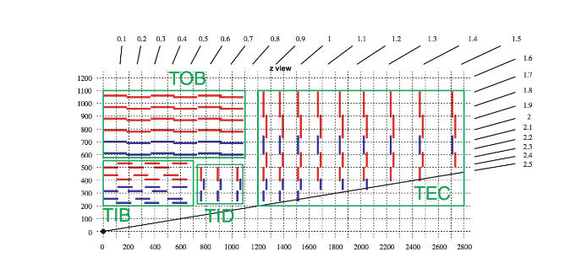
CMS silicon strip tracker
9.3 million strips
5 m long, 2.5 meters in diameter
10 layer in the barrel region, 4 inner barrel layers (TIB) and 6 outer barrel layers
3 inner disks (TID) and 9 endcap disks (TEC)

Slide 7
What are the main concerns of running the detector?
Safety of the detector must be always maintained
Tracker Safety System is responsible for safety of the detector
Operation at cold temperatures requires constant flushing of the detector and service channels of the detector
3 layers of safety are established here
MEMBRANE PLANT
DETECTOR DRY AIR
BOTTLES

Slide 8
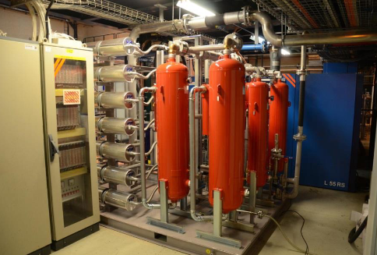
Dry gas system
Membrane plant is able to provide dry air or O2-depleted air
Dew point about -70C

Slide 9
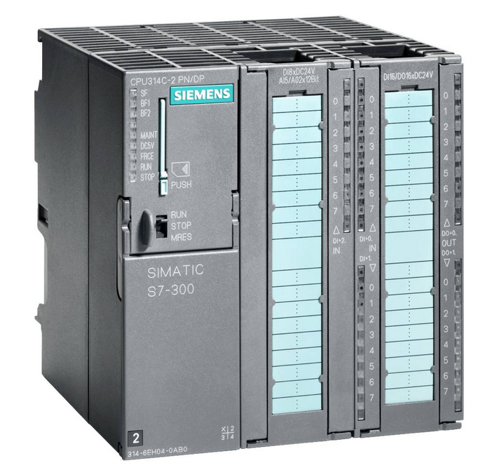
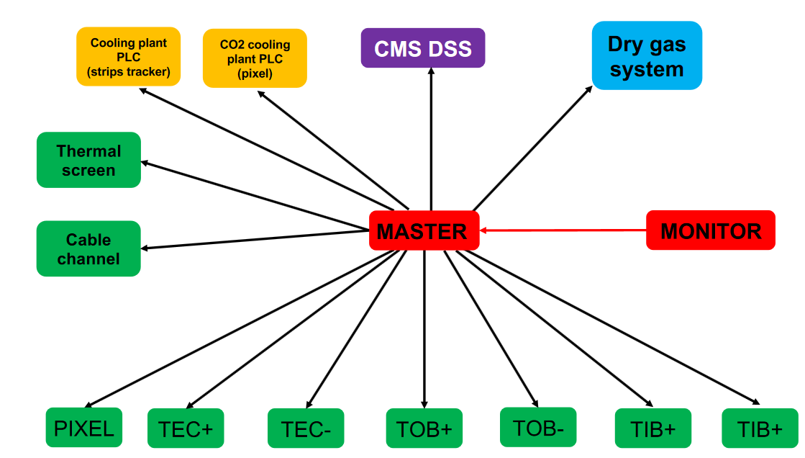
Tracker safety system (TSS)
The key component of safety system is PLC = Programmable Logic Controller (PLC)

Slide 10
Cooling system
Tracker is cooled down by 2 cooling stations (SS1 and SS2) located in the experimental cavern + 2 thermal screens (TS1 and TS2)
All 4 stations are circulating C6F14
SS1+SS2 at -20C
TS1+TS2 at -10C
SS1+SS2: 180 loops
TS1+TS2: 16 loops

Slide 11
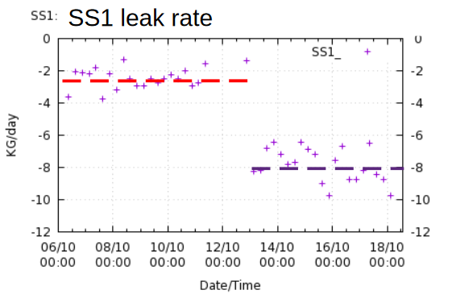
Cooling system
SS2 has suffered from overpressure incident in 2009
This resulted in closure of 5 cooling loops
SS1 has never had overpressure problems and had always acceptable leak rates (0.5 kg/d)
Leak rate increase has been observed in 2021
After that leak search campaigned were carried out

Slide 12
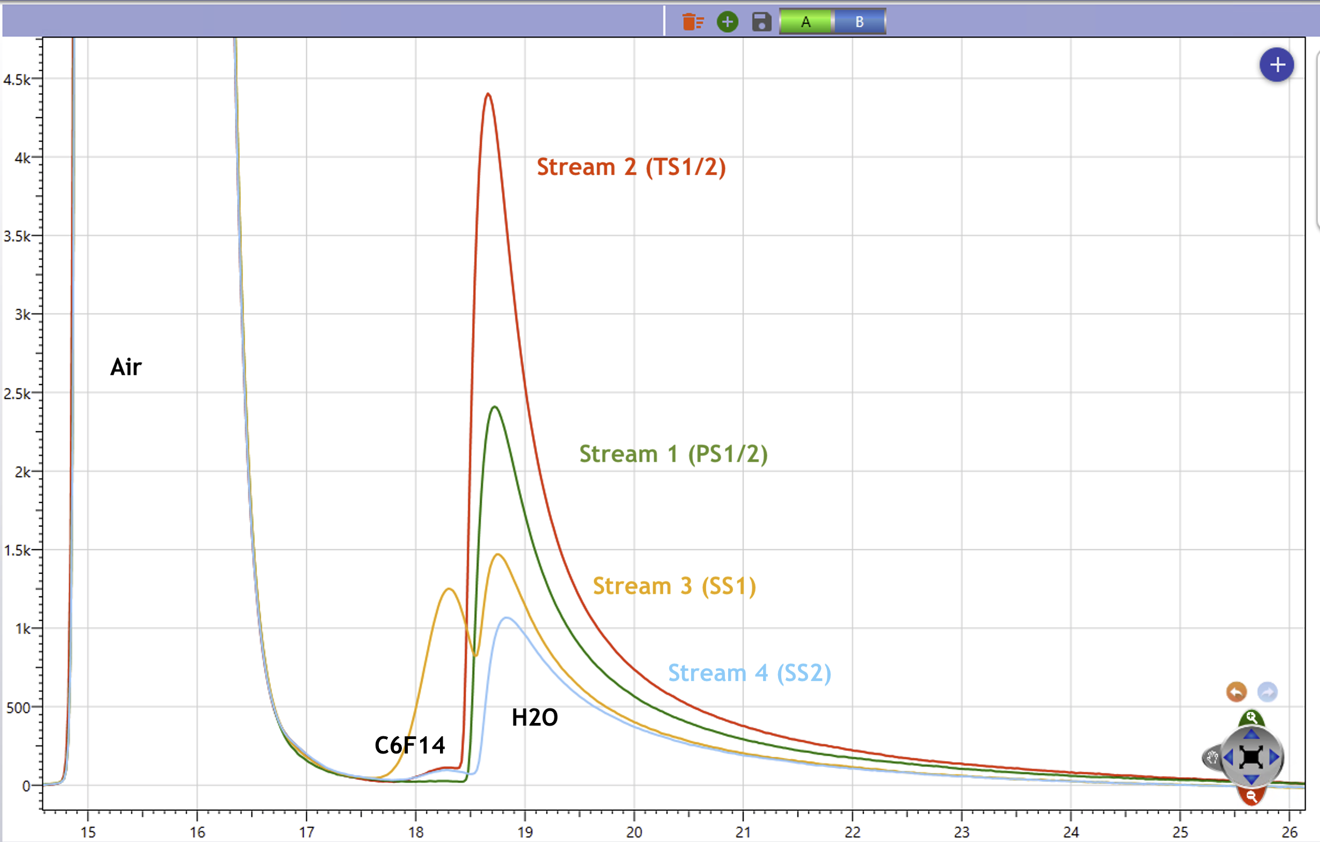
Gas chromatography
Another way for “detect” leaks
Not obvious to interpret results
The method was used to validate the leak rate measurements

Slide 13
What did were the leak rates in the past ?

Slide 14
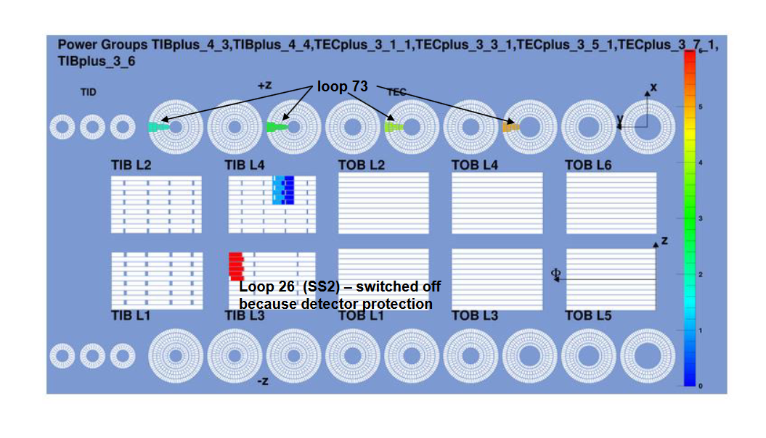
Regions affected
Following regions are affected - they are cooled only by surrounding structure at the moment
Several tests were done to make sure these modules can be operated

Slide 15
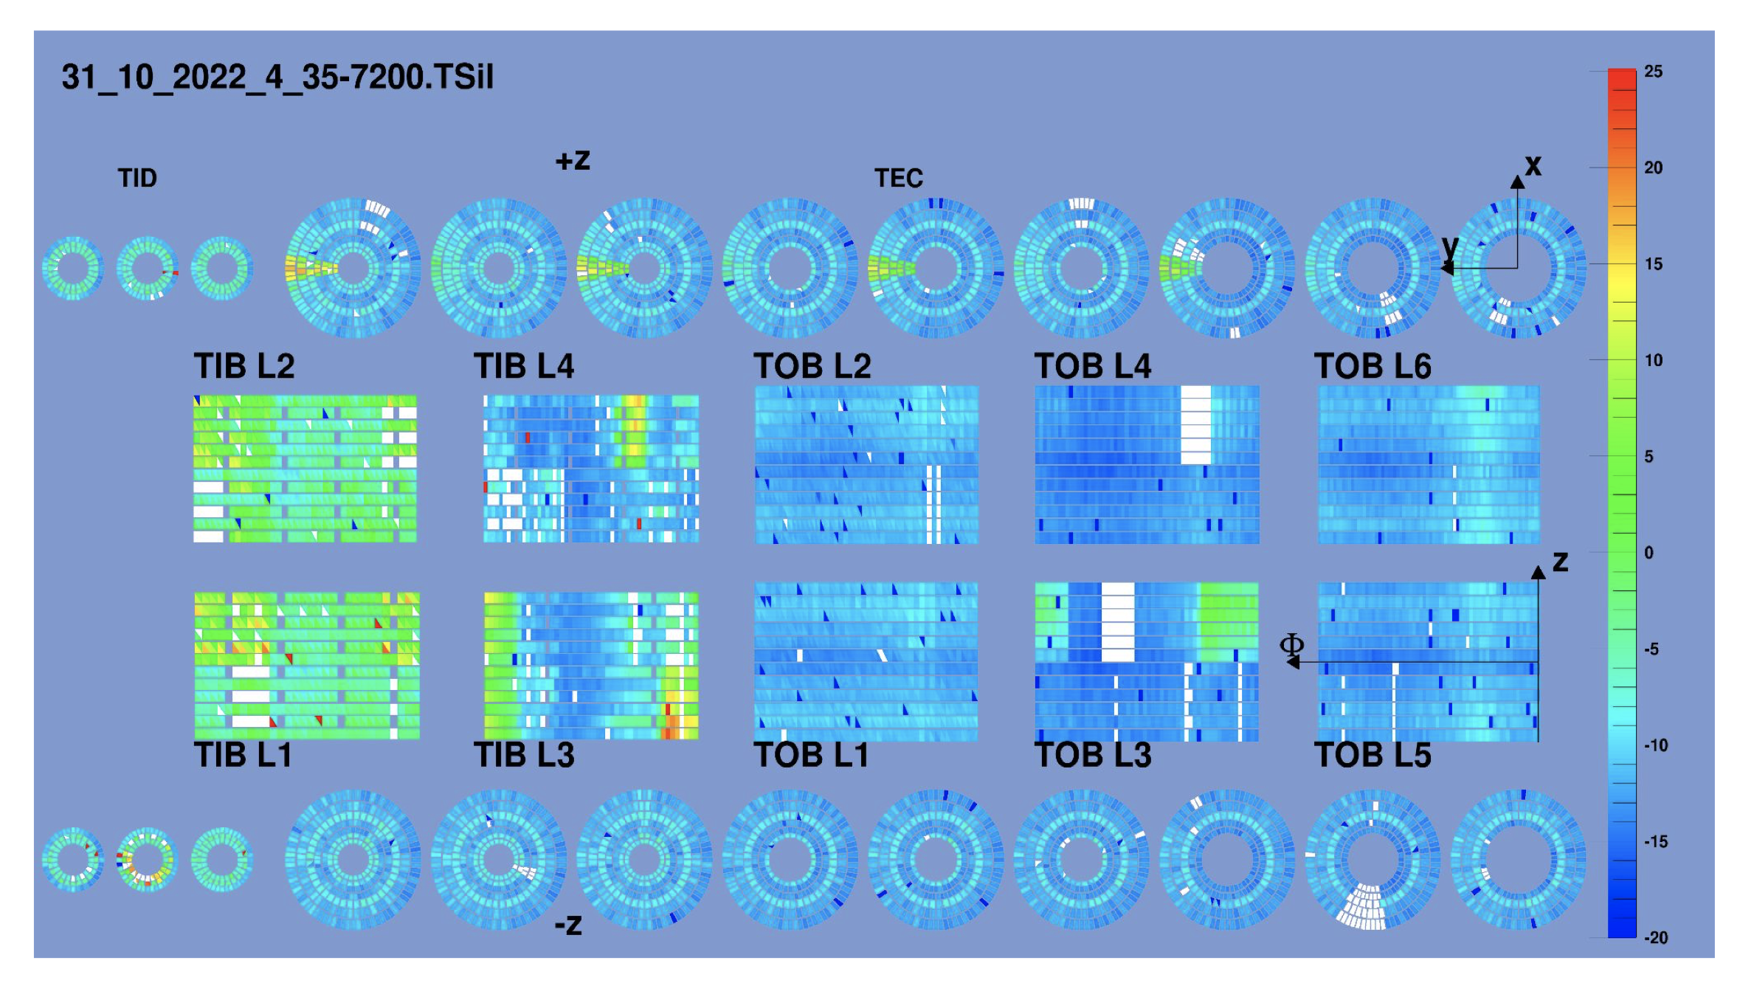
Detector temperatures

Slide 16
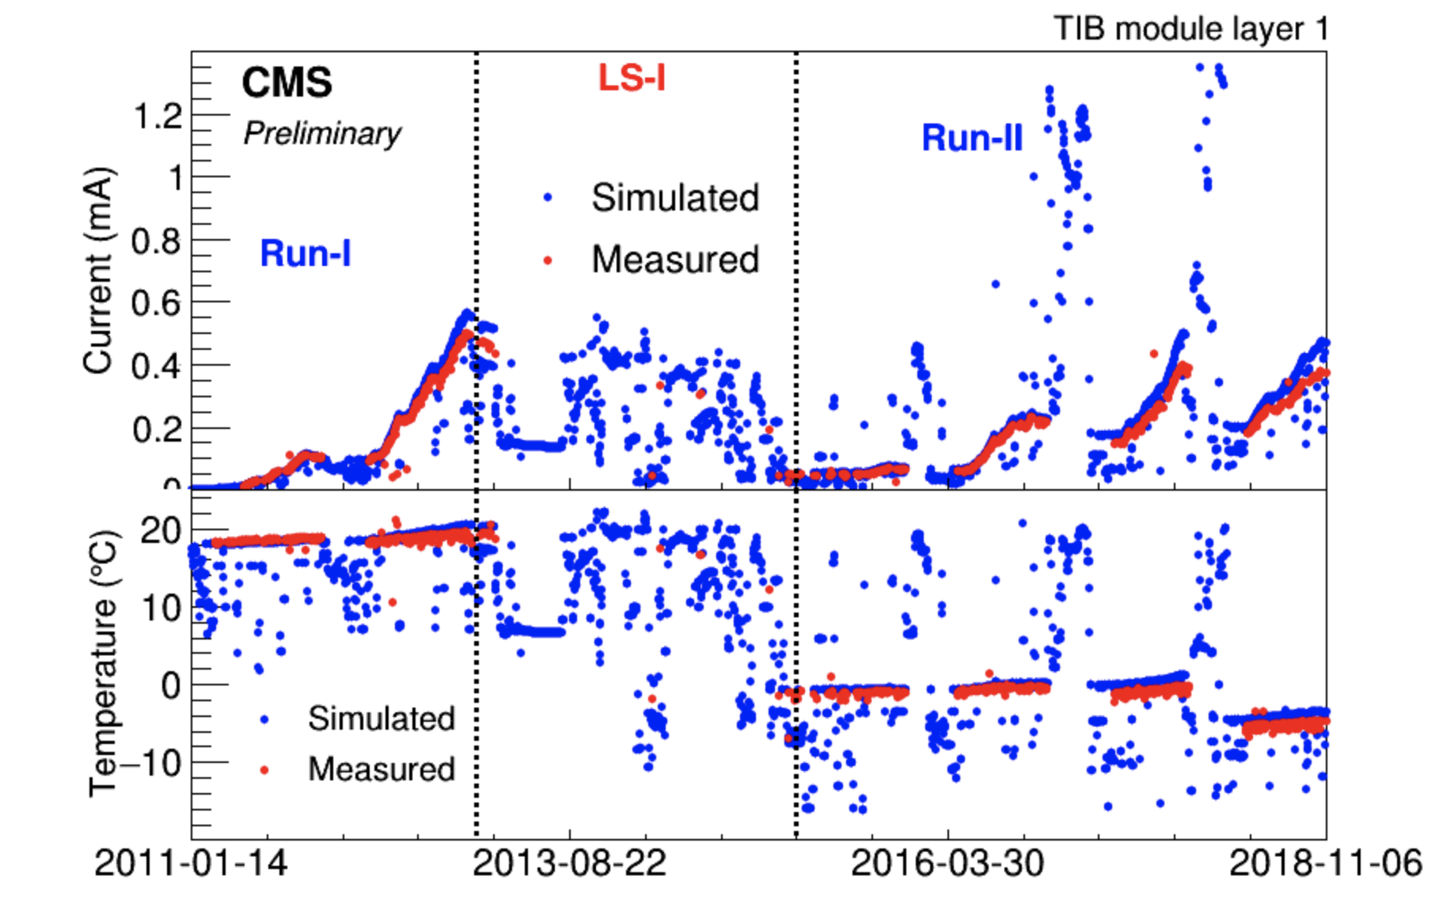
Evolution of the leakage current
Leakage current in silicon is increasing with luminosity

Slide 17
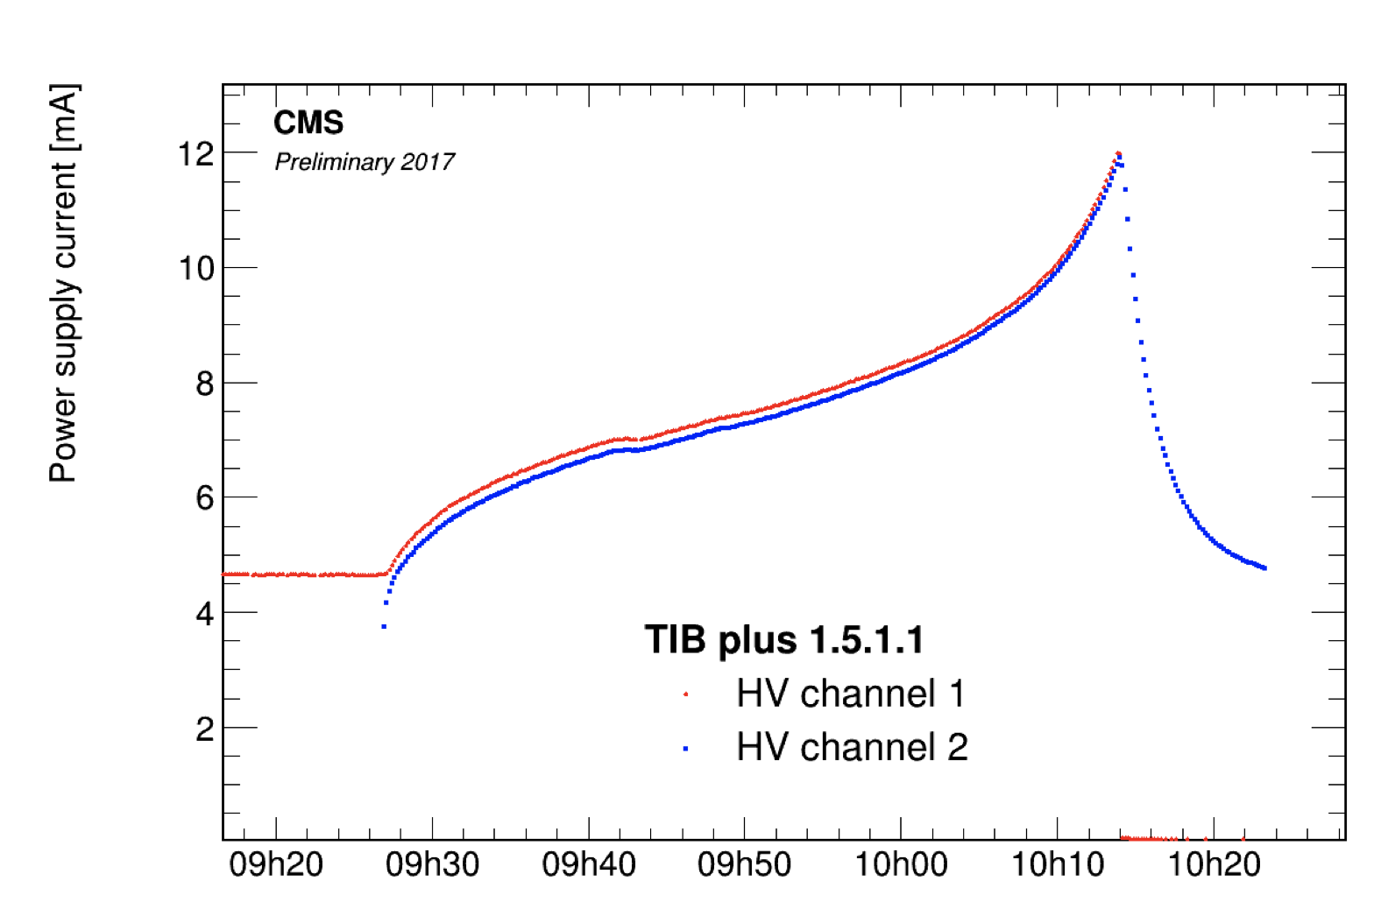
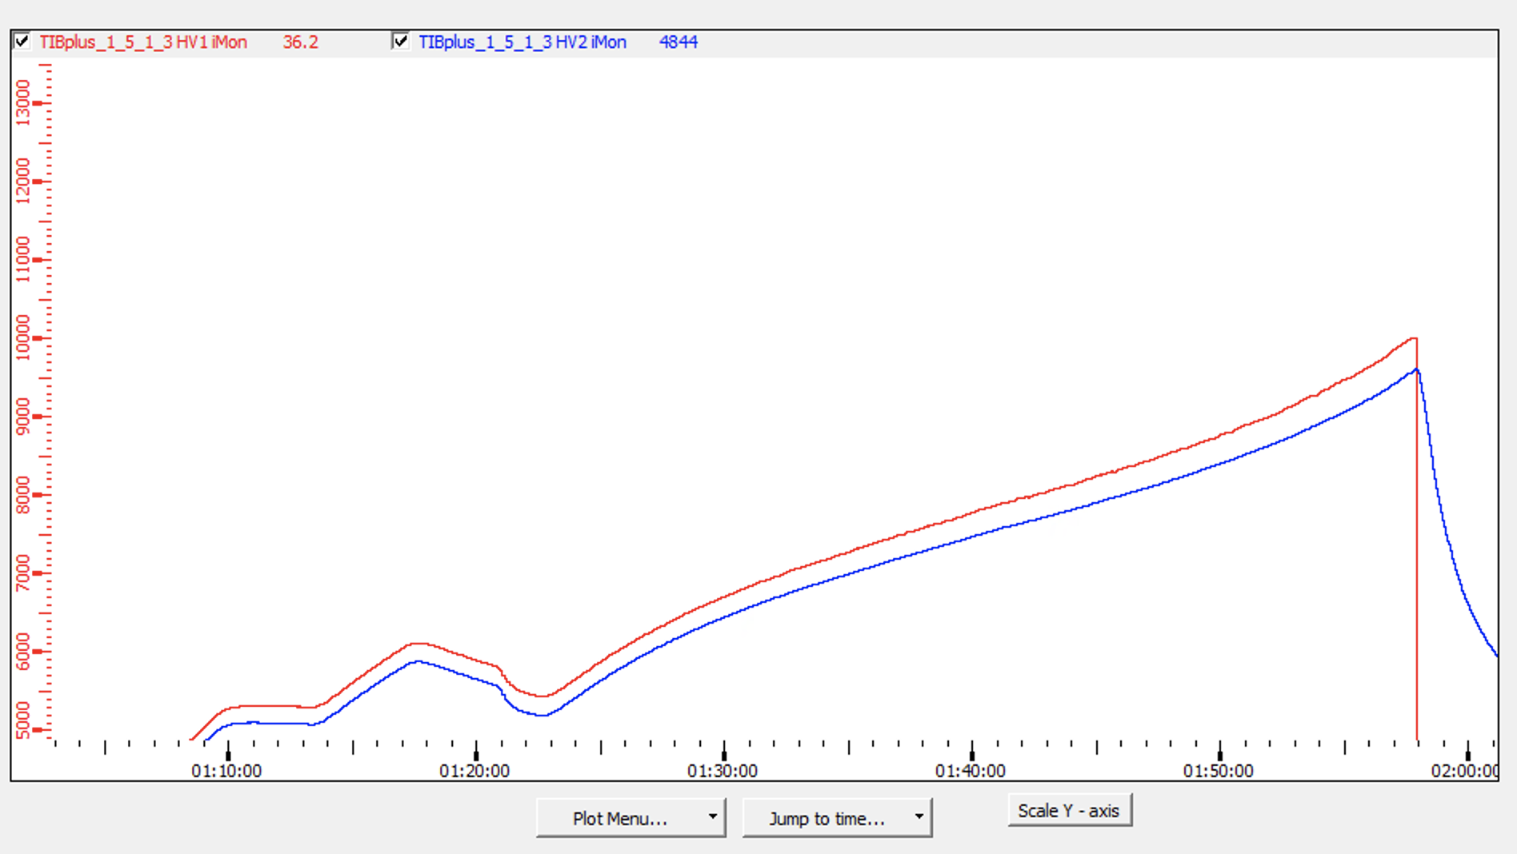
Thermal runaway
First thermal runaway has been observed in 2017 – temperature was lowered from -15°C to -20°C
2017
November 2022

Slide 18
Leakage currents
Leakage currents are increasing in the uncooled regions
We have some ways of dealing with this:
Disconnecting modules electrically (remove jumpers in HV line)
Switching off stereo modules
Lowering depletion voltage (quite limited long term)
Lowering temperature – to be avoided as long as possible (-25C)

Slide 19
Lowering temperature of tracker to -25°C
Expected number of thermal run aways at different temperatures
Test of -25°C performed during LS2

Slide 20
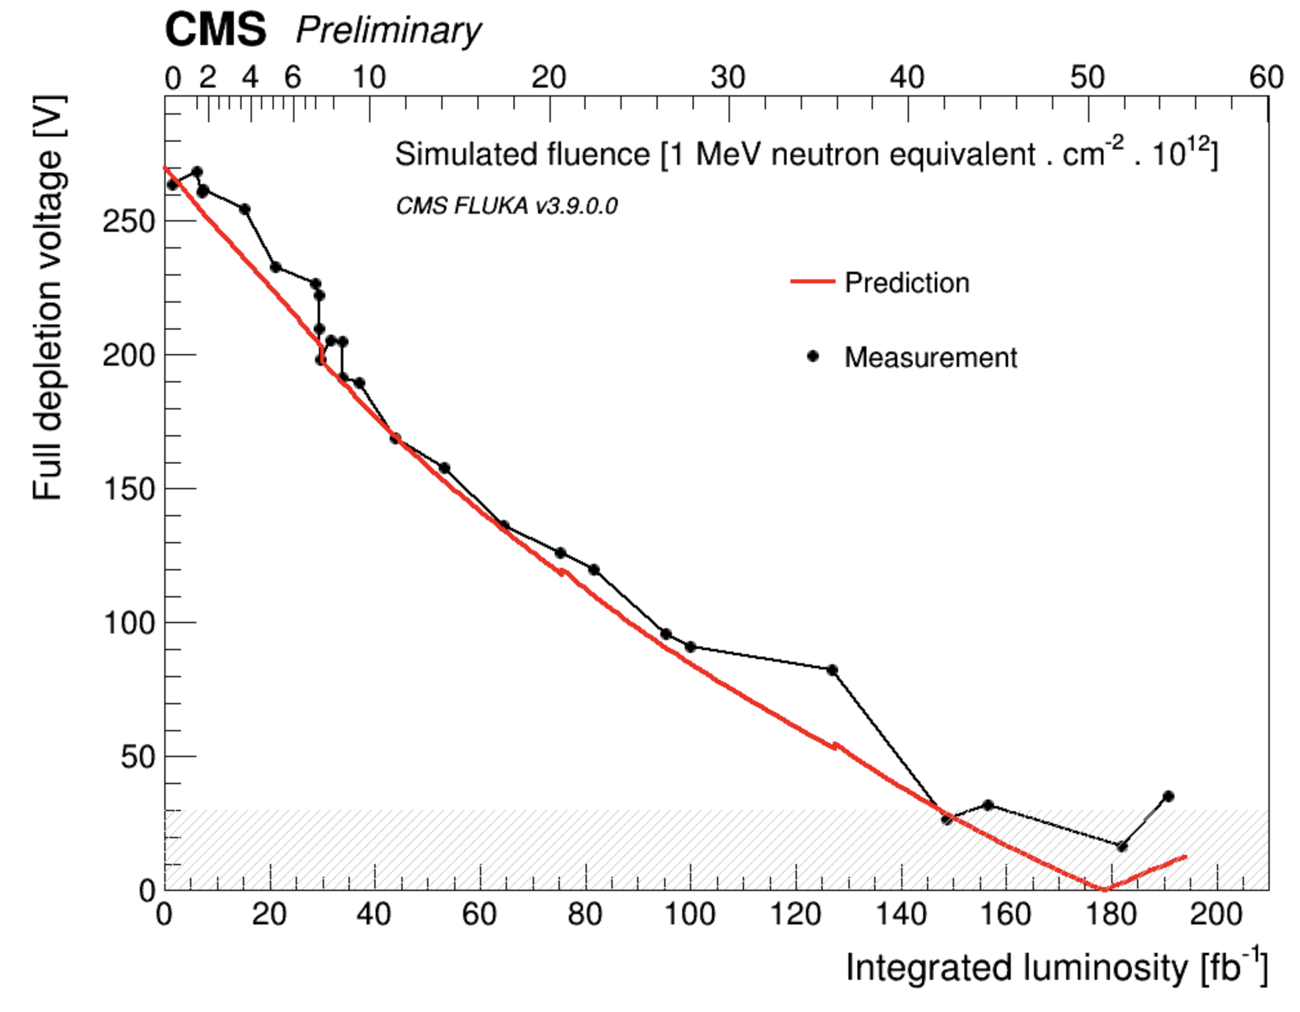
Full depletion voltage evolution
By the end of 2022 layer 1 of TIB is expected to be around 100V

Slide 21
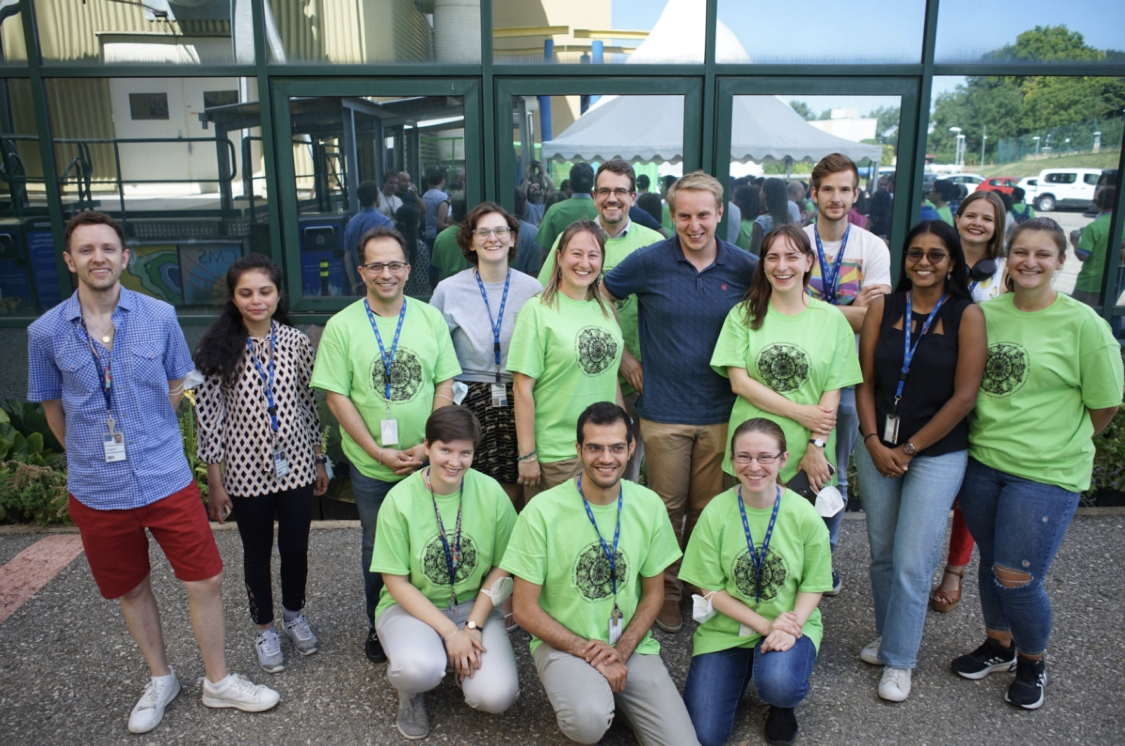
Operation of the CMS tracker
It is critically important for the CMS experiment that tracker is providing good data
In order to make sure this happens we have a crew of usually one shifter per week and experts available to intervene in case of problems
Experts cover typically following areas: DAQ, DCS, power system
If you are interested to participate in tracker operations please contact ivan.shvetsov@cern.ch

Slide 22
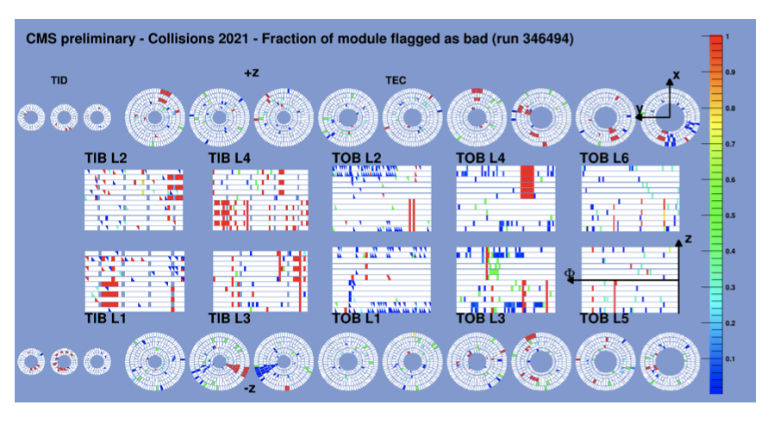
Conclusions
Overall CMS tracker is a good shape
Leak search has been concluded before start of data-taking
Uncooled modules are being delivered data, though leakage currents have been approaching hardware limits (12 mA)
Shift crew has been established, new people trained; if you are interested to join the team please let me know
Good detector fraction about 95%

