Slide 1
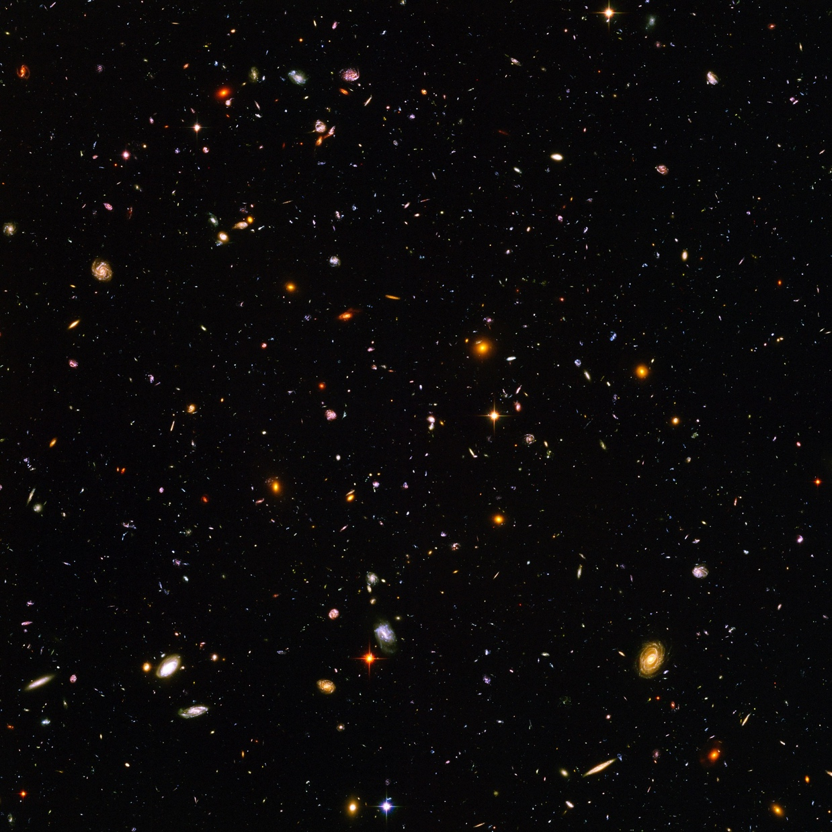
Tritium and the Mass of the Neutrino
Hamish Robertson, CENPA, University of Washington
Tritiumlabor Karlsruhe 30th Anniversary
May 23-5, 2023

Slide 2
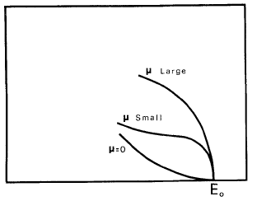
“Hence, we conclude that the rest mass of the neutrino is either zero, or, in any case, very small in comparison to the mass of the electron.”
E. Fermi, 1934
F. Wilson, Am. J. Phys. 36, 1150 (1968)

Slide 3
“Hence, we conclude that the rest mass of the neutrino is either zero, or, in any case, very small in comparison to the mass of the electron.”
E. Fermi, 1934
F. Wilson, Am. J. Phys. 36, 1150 (1968)
This is the “direct” method.

Slide 4
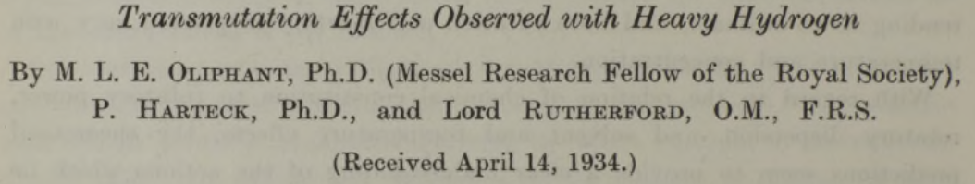
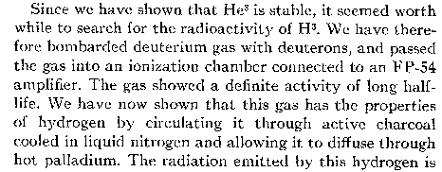
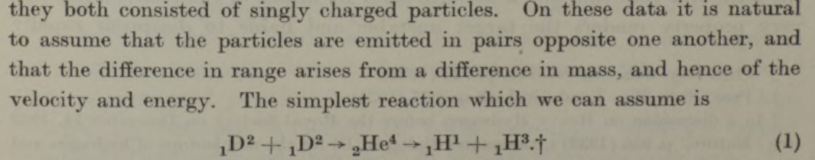
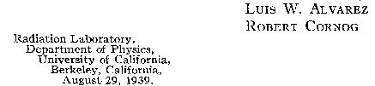
TRITIUM
Rutherford discovers tritium & ³He
Proc. Roy. Soc. A 144, 692 (1934)
Alvarez shows ³H is radioactive
Phys. Rev. 56, 613 (1939)
But is tritium radioactive, or is ³He?

Slide 5
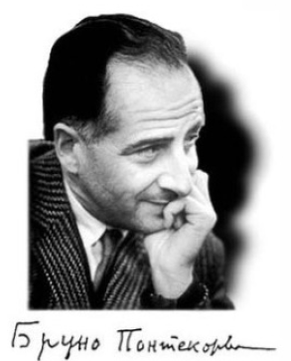

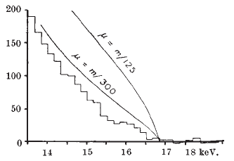

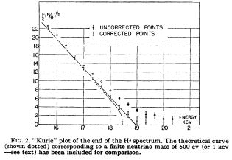
First experiments with gaseous tritium !
  Nature 162, 302 (1948)
m_{v}< 500 eV
  Phys. Rev. 75, 983 (1949)
m_{v}< 1700 eV

Slide 6
First steps on a long road

Slide 7
Now 3 neutrinos
1980:-
Tom Bowles and HR plan on an atomic T experiment at Los Alamos. Soon joined by John Wilkerson.

Slide 8
1980: a signal!

Slide 9
1980: a signal! The universe is closed by ν_{e}

Slide 10
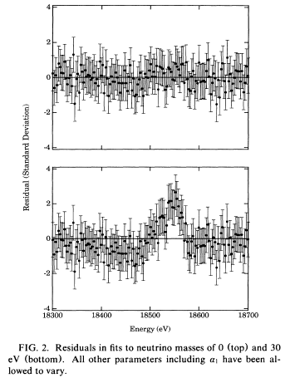
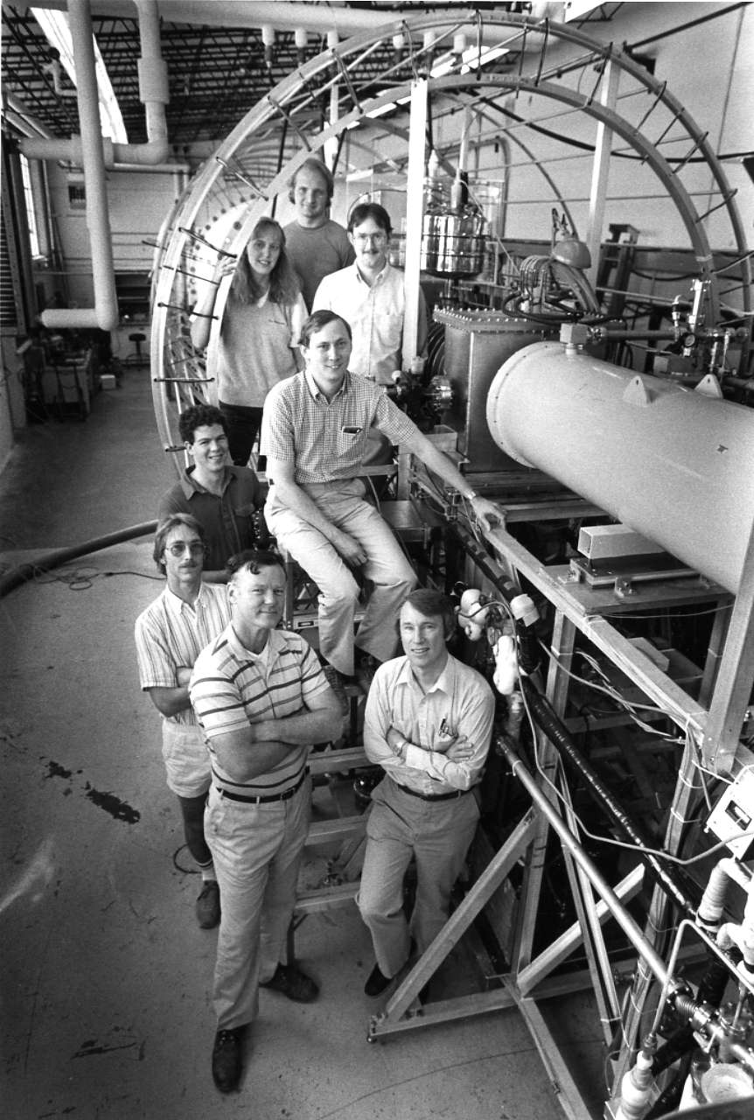
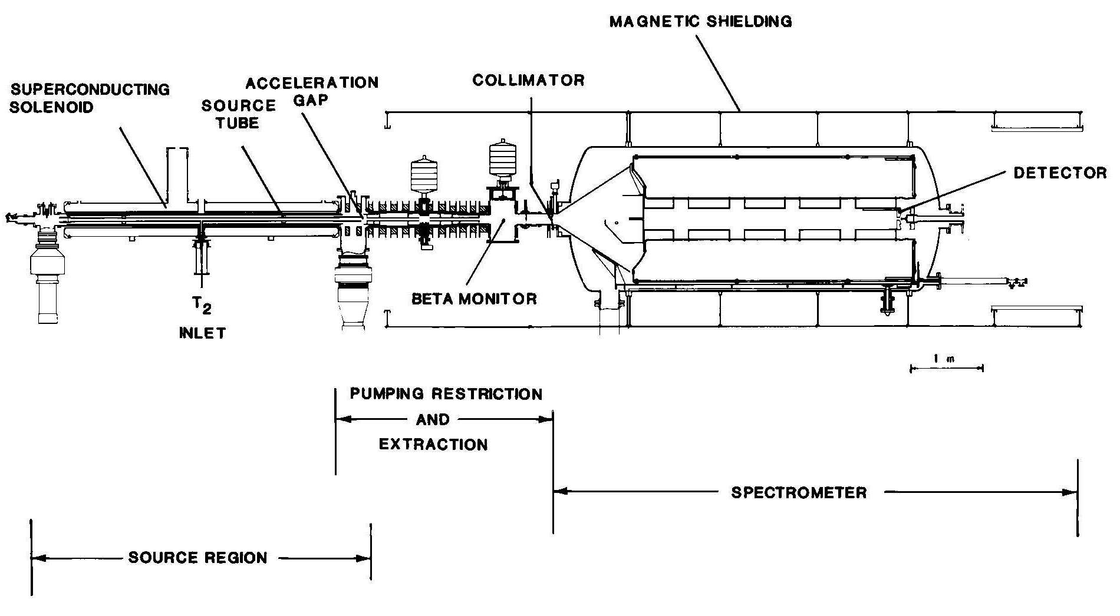
The Los Alamos Experiment:
3 kCi gaseous T₂, magnetic spectrometer
PRL 67, 957 (1991)
0 eV
30 eV

Slide 11
Atomic tritium
In 1980 there was no quantitative theory for the molecular final states, only the atom.
We set out to use atomic T. We failed for 5 reasons:
RF dissociator had a lifetime ~ days. (we know why now)
Severe loss of inventory ~ days. (same thing)
RF got into all the electronics.
Lower Q-value for T makes T₂ a tough background.
T density in source low.
We retreated to T₂. By 1985 theory became available.
And, in the end, it was the problem.

Slide 12
1996-2000: New theory
Fackler et al. PRL 55 (1985)
Saenz et al. PRL 84 (2000)
Variance = 694 eV²
611 eV²

Slide 13
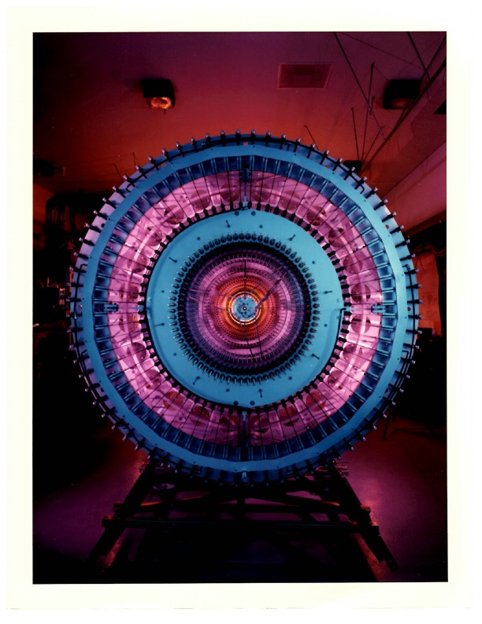
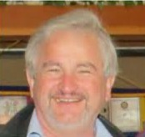
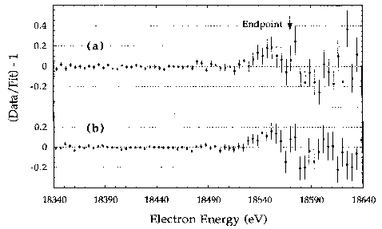
The Livermore Experiment:
Gaseous T₂, magnetic spectrometer
PRL 75, 3237 (1995)
LLNL spectrometer
Wolfgang Stoeffl
0 eV, run 1
0 eV, run 2

Slide 14
2015: An old mystery solved
Theory | Fackler et. al. 1985 | Variance = 611 eV²
 | Saenz et. al. 2000 | Variance = 694 eV²
 | Difference | - 83 eV²
 | Δm_{ν}² = - 2 X difference |  | + 167 eV²
 |  | As published | Re-evaluated
LANL | m_{ν}² = | - 147(79) eV² | 20(79) eV²
LLNL | m_{ν}² = | - 130(25) eV² | 37(25) eV²
Bodine, Parno, HR; PRC 91 035505 (2015)

Slide 15
1980 – 2000: many experiments, no signal.

Slide 16
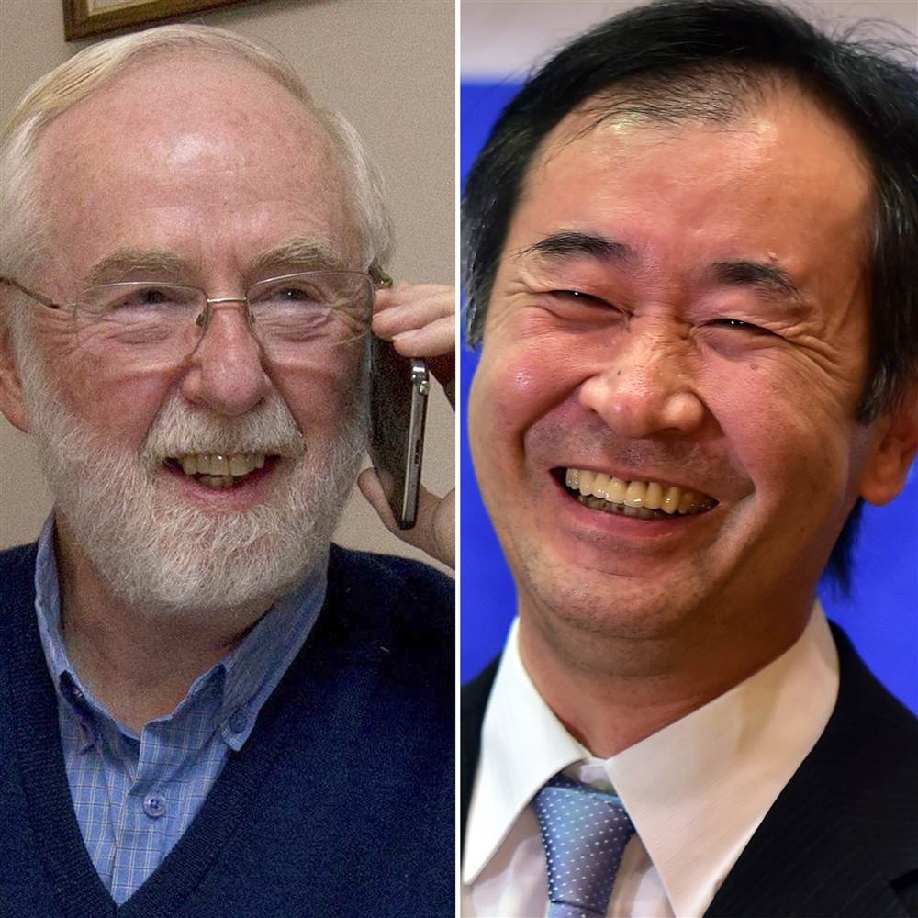
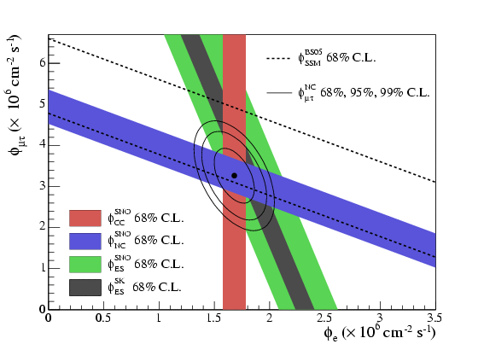
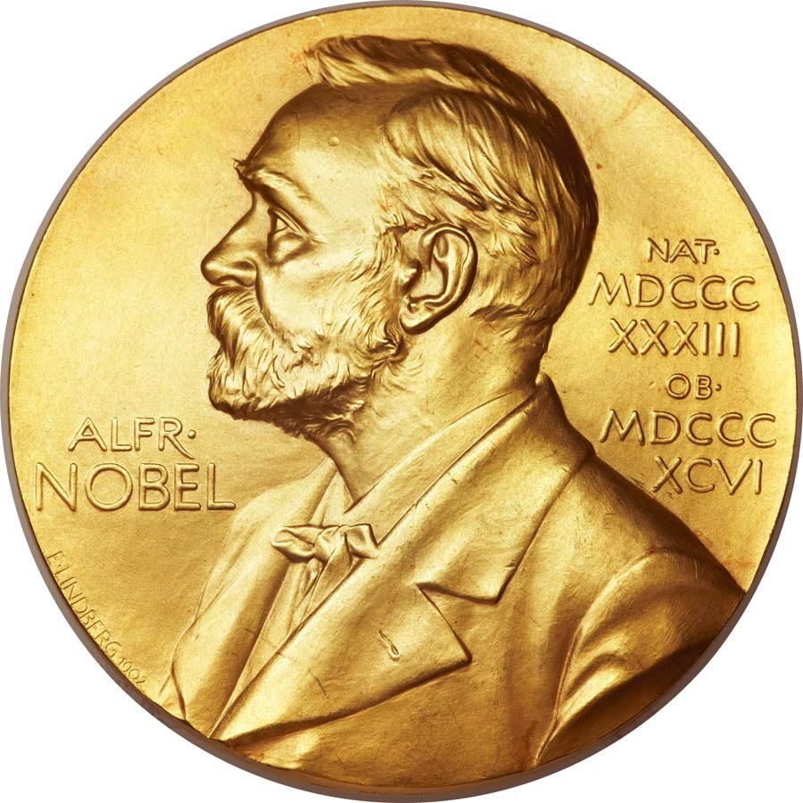
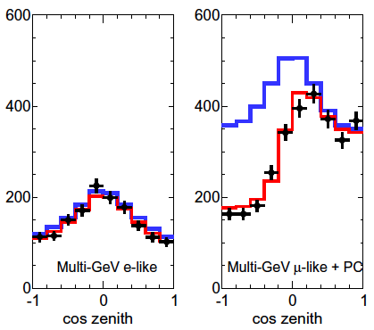
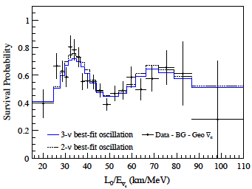
Neutrinos oscillate, have mass
SNO
Super-Kamiokande
KamLAND

Slide 17
Neutrino Masses and Flavor Content
e mu tau
“Normal”
“Inverted”
ν₃
ν₂
Solar
ν₁
Δm₂₃²
2 x 10⁻³ eV²
Atmospheric
Atmospheric
ν₂
Δm₁₂²
Solar
8 x 10⁻⁵ eV²
ν₁
ν₃
?
?

Slide 18

2000: Mass of ν_{e} → m_{β} ~ m₁. Tritium is key.

Slide 19
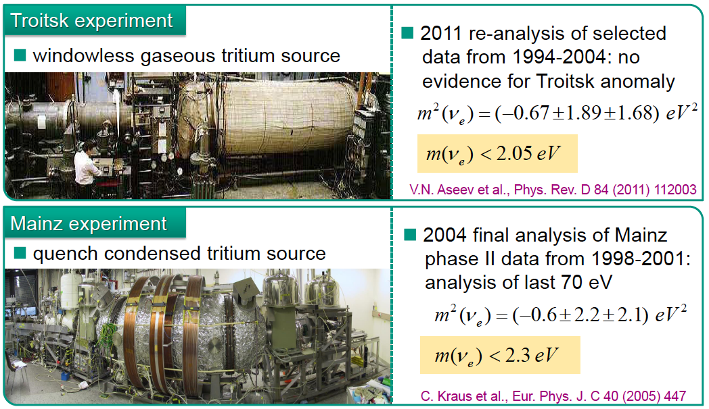
1995 – 2025: The Mac-e filter era
m_{v} < 2 eV

Slide 20
Story so far:
Neutrinos DO have mass, and the average for the 3 must lie between 2 and 0.02 eV.
Cosmological comments.
NOW:
The KATRIN experiment.
FUTURE:
A new idea: CRES (Cyclotron Radiation Emission Spectroscopy).

Slide 21

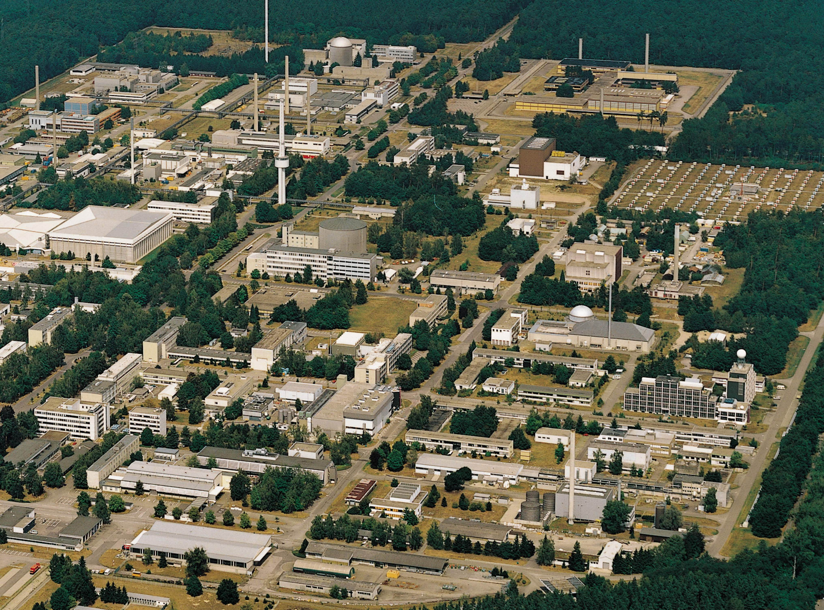
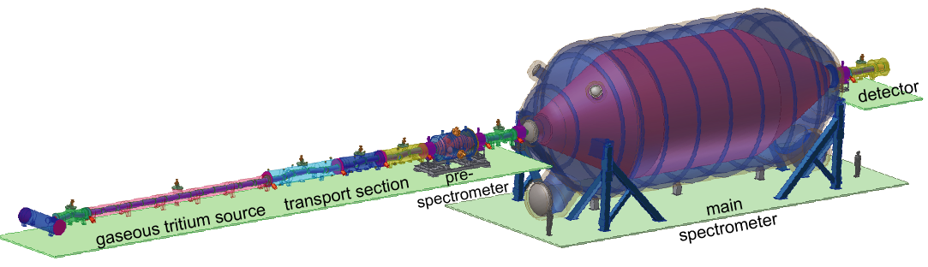
KATRIN
Initially:
5 countries
13 institutions
100 scientists
At Karlsruhe Institute of Technology
unique facility for closed T₂ cycle:
Tritium Laboratory Karlsruhe
TLK
~ 75 m long with 40 s.c. solenoids

Slide 22
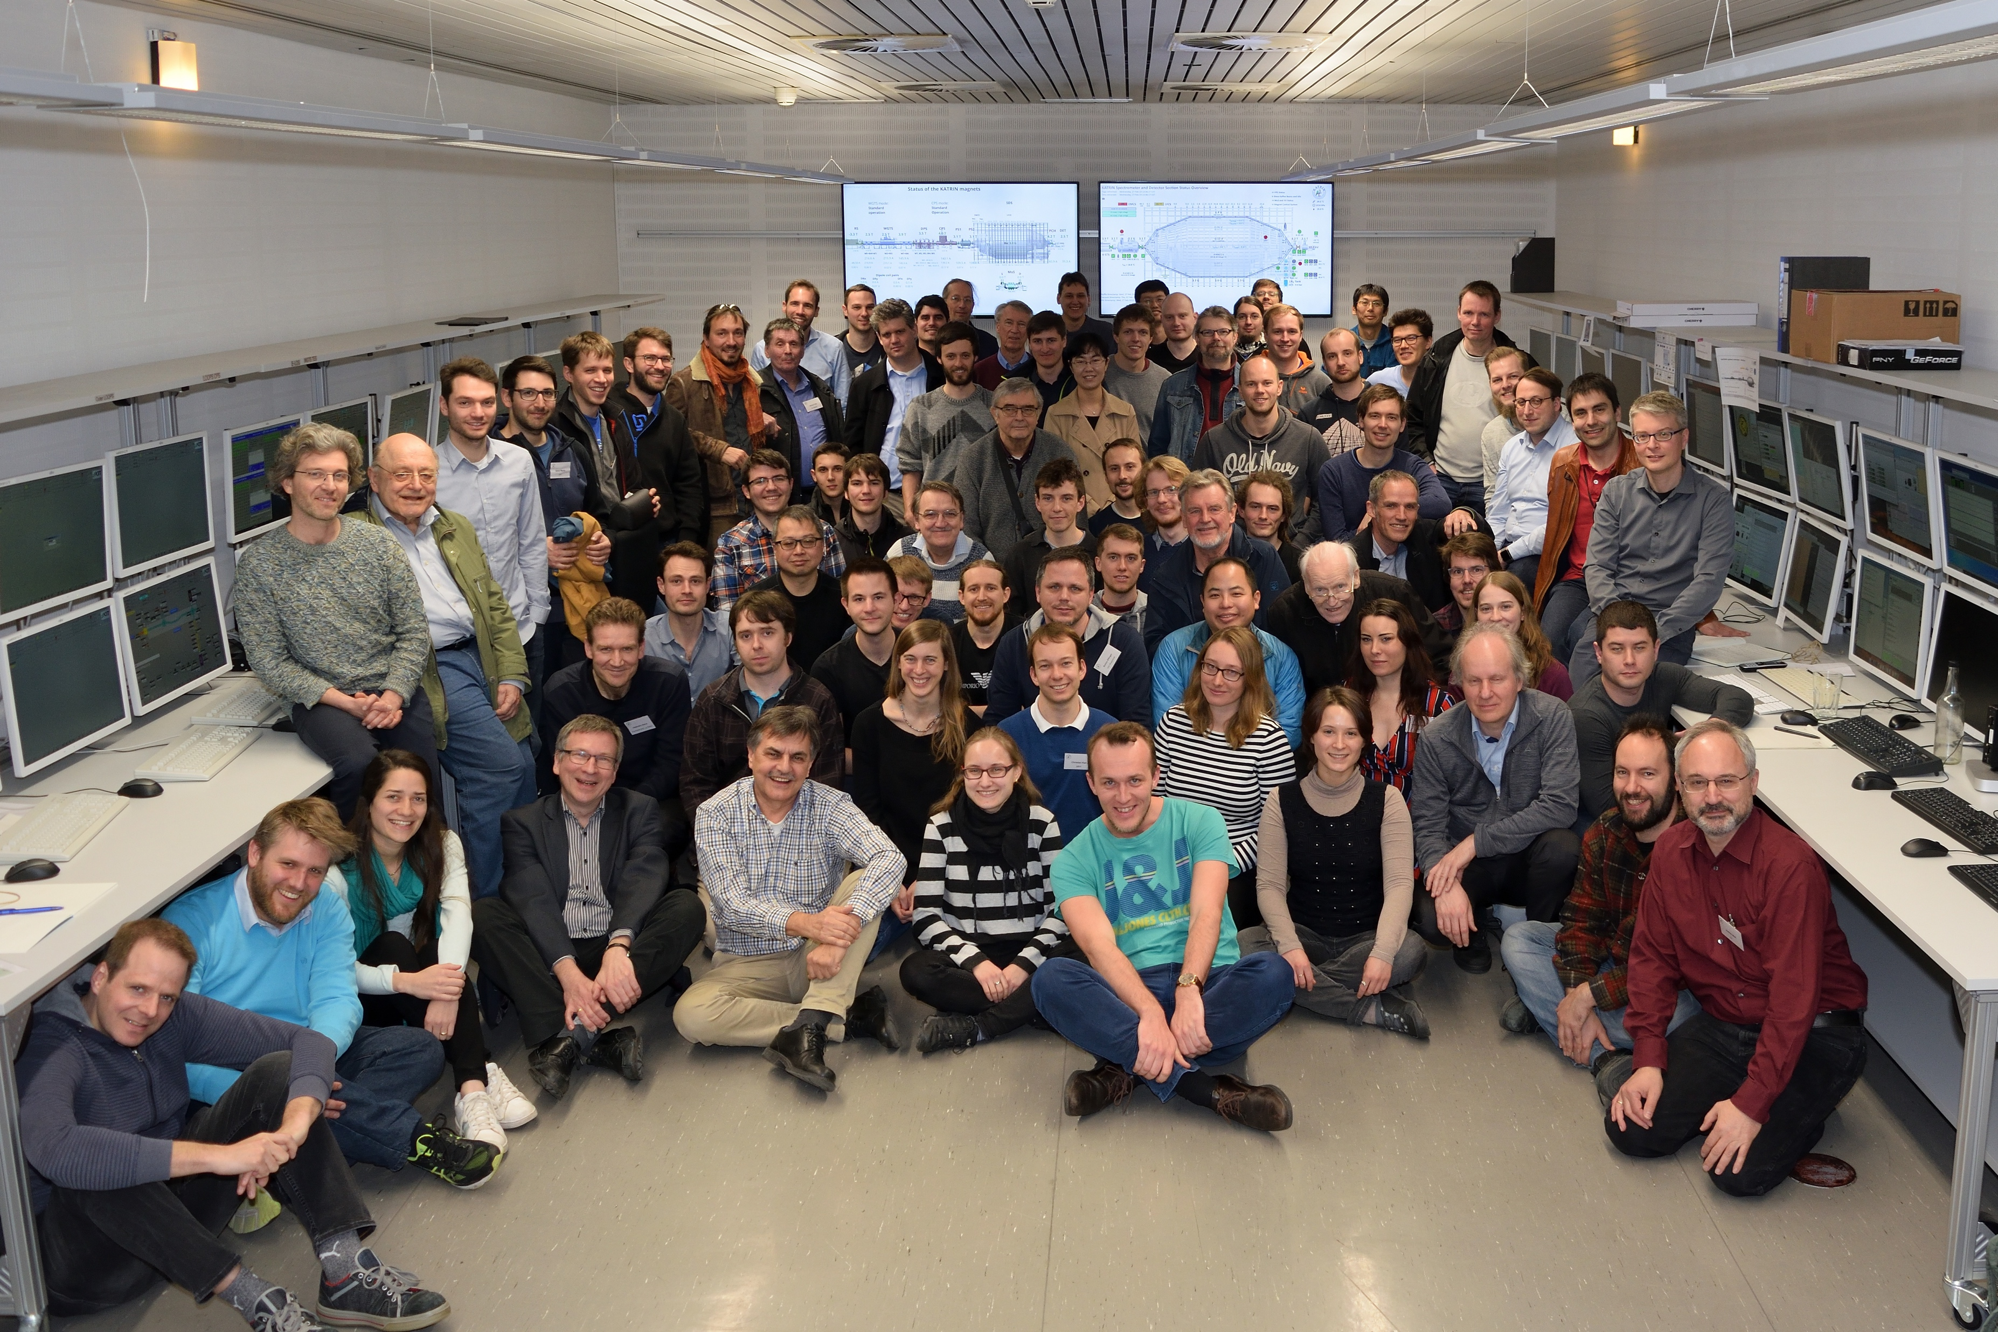
The KATRIN Collaboration

Slide 23
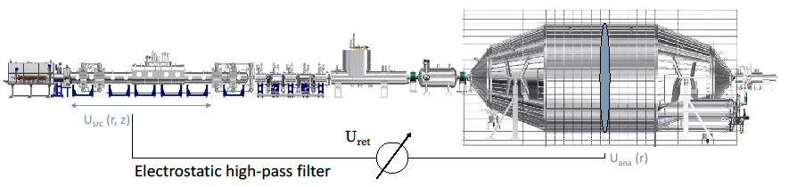
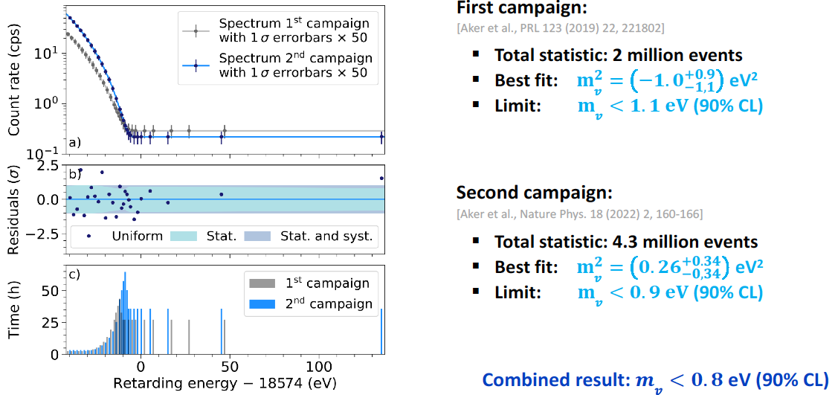
← TLK
KATRIN
2001: Collaboration of all previous T₂ groups (except LLNL)
2023:
m_{β} < 0.8 eV
A. Onillon, T. Laserre

Slide 24
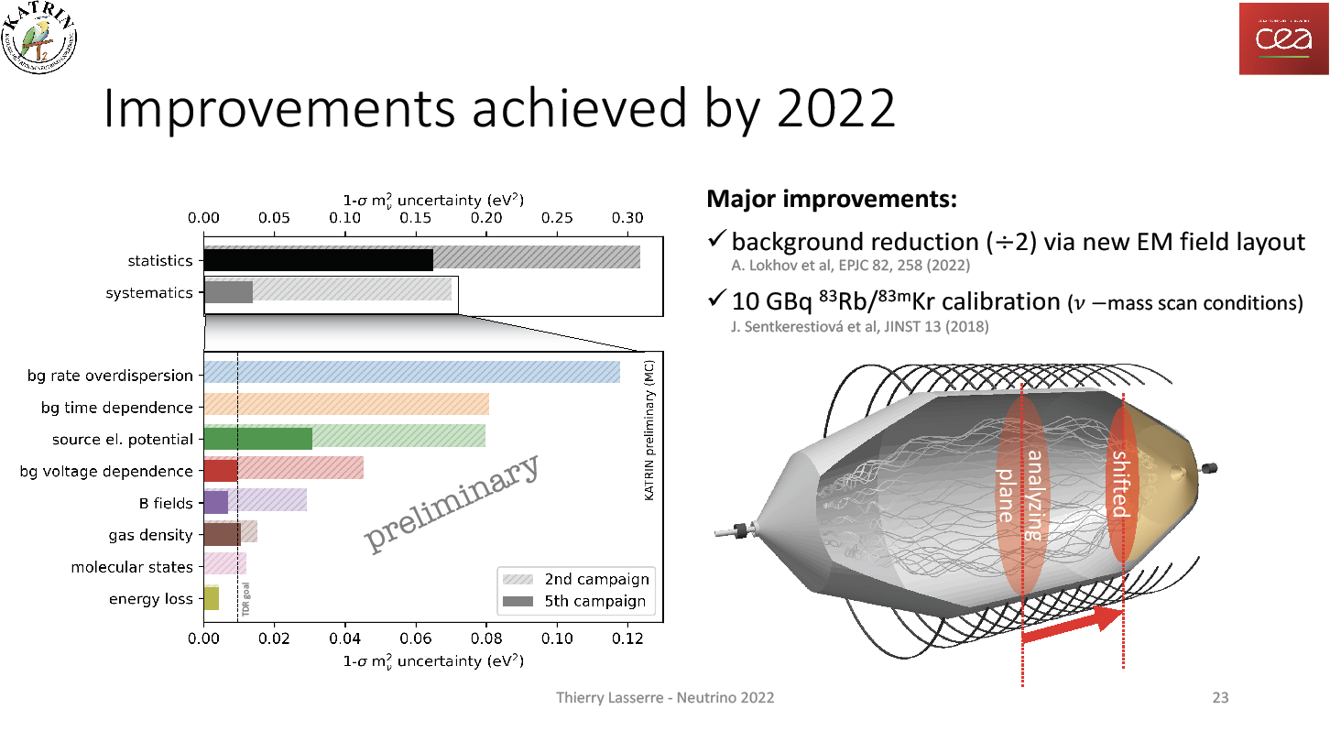
KATRIN’s viselike grip on systematics is key!

Slide 25
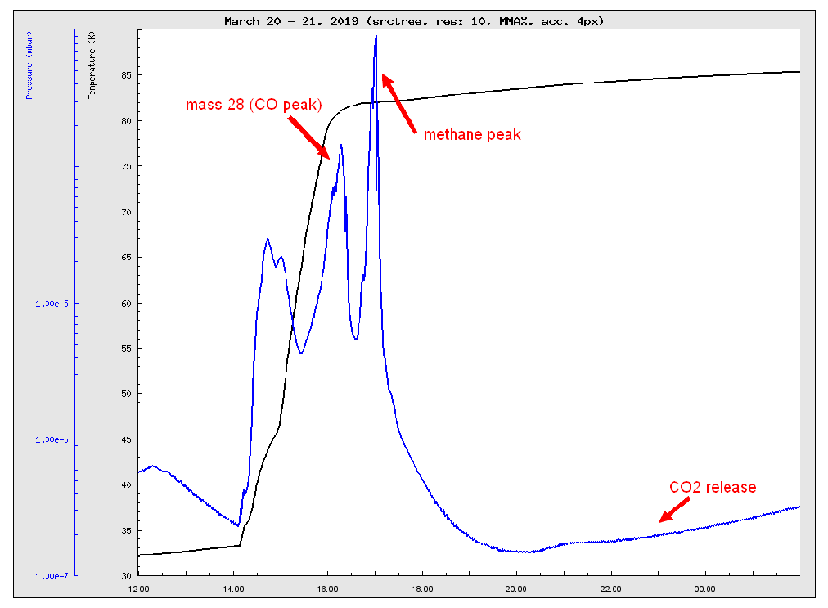
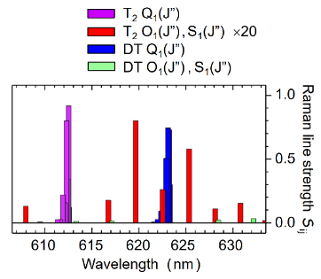
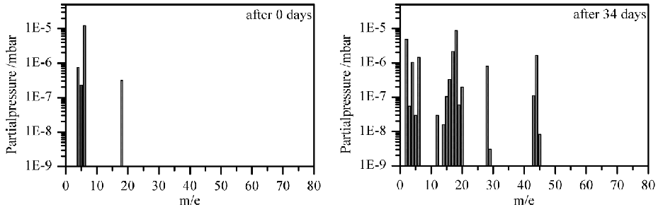
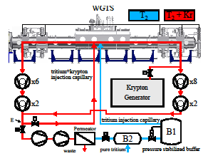
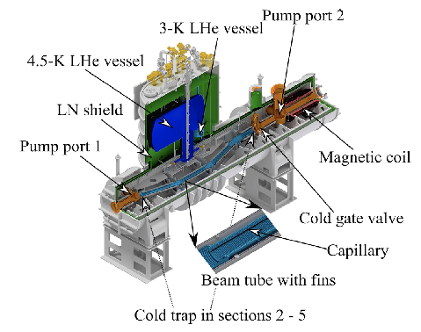
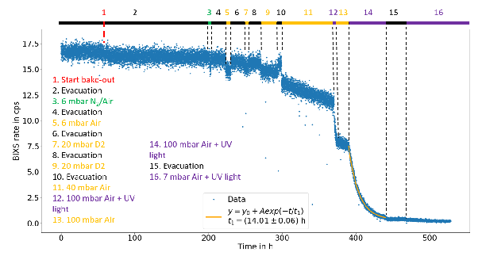
TLK MADE ThIs Possible
CT₄
World-leading tritium-handling facility and the engine for quantifying systematics.
TriTop
LARA
CPS
Decontamination
Loops

Slide 26
2000 – 2023: tritium rules.
KATRIN

Slide 27
2000 – 2023: tritium rules.
KATRIN goal

Slide 28
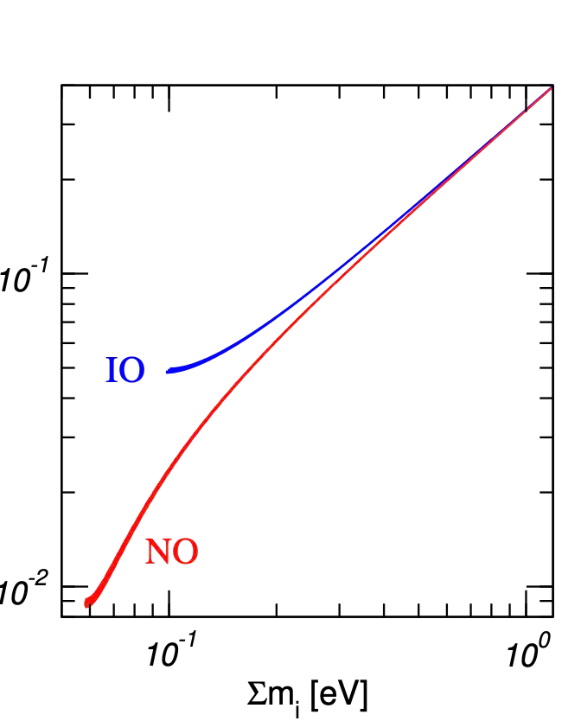
Neutrinos in the cosmos
KATRIN Goal
m_{β} [eV]
ΛCDM + 5 param.
Planck CMB Lensing only

Slide 29
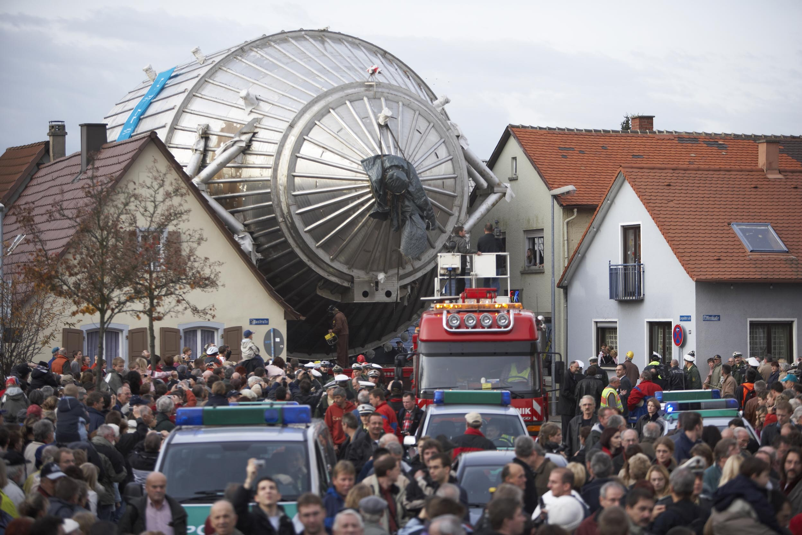
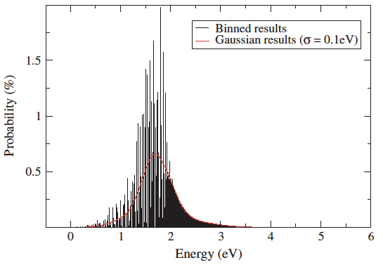

The Last Order of Magnitude
If the mass is below 0.2 eV, how can we measure it?
KATRIN may be the largest such experiment possible.
Statistics
Systematics
FWHM ~ 1 eV
Size of experiment now: 10 m diam.
Molecular rotation and vibration
Next diameter: 300 m!
Theory: Saenz et al. 2000,
Doss & Tennyson 2006

Slide 30
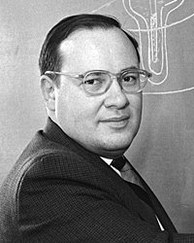
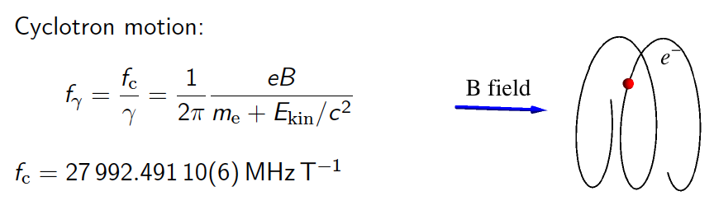


A new idea : Cyclotron Radiation Emission Spectroscopy (CRES).
(B. Monreal and J. Formaggio, PRD 80:051301, 2009)
Arthur Schawlow
(co-inventor of laser)
Only measure frequency!
Surprisingly, this had never been observed for a single electron.

Slide 31
Neutrinos in the cosmos
KATRIN Goal
Project 8 Goal
m_{β} [eV]
ΛCDM + 5 param.
Planck CMB Lensing only

Slide 32


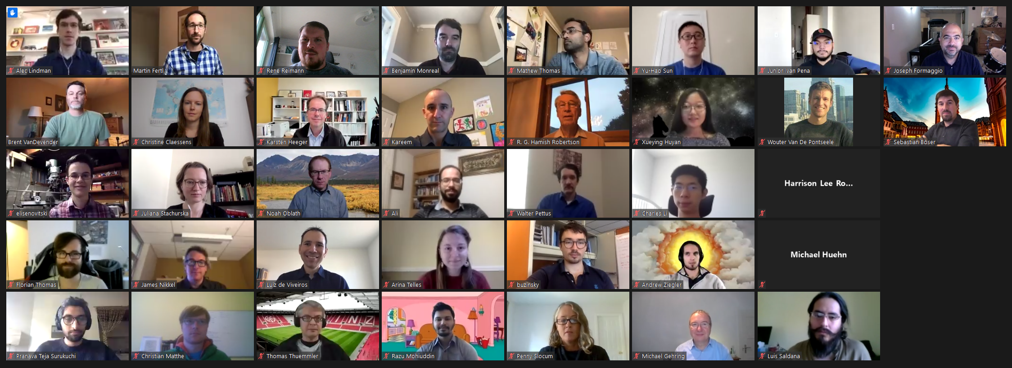












The Project 8 collaboration
Case Western Reserve University
Razu Mohiuddin, Benjamin Monreal, Yu-Hao Sun
University of Illinois
Chen-Yu Liu
Indiana University
Walter Pettus
Johannes Gutenberg-Universität Mainz
Sebastian Böser, Martin Fertl, Alec Lindman, Christian Matthé, Brunilda Mucogllava, René Reimann, Florian Thomas, Larisa Thorne
Karlsruher Institut für Technologie
Thomas Thümmler
Lawrence Livermore National Laboratory
Kareem Kazkaz
Massachusetts Institute of Technology
Nicholas Buzinsky, Joseph Formaggio, Mingyu Li, Junior Peña, Juliana Stachurska, Wouter Van de Pontseele
Pacific Northwest National Laboratory
Jeremy Gaison, Maurio Grando, Xueying Huyan, Mark Jones, Noah Oblath, Dan Rosa de Jesús, Malachi Schram, Jonathan Tedeschi, Brent VanDevender
Pennsylvania State University
Carmen Carmona-Benitez, Richard Mueller, Luiz de Viveiros, Andrew Ziegler
University of Washington
Ali Ashtari Esfahani, Christine Claessens, Peter Doe, Sanshiro Enomoto, Alexander Marsteller, Elise Novitski, Hamish Robertson, Gray Rybka
Yale University
Karsten Heeger, James Nikkel, Luis Saldaña, Penny Slocum, Pranava Teja Surukuchi, Arina Telles, Talia Weiss
Work supported by the US DOE Office of Nuclear Physics, the US NSF, the PRISMA+ Cluster of Excellence at the University of Mainz, and internal investments at all collaborating institutions.

Slide 33
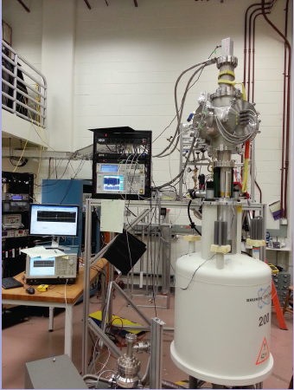
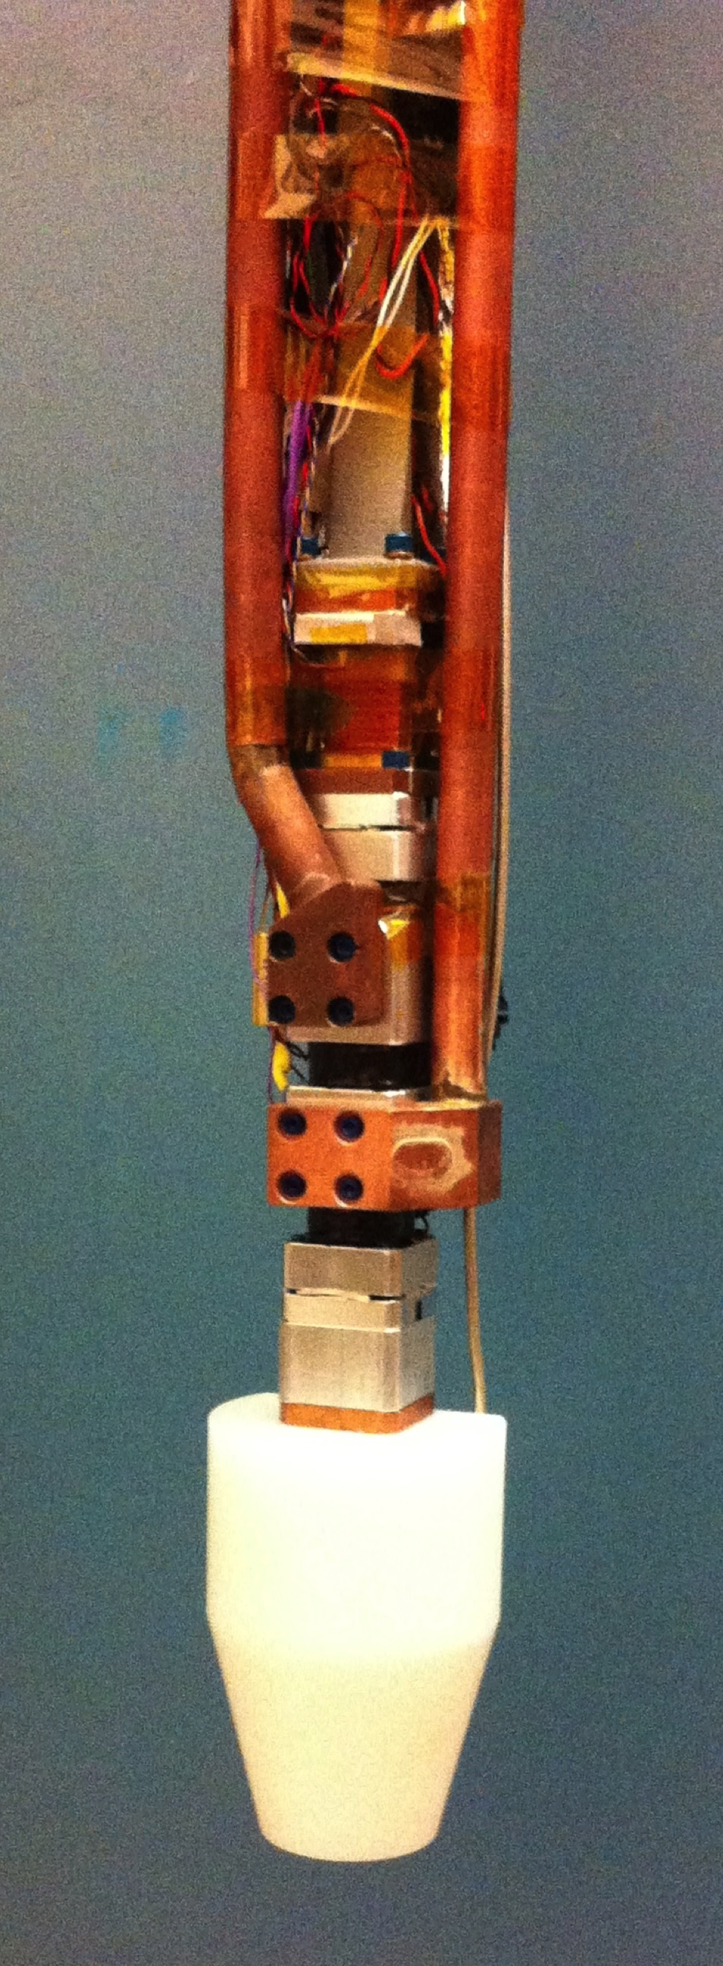
G-M cooler (35K)
26-GHz amplifiers
^{83m}Kr source (behind)
WR-42 waveguide
ESR cell
Gas lines
Trap coils
Superconducting Magnet (0.96 T)
5 cm
Phase I at University of Washington

Slide 34
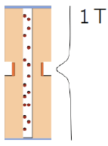
May 23, 2016
34
First CRES event (from ^{83m}Kr)
Waveguide to low-noise amplifier
1 MHz ≈ 20 eV
Weak magnetic trap
Coil
Gas

Slide 35
May 23, 2016
35
First CRES event (from ^{83m}Kr)
start frequency of the first track gives kinetic energy.
1 MHz ≈ 20 eV
frequency chirps linearly, corresponding to ~1 fW radiative loss.
electron scatters inelastically, losing energy and changing pitch angle.
Eventually, scatters to an untrapped angle

Slide 36
Tritium: Phase II Waveguide Cell
1 cm
Improvements:
  Cylindrical waveguide (more volume)
  4 deep trap coils (more statistics)
  Amplifiers colder (less noise)
  Terminator replaces short
  CaF₂ windows for tritium
53 eV FWHM
(Instrumental
33 eV FWHM)

Slide 37
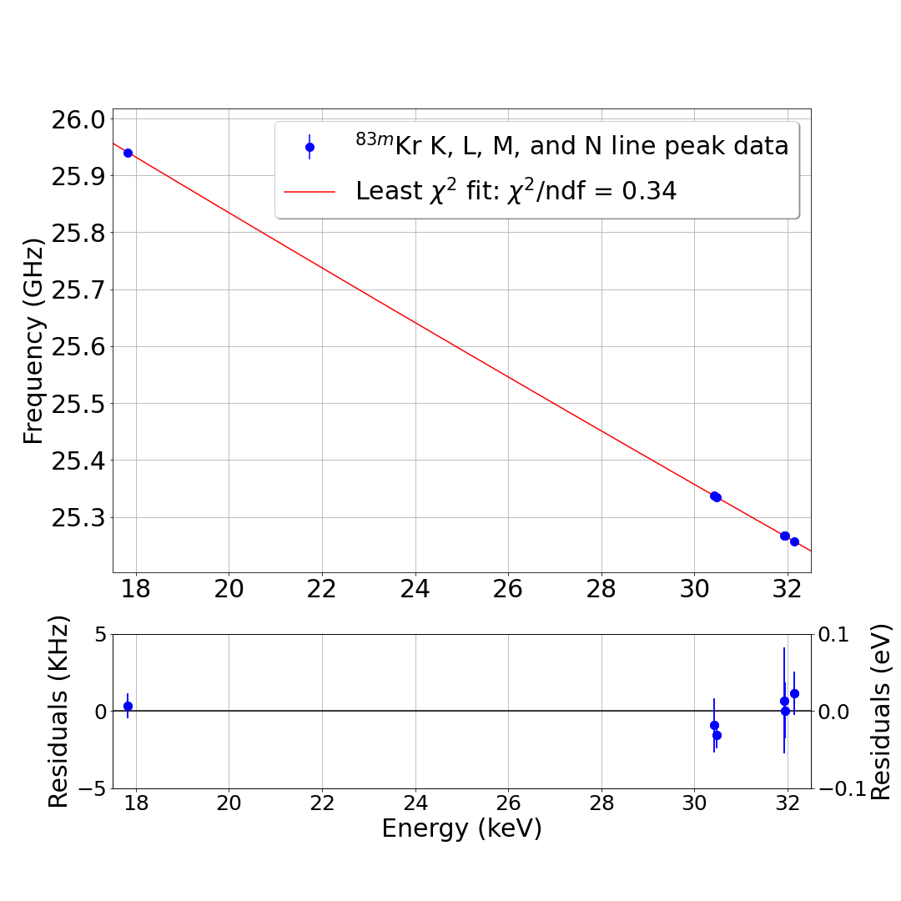
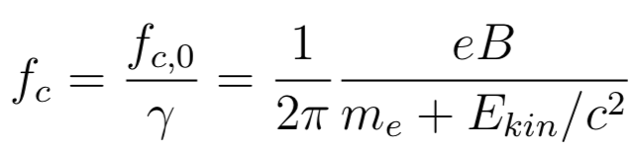
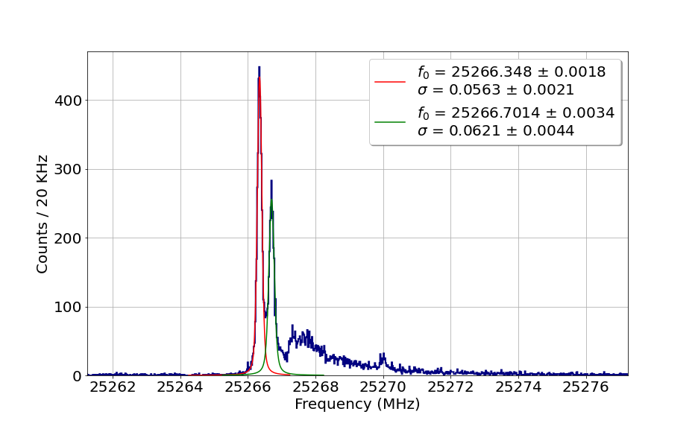
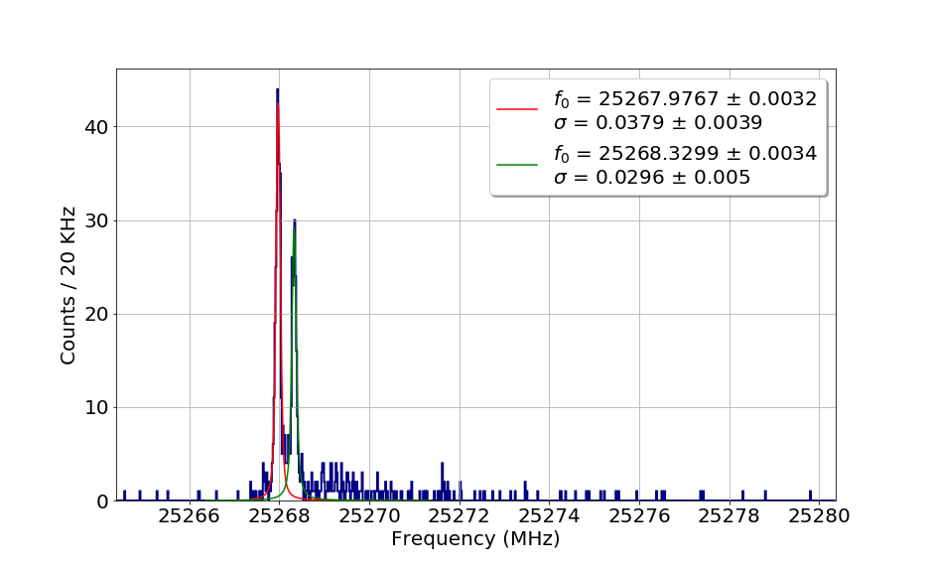
^{83m}Kr data over 17 to 32 keV range
Monoenergetic conversion electrons at 18, 30, 32 keV, bookend the 18.6 keV tritium endpoint
M₃
M₂
M3, M2 lines separated by 8 eV
M₁

Slide 38
Analysis:
^{83m}Kr data
Tritium data
Models
Simulation
Bayesian & Frequentist fits
Letter: 2212.05048
Long paper: 2303.12055
E. Novitski
!

Slide 39
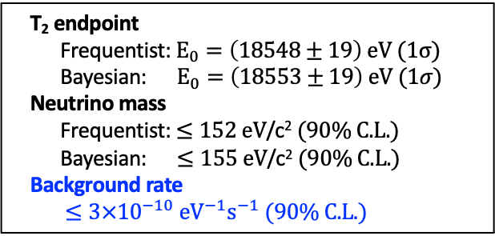
Phase II tritium results
T₂ endpoint
Frequentist:$E_{0}=\left(18548±19\right) \text{eV} (\text{1}σ)$
Bayesian: $E_{0}=\left(18553±19\right) \text{eV} (\text{1}σ)$
Neutrino mass
Frequentist: $≤152 \text{eV}\text{/}\text{c}\text{2} (90\% \text{C}\text{.}\text{L}\text{.})$
Bayesian: $≤155 \text{eV}\text{/}\text{c}\text{2} (90\% \text{C}\text{.}\text{L}\text{.})$
Background rate
$≤3×{10}^{−10} {\text{eV}}^{−1}{\text{s}}^{−1} (90\% \text{C}\text{.}\text{L}\text{.})$
First neutrino mass, T₂ endpoint measurements using CRES
Demonstrated understanding of detector response, control of systematic effects from scattering & field inhomogeneity
Stringent background limit— zero events above endpoint in 82 days!
Project 8 Collaboration, arXiv:2212.05048 (2022)

Slide 40
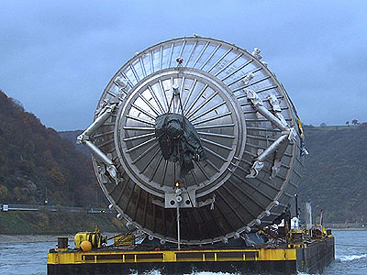
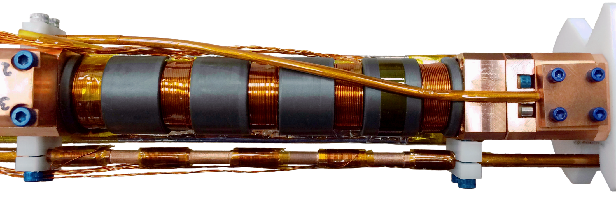
KATRIN spectrometer
Project 8 Phase II spectrometer
(to scale)
40

Slide 41
CRES works: Why is this important?
Source is transparent to microwaves: can make it big. Scales with volume instead of area.
Whole spectrum is recorded at once, not point-by-point.
Excellent resolution obtainable.
Low backgrounds obtainable.
An atomic source of T (rather than molecular T₂) should be possible. Eliminates the molecular broadening.

Slide 42
CRES…
BIG…
ATOMIC

Slide 43
ΔE = 50 eV

Slide 44
ΔE = 1.5 eV

Slide 45
Atomic tritium
“Low-field seekers” can be magnetically trapped

Slide 46
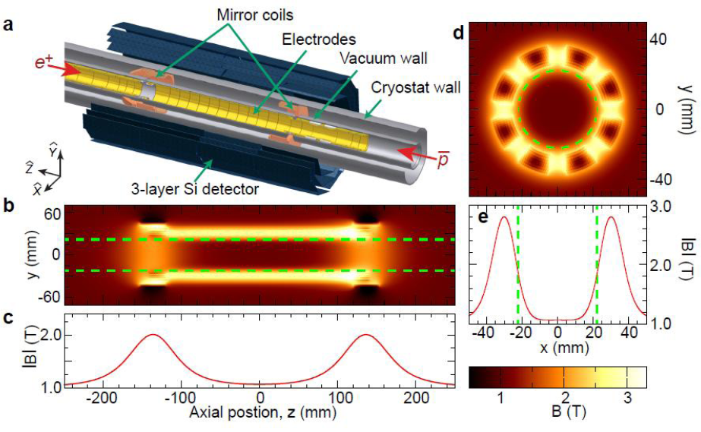

Magnetic trap for atomic T
Ioffe-Pritchard trap
Halbach magneto-gravitational trap
ALPHA Collaboration: Nature Phys 7:558, 2011; arXiv 1104.4982
UCNtau Collaboration: Phys Rev C89, 052501, 2014; arXiv 1310.5759v3

Slide 47


1-GHz Cavity CRES experiment:
Concept for Project 8 Phase III.
Electron gun
Cavity alone for T₂ experiment
Beamline and cavity for an atomic T experiment
Magnetogravitational atom trap. K.E.~1 mK.
Solenoid
Cavity
Pinch coils
3 m
Halbach or Ioffe
Atomic source (“cracker” & accommodator)
Pumps
Evaporative cooling line

Slide 48
ΔE = 0.5 eV
Inverted ordering minimum

Slide 49
2000 – 2023: tritium rules.
Project 8 goal

Slide 50
Congratulations to TLK at 30!
CT₄
…and thanks. The grand quest to answer a fundamental question of nature
would not be possible without you.
On to atomic tritium!
TriTop
LARA
CPS
Decontamination
Loops

Slide 51
Happy Birthday TLK
Thank you

