Slide 1
Welcome and News from KSETA
Ulrich Nierste
27 March 2023

Slide 2
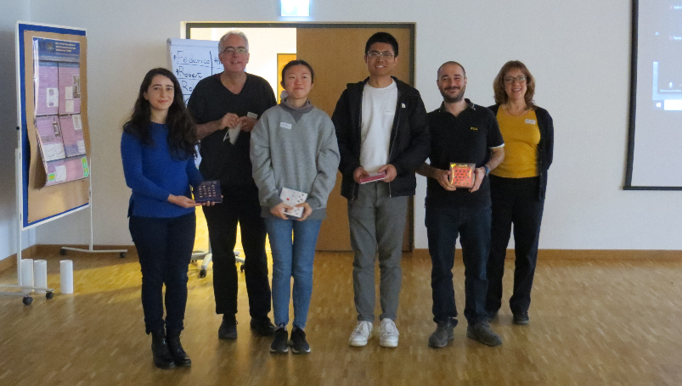
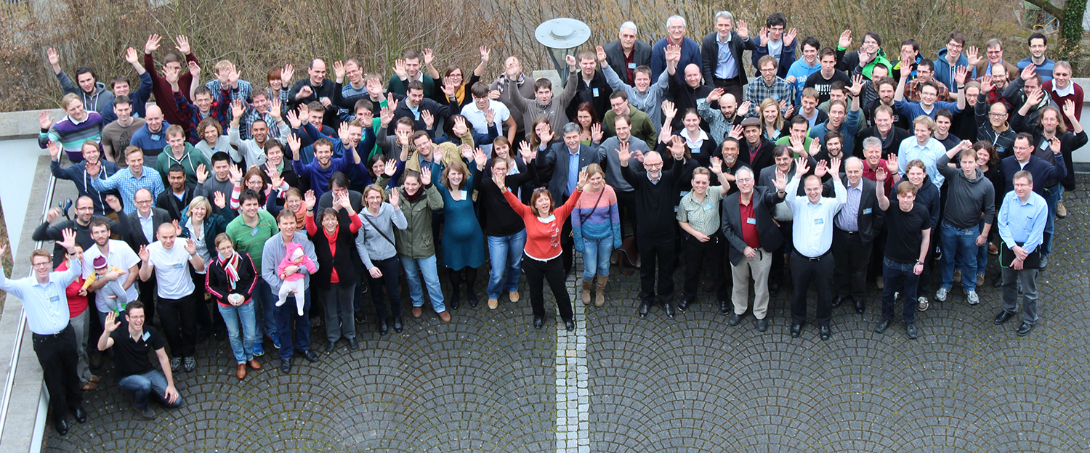
Welcome to the 10th KSETA Plenary Workshop
This event is an important tradition of KSETA
Like a „General Assembly“ with all doctoral researchers and all principal investigators
This year ~90 participants (out of 185)
Opportunity for discussion with external speakers
Talks and posters by fellows
Poster award
Social event
Poster Award 2022
9th KSETA Plenary Workshop
1st KSETA Plenary Workshop

Slide 3
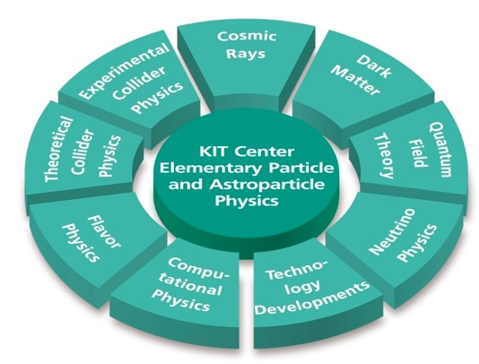
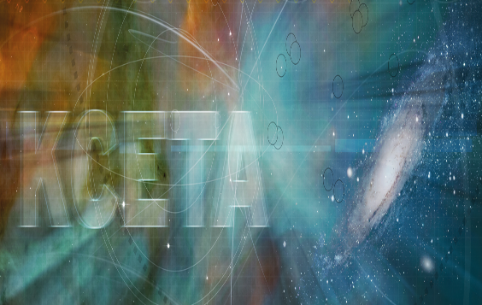
KIT Center Elementary particle and Astroparticle Physics (KCETA)
One out of nine KIT centers
11 institutes
~ 400 people
4 KIT Departments
4 out of 5 KIT Divisions, mainly Division V, Physics and Mathematics
Institute for Experimental Particle Physics (ETP) Institute for Theoretical Particle Physics (TTP) Institute for Theoretical Physics (ITP) Institute for Nuclear Physics (IKP) Institute for Data Processing and Electronics (IPE) Institute for Technical Physics (ITeP) | Steinbuch Centre for Computing (SCC) Institute for Micro- and Nanoelectronic Systems (IMS) Institute for Information Processing Technologies (ITIV) Institute for Technical Thermodynamic and Refrigeration (ITTK) Institute for Accelerator Physics and Technology (IBPT)

Slide 4
Karlsruhe School of Elementary Particle and Astroparticle Physics: Science and Technology (KSETA)
KSETA is the doctoral school of KCETA
45 scientists (principal investigators)
Yearly budget 2023: 588.900 €
All doctoral fellows receive tangible means, courses and workshops.

Slide 5
Funding
sustained funding started November 2019 by local ministry (MWK) and KIT ~ 40% of previous funding from Excellence Initiative
Reduced budget from Nov 2024
Two applications running (COFUND, KIT Strategy Fund)
New Graduate School Scholarship Program (GSSP) grant of DAAD 2023+2024

Slide 6
Some statistics
271 PhD theses since April 2013 until March 2023
20% authored by women
65% in particle physics, 20% in astroparticle physics, 15% in engineering and informatics
Master degree at | Nr. of doctoral researchers | %
KIT | 90 | 33 %
Other university | 181 | 67 %

Slide 7
KSETA in figures Expenses in %
More statistics (by March 2023):
all KSETA Fellows 138
directly paid by KSETA 9
DAAD: 7
international: 59 %
female: 25 %
Graduated Fellows
since Feb. 2022: 24
since Apr 2013: 271
PhD not completed: 30 (9,9 %)

Slide 8
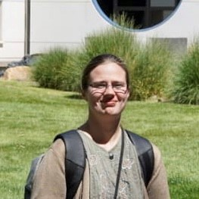
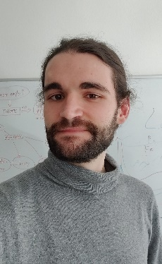
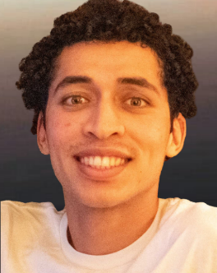
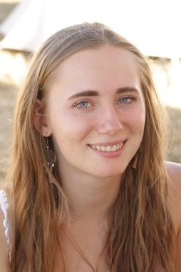
54 new KSETA Fellows since Feb. 2022
Balan, Sowmiya
Bonaparte, Juan
Brusamolino, Alessandro
Dalla Valle Garcia, Giovani
De Jesus, Joaquín
Egner, Manuel
Elicabuk, Umut
Hemme, Nicoline
Ellwanger, Fiona
Eppelt, Jonas
Fengler, Caroline
Finazzi, Lucas
Fuchs, Marvin
Gancarcik, David
Haide, Isabel
Haßelmann, Leonard
Heidelbach, Alexander
Gülzow, Lukas
Heine, Greta

Slide 9
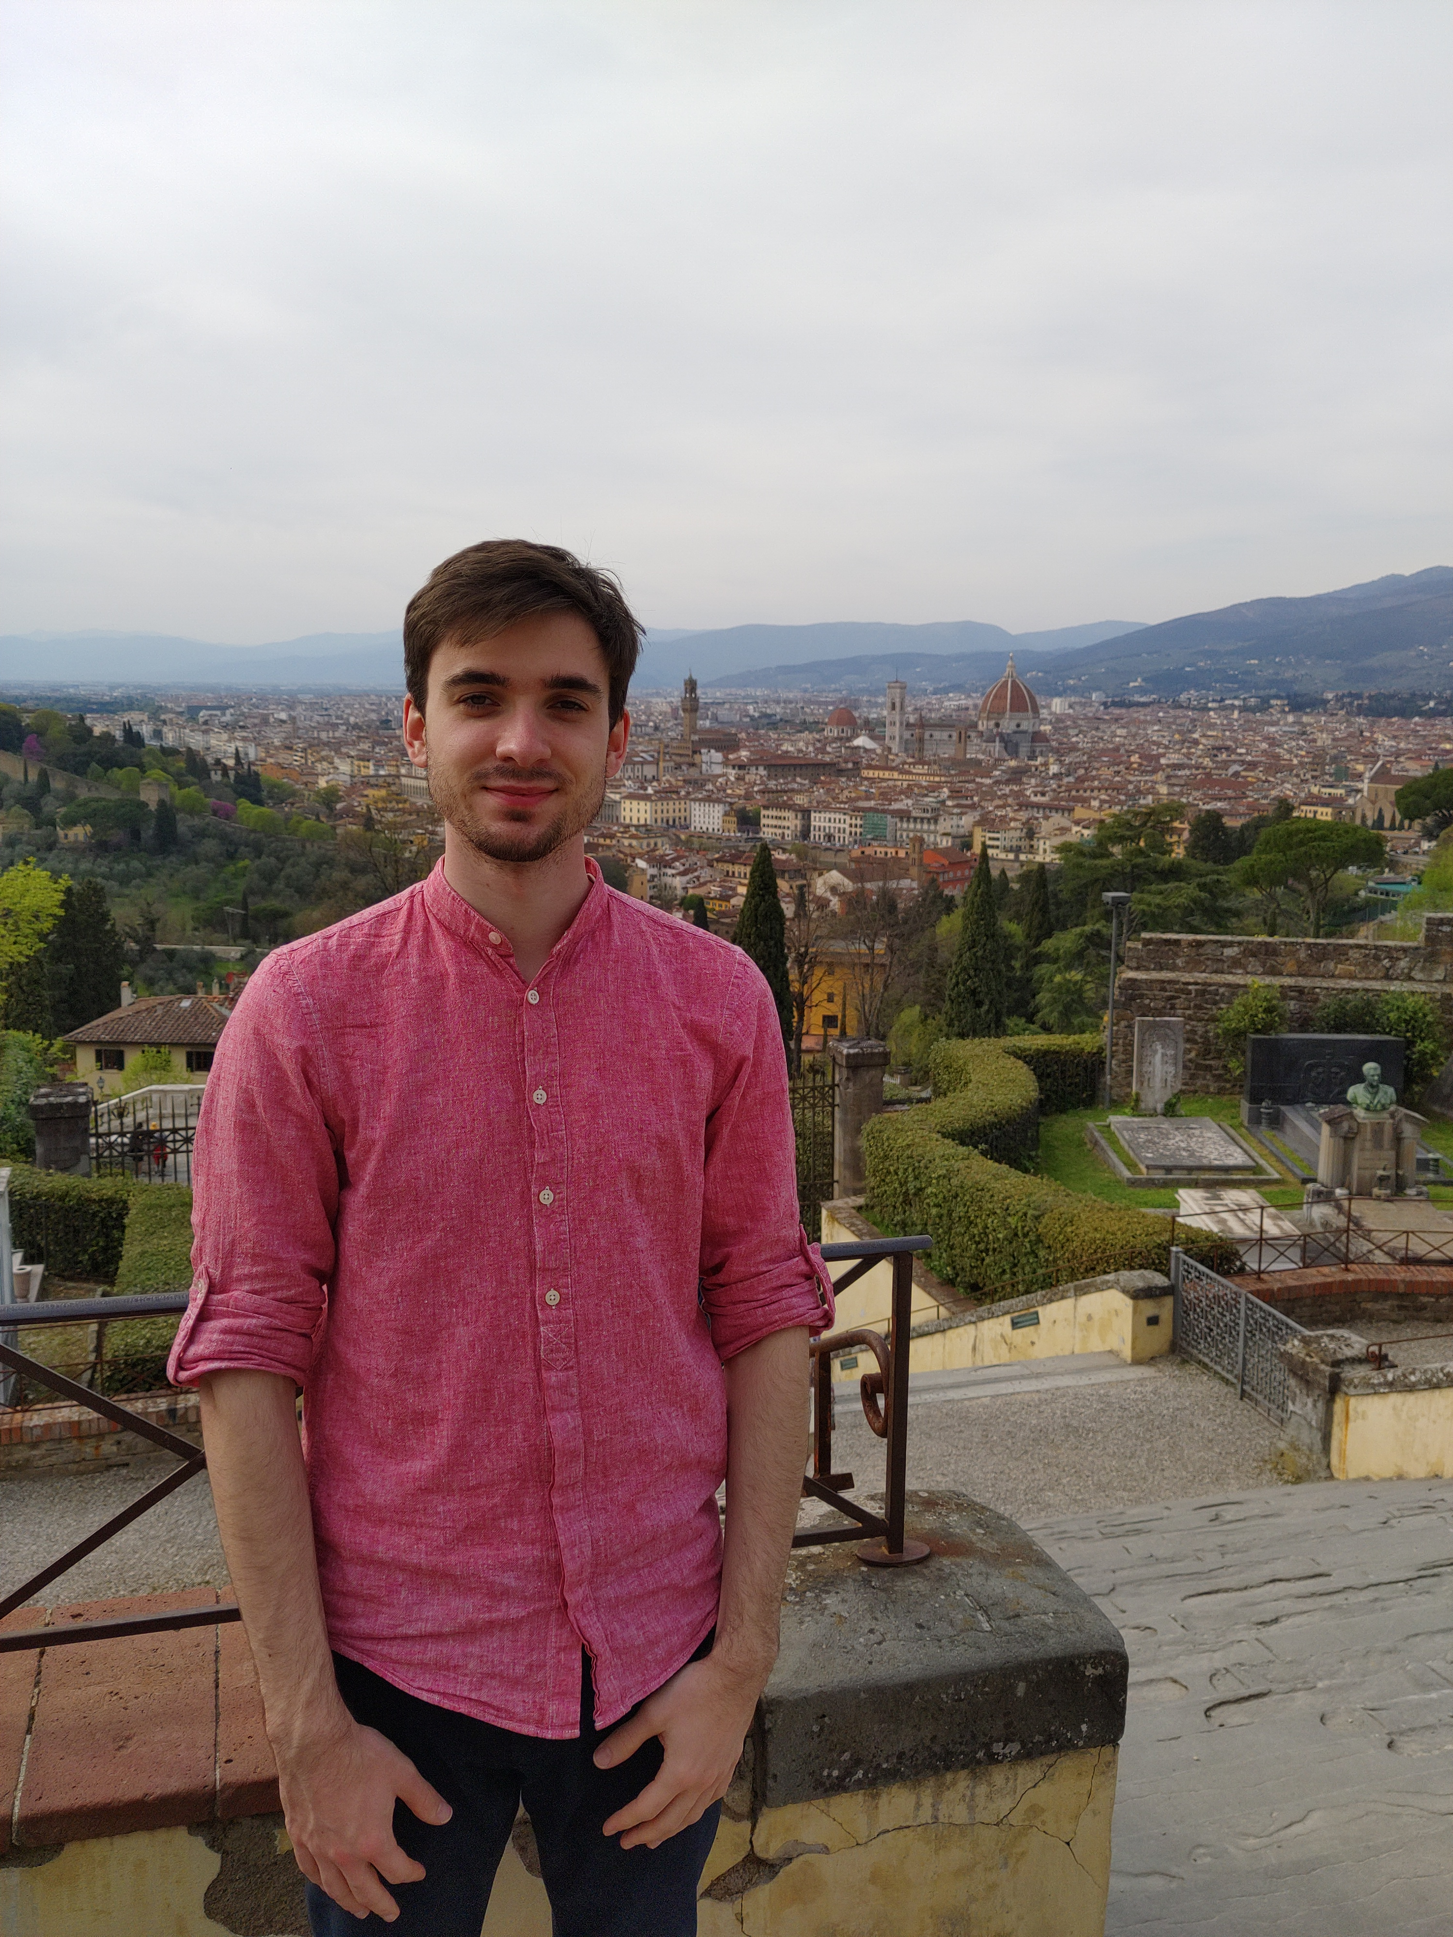
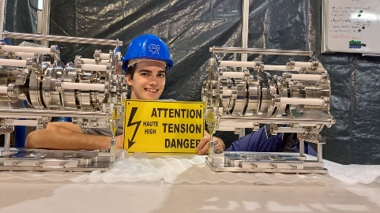
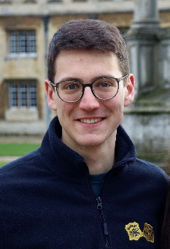
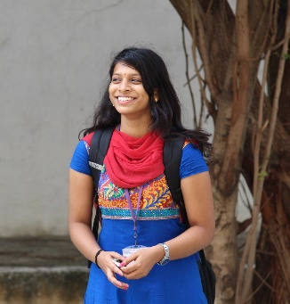
54 new KSETA Fellows since Feb. 2022
Hummer, Fabian
Mormile, Michele
Müller, Nahuel Agustín
Müller, Michael
Muscheid, Timo
Neidig, Martin
Olsson, Anton
Perez Bertolli, Carmina
Petereit, Jelena
Reeck, Pascal
Reuter, Lea
Scheller, Lukas
Schmieder, Ralf
Schuster, Constantin
Sowa, Lars
Stockmeier, Lea
Toms, Maria
Topko, Bogdan
Venugopal, Megha
Verstege, Cedric
Vestner, Augustin
Vetter, Sebastian
Voigtländer, Tim
Von den Driesch, Jost
Weyrauch, Mark
Zaytsev, Alexander
Kiebacher, Stefan
Kizakke Covilakam, Varada Varma
Kovac, Neven
Lauer, Joscha
Lavoryk, Olha
Makarov, Sergei
Manzhura, Olena
Merx, Carmen
Monsch, Artur Artemij

Slide 10
KSETA congratulates.....
Acaroglu, Harun
Angerer, Martin
Baranowski, Daniel
Brommer, Sebastian
Burkart, Maximilian
Damminsek, Kantaphon
Dietrich-Siebert, Heiko
Fatehi, Samira
Gerlach, Marvin
Gesualdi, Flavia
Goos Bosco, Isabel Astrid
Hahn, Steffen
Hinz, Dominic Fabian
Jabbar, Jubna
Karcher, Nick
Koppenhöfer, Roland
Krasch, Bennet
Metzner, Felix
Schlüter, Felix
Stadelmaier, Maximilian
Streich, Alexander
Turcotte-Tardif, Roxanne
Von Cube, Florian
Zhou, Albert
...to their succesful graduation

Slide 11
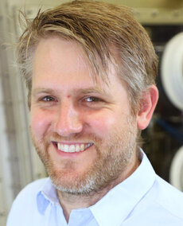
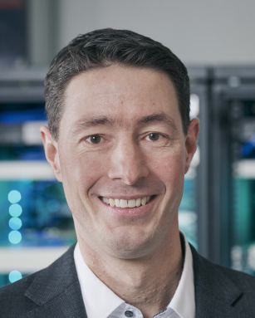
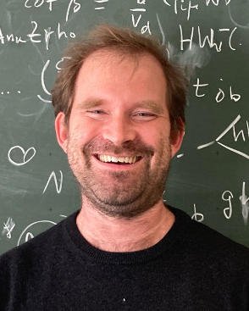
New KSETA PI
Magnus Schlösser: Institute for Astroparticle Physics (IAP),TLK, neutrino physics, KATRIN, PHYS
Frank Simon: Institute for Data Processing and Electronics (IPE), sensor/detector technology, ETIT
Robert Ziegler: Institute for Theoretical Particle Physics (TTP), physics beyond the Standard Model, PHYS

Slide 12
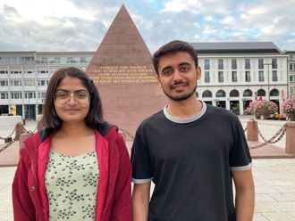
Internships 2022 & 2023 (DAAD-IAESTE program)
Internships for IIT Bombay students 2022 and 2023
Projects 2022 (at KIT in May/July 2022):
Calibration of Scintillators for the South Pole – Anjali Yadav, IAP, supervised by Shefali and Thomas Huber
Cosmic Ray Analysis with Deep Learning -- Harsh Choudhary, IAP, supervised by Andreas Haungs and Paras Koundal
Projects 2023 (planned at KIT in May-July 2023):
DAQ of South Pole Surface Station – Sudeshna Dutta, IAP, supervised by Megha Venugopal and Thomas Huber
Reconstruction of Extensive Air Showers Measured at IceCube – Amangati Rohan Ganesh, IAP, supervised by Andreas Haungs and Mark Weyrauch
Not from IIT: Forward Physics Facility and Cosmic Rays, IAP, supervised by Dennis Soldin
Anne-Solène Bornens from École Supérieure de Physique et de Chimie de Paris (ESPCI Paris), ITP

Slide 13
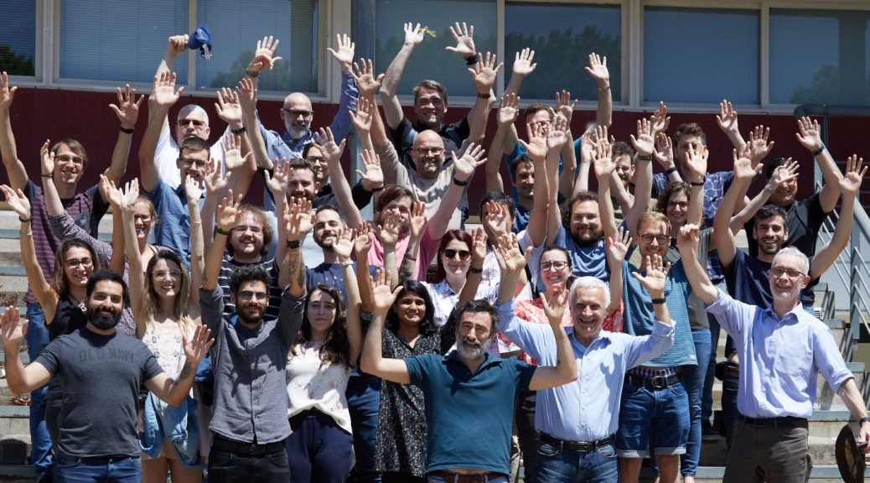
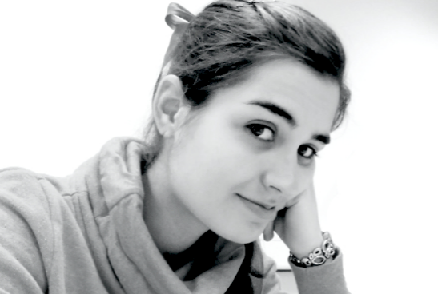
Activities in HIRSAP and Double-degree programs
The annual HIRSAP annual Workshop took place in Buenos Aires November 10 - 11 2022
This is the main meeting where all doctoral students present their work and discuss with their supervisors
The program was complemented by lectures and highlight talks given by Dr. Martin Makler and Prof. Luis Raul Abramo
first face-to-face workshop for some of the PhD students
13 long-term stays in 2022
PhD thesis of HIRSAP/DDAp alumna Ana Laura Müller published by Springer

Slide 14
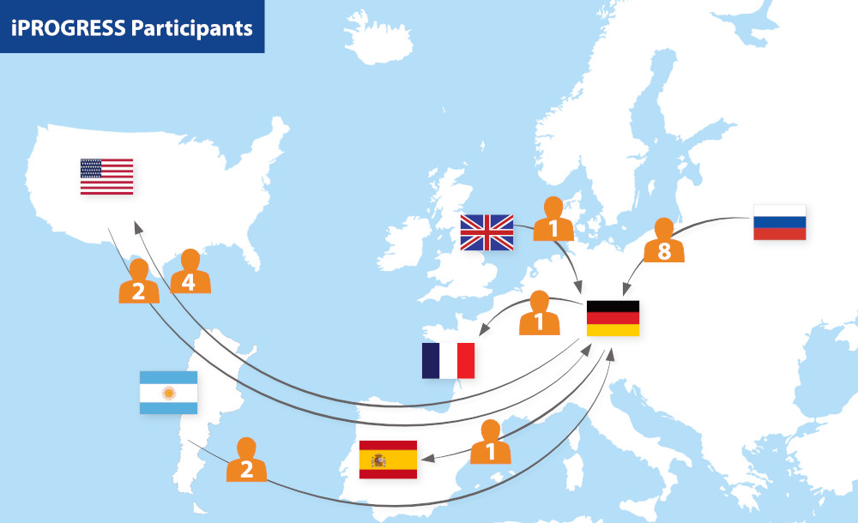
iPROGRESS
two iPROGRESS - Internship Program for Young Research Scientists – research visits
L. Köllenberger
G. Zeller
Status as of 2023-02

Slide 15
Particle Physics Phenomenology after the Higgs Discovery
Second funding period of CRC TRR 257 (2023-2026) granted by the DFG
- 19 PIs (7 from KIT), 21 collaborative research projects (collider- and flavour physics, dark matter)
- at KIT (TTP, ITP, IAP) currently 7 CRC-funded PhD students
Events:
- Annual Meeting
- Young Researchers Meeting
- Topical workshops
- Doctoral exchange program between sites
- CRC Colloquium
- GenderHEP Journal Club
- Outreach program
CRC Annual Meeting in Aachen, March 2023
15

Slide 16
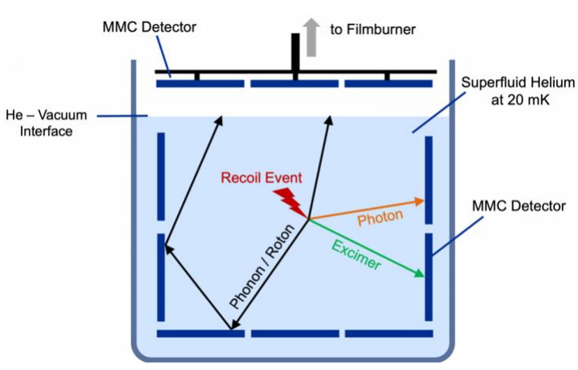
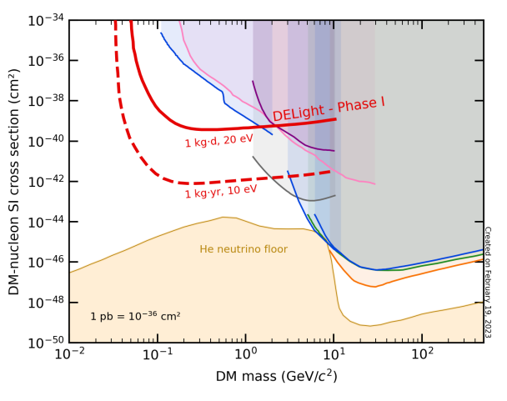
New Dark Matter Experiment in preparation at KIT in collaboration with Heidelberg and Freiburg
First phase will already probe new low-mass Dark Matter parameter space (1kg helium)
KSETA Fellow Greta Heine setting up data pipeline (and logo)

Slide 19
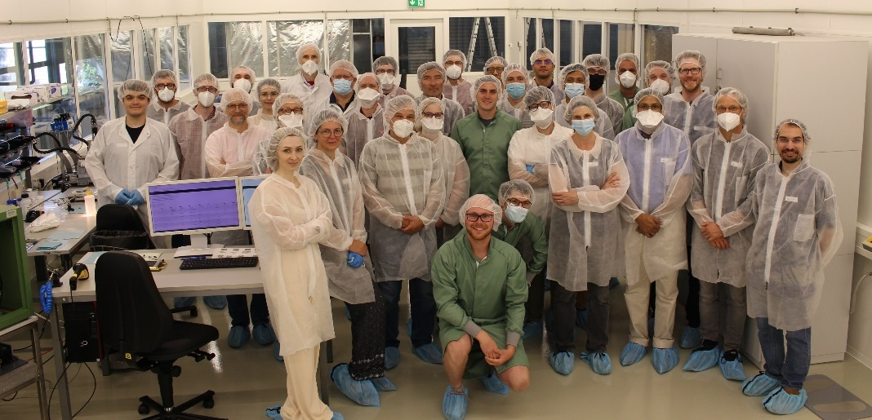
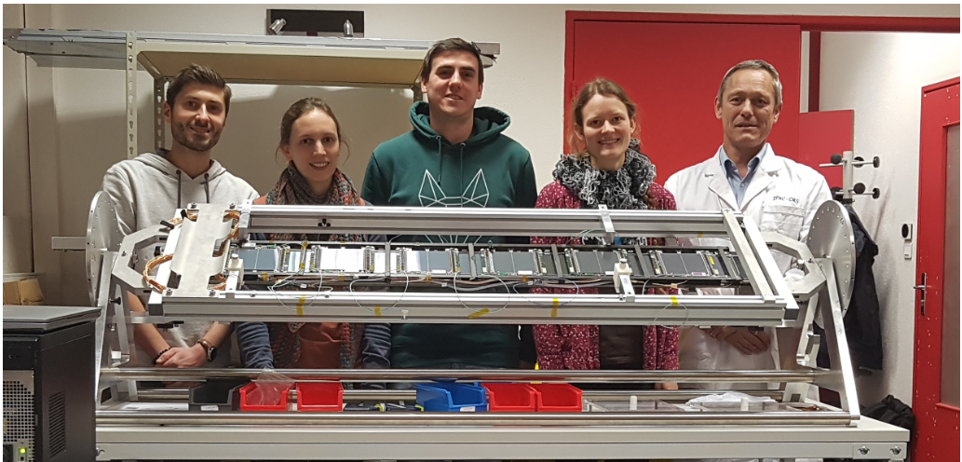
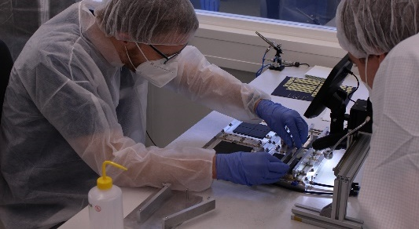
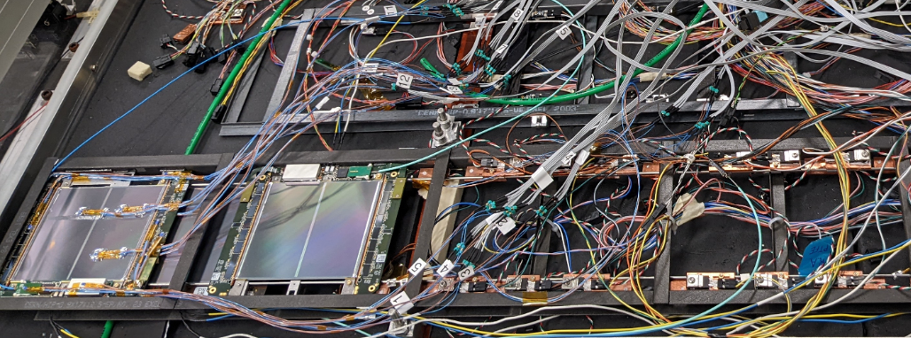
CMS Tracker Upgrade: from modules to ladders
Int. module assembly workshop at KIT (June’22)
Integration tests on full ladder (Jan’23)
.. and in cold environment (March’22)
KSETA fellows Umut Elicabuk, Lea Stockmeier, Florian Wittig and KSETA alumnus Stefan Maier

Slide 20
Electronics for cryogenic applications
Bluefors, Tektronix, Anritsu, Marki, RS, Spectrum, HP
Aim: Integrated readout/control electronics
Flexible platform
Versatile applications
Easy to use
IPE
Notes:
The group was established about 6? years ago to fill in the need for instrumentation for cryogenic applications, such as the detectors presented in the previous talk by Mr. Kempf
Traditionally, fundamental research developing the devices uses a sortiment of laboratory equipment that is not suitable for large-scale applications.
Therefore, the aim of the group is to design an integrated readout and control electronics system that is flexible, that can be used in different applications and that it is user friendly
Targeting primarily those large-scale experiments

Slide 21
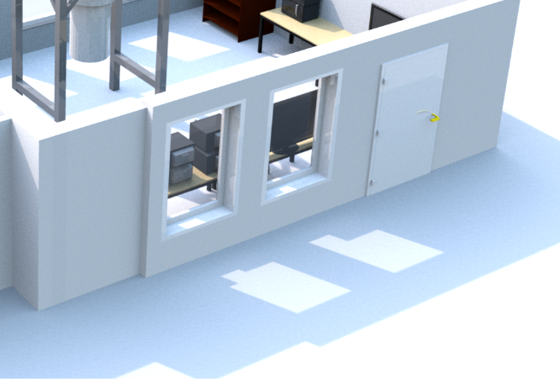
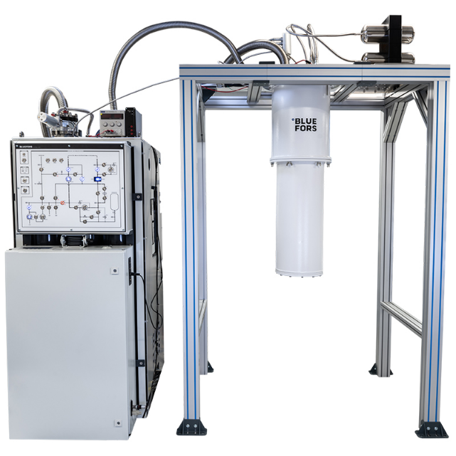
Cryogenic electronics lab at IPE
Mobile version of Bluefors LD250 cryostat (<10mK) has been installed at IPE in Feb 2023
Planned installation of one RF readout chain in combination with cryo switch for up to 6 experiments
Main focus: Characterization of cryogenic detectors, the associated DAQ as well as qubit control and readout electronics
bluefors
IPE

Slide 22
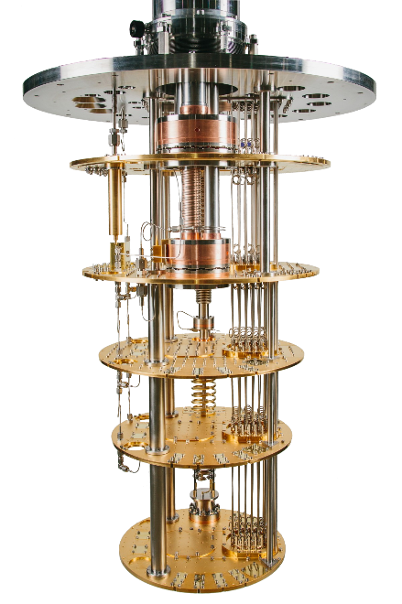
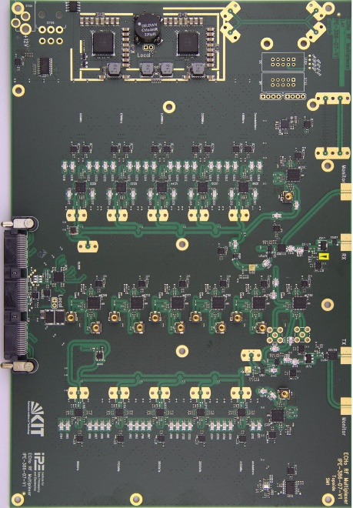
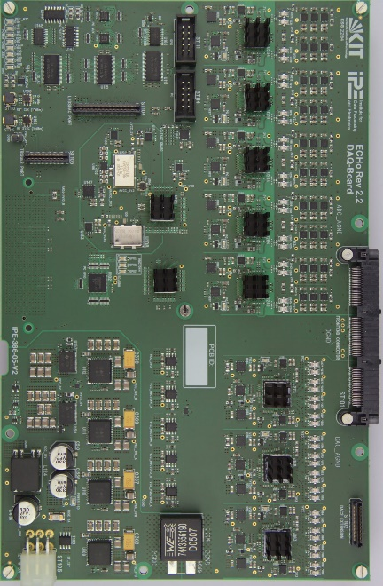
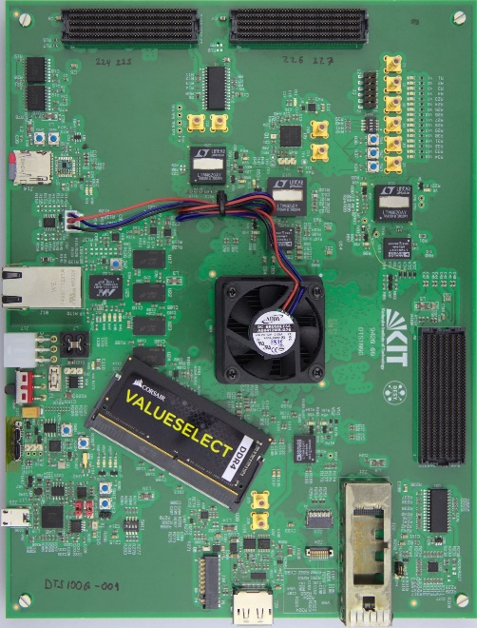
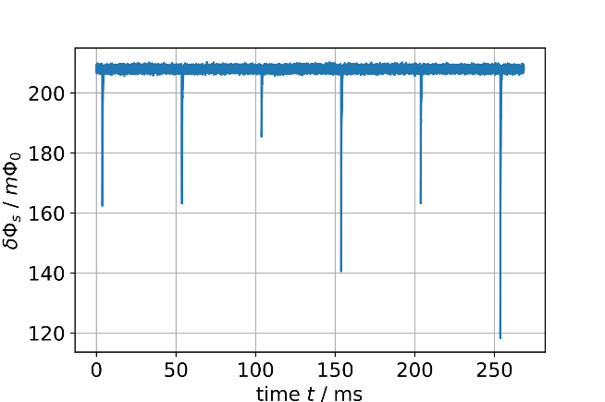
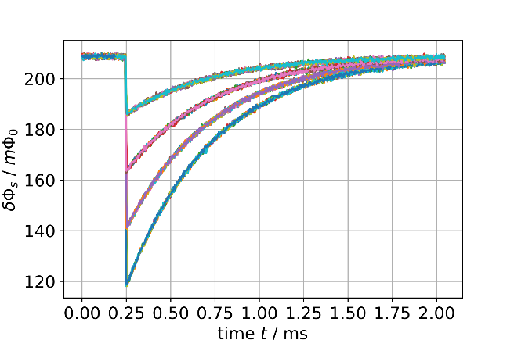
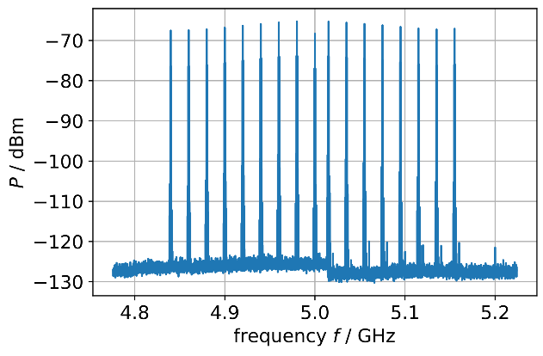
ECHo readout electronics - completed
(Muscheid, et. al. JINST 2022)
Measure electron neutrino mass with metallic magnetic calorimeters (MMCs)
First milestone of the Helmholtz program MT reached: “scalable readout technologies for pixelated cryogenic detector systems with 1000+ channels”
MMCs
RF Board
DAC & ADC
ZynqUS+ Board (DTS-100G)
Input HF signal
Demodulated detector signal
Extracted pulses
IPE
Notes:
Here is a brief overlook of the multiple Hardware boards designed at IPE for the ECHo experiment corresponding to the previously mentioned stages of one platform
And an overview of the type of signal reconstruction by the firmware, where a significant part of the work is invested.
There is a polyphase channelizer, digital down converters, demodulation modules, and pulse extracting modules

Slide 23
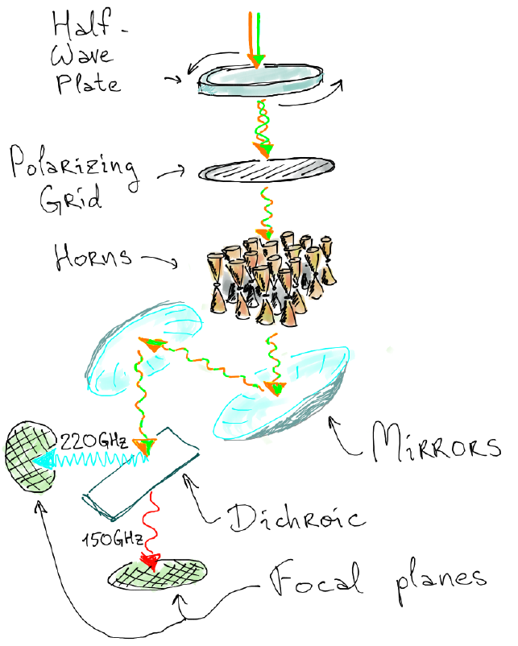
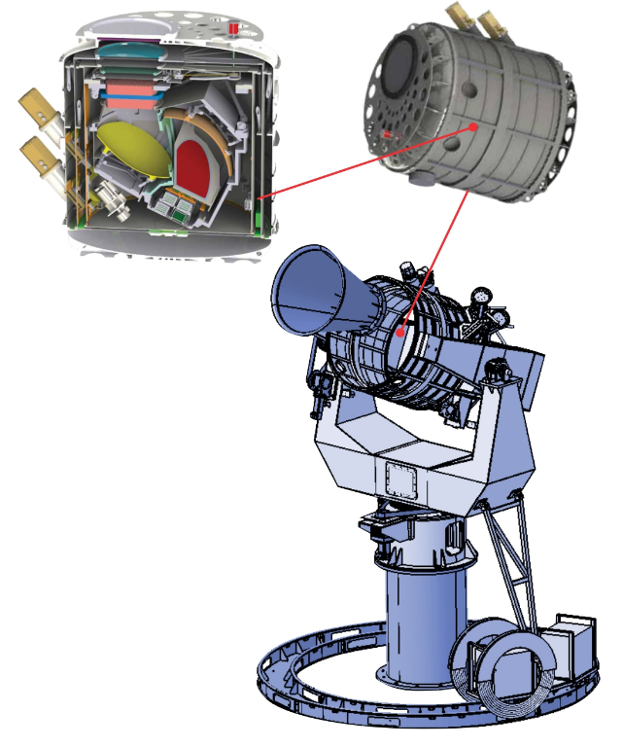
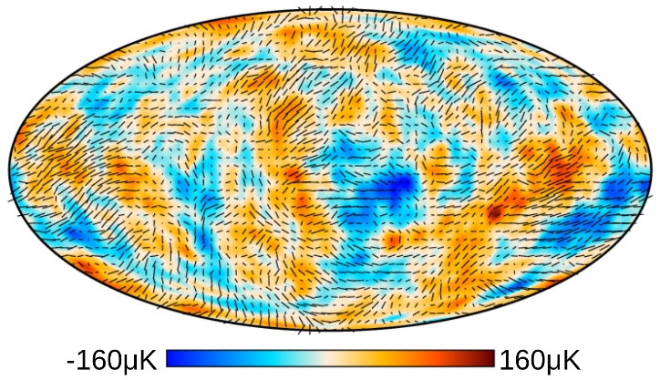
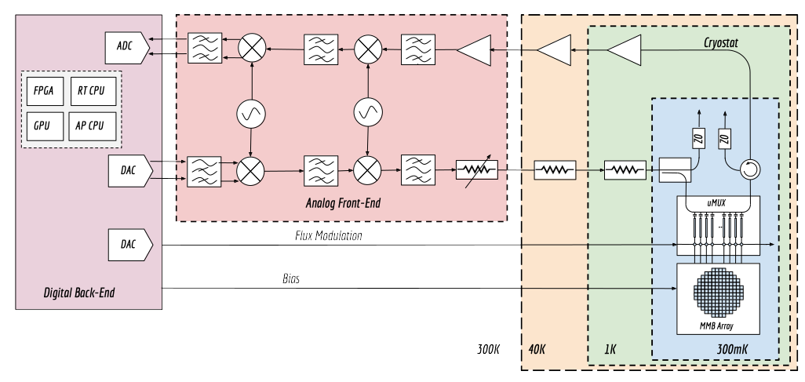
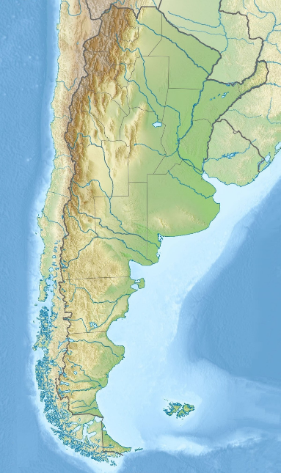
Qubic Experiment
Goal: Measurement of the B-mode polarization of the Cosmic Microwave Background (CMB) radiation
(Hamilton et. al. 2021)
(ESA Planck et. al. 2018)
Argentina
RFSoC
Superconducting sensors
IPE
Notes:
Now, another project our group works on, particularly the dual-degree students, is the QUBIC experiment, which aims to measure the b-mode polarization of the cosmic microwave background radiation.
Following the idea of being versatil, the platform is based on the idea of being able to re-utilize hardware, firmware and software components.
Having as a fall-back solution based on the ECHo electronics already in the pocket, there is a characterization campaign going on to port existing firmware on another kind of heterogeneous device, which now tightly incorporates the ADC and DAC converters on the same die, this are known as RFSoC.

Slide 24
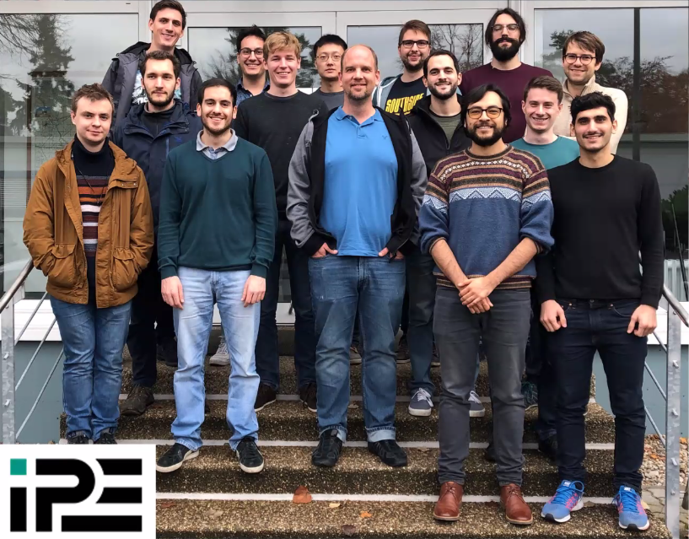
The IPE-SDR group
KSETA PI
Group Leader
Oliver Sander
Post-Docs
Luis Ardila
Doctoral Students
Marvin Fuchs
Robert Gartmann
Torben Mehner
Timo Muscheid
Lukas Scheller
Manuel Garcia (USAM-KIT)
Luciano Ferreiro (USAM-KIT)
Juan Salum (USAM-KIT)
Former doctoral students
Richard Gebauer
Nick Karcher
former fellow
KSETA fellows
KSETA + HIRSAP fellows
both with Helmholtz doctoral prize in 2022 !!!
IPE
Notes:
First off, I want to you give you a general overview of our research group lead by Oliver Sander here present, who has made an enormous effort in establishing one of the youngest and more dynamic groups at the institute with currently 2 postdocs and 8 doctoral students. in a given year, we also have several master and bachelor thesis students joining us for several months
SDR=Software Defined Radio

Slide 25
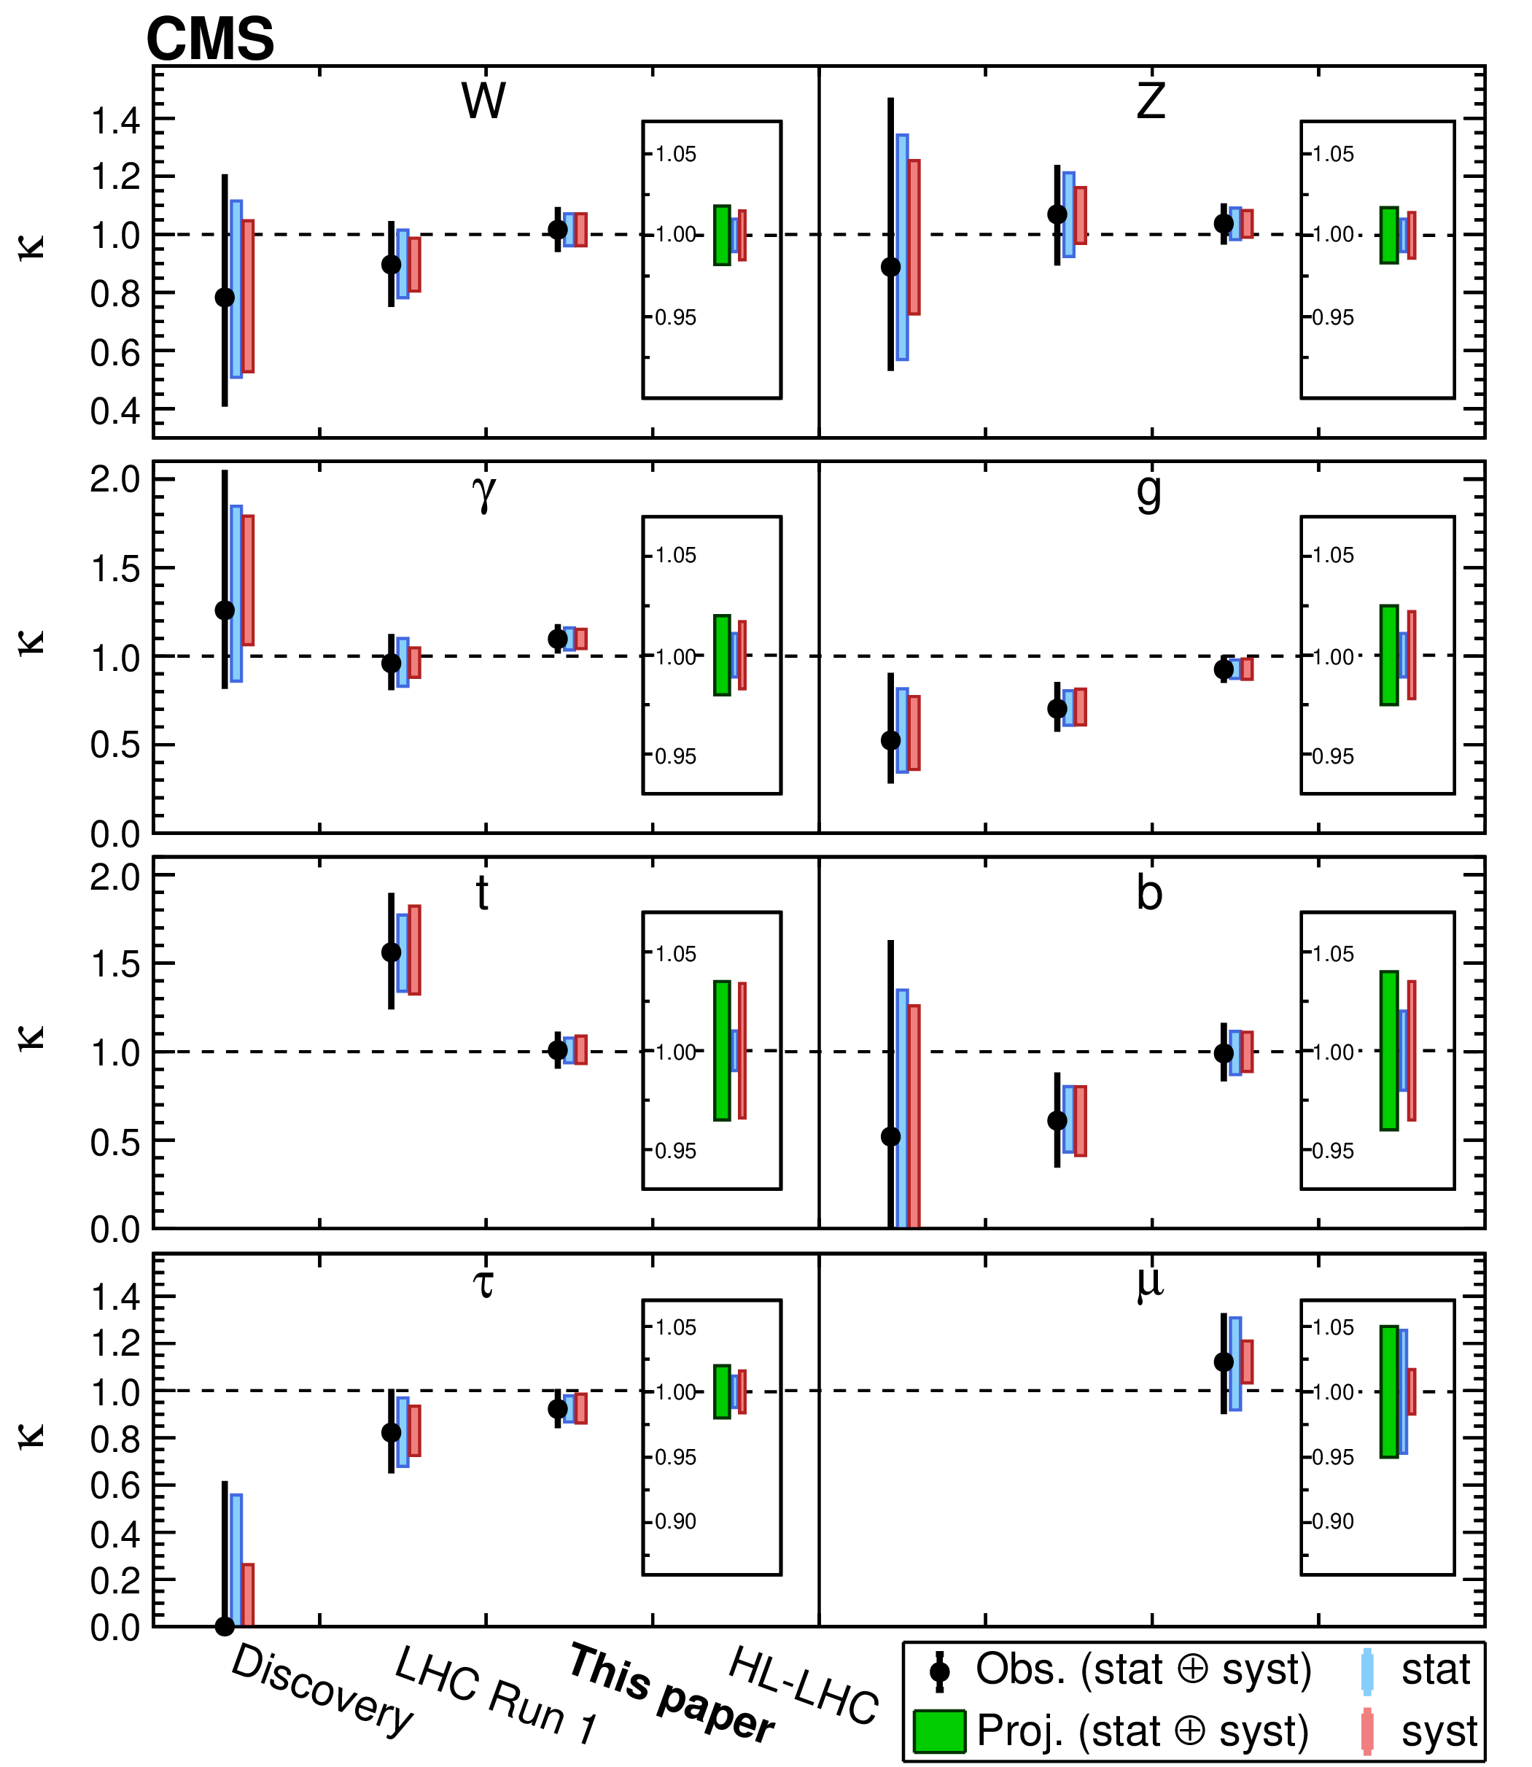
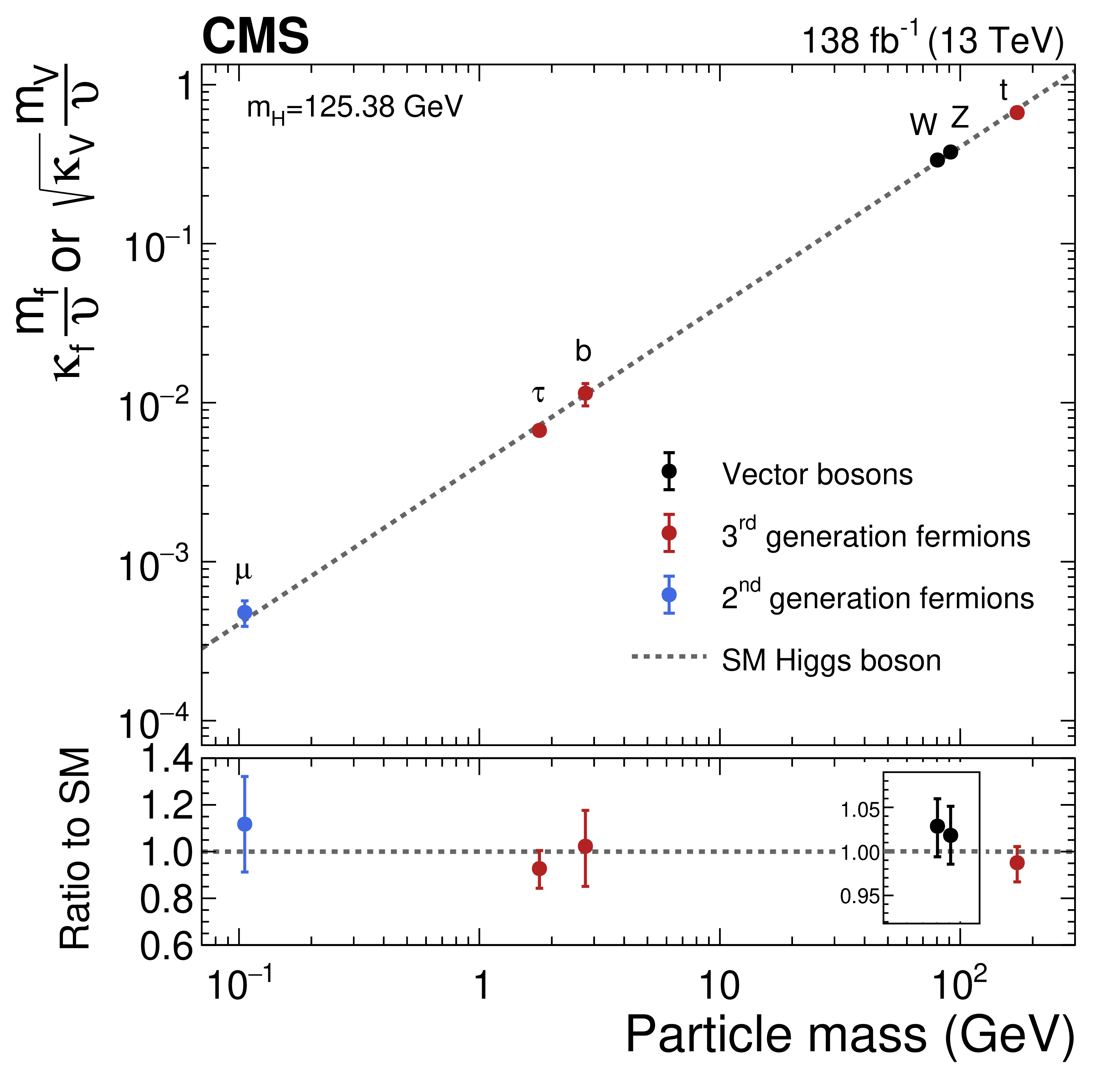
“A portrait of the Higgs boson…
… by the CMS experiment 10 years after the discovery” (Nature 607 (2022) 60):
Since discovery ETP contributes the analysis.
To this paper 6 KSETA fellows contributed between 2019–now
25

Slide 26
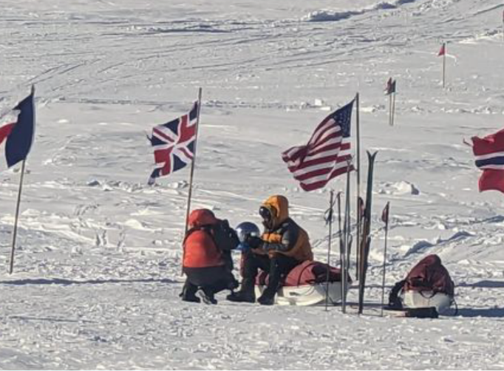
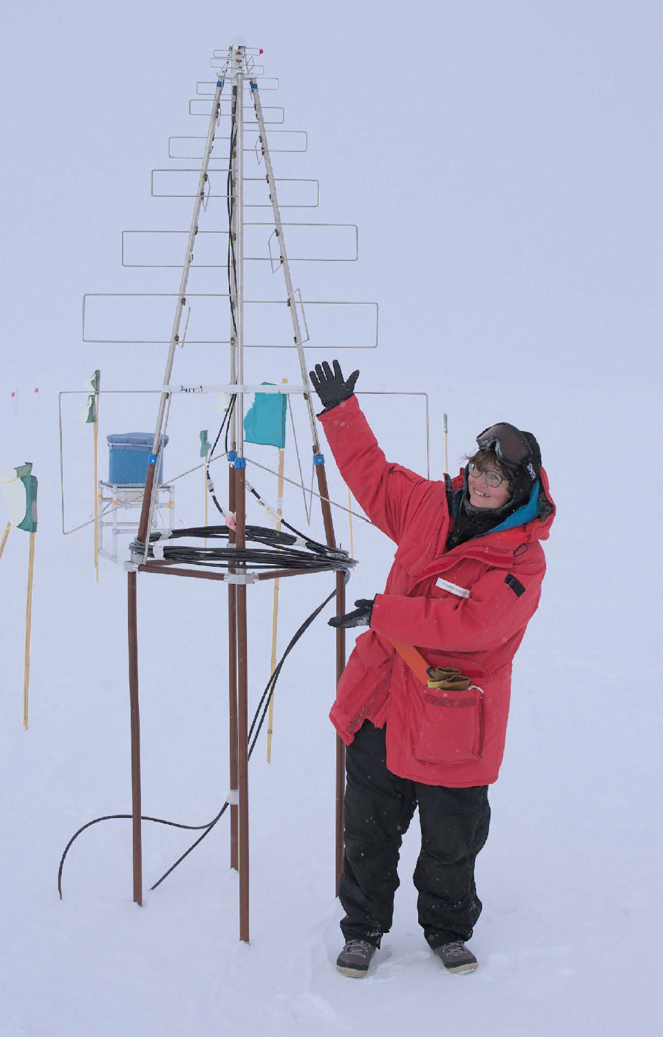
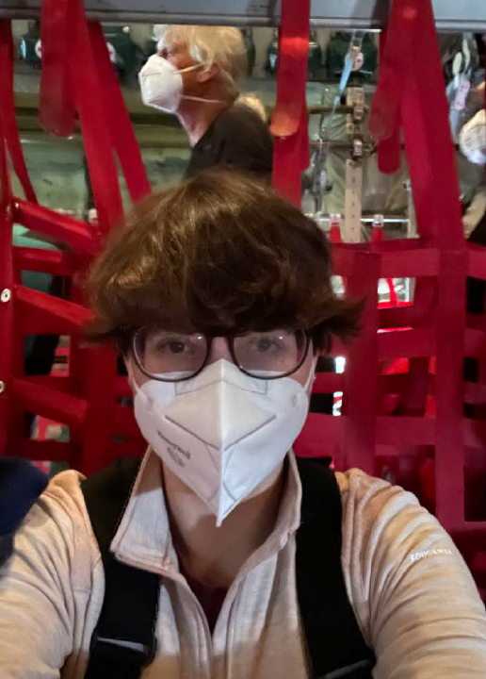
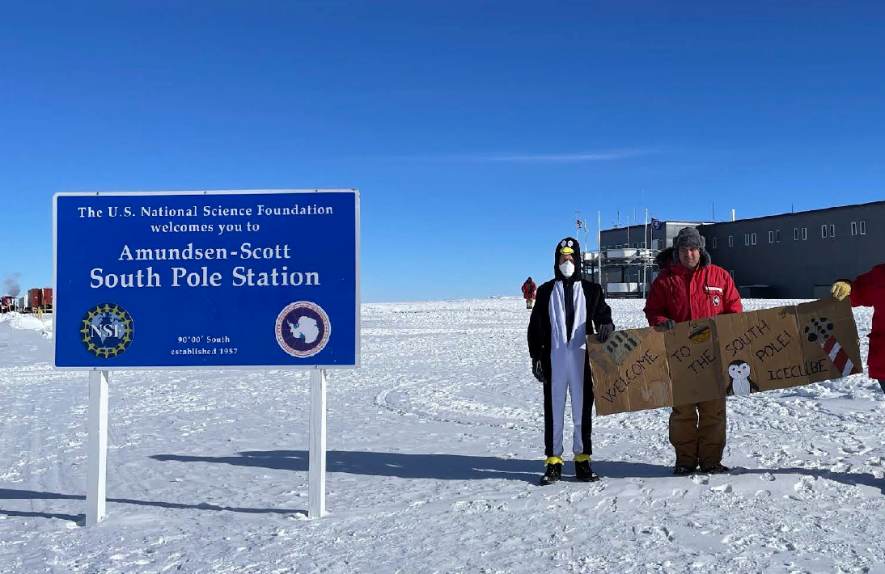
IceCube-KIT at work at Pole
Since October 2023 winterover at the South Pole: Hrvoje Dujmovic (postdoc IAP); Marc Jacquart (internship IAP 2021)
Roxanne Turcotte was on working shift at SP in Dec/Jan
Will Smith was also there…not for IceCube…but for new movie
Roxanne in plane
Hrvoje and Marc welcome Roxanne
Roxanne and new antenna

Slide 27
KATRIN: Unblinding March 2023
Successful unblinding of neutrino mass campaigns KNM1-5 (2019 to mid 2021). Sensitivity < 0.5 eV.
Data release and publications planned for this year!
Martin Descher,
TRISTAN
Max Aker,
Rear wall activity
Johanna Wydra,
Tritium viscosity
Genrich Zeller,
Tritium purity
Dominic Batzler,
Rear wall
Neven Kovač,
Quantum detectors
Jaroslav Storek,
plasma
Joscha Lauer, background reduction
Shailaja Mohanty,
sterile neutrinos
Leonhard Köllenberger,
Neutrino mass analysis
Caroline Fengler,
BSM analysis, plasma
Leonard Hasselmann,
Atomic T source

Slide 28
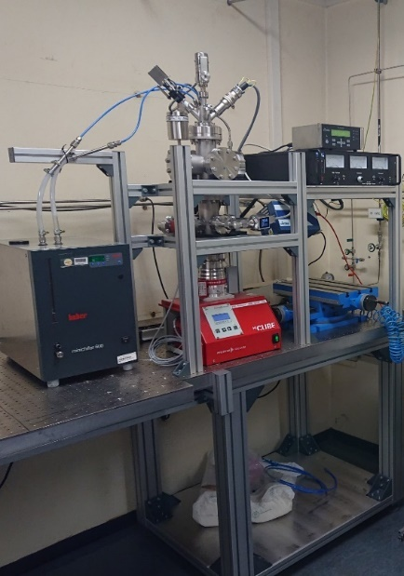
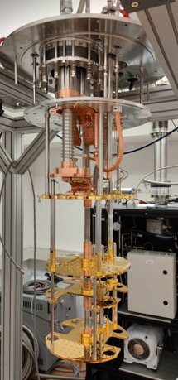
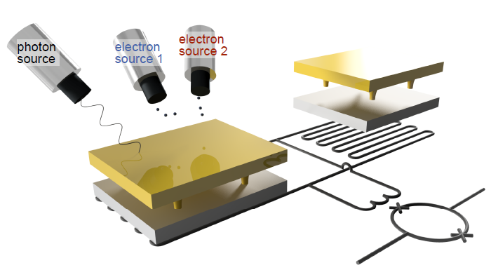
Ongoing R&D towards KATRIN++
IAP-TLK
Leonard Hasselmann, Poster
IMS, IAP, IAP-TLK
Neven Kovač, Poster
Modular atomic hydrogen test setup → preparation of glovebox integration for first atomic tritium experiment ongoing
ELECTRON project (KIT seed funding) Measure external electrons with MMC detectors
Notes:
Quelle / Detector → links rechts tauschen. Future Field Sparen → KIT seed funding
Word leading experts → Sebastian Kempf

Slide 29
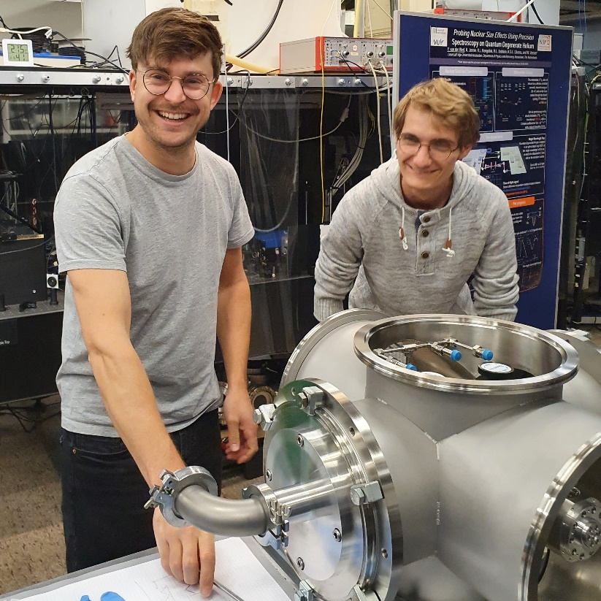
Ultra High resolution spectroscopy of tritiated species
Valentin Hermann
Measurement of molecular energies with 10 kHz (~ 0.05 neV) accuracy via „Noise Immune Cavity Enhanced – Optical Heterodyne Molecular Spectroscopy (NICE-OHMS)
Getter cell with HT (<1 GBq) developed at TLK and brought for measurements to VU Amsterdam
Example measurement with HD
PHYSICAL REVIEW A 105, 062823 (2022)

Slide 30
30 years of TLK
We invite KCETA / KSETA to join our festivities
More information on: https://www.iap.kit.edu/tlk/english/410.php

Slide 31
KCETA „Code of the Universe“
Travelling exhibition „Code of the Universe“ from CERN
At Triangel Open Space
Organised by KCETA together with
Triangel
City of Karlsruhe
CERN
Porgramm
4 weeks exhibition in summer 2022
Opening with vernissage
Afternoon science
Podium discussion
Public talks
Events for pupils

Slide 32
© KCETA

Slide 33
Events for KSETA fellows
Julius Wess Seminar took place 13 – 17 June 2022 by Mark Wise
The seminar was well attended. Nine fellows from KSETA and a lot of other students and members from the theoretical institutes
Get-together of KSETA Fellows with Nobel Laureate Reinhard Genzel (KIT Heinrich-Hertz professor 2022) on Oct 5 in seminar room 3/1: 23 registrations and 16 participants.

Slide 34
10 year KSETA
28 October 2022
Interesting talks from KSETA alumni
Invited colloquium talk by Katherine Freese

Slide 35
35

Slide 36
36

Slide 37
37

Slide 38
38

Slide 39
Julius-Wess Award 2022
Elena Aprile
Columbia University, New York
…for her pioneering scientific achievements in the field of the search for dark matter, in particular the development of highly sensitive detectors.
Date for lecture not yet fixed.

Slide 40
KSETA Fellows Workshop (February 27 to March 1, 2023)
Cultural exchange via presentations about different countries
Fellows’ presentations about their work
Alumni talks from industry and academia
Session about PhD hacks
Fun events: Hike, Board and card games, physics charades
Other Events: Campus North Tour, Stammtisch (gathering for dinner) about every two months
40

Slide 41
KSETA Topical Courses 2022-2023
February 21 - 25, 2022
6 Courses (5 via Zoom) (min. 6h.)
Better: 1
Broader: 5
Deeper: 0
About 154 participants in total
October 10 - 27, 2022
7 Courses (3 via Zoom) (min. 6h.)
Better: 5
Broader: 1
Deeper: 1
About 76 participants in total
Most interesting topics:
Statistical methods in particle physics data analysis
Monte Carlo simulations
Introduction to general relativity
Project management
Python for Scientists
Notes:
Machine learning 55
Python 40

Slide 42
KSETA courses 2023
March 6 - 17, 2023
7 Courses (1 via Zoom) (min. 6h.)
Better: 1
Broader: 4
Deeper: 2
111 registrations(double counting) 89 participants (double counting)
About 73 participants in total

Slide 43
KSETA benefits
As a KSETA Fellow you benefit from....
training program with topical courses, special lectures, workshops, guest scientists, foreign interns
budget for conference travel and equipment,
academic environment with >130 Doctoral Fellows
12% of you are financed from KSETA sources
possibility for short-term postdoc contract after graduation

Slide 44
KSETA Webpage is very informative!
News and events
Equal Opportunity support
Course registrations
Information
www.kseta.kit.edu

Slide 45
KSETA Fellows – rights and duties
For your rights and duties please consult the KSETA Welcome Guide.
Important duties:
attend a minimum number of 6 courses during your 3-year PhD studies,
write your annual report,
keep your personal web page up-to-date,
list your publications in the files publications-reviewed.bib and publications-UNreviewed.bib.
→ We have reporting duties towards our funding agencies and must list the publications.
Don‘t delete
KSETA emails
without reading

Slide 46
Web page and publications
Web pages and publication lists are a serious topic.
Reviewers are likely to look at the web pages.
Web pages contain all relevant information for all reporting.
When we prepared the publication list for our 2019 reports, we observed that
many publications were missing
reviewed and unreviewed publications were not properly separated
If possible, use INSPIRE BibTeX entries for your .bib files and include the DOI number for the reviewed papers.

Slide 47
KSETA Evaluation at the workshop 2020
Only 58 fellows completed the questionnaire
Two aspects rated poorer by 0.1 or 0.2 points compared to last year
More of the fellows would recommend KSETA
??? (Craanen)

Slide 48
Enjoy your stay

