Slide 1





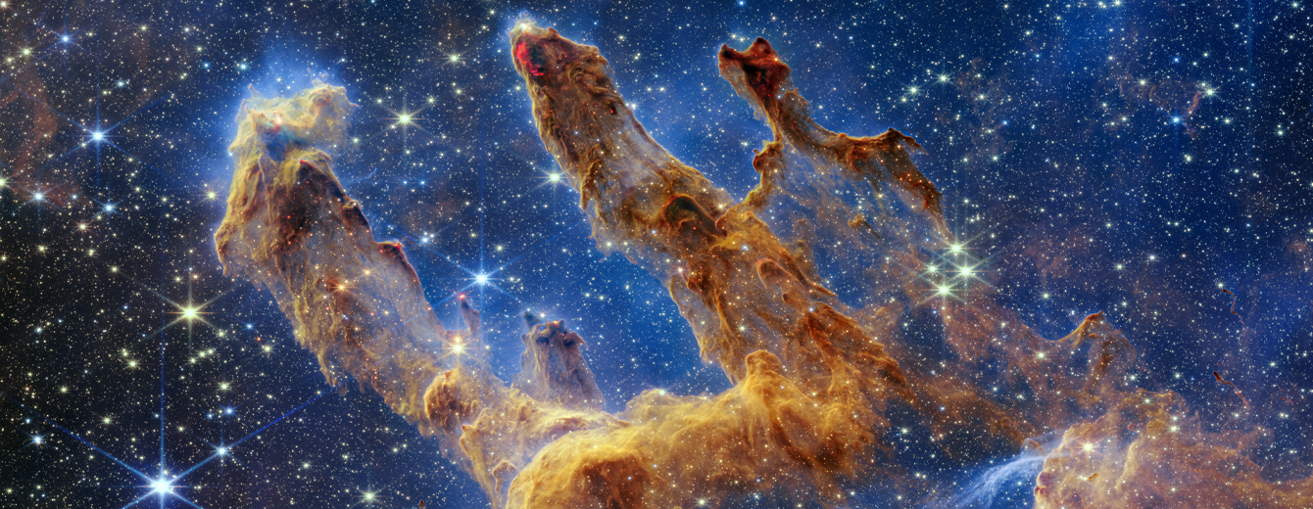
Hunting Supernova Neutrinos with Dark Matter Detectors
KSETA Plenary Workshop
Durbach
27/03/2023
Melih Kara
kara@kit.edu

Slide 2


Slide 3
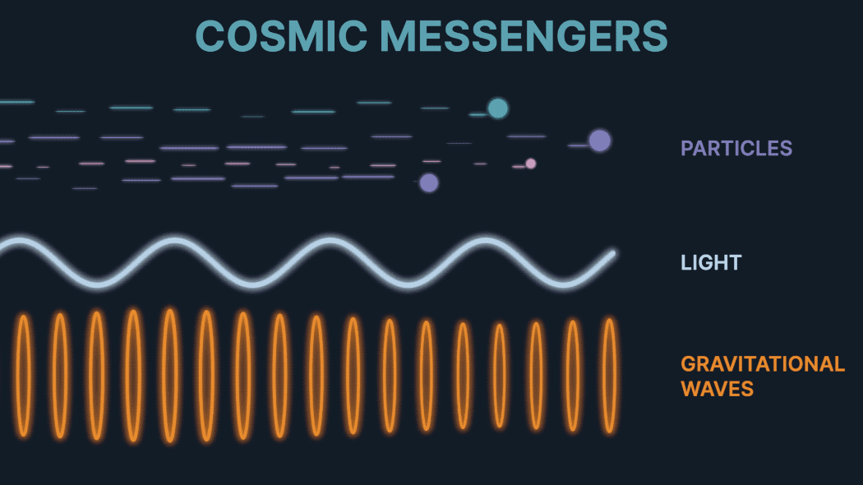
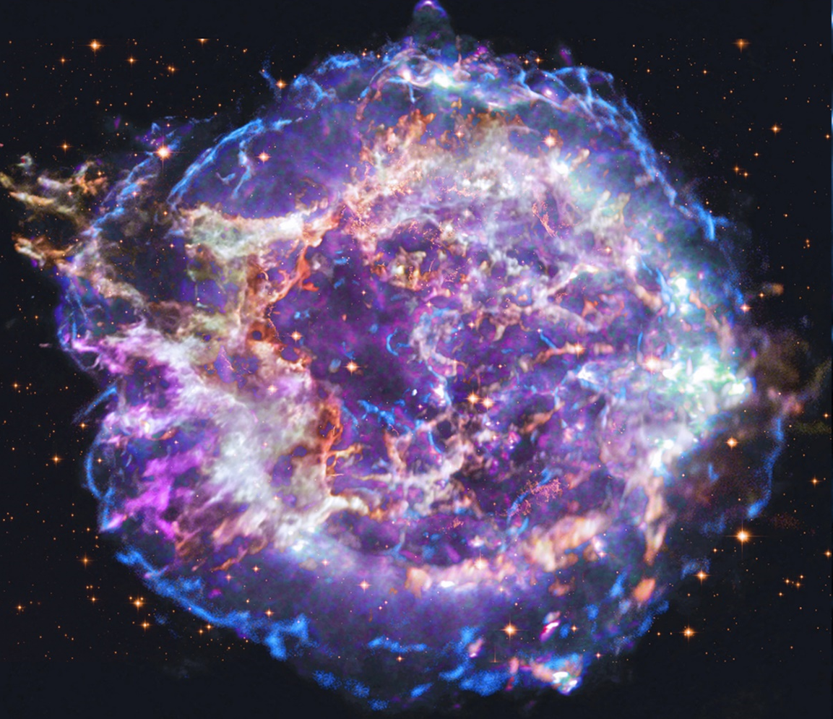
Supernova as a Multimessenger
MultiMessenger Astronomy
Neutrinos
Electromagnetic Signal
Gravitational Waves

Slide 4
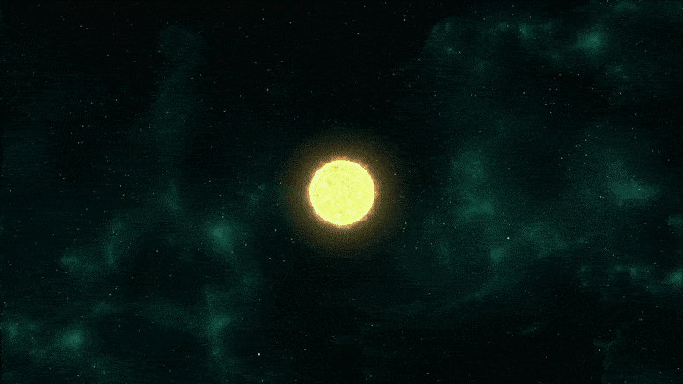
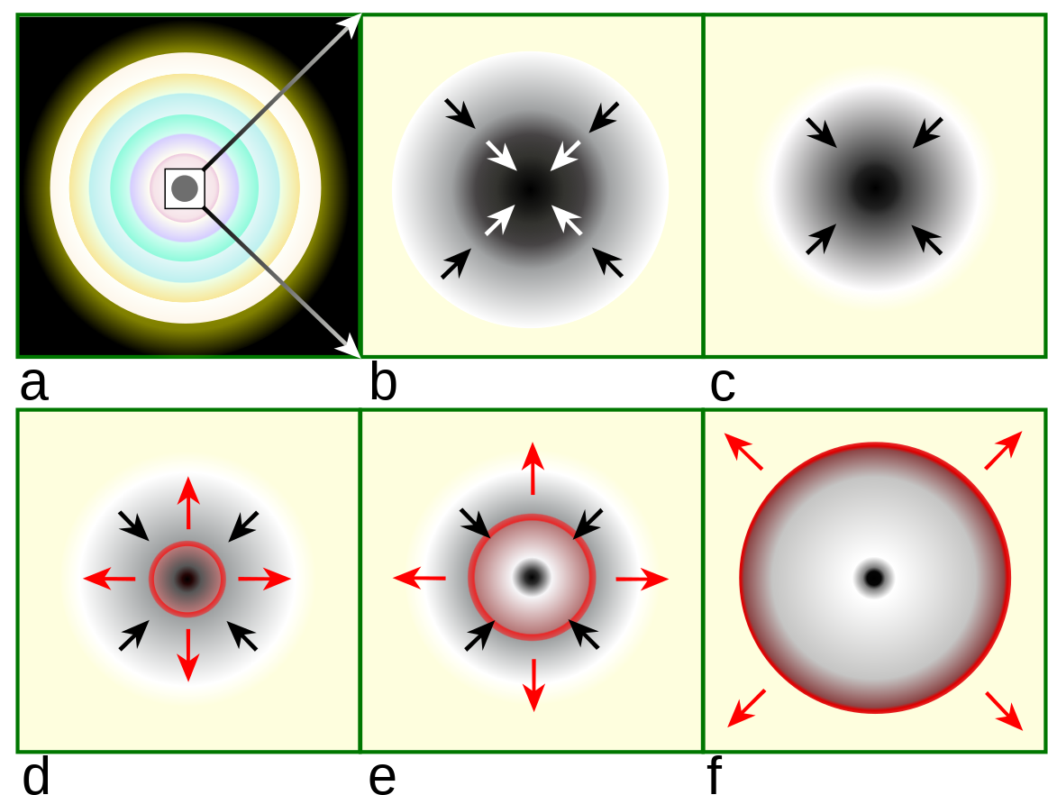
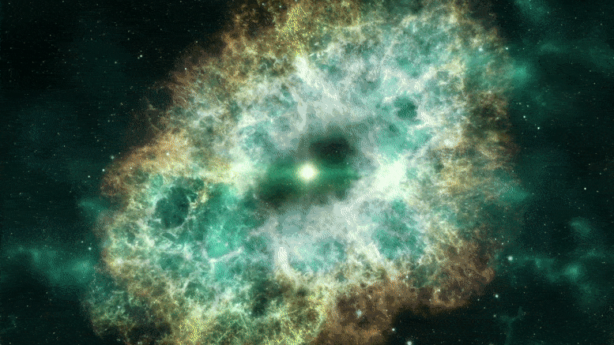
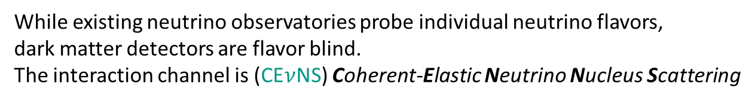
Supernova Neutrino Emission
Supernova 101
Massive Star
Core collapse
Mass infall, nu traps
https://en.wikipedia.org/wiki/Type_II_supernova
Outward shock
forms
Neutrinos
escape
Shock breakout
While existing neutrino observatories probe individual neutrino flavors,
dark matter detectors are flavor blind.
The interaction channel is (CE$ν$NS) Coherent-Elastic Neutrino Nucleus Scattering

Slide 5
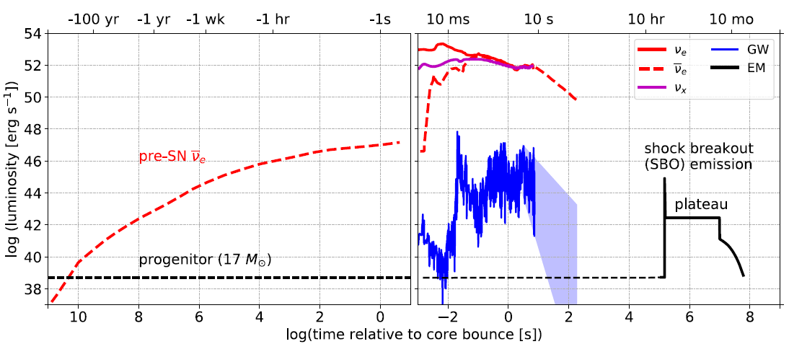
Supernova Neutrino Emission
Supernova 101
Multimessenger Signal
Neutrinos
Gravitational Waves
Electromagnetic Signal
Massive Star
Core collapse
Mass infall, nu traps
https://en.wikipedia.org/wiki/Type_II_supernova
Outward shock
forms
Neutrinos
escape
Shock breakout
While existing neutrino observatories probe individual neutrino flavors,
dark matter detectors are flavor blind.
The interaction channel is (CE$ν$NS) Coherent-Elastic Neutrino Nucleus Scattering

Slide 6
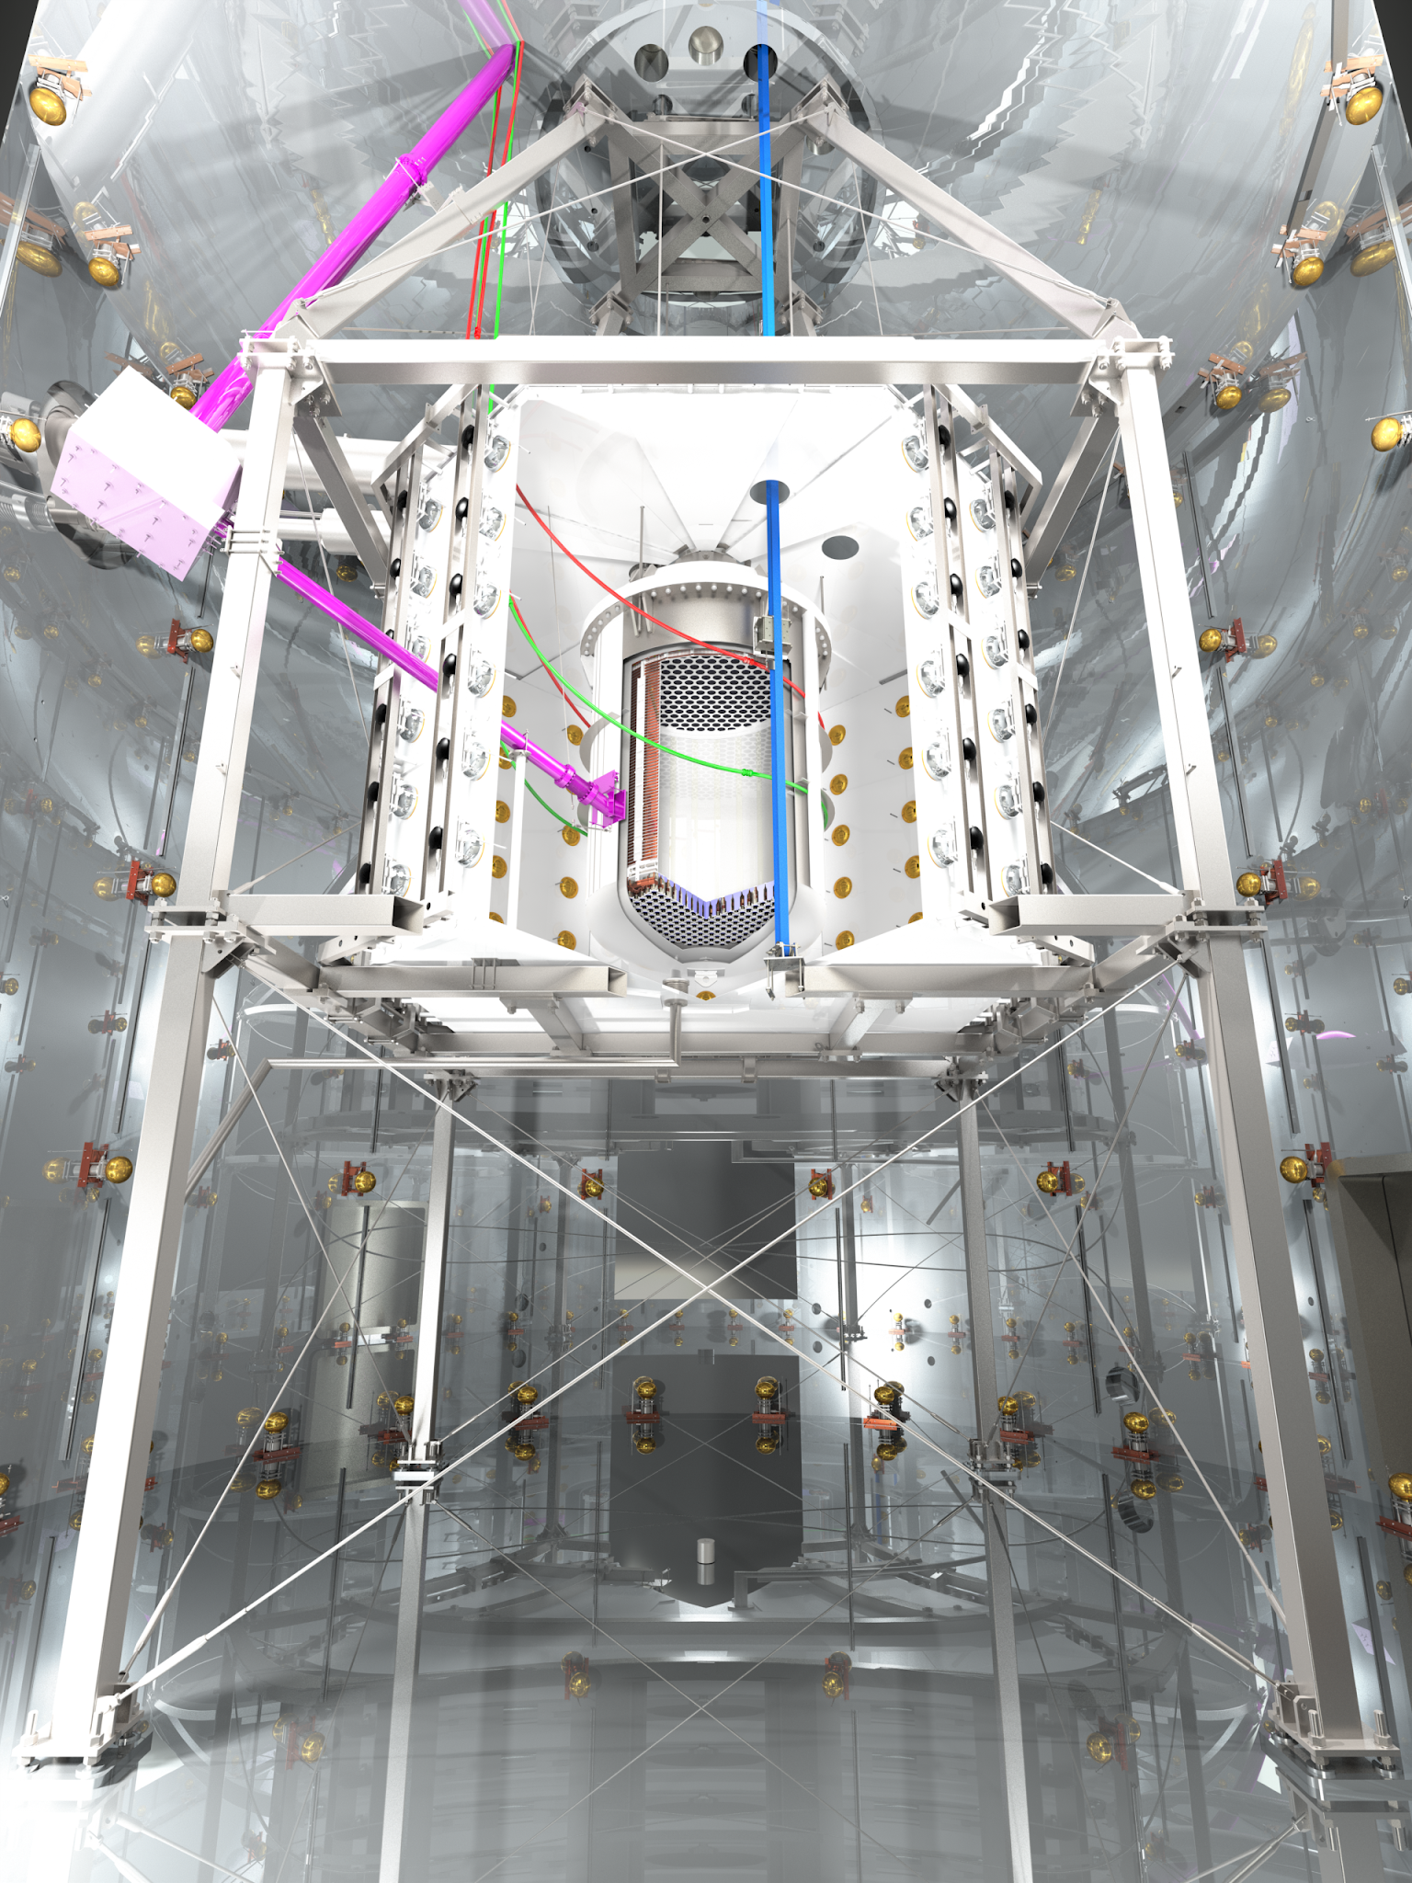



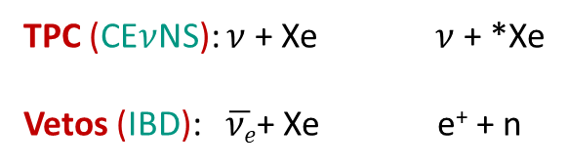
Supernova interactions in the detector
XENONnT
Dual phase noble element dark matter detectors
TPC = Time Projection Chamber
n/mu vetos = neutron/muon veto tanks
TPC
(~30 $M_{⊙}$) Supernova progenitor at 10 kpc
Expected number of interactions
n-veto
TPC (CE$ν$NS): $ν$ + Xe $ν$ + *Xe
Vetos (IBD): $\overline{νe}$+ Xe e⁺ + n
$\sim 150$ (XENONnT-like^{Ϯ}), $\sim 1000$ (DARWIN-like*)
$\sim 200$ (XENONnT-like^{Ϯ}), $∼$285 (DARWIN-like*)
μ-veto
^{Ϯ} XENONnT-like: assuming 6 tons target within the TPC and 700 tons target inside the water tank
* DARWIN-like: assuming 40 tons target within the TPC and 1 kilotons target inside the water tank

Slide 7
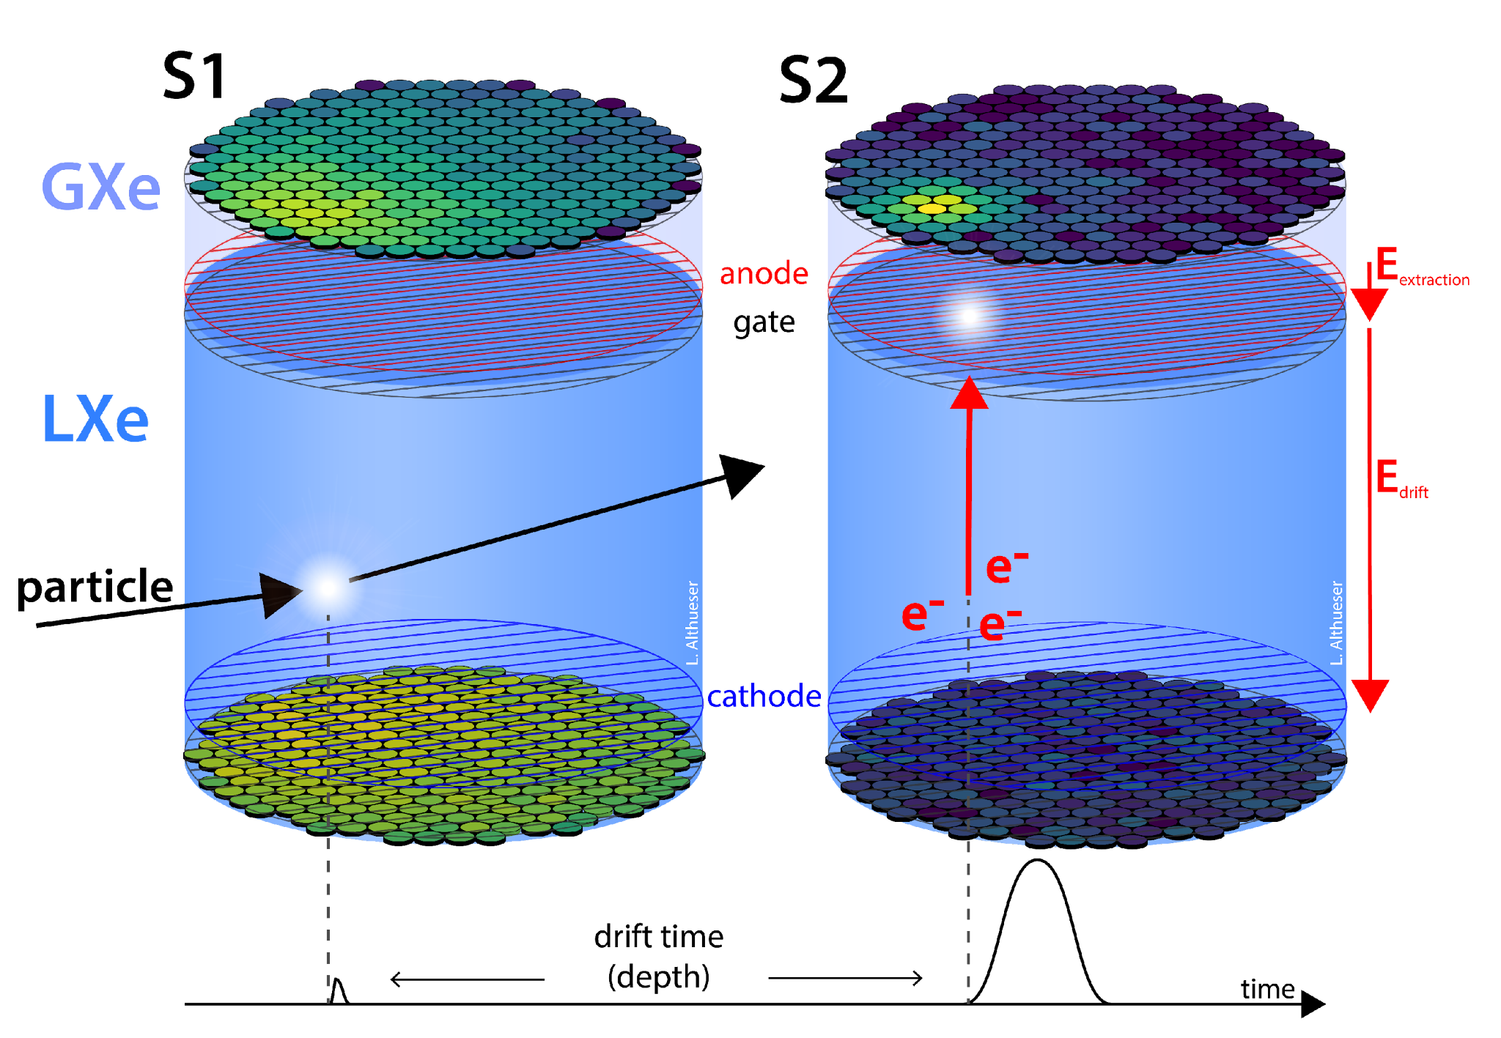
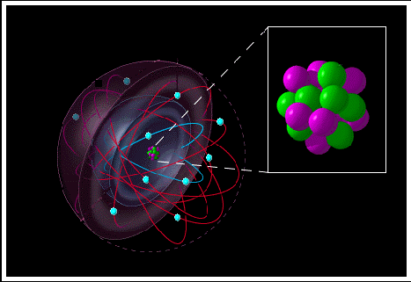
Supernova Interactions in Liquid Xenon TPCs*
Nuclear Recoil
ER
WIMPS, neutrons &
Neutrinos scatter of off
The nucleus
S2
S1
ER
NR
Photons & electrons scatter off
of atomic electrons
Adapted from
The Time Machine Project © Cetin Bal
Neutrinos recoil from the nucleus giving prompt scintillation light (S1)
and frees electrons which are drifted above and create a second, delayed signal (S2)
*Time-Projection-Chamber

Slide 8
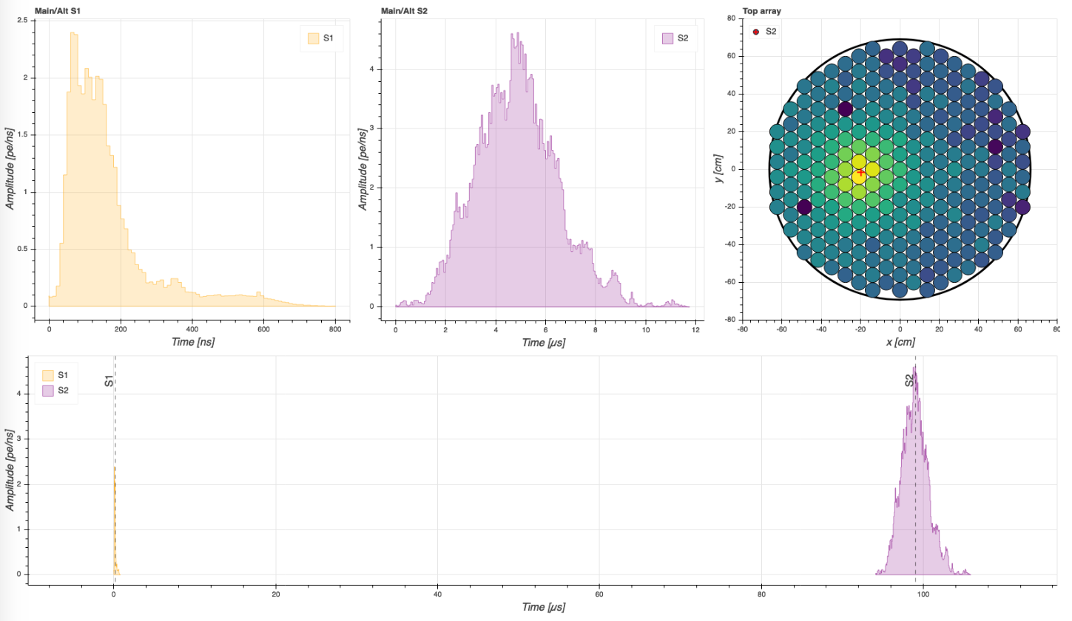
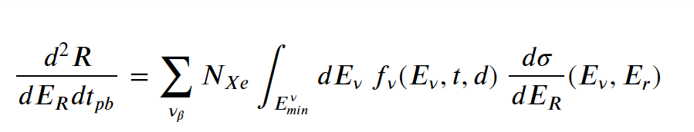

Detector signal
Observables
S2 (x,y)
~160ns
~3.4μs
S2
S1
S2
473 PE
11951 PE
S1
drift time ≈ 100μs (z≈7cm)
(max drift time ≈ 2.2ms)
The waveforms are registered and identified as S1 and S2
waveforms have several features e.g. areas in P.E., widths in ns
x,y,(z) positions.
Differential CE$ν$NS rates
Simulating Supernova signal to identify distinct features.
Then developing cuts to identify the supernova inside a signal.

Slide 9
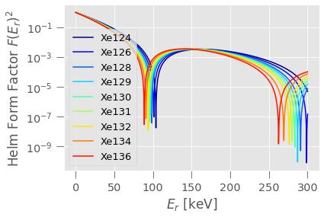
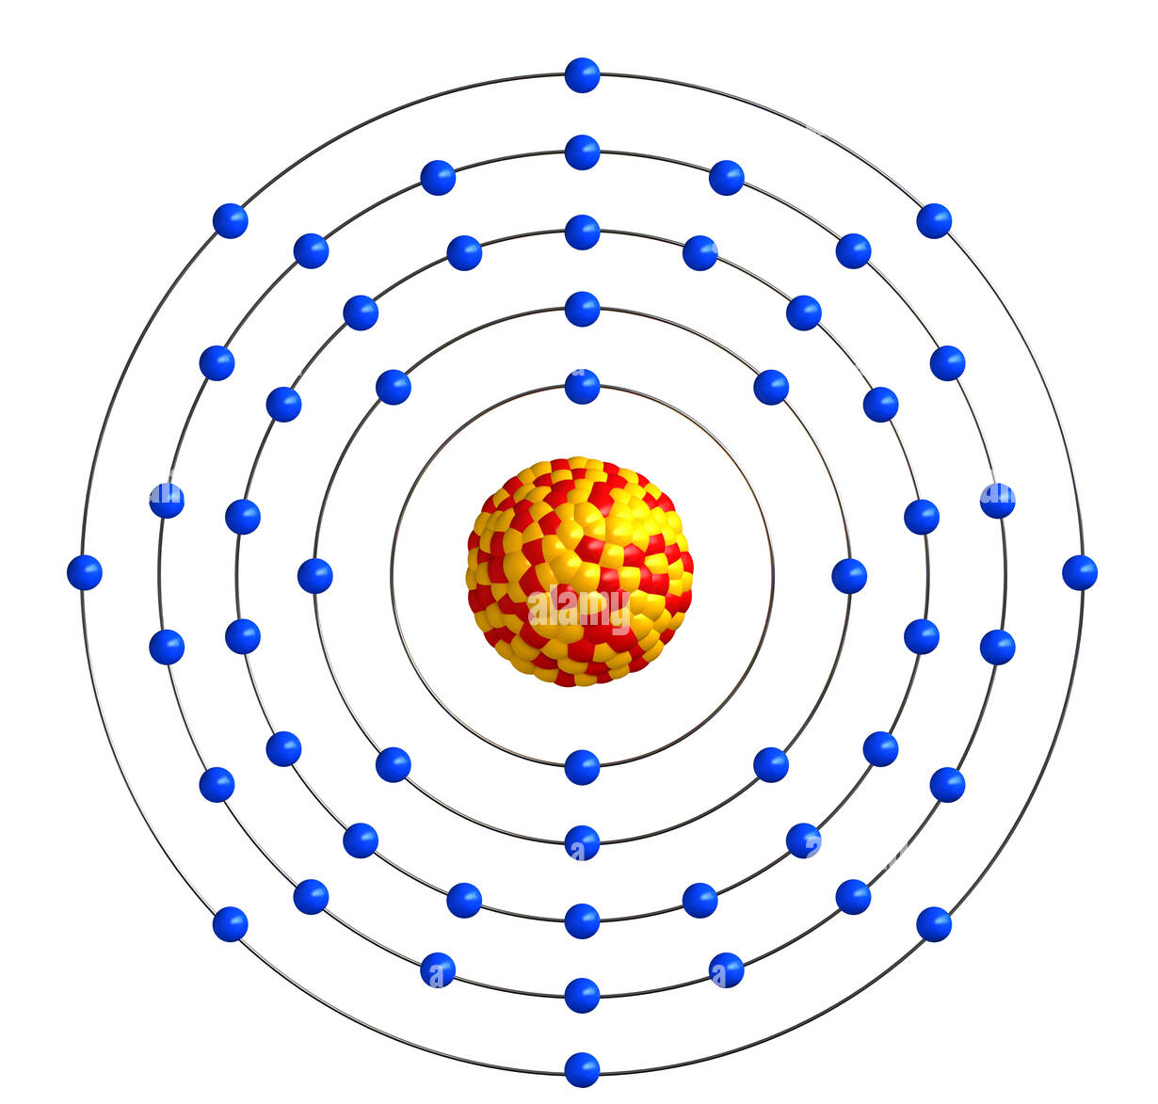
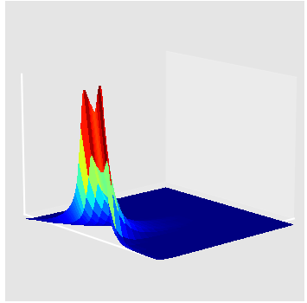
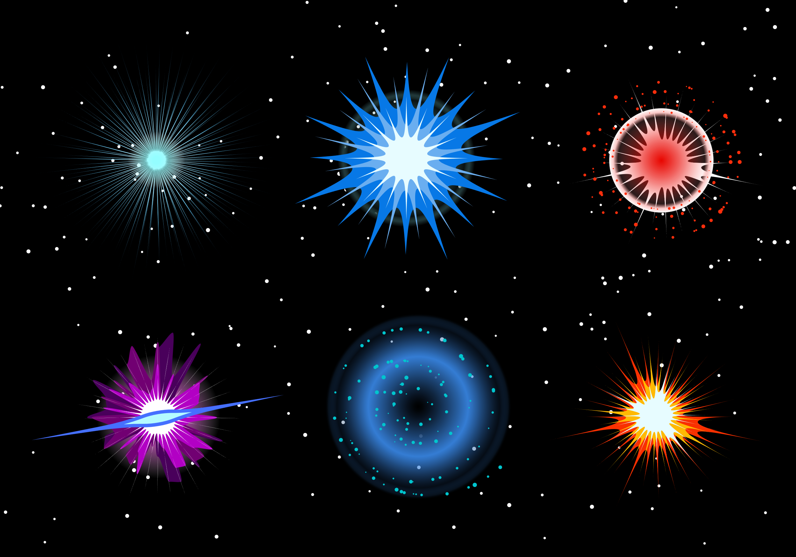
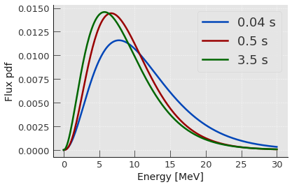
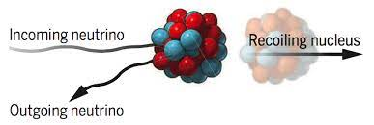
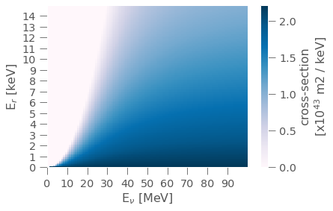
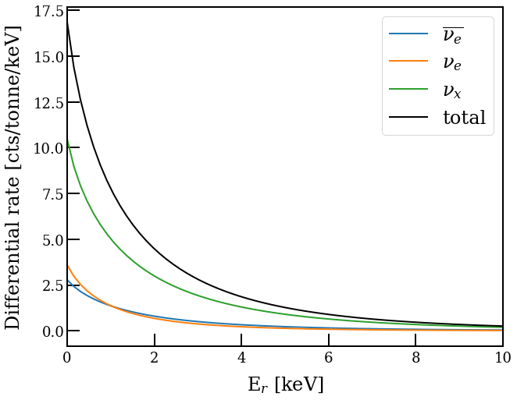
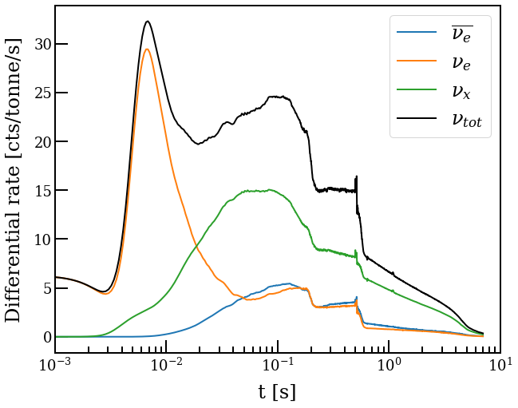



Rate calculation
Differential CE$ν$NS rates
Atomic properties,
Cross-section probabilities
Fluxes as a function of
energy and time
Model-dependent fluxes at any time and with any neutrino energy
multimessenger

Slide 10
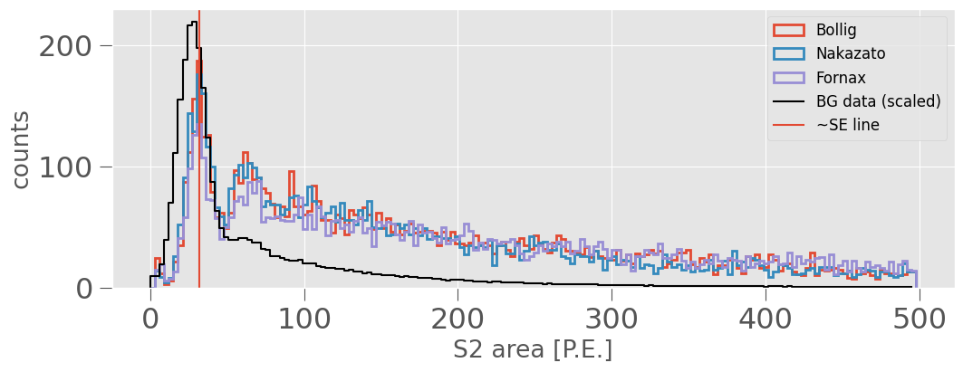
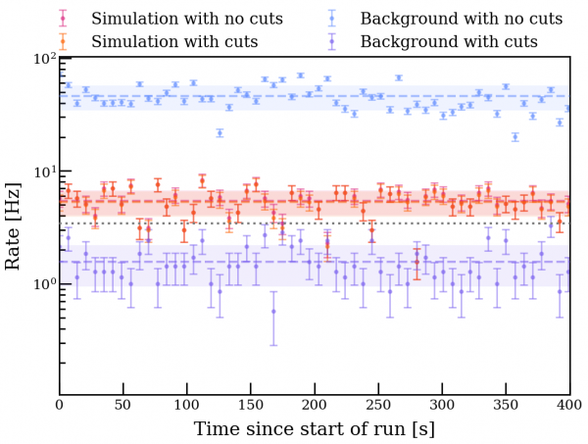
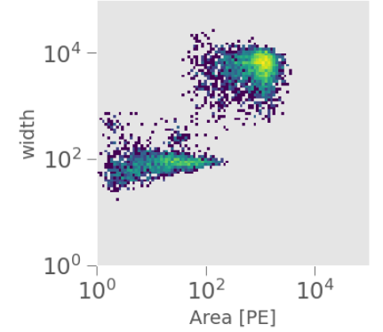
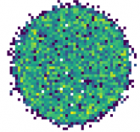
Detector signal
Cuts
Custom developed cuts on features like S2-area, width, position correlation, fiducialization…
To identify the optimal background-free region
[au]
y-pos
x-pos

Slide 11
Detector signal
Coverage and energy threshold
In order to quantify detection significance; signal over background.
Typical signal ~10 sec
Assume fixed background rate.
Conservative assumption:
100% efficiency above 1 keV
0% efficiency below 1 keV
Time where the signal is 90% of its total
Is equal to ~20-30% of the total duration

Slide 12
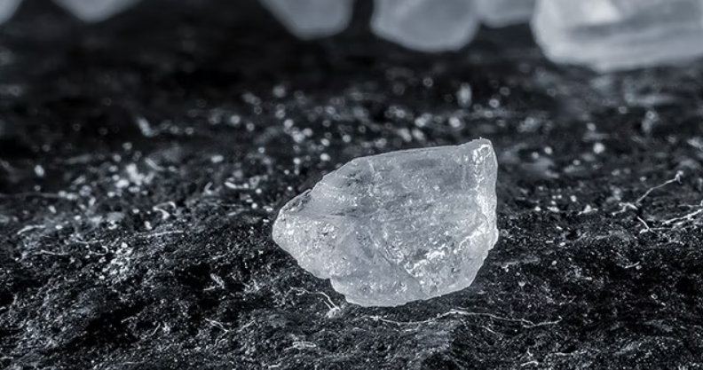
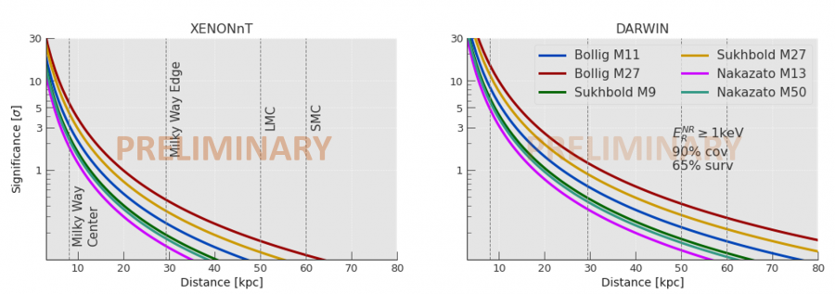
Detector signal
Sensitivity projections
Detection significances under conservative assumptions;
0% efficiency below 1 keV
65% cut survival, 100% background survival!(?)
Still >3sigma detection in the Milky Way center.
[au]

Slide 13
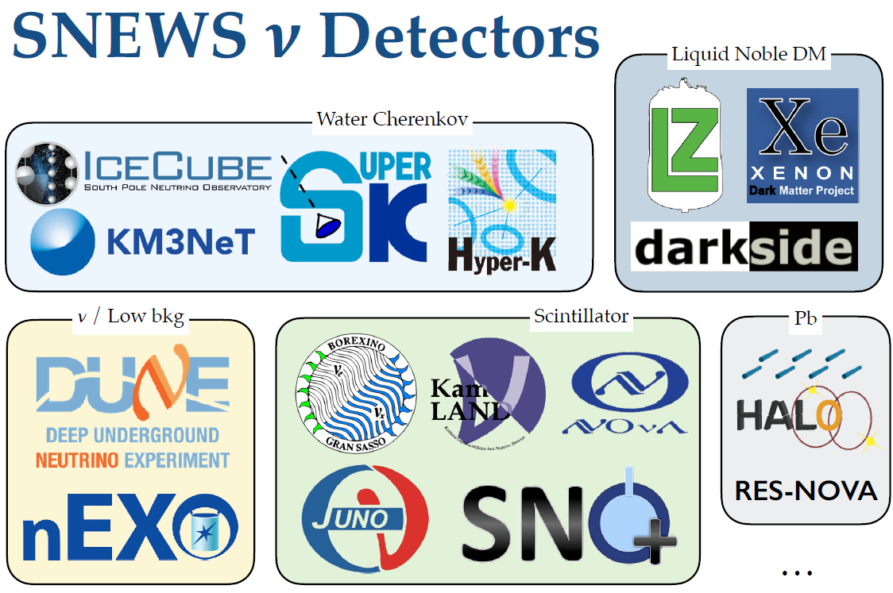
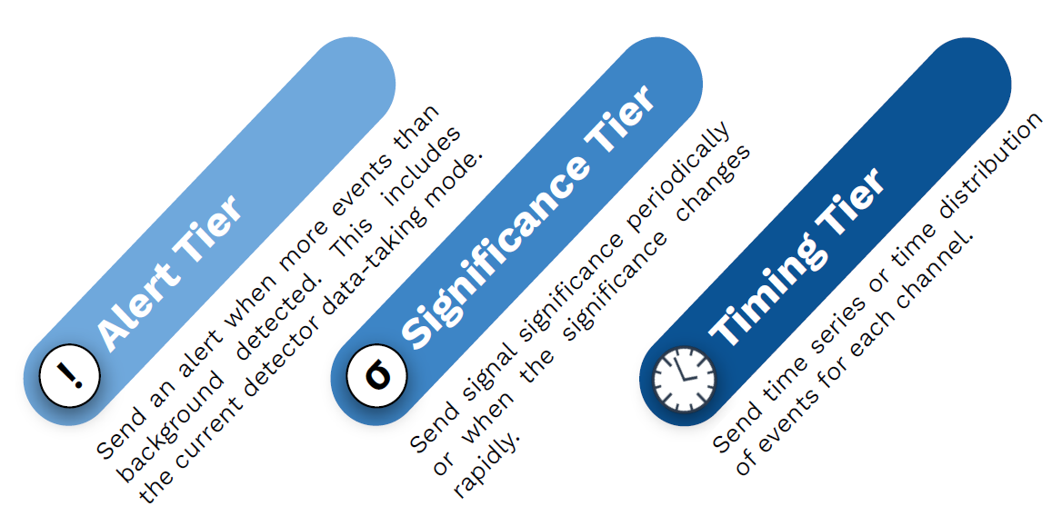
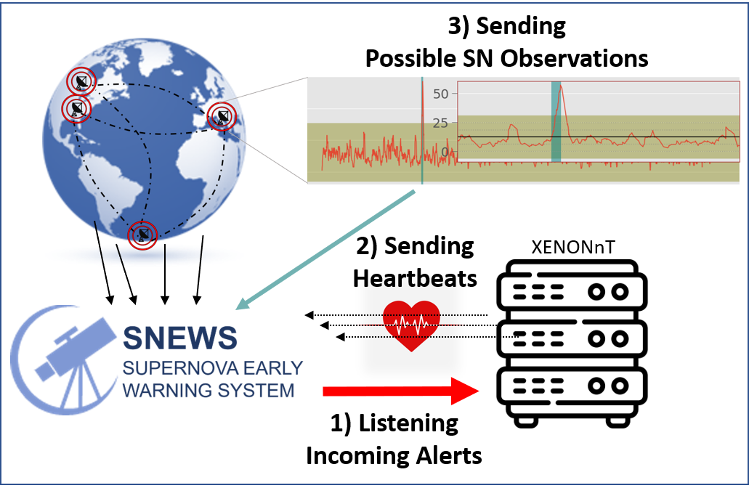

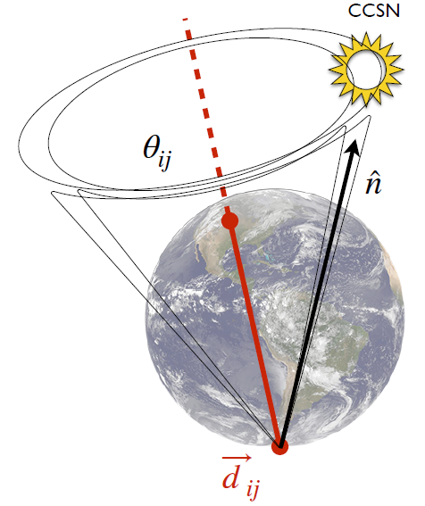
Supernova Early Warning System (SNEWS)
https://snews2.org
SNEWS is a global network of neutrino and dark matter experiments that are sensitive to supernova neutrinos.
By combining otherwise (possibly) faint signals, SNEWS can provide high sensitivity for supernovae detection.
Detectors sending their suspected observation to SNEWS
SNEWS compares the messages and looks for time-coincidences.
snews_pt
snews_cs

Slide 14

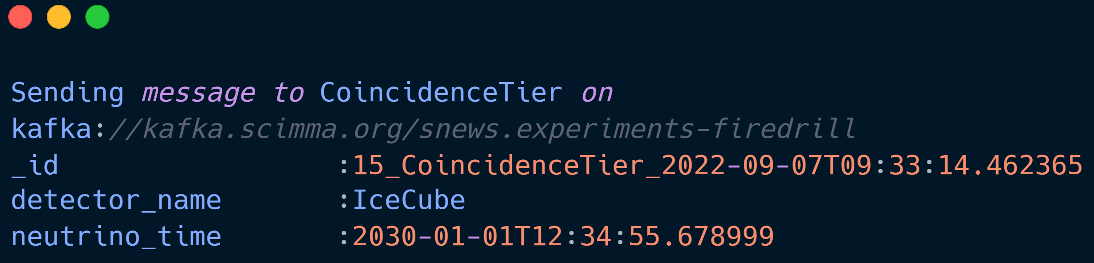




SNEWS logic
SUPER WHAT NOW??

Slide 15
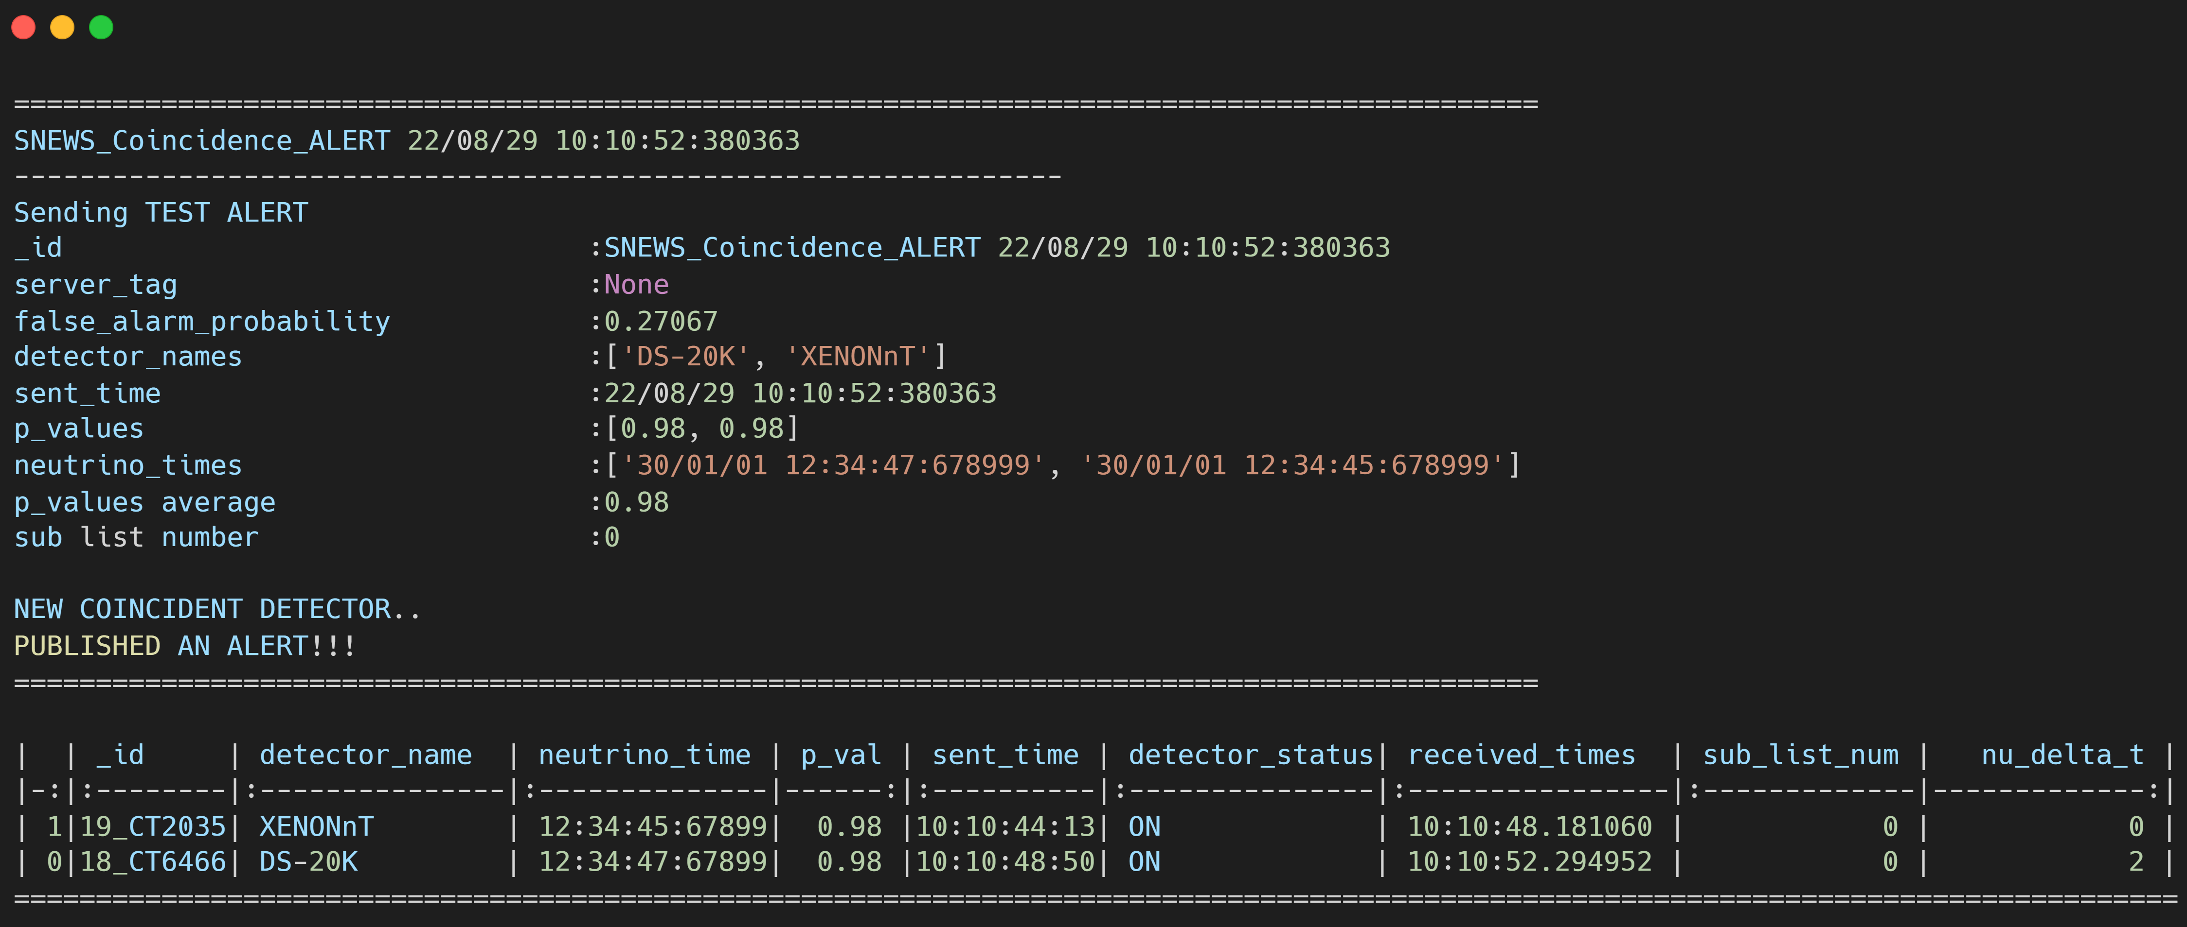
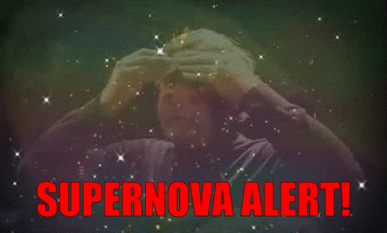

SNEWS logic
KIT Server
Purdue Server
Coincidence Search
Oxford Server

Slide 16
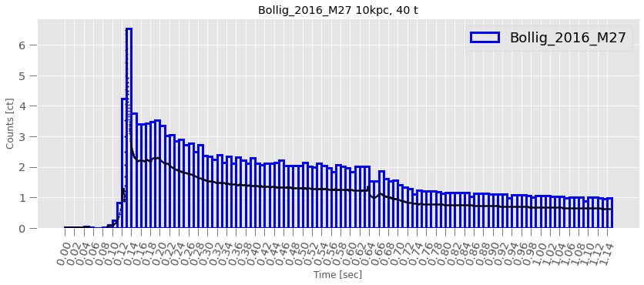
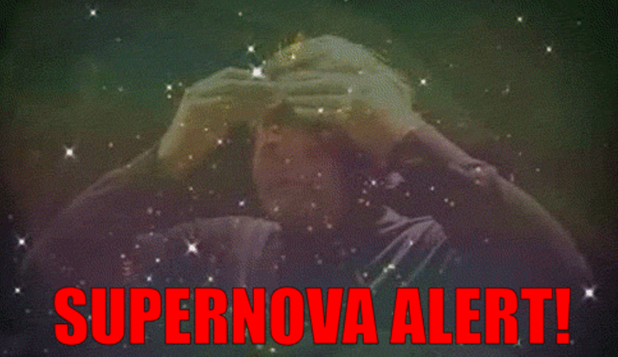
Conclusion & Outlook
Ongoing studies
Realistic simulations and sensitivity projections
Model discrimination based on neutrino arrival times
Inclusion of veto systems
Real-time supernova monitor
Next Galactic Core-Collapse supernova
Insights on neutrino physics
Multimessenger signal: neutrinos + full EM spectrum + gravitational waves
Dark Matter detectors
Getting competitive in neutrino searches
Providing flavor-blind analysis
Can take part in SNEWS

Slide 17

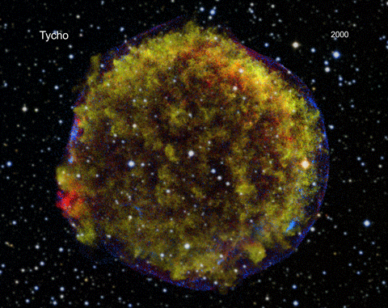
Thanks!
Any questions?

Slide 18

Back up

Slide 19
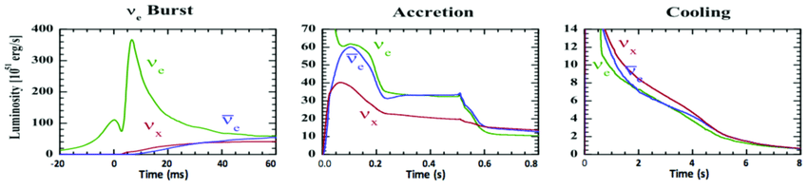

Slide 20
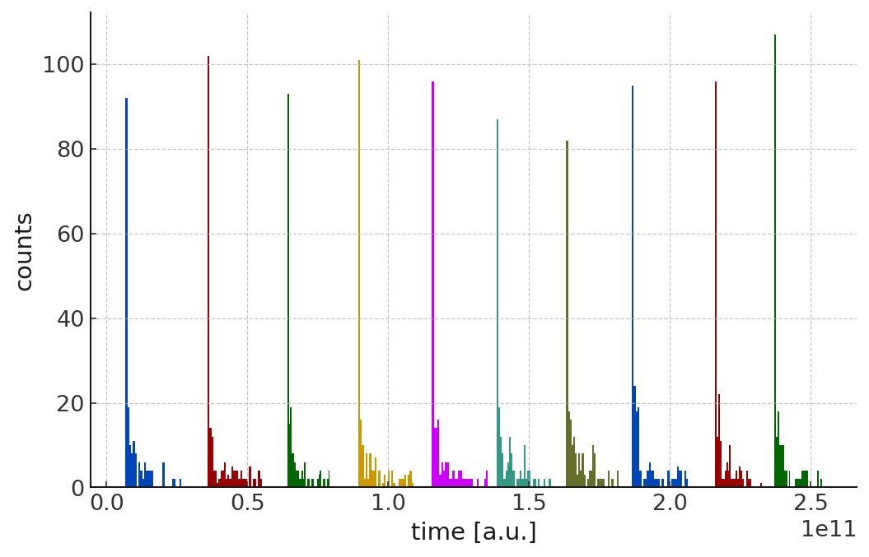
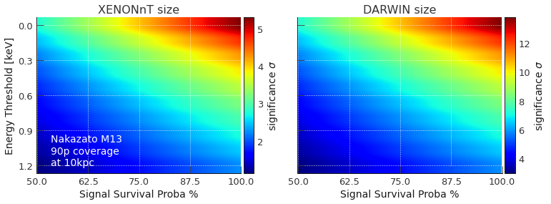
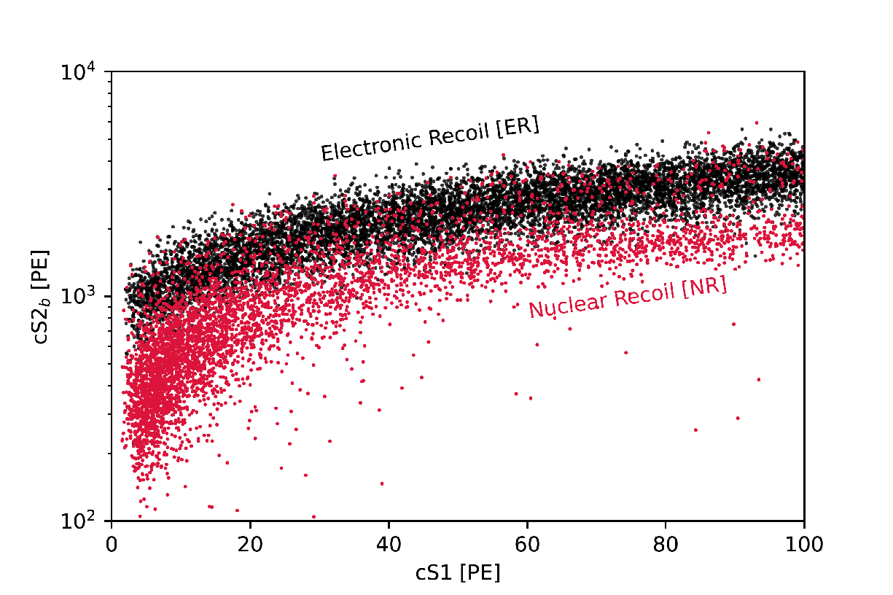
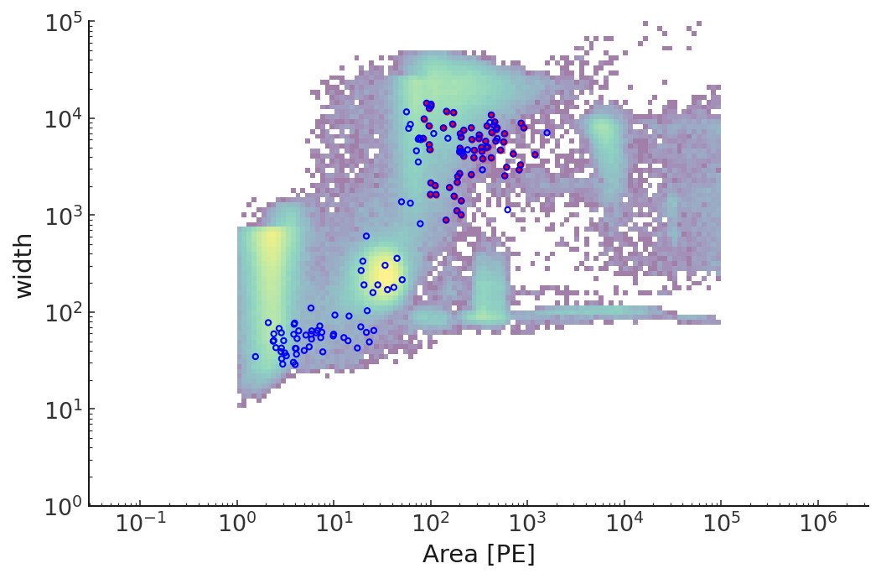

Slide 21
SNEWS and XENONnT
How are we integrating a dark matter detector into SNEWS
There are three main aspects to connection with the SNEWS
Listening
Subscribe to the alerts and receive them once they are triggered by the server.
Sending heartbeats
Server can compute the false-alarm probability,
provide feedback on their latencies,
control a possible community-wide down time.
Sending observation messages
Monitor acquired data for a possible supernova-like signal. Submit every suspected observation.
In XENONnT we are ready to be fully integrated into SNEWS through our custom developed software
Supernova
communications

Slide 22
