Slide 1
Life Cycle Assessment of Geothermal Heating & Cooling Systems
European Geothermal Workshop 2019
Astu Sam Pratiwi
Prof. Evelina Trutnevyte
UNIGE Renewable Energy Systems
10 October 2019
Notes:
Life cycle asse

Slide 2
Life Cycle Analysis for Environment Sustainability
Wells
Cons-truction
Opera-tion
End of Life

Slide 3
Life Cycle Analysis for Environment Sustainability
Wells
Cons-truction
Opera-tion
End of Life
Fuel
Transport
Electricity
Steel
Cement

Slide 4
Heating Demand in Geneva
Fossil fuel dominates the demand
Geneva 2030 targets:
40% greenhouse gas reduction (from 1990)
10% of fossil fuel substitution by renewable energy
Adapted from Narula et al., 2019 and Quiquerez et al., 2020

Slide 5
Geothermal Potential in Geneva
Geothermal energy as renewable source potential
Potentially supplies 75% of Geneva heat demand by 2030 (Groupe de travail PGG, 2011)
Switzerland has the highest density of ground source heat pumps
But less knowledge for deeper systems
shallow
< 100 °C
medium depth
deep
Adapted from https://geothermie-schweiz.ch

Slide 6
GEothermie 2020
shallow
Subsurface characterization for shallow and medium depth
Support the district heating expansion in Geneva
< 100 °C
medium depth
deep
Adapted from https://geothermie-schweiz.ch

Slide 7
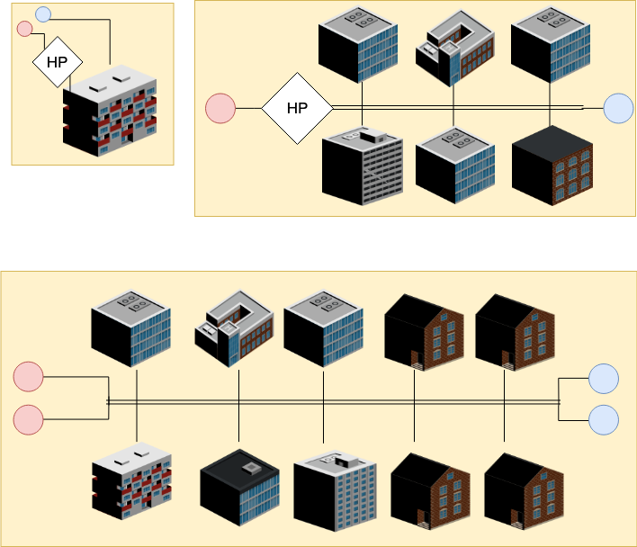
Scenarios of GEothermie 2020
744 m
30°C
1100 m
-
1500 m
-
?
-
Multifamily /
tertiary building
District heating with heat pump
District heating without heat pump
Pilot wells for medium depth
Several scenarios for surface applications

Slide 8
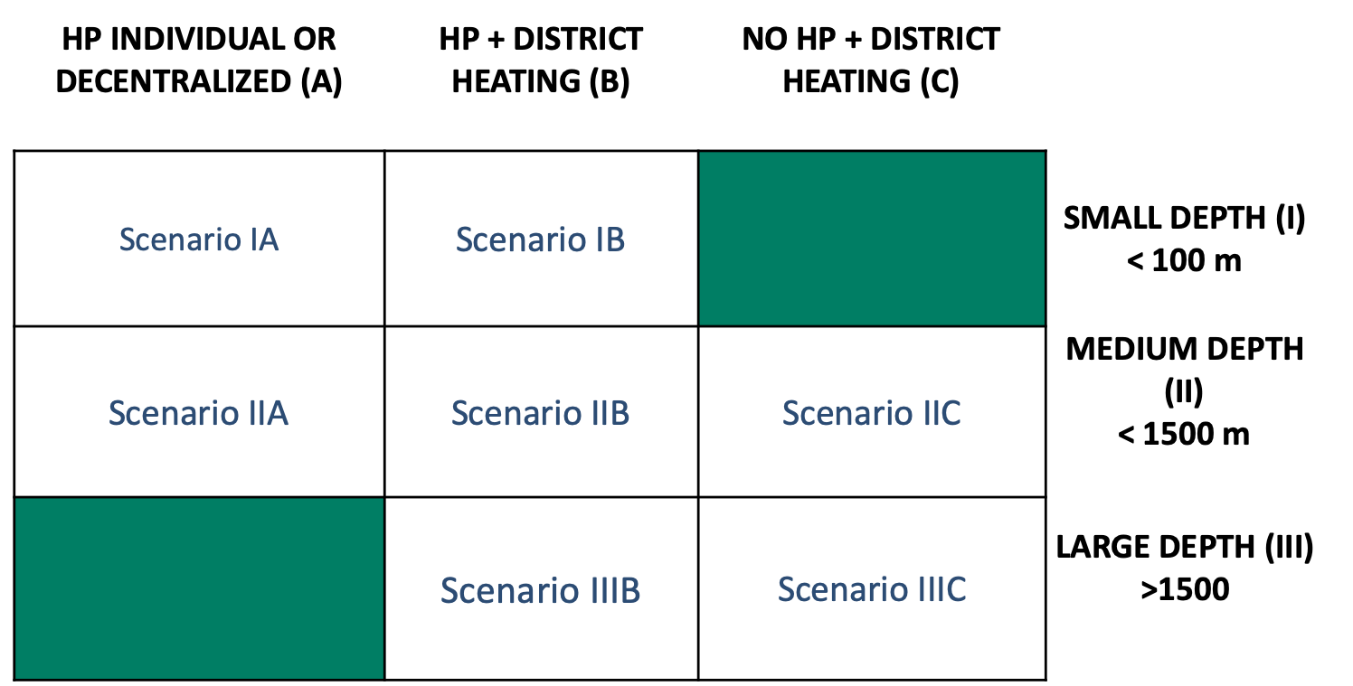
Scenarios of GEothermie 2020

Slide 9
Scenarios of GEothermie 2020
Environmental performance

Slide 10
Literature study

Slide 11
Literature study – LCA for geothermal heating systems
Peer-reviewed environmental studies on geothermal heating applications worldwide

Slide 12
Literature study – LCA for geothermal heating systems
29 studies
quantified environmental performance
22 studies
used LCA methodologies

Slide 13
Literature study – LCA for geothermal heating systems
29 studies
quantified environmental performance
22 studies
used LCA methodologies
gap
Source for the status of geothermal plants: EGEC, 2018

Slide 14
Literature study – LCA for geothermal heating systems
29 studies
quantified environmental performance
22 studies
used LCA methodologies
GEothermie 2020
gap

Slide 15
Literature study – reported impacts
3 most reported impact categories
Ground-source Heat Pumps:
Less homogeneous results
Sensitive to COP and electricity mix
Groundwater Systems:
More homogenous result
More studies are needed

Slide 16
Literature study – reported impacts
3 most reported impact categories
Ground-source Heat Pumps:
Less homogeneous results
Sensitive to COP and electricity mix
Groundwater Systems:
More homogenous result
More studies are needed

Slide 17
Literature study – reported impacts
3 most reported impact categories
Ground-source Heat Pumps:
Less homogeneous results
Sensitive to COP and electricity mix
Groundwater Systems:
More homogenous result
More studies are needed

Slide 18
Preliminary case studies

Slide 19
Preliminary case studies

Slide 20
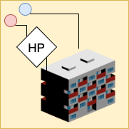
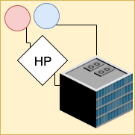
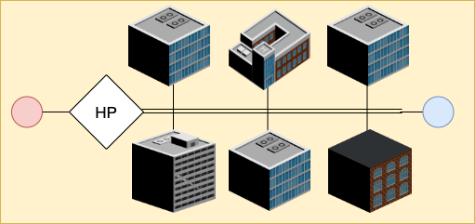
Preliminary case studies
 |  | Scenario IA-1 |  | Scenario IA-2 |  | Scenario I B
Diameter |  | 0.18 m |  | 1 m |  | 1 m
Depth |  | 10 m |  | 30 m |  | 60 m
N. Well |  | 2 |  | 2 |  | 3
Flowrate |  | 5.5 l/s |  | 30 l/s |  | 16 l/s
Cooling |  | Yes |  | Yes |  | No

Slide 21
Preliminary Results
Global Warming:
8.9 – 14.3 kgCO₂/MWh
Fossil Fuel:
62 – 92 MJ/ MWh
Acidification:
0.02 – 0.22 kgSO₂/ MWh
Case studies

Slide 22
Preliminary Results – Global warming potential
Note:
Hydro electricity
30 years of lifetime

Slide 23
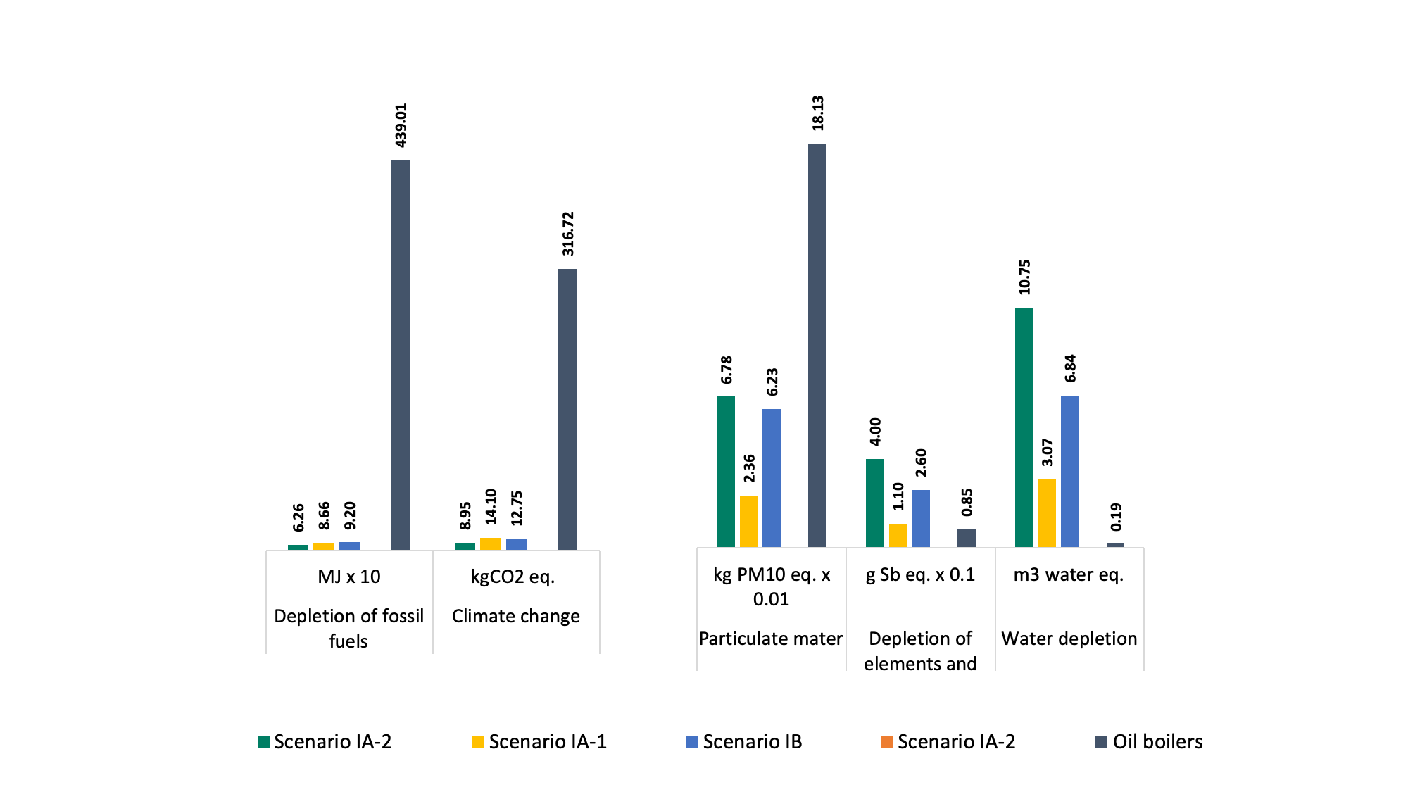
Preliminary Results
lower impacts
higher impacts
Fossil Fuel Depletion
Climate Change
Depletion of abiotic resources
Water depletion
Air Pollution

Slide 24
Preliminary Results
Use of metallic material
Hydro electricity
Fossil Fuel Depletion
Climate Change
Depletion of abiotic resources
Water depletion
Air Pollution

Slide 25
Conclusion
More LCAs are needed for geothermal heating and cooling involving groundwater extraction
Existing literature shows that impacts of ground source heat pump are less homogenous than groundwater systems, and not always lower than individual oil boilers.
Preliminary finding shows
the difference in impact contribution between individual and district heating.
lower impacts on global warming from geothermal and higher impacts on metal and water depletion.

Slide 26
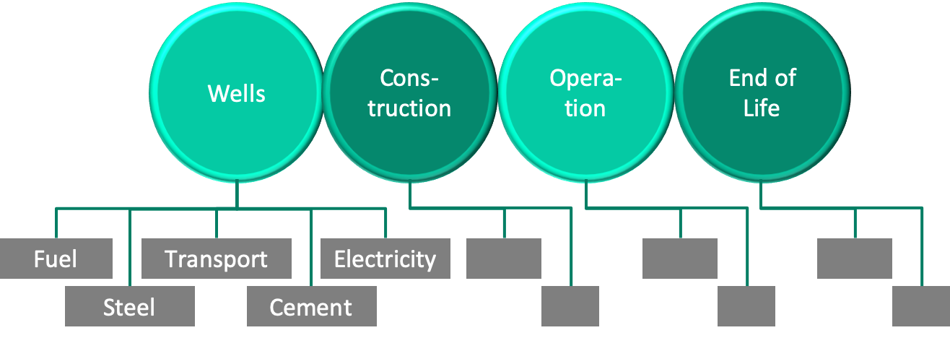
Thank You !
Astu Sam Pratiwi
UNIGE Renewable Energy Systems
astu.pratiwi@unige.ch

