Slide 1
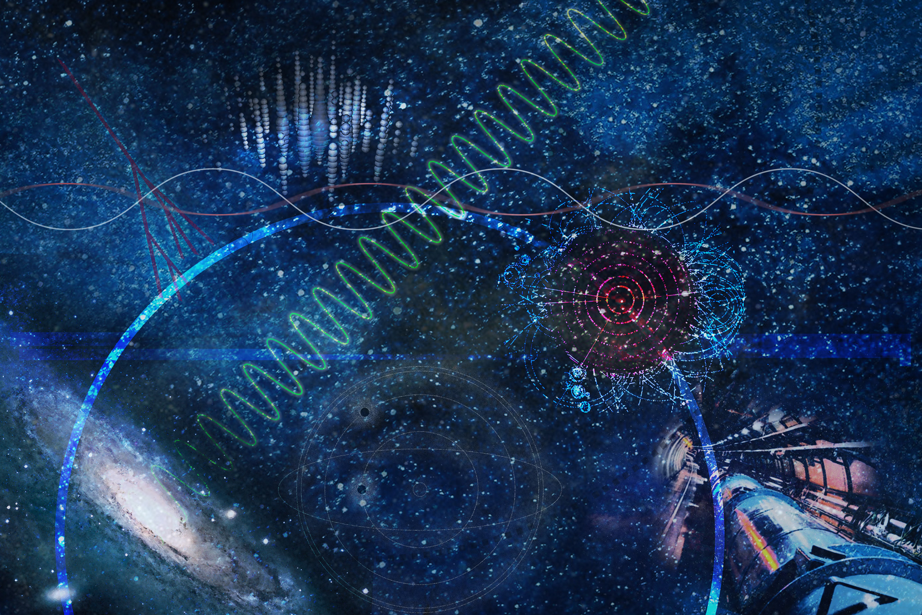









Topic 2
Cosmic Matter in the Laboratory
Highlights
Frank Maas (CML Speaker)
Tetyana Galatyuk (CML Co-Speaker)
Yvonne Leifels (LKII Speaker)

Slide 2
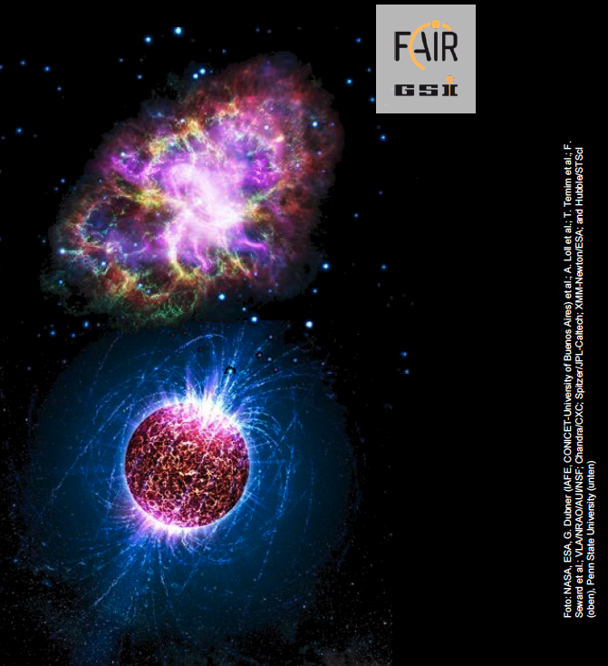
Our objective:
Creating extreme conditions existing in the Universe with heavy-ion/hadron accelerators
To find answers to fundamental questions about the Universe:
The Universe in the lab …

Slide 3
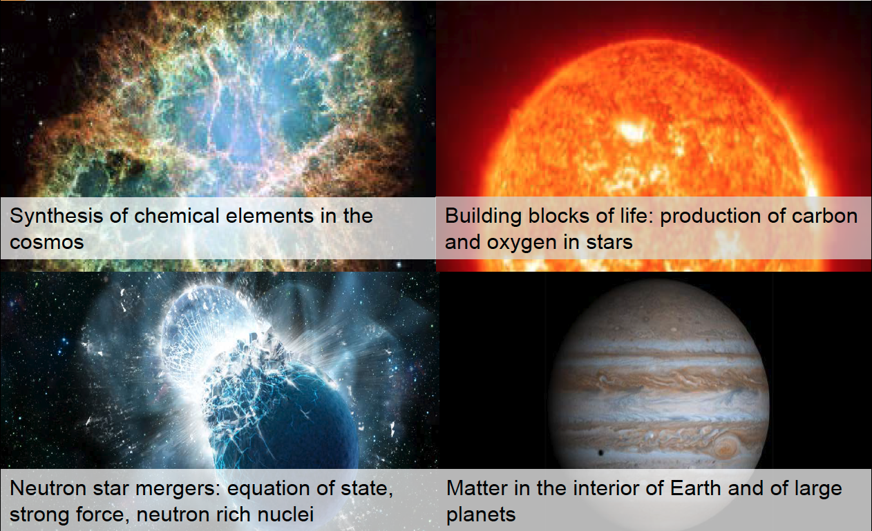

Slide 4




Cosmic Matter in the Laboratory within MU
Mission and objectives
Key contribution to the Helmholtz-Mission:
Emergence of complex phenomena in strong interaction
Role of the strong interaction in the evolution of our universe
Mission
Unravel the properties of hadrons; access and understand the QCD spectrum
Explore strongly interacting systems under
extreme conditions of temperature, density, isospin
Strategy
Study cosmic matter in the laboratory
Use primary and secondary ion beams
from (anti-)proton to Uranium
Apply forefront technologies
Uniqueness
Relativistic ion beams of highest intensities
Storage rings for cooled (secondary) beams
Novel experimental instrumentation
Strong link to
Quarks Hadrons Nuclei
gluons
Notes:
Tests of fundamental symmetries

Slide 5
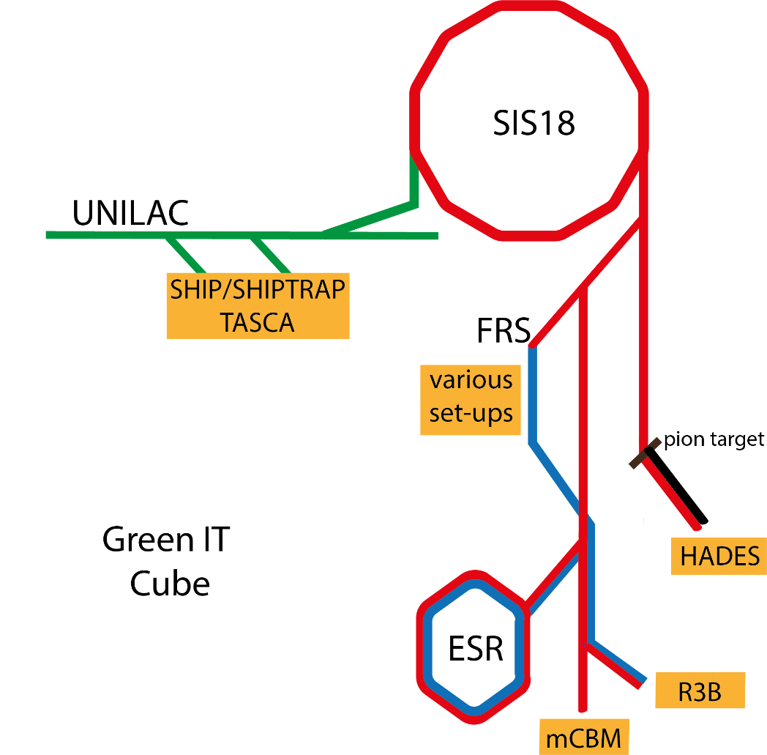
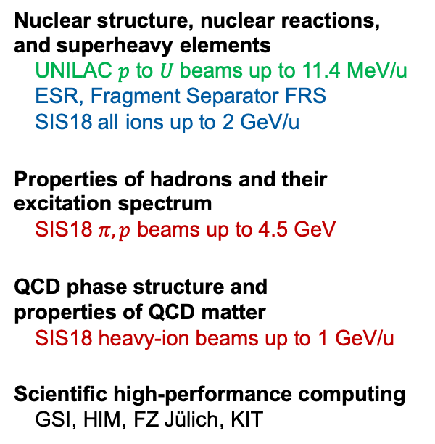
User facilities and instruments available for FAIR Phase 0
MU ion facilities and experimental setups
  FAIR Phase 0 outside campus: LHC / CERN
  AD / CERN
  BEPCII / China
  GANIL / France
  COSY / Germany
  MAMI / Germany
  TRIGA / Germany
  RIKEN / Japan
  CEBAF / USA
  RHIC / USA
Nuclear structure, nuclear reactions,
and superheavy elements
UNILAC $p$ to $U$ beams up to 11.4 MeV/u
ESR, Fragment Separator FRS
SIS18 all ions up to 2 GeV/u
Properties of hadrons and their
excitation spectrum
SIS18 $π, p$ beams up to 4.5 GeV
QCD phase structure and
properties of QCD matter
SIS18 heavy-ion beams up to 1 GeV/u
Scientific high-performance computing
GSI, HIM, FZ Jülich, KIT
See Yvonne Leifels “Outlook on PoF V”

Slide 6
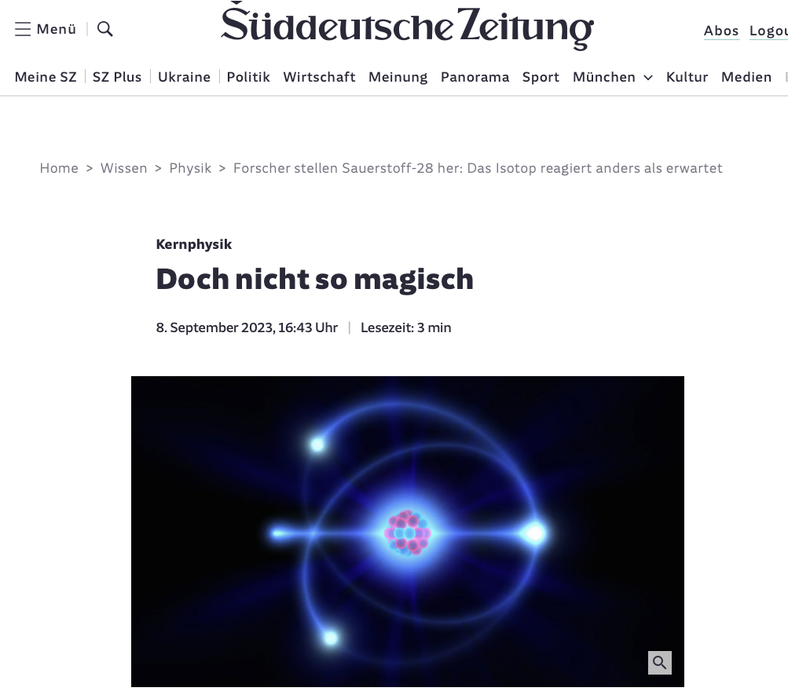
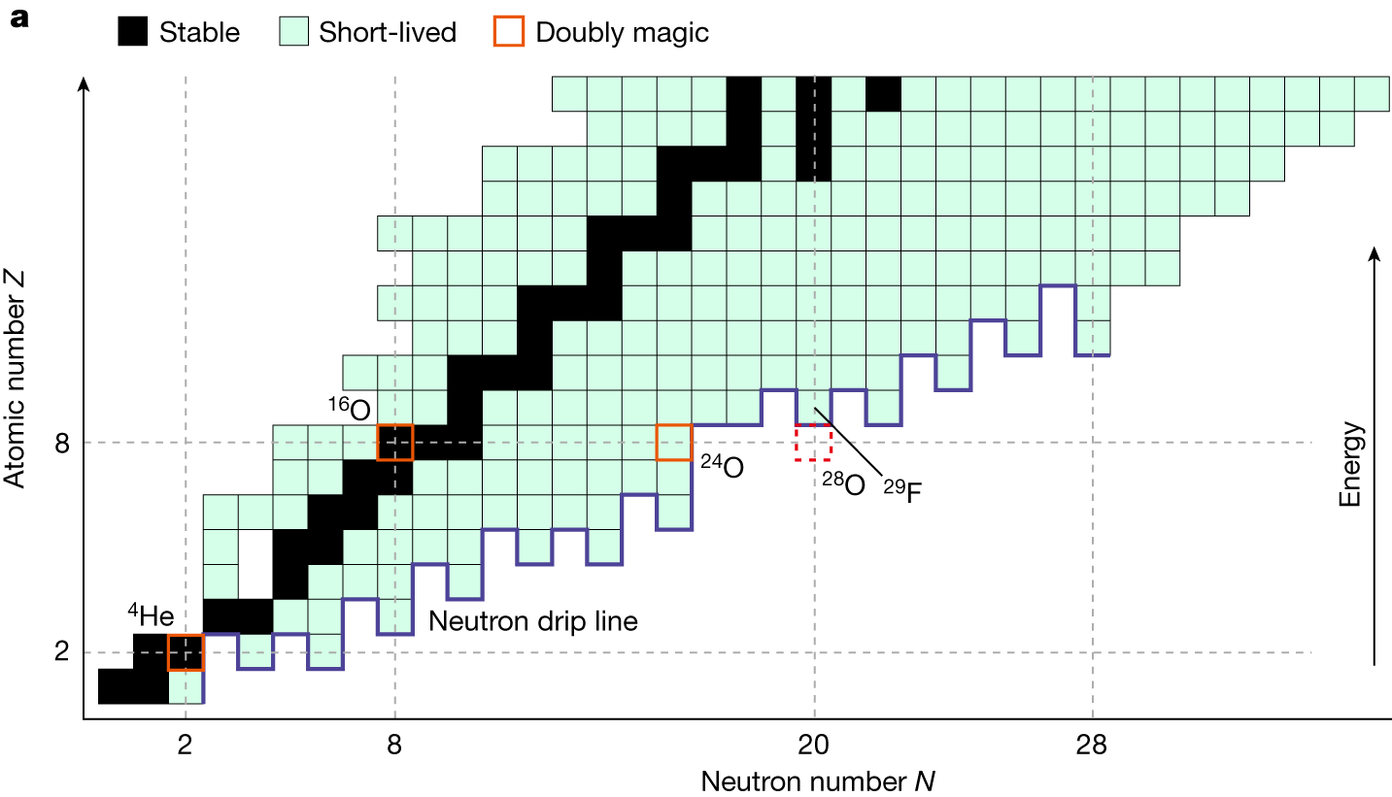
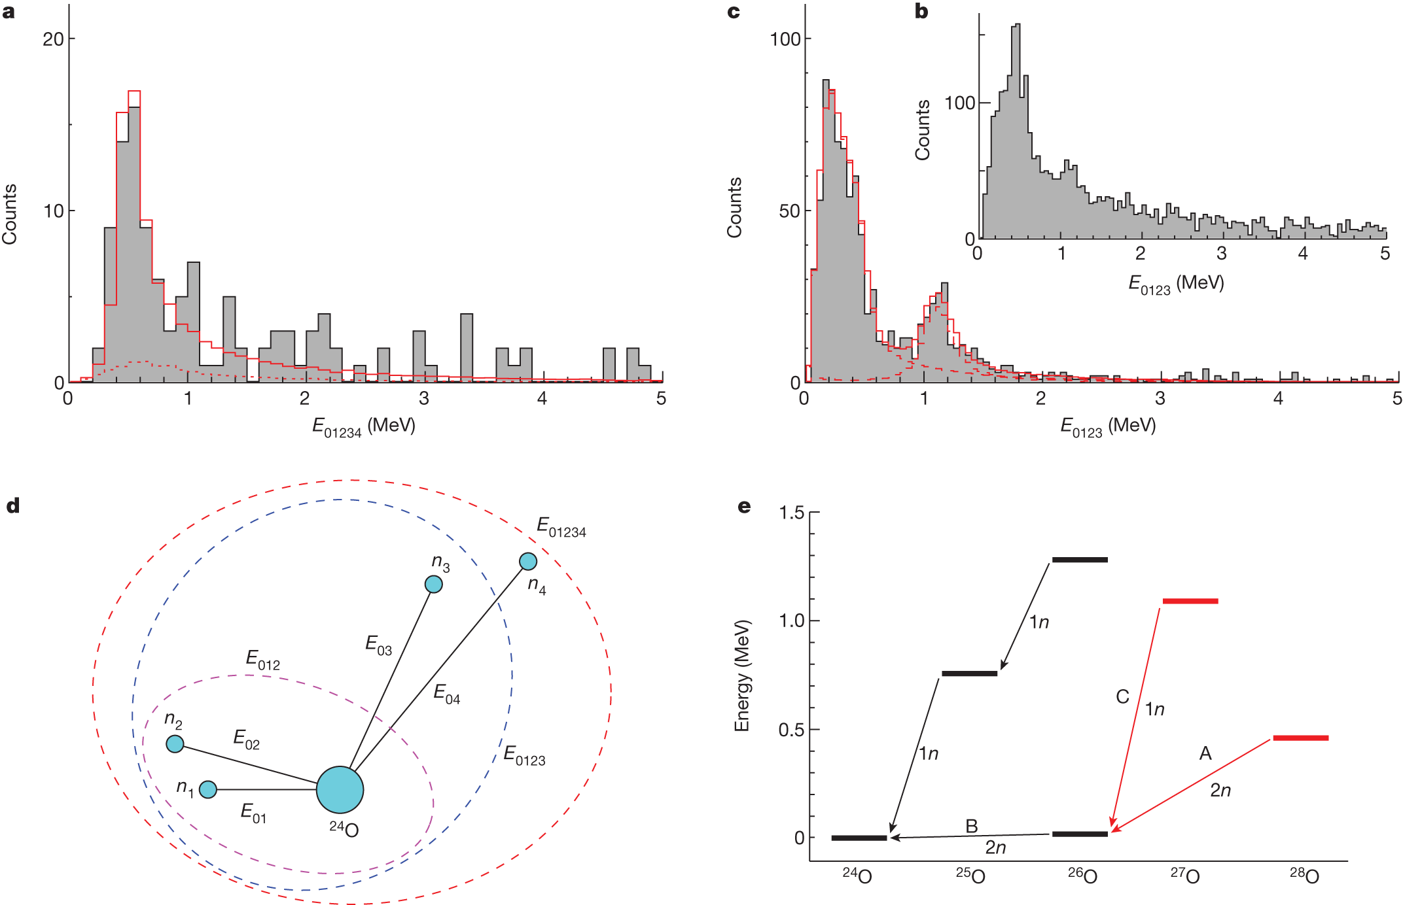
First observation of ²⁸O
Extremely neutron rich, doubly magic
Nature, 620, pages 965–970 (August 30, 2023)
²⁸O of special interest: Z=8, N=20, double magic
Observed through their decay in ²⁴O plus 4 neutrons
Four-body decay shows resonant structure
Not a closed shell nucleus

Slide 7
First Search for Axion-Like Particles in a Storage Ring Using a Polarized Deuteron Beam
Limits for an ALPs signal
see Jörg Pretz “Axion Searches at COSY”
Based on the notion that the local dark-matter field of axions or axion-like particles (ALPs) in our Galaxy induces oscillating couplings to the spins of nucleons and nuclei (via the electric dipole moment of the latter and/or the paramagnetic axion-wind effect), we have established the feasibility of a new method to search for ALPs in storage rings.
Published in Physical Review X

Slide 8
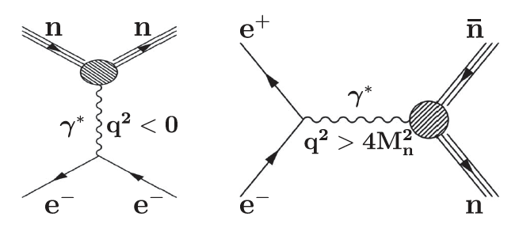
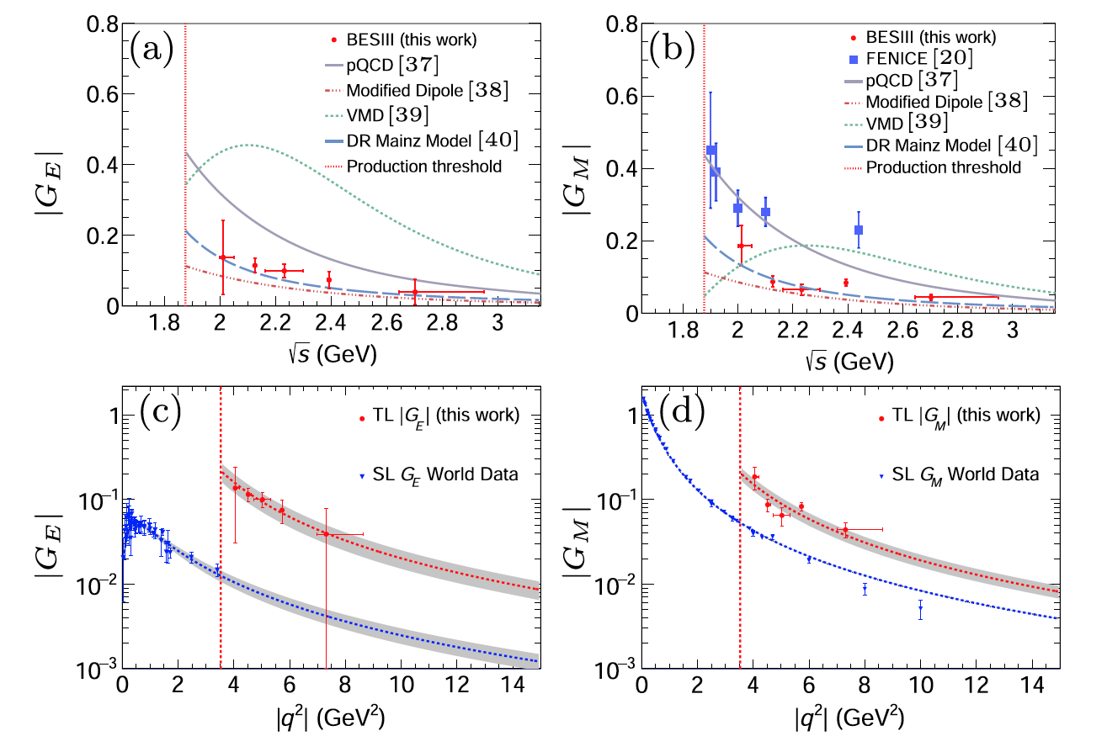
Measurements of the Electric and Magnetic Form Factors of the Neutron for Timelike Momentum Transfer
First measurement for positive momentum transfer (annihilation region)
First measurement of Neutron form factors for positive Q² (annihilation reactions)
Accuracy comparable to data from negative Q² (electron scattering data)
[BESIII Collaboration], PRL 130, 151905 (2023)
Nature Phys. 17 (2021) 11, 1200-1204

Slide 9
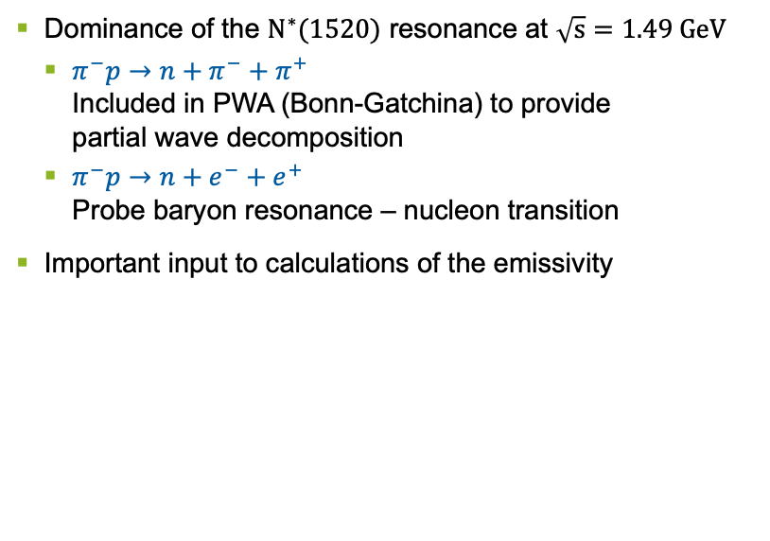
Massive virtual photon emission from N* resonances
[HADES] arXiv:2205.15914 [nucl-ex]
Dominance of the $N^{∗}(1520)$ resonance at $\sqrt{s}=1.49 GeV$
  $π^{−}p→n+π^{−}+π^{+}$
  Included in PWA (Bonn-Gatchina) to provide
  partial wave decomposition
  $π^{−}p→n+e^{−}+e^{+}$
  Probe baryon resonance – nucleon transition
Important input to calculations of the emissivity
Rapp, van Hees; arXiv:1411.4612

Slide 10
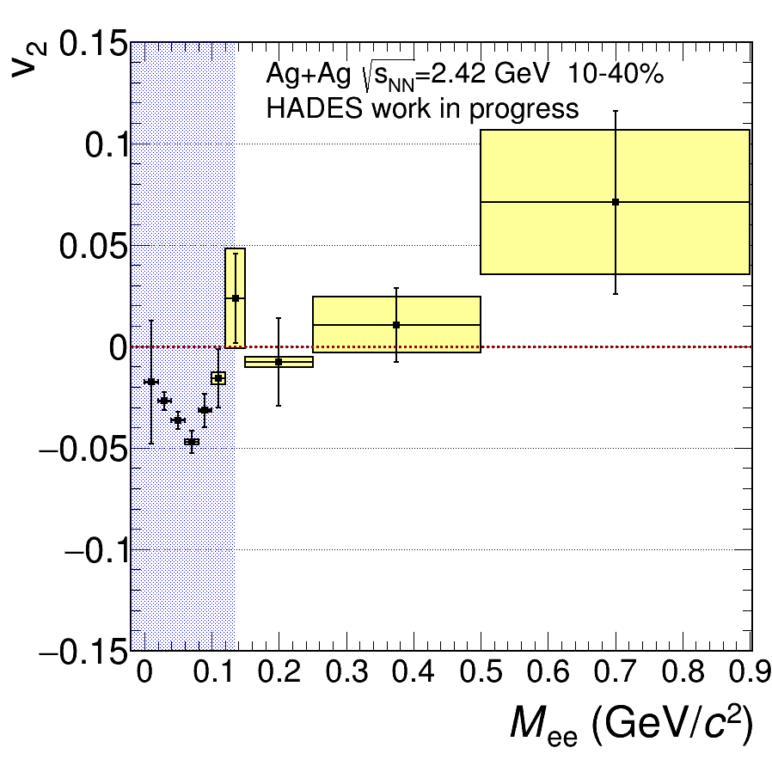
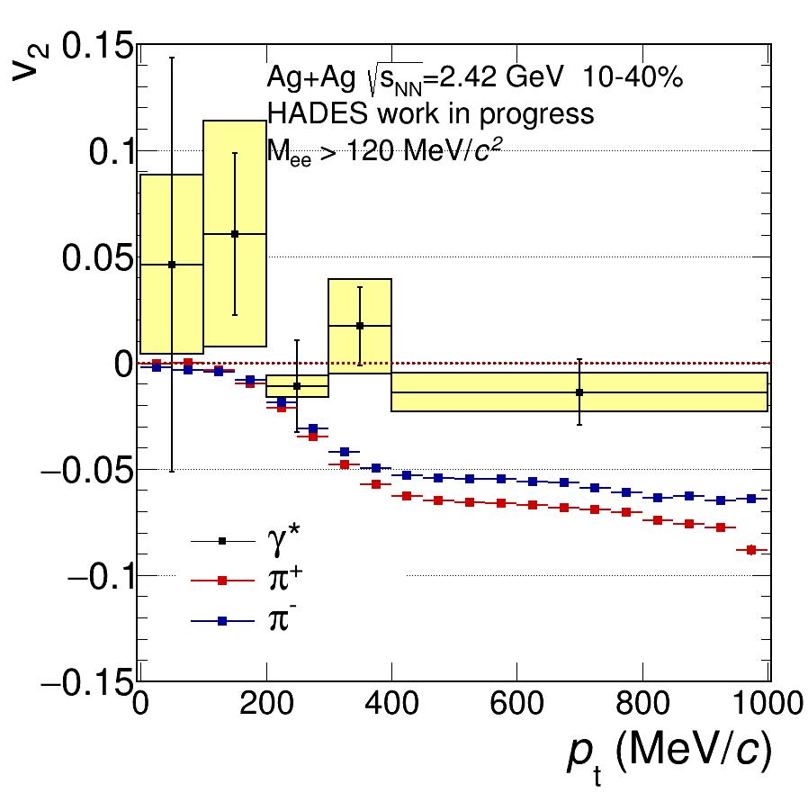
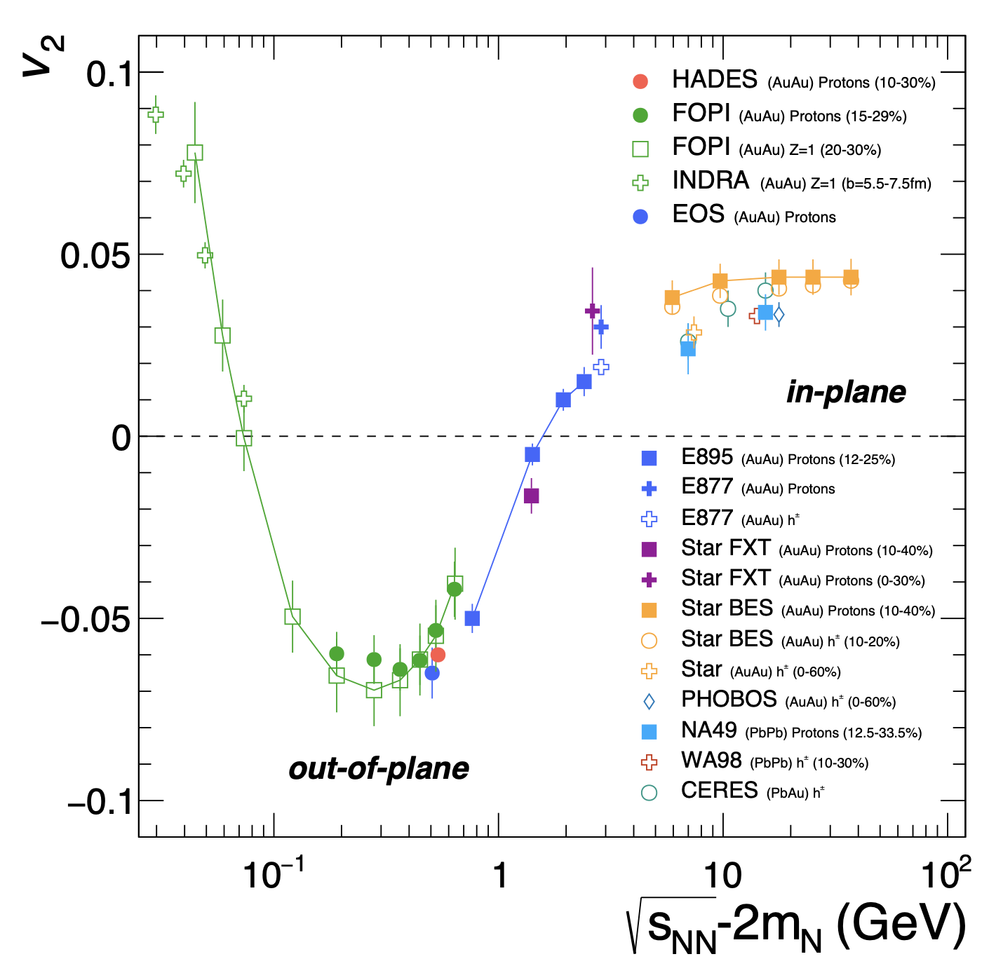


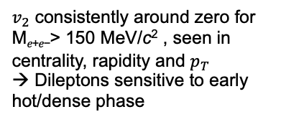
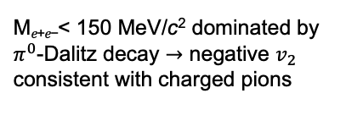
Elliptic flow of inclusive 𝑒⁺𝑒⁻ Ag+Ag $\sqrt{s_{NN}}=2.42 GeV$
HADES, Quark Matter 2023 Highlight
M_{𝑒+𝑒−}< 150 MeV/c² dominated by $π^{0}$-Dalitz decay $→$ negative $v_{2}$ consistent with charged pions
$v_{2}$ consistently around zero for M_{𝑒+𝑒−}> 150 MeV/c² , seen in centrality, rapidity and $p_{T}$
→ Dileptons sensitive to early hot/dense phase
HADES, EPJA 59 (2023) 4, 80
See Behruz Kardan “Decoding the EOS of neutron star-like matter via flow…”

Slide 11





Studies of promising nuclear reactions to synthesize new superheavy elements
Elucidating the influence of closed shells on dynamics of reactions leading to superheavy nuclei
Sequential fission of primary heavy fragment
Primary light fragment
Secondary heavy fragment (A~208)
Secondary light “fragment”
non-fusion
reaction
²⁴⁹Cf
D.Y. Jeung et al., PLB 837 (2023) 137641
⁵⁰Ti
quasi-fission
fusion reaction
fusion-fission
²⁹⁹120*
compound
nucleus
New superheavy nucleus, e.g. ²⁹⁵120
fusion-evaporation
Study of non-fusion reactions at ANU: three-body reaction outcomes need to be considered!
New work accompanies:
Element 120 search at TASCA: J. Khuyagbaatar et al., PRC 102 (2020) 064602
Non-fusion studies at TASCA: A. Di Nitto et al., PLB 784 (2018) 199

Slide 12

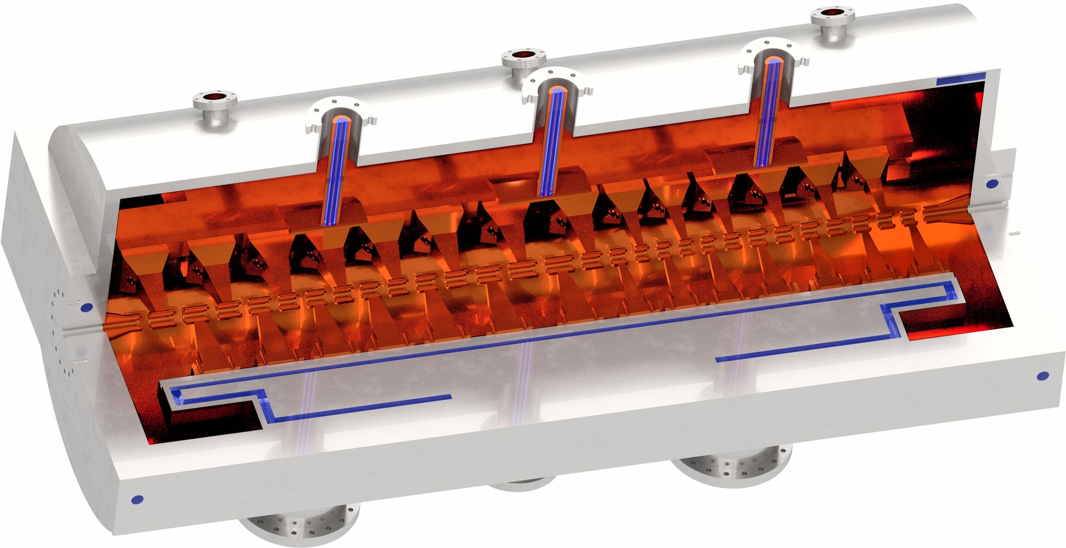
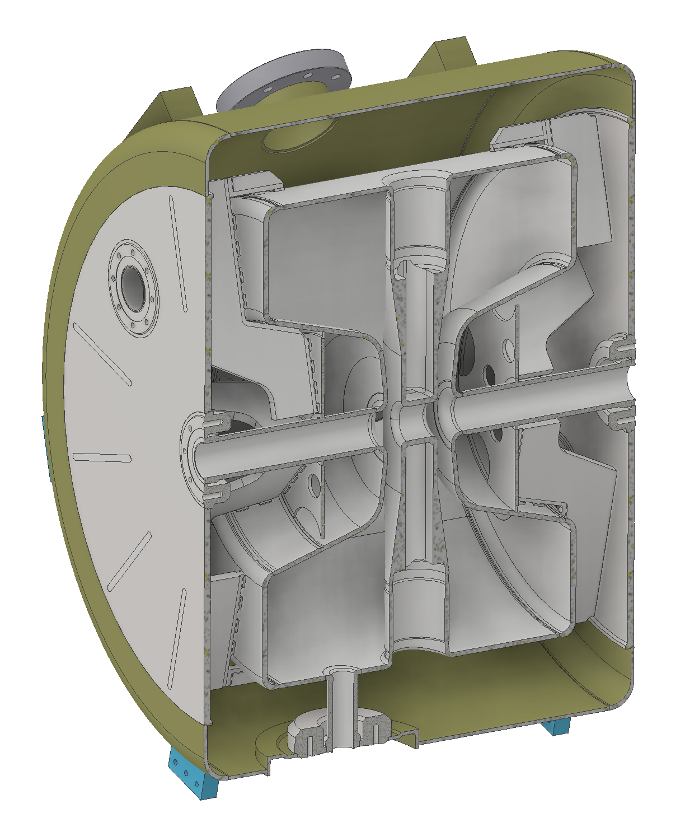
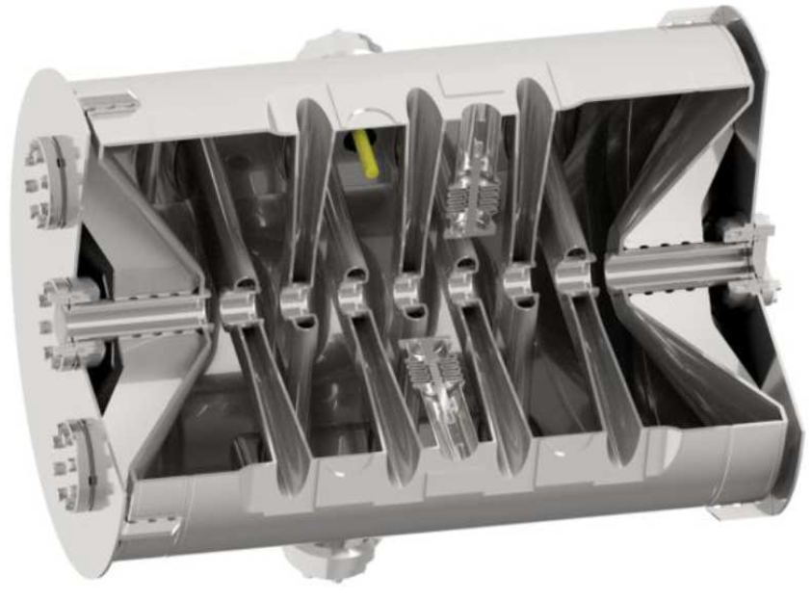
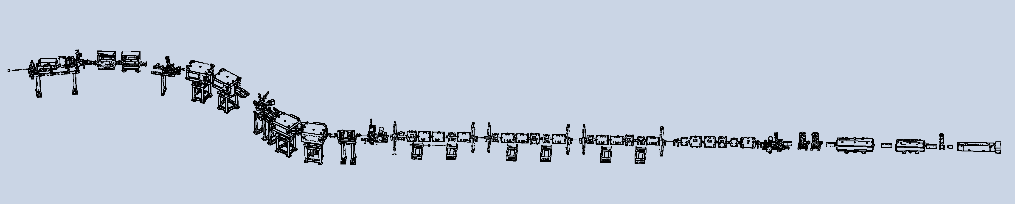
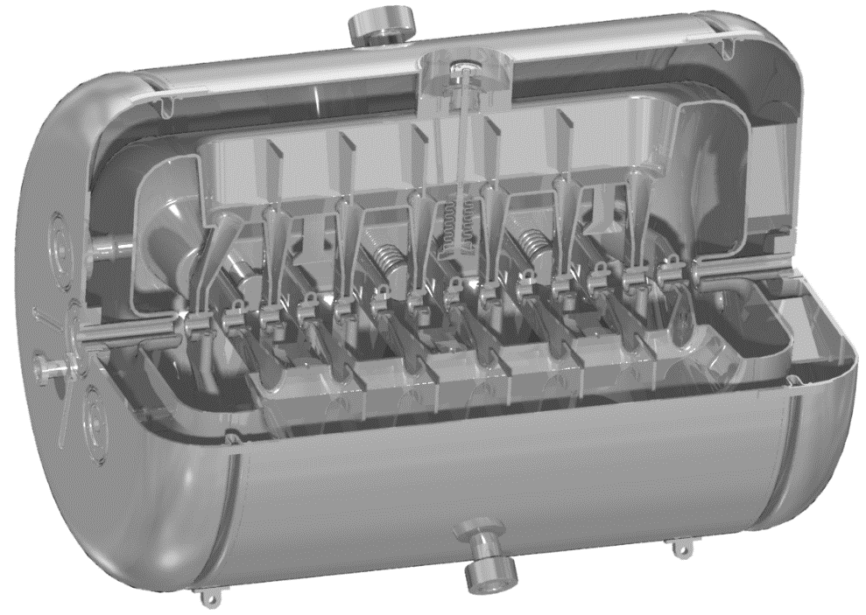
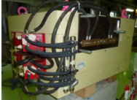
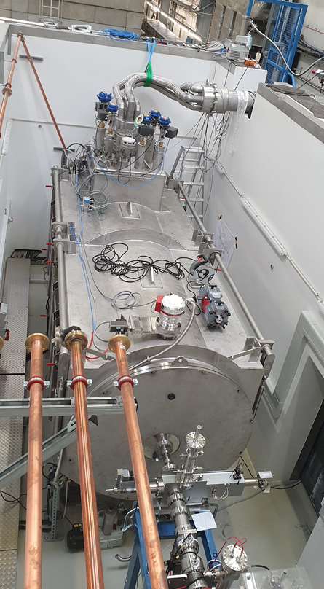
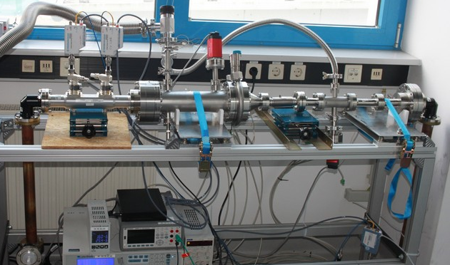
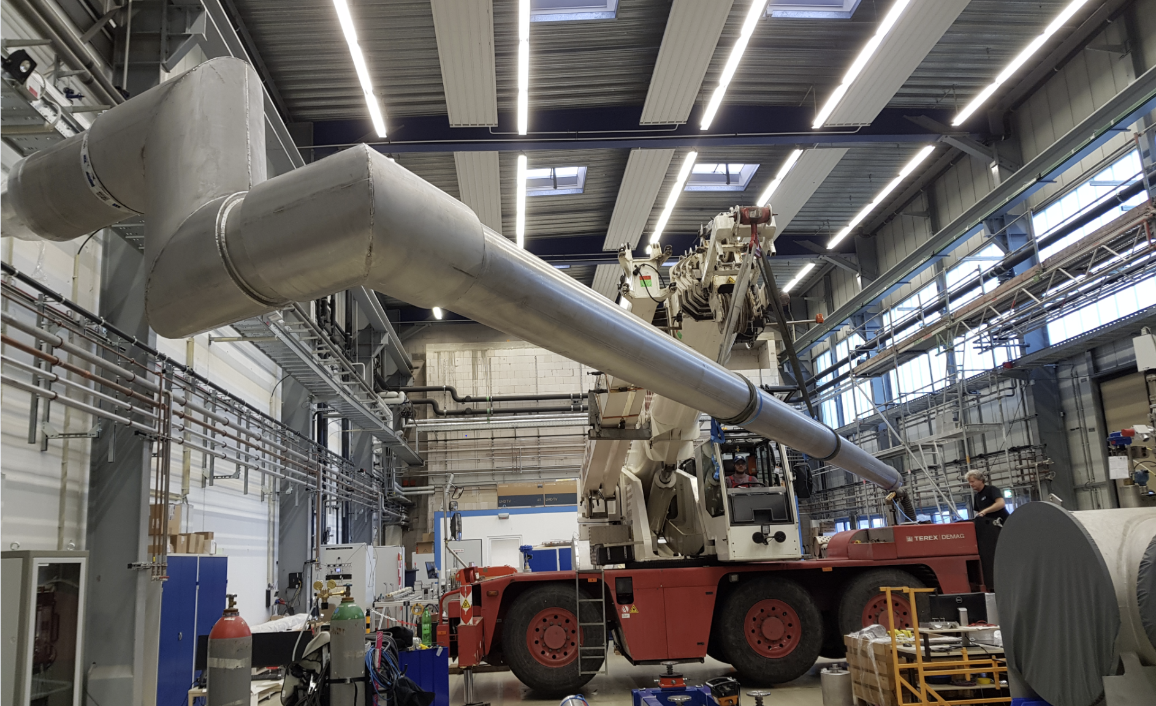
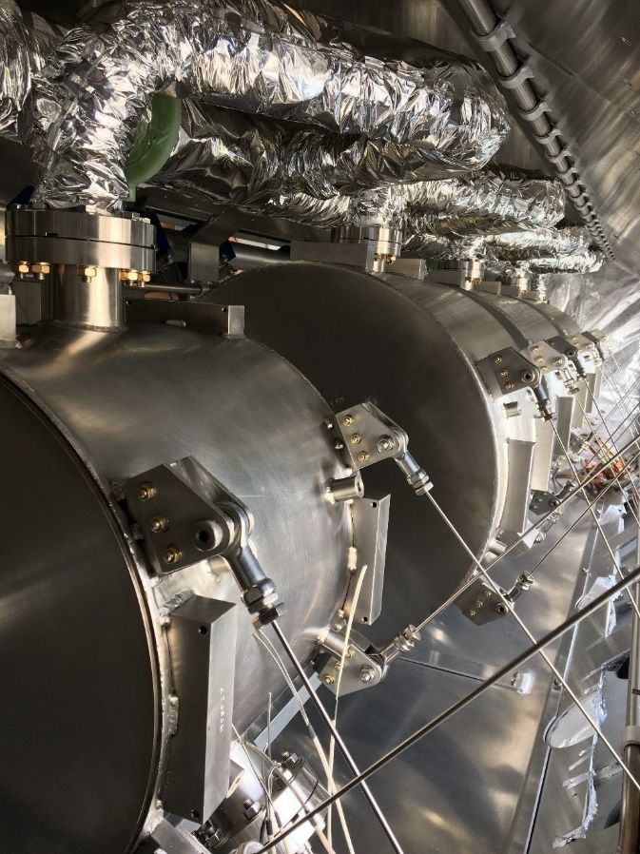
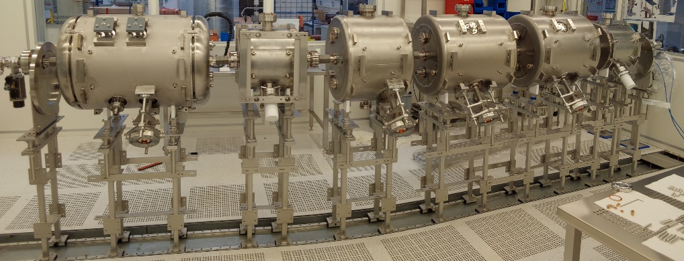
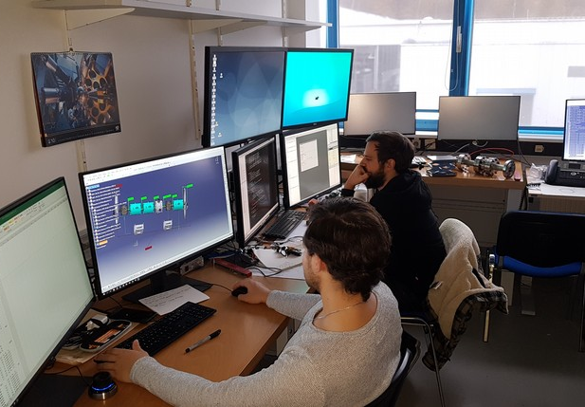
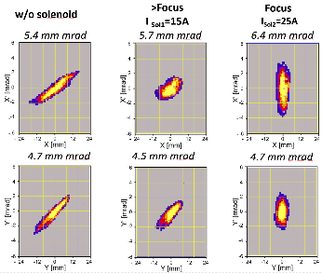
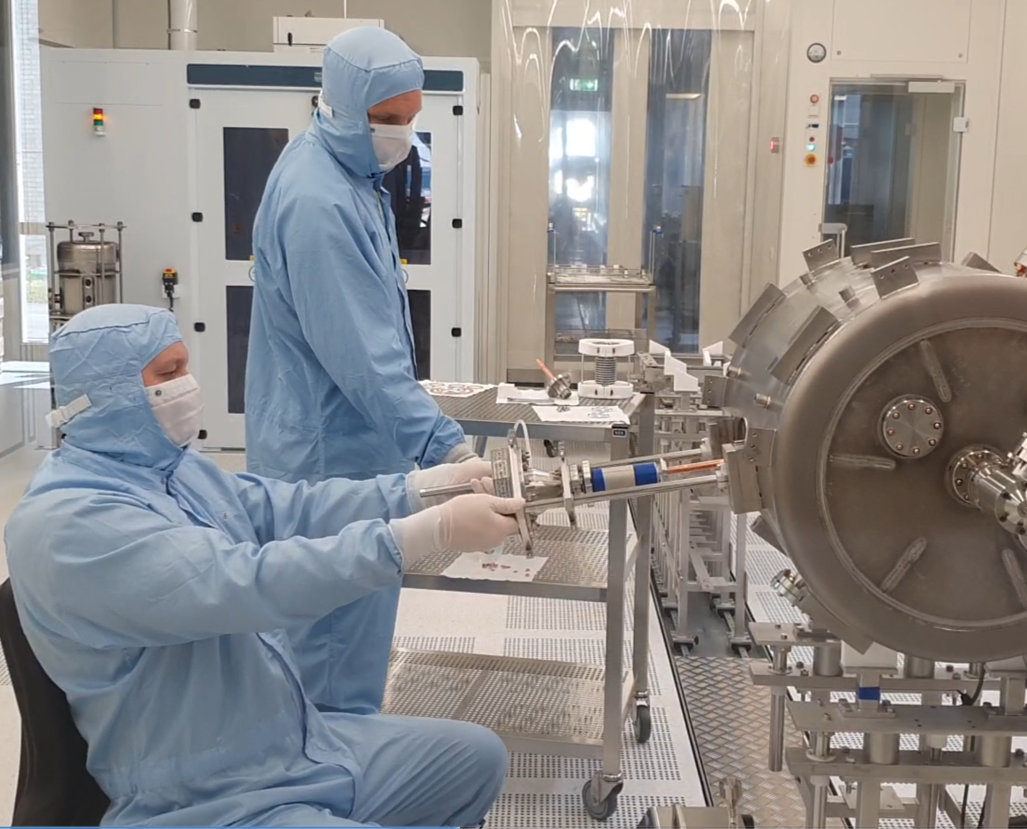
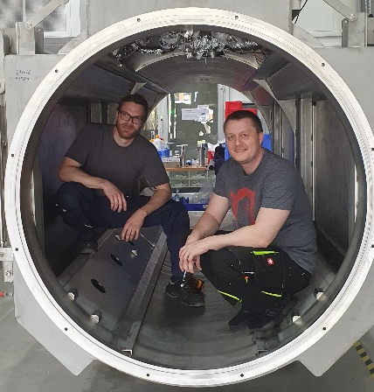
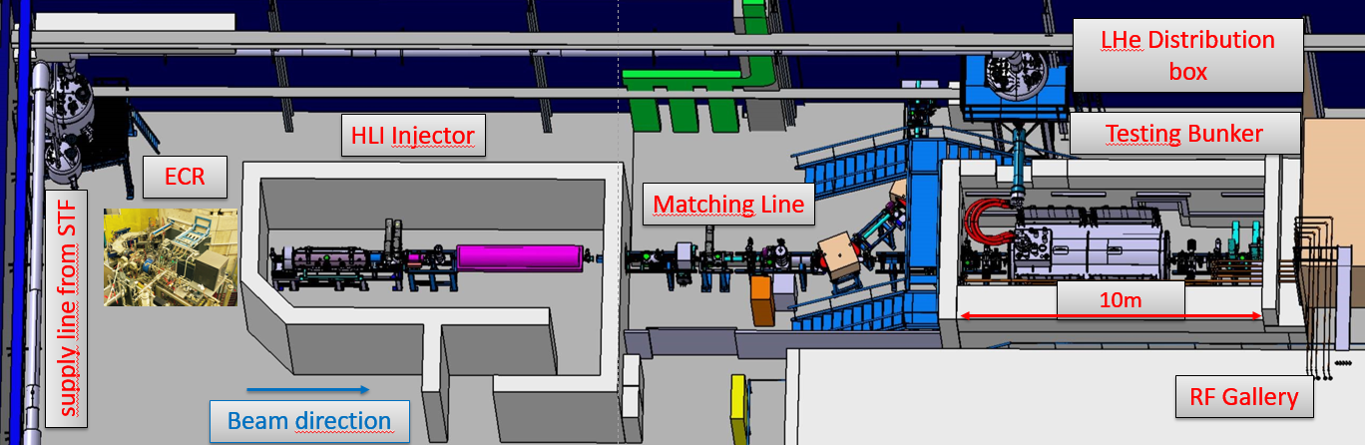
HElmholtz LInear Accelerator
Development at the HI Mainz
Basic HELIAC approach in preparation: ready 2028
CM1 (PoF3) & CM2 (PoF4) &CM3 (BMBF)
Advanced APF-IH-DTL (HGF-Innov. Pool)
Link2UNILAC:
Beam Line magnets
(on stock)
Cryomodule Integration @ HI-Mainz (2022/23)
Test area @GSI

Slide 13
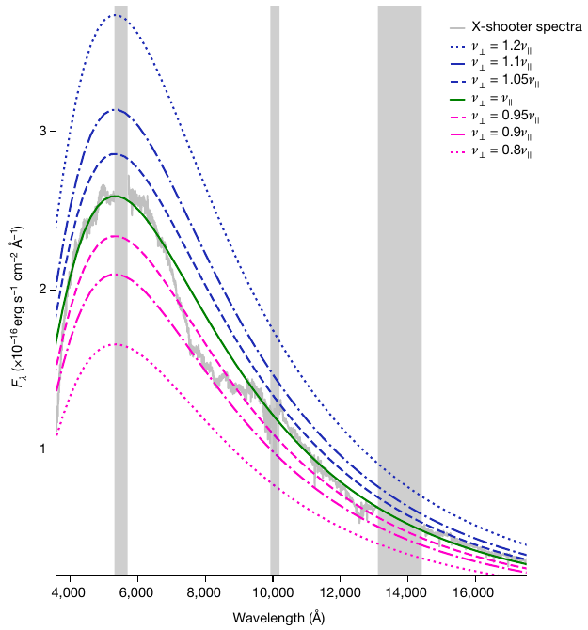
Theory: Spherical kilonova AT2017gfo
(EM counterpart of neutron star merger GW170817)
Detailed analysis of kilonova spectra
  fitting of spectral lines and blackbody
  → expansion velocities in different directions of explosion
  → point to high degree of sphericity of merger outflow
  Either coincidence or additional energy injection (no obvious robust mechanism)
  → constrains merger models
  Yields independent distance measure (via Stefan-Boltzmann fit)
  → best measured distance of GW170817 so far (45.5±0.6) Mpc
  Potential for measuring Hubble constant (recall current tension between cosmic microwave background and Type Ia supernovae measurements)
Best fit
See Vimal Vijayan “Impact of pions on BNS mergers”
Sneppen, Watson, Bauswein, Just, et al., Nature 614, 436 (2023)
See Oliver Just “Using simulations …”

Slide 14
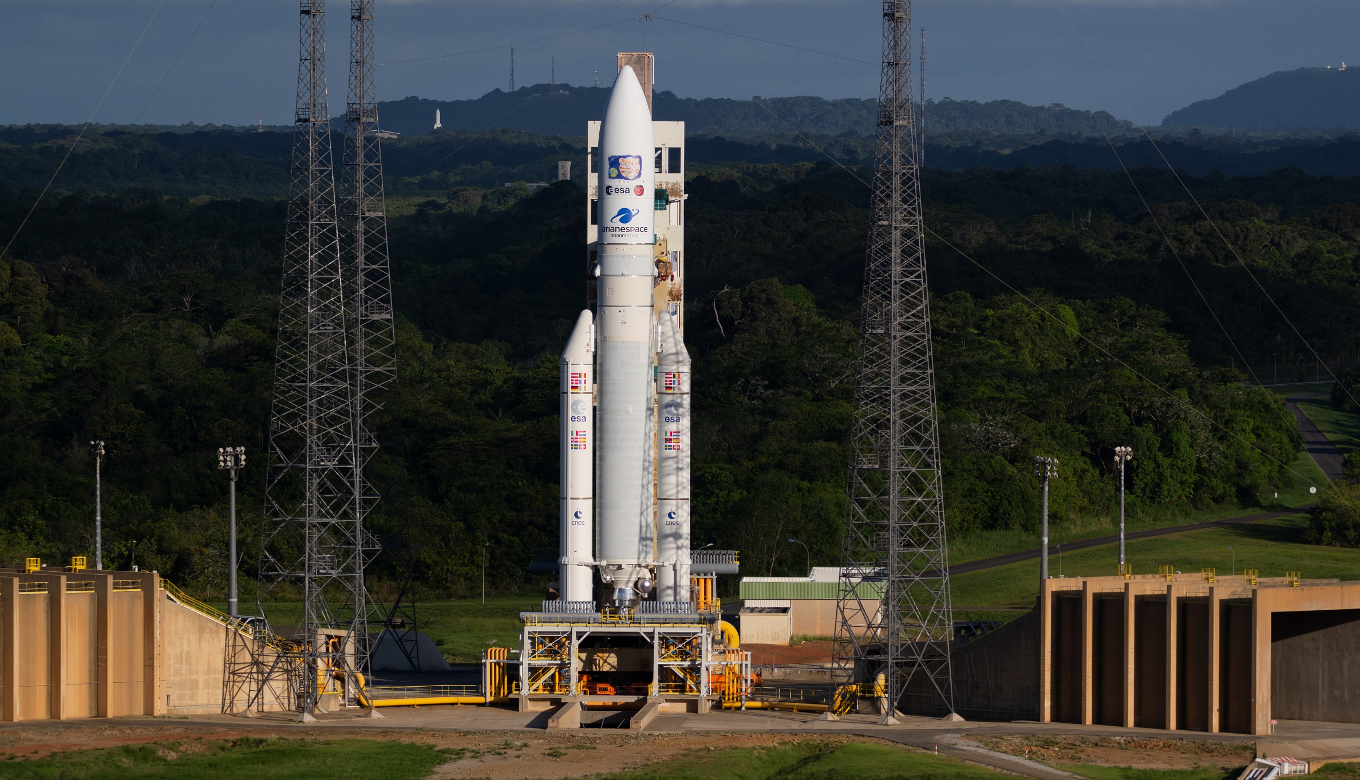
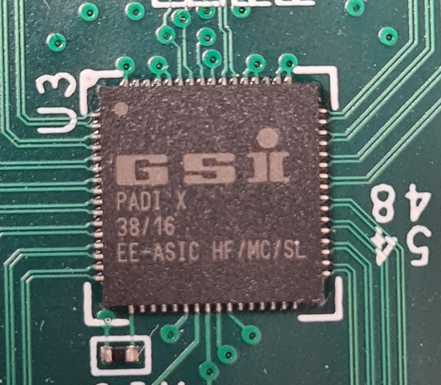
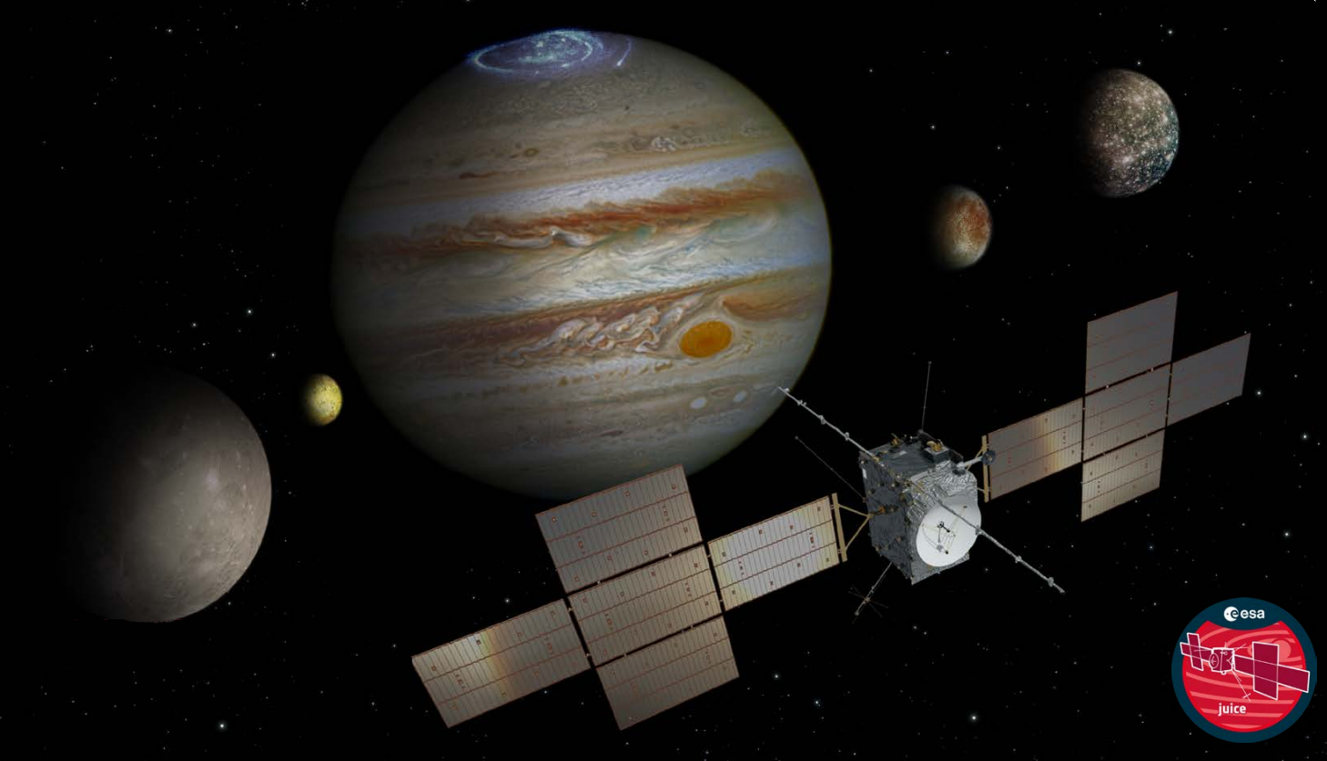
PADI-XII goes to space with JUICE
PADI-XII (ASIC):
Ultrafast PreAmplifier–Discriminator
Application Specific Integrated Circuit
Front-end electronics
Particle Environment Package
PEP/JDC instrument
Destination:
Jupiter
designed at EEL, DTL and ISS (Institute for Space Science, Magurele / Romania)
for the CBM-TOF experiment
Particle spectrometer to study
Jupiter's moons Ganymede, Callisto, Europa and Io, and Jupiter's magnetosphere
Launched
14. Apr. 2023

Slide 15
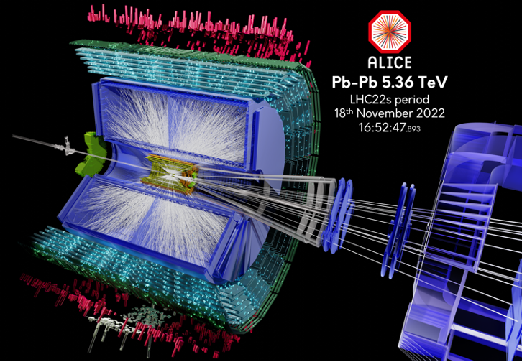
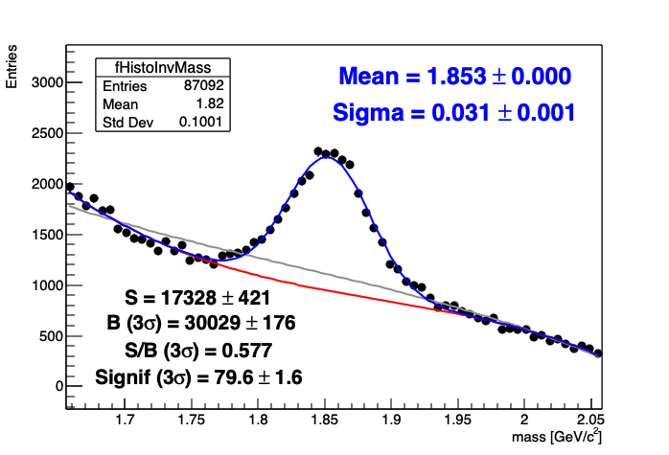
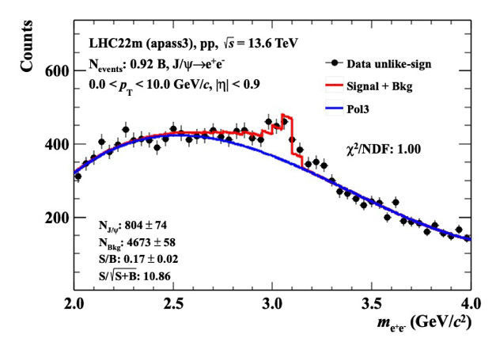
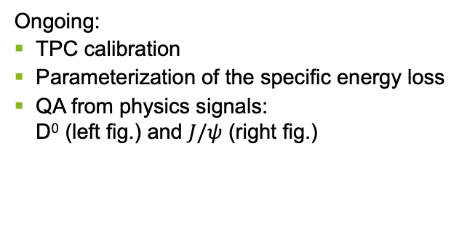
ALICE at LHC in Run 3
Intensive pp data taking at √s = 13.6 TeV:
  interaction rate 3kHz to 1 MHz
  15 pb⁻¹ integrated luminosity
  Pb-Pb test run
Ongoing:
TPC calibration
Parameterization of the specific energy loss
QA from physics signals:
D⁰ (left fig.) and $J/ψ$ (right fig.)

Slide 16
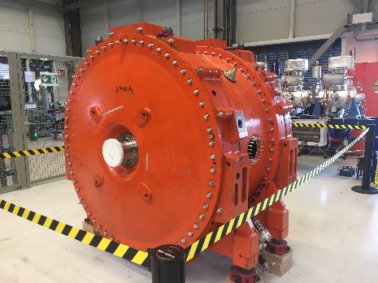
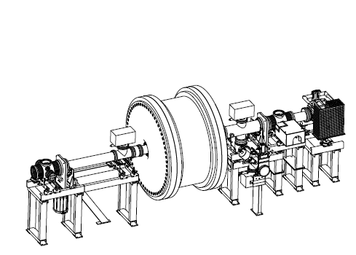
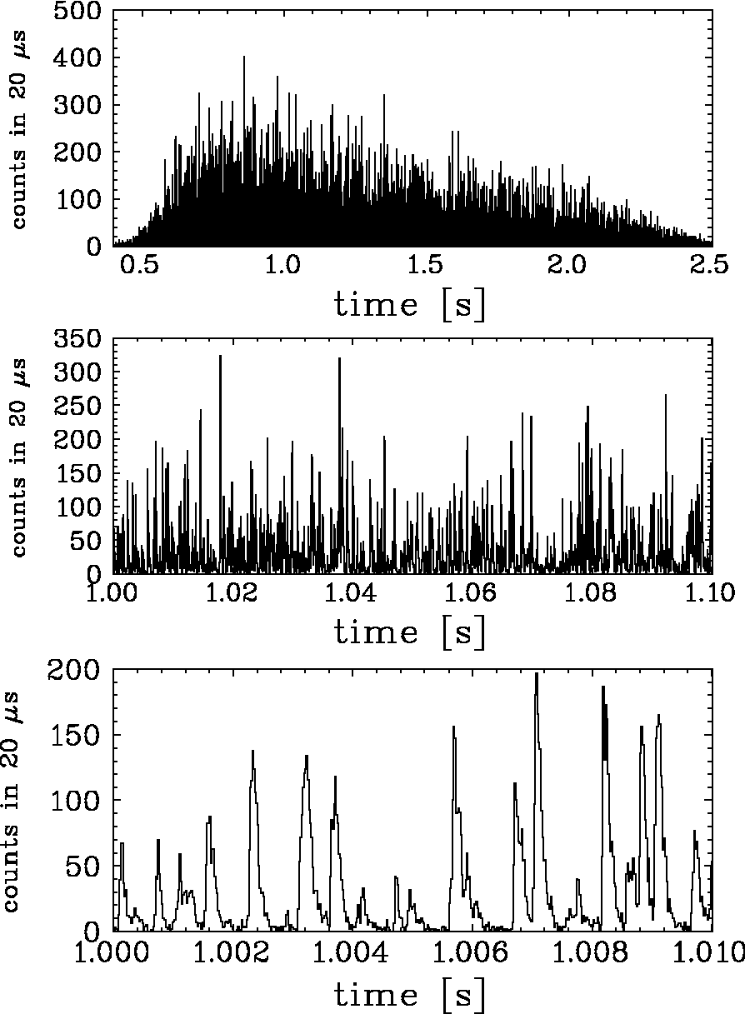
MU accelerator facilities
Spill smoothing cavity for SIS18
Slow extraction of a synchrotron beam is a complex process
  prevention of beam losses
  large span of extraction times (0.2-20 s)
  large difference between vertical and horizontal emittance
  momentum dependence of extraction parameters
  microspill structure problem for high rate experiments
Spill smoothing by rf bunching
  Tune ripple by synchrotron motion and chromaticity
  VHF spill cavity under development
  Demonstration of spill smoothing at AGS, BNL in different operation modes.
  Installation of the test cavity in shut down 2023 completed.
  High shunt impedance limits the use of the test cavity and probably also the beam intensity
10 ms time window
2 s spill

Slide 17



Speeding up SHE chemistry to isotopes with T_{1/2} < 100 ms
SHE Chemistry
UniCell: A new universal buffer gas stopping cell
Allows coupling of fast chemistry setups to TASCA to allow chemical studies of elements Z>115
  Efficiency ~100%
  Extraction time < 10 ms (simulated)
T_{1/2} < 100 ms
T = 300 K
P = 1 bar
UniCell
SHE gas chromatograph
Chemically studied
from
TASCA
Ion thermalization
Concept: V. Varentsov, A. Yakushev; NIM A 940 (2019) 206
Verbundforschung

Slide 18
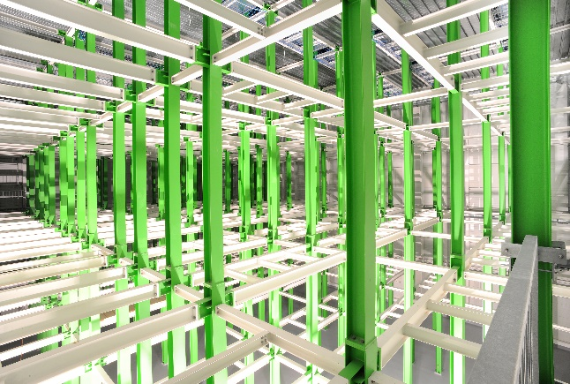
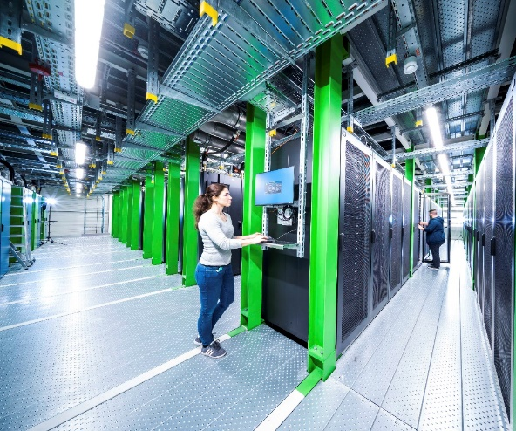
GSI MU Computing facilities
Green-IT cube hosts a Digital Open Laboratory
Providing advanced computing capabilities
to support the MU, MML and MT research programs
Compute
CPU: ~660 server, ~54.000 cores
GPU: 400 AMD Radeon Mi100 GPUs
Storage
~ 60 PByte high-performance online storage
Leading ”Green” Data Center Technology
5.5 M€ EU grant in 2022 to expand the Green-IT cube installations by two more floors
Goal: further strengthen research and collaboration with industry within the FAIR Digital Open Lab (“Reallabor”)
  Open innovation approach to collaborate with industry and other companies
G. Otto/GSI

Slide 19
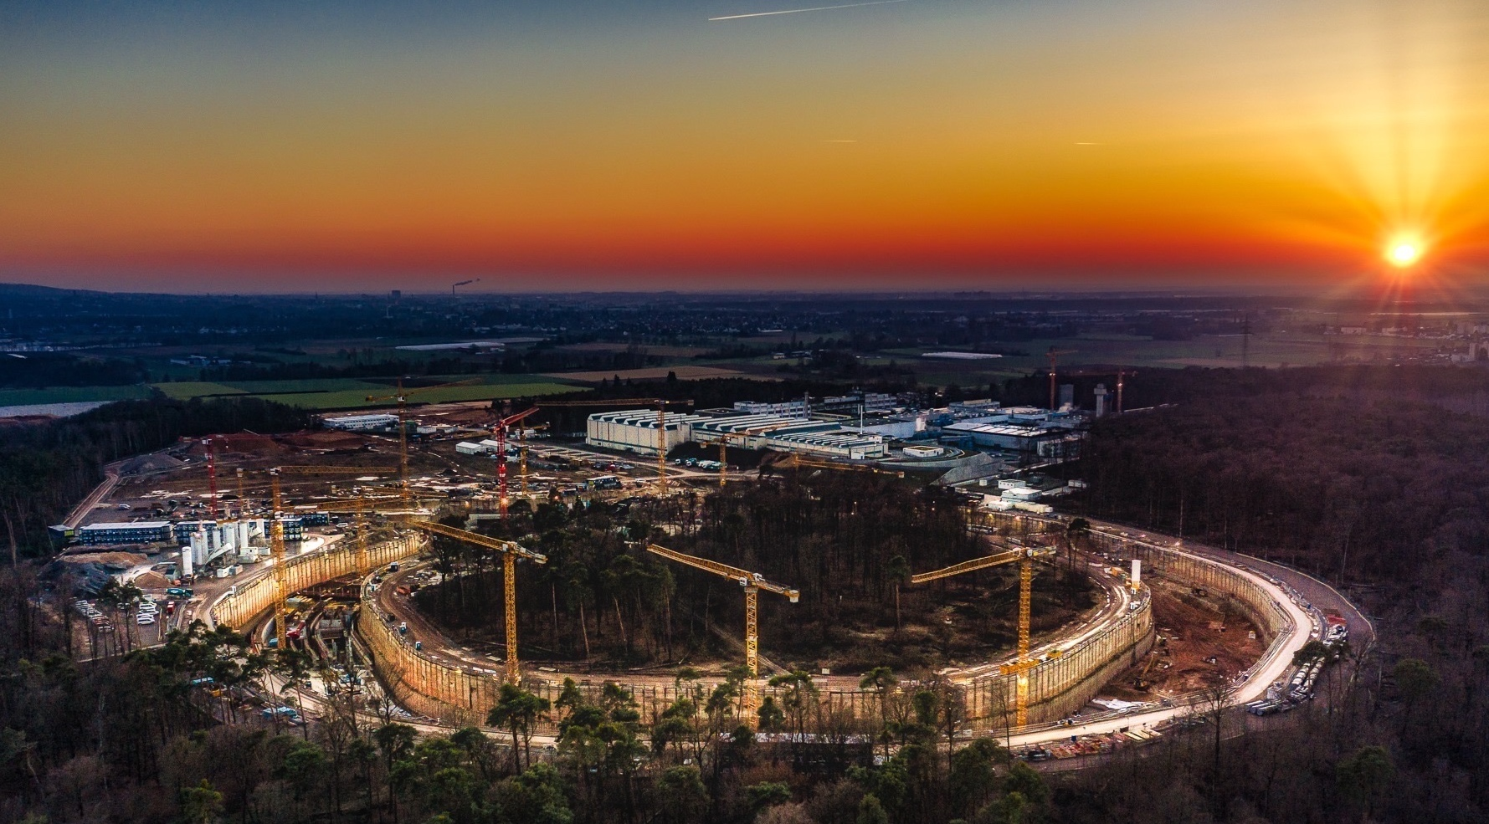
High impact results from FAIR Phase 0
FAIR Phase 0 instrumental on the way to FAIR
Technical preparations for the next big step ongoing
CML goes FAIR
Photo: C. Betz
Thank you for your attention!

Slide 20
Backup

Slide 21
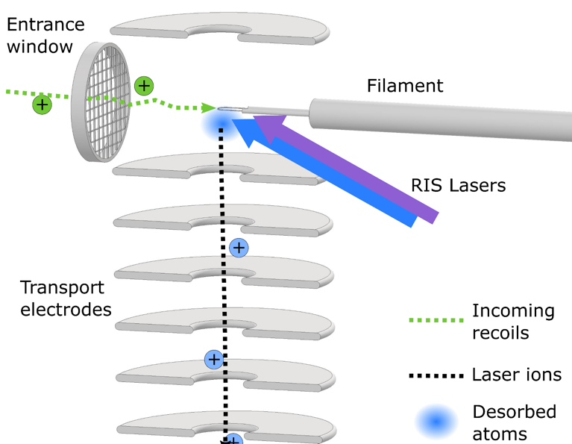
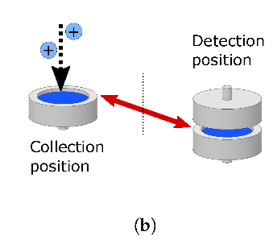

Detector Developments for Laser Spectroscopy
Extending the reach towards heavy elements
RADRIS method for (super)heavy element laser spectroscopy :
two-step laser ionization of atoms
lowest production rates require high efficiency and low background
detect laser ions by characteristic (alpha) decay
use of movable detectors increased efficiency and enabled laser spectroscopy of long-lived rare isotopes such as ²⁵⁴Fm (t_{1/2}=3.2 h)
100mbar
argon
H. Backe et al. Eur. Phys. J. D, 45 (1) (2007), 99
J. Warbinek et al., Atoms 10(2) 41 (2022)
Notes:
In RADRIS we slow down heavy nuclides in argon gas and accumulate them on a filament where they neutralize. After a heating pulse the evaporated atoms are laser ionized. The laser ions are transported to a silicon detector to register the characteristic alpha decay. We have developed two different detector configurations for RADRIS: a double detector increases the solid angle coverage to about double the detection efficiency. RADRIS operates with measurement cycles. After collections on the lower (half) detector, the detector is moved in front of an identical detector to measure the decay.
A rotatable detector system enables measurements of long-lived rare isotopes. We can accumulate laser ions on one detector then rotate it into the another position to register decays while we accumulate ions on the next detector.

Slide 22
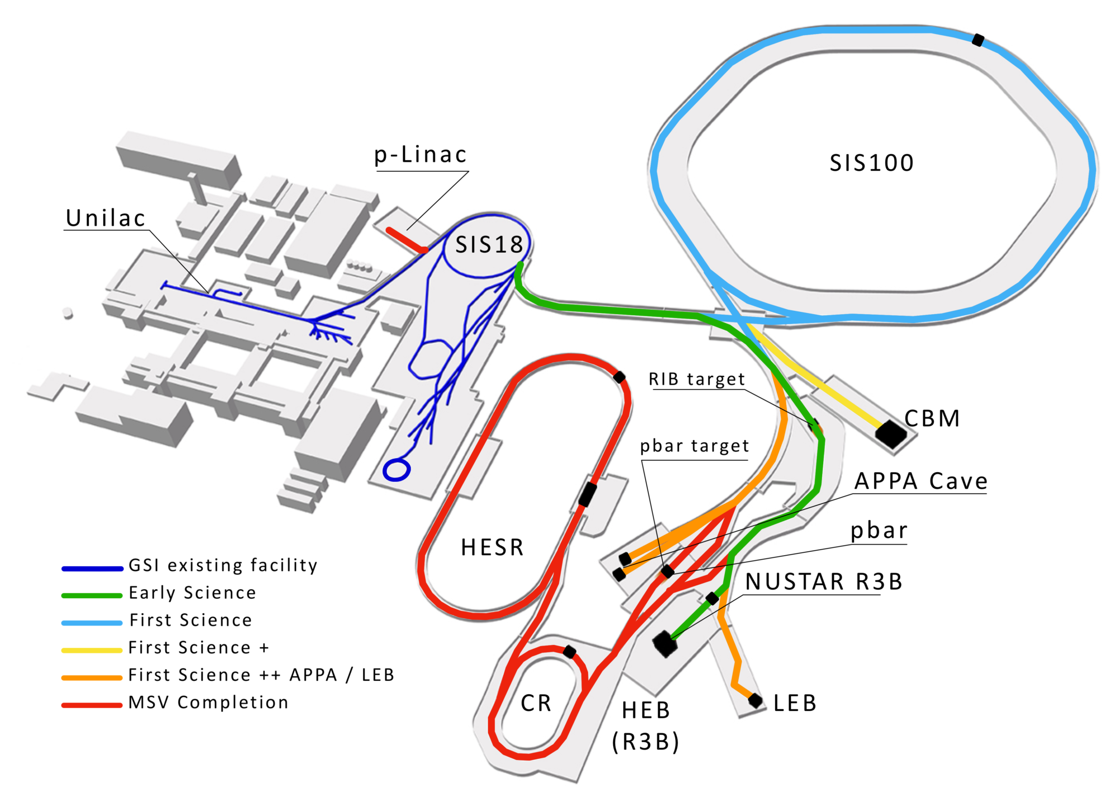
Cosmic Matter in the Laboratory
FAIR accelerator complex
2027 Early Science program (SIS18 beam into the S-FRS)
  exotic nuclei available at higher intensities and with higher beam qualities
2028 First Science/ First Science+ program
(SIS100 beam will be available in the S-FRS and for CBM)
  higher energies/intensities
  more exotic nuclei accessible
In-house experimental research program focus on
the available experimental facilities at GSI/FAIR and
  facilities at the HI Mainz and the JGU Mainz (TRIGA, MESA…)
  participation in ALICE at LHC
  in addition to complementary activities at other laboratories,
  e.g. RIKEN, TRIUMF, participation in JUNO (solar neutrino studies)
See Yvonne Leifels “Outlook on PoF 5”

Slide 23

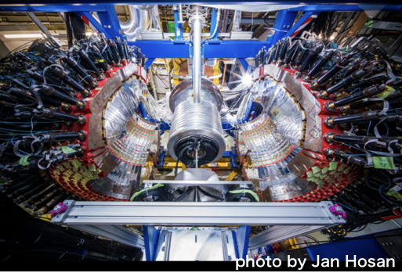





Application of AI-methods in Data Analysis of WASA-FRS Experiments
FRS-F2
Forward high-resolution
spectroscopy with FRS
Decay particle
measurement
WASA
WASA+FRS combined
analysis is ongoing
Achieved WASA Particle ID with Momentum vs β (left) and E vs ΔE (right)
Development of Track Finder
with Graph Neural Network
Y. K. Tanaka et al., Acta Phys. Pol. B Proc. Suppl.16, 4-A27 (2023)
H. Ekawa et al., Accepted in EPJA (2023 April)

Slide 24
Detector Developments for Laser Spectroscopy
Extending the reach towards heavy elements
RADRIS method for (super)heavy element laser spectroscopy :
two-step laser ionization of atoms
lowest production rates require high efficiency and low background
detect laser ions by characteristic (alpha) decay
use of movable detectors increased efficiency and enabled laser spectroscopy of long-lived rare isotopes such as ²⁵⁴Fm (t_{1/2}=3.2 h)
100mbar
argon
H. Backe et al. Eur. Phys. J. D, 45 (1) (2007), 99
J. Warbinek et al., Atoms 10(2) 41 (2022)
Notes:
In RADRIS we slow down heavy nuclides in argon gas and accumulate them on a filament where they neutralize. After a heating pulse the evaporated atoms are laser ionized. The laser ions are transported to a silicon detector to register the characteristic alpha decay. We have developed two different detector configurations for RADRIS: a double detector increases the solid angle coverage to about double the detection efficiency. RADRIS operates with measurement cycles. After collections on the lower (half) detector, the detector is moved in front of an identical detector to measure the decay.
A rotatable detector system enables measurements of long-lived rare isotopes. We can accumulate laser ions on one detector then rotate it into the another position to register decays while we accumulate ions on the next detector.

Slide 25

FAIR Forschung NRW (IKP Jülich)
A new method to induce hyperpolarization
Patent: (Deutsche Patentanmeldung 102022213860.0)
“A method and an apparatus to produce polarized atoms, molecules and their ions”
Possible Applications
1.) New types of polarized ions sources for accelerators
A polarized ³He⁺ source will be tested at COSY in Sep. 2023
2.) Polarized fuel for fusion reactors
First test to polarize an intense deuterium beam in Oct. 2023
3.) Polarized molecular D₂ beams
Collab. with Uni. Swansea / Accumulation and storage as pol. ice
4.) Under discussion: Medical tracer, new type of MRI, ….
Notes:
In Dec. 2022 a patent with the title „Verfahren und eine Vorrichtung zur Erzeugung von polarisierten Atomen, Molekülen und deren Ionen” (“A method and an apparatus for the production of polarized atoms, molecules and their ions”) was accepted. Many particles with a hyperfine structure based on the interaction of the nucleon with an electron spin, a rotational magnetic moment or another nuclear spin within a molecule can be polarized by this technique, thus opening the door for a long list of applications.
The invention relates to a new method for polarisation generation of atoms, molecules and their ions by means of radio wave pulses and quantum interference of the thus induced transitions within the hyperfine structure. This method itself is already theoretically understood and experimentally demonstrated on a beam of metastable hydrogen and deuterium atoms, but should in principle be universally applicable to many other particles.The invention is to some extent a product of chance. The physical principles have been known since the 1930s and are described by the solution of the Schrödinger equation. Surprisingly, however, to the best of our knowledge, no one has yet calculated these physical effects for an unpolarised atomic beam, although corresponding observations have been available since the 1960s.
Durint the last beam time at COSY to validate his invention, in which a polarised 3He+ ion source based on the invention will be tested

Slide 26






Fragmentseparator
Separation and identification of exotic ions
Target Area:
Preparation for complete
remote handling
New vacuum pumps and sensors, modularity of drives, general maintenance
S4 focal plane
Preparation of detectors
for test run in Nov. 2023
Preparation of experiment
setups for 2024
S1 focal plane:
Improved separation and identification of secondary beams (new, turnable disc degrader and new TOF system)
New vacuum pump
S2 focal plane:
Implementation of new, modular support frames for fast and reliable changeover of complex experiment setups
beam
direction
FRS environment and Messhütte:
Many activities ongoing to maintain/improve safety, reliability of all technical areas and sub-systems
Quadrupole magnets:
ACCU - upgrade of all power supplies (in order to stay compatible with FAIR control system)
Steppermotors and insertions:
64-channel COSYLAB system available; installation in 2024
DAQ: Upgrade to higher rate capability ongoing

Slide 27



MU accelerator facilities
UNILAC post stripper upgrade
Replacement of old drift tube linac DTL
  intensity requirements of FAIR
  reducing operation risk
Recent highlight
  all tanks for 1st section are ready for delivery

Slide 28





Σ(1385) reconstruction p+p 4.5 GeV
Study Dalitz decays of Λ(1520)/$Σ$(1385) → Λ𝑒⁺𝑒⁻ allow for first measurement of hyperon form factors in time-like region
Breit-Wigner + background fit:
$M_{Σ(1385)}$ = 1378.17 +/- 0.40 MeV/c²
$Γ_{Σ(1385)}$ = 28.042$±$0.99 MeV/c²
$Λ$ selection enhanced by Machine Learning
Sideband
Sideband
(Blue) - Signal + Background fit
(Green) - Signal (Breit-Wigner) fit
(Red) - Background (polynomial) fit

