Slide 1
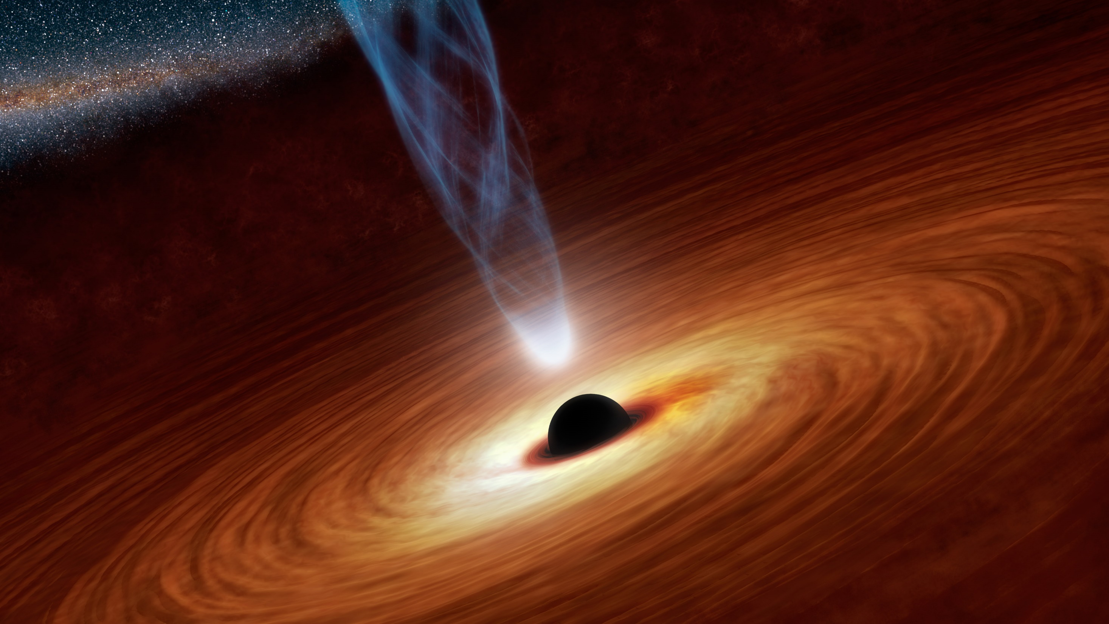


Searching for the missing duo: coincident gravitational-waves and high-energy neutrinos
Doğa Veske

Slide 2
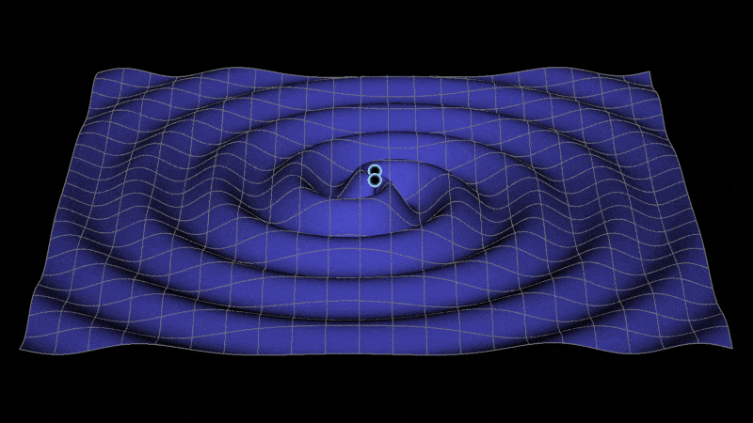
Common sources of gravitational waves (GW) and high energy neutrinos (HEN)
Need a changing quadrupole moment for GW emission
  Binary orbiting systems, non-symmetric ejecta
Need an energetic flow of matter, for high energy neutrinos
  i.e. from decay of photo-mesons created in AGN jets or GRBs
Most probable (proposed) GW-HEN sources are
  Binary neutron stars (a potential kilonova)
  Binary neutron star-black holes
  Binary black holes with an accretion disc
  Core collapse supernova
  …

Slide 3
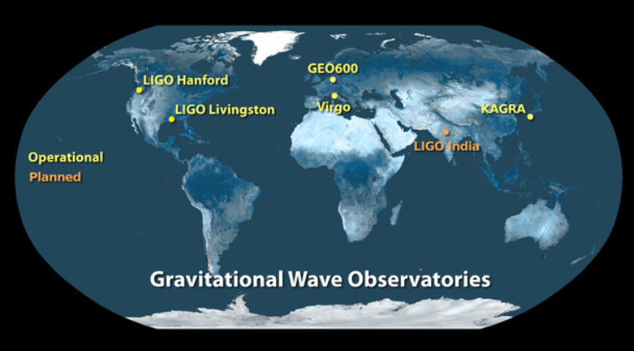
Gravitational-wave detector network
Detectors with different sensitivities
Detections so far are from LIGO and Virgo detectors
A network of detectors is important for sensitivity and localization

Slide 4

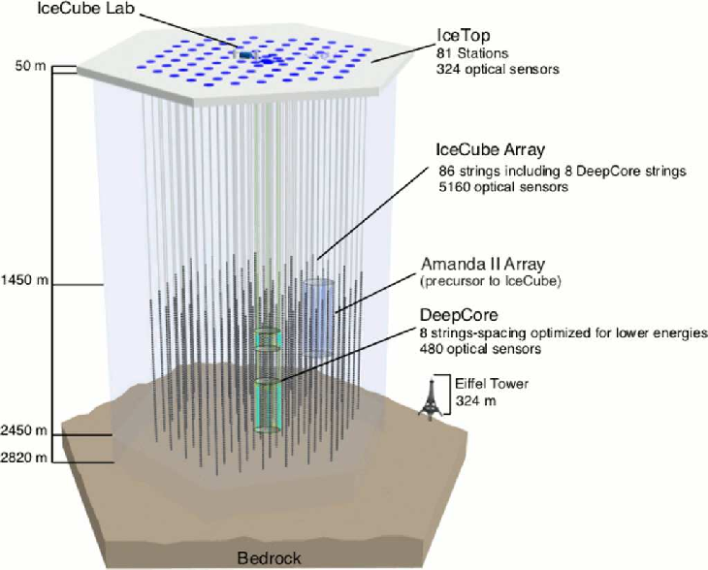
IceCube
High energy neutrino detector located at the geographical South Pole
Consists of ‘‘digital optical modules’’ which see the Cherenkov radiation from the muons created by neutrinos/from scattered particles
We use muon tracks which have better localization compared to cascade events
All sky but higher sensitivity for upgoing muons (coming from North Hemisphere)
Image from Measurement of South Pole ice transparency with the IceCube LED calibration system - IceCube Collaboration (Aartsen, M.G. et al.) Nucl.Instrum.Meth. A711 (2013) 73-89

Slide 5
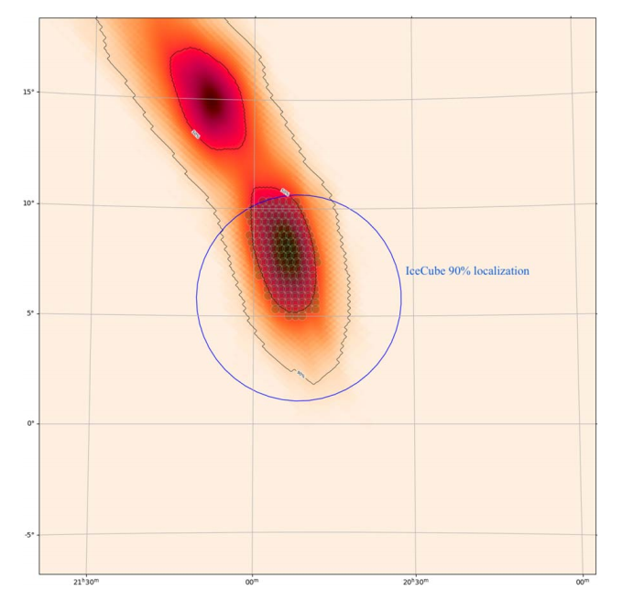
Search for joint gravitational-wave and high energy neutrino events
Learn more about the processes before, during and after the event
Guide astronomers in low latency with better localization
  GW skymaps can range $\sim 10−{10}^{4}\deg^{2}{}$
  High energy neutrino localization $\sim 0.1−10\deg^{2}{}$
  Even smaller overlap with GW and HEN for astronomy follow-up
Swift follow-up for the neutrino coincident with S190728q. Keivani et. al. ApJ 2021

Slide 6
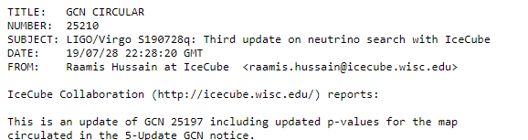
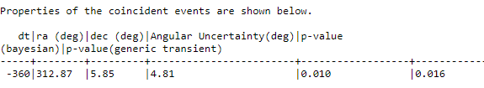
Realtime search during O3 with IceCube
Combined run of 2 LIGO detectors and Virgo detector
  1 year planned run, suspended 1 month before completion
Performed a low-latency search after each open public alert (OPA) from GraceDB. Alerted the community through GCNs.
  Total of 56 non-retracted alerts
3 events with <1% p-value
  S190728q (BBH)
  S191216ap (BBH)
  S200213t (BNS)
Released neutrinos triggered searches from different observatories including HAWC, Swift…

Slide 7
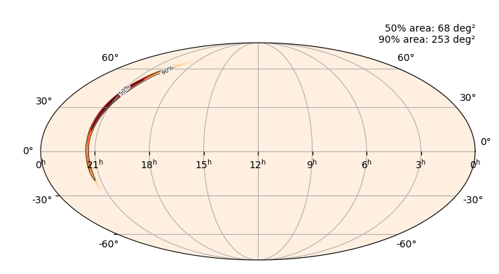
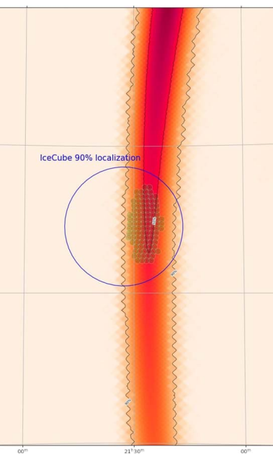
Case study: S191216ap
Localization from gracedb.ligo.org
How to Search for Multiple Messengers—A General Framework Beyond Two Messengers
DV et. al., ApJ 908 216 (2021)
A “close” BBH merger ~376 Mpc
One significant neutrino
p-value ~0.6% in LLAMA search
p-value ~10% in the UML search
Swift follow-up for the neutrino coincident with S191216ap. Keivani et. al. ApJ 2021

Slide 8
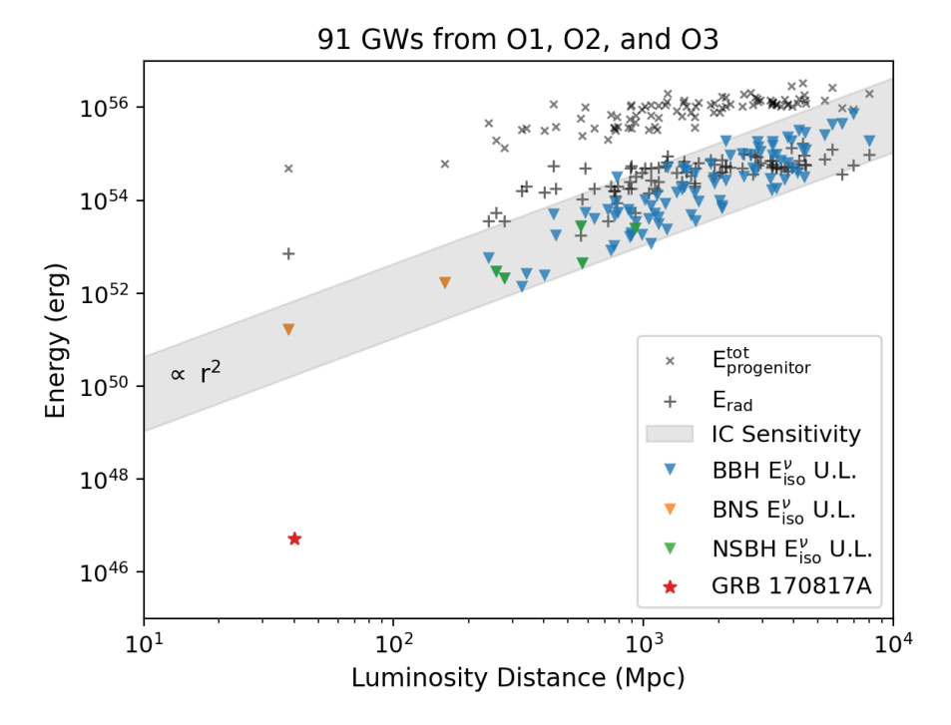
Offline searches
O1-O2
  Analyzed 10 BBH and 1 BNS merger from LIGO-Virgo’s first gravitational wave transients catalog GWTC-1
  Aartsen et al., ApJL 898 L10 (2020)
  No significant neutrino counterpart is found with the most significant having p-value 16%.
O3
  GWTC 2.1, GWTC 3 -> +80 events
  Abbasi et al., ApJ 944 80 (2023)
  Lowest p-value is 0.48%, not significant considering the total number of events
Lowest $E_{iso}$ 90% U.L belongs to GW170817 as$1.7×{10}^{51}$ ergs, due to it being the closest at 40 Mpc

Slide 9
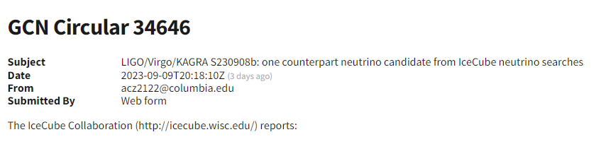
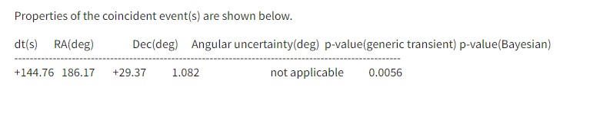
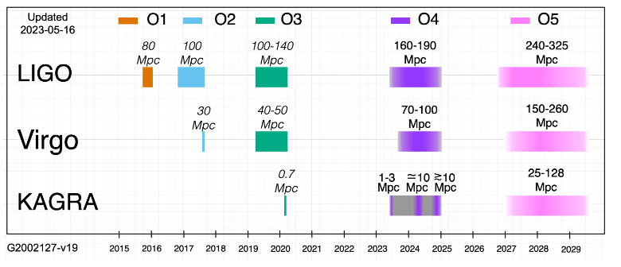
Latest: O4 real-time run
Since end of May 2023
Only 2 LIGO detectors so far
LLAMA search runs on “low-significance” triggers as well

Slide 10
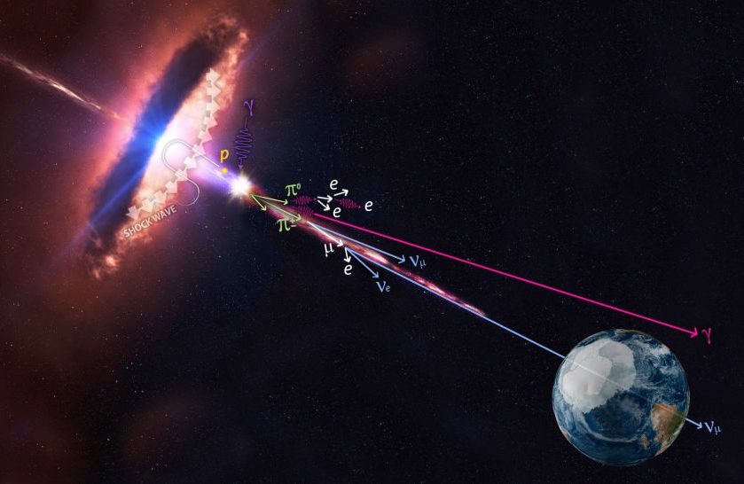
Concluding remarks
Searching for common sources of gravitational-waves and high energy neutrinos
No decisive discovery yet
Guiding astronomers with real-time follow-ups

