Slide 1


Beam test Meeting
23 –February 2023
KIT
PANDA DAQ for beam test
Michele Caselle, Timo Dritschler, Kai Lukas Unger, Vladimir Sidorenko, Lars Eisenblätter, Olena Manzhura, Suren Chilingaryan, Andreas Kopmann

Slide 2
PANDA beam test – Meeting (Giessen-KIT)
Agenda
Introduction
Beam test setup “Hardware side” (Michele)
Beam test setup “low-level Driver – Software” (Timo)
Round table discussion
Conclusion & Next steps
AOB
Lunch
Visit the KIT clean room (detector technologies)
Feedback final remarks from Giessen (if present)

Slide 3

PANDA DAQ for beam test
First version of FPGA firmware that integrated the control/readout of ToASt(s) by the MDC architecture
The first architecture is based on HighFlex v.1 with MDC architecture on FPGA
Readout based on PCIe Gen 3, compatible to any PCs
Data throughput up to 120 Gb/s suitable to readout multiple ToASt(s) simultaneously as a detector module scenario
DDR3
Detector card
PC DAQ/control
GPU-Direct KIT-DMA
Data
ToASt
MDC
(Module data Concentrator)
Strip Detector
ToASt
…
ToASt
PCIe Programmed IO (PIO)
Cmd/Cnfg
User register
FPGA (HighFlex v1) card

Slide 4
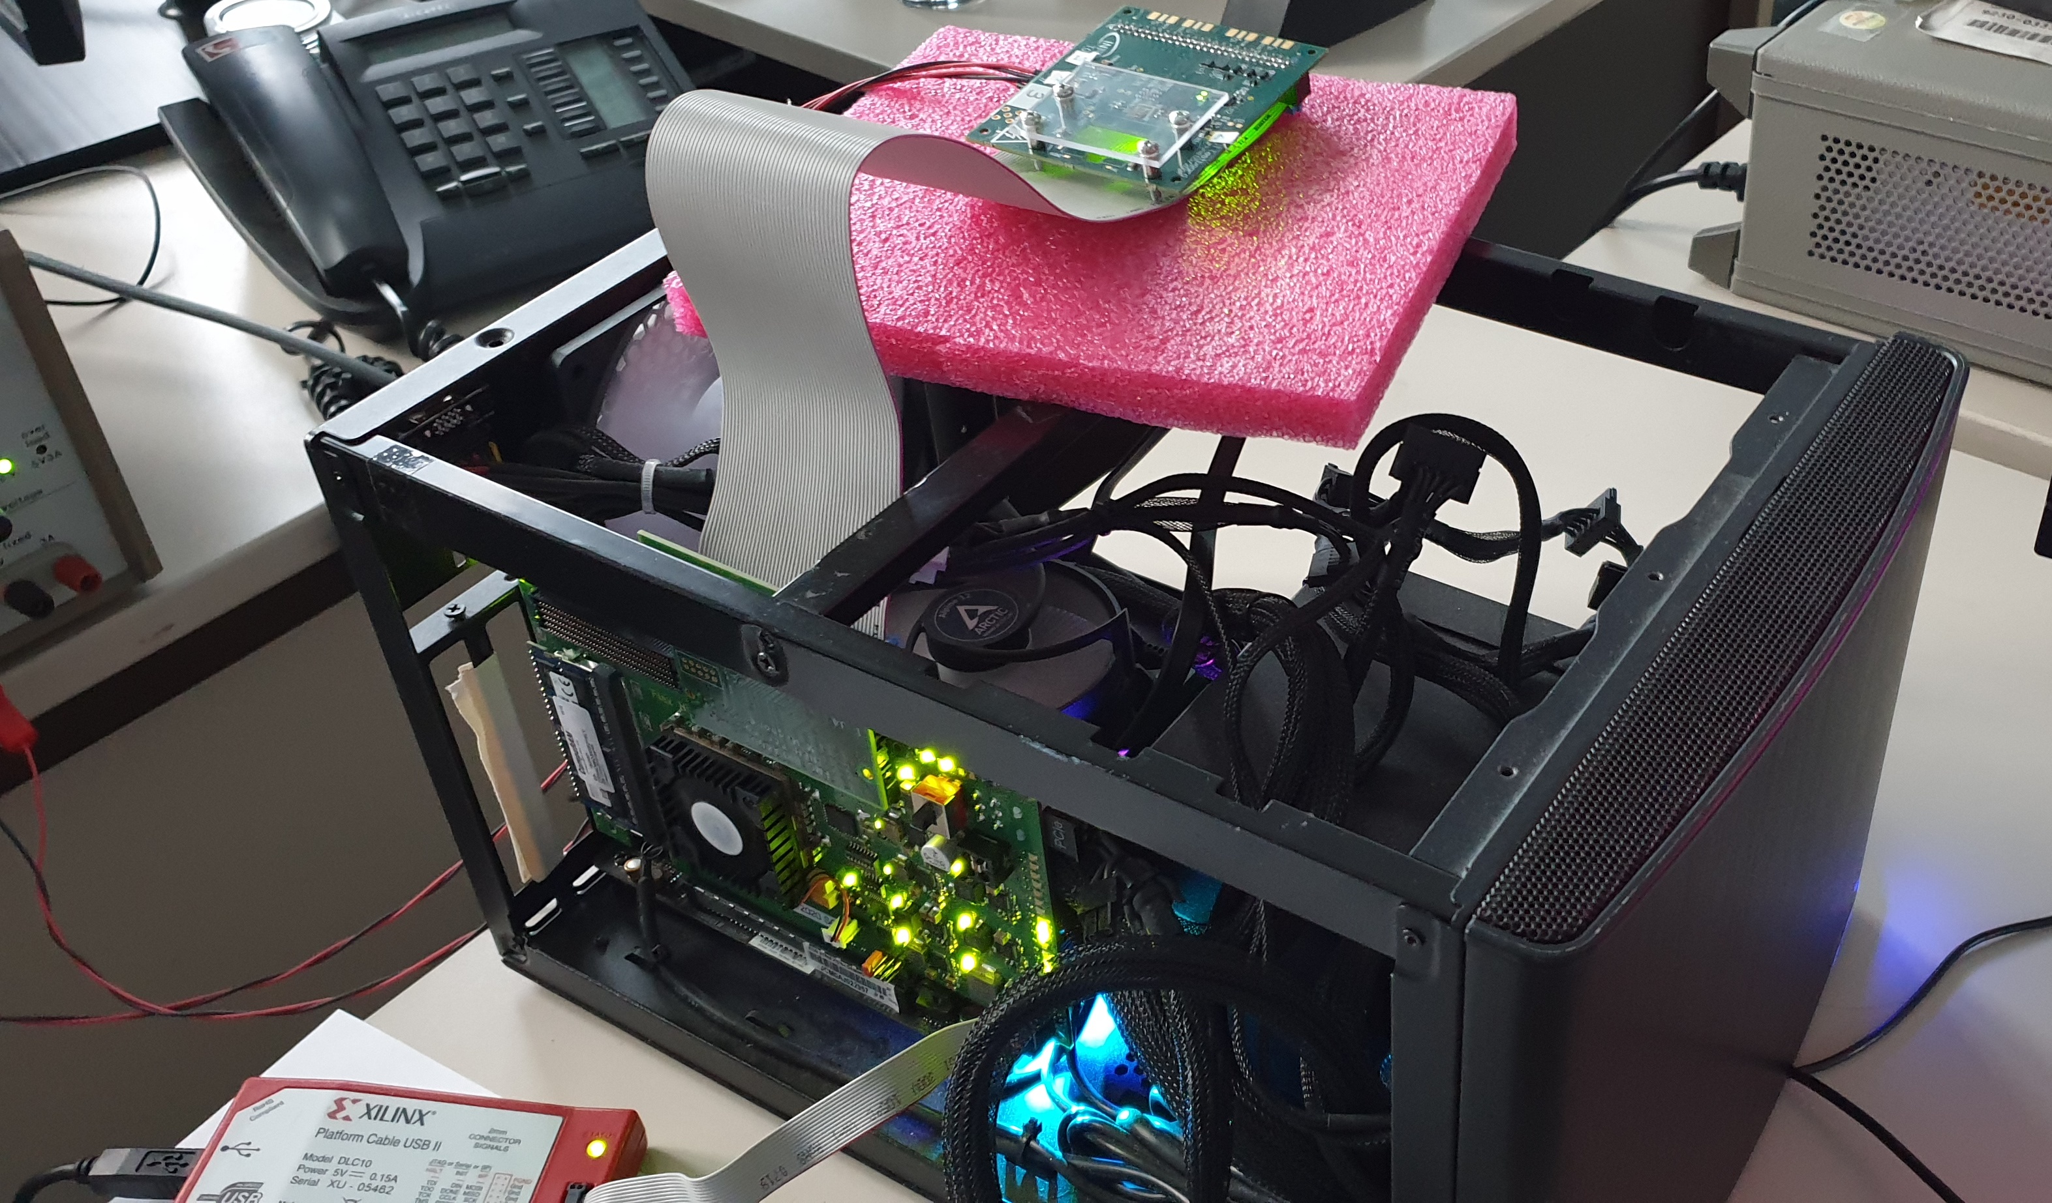
PANDA DAQ for beam test (HW components)
First version of HW setup, development platform
TOASt ASIC on detector card
HighFlex readout card with MDC proto

Slide 5
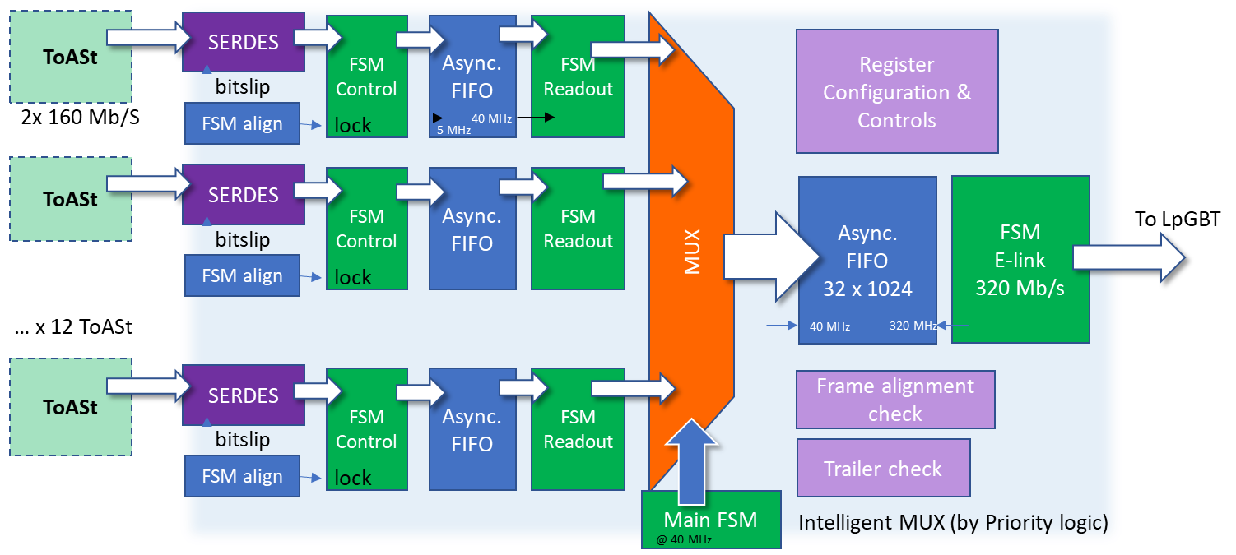

Status of the Module Data Concentrator ASIC
Radiation-tolerant ASIC local controller of the microstrip detector modules
First version of MDC (FPGA) developed, all necessary logic blocks “ready” to be tested with ToASt
MDC architecture implemented
Designed to readout up to 12 ToASt
Dynamic configuration of the number of ToASt and high-speed links
No-active links are kept in low-power mode
Intelligent multiplexing logic to balance the data occupancy between the serial links
Milestone: designing the first prototype of “baby-MDC in UMC 110nm, within 2022

Slide 6
Module Data Concentrator (Data Format)
MDC data format and real-time data consistency check
32 bits
CRC
ToASt
(data format)
Header
SYNC
SYNC
Data
SYNC
Data
…
Trailer
128 packets
ToASt frame (25.6 µs)
SYNC packets → to check the communication between TX_ch channel (ToASt) and MDC
Only HEADER, DATA and TRAILER transmitted
MDC
(channel)
Header
Data
Data
…
Trailer
CRC
CRC
CRC
MDC
(Data format)
…
…
…
Header MDC
Header
Data
Data
Trailer
Header
Data
Data
Trailer
Trailer MDC
ToASt 0
ToASt N
To DAQ
Frame number alignment → performed on MDC and packed in the MDC Header
CRC data check and correction → performed on the FPGA/ZYNQ (off-detector electronics)
MDC Header and Trailer (32 bits) free to any further metadata to be sent to off-detector acquisition

Slide 7
Additional requirements for beam test
Signal requirements for beam test and platform development
External clock at 80 MHz
External reset epoch counter for off-line data analysis
External data acquisition (frame acquisition) → to be defined both the single-shot and continuous acquisition modes
CRC
CRC
MDC
(Data format)
…
…
…
Header MDC
Header
Data
Data
Trailer
Header
Data
Data
Trailer
Trailer MDC
ToASt 0
ToASt N
HEADER MDC = {8'hAA, Epoch_counter, FRAME_NUM}
TRAILER MDC = {32'h5_BEEF_BEEF}
MDC header (opcode)
Epoch counter
Event number generated from the ToASt
Available for additional off-line meta-data

Slide 8
Epoch counter and reset
Counter @ 160 MHz
When an external or internal acquisition command is asserted, the epoch counter is copied in the MDC HEADER field
Ext Reset
@ 160 MHz
Epoch counter
Epoch counter
(timestamp)
External/internal acq. cmd

Slide 9
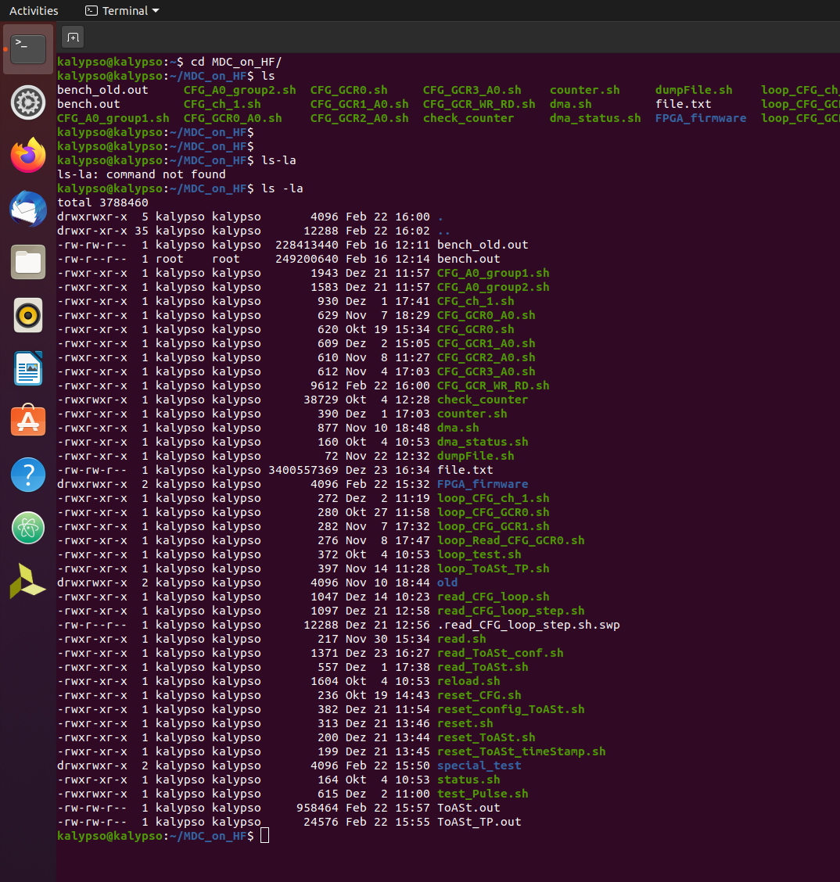
HW-SW interface
ToASt driver installed as PCIe interface
A set of shell scripts prepared to control the system
The script are example to learn how to develop more sophisticated GUI/ routines
To check the dma status
Readout data (streaming)
Reload the driver
Reset and config the ToASt
Test pulse command and readout procedure

Slide 10
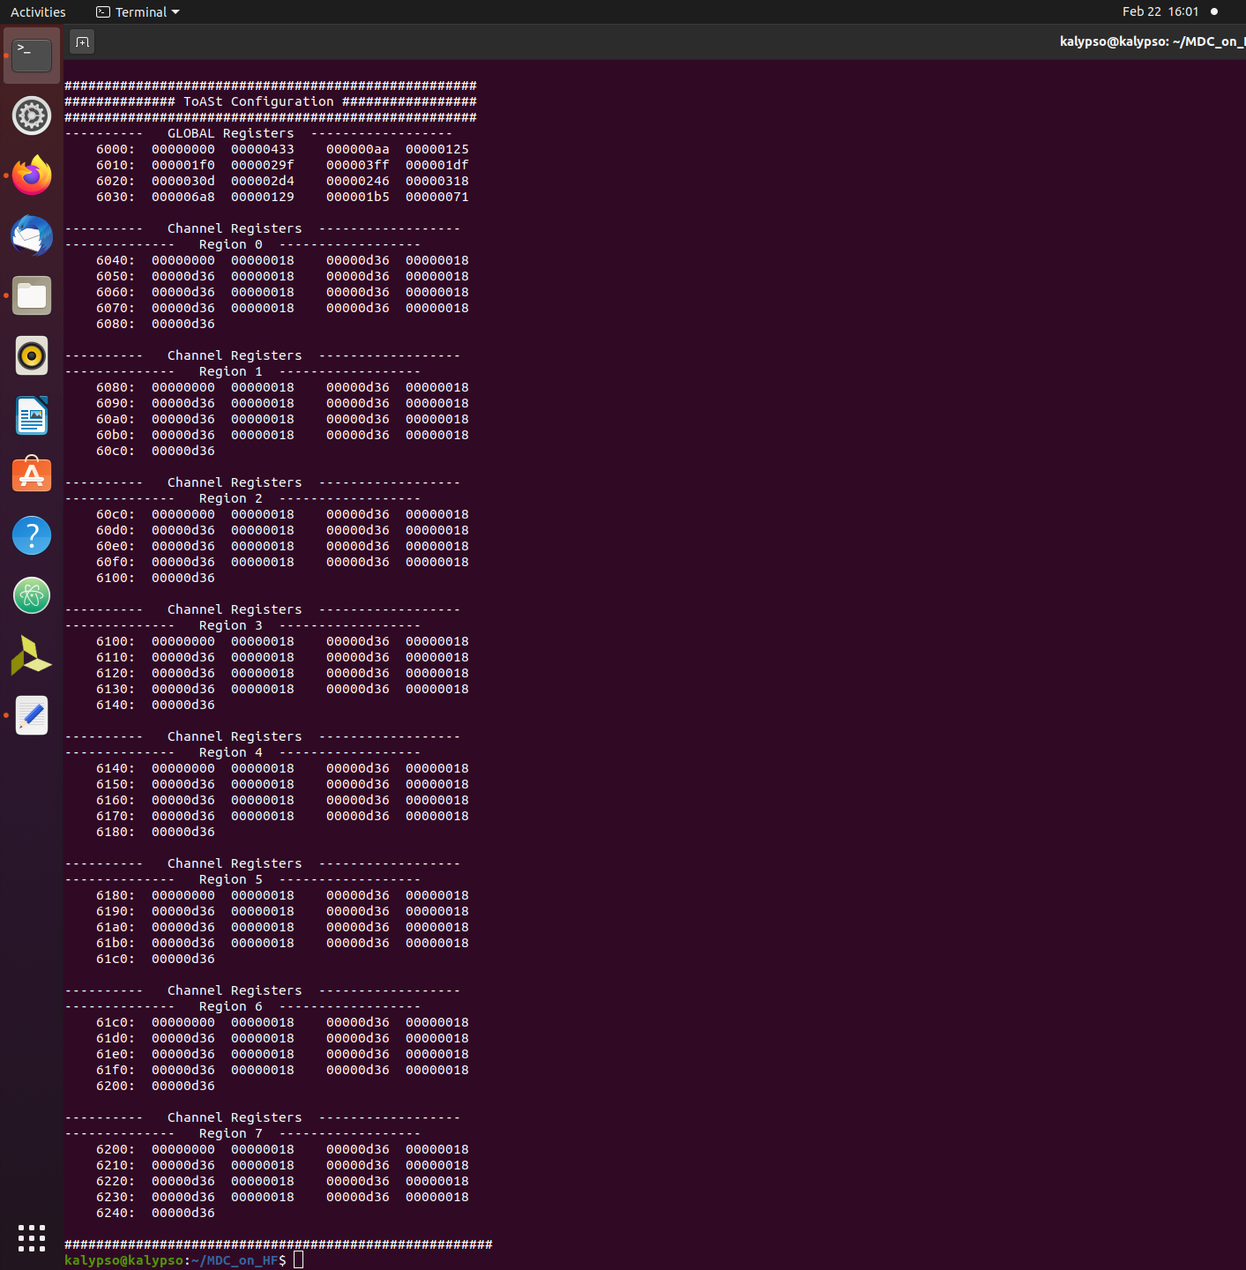
Reset and configuration (ToASt)
PW-On-reset → global-Reset → configuration (Global and channel regs)
16 Global registers
8 regions divided in 8 channels each

Slide 11
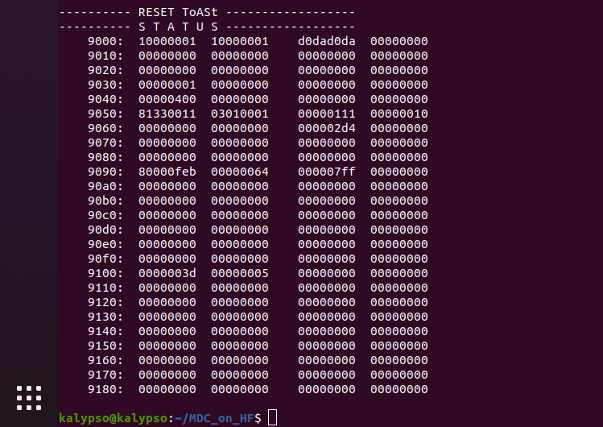
Status registers and errors (DAQ + ToASt)
Status / Errors are ready only registers
Status link TX_0 (ToASt)
Status link TX_1 (ToASt)
Status DAQ and FPGA infras.
Control_register
→ cmds
Status of ToASt & MDC
Number of test pulses

Slide 12
Control register (DAQ + ToASt)
Command register for (reset, configuration, acquisition modes)
FPGA, MDC and ToASt resets
Enable readout (streaming)
Intern./extern. clock source
Enable test pulse procedure (FPGA)
Internal data check (infrastructure-only)
Data from DDR3 → to DMA → to PC<

Slide 14
Global and channel configurations
Global and channel configuration are the same of the ToASt (defined by Ganni)
seq | 15 | 14 | 13 | 12 | 11 | 10 | 9 | 8 | 7 | 6 | 5 | 4 | 3 | 2 | 1 | 0
 |  |  |  |  |  | B
chip sel B | 1 | 1 | 0 | 1 | 0 | 1 | 1 | 0 | 0 | 0 | 0 |  | 0 | 0 | 0 | 0 | 0xD600
GCR0 | 0 | 1 | 0 | 0 | 0 | 0 | 0 | 1 | 0 | 0 | 0 | 0 | 0 | 0 | 0 | 0 | 0x4100
WR | 0 | 1 | 0 | 1 | 0 | 0 | 0 | 0 | 0 | 0 | 1 | 1 | 0 | 0 | 0 | 0 | 0x5030
GCR0 (0x0) | 0 | 1 | 0 | 1 |  | detector pol. | leading edge only | single THR mode |  | frame couter reset | TX_1 EN | TX_0 EN |  |  | timestamp_Gray mode | timestamp EN
default |  |  |  |  |  | 1 | 0 | 0 |  | 0 | 1 | 1 |  |  | 1 | 1 | 0x5433
GCR1 (0x1) | 0 | 1 | 0 | 1 |  | CfgTX inversion | TX_1_inversion | TX_0_inversion | CfgTx output current ctrl |  |  |  | TX_1 and TX_0 output current ctrl
default |  |  |  |  |  | 0 | 0 | 0 | 1 | 0 | 0 | 0 | 1 | 0 | 0 | 0 | 0x5088
GCR2 (0x2) | 0 | 1 | 0 | 1 |  |  | CSA load I bias |  |  |  |  | CSA gain boost Ibias
default |  |  |  |  |  |  | 0 | 1 | 0 | 0 | 1 | 0 |  | 1 | 0 | 1 | 0x5125
GCR3 (0x3) | 0 | 1 | 0 | 1 |  |  | CSA gain boost Vbias |  |  |  |  | CSA source follwer Ibias
default |  |  |  |  |  |  | 0 | 1 | 1 | 1 | 1 | 1 | 0 | 0 | 0 | 0 | 0x51F0
GCR4 (0x4) | 0 | 1 | 0 | 1 |  |  | Preamp feedback pMOS Ibias |  |  |  |  | Preamp feedback nMOS Ibias
default |  |  |  |  |  |  | 1 | 0 | 1 | 0 | 0 | 1 | 1 | 1 | 1 | 1 | 0x529F
GCR5 (0x5) | 0 | 1 | 0 | 1 |  |  | Preamp Ishift |  |  |  |  | PTA Ibuf
default |  |  |  |  |  |  | 1 | 1 | 1 | 1 | 1 | 1 | 1 | 1 | 1 | 1 | 0x53FF
GCR6 (0x6) | 0 | 1 | 0 | 1 | PTA control |  | PTA pMOS Ibias |  |  |  |  | PTA nMOS Ibias
default |  |  |  |  | 0 | 0 | 0 | 1 | 1 | 1 | 0 | 1 | 1 | 1 | 1 | 1 | 0x51DF
GCR7 (0x7) | 0 | 1 | 0 | 1 |  |  | CB Ibias 1 |  |  |  |  | CB Ibias 2
default |  |  |  |  |  |  | 1 | 1 | 0 | 0 | 0 | 0 | 1 | 1 | 0 | 1 | 0x530D
GCR8 (0x8) | 0 | 1 | 0 | 1 |  |  | CB Vbias |  |  |  |  | ToT Ibias
default |  |  |  |  |  |  | 1 | 0 | 1 | 1 | 0 | 1 | 0 | 1 | 0 | 0 | 0x52D4
GCR9 (0x9) | 0 | 1 | 0 | 1 |  |  | BLR Ibias |  |  |  |  | BLR Vcas
default |  |  |  |  |  |  | 1 | 0 | 0 | 1 | 0 | 0 | 0 | 1 | 1 | 0 | 0x5246
GCR10 (0xA) | 0 | 1 | 0 | 1 |  |  | HC Ibias 1 |  |  |  |  | HC Ibias 2
default |  |  |  |  |  |  | 1 | 1 | 0 | 0 | 0 | 1 | 1 | 0 | 0 | 0 | 0x5318
GCR11 (0xB) | 0 | 1 | 0 | 1 |  | HC Ibias 3 |  |  |  |  | Baseline Vbias
default |  |  |  |  |  | 1 | 1 | 0 | 1 | 0 | 1 | 0 | 1 | 0 | 0 | 0 | 0x56A8
GCR12 (0xC) | 0 | 1 | 0 | 1 |  |  | TThr bias |  |  |  |  | EThr bias
default |  |  |  |  |  |  | 0 | 1 | 0 | 0 | 1 | 0 | 1 | 0 | 0 | 1 | 0x5129
GCR13 (0xD) | 0 | 1 | 0 | 1 |  |  | ToT Ifb DAC Ilsb |  |  |  |  | ToT Ifb DAC Imin
default |  |  |  |  |  |  | 0 | 1 | 1 | 0 | 1 | 1 | 0 | 1 | 0 | 1 | 0x51B5
GCR14 (0xE) | 0 | 1 | 0 | 1 |  |  |  |  | calibration EN | Ib calibration
default |  |  |  |  |  |  |  |  | 0 | 1 | 1 | 1 | 0 | 0 | 0 | 1 | 0x5071 | here CAL EN | 0x50F1
GCR15 (0xF) | 0 | 1 | 0 | 1 |  |  |  |  | Reg Dis 7 | Reg Dis 6 | Reg Dis 5 | Reg Dis 4 | Reg Dis 3 | Reg Dis 2 | Reg Dis 1 | Reg Dis 0
default |  |  |  |  |  | 0 | 0 | 0 | 0 | 0 | 0 | 0 | 0 | 0 | 0 | 0 | 0x5000
Channel configuration register
Select channel | 0 | 1 | 0 | 0 | 0 | 0 | 0 | 0 | Region (R2, R1, R0) |  |  | 0 | Channel (C2,C1,C0) |  |  | A0
 |  |  |  |  | 0 | 0 | 0 | 0 |  |  |  | 0 |  |  |  |  | ch --> 7:0 | reg --> 7:0
Reg A0 | 15 | 14 | 13 | 12 | 11 | 10 | 9 | 8 | 7 | 6 | 5 | 4 | 3 | 2 | 1 | 0
0 | 0 | 1 | 0 | 1 |  |  |  |  | Channel mask | Delay enable | CAL ENABLE | ToT discharge current calibration DAC
 |  |  |  |  |  |  |  |  | 0 | 0 | 1 | 1 | 1 | 0 | 0 | 0 | 0x38 | cal_en | 0x5018
1 | 0 | 1 | 0 | 1 | Energy threshold DAC range | Energy threshold DAC |  |  |  |  | Time threshold DAC range | Time threshold DAC
 |  |  |  |  | 1 | 1 | 0 | 1 | 0 | 0 | 1 | 1 | 0 | 1 | 1 | 0 | 0xD36

Slide 15
MDC ToASt configuration module
ToAst configuration and “error protection” architecture
MDC conf FIFO
ToASt
FSM_TX_CFG
LpGBT interface
Downlink from LpGBT (output elinks)
ToASt
…
ToASt
Chip Select
Register select (ch/glob)
Register write (conf data)
….
Register select (ch/glob)
Register write (conf data)
….
Chip Deselect
-----
Register read (conf data)
No operation (idle)
FSM_CFG_check
FSM_RX_CFG
Uplink transmit data from the lpGBT to the counting room
MDC
Implemented on ToASt (Gianni)

Slide 16
MDC ToASt configuration module
ToAst configuration and “error protection” architecture
MDC conf FIFO
ToASt
FSM_TX_CFG
LpGBT interface
Downlink from LpGBT (output elinks)
ToASt
Chip Select
Register select (ch/glob)
Register write (conf data)
….
Register select (ch/glob)
Register write (conf data)
….
Chip Deselect
…
ToASt
Chip Select
Register select (ch/glob)
Register write (conf data)
….
Register select (ch/glob)
Register write (conf data)
….
Chip Deselect
-----
Register read (conf data)
No operation (idle)
FSM_CFG_check
FSM_RX_CFG
Uplink transmit data from the lpGBT to the counting room
MDC
Implemented on ToASt (Gianni)

Slide 17
MDC ToASt configuration module
ToAst configuration and “error protection” architecture
MDC conf FIFO
ToASt
FSM_TX_CFG
LpGBT interface
Downlink from LpGBT (output elinks)
ToASt
Chip Select
Register select (ch/glob)
Register write (conf data)
….
Register select (ch/glob)
Register write (conf data)
….
Chip Deselect
…
ToASt
Chip Select
Register select (ch/glob)
Register write (conf data)
….
Register select (ch/glob)
Register write (conf data)
….
Chip Deselect
-----
Register read (conf data)
No operation (idle)
FSM_CFG_check
FSM_RX_CFG
Uplink transmit data from the lpGBT to the counting room
MDC
Implemented on ToASt (Gianni)

Slide 18
MDC ToASt configuration module
ToAst configuration and “error protection” architecture
MDC conf FIFO
ToASt
FSM_TX_CFG
LpGBT interface
Downlink from LpGBT (output elinks)
ToASt
Chip Select
Register select (ch/glob)
Register write (conf data)
….
Register select (ch/glob)
Register write (conf data)
….
Chip Deselect
…
ToASt
Sequence VALID
Chip Select
Register select (ch/glob)
Register write (conf data)
….
Register select (ch/glob)
Register write (conf data)
….
Chip Deselect
-----
Register read (conf data)
No operation (idle)
FSM_CFG_check
FSM_RX_CFG
Sequence NOT VALID
Uplink transmit data from the lpGBT to the counting room
MDC
Implemented on ToASt (Gianni)

Slide 19
MDC ToASt configuration module
ToAst configuration and “error protection” architecture
MDC conf FIFO
ToASt
CfgTx
FSM_TX_CFG
LpGBT interface
Chip Select
Register select (ch/glob)
Register write (conf data)
….
Register select (ch/glob)
Register write (conf data)
….
Chip Deselect
Downlink from LpGBT (output elinks)
ToASt
…
ToASt
Sequence VALID
Chip Select
Register select (ch/glob)
Register write (conf data)
….
Register select (ch/glob)
Register write (conf data)
….
Chip Deselect
-----
Register read (conf data)
No operation (idle)
FSM_CFG_check
FSM_RX_CFG
Uplink transmit data from the lpGBT to the counting room
MDC
Implemented on ToASt (Gianni)

Slide 20
MDC ToASt configuration module
ToAst configuration and “error protection” architecture
MDC conf FIFO
ToASt
CfgRx
FSM_TX_CFG
LpGBT interface
Chip Select
Register select (ch/glob)
Register write (conf data)
….
Register select (ch/glob)
Register write (conf data)
….
Chip Deselect
Downlink from LpGBT (output elinks)
ToASt
…
ToASt
Chip Select
Register select (ch/glob)
Register write (conf data)
….
Register select (ch/glob)
Register write (conf data)
Register read (conf data)
COMPARE
….
Chip Deselect
COMPARE
FSM_CFG_check
FSM_RX_CFG
Uplink transmit data from the lpGBT to the counting room
MDC
Every write operation is completed by a readback
Implemented on ToASt (Gianni)

Slide 21
ToASt Configuration & Control FSM
ToASt
SERDES
FSM
Control
Async.
FIFO
FSM
Readout
bitslip
FSM align
lock
80 MHz
Test Pulse
5 MHz
ToASt
SERDES
FSM
Control
Async.
FIFO
32 x 64
FSM
Readout
Async.
FIFO
32 x 1024
bitslip
MUX
To external DDR3 device
FSM align
lock
… x 12 ToASt
40 MHz
320 MHz
ToASt
SERDES
Trailer check
FSM
Control
Async.
FIFO
FSM
Readout
bitslip
Frame alignment check
FSM align
lock
Main FSM
intelligent Round-Robin controller
@ 80 MHz

Slide 22
User Bank Register on FPGA infrastructure
Sequencer will automatically generates the configuration sequence
User registers
By Sequencer generator
add: from 6000
CFG_SequenceGen
ReadBack to User
Direct ToASt configuration
add: 9064
Downlink_GBT_Data_reg
Downlink_GBT_Data_seq
MUX
Downlink_GBT_Data
MDC
Sync_FIFO
SERIAL_OUT
FSM_SHIFT
TX
Cfg_TX
ToASt
Cfg_RX
FSM_RX_CFG
CfgRx_int_reg
DATA_RX_CFG
Serial_CFG_interface_V2

Slide 23
Address by PCIe | Global Register | Defaults value | Description
6000 | GCR_0 | 0x433 | Tx_0 and TX_1 enable for each ToASt, Detector polarity =1 (electrons)
6004 | GCR_1 | 0x088
6008 | GCR_2 | 0x125
600C | GCR_3 | 0x1f0
6010 | GCR_4 | 0x29f
6014 | GCR_5 | 0x3ff
6018 | GCR_6 | 0x1df
601C | GCR_7 | 0x30d
6020 | GCR_8 | 0x2d4
6024 | GCR_9 | 0x246
6028 | GCR_10 | 0x318
602C | GCR_11 | 0x6a8
6030 | GCR_12 | 0x129
6034 | GCR_13 | 0x1b5
6038 | GCR_14 | 0x071 | Calibration enable = 0 (please set 0xF1 to enable the test pulse)
603C | GCR_15 | 0x000 | No region disabled

Slide 24
Address by PCIe | Channel register | Defaults value | Description
6040 | Region 0 - Channel 0 Reg 0 | 0x038 | Set 0x18 to enable the test pulse on this channel
6044 | Region 0 - Channel 0 Reg 1 | 0xd36
6048 | Region 0 - Channel 1 Reg 0 | 0x038 | Set 0x18 to enable the test pulse on this channel
604C | Region 0 - Channel 1 Reg 1 | 0xd36
6050 | Region 0 - Channel 2 Reg 0 | 0x038 | Set 0x18 to enable the test pulse on this channel
6054 | Region 0 - Channel 2 Reg 1 | 0xd36
6058 | Region 0 - Channel 3 Reg 0 | 0x038 | Set 0x18 to enable the test pulse on this channel
605C | Region 0 - Channel 3 Reg 1 | 0xd36
6060 | Region 0 - Channel 4 Reg 0 | 0x038 | Set 0x18 to enable the test pulse on this channel
6064 | Region 0 - Channel 4 Reg 1 | 0xd36
6068 | Region 0 - Channel 5 Reg 0 | 0x038 | Set 0x18 to enable the test pulse on this channel
606C | Region 0 - Channel 5 Reg 1 | 0xd36
6070 | Region 0 - Channel 6 Reg 0 | 0x038 | Set 0x18 to enable the test pulse on this channel
6074 | Region 0 - Channel 6 Reg 1 | 0xd36
6078 | Region 0 - Channel 7 Reg 0 | 0x038 | Set 0x18 to enable the test pulse on this channel
607C | Region 0 - Channel 7 Reg 1 | 0xd36

Slide 25
Address by PCIe | Region
6040 | Region 0
6080 | Region 1
60C0 | Region 2
6100 | Region 3
6140 | Region 4
6180 | Region 5
61C0 | Region 6
6200 | Region 7

Slide 26
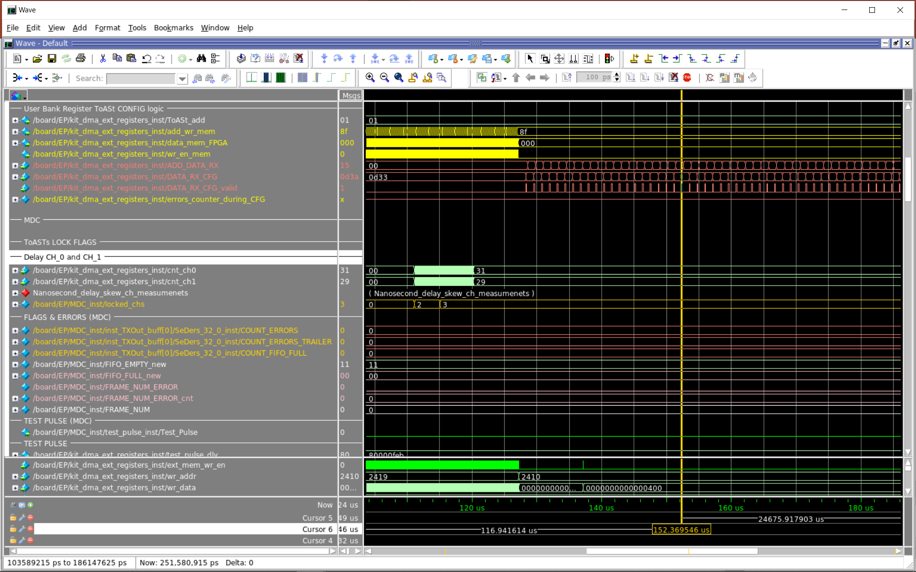

Slide 27
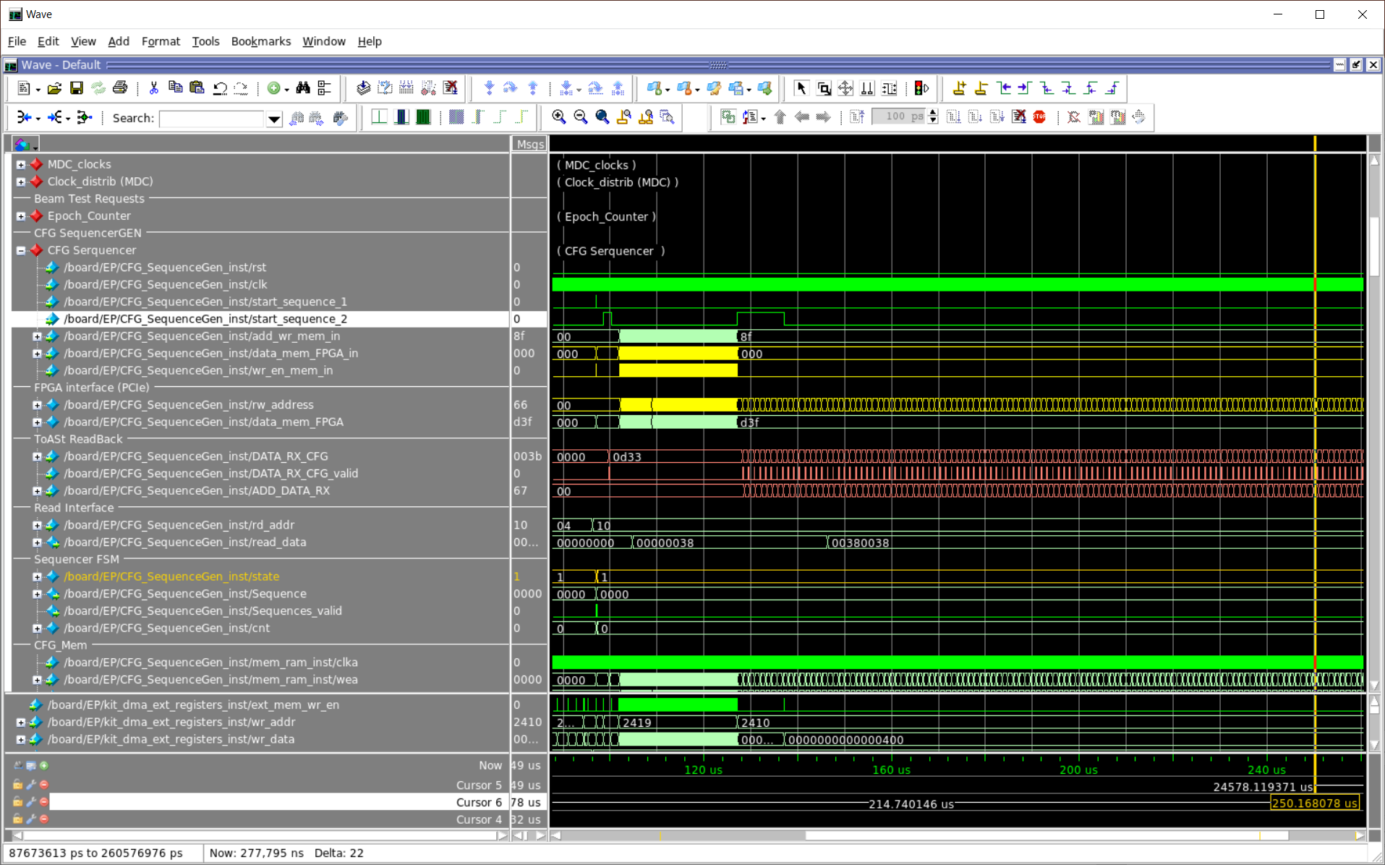

Slide 28
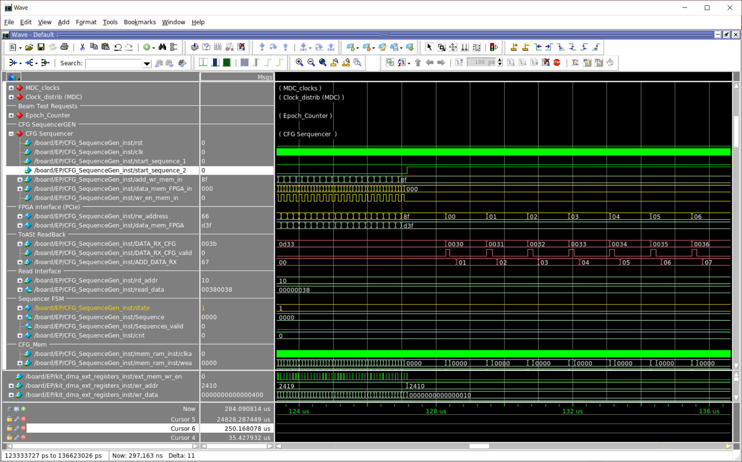

Slide 29
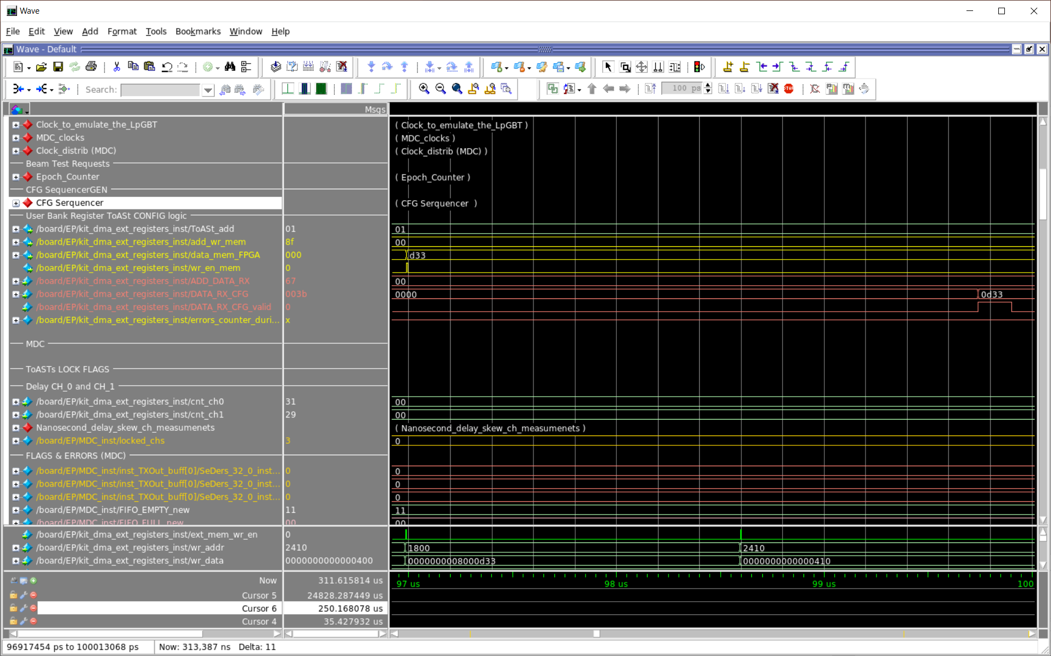

Slide 30
