Slide 1
periodical meeting
29 –March 2023
Status of the DAQ system
Michele Caselle, Timo Dritschler, Kai Lukas Unger, Vladimir Sidorenko, Lars Eisenblätter, Olena Manzhura, Suren Chilingaryan, Andreas Kopmann

Slide 2
PANDA DAQ for beam test
First version of FPGA firmware that integrated the control/readout of ToASt(s) by the MDC architecture
The first architecture is based on HighFlex v.1 with MDC architecture on FPGA
Readout based on PCIe Gen 3, compatible to any PCs
Data throughput up to 120 Gb/s suitable to readout multiple ToASt(s) simultaneously as a detector module scenario
DDR3
Detector card
PC DAQ/control
GPU-Direct KIT-DMA
Data
ToASt
MDC
(Module data Concentrator)
Strip Detector
ToASt
…
ToASt
PCIe Programmed IO (PIO)
Cmd/Cnfg
User register
FPGA (HighFlex v1) card

Slide 5
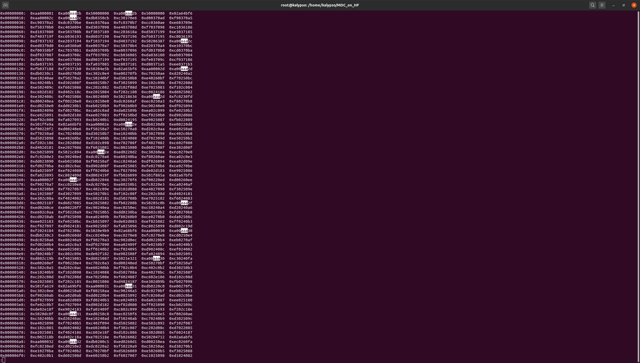
PANDA DAQ for beam test (HW components)
First version of HW setup, development platform

Slide 6
Global and channel configurations
Global and channel configuration are the same of the ToASt (defined by Ganni)
seq | 15 | 14 | 13 | 12 | 11 | 10 | 9 | 8 | 7 | 6 | 5 | 4 | 3 | 2 | 1 | 0
 |  |  |  |  |  | B
chip sel B | 1 | 1 | 0 | 1 | 0 | 1 | 1 | 0 | 0 | 0 | 0 |  | 0 | 0 | 0 | 0 | 0xD600
GCR0 | 0 | 1 | 0 | 0 | 0 | 0 | 0 | 1 | 0 | 0 | 0 | 0 | 0 | 0 | 0 | 0 | 0x4100
WR | 0 | 1 | 0 | 1 | 0 | 0 | 0 | 0 | 0 | 0 | 1 | 1 | 0 | 0 | 0 | 0 | 0x5030
GCR0 (0x0) | 0 | 1 | 0 | 1 |  | detector pol. | leading edge only | single THR mode |  | frame couter reset | TX_1 EN | TX_0 EN |  |  | timestamp_Gray mode | timestamp EN
default |  |  |  |  |  | 1 | 0 | 0 |  | 0 | 1 | 1 |  |  | 1 | 1 | 0x5433
GCR1 (0x1) | 0 | 1 | 0 | 1 |  | CfgTX inversion | TX_1_inversion | TX_0_inversion | CfgTx output current ctrl |  |  |  | TX_1 and TX_0 output current ctrl
default |  |  |  |  |  | 0 | 0 | 0 | 1 | 0 | 0 | 0 | 1 | 0 | 0 | 0 | 0x5088
GCR2 (0x2) | 0 | 1 | 0 | 1 |  |  | CSA load I bias |  |  |  |  | CSA gain boost Ibias
default |  |  |  |  |  |  | 0 | 1 | 0 | 0 | 1 | 0 |  | 1 | 0 | 1 | 0x5125
GCR3 (0x3) | 0 | 1 | 0 | 1 |  |  | CSA gain boost Vbias |  |  |  |  | CSA source follwer Ibias
default |  |  |  |  |  |  | 0 | 1 | 1 | 1 | 1 | 1 | 0 | 0 | 0 | 0 | 0x51F0
GCR4 (0x4) | 0 | 1 | 0 | 1 |  |  | Preamp feedback pMOS Ibias |  |  |  |  | Preamp feedback nMOS Ibias
default |  |  |  |  |  |  | 1 | 0 | 1 | 0 | 0 | 1 | 1 | 1 | 1 | 1 | 0x529F
GCR5 (0x5) | 0 | 1 | 0 | 1 |  |  | Preamp Ishift |  |  |  |  | PTA Ibuf
default |  |  |  |  |  |  | 1 | 1 | 1 | 1 | 1 | 1 | 1 | 1 | 1 | 1 | 0x53FF
GCR6 (0x6) | 0 | 1 | 0 | 1 | PTA control |  | PTA pMOS Ibias |  |  |  |  | PTA nMOS Ibias
default |  |  |  |  | 0 | 0 | 0 | 1 | 1 | 1 | 0 | 1 | 1 | 1 | 1 | 1 | 0x51DF
GCR7 (0x7) | 0 | 1 | 0 | 1 |  |  | CB Ibias 1 |  |  |  |  | CB Ibias 2
default |  |  |  |  |  |  | 1 | 1 | 0 | 0 | 0 | 0 | 1 | 1 | 0 | 1 | 0x530D
GCR8 (0x8) | 0 | 1 | 0 | 1 |  |  | CB Vbias |  |  |  |  | ToT Ibias
default |  |  |  |  |  |  | 1 | 0 | 1 | 1 | 0 | 1 | 0 | 1 | 0 | 0 | 0x52D4
GCR9 (0x9) | 0 | 1 | 0 | 1 |  |  | BLR Ibias |  |  |  |  | BLR Vcas
default |  |  |  |  |  |  | 1 | 0 | 0 | 1 | 0 | 0 | 0 | 1 | 1 | 0 | 0x5246
GCR10 (0xA) | 0 | 1 | 0 | 1 |  |  | HC Ibias 1 |  |  |  |  | HC Ibias 2
default |  |  |  |  |  |  | 1 | 1 | 0 | 0 | 0 | 1 | 1 | 0 | 0 | 0 | 0x5318
GCR11 (0xB) | 0 | 1 | 0 | 1 |  | HC Ibias 3 |  |  |  |  | Baseline Vbias
default |  |  |  |  |  | 1 | 1 | 0 | 1 | 0 | 1 | 0 | 1 | 0 | 0 | 0 | 0x56A8
GCR12 (0xC) | 0 | 1 | 0 | 1 |  |  | TThr bias |  |  |  |  | EThr bias
default |  |  |  |  |  |  | 0 | 1 | 0 | 0 | 1 | 0 | 1 | 0 | 0 | 1 | 0x5129
GCR13 (0xD) | 0 | 1 | 0 | 1 |  |  | ToT Ifb DAC Ilsb |  |  |  |  | ToT Ifb DAC Imin
default |  |  |  |  |  |  | 0 | 1 | 1 | 0 | 1 | 1 | 0 | 1 | 0 | 1 | 0x51B5
GCR14 (0xE) | 0 | 1 | 0 | 1 |  |  |  |  | calibration EN | Ib calibration
default |  |  |  |  |  |  |  |  | 0 | 1 | 1 | 1 | 0 | 0 | 0 | 1 | 0x5071 | here CAL EN | 0x50F1
GCR15 (0xF) | 0 | 1 | 0 | 1 |  |  |  |  | Reg Dis 7 | Reg Dis 6 | Reg Dis 5 | Reg Dis 4 | Reg Dis 3 | Reg Dis 2 | Reg Dis 1 | Reg Dis 0
default |  |  |  |  |  | 0 | 0 | 0 | 0 | 0 | 0 | 0 | 0 | 0 | 0 | 0 | 0x5000
Channel configuration register
Select channel | 0 | 1 | 0 | 0 | 0 | 0 | 0 | 0 | Region (R2, R1, R0) |  |  | 0 | Channel (C2,C1,C0) |  |  | A0
 |  |  |  |  | 0 | 0 | 0 | 0 |  |  |  | 0 |  |  |  |  | ch --> 7:0 | reg --> 7:0
Reg A0 | 15 | 14 | 13 | 12 | 11 | 10 | 9 | 8 | 7 | 6 | 5 | 4 | 3 | 2 | 1 | 0
0 | 0 | 1 | 0 | 1 |  |  |  |  | Channel mask | Delay enable | CAL ENABLE | ToT discharge current calibration DAC
 |  |  |  |  |  |  |  |  | 0 | 0 | 1 | 1 | 1 | 0 | 0 | 0 | 0x38 | cal_en | 0x5018
1 | 0 | 1 | 0 | 1 | Energy threshold DAC range | Energy threshold DAC |  |  |  |  | Time threshold DAC range | Time threshold DAC
 |  |  |  |  | 1 | 1 | 0 | 1 | 0 | 0 | 1 | 1 | 0 | 1 | 1 | 0 | 0xD36

Slide 7
User Bank Register on FPGA infrastructure
Sequencer will automatically generates the configuration sequence
User registers
By Sequencer generator
add: from 6000
CFG_SequenceGen
ReadBack to User
Direct ToASt configuration
add: 9064
Downlink_GBT_Data_reg
Downlink_GBT_Data_seq
MUX
Downlink_GBT_Data
MDC
Sync_FIFO
SERIAL_OUT
FSM_SHIFT
TX
Cfg_TX
ToASt
Cfg_RX
FSM_RX_CFG
CfgRx_int_reg
DATA_RX_CFG
Serial_CFG_interface_V2

Slide 8
Address by PCIe | Global Register | Defaults value | Description
6000 | GCR_0 | 0x433 | Tx_0 and TX_1 enable for each ToASt, Detector polarity =1 (electrons)
6004 | GCR_1 | 0x088
6008 | GCR_2 | 0x125
600C | GCR_3 | 0x1f0
6010 | GCR_4 | 0x29f
6014 | GCR_5 | 0x3ff
6018 | GCR_6 | 0x1df
601C | GCR_7 | 0x30d
6020 | GCR_8 | 0x2d4
6024 | GCR_9 | 0x246
6028 | GCR_10 | 0x318
602C | GCR_11 | 0x6a8
6030 | GCR_12 | 0x129
6034 | GCR_13 | 0x1b5
6038 | GCR_14 | 0x071 | Calibration enable = 0 (please set 0xF1 to enable the test pulse)
603C | GCR_15 | 0x000 | No region disabled

Slide 9
Address by PCIe | Channel register | Defaults value | Description
6040 | Region 0 - Channel 0 Reg 0 | 0x038 | Set 0x18 to enable the test pulse on this channel
6044 | Region 0 - Channel 0 Reg 1 | 0xd36
6048 | Region 0 - Channel 1 Reg 0 | 0x038 | Set 0x18 to enable the test pulse on this channel
604C | Region 0 - Channel 1 Reg 1 | 0xd36
6050 | Region 0 - Channel 2 Reg 0 | 0x038 | Set 0x18 to enable the test pulse on this channel
6054 | Region 0 - Channel 2 Reg 1 | 0xd36
6058 | Region 0 - Channel 3 Reg 0 | 0x038 | Set 0x18 to enable the test pulse on this channel
605C | Region 0 - Channel 3 Reg 1 | 0xd36
6060 | Region 0 - Channel 4 Reg 0 | 0x038 | Set 0x18 to enable the test pulse on this channel
6064 | Region 0 - Channel 4 Reg 1 | 0xd36
6068 | Region 0 - Channel 5 Reg 0 | 0x038 | Set 0x18 to enable the test pulse on this channel
606C | Region 0 - Channel 5 Reg 1 | 0xd36
6070 | Region 0 - Channel 6 Reg 0 | 0x038 | Set 0x18 to enable the test pulse on this channel
6074 | Region 0 - Channel 6 Reg 1 | 0xd36
6078 | Region 0 - Channel 7 Reg 0 | 0x038 | Set 0x18 to enable the test pulse on this channel
607C | Region 0 - Channel 7 Reg 1 | 0xd36

Slide 10
Address by PCIe | Region
6040 | Region 0
6080 | Region 1
60C0 | Region 2
6100 | Region 3
6140 | Region 4
6180 | Region 5
61C0 | Region 6
6200 | Region 7

Slide 11
ToASt
SERDES
FSM
CH
Channel
FIFO
FSM
Readout
bitslip
FSM align
lock
Clock = DATA_CLOCK = 80 MHz
Reset = IORESET
Clock = CLK_DIV = 5 MHz
Reset = IORESET
Reset 0
Reset 0
WR_FIFO <= #dly 1'b1;
Write_Data_FIFO <= #dly DataOut_32;
FIFO_FULL
Idle
1
Idle 1
start_Readout_ToASt & (DataOut_32[31:28] == 4'b1010)
Trailer_found_sync_5
HEAD_DATA 2
Fifo_ready = 1
Rd_data_en = 1
Move to fsm_data_read_start
READY 2
start_read_fifo (from Main_FSM_Readout)
(!start_Readout_ToASt)
ERROR 3
ERROR FIFO FULL 4
Start Readout 3
Stop Readout 4
If the sequence HEADER→SYNC→DATA_TRAILER are wrong
DATA_COUNT_tmp counts the number of data received between HEADER and TRAILER
When all data have been readout and sent to MAIN_FSM
ERROR 5

Slide 12
FSM
Readout
Clock = DATA_CLOCK = 80 MHz
Reset = MDC_RESET
Reset 0
FSM
Readout
Idle 1
Async.
FIFO
32 x 1024
FIFO_READY_OR
MUX
Header_MDC 2
Readout till ToASt_Trailer
Channel Select link 0 4
start_read_fifo = 1
Readout link 0 5
Link not locked
Channel Select link 1 5
Readout link 1 6
FSM
Readout
FIFO_FULL
ERROR F
Trailer_MDC 7
Main FSM

Slide 13
Clock_EXT (80 MHz)
BUFR (/2)
clk_elink (320 MHz)
clock_ToASt (160 Mhz)
clock_cfg (80 MHz)
clock_readout (80 MHz)
clk_div_elink (10 MHz)
CLK_DIV (5 MHz)
LpGBT_pll
Clock_buffer_logic (pll)
Clock_LpGBT (320 MHz)
Serial_CFG_interface_V2
Clock_PCie (80 MHz)
MDC

Slide 14
PLLs architecture
Clock_from_PCIe_to_80MHz
User_clk (250 MHz)
internal_clock_80MHz
clk_LpGBT
ClockIn_GBT_p (320 MHz)
Ext_clock_buf (80 MHz)
clock_dist_MDC (PLL)
clock_ToASt
BUFG
BUFR
To ToASt (160 MHz)

Slide 15
External pins on FPGA
Ext_clk
BB31 → GPIO_DIP_SW7
Fast trigger
AY30 → GPIO_DIP_SW5
Slow trigger
BA32 → GPIO_DIP_SW3
spare
AY33 → GPIO_DIP_SW1

Slide 16
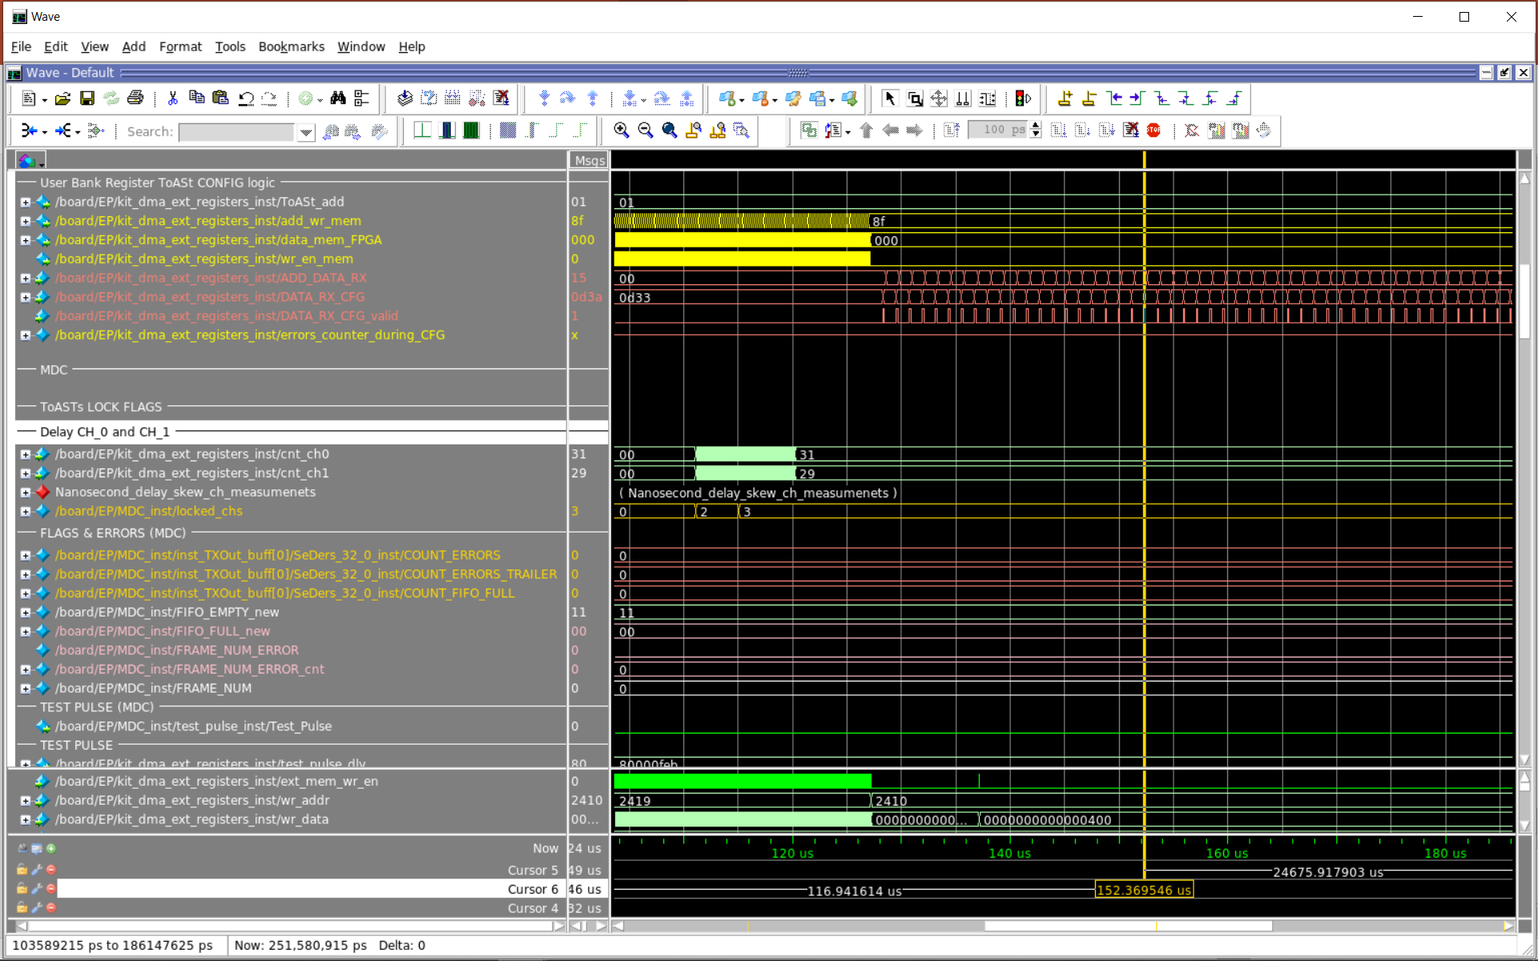

Slide 17
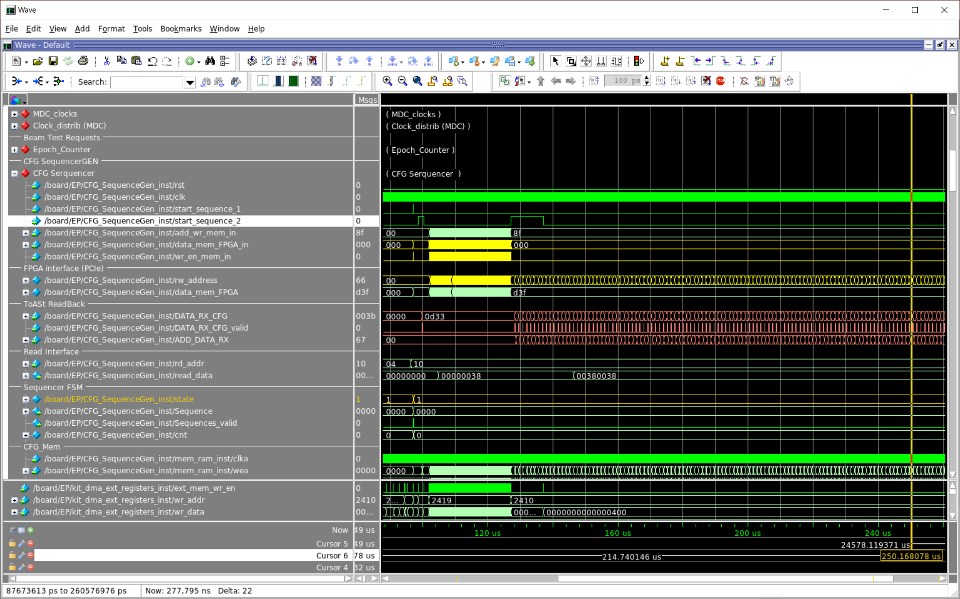

Slide 18
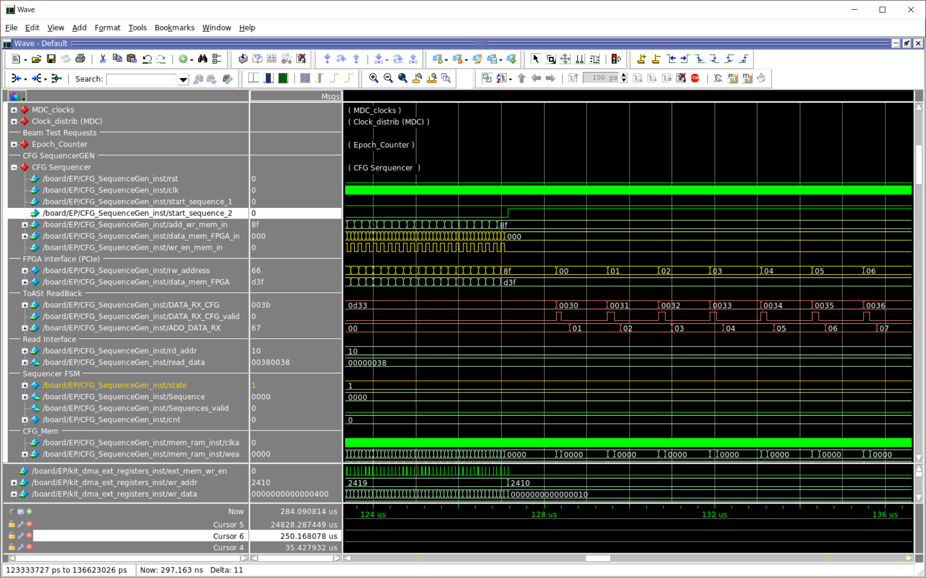

Slide 19
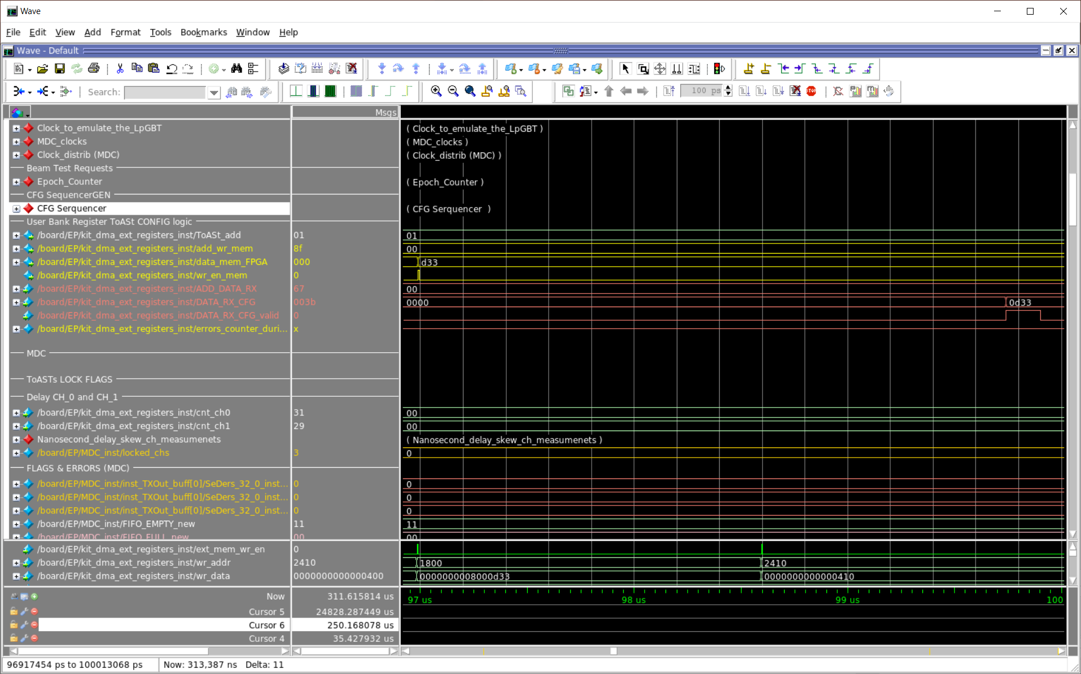

Slide 20
