Slide 1
The soil-crop multi-model library,
Expert-N on HPCs
9th bwHPC Symposium, university of Mannheim (Aula), 23 October, 2023
Fasil RETTIE, Tobias WEBER, Sebastian GAYLER, Daniela BENDEL & Thilo STRECK
Institute of Soil Science and Land Evaluation/Biogeophysics (310D)
Notes:
As a PostDoc at the Hohenheim University, I conduct research in integrated cropping systems, and the fate of agrichemicals in agricultural landscapes. My workbench is mainly filled with computational agro-ecosystems research,
but I have a strong background in experimental research, too.

Slide 2
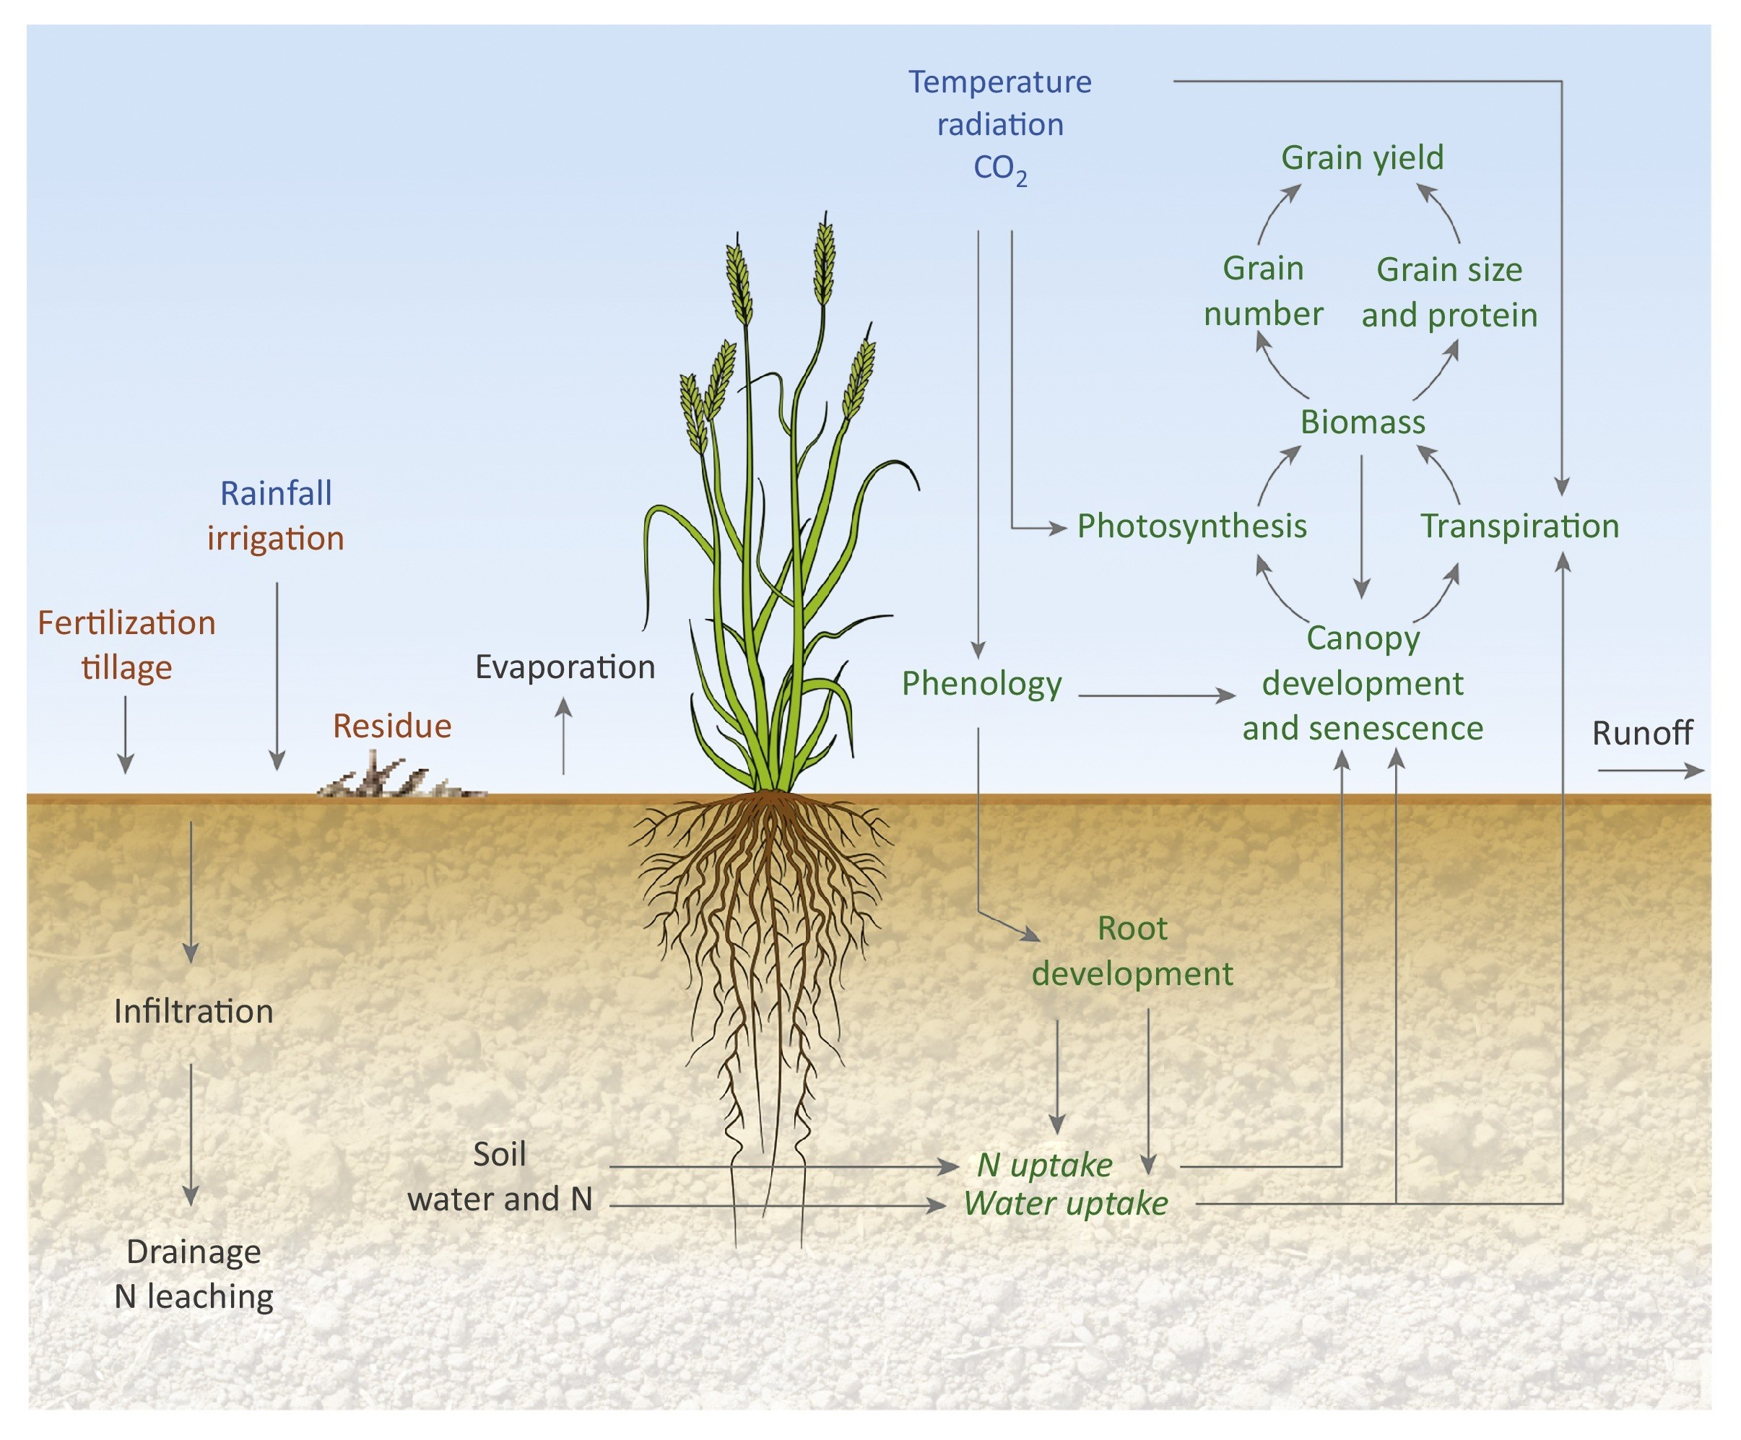
Soil-crop modeling
Soil-crop modeling plays a pivotal role in agricultural research.
  Optimizing Resource Management
  Enhancing Crop Yield Predictions
  Mitigating Environmental Impact
  Adapting to Climate Change
  Scientific Advancements
Simplified framework of key processes involved in crop growth and development in a typical crop model (Chenu et al. 2017)

Slide 3
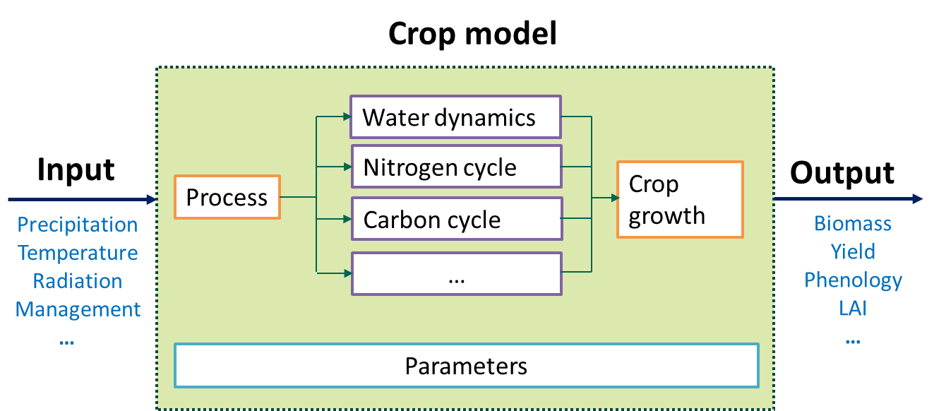
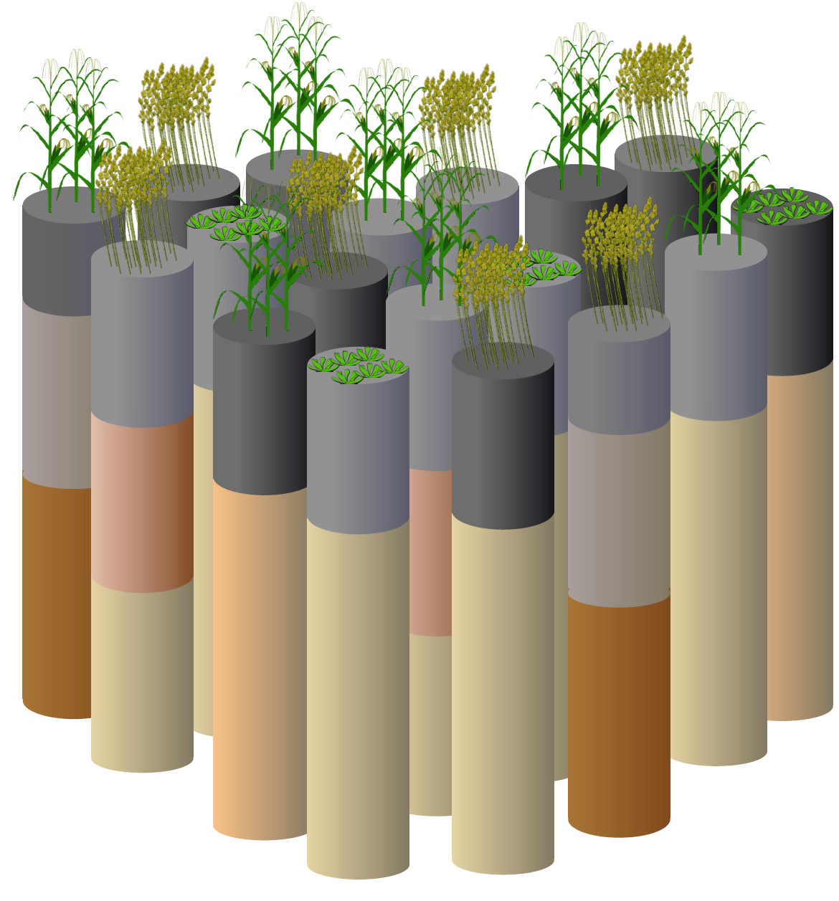
Typical process model
Huang et al. 2017, Chenu et al. 2017
Notes:
estimating environmental impacts, optimizing resource use, and predicting crop yields, particularly in the face of climate change.
an agro-ecosystem model library,
, leveraging High-Performance Computing (HPC) to enhance model accuracy through calibration and sensitivity analysis

Slide 4
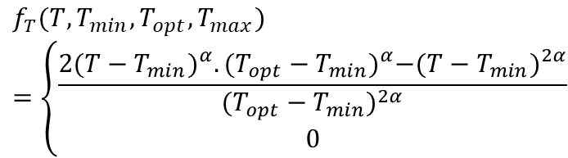
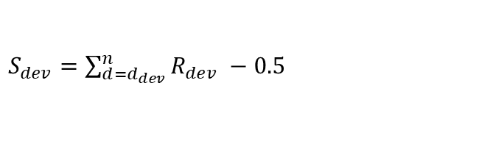
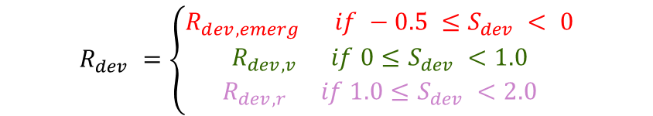


SPASS phenology model
$R_{dev}={Rmax}_{dev}.f_{T}$(T)
$$f_{T}(T,T_{min},T_{opt},T_{max})=\left\{\begin{aligned}\frac{{2(T−T_{min})}^{α}.{(T_{opt}−T_{min})}^{α}−{(T−T_{min})}^{2α}}{{(T_{opt}−T_{min})}^{2α}} \\ 0\end{aligned}\right.$$
$$α=\frac{ln⁡(2)}{ ln⁡(\frac{(T_{max}−T_{min})}{(T_{opt}−T_{min})})}$$
$S_{dev}=$ $\sum_{d=d_{dev}}^{n}{R_{dev} −0.5}$
$$R_{dev} =\left\{\begin{aligned}R_{dev,emerg} if −0.5 ≤S_{dev} < 0 \\ R_{dev, v} if 0≤S_{dev} <1.0 \\ R_{dev,r} if 1.0≤S_{dev} <2.0\end{aligned}\right.$$
Viswanathan et al (2022)
Kuester & Spengler (2018)
Notes:
estimating environmental impacts, optimizing resource use, and predicting crop yields, particularly in the face of climate change.
an agro-ecosystem model library,
, leveraging High-Performance Computing (HPC) to enhance model accuracy through calibration and sensitivity analysis

Slide 5

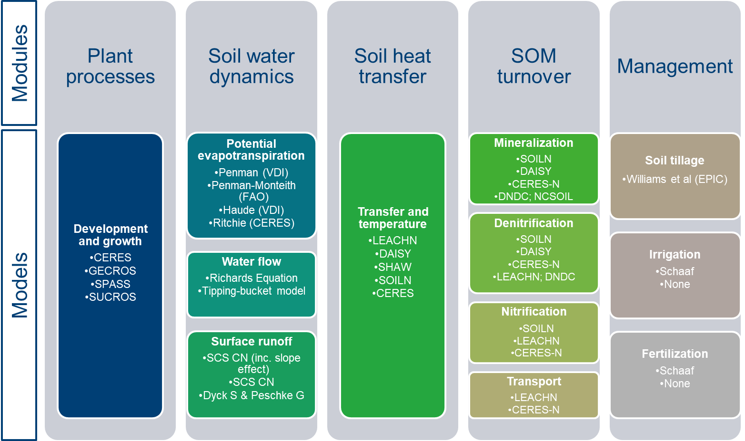

Expert-N modeling framework
Expert-N provides a versatile framework for soil-plant-atmosphere modeling.
It encompasses process-based models to describe various processes in the soil-plant system.
Rettie et al. 2022
Notes:
estimating environmental impacts, optimizing resource use, and predicting crop yields, particularly in the face of climate change.
an agro-ecosystem model library,
, leveraging High-Performance Computing (HPC) to enhance model accuracy through calibration and sensitivity analysis

Slide 6
Expert-N on HPCs
These complex models require substantial computational power.
HPC is pivotal in advancing agroecosystem modeling, especially:
  Calibration and sensitivity analysis, and
  Uncertainty analysis of model predictions
Notes:
estimating environmental impacts, optimizing resource use, and predicting crop yields, particularly in the face of climate change.
an agro-ecosystem model library,
, leveraging High-Performance Computing (HPC) to enhance model accuracy through calibration and sensitivity analysis

Slide 7
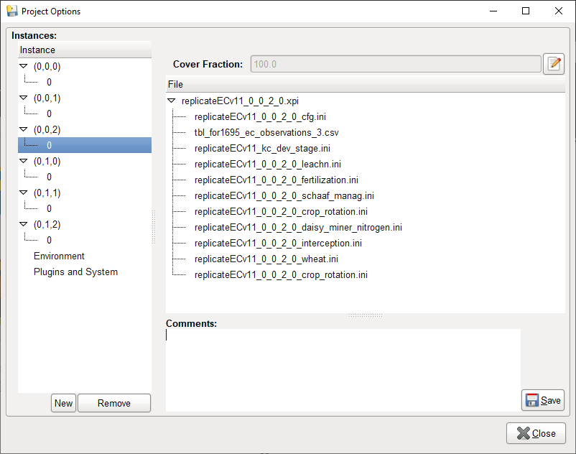
The XN5 crop model
. . .
. . .
. . .
. . .
. . .
. . .
. . .
. . .
. . .
. . .
. . .
. . .
. . .

Slide 8
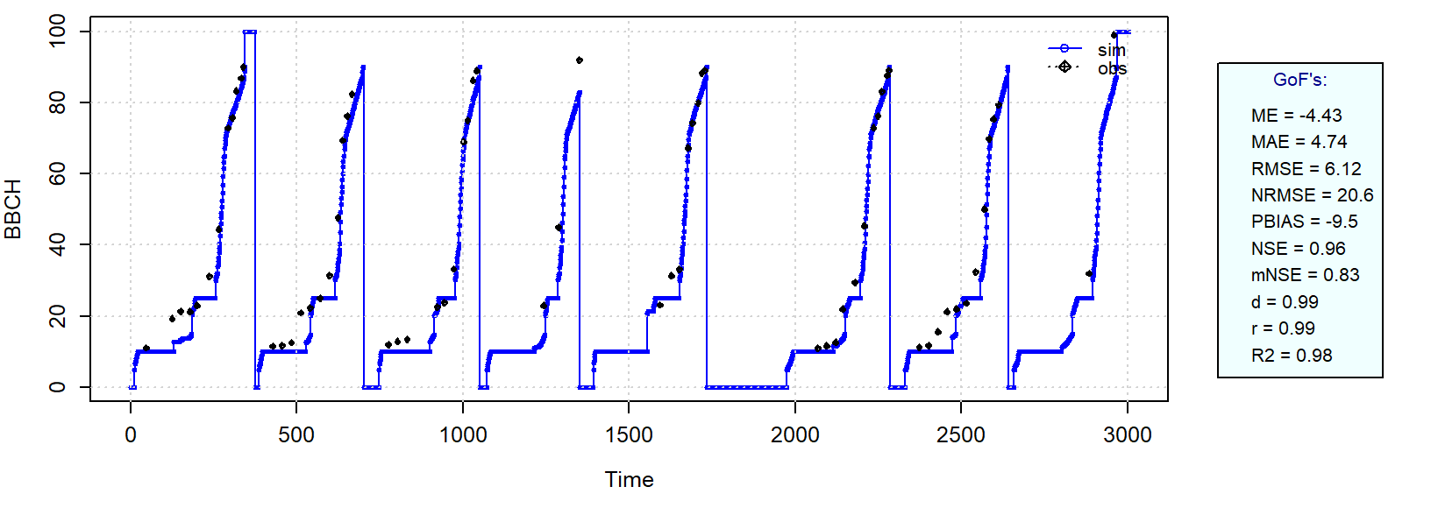
Phenology calibration

Slide 9
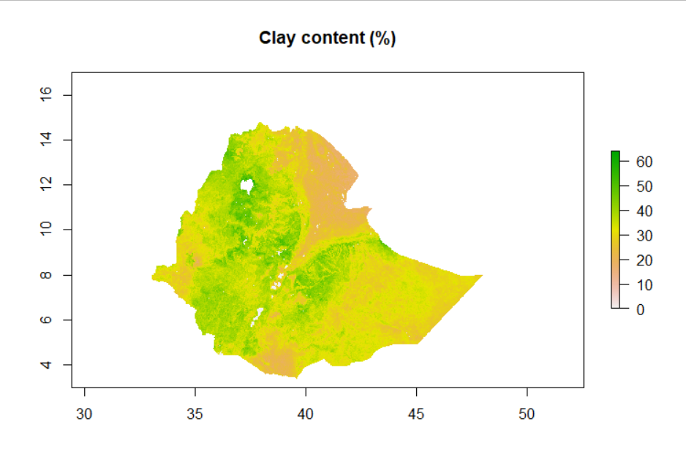
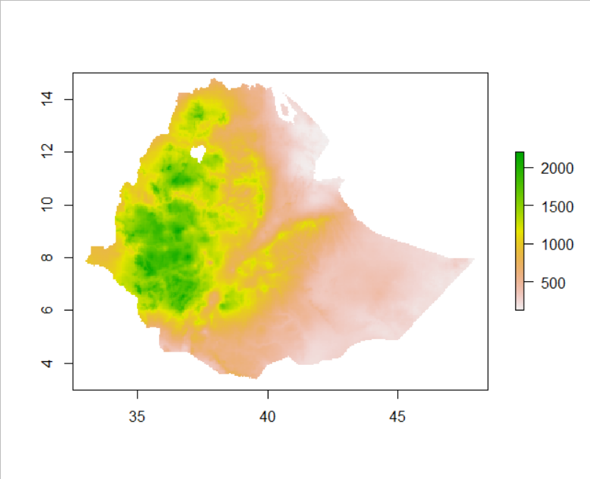
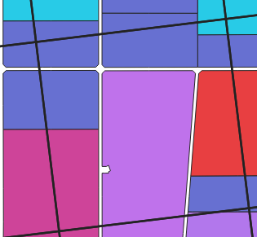
Spatial calibration
. . .
. . .
. . .
Model Cube
. . .
Model
Input
Total
n = 7443
. . .
. . .
. . .
. . .
. . .
. . .
. . .
. . .
. . .
For i’th Calibration
= 40
Spatial Model Representation
i = 7
per iteration
m = 40 x 50
= 2000

Slide 10
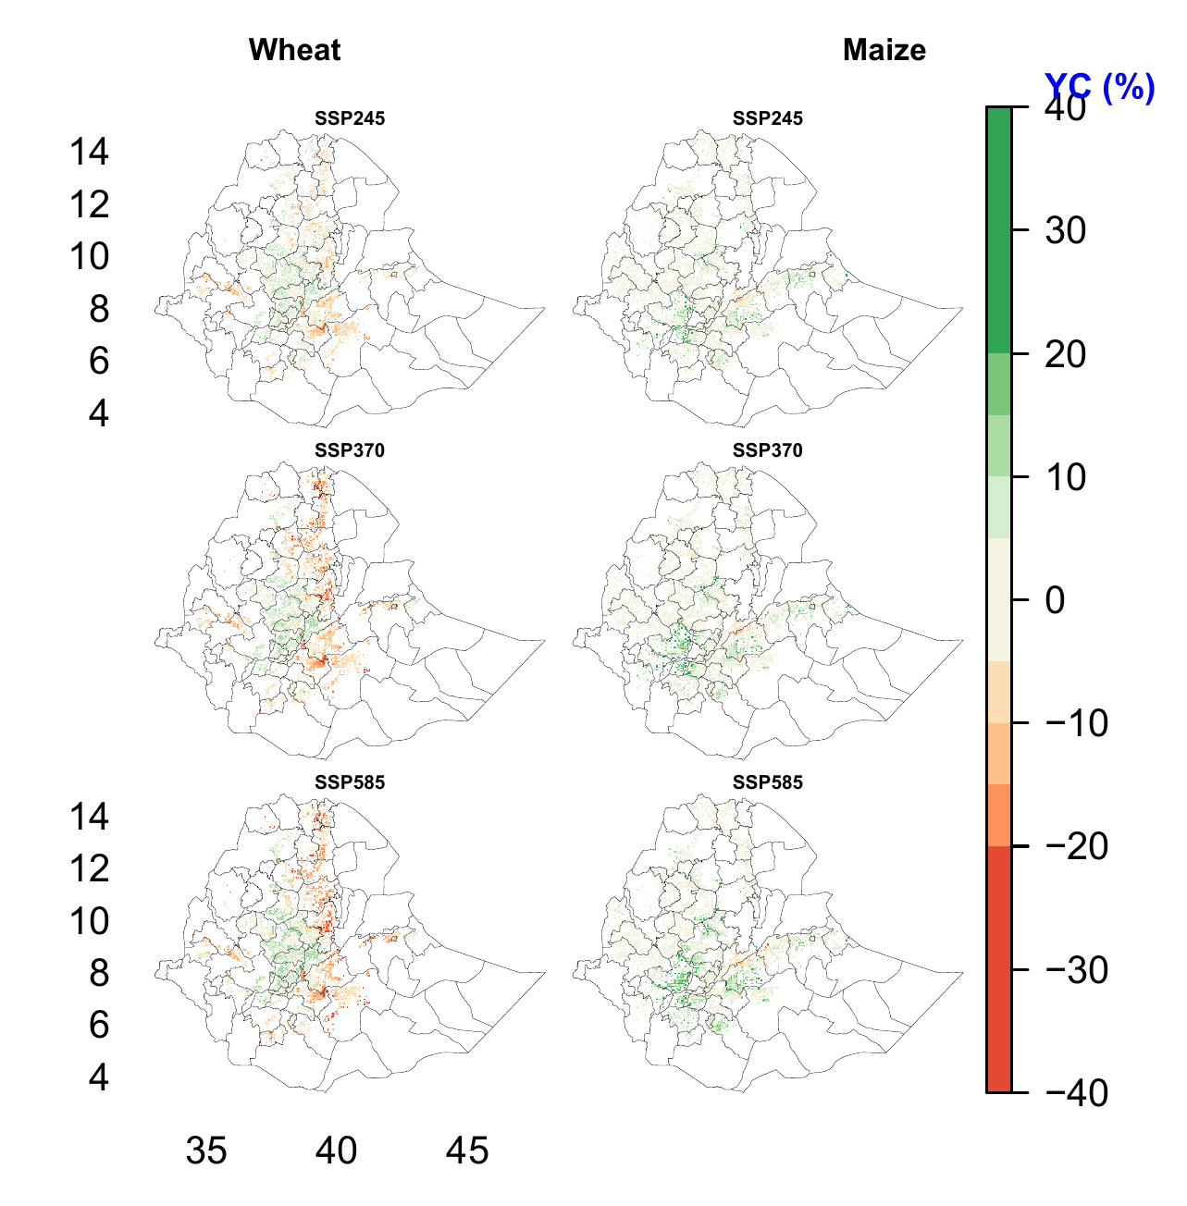
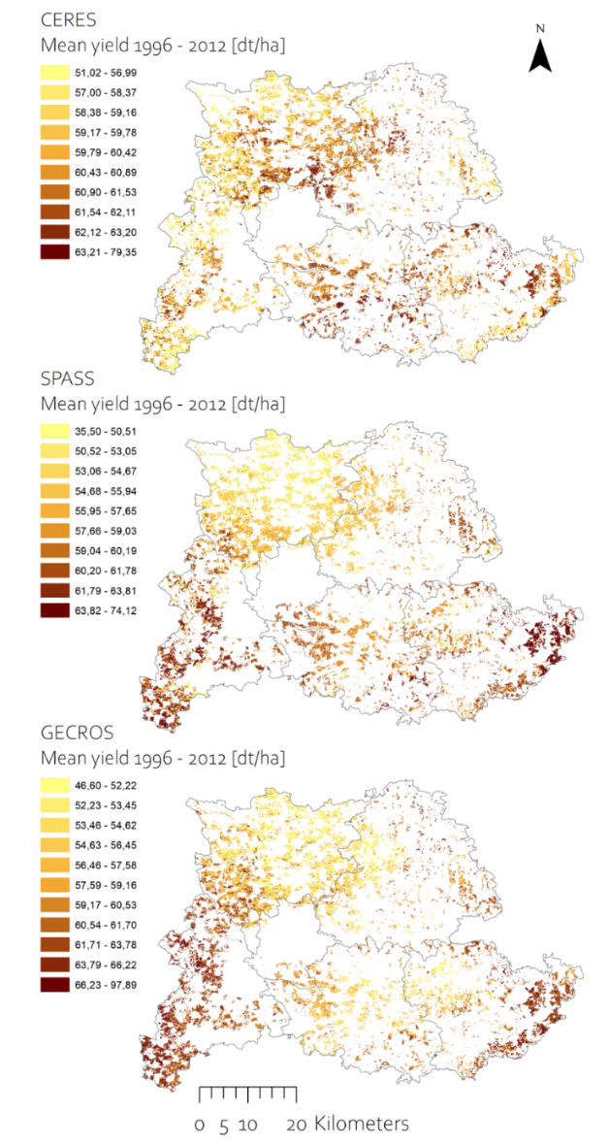
Some examples

Slide 11
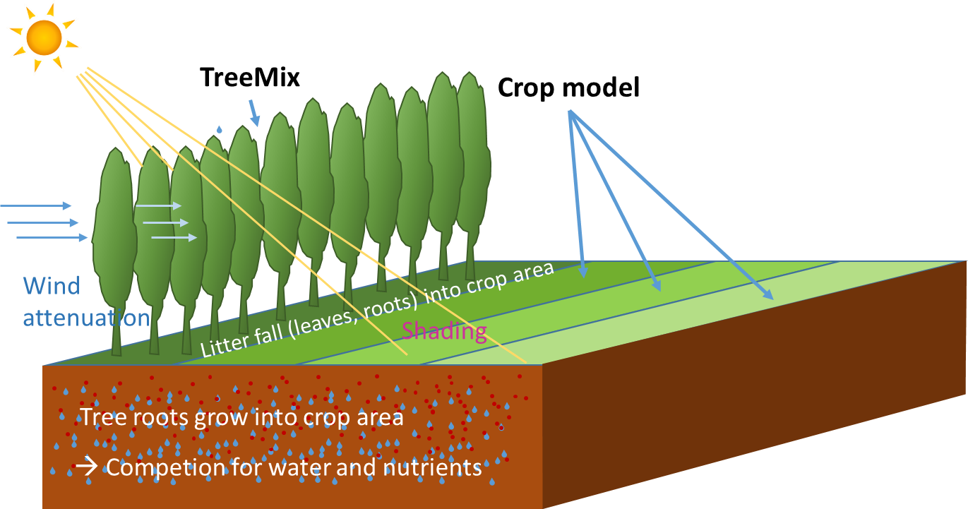
The XN5-AF model
Combines TreeMix model with Crop models (Gecros, Spass, Ceres)
Calculates interaction between tree and crop grid cells:
one (or more grid) cells for trees + one to many grid cells with crop.

Slide 12
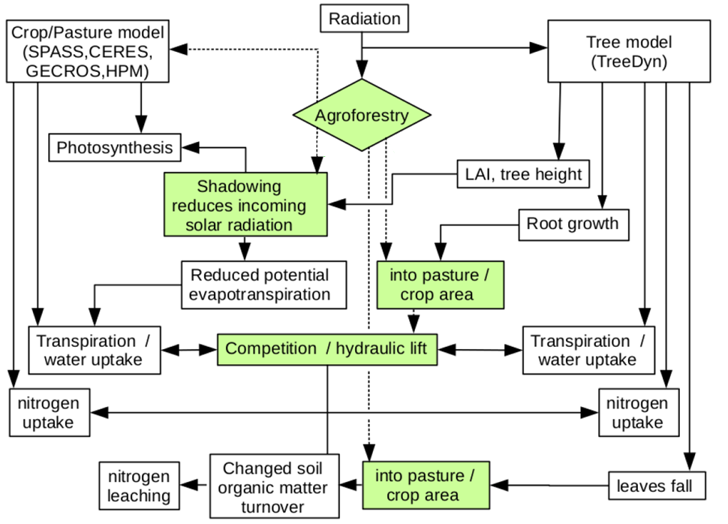
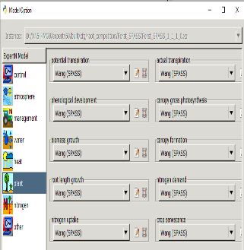
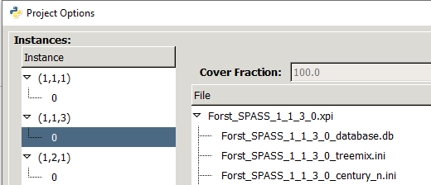
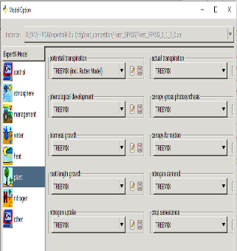
Challenges
These models simulate interactions between tree rows and cropping fields.
Information exchange between model instances at each simulation timestep.
Current efforts involve distributing independent projects across nodes.
. . .
. . .
. . .
. . .
. . .
. . .
. . .
. . .
. . .
. . .
. . .
. . .
. . .

Slide 13
Thank you!
Fasil RETTIE, Tobias WEBER, Sebastian GAYLER, Daniela BENDEL & Thilo STRECK
Hohenheim University
Institute of Soil Science and Land Evaluation/Biogeophysics (310D)

Slide 14
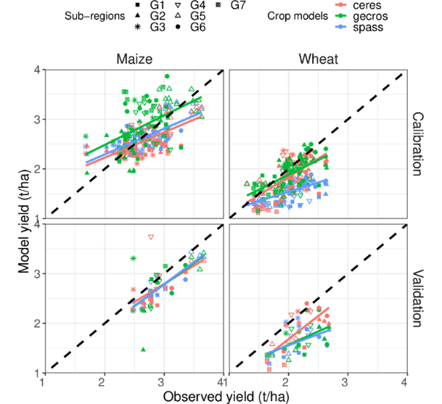
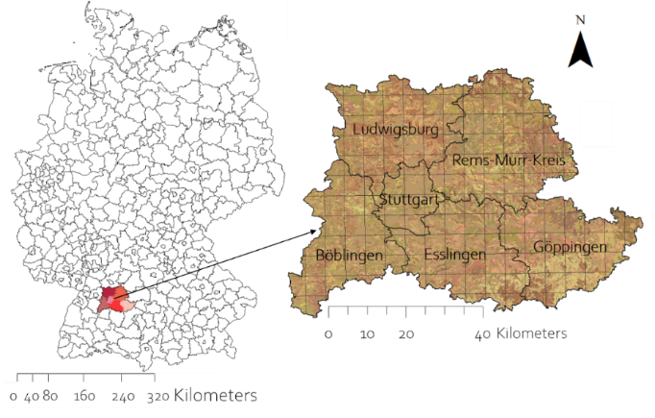
Expert-N implementation on HPCs
Calibration
Climate Change Impact Assessment
Sample grid cells
Baseline climate
(1990-2018)
Future climate
(2021-2050) X 9 GCMs x 2 CO₂
Simulation of all grid cells
1 Phenology calibration
Calibrated model
2 Growth calibration and validation
Baseline climate
(1990-2018)
Bendel ea al 2023, Rettie et al 2022
Notes:
estimating environmental impacts, optimizing resource use, and predicting crop yields, particularly in the face of climate change.
an agro-ecosystem model library,
, leveraging High-Performance Computing (HPC) to enhance model accuracy through calibration and sensitivity analysis

