Slide 1
KIT accelerators and research highlights - an overview
Bastian Härer on behalf of the KIT team

Slide 2
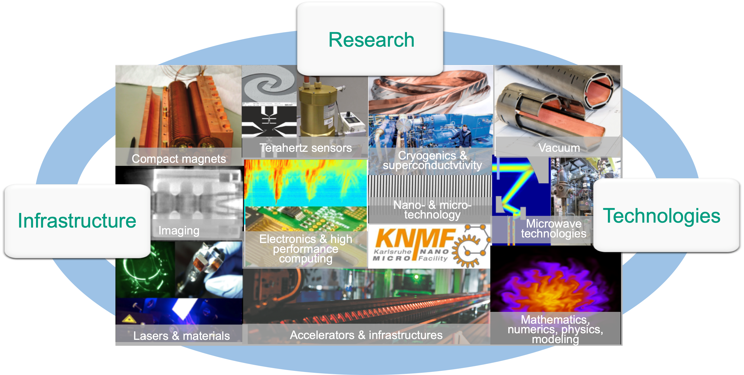



The Accelerator Technology Platform @KIT (ATP)
  5 divisions
  6 KIT facilities
  14 institutes
  The Research University in the Helmholtz Association
ATP in
lookKIT
(German)
  + strong
  industrial partners
  Helmholtz
  3 research fields
  6 programs

Slide 3
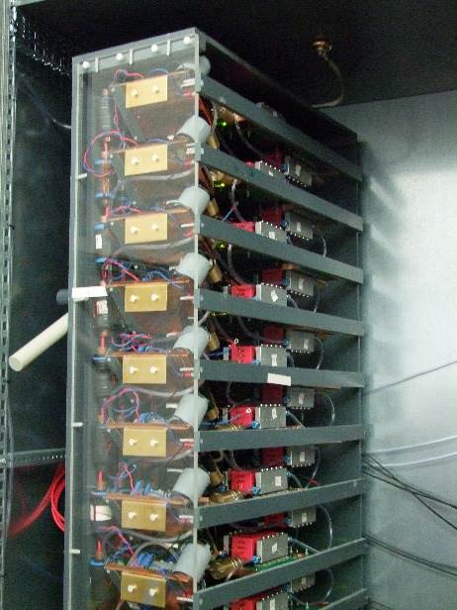
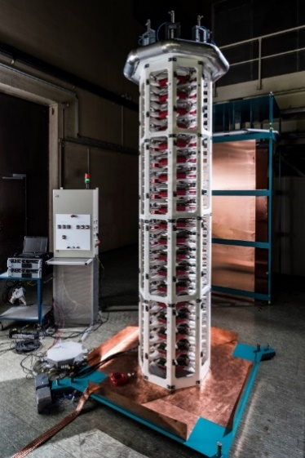
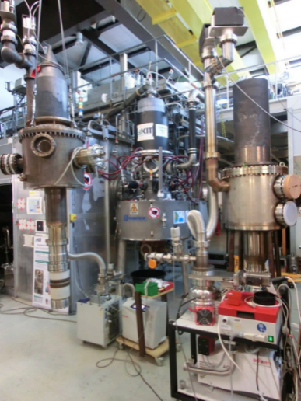
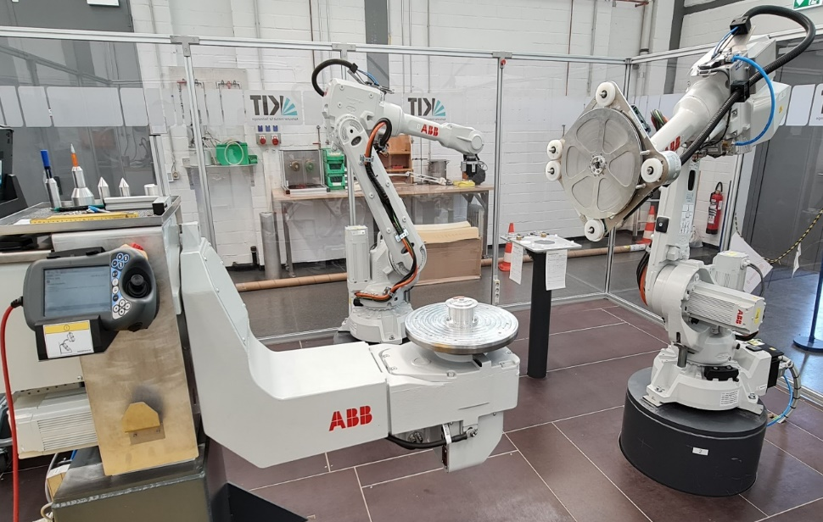
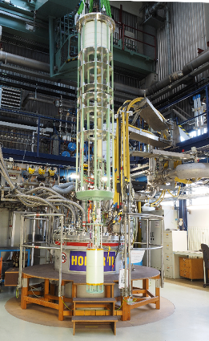
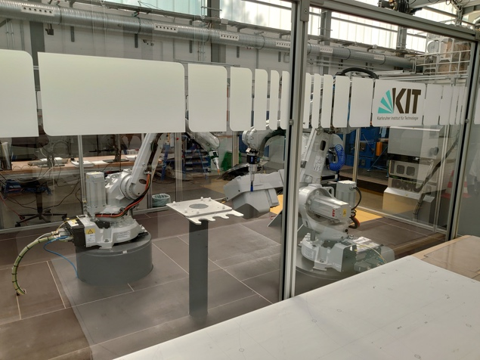
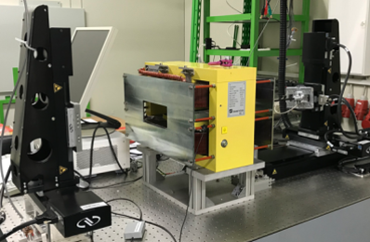
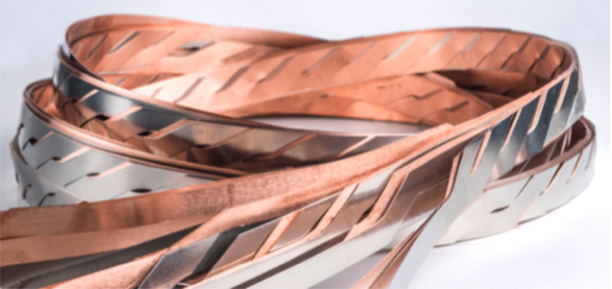

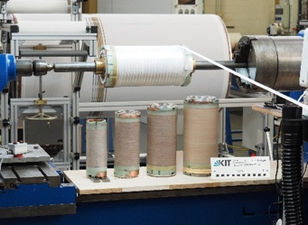
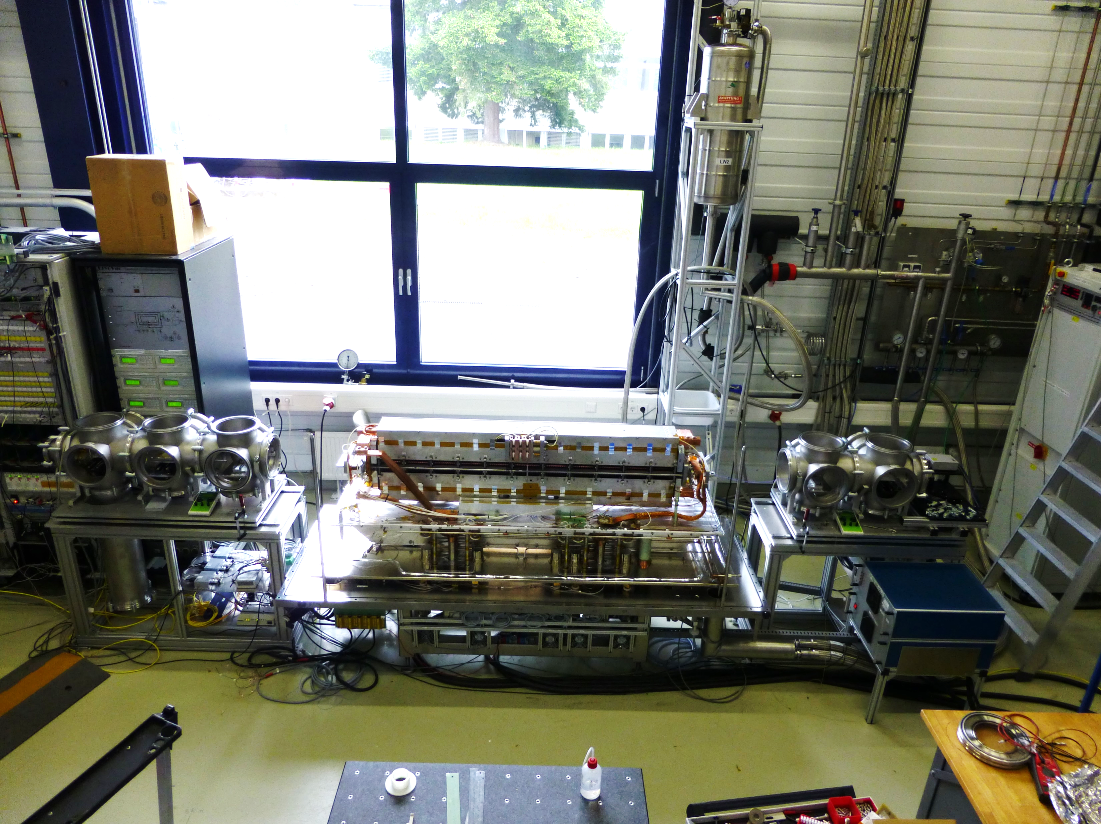
Test facilities & technologies - examples
Pulse power technology Gyrotrons
Winding technologies
Magnet test facilities
Cable technologies High temperature superconductors

Slide 4

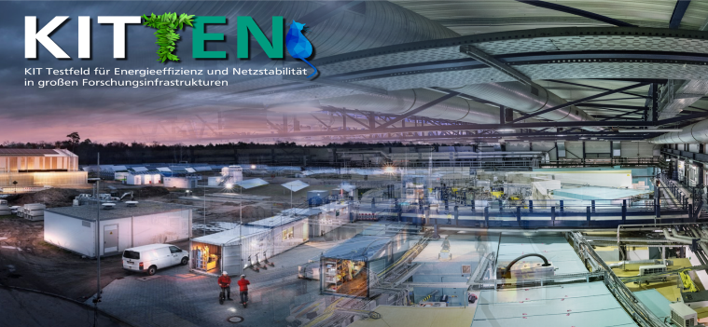

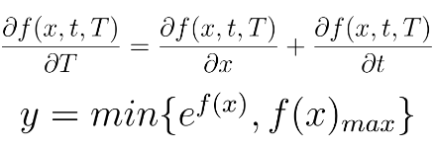

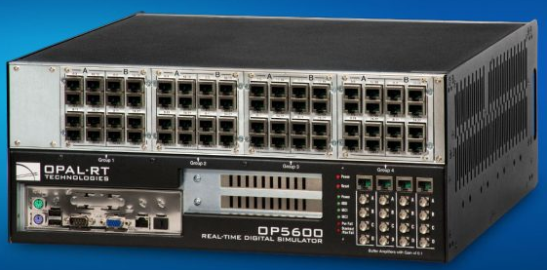
Accelerator & energy systems
Test field KITTEN
mathematical model
model
control
time-efficient
real-time model
energy-informed &
physics-informed
digital twin of KARA
simplify
COLLAGE: ANKE-SUSANNE MÜLLER, FOTO : MARKUS BREIG
Digital twin of KARA
  Analyzing, developing and testing future energy solutions for research infrastructures
InnovEEA
  Load management (grid stability)
implement
Courtesy: Giovanni De Carne,
Head of „Real Time System Integration“, KIT
real-time simulator

Slide 5



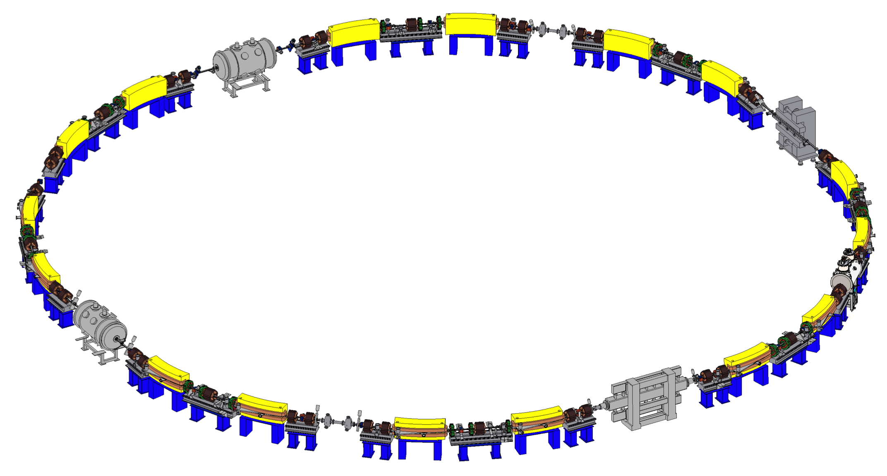




Karlsruhe Research Accelerator (KARA)
KIT synchrotron light-source & accelerator test facility
Parameters | Values
Circumference | 110.4 m
Energy range | 0.5 – 2.5 GeV
RF frequency / period | 500 MHz / 2 ns
Revolution frequency / period | 2.715 MHz / 368 ns
Beam current | up to 200 mA
RMS bunch length | 45 ps (2.5 GeV) a few ps (1.3 GeV)
FCC-FS
FCCIS
Courtesy:
U. Herberger
www.ibpt.kit.edu/kara

Slide 6
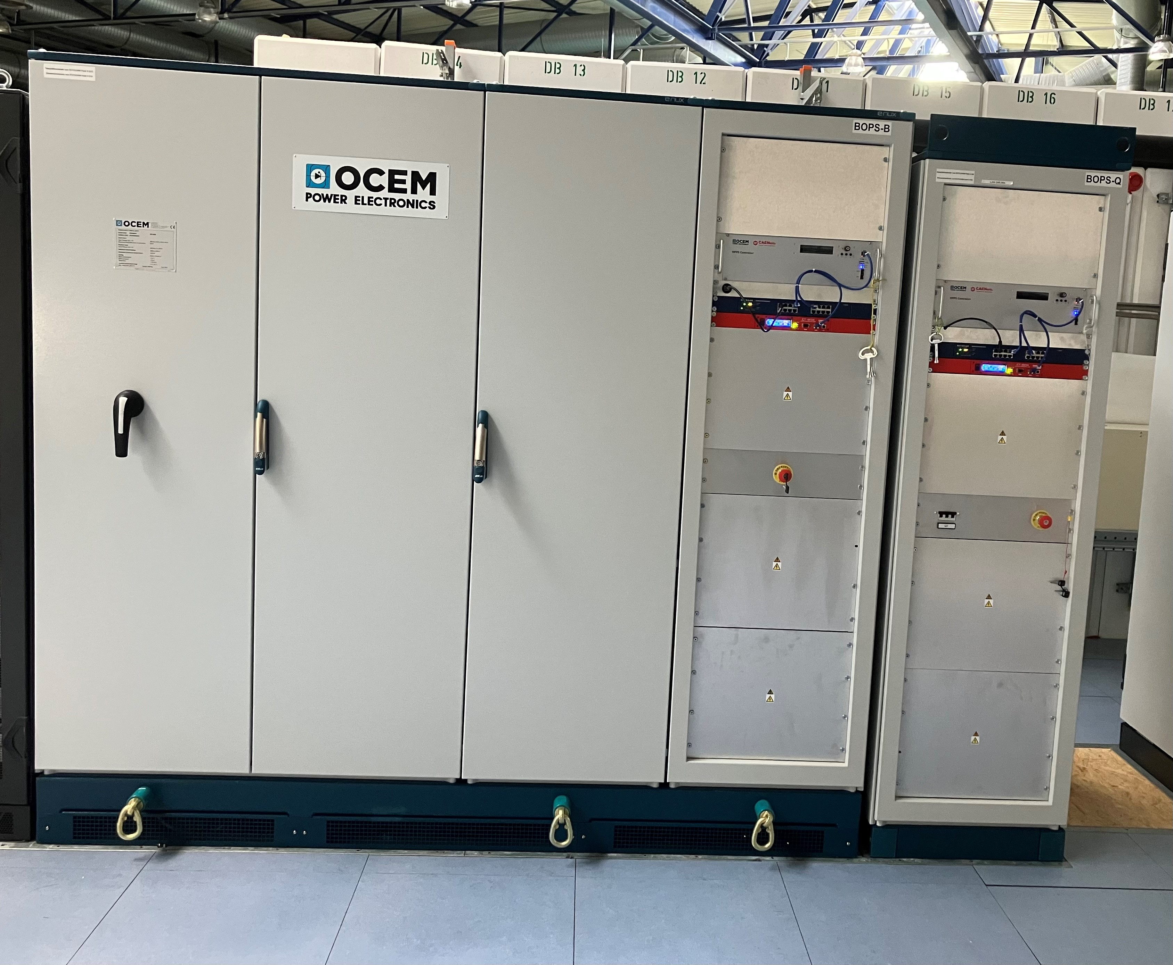
KARA Operation Status
Operation modes in 2022:
  0.5/2.3/2.5 GeV user optics, 0.5/1.3 GeV low-alpha, 0.5/1.3 GeV negative alpha
Power supply refurbishment program
  Replaced Booster main power supplies
    Direct EPICS control interface on device
    Continuous operation at all energies (50 – 500 MeV)
  Replaced KARA dipole power supply (800 A / 520 V)
    Direct EPICS control interface on device
    Enable new operation modes like down ramping
  New KARA quadrupole power supplies in the ordering process
    Start with family powering
    Test individual powered quadrupole magnets
  Installed new PS for KARA sextupole magnets and split them from two into tree families
Picture: H. Hoteit
Booster
Dipole PS
(1000 A / ±240 V)
Booster Quadrupole PS
(120 A / ±108 V )

Slide 7

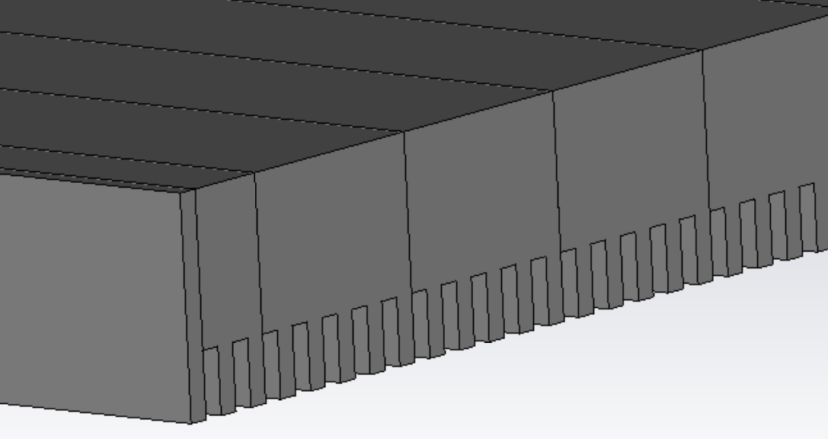
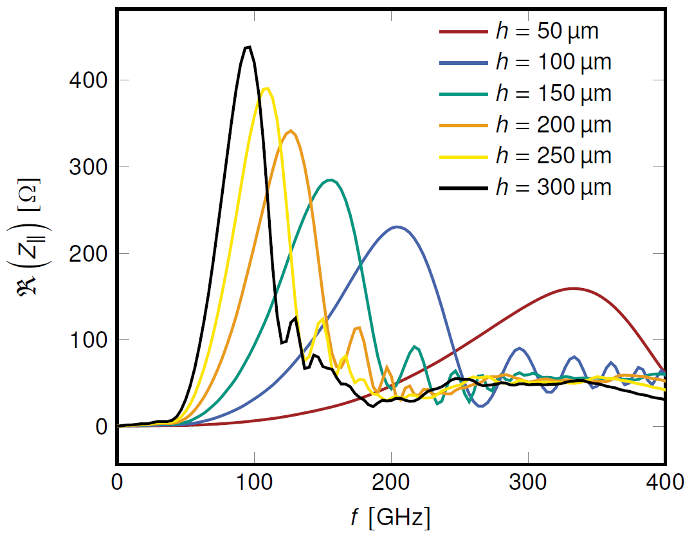
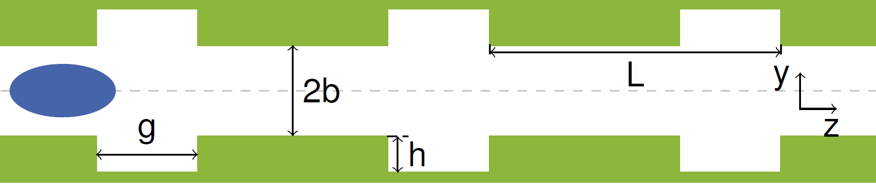
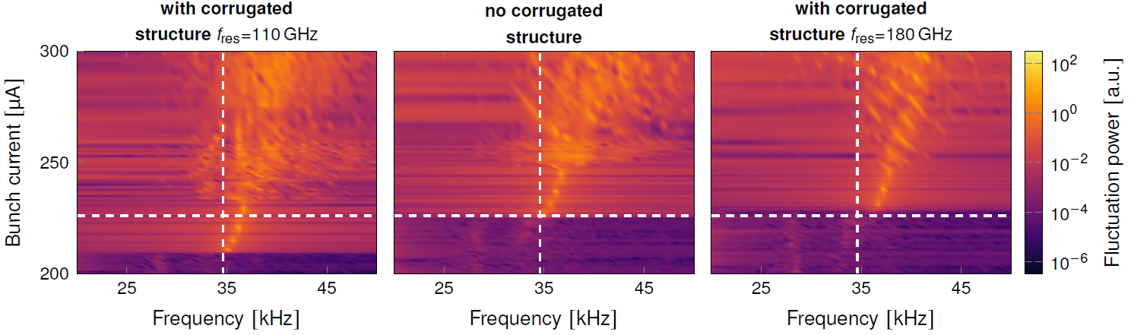

Impedance manipulation at KARA
Goal: Observe, understand, and control the microbunching instability
Corrugated plates will be installed at KARA
Affecting threshold current and/or bursting frequency with additional impedance
S. Maier et al. https://doi.org/10.18429/JACoW-IPAC-23-WEPL189

Slide 8

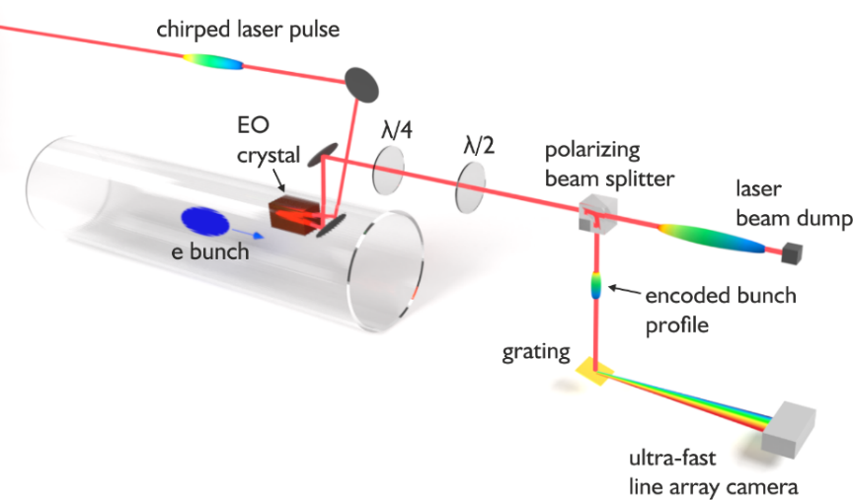
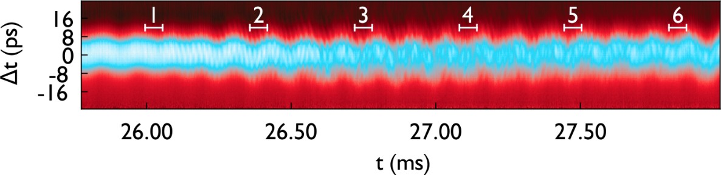
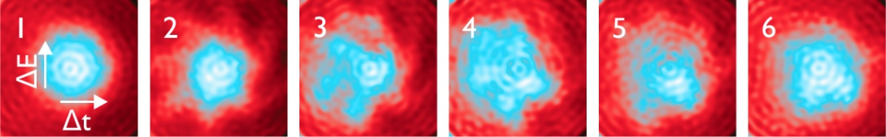
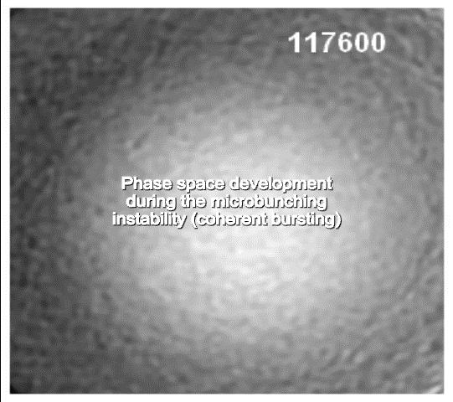
EO Near-Field @ KARA:
Phase Space Tomography
05K22VKB
05K19VKD
revolution plots/ sinograms
phase space density
Phase space tomography
Complete phase space image reconstructed from time interval of 61 μs
“Randon morphing“ between independent measurements
S. Funkner et al., Sci Rep, March 2023, Vol. 13.1, pp. 1-11.
doi:10.1038/s41598-023-31196-5
single-bunch @ 2.7 MHz
S. Funker et al., Sci. Rep. 4618 (2023)
https://doi.org/10.1038/s41598-023-31196-5

Slide 9
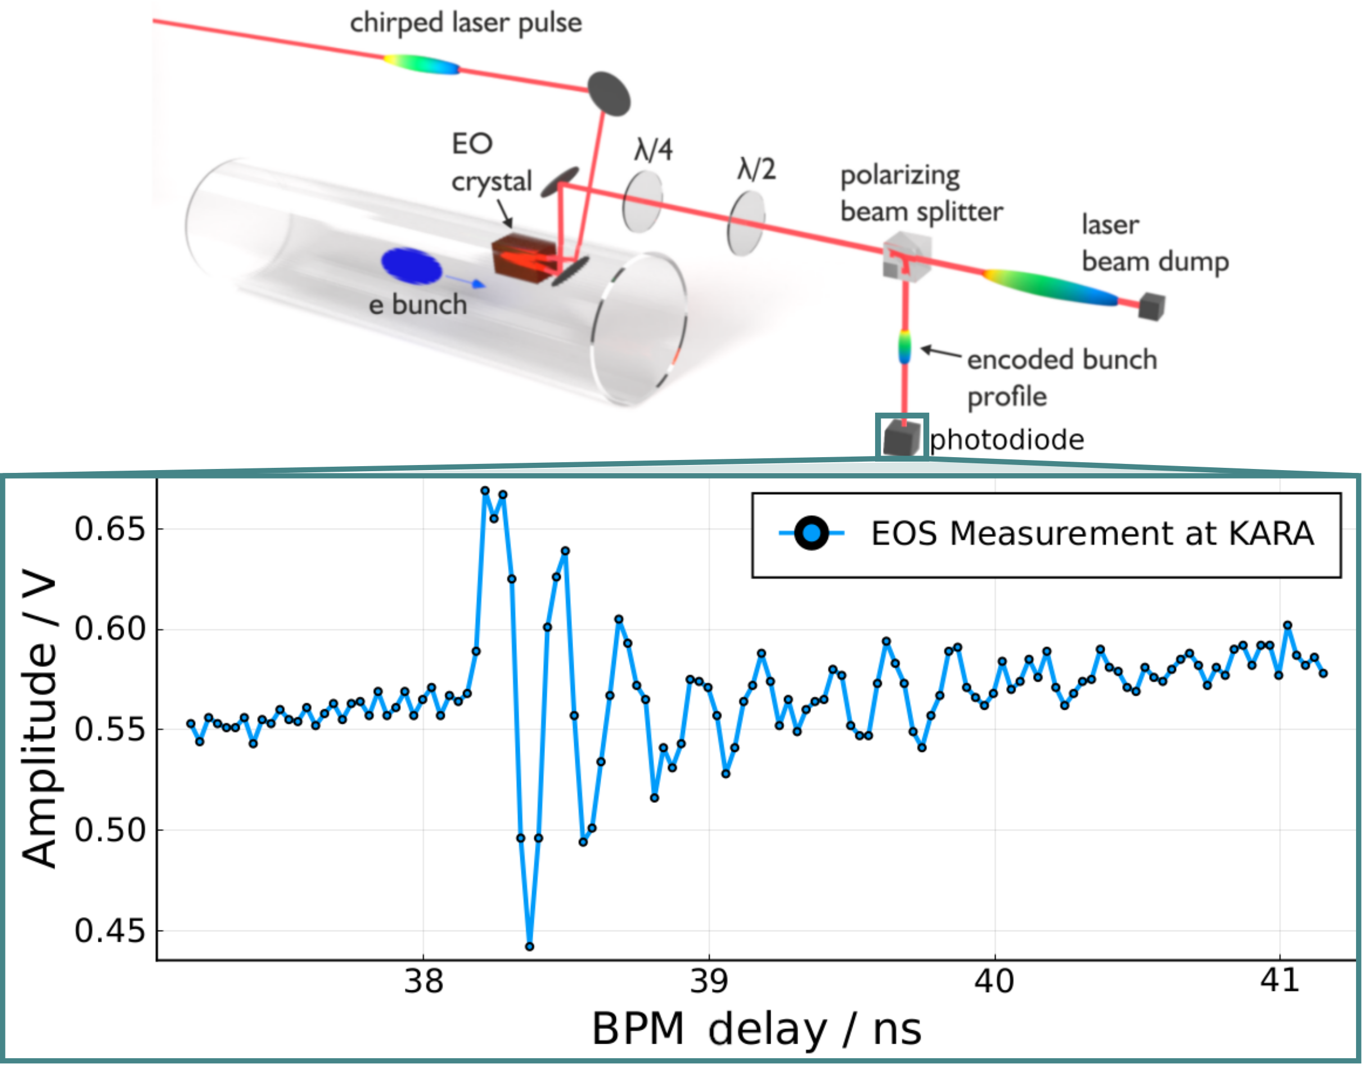
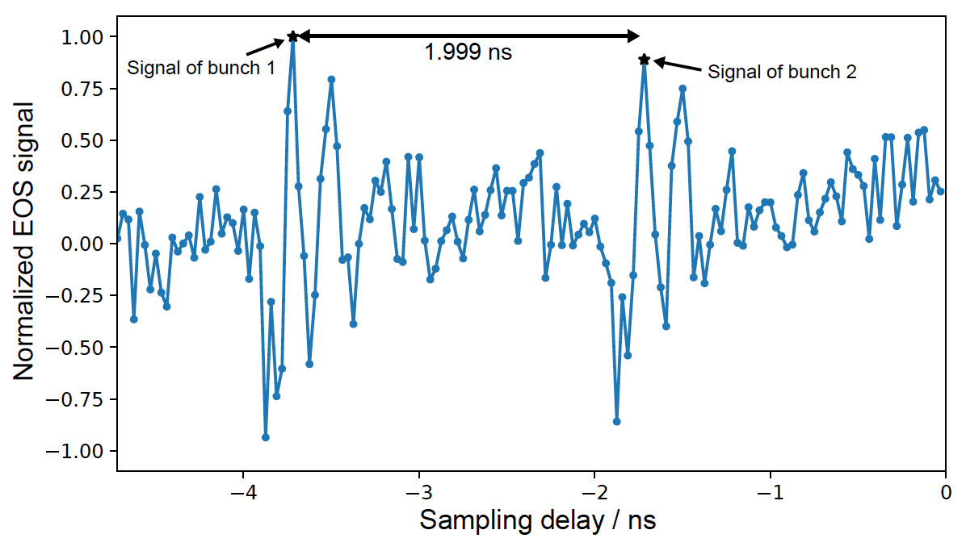
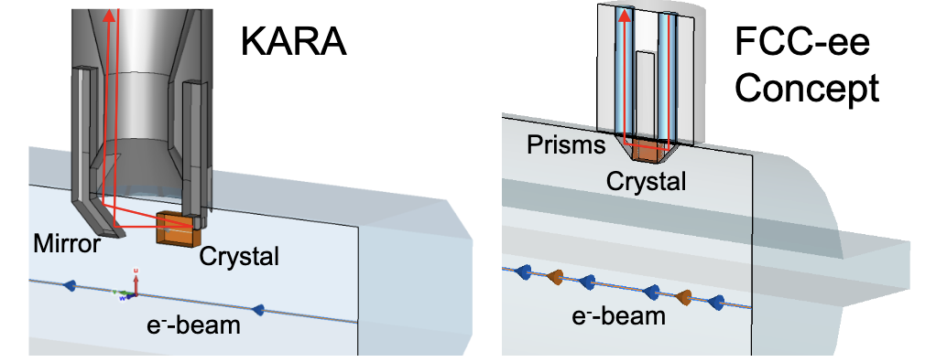
EO Near-Field @ KARA:
Towards Multi-Bunch Measurements
First 2 bunch EOS measurements at KARA:
Compensation for signal drift (heating?)
Two bunches are clearly visible in the measurement
Prototype for an EO Bunch Profile Monitor for FCC-ee:
M. Reißig et al. https://doi.org/10.18429/JACoW-IPAC2023-THPL121

Slide 10

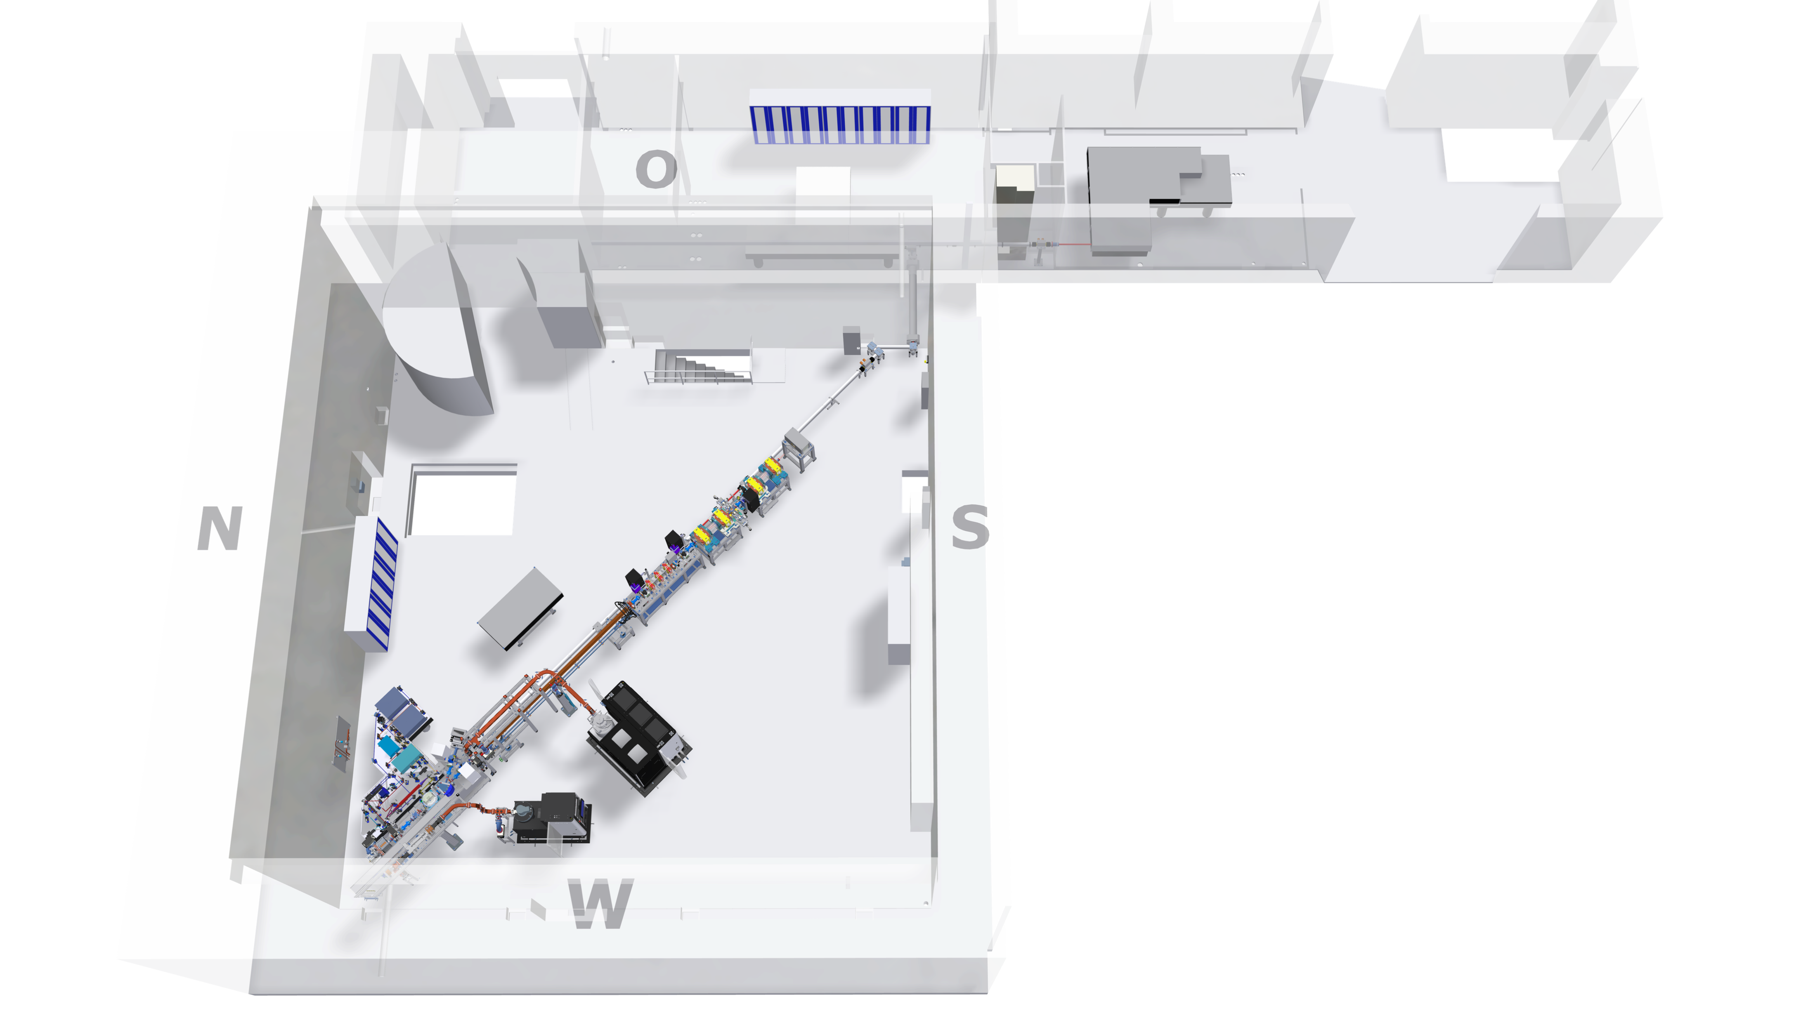

FLUTE: Accelerator Test Facility at KIT
FLUTE (Ferninfrarot Linac- Und Test-Experiment)
  Test facility for accelerator physics within ARD
  Experiments with THz radiation
Final electron energy | ~ 41 | MeV
Electron bunch charge | 0.001 - 1 | nC
Electron bunch length | 1 - 300 | fs
Pulse repetition rate | 5 | Hz
THz E-Field strength | up to 1.2 | GV/m
R&D topics
  Serve as a test bench for new beam diagnostic methods and tools
  Systematic bunch compression
  and THz generation studies
  Develop single shot fs diagnostics
  Synchronization on a femtosecond level
Courtesy: S. Schott
www.ibpt.kit.edu/flute

Slide 11
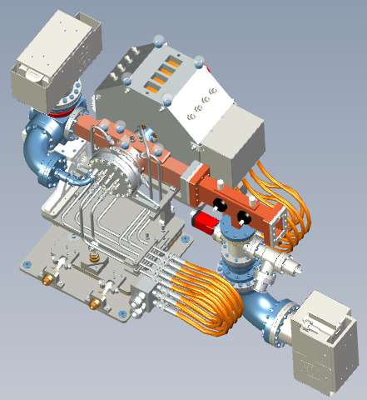
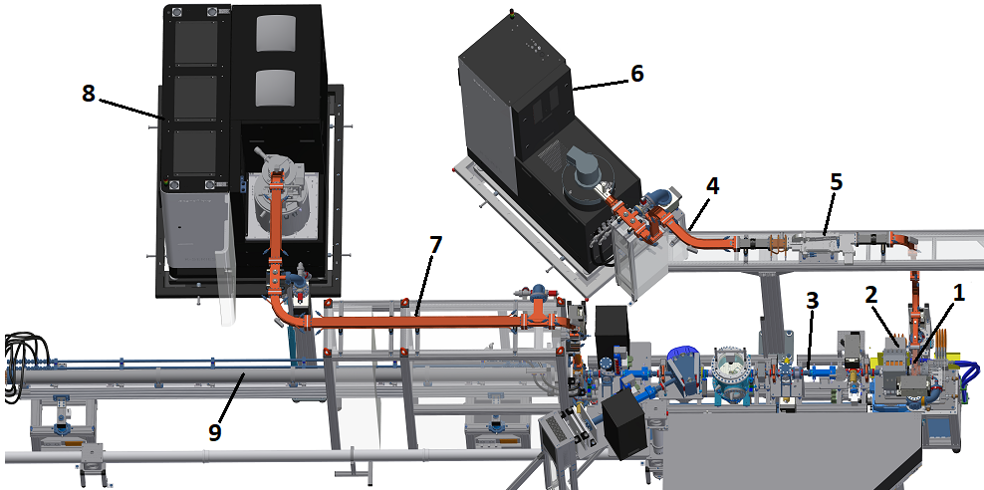

: upgrade status
Dedicated RF units for RF photo-injector and linac have been installed and commissioned
New RF photo-injector with low dark current has been delivered, installation and commissioning is under way
Installation of the RF waveguide for the linac and its conditioning will follow
UV laser beam aligned and referenced
RF photo-injector
Solenoid
Diagnostic section
K100 waveguide
Circulator
K100 RF unit (10 MW)
K300 waveguide
K300 RF unit (37 MW)
Linac
Parameter | Value
Input RF power | 9.5 MW
Output Energy | 5.5 MeV
Operating Frequency | 2.998 GHz
Repetition rate | 50 Hz
Peak cathode field | 120 MV/m
Bunch charge (max) | 1 nC
Courtesy: S. Schott

Slide 12
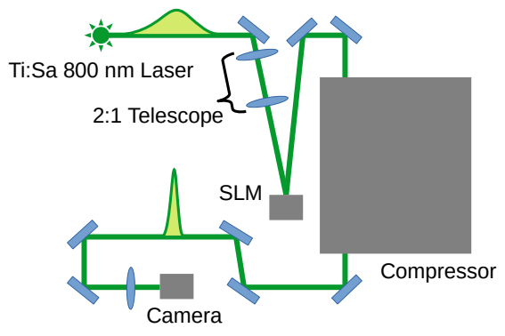
Controlling the Transverse Beam Shape of the Photoinjector Laser via an SLM
Neural network architecture
Evolve last year’s test setup and approach by ...
  Using the Ti:Sa 800 nm photoinjector laser system
  Including a compressor in the optical path
  Mapping the camera intensity directly to the
  phase modulation via a deep neural network
Camera images
Size: 100x100
Body:
EfficientNetV1B1
Zernike
Amplitudes
Head: Conv2D
Tail: Dense
Test results
Schematic setup
Head: Conv2D
Tail: Dense

Slide 13


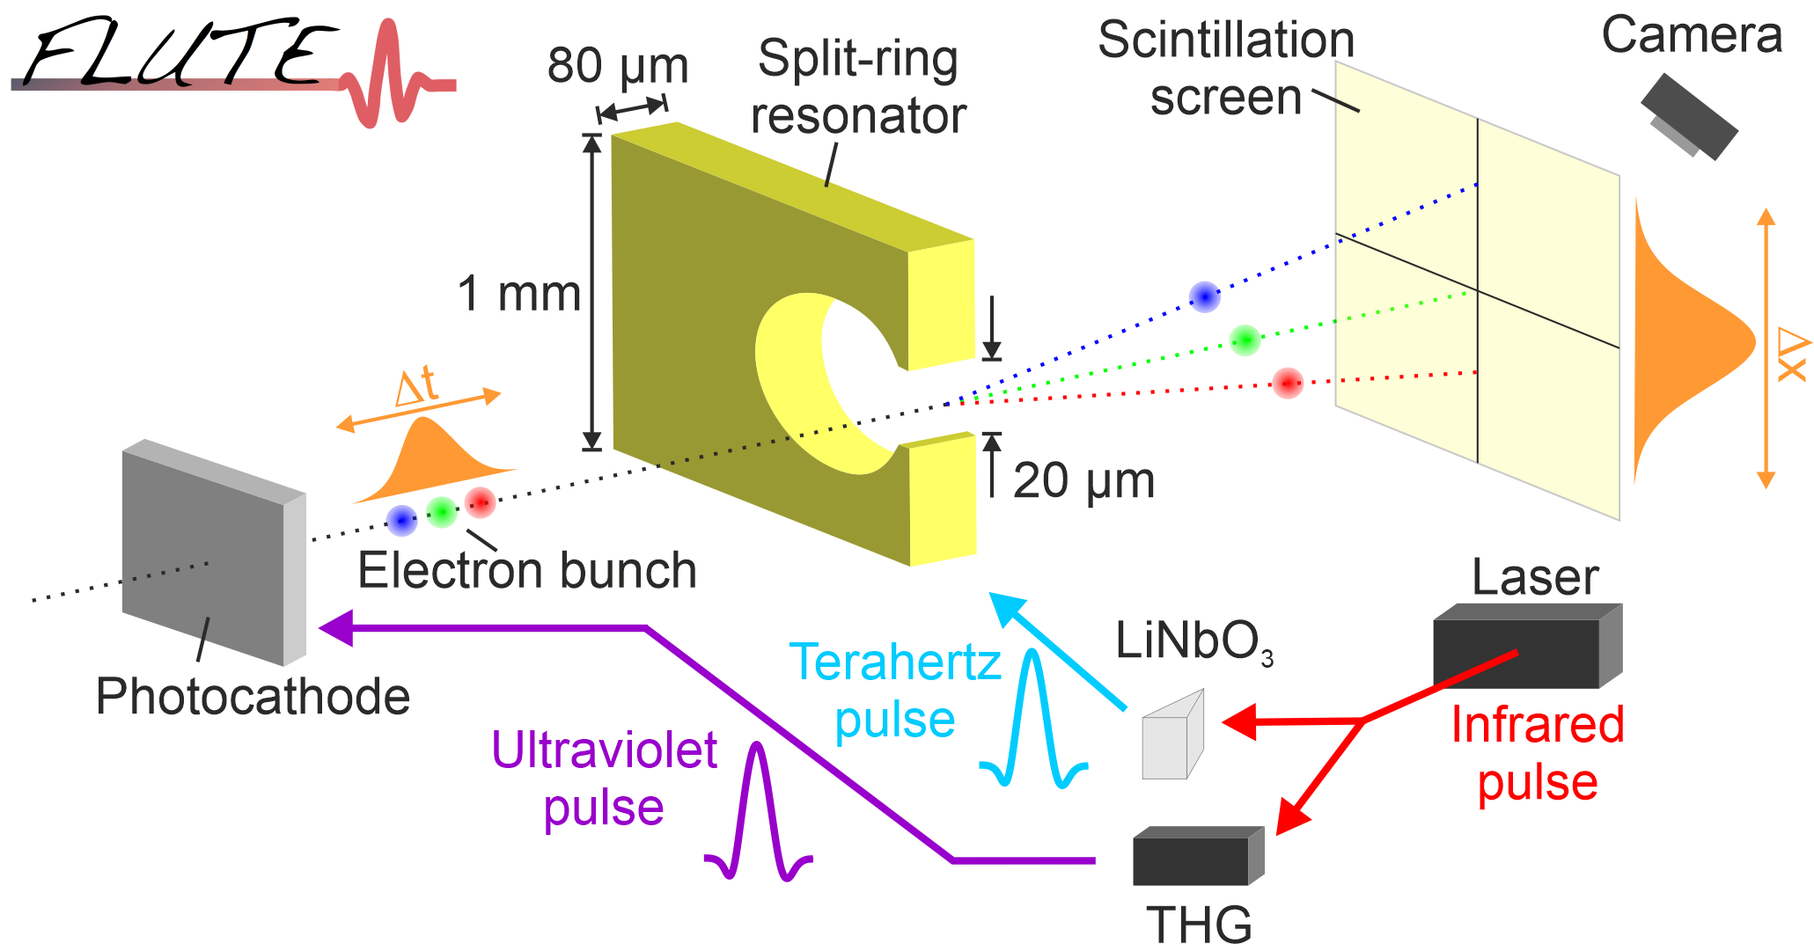
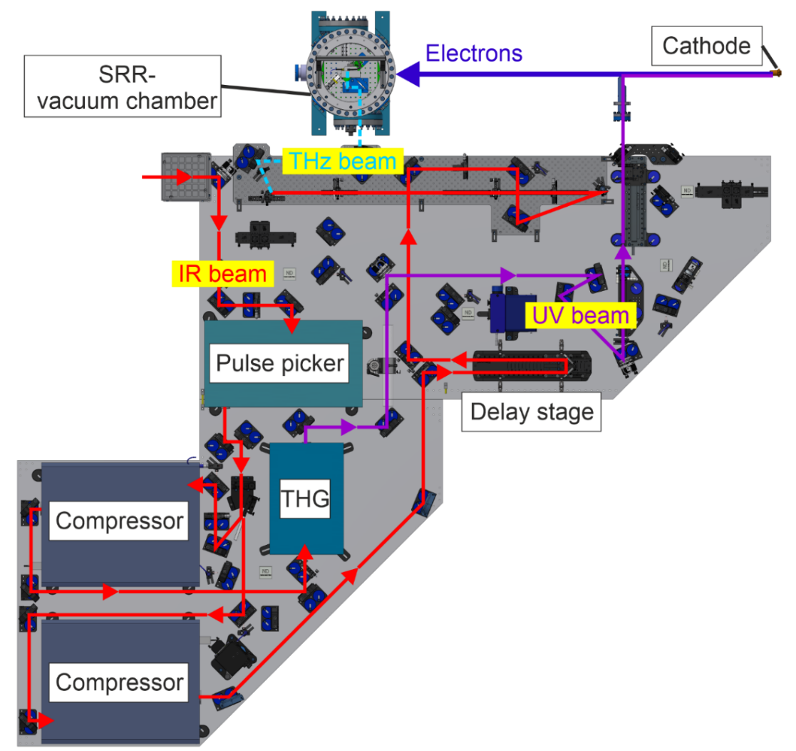
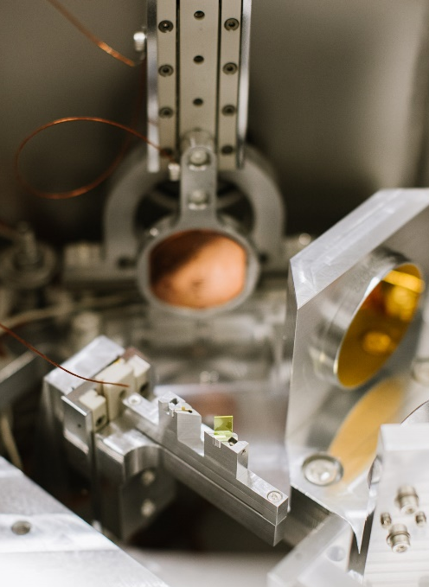
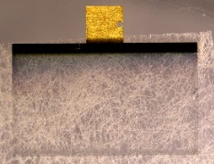
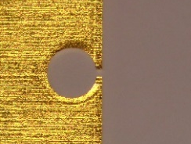
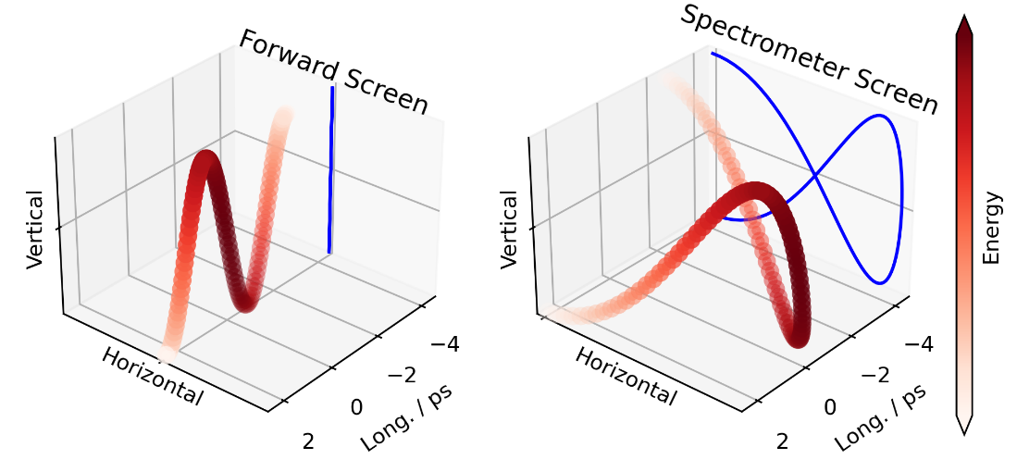
Split-ring resonator
Optical setups
Courtesy: S. Schott
© Katja Heil, IBPT
Streaking with THz radiation and amplifying the electric field with a 20 µm gap split-ring resonator
Illustration
20 μm
Setup of the split-ring resonator measurement in low energy section at FLUTE
Experimental setup in vacuum chamber installed and in commissioning
J. Schäfer et al. https://doi.org/10.18429/JACoW-IPAC-23-THPL122
M. Nabinger et al. https://doi.org/10.18429/JACoW-IPAC-23-THPA079

Slide 14
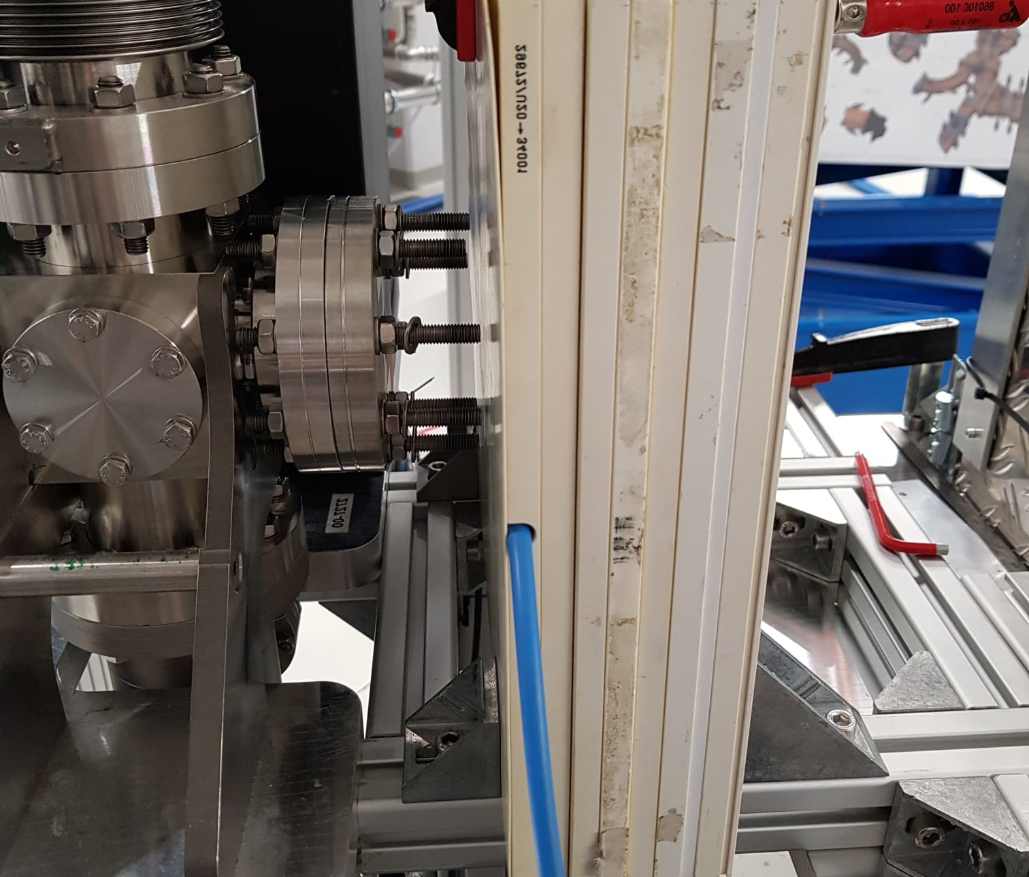
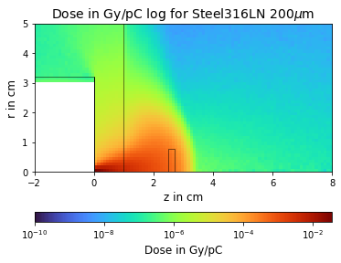
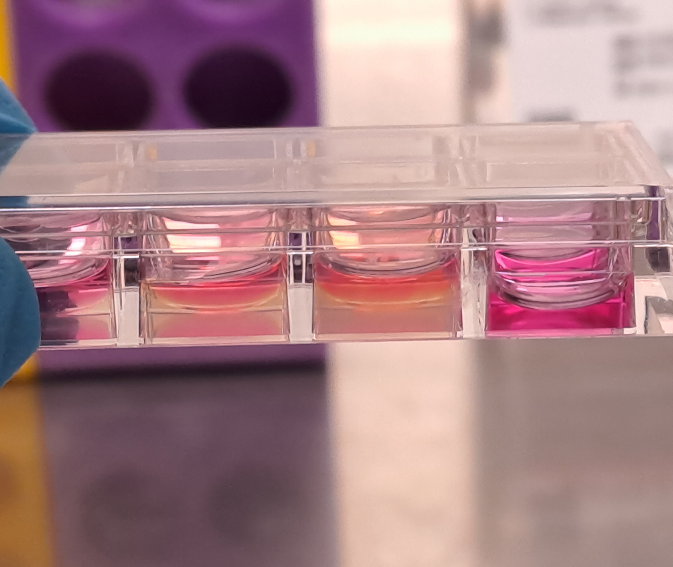
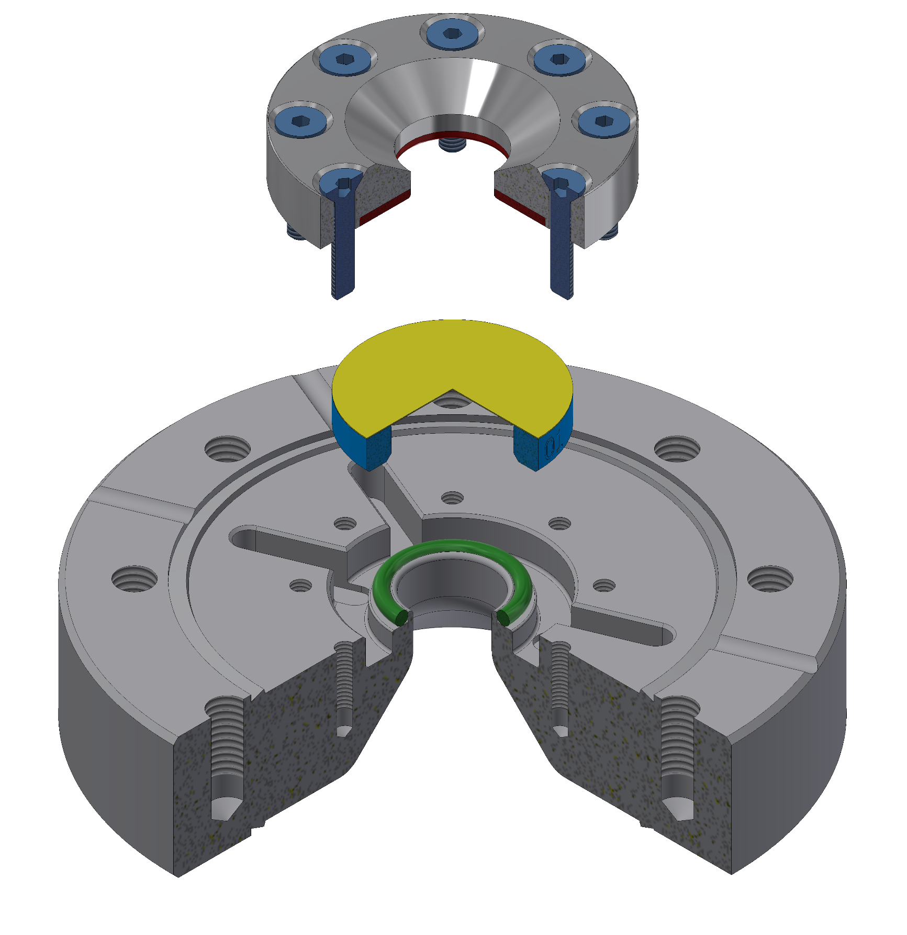
Accelerator technology for precision medicine
KIT Center HealthTech
Development and implementation of innovative technologies leading to the transformation of health technologies into future healthcare.
KARA → photon irradiation
FLUTE → electron irradiation
First tests in cooperation with DKFZ
https://www.healthtech.kit.edu/
K. Mayer, Master thesis 2023
e⁻
water equivalent plates
Hydrogel
Lab, AK Schepers, KIT - IFG
Courtesy: C. Stengl, S. Schott

Slide 15

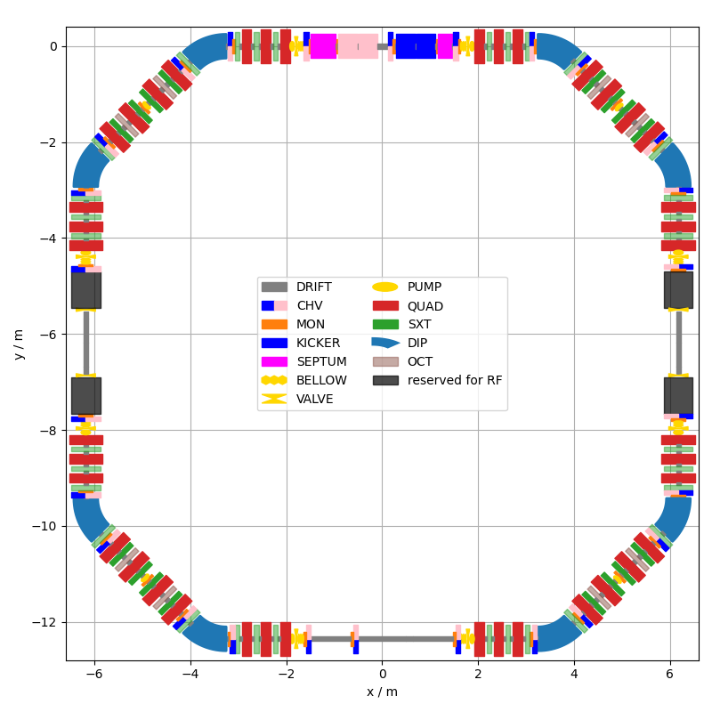
cSTART Project
Motivation: Storage of ultra-short (fs) electron bunches with high repetition rate
Compact storage ring with very large momentum acceptance and dynamic aperture
FLUTE with new transfer line as injector
Status:
  Conceptual design and specification: finished
  Transfer line magnets: first magnets delivered
  Test diagnostics at KARA booster: ongoing
y / m
Circumference | 43.2 m
Energy | 50 MeV
Revolution time | 144 ns; 6.9 MHz
Storage time | 100 ms
A. Papash et al. https://doi.org/10.18429/JACoW-IPAC2022-THPOPT023
M. Schwarz et al. https://doi.org/10.18429/JACoW-IPAC-23-WEPL167
D. El Khechen et al. https://doi.org/10.18429/JACoW-IPAC2022-MOPOPT026
J. Schäfer et al. https://doi.org/10.18429/JACoW-IPAC2022-MOPOST041
B. Härer et al. https://doi.org/ 10.18429/JACoW-IPAC2022-THPOPT059
x / m

Slide 16
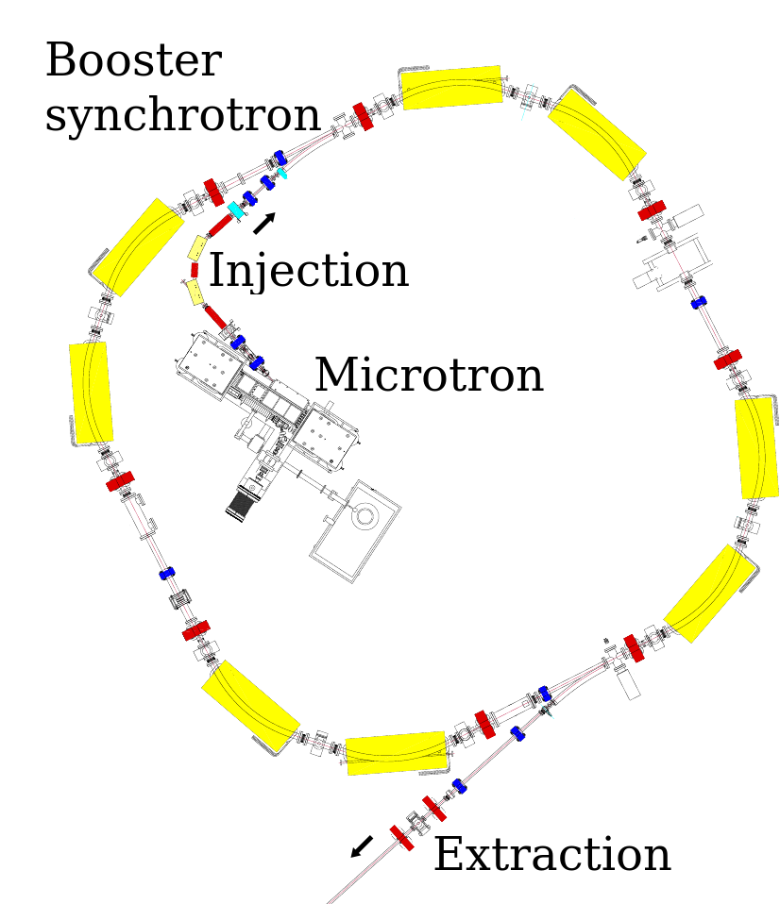
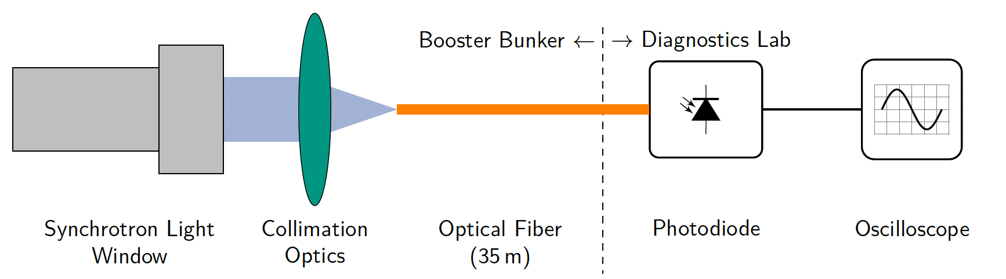
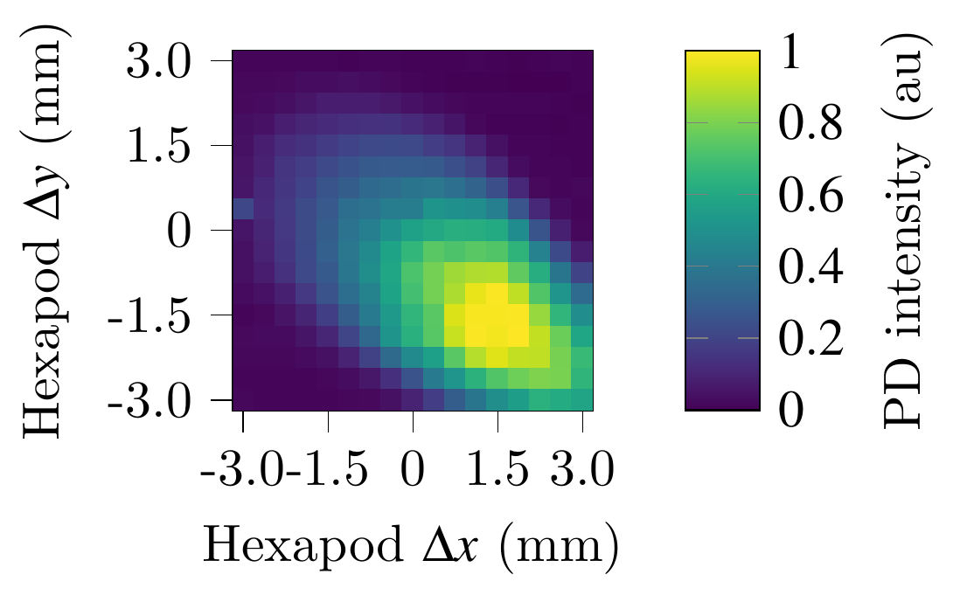
KARA Booster Diagnostics
Diagnostic Devices:
  Button/Stripline beam position monitors
  Two synchrotron radiation ports
Implement longitudinal diagnostics to improve storage ring injection efficiency
⌀ 62 micro-meter
Injection facility for KARA
Components:
  53 MeV racetrack microtron
  Injection line
  26 m circumference booster synchrotron
  (53 MeV → 500 MeV, RMS bunch length: 200 ps...1000 ps)
  Extraction line
Preliminary results,
scan using
hexapod system:
M.-D. Noll et al. https://doi.org/10.18429/JACoW-IPAC2023-THPL126

Slide 17
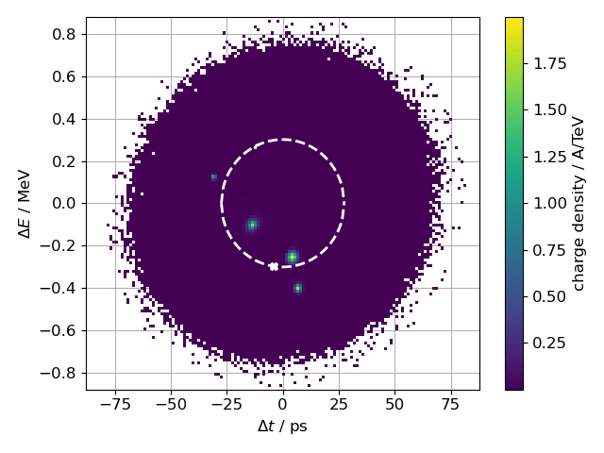
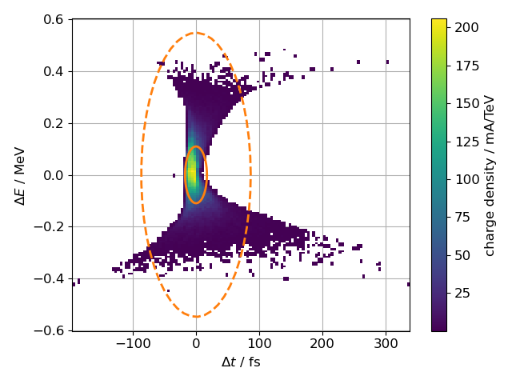
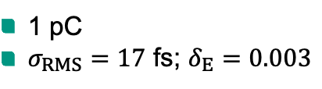
Longitudinal beam dynamics for different initial distributions at cSTART
Storage time ≪ damping time → Non-equilibrium dynamics
Simulation of 700 k turns with 1 M macro-particles
Initial distribution
Distribution after 100 ms
1 pC
$σ_{RMS}=17$ fs; $δ_{E}=0.003$
Sub bunches
Contain 40 % of particles
Survive for 100 ms
RMS bunch length ≤ 1 ps
M. Schwarz et al. https://doi.org/10.18429/JACoW-IPAC-23-WEPL167

Slide 18
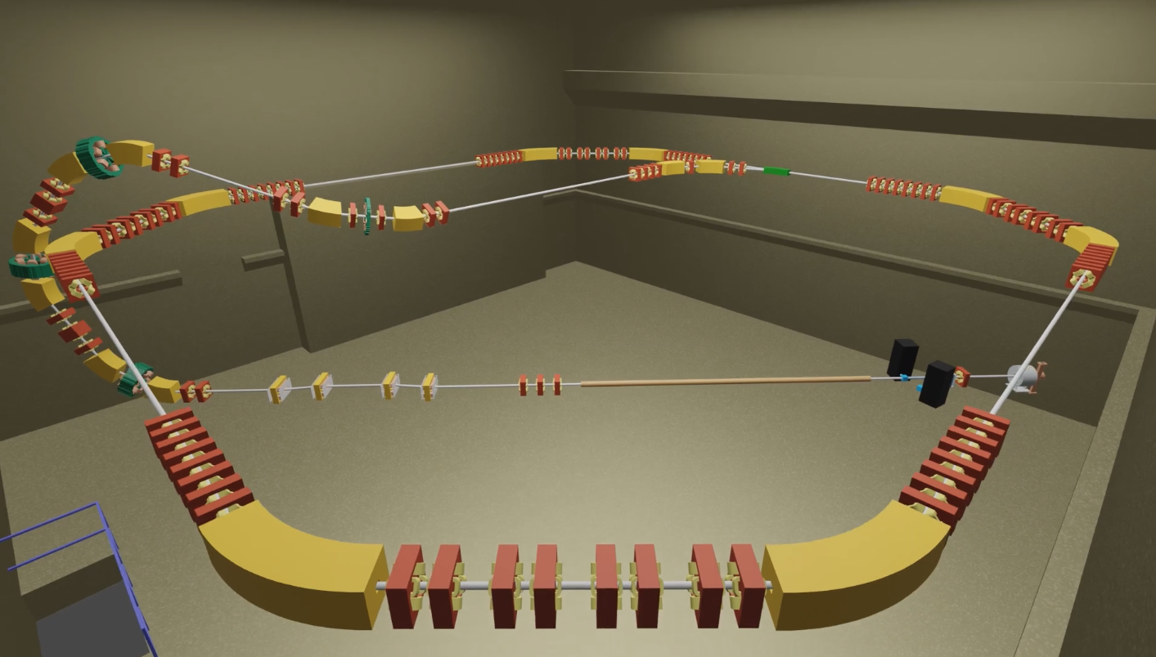
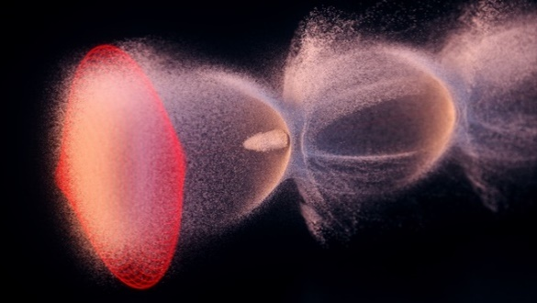


@KIT - Status
Goal: injection & storage of a laser plasma accelerator beam in a storage ring
Courtesy: S. Jalas, M. Kirchen, DESY
LPA
LPA plasma cell
intersection dipole
Clean room for laser system built ✓
Commercial laser system in commissioning
Conceptual design of transfer lines including diagnostics finished ✓
Next step: Fine-tuning of optics and tracking calculations
Additional professor at KIT in 2023

Slide 19




AI4Accelerators team highlights
Reinforcement Learning
Bayesian Optimization
Time to inject to KARA cut in half with automated tuning by BO algorithm
Emitted THz radiation at FLUTE optimized with parallel BO in simulation
Transfer of algorithm to EuXFEL to tune SASE emission
First successful application of RL in an accelerator with online training and running on hardware in the world at KARA!
https://doi.org/10.1103/PhysRevAccelBeams.26.034601
https://doi.org/10.18429/JACoW-IPAC2022-WEPOMS023
Lattice agnostic RL
https://www.ipac23.org/preproc/pdf/THPL028.pdf
Code usable in different accelerators
RL vs BO
https://arxiv.org/abs/2306.03739
Creation of the Collaboration on Reinforcement Learning for Autonomous Accelerators (RL4AA)!
Kick-off with workshop organized at KIT
Proceedings to be published
https://rl4aa.github.io/

Slide 20

Lattice-Agnostic Reinforcement Learning Control
The trained RL agent could perform the tuning task at ARES-EA fast and accurately.
Goal: train a generalisable RL agent for transverse control
Method: extends the domain randomization (DR) in training, change magnet positions in each episode
Result: in simulation, the DR-agent could perform the task zero-shot; with only 2% fine-tuning steps it recovers the full performance.
C.Xu, IPAC23-THPL029

Slide 21





Technology transfer from KARA to the world
Superconducting Undulators – The future is now
2022
EuXFEL
SCUs for FELs
USA
NSLS-II@BNL
3 GeV SCW
2020
2020
© Bilfinger Noell GmbH
Australia
Synchrotron, Melbourne
ANSTO - BioSAXS beamline
First light: Nov. 2022
Bilfinger Website: “Superconducting undulators …
most powerful light source for any experiment”
© Bilfinger Noell GmbH
First light: Nov. 2022

Slide 22


HTS magnet technology
HTS miniature magnets
HTS compact undulator
periodic quadrupole
Main challenges: Bending radii < 5 mm
Quench protection
I = 1.3 kA at 4.2 K, g_{max} = 170 T/m
Demonstrator
- HTS windings in 72 turns
- iron core
HTS tape
iron
VR and hel. prototype coils were manufactured and successfully tested
Successfully tested in LN₂ at 77 K

Slide 23





Acknowledgements
Thank you for your attention!
The accelerator team
Falastine Abusaif, Axel Bernhard, Edmund Blomley, Simon Braner, Erik Bründermann, Hyuk Jin Cha, Kantaphon Damminsek, Dima El Khechen, Samira Fatehi, Stefan Funkner, Julian Gethmann, Christian Goffing, Andreas Grau, Leander Grimm,Steffen Grohmann, Bastian Härer, Michael Hagelstein, Erhard Huttel, Igor Kriznar, Stephan-Robert Kötter, Bennet Krasch, Anton Malygin, Sebastian Maier, Sebastian Marsching, Yves-Laurent Mathis, Katharina Mayer, Wolfgang Mexner, Matthias Nabinger, Michael J. Nasse, Gudrun Niehues, Marvin Noll, Alexander Papash, Meghana Patil, Micha Reißig, Robert Ruprecht, Andrea Santamaria Garcia, Patrick Schreiber, David Seaz de Jauregui, Jens Schäfer, Thiemo Schmelzer, André Schmidt, Marcel Schuh, Markus Schwarz, Nigel John Smale, Johannes L. Steinmann, Pawel Wesolowski, Christina Widmann, Chenran Xu and Anke-Susanne Müller
KIT Partner Institutes (ETP, IHM, IMS, IPE, IPS, LAS, IAR, IPQ)
Collaboration partners:
Felipe Donoso Aguirre,

Slide 24




EO diagnostics at IBPT
Presentation by L. Grimm
Presentation by A. Schmidt
Near-field:
Far-field:
Experiment under commission, status: successful EOS demonstration with off-line demonstrator using balanced detection
Aiming to measure the complete THz pulse in single-shot
Resolving electron bunch profile in every turn @ 2.7 MHz
Capable of uninterrupted data acquisition for up to several millions of turns
First measurements with two bunches
Off-line demonstrator:
Section of a measurement dataset of 100000 turns
Presentation by M. Reißig

Slide 25


Bayesian Optimization for SASE at EuXFEL
Applied Bayesian Optimization (BO) for FEL pulse energy tuning
  Tune up to 10 air-coil correctors at SASE1 Beamline
  Plug-and-play implementation (operator friendly), automatic hyperparameter determination at runtime
  Comparable performance as the daily tuning tool in OCELOT optimizer (Nelder-Mead simplex), but faster and smoother convergence
Code available at: https://github.com/cr-xu/bo-4-euxfel
C.Xu, IPAC23-THPL028

Slide 26



New technology and transfer
– THz undulator for FLUTE
Development of world first superconducting undulator in the THz regime
In cooperation with industrial partner Bilfinger Noell (BNG)
Target photon frequencies of 1st harmonic: 4 THz (15.5 meV) – 12 THz (50 meV)
Magnet design:
  Period length 65 mm
  Magnetic gap 40 mm
  peak magnetic field 0.88 T
  Nominal current main coils to reach field IMC = 355 A
  Number of full periods 14.5 (overall length 1800 mm)
Project status:
  CDR finished
  TDR ready in summer 2023
  Magnets produced till end 2023

