Slide 1
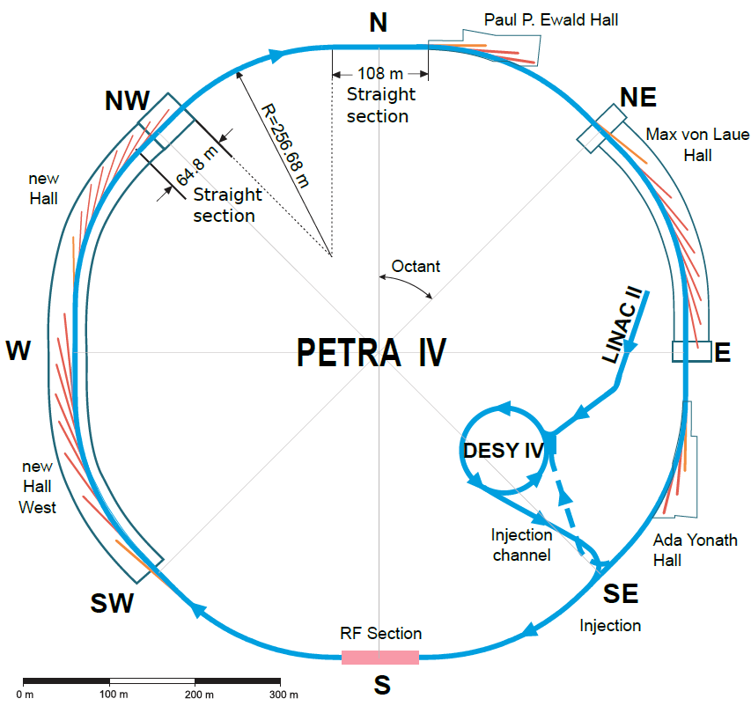
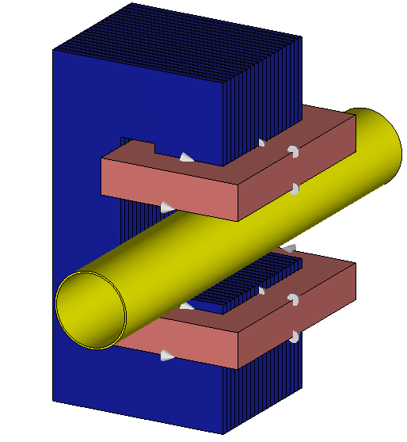
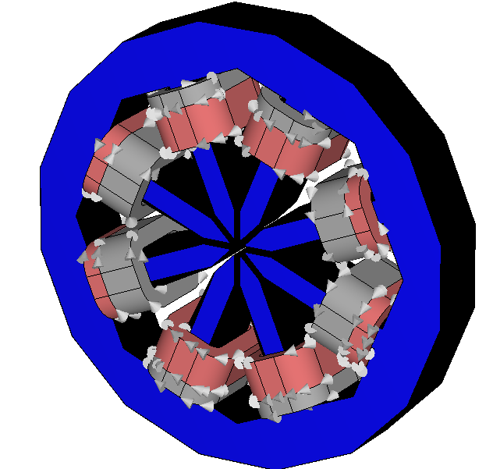
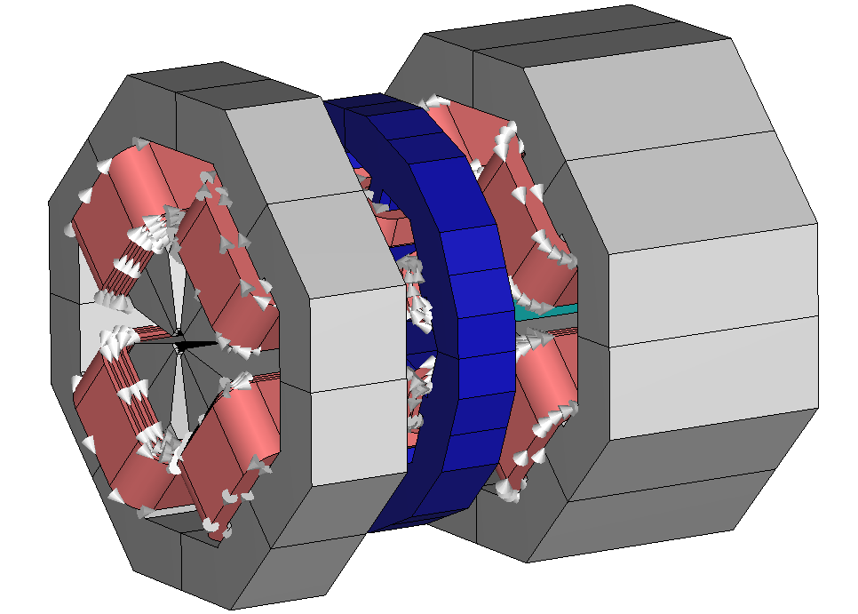
Finite Element Simulation of fast corrector magnets for petra iv
Jan-Magnus Christmann¹, Moritz von Tresckow¹, Herbert De Gersem¹, Alexander Aloev², Sajjad H. Mirza², Sven Pfeiffer², and Holger Schlarb²
¹TEMF, TU Darmstadt, Germany
²DESY, Hamburg, Germany
PETRA IV Conceptual Design Report
Notes:
.

Slide 2
Contents
1
6
Introduction
Conclusion/Outlook
2
Homogenization Technique
3
Toy Model
4
Stand-Alone Corrector Magnet
5
Corrector Magnet with Neighboring Quadrupoles
Notes:
We will start with an introduction motivating this work and explaining why simulating these orbit correctors is computationally very demanding.
Then, we explain a technique to ease the computational effort by homogenizing the laminated yoke of the magnets.
Next, we investigate the toy model and use it to validate the homogenization technique.
And this homogenization is then applied to the realistic model of an orbit corrector magnet for PETRA IV and we will give an overview of the studies that we are conducting with this technique.
Finally, we give a conclusion and an outlook.

Slide 3
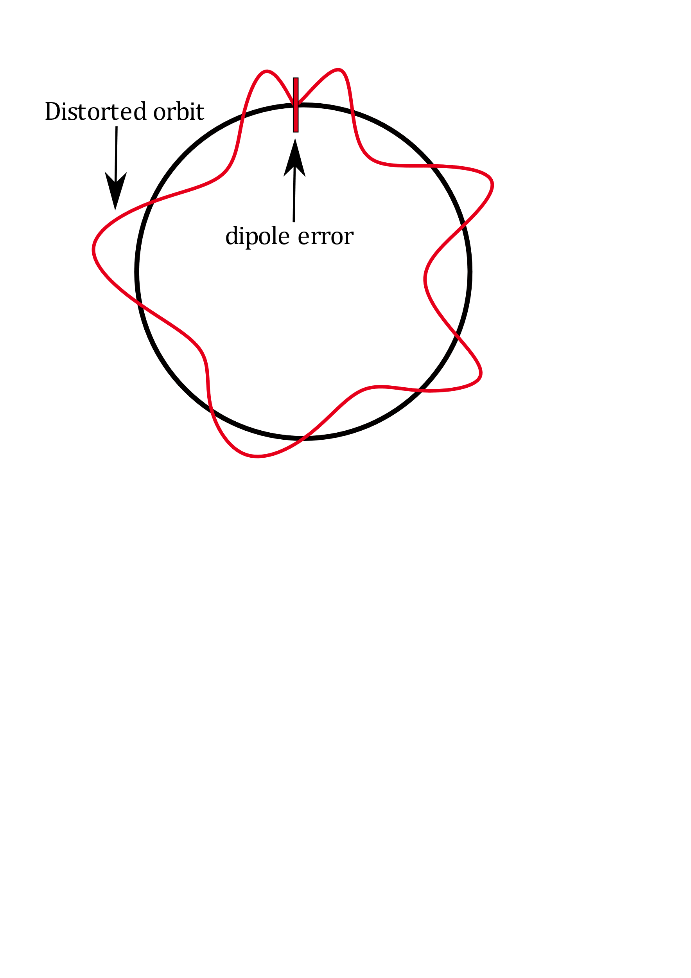
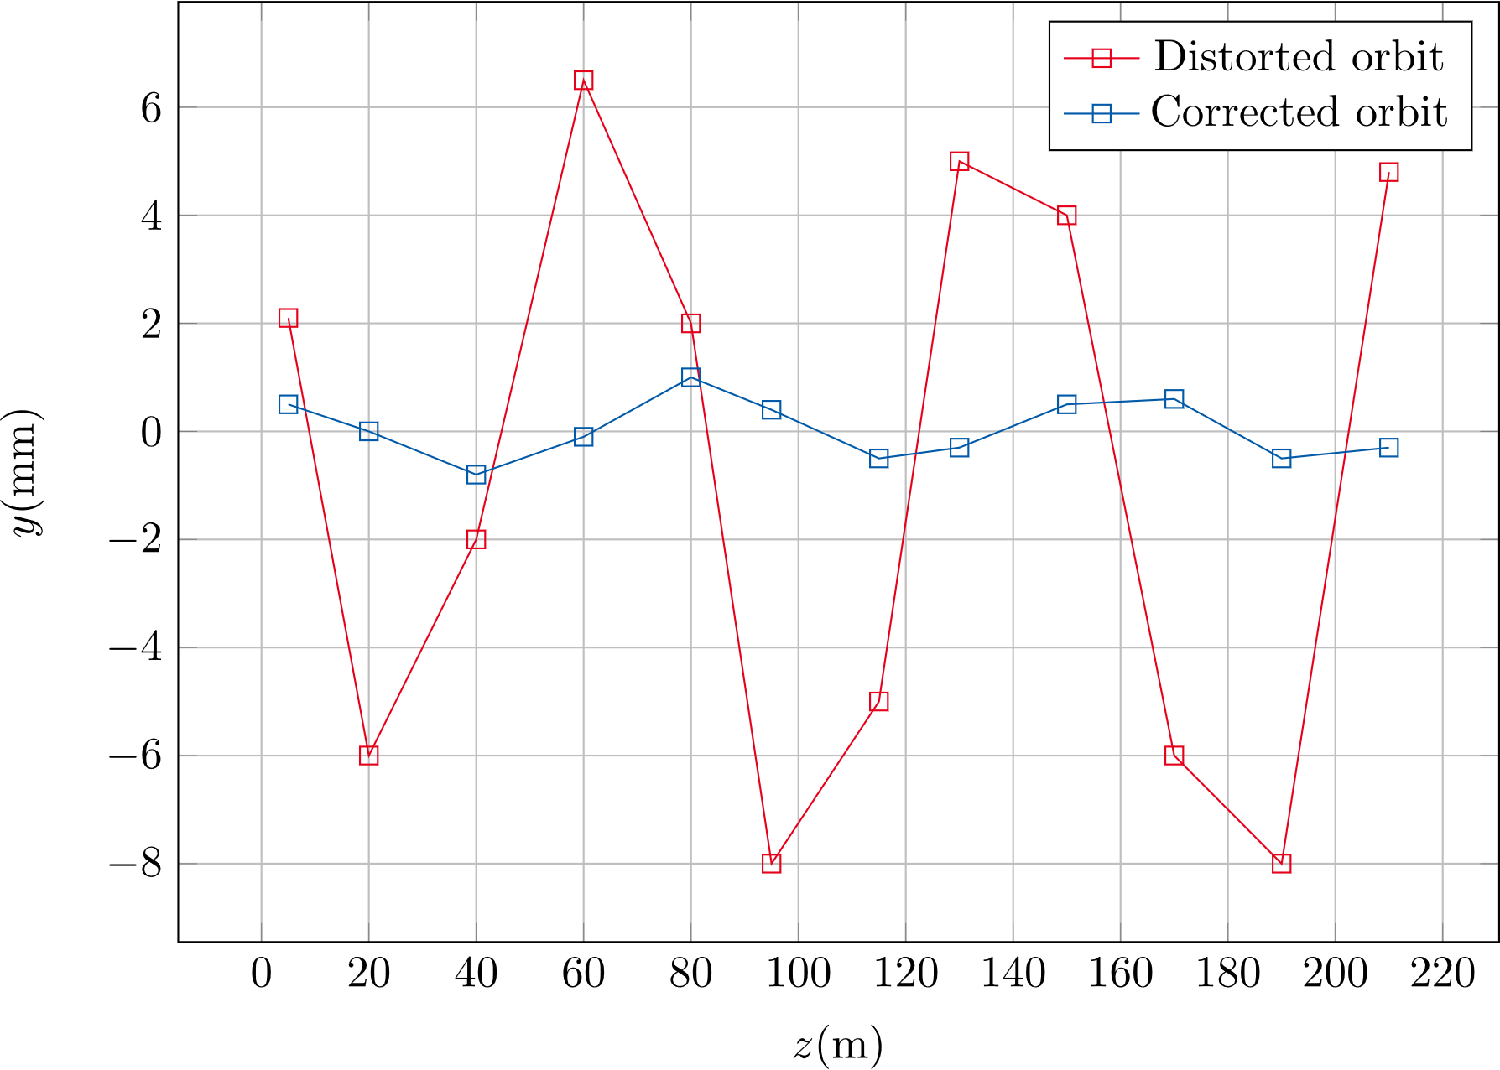
Introduction
Introduction
Circular accelerators need dipole magnets to correct orbit distortions
PETRA IV: ultra-low emittance synchrotron radiation source
fast orbit feedback system, corrector magnets with frequencies in kHz range necessary
Strong eddy currents ➔ power losses, time delay, and field distortion
Simulation challenging due to small skin depths and laminated yoke
➔ Need for technique to simplify simulations
Notes:
Large circular accelerators employ special dipole magnets to correct orbit distortions, which are for example caused by field errors in the bending magnets, by vibrations in the environment, or noise coming from the power supply.
Such a distorted orbit is depicted in the lower right, in an exaggerated way of course.
Since PETRA IV will be an ultra-low emittance synchrotron radiation source, it is in this case especially important to keep these distortions under control. For this purpose, hundreds of orbit corrector magnets will be installed and some of them will operate at frequencies in the kHz range, which gives rise to strong eddy currents.
These eddy currents cause power losses, time delay and distortions in the magnetic field. All of which
are highly undesirable effects that should be predicted via FE simulations.
However, due to the small skin depths at high frequencies and the laminated structure of the magnets yoke, a very fine mesh is necessary which leads to a very high computational effort and long simulation times.
Therefore, we need a technique that can simplify the simulations drastically but still captures the eddy current effects accurately.

Slide 4
Contents
1
6
Introduction
Conclusion/Outlook
2
Homogenization Technique
3
Toy Model
4
Stand-Alone Corrector Magnet
5
Corrector Magnet with Neighboring Quadrupoles

Slide 5
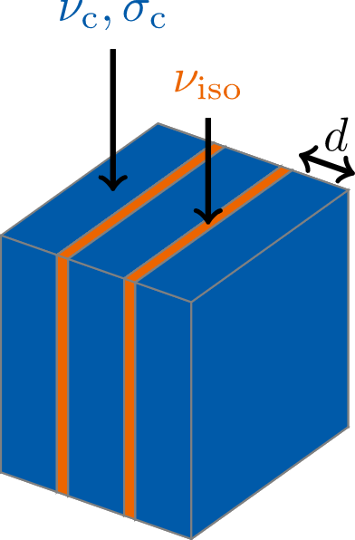
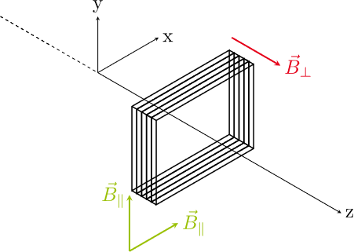
Homogenization Technique
Homogenization technique
Magnetoquasistatic PDE: $∇×\underset{ }{(ν(}\vec{r} )∇×\underline{\vec{A}} \left(\vec{r}\right))+jωσ(\vec{r})\underline{\vec{A}}(\vec{r})= {\vec{\underline{J}}}_{s}(\vec{r})$
Replace reluctivity $ν(\vec{r})$ and conductivity $σ(\vec{r})$ in the laminated yoke with spatially constant tensors
$$ν(\vec{r})→\overset{̿}{\underline{ν}}=\frac{1}{8}σ_{c}dδω\left(1+j\right)\frac{\sinh{(\left(1+j\right)δ^{−1}d)} }{\sinh^{2}\left(\left(1+j\right)δ^{−1}d/2\right) }\left[\begin{matrix}1 & 0 & 0 \\ 0 & 1 & 0 \\ 0 & 0 & 0\end{matrix}\right]+ν_{c}\left[\begin{matrix}0 & 0 & 0 \\ 0 & 0 & 0 \\ 0 & 0 & 1\end{matrix}\right]$$
$$σ(\vec{r})→\overset{̿}{σ}=γσ_{c}\left[\begin{matrix}1 & 0 & 0 \\ 0 & 1 & 0 \\ 0 & 0 & 0\end{matrix}\right]$$
Skin depth $δ= \sqrt{2/{ωσ_{c}μ_{c}}}$
Stacking factor $γ= \frac{V_{c}}{V_{Yoke}}$
P. Dular et al., 2003
L. Krählenbühl et al., 2004
H. De Gersem et al., 2012
Notes:
And the homogenization technique we are using is explained here on this slide.
So let’s first look at the typical magnetoquasistatic PDE which we have to solve when we are simulating such a magnet.
And we look at the equation in the frequency domain because we will be dealing exclusively with frequency domain simulations.
Here A is the magnetic vector potential, Js is the applied current density in the coils, nu is the reluctivity and
Sigma is the conductivity.
Inside the laminated yoke of the magnets, the reluctivity and the conductivity are functions of the spatial coordinate since they are different for the conducting laminates shown here in blue and the isolation sheets in between, shown in orange.
And the homogenization now consists in replacing nu and sigma inside
the yoke with these spatially constant material tensors. Herein, delta is the skin depth, d is the lamination thickness and gamma is the so-called stacking factor which is the percentage of the yoke’s volume that consists of conducting material.
The coordinate system is chosen as shown here in the graphic: The z-direction is perpendicular to the lamination stack.
In the x- and y-component of the complex relucitivity tensor, we have this term with the hyperbolic functions which is derived from the analytical field solution for one lamination and in the z-component we just have the reluctivity of the conducting laminates.
For the conductivity tensor we weight the x- and y- components with the stacking factor and set the z-component to
zero. Which models the fact that there is no current passing through the isolation.

Slide 6
Contents
1
6
Introduction
Conclusion/Outlook
2
Homogenization Technique
3
Toy Model
4
Stand-Alone Corrector Magnet
5
Corrector Magnet with Neighboring Quadrupoles

Slide 7
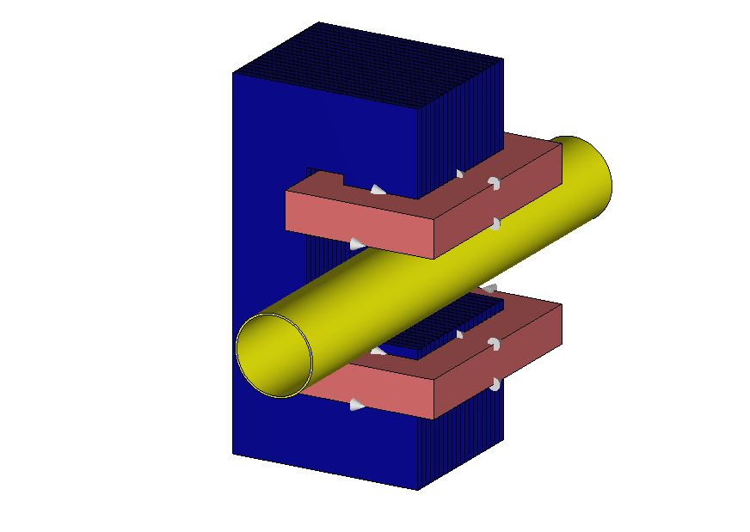
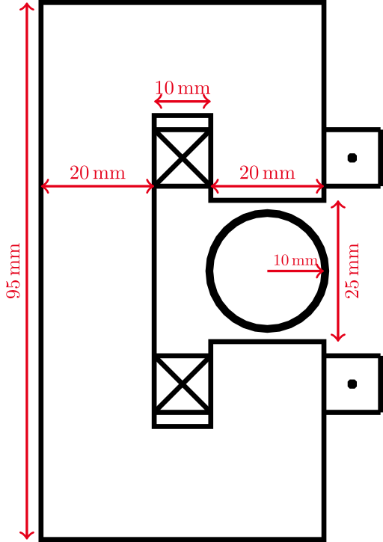
Toy Model
Model Description
Iron yoke: length = 40 mm, lamination thickness = 1.83 mm
Copper beam pipe: thickness = 0.5 mm, length = 140 mm
Coils: current = 10 A (peak), # turns = 250
Frequency domain simulation via ${\text{CST} \text{Studio} \text{Suite}}^{\text{® }}$
Notes:
First, we describe the model, which is shown here. We have a normal conducting dipole magnet with an iron yoke that is 40 mm long with a lamination thickness of 1.83 mm.
The transversal dimensions are summarized in the sketch on the right.
and the copper beam pipe has a thickness of 0.5 mm and a length of 140 mm.
The coils have 250 turns, carrying a peak current of 10 A.
For this model we conduct frequency domain simulations in CST.

Slide 8
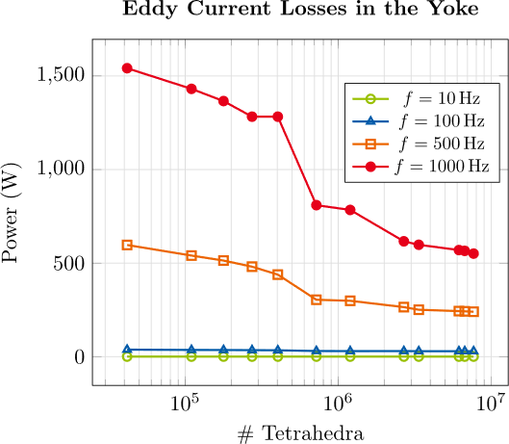
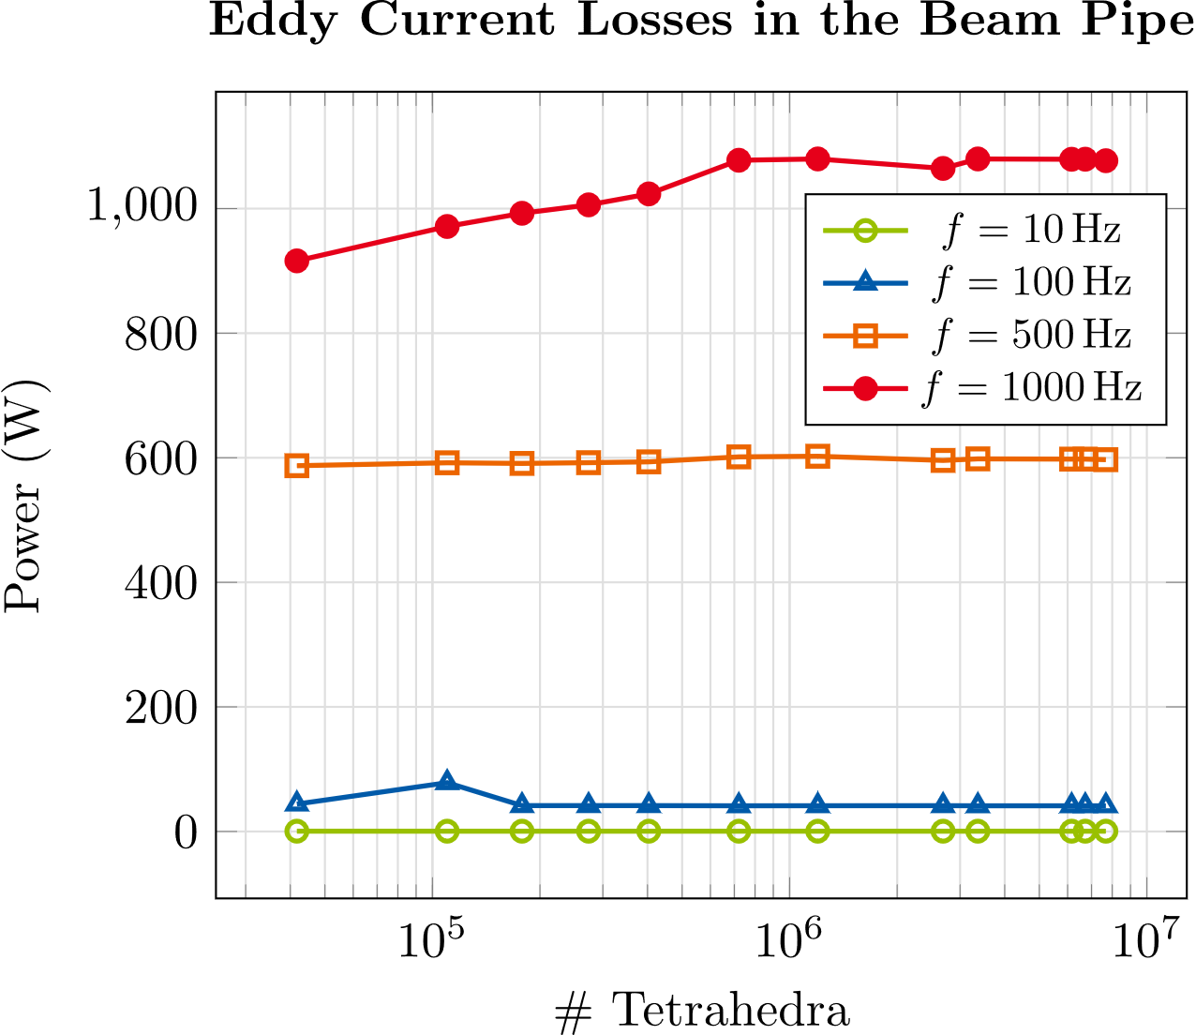
Toy model
Simulation of the full model
Strong mesh dependence of power losses at higher frequencies
Obtaining reliable results is difficult
Need for simplified model
# Tetrahedra | $$4.2⋅{10}^{4}$$ | $$4.0 ⋅{10}^{5}$$ | $$1.2⋅{10}^{6}$$ | $$3.4⋅{10}^{6}$$ | $$7.7⋅{10}^{6}$$
Simulation time | $$2 min$$ | $$20 min$$ | $$1 h$$ | $$7.5 h$$ | $$21.5 h$$
Notes:
An in doing so, one notices that it is not easy to reach stable results.
We can see here in the plots the power losses at four test frequencies as a function of the number of tetrahedra in the mesh.
On the left in the iron yoke and then on the right in the beam pipe.
Especially when looking at the losses in the yoke we notice a strong mesh dependence at higher frequencies which can be attributed to the small skin depths which must be resolved to reach stable results.
To get this under control one has to invest a lot of simulation time, which is shown here in the table:
For the last shown data point on the right we have already 7.7*10^6 tetrahedra and a simulation time of 21.5 h.
So this really shows that even for this toy model, a simplification of the model would be very useful and to that end we use the homogenization techniques.

Slide 9
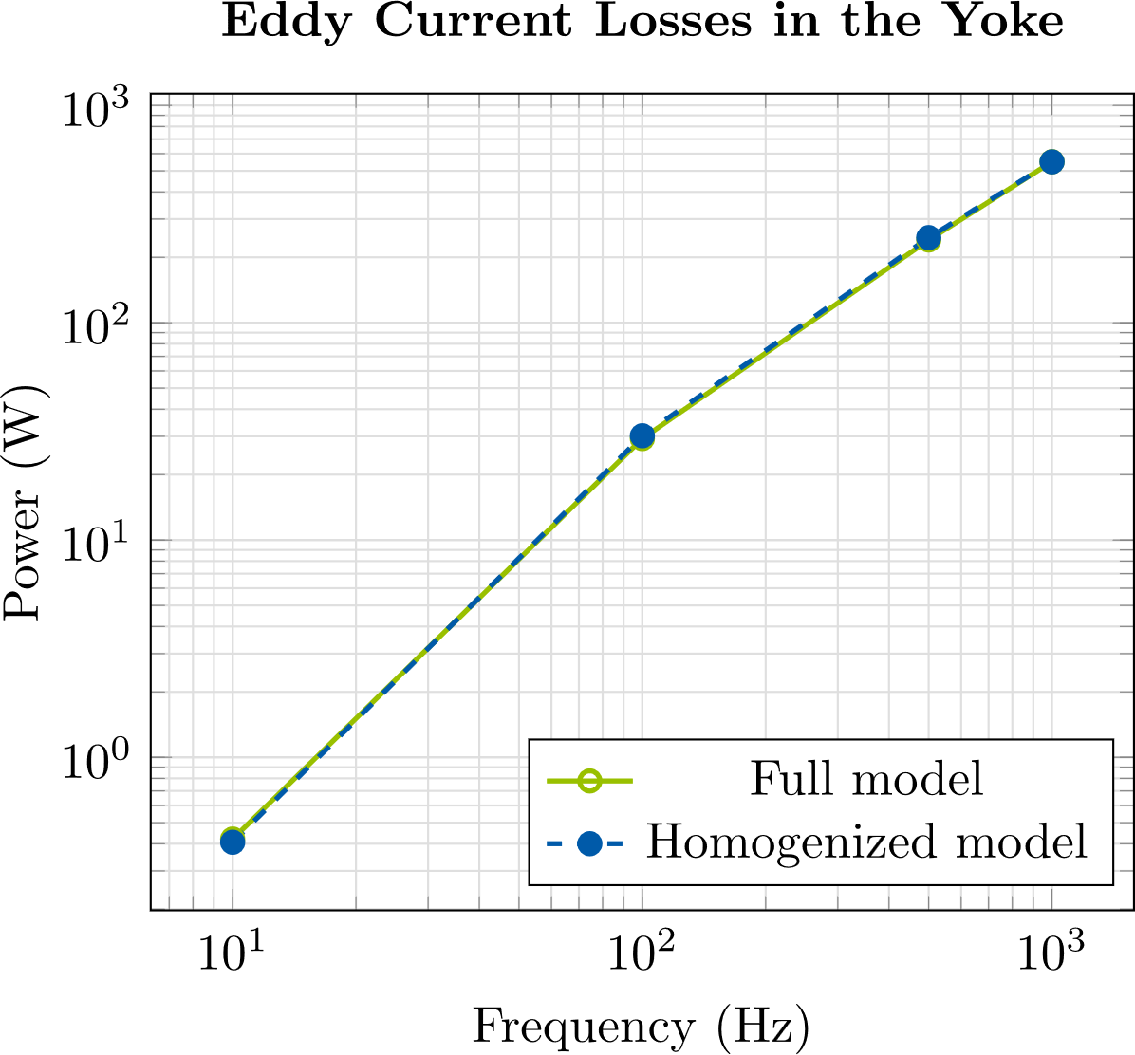
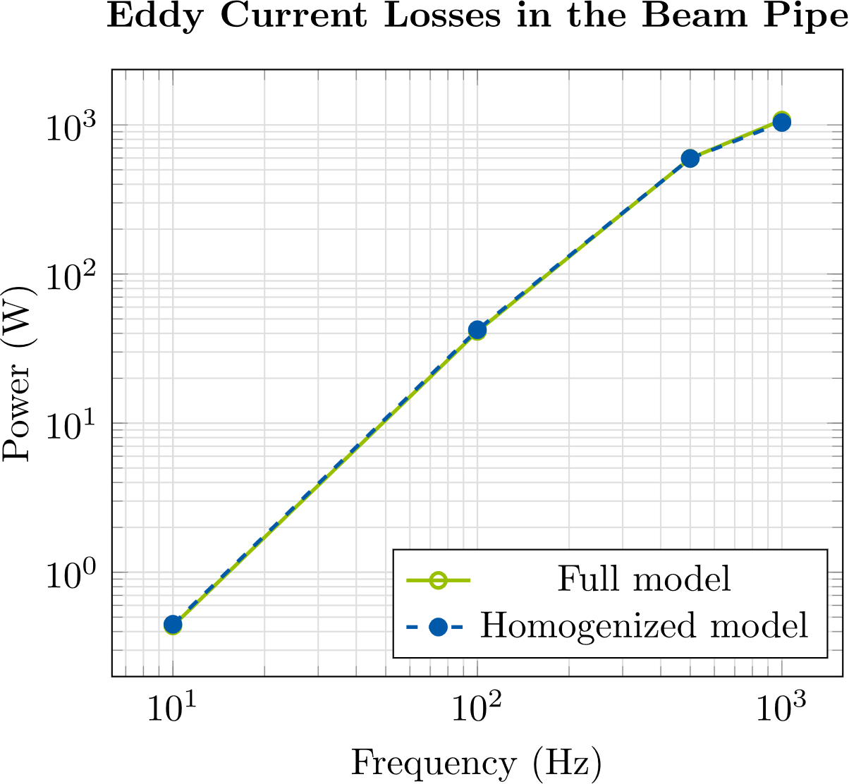
Toy Model
Homogenized vs. full model
Good approximation of losses in yoke & beam pipe (max. relative error 4 %)
Simulation time reduced from several hours to 4 min
Notes:
So now lets see how the homogenization technique performs.
First in terms of the approximation of the power losses.
The green solid line, these are the losses in the full model, where all laminations are resolved individually. And then the blue dashed line are the results obtained with the homogenization technique.
We observe that we get a really good approximation of the losses in the full model for all frequencies, with a maximum relative error of 4 % for both the losses in the yoke and in the beam pipe and the simulation time drops from several hours to just four minutes.

Slide 10
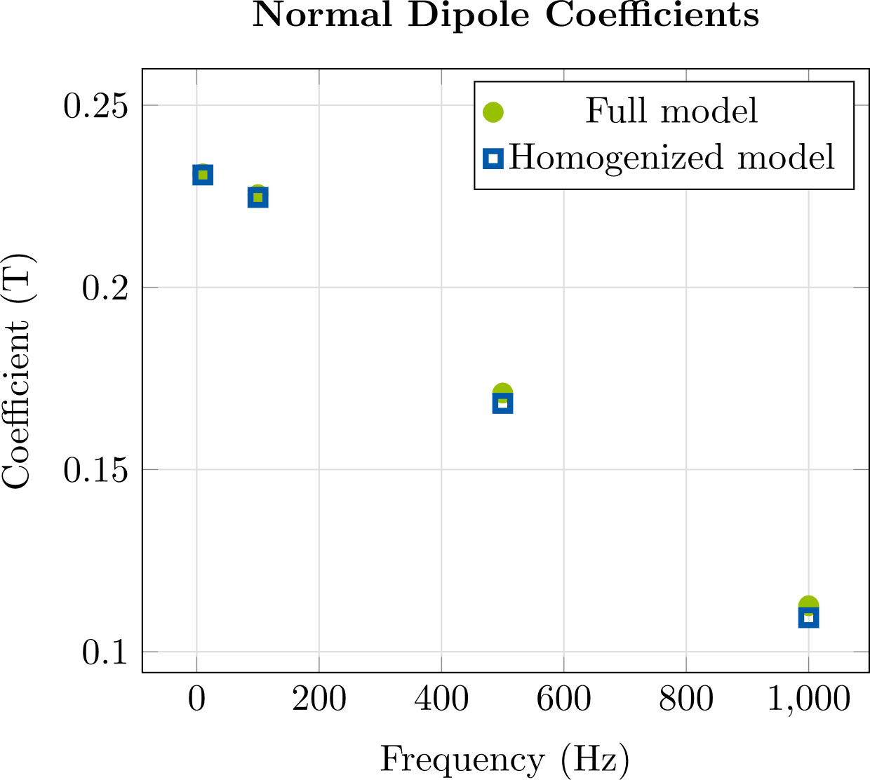
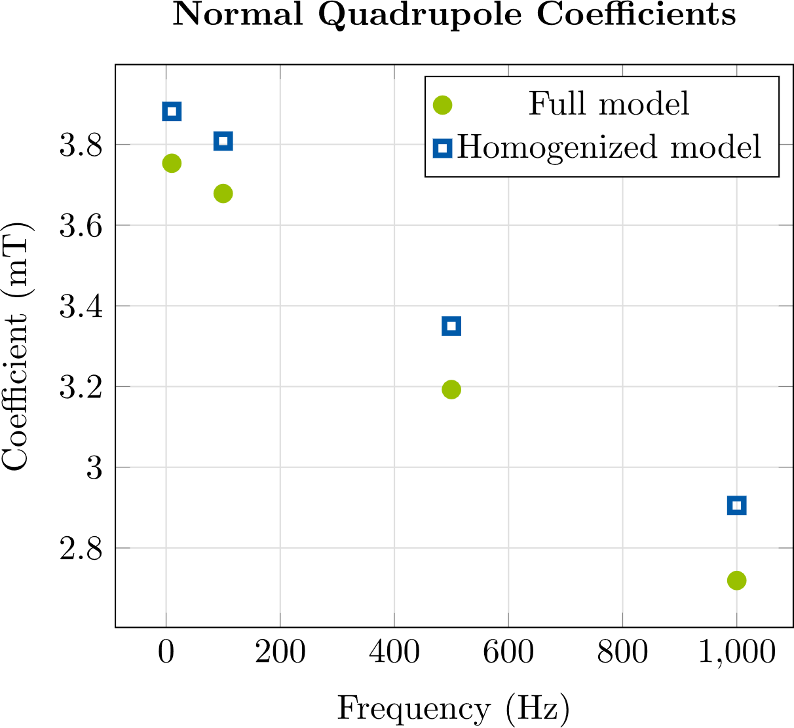
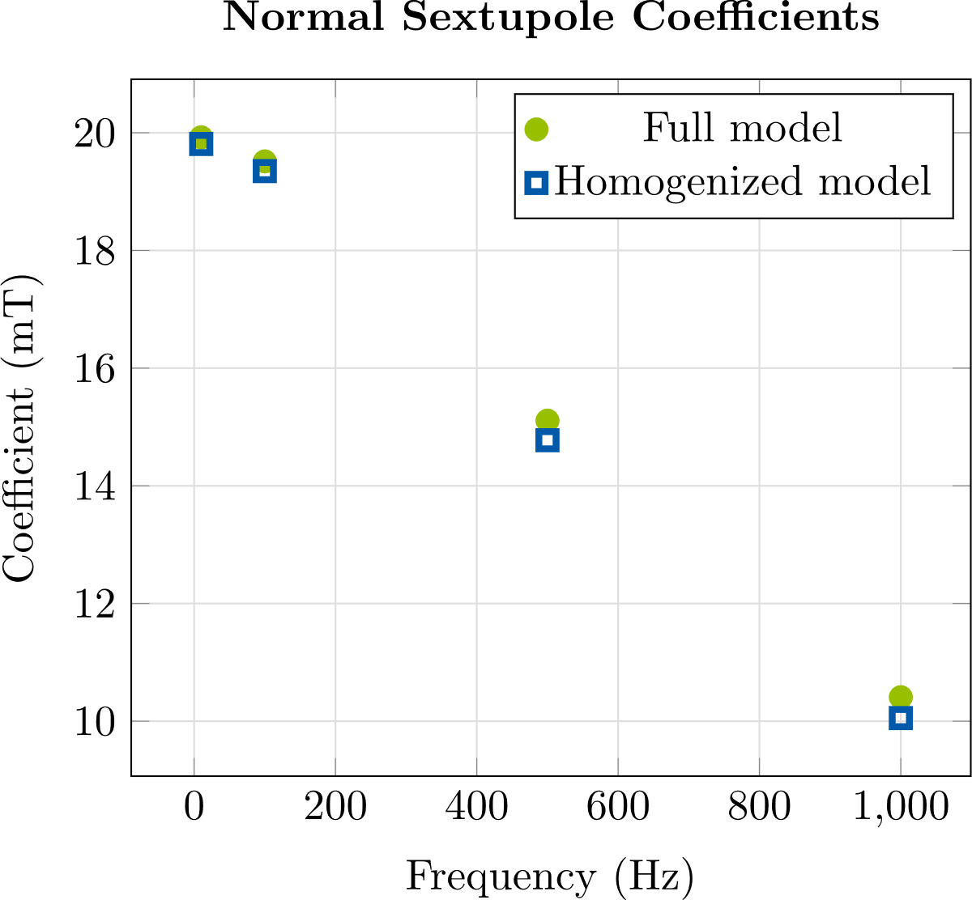
Toy Model
Homogenized vs. Full model
Homogenization technique yields accurate approximation of multipole coefficients ➔ Aperture field accurately represented
Multipole coefficient | Average rel. error
Dipole | $$1 \%$$
Quadrupole | $$5 \%$$
Sextupole | $$2 \%$$
Notes:
Next, we come to the approximation of the multipole coefficients.
We see here the Dipole, Quadrupole and Sextupole Coefficients.
We observe very good agreement between the full and the homogenized model, with the strongest deviations occurring in the quadrupole coefficients. But also for these coefficients we get a good approximation with an average relative error of 5 %.
And overall we can say that the homogenization technique does not only yield a good approximation of the power losses, but it also accurately represent the field distribution inside the aperture.

Slide 11
Contents
1
6
Introduction
Conclusion/Outlook
2
Homogenization Technique
3
Toy Model
4
Stand-Alone Corrector Magnet
5
Corrector Magnet with Neighboring Quadrupoles

Slide 12
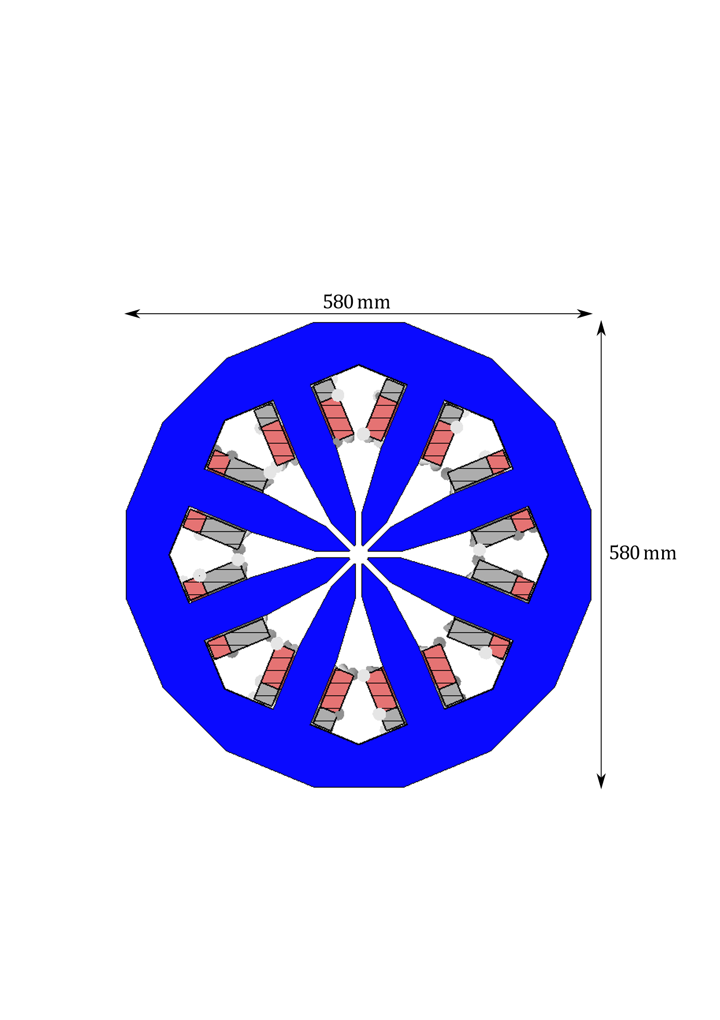
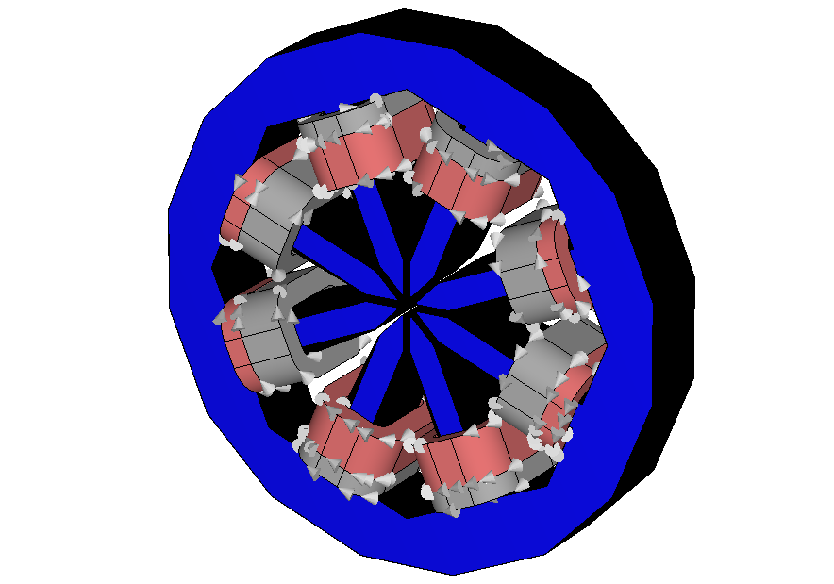
Stand-alone Corrector Magnet
Model Description
Dipole corrector with octupole-like design
Coils:
4 main coils: current = 27.4 A (peak), # turns = 53
4 auxiliary coils: current = 27.4 A (peak), # turns = 22
Iron yoke:
Diameter = 580 mm, length = 90 mm
Lamination thickness = 0.5 mm
At first no beam pipe
main coil
auxiliary coil
Design by A. Aloev (DESY),
inspired by APS
Notes:
But first we give a short description of the model.
The model is a dipole corrector magnet with an octupole-like design. So we have here these eight posts pointing to the aperture and on each
Of them we have two coils, one thick main coil and a thinner auxiliary coil only one of which carries current. The active, current-carrying coils are shown here in red and the ones that don’t carry current are shown in gray.
If the coils are powered as shown, the magnet produces a vertical field and if the roles of the active and inactive coils are switched, we get a horizontal field.
The main coils have 53 turns, the auxiliary coils have 22 turns and both get a current of 27.4 A
The transversal dimensions are shown here, the longitudinal extent is 90 mm and the lamination thickness 0.5 mm.
And at first we have not included a beam pipe.

Slide 13
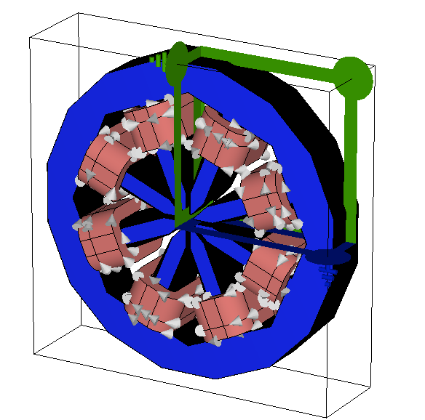
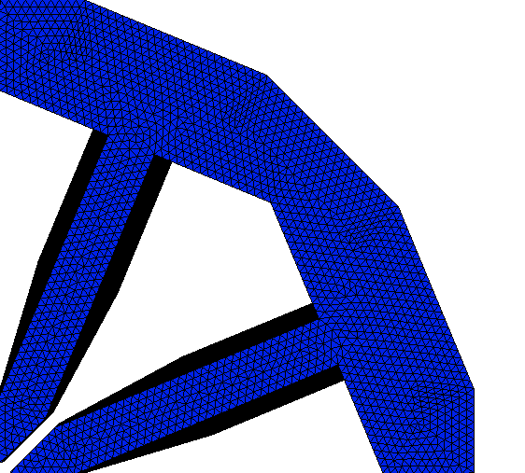
Stand-alone Corrector Magnet
Simulation of the full model
Frequency domain simulation via ${\text{CST} \text{Studio} \text{Suite}}^{\text{® }}$
Three symmetry planes, test frequencies $f=10 Hz, 100 Hz, 500 Hz, 1 kHz$
Long simulation times even for relatively coarse meshes
Finest mesh: # tetrahedra = $2.3⋅{10}^{6}$➔ simulation time = 26 h
Skin depth cannot be resolved ➔ power loss still mesh-dependent
Notes:
Again we conduct frequency domain FE simulations in CST, at the four test frequencies and we use all
three symmetry planes.
Simulating this model is very difficult because we get very long simulation times even for relatively coarse meshes.
The finest mesh we could use, which is also shown has 2.3*10^6 tetrahedra which leads to a total simulation time of 26 h for these 4 frequency points.
Despite these long simulation times, the skin depths cannot be resolved such that the power loss is still mesh dependent.

Slide 14
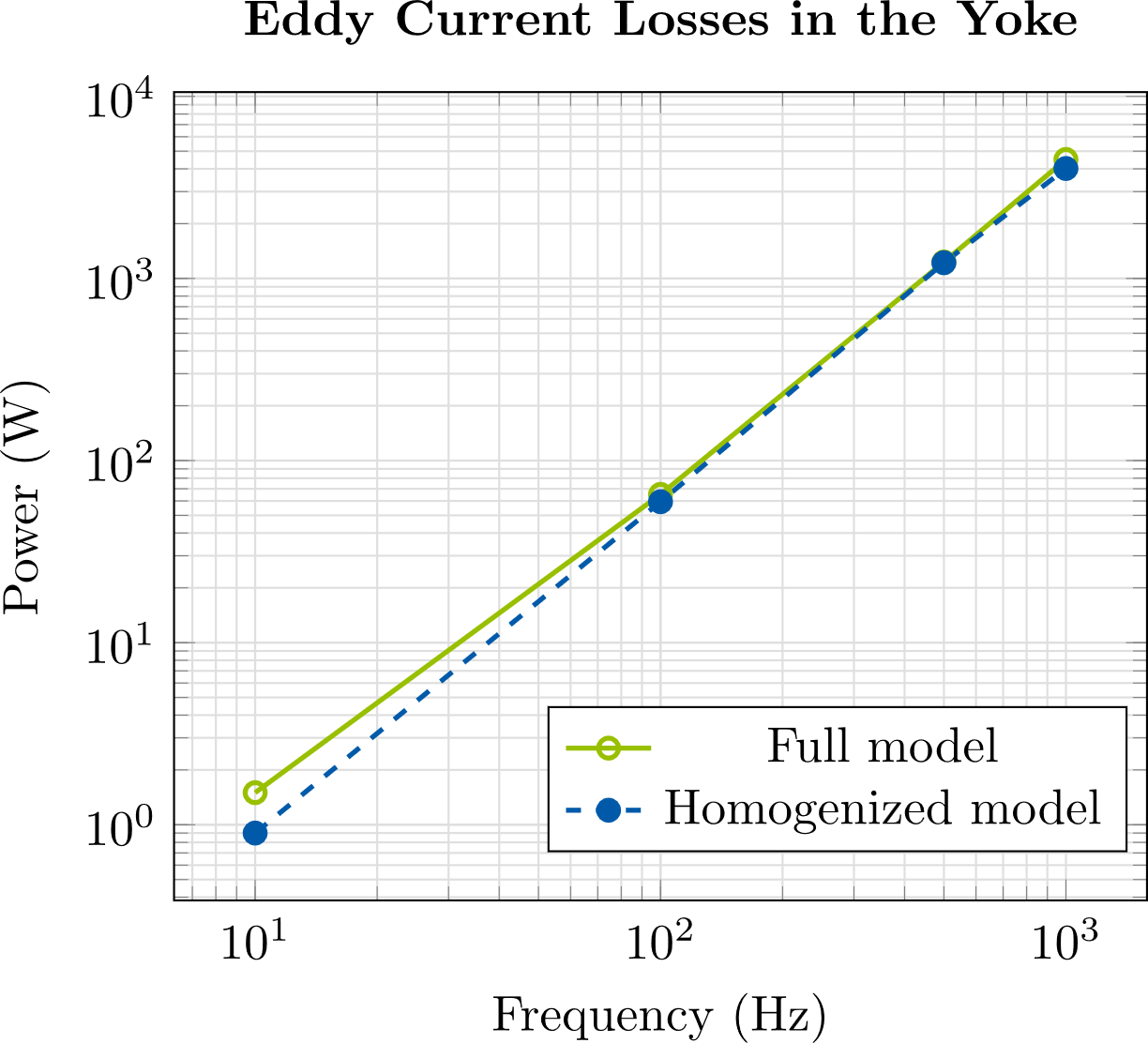
Stand-alone Corrector Magnet
Homogenized vs. full model
Multipole coefficient | Average rel. deviation
Dipole | $$1 \%$$
14-pole | $$1 \%$$
18-pole | $$3 \%$$
Similar power losses
Good agreement in multipole coefficients
Simulation time reduces from 26 h to 5 min
➔ Homogenized model can be used for further studies
Keep in mind: Power losses in full model are still mesh-dependent !
Notes:
Nevertheless, lets compare the results of the full model to those of the homogenized model,
Lets first look at the plot on the left, where we see the eddy current losses in the yoke. Here we have to keep in mind that the losses in the full model are still mesh-dependent. But still,we can see that we obtain the quite similar results with the full and the hom. Model and the simulation time is greatly reduced from 26h to 5min.
Ok and next to the plot in the table we can see the average relative deviations of the multipole coefficients computed with the homogenized model from those computed with the full model. Here, we look at the dipole, 14- and 18-pole coefficients because the quadrupoles, octupoles, … are zero due to symmetry and the sextupoles and decapoles are also very small due to the particular choice of the number of turns and currents in the coils .
Here we observe very good agreement between the full and the homogenized model.
Based on all of these results we come to the conclusion that we can use the homogenization technique for further studies of this octupole-like model.

Slide 15
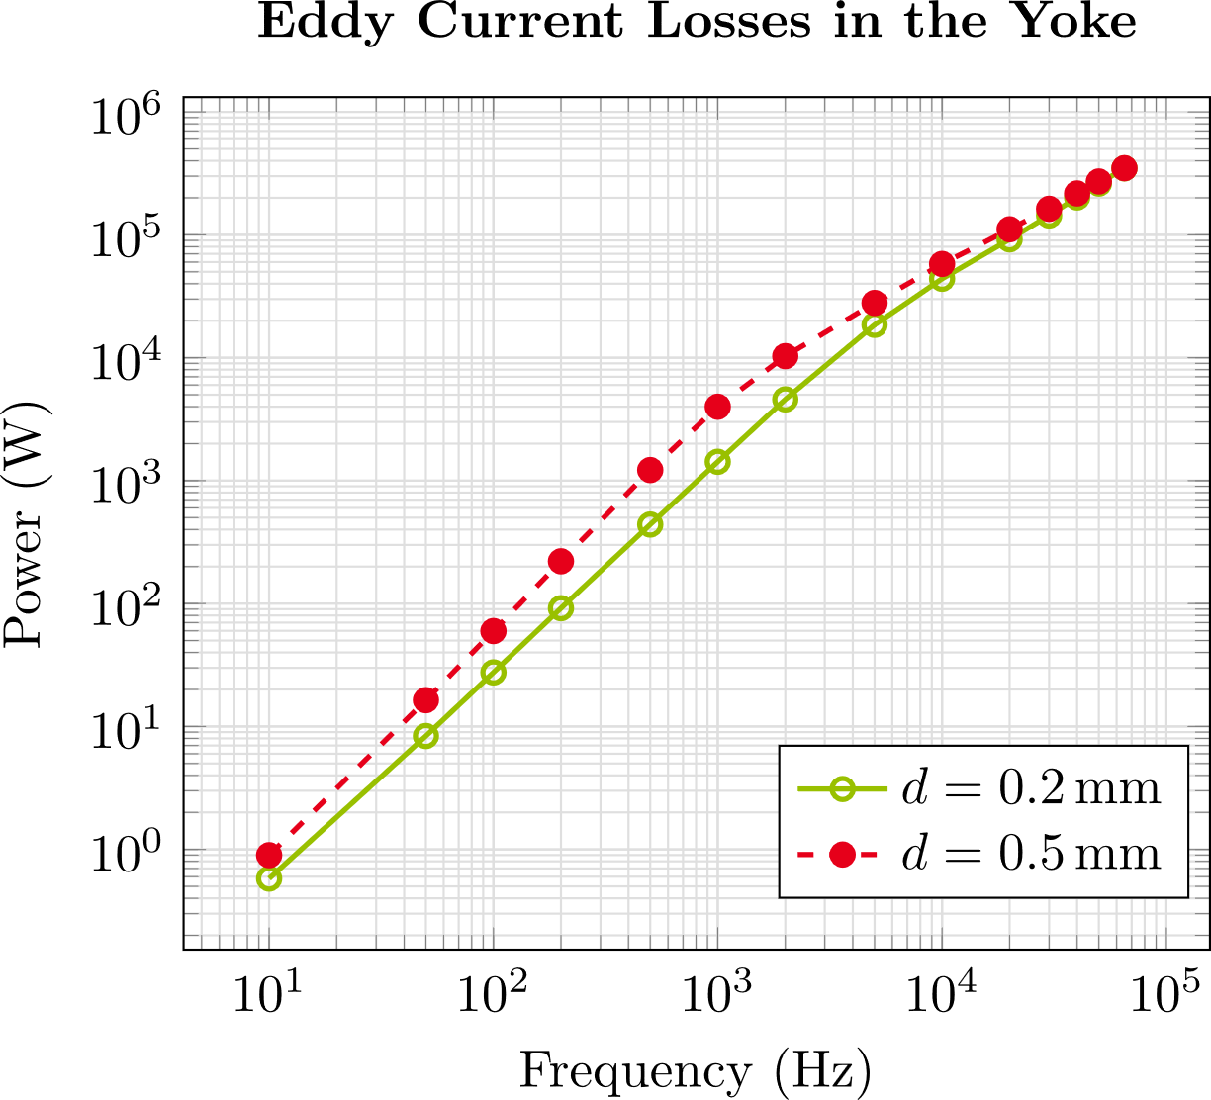
Stand-alone Corrector Magnet
losses for different lamination thicknesses
Use homogenization to investigate losses up to $65 kHz$
Vary $d=0.2 −0.5 mm$, keep $γ≈0.91$ constant
At low frequencies, the lamination thickness has strong influence on the losses
At very high frequencies, the lamination thickness has no influence on the losses
$f$(Hz) | Eddy current losses (W)
 | $$d=0.2 mm$$ | $$d=0.3 mm$$ | $$d=0.4 mm$$ | $$d=0.5 mm$$
10 | $$5.8⋅{10}^{−1}$$ | $$6.5⋅{10}^{−1}$$ | $$7.6⋅{10}^{−1}$$ | $$9.0⋅{10}^{−1}$$
100 | $$2.8⋅{10}^{1}$$ | $$3.4⋅{10}^{1}$$ | $$4.6⋅{10}^{1}$$ | $$6.0⋅{10}^{1}$$
500 | $$4.4⋅{10}^{2}$$ | $$6.2⋅{10}^{2}$$ | $$9.0⋅{10}^{2}$$ | $$1.2⋅{10}^{3}$$
1000 | $$1.4⋅{10}^{3}$$ | $$2.1⋅{10}^{3}$$ | $$3.1⋅{10}^{3}$$ | $$4.0⋅{10}^{3}$$
10000 | $$4.4⋅{10}^{4}$$ | $$4.9⋅{10}^{4}$$ | $$5.5⋅{10}^{4}$$ | $$5.8⋅{10}^{4}$$
30000 | $$1.4⋅{10}^{5}$$ | $$1.6⋅{10}^{5}$$ | $$1.6⋅{10}^{5}$$ | $$1.6⋅{10}^{5}$$
65000 | $$3.5⋅{10}^{5}$$ | $$3.6⋅{10}^{5}$$ | $$3.6⋅{10}^{5}$$ | $$3.5⋅{10}^{5}$$
Simulation uses the same current for all frequencies !
Notes:
In the following I just want to give an overview of the kind of studies that we are currently conducting with the help of this homogenization technique.
The first study concerns the power losses. In this study, we use the homogenized model to investigate the losses in the yoke for frequencies up
To 65 kHz.
And we vary the lamination thickness between 0.2 and 0.5 mm while we keep the stacking factor gamma const. at roughly 91 %.
And it should also be mentioned here that in the simulation the same current is supplied to the coils over the whole frequency range. In reality the power supply won’t be able to maintain the same current as the frequency is increased. Therefore the losses
In the real magnet will be much smaller, but our results can just be scaled to the actual current.
With that in mind, the results for the thickest and the thinnest lamination thickness in the investigated range are shown in the plot on the left, the results for the other lamination thicknesses are shown in the table.
If we look at the losses at 10 Hz in the first row, there is roughly a factor 1.5 between the losses with the thinnest and the thickest lamination thickness.
At 100 Hz we have a factor of more than 2 and at 1000 Hz there is almost a factor of 3.
But at the very high frequencies, so at 30 kHz and 65 kHz, the losses are essentially the same for all lamination thicknesses.
So we can conclude that at low and medium frequencies, the choice of the lamination thickness has a strong influence on the losses, but at the very high frequencies, it does not matter.

Slide 16
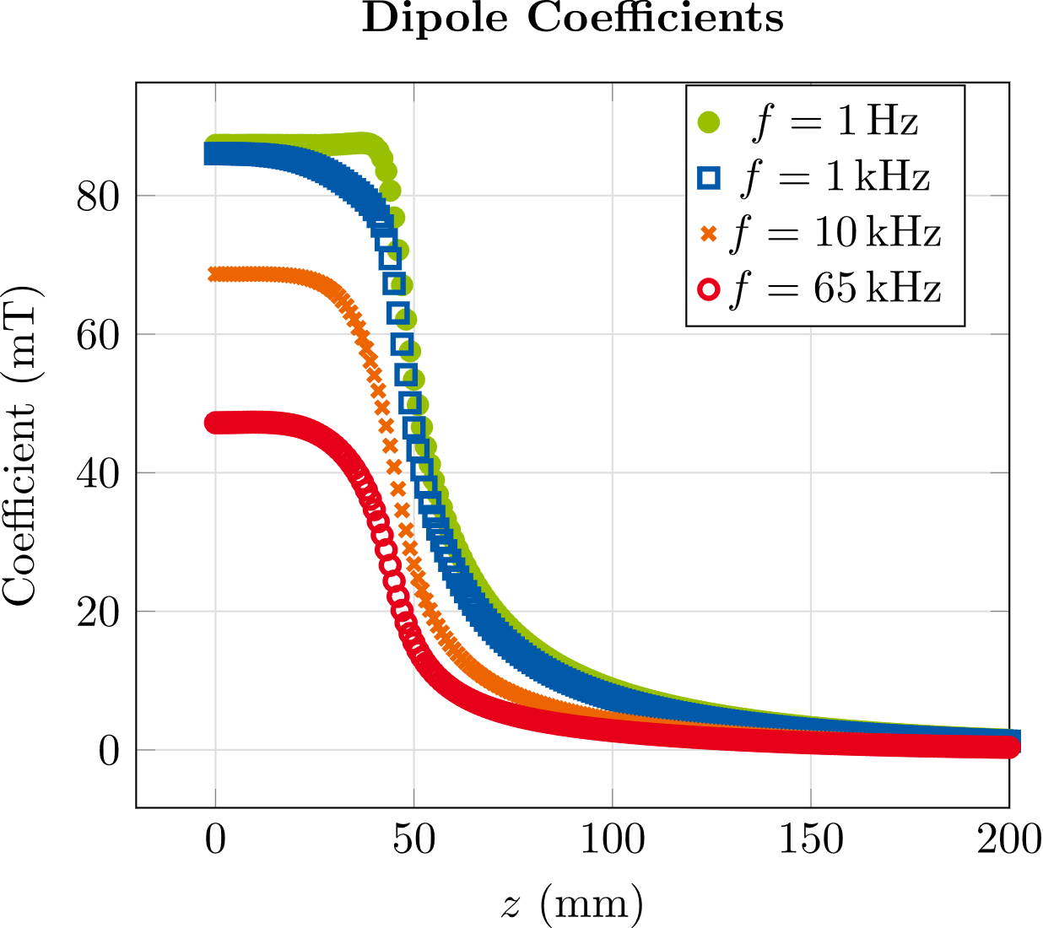
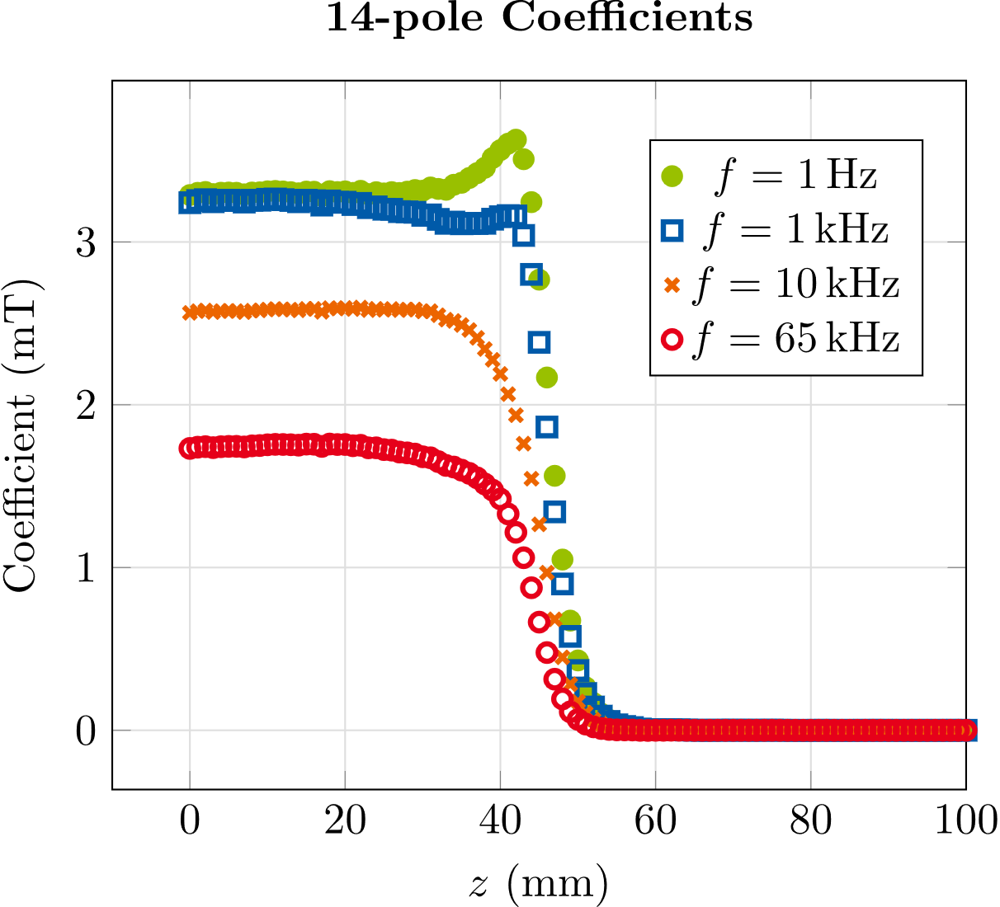
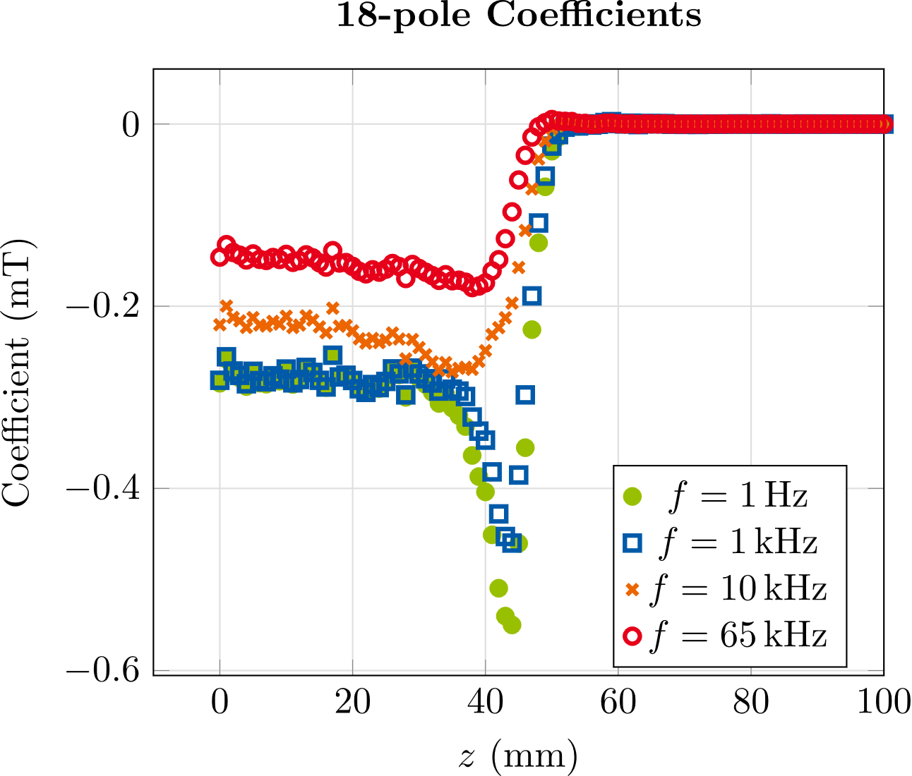
Stand-alone Corrector Magnet
Longitudinal Multipole Distribution
Updated # turns & current:
Main coils:$65$ turns, $15 A$
Aux. coils: $27$ turns, $15 A$
$65 kHz$ vs. $1 Hz$:
➔Int. dipoles: $−57 \%$
➔Int. 14-poles: $−52 \%$
➔Int. 18-poles: $−54 \%$
$f$ (Hz) | Int. dipole ($mT m$) | Int. 14-pole ($μT m$) | Int. 18-pole $(μT m)$
1 | $$11.6$$ | $$316.4$$ | $$−30.3$$
1000 | $$10.7$$ | $$300.4$$ | $$−28.6$$
10000 | $$7.6$$ | $$229.0$$ | $$−21.5$$
65000 | $$5.0$$ | $$150.3$$ | $$−13.9$$
Notes:
The next study concerns the distribution of the multipole coefficients along the magnets longitudinal axis.
I should mention here that at this point the number of windings and the value of the current have been changed so from now on all results are computed with main coils with 65 turns and auxiliary coils with 27 turns and both get a current of 15 A.
So in the plots we can see the longitudinal distributions of the dipole, 14-pole and 18-pole coefficients at different frequencies and in the table below we can see the integrated coefficients at these frequencies and some additional frequencies.
And looking at the integrated coefficients, we observe a decrease of 50-60 % over the whole frequency range due to the eddy currents in the yoke.

Slide 17
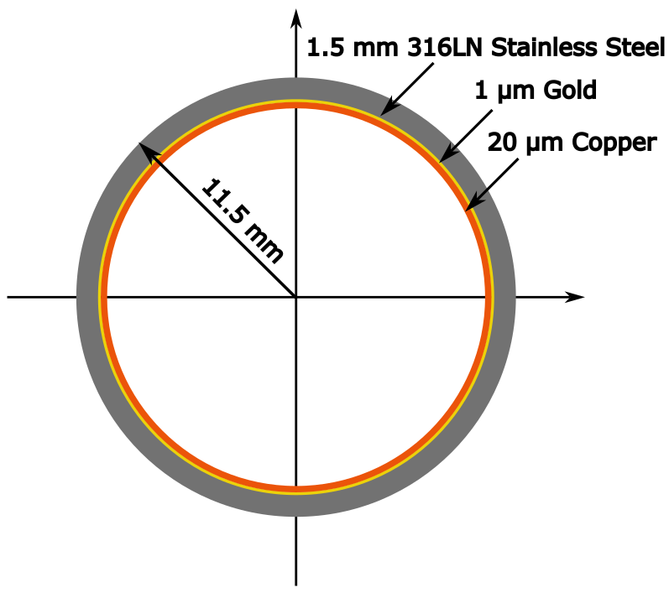
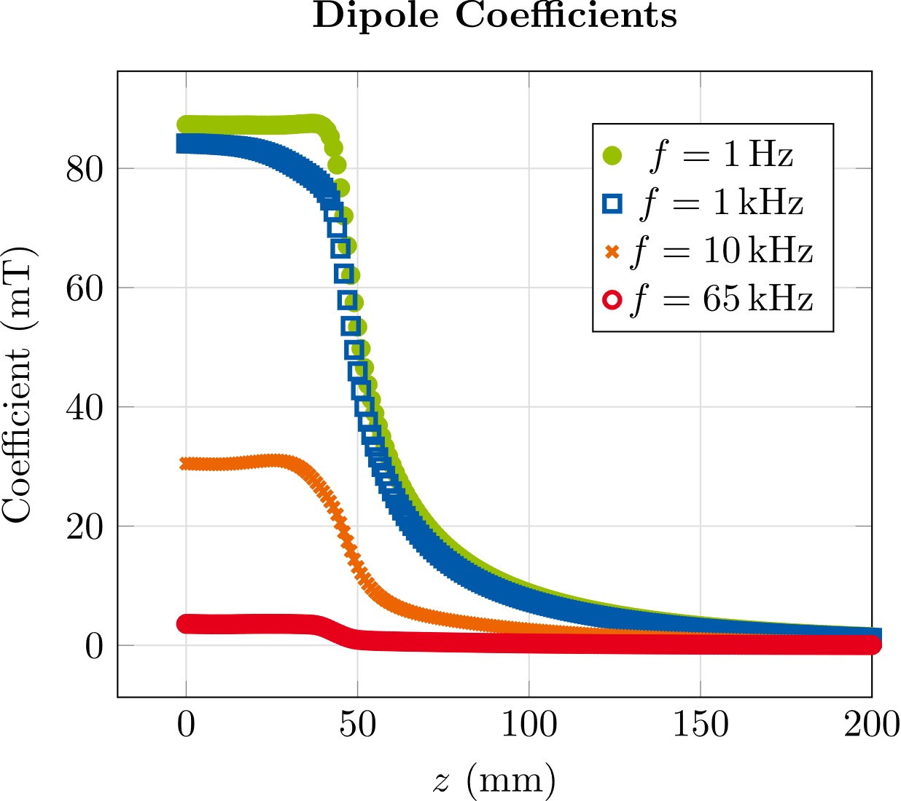
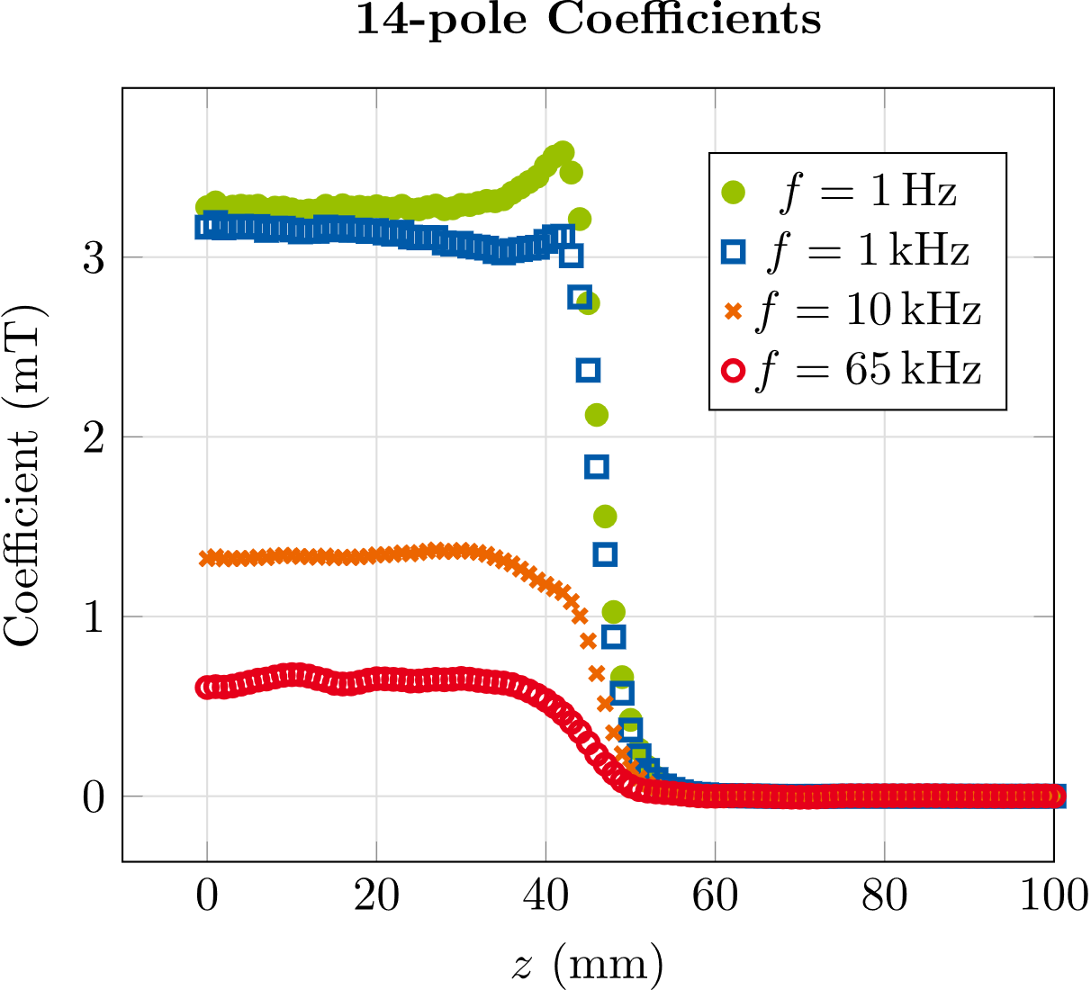
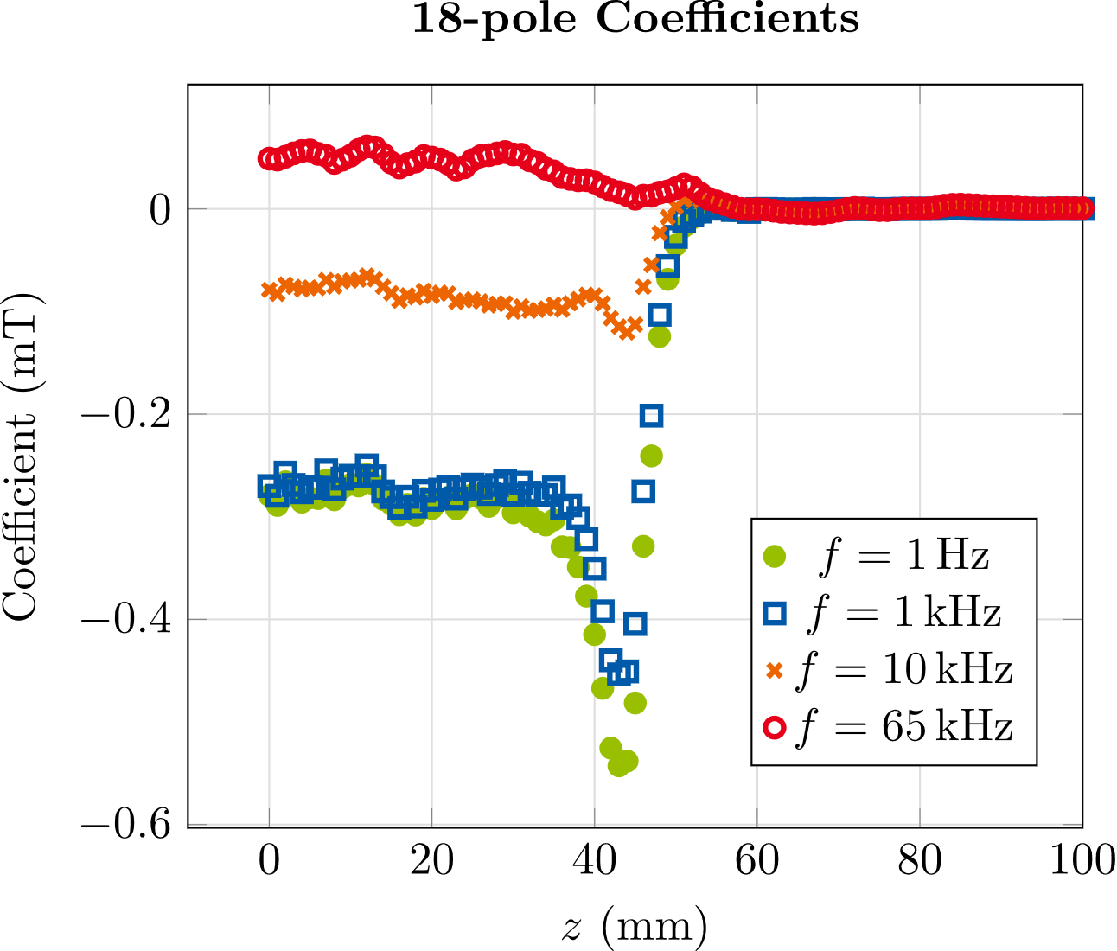
Stand-alone Corrector Magnet
Inclusion of Beam pipe
$$y$$
$$x$$
$f$ (Hz) | Int. dipole ($mT m$) | Int. 14-pole ($μT m$) | Int. 18-pole $(μT m)$
1 | $$11.5$$ | $$313.3$$ | $$−30.6$$
1000 | $$10.5$$ | $$292.7$$ | $$−28.1$$
10000 | $$3.6$$ | $$122.6$$ | $$−8.3$$
65000 | $$0.4$$ | $$57.4$$ | $$4.3$$
General shape similar to model without beam pipe
$65 kHz$ vs. $1 Hz$:
➔Int. dipoles: $−97 \%$ ($−57 \%$)
➔Int. 14-poles: $−82 \%$ ($−52 \%)$
➔Int. 18-poles change sign ($−54 \%)$
Notes:
Ok now let’s have a look at what happens if we include a beam pipe, in this case we have a round beam pipe with an outer radius of 11.5 mm made out of 1.5 mm thick SS and a thin gold and copper layer. But this is just one example, we are considering many different options for the beam pipe.
If we look at the dipole, 14 and 18-pole coefficients along the longitudinal axis in the model with a beam pipe, we observe first of all that the general shape of these distributions is pretty similar to the model without beam pipe.
The main difference is the fact that here, in the model that includes a beam pipe, the coefficients decrease faster as the frequency is increased. In the table here with integrated coefficients we see that the integrated dipoles decrease by 97% over the frequency range from 1 Hz to 65 kHz while in the model without the beam pipe they decreased by roughly 57 % percent.
The integrated 14-poles decrease by 82 % compared to the 52 % in the model without beampipe
And the 18-pole coefficients even change there sign here at the high frequencies 30 kHz, 65 kHz.

Slide 18
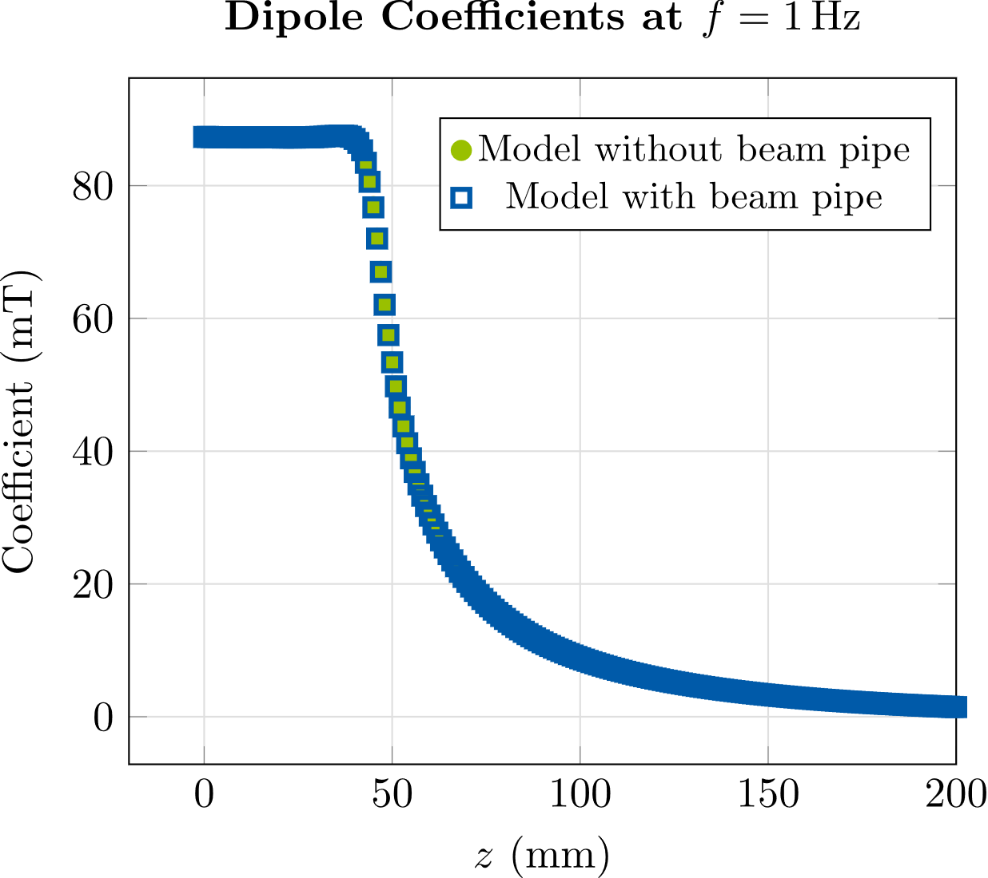
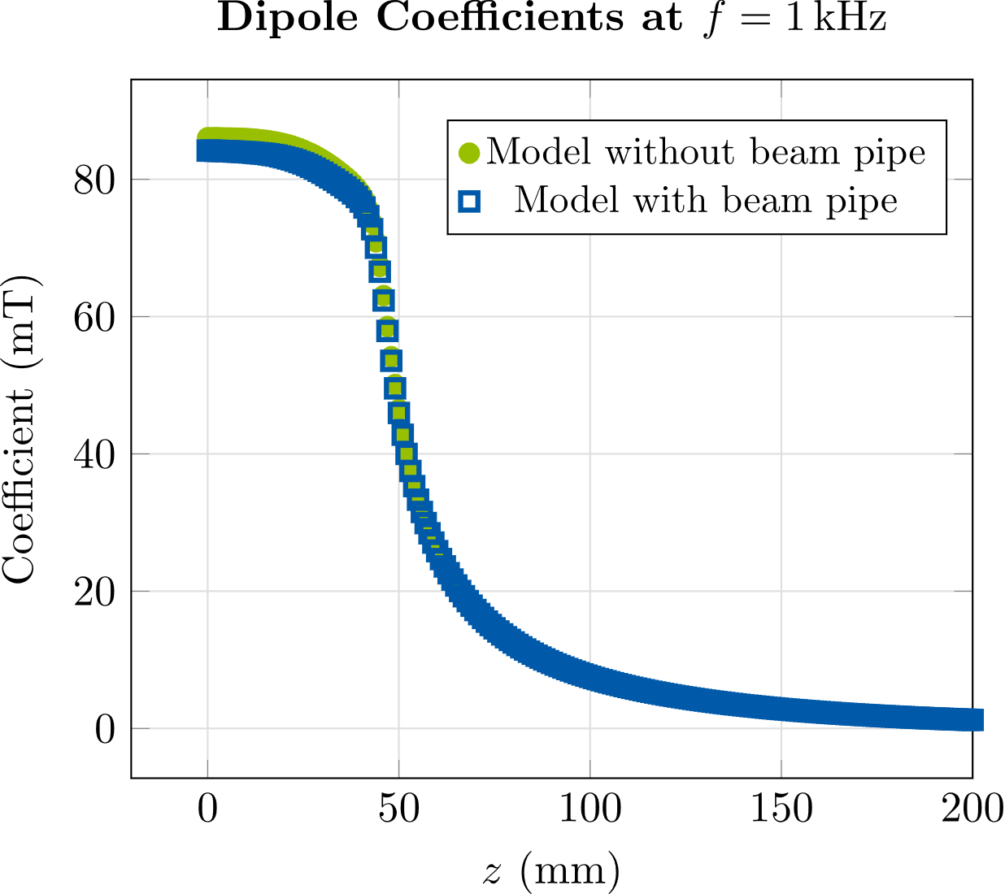
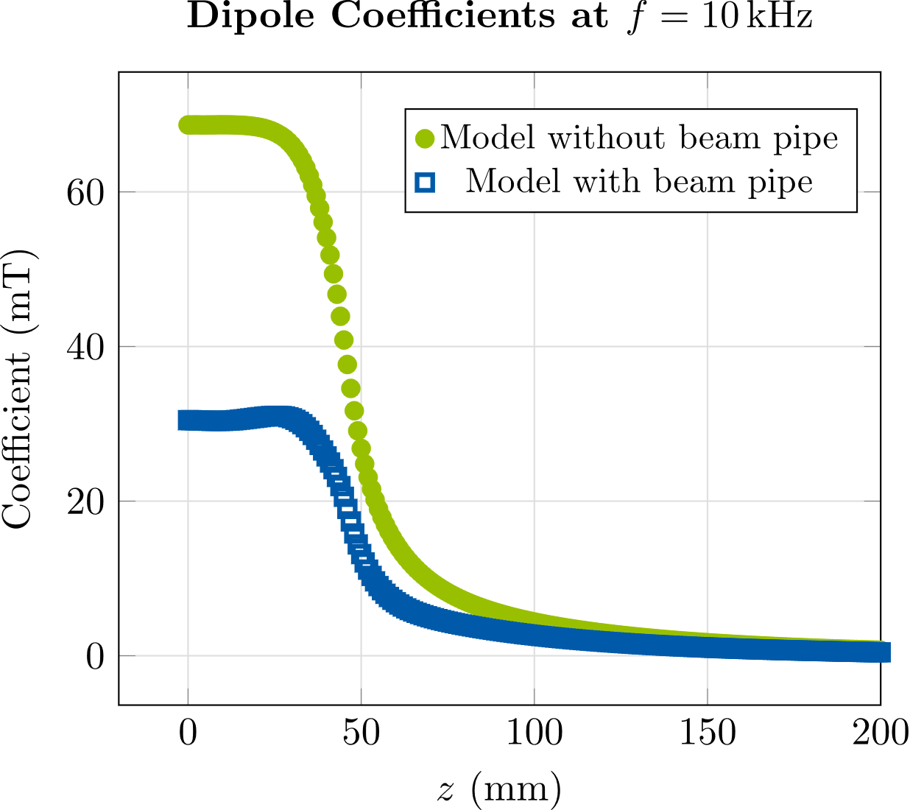
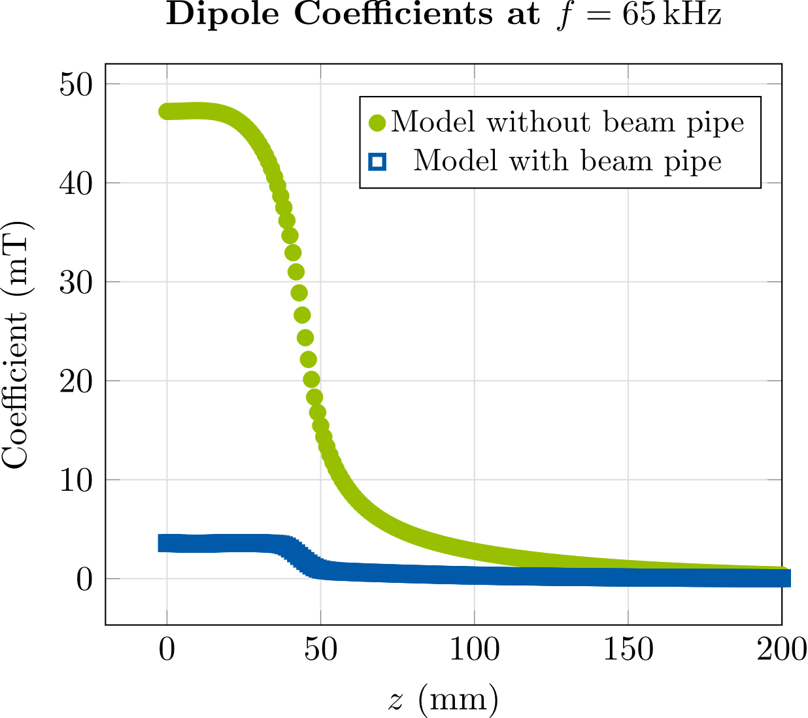
Stand-alone Corrector Magnet
Inclusion of beam pipe
Up to $f≈ 1 kHz:$ Only minor differences between the two models
For $f>>1 kHz$: Strong attenuation of dipole field due to eddy currents in beam pipe
At higher frequencies, beam pipe leads to greater effective length of the magnet
Notes:
To get a more precise understanding of the beam pipe’s effect, we show here a direct comparison of the dipoles along the longitudinal coordinate.
In green we have the result without beam pipe and in blue the results with beam pipe for 1Hz, 1 kHz, 10 kHz, and 65 kHz.
We observe that up to roughly 1 kHz, there are only very minor differences in the dipole coefficients of both models.
But above 1 kHz, the difference between both models starts to grow: The eddy currents in the beam pipe then lead to
a much stronger attenuation of the dipole field. So we can see here at 10 kHz and 65 kHz that the dipole field in the model with a beam pipe is much weaker than in the model without beam pipe.
Another effect that is reflected in these plots is that the beam pipe influences the effective length of the magnet.
Here at 10 kHz and 65 kHz we can see that the section where the magnetic field is at its maximum is significantly longer in the model that includes a beam pipe than it is in the model without a beam pipe.
This leads to a greater effective length of the magnet at high frequencies in the model with beam pipe.

Slide 19
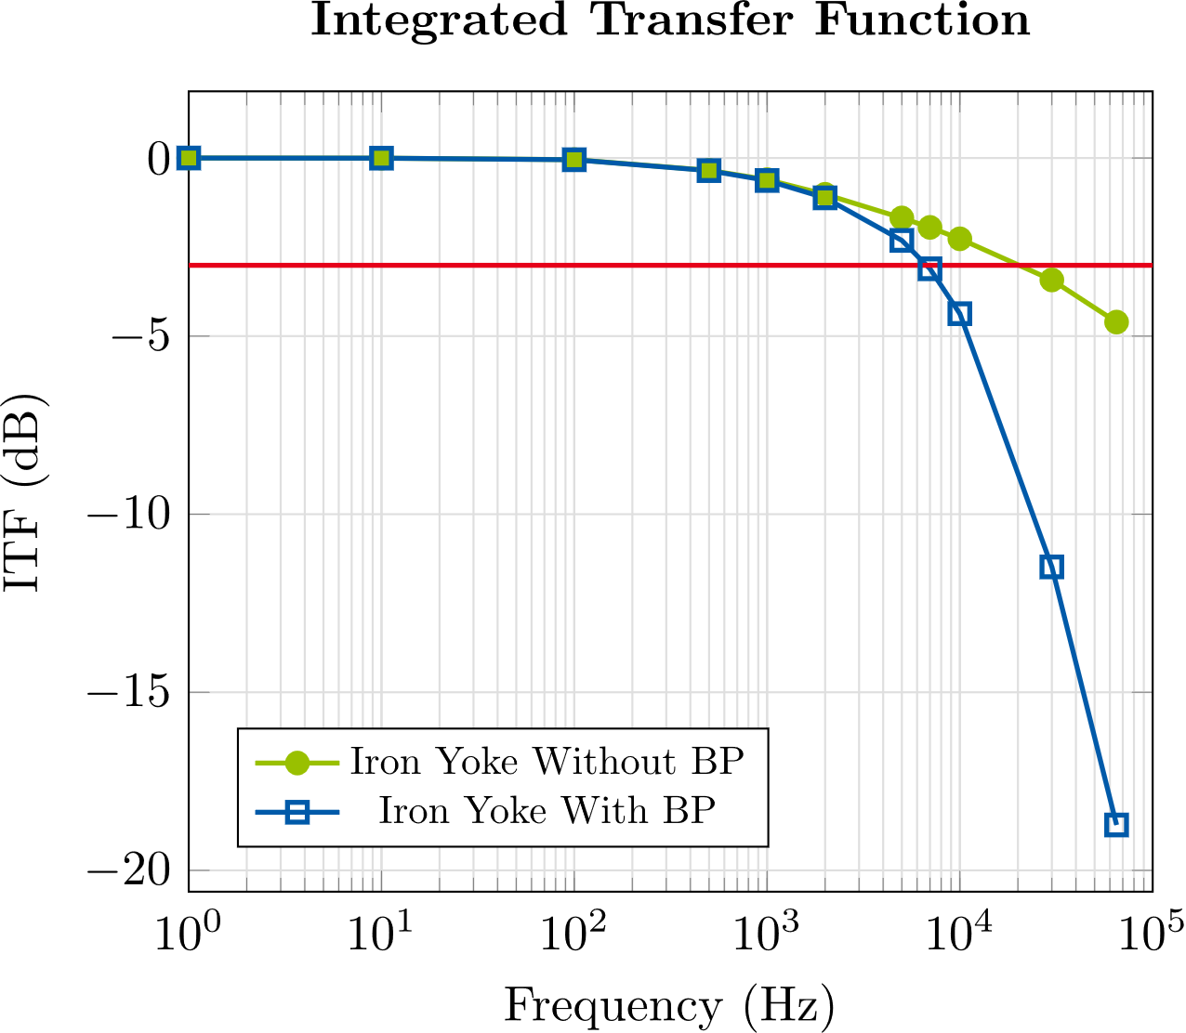
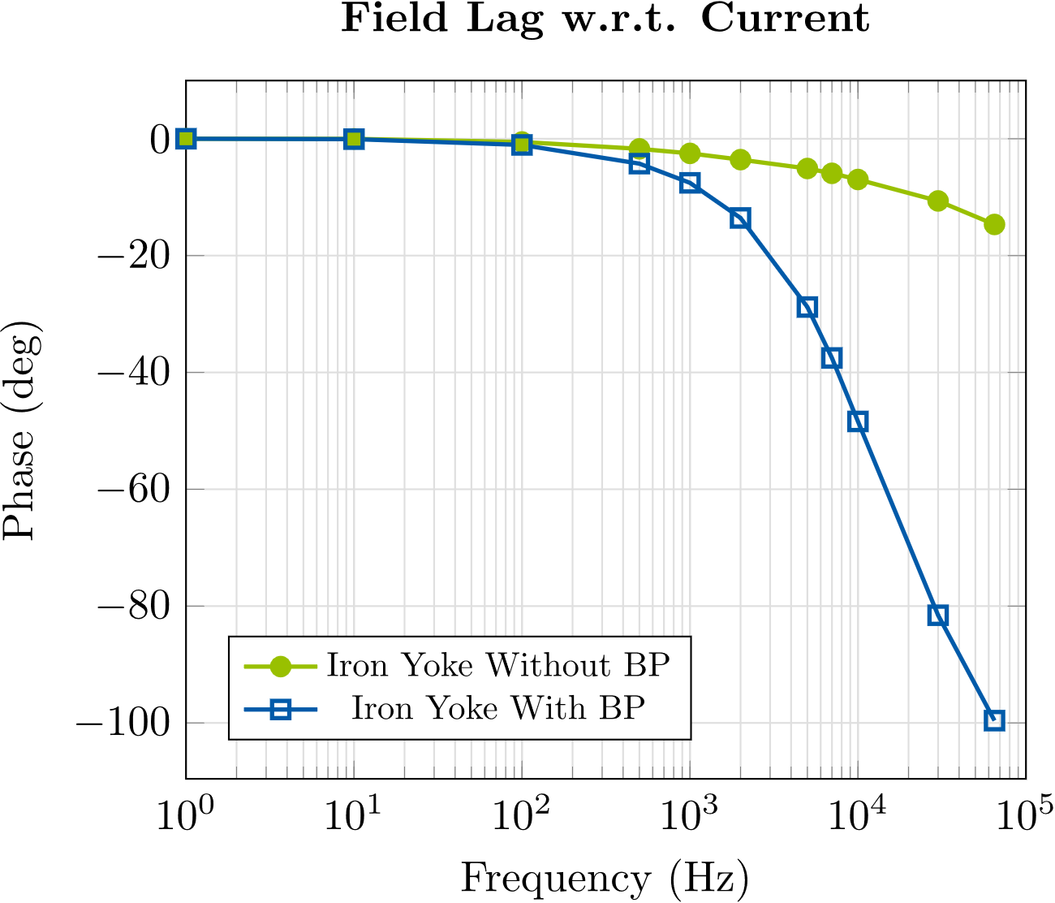
Stand-alone Corrector Magnet
Integrated Transfer function and field lag
$$ITF(f)= \frac{\int_{l}{B_{1}(z,f)}dz}{\int_{l}{B_{1}(z,f= 1Hz)}dz}$$
Yoke material | 3 dB bandwidth | Phase shift at bandwidth
Iron | $$7 kHz$$ | $$38°$$
M-19 Steel | $$10 kHz$$ | $$46°$$
1010 Steel | $$7 kHz$$ | $$38°$$
Yoke material | Average relative permeability* | Conductivity (MS/m)
Iron | $$5690$$ | $$10.4$$
M-19 Steel | $$4166$$ | $$1.9$$
1010 Steel | $$2780$$ | $$6.993$$
Beam pipe is made out of 316 LN SS ($σ=1.351⋅{10}^{6}, μ_{r}=1.01)$ and has an outer radius of $11 mm$ and a thickness of $1 mm$
* Values are computed from results of static simulations with non-linear BH-curve
Notes:
Another major subject of interest is the transfer function of the magnet.
We have on the left the integrated transfer function which is computed by dividing the integrated dipole coefficients at the respective frequency by the integrated dipole coefficient at 1 Hz. And the field lag is just the phase difference between the current in the coils and the magnetic field in the center of the aperture.
In the plots we see the results for an iron yoke with and without BP and I should note here that the specifics of the beam pipe have been changed. And we can see that without a beam pipe we have a 3 dB bandwidth of 20 kHz and the phaseshift at the bandwidth is roughly at 10° and then if the beam pipe is included, the 3 dB bandwidth is reduced to 7 kHz and the phase shift at the bandwidth is at 38°, which is also shown here in the table.
And here I also show the results for some more yoke materials so for M19-steel the bandwidth is at 10 kHz and the phase shift at 46°. For 1010 Steel the results are basically the same as for iron.

Slide 20
Contents
1
6
Introduction
Conclusion/Outlook
2
Homogenization Technique
3
Toy Model
4
Stand-Alone Corrector Magnet
5
Corrector Magnet with Neighboring Quadrupoles
Notes:
Ok now we come to the corrector magnet model with the neighboring quadrupole magnets

Slide 21
Corrector Magnet with Neighboring Quadrupoles
Model Description
Corrector magnet (FC) with two neighboring quadrupole magnets (PQB & PQC)
AC currents in corrector coils, DC currents in quadrupole coils
All yokes are 1010 steel, PQB quadrupoles have Vacoflux-50 poles
Quadrupole yokes are solid, corrector yoke is laminated
Beam pipe made out of 316LN SS with outer radius of $11 mm$ and thickness of $1 mm$
Distance between corrector yoke and quadrupole yokes $\sim 11.5 cm$
PQC
FC
PQB
Material | Average Relative Permeability* | Conductivity (MS/m)
1010 Steel (PQC) | 1450 | 6.993
1010 Steel (PQB) | 1810 | 6.993
Vacoflux-50 (PQB) | 5000 | 2.38
1010 Steel (FC) | 2780 | 6.993
Coils | Ampere turns
PQB | $$5728.1 At$$
FC (main) | $$975 At$$
FC (aux.) | $$405 At$$
PQC | $$5659.5 At$$
-167.05
$z$/$mm$
635.8
Eval. limits:
-400…+800 mm
* Values are computed from results of static simulations with non-linear BH-curve
Notes:
First again a short model description.
We have the corrector magnet here in blue in the middle and the a larger quadrupole (PQB) on the right here and a smaller one on the left (PQC). The corrector coils get AC currents the quadrupole coils get DC current and all yokes are 1010 steel, with one small exception here for the PQB magnet, here the poles are made out of Vacoflux 50.
Quadrupole yokes are solid, corrector yoke is laminated to surpress the eddy currents and the beam pipe is again 316LN SS with outer radius of 11 mm and thickness of 1mm.
And since these magnets are very close to each other (the distance from the corrector yoke to the quadrupole yokes is roughly 11.5 cm), we are interested to see if there is any kind of cross-talk.

Slide 22
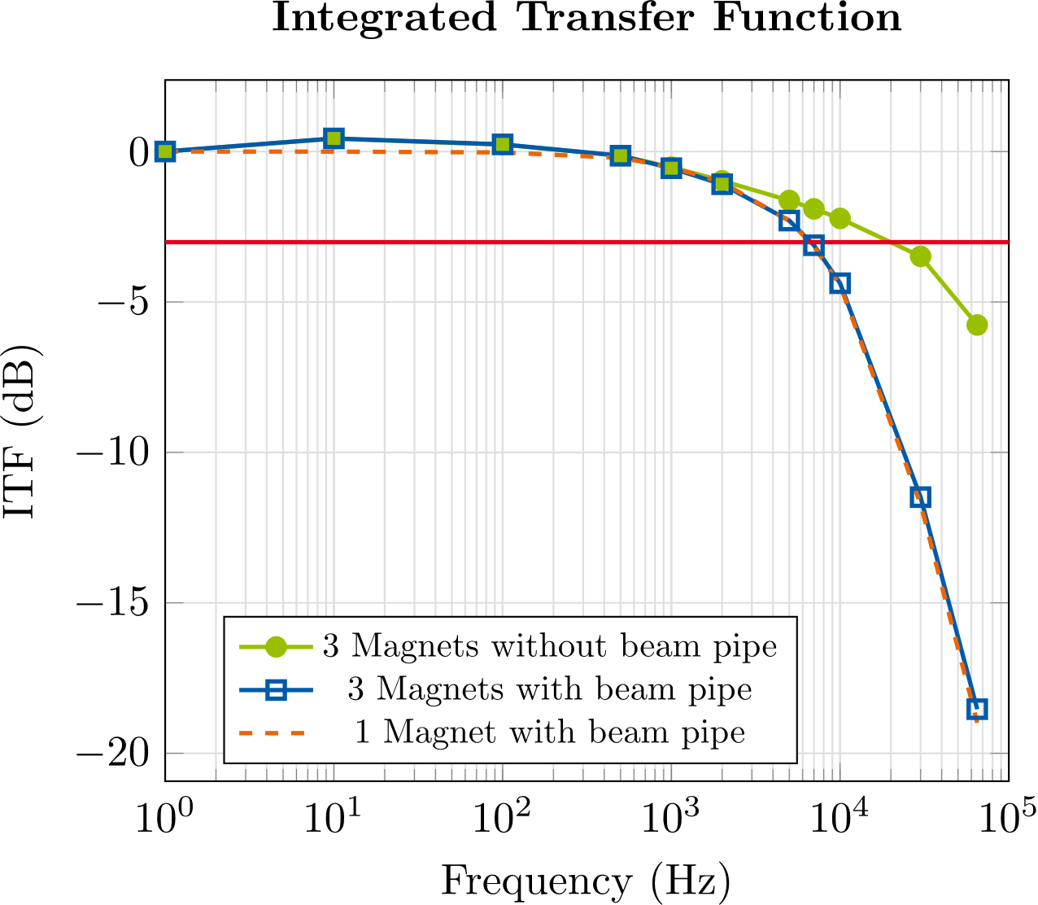
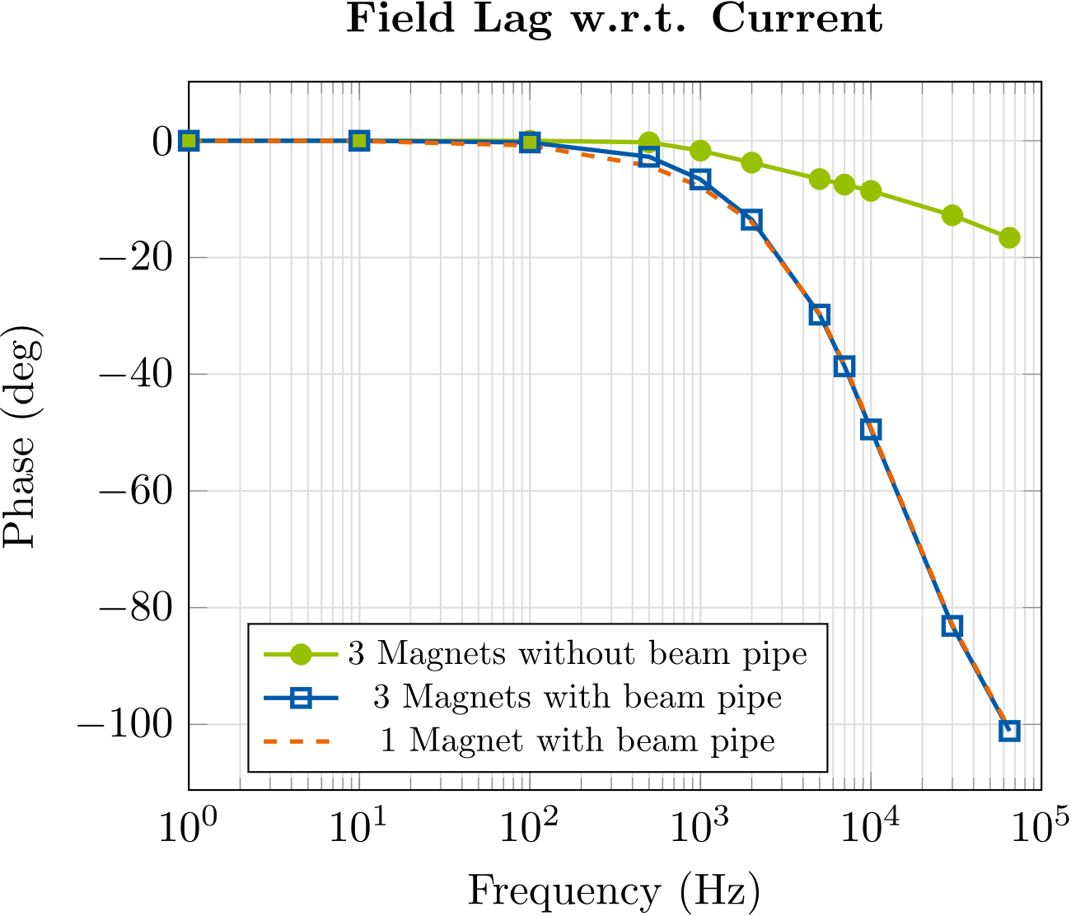
Corrector Magnet with Neighboring Quadrupoles
Integrated Transfer function and Field lag
 | Model without beam pipe | Model with beam pipe
3 dB bandwidth | $$20 kHz$$ | $$7 kHz$$
Phase shift at bandwidth | $$11°$$ | $$39°$$
Very similar results as for the model without neighboring quadrupoles
Main difference: at low frequencies, a $\sim 0.5 dB$ peak is occurring in the ITF of the model with the neighboring quadrupoles
Notes:
So first we look again at the ITF and the field lag and compare it to the results for the model without the neighboring quadrupoles. Here the green solid line shows the results for the model with the 3 magnets without BP, the blue solid line shows the results for the model with 3 magnets with a BP and the orange dashed line indicates the results for the stand-alone model of the corrector with BP. And we observe first of all for the model with the neighboring quadrupoles we have without BP a BW of 20 kHz and a phase shift at BW of 11° and with a BP 7 kHz BW and 39° phase shift at BW.
Now if we look at the results for the stand-alone corrector without the quadrupoles they are very similar, the only difference is here at the low frequencies where we have a small 0.5 dB peak in the ITF of the model with quadrupoles.

Slide 23
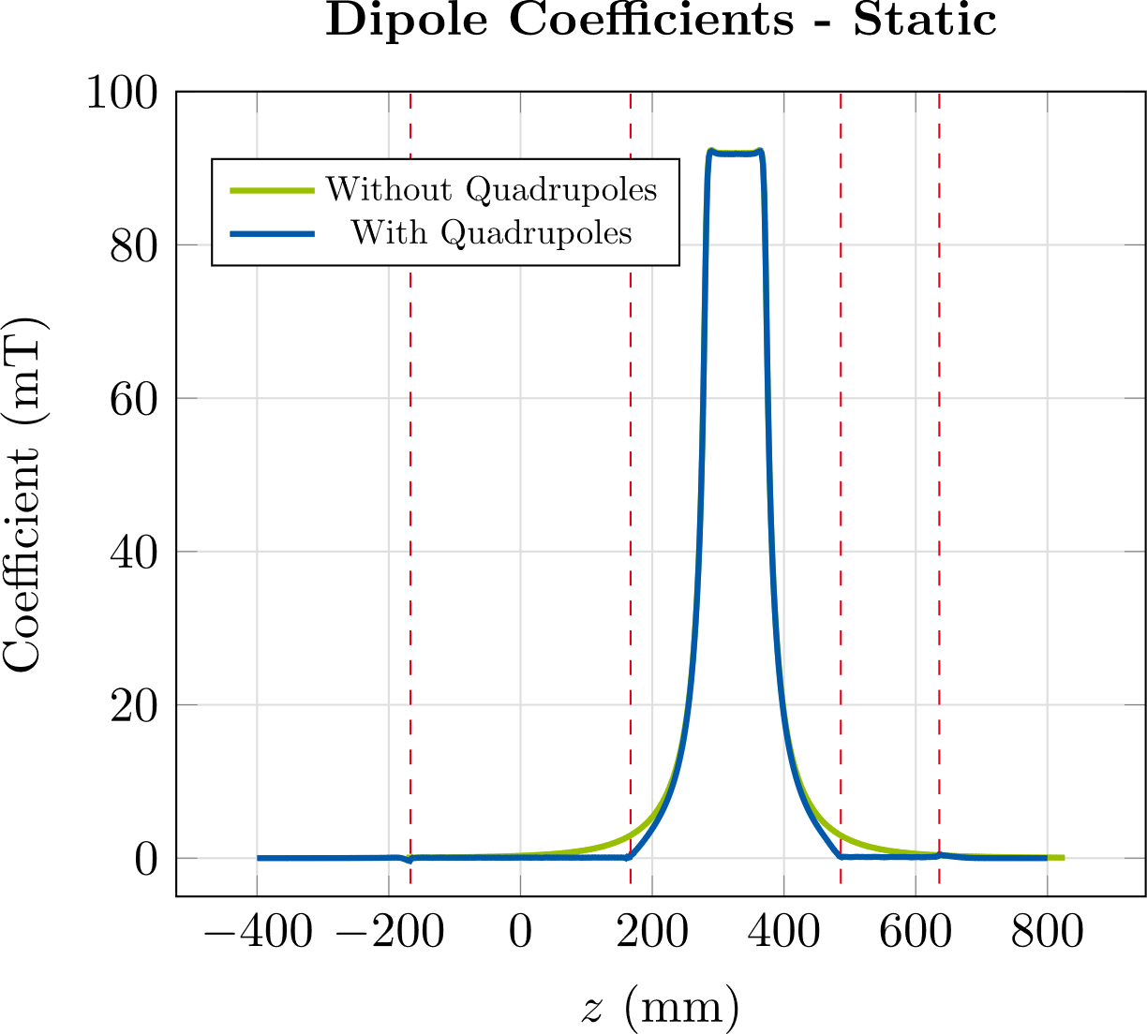
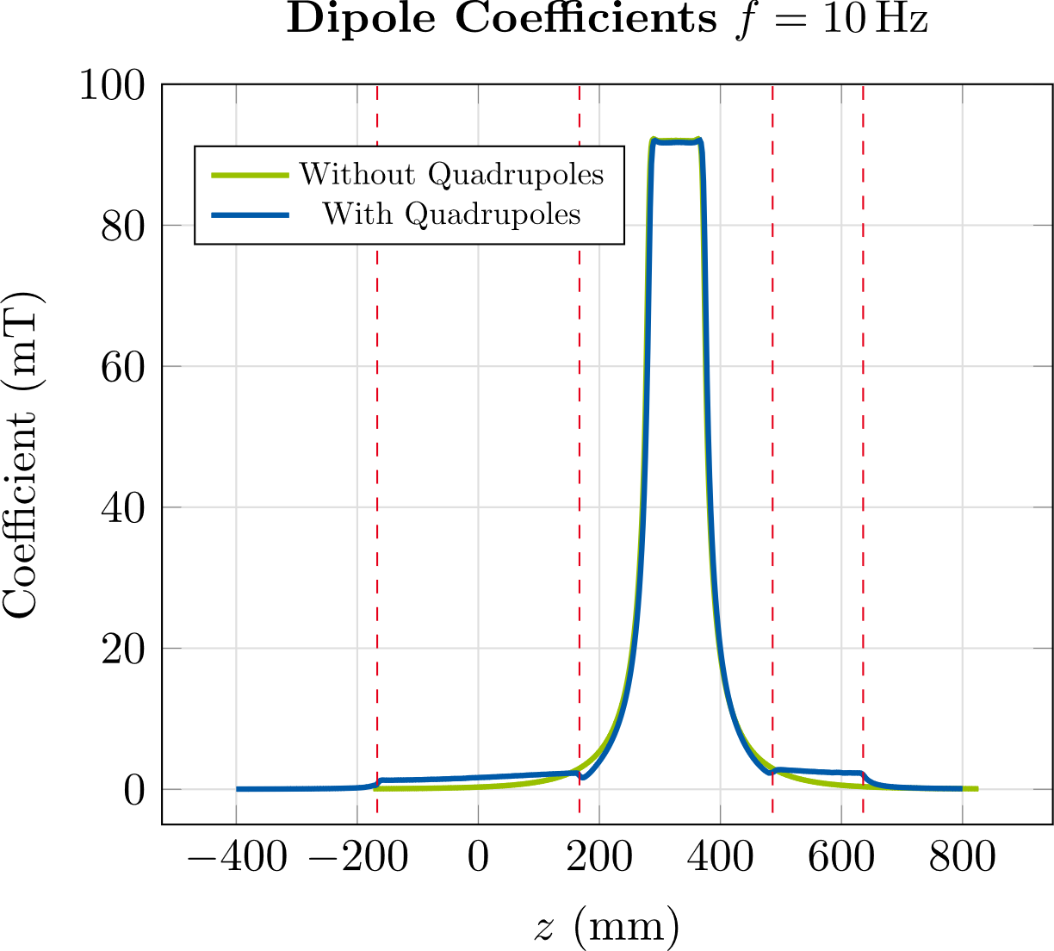
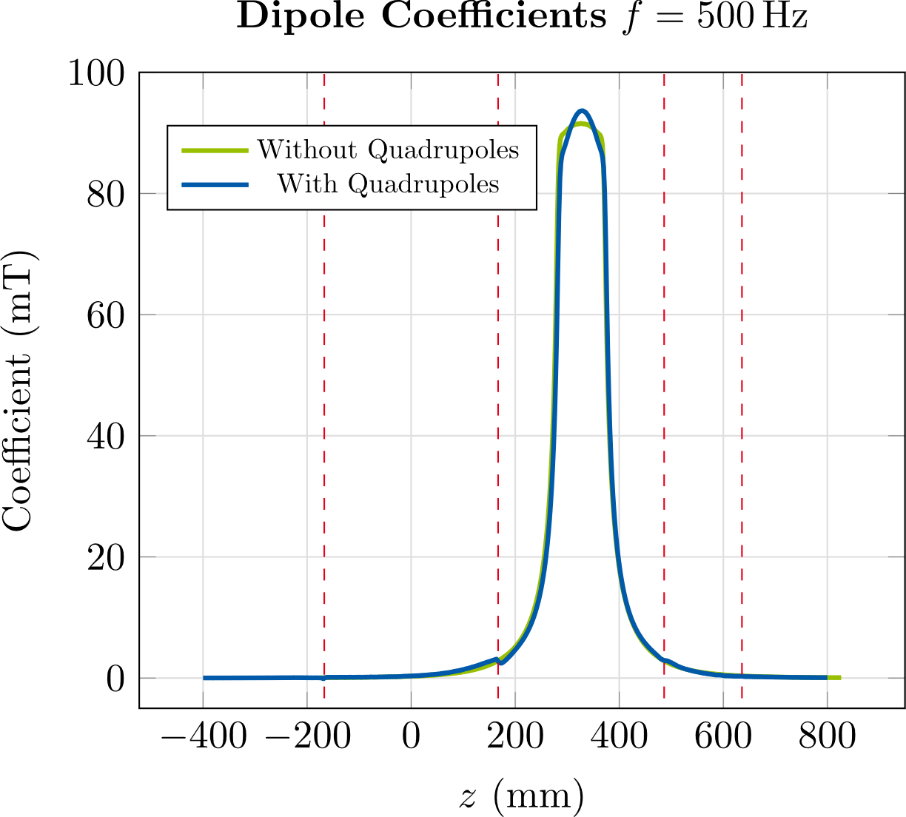
Corrector Magnet with Neighboring Quadrupoles
Dipole Coefficients along the axis
Simulation with beam pipe
At low frequencies ($f≤100 Hz$), we observe a parasitic dipole component inside the quadrupole magnets
This dipole component is due to eddy currents induced in the quadrupole yokes by the AC corrector field
➔ Peak in ITF at low frequencies
➔ Shift of the center of mass ( $\sim 0.5 cm$ at most)
Notes:
Now lets look at where this peak is coming from.
So here we have the dipole coefficients along the axis in green for the model without Quadrupoles
And in blue for the model with quadrupoles. And the red dashed lines indicate the quadrupole yokes.
And now we see that at the lower frequencies so for example at 10 Hz we observe that we have this parasitic dipole component
Inside the quadrupoles which is almost constant across the quadrupole yokes. And this dipole component is caused by the eddy currents that are induced in the quadrupole yokes by the corrector field.
And since these parasitic dipole components are within our evaluation limits for the computation of the integrated coefficients, they cause the peak in the ITF that we have observed.
Furthermore this results in a shift of the center of mass but the shift is less than a 1 cm, 0.5 cm max.

Slide 24
Contents
1
6
Introduction
Conclusion/Outlook
2
Homogenization Technique
3
Toy Model
4
Stand-alone Corrector Magnet
5
Corrector Magnet with Neighboring Quadrupoles

Slide 25
Conclusion/Outlook
Conclusion/Outlook
Validation of homogenization technique using toy model
➔ Good approximation of multipoles and power losses
➔ Simulation time reduced from several hours to a few minutes
Application to corrector magnet model
Power losses for different lamination thicknesses
Longitudinal multipole distributions
Integrated transfer function and field lag
Cross-talk with neighboring magnets
Ongoing investigations:
Simulations with different variations of the beam pipe and cooling channels
Approximate treatment of non-linear material properties
Homogenization enables us to study this over the frequency range of interest from DC up to 65 kHz
Notes:
First, we have introduced a technique to homogenize the magnets yoke and we have used a toy model for validation. We’ve found that the technique yields a good approximation of the power losses and the multipole coefficients while reducing the simulation time from several hours to just a few minutes.
Second, we have investigated a more realistic model of an orbit corrector magnet for PETRA IV. Here we have used the homogenization technique to cover the full frequency range of interest from DC up to 65 kHz which would not have been possible without the homogenization technique.
In particular, we have studied the power losses for different lamination thicknesses and the longitudinal multipole distributions. Further we have shown ITF and field lag for model with and without beam pipe
Further ongoing investigations are simulations with different variations of the beam pipe, so with copper parts and cooling channels and also to incorporate an approximate treatment of non-linearities.

Slide 26
references
References
[1] PETRA IV Conceptual Design Report.
[2] K. Wille, Physik der Teilchenbeschleuniger und Synchrotronstrahlungsquellen. Stuttgart, Germany: Teubner, 1992.
[3] P. Dular et al., “A 3-D Magnetic Vector Potential Formulation Taking Eddy Currents in Lamination Stacks Into Account,” IEEE Trans. Magn., vol. 39, no. 3, pp. 1424-1427, May 2003.
[4] L. Krähenbühl et al., “Homogenization of Lamination Stacks in Linear Magnetodynamics,” IEEE Trans. Magn., vol. 40, no. 2, pp. 912 - 915 Mar. 2004.
[5] H. De Gersem, S. Vanaverbeke, and G. Samaey, “Three-Dimensional-Two-Dimensional Coupled Model for Eddy Currents in Laminated Iron Cores,” IEEE. Trans. Magn., vol. 48, no. 2, pp.815 – 818, Feb. 2012.

