Slide 1
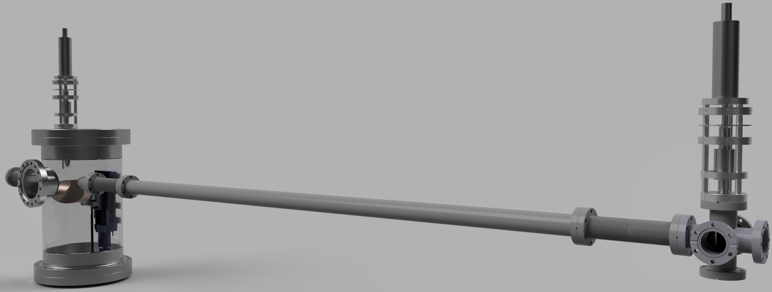
Compton backscattering
GRK-Day - 2023 KIT
Work supported by DFG through GRK 2128
Notes:
Hello, my name is Chrstoph Lorey, and I will give you a brief status update on the Thomson Backscattering Investigation at MESA, which is the topic of my PhD here at the Institute of Nuclear Physics, the KpH of the Johannes Gutenberg university Mainz

Slide 2
Compton Backscattering used for...
Bright, monochromatic and tunable X-Ray (to γ Ray) sources of very small size
Near future:
Far future:
Photo Nuclear Reactions
+
Brilliant light source at TU Darmstadt
Crystallography microscopic radiography…
Electron Beam Diagnostics
Material & Biomedical Science
Non-destructive detection
Energy and energy spread
ERL with LCB development
Investigation of nuclear structure and cross-sections
Nuclear resonance fluorescence
Photo-Fission

Slide 3
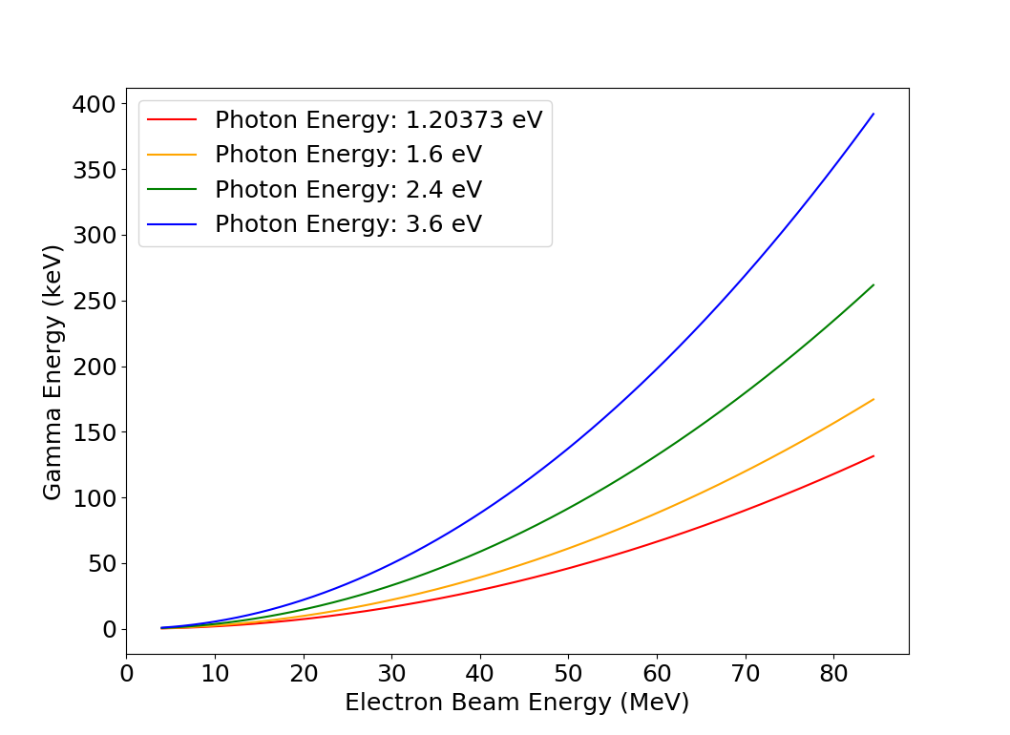
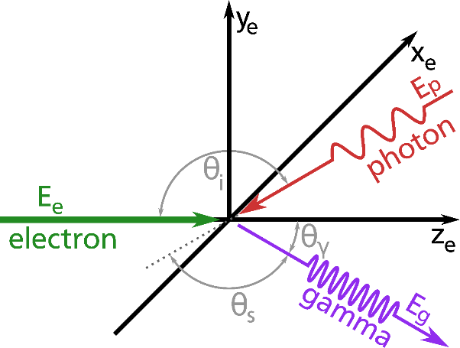
Compton Backscattering – Photon Energy
Scattered photon gains energy
Higher photon energy preferred
Scattered photon energy
$$E_{ph}= \frac{(1 −β\cos\left(ϴ_{i}\right))E_{L}}{\left(1 −βcos\left(ϴ_{γ}\right)\right)+\left(1−\cos\left(ϴ_{s}\right)\right)\left({E_{L}}/{E_{e}}\right)}$$
$$E_{ph}^{max}= \frac{4γ^{2}E_{L}}{1+4γ^{2}\left({E_{L}}/{E_{e}}\right)}$$
$$γ= E_{e}/(m_{e}c^{2})$$
Lorentz boost $4γ^{2}$ of scattered photon energy

Slide 4
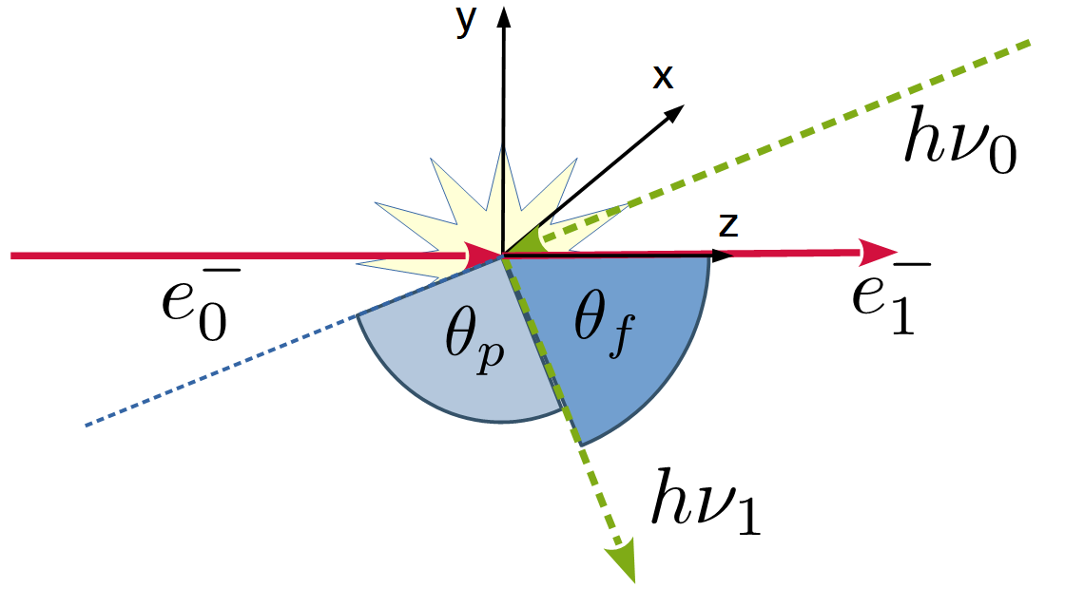
Compton/Thomson Backscattering - Recoil
θ : observation angle of scattered
photon in lab reference system
Thomson cross-section is very low:
3D Recoil factor :
electron & photon 3D-momenta
Notes:
- Man denkt bei Kollision Photon – Elektron passiert nicht viel beim Elektron, aber ein bisschen Rückstoß gibt es eben schon
- Rückstoß auf Elektron in relativistischem Zweikörperstoß betrachten
- Recoilfaktor beispielrechnen (3 Fälle, zeigen das einheitenlos klein rauskommt)

Slide 5
Compton/Thomson Backscattering - Recoil
θ : observation angle of scattered
photon in lab reference system
Thomson cross-section is very low:
3D Recoil factor :
electron & photon 3D-momenta
Notes:
- Man denkt bei Kollision Photon – Elektron passiert nicht viel beim Elektron, aber ein bisschen Rückstoß gibt es eben schon
- Rückstoß auf Elektron in relativistischem Zweikörperstoß betrachten
- Recoilfaktor beispielrechnen (3 Fälle, zeigen das einheitenlos klein rauskommt)

Slide 6
Compton/Thomson Backscattering - Recoil
θ : observation angle of scattered
photon in lab reference system
Thomson cross-section is very low:
3D Recoil factor :
electron & photon 3D-momenta
Notes:
- Man denkt bei Kollision Photon – Elektron passiert nicht viel beim Elektron, aber ein bisschen Rückstoß gibt es eben schon
- Rückstoß auf Elektron in relativistischem Zweikörperstoß betrachten
- Recoilfaktor beispielrechnen (3 Fälle, zeigen das einheitenlos klein rauskommt)

Slide 7
Compton/Thomson Backscattering - Recoil
θ : observation angle of scattered
photon in lab reference system
Thomson cross-section is very low:
3D Recoil factor :
recoil examples:
for
Notes:
- Man denkt bei Kollision Photon – Elektron passiert nicht viel beim Elektron, aber ein bisschen Rückstoß gibt es eben schon
- Rückstoß auf Elektron in relativistischem Zweikörperstoß betrachten
- Recoilfaktor beispielrechnen (3 Fälle, zeigen das einheitenlos klein rauskommt)

Slide 8
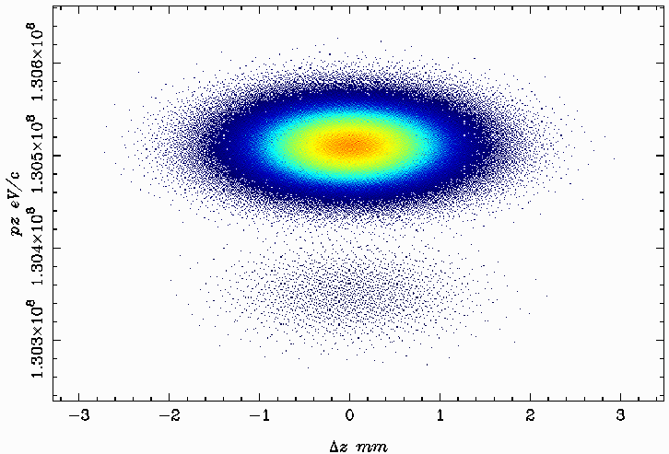
Impacted Electron Phase Space
Q_{bunch} | = 0.77 pC
mn_{e} | = 2000
θ | = 0
λ | = 1030 nm
E_{e} | = 130 MeV
E_{ph} | ≈ 1.2037 eV
E’_{ph} | ≈ 313.323 keV
σ_{th} | ≈ 6.6525·10⁻²⁹m²
 | Δ ≈ 0.0024
Ē_{e} ≈ 130.511 MeV
Ē_{e} ≈ 130.197 MeV

Slide 9
Compton Backscattering - Flux
Higher photon energy preferred
Flux
$$F=σ_{T}L$$
$$σ_{T}=66.5 {\text{fm}}^{2}$$
$$νh ≪mc^{2}$$
For higher Energy
Easier overlap
Head-On Collision
Luminosity
High Laser Pulse Energy $(N_{L})$
$$L= \frac{fN_{e}N_{L}cos⁡\left(φ/2\right)}{2π\sqrt{σ_{e,y}^{2}+σ_{L,y}^{2}} \sqrt{(σ_{e,x}^{2}+σ_{L,x}^{2})\cos^{2}\left(φ/2\right)+(σ_{e,z}^{2}+σ_{L,z}^{2})\sin^{2}\left(φ/2\right)}}$$
$φ=ϴ_{i}$ - $π$
High scattering frequency $(f)$
Small beam size at IP
Head-On
$$L= \frac{fN_{e}N_{L}}{2π{(σ}_{e}^{2}+σ_{L}^{2}) }$$

Slide 10
Compton Backscattering | Bandwidth
Higher photon energy preferred
Relative bandwidth
For higher Energy
Easier overlap
Head-On Collision
$$\frac{ΔE_{ph}}{E_{ph}}≥ \sqrt{2{\left(\frac{σ_{∆E_{e}}}{E_{e}}\right)}^{2}+{\left(\frac{ε_{n}}{σ_{e}}\right)}^{4}+{\left(\frac{σ_{∆E_{L}}}{E_{L}}\right)}^{2}+{\left(\frac{M^{2}λ}{2πω_{0}}\right)}^{4}}$$
High Laser Pulse Energy $(N_{L})$
High scattering frequency $(f)$
Small beam size at IP
Low $M^{2}$
Low $σ_{∆E_{p}}$; $\frac{σ_{∆E_{L}}}{E_{L}}≤\frac{σ_{∆E_{e}}}{E_{e}}$
R. Hajima et al., Phys. Rev. Accel. Beams 19, 020702 (2016)

Slide 11
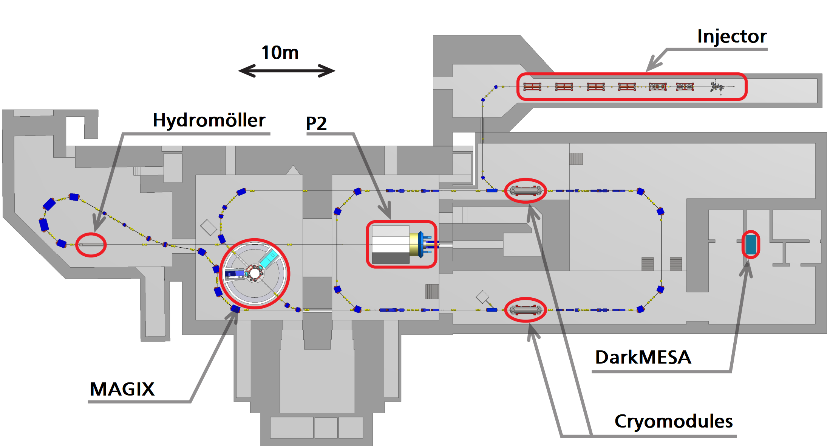
Thomson Backscattering at MESA
Mainz Energy-recovering Superconducting Accelerator MESA
possible location for
Thomson scattering arc
10 m
Courtesy of D. Simon
- MESA can generate electron beams up to 105-155 MeV
- 0.77 (7.7) pC bunch charge at 1300 MHz RF-frequency
- can run in Energy Recovery (ER) or External Beam (EB) mode
- spin polarization of the electron beam available at lower beam current of 150µA instead of 1mA

Slide 12
Sampling scheme as currently under development

Slide 13
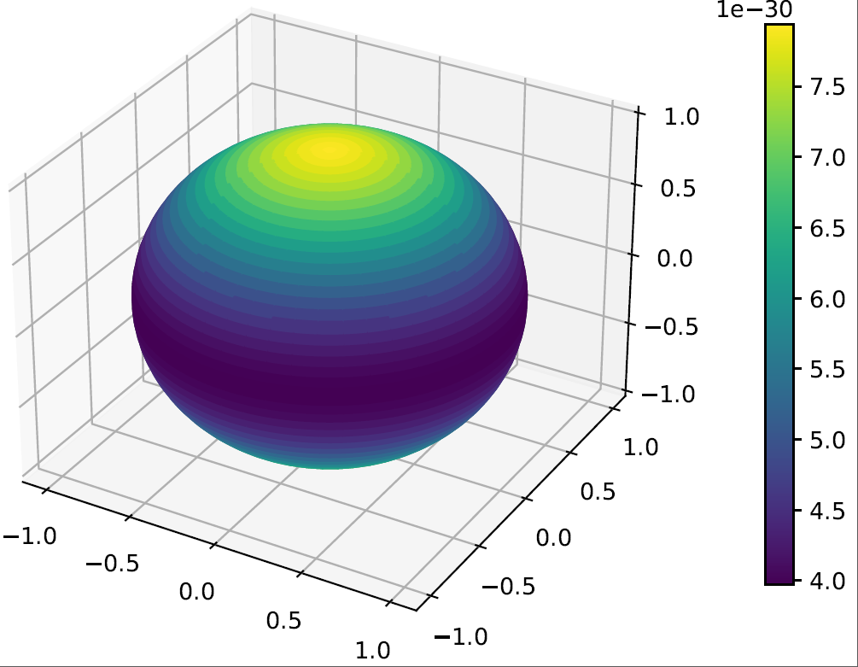
Results of Comparse
Cross-section in 3D electron rest frame space

Slide 14
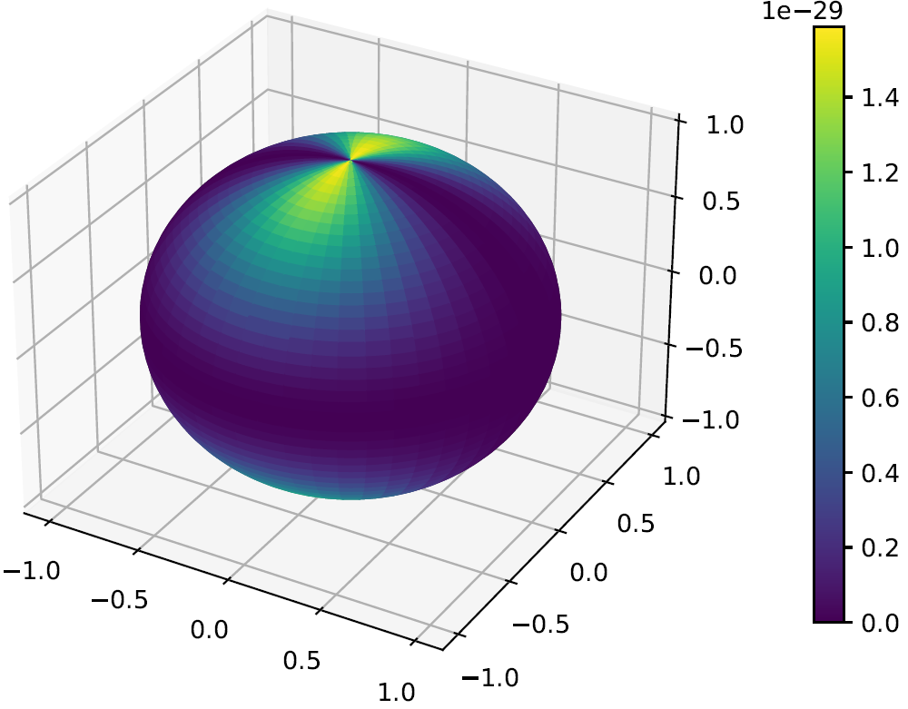
Results of Comparse
Polarized (fully linear) cross-section in 3D electron rest frame space

Slide 15
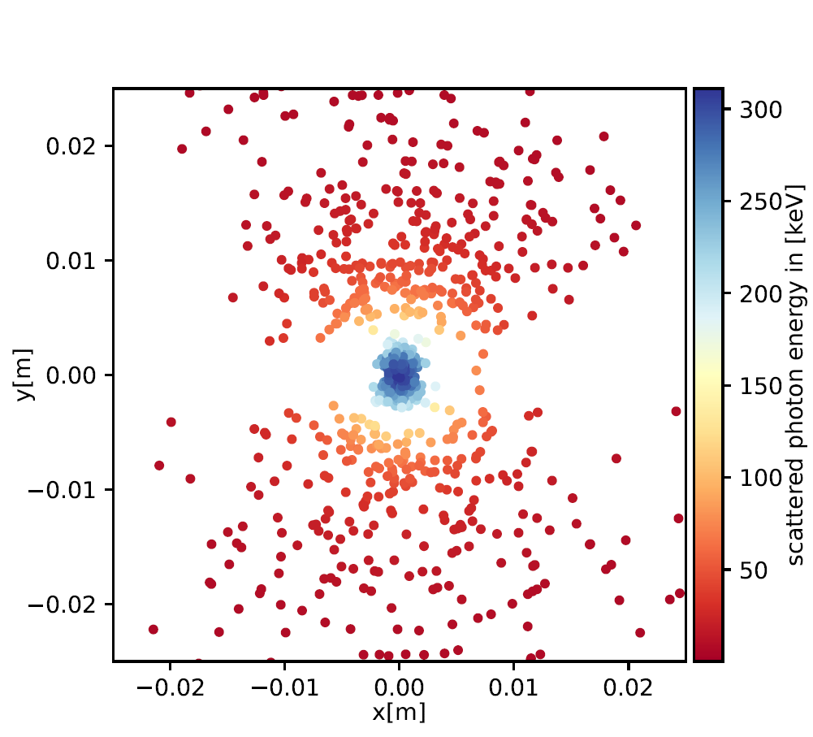
Results of Comparse
Polarized (fully linear) scattered photons on screen

Slide 16
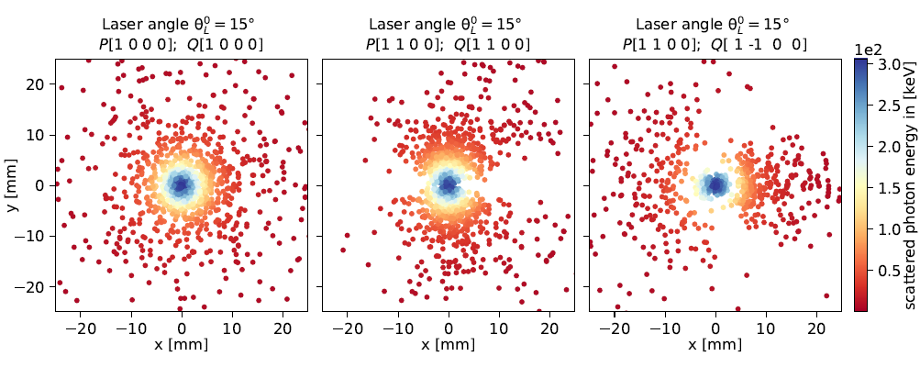
Results of Comparse

Slide 17
Laser Compton Backscattering @ S-DALINAC
Higher photon energy preferred
For higher Energy
Easier overlap
Head-On Collision
Injector
Electron Guns
Main Accelerator
High Laser Pulse Energy $(N_{L})$
High scattering frequency $(f)$
Small beam size at IP
Low $M^{2}$
Laser
40 m Beam Transport
Low $σ_{∆E_{p}}$; $\frac{σ_{∆E_{L}}}{E_{L}}≤\frac{σ_{∆E_{e}}}{E_{e}}$

Slide 18
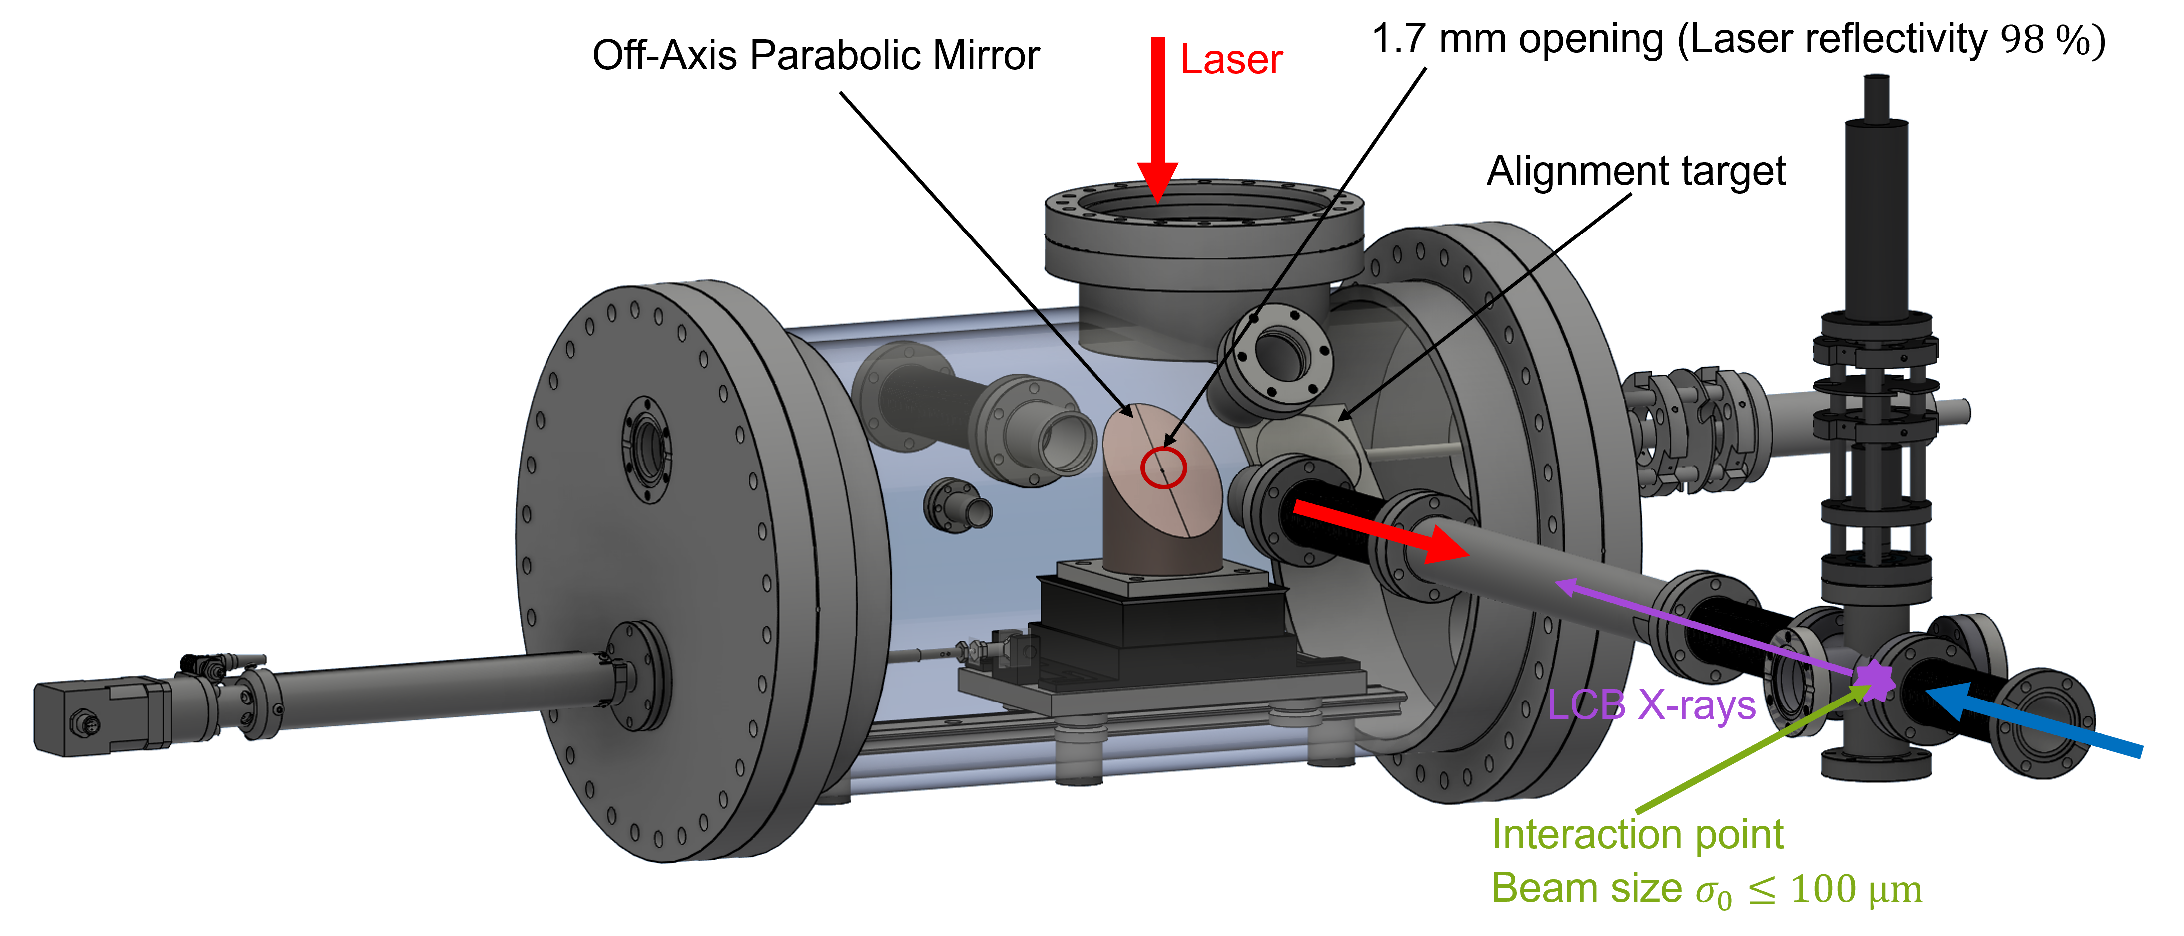
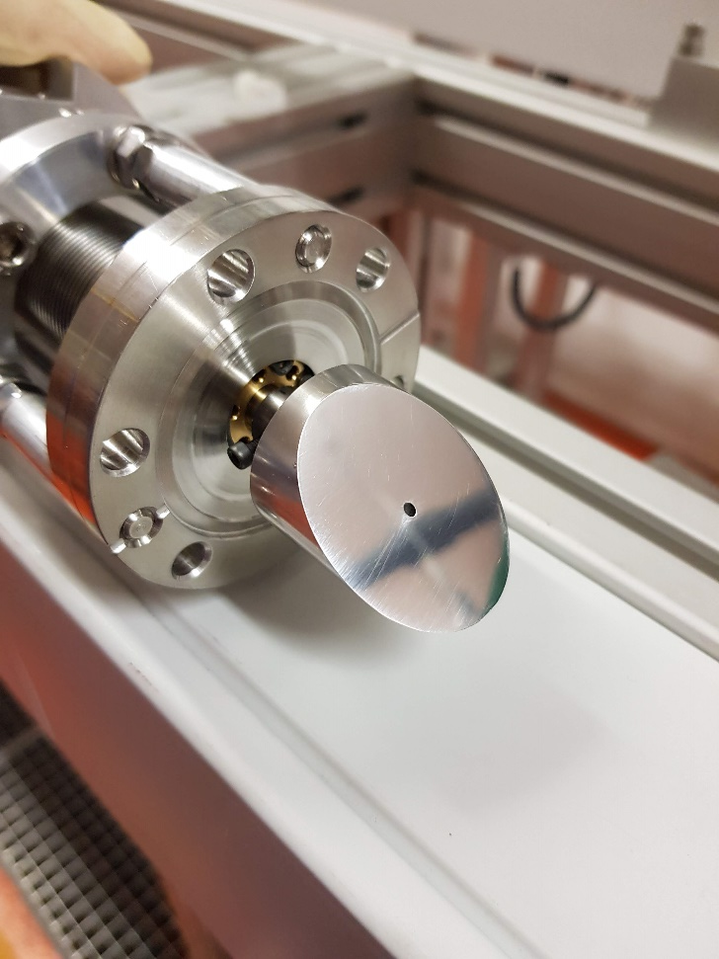
Coupling Chamber of LCB-Source
Electron Beam deposition < 1%

Slide 19
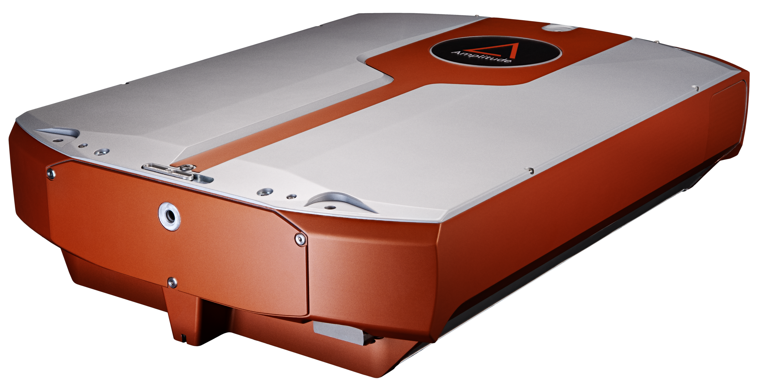
Laser System
Higher photon energy preferred
SHG: $λ=515$ nm $η>50 \%$
THG: $λ=343$ nm $η>25 \%$
$λ=$1030 nm (Ytterbium)
$\frac{Δλ}{λ}\sim 1∙{10}^{−3}$
$P_{avg}=$100 W
$E_{Pulse}≤0.5$mJ
$f=$200 kHz – 40MHz
$M^{2}<1.3$
$σ_{z}=3 ps$
Higher Harmonic Generation
Amplitude – Laser Tangor 100
For higher Energy
Easier overlap
Head-On Collision
High Laser Pulse Energy $(N_{L})$
High scattering frequency $(f)$
Small beam size at IP
Low $M^{2}$
Low $σ_{∆E_{p}}$; $\frac{σ_{∆E_{L}}}{E_{L}}≤\frac{σ_{∆E_{e}}}{E_{e}}$

Slide 20
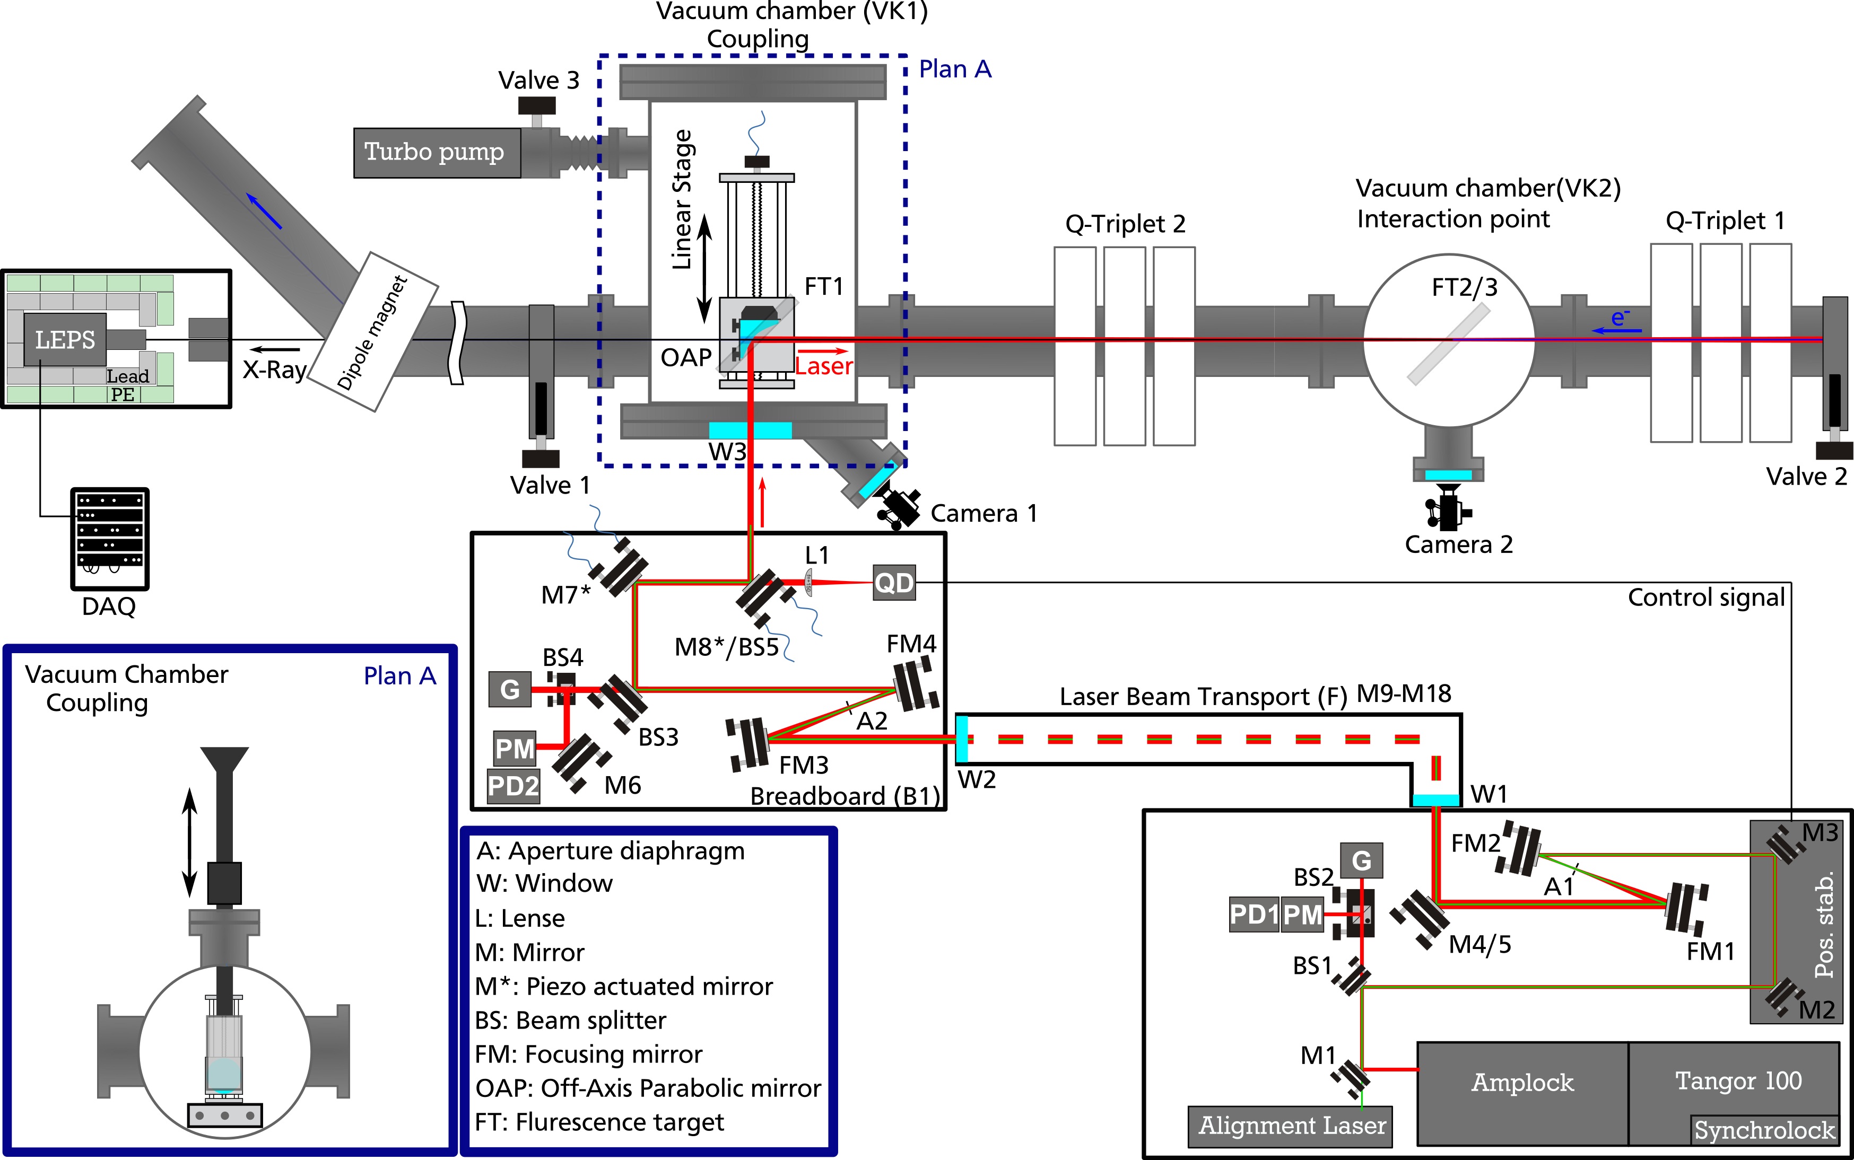
Laser Beam Line
Higher photon energy preferred
For higher Energy
Easier overlap
Head-On Collision
High Laser Pulse Energy $(N_{L})$
High scattering frequency $(f)$
Small beam size at IP
Low $M^{2}$
Low $σ_{∆E_{p}}$; $\frac{σ_{∆E_{L}}}{E_{L}}≤\frac{σ_{∆E_{e}}}{E_{e}}$

Slide 21
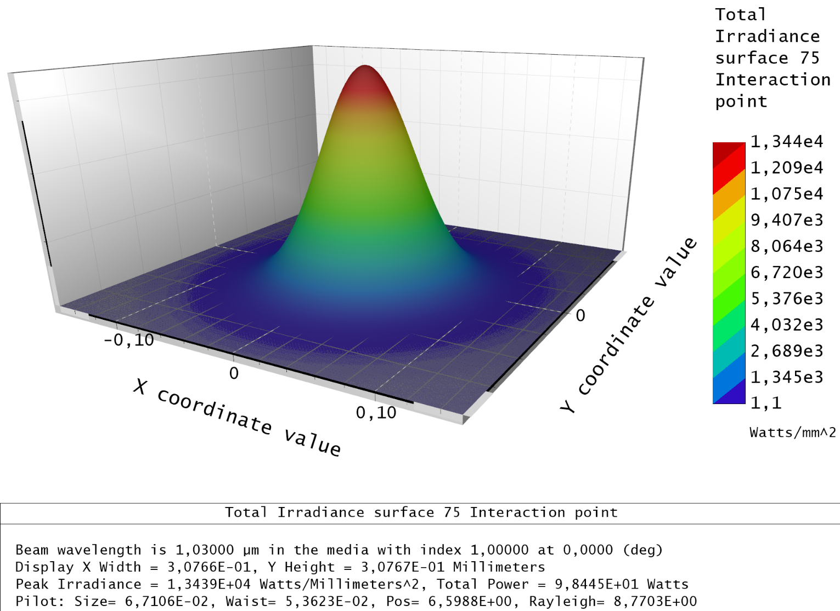
Laser Beam Transport
Simulation:
Zemax OpticStudio
Physical optics propagation
40 m beam transport
Telescopes and “relay imaging“
Off-axis parabolic mirror with hole
Physical optics propagation @ IP:
Total power: 94.5 W (100 W)
Waist size: 53.6 µm (12 mm)
Rayleigh length: 8.8 mm

Slide 22
Laser Compton Backscattering @ S-DALINAC
Parameters | Values
Electron Beam
Electron Energy ($E_{e}$) | $$39 MeV −98.8 \text{MeV}$$
Rel. Error of Electron Energy ($∆E_{e}$) | $${<10}^{−3}$$
Beam Current ($I$) | $$10 \text{µ}\text{A}$$
Beam normalized emittance | $$5 ∙{10}^{−6} \text{m} \text{rad}$$
Electron Beam Size ($σ_{e,rms}$) | $$≤100 \text{µ}\text{m}$$
Laser Beam
Wavelength ($λ$) | $$1030 \text{nm}$$
Photon Energy ($E_{L}$) | $$1.2 \text{eV}$$
Error Photon Energy ($∆E_{L}$) | $$1 ∙{10}^{−3} \text{eV}$$
Pulse Energy ($E_{pulse}$) | $$0.25 \text{mJ}$$
Repetition Rate ($f_{rep}$) | $$200 \text{kHz}$$
Beam Size ($σ_{pulse,rms}$) | $$≤100 \text{µ}\text{m}$$
Scattered Photon – Results for Head-On Collision
Energy | $$28 \text{keV}\text{ − 179 }\text{keV}$$
Min. rel. Energy Bandwidth, FWHM | $$0.7 \%$$
Total Flux | $$6 ∙103{\text{Ph}}/{\text{s}}$$
Spectral Flux at min. Bandwidth | $$38 {\text{Ph}}/{\text{s} }$$
Injector
Electron Guns
Main Accelerator
28keV - 179.7 keV
< 500 Photons /s
$$\frac{ΔE_{ph}}{E_{ph}}\sim 2.5 \%$$
MOPA-Laser: 95 W @ 1030 nm, 475 µJ, 3ps
200kHz
39MeV - 98,8 MeV & 10 μA(~3 fC) @3 GHz

Slide 23
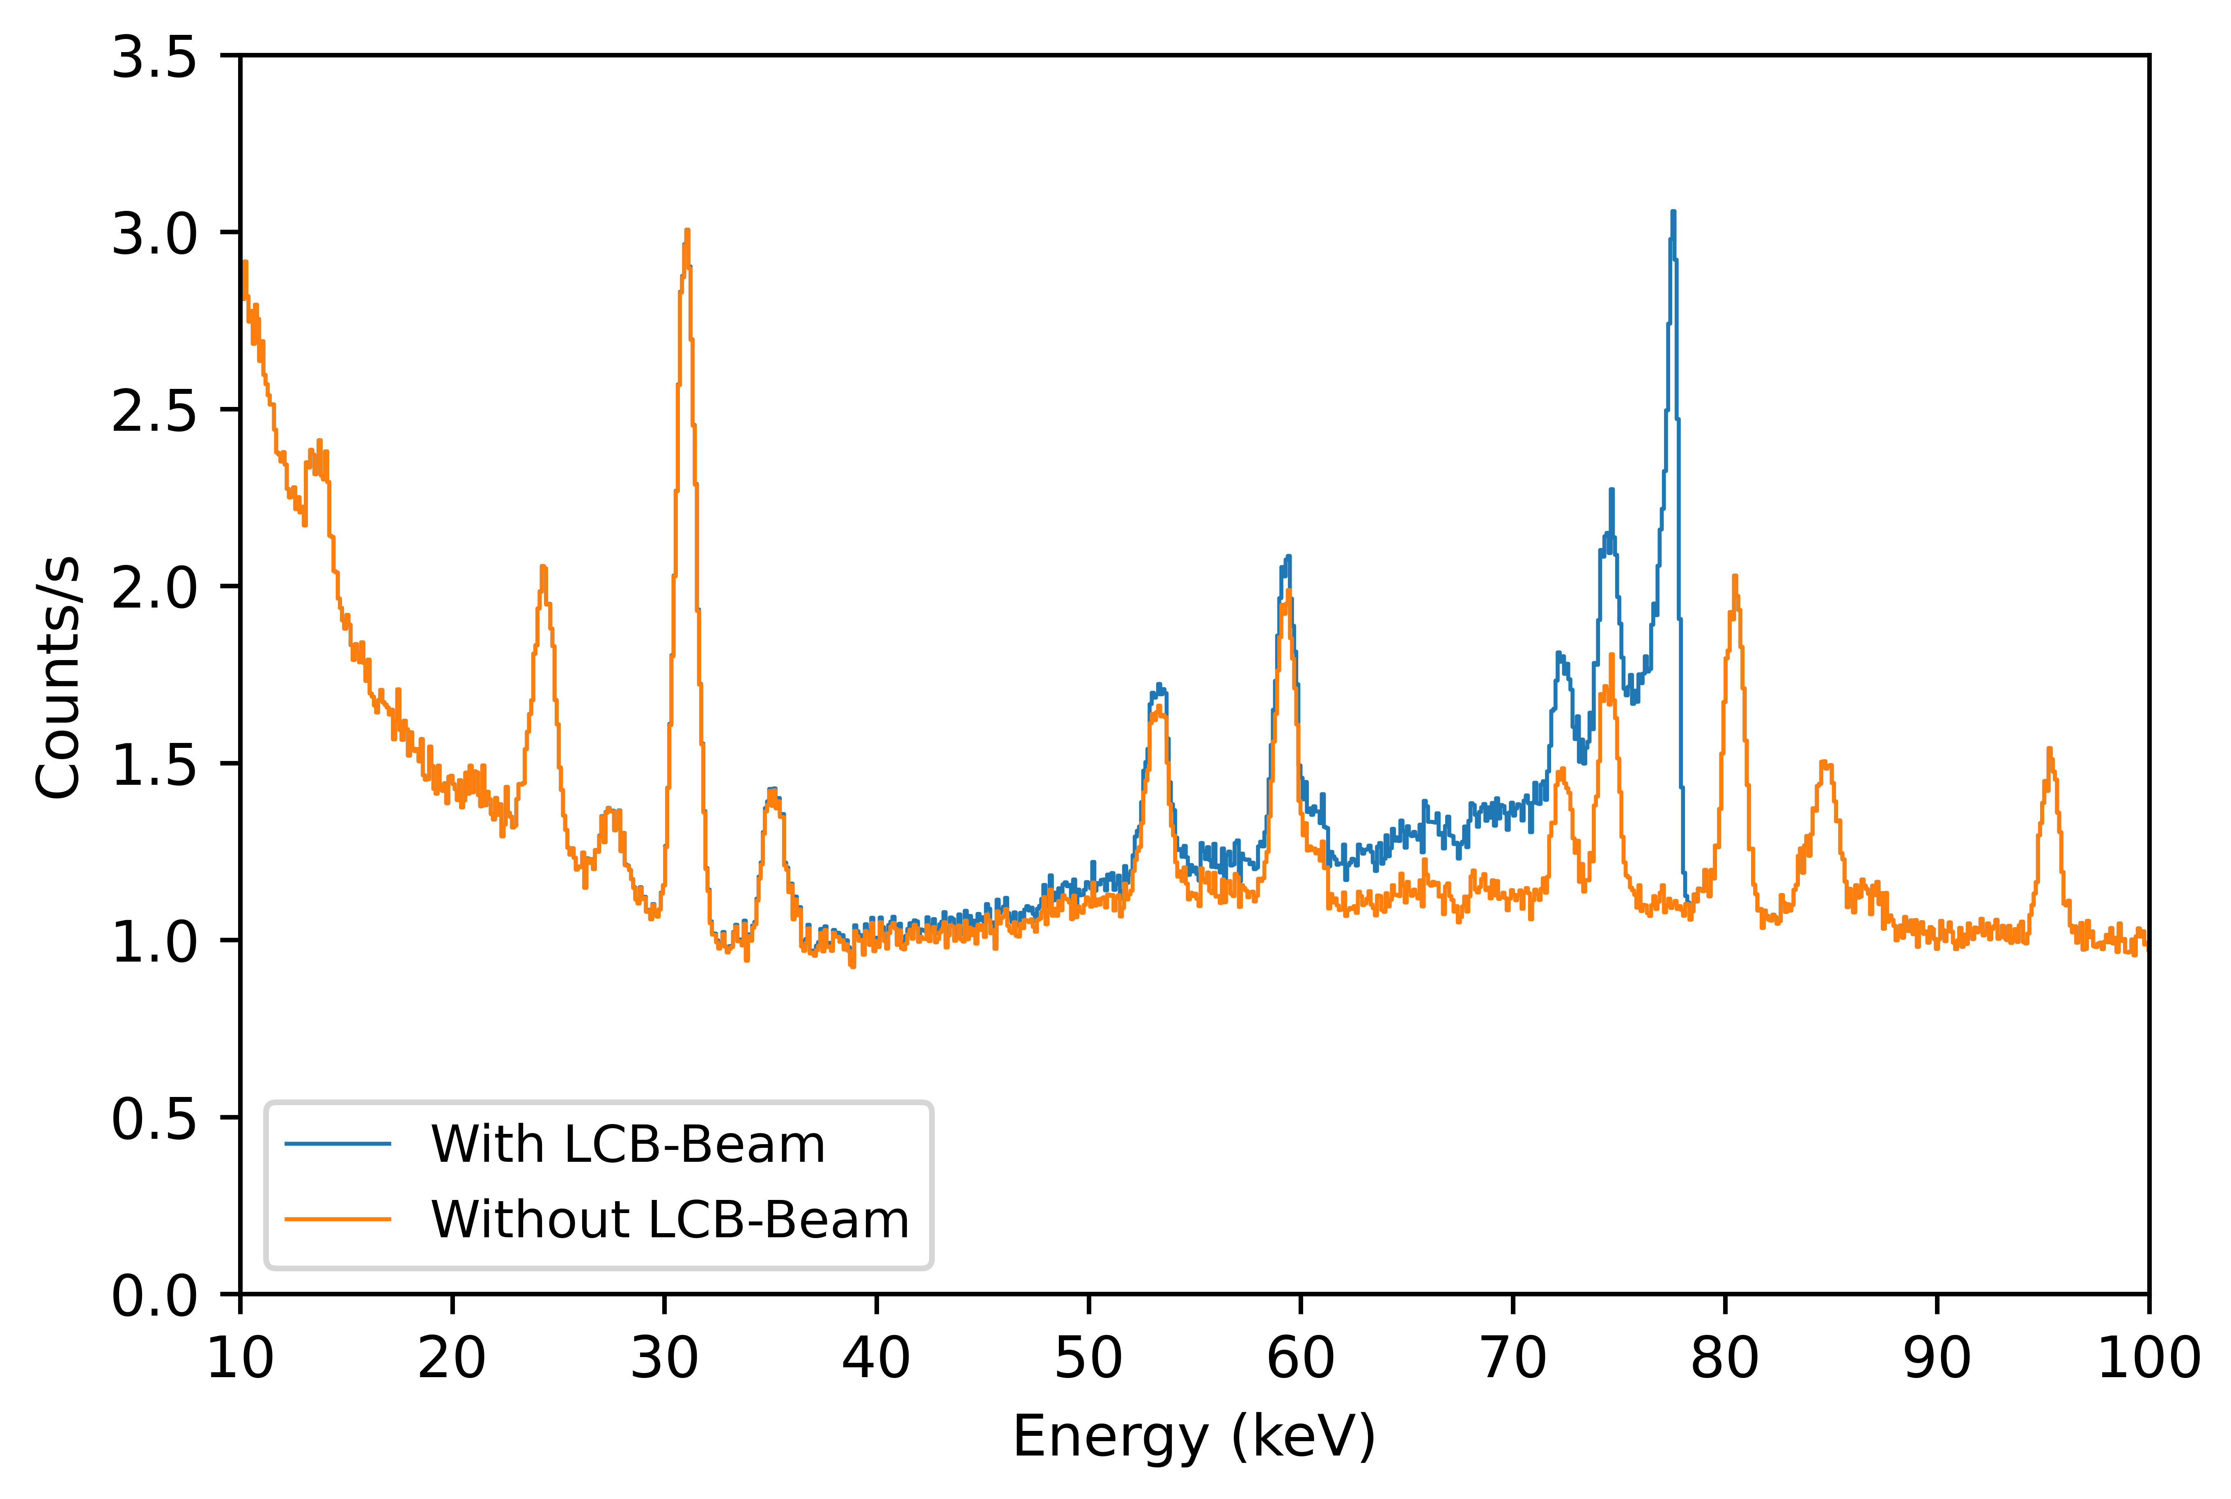
Background Measurement @S-DALINAC
Measurement
Maximum Electron Beam Energy: 85 MeV
Electron Beam Energy in 3. Recirculation: 65 MeV
Electron Beam Current: 5 µA
Simulation
MOPA-Laser: 100 W @ 1030 nm, 0.5 mJ, 3ps,
200kHz, $σ$ = 100µm
LCB: 77.8keV 473 Ph/s
$$\frac{ΔE_{ph}}{E_{ph}}\sim 2.5 \%$$

Slide 24
Current Status and Outlook
We can calculate the polarized and unpolarized angular Thomson cross section with linear laser polarization and the relativistic 3D collision between photon and electron with recoil
The sampling routine combining the polarized cross section and relativistic collision calculation with a flux formula to estimate realistic scattered photon distributions in space will be finalized
We will verify our results using simulation software and measurements
Finally, several case studies of varying laser and electron beam energies and polarizations including concrete MESA implementation scenarios will form the feasibility study
Finish Order Process
Beam Dynamic Simulations
Electron Beam Simulations: Elegant
Redistribution of the Quadrupoles
Pre-Commissioning
Laser Transport, Coupling Chamber
Test Setup in Parts
Internship at KPH Uni Mainz
Compton Backscattering Simulations
(Atoosa Meseck, Christoph Lorey)
Data Analysis
Techniques for photon flux measurements
Write & Publish a Paper
Commissioning
Final Measurement
Finish with PhD Thesis

Slide 25
Supported by…
Thank you!

Slide 26
Fin. ...for now
Thank you for your attention!

Slide 27
Unpolarized Thomson Cross Section
Derived from the general Klein-Nishina cross section of photons scattered by a single free electron.

Slide 28
Unpolarized Thomson Cross Section
Derived from the general Klein-Nishina cross section of photons scattered by a single free electron.
stars * denote parameters
in the center of mass system
Acquired by relativistic Lorentz boost in four vector algebra
Used because scattering is easier calculated in the center of mass rest frame

Slide 29
Unpolarized Thomson Cross Section
Derived from the general Klein-Nishina cross section of photons scattered by a single free electron.
Acquired by relativistic Lorentz boost in four vector algebra
Used because scattering is easier calculated in the center of mass rest frame

Slide 30
Unpolarized Thomson Cross Section
Derived from the general Klein-Nishina cross section of photons scattered by a single free electron.
In our calculations often < 1
unitless

Slide 31
Unpolarized Thomson Cross Section
Derived from the general Klein-Nishina cross section of photons scattered by a single free electron.
The differential Thomson cross section is dependant on scattering angle θ* and recoil Δ.

Slide 32
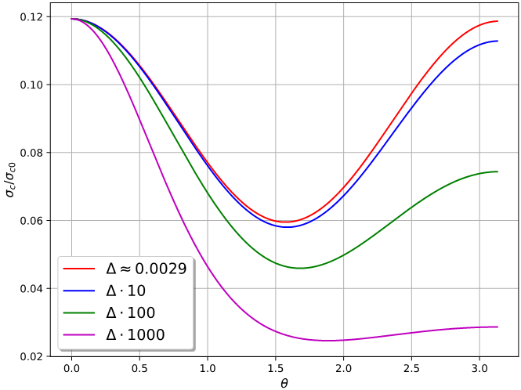
Unpolarized Thomson Cross Section
E_{e} | = 155 MeV
Q_{bunch} | = 0.77 pC
no | polarisation
λ | = 1030 nm
E_{ph} | ≈ 1.2037 eV
σ_{c0} | ≈ 6.6525·10⁻²⁹m²
Δ | ≈ 0.0029
Notes:
- Hier lieber nicht MESA Wert
- im grauen Feld: Recoil
- Recoilfälle wie bei Curatolo

Slide 33
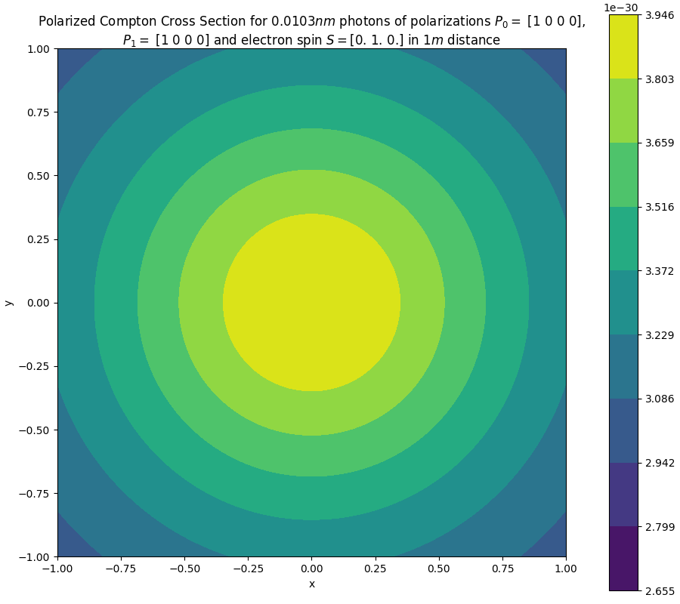
Calculation of Scattered Photons on a Screen
Q_{bunch} | = 0.77 pC
mn_{e} | = 100000
θ | = 0
λ | = 1030 nm
E_{e} | = 130 MeV
E_{ph} | ≈ 1.2037 eV
E’_{ph} | ≈ 313.323 keV
σ_{th} | ≈ 6.6525·10⁻²⁹m²
 | Δ ≈ 0.0024

Slide 34
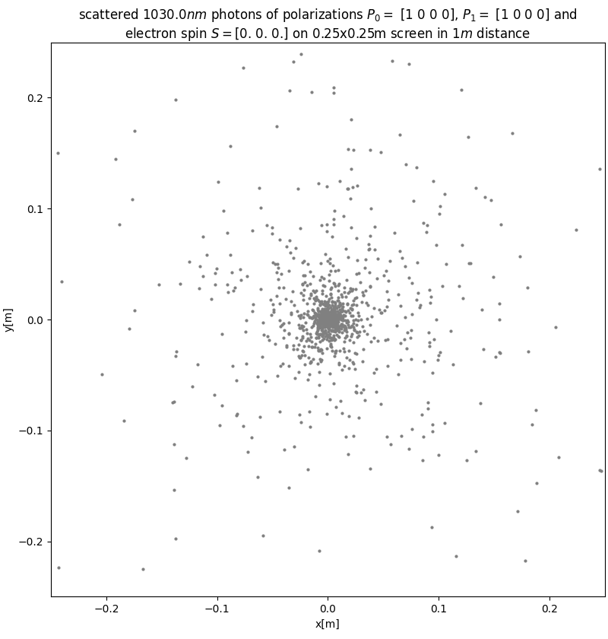
Calculation of Scattered Photons on a Screen
Q_{bunch} | = 0.77 pC
mn_{e} | = 100000
θ | = 0
λ | = 1030 nm
E_{e} | = 130 MeV
E_{ph} | ≈ 1.2037 eV
E’_{ph} | ≈ 313.323 keV
σ_{th} | ≈ 6.6525·10⁻²⁹m²
 | Δ ≈ 0.0024

Slide 35
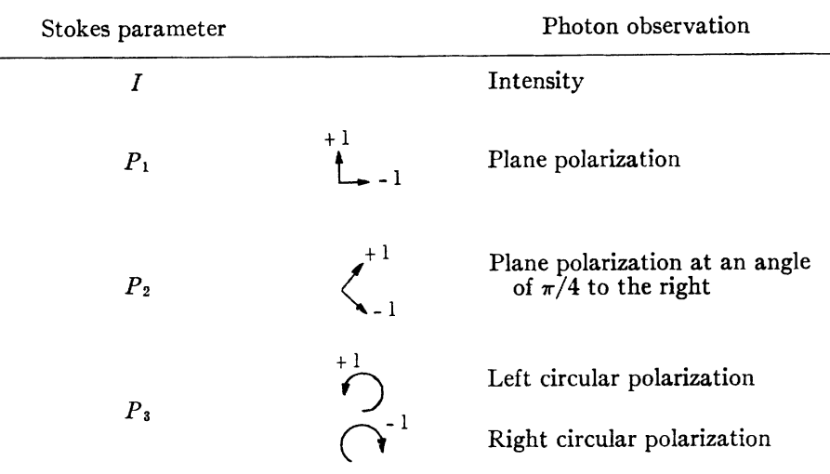
Polarization: Stokes Notation
information is commonly defined via Stokes parameters forming the Stokes vector
: degree of linear polarization
: degree of circular polarization
: azimuthal angle of linear polarization
: azimuthal angle of scattering plane
incident photon: are defined in
scattered photon: are defined in
Table: William H. McMaster, Rev. Mod. Phys. 33, 8 (1961)
Notes:
in ensemble particle view:
circular polarization: particles have same handedness
linear polarization: superposition of left- and right-handed resulting in an oscillation
Unterschied Polarisation und Helizität

Slide 36
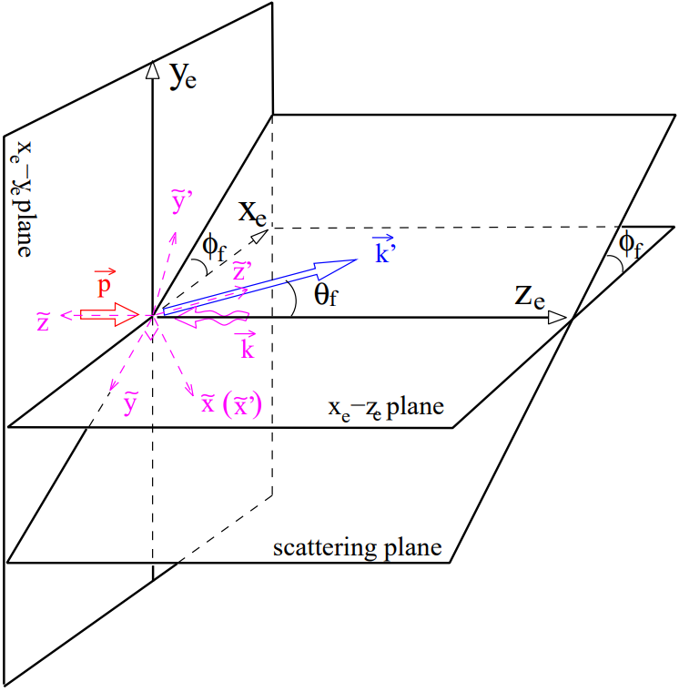
Polarization: Stokes Notation
information is commonly defined via Stokes parameters forming the Stokes vector
: degree of linear polarization
: degree of circular polarization
: azimuthal angle of linear polarization
: azimuthal angle of scattering plane
incident photon: are defined in
scattered photon: are defined in
Table: William H. McMaster, Rev. Mod. Phys. 33, 8 (1961)
Fig: C. Sun and Y. K. Wu, Phys. Rev. ST Accel. Beams 14, 044701
Notes:
in ensemble particle view:
circular polarization: particles have same handedness
linear polarization: superposition of left- and right-handed resulting in an oscillation
Unterschied Polarisation und Helizität

Slide 37
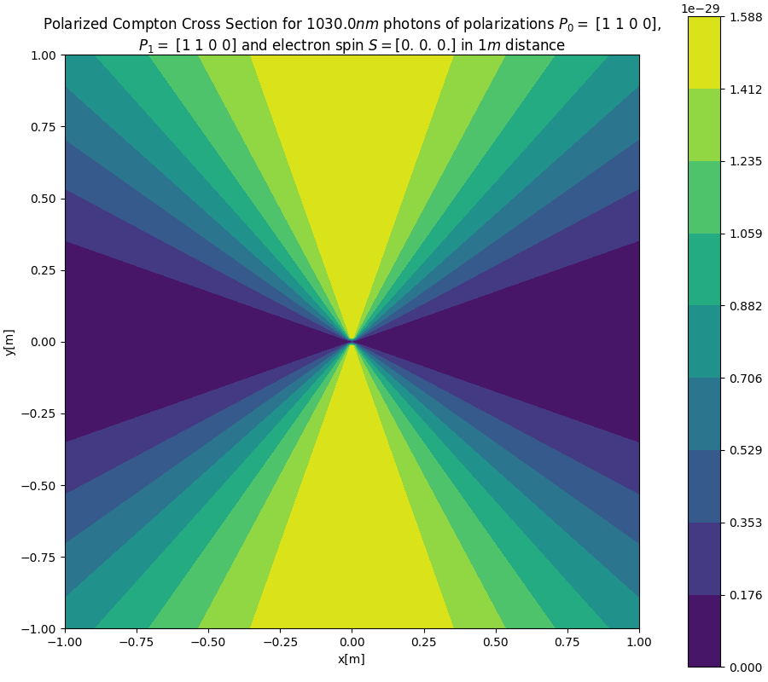
Scattering Images with Polarisation
Q_{bunch} | = 0.77 pC
mn_{e} | = 100000
θ | = 0
λ | = 1030 nm
E_{e} | = 130 MeV
E_{ph} | ≈ 1.2037 eV
E’_{ph} | ≈ 313.323 keV
σ_{up} | ≈ 6.6525·10⁻²⁹m²
 | Δ ≈ 0.0024

Slide 38
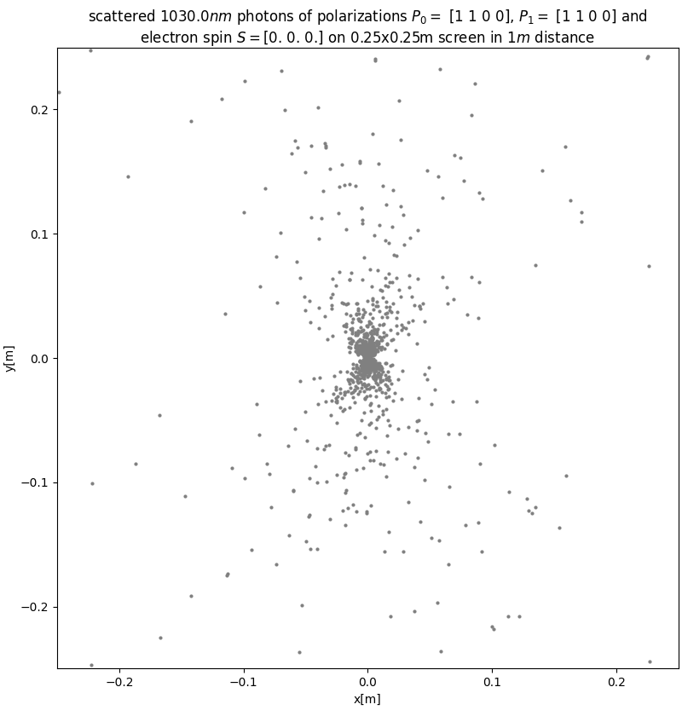
Scattering Images with Polarisation
Q_{bunch} | = 0.77 pC
mn_{e} | = 100000
θ | = 0
λ | = 1030 nm
E_{e} | = 130 MeV
E_{ph} | ≈ 1.2037 eV
E’_{ph} | ≈ 313.323 keV
σ_{up} | ≈ 6.6525·10⁻²⁹m²
 | Δ ≈ 0.0024

Slide 39
Scattering Images with Polarisation
Q_{bunch} | = 0.77 pC
mn_{e} | = 100000
θ | = 0
λ | = 1030 nm
E_{e} | = 130 MeV
E_{ph} | ≈ 1.2037 eV
E’_{ph} | ≈ 313.323 keV
σ_{up} | ≈ 6.6525·10⁻²⁹m²
 | Δ ≈ 0.0024

Slide 40
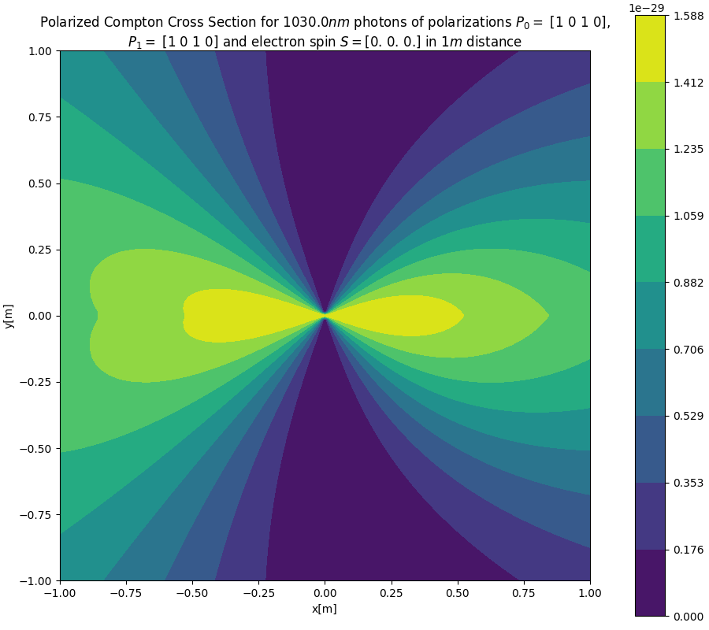
Scattering Images with Polarisation
Q_{bunch} | = 0.77 pC
mn_{e} | = 100000
θ | = 0
λ | = 1030 nm
E_{e} | = 130 MeV
E_{ph} | ≈ 1.2037 eV
E’_{ph} | ≈ 313.323 keV
σ_{up} | ≈ 6.6525·10⁻²⁹m²
 | Δ ≈ 0.0024

Slide 41
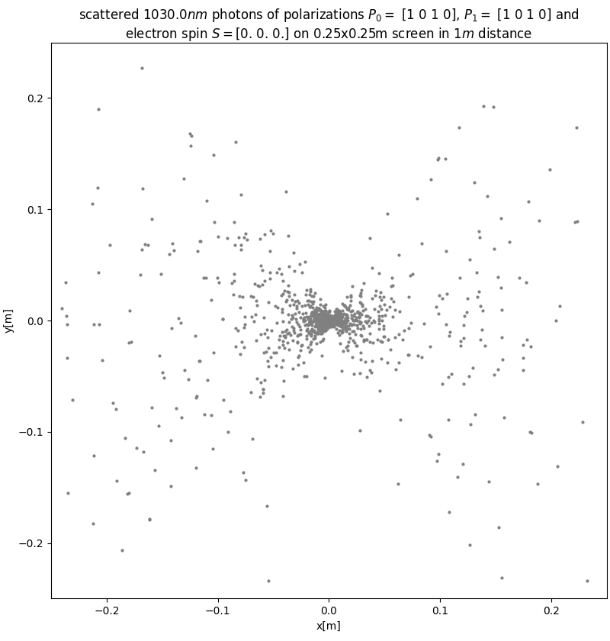
Scattering Images with Polarisation
Q_{bunch} | = 0.77 pC
mn_{e} | = 100000
θ | = 0
λ | = 1030 nm
E_{e} | = 130 MeV
E_{ph} | ≈ 1.2037 eV
E’_{ph} | ≈ 313.323 keV
σ_{up} | ≈ 6.6525·10⁻²⁹m²
 | Δ ≈ 0.0024

Slide 42
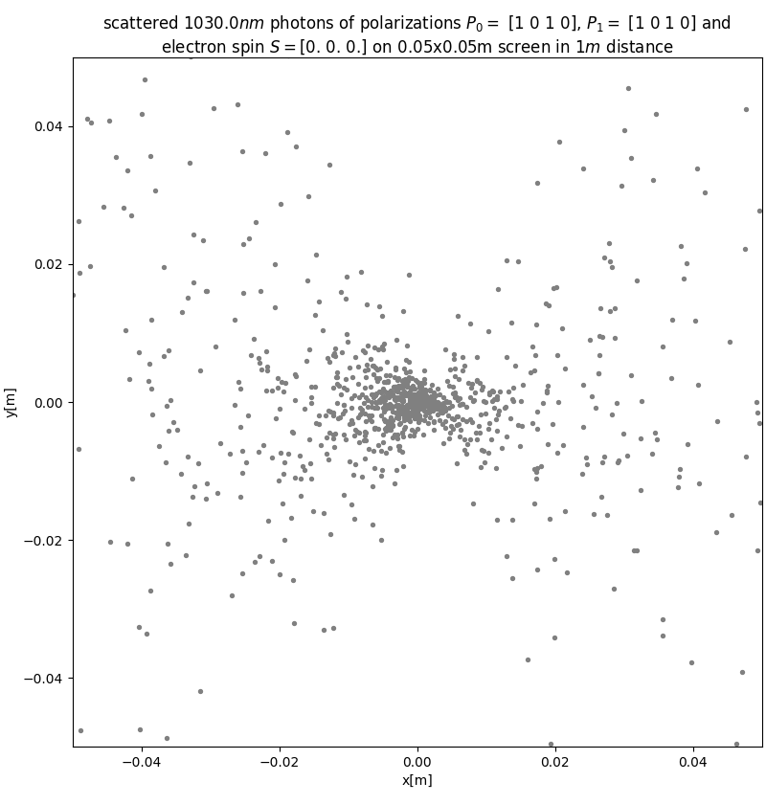
Scattering Images with Polarisation
Q_{bunch} | = 0.77 pC
mn_{e} | = 100000
θ | = 0
λ | = 1030 nm
E_{e} | = 130 MeV
E_{ph} | ≈ 1.2037 eV
E’_{ph} | ≈ 313.323 keV
σ_{up} | ≈ 6.6525·10⁻²⁹m²
 | Δ ≈ 0.0024

Slide 43
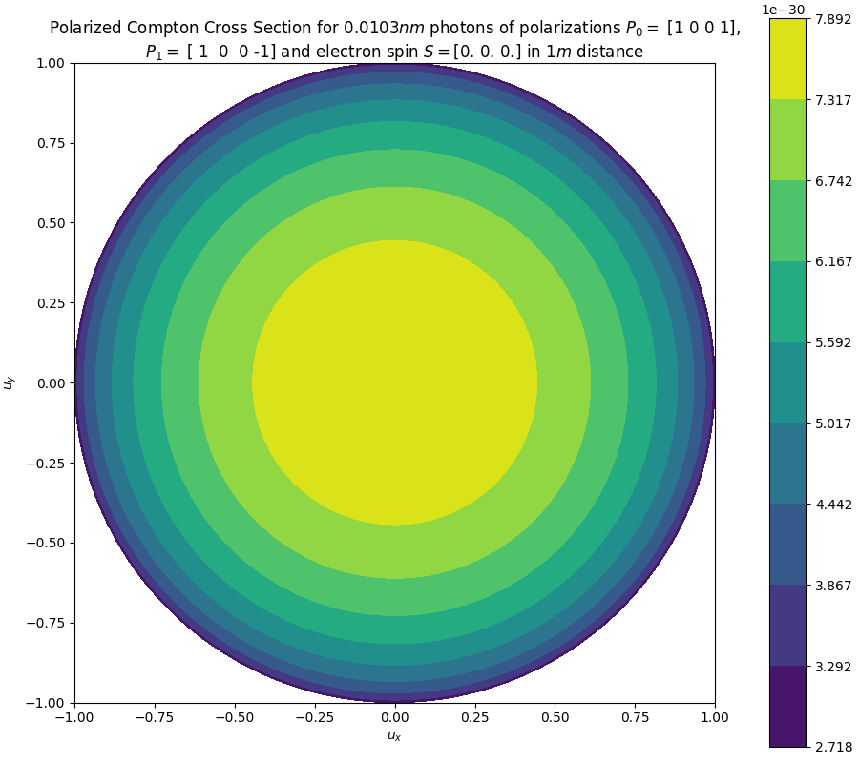
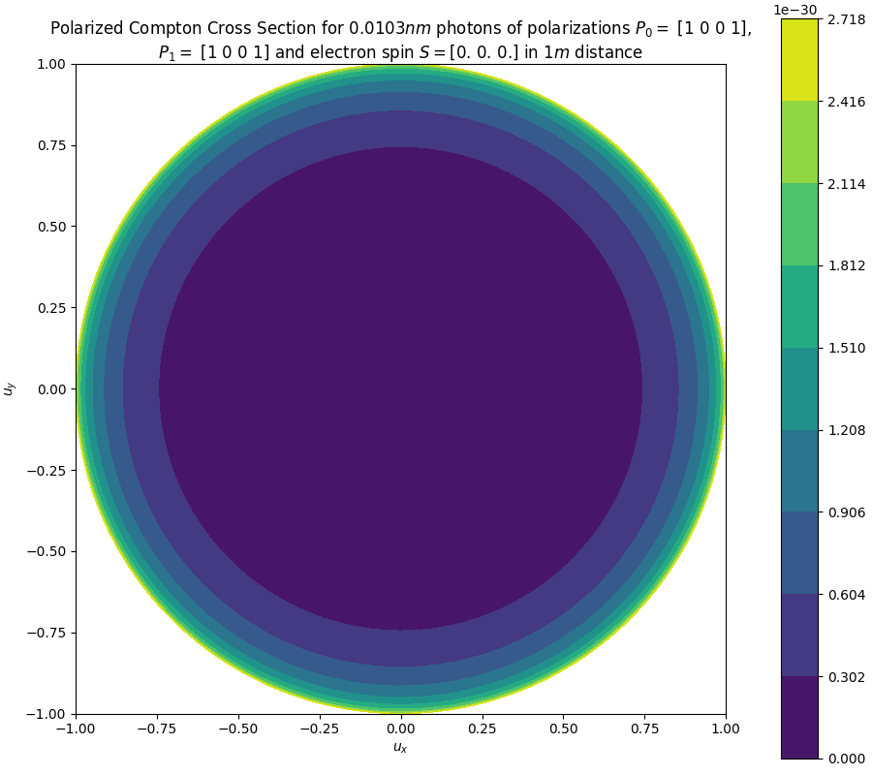
What about Spin and circular polarization?
Q_{bunch} | = 0.77 pC
mn_{e} | = 100000
θ | = 0
λ | = 0.01030 nm
E_{e} | = 130 MeV
E_{ph} | ≈ 1.2037 eV
E’_{ph} | ≈ 313.323 keV
σ_{up} | ≈ 6.6525·10⁻²⁹m²
 | Δ ≈ 0.0024

Slide 44
What about Spin and circular polarization?
Q_{bunch} | = 0.77 pC
mn_{e} | = 100000
θ | = 0
λ | = 0.01030 nm
E_{e} | = 130 MeV
E_{ph} | ≈ 1.2037 eV
E’_{ph} | ≈ 313.323 keV
σ_{up} | ≈ 6.6525·10⁻²⁹m²
 | Δ ≈ 0.0024
Q_{bunch} | = 0.77 pC
mn_{e} | = 100000
θ | = 0
λ | = 0.01030 nm
E_{e} | = 130 MeV
E_{ph} | ≈ 1.2037 eV
E’_{ph} | ≈ 313.323 keV
σ_{up} | ≈ 6.6525·10⁻²⁹m²
 | Δ ≈ 0.0024
In Thomson scattering, the circular
polarization is inverted in the process

Slide 45
What about Spin and circular polarization?
Q_{bunch} | = 0.77 pC
mn_{e} | = 100000
θ | = 0
λ | = 0.01030 nm
E_{e} | = 130 MeV
E_{ph} | ≈ 1.2037 eV
E’_{ph} | ≈ 313.323 keV
σ_{up} | ≈ 6.6525·10⁻²⁹m²
 | Δ ≈ 0.0024
Q_{bunch} | = 0.77 pC
mn_{e} | = 100000
θ | = 0
λ | = 0.01030 nm
E_{e} | = 130 MeV
E_{ph} | ≈ 1.2037 eV
E’_{ph} | ≈ 313.323 keV
σ_{up} | ≈ 6.6525·10⁻²⁹m²
 | Δ ≈ 0.0024
In Thomson scattering, the circular
polarization is inverted in the process

Slide 46
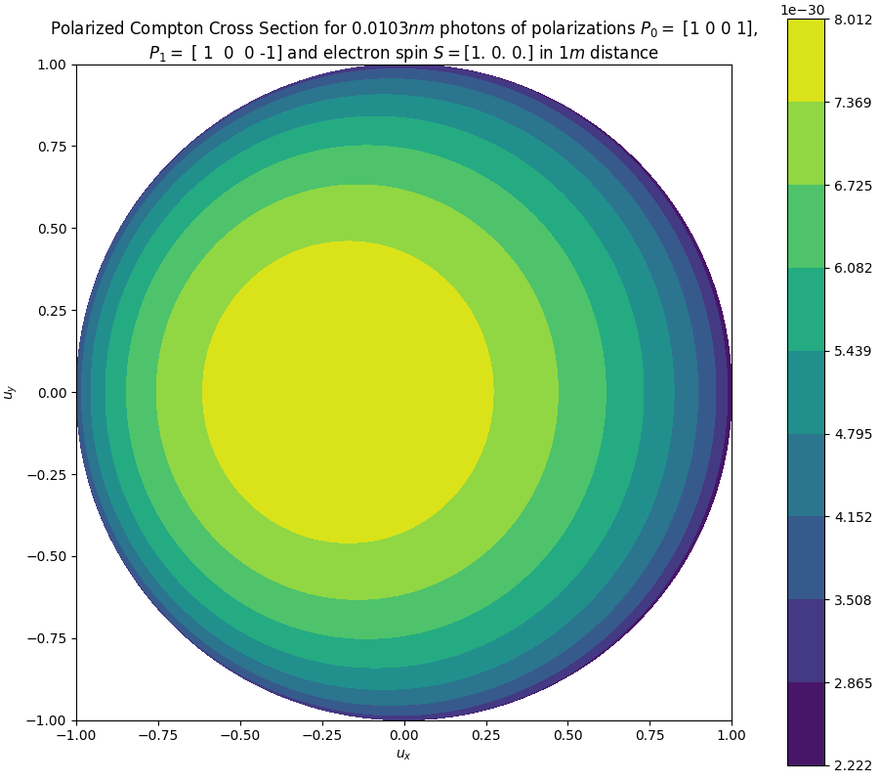
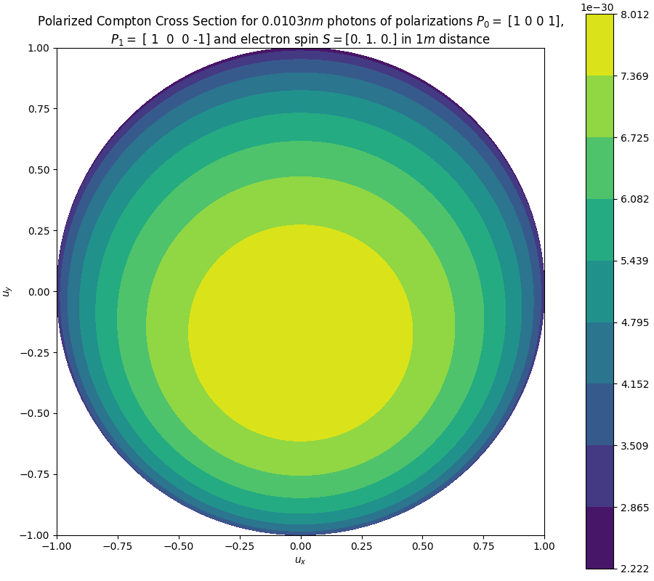
Electron Spin Interaction with High Energy Photons (0.01030nm)
Q_{bunch} | = 0.77 pC
mn_{e} | = 100000
θ | = 0
λ | = 0.01030 nm
E_{e} | = 130 MeV
E_{ph} | ≈ 1.2037 eV
E’_{ph} | ≈ 313.323 keV
σ_{up} | ≈ 6.6525·10⁻²⁹m²
 | Δ ≈ 0.0024

Slide 47
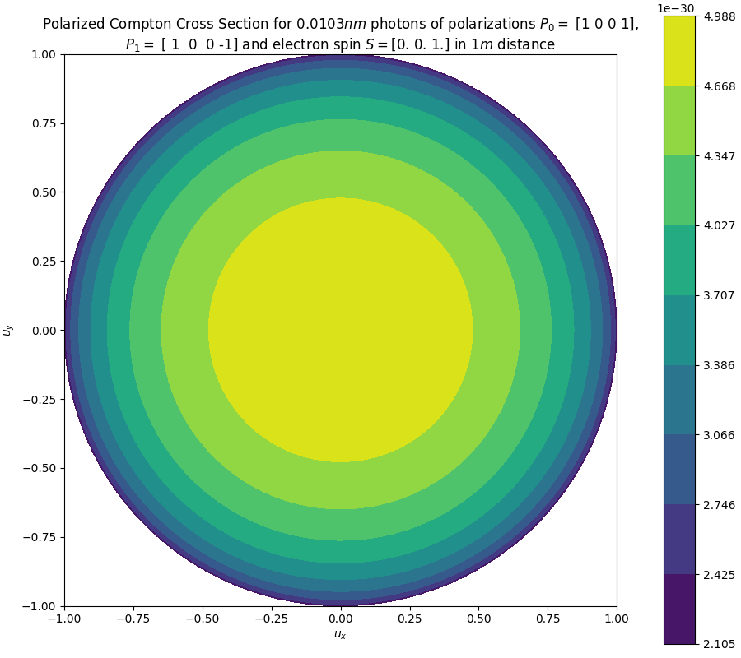
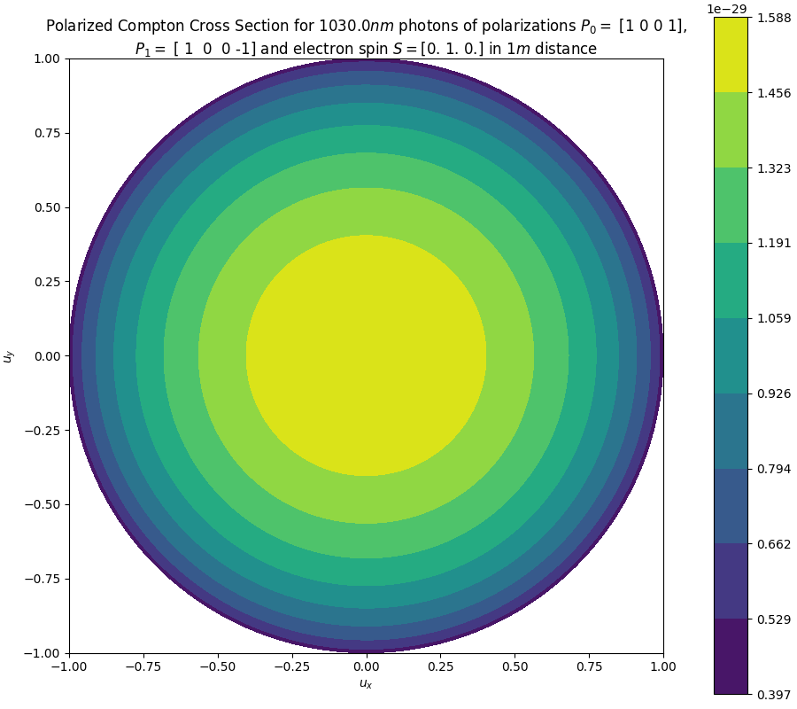
Electron Spin Interaction with High Energy Photons (0.01030nm)
Q_{bunch} | = 0.77 pC
mn_{e} | = 100000
θ | = 0
λ | = 0.01030 nm
E_{e} | = 130 MeV
E_{ph} | ≈ 1.2037 eV
E’_{ph} | ≈ 313.323 keV
σ_{up} | ≈ 6.6525·10⁻²⁹m²
 | Δ ≈ 0.0024

Slide 48
Electron Spin Interaction with High Energy Photons (0.01030nm)
Q_{bunch} | = 0.77 pC
mn_{e} | = 100000
θ | = 0
λ | = 0.01030 nm
E_{e} | = 130 MeV
E_{ph} | ≈ 1.2037 eV
E’_{ph} | ≈ 313.323 keV
σ_{up} | ≈ 6.6525·10⁻²⁹m²
 | Δ ≈ 0.0024
Electron spin effects are not observed
if the electron spin vector points in the
momentum direction z...

Slide 49
Electron Spin Interaction with High Energy Photons (0.01030nm)
Q_{bunch} | = 0.77 pC
mn_{e} | = 100000
θ | = 0
λ | = 0.01030 nm
E_{e} | = 130 MeV
E_{ph} | ≈ 1.2037 eV
E’_{ph} | ≈ 313.323 keV
σ_{up} | ≈ 6.6525·10⁻²⁹m²
 | Δ ≈ 0.0024
Q_{bunch} | = 0.77 pC
mn_{e} | = 100000
θ | = 0
λ | = 0.01030 nm
E_{e} | = 130 MeV
E_{ph} | ≈ 1.2037 eV
E’_{ph} | ≈ 313.323 keV
σ_{up} | ≈ 6.6525·10⁻²⁹m²
 | Δ ≈ 0.0024
...or the initial photon energy is
set well below 100keV.

Slide 50
Electron Spin Interaction with High Energy Photons (0.01030nm)
Q_{bunch} | = 0.77 pC
mn_{e} | = 100000
θ | = 0
λ | = 0.01030 nm
E_{e} | = 130 MeV
E_{ph} | ≈ 1.2037 eV
E’_{ph} | ≈ 313.323 keV
σ_{up} | ≈ 6.6525·10⁻²⁹m²
 | Δ ≈ 0.0024
Q_{bunch} | = 0.77 pC
mn_{e} | = 100000
θ | = 0
λ | = 0.01030 nm
E_{e} | = 130 MeV
E_{ph} | ≈ 1.2037 eV
E’_{ph} | ≈ 313.323 keV
σ_{up} | ≈ 6.6525·10⁻²⁹m²
 | Δ ≈ 0.0024

Slide 51
Electron Spin Interaction with High Energy Photons (0.01030nm)
Q_{bunch} | = 0.77 pC
mn_{e} | = 100000
θ | = 0
λ | = 0.01030 nm
E_{e} | = 130 MeV
E_{ph} | ≈ 1.2037 eV
E’_{ph} | ≈ 313.323 keV
σ_{up} | ≈ 6.6525·10⁻²⁹m²
 | Δ ≈ 0.0024
Q_{bunch} | = 0.77 pC
mn_{e} | = 100000
θ | = 0
λ | = 0.01030 nm
E_{e} | = 130 MeV
E_{ph} | ≈ 1.2037 eV
E’_{ph} | ≈ 313.323 keV
σ_{up} | ≈ 6.6525·10⁻²⁹m²
 | Δ ≈ 0.0024

