Slide 1
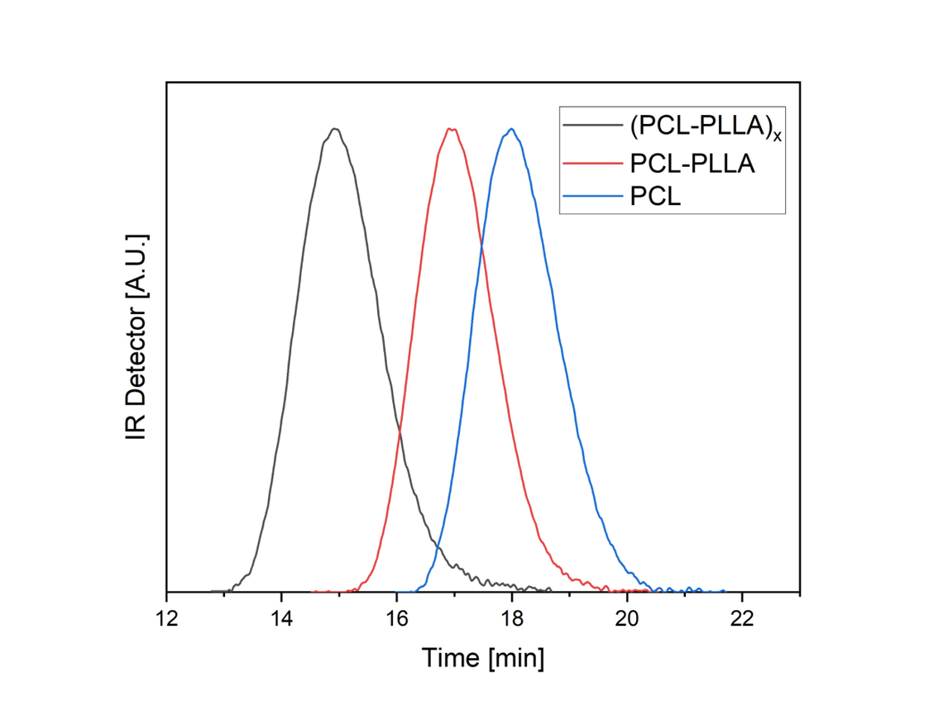
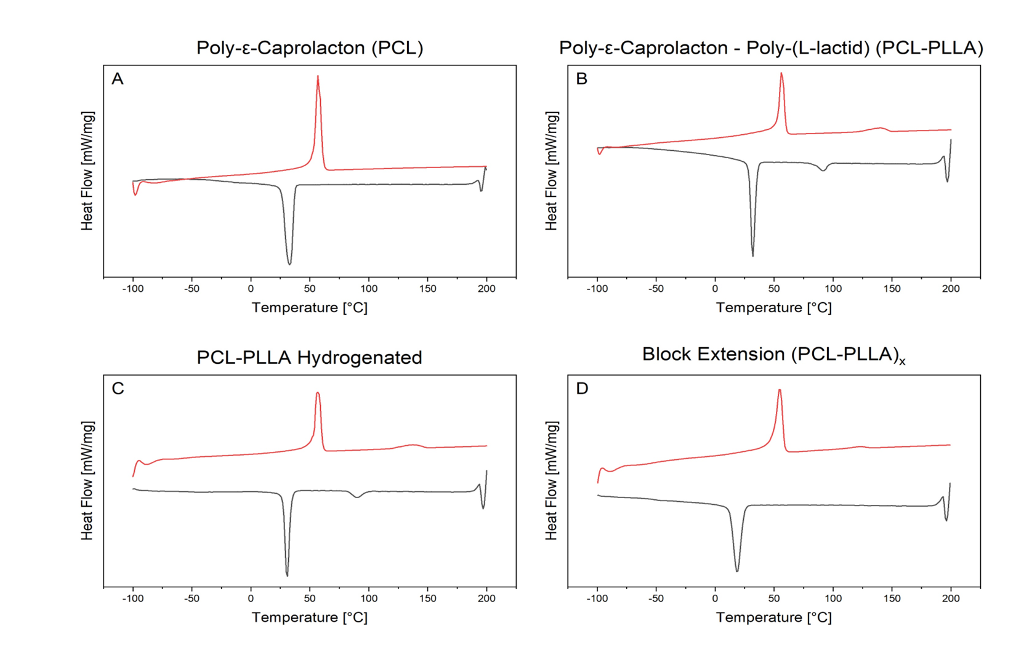
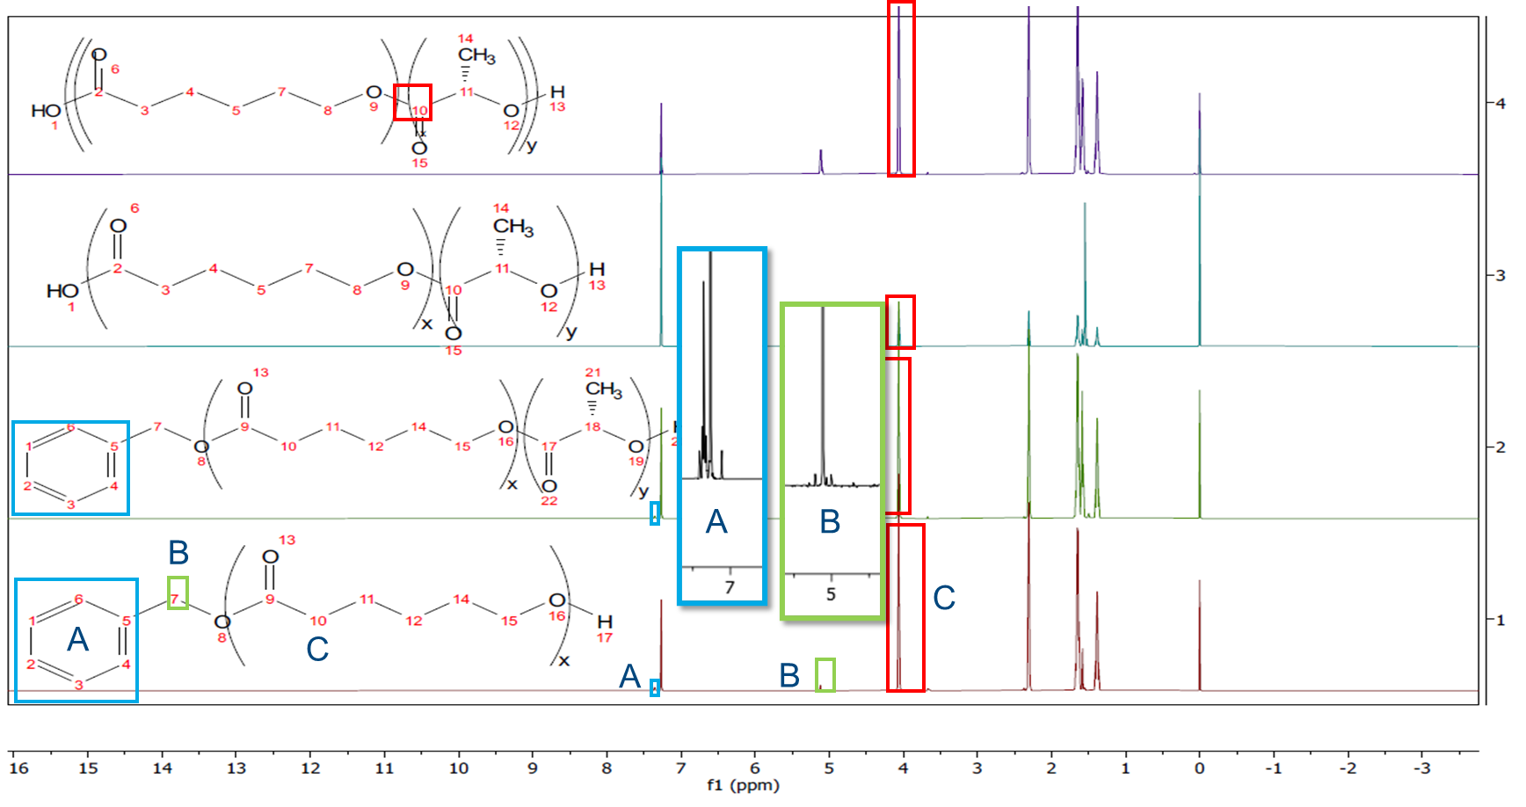
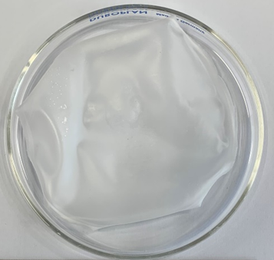
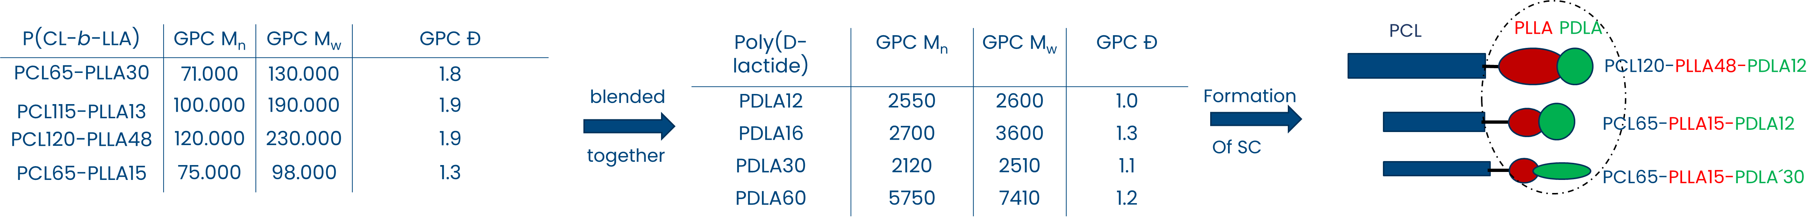
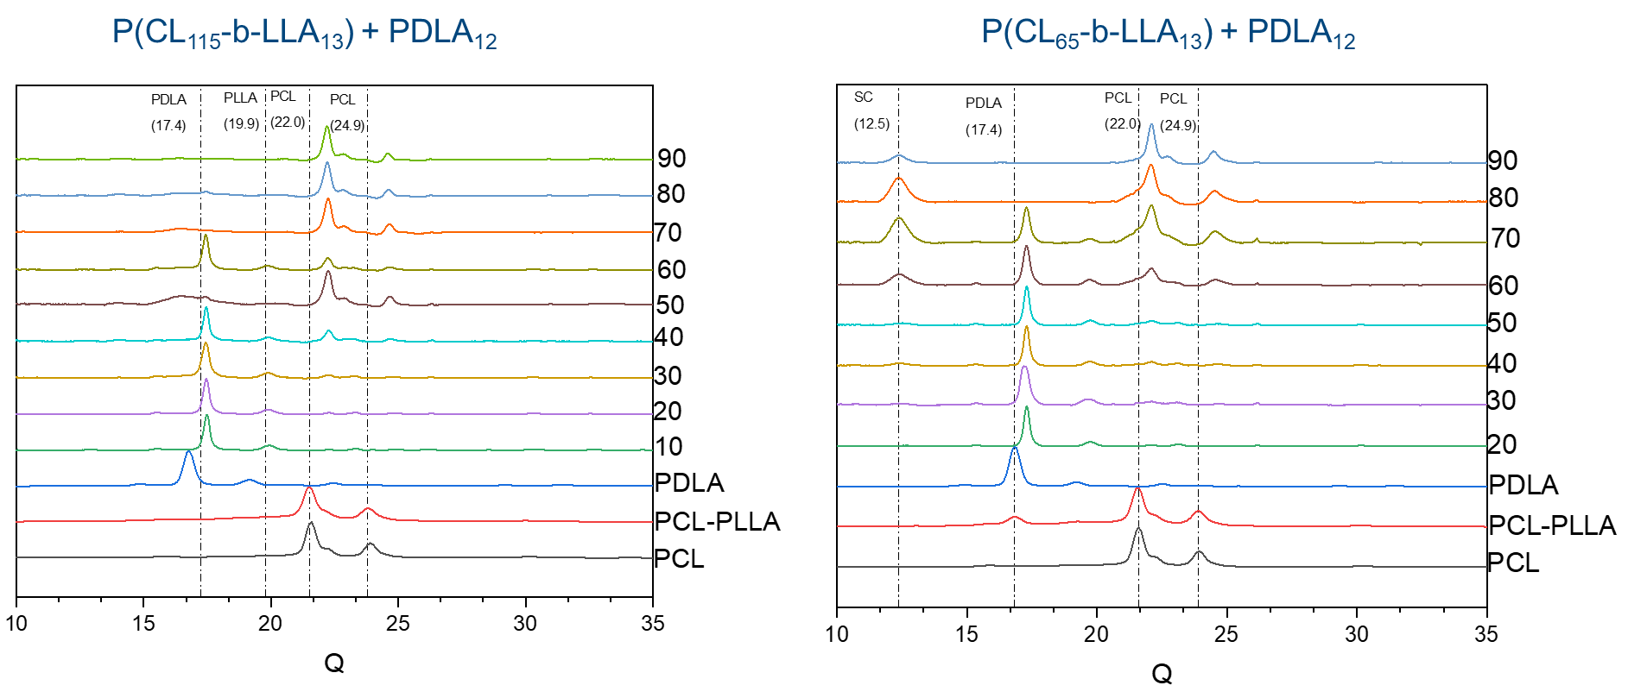
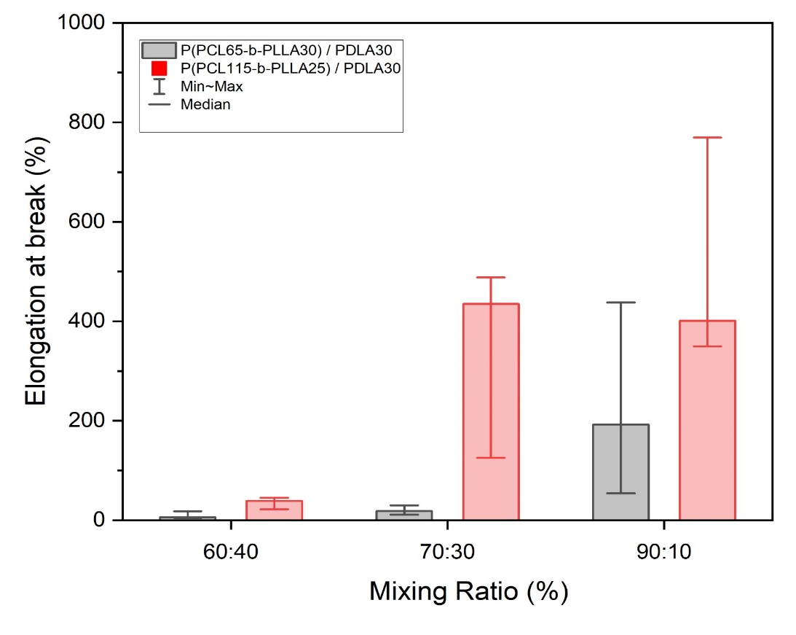
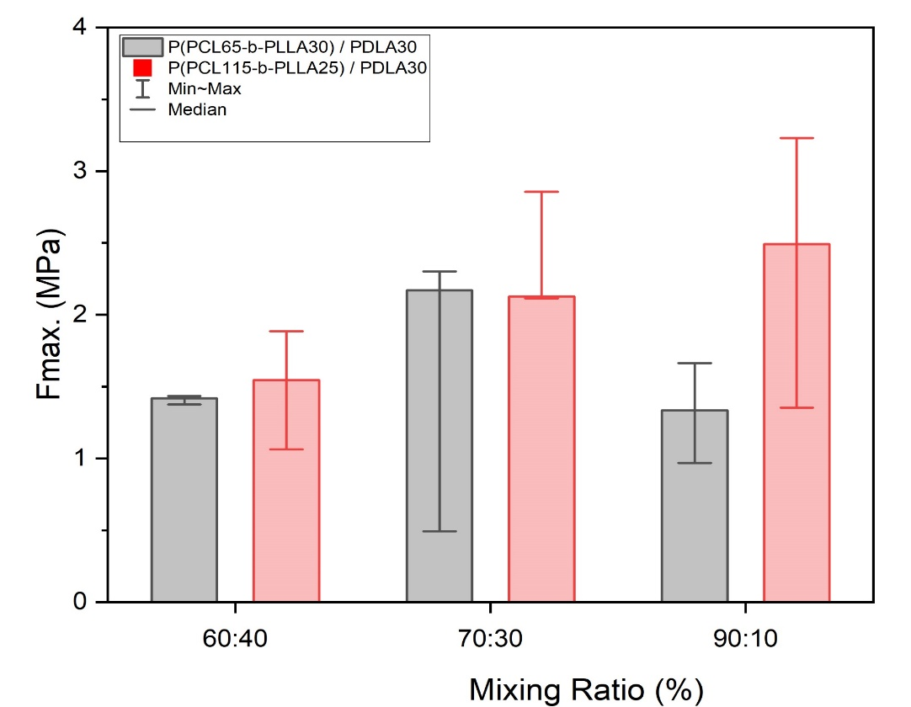
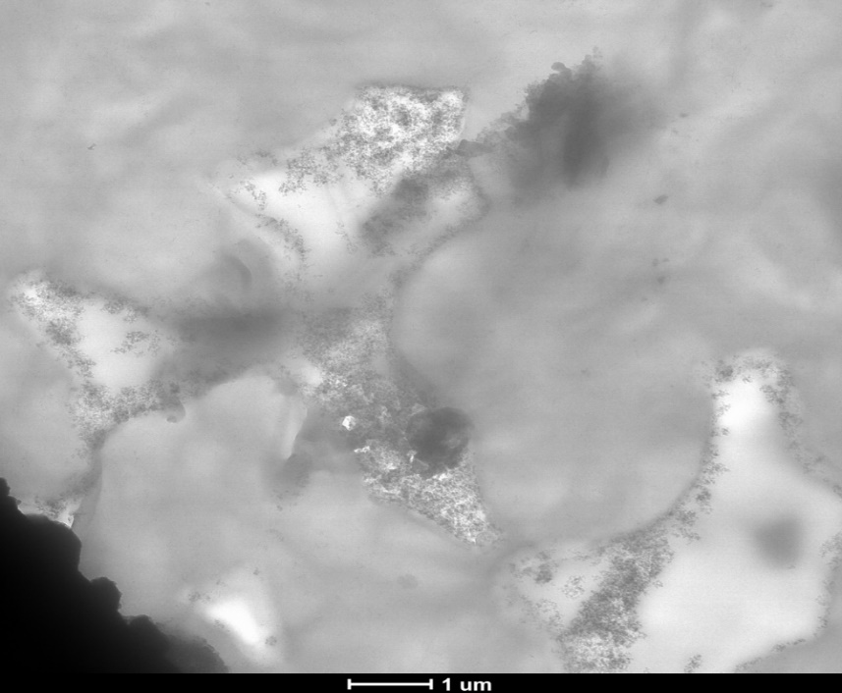
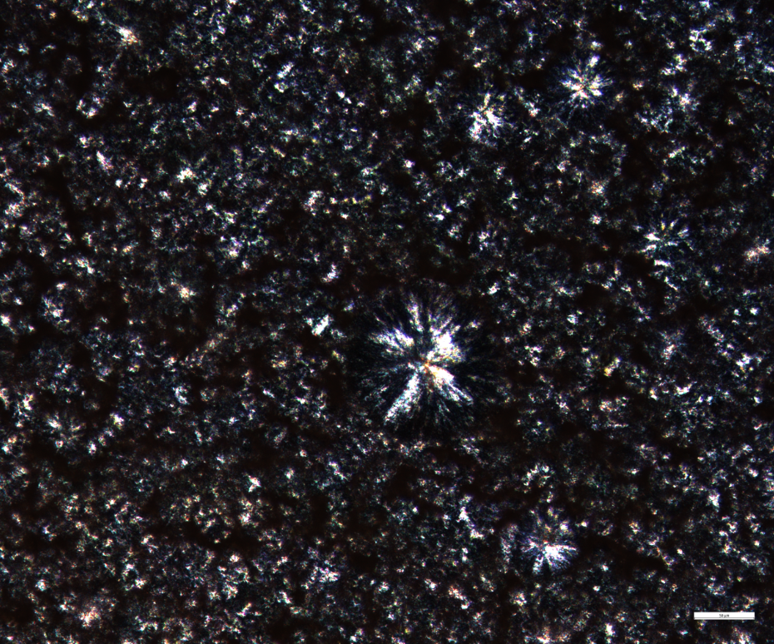
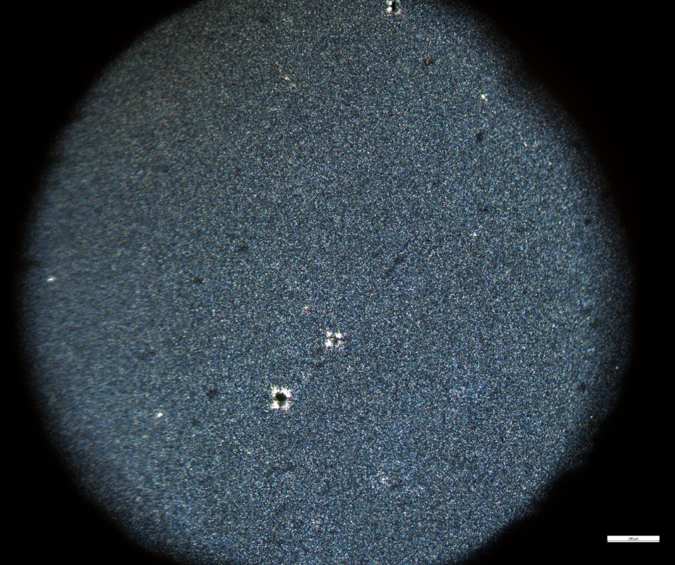
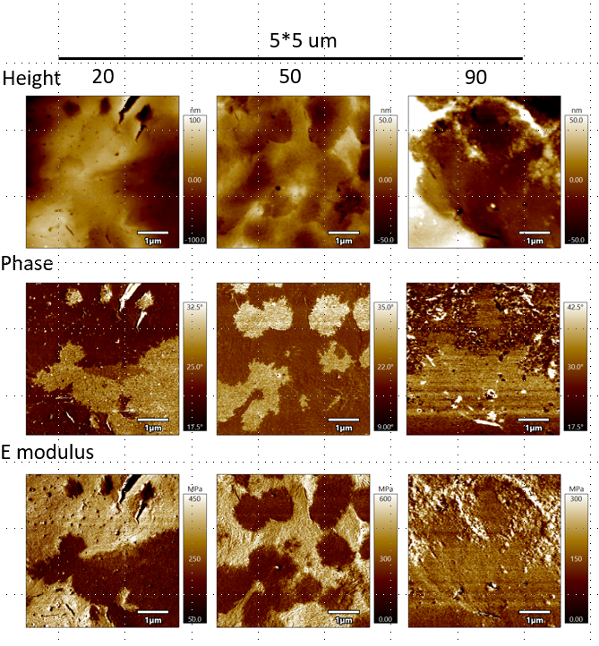
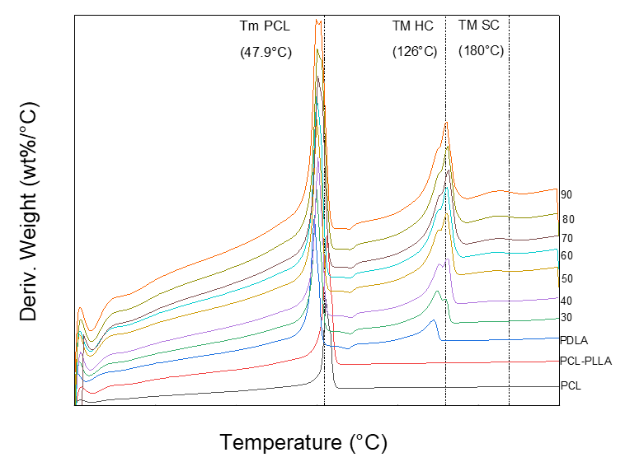
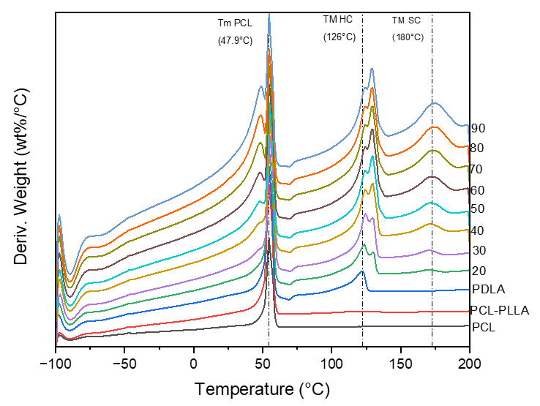


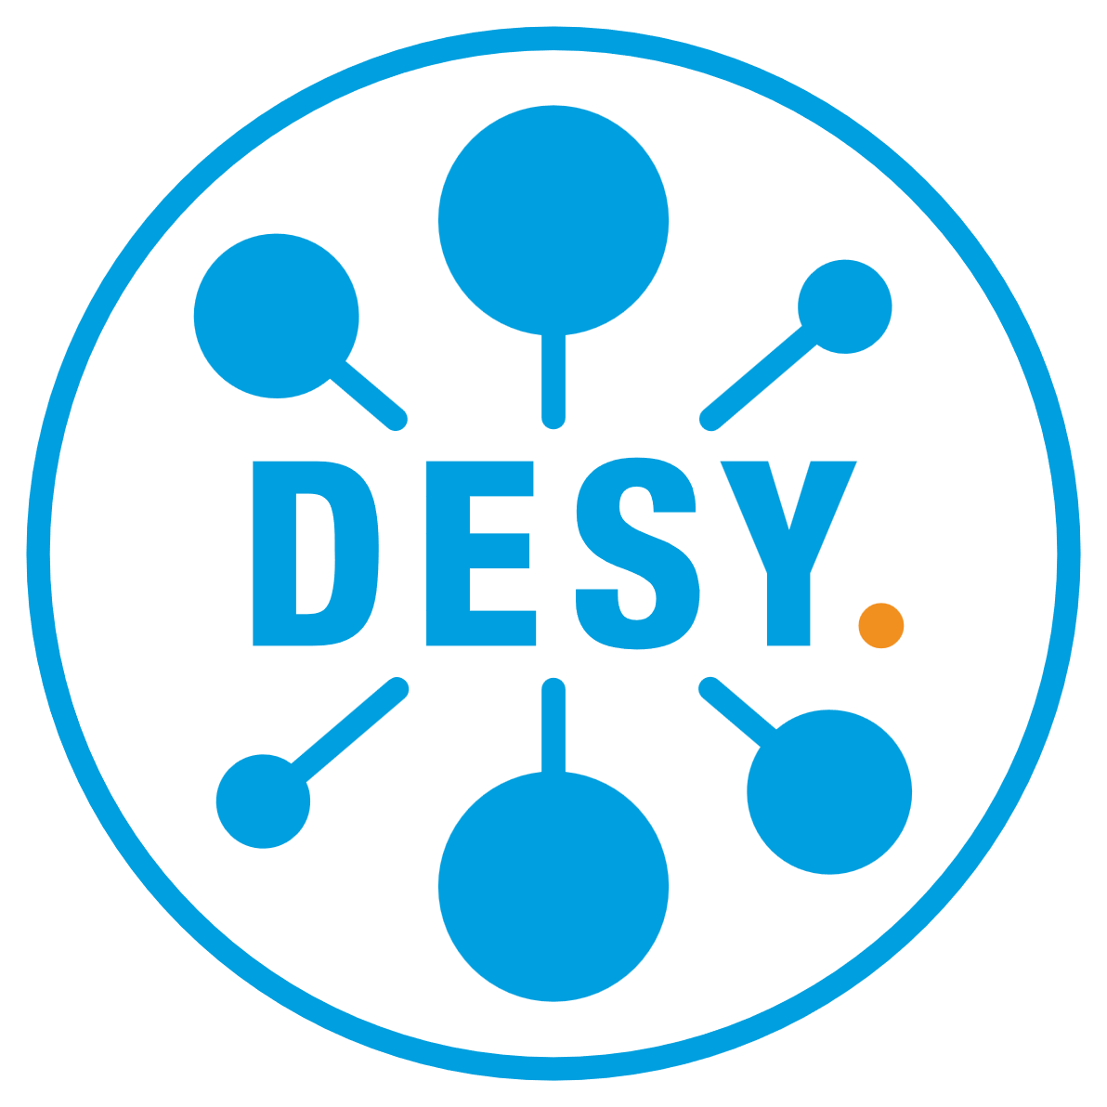



Correlative characterization of stereocomplex formation in aliphatic polyester P(PCL-b-PLLA)
block-copolymers.
Armando J. Mandlule¹; Yvonne Pieper¹; Yue Liu¹; Kamila Iskhakova²; Florian Wieland²; Berit Zeller-Plumhoff²; Axel T. Neffe¹; Francesca M. Toma¹
Helmholtz-Zentrum Hereon, Institute of Functional Materials for Sustainability, Kantstr. 55, 14513 Teltow
Helmholtz-Zentrum Hereon, Institute of Metallic Biomaterials, Notkestr 85, 22607 Hamburg
Introduction
Quantifying the relationship between molecular structure and macroscopic properties in phase-separating semicrystalline block copolymers is a complex challenge, yet crucial for their processing and biomedical applications. In this work, I am studying a polymer system consisting of block copolymers of L-lactide (PLLA) and ε-caprolactone (PCL) that are blended with Poly(D-lactid) (PDLA). PLLA and PDLA sequences can form co-crystallites, referred to as stereocomplexes (SC). Stereocomplexation is faster and more reliable than homocrystallization of PLLA or PDLA alone, and the formed stereocomplexes are more resistant to mechanical deformation and hydrolysis than the corresponding homocrystallites, while furthermore displaying higher melting temperatures. Here, we aim to quantify the relationship between molecular structure and macroscopic properties in this class of copolymers, by combining correlative characterization techniques at different scales. P(PCL-b-PLLA) and PDLA with defined block lengths and molar masses were prepared to elucidate minimum block lengths for crystallization and stereocomplexation (SC), to characterize the size and spatial distribution of crystallites and their impact on physico-chemical properties. Our study showcases the precise control of stereocomplex formation and fine-tuning in high-performance PLA-based materials through strategic polymer synthesis and blending.
Methods
2. Hydrogenation
1. Diblock copolymer synthesis
3. Multiblock copolymer (MBC) synthesis
GPC
4. Film preparation
DSC
¹H-NMR
P(CL65-b-LLA13) 90 % + PDLA12 10 % polymer film.
MBC´s
PDLA´s
Mixed in different ratios 10-90 %
Results
1. Wide angle x-ray scattering (WAXS)
3. Tensile testing
5. Transmission electron microscopy (TEM) and Polarized optical microscopy (POM)
SC
SC formation can be observed for P(CL₆₅-b-LLA₁₃) + PDLA₁₂ (right, Q = 12.5°). The crystallite size of the stereocomplexes could be controlled in the range between 1 and 8 nm. Co-crystallization of PCL occurred during the formation of SC.
PCL / HC
Tensile tests of P(CL₁₁₅-b-LLA₁₃) + PDLA₁₂ and P(CL₆₅-b-LLA₁₃) + PDLA₁₂ films and elongation at the break from 10% to 800% at room temperature.
TEM image (above) shows amorphous region of PCL and crystalline SC domains and POM images show Maltese-cross spherulites (10%) and fine structure (90%).
2. Differential scanning calorimetry (DSC)
4. Atomic force microscopy (AFM)
Phase mapping
Conclusion
Stereocomplex (SC) formation could be shown by combining correlative characterization techniques at different scales. WAXS showed SC formation in short-chained MBCs mixed with poly(D-lactide) for seventy, eighty and ninety percent mixing ratios. The crystallite size of the stereocomplexes could be controlled depending on the mixture and chain length of the MBCs. SC formation in semi-crystallization block copolymers lead to hyperelastic material behavior under linear tension. These findings offer opportunities for the development of versatile materials with tunable mechanical and thermal properties.
Force mapping
SC formation was indicated by the peak at 180°C. Crystallinities of 0-70 % (SC), 2-50 % (PCL) and 3-80 % (HC) were calculated.
20 %
50 %
90 %
Microstructural hardness decreases significantly in P(CL65-b-LLA13) films. Phase composition changes in relation to the mixing ratio.
  References: Izraylit, Victor, et al. Biomacromolecules 21.2 (2019)
  Neffe, Axel T., et al. European Polymer Journal (2021)
Helmholtz-Zentrum Hereon • Kantstraße 55 • 14513 Teltow I Germany • T +49 3328 352-0 • teltow@hereon.de • www.hereon.de/biomaterials
Contact: MSC. Armando Josef Mandlule • T +49 3328 352-279 • Armando.Mandlule@hereon.de

