Slide 1
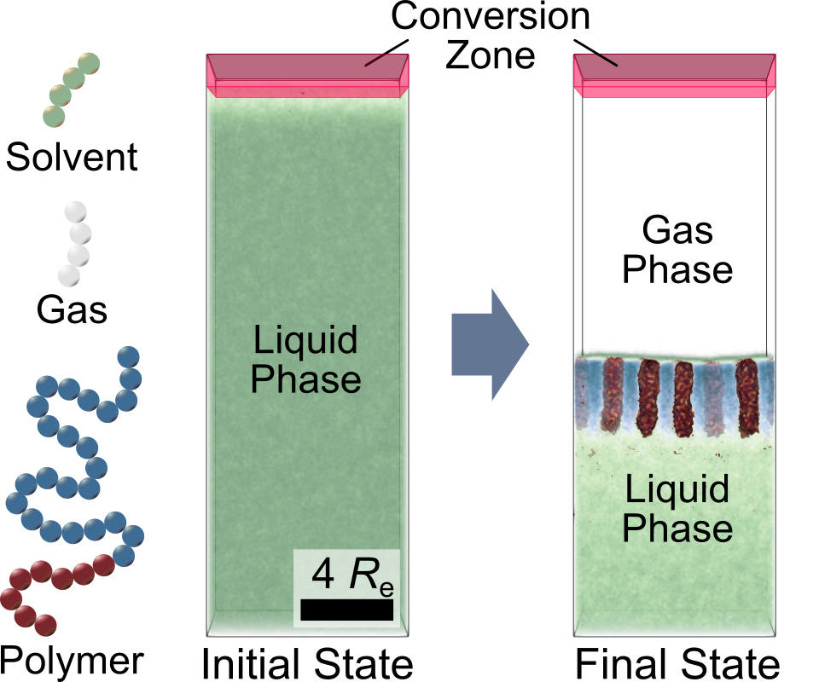
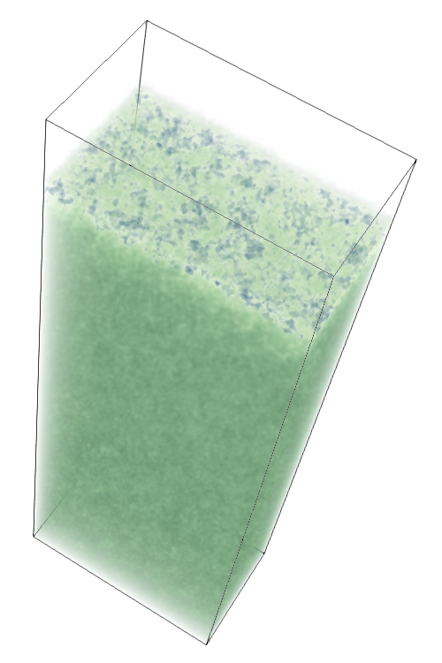
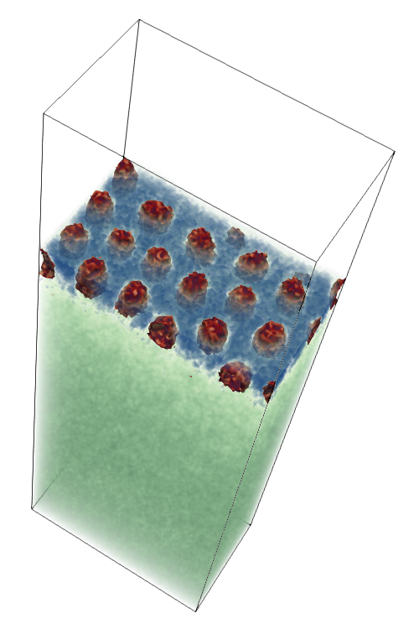
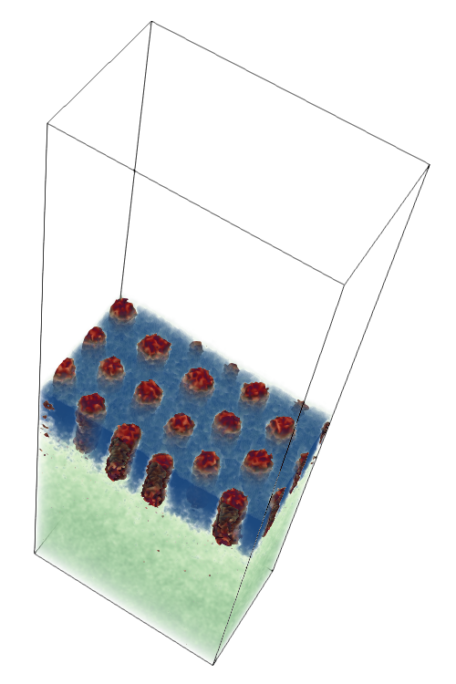

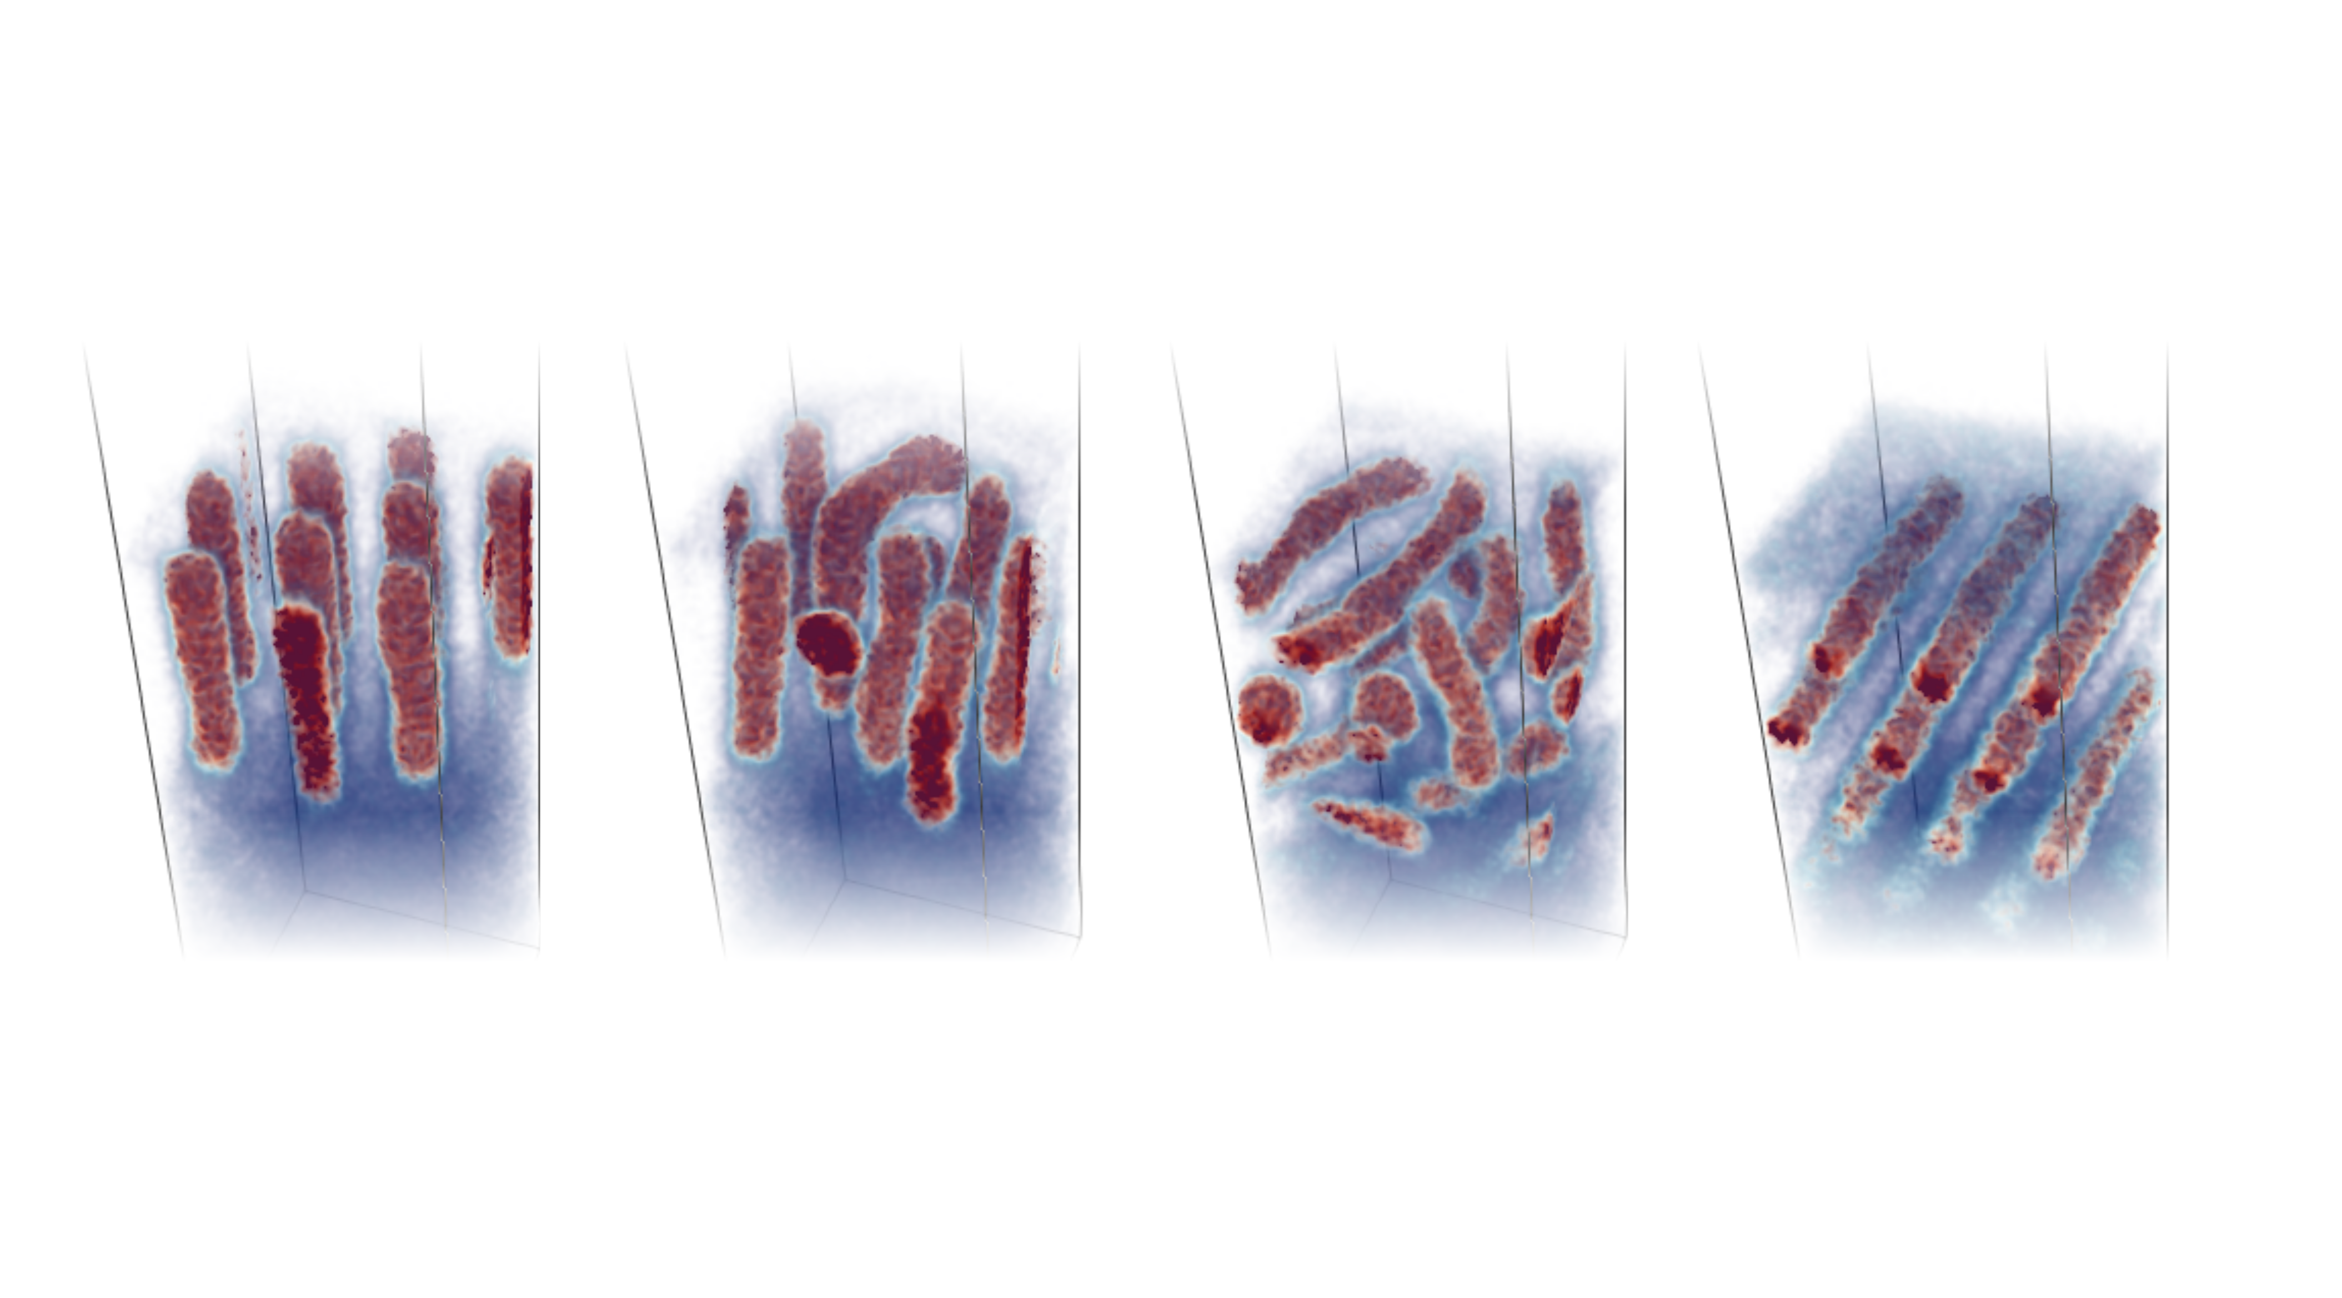
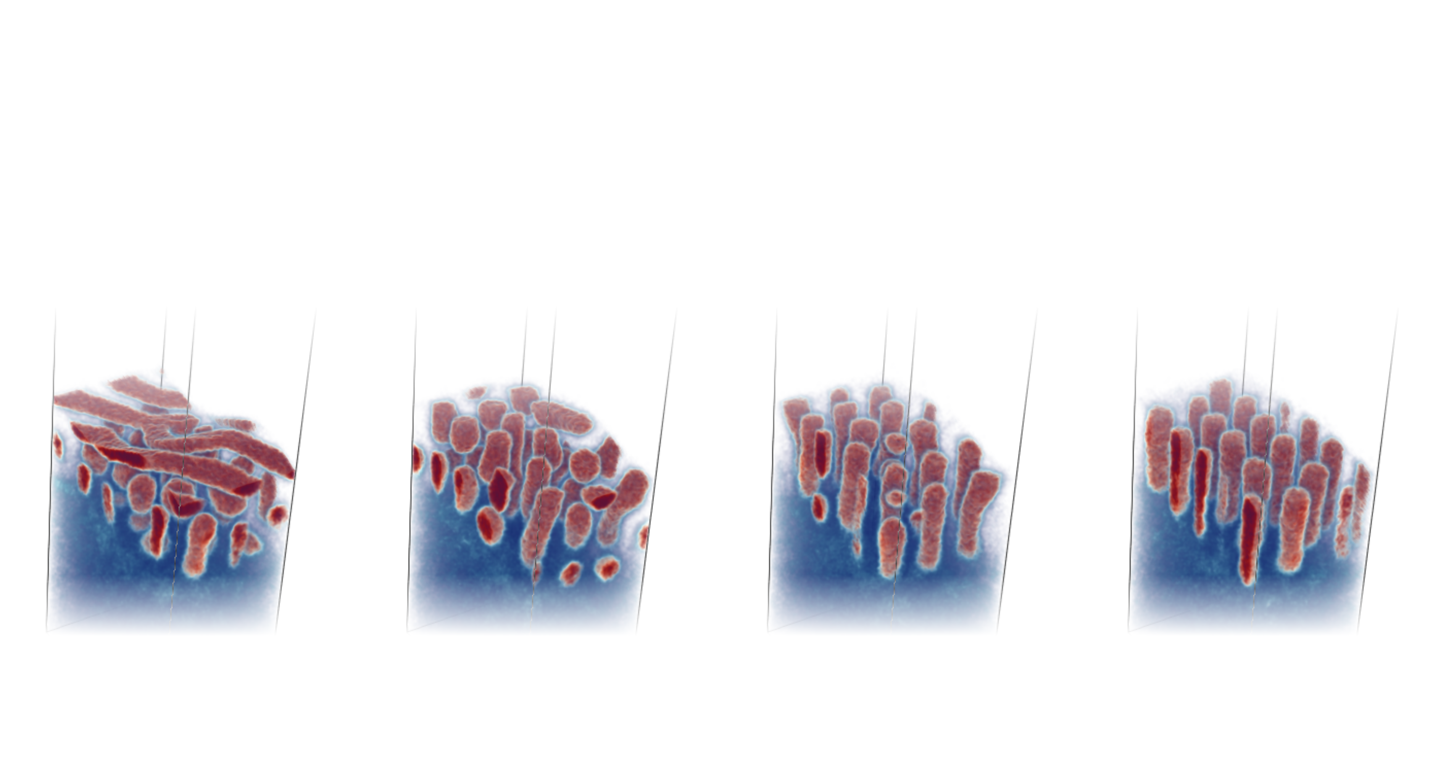
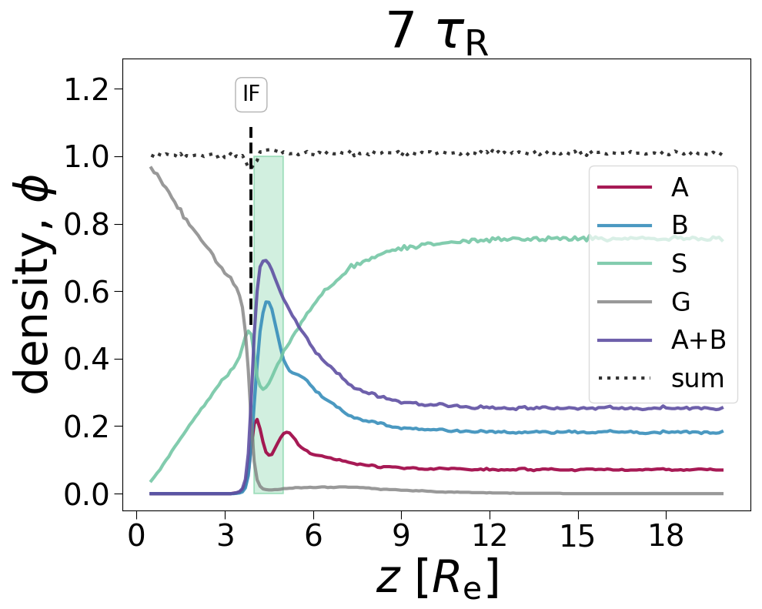
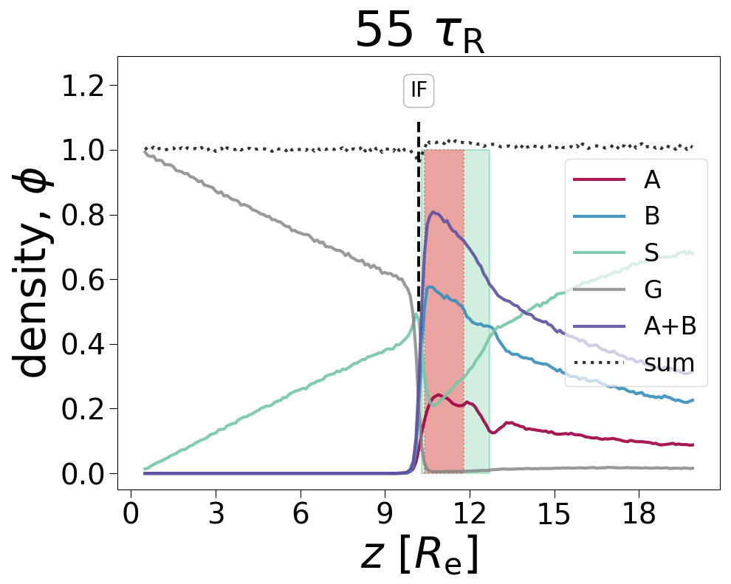
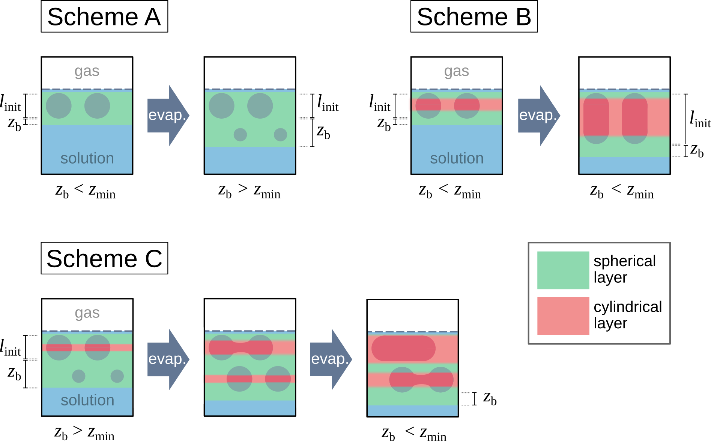
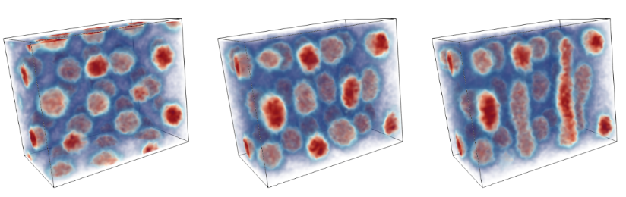
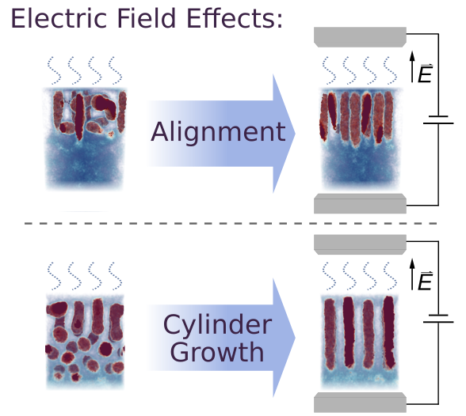
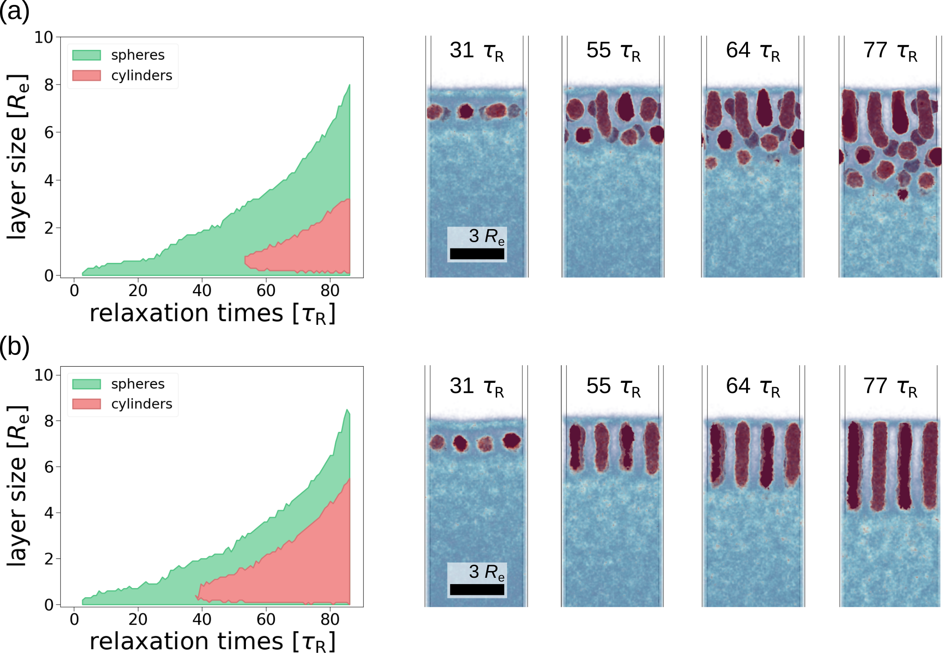

Simulating Evaporation-Induced Self-Assembly of Diblock Copolymer Solutions: Identifying Key Parameters
Oliver Dreyer, Dr. Maryam Radjabian, Institute of Membrane Research – Self-Assembly and Functional Nanostructures (PMB), Prof. Dr. Volker Abetz, Institute of Membrane Research – Head of Institute (PM)
Introduction
„DIGIZWIMEM“ (I²B) & „MExMeMo“ (BMBF)
Motivation: Understand the interplay of parameters and processes during diblock copolymer membrane formation → digital twin
Current goal: Identify which parameters influence the resulting morphology during evaporation-induced self-assembly (EISA)
Open source simulation tool: SOMA – „Soft Coarse-Grained Monte-Carlo Acceleration“^{[1]} (particle-based)
Simulation Setup
Chemical species: Polymer A-B, Solvent S, Gas G
Conversion scheme (S→G) mimics solvent evaporation
[1] Schneider, Müller, Comput. Phys. Commun., 2019, 235, 463-476.
Time evolution of an evaporation simulation
Simulation box and typical polymer architecture
Aligning the cylindrical morphology^{[2,3]}
Layer Evolution Model (LEM)^{[2]}
Evaporation Rate
Adjusted by repulsiveness between solvent and gas, χ_{SG}N₀
High evaporation rates favor perpendicular alignment
χ_{SG}N₀ = 0
χ_{SG}N₀ = 20
χ_{SG}N₀ = 35
χ_{SG}N₀ = 40
Proposed Structure Formation Mechanisms
Concentration gradient forms during evaporation
  Governs polymer morphology
  Determination of spherical and cylindrical layers
Emergence and growth rate of spherical and cylindrical layer govern final morphology
Dependent on concentration gradient
Directly linked to experimentally accessible parameters
evaporation rate
Effective Gas Affinity
Solvent selective for majority block
Evaporation: Selective solvent „vapor“ at surface, ϕ_{S,surf}
ϕ_{S,surf} = 0.04
ϕ_{S,surf} = 0.12
ϕ_{S,surf} = 0.22
ϕ_{S,surf} = 0.30
solvent vapor density
1D density profiles of evaporation simulations at early (7 τ_{R}) and later stage (55 τ_{R}).
Homogeneous Electric Field
Developed as new feature in SOMA
Effectively shifts order-order transition (OOT)
During EISA simulations
  Alignment
  Cylinder growth
Alignment
  EF aligns permittivity interface along its direction
Cylinder growth
  Captured by LEM
  OOT shift increases cylindrical layer
  Increased growth rate during structure formation
electric field strength
without electric field
with electric field
Proposed mechanisms (LEM) for stacked layers of spheres (Scheme A), perpendicular cylinders (Scheme B) and parallel cylinders (Scheme C)
[2] Dreyer, Ibbeken, Schneider, Blagojevic, Radjabian, Abetz, Müller, Macromolecules., 2022, 55, 7564.
[3] Dreyer, Schneider, Radjabian, Abetz, Müller, Macromolecules., 2023, 56, 6880.
Helmholtz-Zentrum Hereon • Max-Planck-Straße 1 • 21502 Geesthacht I Germany • T +49 4152 87-0 • contact@hereon.de • www.hereon.de
Contact: Oliver Dreyer, Dr. Maryam Radjabian • T +49 4152 87-2212 / 2802 • oliver.dreyer@hereon.de, maryam.radjabian@hereon.de

