Slide 1
Bunch-by-Bunch Feedback in the BESSYII booster
Meghan McAteer, Bessy II Machine Group
I.FAST Workshop 2024 on Bunch-by-bunch Feedback Systems
04.03.2024

Slide 2
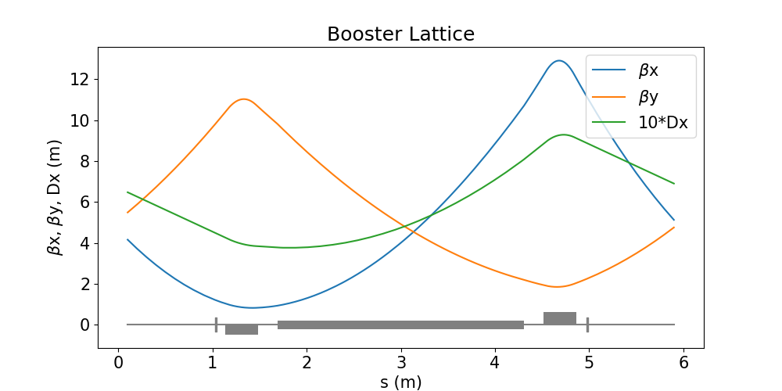
The BESSYII Booster
Energy | 50 MeV–1.9 GeV
Circumference | 96 m
# cells | 16
RF frequency | 500 MHz
H | 160
Qx, Qy | 5.88, 3.69
ξx, ξy | 2, 2
Ramping time | 100 ms
Max. current | 6 mA

Slide 3
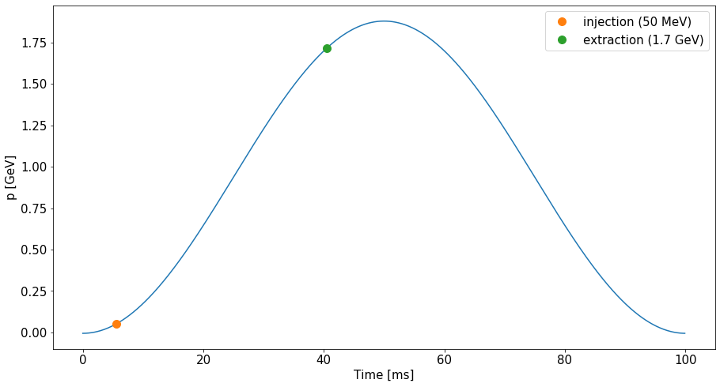
The BESSYII Booster
50 MeV to 1.9 GeV in 100 ms
Large (factor of 40) energy range, so significant field errors at low energy
Beam injected when energy is already ramping up, not into stationary bucket
Booster energy ramp.

Slide 4
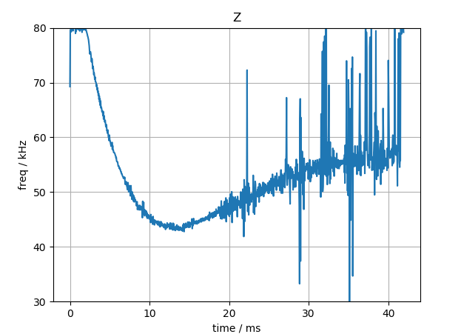
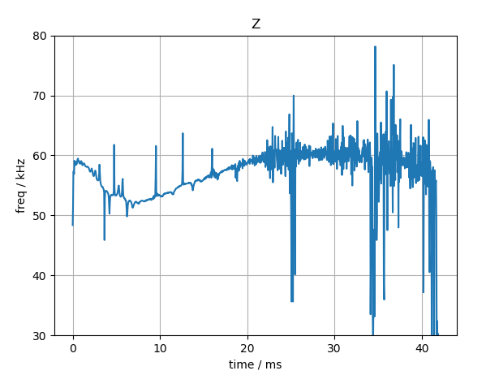
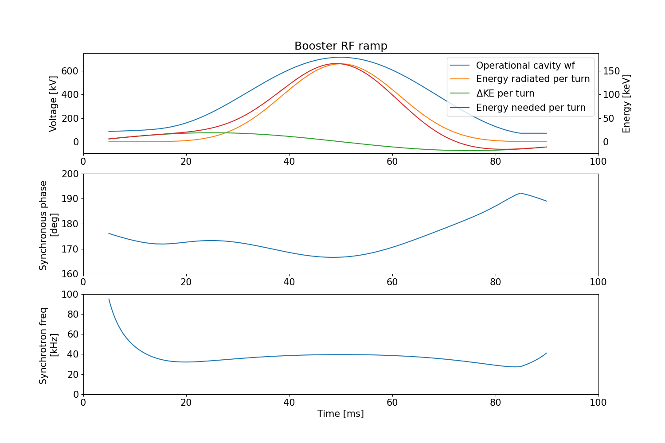
RF ramp
Measured synchrotron frequency.
Flattening the synchrotron tune at injection resulted in beamloss for multi-bunch shots
  RF ramp shape seems to have been empirically tuned to increase acceptance at injection
Synchronous phase varies by ~15 degrees during acceleration cycle
  Flattening the synchronous phase, without reducing acceptance at injection, would require more rf power than currently available
Booster RF waveform, and corresponding calculated synchronous phase and synchrotron tune during ramp.

Slide 5
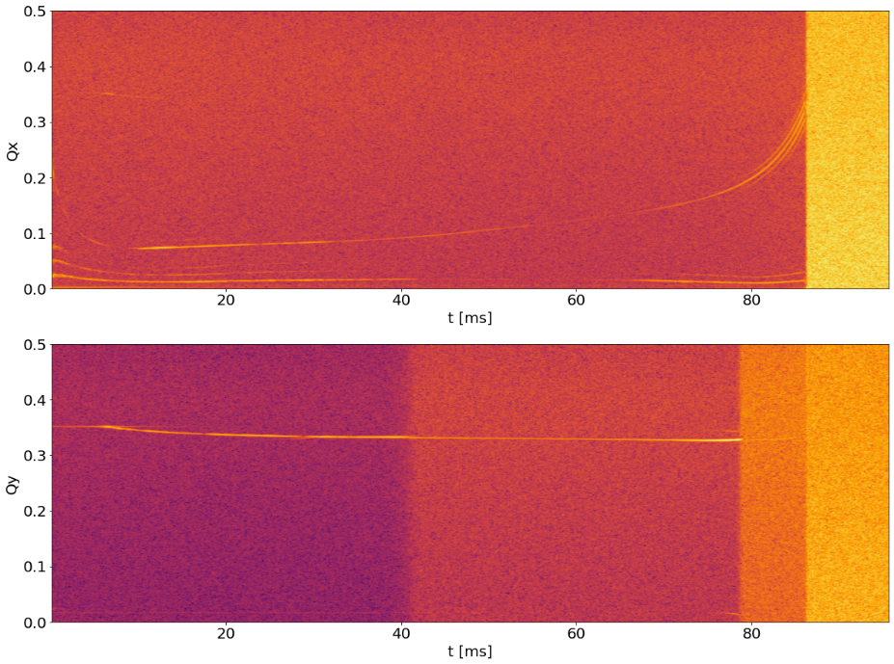
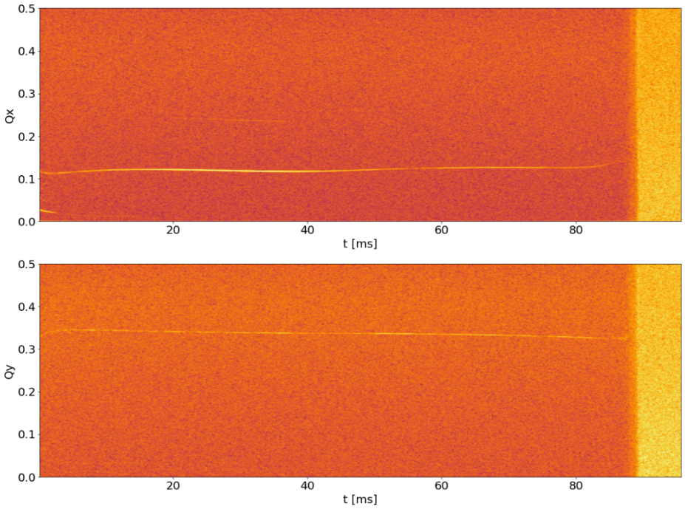
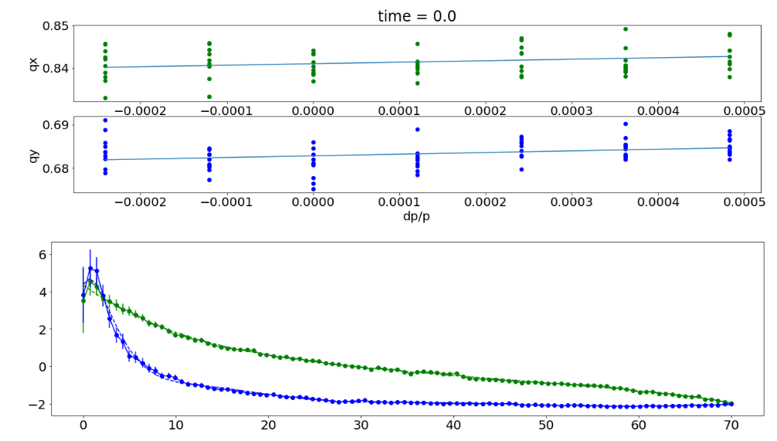
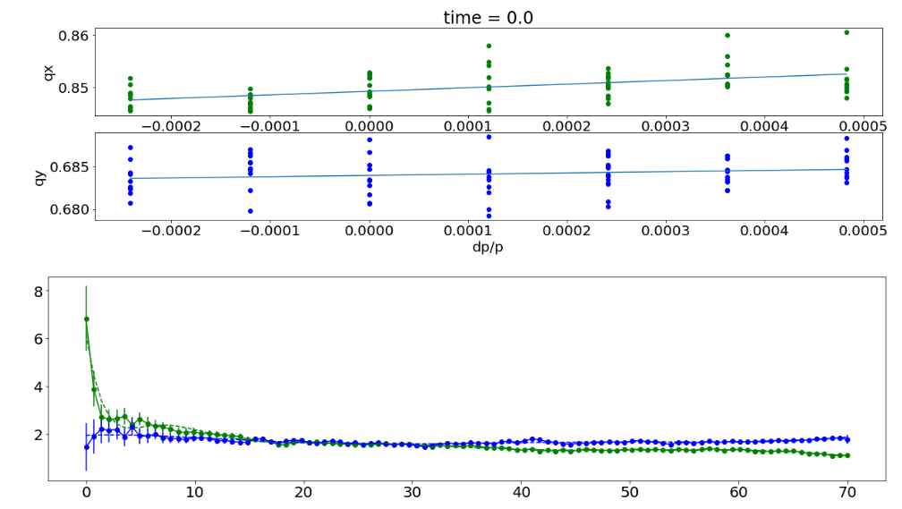
Why BBFB?
Uncorrected tunes throughout acceleration ramp:
Uncorrected chromaticity throughout acceleration ramp : (green is horizontal, blue is vertical)
Instabilities can potentially reduce efficiency of injection into the storage ring, so must be controlled
Main motivation for implementing bbfb was plan to reduce booster bunch length
  shorter bunches + increased impedance would reduce instability threshold
Transverse motion has been stabilized by correcting optics; transverse feedback isn’t currently necessary
  May change when using the ‘flexi-gun’ with variable bunch spacing
At the moment we can operate without bbfb, even with high booster current, but injection efficiency is much better with longitudinal fb
Corrected chromaticity throughout acceleration ramp:
Corrected tunes throughout acceleration ramp:

Slide 6
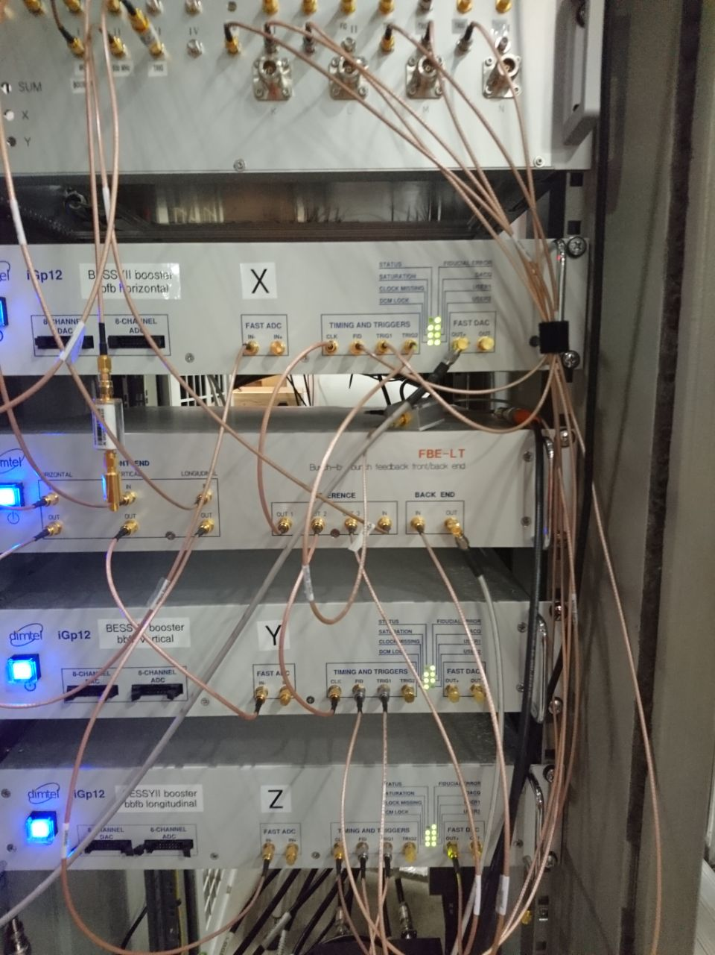
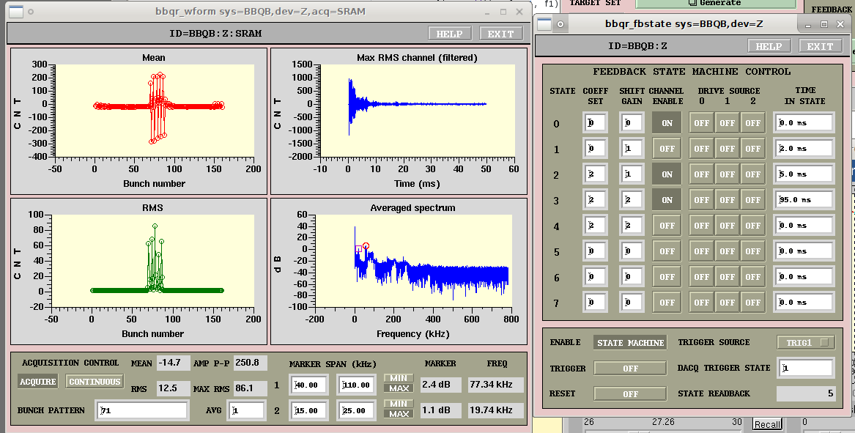
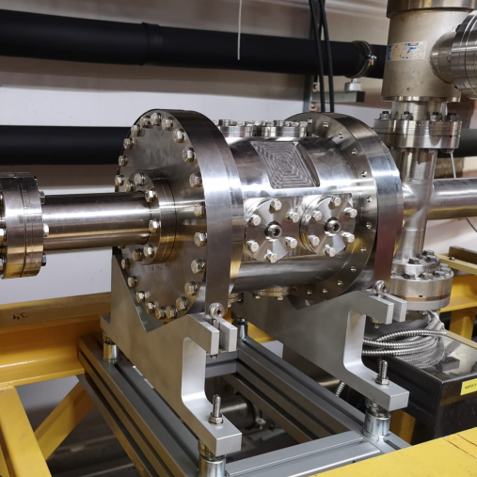
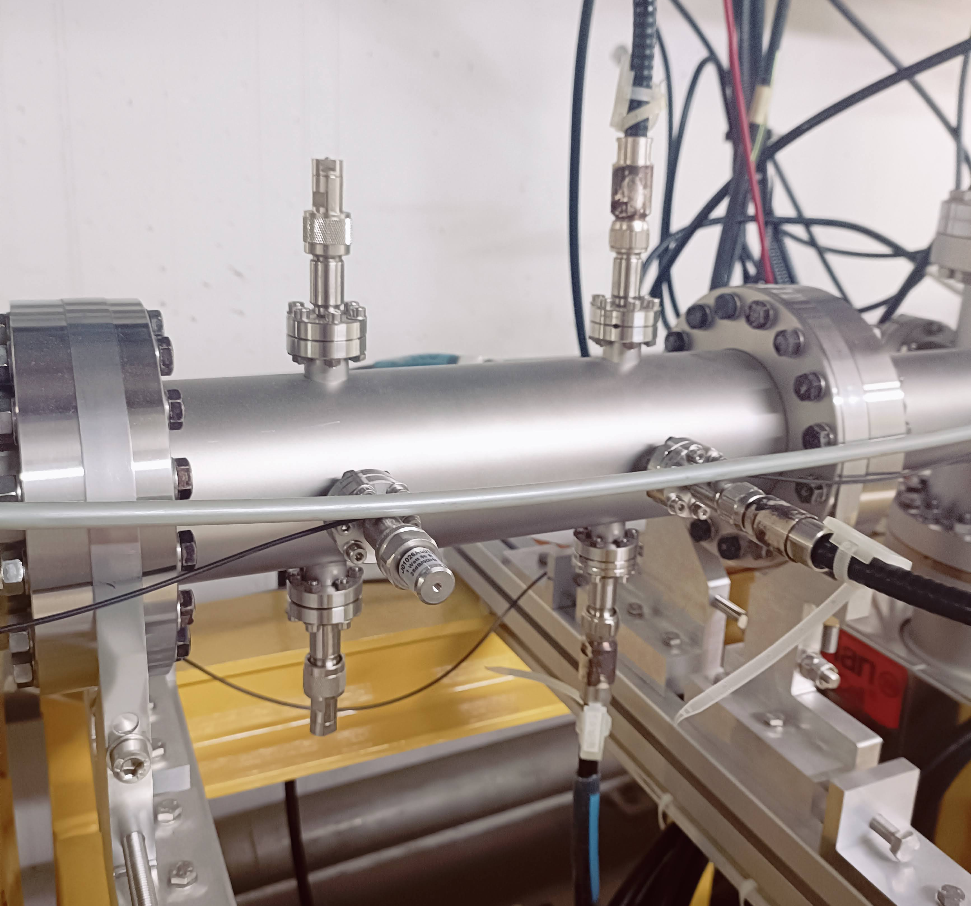
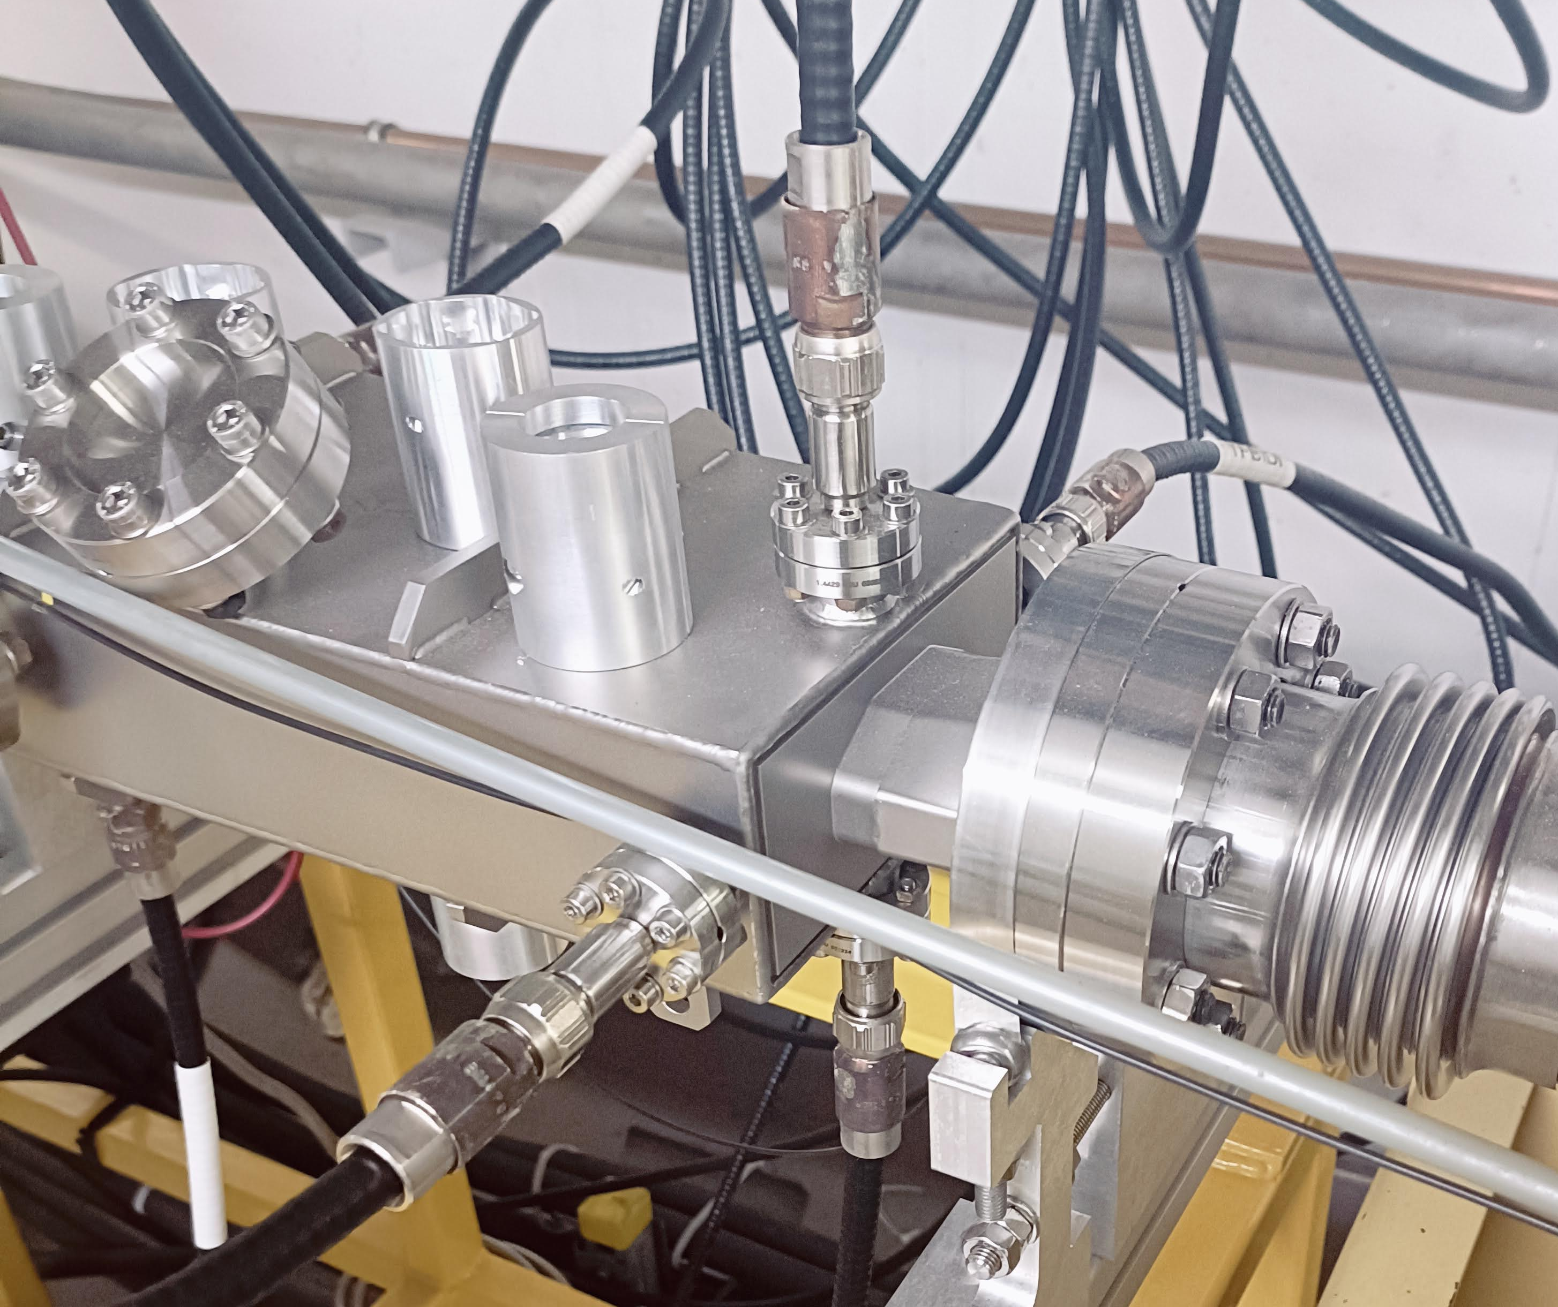
BBFB setup
Dimtel system: FBE-LT front/back end, three iGP-12 processors w/ state machine firmware
Longitudinal kicker cavity based on DLS design (1.625 GHz, 300 V max kick)
Stripline pickup and kicker

Slide 7
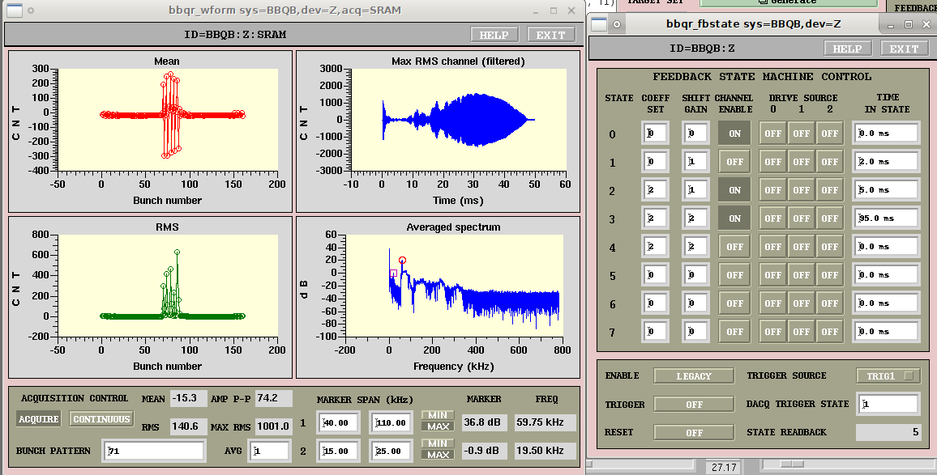
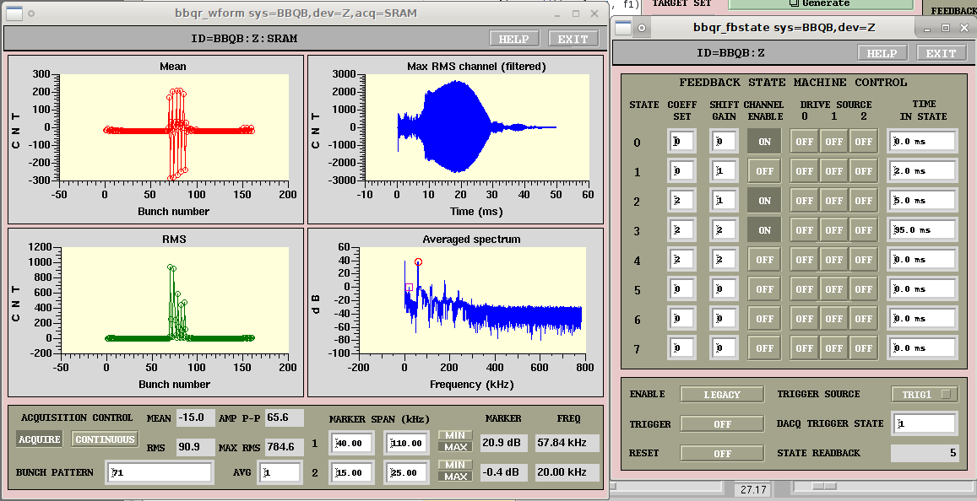
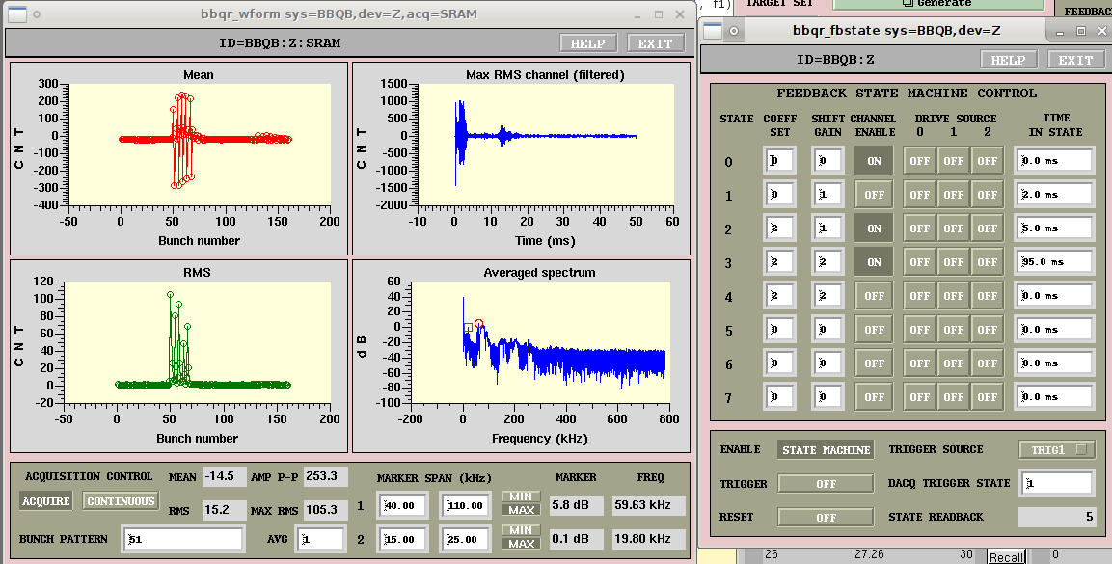
Results
Without Damping:
With Longitudinal Damping:
Longitudinal feedback is very effective at suppressing instabilities and keeping injection efficiency high (~99%), even with highest booster current
Transverse feedback isn’t necessary now, but might become essential with future flexible bunch pattern from gun

Slide 8
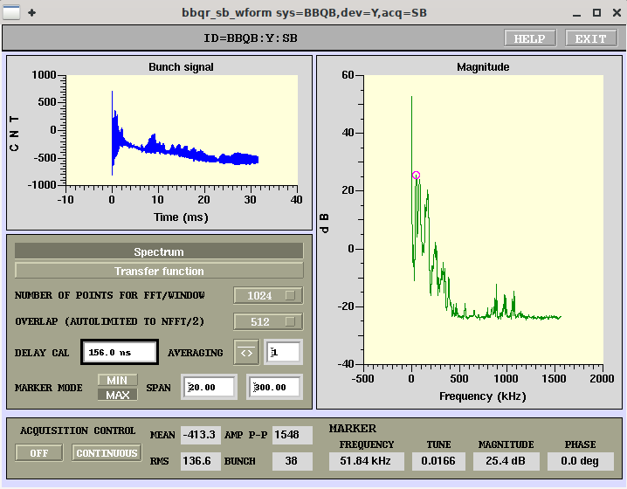
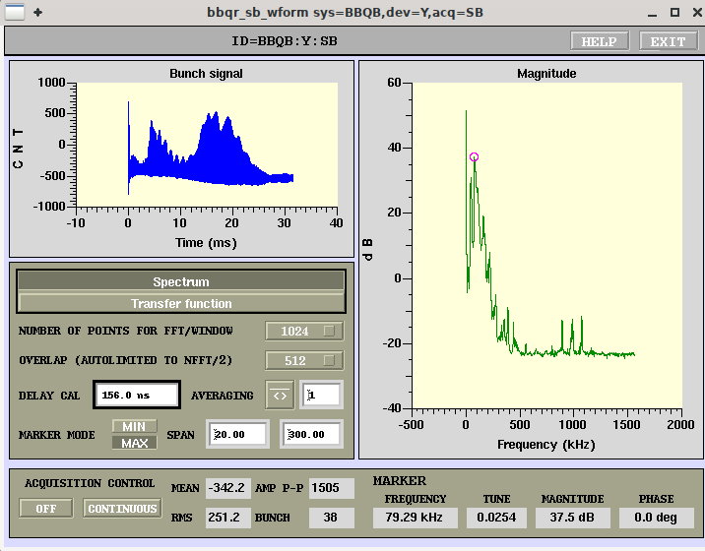
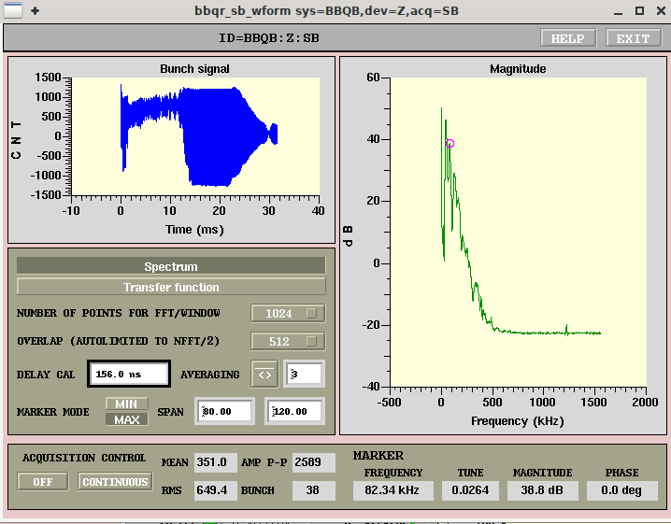
But…
There was a lot of unexpected behavior to be understood first!
(particularly, the Front End phasing throughout the acceleration ramp)

Slide 9
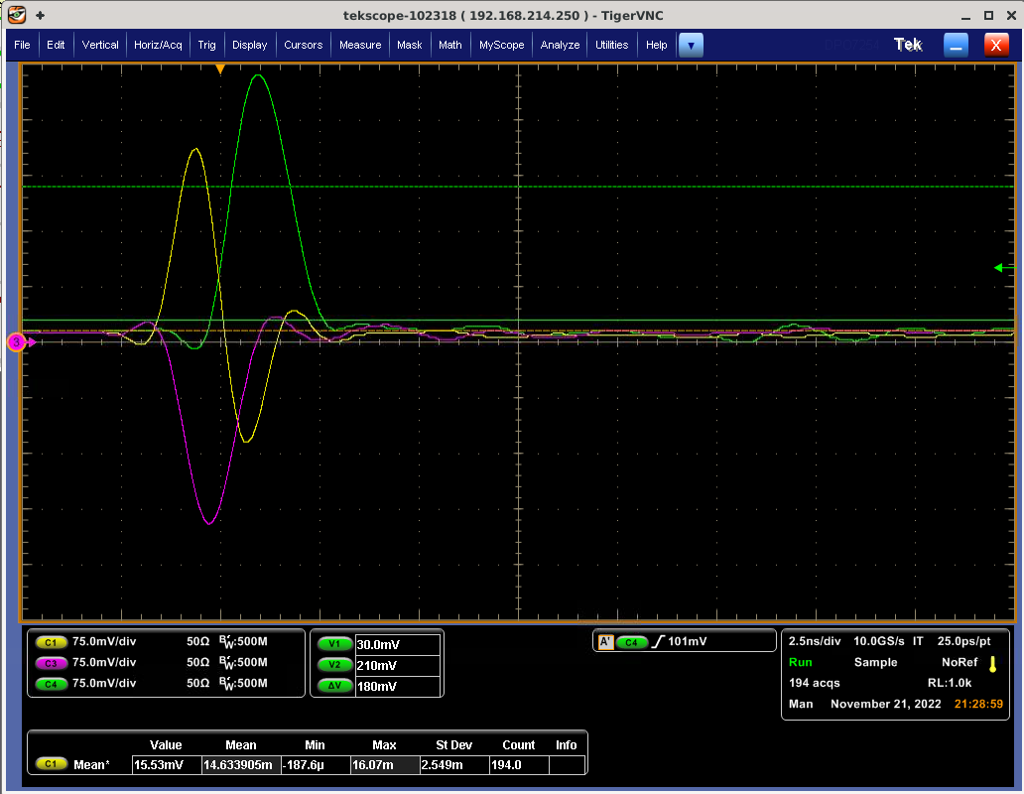
Front End Phase setup
FE phase adjusted by looking at FE output on scope
Setting FE delay so that phases are correct at injection leads to erratic and incorrect signal later in ramp

Slide 10
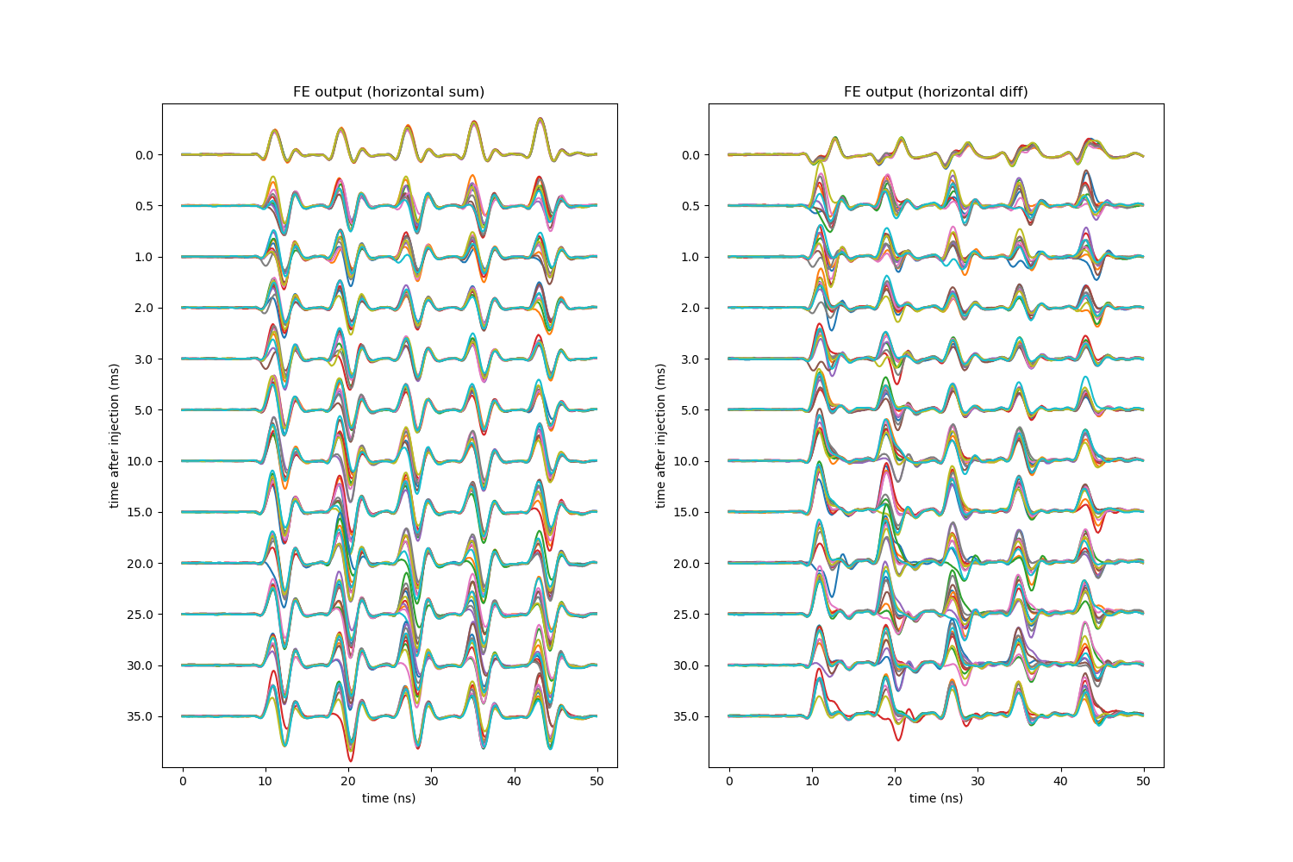
Front End Phase setup
Setting FE delay so that phases are correct at injection leads to erratic and incorrect signal later in ramp
Beam arrival phase changes enough from (during the acceleration ramp, and also shot to shot) that the FE mixing phase is often totally wrong
FE output on multiple shots, at various time points during the acceleration ramp, without feedback.

Slide 11
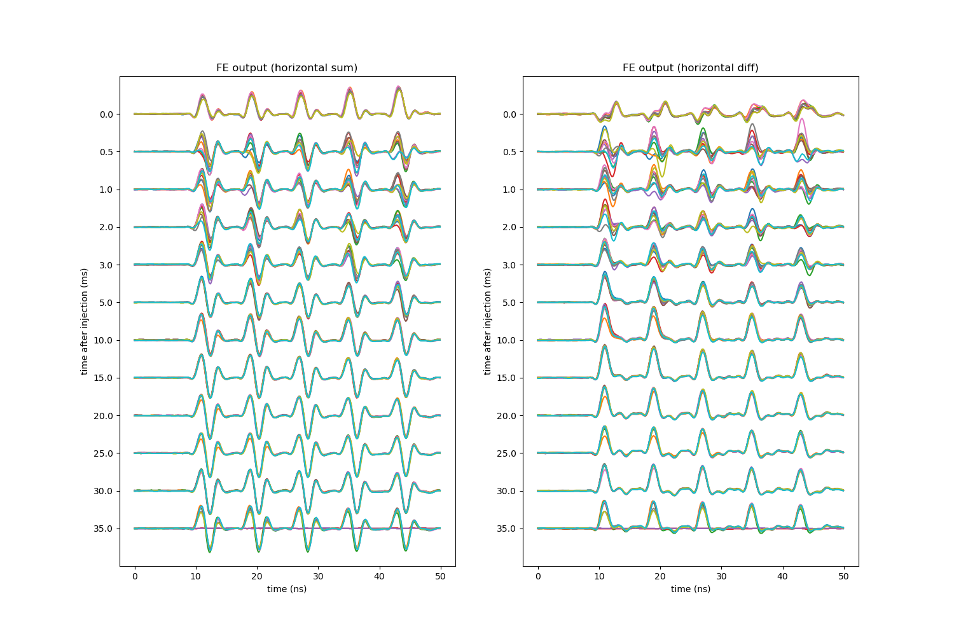
Front End Phase SEtup
(Once longitudinal feedback was set up correctly, the arrival phase stabilized a few ms after injection.)
FE output on multiple shots, at various time points during the acceleration ramp, with longitudinal feedback.

Slide 12
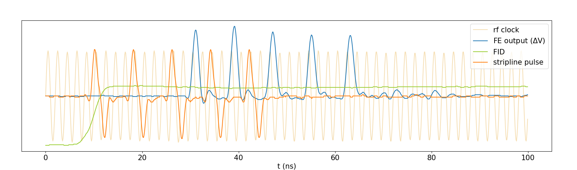
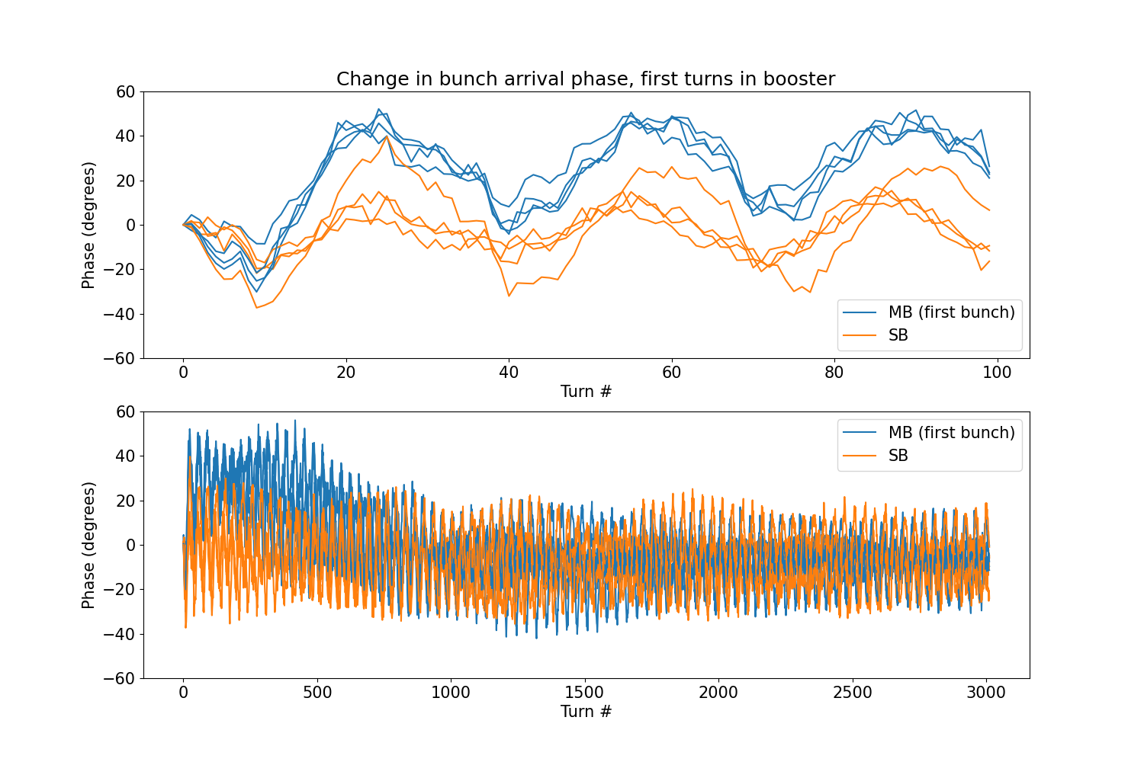
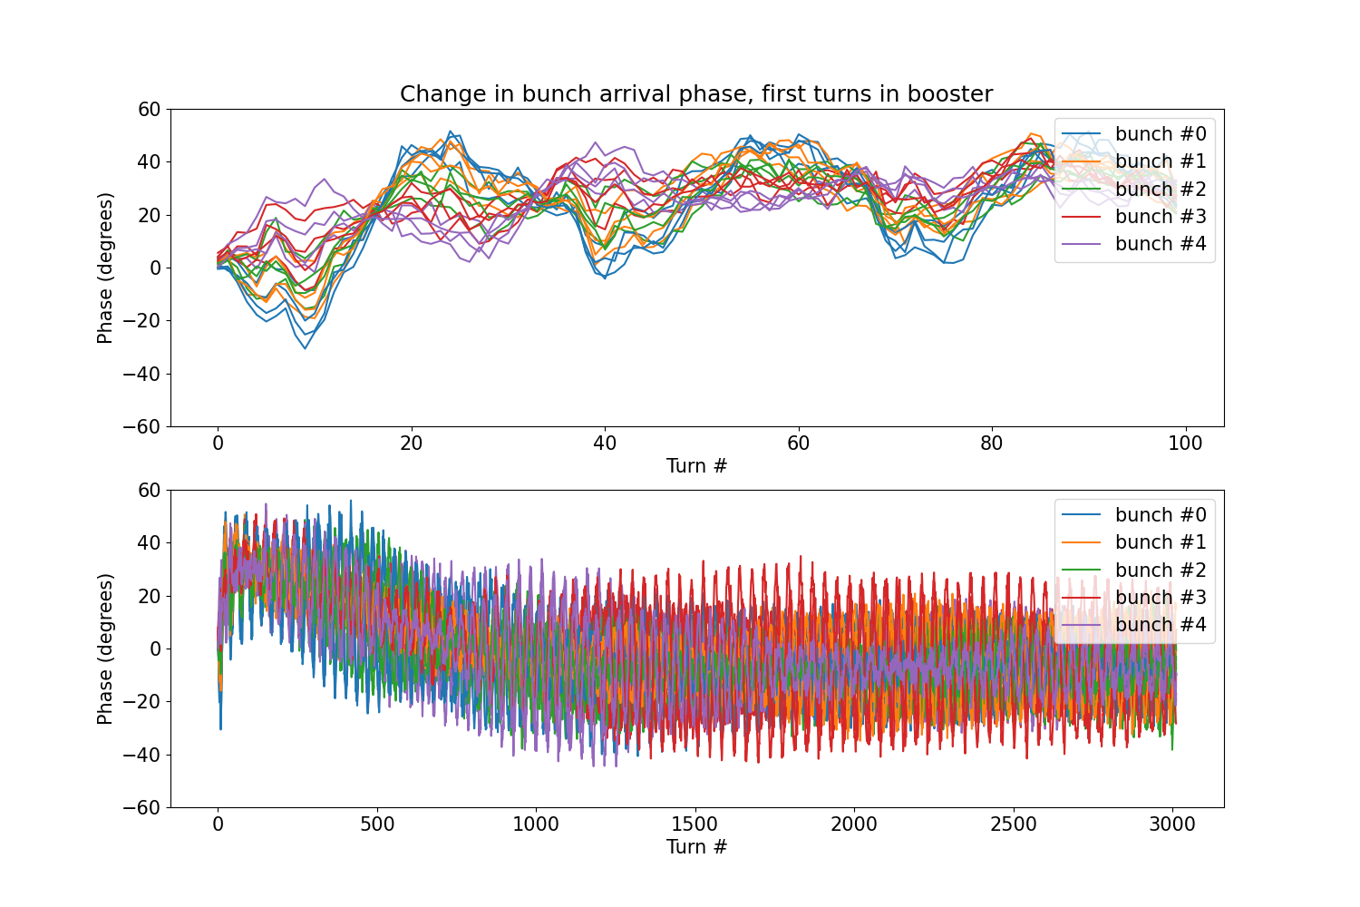
Measurement of Bunch arrival time jitter
Measured arrival time of beam pulse relative to RF by recording stripline and RF clock signals with scope, and fitting peaks
Beam arrival time fluctuates by as much as 90 degrees in the first tens of turns after injection
More fluctuation for multi-bunch beam than for single-bunch
For multi-bunch beam, arrival phase of each bunch oscillates differently
Synchrotron period at injection is ~35 turns

Slide 13
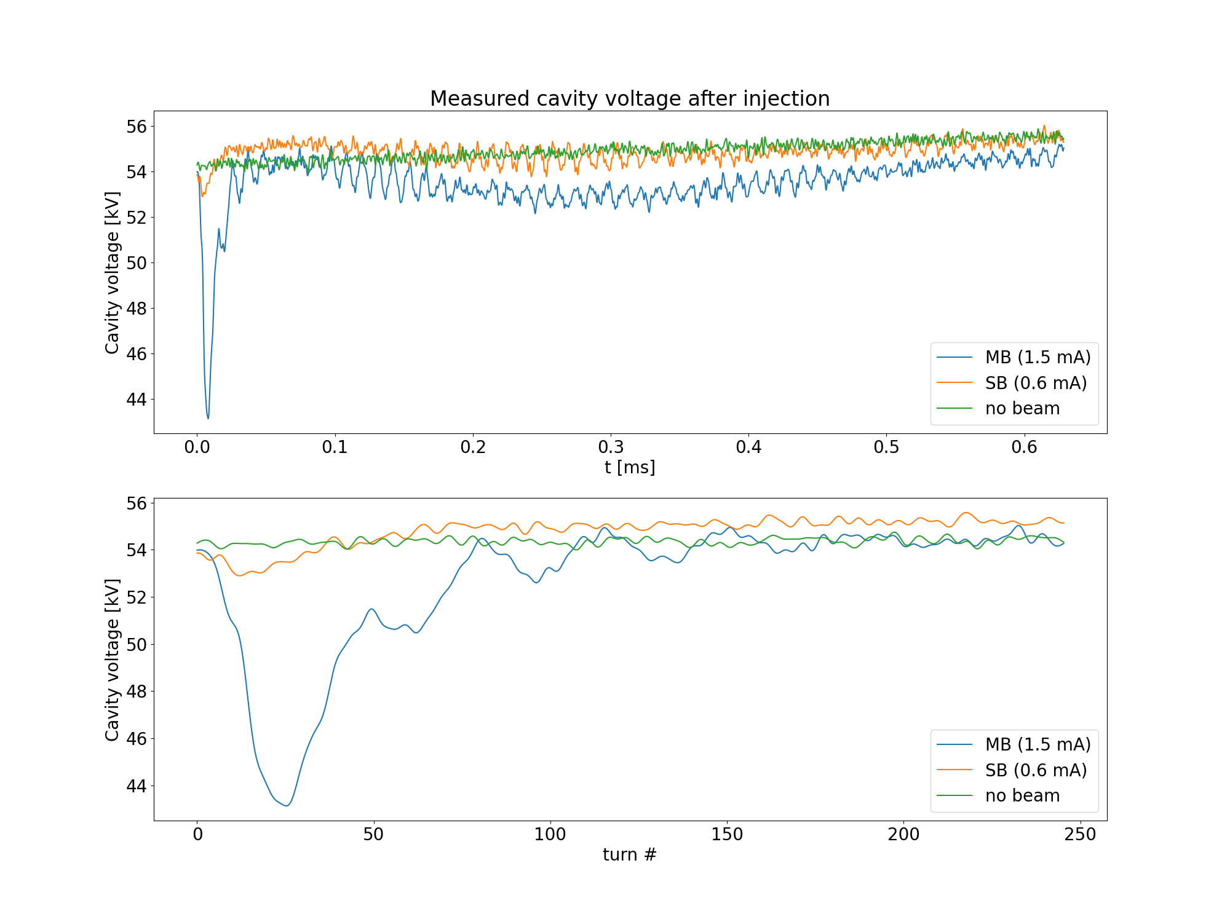
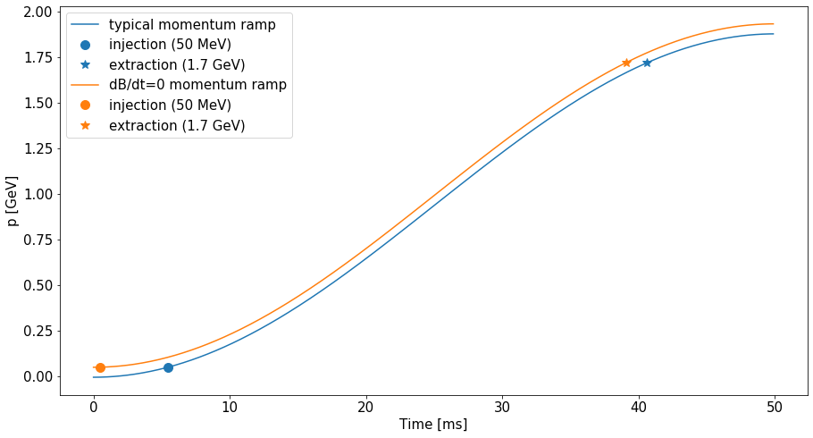
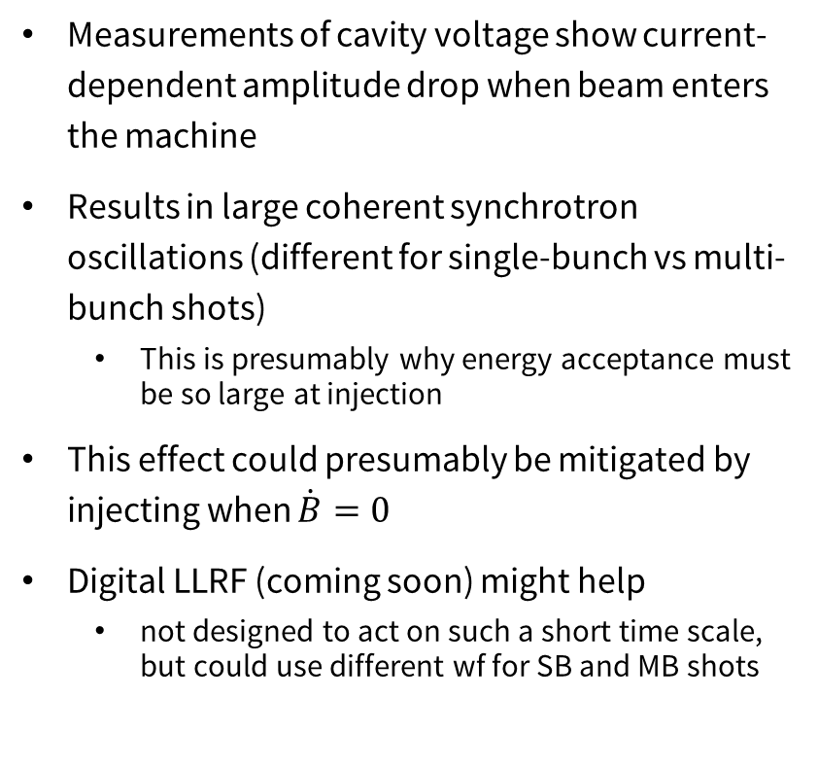
Causes of arrival time jitter
Measurements of cavity voltage show current-dependent amplitude drop when beam enters the machine
Results in large coherent synchrotron oscillations (different for single-bunch vs multi-bunch shots)
  This is presumably why energy acceptance must be so large at injection
This effect could presumably be mitigated by injecting when $\dot{B}=0$
Digital LLRF (coming soon) might help
  not designed to act on such a short time scale, but could use different wf for SB and MB shots

Slide 14
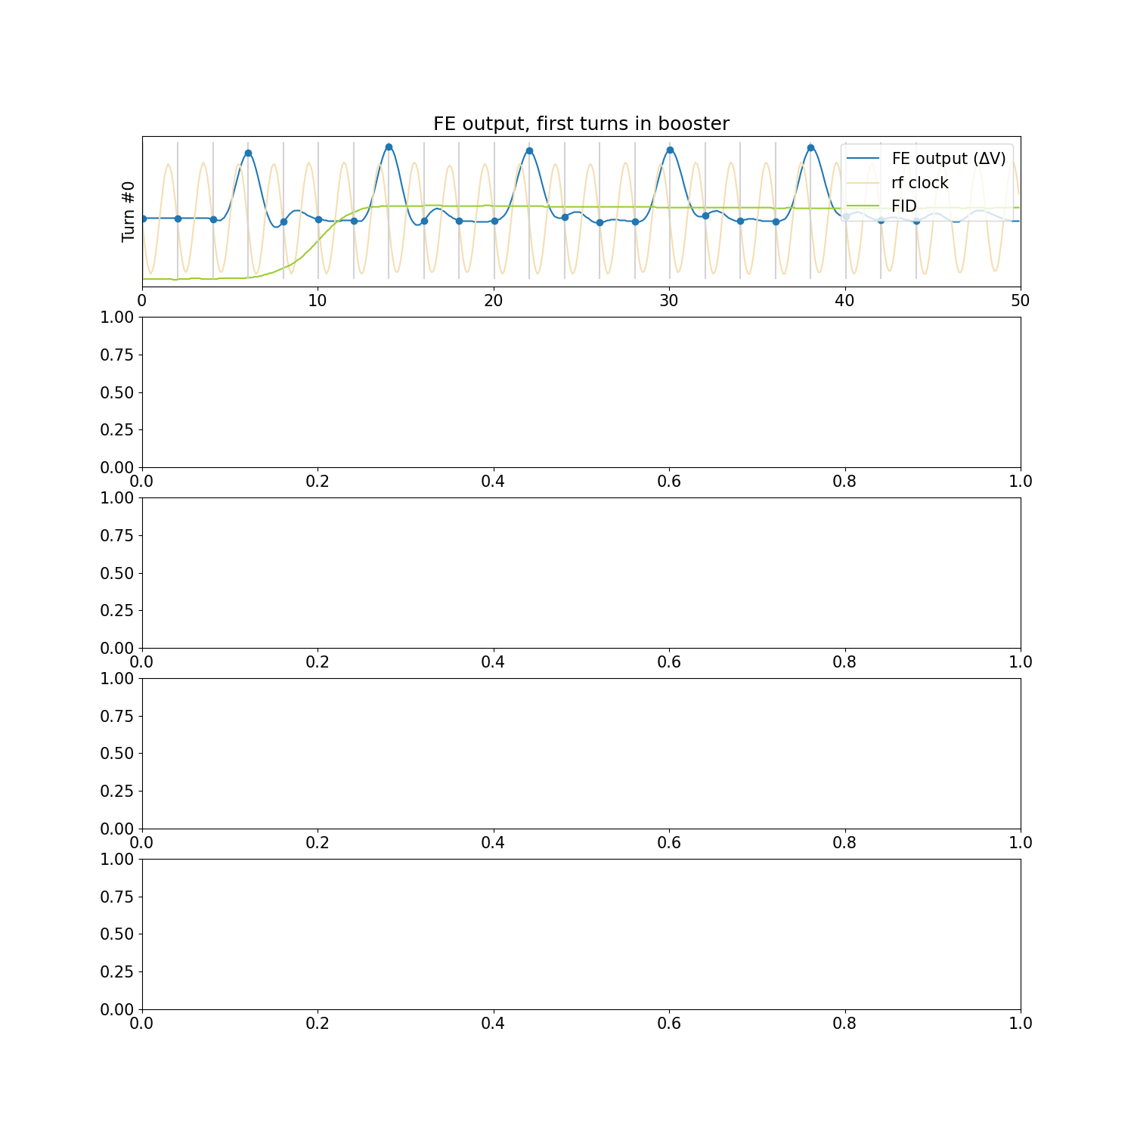
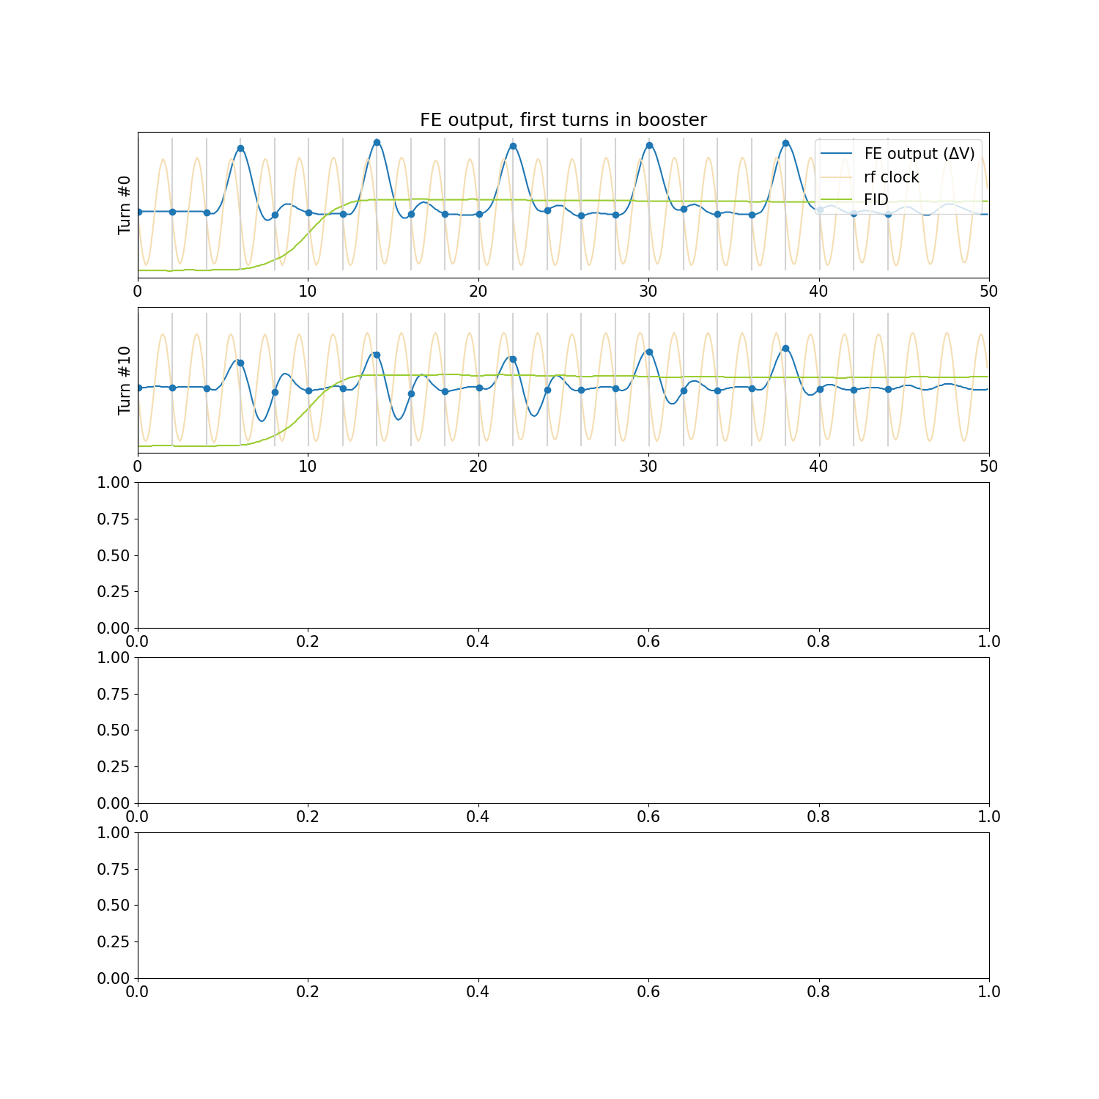
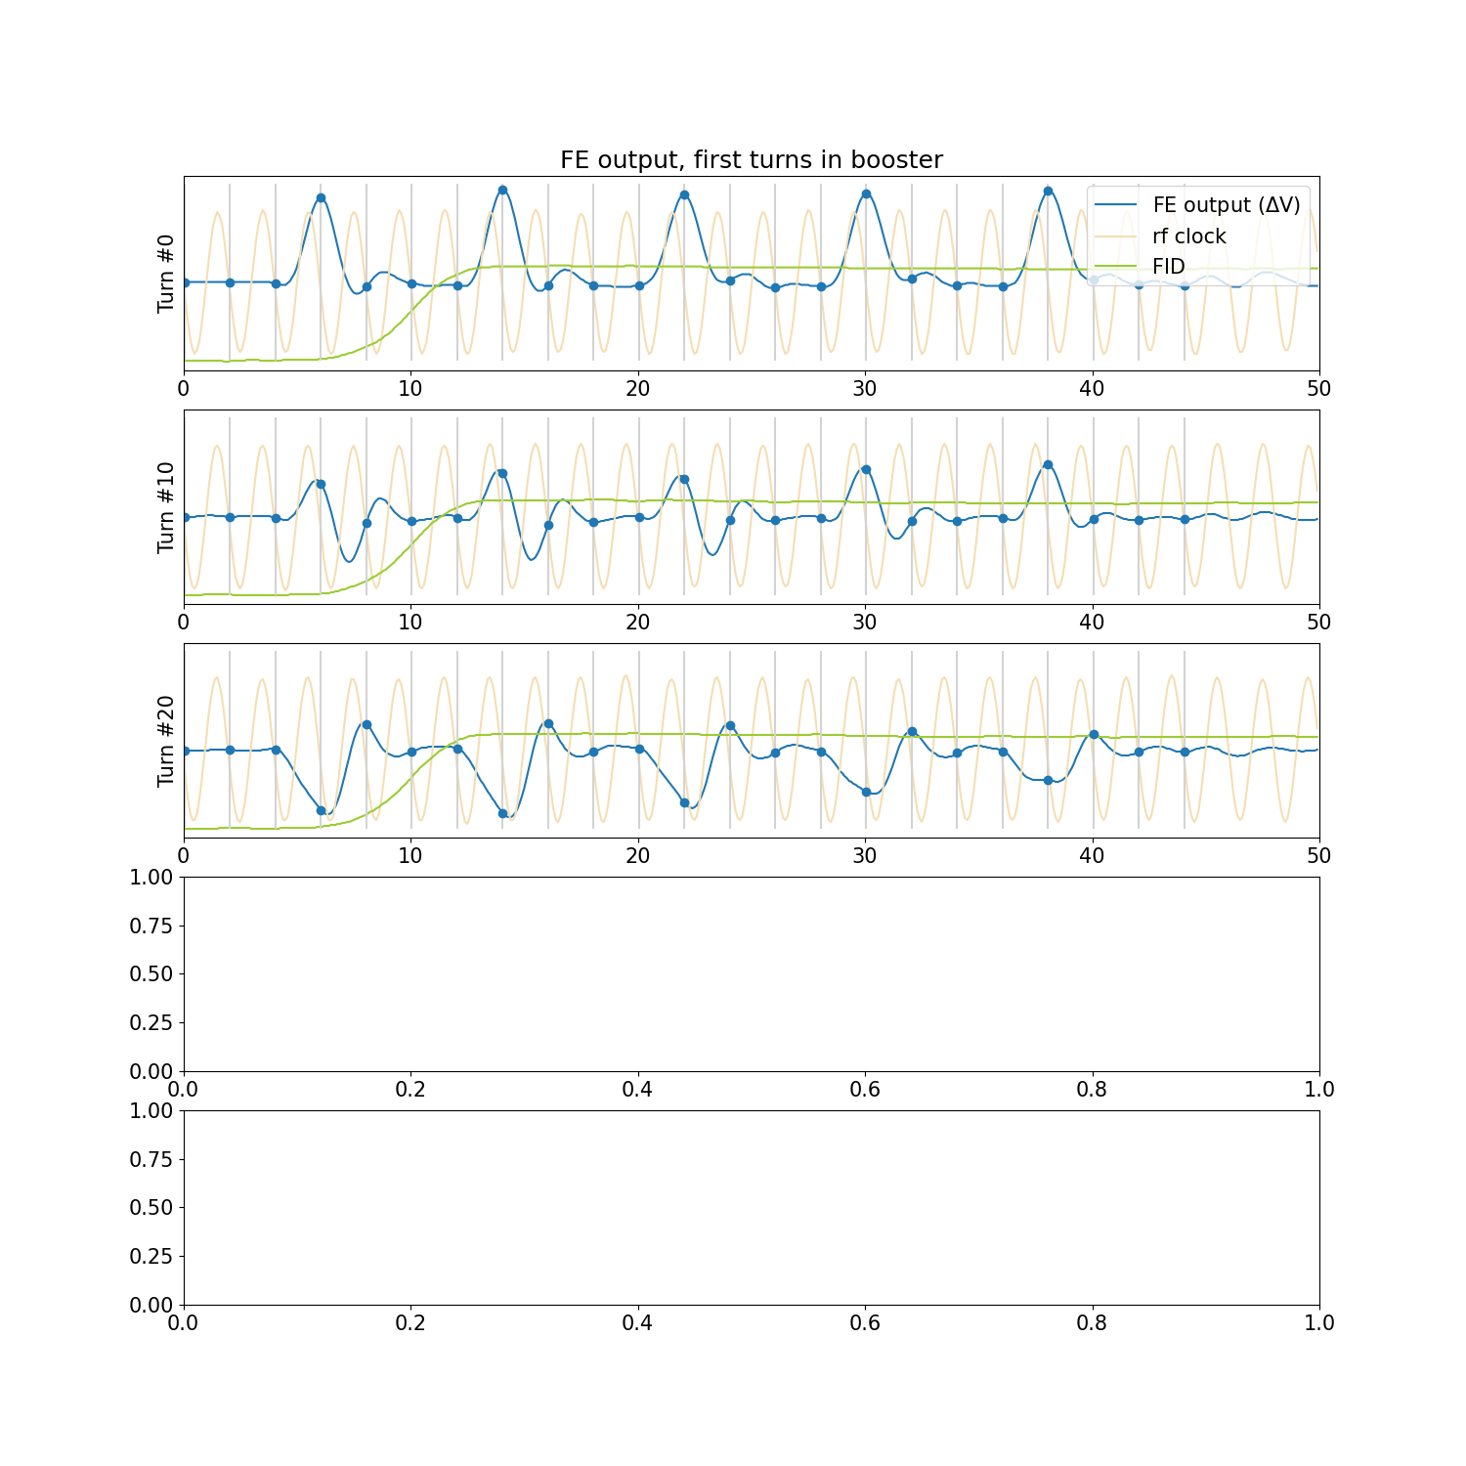
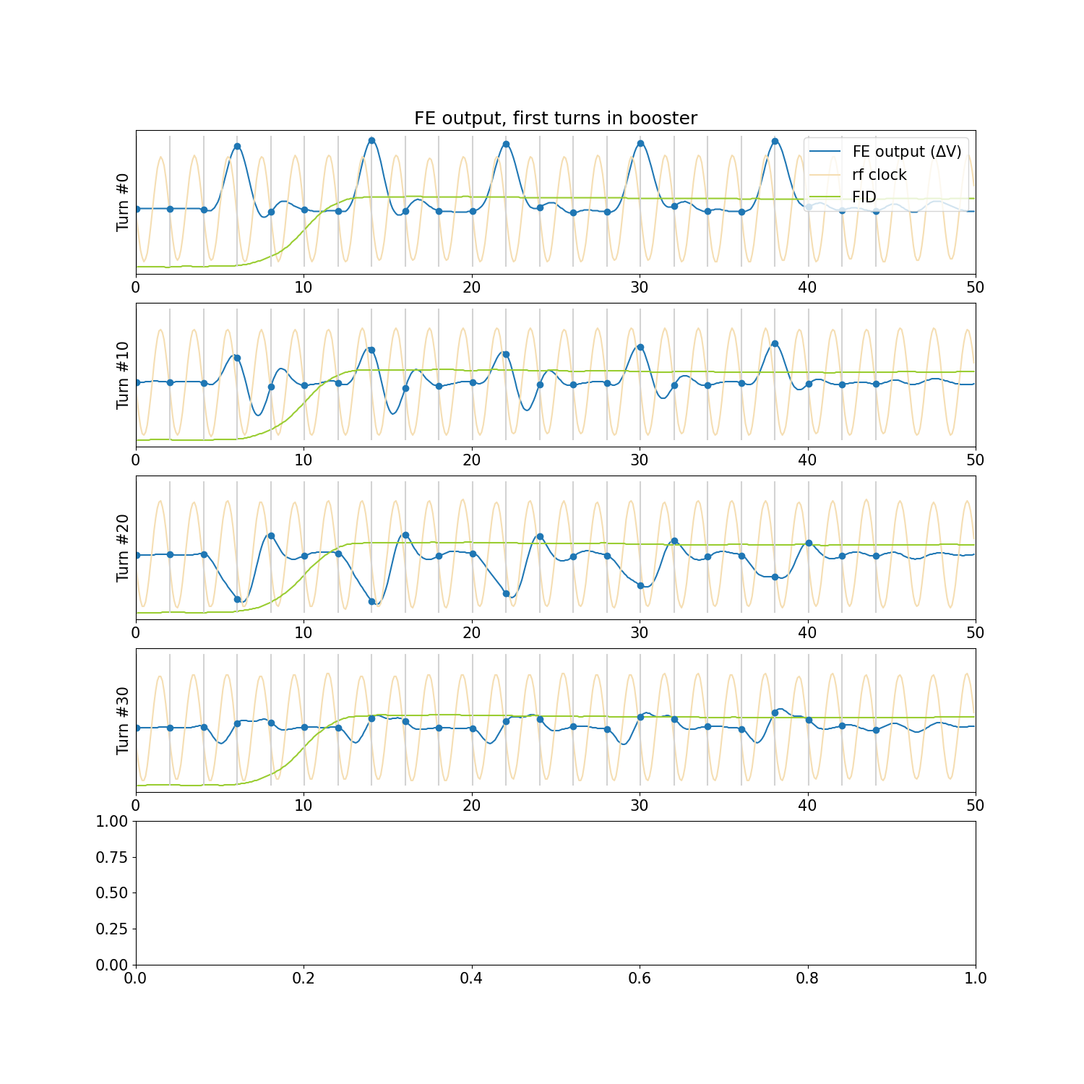
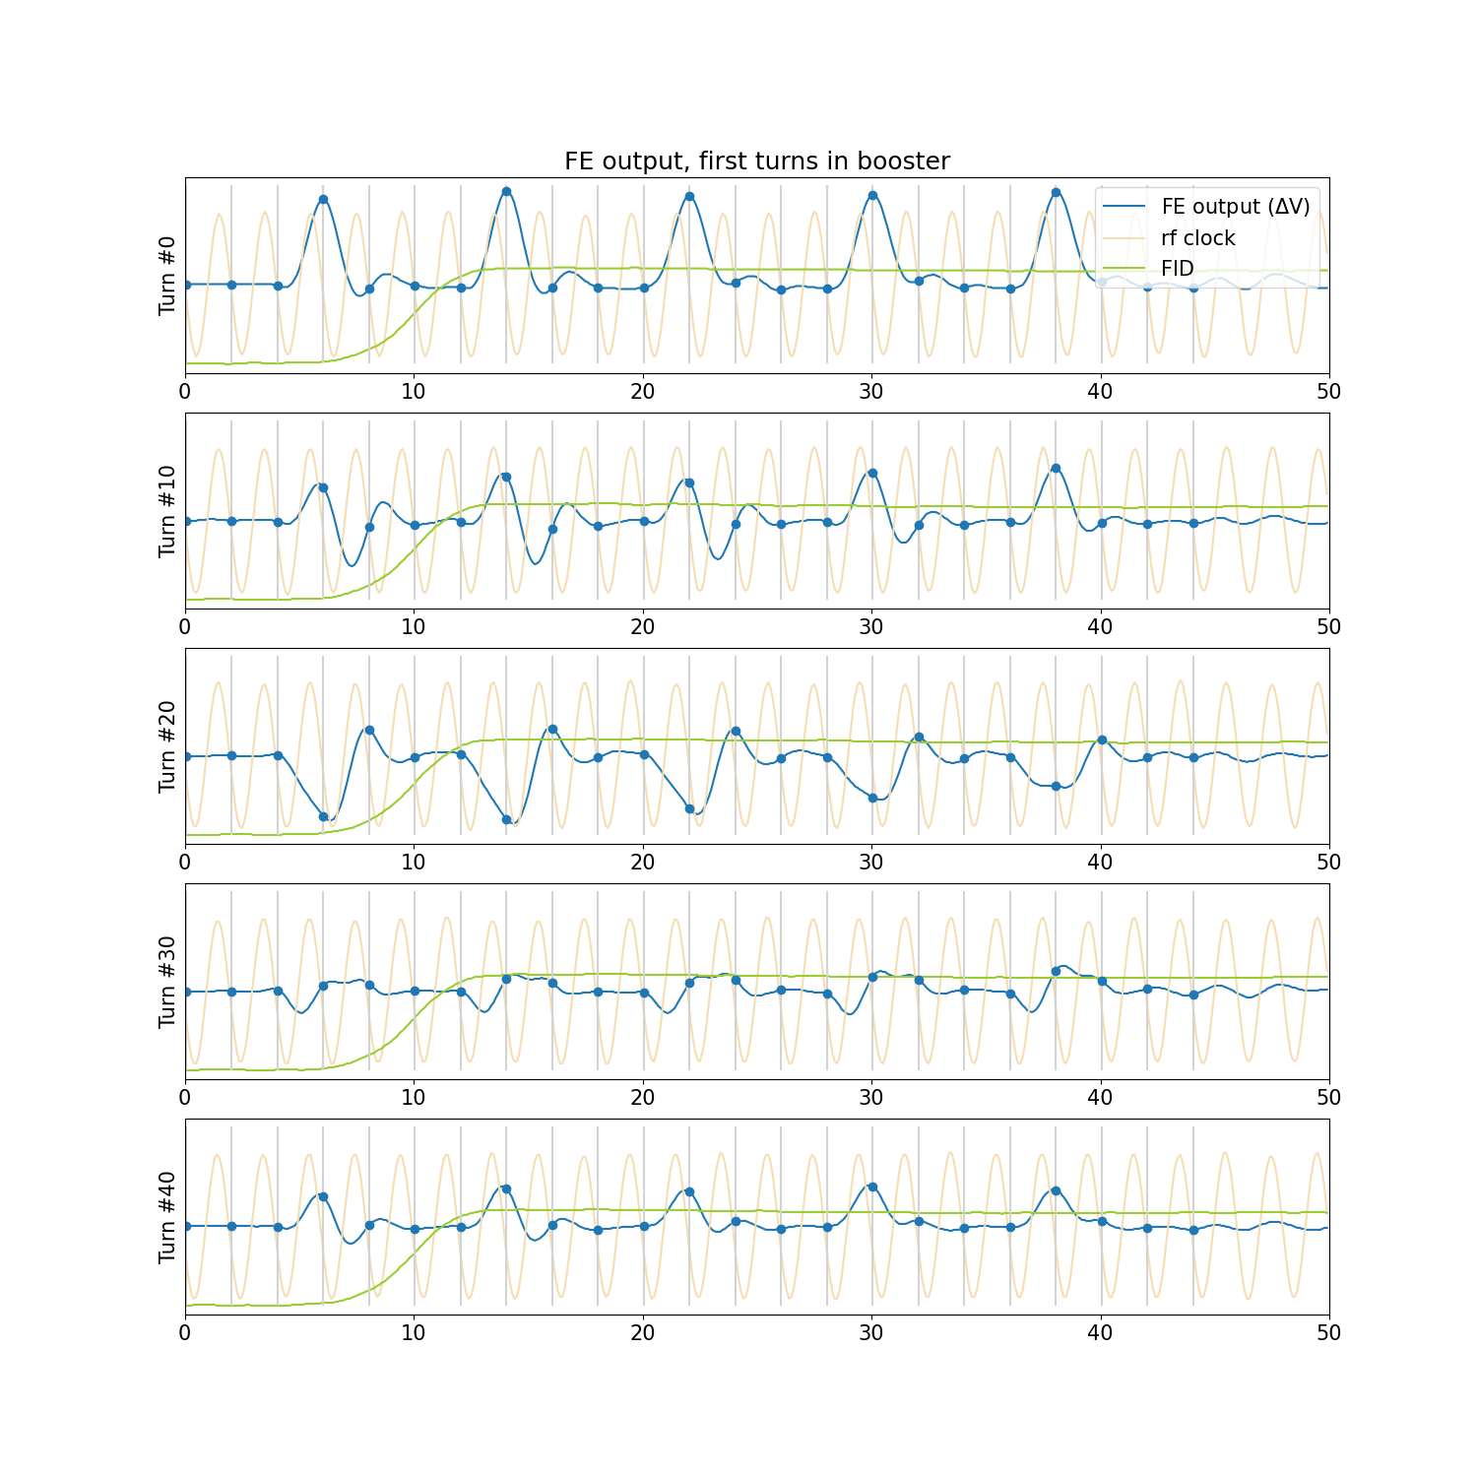
Effect of arrival time jitter on sampled waveform

Slide 15
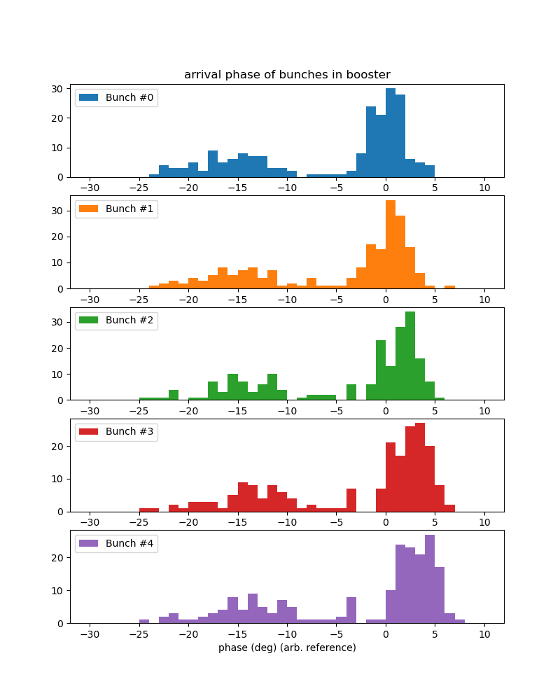
Klystron jitter
Klystron tends to jitter between two states (well within specified tolerances, but still produces noticeable change in energy and arrival time from shot to shot)
With ‘correct’ klystron state, the arrival time only fluctuates by a few degrees
Mean arrival time difference between the two klystron states is about 15 degrees
This ~15 degree arrival phase jump on off-momentum shots can be enough to cause erratic fb results

Slide 16
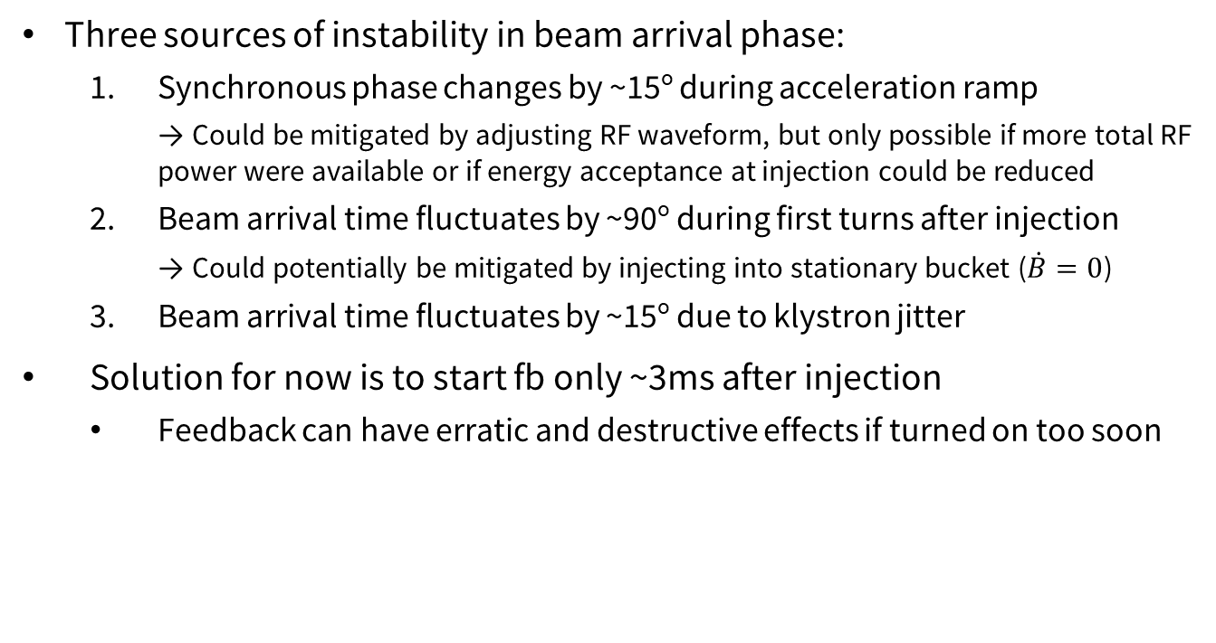
Summary – arrival time jitter
Three sources of instability in beam arrival phase:
  Synchronous phase changes by ~15º during acceleration ramp
    → Could be mitigated by adjusting RF waveform, but only possible if more total RF power were available or if energy acceptance at injection could be reduced
  Beam arrival time fluctuates by ~90º during first turns after injection
    → Could potentially be mitigated by injecting into stationary bucket ($\dot{B}=0$)
  Beam arrival time fluctuates by ~15º due to klystron jitter
Solution for now is to start fb only ~3ms after injection
  Feedback can have erratic and destructive effects if turned on too soon
Longitudinal beam motion with longitudinal feedback.
Longitudinal beam motion without feedback.

Slide 17
Summary and outlook
Significant beam arrival time jitter throughout acceleration ramp complicates bbfb setup
  Could potentially be reduced by modifying RF ramp and/or changing injection scheme
Longitudinal bbfb is very effective at controlling beam instabilities, keeping high injection efficiencies
Transverse feedback is currently not needed, but may become important after gun upgrades

Slide 18
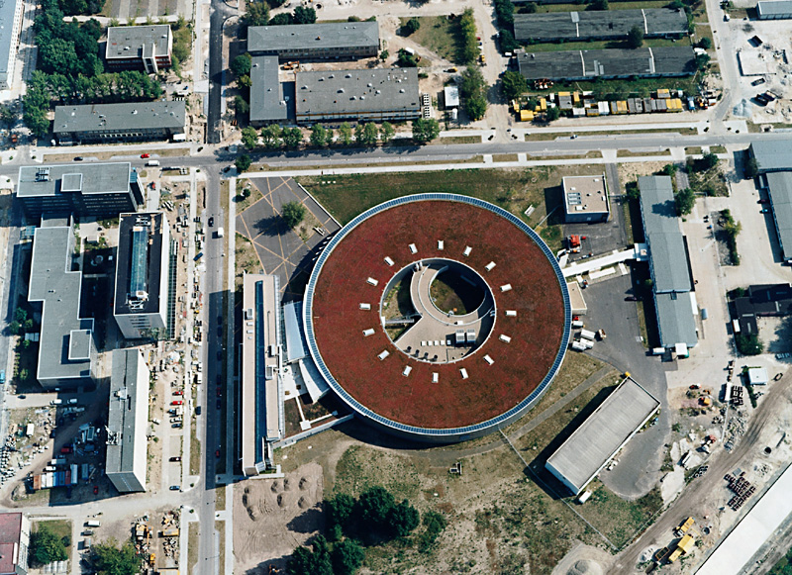
Questions? Comments?
Thanks to
T. Atkinson, M. Dirsat, F. Falkenstern, T. Flisgen, H. Glass, P. Goslawski, T. Löwner, P. Kuske, A. Matveenko, R. Müller, G. Rehm, M. Ries, M. Ruprecht, A. Schälicke, T. Schneegans, B. Schriefer, D. Schüler, Y. Tamashevich, D. Teytelman
and many others in the BII machine group who have contributed to this project in numerous ways.

