Slide 1
Modeling of the longitudinal bunch by bunch feedback including harmonic cavities
Micha Dehler/A. Citterio :: RF Group :: Paul Scherrer Institute
I.FAST Workshop 2024 on Bunch-by-Bunch Feedback Systems and Related Beam Dynamics

Slide 2
Today’s menu
SLS 2.0: General
RF transients and the longitudinal dynamics: damping, synchronous frequency and phase
Secondary effects: Kicker cavity and modulator system
Constraints on bunch by bunch feedback
Simulated performance of basic bunch by bunch feedback
Conclusions

Slide 3
SLS 2.0 Synchrotron Parameters
 | SLS 2.0 (TDR)
Circumference [m] | 288
Energy [GeV] | 2.7
Lattice and ID Energy loss/turn [keV] | 943
Energy loss/turn in wake fields [keV] w. (w.o) 3HC | 7 (22)
Energy spread | 1.16·10⁻³
Momentum compaction α_{c} | 1.05·10⁻⁴
Energy acceptance (without harmonic cavity) | 5.1%
Main RF frequency [MHz] | 499.6537
Total main RF voltage nominal [kV] | 1780
Total main RF voltage maximum [kV] | 2200
Harmonic number | 480
Gap in the filling pattern, empty buckets | 30
Damping times x/y/E [ms] | 4.14/7.54/6.41
Longitudinal stability threshold per cavity [GHz kΩ] | 6.2
Horizontal stability threshold per cavity [MΩ/m] | 3.3
Vertical stability threshold per cavity [MΩ/m] | 4.4
Beta functions at main cavity location β_{x} [m] / β_{y} [m] | 9.6/7.0
Beta functions at harmonic cavity β_{x} [m] / β_{y} [m] | 6.8/4.1
Synchrotron frequency without harmonic cavity [kHz] | 2.172
Energy fluctuations relative to energy spread | <10%

Slide 4
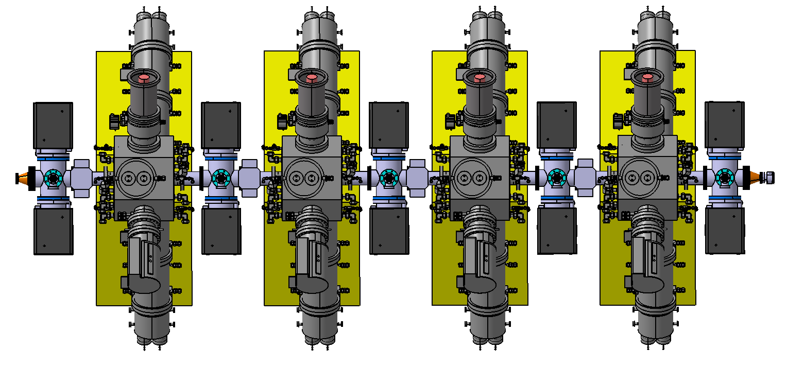
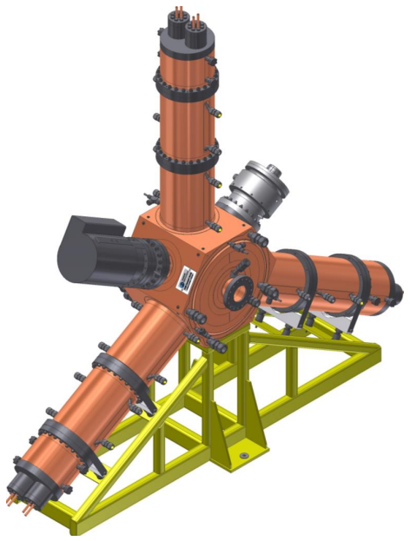
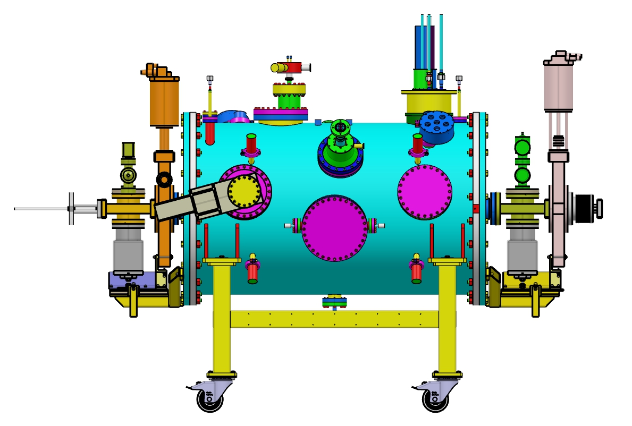
RF system
Main RF-System
Total voltage [kV] | 1780
Energy acceptance (without harmonic cavity) | 5.2%
Number of cavities | 4
Voltage per cavity [kV] | 445
Wall loss per cavity [kW] | 30
Required RF-power with beam and minimum ID Power [kW] | 98.1
Required RF-power with beam and maximum ID Power [kW] | 124
Optimal coupling | 3.4…4.3
Detuning for matching [kHz] | -32.4…-44.6
HOM control | HOM damper
Max. voltage for ≤150kW reflected pulse power [kV] (restriction from amplifier specification) | 540

Slide 5
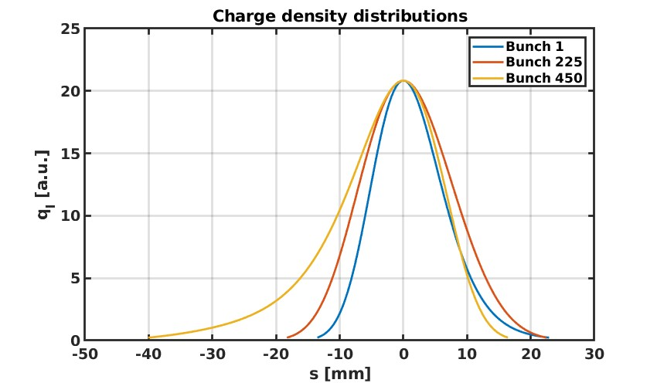
Landau damping and RF transients
Harmonic cavity
Transients from Elegant
Densities, damping etc via semianalytical model in Matlab
Cross validated with Elegant, where possible

Slide 6
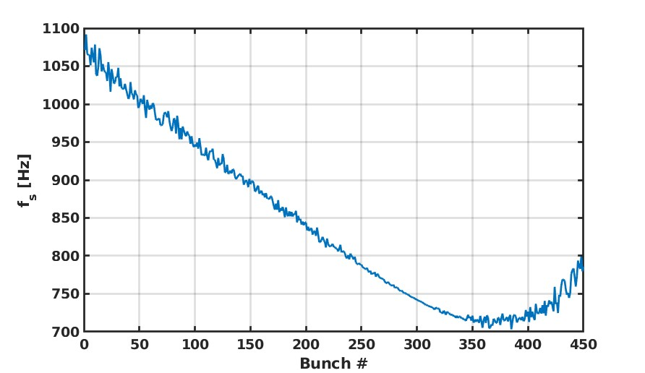
Damping and synchronous frequency over bunch train
Pure Landau damping excluding e.g. radiation damping
Effective damping and threshold actually not dominated by Landau damping, but by decoherence over bunch train

Slide 7
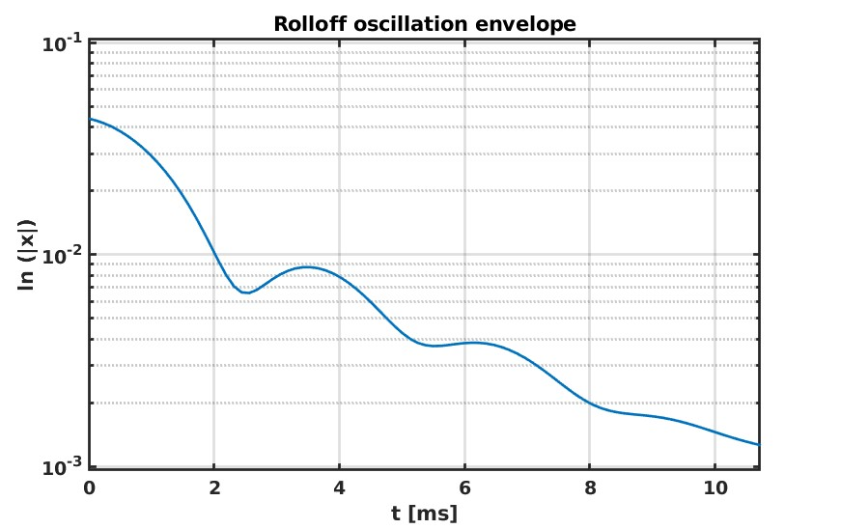
Cumulative spectra of full bunch train (Imagine you’re a HOM: What would you see?)
Side remark: It’s always difficult to assign something like a damping time ….
A mix of Gaussian, Exponential and Sin(x)/x (?) roll off ….

Slide 8
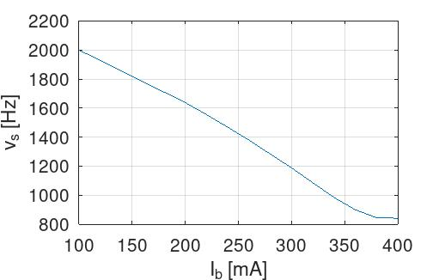
Other important aspects for MBF
Synchronous frequency also varies with total beam current
Bunch timing/synchronous phase varies over bunch train

Slide 9
Functional blocks of a longitudinal bunch by bunch feedback
Beam phase
Pick
RF front end
Digital Notch Filter
SSB modulator
All pass filter
Kicker cavity
Beam kick
Front end somewhat affected by synchronous phase slip
Correct choice of bandwidth will eliminate cross talk between bunches
Some influence on open loop gain
Choose center frequency low enough to accommodate sync. phase shift
Interesting stuff all happens in the backend … let’s start with the kicker going backwards

Slide 10
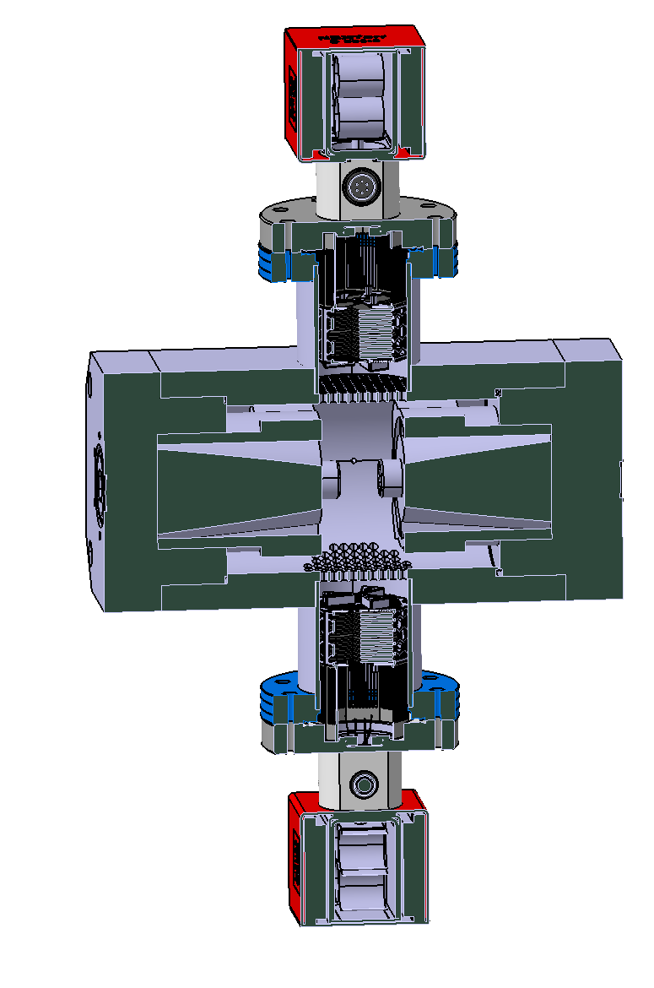
Longitudinal kicker
TM010 shunt impedance =1.8kOhm.
The center frequency =1.875GHz
Loaded Q = 7.5 (BW=250MHz)
(SLS 1: 1.5 kOhm @ 1.375 GHz).
Transverse systems have stripline kickers, which (idealized) have a FIR response
Here we have a resonator cavity (dictated by power requirements), which is an IIR device
IIR = Infinite Impulse Response
Crosstalk?
Group delay variations?
Phase distortion?

Slide 11
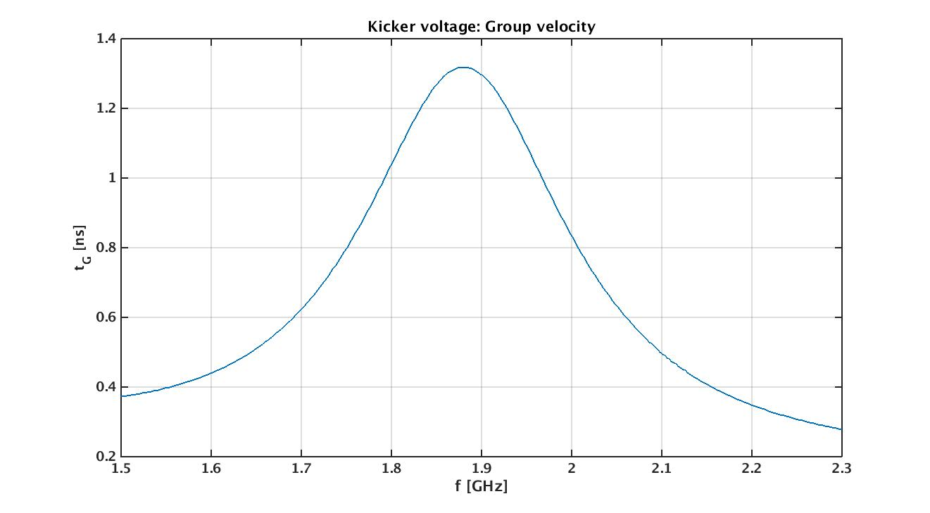
Operating bandwidth
Carrier is 2 GHz, period of 0.5 ns!!!

Slide 12
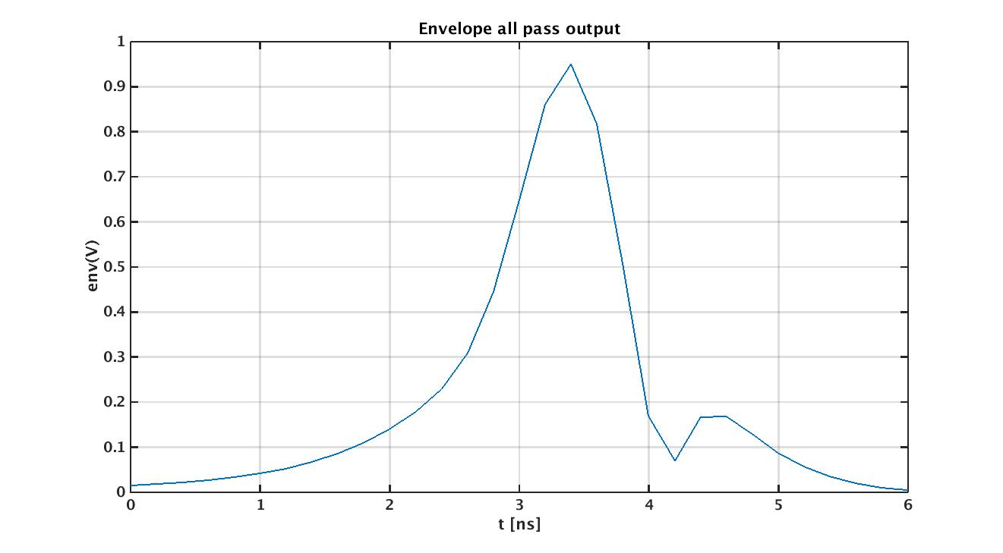
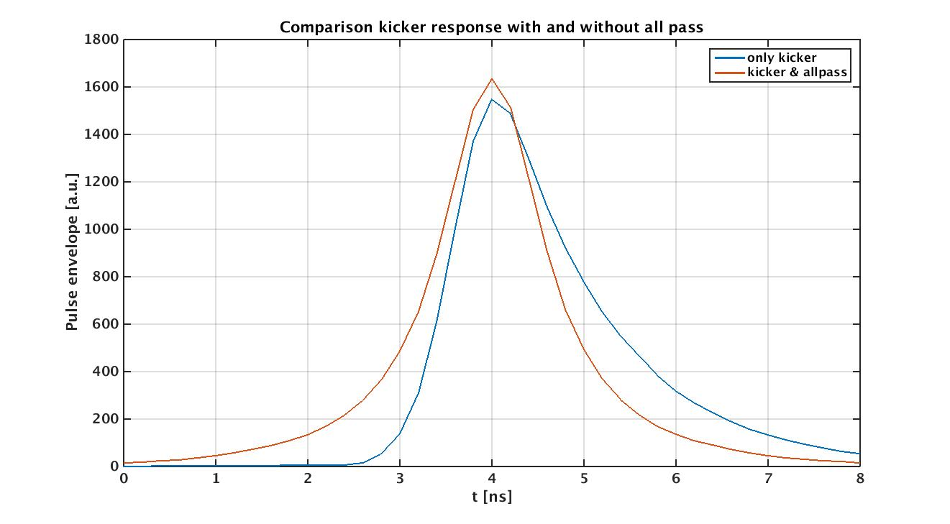
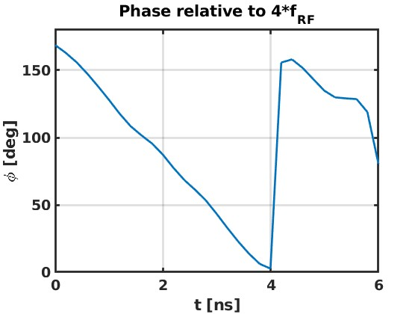
Excitation by short Gaussian Sine pulse
Kicker response computed with CST
Introducing an excellent all pass filter (should be no problem with modern digital system), symmetrizes response, optimizes roll off
But still cross talk between bunches, solution is single side band modulation

Slide 13
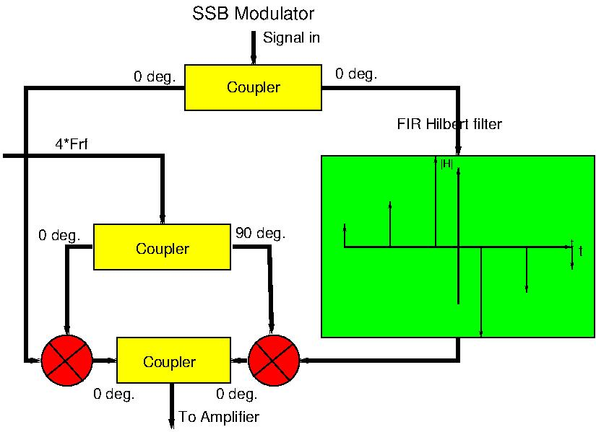
Functional layout

Slide 14
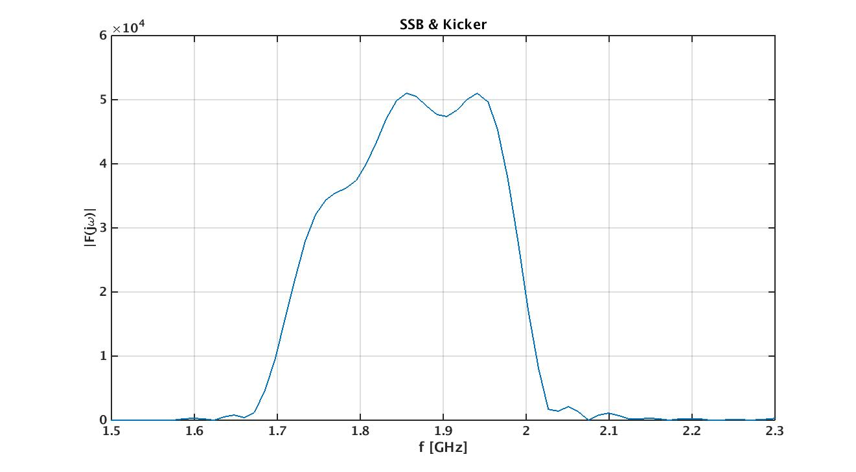
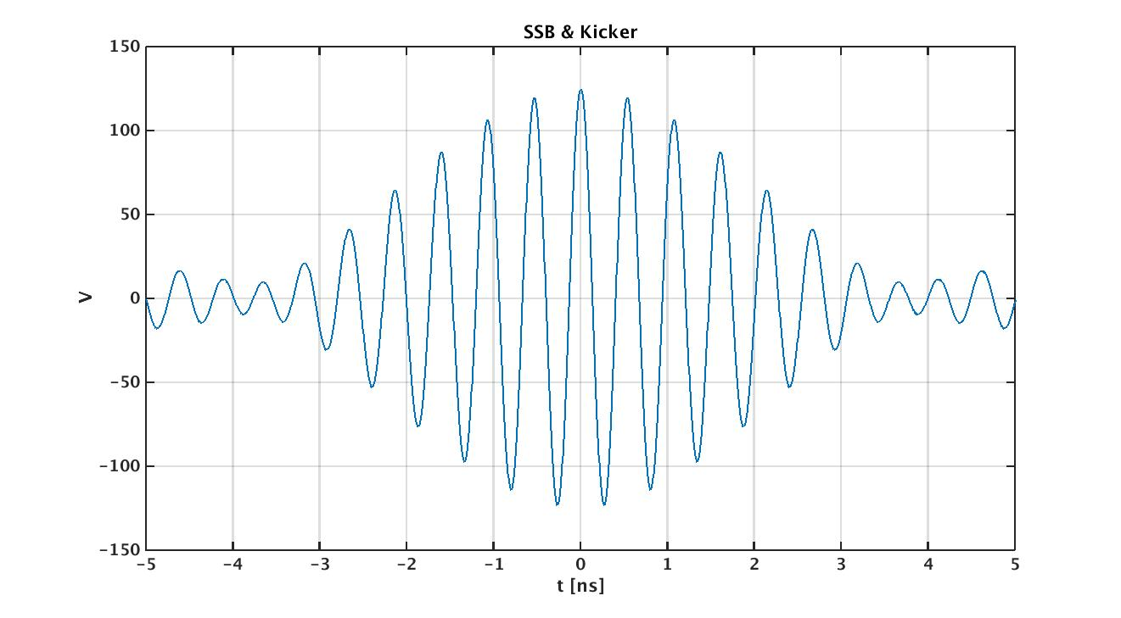
Response Modulator & Allpass & Kicker

Slide 15
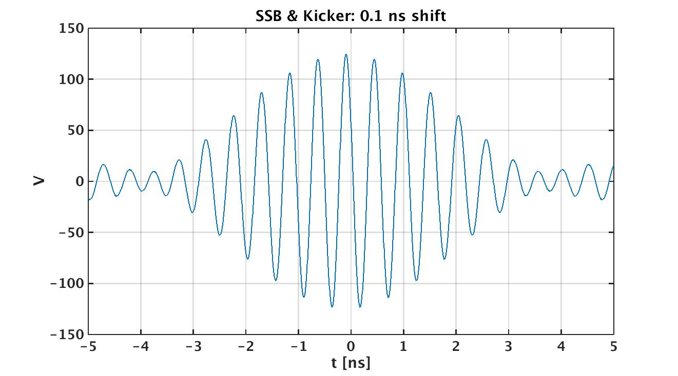
Shift synchronous phase shift by 100 ps

Slide 16
How does a single kick drive different coupled bunch modes?
Bunch # | -2 | -1 | 0 | 1 | 2
Kick | -10 | -60 | 60 | 60 | 10
CBI φ=0 | + | + | + | + | +
CBI φ=π | + | - | + | - | +
CBI φ=π/2 | - | 0 | + | 0 | -
CBI φ=π/2 | 0 | - | 0 | + | 0
We see a kick, whose amplitude and phase depends not only on the synchronous phase shift, but also of CBI order. How to describe?
With given phase shift vs bunch number calculate response for given CBI mode order
Expand response again into CBI modes

Slide 17
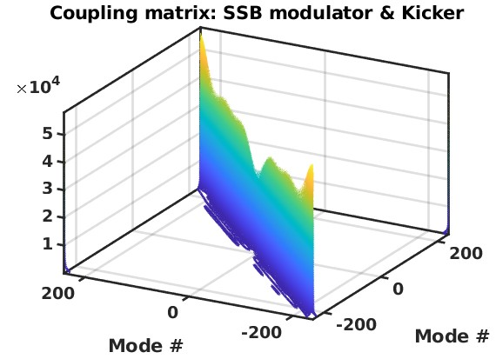
A perfect system would be represented by diagonal matrix with constant diagonal elements
Interesting: non zero off diagonals, variation of diagonal elements

Slide 18
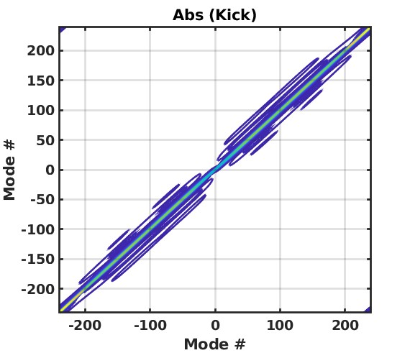
A closer look
Lower left of Matrix | 10⁺⁰⁴
5.8141 - 0.0000i | -1.2937 + 0.2967i | -0.3664 + 0.2656i | -0.1821 + 0.2097
-1.3132 - 0.2999i | 5.8130 - 0.0005i | -1.2739 + 0.2935i | -0.3587 + 0.2621i
-0.3814 - 0.2722i | -1.3322 - 0.3029i | 5.8099 - 0.0010i | -1.2535 + 0.2902i
-0.1936 - 0.2182i | -0.3886 - 0.2754i | -1.3508 - 0.3058i | 5.8047 - 0.0015i

Slide 19
Diagonals
Amplitude varies by factor two
The really good news: Negligible phase variations (also true for weird fill patterns?)
IF only narrow band HOMs, only diagonal elements relevant

Slide 20
An easy and simple MBF system
FIR filter with three taps, specs:
DC offset suppression
90 degrees phase rotation at synchrotron tune
64 times down sampling covering 256 ns of signal (90 degrees at fs=1 kHz)
Used linear matlab model in time domain and eigenvalue analysis to deduct damping rates
Deduce new threshold via analytical formula
Limited cross check with Elegant (no function to evaluate interaction synchronous phase with kicker/modulator block)
Filter needs to accommodate:
Variation and spread in synchronous frequency
Gain variation due to CBI order

Slide 21
Using just one filter setting for all conditions
F_{s} [Hz] | Gain [%] | I_{b} [mA] | Τ_{total} [ms] | Z_{th, ana} [kΩ GHz]
2000 | 100 | 100 | 1.0 | 973
1640 | 100 | 200 | 0.80 | 504
1190 | 100 | 300 | 1.1 | 176
700 | 100 | 400 | 2.0 | 43.7
700 | 50 | 400 | 2.8 | 30
1100 | 100 | 400 | 1.05 | 129
1100 | 50 | 400 | 1.66 | 81
$$Z_{th}= \frac{2\frac{E}{e}ν_{s}}{f_{rev}I_{b}τα_{c}}$$
Cross check with Elegant corresponds to 10-15%

Slide 22
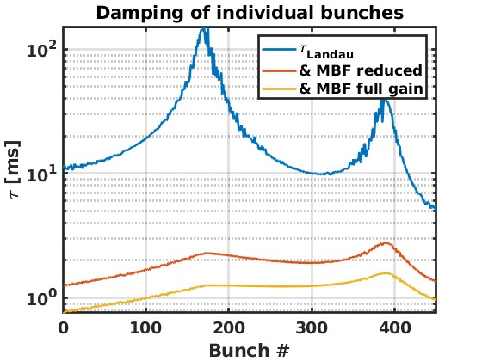
Now with all transients:

Slide 23
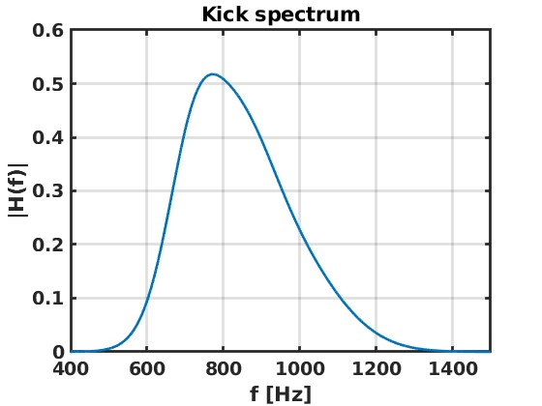
Collective spectra (From the perspective of a higher order mode)

Slide 24
Fitted (approximate) damping factors:
Gain 100%: τ=0.47 ms, Z_{th}= 222 kΩ GHz (from formula)
Gain 50%: τ=0.55 ms, Z_{th}= 187 kΩ GHz (from formula)

Slide 25
Preliminary results (just arrived) from Elegant point towards 115 kΩ GHz
Threshold without MBF ~40 kΩ GHz
(Design threshold: 26 kΩ GHz )

Slide 26
The important points
RF transients caused by an ion clearing gap in a system with harmonic cavity lead to
Variations of synchronous frequency over the bunch train
Current dependent variations of the synchronous frequency
A transient in the synchronous phase
Secondary effects in a longitudinal bunch by bunch feedback
Amplitude dependency in front end due to phase transient
Mode coupling effects in back end
Narrow band HOM: Amplitude variation versus CBI order
Broad band or weird fill patterns may lead to phase errors in the open loop gain of the feedback
Feedback must accommodate synchronous frequency range
Basic system for SLS 2.0 shows very satisfying performance, even when taking into account all effects
Expected threshold far beyond design value giving large margin of error

