Slide 1

The journey to multi bunch emittance control
More than just feedback
Alun Morgan, Dmitrii Rabusov

Slide 2
What do we do now
1 of 15
Feedback loop using pinhole cameras as detector and skew quadrupole magnets as actuators
Desired emittance
Feedback actuator (skew quadrupole magnets)
Pinhole camera
Emittance calculation
Feedback calculation
Pinhole camera
Beam
Beam

Slide 3
Why not just keep doing that?
2 of 15
It cannot stabilise horizontal and vertical emittance simultaneously as it is coupling control based.
Small reduction in dynamic aperture​
Suffers from hysteresis
  performance degrades over time
Feedback loop limited to a few Hz due to pinhole camera update rate.
We will not have the flexibility to use the skew quadrupole magnets due to the impact on off axis injection
Operating modes in Diamond-II may require per bunch size manipulation. (e.g. hybrid bunch)
Limitations of existing system
Additional Diamond-II
considerations

Slide 4
Why use side band excitation with the MBF?
3 of 15
It has less impact on lifetime and injection efficiency compared to the existing skew quadrupole approach
No new hardware required in the storage ring.
This allows the emittance control to be applied to all or a subset of bunches as operations require.
Sideband excitation
Additional MBF bonuses
There are some differences in behaviour which need to be accounted for before it can be used in operation.
Emittance Control for Diamond-II​
Ian Martin, Alun Morgan, Shaun Preston
9th Low Emittance Rings Workshop​
CERN, 13th-16th February 2024​

Slide 5
What is the new approach?
4 of 15
Keep the existing emittance monitoring but replace the actuator of the feedback.
Desired emittance
Pinhole camera
Emittance calculation
Feedback calculation
Feedback actuator
Part of the control loop replaced an oscillator controlled by and part of the multi bunch feedback system.
Pinhole camera
A new feedback controller algorithm is required
Beam
Beam

Slide 6
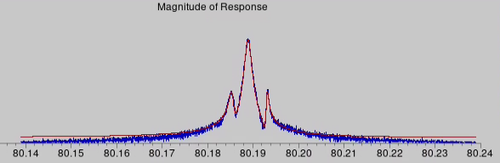
Tune tracking
5 of 15
  In Diamond we need to use tune tracking to make sideband excitation practical
Excitation at fixed frequency and amplitude
Tune and sidebands jitter in frequency
Frequency jitter is converted into a variation in effectiveness and so beam size variation
We may not need this in Diamond-II due to the 3rd harmonic cavity.

Slide 7
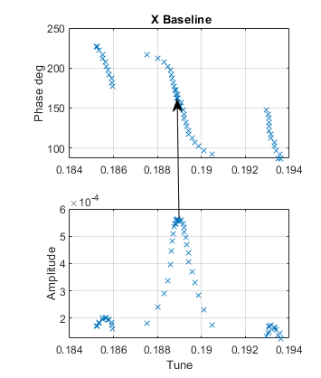
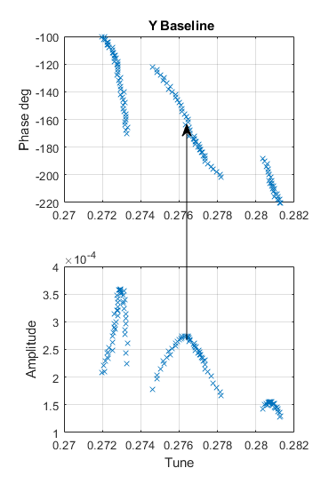
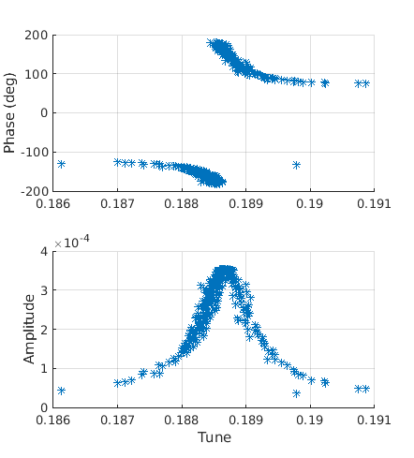
Tune tracking limitations
6 of 15
Machine change has broken the tune tracking twice since 2020
Unable to identify the causes
The past
2020 multivalued solutions
2023 unexpected phase shift
Developed improved locking scheme
Retuned the entire system

Slide 8
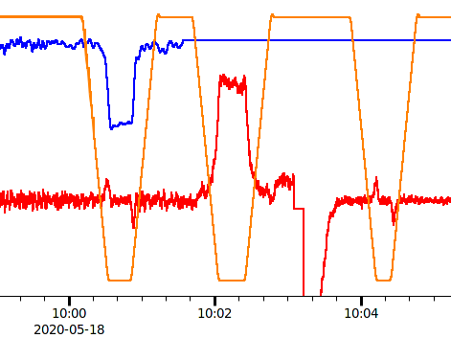
MBF emittance feedback development
7 of 15
Initial proof of concept done in 2020 by Guenther
ID gap
MBF feedback
No feedback
Magnet feedback
Largely manual but looked promising.
Various issues identified in operating alongside standard operation,
for example:
Making sure the target bunch is filled
The need to turn off the feedback on the few bunches either side of the tracking bunch
Basically, it allowed us to define the problem much more clearly.
MBF actuator
Emittance

Slide 9
Development of a new MBF vertical emittance feedback algorithm
8 of 15
Existing skew quadrupole base algorithm
Much of the controller is related to the magnet dynamics and so needs to be redeveloped to use the MBF system instead
r
ε_{error}
Scalar controller
Dynamic controller
Emittance measurement
ε
ε_{F}
MBF based algorithm (tested September 2022)
ε_{Target}
ε_{error}
Operational proof of concept
No dynamic adjustment of parameters so currently it takes too long to stabilise after ID changes.
Scalar controller
Emittance measurement
ε

Slide 10
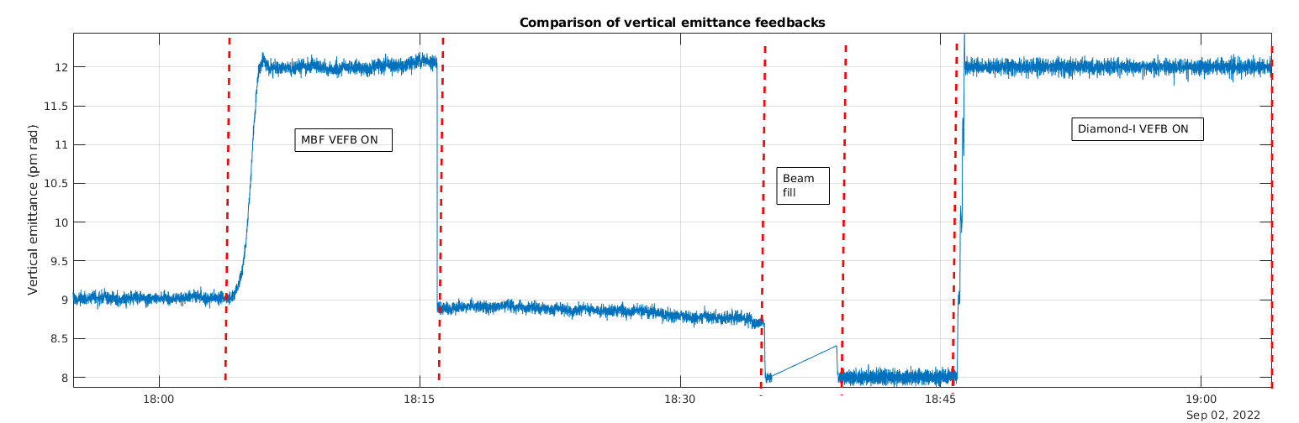
Testing the simple emittance control
9 of 15
Response rate when changes occur:
Standard deviation over a few mins in the stable state:
Magnet based system | 8 s / pm rad
MBF system | 29 s / pm rad
No feedback | 0.030pm rad
Magnet based system | 0.037pm rad
MBF system | 0.060pm rad
Next step is to use proper systems analysis to develop a full feedback model

Slide 11
10 of 15
Broader considerations
The MBF system will become machine critical in more ways.
MBF focussed
Assessing and developing new operational uses of the MBF system.​
  PPRE​
  Bunch cleaning​
  Emittance feedback​
Integrating all the different operating modes to work together in various combinations.​
Accelerator focussed
Improving our assessment of the working point stability.
Identifying the impact of various machine settings.
Improving our understanding of the impact of MBF setting changes.
Notes:
I will touch on the broader studies which impact the sideband excitation scheme only.

Slide 12
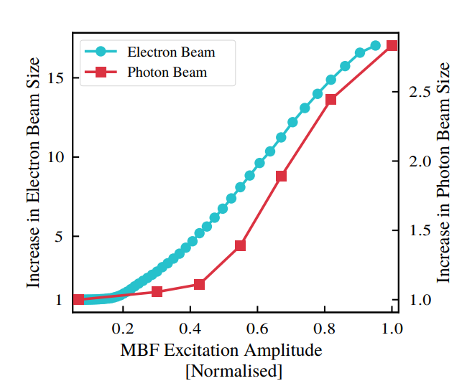
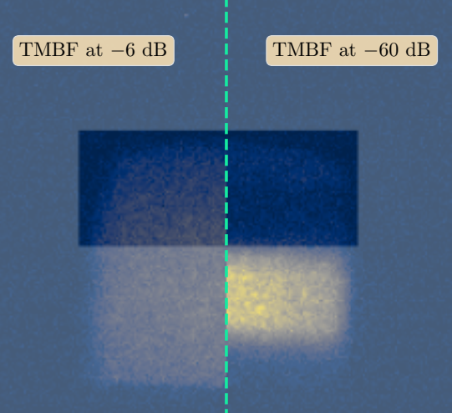
Broader studies – Pulse Picking by Resonant Excitation for use with 'timing users'
11 of 15
An alternative to hybrid fill.
  Feasibility study in collaboration with one of our beam lines
Lifetime without Compromise
doi: 10.18429/JACoW-IPAC2023-MOPM036
S. Wilkes
Investigations into operating Pulse Picking by Resonant Excitation (PPRE) in the vertical plane
doi: 10.18429/JACoW-IPAC2023-MOPM037
S. Wilkes, A. Morgan, G. Karras, I. Martin, M. Warren
Machine measurement
Beamline measurement

Slide 13
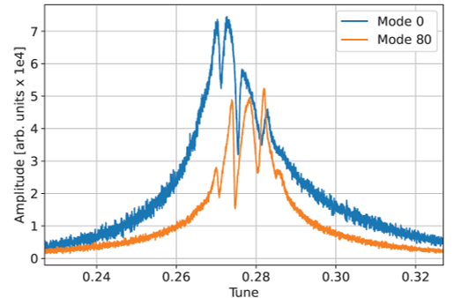
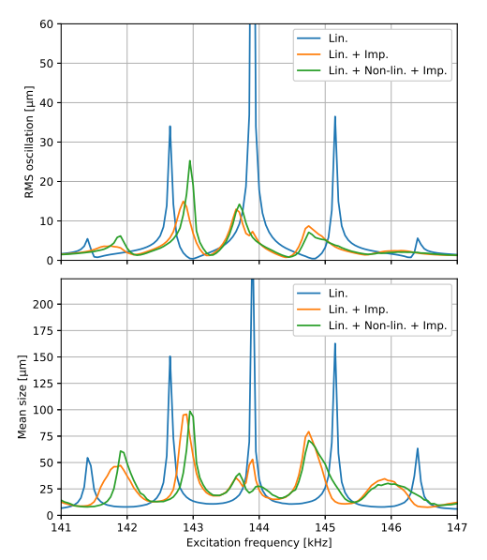
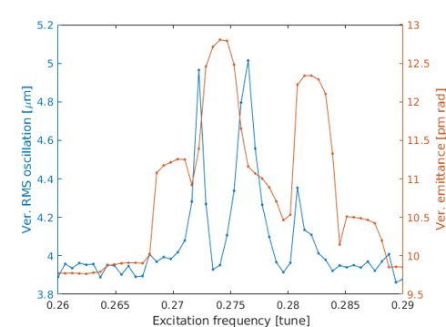
Broader studies – settings optimisation
12 of 15
Simulation
Measurement
Emittance feedback for the Diamond-II storage ring using resonant excitation
doi:10.18429/JACoW- IPAC2022 - TUPOMS035
S. T. Preston∗ , T. Olsson, B. Singh
Measured impact of chromaticity and bunch charge
The Asymmetry of the peaks and the sensitivity with excitation harmonic
indicates that long-range wakefields have a significant impact. ​
Measurements for emittance feedback based on resonant excitation at Daimond light source
doi:10.18429/JACoW-IBIC2022-WEP37
S. T. Preston∗ , T. Olsson, A. Morgan† , L. Bobb
Including the impedance causes a broadening and shifting of the sidebands as well as showing the asymmetry similar to the measured data.

Slide 14
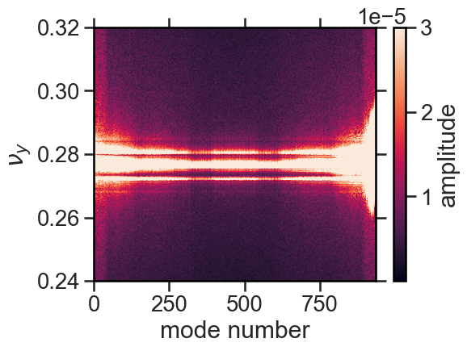
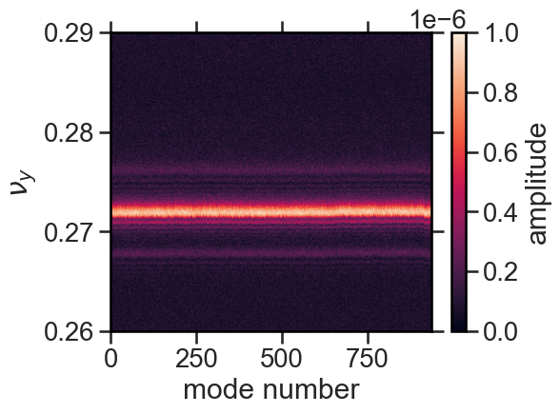
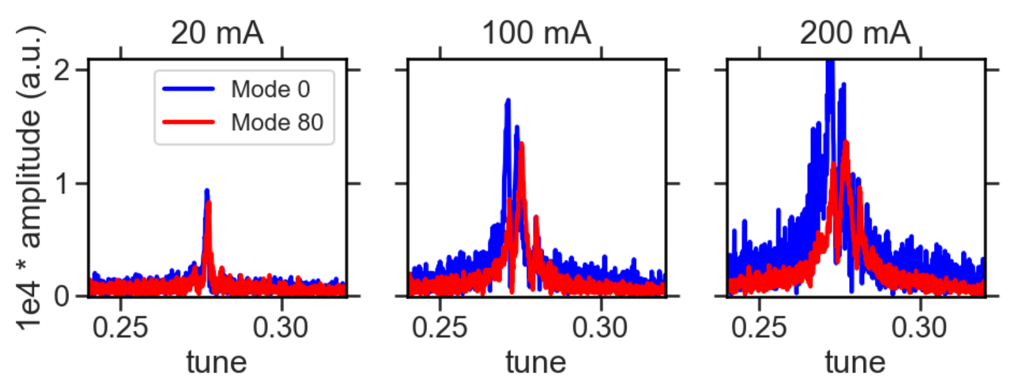
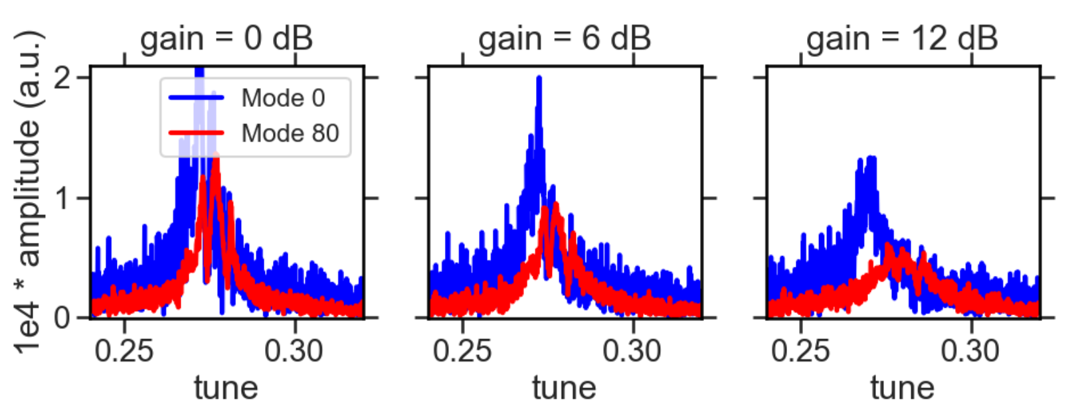
Broader studies – further investigation of excitation harmonic modes
13 of 15
Dependencies investigated so far
Fill pattern
Excitation amplitude
Beam current
Tune excitation with equivalent charge per bunch.
Full fill
Single bunch
Signal integrated over the beam depends on excitation mode

Slide 15
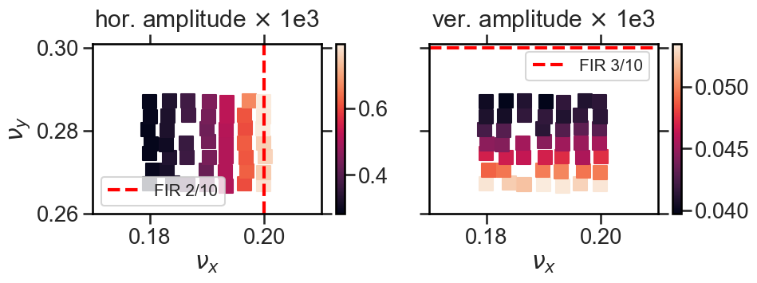
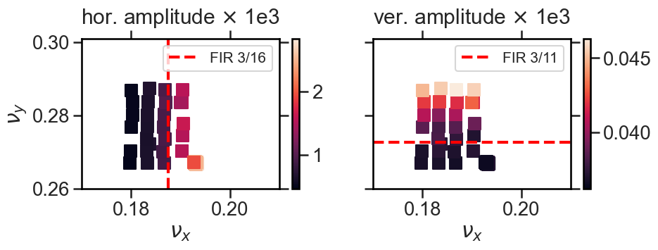
Broader studies – Measuring the effects of MBF bandwidth on feedback robustness
14 of 15
tune scans at I = 150 mA around the current working point
Shorter filter
Wider bandwidth
Longer filter
Narrower bandwidth

Slide 16
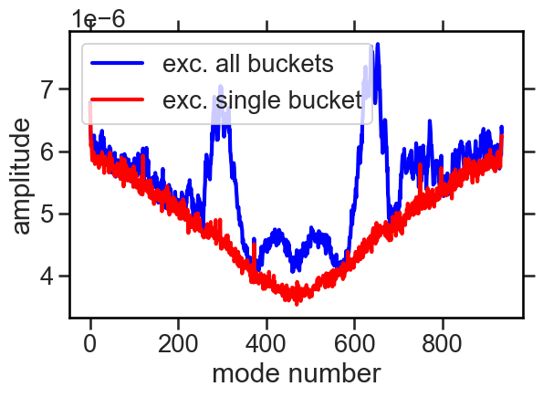
Future work and questions
15 of 15
Develop an improved feedback algorithm
Measurement studies
  Single bunch operation - To better separate the effect of long and short range wakefields.
  Find a more optimal accelerator setup with minimal sideband driven centroid motion
  Can this residual centroid motion be mitigated by the multi-bunch feedback ?
Simulation
  Understand the effects of a 3rd harmonic cavity
  Include both short and long range wakefields
Noise measurements
Where does the noise floor variation with excitation mode come from?
Questions
Experience with 3rd harmonic cavity
Experience with ramped / booster operation
Experience with Amplifiers

