Slide 1
Transverse feedback in Large Hadron Collider – a Swiss tool for LHC
Xavier Buffat, Gerd Kotzian, Martin Söderén, Daniel Valuch*
IFAST workshop, Karlsruhe, 4.3.2024
*daniel.valuch@cern.ch

Slide 2
Transverse feedback in Large Hadron Collider - a Swiss tool for LHC
About the talk:
Transverse feedback in LHC (ADT) is a very complex system with myriad functions and duties
20 years since the first designs, 16 years in operation, functionality is constantly evolving
It provides more “other” services to the machine than the primary feedback itself
This 20’ talk gives only a very brief introduction to get a taste
More details in person discussions

Slide 3
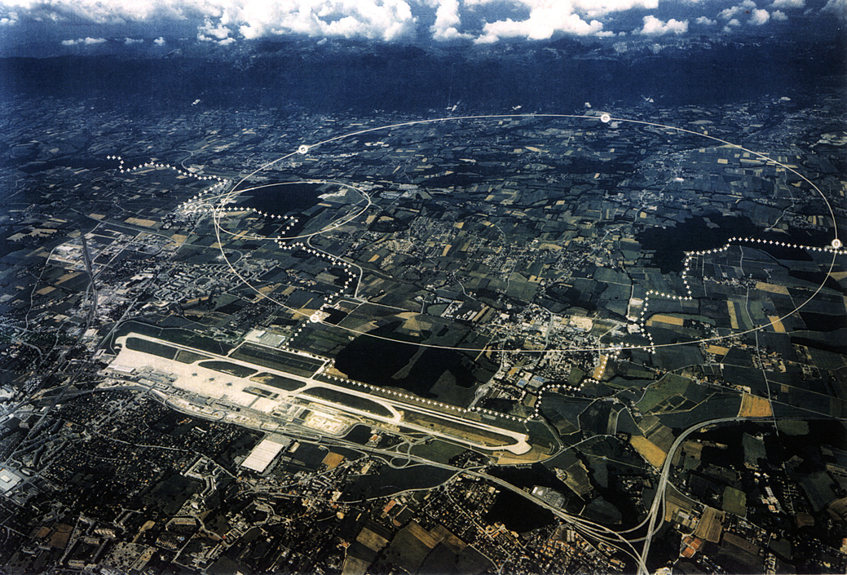
Large hadron collider – few key figures
27 km circumference
Two counter rotating beams (B1, B2)
Ion species: protons and heavy ions (Pb)
Operating frequency 400.8 MHz
Harmonic number 35 640
Bunch spacing 25 ns, i.e. 40 MHz repetition rate
Typical bunch length 1.0-1.5 ns
Typical charge: pilot intensity 1e9, nominal 1-2e11 charges/bunch
Acceleration from 450 GeV to 7 TeV
Filling time ~20 min, Ramp to physics ~20-40 min, Physics 12-18 hours (no top-up)
Most of the controls is dynamic, on the fly, and bunch by bunch

Slide 4
Large hadron collider – an introduction to operation
1 turn ~89.2 μs
Injection gap 12 μs
Abort gap 3 μs
Already circulating beam
Beam to be injected
Bunch slot #1
Witness bunches
12x25 ns = 300 ns
Bunch slot #1
Bunch slot #3564
Bunch slot #3564

Slide 5
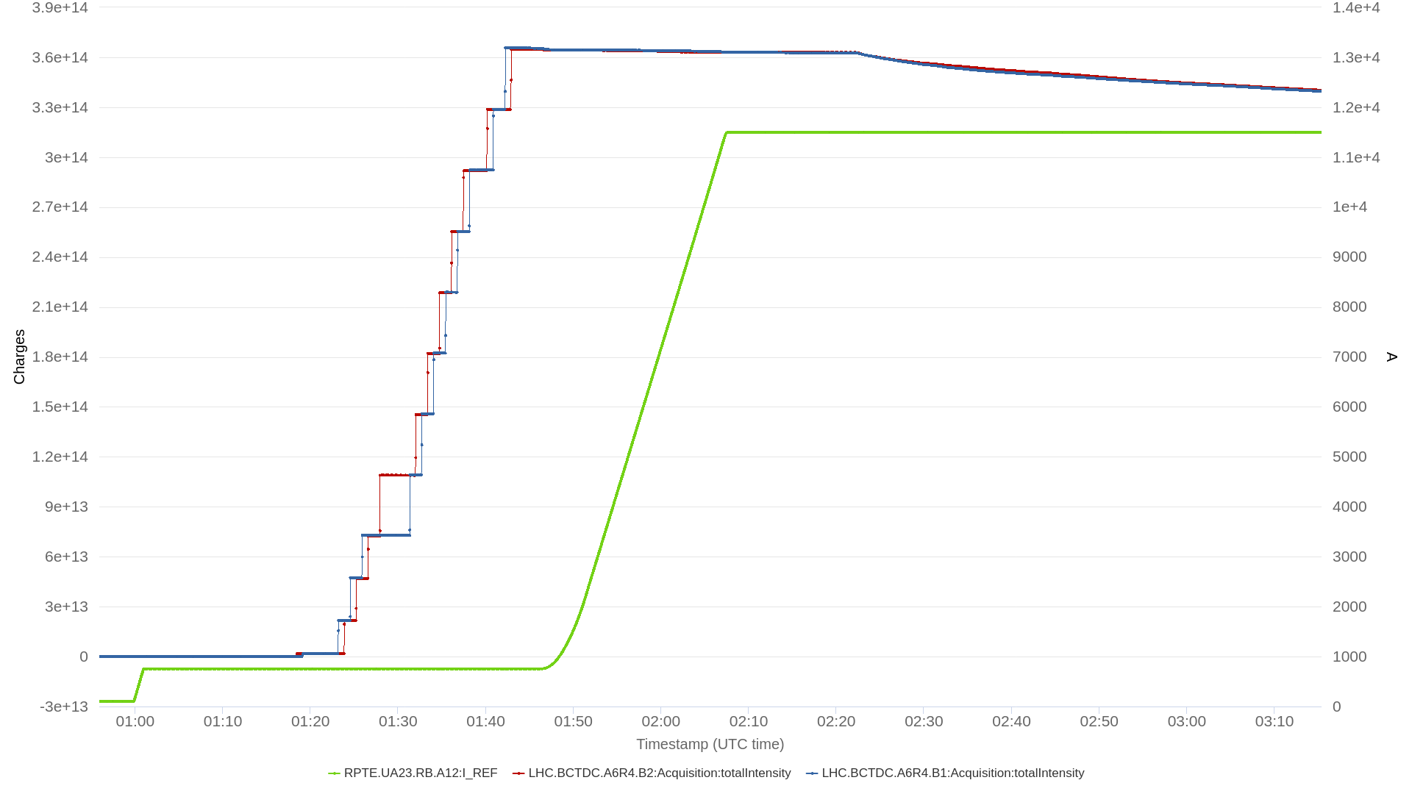
Large hadron collider – an introduction to operation
Colissions …
… Dump, ramp down
Squeeze, Q change, preparation for physics
Injection of pilot intensity, measurements, setting up
Injection of nominal intensity 12-b
Filling with nominal trains
Ramp

Slide 6
LHC transverse feedback system – omni-purpose device vital for LHC operation
Beam dynamics:
Damping of injection oscillations
Preservation of transverse emittance
Counteracting the coupled bunch instability
Accelerator operation:
Abort gap, injection gap cleaning
Controlled transverse emittance blow-up
Tune, chromaticity, optics, coupling… measurements
Beam observation and measurements:
Real time accelerator and beam parameter extraction
Real time transverse instability detection

Slide 7
Overview of the LHC transverse feedback system
4 pickups in the tunnel per beam per plane (16 total)
Digital signal processing
4 E-field kickers per beam per plane (2 μrad, 10kV peak, 6 meters total)
Fully remote and automatic operation and setting up
ObsBox

Slide 8
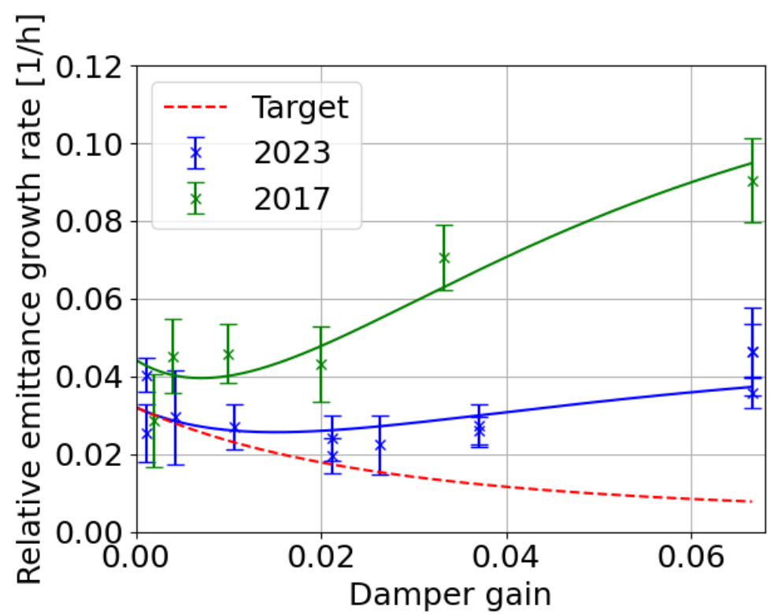
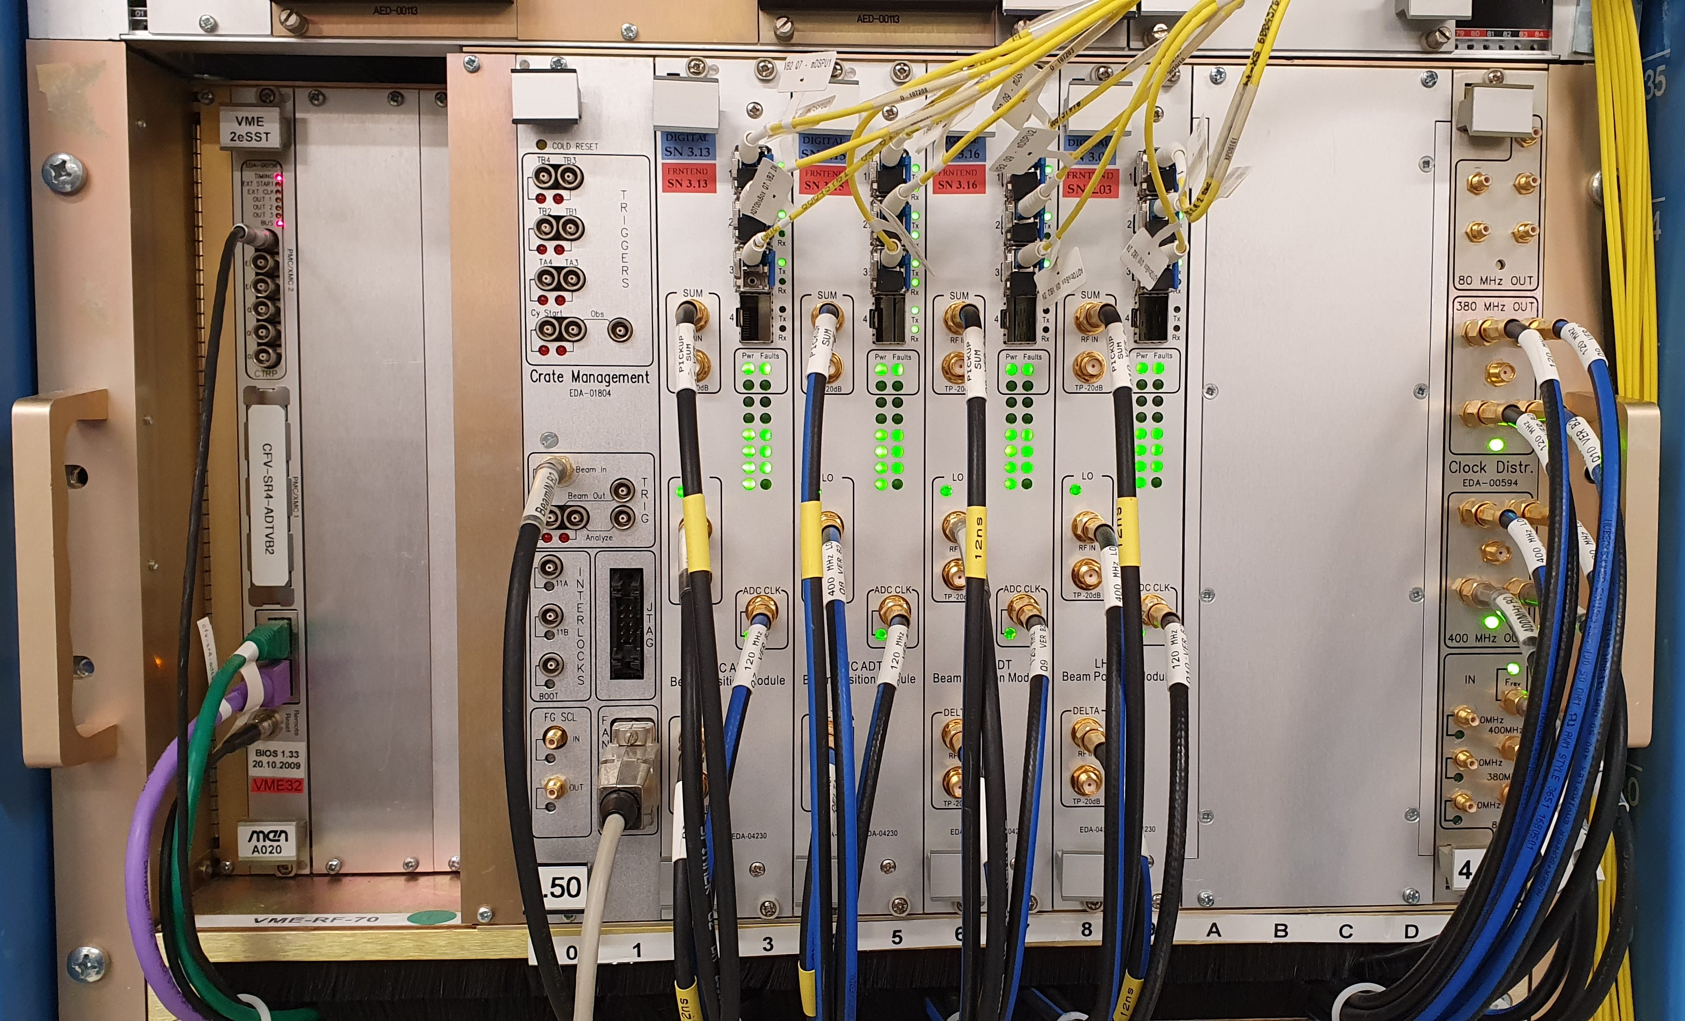
Beam position measurement
4 pickups in the tunnel per beam (1/2) per plane (H/V). 16 in total
Quadruple redundancy for the operation
Feedback is active during the full cycle, noise performance is of critical importance
Noise feedback for the coming Crab cavitities for High lumi LHC

Slide 9
Beam position measurement
New Generation, Very Low Noise Beam Position Measurement System for High Lumi LHC operation

Slide 10
Beam position measurement and feedback noise performance references
[1] Xavier Buffat et al.: Modeling of the emittance growth due to decoherence in collision at the Large Hadron Collider DOI 10.1103/PhysRevAccelBeams.23.021002
[2] Sondre Vik Furuseth et al.: Emittance growth suppression with a multibunch feedback in high-energy hadron colliders: Numerical optimization of the gain and bandwidth DOI 10.1103/PhysRevAccelBeams.24.011003
[3] Philippe Baudrenghien and Themistoklis Mastoridis: Transverse emittance growth due to rf noise in the high-luminosity LHC crab cavities DOI 10.1103/PhysRevSTAB.18.101001
[4] Daniel Valuch, Viera Stopjakova: New Generation of Very Low Noise Beam Position Measurement System for the LHC Transverse Feedback DOI 10.18429/JACoW-IPAC2022-TUPOST007

Slide 11
Digital signal processing
Feedback functionality – everything treated bunch by bunch
Receive the four beam position streams (1 sample per bunch per turn, i.e. each 25 ns for all 3564 possible bunch slots)
Apply the closed orbit suppression, β-function normalization and phase rotation
Route the feedback signals via four possible, independent feedback channels
Apply individual pre-distortion to each channel
Generation of excitation signals – harmonic, vectorial excitation, stochastic (white noise, coloured noise)
Sum all feedback, excitation, or transfer function measurement signals and provide analogue drive for tube amplifiers

Slide 12
Details of the LHC transverse feedback signal processing

Slide 13
LHC transverse feedback signal processing
Pickup to kicker phase rotation. We have three methods implemented:
Simple vector sum – requires at least two pickups at convenient phase advance wrt. kicker.
  ++ no additional delay -- requires dedicated optics -- always requires two fully operational pickups
Hilbert phase shifter – single pickup sufficient, arbitrary phase between the pickups and the kicker possible
  ++ full phase control ++ works with a single pickup -- longer processing delay
More advanced methods, e.g. Komppula filters
  ++ shorter group delay, but still full phase rotation capability including notch filter functionality [1]
[1] Komppula Jani: MD4036: New ADT signal processing for large tune acceptance https://cds.cern.ch/record/2668389?ln=en

Slide 14
Power system and deflectors
Four kickers per beam, per plane (16 total), located in the RF zone (UX451) at point 4
E-field kickers, total length 4x1.5 m, powered by a class AB, tetrode push-pull amplifiers
Max. differential voltage ~10 kV, providing a kick of ~2 μrad @ 450 GeV (all 4 units combined). Scales with momentum (130 nrad @ 6.8 TeV)
Useful bandwidth ~1 kHz – 20 MHz* (* terms and conditions may apply)
Dominant pole at ~800 kHz

Slide 15
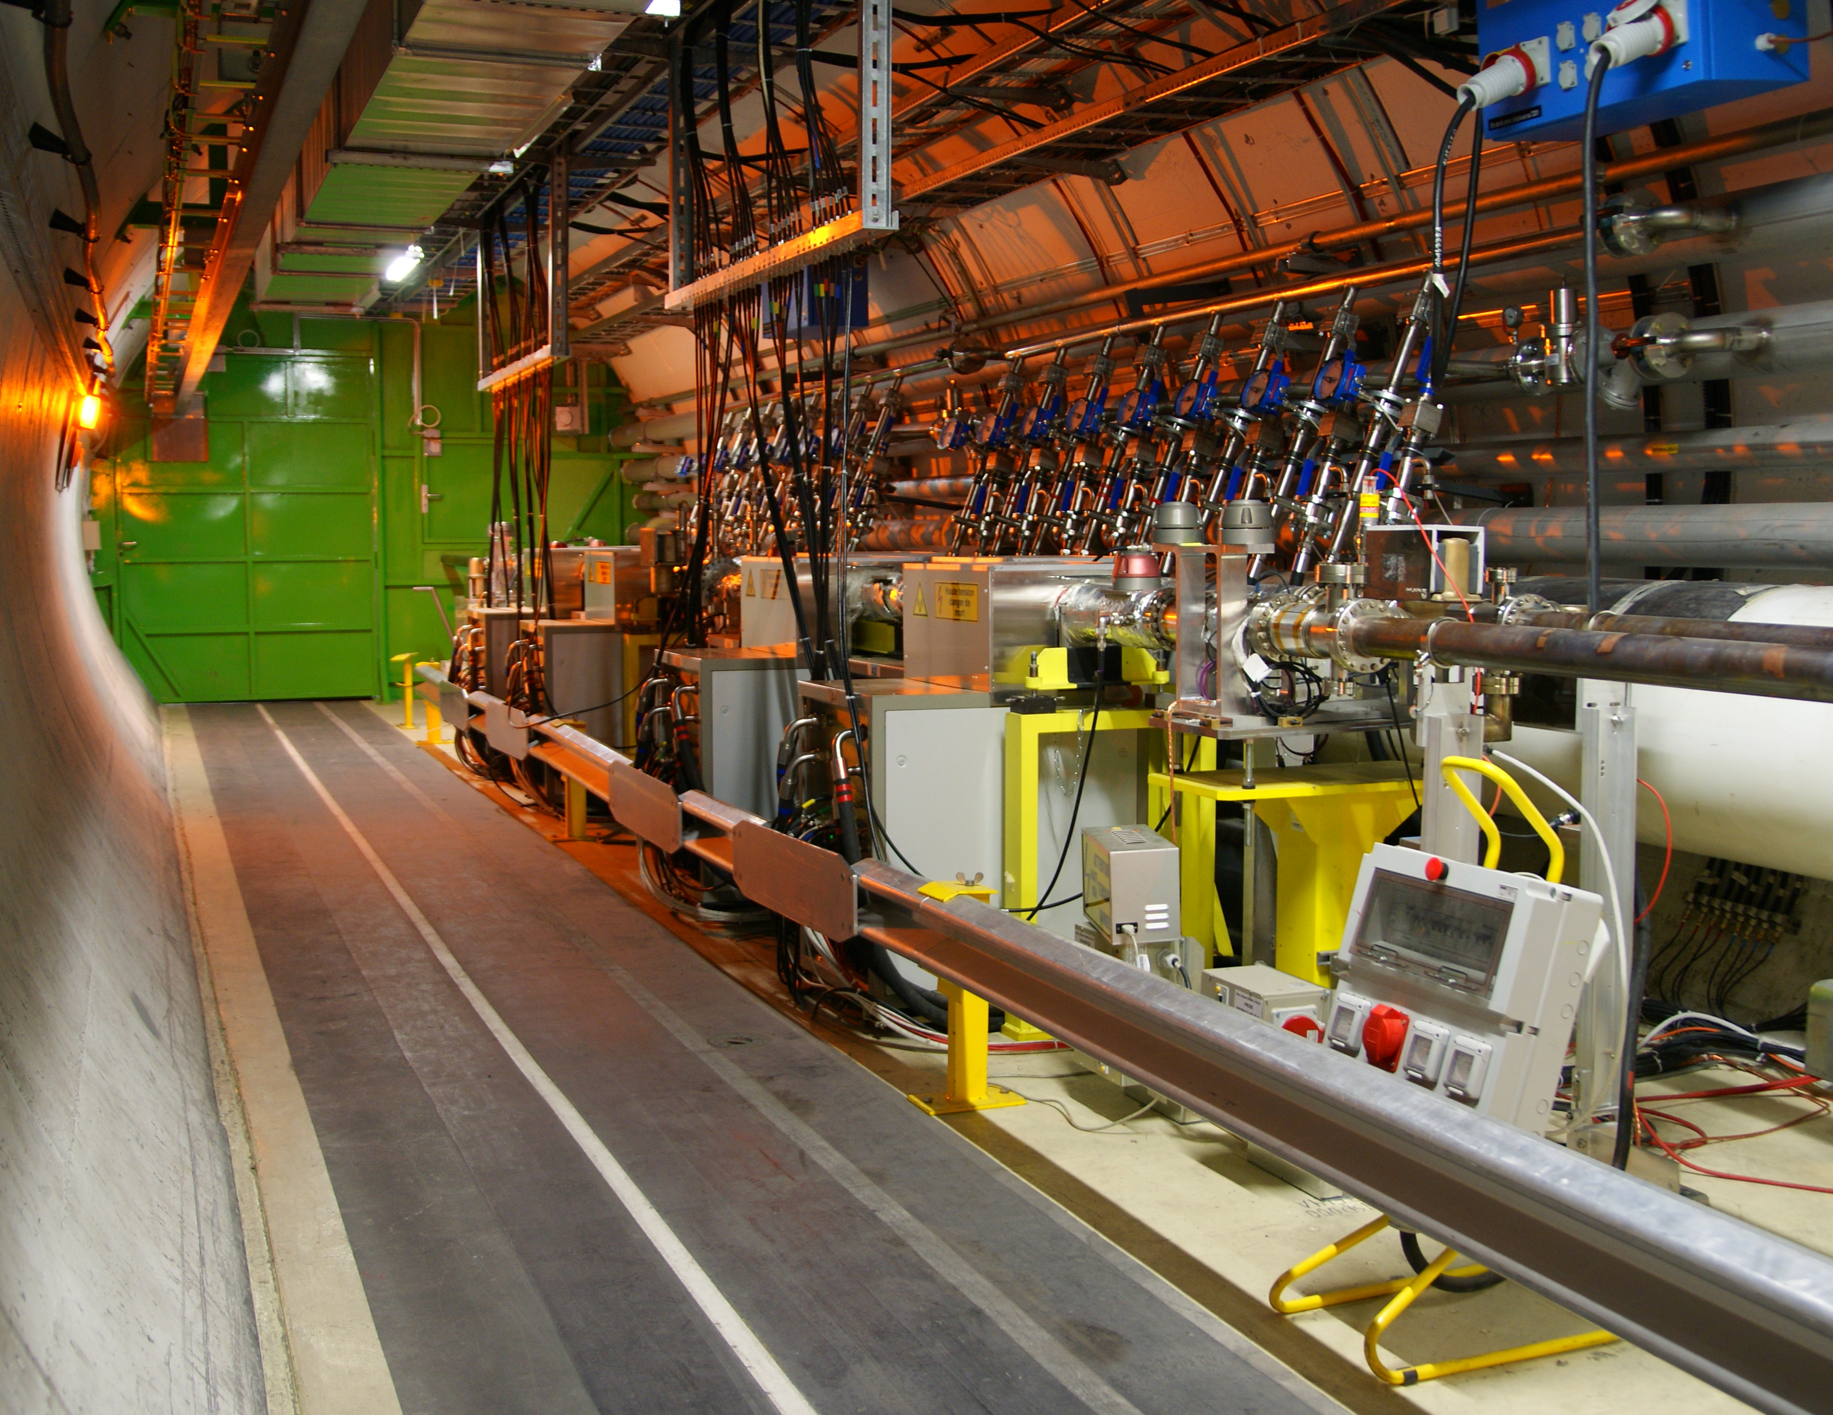
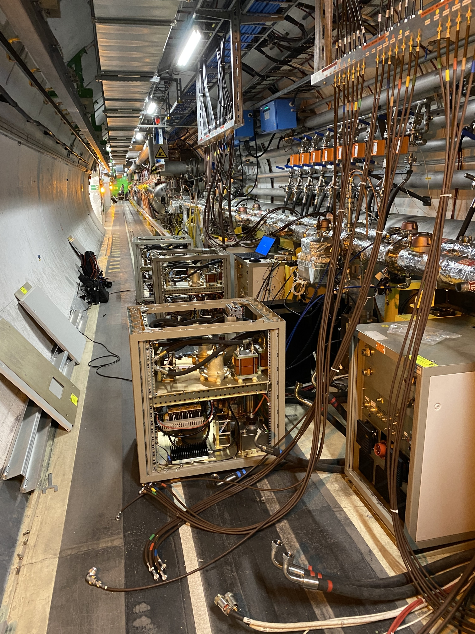
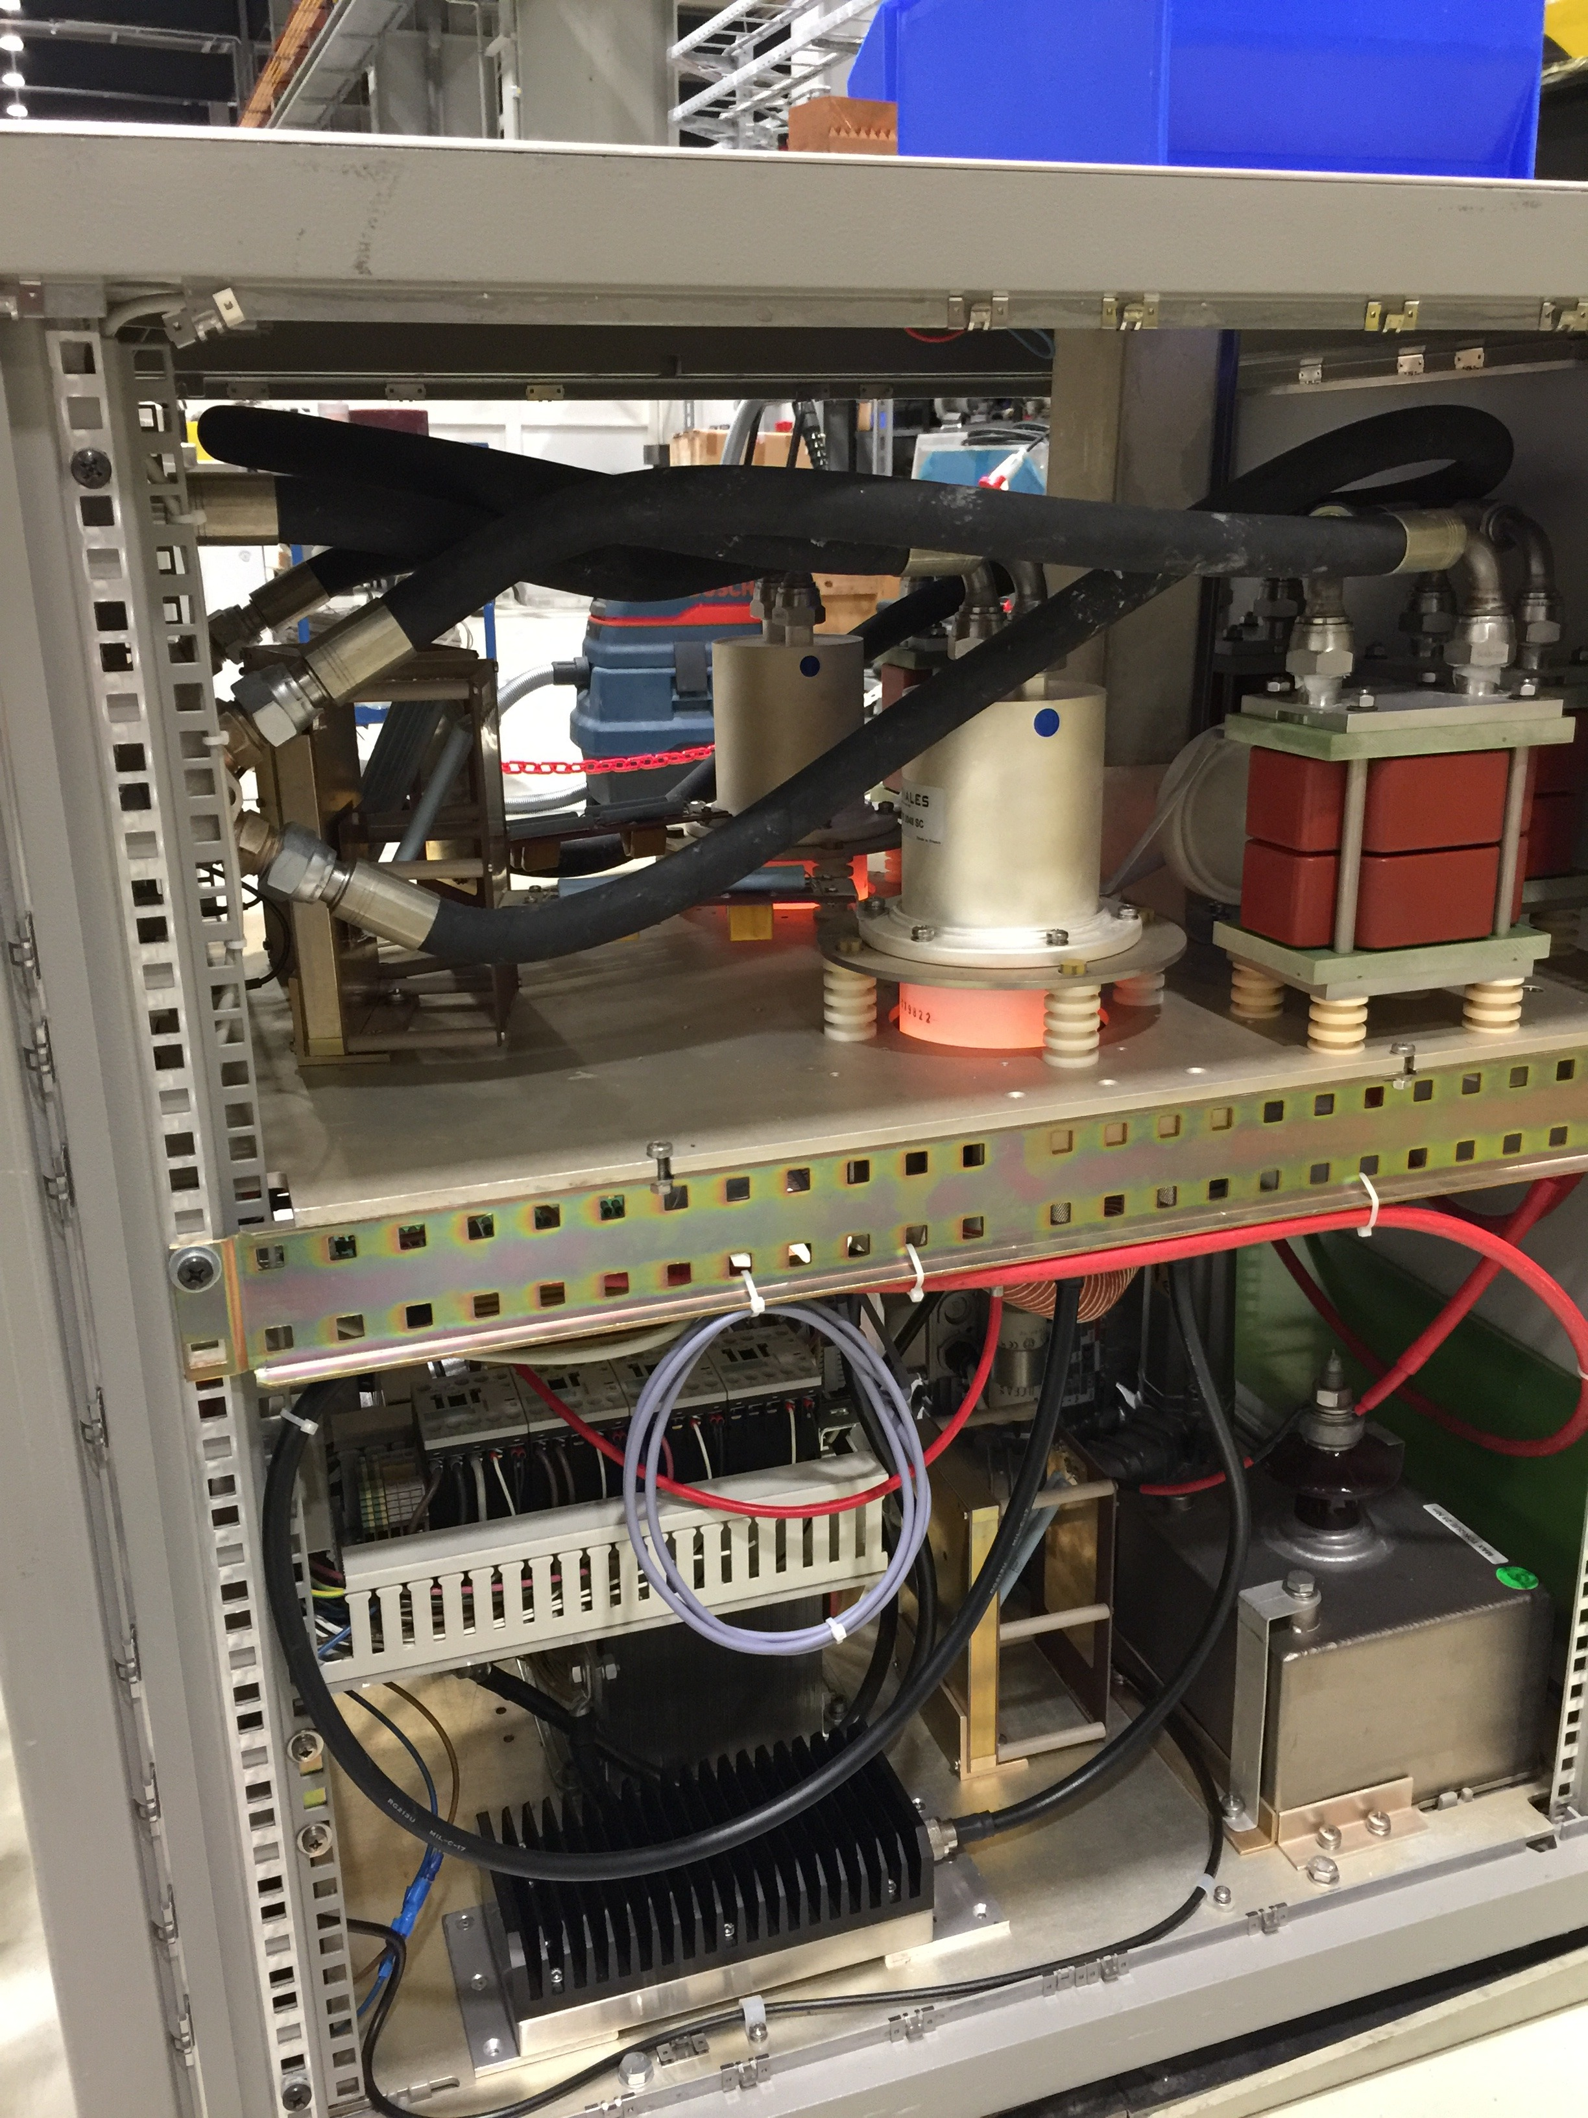
Power system and deflectors
Tetrode power amplifiers and kickers in the tunnel, at LHC point 4

Slide 16
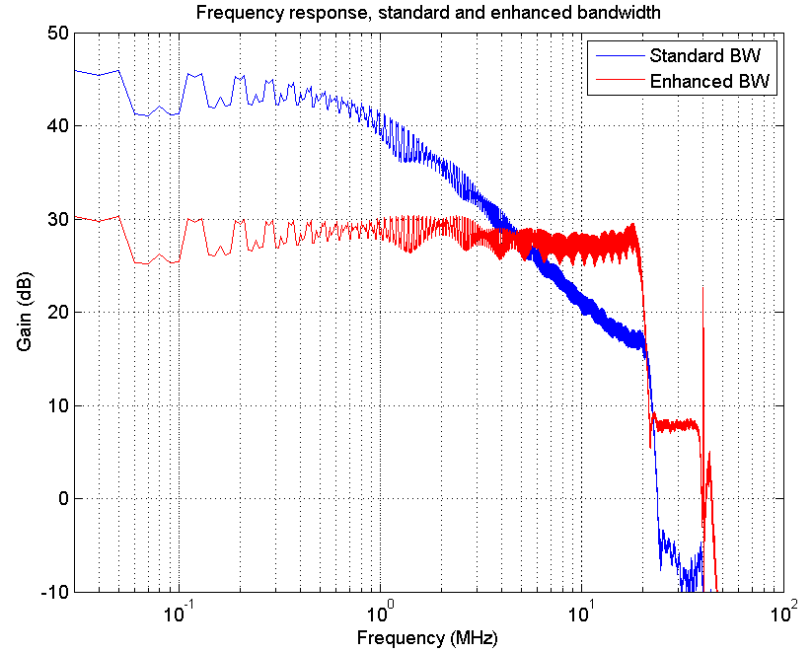
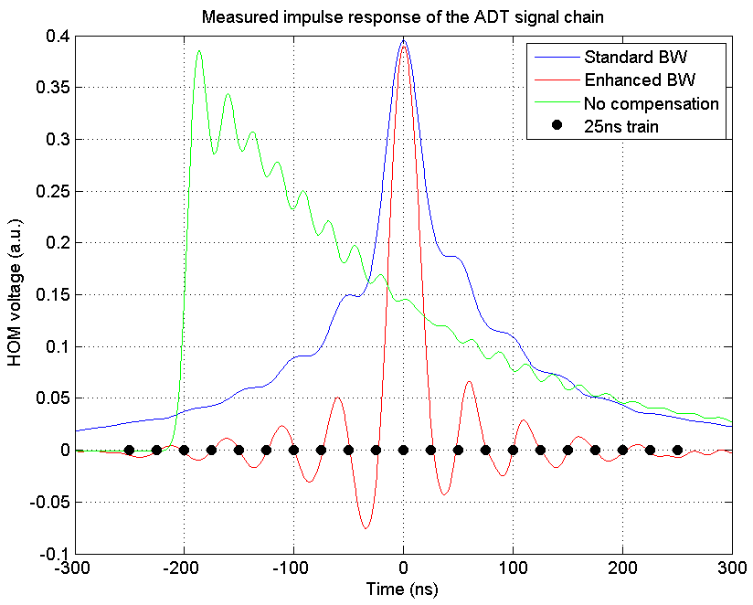
Power system and deflectors
Digital predistortion allows to control the feedback/excitation bandwidth
High power, low bandwidth mode → full deflection
High bandwidth mode → true bunch by bunch operations possible (feedback, excitation, cleaning)

Slide 17
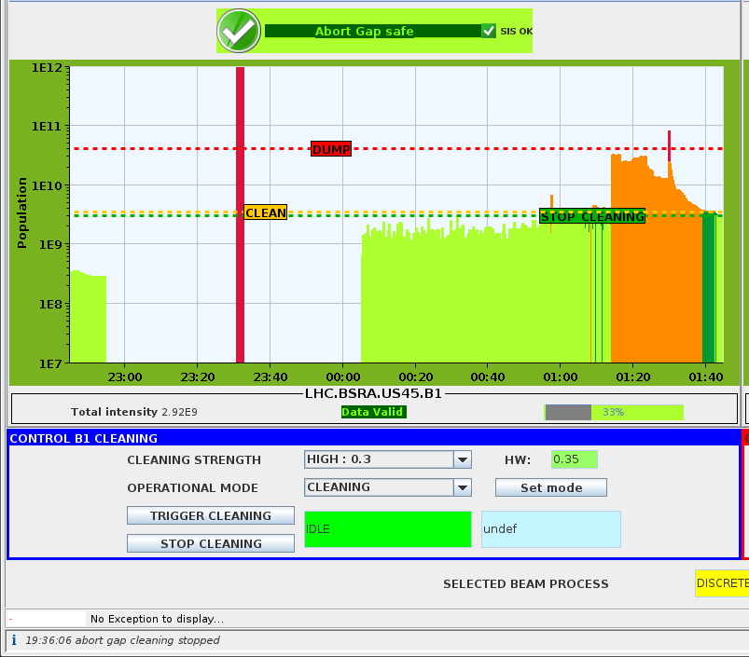
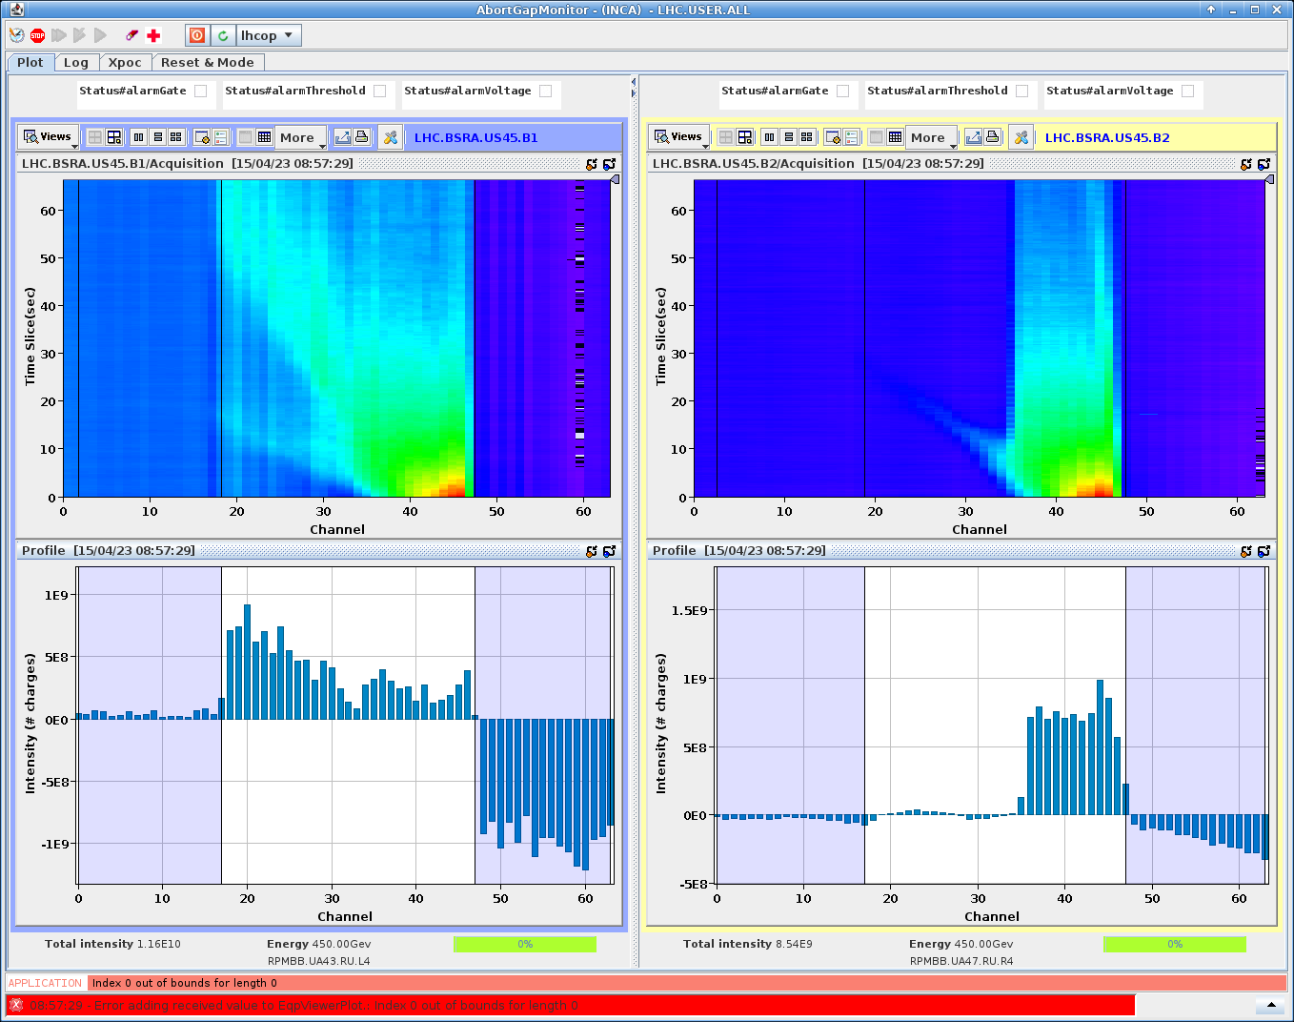
Much more than a transverse feedback
Abort gap and injection gap cleaning
Abort gap
Cleaning region
Real time abort gap population measurement from synchrotron light telescope

Slide 18
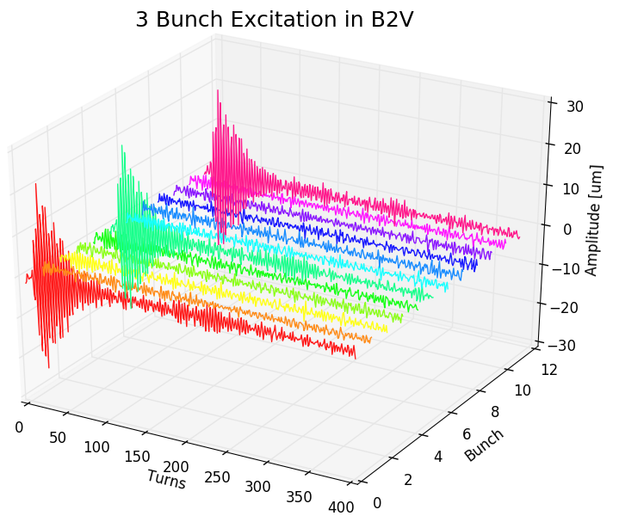
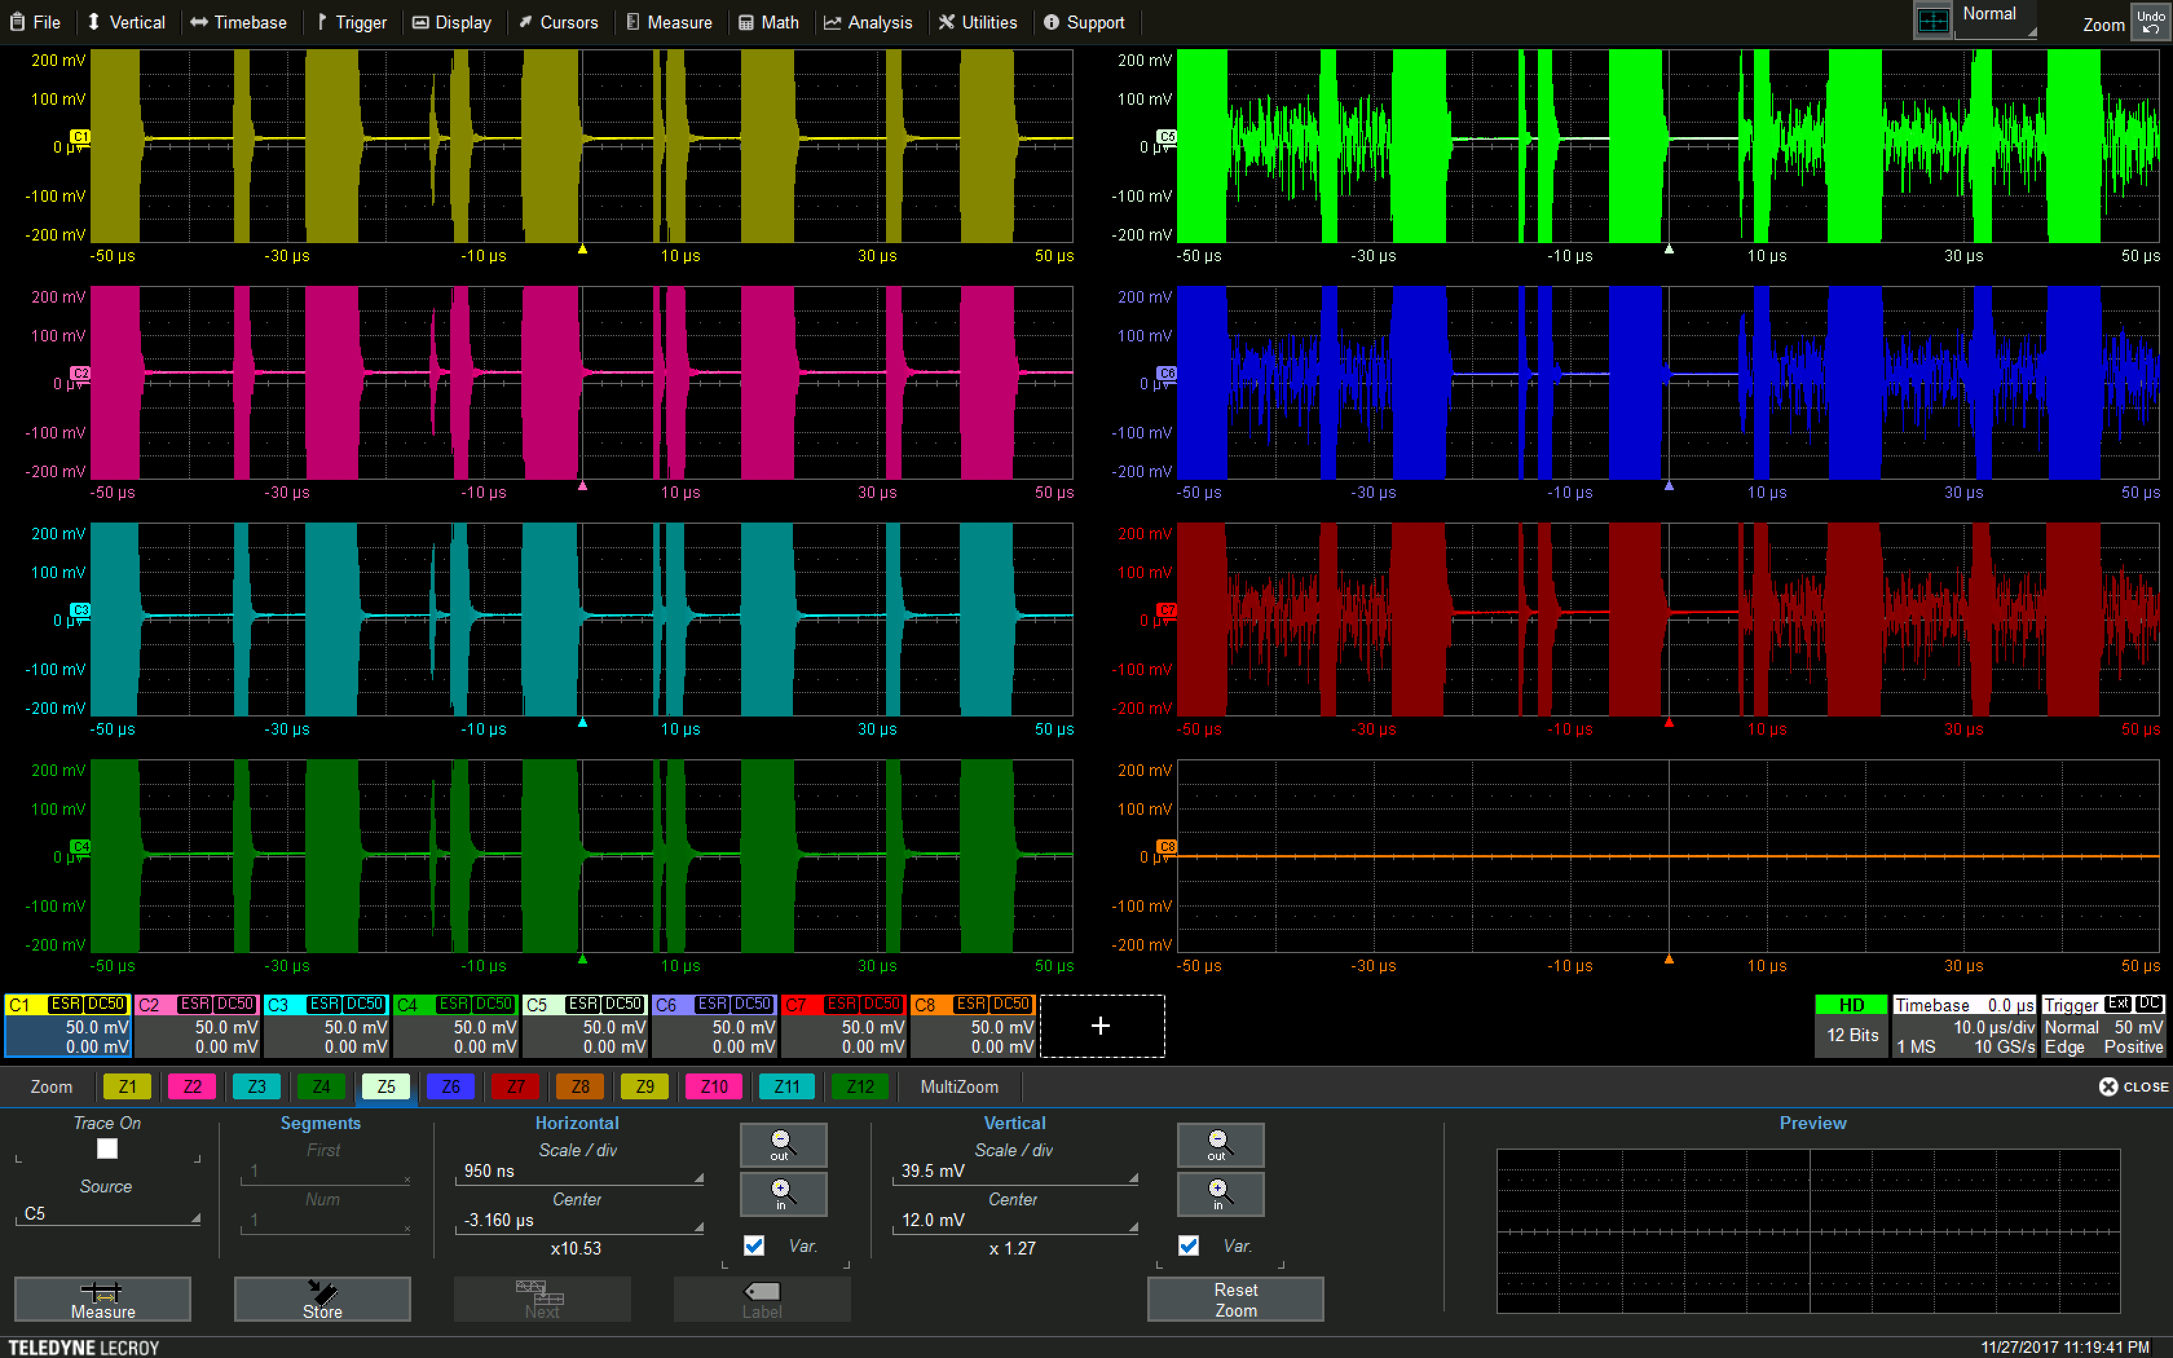
Much more than a transverse feedback
Selective excitation of single bunches within a 25 ns bunch train
Controlled scraping of selected bunches/bunch trains

Slide 19
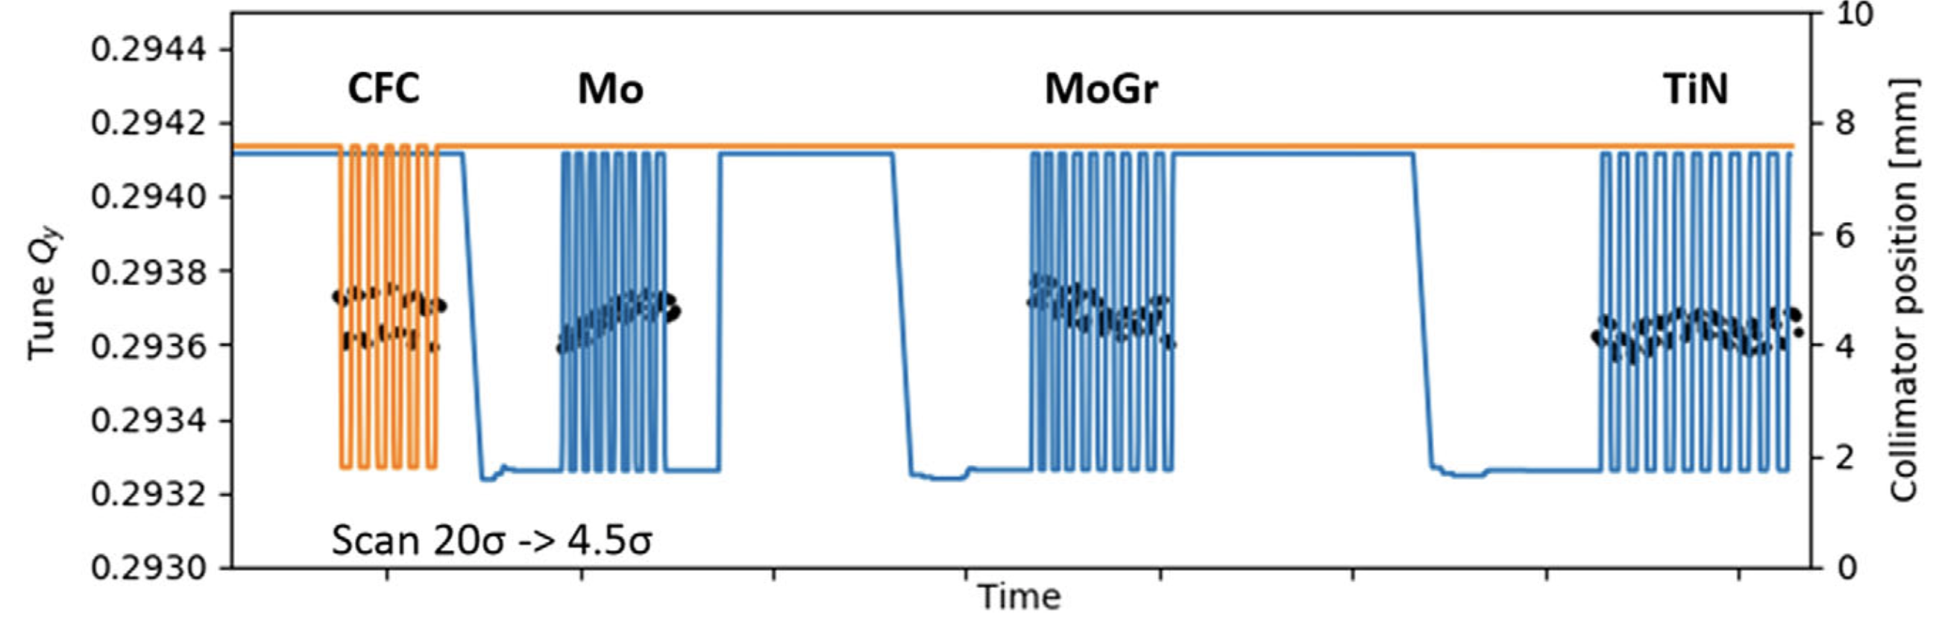
Much more than a transverse feedback
Very high resolution tune measurement using ADT-AC dipole and ADT observation systems to calculate impedance of new, very low impedance collimators.
David Amorim et al.: Transverse beam stability with low-impedance collimators in the High-Luminosity Large Hadron Collider: Status and challenges DOI 10.1103/PhysRevAccelBeams.23.034403

Slide 20
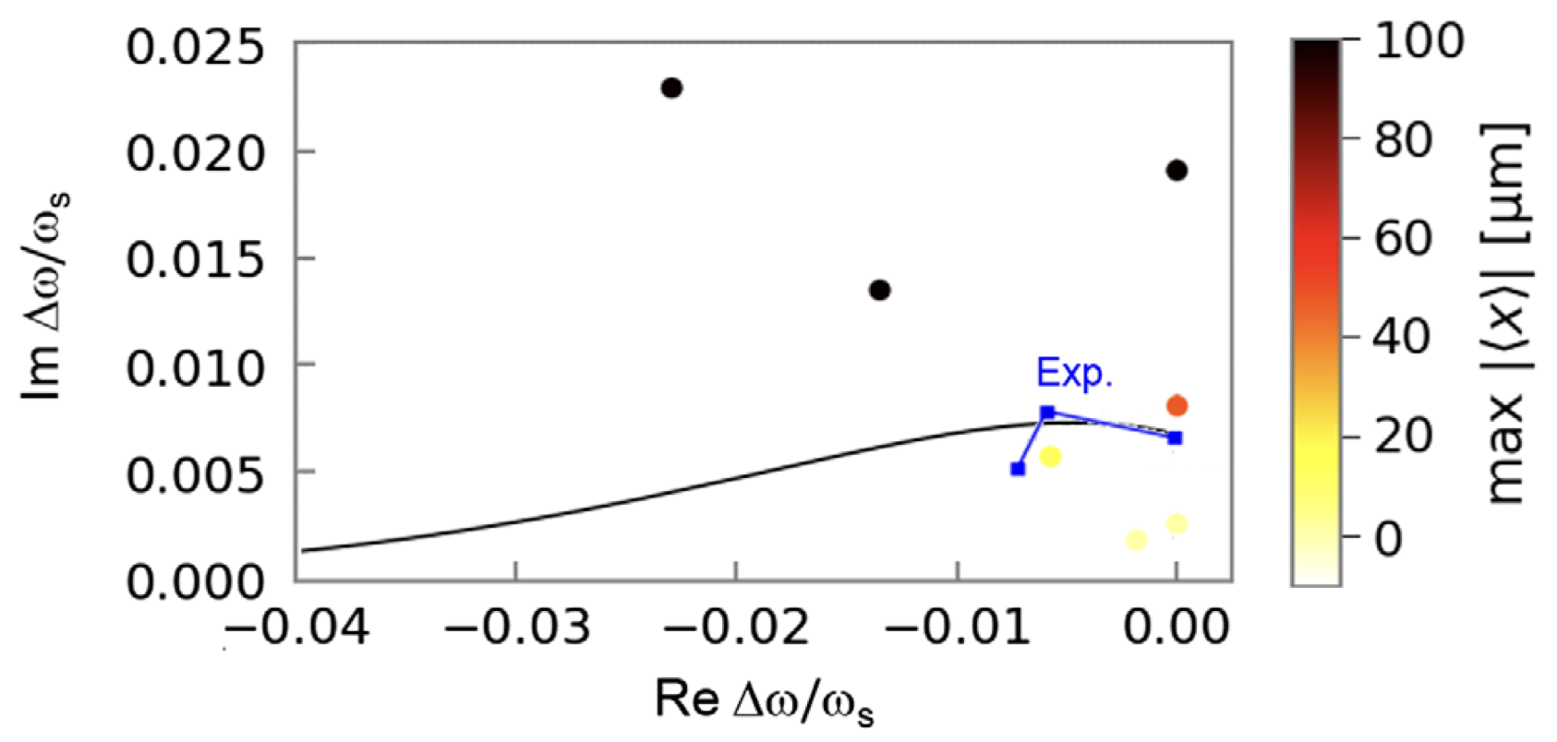
Much more than a transverse feedback
Transverse feedback can be made a source of controlled machine impedance – Proof-of-Principle Direct Measurement of Landau Damping Strength at the Large Hadron Collider with an Antidamper
Sergey Antipov et al.: Proof-of-Principle Direct Measurement of Landau Damping Strength at the Large Hadron Collider with an Antidamper DOI 10.1103/PhysRevLett.126.164801

Slide 21
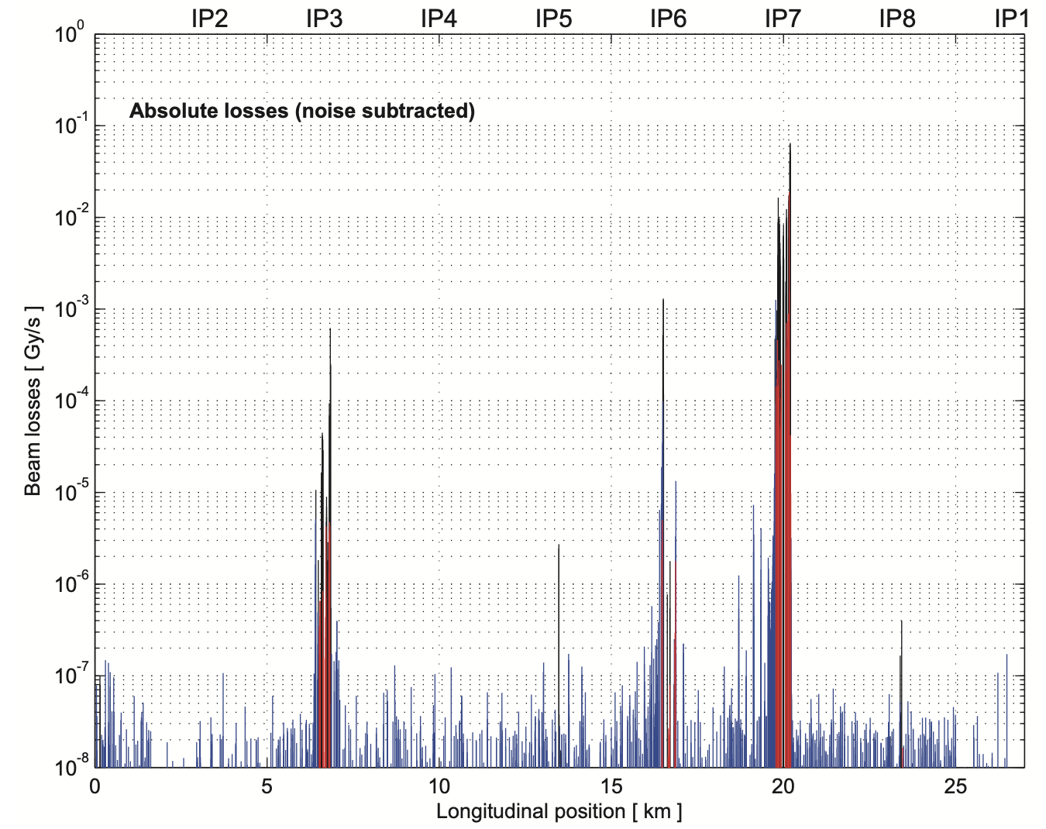
Much more than a transverse feedback
Betatron loss maps in LHC are measured exclusively by damper excitation, instead of previously used 3rd order resonance crossing. All loss maps can be done in one single cycle. Major saving of the machine time.
Wolfgang Hofle et al.: Controlled Transverse Blow-up of High Energy Proton Beams for Aperture Measurements and Loss Maps, IPAC2012 https://accelconf.web.cern.ch/IPAC2012/papers/THPPR039.pdf

Slide 22
Much more than a transverse feedback
Quench tests. Transverse feedback used in 3 out of 4 types of tests. Noteworthy:
Sustained 1 MW losses for 30 seconds on primary collimators
Direct hit of a selected superconducting magnet coil
  Inject a bunch with 5e9 charges. Scrape down to 2e8 with damper
  Provide initial “seeding” kick with a tune kicker while closing the loop with opposite sign
  Build up the oscillation in couple of turns to directly hit the selected magnet coil
  Quench
Mariusz Sapinski et al.: Testing beam-induced quench levels of LHC superconducting magnets
DOI: 10.1103/PhysRevSTAB.18.061002

Slide 23
Operational flexibility
Per-bunch, intensity based parameters
Bunch by bunch settings for beam position measurements (pilot/nominal intensity)
Optics based parameters
Machine optics and tune change through the cycle, feedback settings must follow
Operational cycle based parameters
Different requirements for different phases of the cycle (injection, ramp squeeze, physics…)
Different feedback gain for different bunch trains (witness/main bunches)
Conservation of constant damping time as a function of momentum
Low noise operation in physics

Slide 24
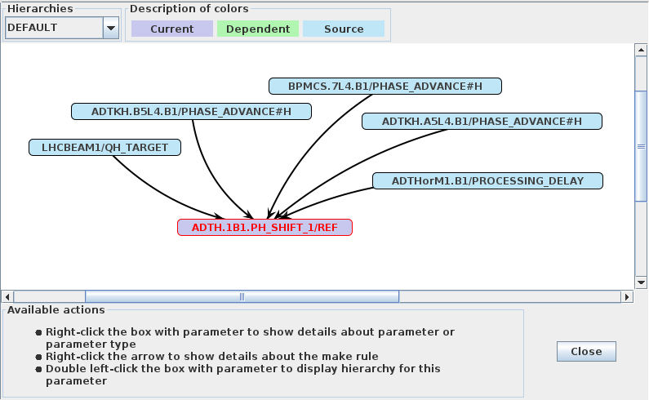
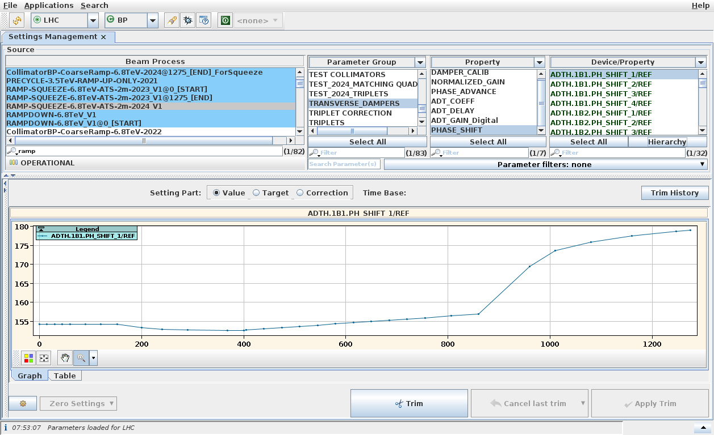
Operational flexibility
LHC accelerates only two types of beams. But the operation is very complex. All feedback parameters are dynamically controlled by functions, timings, or high-level software
Example: feedback phase is automatically calculated and programmed based on the actual optics and betatron tune within the cycle.

Slide 25
Operational flexibility
LHC accelerates only two types of beams. But the operation is very complex. All feedback parameters must be dynamically controlled by functions, timings, or high-level software
More examples of required flexibility:
Beam position front-ends can have different gain for individual bunches (real time modulation)
Different bunches can be processed by different feedback loops with different dynamics
Feedback parameters can be altered from one turn to other
Excitation of individual bunches, or full trains
Built-in performance verification

Slide 26
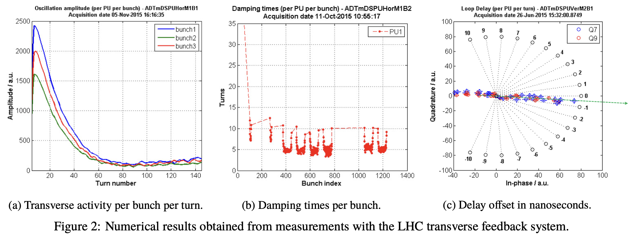
Operational flexibility
Identification of feedback parameters using the feedback itself. Automation for setting up, automatic operationalk checks of the feedback performance, etc.
Gerd Kotzian: Transverse Feedback Parameter Extraction from Excitation Data DOI: 10.18429/JACoW-IPAC2017-TUPIK094
Soon to be published PhD. Thesis – Gerd Kotzian: Signal Processing Techniques for Transverse Feedback Systems in Hadron Accelerators

Slide 27
Observation system (ADTObsBox)
Transverse feedback in LHC is the only place in the machine where a bunch by bunch, turn by turn bunch position with high resolution is available.
Extremely valuable information for the accelerator physicists, or machine operation.
The information can be routed out of FPGAs by means of 1 Gbps links.
A very high performance computing system called ObsBox was invented, developed and put into operation.
Introduction of the system had changed the way we understand and operate the LHC.
Martin Söderén: Low Latency, Online Processing of the High-Bandwidth Bunch-By-Bunch Observation Data From the Transverse Feedback System in the LHC DOI: 10.1051/epjconf/202024501036

Slide 28
Observation system (ADTObsBox)
Three servers:
Real time processing (Spongebob) 48 cores, 768 GB RAM
  On demand buffers (4k – 128k turns)
  Real time transverse activity analysis, real time transverse instability detection
  Injection and damper performance analysis
  All beam measurements (chromaticity, tune, external vibrations, ground motion etc.)
Storage (Patrick) 48 cores, 144 TB ultra high throughput solid state drives
  24-48 hour circular buffer at full rate and resolution for all 16 pickups
  Dedicated post mortem buffers
Development (Squidward) 48 cores, 384 GB ram, 48 TB SSD

Slide 29
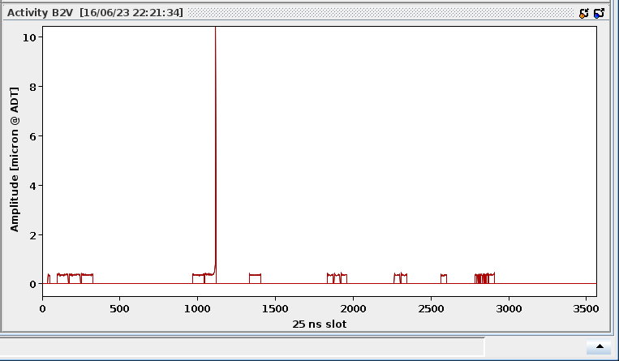
Observation system (ADTObsBox)
One of many examples: Real time transverse activity monitor and instability detection

Slide 30
Summary
Bunch by bunch feedbacks are vital for machine operation (stability, emittance conservation)
These systems have simultaneous access to the real time beam measurements, and they can also act on the beam – unlimited applications outside the traditional “feedback”
Current state of the art electronics and computing systems allow for extremely sophisticated beam manipulations never imagined before (…just profit!)
The bunch-by-bunch, turn-by-turn measurements are invaluable “commodity” to the accelerator physicists and the machine operation. Make it available!
A very close collaboration with accelerator physicists is absolutely essential to exploit the full potential of these systems. Both engineers and physicists have brilliant ideas, but they are impossible without working together, stimulating the studies and developments.

Slide 31
Thank you for your attention

