Slide 1
Modelling of RF Feedbacks for Tracking Simulations in Hadron Synchrotrons
Birk Emil Karlsen-Bæck, CERN, SY-RF, birk.beck@cern.ch
I.FAST Workshop 2024 on Bunch-by-bunch Feedback Systems
and Related Beam Dynamics, KIT, Karlsruhe, 4th March 2024
Many Thanks to H. Timko and the BLonD team

Slide 2
Outline
The Beam Longitudinal Dynamics (BLonD) [1] particle tracking code
  Brief introduction to the code
  Code structure
Modelling control loops in BLonD
Examples
  The Super Protons Synchrotron One-turn delay feedback
  The Large Hadron Collider Low-level RF systems
  Implementing new feedback models in BLonD
[1] H. Timko et al., “Beam Longitudinal Dynamics Simulation Studies”, Phys. Rev. Accel. Beams 26, 114602, 2023

Slide 3


Motivation
What do we use beam dynamics simulations for?
  Understand unexpected beam behaviour in machine operation
  Design new machines or upgrades to push limitations e.g. in bunch intensity
  Commission modified or new systems
When did we use such simulations?
  Make sure we understand our machine
    E.g. reproduce the measured beam stability threshold in simulations
  Major Project and Upgrades
    LHC Injectors Upgrade (LIU)
    High-Luminosity LHC (HL-LHC)
    Future Circular Collider (FCC) and Muon Collider studies

Slide 4
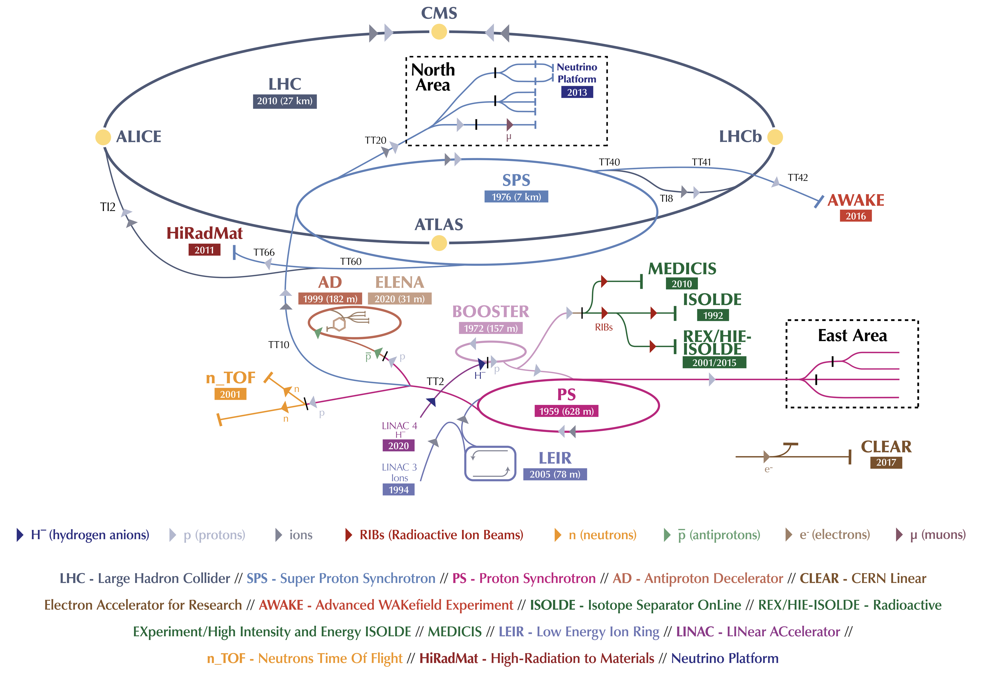
The CERN Accelerator Complex

Slide 5
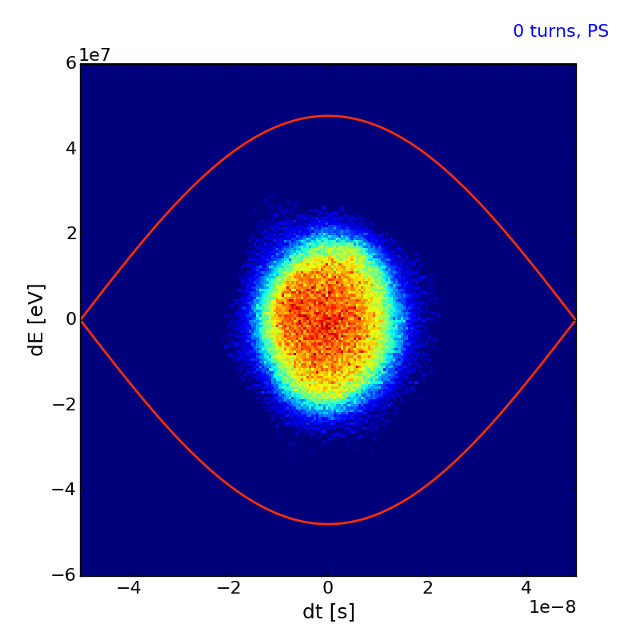
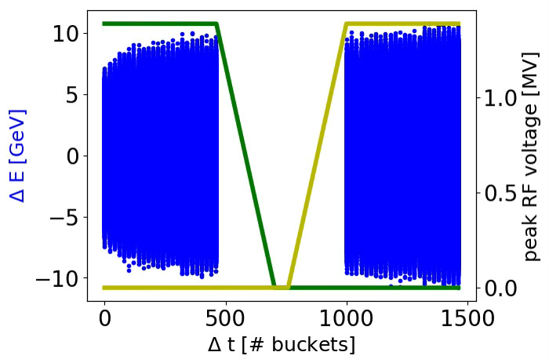
Some examples of Applications
Simulation of momentum slip stacking.
Courtesy of D. Quartullo
Simulation of double splitting and bunch rotation in the PS and capture in the SPS.
Courtesy of H. Timko

Slide 6
The Beam Longitudinal Dynamics Code
Models longitudinal beam motion in synchrotrons
Includes RF specific items
  Longitudinal machine impedance
  RF manipulations
  RF noise/modulation
  LLRF loops
Development mainly driven by CERN needs
  Pushing the machines to their design limit
  Effort for understanding beam motion with the present LLRF systems
  In the future, we can design LLRF systems based on beam motion
Growing user community outside CERN
  GSI, KIT, KEK, J-PARC, HIAF, Fermilab, Jefferson Lab, …

Slide 7
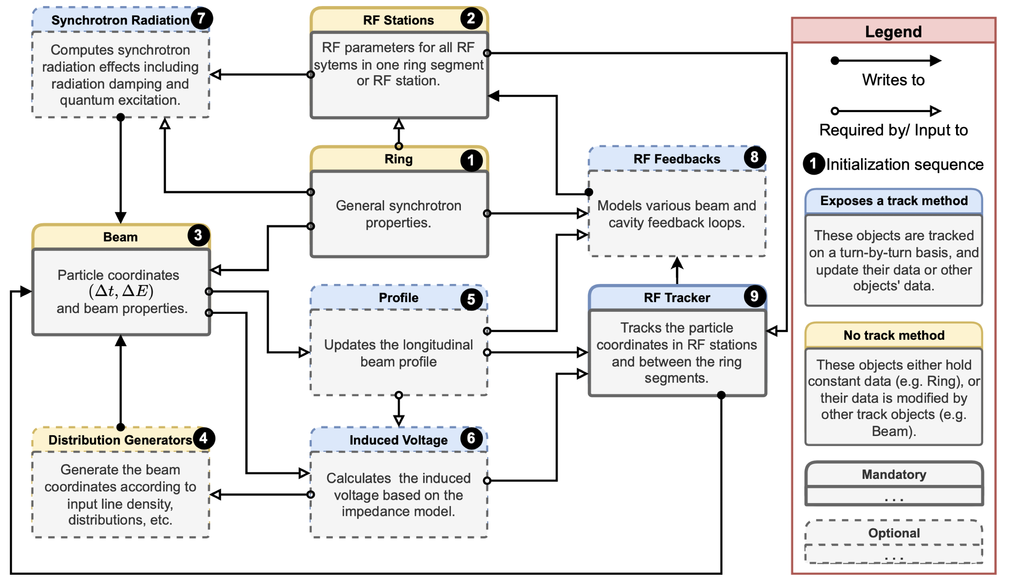
Code Structure
Modular, flexible structure
Object-oriented Python code with C++/CUDA computational kernels
  Optional usage of most modules
  Defined by the user in their input file
The BLonD code structure with mandatory (solid line) and optional (dashed line) objects. Courtesy of K. Iliakis
[2] K. Iliakis, “Large-scale software optimization and micro-architectural specialization for accelerated high-performance computing”, PhD Thesis, 2022

Slide 8
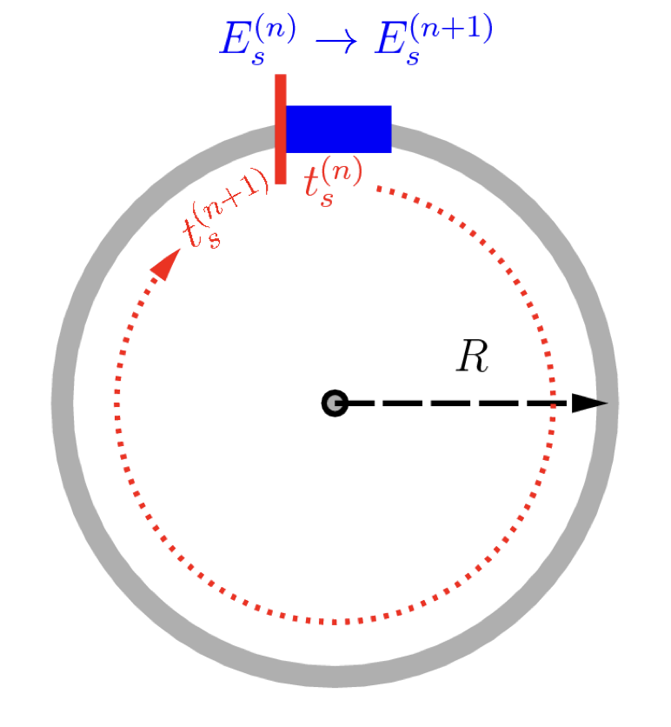
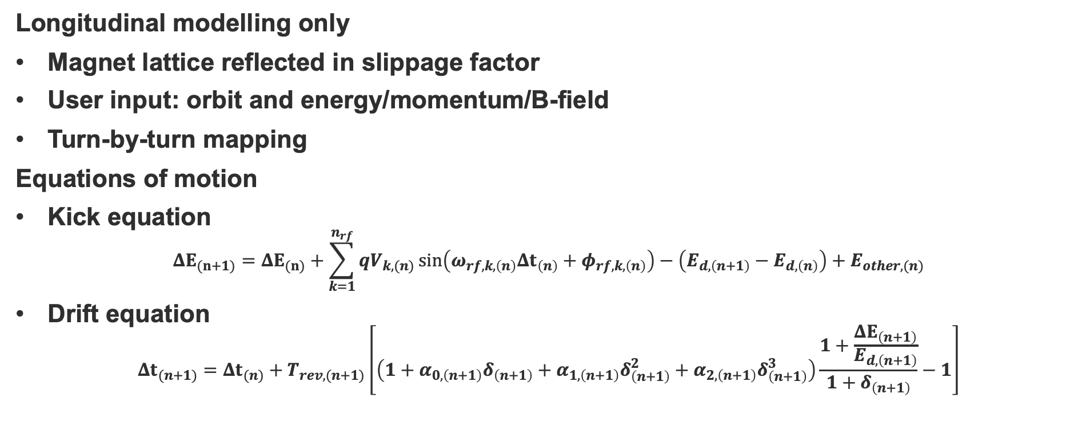
Principles of Longitudinal Macroparticle Tracking
Longitudinal modelling only
Magnet lattice reflected in slippage factor
User input: orbit and energy/momentum/B-field
Turn-by-turn mapping
Equations of motion
Kick equation
$$ΔE_{(n+1)}=ΔE_{(n)}+\sum_{k=1}^{n_{rf}}{qV_{k,(n)}\sin\left(ω_{rf,k,\left(n\right)}Δt_{\left(n\right)}+φ_{rf,k,\left(n\right)}\right)−\left(E_{d,\left(n+1\right)}−E_{d,\left(n\right)}\right)+E_{other,(n)}}$$
Drift equation
$$Δt_{(n+1)}=Δt_{(n)}+T_{rev,(n+1)}\left[\left(1+α_{0,\left(n+1\right)}δ_{\left(n+1\right)}+α_{1,\left(n+1\right)}δ_{\left(n+1\right)}^{2}+α_{2,\left(n+1\right)}δ_{\left(n+1\right)}^{3}\right)\frac{1+\frac{ΔE_{\left(n+1\right)}}{E_{d,\left(n+1\right)}}}{1+δ_{\left(n+1\right)}}−1\right]$$
Ring and single RF station.
Courtesy of H. Timko
One value per turn

Slide 9
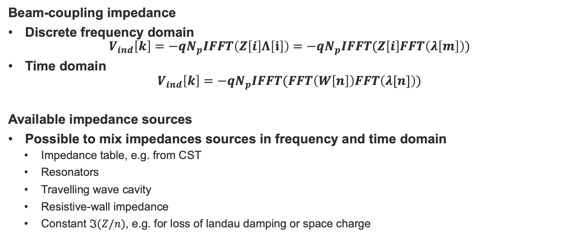
Beam-induced Voltage and Impedance
Beam-coupling impedance
Discrete frequency domain
$$V_{ind}\left[k\right]=−qN_{p}IFFT\left(Z\left[i\right]Λ\left[i\right]\right)=−qN_{p}IFFT(Z\left[i\right]FFT\left(λ\left[m\right]\right))$$
Time domain
$$V_{ind}\left[k\right]=−qN_{p}IFFT(FFT\left(W\left[n\right]\right)FFT\left(λ[n]\right))$$
Available impedance sources
Possible to mix impedances sources in frequency and time domain
  Impedance table, e.g. from CST
  Resonators
  Travelling wave cavity
  Resistive-wall impedance
  Constant $ℑ(Z/n)$, e.g. for loss of landau damping or space charge

Slide 10
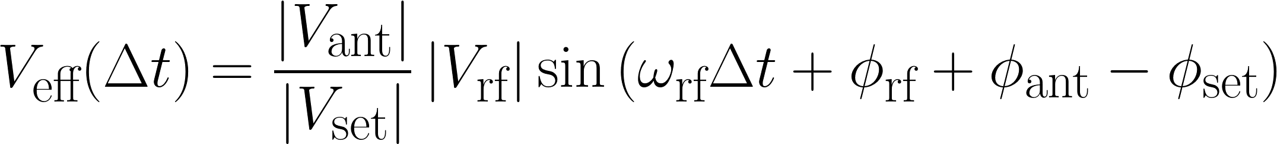
Local Feedback Loops in BLonD
Cavity-based loops included through a CavityFeedback object
  Impedance of the RF cavity
  One-turn delay feedbacks
  Feed-forwards
  Direct RF feedbacks
RF frequency and RF phase are now arrays along a turn
Comparison of beam-induced voltage computed from TWC impedance model and CavityFeedback model in the SPS

Slide 11
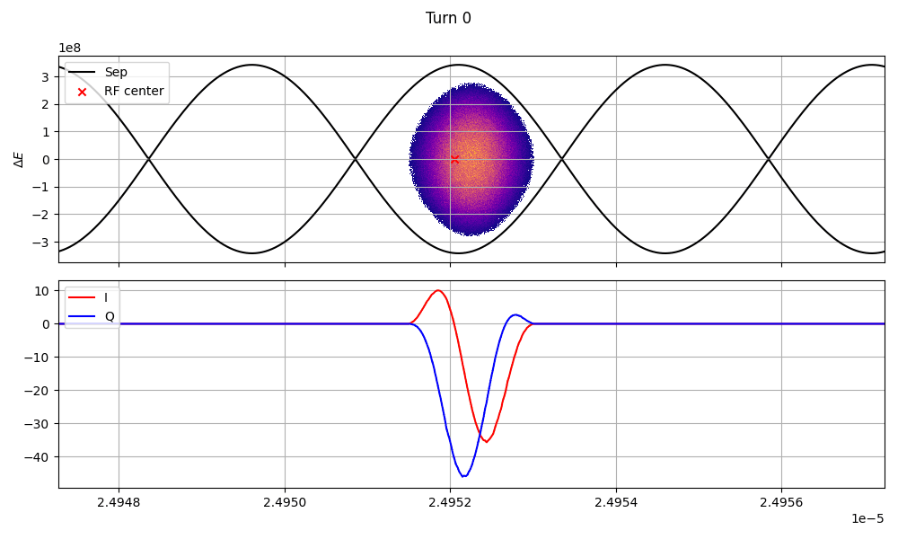
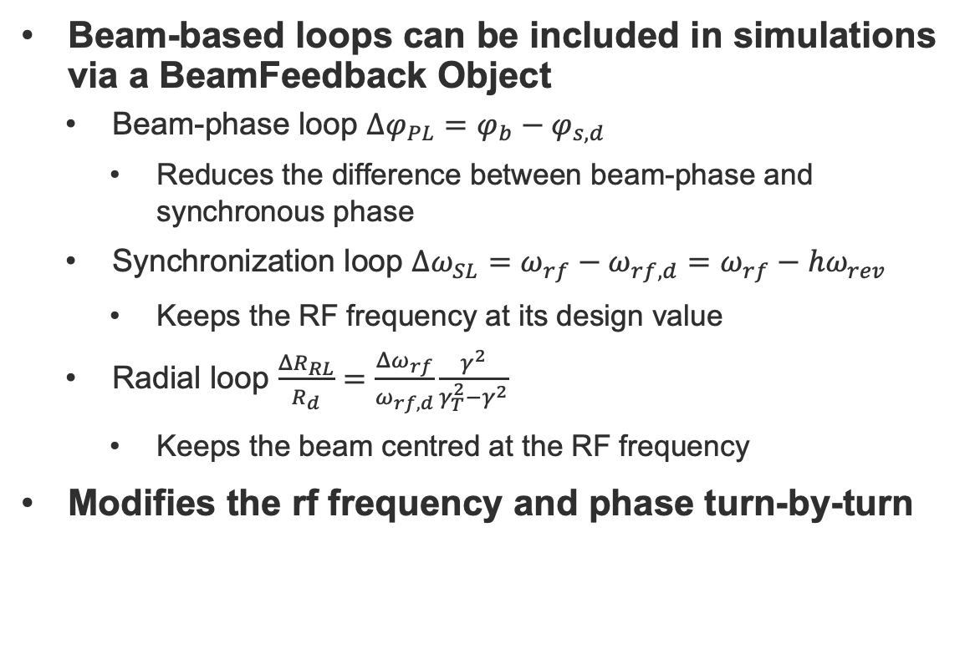
Global RF Feedback Loops in BLonD
Beam-based loops can be included in simulations via a BeamFeedback Object
  Beam-phase loop $Δφ_{PL}=φ_{b}−φ_{s,d}$
    Reduces the difference between beam-phase and synchronous phase
  Synchronization loop $Δω_{SL}=ω_{rf}−ω_{rf,d}=ω_{rf}−hω_{rev}$
    Keeps the RF frequency at its design value
  Radial loop $\frac{ΔR_{RL}}{R_{d}}=\frac{Δω_{rf}}{ω_{rf,d}}\frac{γ^{2}}{γ_{T}^{2}−γ^{2}}$
    Keeps the beam centred at the RF frequency
Modifies the rf frequency and phase turn-by-turn
Bunch injected into the LHC with phase-loop acting

Slide 12
Examples of Cavity Feedback Models
Applications in the Super Protons Synchrotron and the Large Hadron Collider

Slide 13
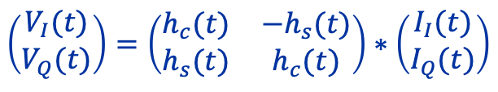
BLonD Model of the SPS Cavity Controller
SPS 200 MHz Cavity Controller [3,4]
  One-turn delay feedback
  Feed-forward
Implemented in time-domain
  Sampled at 200 MHz, every bucket
  Normal-conducting travelling wave cavity (TWC)
  Induced-voltage calculated through impulse response
  A comb filter to damp the TWC at every f_{rev}
  Cavity response is represented by a moving average
  Feed-forward FIR filter
Impulse response matrix
$$\left(\begin{matrix}V_{I}(t) \\ V_{Q}(t)\end{matrix}\right)=\left(\begin{matrix}h_{c}(t) & −h_{s}(t) \\ h_{s}(t) & h_{c}(t)\end{matrix}\right)∗\left(\begin{matrix}I_{I}(t) \\ I_{Q}(t)\end{matrix}\right)$$
[3] P. Baudrenghien and T. Mastoridis, “I/Q model of the SPS 200 MHz travelling wave cavity and feedforward design”, CERN-ACC-NOTE-2020-0032, 2020
[4] G. Hagmann et al., “CERN SPS low-level RF architecture and implementation”, Presentation at LLRF’22 workshop, Brugg-Windisch, Switzerland

Slide 14
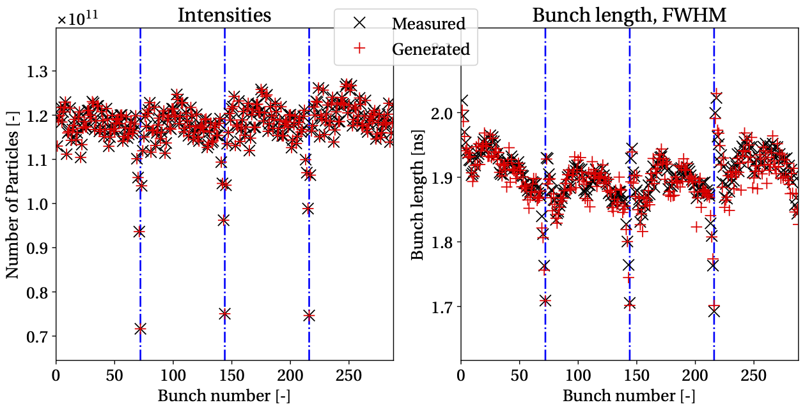
Recreating Beam Distributions using the SPS Cavity Controller Model
Tails in the beam distribution at SPS flat-top is important for the losses in the LHC
Generating a matched distribution in BLonD
  Only able to recreate bunch-by-bunch intensity and bunch length
Tracking the generated beam with the SPS cavity controller model
  Able to recreate the bunch-by-bunch position variation

Slide 15
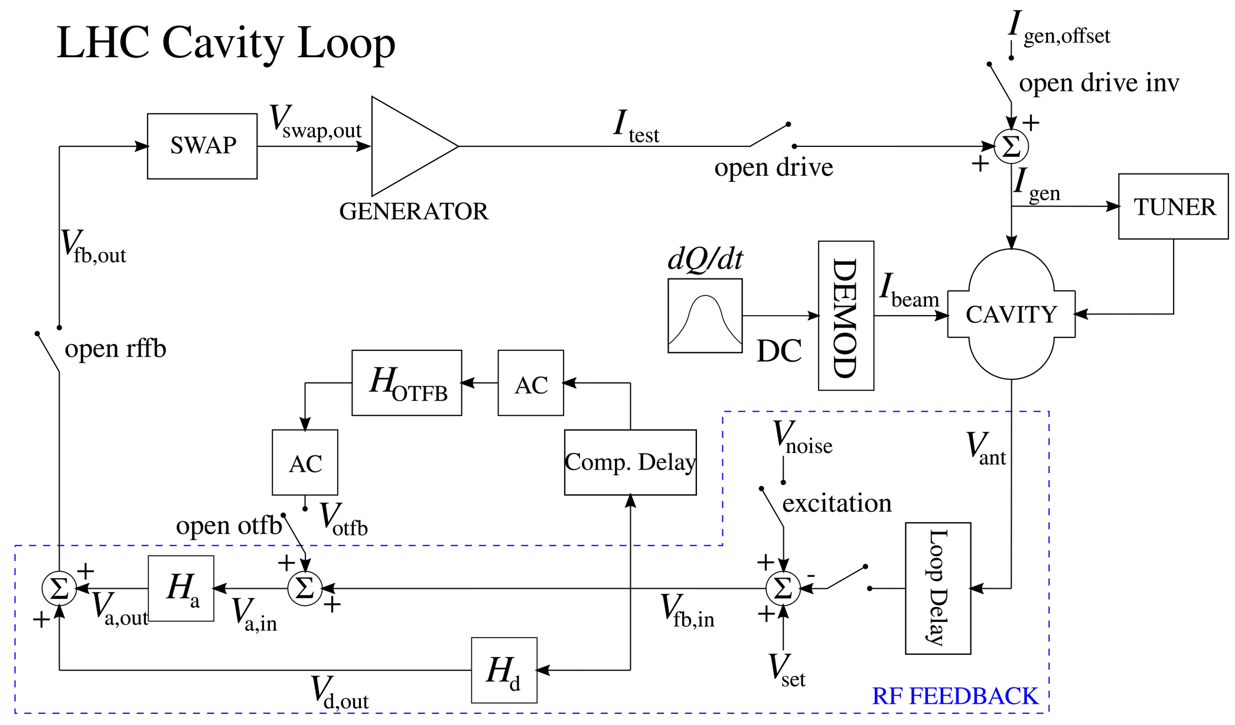
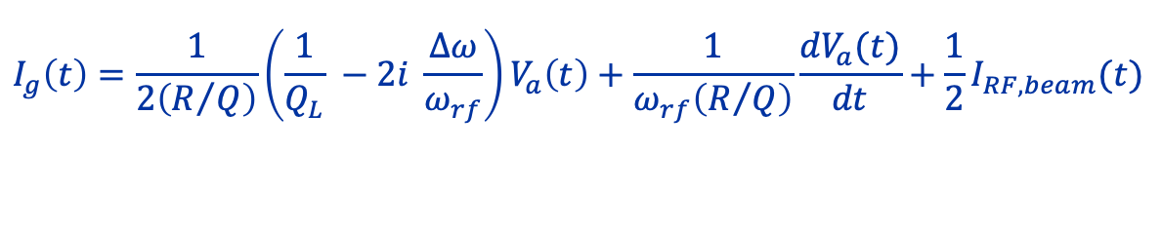
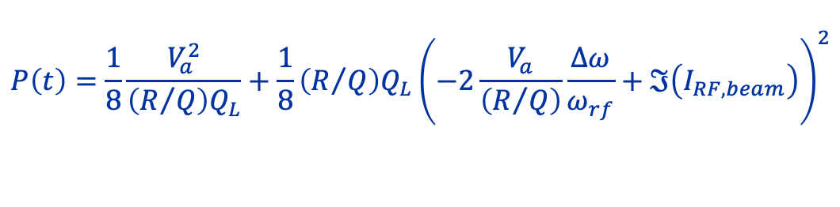
BLonD Model of the LHC Cavity Controller
LHC 400 MHz cavity controller [5]
  Superconducting standing-wave cavities
  Direct RF feedback
    Analog and digital feedback
  One-turn delay feedback
BLonD implementation
  Sampling at 40 MHz, every 10 buckets
  Beam-cavity-transmitter interaction model [6]
  High-pass analog feedback
  Low-pass digital feedback
  One-turn delay feedback
  Cavity tuner
$$I_{g}\left(t\right)=\frac{1}{2\left(R/Q\right)}\left(\frac{1}{Q_{L}} −2i \frac{Δω}{ω_{rf}}\right)V_{a}\left(t\right)+\frac{1}{ω_{rf}\left(R/Q\right)}\frac{dV_{a}(t)}{dt}+\frac{1}{2}I_{RF,beam}(t)$$
$$P\left(t\right)=\frac{1}{8}\frac{V_{a}^{2}}{\left(R/Q\right)Q_{L}}+\frac{1}{8}\left(R/Q\right)Q_{L}{\left(−2\frac{V_{a}}{\left(R/Q\right)}\frac{Δω}{ω_{rf}}+ℑ\left(I_{RF,beam}\right)\right)}^{2}$$
[5] J. Holma, “The model and simulations of the LHC 400 MHz cavity controller”, CERN-AB-Note-2007-012, 2007
[6] J. Tückmantel, “Cavity-beam-transmitter interaction formula collection and derivation”, CERN-ATS-NOTE-2011-002 TECH, 2011

Slide 16
Simulating the Response of the LHC RFFB
Simulating base-band network analyser measurements
Measurements performed during commissioning of the LHC LLRF
  Open-loop response
    Estimate Q_{L} and verify phase before closing the loop
  Closed-loop response
    Fine-tune correct feedback gain and phase

Slide 17
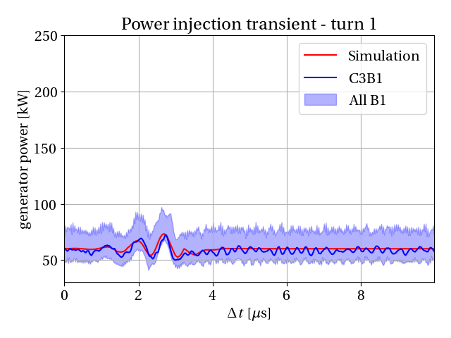
Simulating Bunch-to-Bucket Capture in the LHC
LHC model used for injection simulations to study RF power limitations for HL-LHC
Example of a 36-bunch batch being injection
  Average bunch intensity of 1.8 x 10¹¹ protons per bunch (p/b)
  25 ns bunch spacing
  5 MV capture voltage

Slide 18
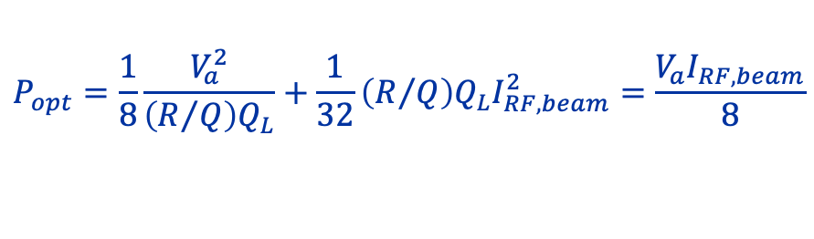
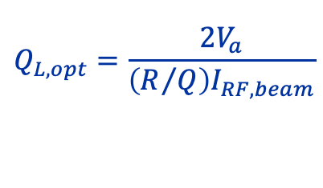
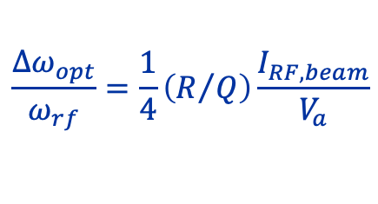
Optimizing RF Power at LHC Injection using the Feedback Loop Models
$$P_{opt}=\frac{1}{8}\frac{V_{a}^{2}}{\left(R/Q\right)Q_{L}}+\frac{1}{32}\left(R/Q\right)Q_{L}I_{RF,beam}^{2}=\frac{V_{a}I_{RF,beam}}{8}$$
In operation we use the half-detuning beam-loading compensation scheme [7]
  Steady-state optimum keeping voltage constant in amplitude and phase
  Cavities are tuned after batch is injected
RF cavity pre-detuning [8]
  Detuning the RF cavity to the beam about to be injected
Measurements performed during operation
Optimization and better understanding obtained via simulation
  Enabled prediction of by how much the injection transients in RF power can be reduced
$$\frac{Δω_{opt}}{ω_{rf}}=\frac{1}{4}\left(R/Q\right)\frac{I_{RF,beam}}{V_{a}}$$
$$Q_{L,opt}=\frac{2V_{a}}{\left(R/Q\right)I_{RF,beam}}$$
[7] D. Boussard, “RF power requirements for a high intensity proton collider; parts 1 (chapters I, II, III) and 2 (chapters IV, V, VI)”, CERN-SL-91-16-RFS, 1991
[8] B. E. Karlsen-Baeck et al., “Effects of cavity pre-detuning on RF power transients at injection into the LHC”, in proc. HB2023, 2023

Slide 19
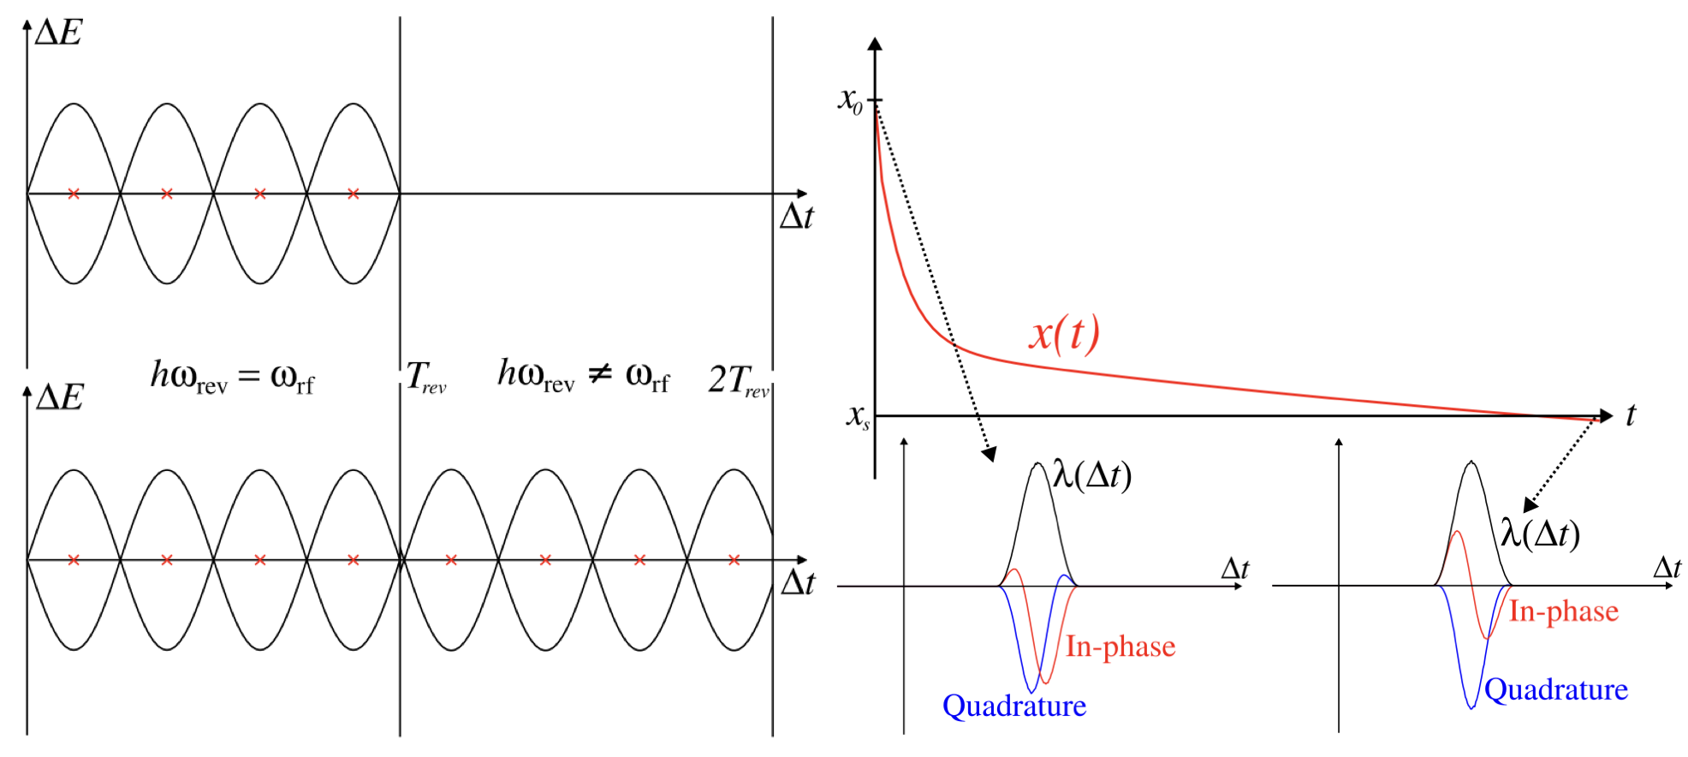
Coupling Global and Local Feedbacks
BLonD capable to model both global and local loops in the same simulation
  Decoupling the RF from the revolution frequency
  Important for conditions with high beam-loading
    E.g. Injection into the SPS or LHC
Implementation
  In the local loop: RF frequency and RF phase modified GlobalFeedback
  RF beam current is modulated synchronous to the RF frequency and changes as the global loop acts
Sampling of local feedback changes as RF is decoupled from the revolution period
Modulation and sampling of RF beam current changes

Slide 20
Implementing New Feedback Models
Designing LLRF Feedbacks

Slide 21
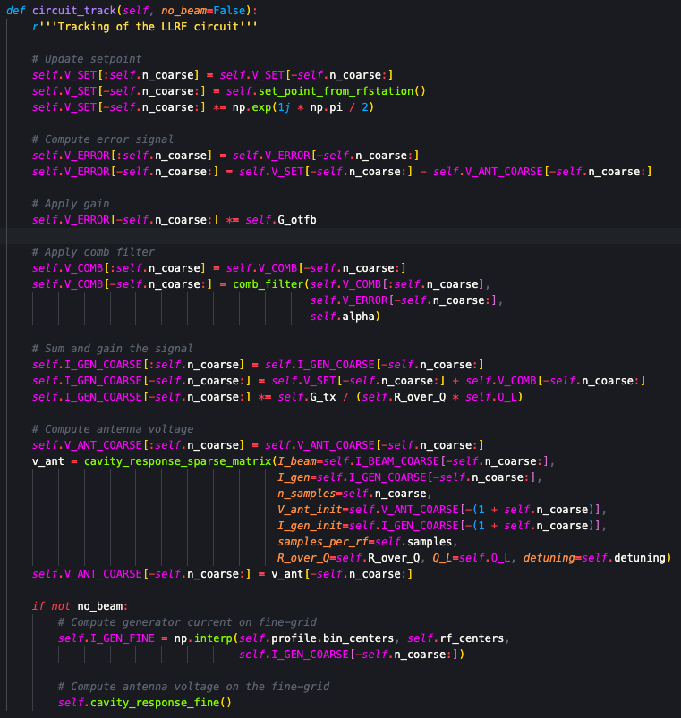
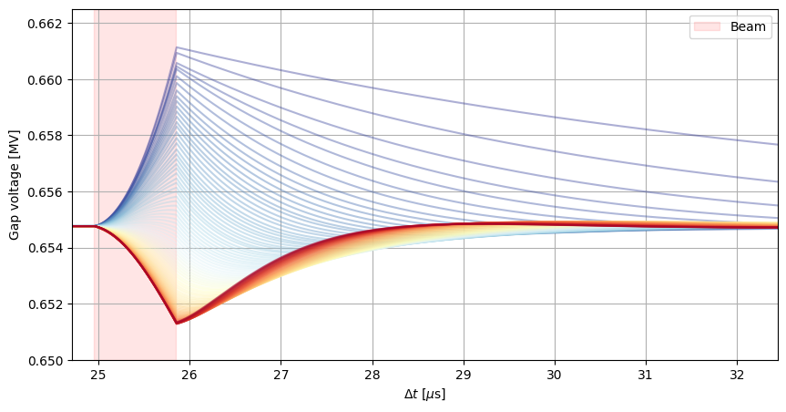
Example implementation of a simple one-turn delay feedback in the LHC
The BLonD LLRF package can be used to design feedbacks based on beam behaviour
  The base class CavityFeedback handles interface with the rest of the code
  New feedback is a child class of CavityFeedback
  Implement the LLRF circuit and calculate the gap voltage from this

Slide 22
Thank you for your attention

Slide 23
Backup Slides

Slide 24
Simulating the Response of the SPS OTFB
Benchmarks without beam
Verifying the correct orientation between beam-induced, generator-induced and antenna voltage
Simulating base-band network analyser measurements
  Verify gain of the feedback and the stability margin

Slide 25
Example at SPS Injection
With beam-phase loop acting
Beam phase
RF power in 3-section TWC
Injection into the SPS
  High beam-loading
  Significant injection transients
Simulation of a 72-bunch injection
  Injection phase error of 60 degrees
With beam-phase loop acting
  Injection error is corrected by the global loops
Without beam-phase loop acting
  Beam oscillates and debunches due to injection error
Without beam-phase loop acting
Beam phase
RF power in 3-section TWC

