Slide 1
Information and organization:
The IFAST Workshop 2024 on
Bunch-by-Bunch Feedback Systems and Related Beam Dynamics
KARA Large Seminar Room, 4. March 2024
Akira Mochihashi, KIT - IBPT

Slide 2
Information
Transport
  Workshop shuttle bus will take you between the KIT North Campus and Achat Hotel Karlsruhe every morning/evening.
  A shuttle bus organised by KIT is also available from the KIT North Campus to the South Campus in Karlsruhe City.
  Please be aware: everyone entering the KIT North Campus must be controlled at the entrance gate.

Slide 3
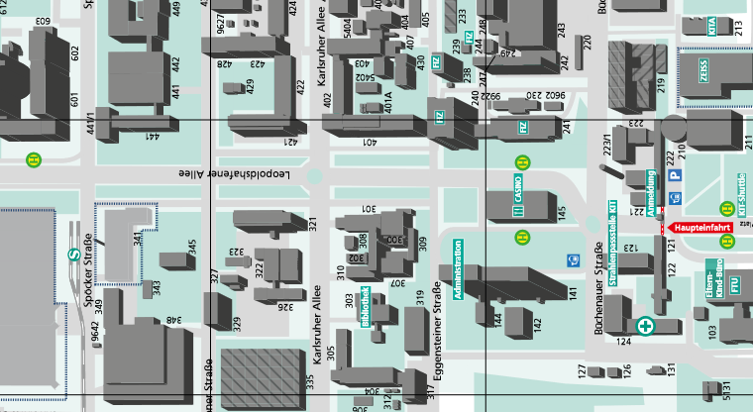
Campus Shuttle
Canteen
Seminar Room
We are here

Slide 4
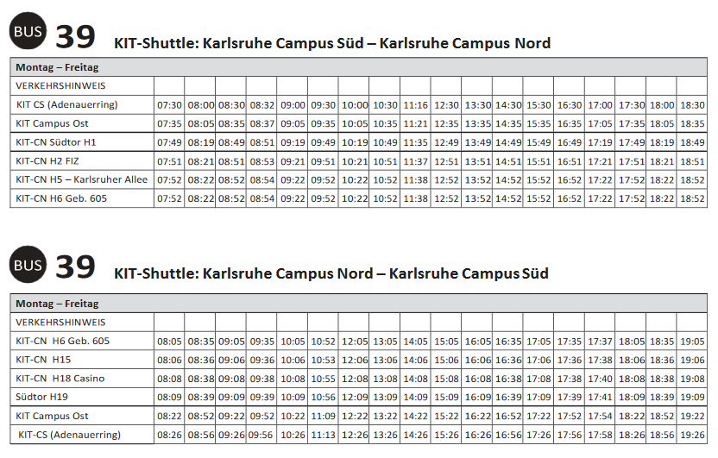
Campus South (Karlsruhe) to Campus North (KARA)
Campus North (KARA) to Campus South (Karlsruhe)

Slide 5
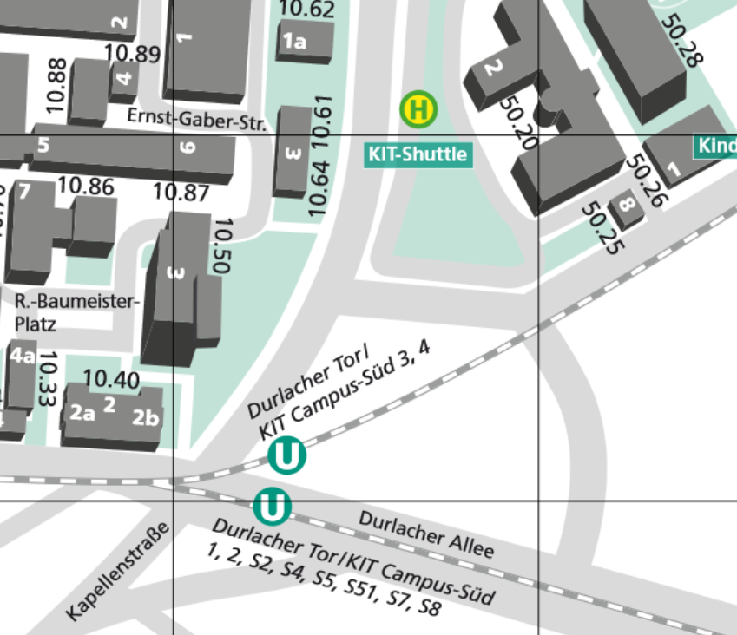
KIT Shuttle
Bus-Stop
Tram Station
Durlacher Tor / KIT Campus Süd
To the Central Station:
2, S4, S7 and S8

Slide 6
Information
Lunch
  Boucher (10€ per ticket) is available at the KIT canteen.
  We will go on foot together.
  This week‘s menu (English)… uploaded on the timetable: info session
Group picture
  On Monday, before lunch
Workshop Dinner
  Achat Hotel Karlsruhe at 19:00
  The workshop shuttle bus will take you to the Achat hotel directly.

Slide 7
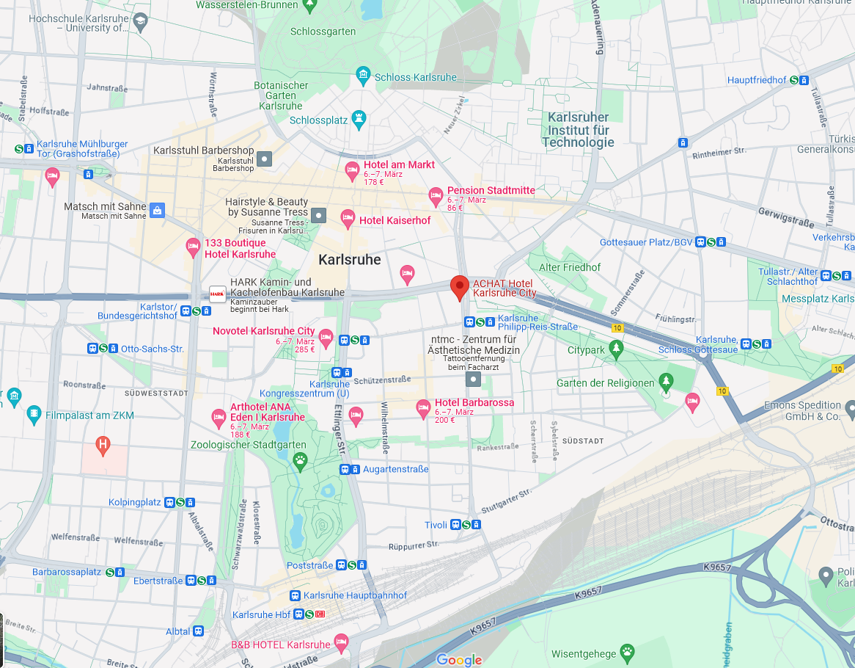

Slide 8
Organization
Presentation
  20 Minutes for talk + 5 Minutes for discussion
  Please respect the timetable (The bus can‘t wait so long time...)
Discussion sessions
  10 Minutes after each session category
  Just before the closing remark
  For additional discussions and planning joint experiments

Slide 9
Organization
Safety Instructions (important!)
  The participants who will join the experiment must take the safety instructions before the experiment.
  The safety instructions will start after the lunch break on 5. March in the KARA large seminar hall. It will take around 30 Minutes.
  After the safety instructions, we start the site tour and the experiment.
  People who will not join the experiment will start the site tour after the lunch break (during the safety instructions).

Slide 10
Organization
Site Tour
  Three groups
  The KARA control room and walking around the KARA storage ring floor
  The FLUTE (linear accelerator) hall
  After the site tour, we move to the KARA control room directly and start the experiments.

