Slide 1
Closing Remark:
IFAST Workshop 2024 on Bunch-by-Bunch Feedback Systems and Related Beam Dynamics
5.March 2024
Akira Mochihashi, KIT-IBPT

Slide 2
The purpose of the Workshop
Networking
  with engineering and beam physics side
  with various types of accelerators (lepton and hardon machines, light sources and colliders etc.)
  with different types of frames of BbB feedback systems
  with different institutes worldwide
  With different kinds of food at the reception and the dinner

Slide 3
Presentations and participants
18 presentations, including 2 online presentations
Session categories: 4
43 on-site participants, 17 online participants
Lots of questions and comments in discussion sessions

Slide 4
Information
Abstract
  Please submit abstracts for the presentation by the end of March 2024.
  The abstract will be summarized as an official IFAST project report and be submitted to the IFAST project office.
  The abstract booklet will be published on the Indico website.
  You can submit the abstract on the Indico website. The abstract submission is open now.

Slide 5
Information
@ IPAC‘24
  The network activities of IFAST project (including the BbB feedback workshop, joint experimental session and the injector workshop) will be summarized and be presented at the IPAC‘24.

Slide 6
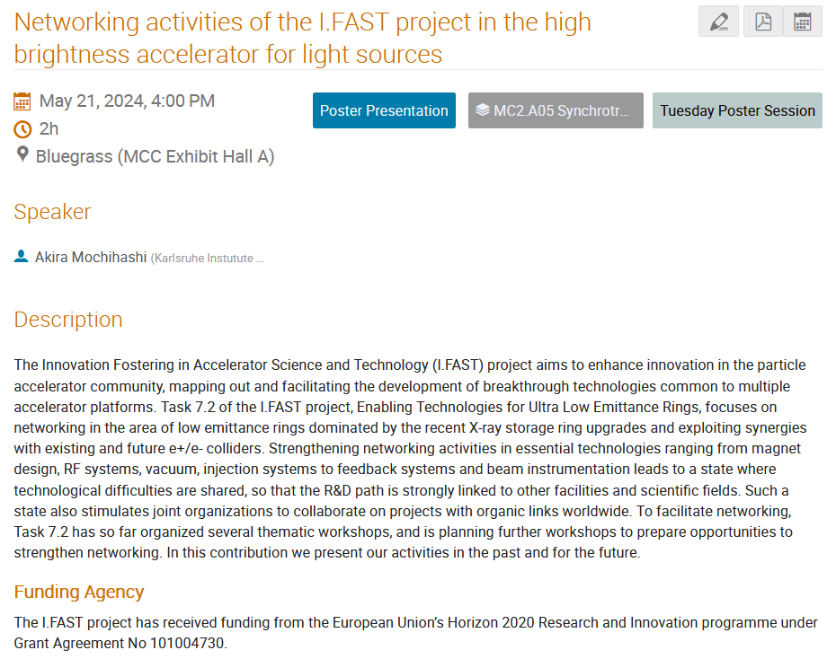
I will present the results there, on behalf of everyone who contributed to the IFAST activities (workshop participants).

Slide 7
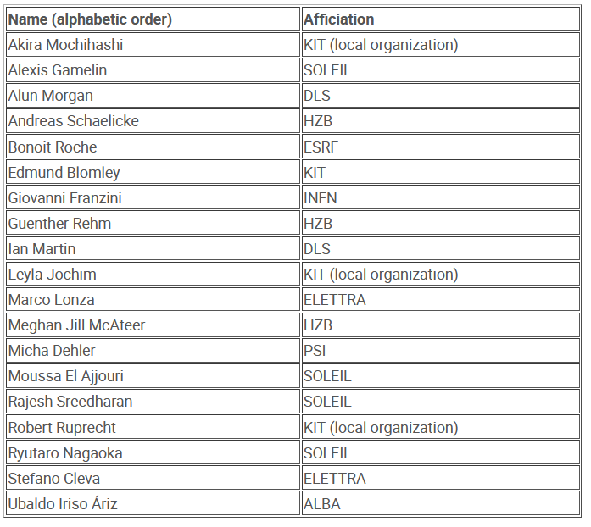
Acknowledgement
Workshop Organizing Committee
  Organizing the BbB workshop
  Planning the experimental sessions
  Exchanging the information and knowledge

Slide 8
Acknowledgement
Joint Organization with SOLEIL and KIT-IBPT
  Ryutaro Nagaoka (SOLEIL)
  Alexis Gamelin (SOLEIL)
  Moussa El Ajjouri (SOLEIL)
  Rajesh Sreedharan (SOLEIL)
  Leyla Johim (KIT-IBPT)
  Deniz Birli (KIT-IBPT)
  Edmund Blomley (KIT-IBPT)
  Katharina Mayer (KIT-IBPT)
  Robert Ruprecht (KIT-IBPT)

Slide 9
This is not the end.
Joint experimental campaign (5 – 6, March)
  Safety instructions will start at 13:30 at the KARA large seminar hall. It will take 30 minutes.
  The place: the KARA control room and the RF lab (the next to the control room)
  The KIT-IBPT members operate the machine.
  The KARA Hall is a controlled area… 5 entrance cards are available.

