Slide 1
Precision measurement of vibrational transition in HT
Valentin Hermann

Slide 2
How well do we understand molecules?
H
O
H
H
H

Slide 3
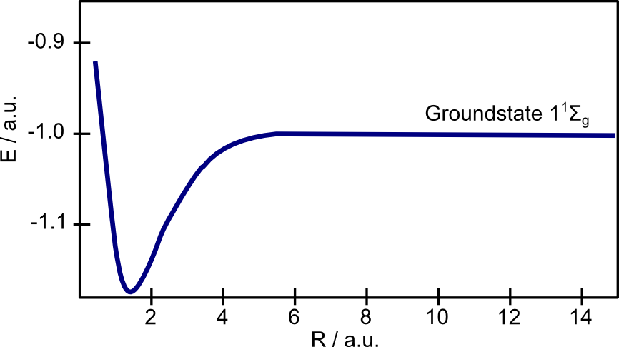
What is „understanding a molecule“?
„Good understanding“ = accurate model of the energy levels in molecule

Slide 4
What is „understanding a molecule“?
„Good understanding“ = accurate model of the energy levels in molecule
E = E_{BO} + E_{ad} + E_{nad} + E_{rel} + E_{QED} + ?*
Includes:
Molecular QED theory
Fundamental constants
Potentially new physics

Slide 5
What is „understanding a molecule“?
Simplest molecule to test depth of „understanding“?:
Molecular hydrogen!
H
H

Slide 6
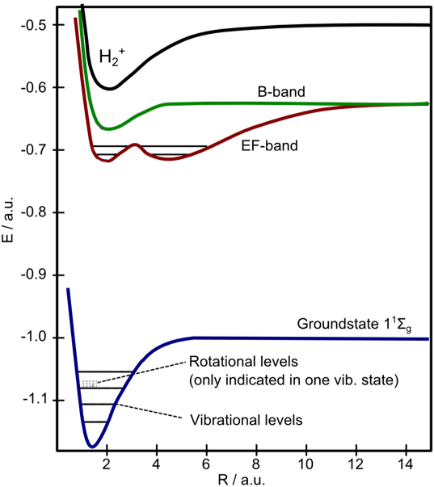
Energy levels in the hydrogen molecule
Calculated and measured with high precision
Competition: theory vs. experiment
Species: H₂, HD and D₂
mass: $m(H) : m(D) : m(T) = 1 : 2 : 3$ nuclear spin:$I(H) : I(D) : I(T) = ½ : 1 : ½$
Limited advancements in theory!^{[1,2]}
^{[1]} J. Komasa, M. Puchalski, and K. Pachucki, Phys. Rev. A 102 (2020)
^{[2]} C. Delaunay, J.-P. Karr, T. Kitahara, J.C.J. Koelemeij, Y. Soreq, and J. Zupan
Phys. Rev. Lett. 130, 121801 (2023)

Slide 7
The solution: Tritium!
D
T
3 additional molecules to test! (HT, DT, T₂)
Mass of 3u and fermionic
Best spectroscopy data ~15 MHz accuracy^{[1,2]} (vs. HD: ~60 kHz^{[3]})
Test object for New Physics^{[4]}
! Radioactive
! Radiochemical active
H
T
T
T
Combined expertise of high-res. spectroscopy and tritium technology needed!
^{[1]} M Schlösser et al., J. Phys. B: At. Mol. Opt. Phys. 50 214004 (2017)
^{[2]} K.-F. Lai, VH, et al., PCCP, 22, 8973-8987 (2020)
^{[3]} F.M.J. Cozijn, VH, et al., Phys. Rev. A 105, 062823 (2022)
^{[4]} W.G. Hollik, M. Linster, M. Tabet, Eur. Phys. J. C 80, 661 (2020)

Slide 8
Precision measurement of vibrational transition in HT
Valentin Hermann , Benedict Rothmund, Magnus Schlösser
Frank M.J Cozijn, Meissa L. Diouf, Wim Ubachs
“Precision Measurement of Vibrational Quanta in Tritium Hydride (HT)”,
F.M.J. Cozijn, M.L. Diouf, W. Ubachs, V. Hermann, M. Schlösser, accepted by PRL (2024)

Slide 9
The Technique: Noise-Immune Cavity-Enhanced Optical-Heterodyne Molecular Spectroscopy (NICE-OHMS)

Slide 10
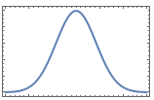
Cavity enhanced spectroscopy
High-reflective mirrors R=99.996%
Finesse of 80000
26 mW Input→ 400W P_{eff}
! Wavelength needs to fit free spectral range (FSR)
! Extremely stable conditions required
FWHM≈1.5 GHz
→Enhancement by optical resonator

Slide 11
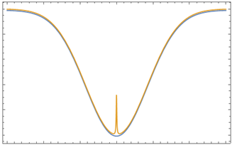
Saturation spectroscopy
Lamb-dip in Doppler broadened profile:
Saturation of molecules with v=0
1/1000 linewidth
$$\left|E⟩\right.$$
$$\left|G⟩\right.$$

Slide 12
Saturation spectroscopy
Lamb-dip in Doppler broadened profile:
Saturation of molecules with v=0
1/1000 linewidth
$$\left|E⟩\right.$$
Only ~10 ppm absorption!
$$\left|G⟩\right.$$

Slide 13
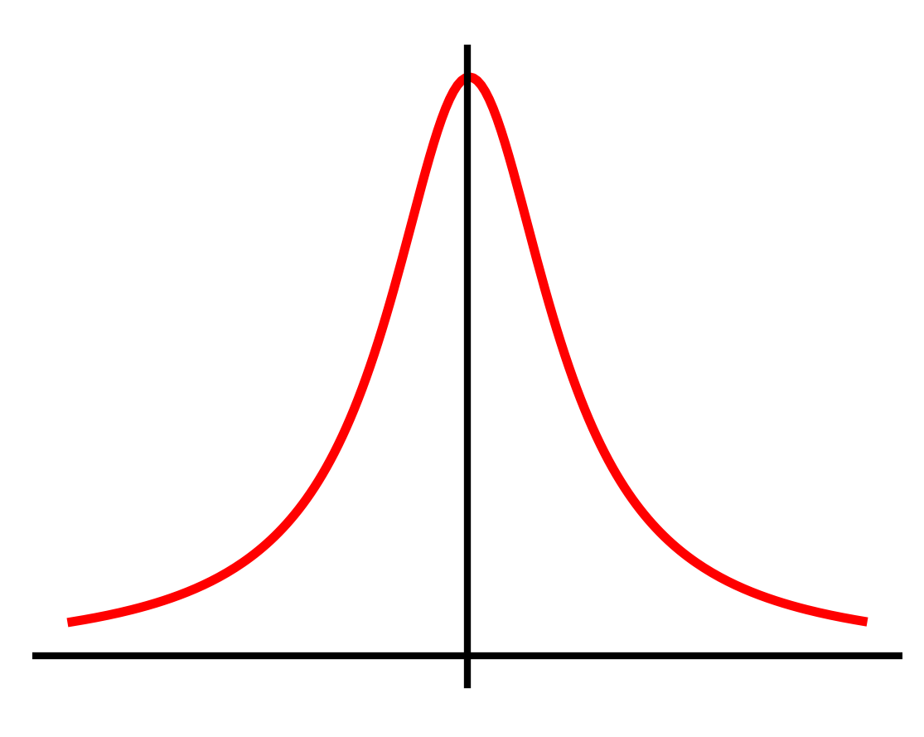
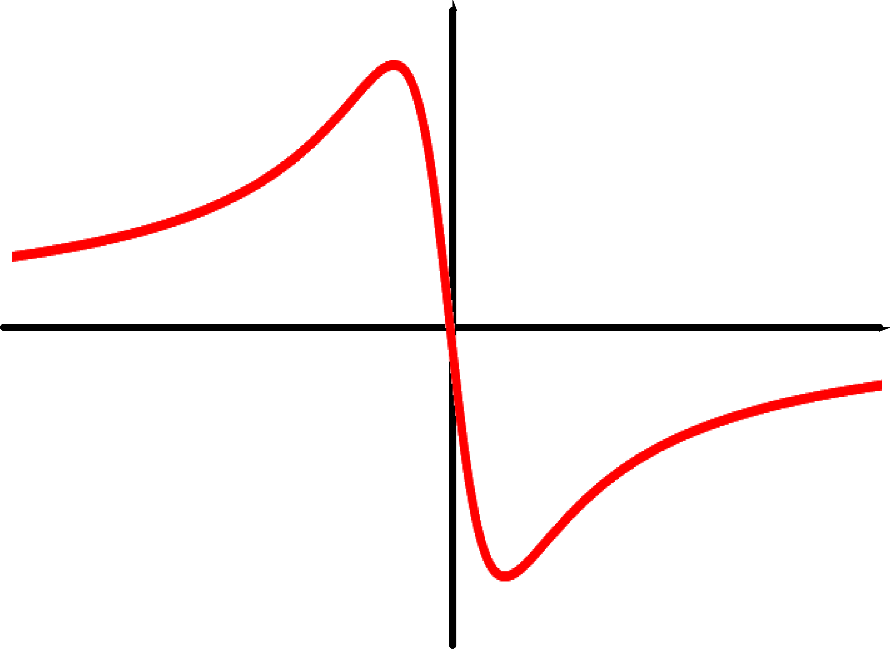
How to extract NICE-OHMS signal?
$$χ=χ^{Real}+i χ^{Imag}$$
Light matter interaction $χ$
Dispersion
Absorption

Slide 14
How to extract NICE-OHMS signal?
$$χ=χ^{Real}+i χ^{Imag}$$
Light matter interaction $χ$
Dispersion
→Dispersion measurement?

Slide 15
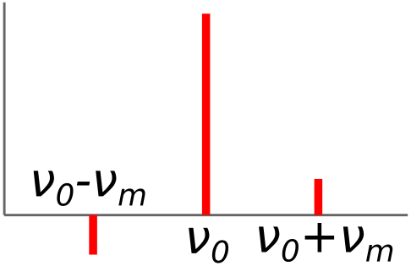
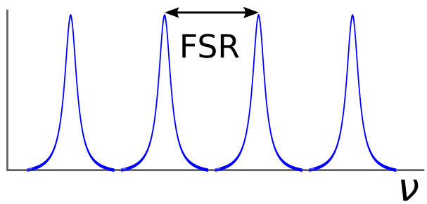
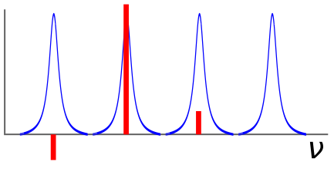
Frequency modulation spectroscopy (FM) in the cavity
Electro-optical modulator (EOM) produces sidebands with ν₀±ν_{m}
ν_{m} fits FSR of cavity
Sidebands are 180° phase-shifted
Dispersion changes cause imbalance in sidebands
Phase sensitive detection
+
=

Slide 16
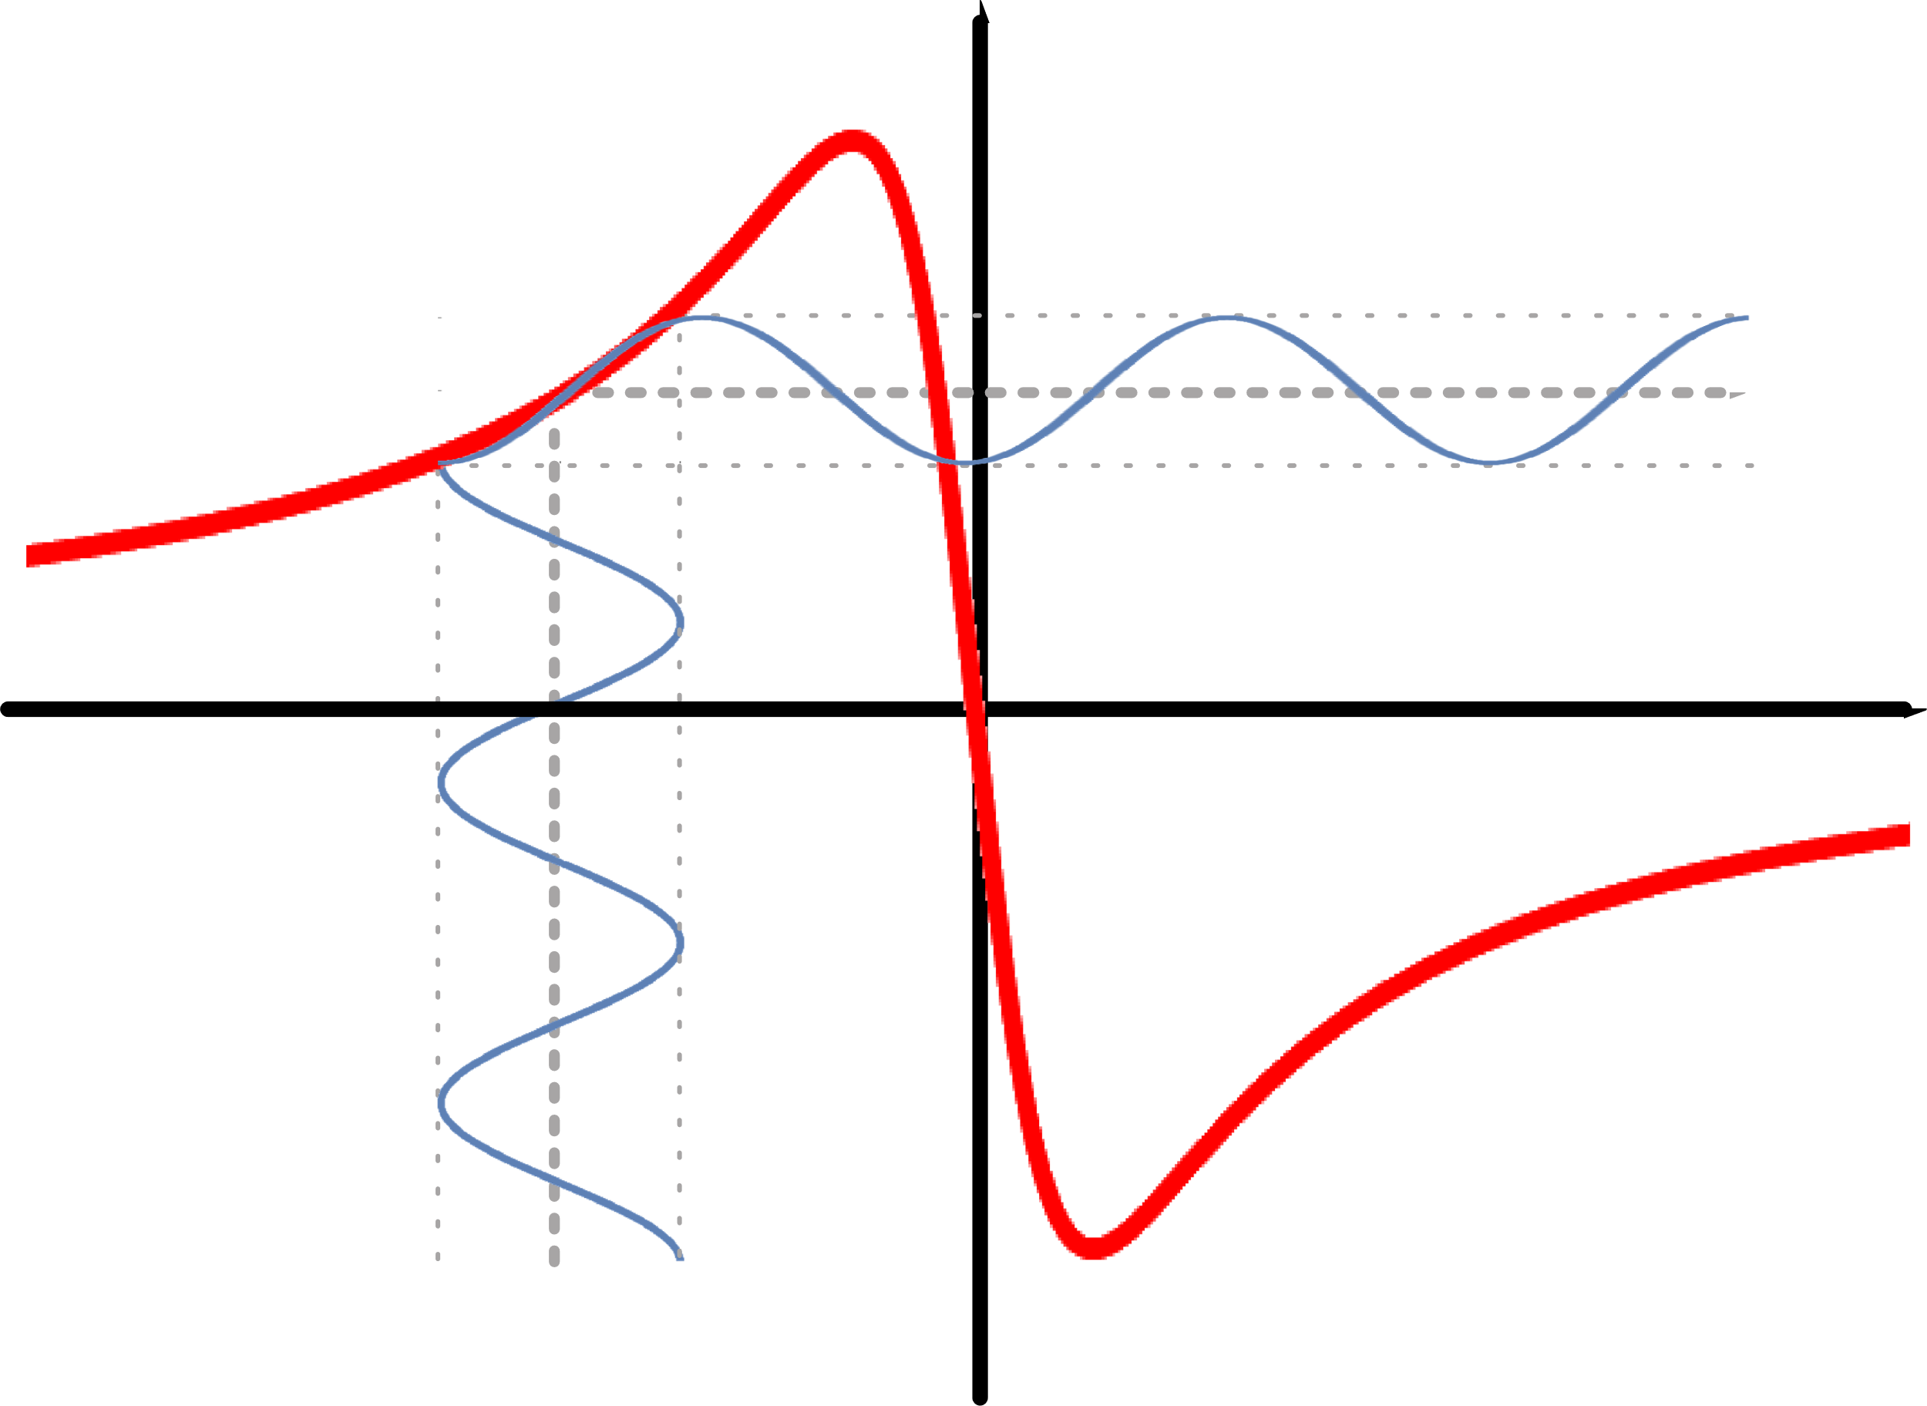
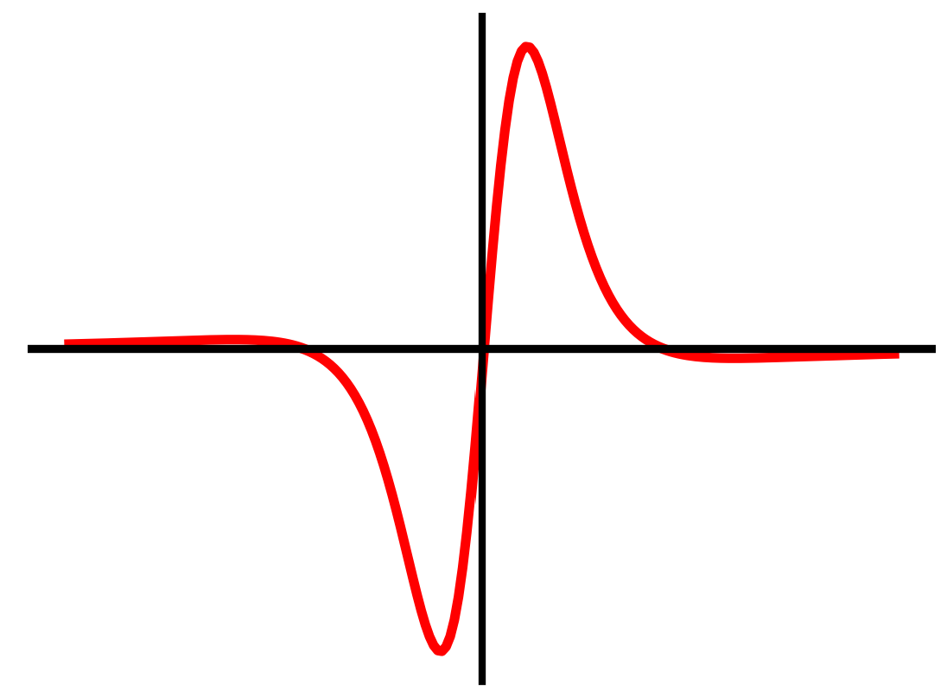
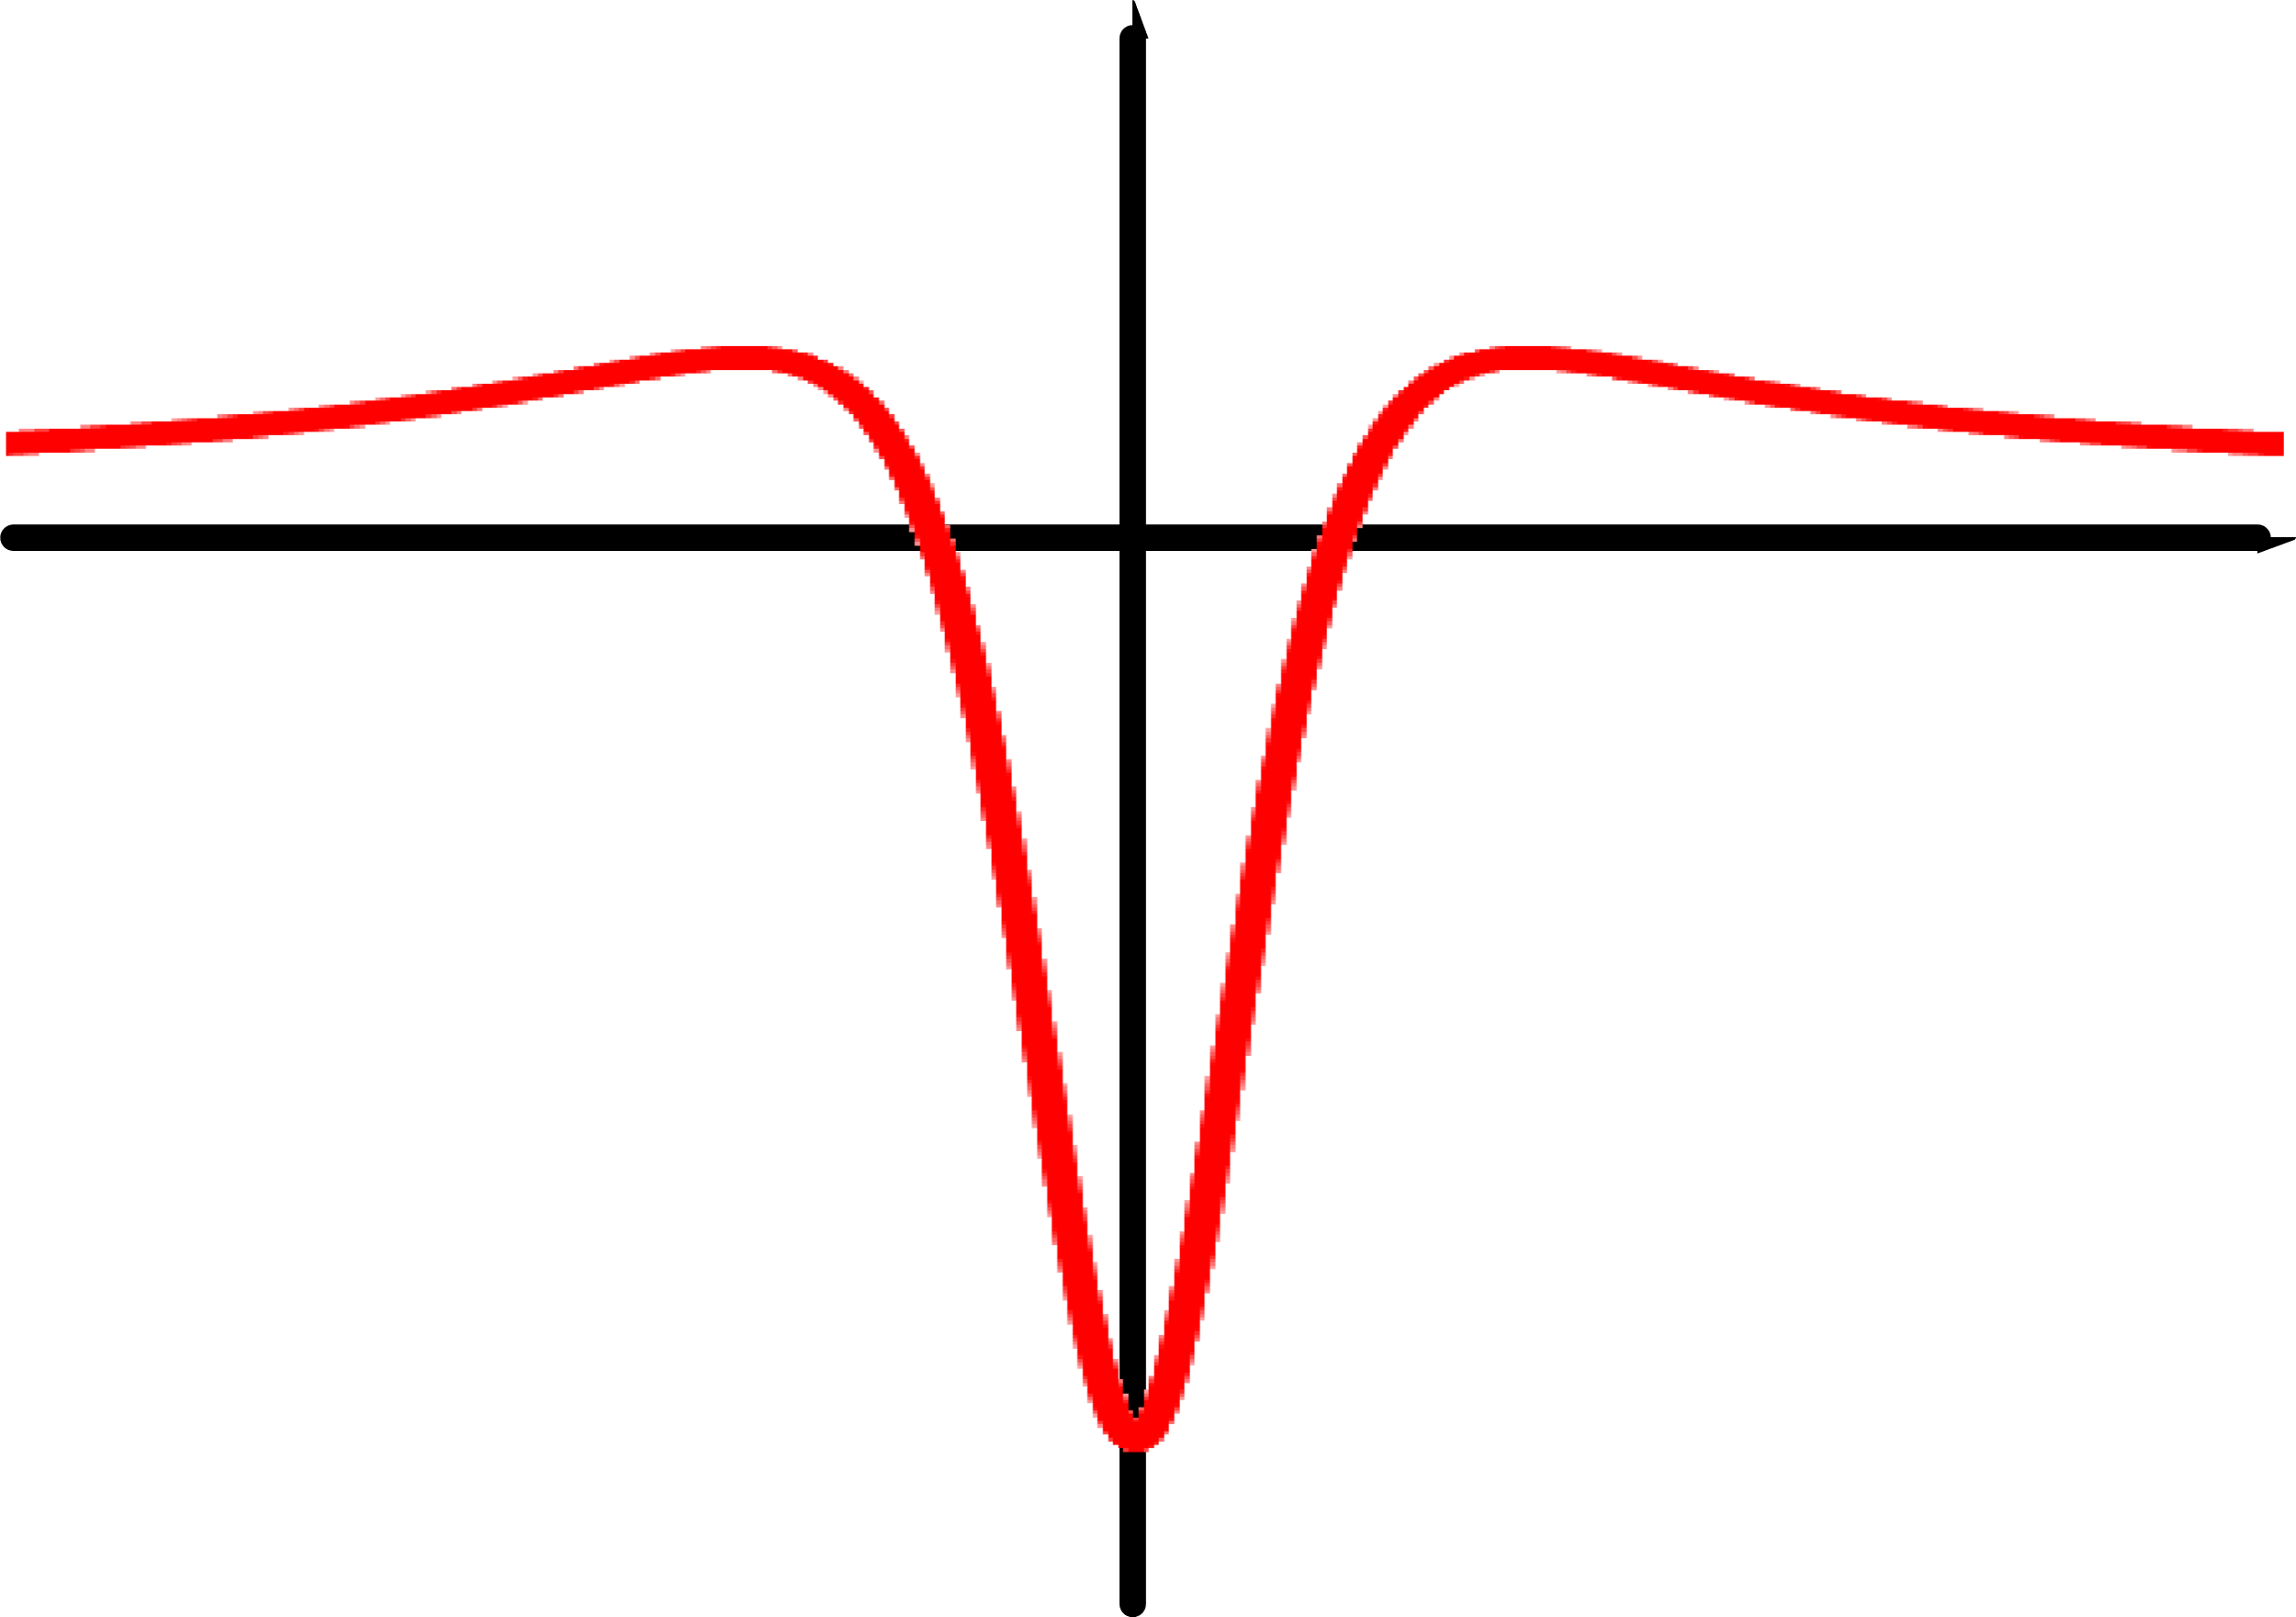
Wavelenght modulation in NICE-OHMS
Additional low-frequency dither (modulation)
Derivative detection→ symmetric line shape
Further noise suppression
Eliminates background drifts
Any order possible(1f, 2f, 3f)
$$S(v)$$
1f: $\frac{dS}{dv}$
2f: $\frac{d^{2}S}{dv^{2}}$

Slide 17
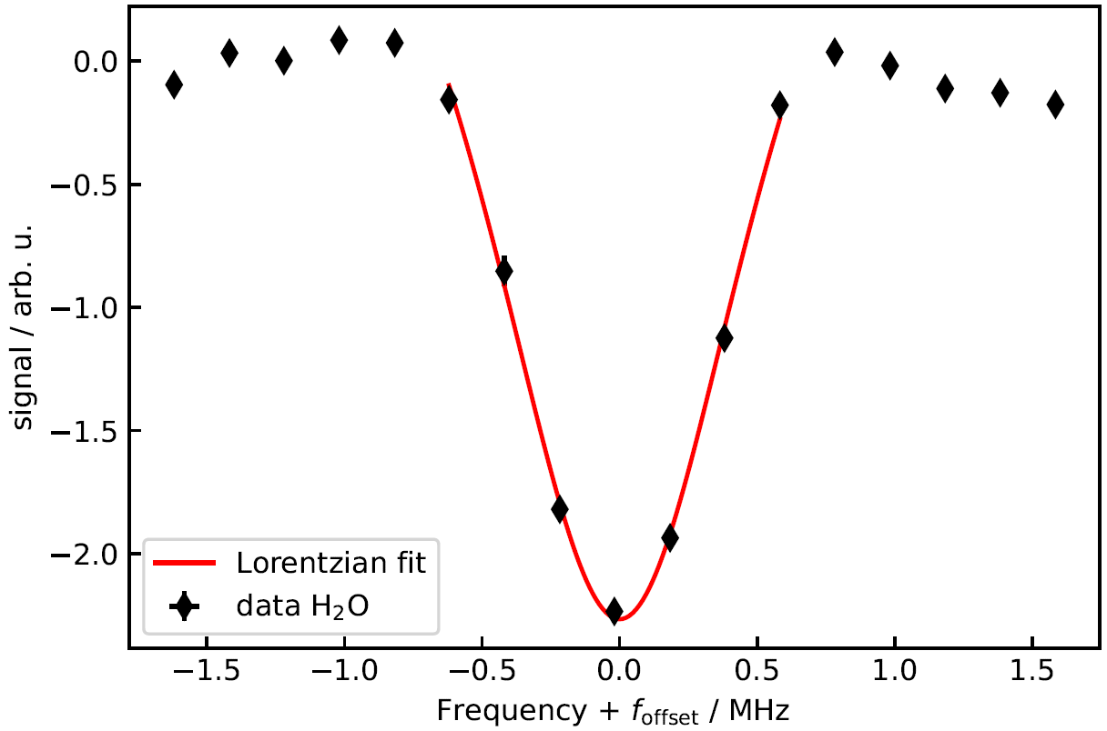
Typical Result: 1f signal in H₂O
Single scan of residual water
1f of dispersive signal →symmetric line shape
High SNR

Slide 18
The Experimental Setup:

Slide 19
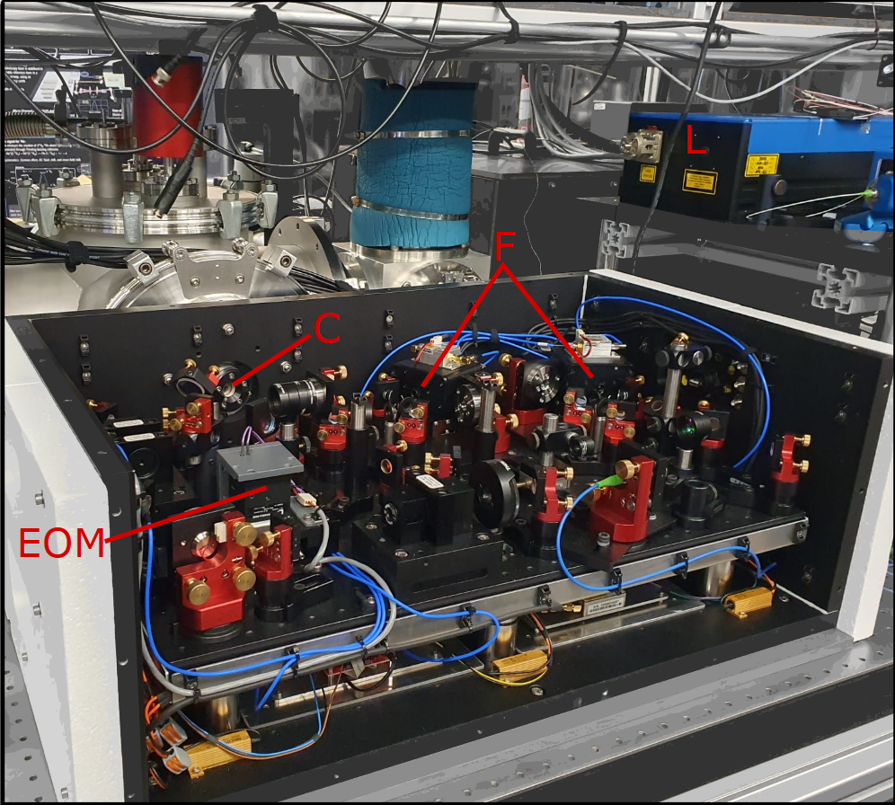
The optical setup @Amsterdam

Slide 20
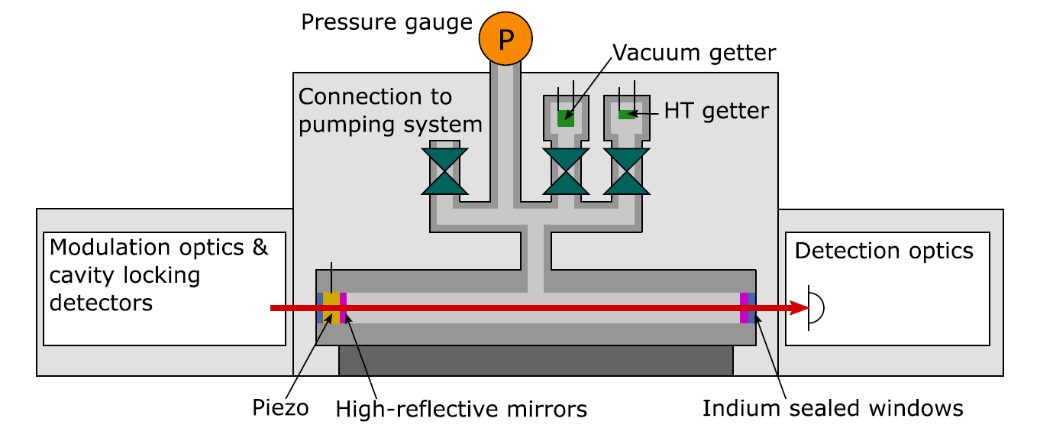
The Tritium setup @Amsterdam
1 GBq activity of H:T mixture (~20 mbar*cm³)
Fully tritium compatible, enclosed setup
Non-evaporable Getter (NEG) as vacuum pump
Tritium storage and pressure regulation from 0.005 Pa - 5 Pa using special NEG
Cavity and tritium infrastructure in second evacuated containment for noise reduction

Slide 21
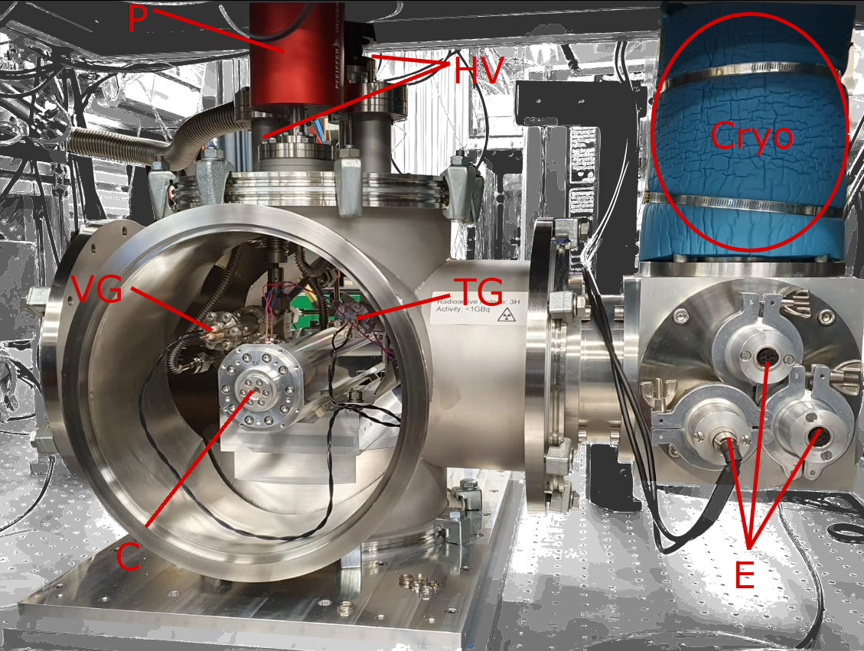
The Tritium setup
1 GBq activity of H:T mixture (~20 mbar*cm³)
Fully tritium compatible, enclosed setup
Non-evaporable Getter (NEG) as vacuum pump
Tritium storage and pressure regulation from 0.005 Pa - 5 Pa using special NEG
Cavity and tritium infrastructure in second evacuated containment for noise reduction

Slide 22
The Tritium setup
1 GBq activity of H:T mixture (~20 mbar*cm³)
Fully tritium compatible, enclosed setup
Non-evaporable Getter (NEG) as vacuum pump
Tritium storage and pressure regulation from 0.005 Pa - 5 Pa using special NEG
Cavity and tritium infrastructure in second evacuated containment for noise reduction
Tritium storage and pressure regulation?

Slide 23
Tritium storage & pressure regulation using NEGs
Zirconium-based non-evaporable getters (NEGs) from SAES (type St171)
Irreversible binding of (non-noble) gases when heated
Reversible binding of hydrogen when cold
Desorption of hydrogen following Sievert‘s law
log(p_{eq}) = 3.6 + 2log(C_{getter}) – 5200/T ^{[1]}
Temperature of getter → Hydrogen pressure
^{[1]} www.saesgetters.com/sites/default/files/St 171 - 172_Sintered Porous Getters_1.pdf

Slide 24
Tritium storage & pressure regulation using NEGs
Zirconium-based non-evaporable getters (NEGs) from SAES (type St171)
Irreversible binding of (non-noble) gases when heated
Reversible binding of hydrogen when cold
Desorption of hydrogen following Sievert‘s law
log(p_{eq}) = 3.6 + 2log(C_{getter}) – 5200/T ^{[1]}
And for tritium?
^{[1]} www.saesgetters.com/sites/default/files/St 171 - 172_Sintered Porous Getters_1.pdf

Slide 25
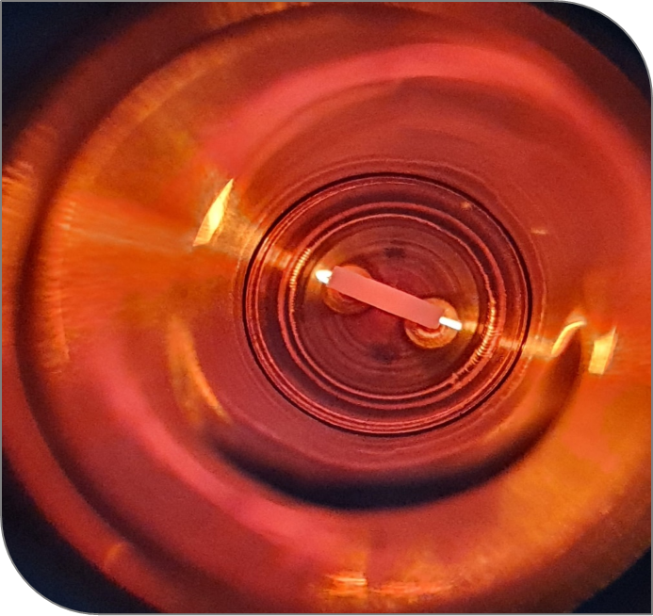
Sorption tests with tritium and mixture
Desorption tests with H₂, D₂, T₂ and H₂:HT:T₂ mixture (H:T = 1:1)
Loading amount equivalent to 1 GBq HT activity
Reference volume ~60 cm³
Temperature read-out from getter resistivity

Slide 26
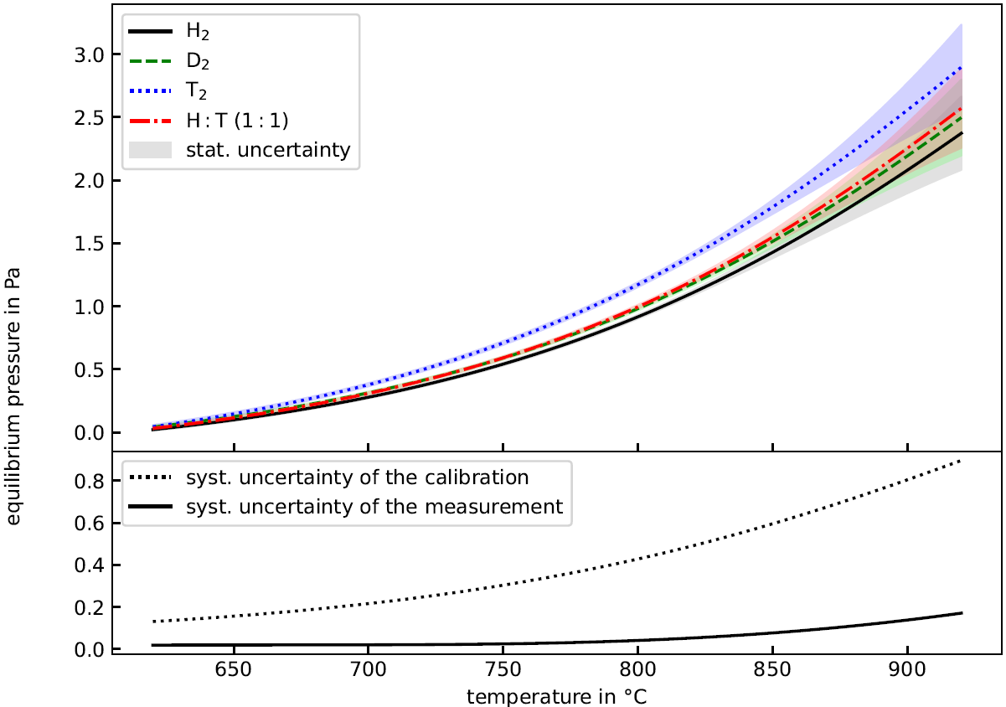
Sorption tests with tritium and mixture
Desorption successful for all gas (mixtures)
Loads of uncertainties
Possible isotope effect? →Calculation shows: Changes on scale not relevant for HT spectroscopy
Proven reversible tritium storage!

Slide 27
The Results:

Slide 28
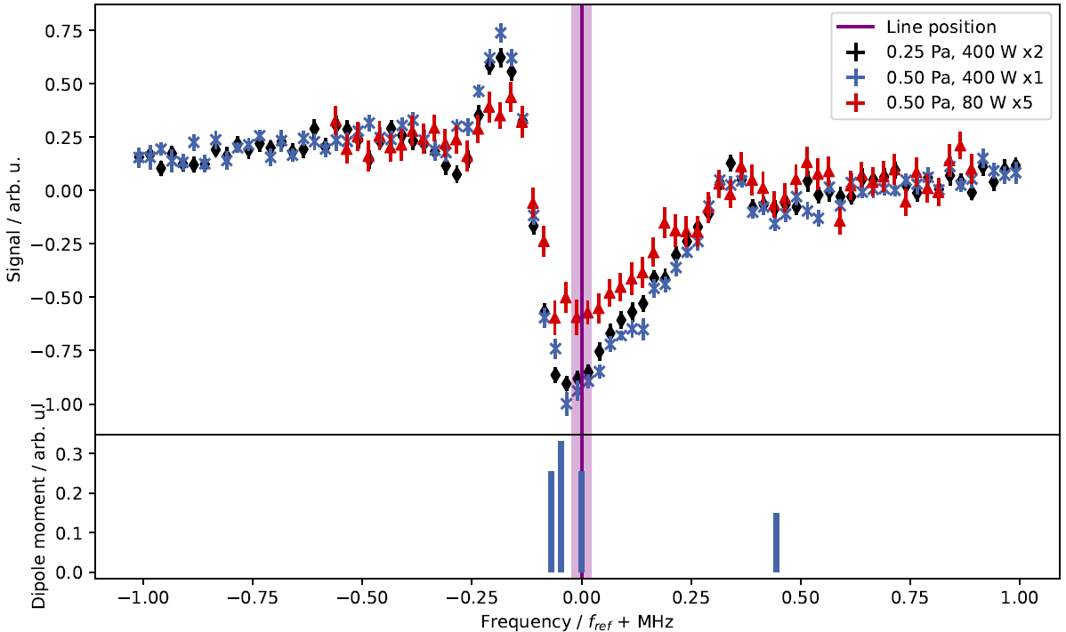
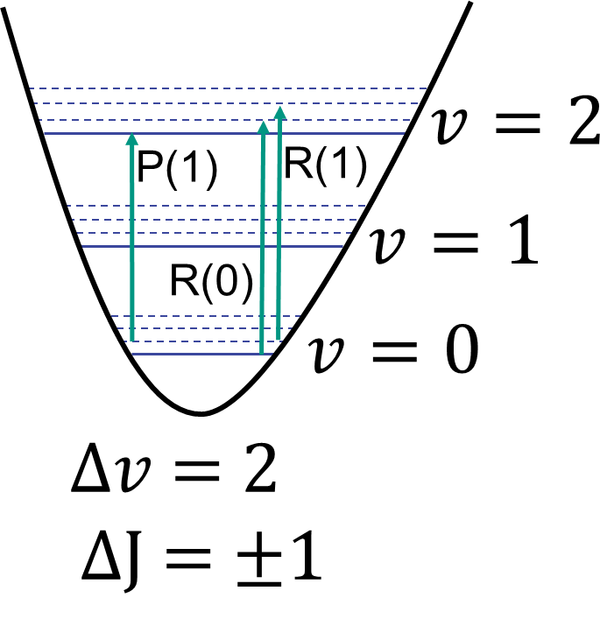
Measured lines: R(0)
R(0), R(1) and P(1) measured ν= 0→2
R(0) (1f signal)
(Hidden)

Slide 29
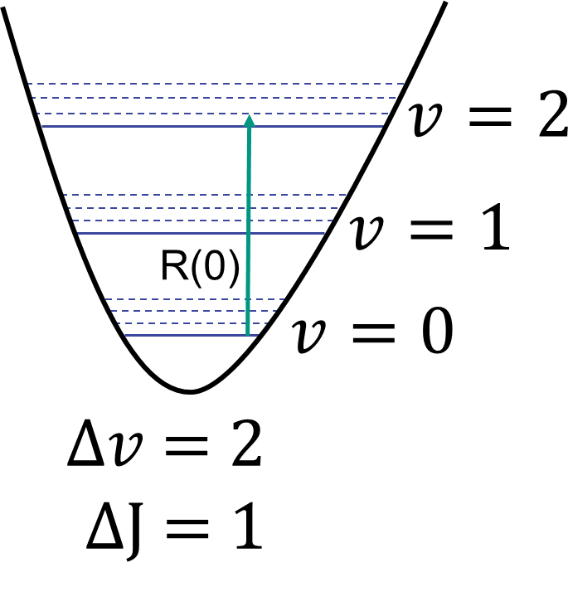
Measured lines: R(0)
R(0), R(1) and P(1) measured ν= 0→2
H₂O (1f signal)
R(0)
(Hidden for instance)

Slide 30
Measured lines: R(0)
R(0), R(1) and P(1) measured ν= 0→2
R(0) (1f signal)
(Hidden)
Dispersive line shape
(like for HD)

Slide 31
Measured lines: R(0)
R(0), R(1) and P(1) measured ν= 0→2
R(0) (1f signal)
Hyperfine splitting enables assignment

Slide 32
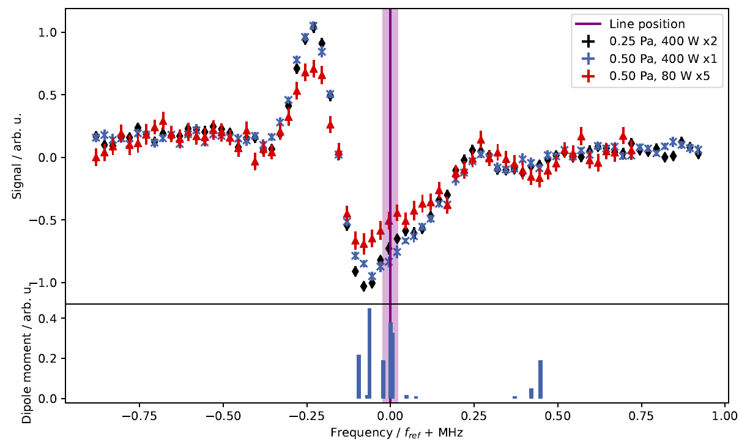
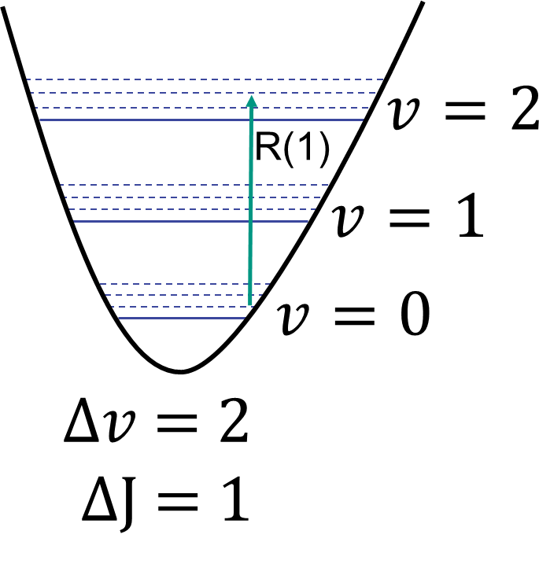
Measured lines: R(1)
R(0), R(1) and P(1) measured ν= 0→2
R(1) (1f signal)

Slide 33
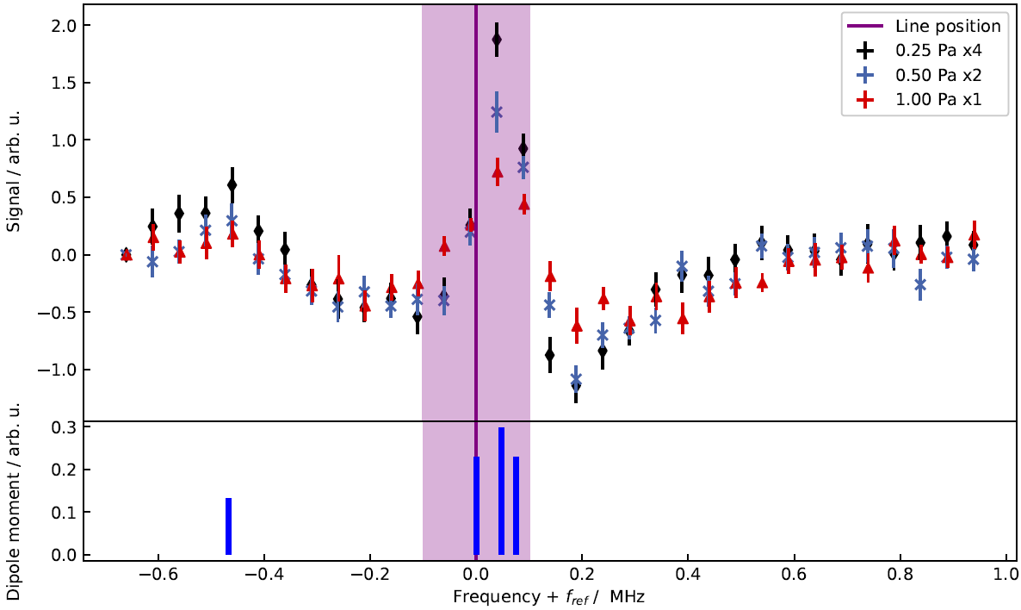
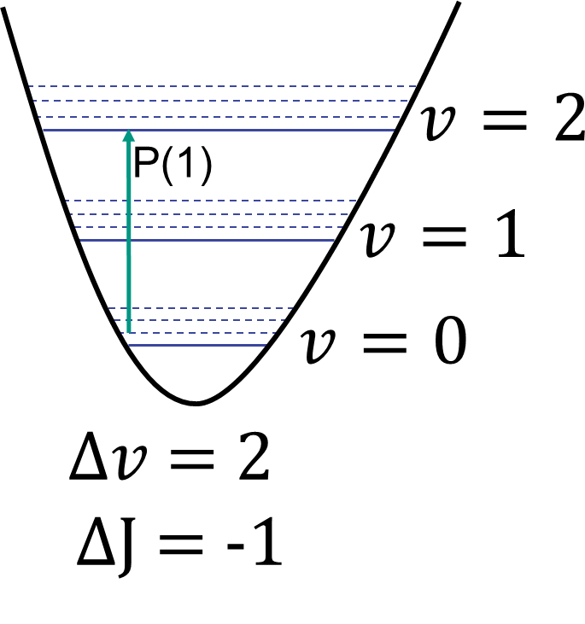
Measured lines: P(1)
R(0), R(1) and P(1) measured ν= 0→2
P(1) (1f signal)

Slide 34
Measured lines: Comparison to theory
v=0→2 | Freq.^{[1]} / MHz | Diff. to theory^{[2]} / MHz
R(0) | 203 396 426. 692 (21) | 1.8 (1.1)
R(1) | 205 380 033. 644 (22) | 1.8 (1.0)
P(1) | 198 824 820. 600 (100) | 1.9 (1.1)
All positions 1.8 MHz off theory (~2 σ)
^{[1]}“Precision Measurement of Vibrational Quanta in Tritium Hydride (HT)”,
F.M.J. Cozijn, M.L. Diouf, W. Ubachs, V. Hermann, M. Schlösser, accepted by PRL (2024)
^{[2]} H2SPECTRE ver. 7.4 Fortran source code, University of
323 Warsaw, Poland (2022).
Most accurate spectroscopy of a molecule with tritium!

Slide 35
Summary: NICE-OHMS on HT
Technical achievements
Successful tritium sample preparation and resorption using NEG
Using only 20 mbar*cm³ HT
Target parameters achieved
No degradation observed
Over 6 weeks continuous measurements
Spectroscopic achievements
v=0→2: R(0), R(1) & P(1)
Line shape not yet fully understood
Isolated hyperfine component observed
Lamb-dip for low power at isolated hyperfine → Line assignment
Accuracy of 21-100 kHz (rel. 10⁻¹⁰ / <1/10 theory)
Deviation to theory of ~2σ

Slide 36
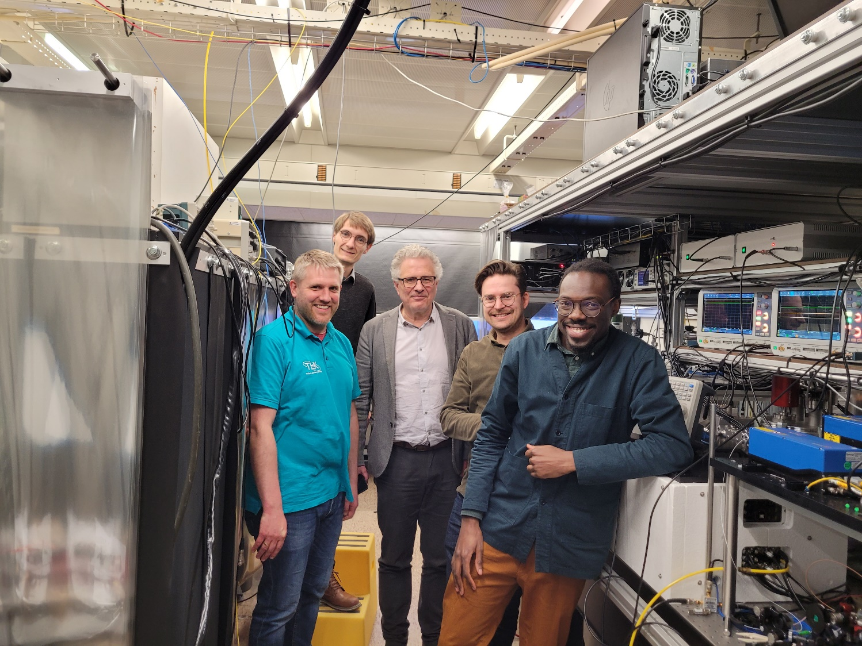
Magnus Schlösser
Benedict Rothmund
Frank M. Cozjin
Meissa Diouf
Wim Ubachs
Access Program of Laserlab–Europe (Grants No. 654148 and No. 871124)

