Slide 1
Optimization at the GSI/FAIR accelerator facility
S. Appel

Slide 2
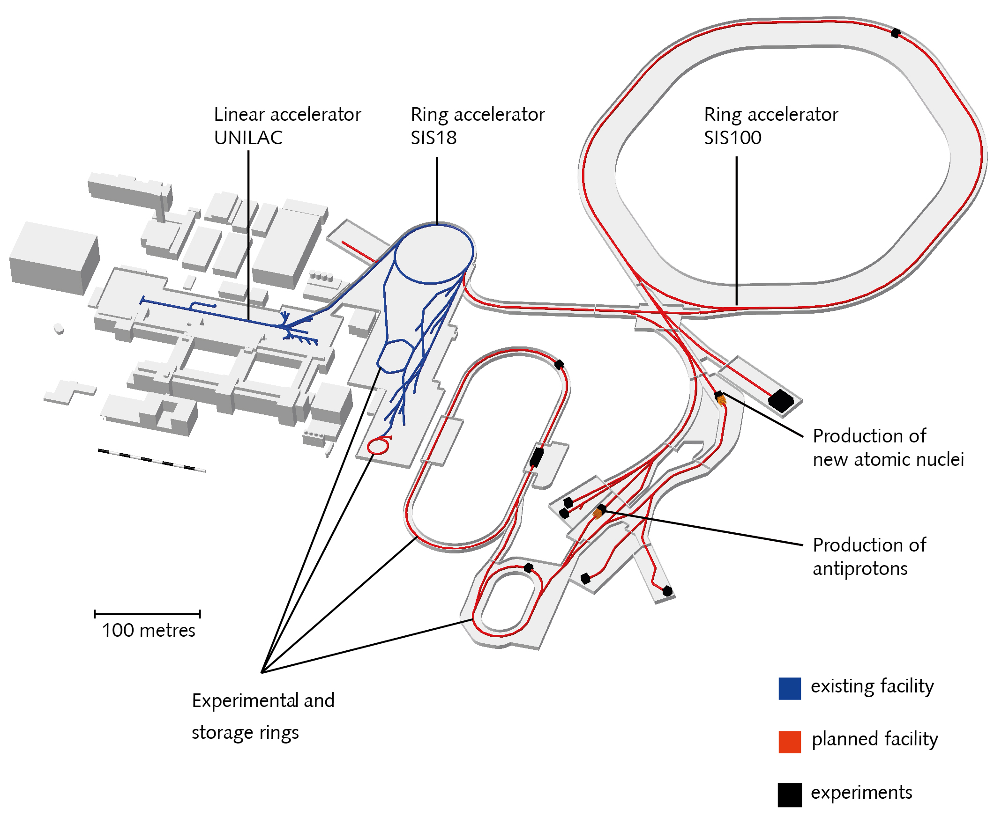
FAIR/GSI
Optimization with numerical optimizers:
Multi-turn injection (SIS18)
Closed orbit correction for challenging optics (SIS18)
Slow extraction (SIS18)
Beam steering to production target (FRS)
…
Notes:
correction for challenging machine optics

Slide 3
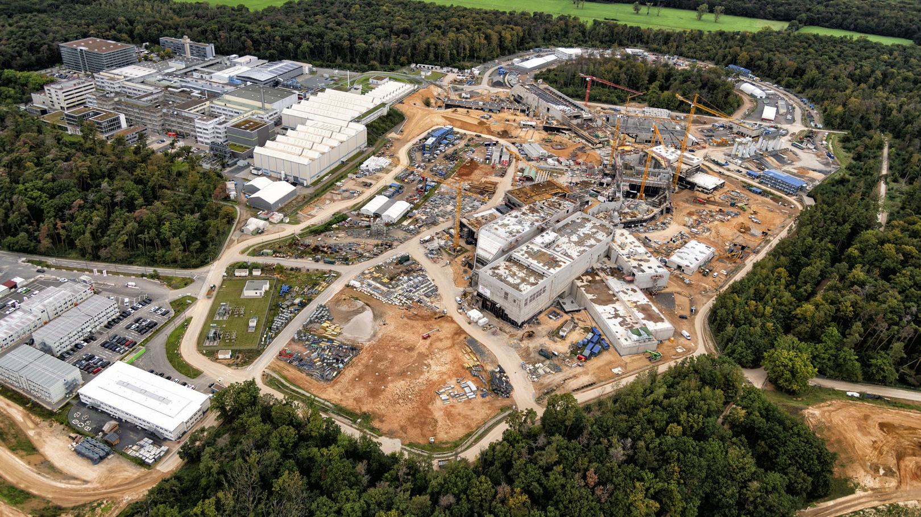
FAIR construction site: October 2023

Slide 4
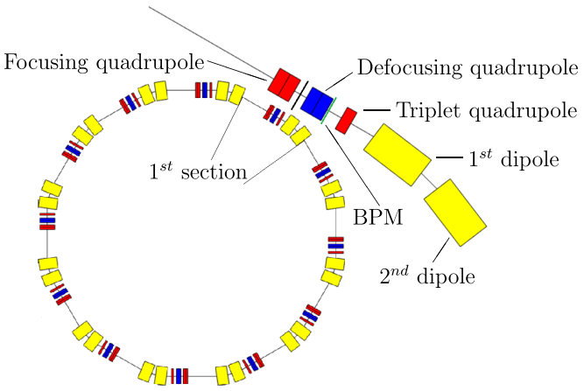
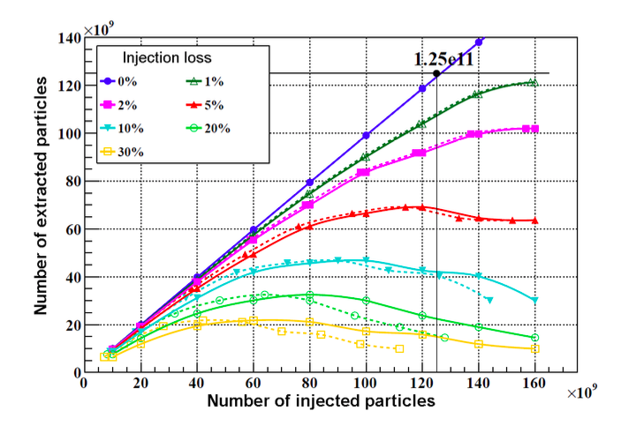
SIS18 (SchwerIonenSynchrotron)
Booster for FAIR SIS100 Synchrotron.
Multi-turn injection into SIS18 is one bottleneck to reach intense beams for FAIR.
The (incoherent) transverse space charge force is the main intensity limiting effect in the FAIR synchrotrons.
For intermediate charge state ions, the loss-induced vacuum degradation is another important key intensity-limiting factor.
Beam Energy | U : 50-1000 MeV/u Ne: 50-2000 MeV/u p : 4,5 GeV
Particle Number Per Cycle | 10¹⁰ (U⁷³) – 10¹²(p)
Typical Cycle | 3 s (FAIR 2.7 Hz)
Extraction | fast: 1 μs with compression: 200 ns slow: 10-8000 ms

Slide 5
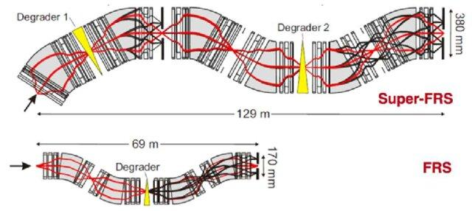
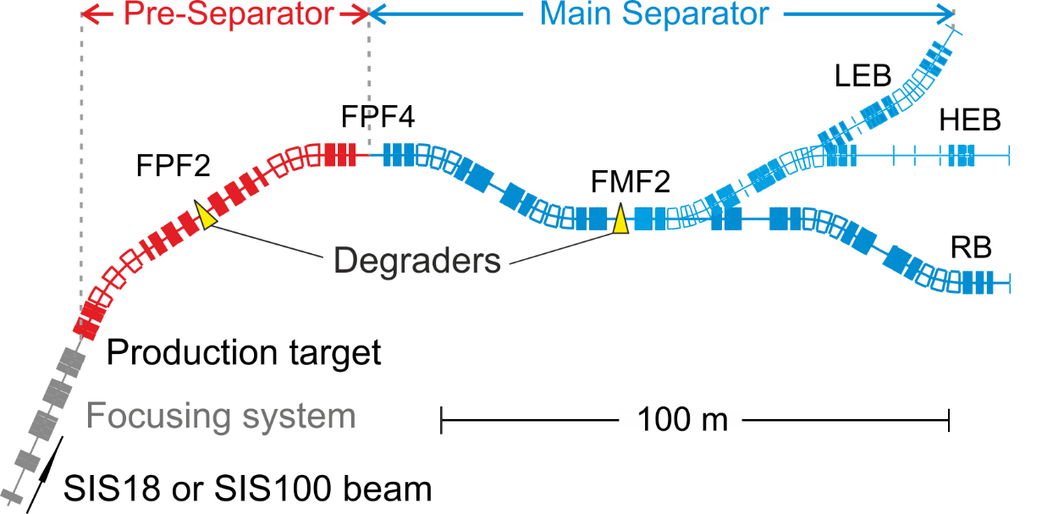
FRS (FRagment Separator) and Super-FRS
Production and investigation of nuclear structure of exotic nuclei.
characteristics of the high-resolution magnetic spectrometer FRS, exotic nuclei can be produced, separated, identified and eventually stored in a storage ring
Super-FRS increas of acceptance and complexity (about 4 times more magnets), Gain factors of 1000 (¹²C) and 7500 (¹³²Sn) can be reached¹.
Automation of time-consuming tasks will therefore be essential
Super-FRS layout:
¹H. Simon et al., EMIS XVIII workshop, 2018.

Slide 6
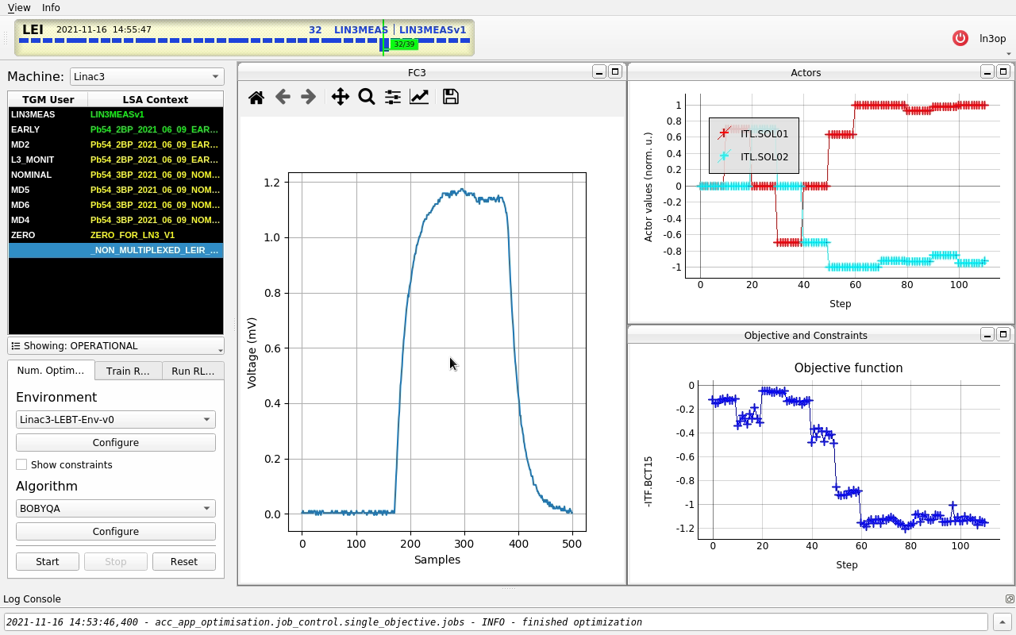
GeOFF at GSI
Generic Optimization Frontend & Framework (GeOFF) is a widely used framework for testing automation at CERN
Python-based framework with use of pjlsa
lists, configures and runs optimization problems
standardized interfaces and adapters for various packages via Common Optimization Interfaces
Optimization problem formulated in standard interfaces
Class contains logic for live plotting, data logging, and communication with LSA, FESA and the Device Access system
Adaption of code quickly and on-the-fly during shift: Flexibility of framework made this easy

Slide 7
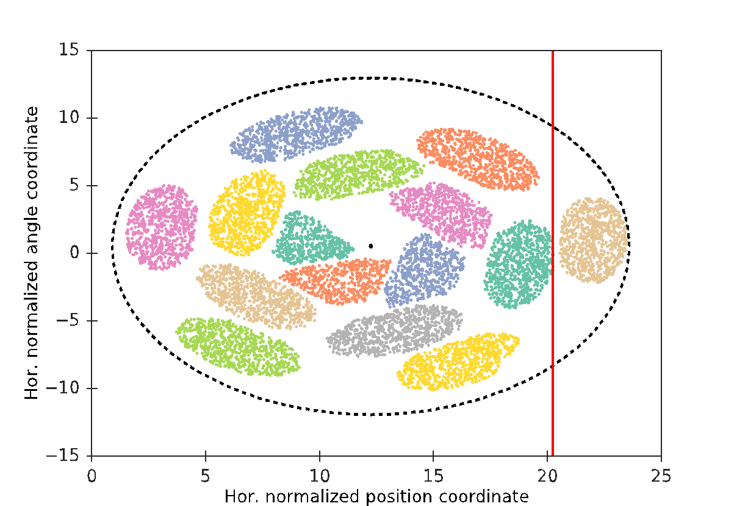
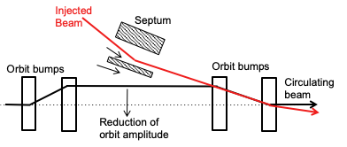
Multi-Turn-Injection
MTI has to respect Liouville’s theorem: Injected beams only in free space
Gain factor should be as high as possible to reach the space charge limit
Injection loss should be as low as possible to avoid loss-induced vacuum degradation
Objective: Minimize beam loss for given number of injection with five parameters
MTI model has been implemented in Xsuite¹ for fast tracking
Xsuite support CPUs and GPUs
Testing RL optimization with SCL + MPC, see poster
Acceptance
Septum
¹https://xsuite.readthedocs.io/en/latest/

Slide 8
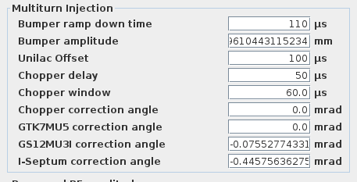
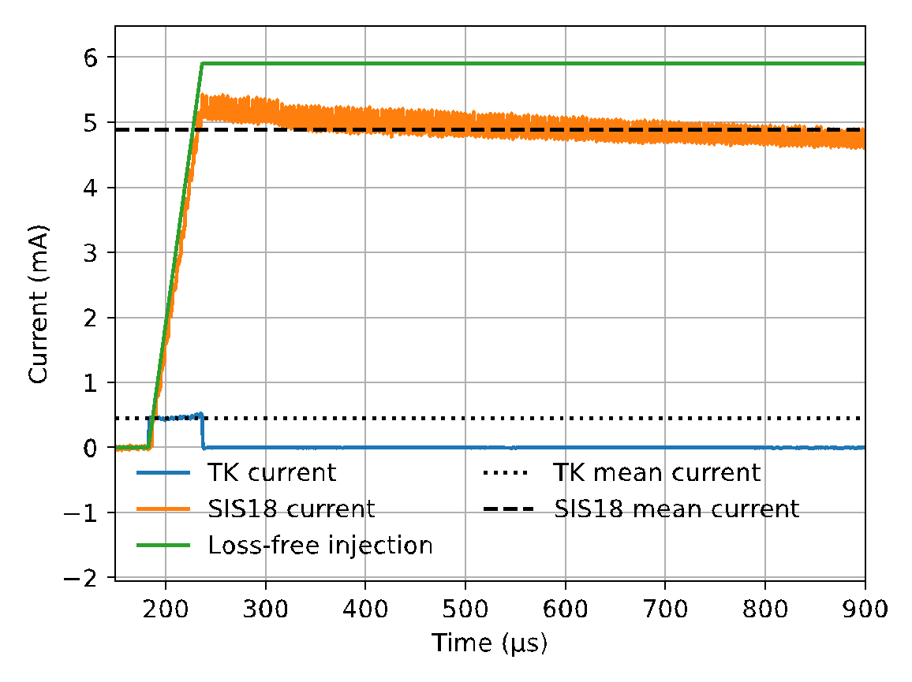
Automation of Multi-Turn Injection
Usually, MTI is optimized manually with varying success
Idea: Automated optimization of MTI
with numerical optimizer (Py-BOBYQA)
by using GeOFF and Python bridge
Goal: low loss injection over many turns
injection variables to be modified by numerical optimizer
Loss definition:
Loss = (ideal current– SIS18 mean current) ÷ ideal current
ideal current = mean TK current × expected number of injections
Expected number of injections = Chopper window ÷ SIS18 rel. time
Sabrina Appel (GSI), Nico Madysa (GSI)

Slide 9
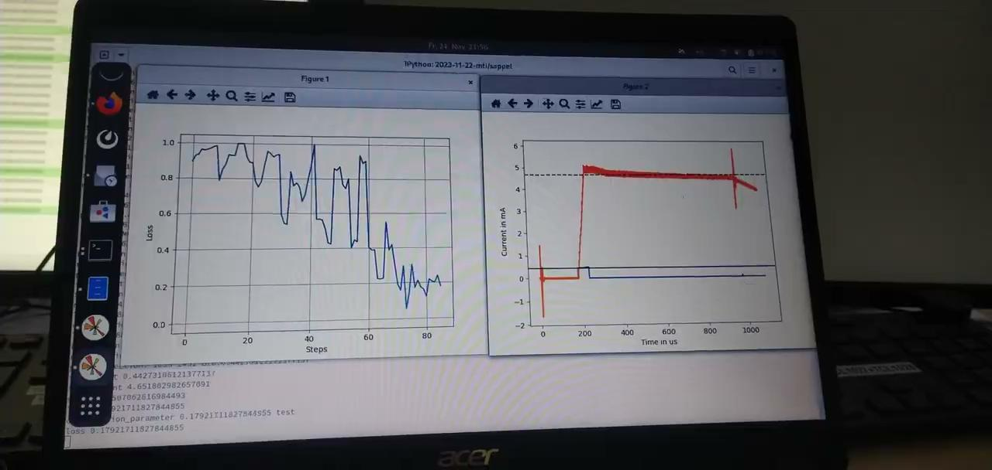
Automation of Multi-Turn Injection
With the Python bridge fully automated multi-turn injection optimization can be performed in about 15–20 min.
The loss could be reduced from 40 % to 15 % using five optimization parameter.
Usage of GeOFF in a scripting context, with the terminal window in the background, and continuously updating figures for monitoring in the foreground.
Sabrina Appel (GSI), Nico Madysa (GSI)

Slide 10
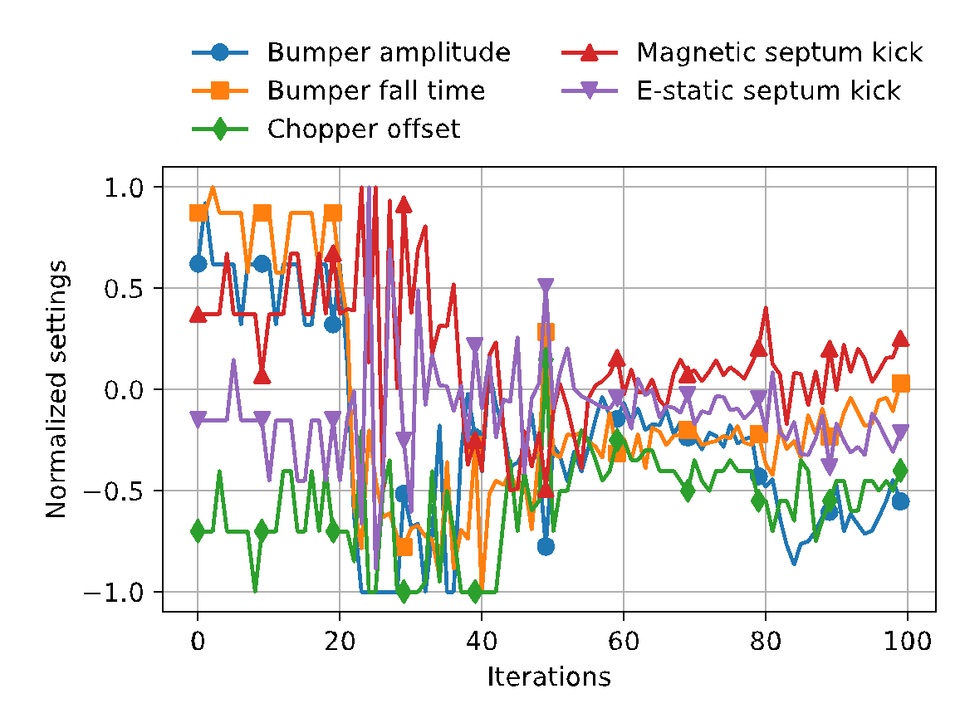
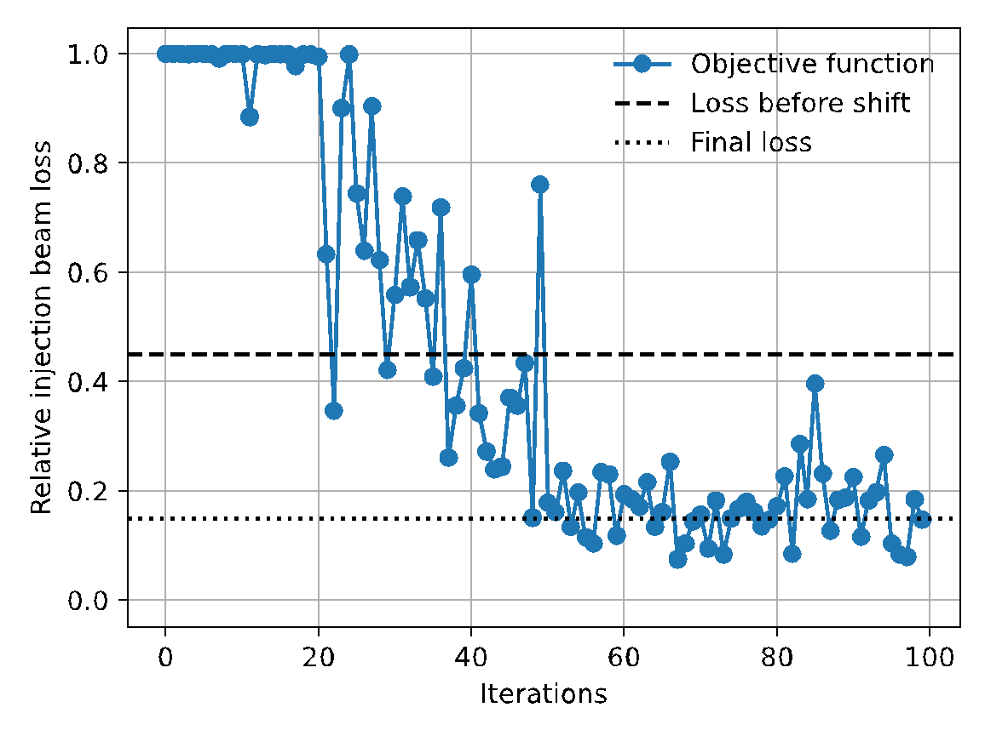
Automation of Multi-Turn Injection
Using five optimization parameters.
It ran for 100 iterations, which took about 19 minutes.
Loss could be reduced from 40 % to 15 %.
Optimum was found, even though beam was fully lost in the beginning.
1
2
3
4
5
Start of optimization
Sabrina Appel (GSI), Nico Madysa (GSI)

Slide 11
FRS: Automatic online steering
Objective Functions: Misplacement or distance to the beam target using to two grids in front of the target
steerer
dipol
Ver. Foucs quad
grids
target
Hor. foucs quad
Limitation/time condition:
Bandwidth multiplexer: multiple shots were necessary to acquire X/Y-grids
“Bad shots”: analysis class cloud not perform reliable analysis of grids
Slow extraction: SIS18 cycle length
S. Appel, E. Kazantseva, N. Madysa and S. Pietri (all GSI)

Slide 12
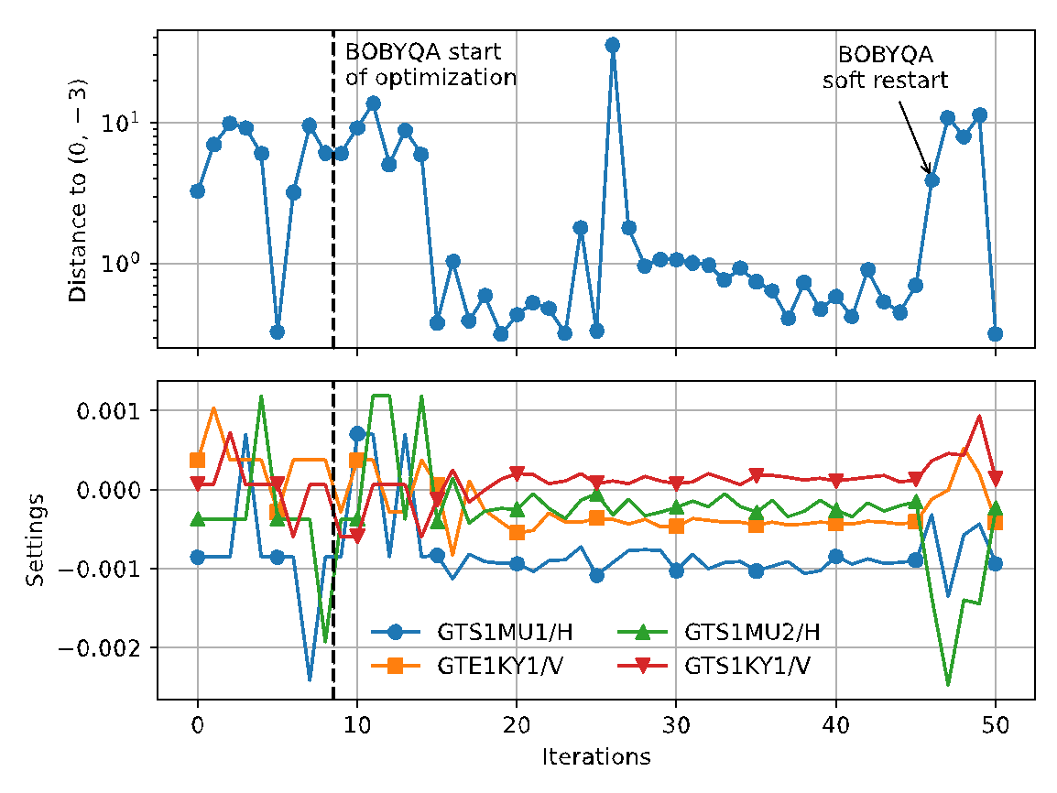
FRS: Automatic online steering
Proof of principle:
Online beam steering in 50 iteration and took 18 minutes.
S. Appel, E. Kazantseva, N. Madysa and S. Pietri (all GSI)

Slide 13
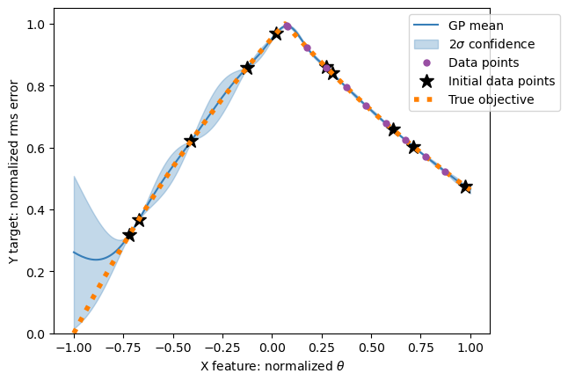
Idea of Bayesian Optimization (BO) based closed orbit correction
BO-based closed orbit correction:
Simulation of the correction of a FODO cell (noise free):
Probability distribution (Gaussian Process) acts as a surrogate model
Described by mean function and the covariance function or kernel
(currently using a Matern kernel, next step: physics-informed kernel)
Objective function: RMS deviation at BPMs
Next most promising evaluation point:
Optimizing acquisition function (Upper Confidence Bound)
V. Isensee, MSc thesis 2023, Methods of Closed-Orbit Correction in Synchrotrons"
V. Isensee (TU Darmstadt), C. Caliari (TU Darmstadt), A. Oeftiger (GSI)

Slide 14
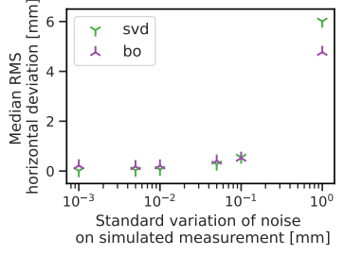
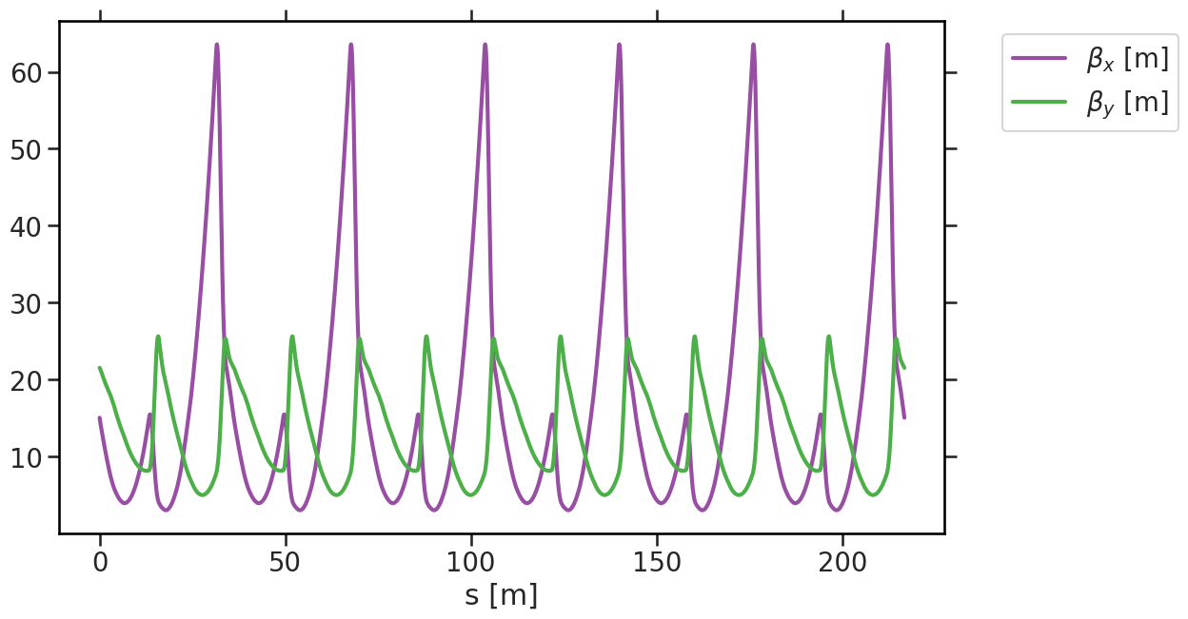
Challenging scenario at the experiment
Challenges due to:
Nonlinearities introduced by the chromaticity correction with sextupoles
BPM Noise
Asymmetric optics:
Optical setting to shift the transition energy, called sigma optics
Superperiodicity reduced from S=12 to S=6
Can cause standard closed orbit correction methods to fail
(see:
B. Franczak, K. Blasche and K. H. Reich, "A Variable Transition Energy Lattice for SIS 12/18," in IEEE Transactions on Nuclear Science, vol. 30, no. 4, pp. 2120-2122, Aug. 1983)
Simulated influence of
Noise on BPMS:
For higher noise level BO achieves better results than SVD
Simulated Betafunctions in sigma optics scenario:
V. Isensee (TU Darmstadt), C. Caliari (TU Darmstadt), A. Oeftiger (GSI)

Slide 15
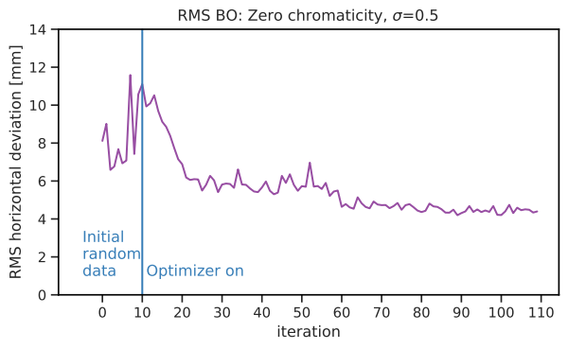
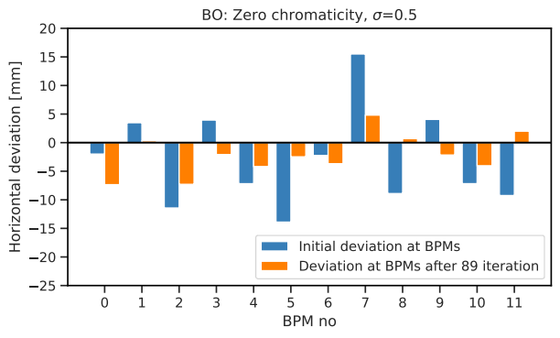
BO-based correction for challenging machine optics
Results of BO-based correction:
Sigma optics with sigma value = 0.5
Random data needed for initialization
RMS of horizontal deviation converges
BO-based correction found result, where the standard methods (SVD) fails
Best found closed orbit:
Trained surrogate model, including a hyperparameter for noise, which can be reused
→ Basis for physics-informed kernel: BO with orbit model in between BPMs
V. Isensee (TU Darmstadt), C. Caliari (TU Darmstadt), A. Oeftiger (GSI)

Slide 16
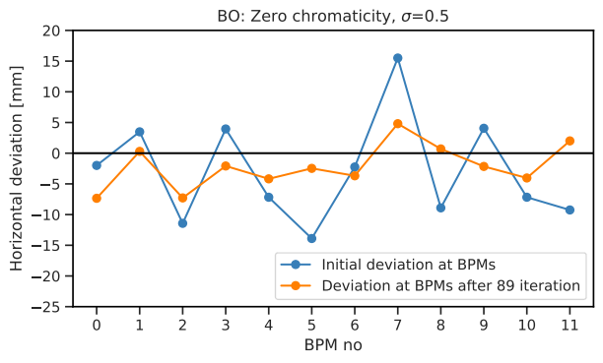
BO-based correction for challenging machine optics
Results of BO-based correction:
Sigma optics with sigma value = 0.5
Random data needed for initialization
RMS of horizontal deviation converges
BO-based correction found result, where the standard methods (SVD) fails
Best found closed orbit:
Trained surrogate model, including a hyperparameter for noise, which can be reused
→ Basis for physics-informed kernel: BO with orbit model in between BPMs
V. Isensee (TU Darmstadt), C. Caliari (TU Darmstadt), A. Oeftiger (GSI)

Slide 17
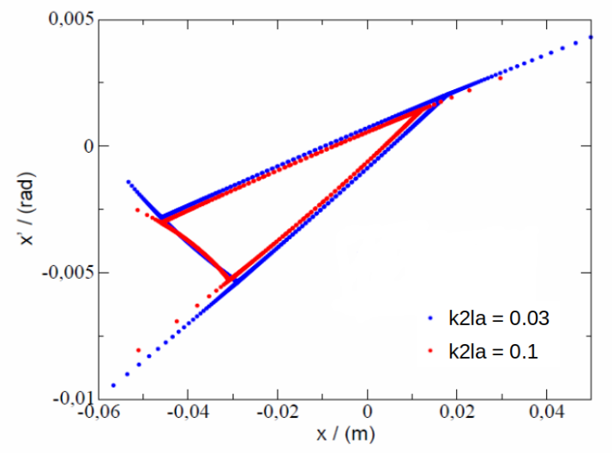
Optimization of slow extraction from SIS18
Slow extraction (typ. 1 to 10 s) based on interplay of many parameters
Very important for the fix target experiment (production of rare isotopes, compressed matter)
Slow Extraction by Tune sweep:
Excitation of 3rd integer resonance with sextupoles.
Shrinkage of separatrix due to quadrupole ramp.
Sextupole strengths are characterized by amplitude and phase.
Large amplitude results in lower particle loss due to transit from beam extraction channel in large steps.
Phase affects orientation of triangle, thus, determines particle loss.
Olha Kazinova, TU Darmstadt
Stefan Sorge, GSI

Slide 18
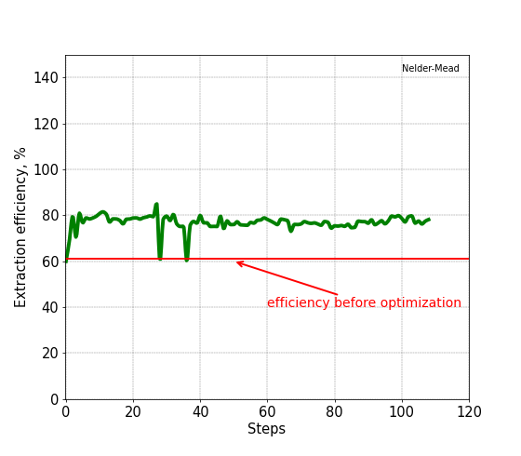
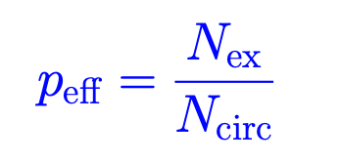
Optimization of slow extraction from SIS18
Maximizing extraction efficiency
Extracted particles
Particles in circulating beam
Variables used for optimization:
sextupole amplitude (k₂L)_{a} and phase φ which define strengths of the resonances sextupoles by
Extraction efficiency could be increase from from 60 % to 80 %.
Olha Kazinova, TU Darmstadt
Stefan Sorge, GSI

Slide 19
Thank you for your attention.
Questions?

