Slide 1


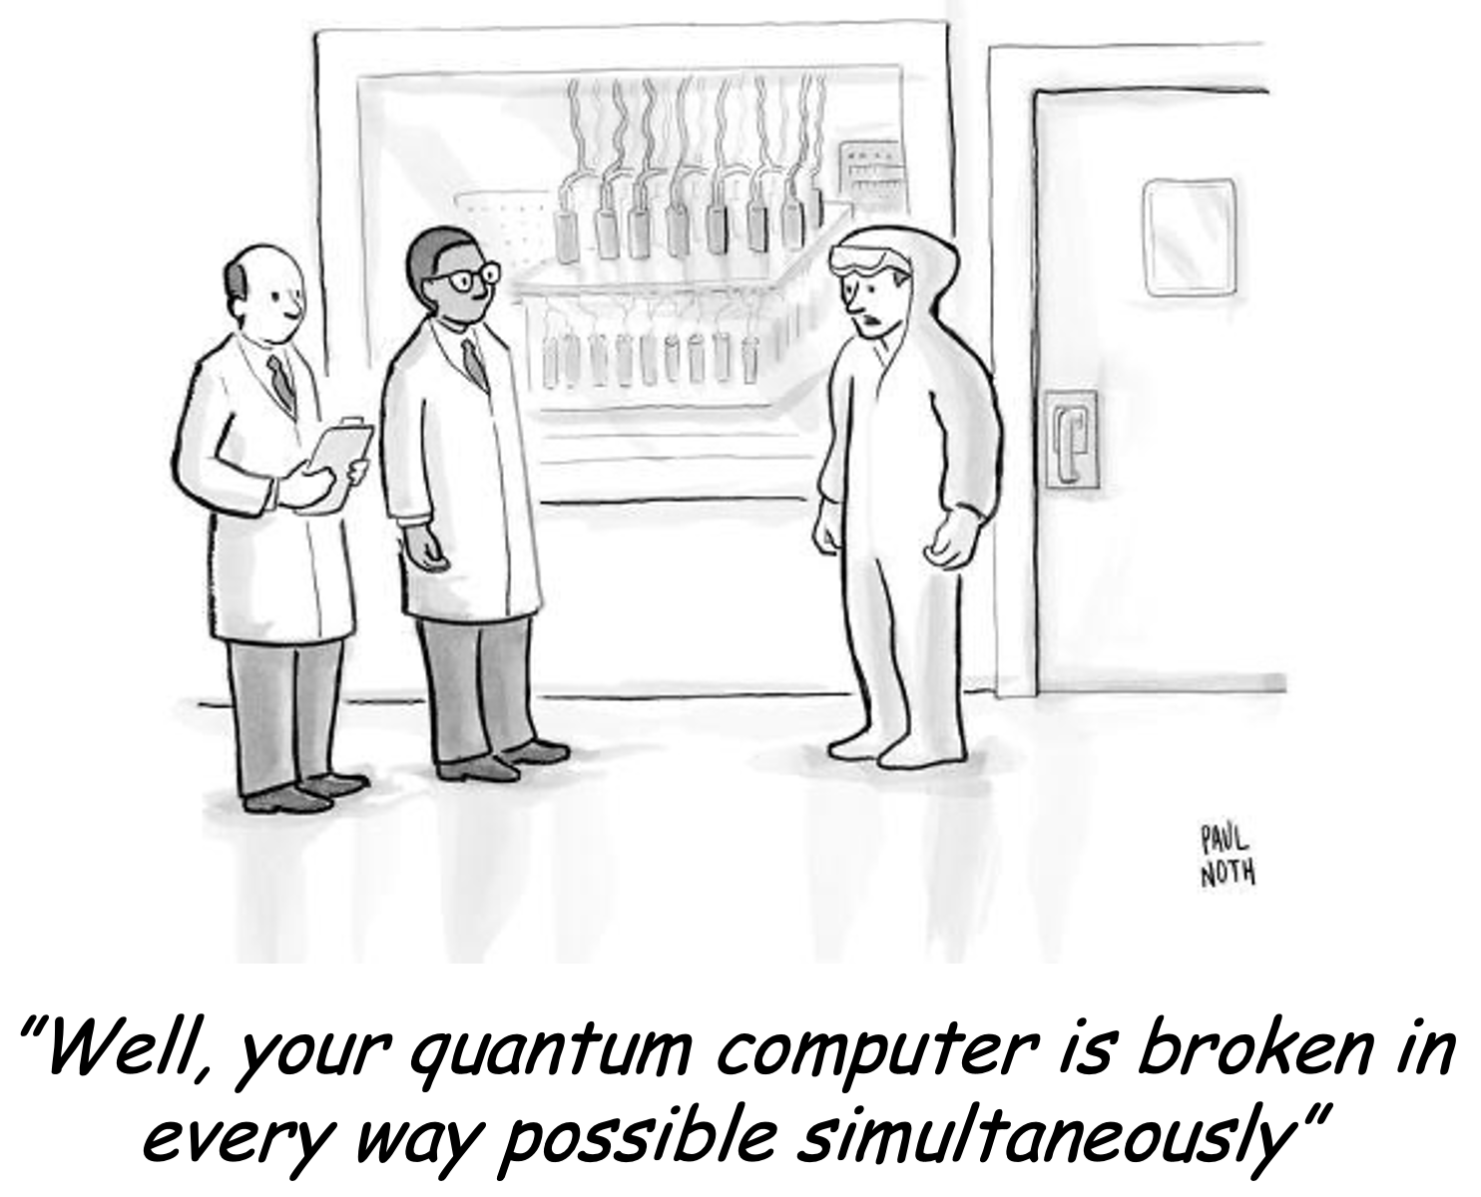
Quantum annealing for sample-efficient reinforcement learning
M. Schenk, M. Grossi, V. Kain, K. Li, S. Vallecorsa
CERN, Switzerland
E.F. Combarro
University of Oviedo, Spain
2nd RL4AA, Salzburg, Austria 07. February 2024

Slide 2
Contents
    Motivation
    Free-energy based RL
    Results
    Conclusions & outlook

Slide 3
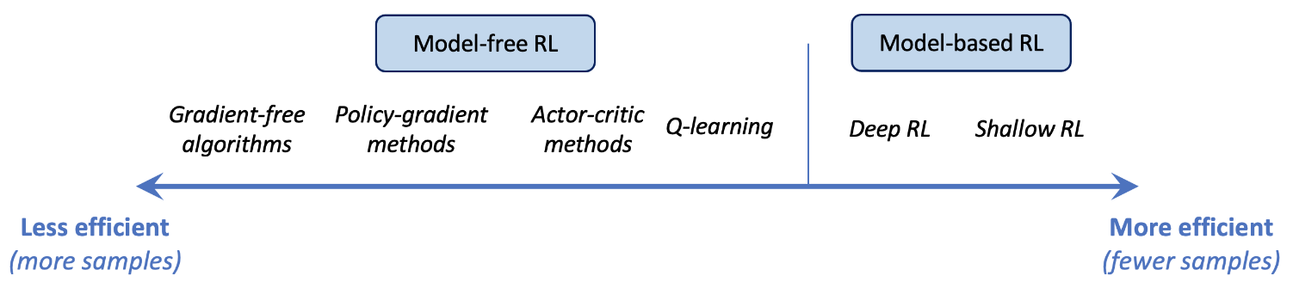
Motivation
RL challenges: sample efficiency
  Sample-efficiency is one of the main challenges in RL
  Makes online training difficult or unfeasible (cost, time, …)
  Various ways to address it
  Reliable simulations / surrogate models
  Train RL agent on simulation data, then deploy in real world (sim2real)
  Choice of algorithm
  Model-based RL / GP-MPC, Meta RL, … ?
Free energy based RL ?

Slide 4
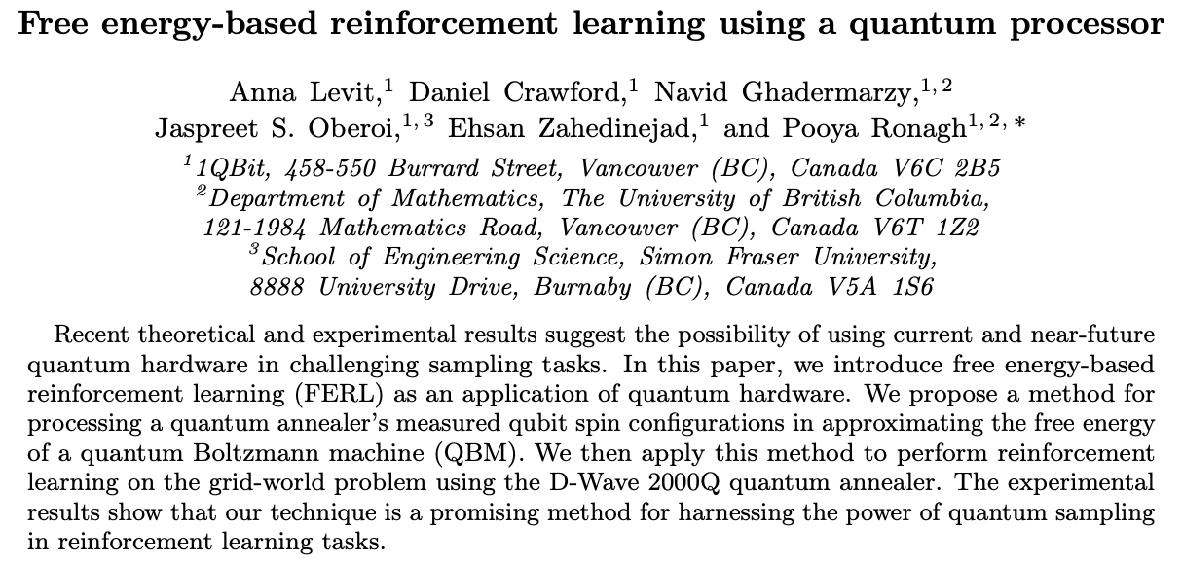
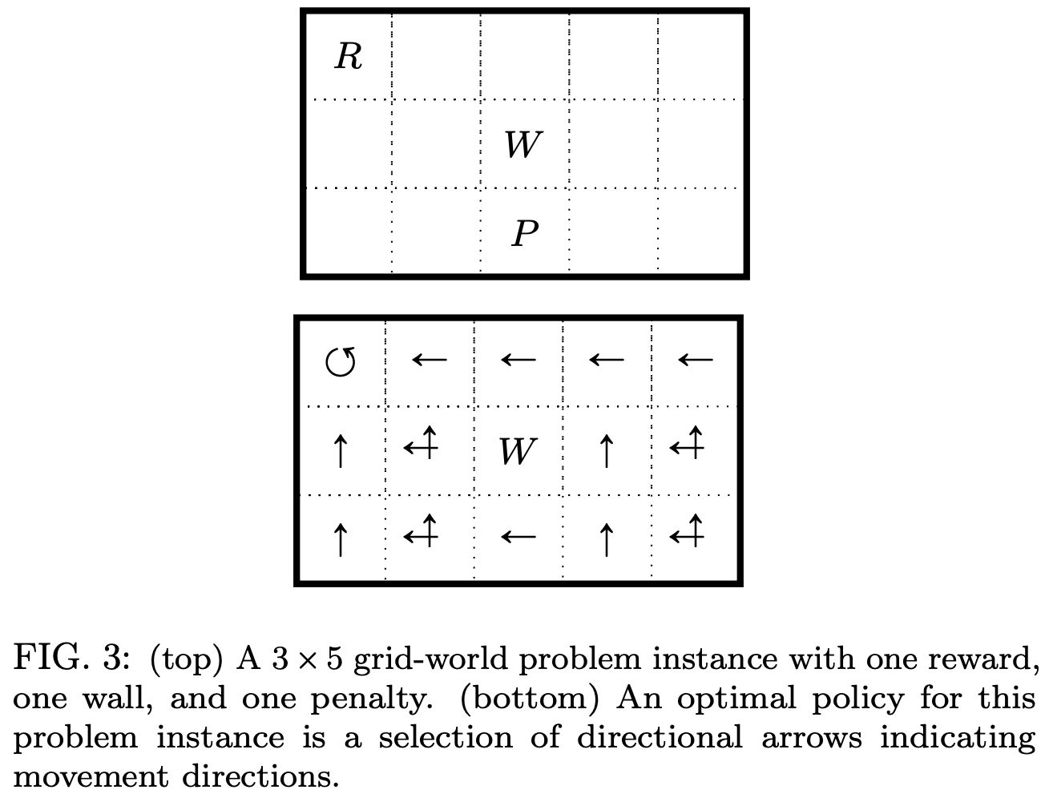
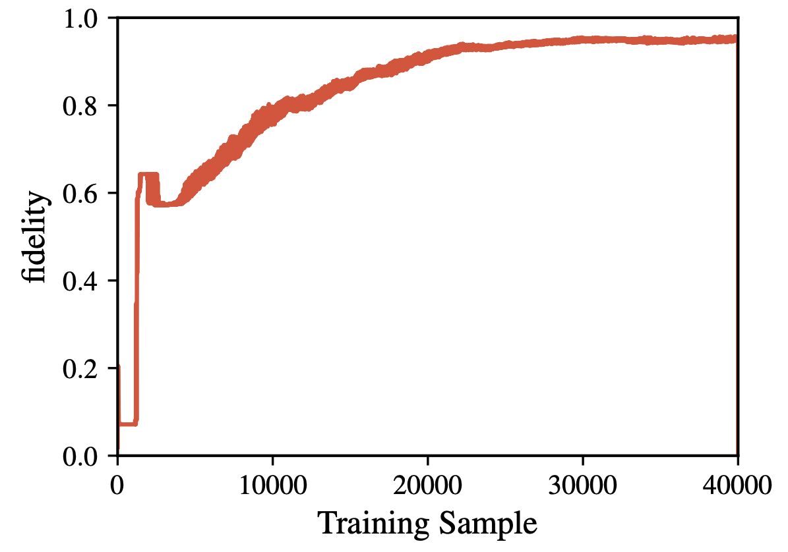
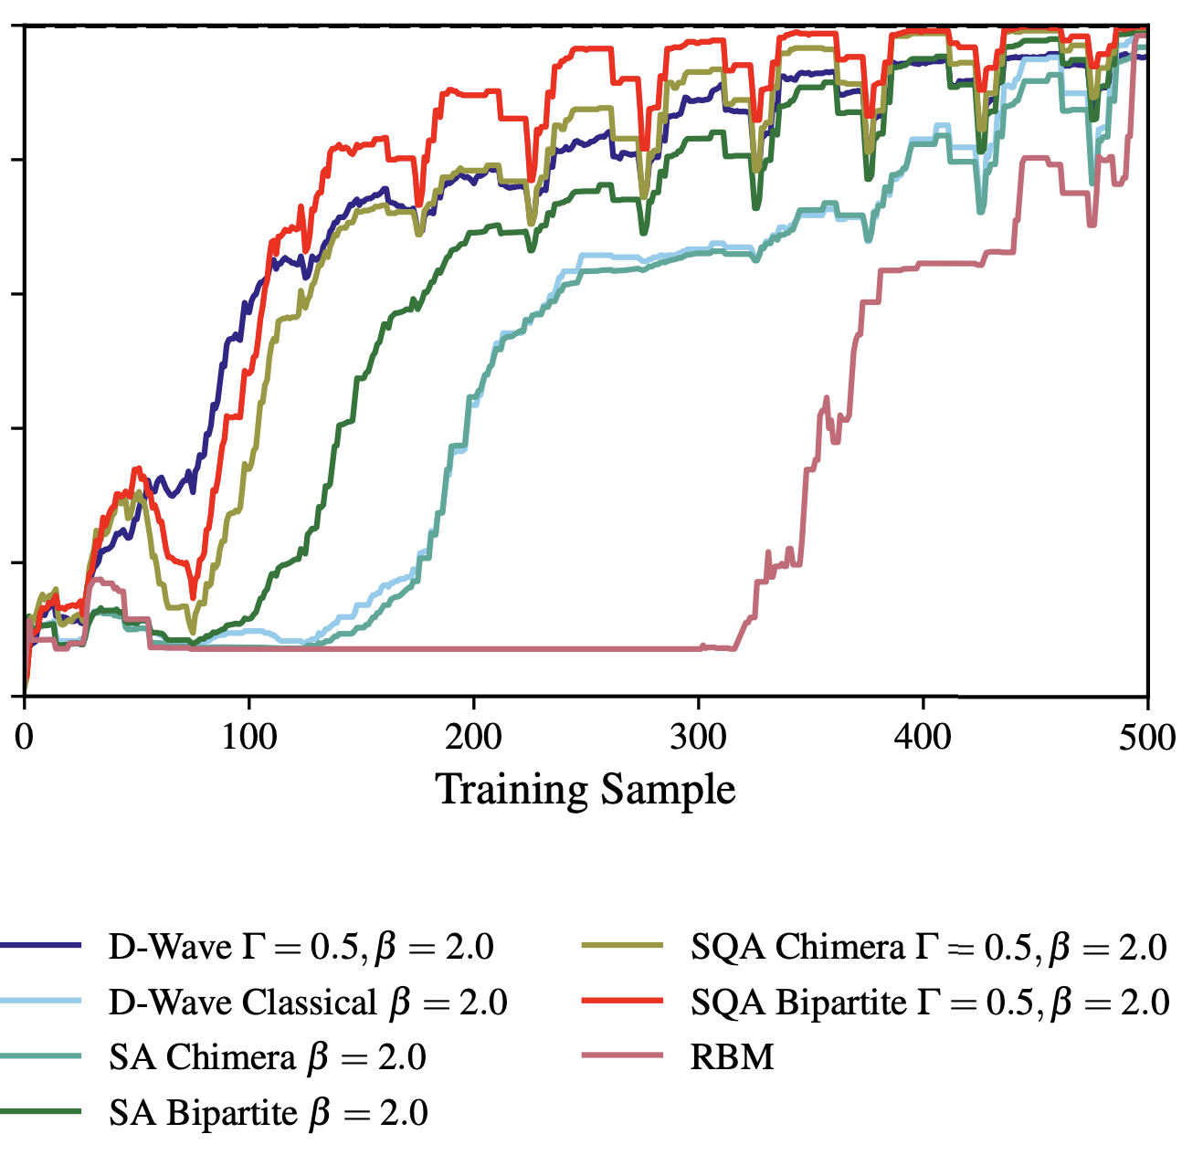
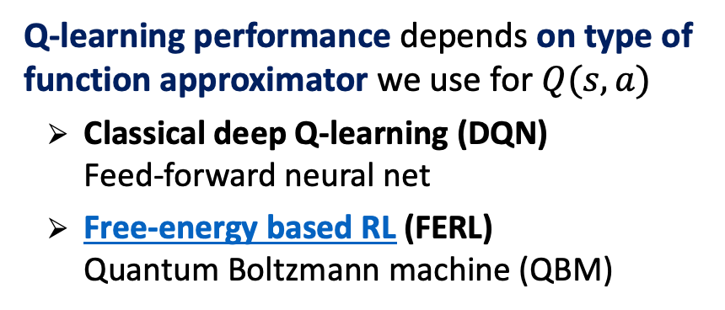

Motivation
Free-energy based RL
    Q-learning performance depends on type of function approximator we use for $Q(s,a)$
      Classical deep Q-learning (DQN)
      Feed-forward neural net
      Free-energy based RL (FERL)
      Quantum Boltzmann machine (QBM)
$$π^{∗}$$
10³ x fewer
DQN
FERL
https://arxiv.org/pdf/1706.00074.pdf

Slide 5

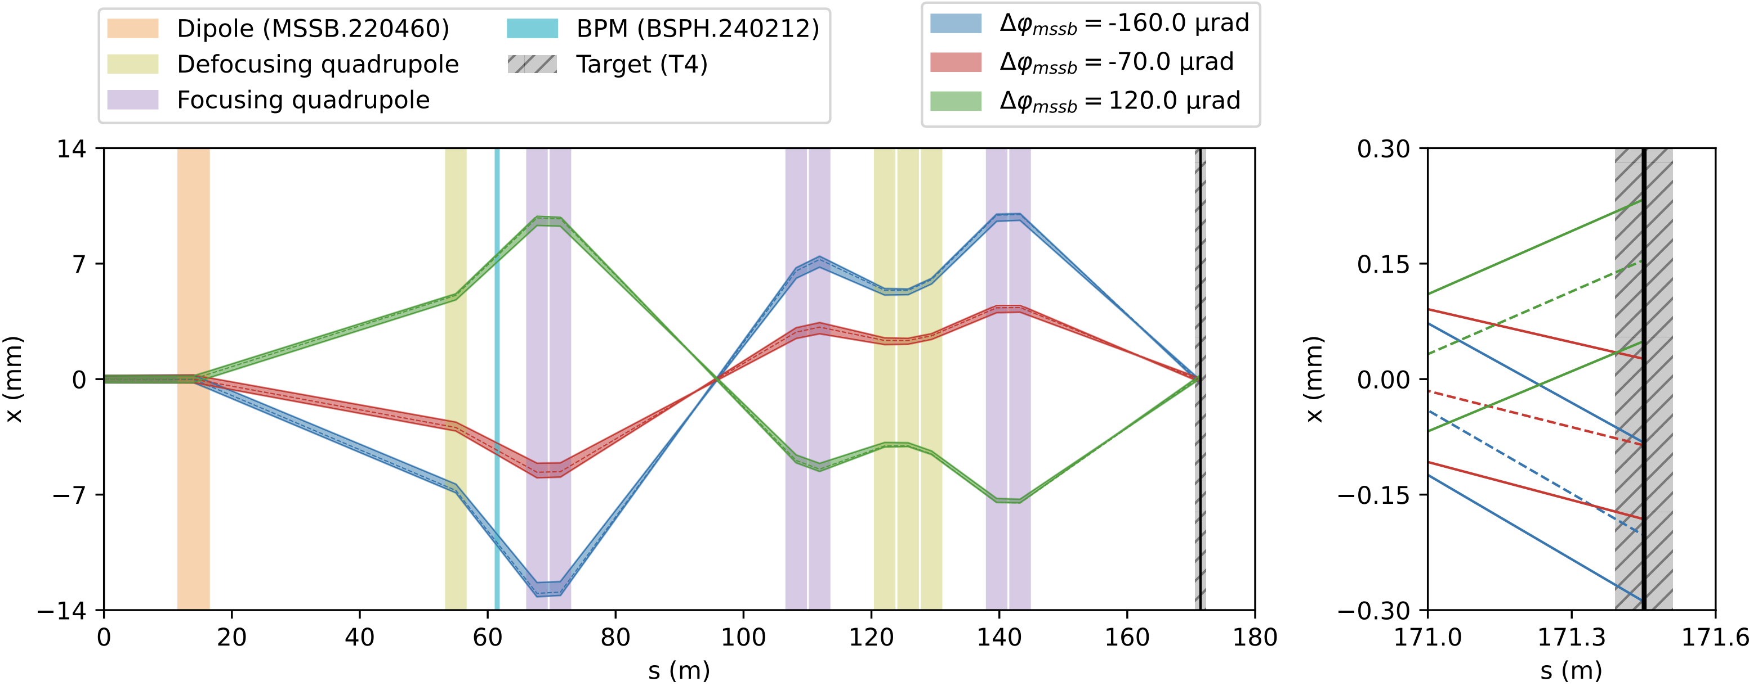
Motivation
1-d beam steering: definition
    Our first attempt: beam steering for SPS NA
    Continuous state: beam position (1-d)
    Discrete action: ±Δ on dipole kick strength (1-d)
    Reward: amount of beam on target
North Area TT24-T4 transfer line

Slide 6
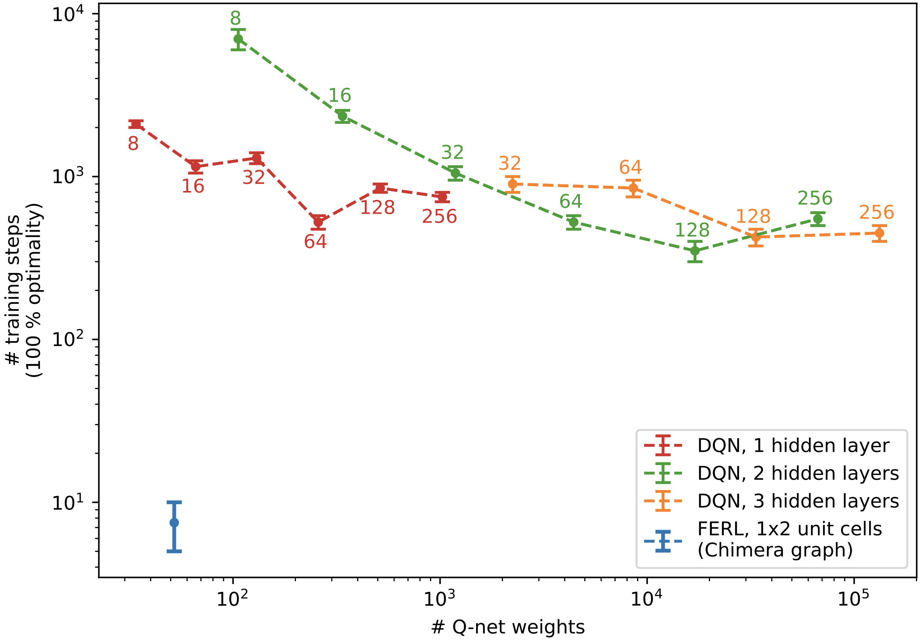
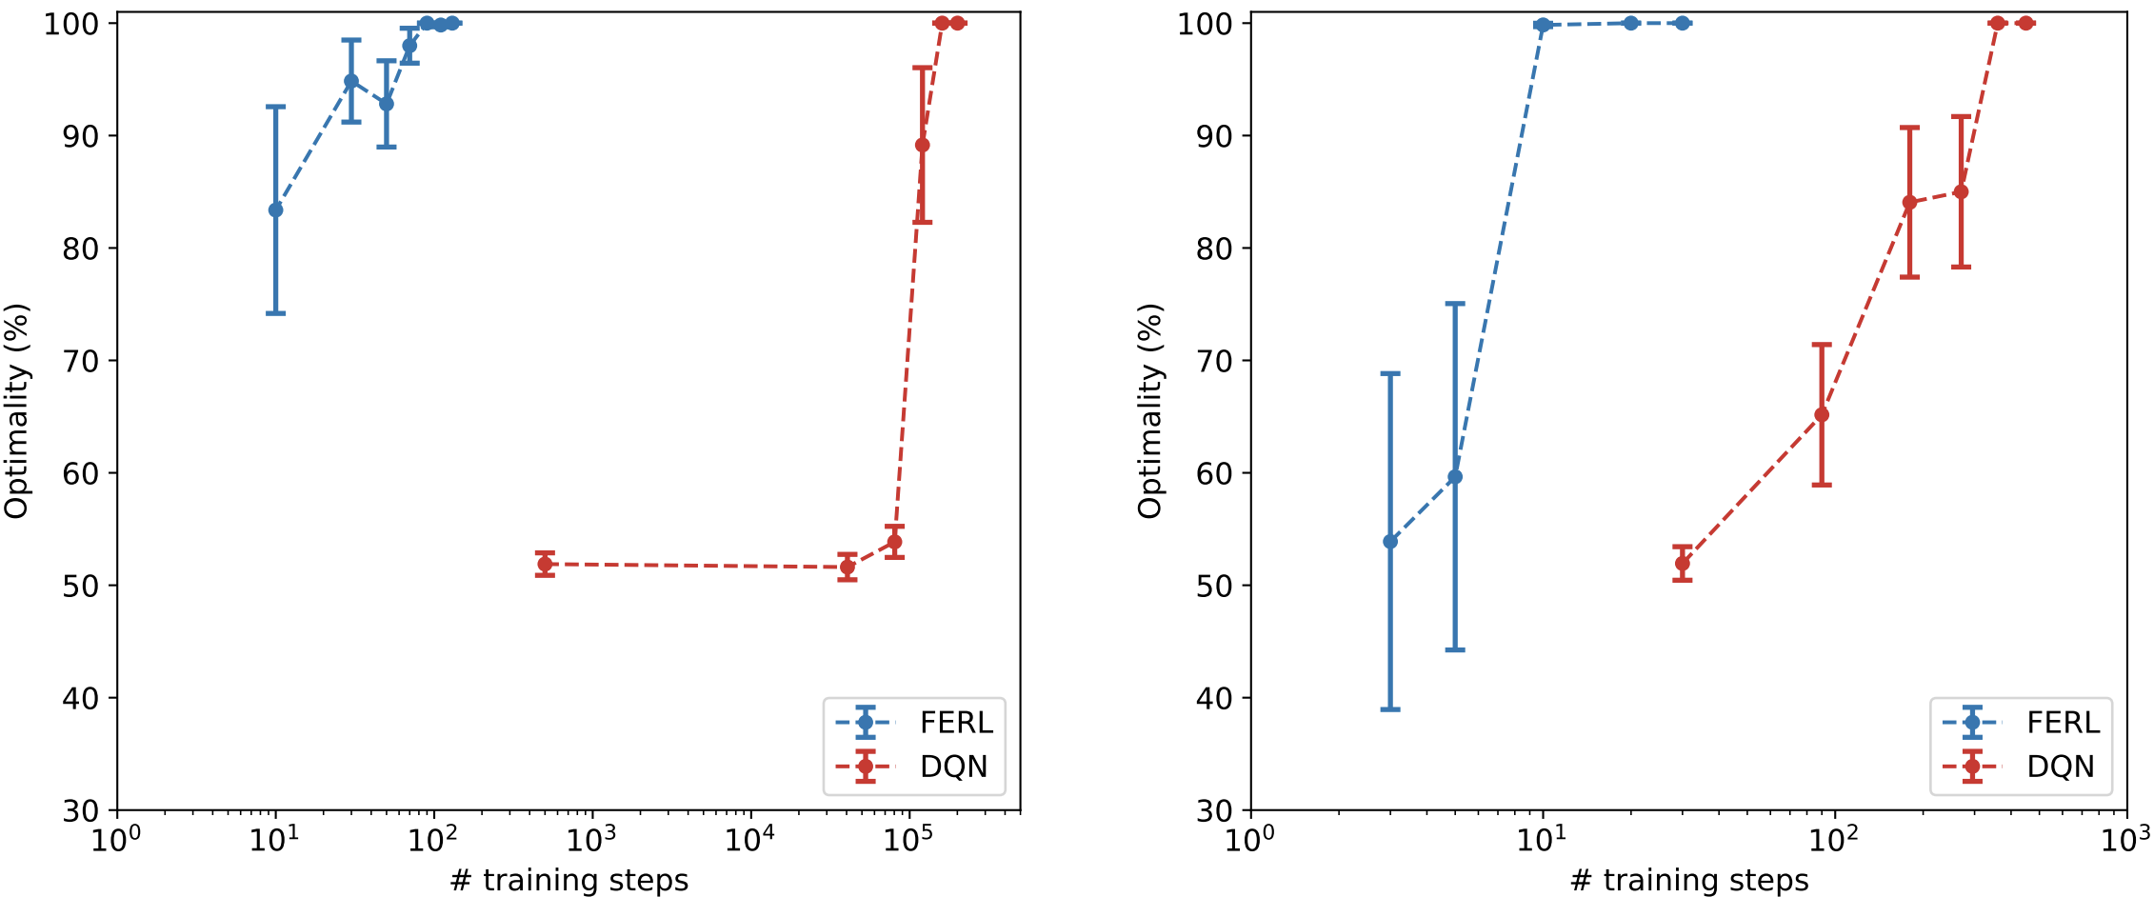
Motivation
1-d beam steering: results
DQN
10³ x fewer
No experience replay Improvement in sample efficiency similar to original study
50x fewer training steps
300x fewer network parameters
FERL
50 x fewer
    This looks promising
    How does FERL work?
    Quantum Boltzmann machine combined with quantum annealing
    Evaluate for other (accelerator physics) problems
With experience replay
Classical DQN sees more significant benefit using replay

Slide 7
Contents
    Motivation
    Free-energy based RL
    Results
    Conclusions & outlook

Slide 8
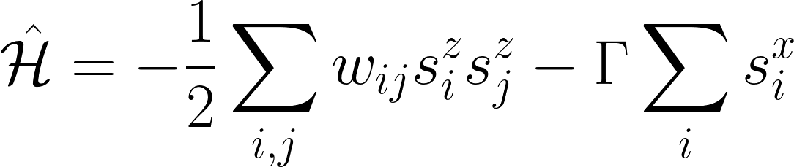
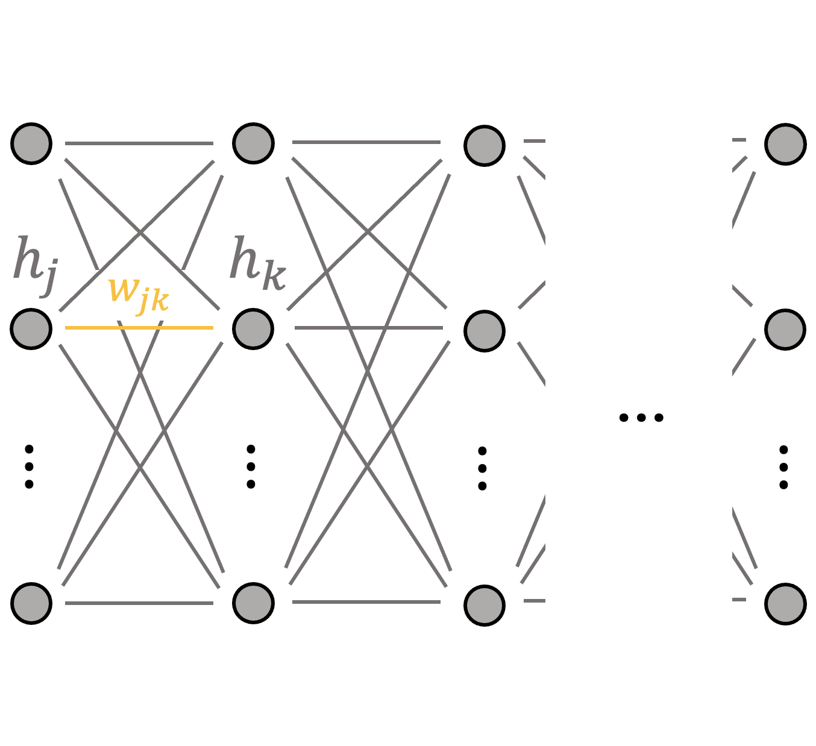
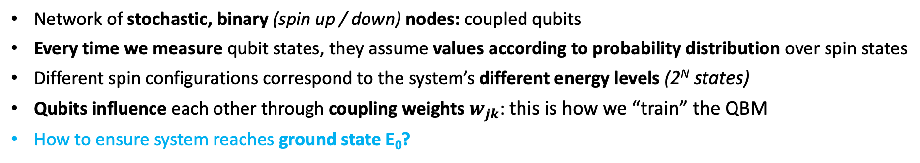
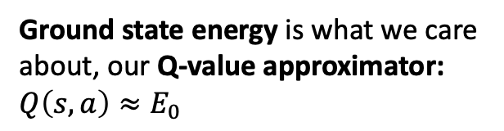
Free-energy based RL
Hamiltonian of Ising spin model
Quantum Boltzmann machine
E
…
E₃
…
E₂
Ground state energy is what we care about, our Q-value approximator: $Q\left(s,a\right)≈E_{0}$
E₁
E₀
c
Network of stochastic, binary (spin up / down) nodes: coupled qubits
Every time we measure qubit states, they assume values according to probability distribution over spin states
Different spin configurations correspond to the system’s different energy levels (2^{N} states)
Qubits influence each other through coupling weights $w_{jk}$: this is how we “train” the QBM
How to ensure system reaches ground state E₀?
(simulated) quantum annealing

Slide 9
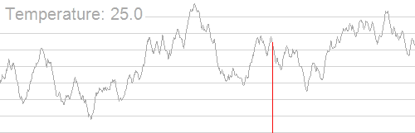
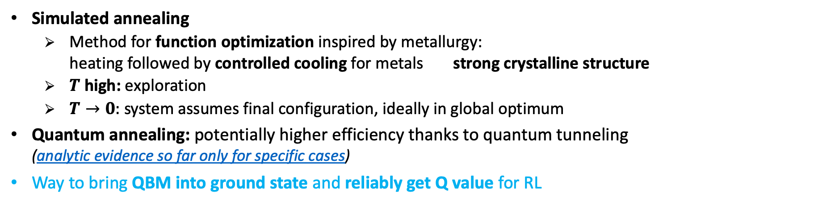
Free-energy based RL
Annealing: looking for the system’s ground state
Simulated annealing
  Method for function optimization inspired by metallurgy:
  heating followed by controlled cooling for metals strong crystalline structure
  $T$ high: exploration
  $T→0:$ system assumes final configuration, ideally in global optimum
Quantum annealing: potentially higher efficiency thanks to quantum tunneling
(analytic evidence so far only for specific cases)
Way to bring QBM into ground state and reliably get Q value for RL
Energy E
Thermal annealing
Quantum annealers
Different type of quantum computer: non-gate based
More qubits, but not as generic as gate-based QPUs
Suited for quadratic minimization problems
quantum annealing
(tunneling allowed)
Spin configuration c

Slide 10

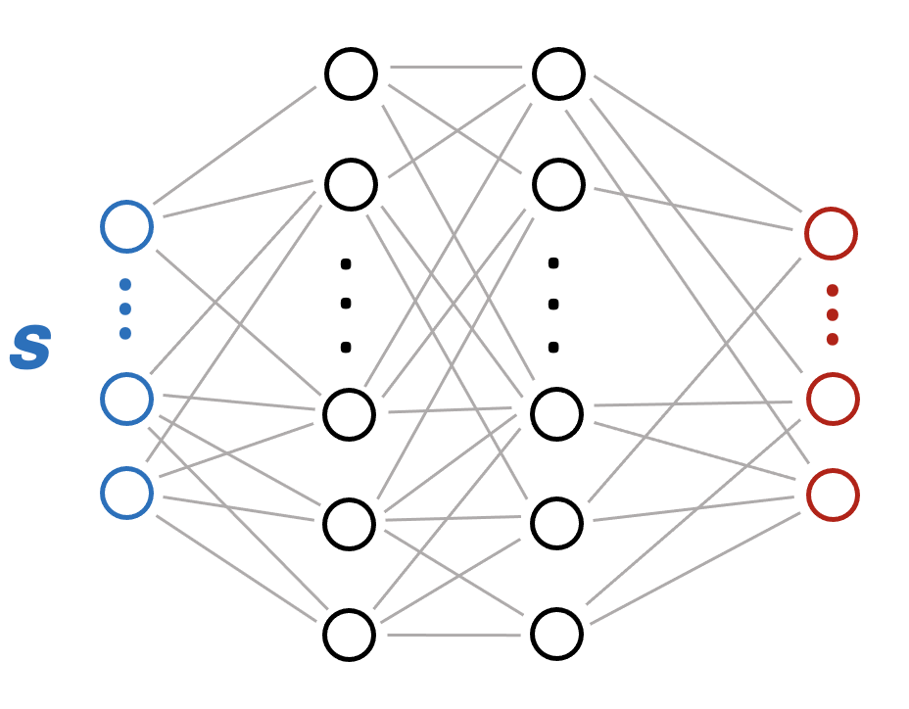




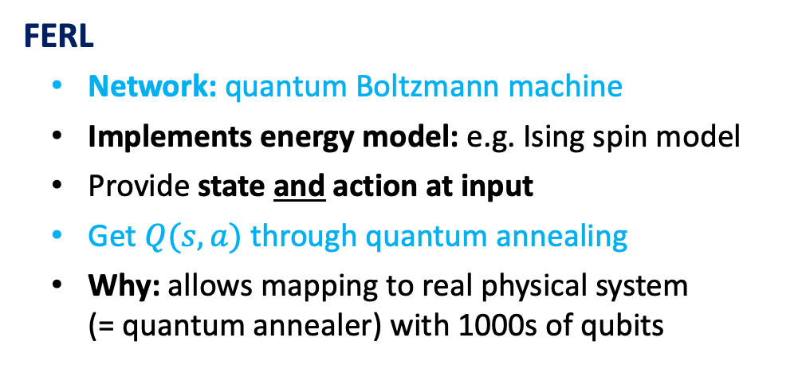

Free-energy based RL
Comparison to deep Q-learning
Difference lies in how we approximate and predict Q
DQN
Network: typically fully connected feed-forward
Provide state at input
Q-value estimates at output for discrete set of actions
$$Q(s, a_{1})$$
$$Q(s, a_{m−1})$$
$$Q(s, a_{m})$$
FERL
Network: quantum Boltzmann machine
Implements energy model: e.g. Ising spin model
Provide state and action at input
Get $Q(s, a)$ through quantum annealing
Why: allows mapping to real physical system
(= quantum annealer) with 1000s of qubits

Slide 11
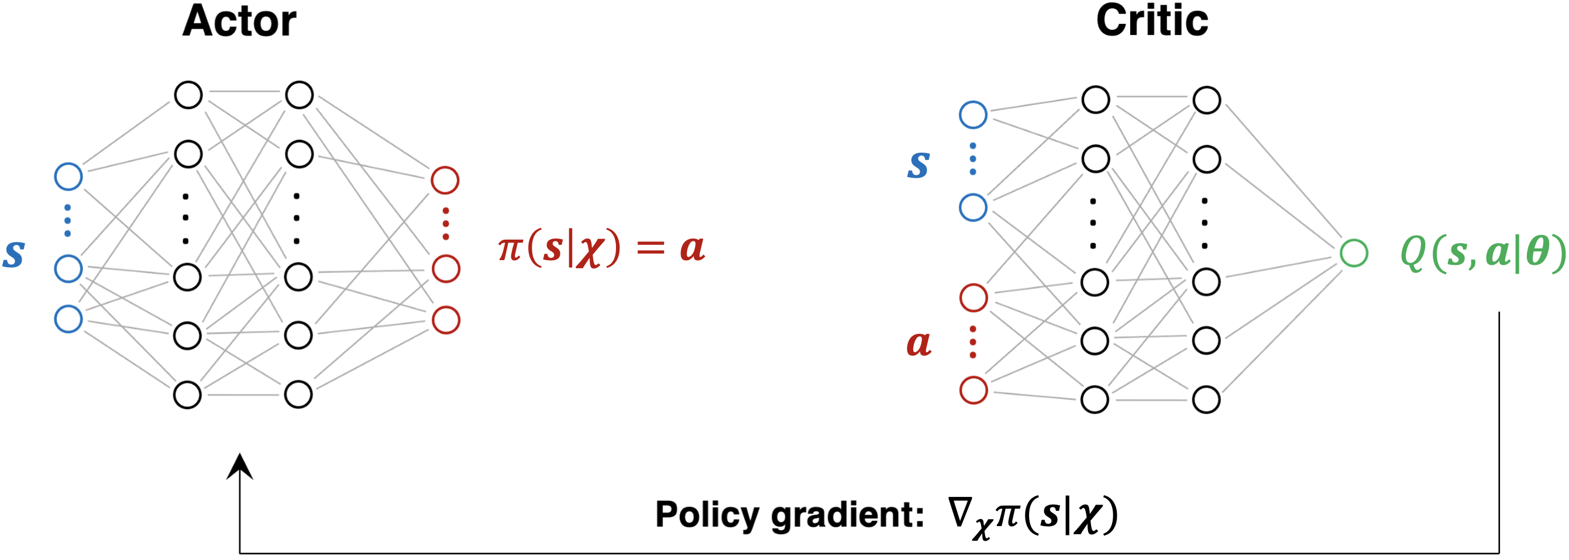

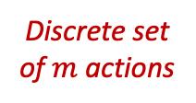
Free-energy based RL
Hybrid actor-critic scheme for continuous action-space problems
Q-learning: only discrete action-space environments
Our problems often require continuous action space develop hybrid actor-critic algorithm
Based on Deep Deterministic Policy Gradient family: DDPG, TD3, etc.
  QBM replaces classical critic, train with FERL approach
  Does it work? Can we exploit high learning efficiency of FERL?
  Intuitively: if critic learns faster, should benefit actor training via policy gradient
Q-learning
DDPG family
$$Q(s, a_{1})$$
QBM
Classical
$$∈ℝ^{n}$$
$$Q(s, a_{m−1})$$
$$Q(s, a_{m})$$
Discrete set of $m$ actions

Slide 12
Contents
    Motivation
    Free-energy based RL
    Results
    Conclusions & outlook

Slide 13
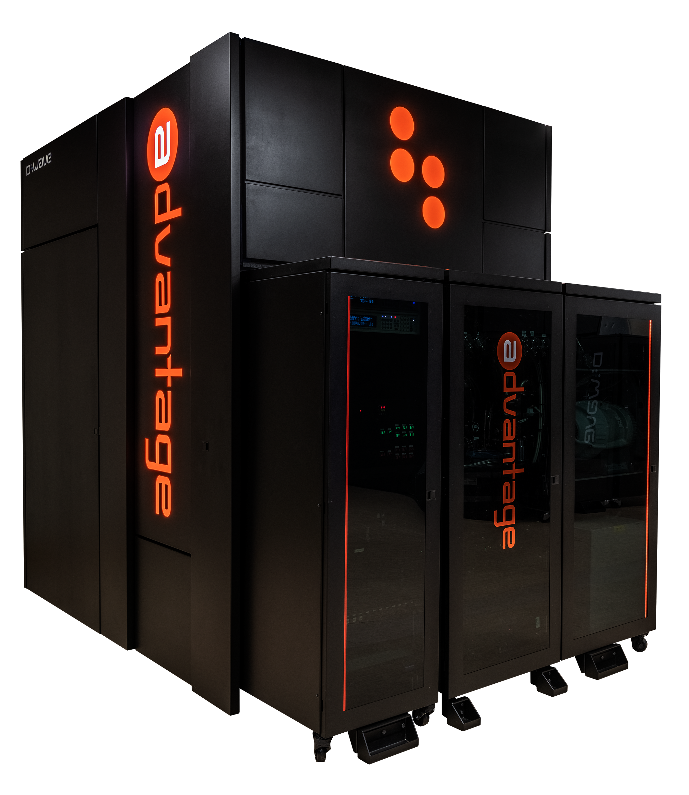
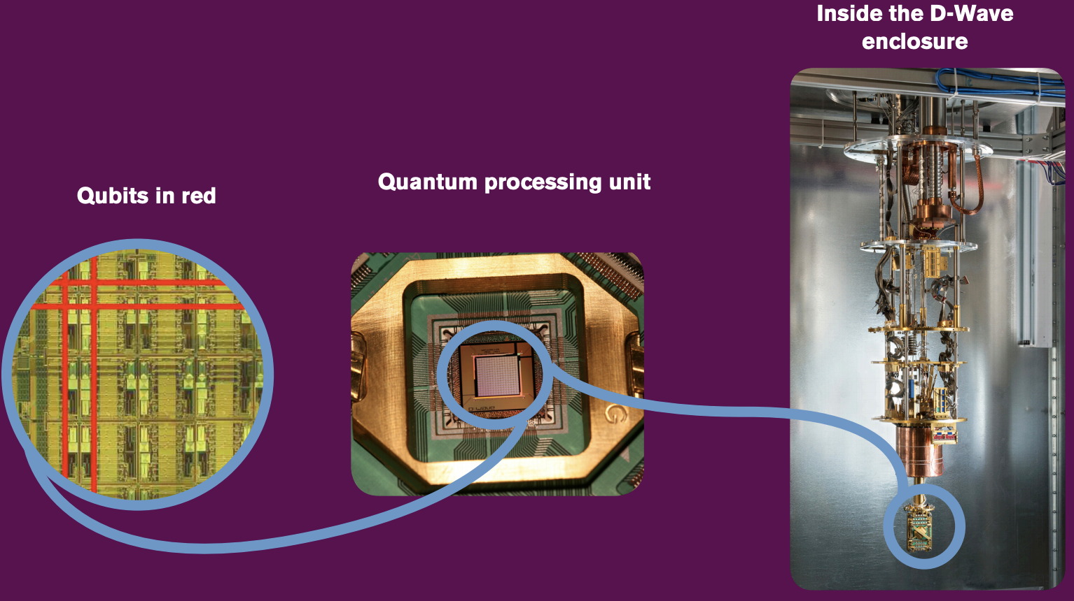
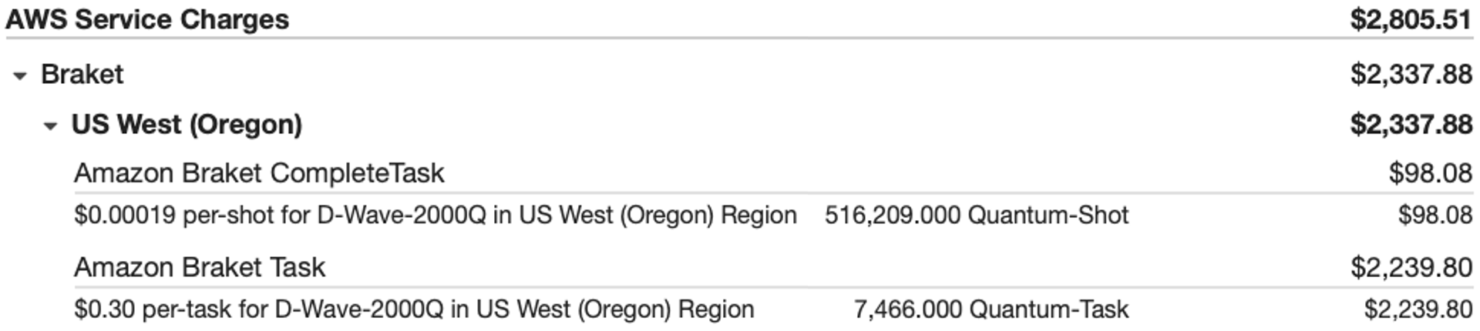
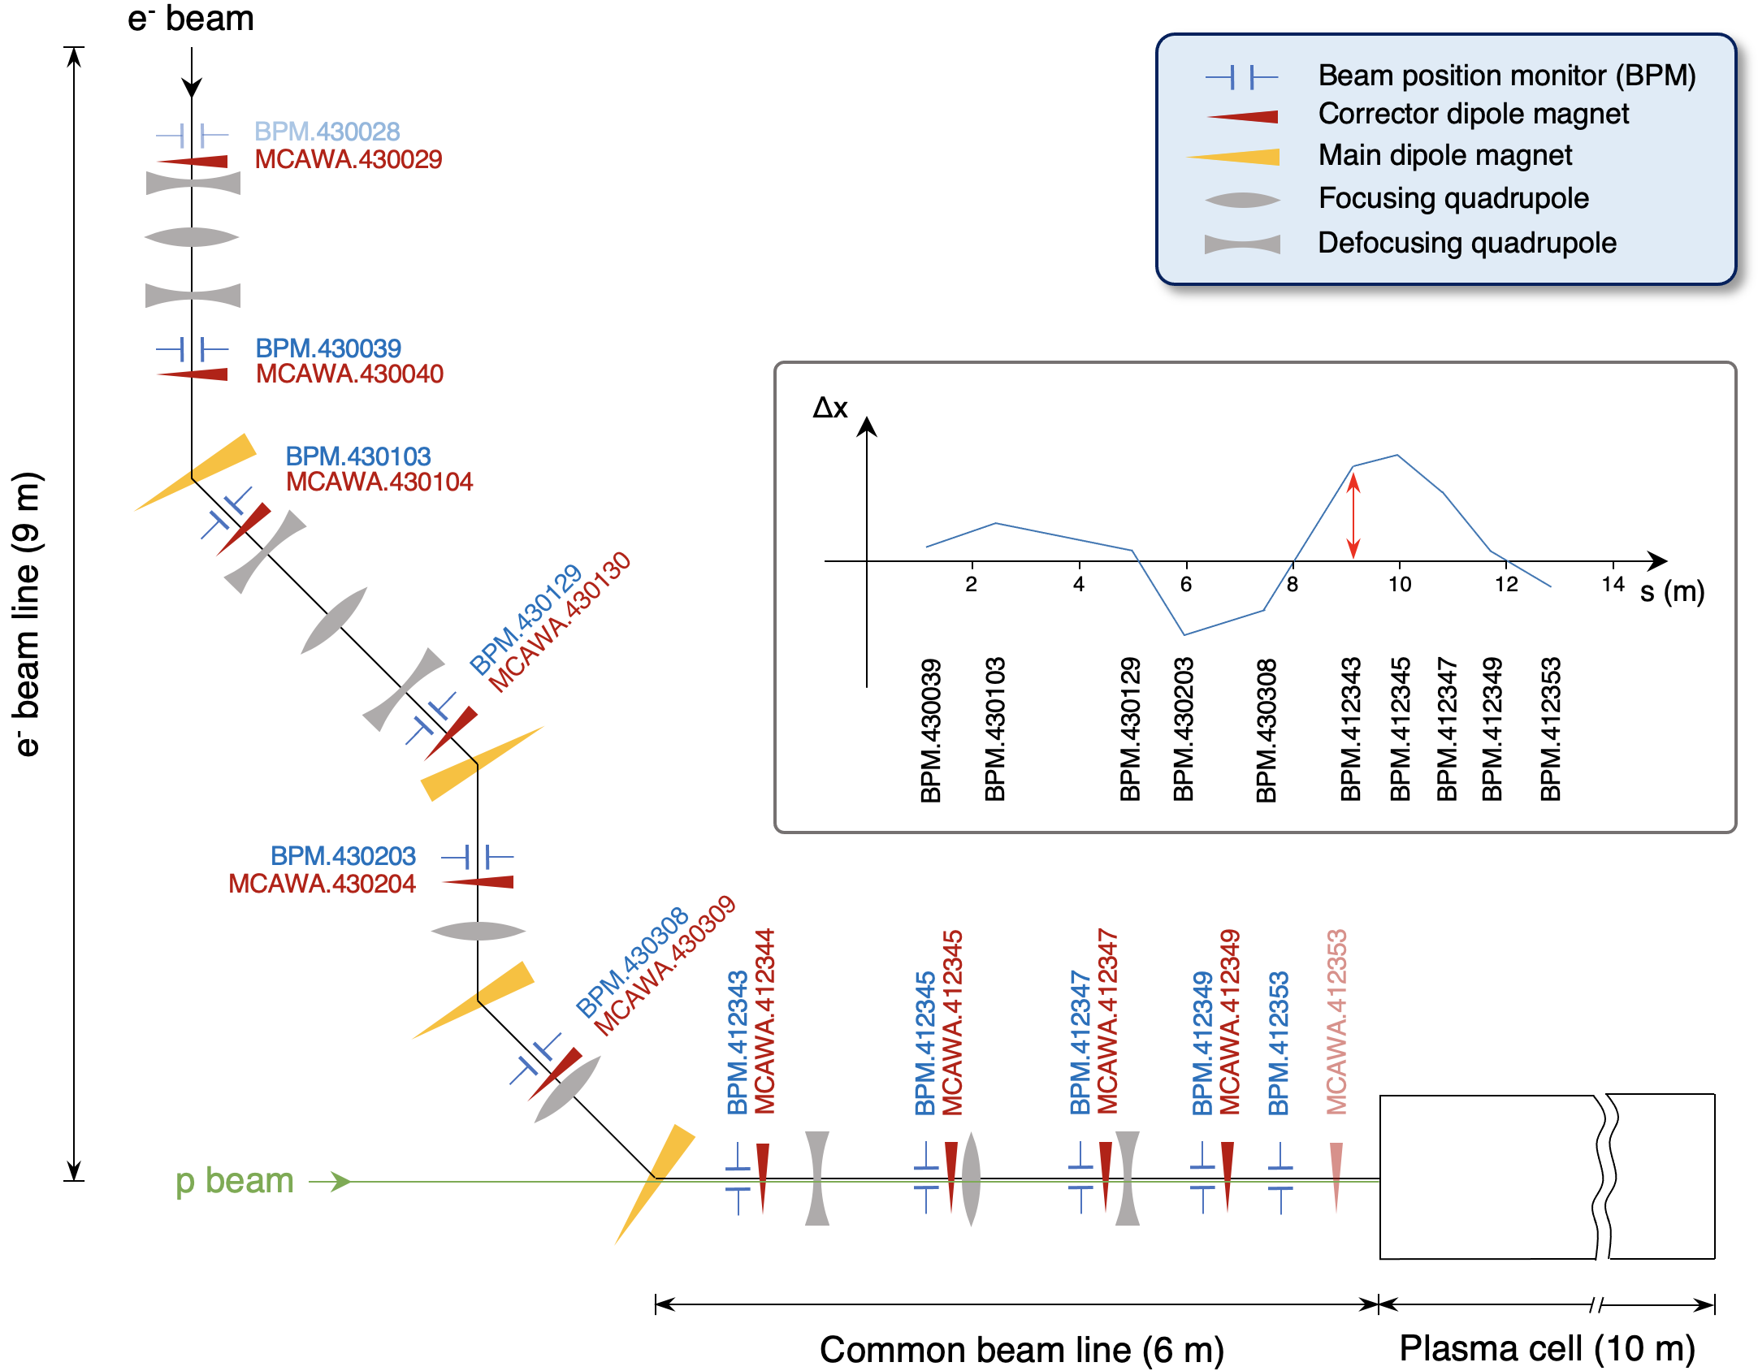
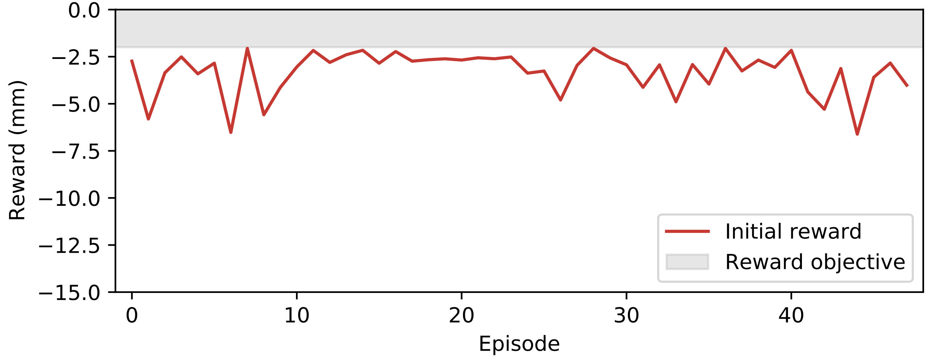
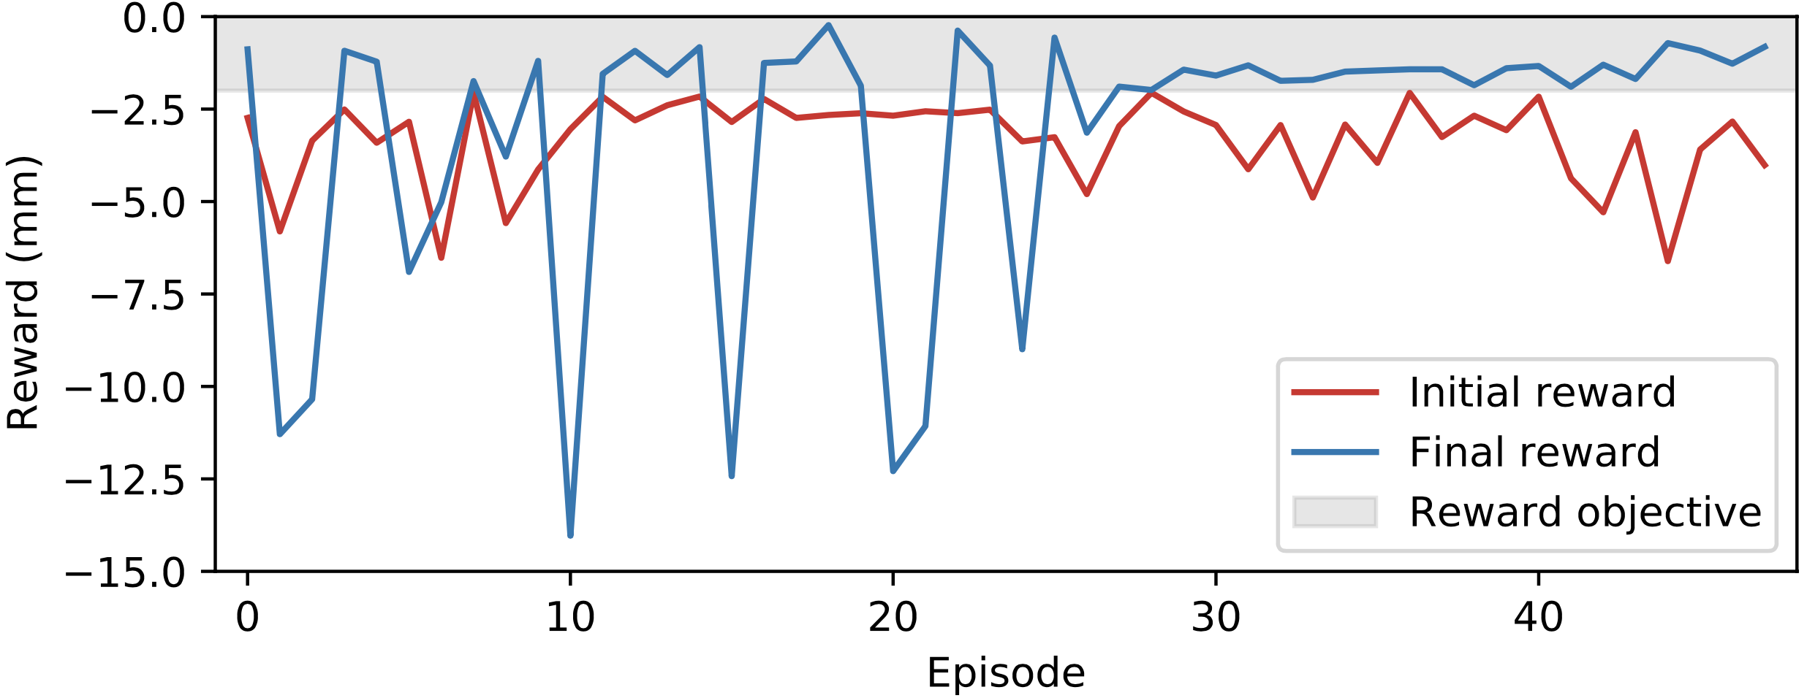
2nd study: 10-d continuous beam steering
RL problem and training on quantum annealer
Framing the RL problem
Action: deflection angles at 10 correctors
State: beam positions at 10 BPMs
Objective: minimize beam trajectory rms
reward: negative rms from 10 BPMs
🤯
Training: on D-Wave Advantage quantum annealer (QA)
Objective
Exploring & learning
Success

Slide 14
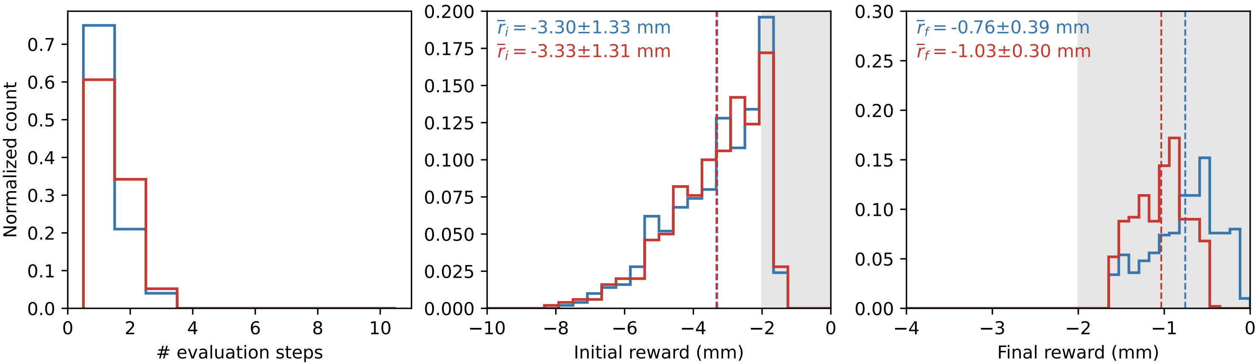
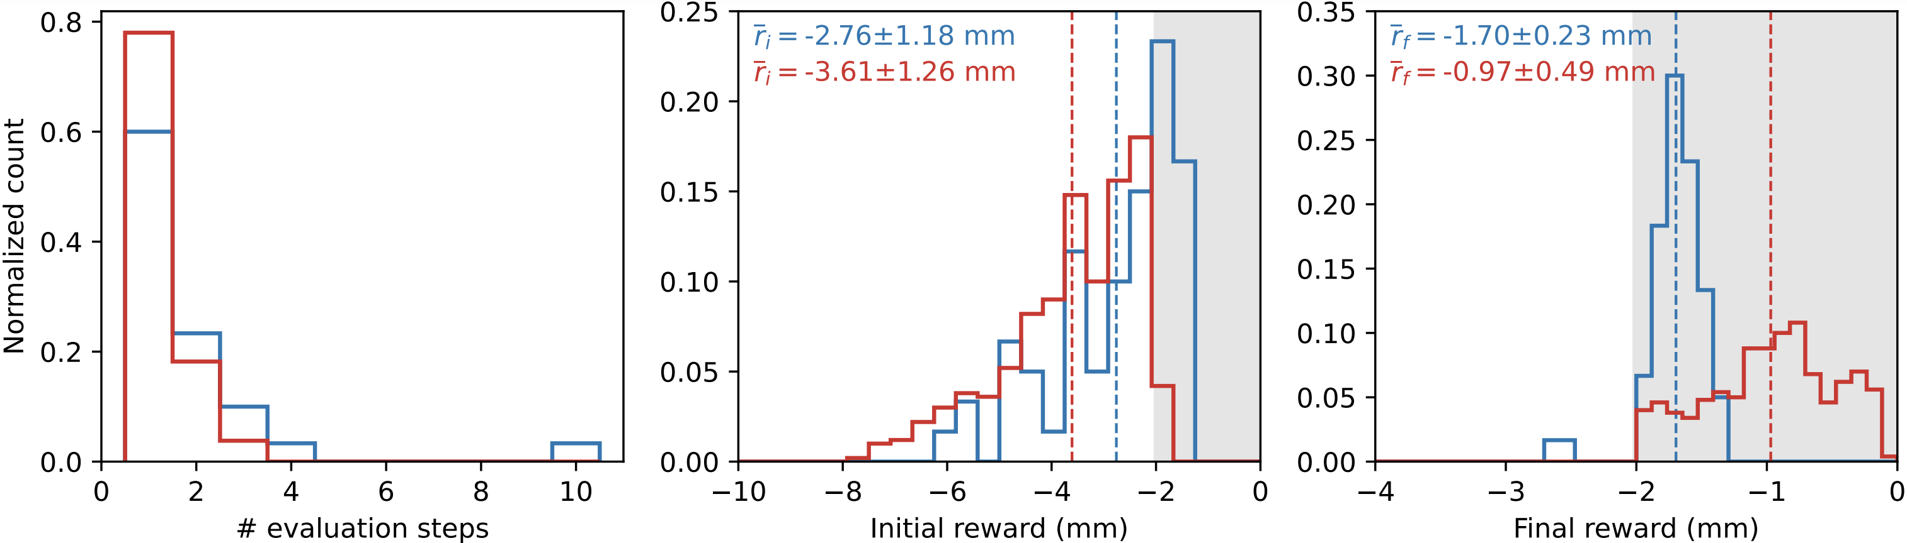
2nd study: 10-d continuous beam steering
Evaluation
Real (QA) vs simulated (SQA) quantum annealing
But it works ☺ !
Hyperparameter tuning with simulated quantum annealing
Consistent performance on simulated line
Agents minimize rms in 1 step for 60 – 70 % cases
Both also perform fine on real beamline
SQA-agent better on real line compared to QA agent
Simulated beam line
Real beam line

Slide 15
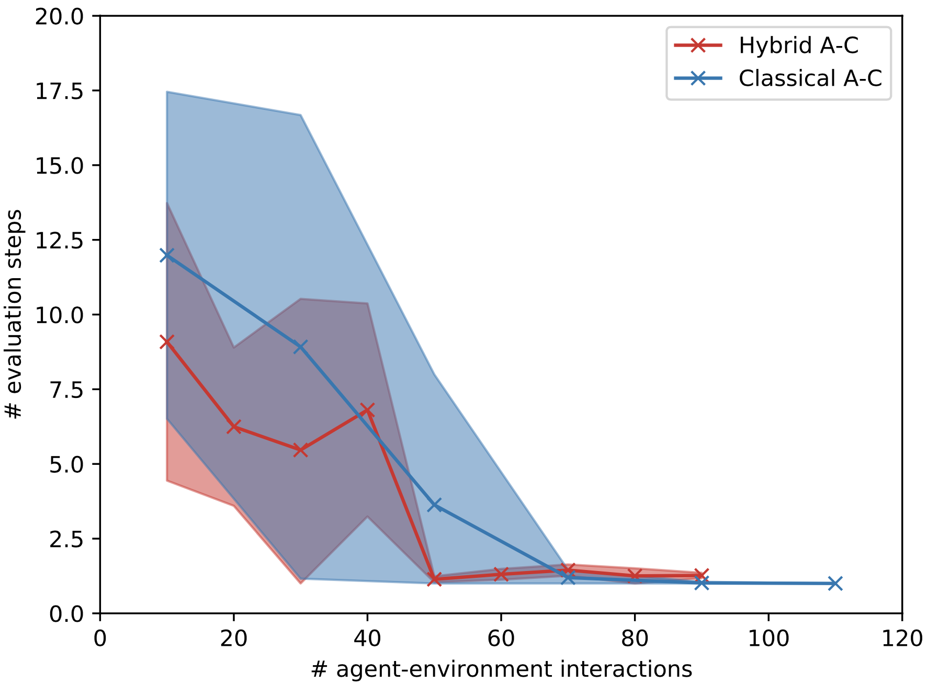
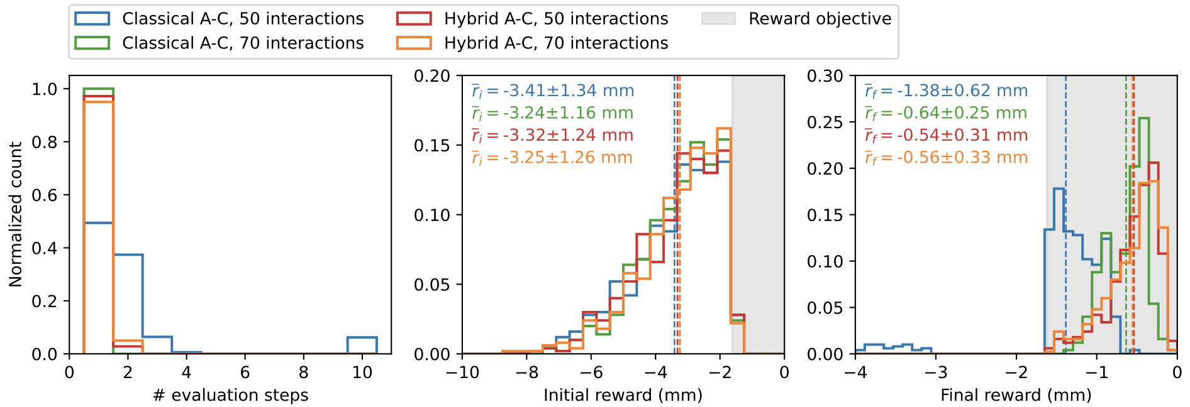
2nd study: 10-d continuous beam steering
Comparison to a classical actor-critic
Potentially a slight improvement in sample efficiency:
50 vs 70 interactions
Very few interactions sufficient for both approaches
Dynamics mayb too simple (linear problem) ?!
Move towards non-linear RL benchmarks

Slide 16
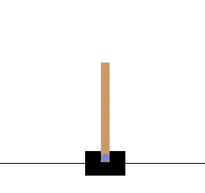
3rd study: Cart-Pole v1
Overview
Cart-Pole v1: official env from classic control problems domain
  Continuous state (4-d): cart position & velocity, pole angle & angular velocity
  Discrete action (1-d): push cart left or right
  Reward: +1 per iteration
  Max. episode length: 500 iterations
Non-linear dynamics
Agents
  Deep Q-learning: various architectures optimized with ray-tune
  FERL: 2x2 unit cell QBM (32 qubits), simulated QA and on D-Wave

Slide 17
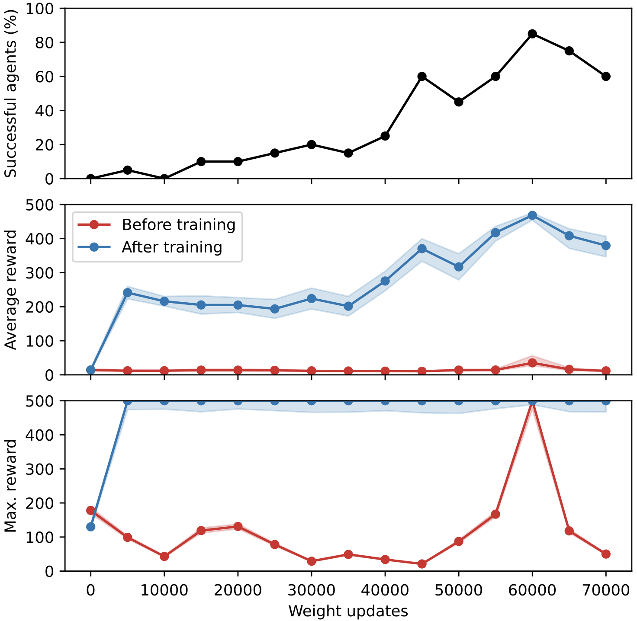
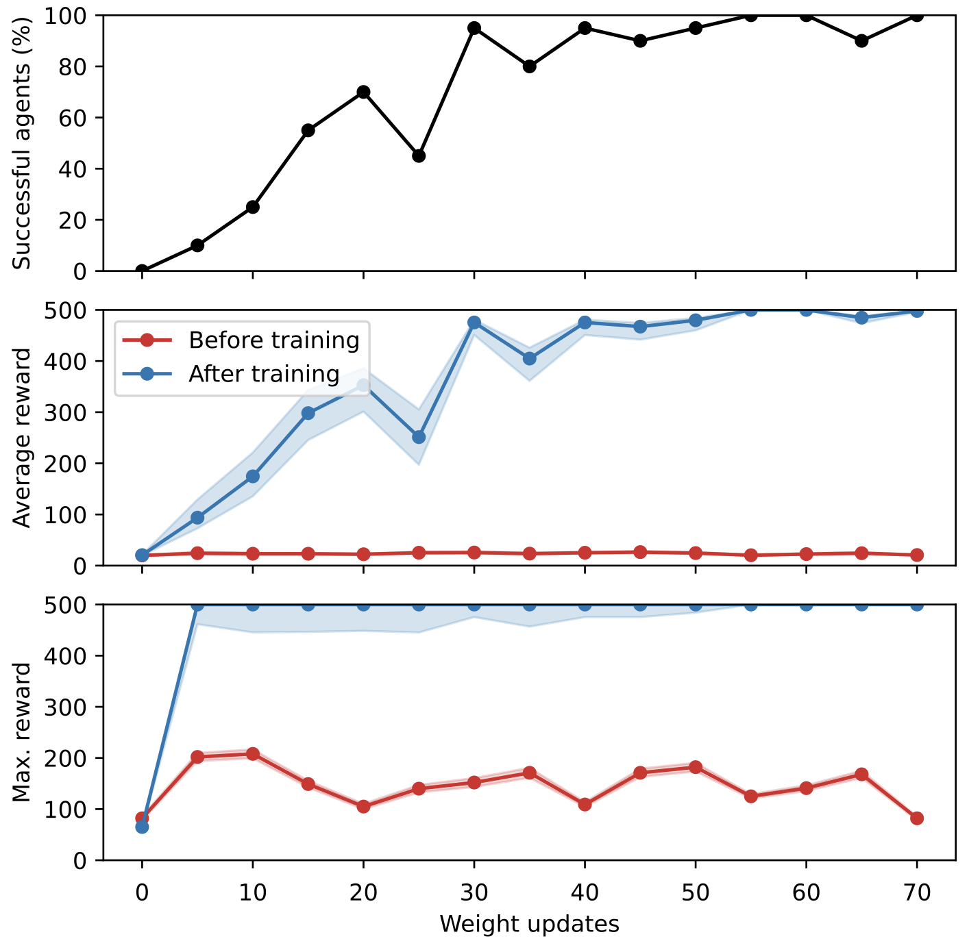
3rd study: Cart-Pole v1
Comparing DQN vs FERL
FERL
simulated QA
Deep Q-learning
Preliminary

Slide 18
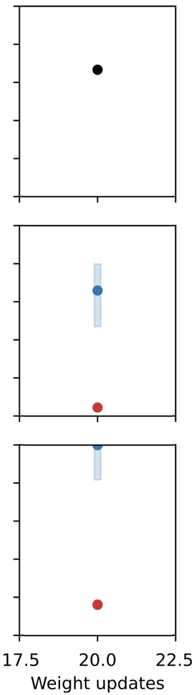
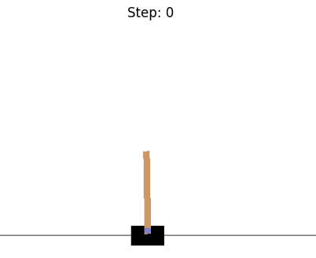
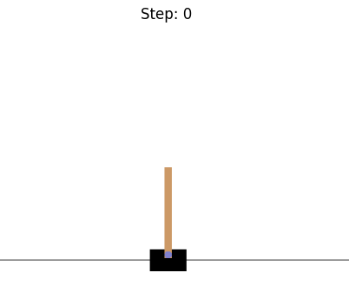
3rd study: Cart-Pole v1
Comparing DQN vs FERL
FERL
simulated QA
FERL
D-Wave
Deep Q-learning
Preliminary
before
after
Very high sample efficiency and robustness for FERL approach
Similar performance on D-Wave hardware

Slide 19
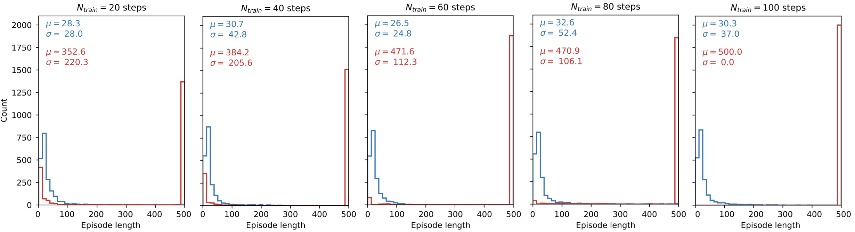
3rd study: Cart-Pole v1
Converges very fast
How about continuous action problems with non-linear dynamics?
More detailed study on FERL
Distribution of episode length before and after for different amount of training iterations
  50 independent agents
  40 evaluation episodes
Same 40 initial states for every agent
N_{train} = 100: all agents optimal

Slide 20
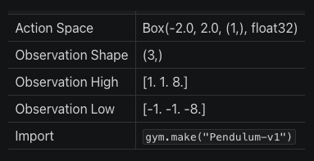
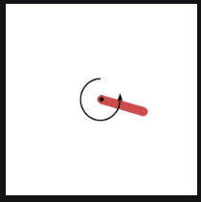

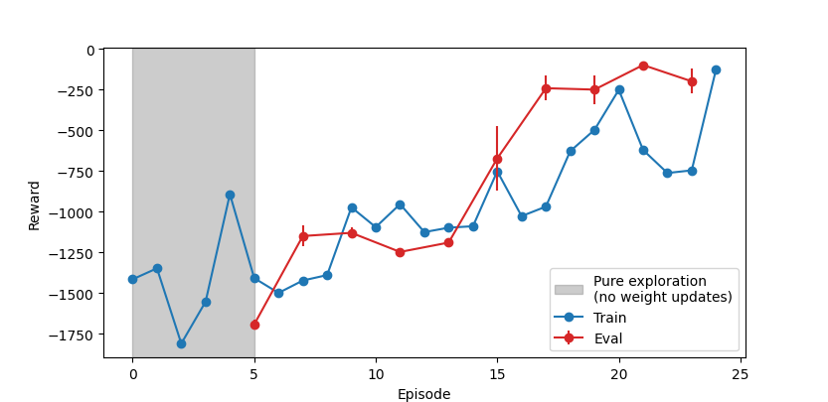
4th study: Pendulum-v1
Continuous action space
Classic DDPG (baseline)

Slide 21
Contents
    Motivation
    Free-energy based RL
    Results
    Conclusions & outlook

Slide 22
Some final thoughts and speculation I
Why is FERL interesting
Closely related to classical energy-based models (EBM)
  Employ energy function that assigns to each input a specific energy
  Optimize EBM weights to assign low-energy states to desirable inputs (-> more likely to be sampled)
Using EBMs allows mapping the RL problem to an actual physical system (e.g. quantum annealer)
Particularly interesting for larger networks
Performance increases seen so far significant for discrete action space problems
Some of its limitations
Difficult to tune / stabilize for continuous state-action space, i.e. sensitive to hyperparameters
Simulations computationally heavy
Real quantum annealers are expensive
N.B.: hybrid A-C does not need quantum annealer for policy network

Slide 23
Some final thoughts and speculation II
Why we think FERL could be more efficient than a classical approach?
Based on observations made …
Thought 1
  QBMs have higher expressivity compared to classical networks:
  every node is characterized by a probability distribution, rather than a simple marix multiplication
  Hence require fewer nodes than classical networks to represent Q-function
  This means fewer parameters to fit and hence less training data needed
  N.B.: classical network with few nodes failed to solve the task
Thought 2
  QBM training itself is more efficient, i.e. fewer weight updates needed to reach convergence
  Reason: quantum annealing finds global optimum more reliably

Slide 24
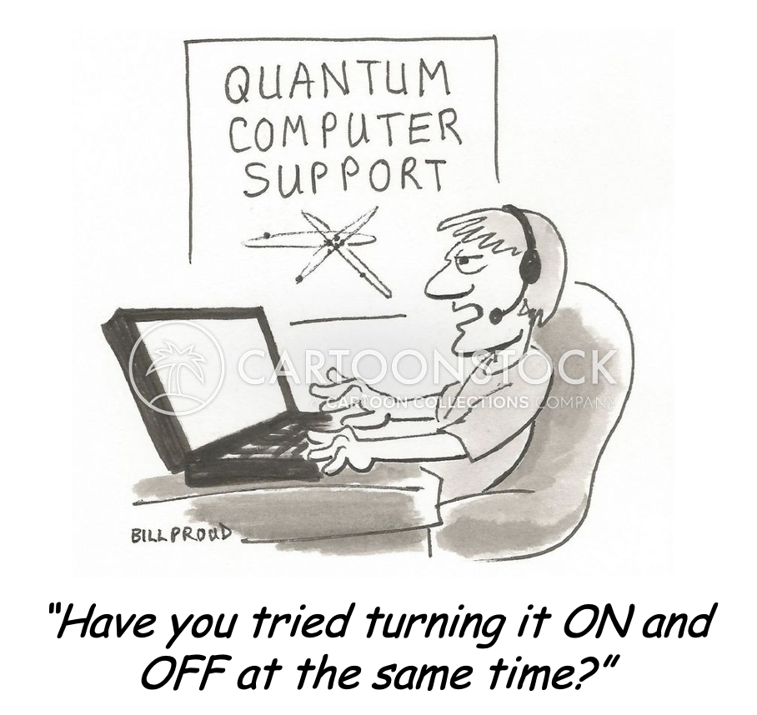
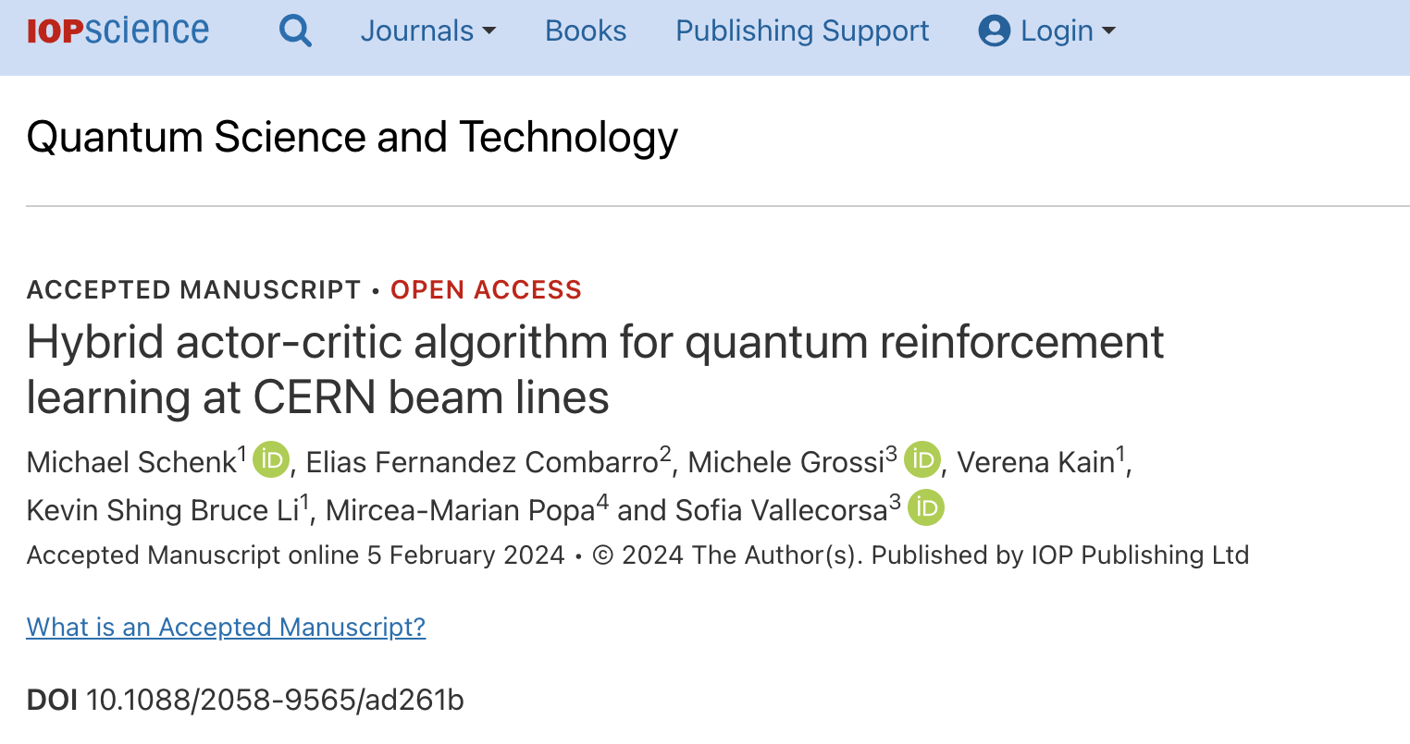
Final remarks & outlook
Sample efficiency depends on Q-approximator & algorithm:
FERL can be more sample efficient than classical approach
Developed hybrid actor-critic to solve continuous action problems
Successfully trained on simulated & real quantum annealer
and evaluated on simulated & real AWAKE beam line
FERL on non-linear Cart-Pole problem shows fast convergence
Outlook: try other quantum hardware, progress on non-linear continuous action problem, explore alternative methods
Questions?
DOI 10.1088/2058-9565/ad261b

Slide 25
Backup

Slide 26
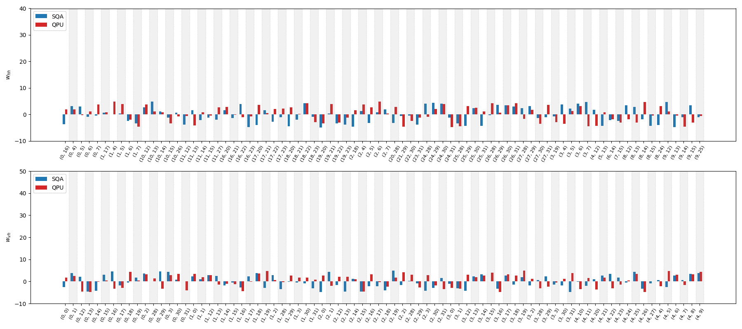
3rd study: Cart-Pole v1
Coupling weights evolution: simulated vs real QA
QBM coupling weights trained with SQA and on QPU
  Similar distribution and convergence time scales

Slide 27
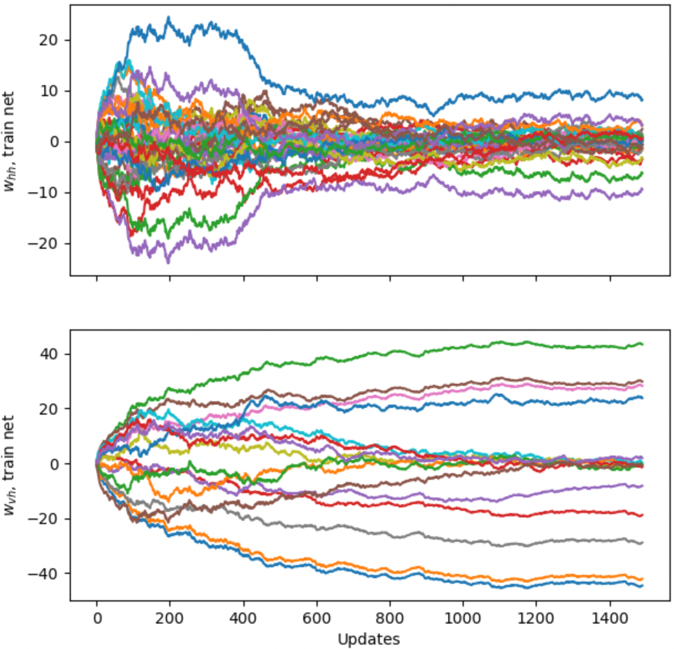
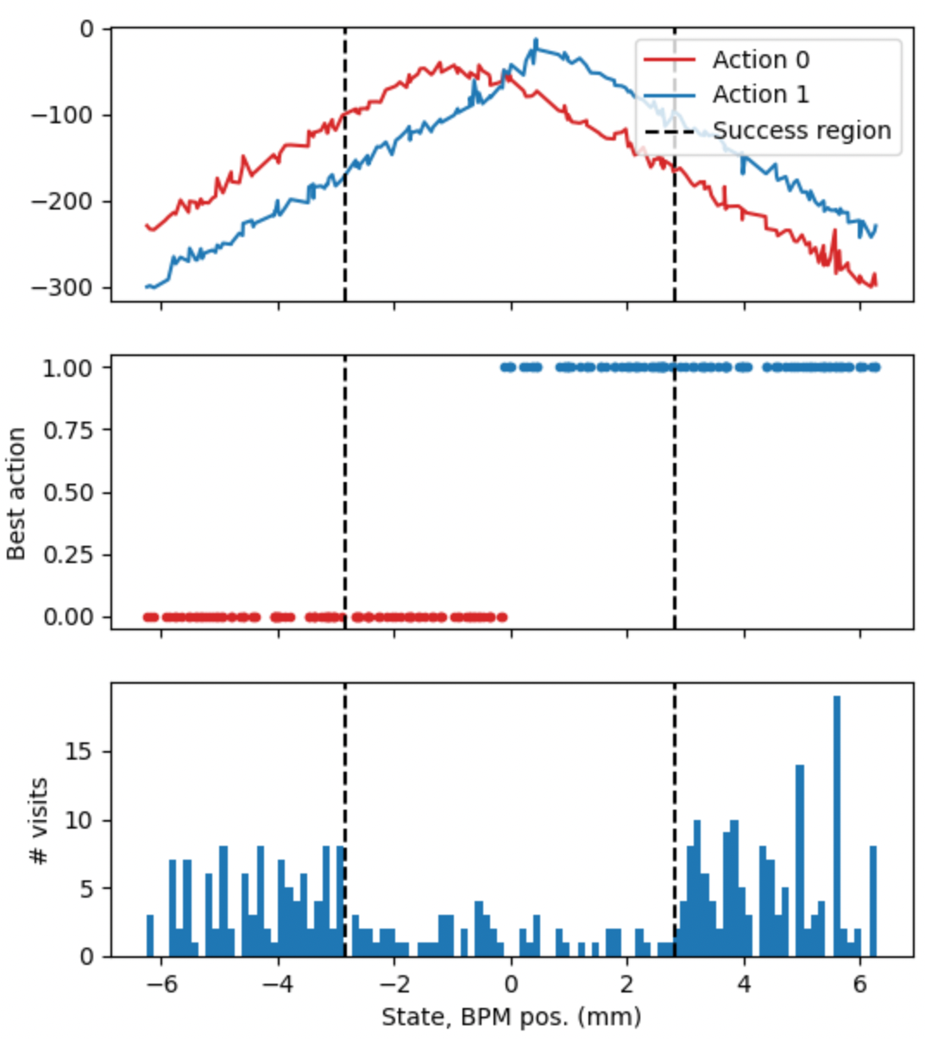
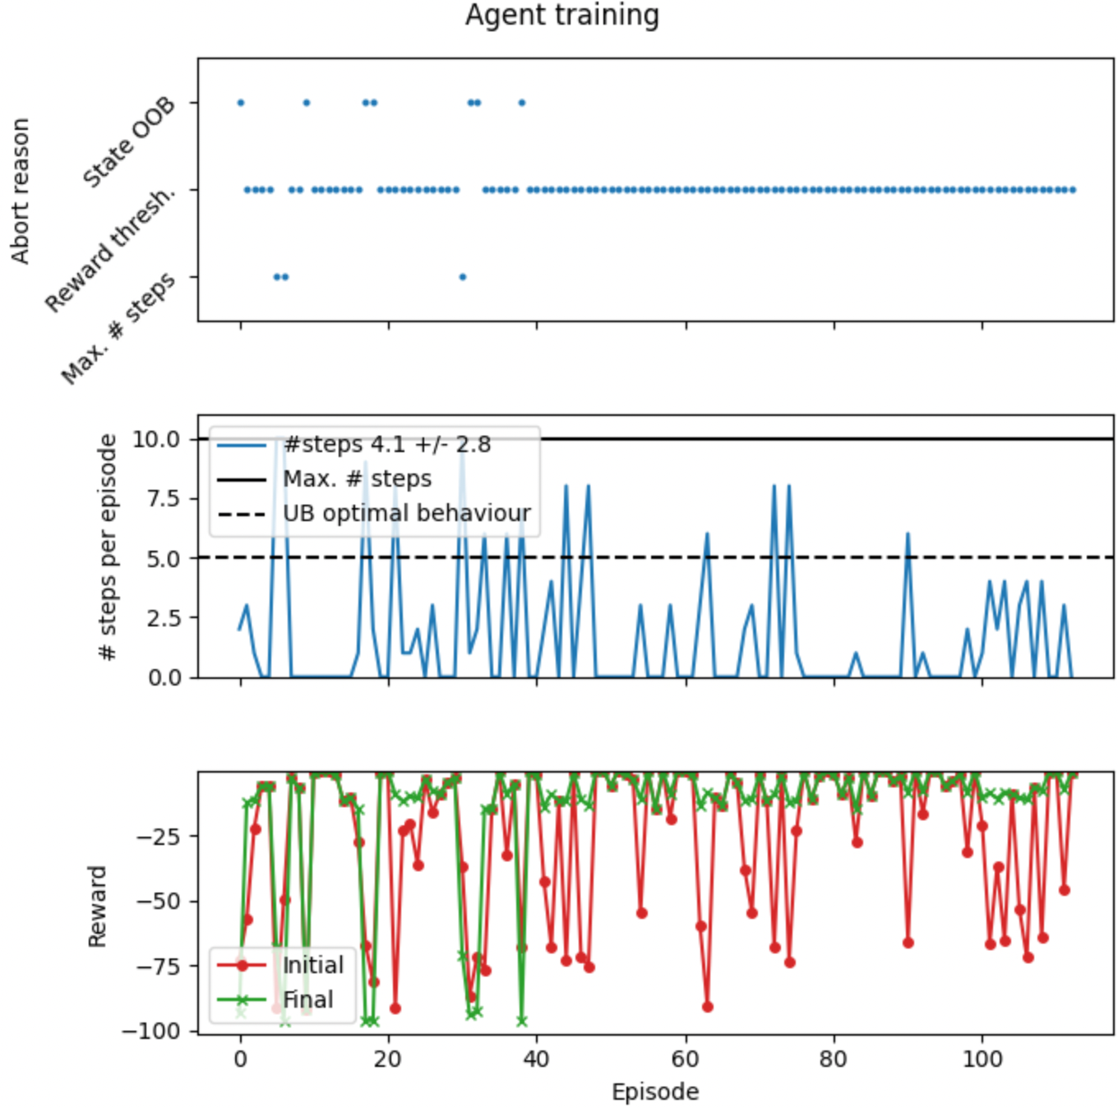
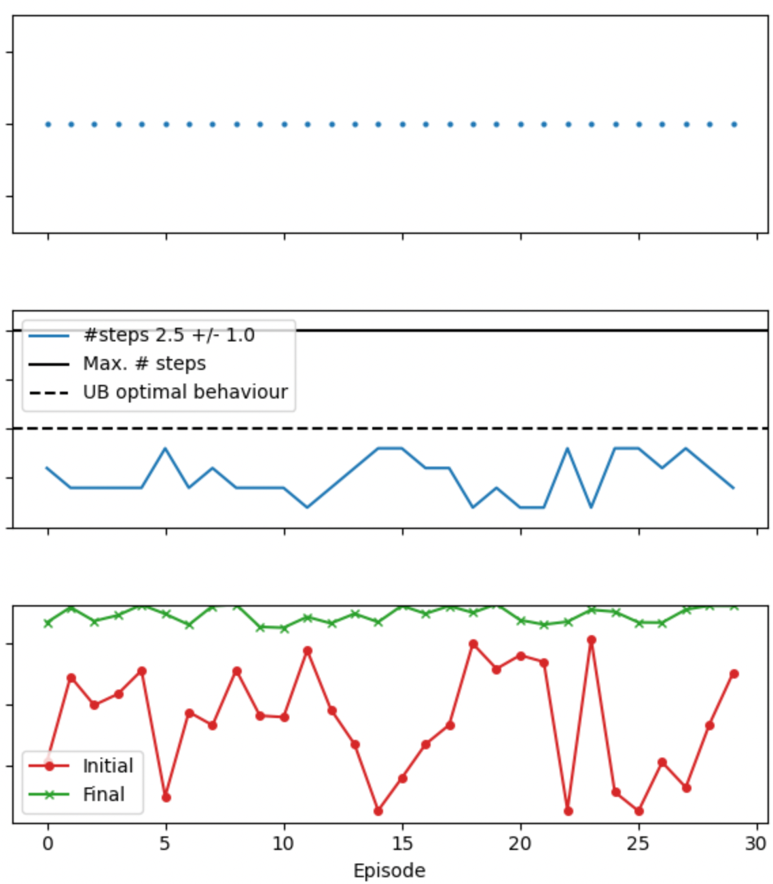
Alternative approaches
RL with QAOA
QAOA: Quantum Approximate Optimization Algorithm
Solver for combinatorial optimization problems: finds spin configuration with minimum energy; not based on annealing, but more generic gate-based QPU
Can solve quadratic unconstrained binary optimization (QUBO) problems
Works well, but simulations compute-intensive (~5.5 h for 100 interactions)
On hardware (e.g. IBM), could be affected by noise
Training
Evaluation

Slide 28
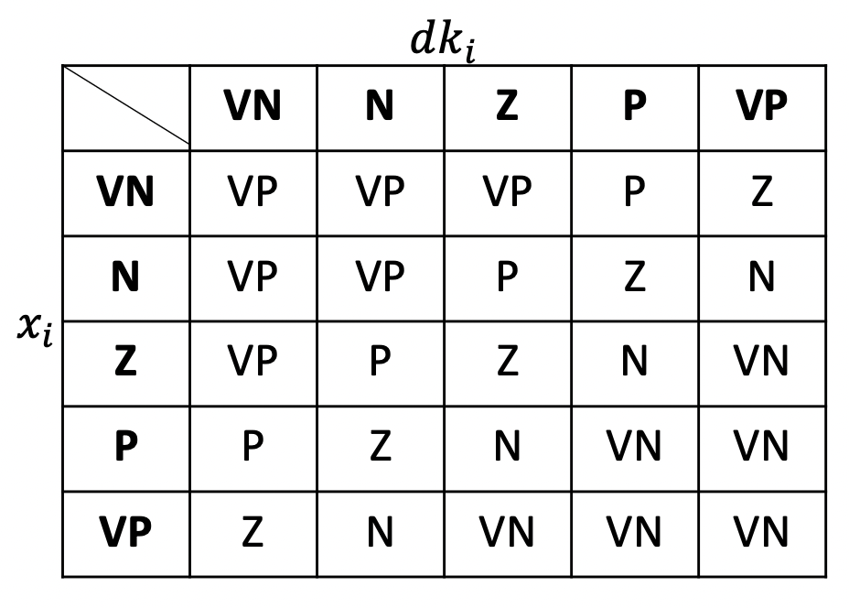
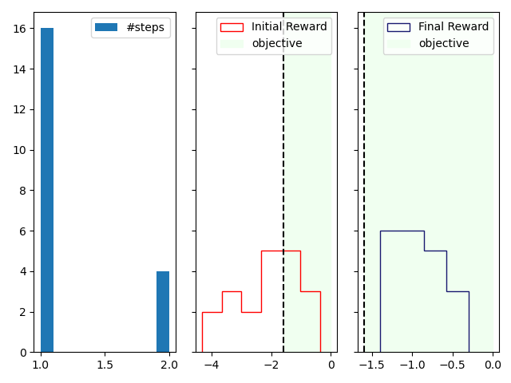
Alternative approaches: quantum fuzzy logic controller
Evaluation on AWAKE beam line
Alternative control algorithm
Fuzzy Logic is used to develop control systems based on linguistic rules highly interpretable
Quantum Fuzzy Control System (G. Acampora, R. Schiattarella, A. Vitiello)
Exploit exponential advantage in computing fuzzy rules on quantum computers
Successfully evaluated on AWAKE beam line (no training required)
Evaluation: on AWAKE beam line
Objective reached typically in 1 step

Slide 29
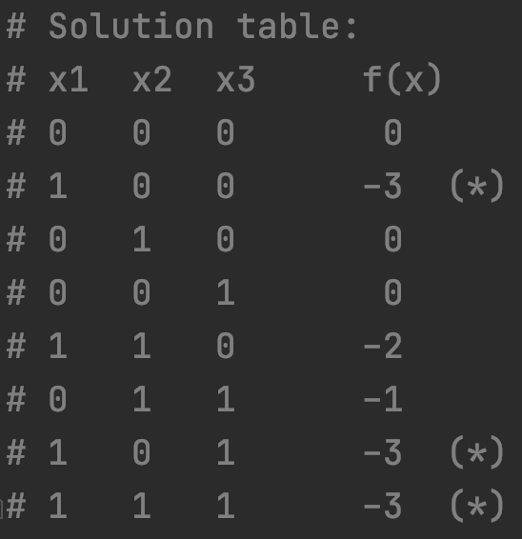



QUBO formulation
QUBO: quadratic unconstrained binary optimization problems
The kind of problems that quantum computers (annealers) solve efficiently
Example with 3 qubits
$$f\left(x_{1},x_{2},x_{3}\right)=−3x_{1}+x_{1} x_{2} −x_{2} x_{3}$$
QUBO matrix
  On diagonal terms describe self-couplings, i.e. biases
  Off diagonal terms describe quadratic couplings between qubits
Run annealing 5000 times
Corresponds to our solution table
$$Q=\left[\begin{matrix}−3 & 1 & 0 \\ 0 & 0 & −1 \\ 0 & 0 & 0\end{matrix}\right]$$

Slide 30




Accelerators seen by the …
… machine operators & and beam physicists
… funding agency
… visitors
… experimental physicist
D. L. Judd & R. MacKenzie, “The Cyclotron, as seen by”

Slide 31
Accelerators seen by the …
… machine operators & and beam physicists
… funding agency
… visitors
… experimental physicist
D. L. Judd & R. MacKenzie, “The Cyclotron, as seen by”

Slide 32


Introduction
Motivation
CERN maintains dense & diverse physics program
Imposes challenges on accelerator operation
Machine availability & beam quality critical for experiments to reach physics objectives
Broad spectrum of machine & beam types requiring high flexibility and efficient parameter tuning
Ideally, machine operation based on physics models
Not always possible: complexity, completeness, online evaluation, ...
Explore new technologies
What does the optimization & ML toolbox have to offer?
Will discuss specific aspects of reinforcement learning (RL) today

Slide 33


Introduction
RL and the machine learning landscape
  Goal: find mapping $f: x_{i}⟼y_{i}$
  Data: labelled samples $(x_{i}, y_{i})$
  Goal: find structure in data
  Data: unlabelled samples $(x_{i})$
Other approaches
Classic control
Numerical and Bayesian optimization, (GP-)MPC, fuzzy logic, etc.
Some of them very suitable for accelerator-related problems
  Goal: learn to take optimal decisions
  Data: agent actively interacts with environment collecting samples & rewards
Image source

Slide 34
Contents
    Introduction
    Reinforcement learning
    Beyond classical RL
    Results
    Conclusions & outlook

Slide 35
Contents
    Introduction
    Reinforcement learning
    Beyond classical RL
    Results
    Conclusions & outlook

Slide 36





Reinforcement learning (RL)
DeepMind, 2022: AlphaTensor
Improve computational efficiency of matrix multiplication
Benefits countless fields
RL agent discovered more efficient algorithms than developed by humans
State-of-the-art
DeepMind & EPFL, 2022: Tokamak control
Maintaining plasma within tokamak requires high-dimensional, high-frequency, closed-loop control using magnetic actuator coils
RL agent successfully trained as magnetic controller
DeepMind, 2016: AlphaGo
UZH & Intel Labs, 2023: Drone racing
RL agent beats human drone racing champions in real environment
Training in simulations with mixed-in residual models from real data
OpenAI, 2019: Hide and seek
and more …

Slide 37



Reinforcement learning (RL)
... in a nutshell
Trial-and-error learning
Agent takes actions in environment and collects rewards
Goal
  learn optimal behavior ⬄ maximize return $G_{t}$
  sum of discounted, future rewards
$G_{t}=\sum_{k=0}{γ^{k} r_{t+k}}$ with $γ∈\left(0, 1\right)$
Policy $π$: encodes agent’s behavior – “what action to take in a given state?”
Can be solved in various ways: many kinds of algorithms exist
Sutton & Barto
Example: Pacman
State: where am I? Where are ghosts, snacks, cookies?
Actions: up, down, left, right
Reward: food (+), ghosts (-)
Return: how much food am I going to eat over time
Policy: given state, should I go up, down, left, or right?

Slide 38

Reinforcement learning (RL)
Algorithm zoo
OpenAI – spinning up
Focus on Q-learning
  Can understand a large selection of RL algorithms, and this talk
  Also covers algorithms mostly employed for CERN RL applications so far

Slide 39


RL challenges
… for accelerator applications, but not only
    Sample efficiency
      How many agent-environment interactions are required for convergence?
      Relevant for particle accelerator control given cost of beam time (online training)
    Reward engineering
      Alignment: getting the objective right
      “Making sure the agent does what we want it to do”
    State definition
      Ideally “fully observable”
      Limited beam instrumentation
      Can be a real RL show-stopper
    Parameter drifts
      Dependencies we can not easily include in our state
    Safety
      Particularly a concern during exploration
      There are ways to add safety to RL agents
https://arxiv.org/abs/2205.10330

Slide 40
RL challenges
… for accelerator applications, but not only
    Sample efficiency
      How many agent-environment interactions are required for convergence?
      Relevant for particle accelerator control given cost of beam time (online training)
    Reward engineering
      Alignment: getting the objective right
      “Making sure the agent does what we want it to do”
    State definition
      Ideally “fully observable”
      Limited beam instrumentation
      Can be a real RL show-stopper
    Parameter drifts
      Dependencies we can not easily include in our state
    Safety
      Particularly a concern during exploration
      There are ways to add safety to RL agents
Focus today
https://arxiv.org/abs/2205.10330

Slide 41



Q-learning
How does it work?
Use Q-function $Q(s,a)$ to estimate return $G_{t}=\sum_{k=0}{γ^{k} r_{t+k}}$ for every $(s, a)$ pair
Q answers: “In a given state, what is the best action to take to maximize return?”
Greedy policy: $a_{t}=arg max_{a′} Q(s_{t},a′)$
Learning Q
Iterative approach based on temporal difference (TD) rule using collected agent-environment interactions
$$!$$
$Q\left(s_{t}, a_{t}\right)=r_{t}+γ max_{a′}$ $Q\left(s_{t+1}, a^{′}\right)$
learning rate
TD error
$$Q\left(s_{t}, a_{t}\right)←Q\left(s_{t},a_{t} \right)+α [r_{t}+γmax_{a′}{Q\left(s_{t+1}, a^{′}\right)−Q(s_{t}, a_{t})]}$$
target (new best guess)
old
prediction
Bootstrapping: update $Q\left(s_{t},a_{t}\right)$ using target based on estimate.
“Moving target”: training could be unstable double Q-learning
Q-function represented by e.g.: table, parametrized model (neural network, ?)

Slide 42







Q-learning
N.B.: we often deal with (large) continuous state-action spaces
An example: Q-table
-1
+30
-10
-5
$$Q\left(s_{t}, a_{t}\right)←Q\left(s_{t},a_{t} \right)+α [r_{t}+γmax_{a′}{Q\left(s_{t+1}, a^{′}\right)−Q(s_{t}, a_{t})]}$$
greedy
policy
RL lecture @TU Darmstadt

Slide 43
Q-learning
Deep Q-learning (DQN)
$$Q(s, a_{1})$$
$$Q(s, a_{m−1})$$
$$Q(s, a_{m})$$
Q-function of continuous or very large state-spaces can no longer be represented by a table
Replace table by a neural network: deep Q-learning (DQN)
  universal function approximator
  great interpolator (e.g. for unseen states)
Train network weights using temporal difference learning
Does not yet solve the continuous action problem: see e.g. actor-critic schemes

