Slide 1

Reinforcement Learning for FLASH Dose Delivery Optimization
Jonathan Edelen, Joshua Einstein-Curtis, Christopher Hall, Morgan Henderson (RadiaSoft)
Auralee Edelen, Jorge Diaz Cruz (SLAC)
February 7th 2024
RL4AA 2024: Salzburg Austria
This material is based upon work supported by the U.S. Department of Energy, Office of Science, Office of Accelerator R&D and Production award number DE-SC0023641
Boulder, Colorado USA | radiasoft.net

Slide 2


RadiaSoft is an industry leader in high-level research & design and scientific consulting for beamline physics and machine learning
Diverse staff covering a wide range of scientific and software expertise
  Seven full time software developers with expertise in Java, Python, C++, and Perl.
  Eleven full time computational scientists and engineers with expertise in a variety of specialty disciplines, including: optics, controls, embedded systems, and computational modeling.
  Three administrative staff and one marketing professional.
Regular contributions to more than 20 workshops and conferences annually, including accelerator education
Computational Support
User Support
Operational Systems
Sirepo: browser based computational gateway
Image processing: Sample identification and noise reduction
Embedded systems for edge AI and LLRF
Jupyterhub: customized computational environment
Data analysis and visualization workflows
Digital twins and online modeling
Shielding design and radiation transport simulations
https://sirepo.com
Contract R&D / Engineering Services

Slide 3
Industrial Applications of Accelerators
Security and Defense
Imaging
Manufacturing
Directed energy
Single effects testing
Polymer treatment
Industrial Curing
X-ray sources
Gamma-ray sources
Medical
electron microscopy
Welding
Ion Implantation
Proton Therapy
X-ray therapy
Next generation of industrial systems are increasing in complexity
  Distributed RF generation
  Multi-cavity designs for higher energy
E-beam therapy
Sterilization
Medical device sterilization
Food irradiation
Wastewater treatment

Slide 4
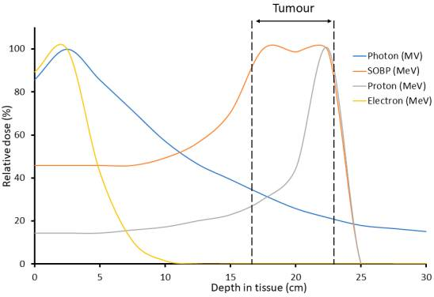
What is FLASH Radiotherapy?
Ultrafast delivery of radiation
  dose rates that are several orders of magnitude greater than those used in conventional radiotherapy
  40 Gy/s (FLASH) vs 0.5–5 Gy/min (conventional)
Preclinical data suggesting that FLASH could achieve better disease control with fewer side effects
  Improved safety and efficacy (confirmed by clinical trials)
Hughes JR, Parsons JL. FLASH Radiotherapy: Current Knowledge and Future Insights Using Proton-Beam Therapy. Int J Mol Sci. 2020 Sep 5;21(18):6492. doi: 10.3390/ijms21186492. PMID: 32899466; PMCID: PMC7556020.

Slide 5
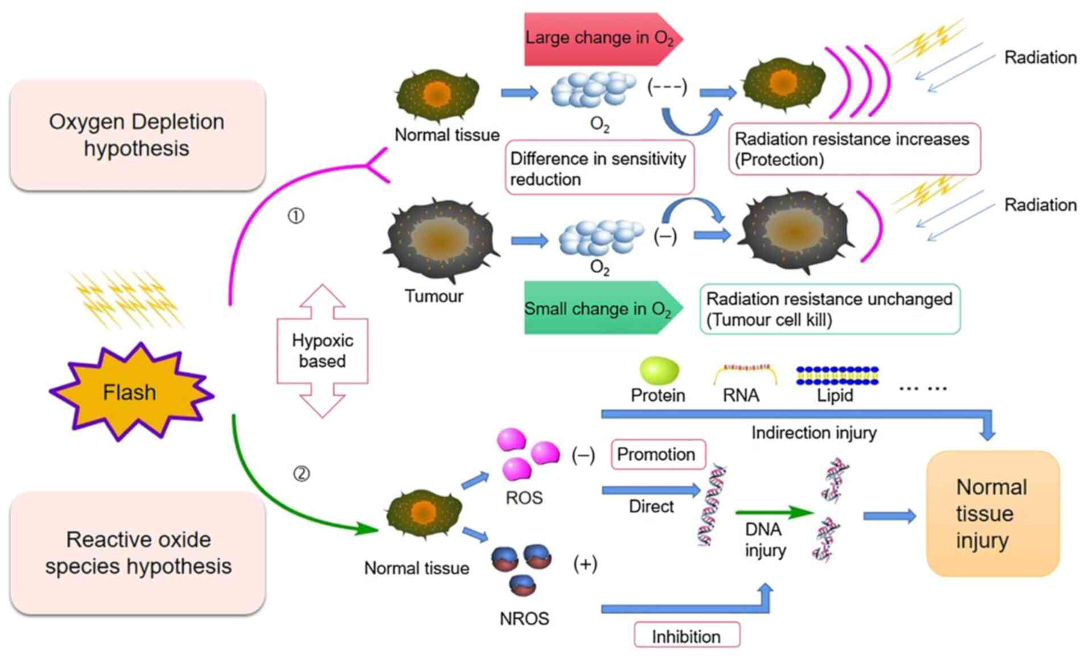
How does FLASH Radiotherapy work?
Right: Mechanistic diagram of the oxygen consumption hypothesis and ROS hypothesis:
  Top: Oxygen consumption hypothesis: High-dose transient irradiation reduces the presence of oxygen, and this effect is greater on normal cells, resulting in stronger radiation resistance.
  Bottom: Reactive Oxygen Species (ROS) levels that causes DNA, RNA, protein and lipid injury, and an increase in the protective non-reactive oxygen species (NROS) levels that inhibits DNA injury.

Slide 6
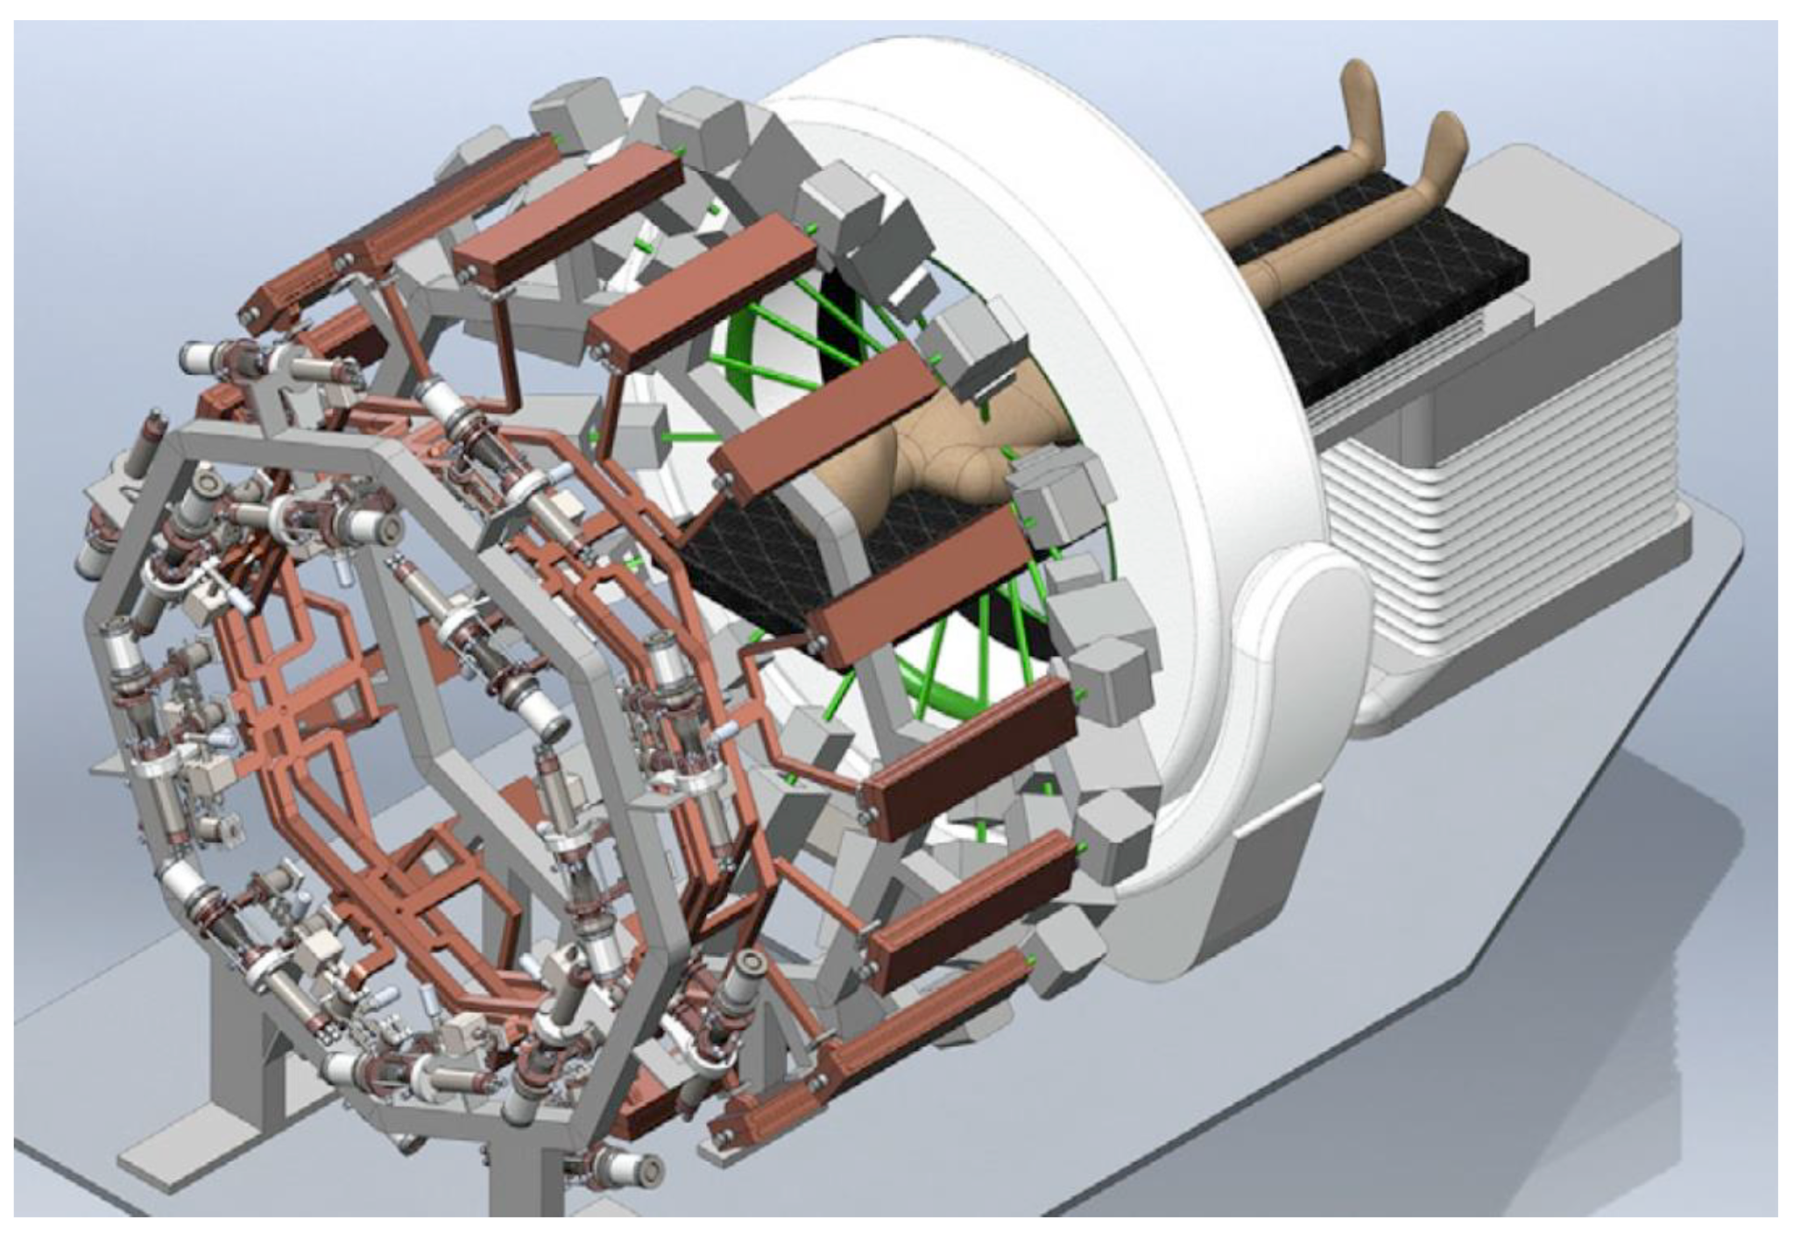
PHASER: A solution for FLASH-RT
PHASER (pluridirectional high-energy agile scanning electronic radiotherapy)
  16 klystrinos power combined to drive a given linac with 5.3 MW of peak power
  Switching between LINACs occurs at 300ns

Slide 7
PHASER: A solution for FLASH-RT
PHASER (pluridirectional high-energy agile scanning electronic radiotherapy)
  16 klystrinos power combined to drive a given linac with 5.3 MW of peak power
  Switching between LINACs occurs at 300ns
Understanding the accelerator
  Modeling the power combining is challenging (compensating for phase and amplitude jitter in the klystrinos)
  Different LINACs need to operate at different energies
  Beam steering using magnets

Slide 8
PHASER: A solution for FLASH-RT
PHASER (pluridirectional high-energy agile scanning electronic radiotherapy)
  16 klystrinos power combined to drive a given linac with 5.3 MW of peak power
  Switching between LINACs occurs at 300ns
Understanding the accelerator
  Modeling the power combining is challenging (compensating for phase and amplitude jitter in the klystrinos)
  Different LINACs need to operate at different energies
  Beam steering using magnets
Patient treatment
  Rapid computation of optimal dose
  Compensation for breathing

Slide 9
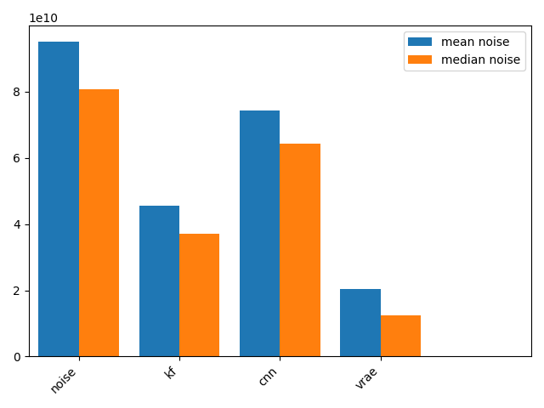
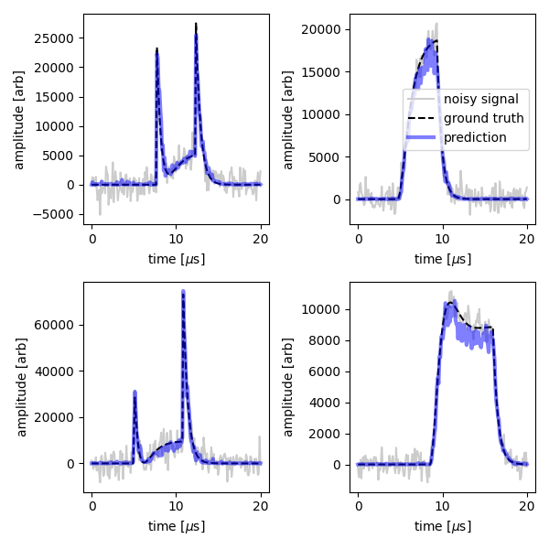
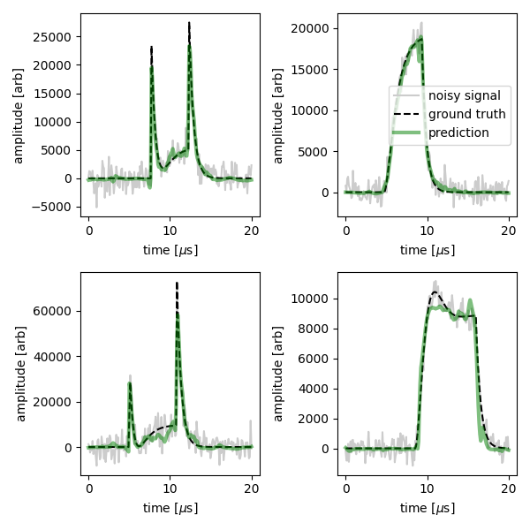
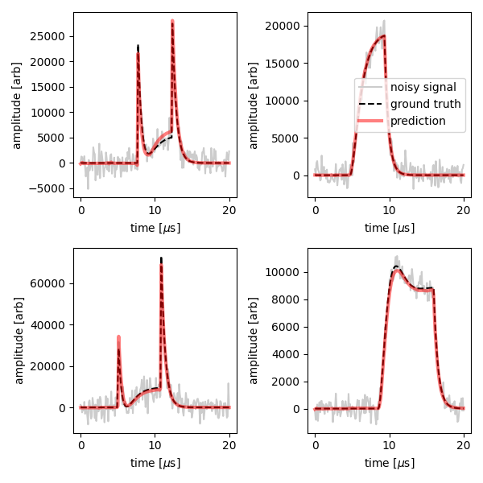
Reducing Noise in RF Signals
Comparison of noise reduction methods
  Kalman filter includes noise term in model
  1D CNN autoencoder
Noise statistics computed from FFT of the model error with the clean data.
Kalman Filter
Convolutional Neural Network
VRAE

Slide 10
A toy model for power combining
The RF power at a given station is the sum of the inputs from the klystrinos
Beam energy is actively controlled by adjusting set point phase of the different RF sources
Gain error (beam current, cathode voltage, output cavity)
Mechanical phase errors (fabrication)
Phase set point (control parameter / action)
Electrical phase error (LLRF)

Slide 11
Tuning the Beam Energy
Optimization
Lookup Table
Inverse Models
Too slow to converge
Sensitive to noise and perturbations
Problem is not invertible / highly degenerate
Nonstationary System

Slide 12
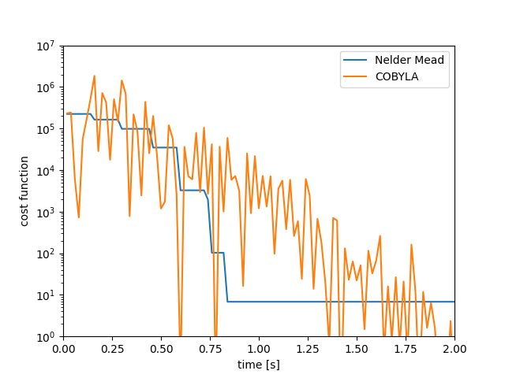
Optimization Studies for RF
Comparing optimization routines
  Nelder-Mead and COBYLA
  Completion time assumes 50Hz operation of the linac
  Higher repetition rate possible
    software could limit the optimizer update rate

Slide 13
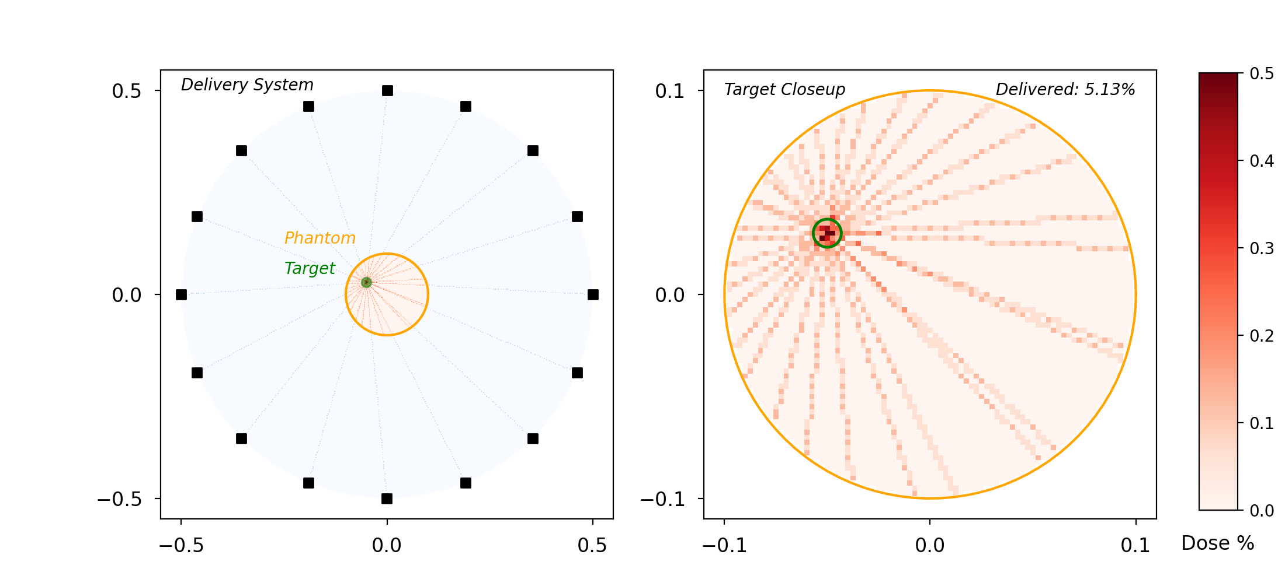
A Toy Model for A PHASER-like system
Sixteen different x-ray sources with the ability to tune energy and steering to optimize the dose delivery profile
  Toy model assumes a single target plane (2D)
  Energy deposited in a water phantom
  Energy range of the x-rays is 1-20 MeV
  Can adjust commensurate with PHASER parameters
Water phantom simulated in GEANT-4
  Modeling 1-D energy loss / deposition

Slide 14
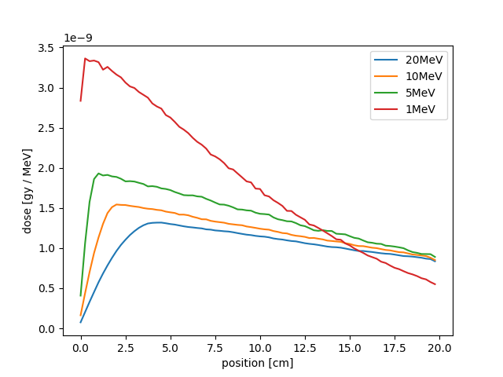
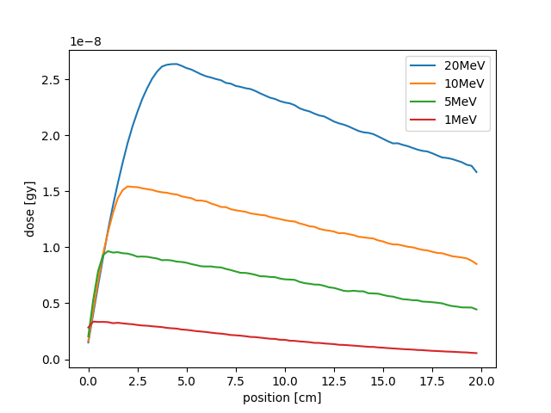
Dose delivery simulations in GEANT-4
Compute the energy loss as a function of position inside a water phantom
  Scan energy then use interpolating function to generate a continuous control knob for the RL model
  Dose computed for 10⁶ x-rays – realistic beams would deliver ~10k times this dose

Slide 15
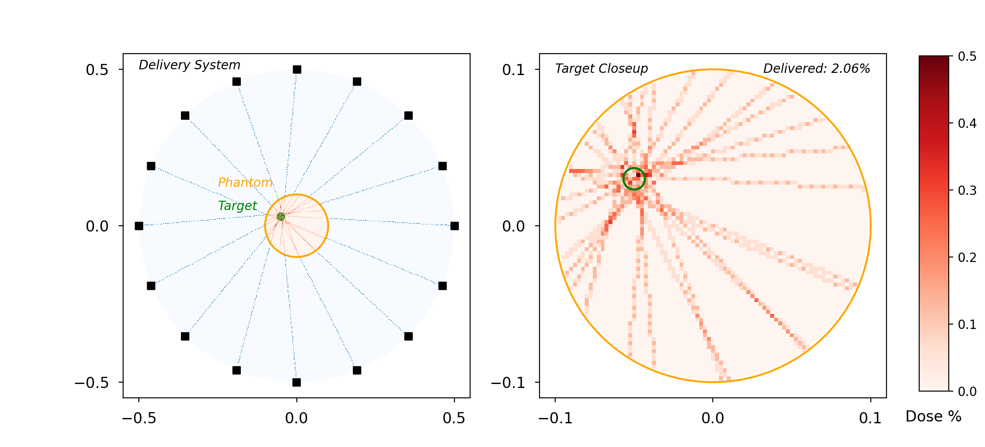
A Toy Model for A PHASER-like system
Compute target direction and energy deposition in the phantom
  Compute beam entry and exit point and associated path length inside the phantom
  Use path length data to compute the energy deposition curve
  Compute a histogram of the energy deposition weighted by the dose data from GEANT-4
Target defined as a circular region with a fixed center point
Beam steering and energy are the model input parameters
Right shows the dose distribution for two cases
  Correct beam steering (top)
  Random errors in the steering (bottom)

Slide 16
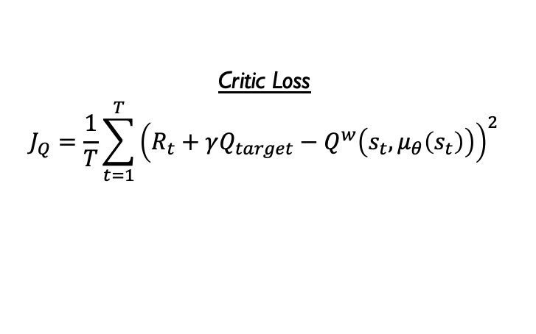

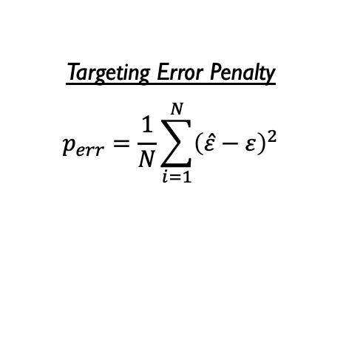
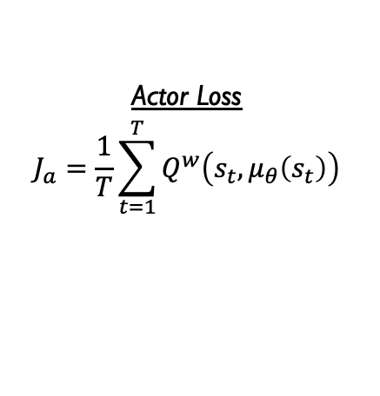
RL Methods
Problem setup
  PHASER-like system with unknown targeting offsets
  Phantom targets with randomized size & location
  Actions space consists of source targets & energies
Actor-critic approach with deterministic policy gradient (DPG)
  Actor & critic both represented as deep neural networks (DNNs)
  Policy & action-value networks trained concurrently
  Avoids need for importance sampling
Rewards & penalties tailored to dose delivery problem
  Reward for percentage of successfully delivered dose
  Penalty for extraneous patient radiation above threshold
  Penalty for targeting offset errors
Critic Loss
$$J_{Q}=\frac{1}{T}\sum_{t=1}^{T}{{\left(R_{t}+γQ_{target}−Q^{w}\left(s_{t},μ_{θ}\left(s_{t}\right)\right)\right)}^{2}}$$
Actor Loss
$$J_{a}=\frac{1}{T}\sum_{t=1}^{T}{Q^{w}\left(s_{t},μ_{θ}\left(s_{t}\right)\right)}$$
Targeting Error Penalty
$$p_{err}=\frac{1}{N}\sum_{i=1}^{N}{{\left(\hat{ε}−ε\right)}^{2}}$$
Radiation Penalty
$$p_{rad}=\frac{1}{1+e^{−ρ\left(\frac{γ}{γ_{c}}−0.5\right)}}$$
Notes:
In the loss functions, T is steps per-episode, R is the reward, Q is the future action-value (sup. w is the network approximation), gamma is the discount rate, s is the state, and mu is the actor policy.
In the targeting policy, epsilons are just the targeting offsets of the system (hat is predicted from the actor, regular is true offsets)
The form of the radiation penalty was carefully chosen, it applies little or no penalty for extra radiation well below the threshold, then quickly turns on at around half the threshold value. The rate at which the penalty turns on is dictated by rho. Gamma is just the extraneous dose (wasn’t sure what variable to use), and sub. c is just the threshold value for it.

Slide 17
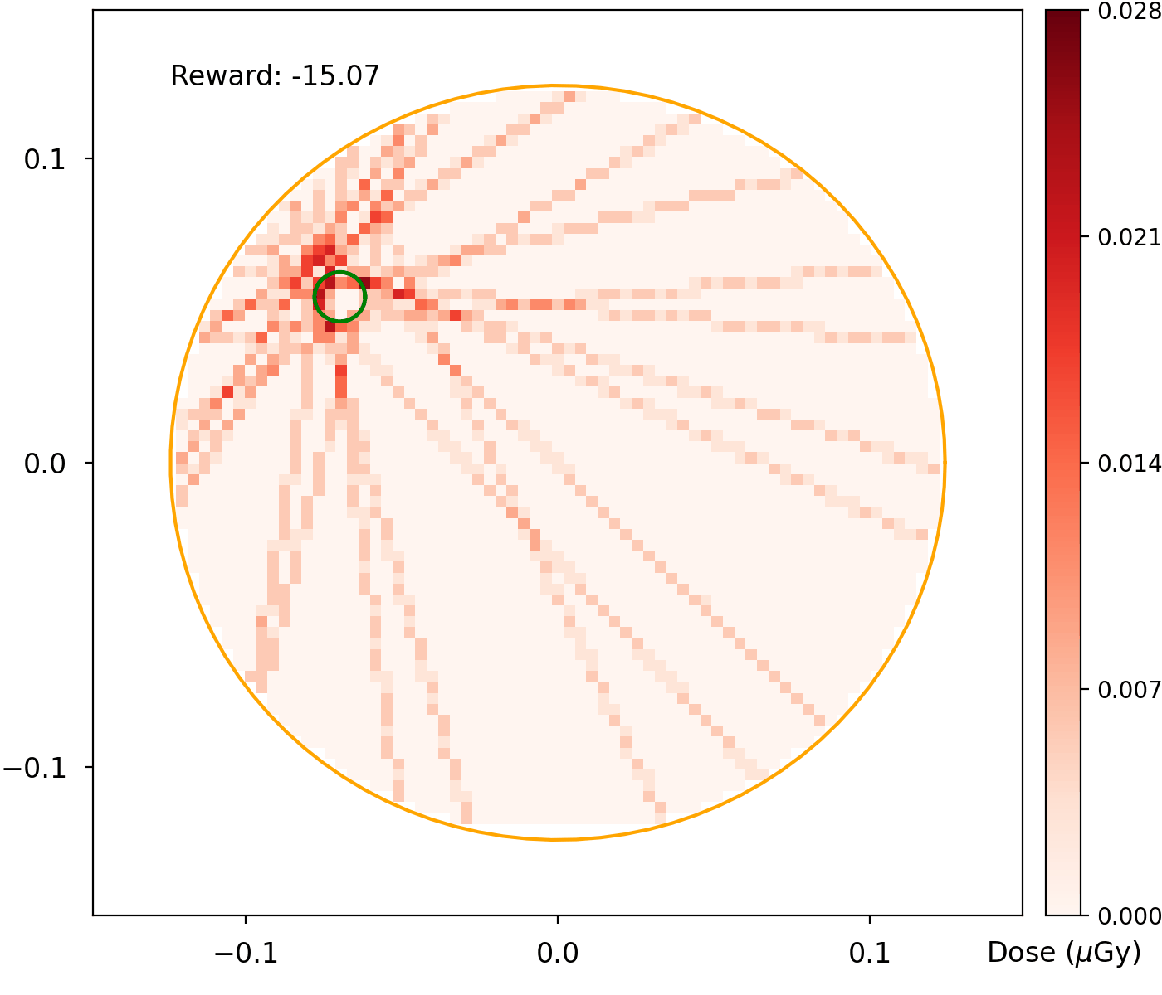

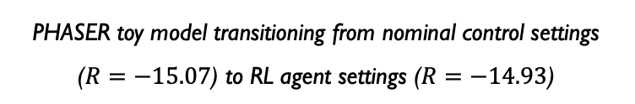
RL Results & Ongoing Efforts
Achieved slightly better-than-nominal targeting
  Nominal targets assume no targeting offsets
  Still highly sensitive to variations between episodes
    Known drawback to NN actor-critic approach
Optimizing training scheme
  Learning/discount rates
  Relative weighting of terms within rewards & losses
Exploring additional network architectures
  Began with basic 3-layer NNs, ReLU activation, etc.
Seeking to reach optimal or near-optimal controls
  Perfectly correcting for targeting offsets
  Energy controls accounting for target depth, size, etc.
Eventually, add complexity
  e.g. irregular target shapes, real-time target deformation, etc.
PHASER toy model transitioning from nominal control settings ($R=−15.07$) to RL agent settings ($R=−14.93$)
Notes:
The QR code is there just in case the GIF doesn’t work in slide-show or PDF mode. It has a link to the GIF on GDrive that anyone with the link can access.

Slide 18
Disclaimer
This report was prepared as an account of work sponsored by an agency of the United States Government. Neither the United States Government nor any agency thereof, nor any of their employees, makes any warranty, express or implied, or assumes any legal liability or responsibility for the accuracy, completeness, or usefulness of any information, apparatus, product, or process disclosed, or represents that its use would not infringe privately owned rights. Reference herein to any specific commercial product, process, or service by trade name, trademark, manufacturer, or otherwise does not necessarily constitute or imply its endorsement, recommendation, or favoring by the United States Government or any agency thereof. The views and opinions of authors expressed herein do not necessarily state or reflect those of the United States Government or any agency thereof.

