Slide 1
Explainability in Reinforcement Learning:
An Application for Powertrain Control
Catherine Laflamme, PhD

Slide 2
Reinforcement Learning
Success Stories
AlphaZero (2017):
  General-purpose game-playing AI.
  Chess, shogi, and Go at a superhuman level.
  Training solely through self-play, without any prior knowledge of the games.

Slide 3
RL in Industry Applications
Job Shop Scheduling
Planning in Matrix Production
Routing
Energy Management Systems

Slide 4
RL in Industry Applications
Challenges
Where and when RL can be beneficial?
  How big does my state space and action space need to be for RL to beat heuristics?
  How does stochasticity impact results?

Slide 5
RL in Industry Applications
Challenges
Where and when RL can be beneficial?
  How big does my state space and action space need to be for RL to beat heuristics?
  How does stochasticity impact results?
Simulations
  Creating simulations / digital twins is hard!
  Even when you have the simulation, there is the real-world gap.

Slide 6
RL in Industry Applications
Challenges
Where and when RL can be beneficial?
  How big does my state space and action space need to be for RL to beat heuristics?
  How does stochasticity impact results?
Simulations
  Creating simulations / digital twins is hard!
  Even when you have the simulation, there is the real-world gap.
Implementing a function approximator is hard for companies to do!
  Lack of transparency/explainability.
  Lack of standard processes.

Slide 7
RL in Industry Applications
Challenges
Where and when RL can be beneficial?
  How big does my state space and action space need to be for RL to beat heuristics?
  How does stochasticity impact results?
Simulations
  Creating simulations / digital twins is hard!
  Even when you have the simulation, there is the real-world gap.
Implementing a function approximator is hard for companies to do!
  Lack of transparency/explainability.
  Lack of standard processes.

Slide 8
RL in Industry Applications
Research Question
Can we still benefit from an RL Agent without having to implement a neural network?

Slide 9
Explainability in Reinforcement Learning
Powertrain Control Use Case
Gear shifting logic for an automatic drive vehicle.
Just a good, well understood use case to demonstrate feasibility.
Start boring ☺

Slide 10
Explainability in Reinforcement Learning
Powertrain Control Use Case
Gear shifting logic for an automatic drive vehicle.
Just a good, well understood use case to demonstrate feasibility.
Start boring ☺
RL Agent

Slide 11
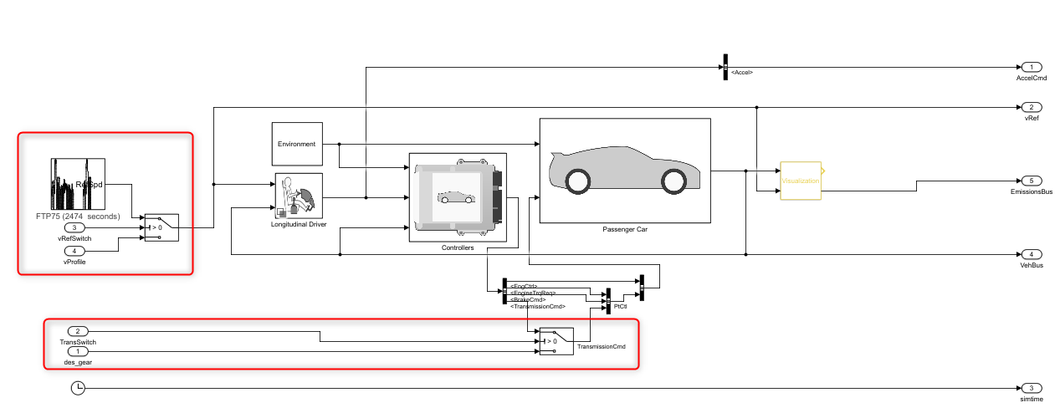
Explainability in Reinforcement Learning
Matlab: Conventional Vehicle Reference Application
Full vehicle model with internal combustion engine, transmission, powertrain control algorithms.
Used for powertrain matching analysis and component selection, control and diagnostic algorithm design, and hardware-in-the-loop testing
https://www.mathworks.com/help/autoblks/ug/conventional-vehicle-reference-application.html

Slide 12
Explainability in Reinforcement Learning
Matlab: Conventional Vehicle Reference Application
Driving Cycle:
Reference Velocity to be followed

Slide 13
Explainability in Reinforcement Learning
Matlab: Conventional Vehicle Reference Application
Driver:
Driver generates normalized acceleration and braking commands.

Slide 14
Explainability in Reinforcement Learning
Matlab: Conventional Vehicle Reference Application
Control Unit: Implements a powertrain control module (PCM) containing a transmission control module (TCM) and engine control module (ECM)

Slide 15
Explainability in Reinforcement Learning
Matlab: Conventional Vehicle Reference Application
TransSwitch: External input for transmission control model. Allows for external input of gear.

Slide 16
Explainability in Reinforcement Learning
Goal:
Can we replace this gear shifting logic with an explainable RL-based policy?

Slide 17
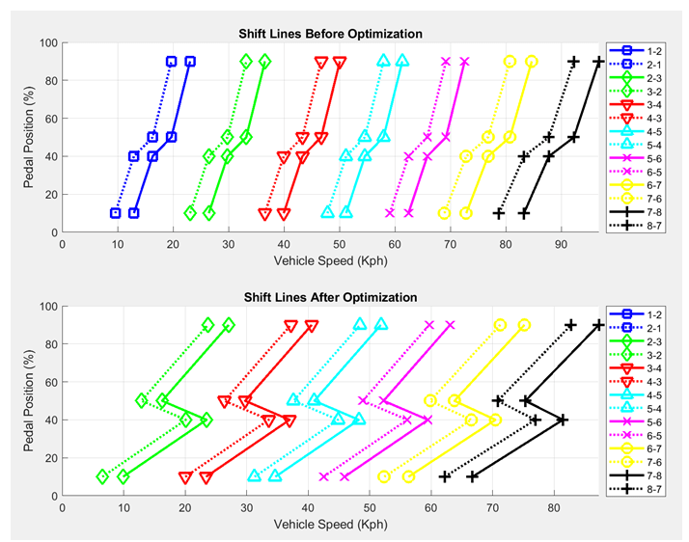
Explainability in Reinforcement Learning
Benchmark
Matlab optimised controller
Inputs:
  Vehicle Speed
  Pedal Position
  Current Gear

Slide 18
Explainability in Reinforcement Learning
Benchmark
Matlab optimised controller
Inputs:
  Vehicle Speed
  Pedal Position
  Current Gear
State Space

Slide 19
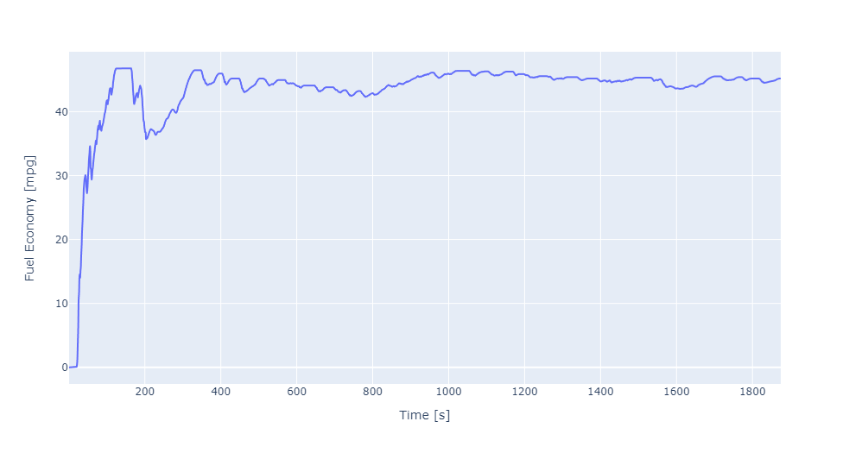
Explainability in Reinforcement Learning
Evaluation
Fuel Economy
  Total distance / total fuel accumulated for the complete driving cycle.

Slide 20

Explainability in Reinforcement Learning
Evaluation
Fuel Economy
  Total distance / total fuel accumulated for the complete driving cycle.
Higher is better!

Slide 21
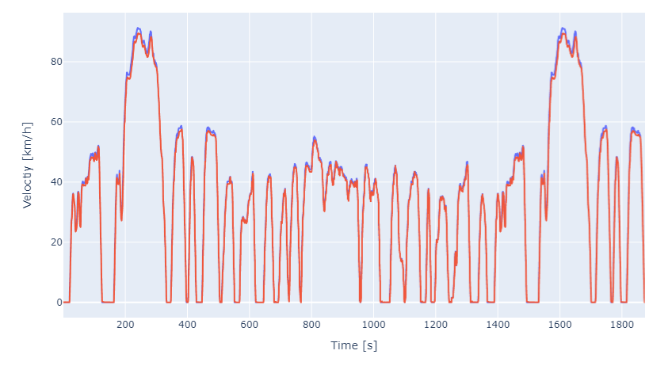
Explainability in Reinforcement Learning
Evaluation
Velocity Following

Slide 22
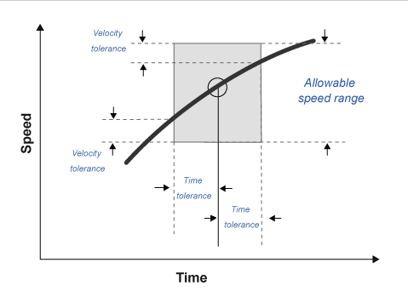
Explainability in Reinforcement Learning
Speed Faults
European Union Commission. "Speed trace tolerances". European Union Commission Regulation. 32017R1151, Sec 1.2.6.6, June 1, 2017.

Slide 23
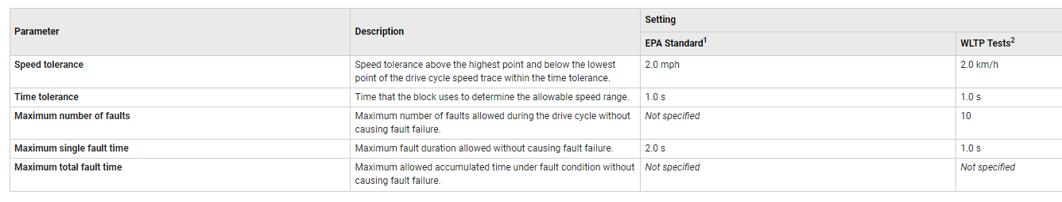
Explainability in Reinforcement Learning
Velocity Following
European Union Commission. "Speed trace tolerances". European Union Commission Regulation. 32017R1151, Sec 1.2.6.6, June 1, 2017.

Slide 24
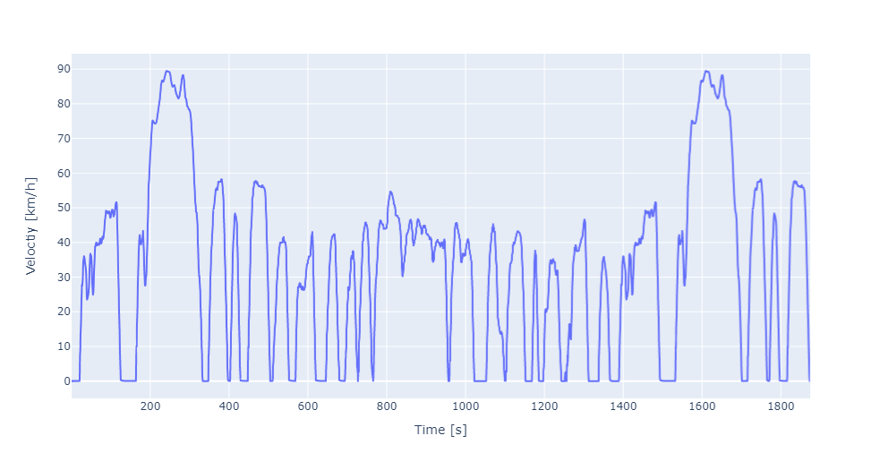
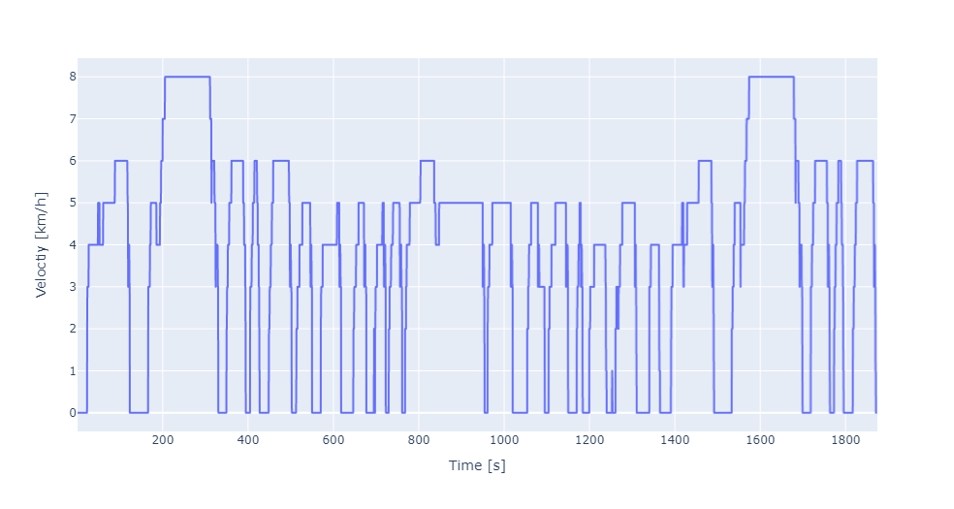
Explainability in Reinforcement Learning
Benchmark
 | Fuel Economy | # Faults
Matlab | 38.76 | 8

Slide 25
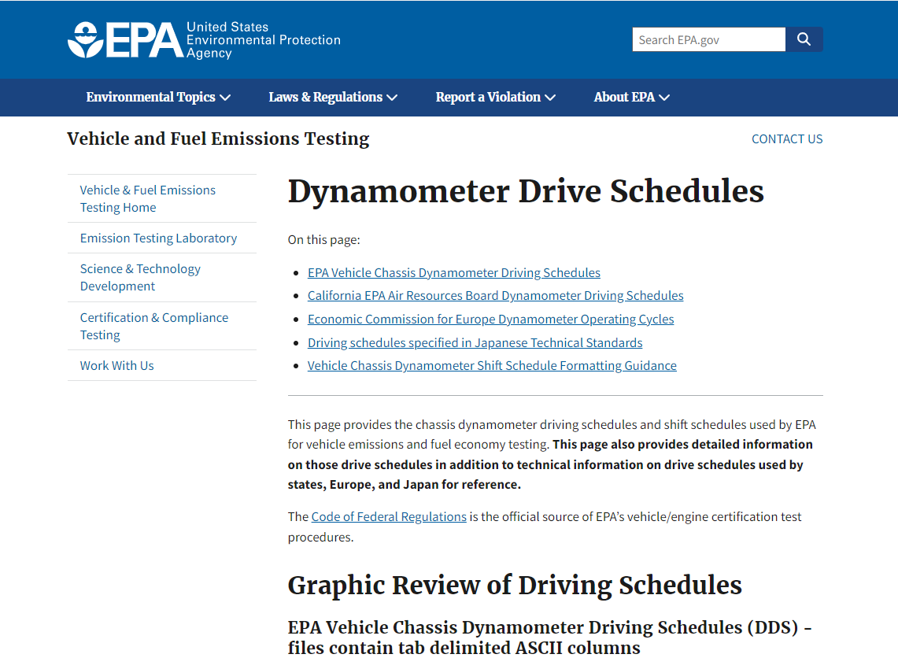
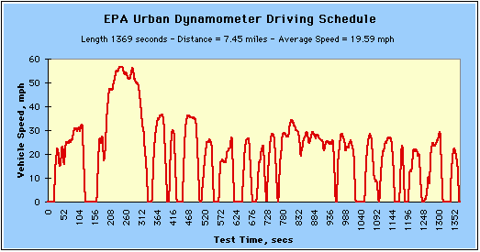
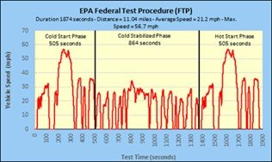
Explainability in Reinforcement Learning
Driving Cycles

Slide 26
Explainability in Reinforcement Learning
Gymnasium Environment
Compile Matlab simulation into a *.dll file.
  Can be called in Python via a step() function.
  Includes our reward function

Slide 27
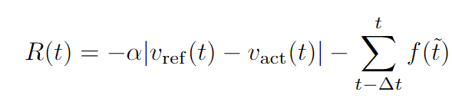
Explainability in Reinforcement Learning
Gymnasium Environment
Compile Matlab simulation into a *.dll file.
  Can be called in Python via a step() function.
  Includes our reward function
Free parameter

Slide 28
Explainability in Reinforcement Learning
Stable Baslines implementation
Gymnasium environments are compatible with stable baselines.
Stable Baselines3 is “a set of reliable implementations of reinforcement learning algorithms in PyTorch.”
PPO:

Slide 29
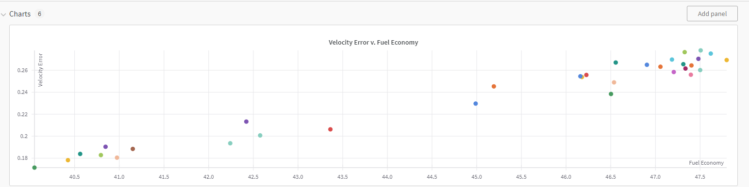
Explainability in Reinforcement Learning
Hyperparameter Tuning with Weights and Biases

Slide 30
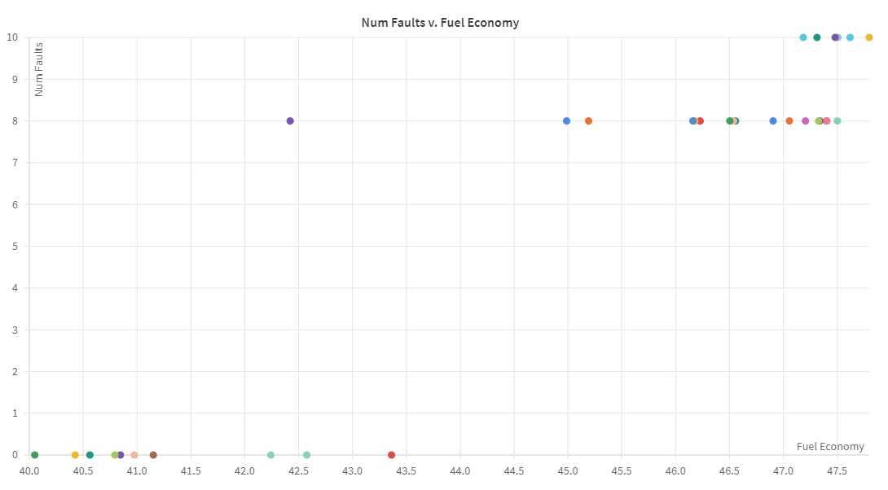
Explainability in Reinforcement Learning
Results RL Agent
 | Fuel Economy | # Faults
Matlab | 38.76 | 8

Slide 31
Explainability in Reinforcement Learning
Results RL Agent
 | Fuel Economy | # Faults
Matlab | 38.76 | 8
Summary: Many „good“ neural network policies. Can we use them to form a lookup table?

Slide 32
Explainability in Reinforcement Learning
Q-Table Attempt
Note: We did attempt to train a Q-table from scratch.
  How to discretize continuous variables?
  Very inefficient training
Never obtained a policy better than the benchmark.

Slide 33
Explainability in Reinforcement Learning
Method
Train RL Agent
Sample the policy network
  (small state space -> can sample uniformly.)
Train a decision trees with standard supervised learning
  Fix depth of decision tree
Evaluate the decision tree as a lookup-table policy

Slide 34
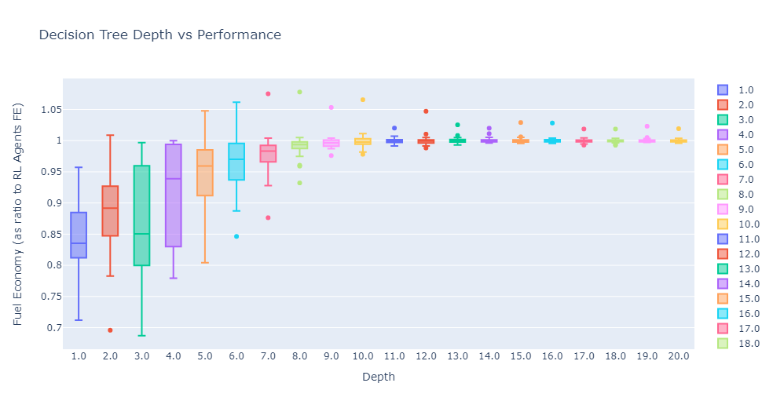
Explainability in Reinforcement Learning
Performance on Driving Cycle „FTP“

Slide 35
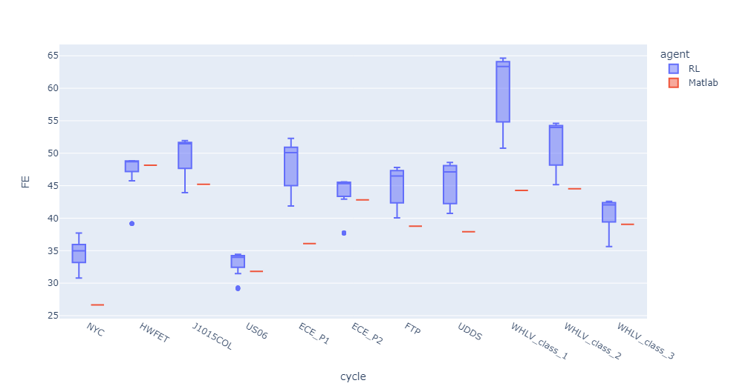
Explainability in Reinforcement Learning
Testing on Different Driving Cycles

Slide 36
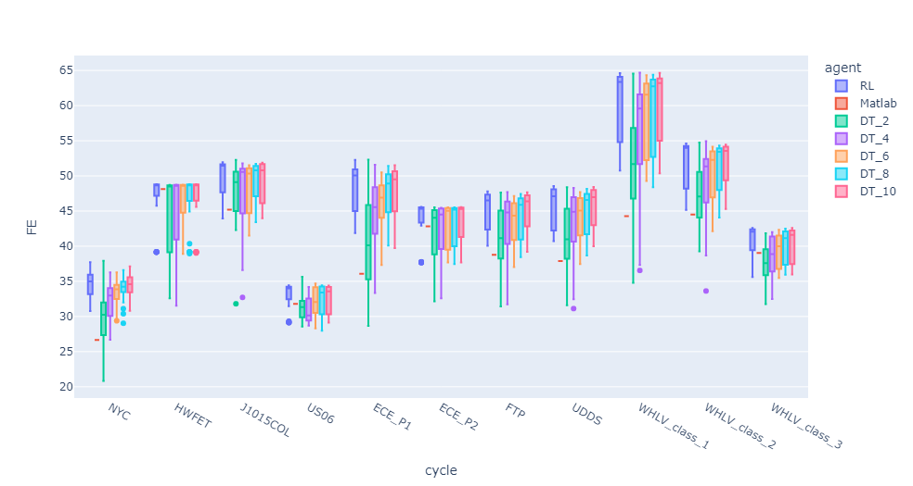
Explainability in Reinforcement Learning
Testing on Different Driving Cycles

Slide 37
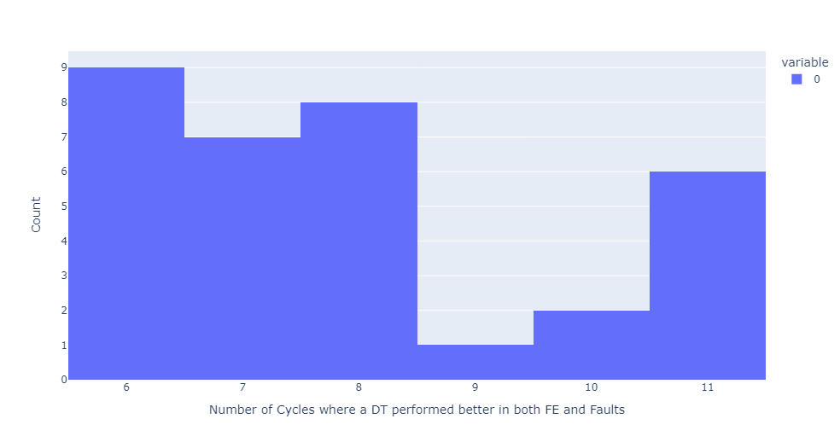
Explainability in Reinforcement Learning
Testing on Different Driving Cycles

Slide 38
Explainability in Reinforcement Learning
Testing on Different Driving Cycles
Smallest DT that outperforms benchmark (in FE and #Faults) on all cycles: depth = 5

Slide 39
Explainability in Reinforcement Learning
Example Result
Agent | Fuel Economy | # Faults
RL | 46.502527 | 8
DT (Depth 3) | 40.878837 | 0
Matlab Benchmark | 38.762721 | 8
DT (Depth 3, Nodes 15)
Vehicle Speed [km/h] | 20.45 | 39.55
Engine Speed [rpm] | 2090.91 | 3484.85 | 3545.45 | 3666.67
Pedal Position [0-1] | 0.50

Slide 40
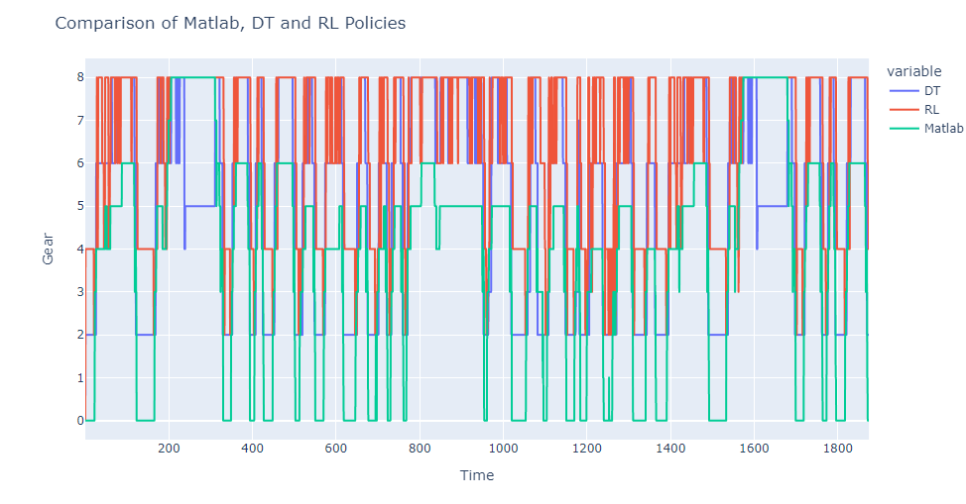
Explainability in Reinforcement Learning
Results

Slide 41
Explainability in Reinforcement Learning
Conclusions
Sampling a neural network policy could be a method to create a user-friendly and explainable policy for small state spaces.
Larger state spaces (where uniform sampling is not possible) could be possible but not studied here.
Despite small tables, still improved performance compared to benchmarks.

Slide 42
Thank you!

