Slide 1
Optimization and Control at DESY - RL and Beyond
Facility talk
Jan Kaiser and Jannis Lübsen on behalf of Annika Eichler, the DESY IPC group and many others

Slide 2
Facilities at DESY

Slide 3
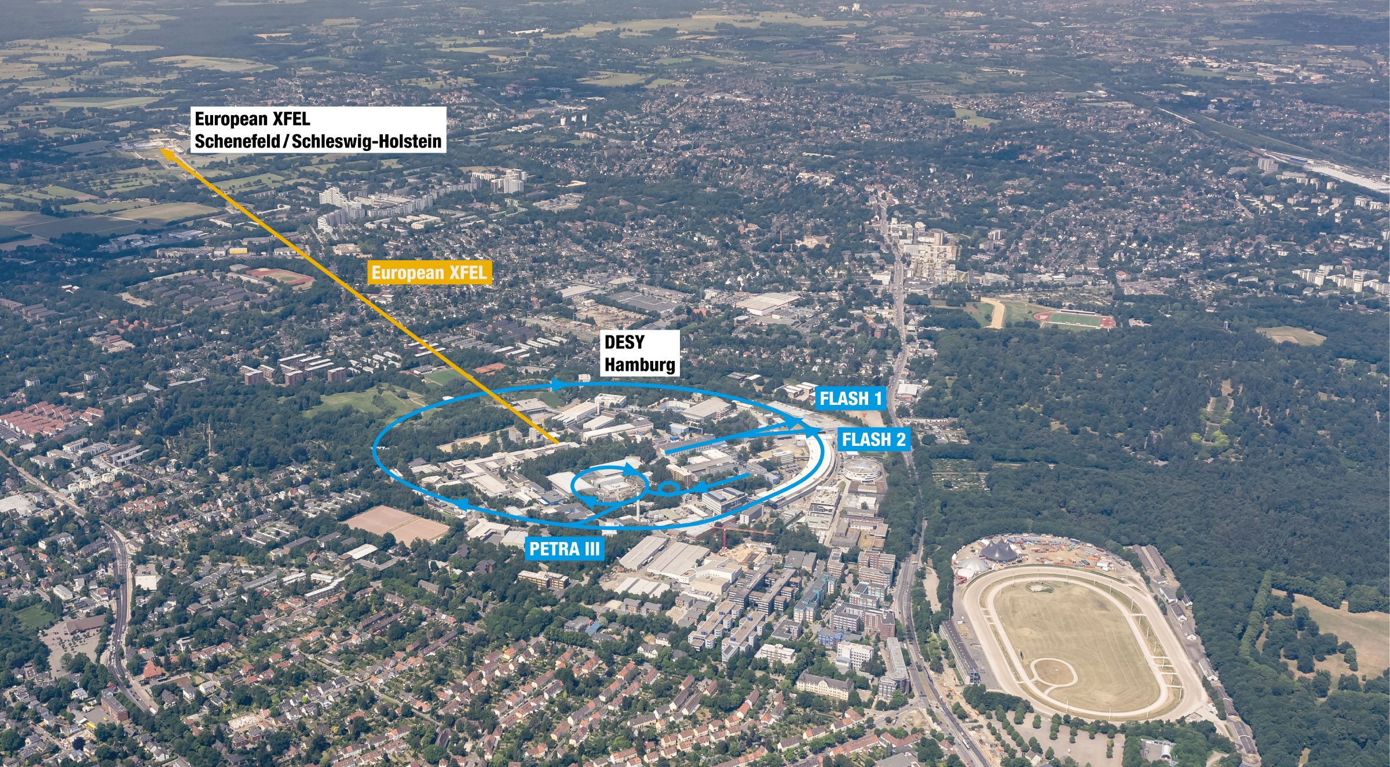

Slide 4
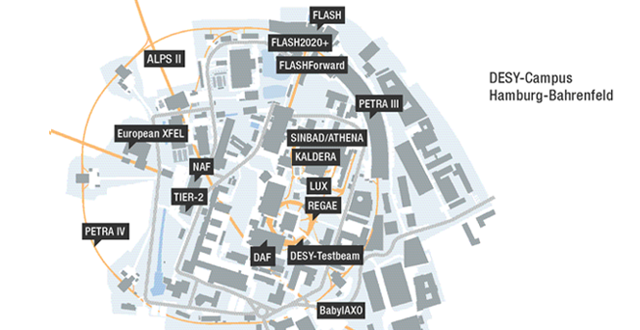
Research infrastructure
REGAE: The source of relativistic electron beams enables innovative experiments.
DESY test beam: Groups from all over the world use the DESY test beam to check detector components
DAF: Complex components for the LHC detectors ATLAS and CMS are being built and tested in the Detector Assembly Facility.
Tier-2: As part of the IDAF, the grid infrastructure provides computing and storage systems for particle and astroparticle physics.
NAF: The National Analysis Facility within the IDAF is a powerful computing complex for particle physics.
Maxwell HPC: The high-performance computing system complements the IDAF’s facilities for photon science and accelerator R&D.
What is located at the DESY Campus Bahrenfeld
PETRA III: One of the brightest storage ring X-ray radiation sources in the world.
PETRA IV: The storage ring PETRA is to be expanded into the world’s most powerful synchrotron radiation source.
FLASH: Free-electron laser for ultrashort-pulse X-ray laser light.
FLASH2020+: The upgrade project makes the FLASH free-electron laser even more flexible and powerful.
European XFEL: DESY is the main shareholder and operates the accelerator of Europe’s big X-ray laser.
ALPS II: The experiment searches for extremely light particles.
BabyIAXO: The prototype for the International Axion Observatory (IAXO) will search for extremely light particles from the sun.
FLASHForward: The electron bunches of FLASH are used to explore particle-driven plasma acceleration.
LUX: LUX is used to investigate and further develop laser-driven plasma acceleration.
KALDERA: The high-power laser will make plasma accelerators competitive.
SINBAD/ATHENA: SINBAD and ATHENA offer unique infrastructures for the development of novel accelerators.
ARES: ARES enables accelerator research and the development of autonomous accelerator procedures.

Slide 5
Control and Optimization Tasks

Slide 6
Control and optimization for accelerators
They could not run without control
Time scale
PID / (distributed) H2 optimal MIMO control
PID + system inversion (IMC) / nonlinear system inversion
IMC / RL
Manual, numeric optimizer/ RL & Bayesian optimization
Controller / algorithm complexity Usage of ML
Low-level hardware-focused systems
Magnet powering: converter voltage/current regulation
Low-level Radio-Frequency (RF) control
Synchronization
Fast transverse feedbacks (turn-by-turn → bunch-by-bunch → intra-bunch time scales)
damping of injection oscillations, improving single/coupled bunch (in-)stability thresholds
Burst mode XFEL/FLASH
Beam-based feedback systems
Set-up and tuning
Controller gain optimization
9...81MHz
1...5MHz
130kHz
25kHz
1...0.05Hz
1/week
1/months
20161025_PCaPAC16_FB_tutorial-1.pdf (cnpem.br)

Slide 7
Control and optimization for accelerators
They could not run without control
Time scale
PID / (distributed) H2 optimal MIMO control
PID + system inversion (IMC) / nonlinear system inversion
IMC / RL
Manual, numeric optimizer/ RL & Bayesian optimization
Controller / algorithm complexity Usage of ML
Low-level hardware-focused systems
Magnet powering: converter voltage/current regulation
Low-level Radio-Frequency (RF) control
Synchronization
Fast transverse feedbacks (turn-by-turn → bunch-by-bunch → intra-bunch time scales)
damping of injection oscillations, improving single/coupled bunch (in-)stability thresholds
Burst mode XFEL/FLASH
Beam-based feedback systems
Set-up and tuning
Controller gain optimization
9...81MHz
1...5MHz
130kHz
25kHz
1...0.05Hz
1/week
1/months
20161025_PCaPAC16_FB_tutorial-1.pdf (cnpem.br)

Slide 8
1) The optical synchronization system of the European XFEL

Slide 9
The optical synchronization system of the European XFEL
Jitter in the femtosecond range
Goal: Minimize timing gap between X-Rays and Pump-Probe laser pulses by tuning controllers
min (timing jitter)2
Controller
such that controller is decentralized and stabilizing

Slide 10
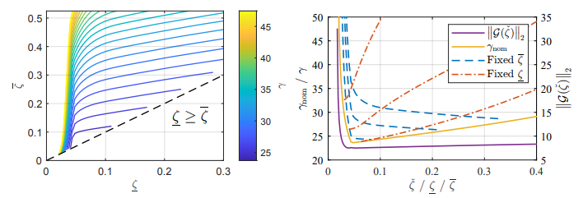
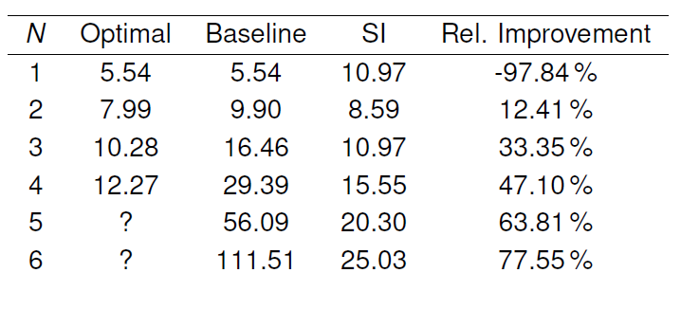
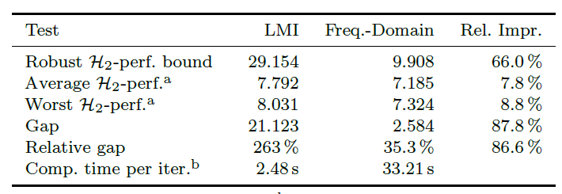
Controller optimization
Adding robustness → introducing integral quadratic constraints
Solution in frequency domain → solving the non-convex problem exploiting existing infrastructure
With a model-based (white-box) approach
Sparsity invariance → convex approximation of non-convex objective
M Schütte, A Eichler, H Schlarb, G Lichtenberg, H Werner, ”Convex Synthesis of Robust Distributed Controllers for the Optical Synchronization System at European XFEL“, IEEE Conference on Control Technology and Applications (CCTA), pp. 1061-1067, 2022
M Schütte, A Eichler, H Schlarb, G Lichtenberg, H Werner, ” Decentralized Output Feedback Control using Sparsity Invariance with Application to Synchronization at European XFEL“, 60th IEEE Conference on Decision and Control (CDC), pp. 5723-5728, 2021
M Schütte, A Eichler, H Werner, ”Structured IQC Synthesis of Robust H2 Controllers in the Frequency Domain”, IFAC World Congress, to appear, 2023

Slide 11
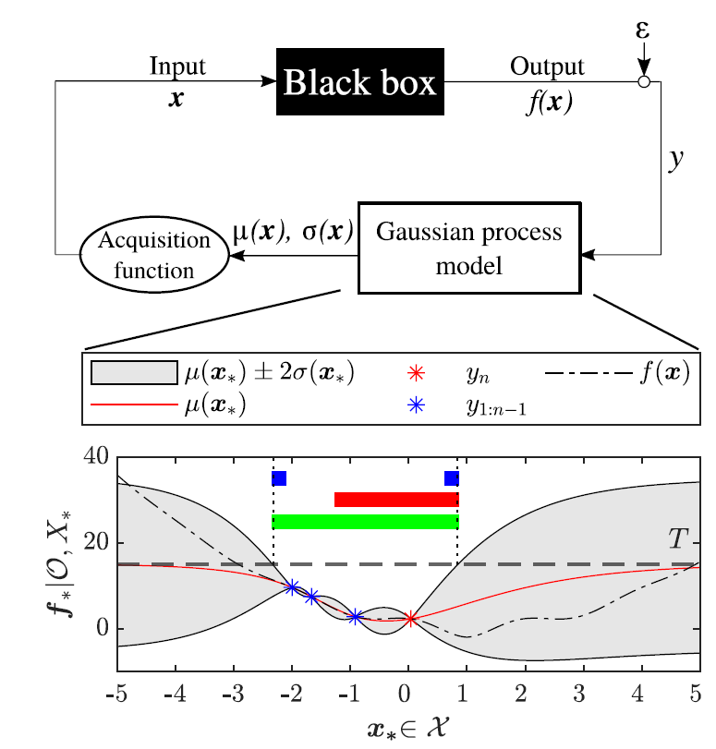
Controller optimization
With a model-free (black-box) online approach
min (timing jitter)2
Controller
such that controller is decentralized and stabilizing
laser out of lock
Modified Safe Bayesian optimization
Black Box approach
Safe during optimization
Learns a probabilistic surrogate model
Increased convergence rate compared to other Bayesian optimization approaches → Divide into exploration and exploitation
Efficient exploration by evaluating points at the boundaries
Efficient exploitation by fitting the kernel on the data
J O Lübsen, M Schütte, S Schulz, A Eichler, ”A Safe Bayesian Optimization Algorithm for Tuning the Optical Synchronization System at European XFEL”,
IFAC World Congress, to appear, 2023

Slide 12
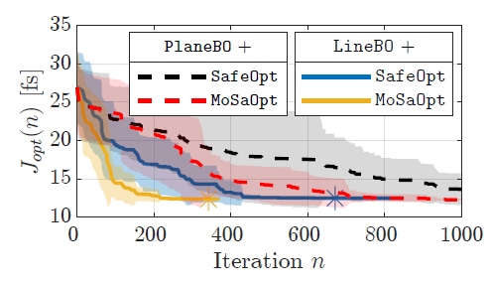
Controller optimization
With a model-free (black-box) online approach
Simulation - Synchronization system of the EuXFEL
N = 5 subsystems, each equipped with a PI controller
Experimental - Small scale synchronization system
N = 2 subsystems
J O Lübsen, M Schütte, S Schulz, A Eichler, „A Safe Bayesian Optimization Algorithm for Tuning the Optical Synchronization System at European XFEL”,
IFAC World Congress, to appear, 2023

Slide 13
Control and optimization for accelerators
They could not run without control
Time scale
PID / (distributed) H2 optimal MIMO control
PID + system inversion (IMC) / nonlinear system inversion
IMC / RL
Manual, numeric optimizer/ RL & Bayesian optimization
Controller / algorithm complexity Usage of ML
Low-level hardware-focused systems
Magnet powering: converter voltage/current regulation
Low-level Radio-Frequency (RF) control
Synchronization
Fast transverse feedbacks (turn-by-turn → bunch-by-bunch → intra-bunch time scales)
damping of injection oscillations, improving single/coupled bunch (in-)stability thresholds
Burst mode XFEL/FLASH
Beam-based feedback systems
Set-up and tuning
Controller gain optimization
9...81MHz
1...5MHz
130kHz
25kHz
1...0.05Hz
1/week
1/months
20161025_PCaPAC16_FB_tutorial-1.pdf (cnpem.br)

Slide 14
Control and optimization for accelerators
They could not run without control
Time scale
PID / (distributed) H2 optimal MIMO control
PID + system inversion (IMC) / nonlinear system inversion
IMC / RL
Manual, numeric optimizer/ RL & Bayesian optimization
Controller / algorithm complexity Usage of ML
Low-level hardware-focused systems
Magnet powering: converter voltage/current regulation
Low-level Radio-Frequency (RF) control
Synchronization
Fast transverse feedbacks (turn-by-turn → bunch-by-bunch → intra-bunch time scales)
damping of injection oscillations, improving single/coupled bunch (in-)stability thresholds
Burst mode XFEL/FLASH
Beam-based feedback systems
Set-up and tuning
Controller gain optimization
9...81MHz
1...5MHz
130kHz
25kHz
1...0.05Hz
1/week
1/months
20161025_PCaPAC16_FB_tutorial-1.pdf (cnpem.br)

Slide 15
Slow longitudinal feedback system at FLASH

Slide 16
Control system approach
Linear sensitivity matrix
Have one matrix
But only diagonal elements are considered

Slide 17
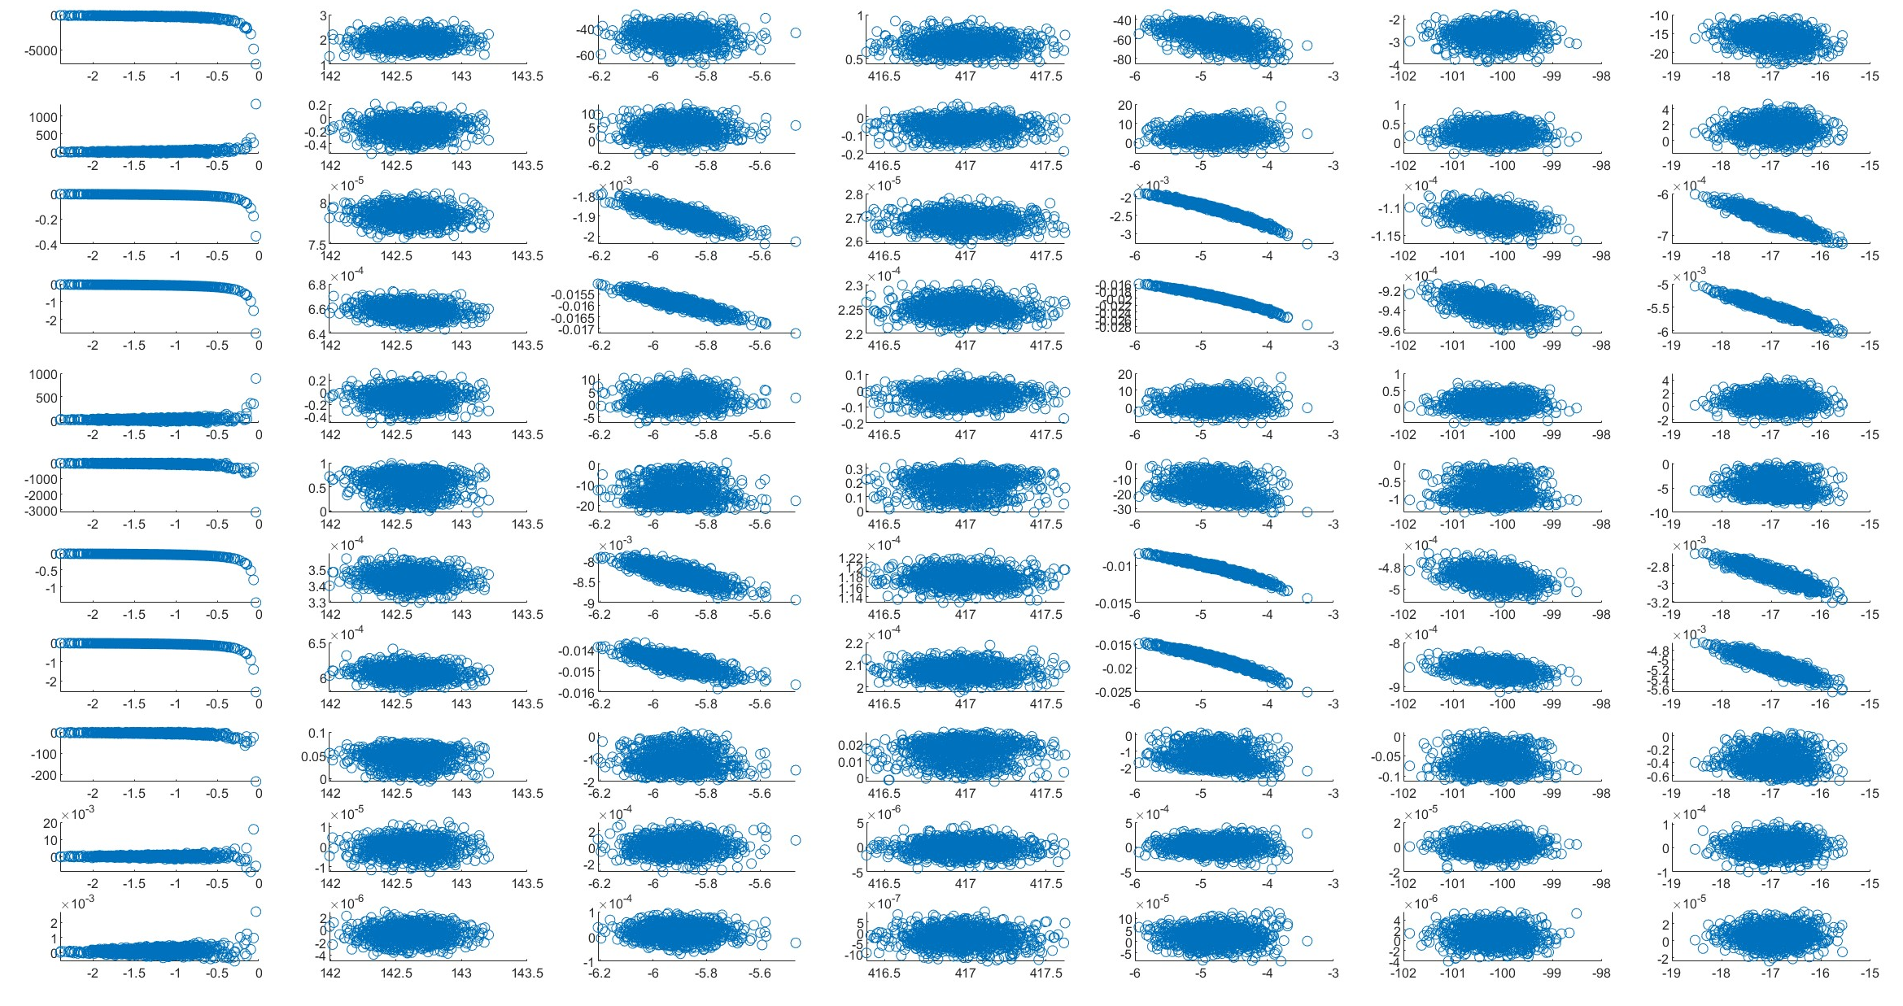
Show it is nonlinear
Next:
Gun_P
ACC139SV
ACC139C
ACC23SV
ACC23C
ACC45SV
ACC67SV
BAM UBC1
BAM DBC2
BCM DBC1.1
BCM DBC1.2
BAM UBC2
BAM DBC2
BCM DBC2.1
BCM DBC2.2
BAM SEED
BCM SEED1
BCM SEED2

Slide 18
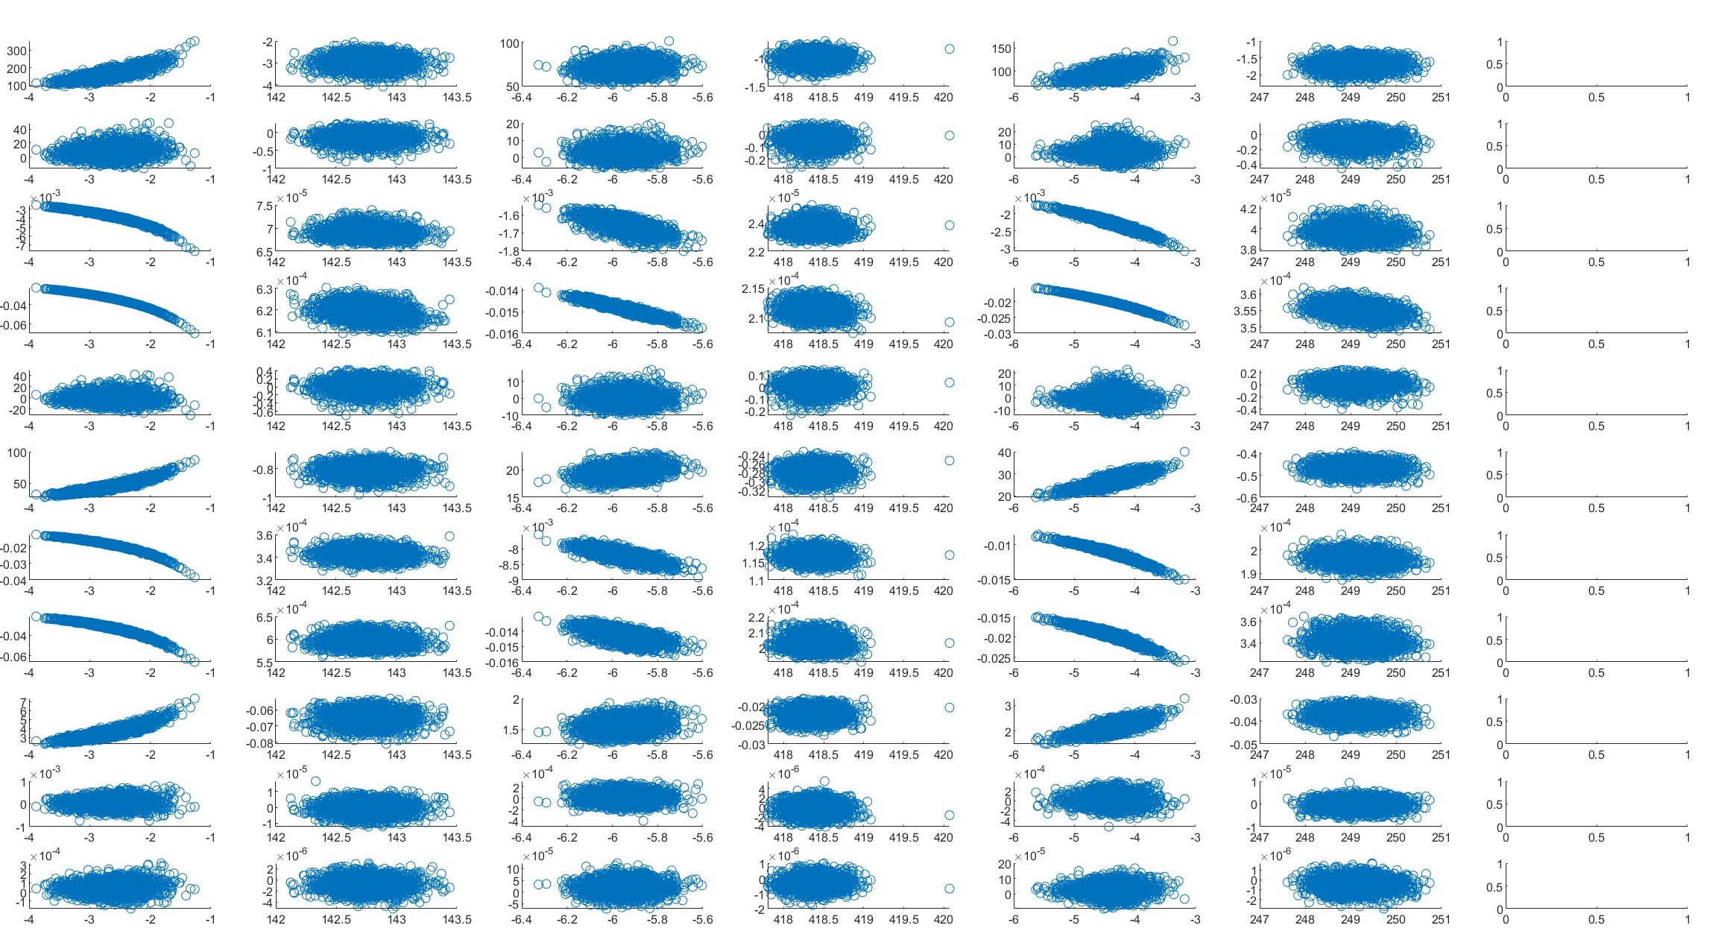
Different Energy
Parameter scan from 08.12.2024
New data set:

Slide 19
Goal:
Derive nonlinear response matrix (Koopman operator)
Measure this each measurement time (what are the minimum number of measurements to get the desired certainty)
Get the full picture (also with respect to energy, and see how fast this drifts)

Slide 20
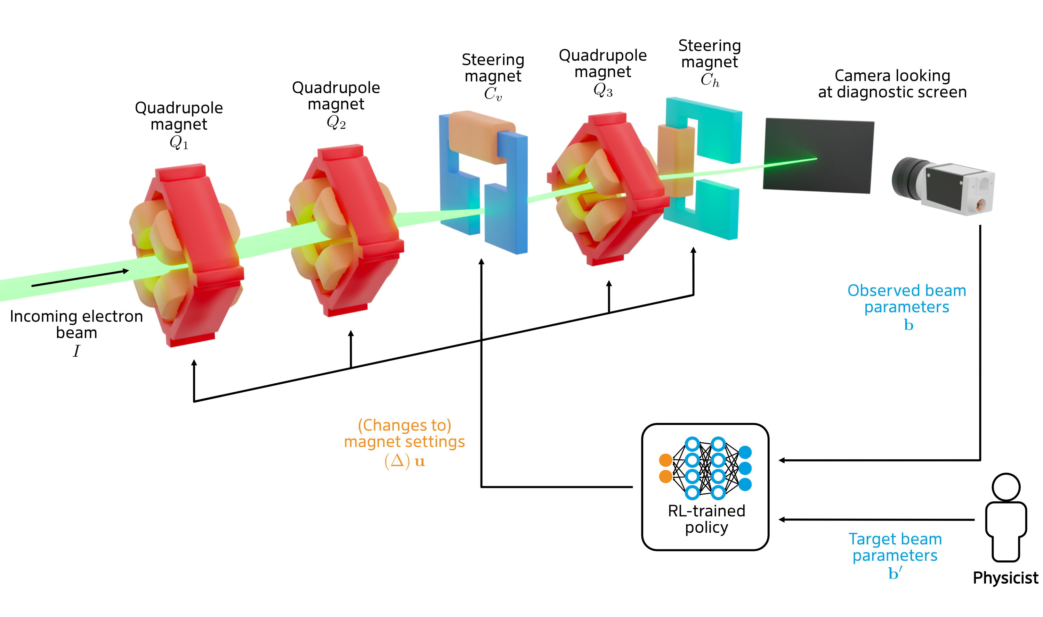
RL for beam steering at ARES

Slide 21
Reinforcement Learning for Beam Steering
Courtesy: Jan Kaiser
At ARES
The Task
Focus and position electron beam on a diagnostic screen using a quadrupole triplet and two correctors
Actions
Continuous 5-dimensional action defined as change to magnet settings
Observations
Continuous 13-dimensional observations of magnet settings, desired beam parameters and measured beam parameters
Partially observability of a more than 29-dimensional state space
Reward
Improvement of the objective
Observed beam
Desired beam
J Kaiser, O Stein, A Eichler. “Learning-based Optimization of Particle Accelerators Under Partial Observability Without Real-World Training.” Proceedings of the 39th International Conference on Machine Learning, PMLR 162:10575-10585, 2022.

Slide 22
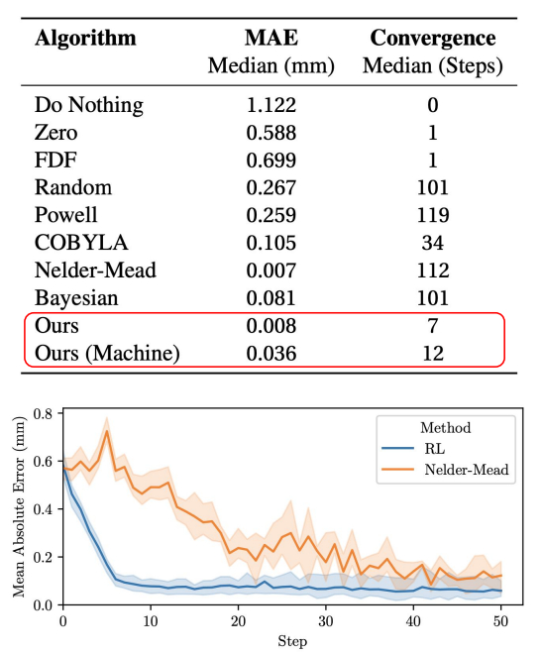
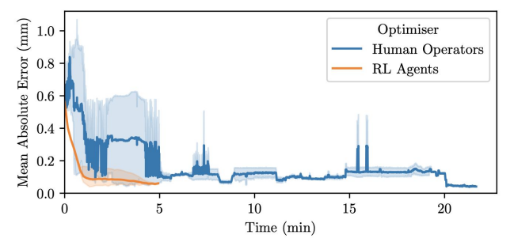
Reinforcement learning for beam steering
Courtesy: Jan Kaiser
Setup and results
Reinforcement Learning setup
TD3 algorithm used for training
Agents are trained in simulation running 6 million steps
Simulation environment: Cheetah (Simple high-speed linear beam dynamics simulation written in Python)
Sim2Real transfer
Domain randomization
Differential actions
Logarithmic rewards
O Stein, J Kaiser, A Eichler, I Agapov. “Accelerating linear beam dynamics simulations for machine learning applications.” Proceedings of the 13th International Particle Accelerator Conference, 2022

Slide 23
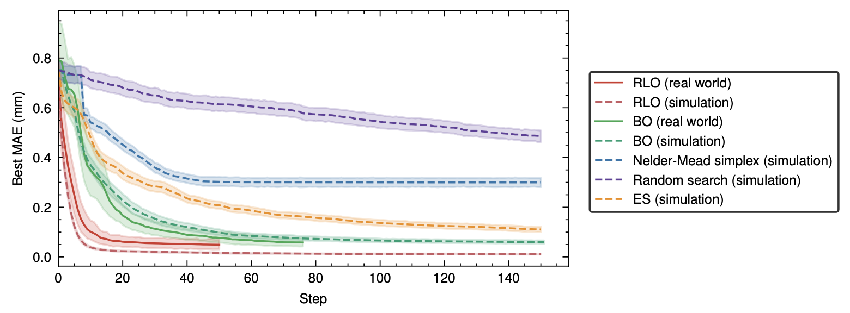
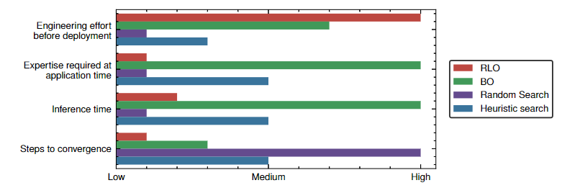
Comparison to Bayesian optimization
At ARES
Simulation and real world fits best for BO as no pretraining
RLO gives best performance and converges the fastest
For BO the best seen has to be set after optimization
frequently
How often tuning is performed?
A limited amount

Slide 24
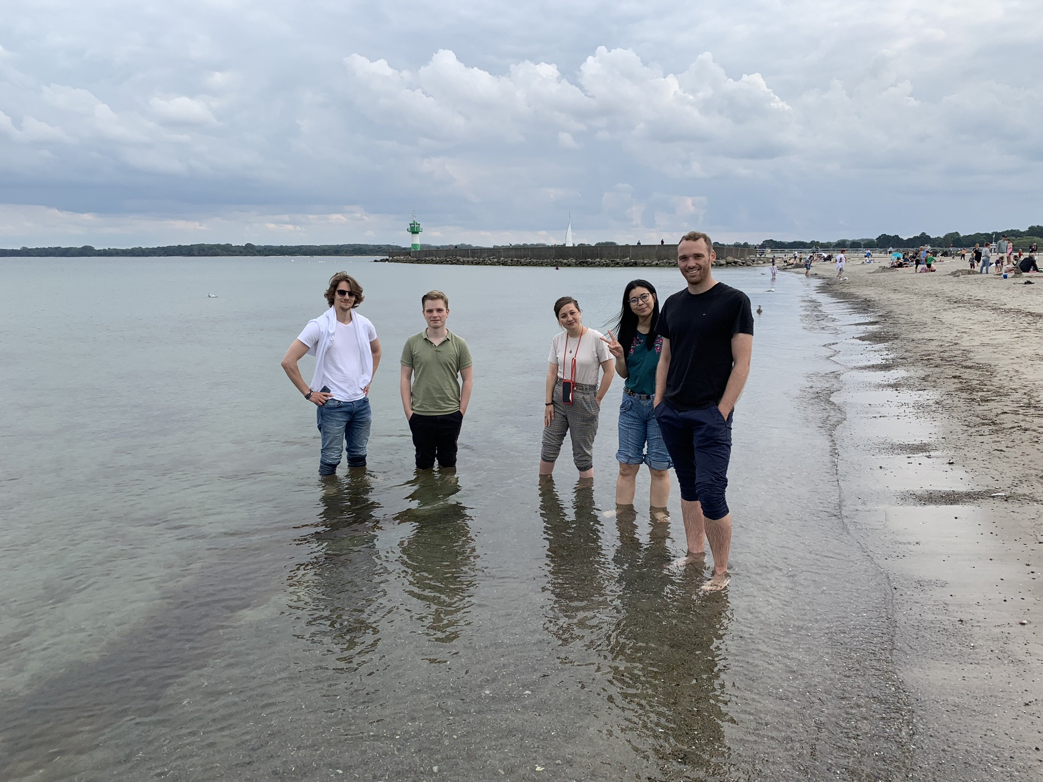
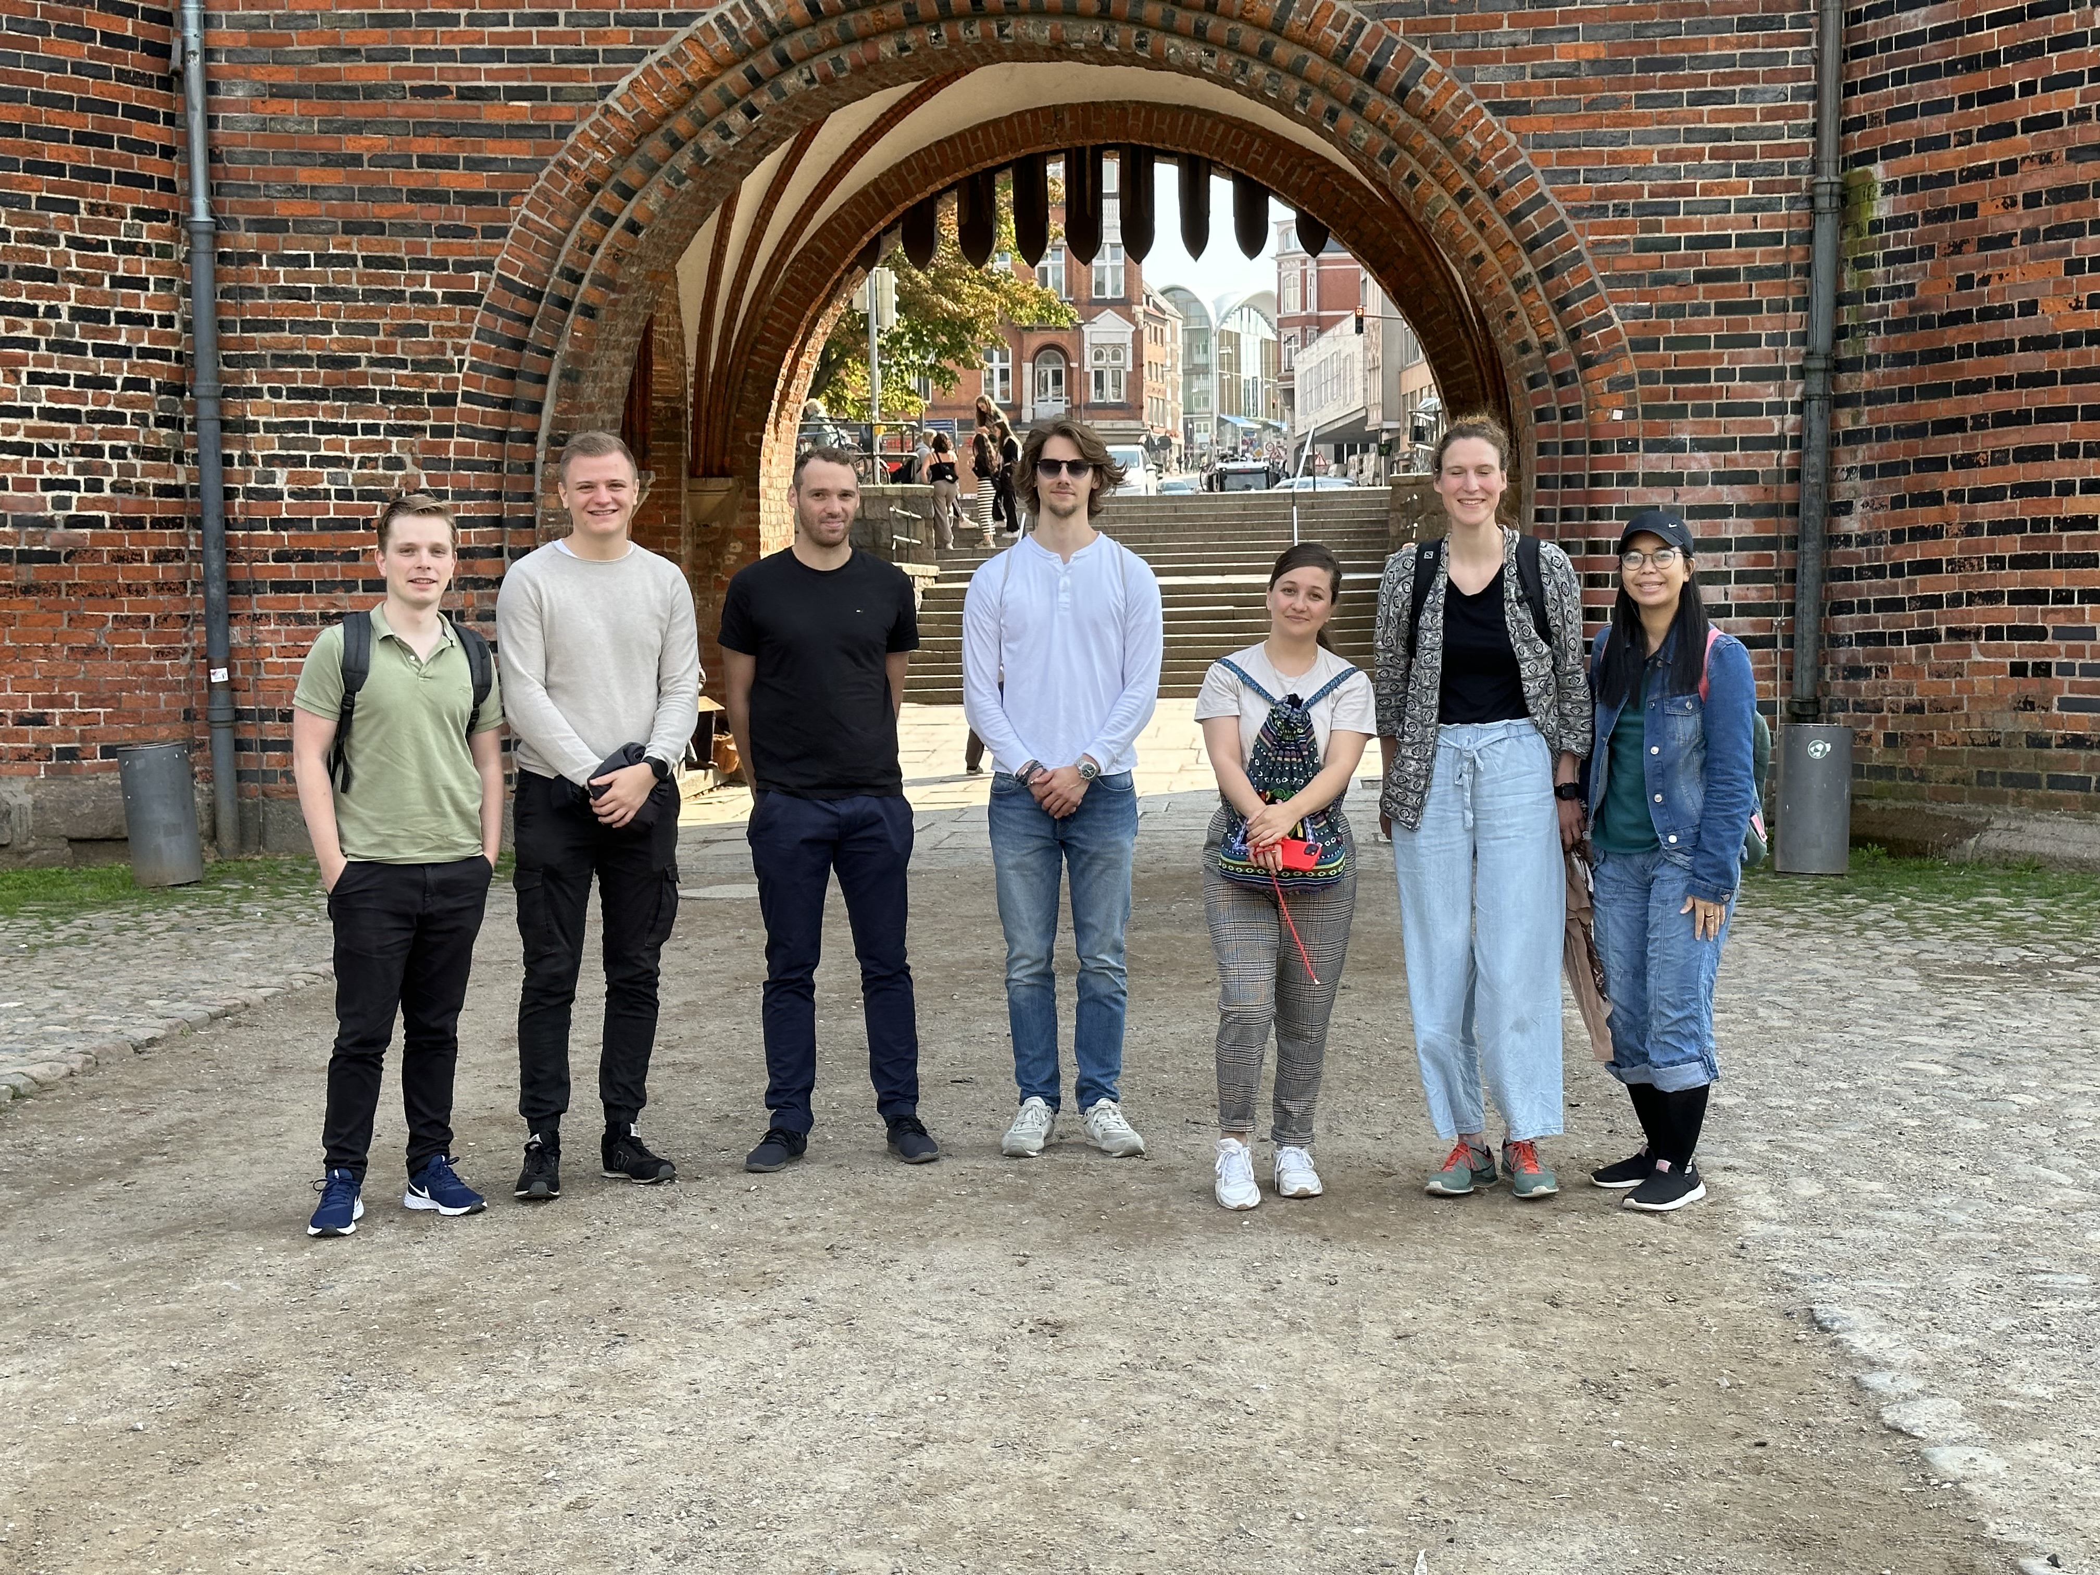
Thank you

Slide 25
Hamburg University of Technology
www.tuhh.de
Annika Eichler
ICS
annika.eichler@tuhh.de
Annika Eichler
MSK
annika.eichler@desy.de
+49 (0)40 8998 4041

