Slide 1
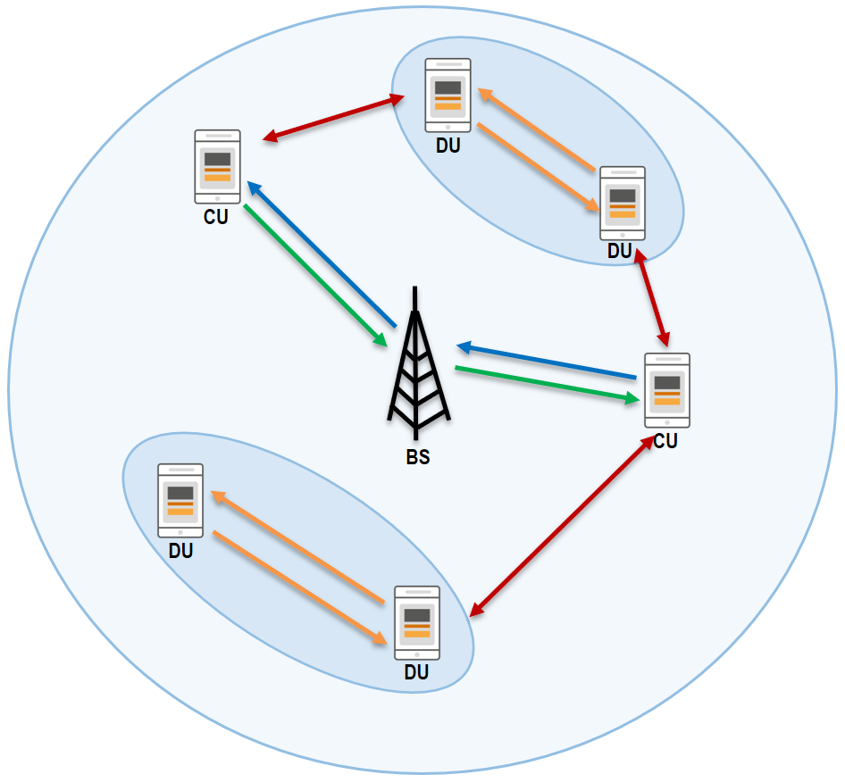
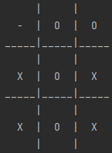
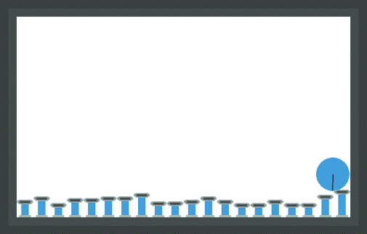
Multi-Agent Reinforcement Learning and a comparison to Single-Agent RL
Sabrina Pochaba, Peter Dorfinger, Roland Kwitt, Simon Hirländer
05/02/2024
RL4AA’24, Student Session

Slide 2
Multi-Agent Reinforcement Learning
Agent
Agent
State
Agent
Action
Reward
Environment

Slide 3
Multi-Agent Reinforcement Learning
Adversarial Games:
Cooperative Games:
Mixed Games:

Slide 4
Game Theory
Extensive-Form Game:
a tuple $(N, {\left\{S^{i}\right\}}_{iεN}, H, T, { \left\{v^{i}\right\}}_{iεN})$
Normal Form Game:
a triple $(N, {\left\{S^{i}\right\}}_{iεN}, {\left\{v^{i}\right\}}_{iεN})$
Anne
clean
refuse
4
5
Bob
offer 5€
offer lunch
 | Rabbit | Deer
Rabbit | ($2$ ,$2$) | ($4$,$0$)
Deer | ($0$, $4$) | ($5 , 5$)
Anne
Anne
reject
reject
accept
accept
1
4
2
2
5
3
3
1

Slide 5
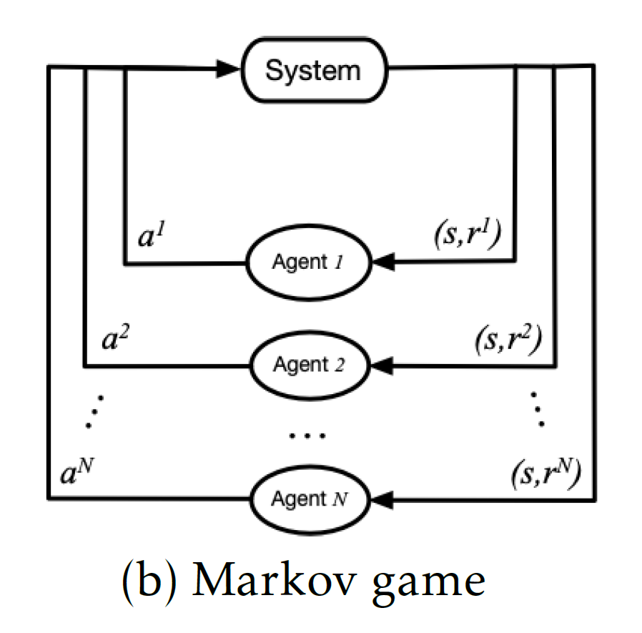
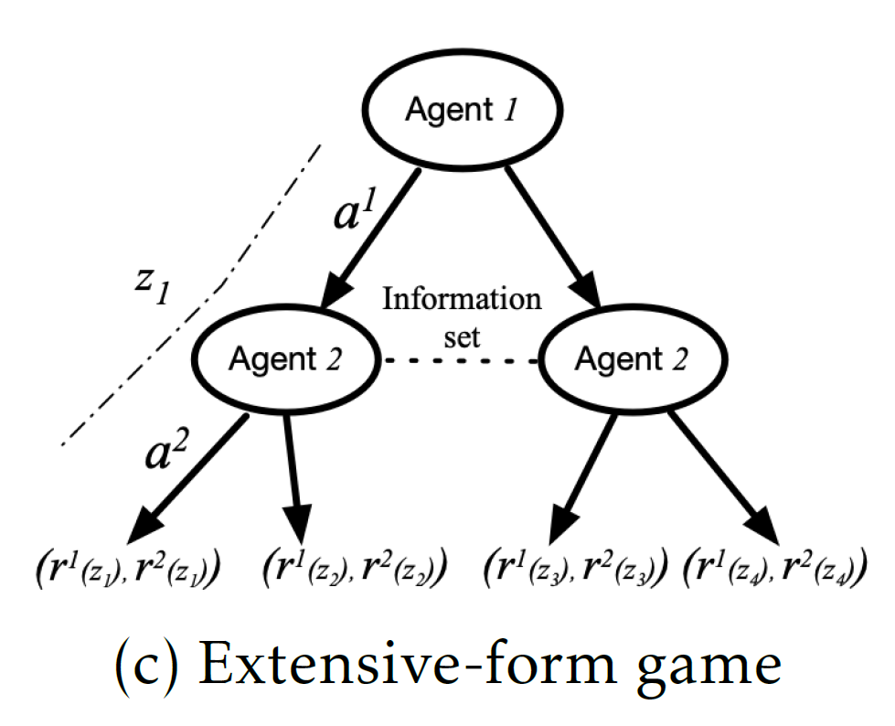
Frameworks of MARL
Markov Game:
a tuple $(N, S, {\left\{A^{i}\right\}}_{iεN}, P, {\left\{R^{i}\right\}}_{iεN},γ)$,
Extensive-form Game:
a tuple $(𝒩∪\left\{c\right\}, ℋ,𝒵, 𝒜, {\left\{ℛ^{i}\right\}}_{iε𝒩},τ, π^{c},𝒮)$,

Slide 6
Game Theory
Equilibrium:
$$A policy x^{∗} achieves the Nash \\ Equilibrium if ∀i, x_{i}∈X_{i},$$
$u_{i}\left(x_{i}^{∗},x_{−i}^{∗}\right)≥u_{i}\left(x_{i},x_{−i}^{∗}\right)$.
Environment
Action?
Action?
Action?
Action?
BUT: Many different types of Equilibria
Mixed Nash
Stackelberg
Action?
Action?
Notes:
Reward: oft nicht möglich Reward von allen Agenten zu maximieren
Suche steady state (bestes Ergebnis für alle Agenten gegeben die Aktionen der Anderen)
Nash Equi
Existieren ein paar MARL algorithmen, aber nicht viele
Forschung in MARL ist in Anfangsstadium
Nash
u_i Gewinn von Agent i
x_i policy von Agent i
Nicht eindeutig-> Koordinations problem
Additional:
Je nach Spiel/ Verhalten der Agenten, können unterschiedliche Equis sinnvoll sein
-> Mixed Nash: Unsicherheit (für Interaktion der Agenten)
-> Stackelberg: Follower/ Leader (for repeated games)
Nash Equi:
->mehr als 1 Nash Equi mit verschiedenem Reward für verschiedene Agenten
->Kein eindeutiges Ergebnis
->Wie wählt man das richtige NE? (Koordinierungsproblem)

Slide 7
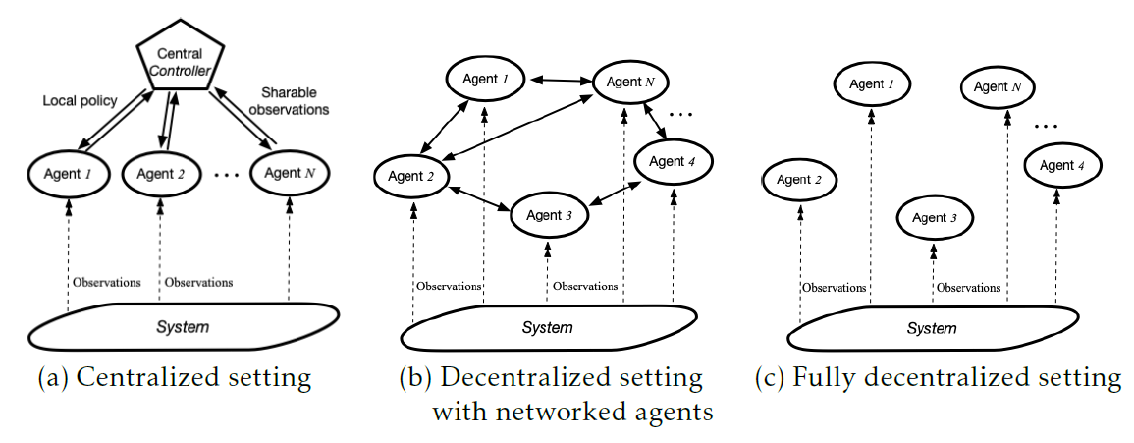
Challenges of MARL
Environment
Non-unique Learning Goals
Non-stationarity
Scalability issues
Various information structures
Does often not exist
Cooperative
Cooperative
Competitive
Exchange of local information
Competitive
Notes:
Cooperative vs Adversarial Games
Non-Unique Learning Goals:
Unclarity of problem
Goals can be multi-dimensional
Assumption for NE: Agents are all rational (fähig perfekt zu denken & unendlich wechselseitige Modellierung der anderen Agenten)
Goal: best learning strategy for a given agent & a fixed class of the other agents
If stable (convergence) & rational (convergence to best-response) learning goal, then naturally convergence to NE
Non-Stationary:
Agents learn concurently, thus environment is non-stationary
Agent muss sich an das gemeinsame Verhalten aller Agenten anpassen
Single-agent RL analysis can‘t be used for MARL
Ignoring non-stationarity, may fail to converge (independent learner)
Scalability:
Combinatorial nature of MARL: each agent need to look at joint action space, but dimension increases exponentially
Large number of agents complicates the theoretical analysis
Possibilities to face scalability issue: Assume additionally the factorized structures of value or reward fct
Erforderliche Verwendung von Fkts Approximation
Theoretical analysis of deep MARL is an almost uncharted territory (see Future Directions)
- Information structures (who knows what) -> They are more involved in MARL

Slide 8
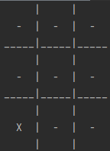
Tic-Tac-Toe
2 player adversarial game
Action: number between 0 and 8
State: actual positions of x and o in 3x3 field
Reward: +1 for winning agent, -1 for loosing agent, 0 if draw
Agent 1
Agent 2
State
Action
Reward
Environment

Slide 9
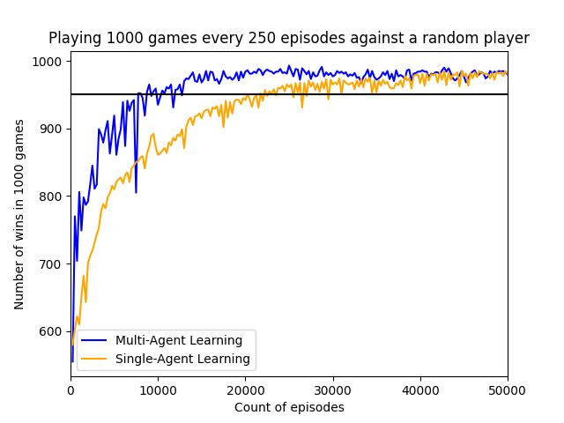
Tic-Tac-Toe Results: Comparison

Slide 10
Cellular and D2D communication
DU
Problem: Reliable Communication without regulation of BS
CU
DU
BS = Base Station
CU = Cellular User
DU = D2D User
Solution: Multi-Agent Reinforcement Learning
BS
CU
DU
DU

Slide 11
Cellular and D2D communication
Resource Usage in Resource Blocks (RBs):
Problem: Reliable Communication without regulation of BS
Frequency (kHz)
RB
180 kHz
1 ms
Time (ms)
Notes:
So far regulation of comm traffic entirely/completely via BS
BS has certain frequency spectrum that it can distribute during time (graphic)
Divides frequency sprectrum into frequency bands of 180 kHz and time intervalls of 1 ms
In every ½ ms it assigns every frequency band (full spectrum)
Resource Block (RB)
-> thats the way how the BS distributes all ist resources
AIM: devices (agents) should learn to assign RBs independently, without disturbing neighbors

Slide 12
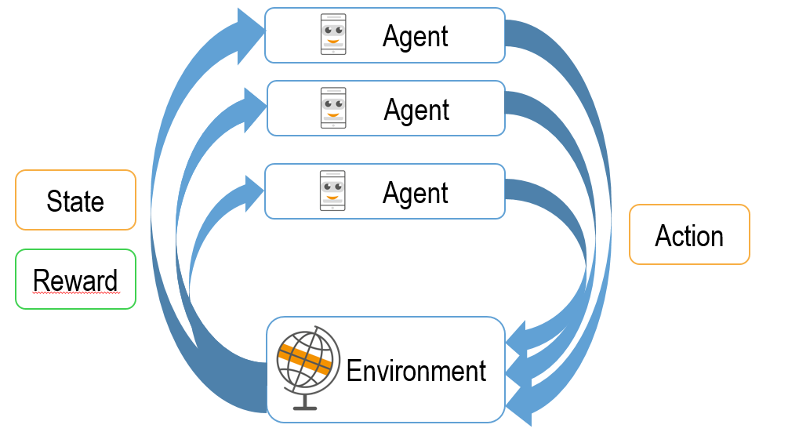
MARL in D2D communication
Action: Choose RB
State:
Own RB selection
Satisfaction (QoS)
Neighbors
RB selection of neighbors
Reward: Satisfaction (QoS) of all devices

Slide 13
Questions?
Sabrina Pochaba
Salzburg Research Forschungsgesellschaft mbH
Jakob-Haringer-Str. 5/3 | Salzburg, Austria
+43 662 2288-459
sabrina.pochaba@salzburgresearch.at
References
Arash Asadi, Qing Wang, and Vincenzo Mancuso. A survey on device-to-device communication in cellular networks. IEEE Communications Surveys Tutorials,16(4):1801–1
Khaled B. Letaief, Wei Chen, Yuanming Shi, Jun Zhang, and Ying-Jun Angela Zhang. The roadmap to 6g: Ai em-powered wireless networks. IEEE Communications Magazine, 57(8):84–90, 2019.
Andreas F. Molisch. Wireless Communications. Wiley Publishing, 2nd edition, 2011.
Ann Nowé, Peter Vrancx, and De Hauwere Yann-Micha ̈el. Game Theory and Multi-agent Reinforcement Learning, pages 441–470. Springer-Verlag Berlin Heidelberg, 2012.
Richard S. Sutton and Andrew G. Barto. Reinforcement Learning: An Introduction. The MIT Press, second edition, 2018
Huaqing Zhang and Shanghang Zhang. Multi-Agent Reinforcement Learning, pages 335–346. Springer Singapore, Singapore, 2020.
Kaiqing Zhang, Zhuoran Yang, and Tamer Basar. Multi-agent reinforcement learning: A selective overview of theories and algorithms. CoRR, abs/1911.10635, 2019.
Yuan Zhi, Jie Tian, Xiaofang Deng, Jingping Qiao, and Dianjie Lu. Deep reinforcement learning-based resource allocation for d2d communications in heterogeneous cellular networks. Digital Communications and Networks, 2021.
Sabrina Pochaba

Slide 14
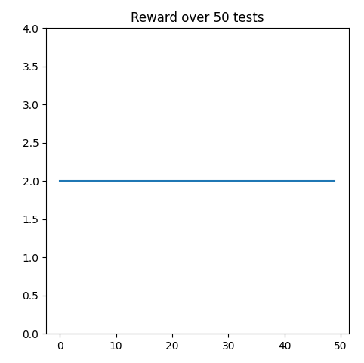
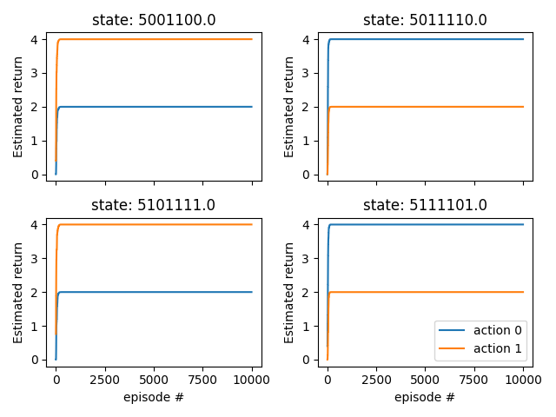
First Results
2 Agents
Q-Values for Device 1:
Notes:
Make a testing scenario (50 tests with random states)
Maximum Reward for 2 Agents = 2
Works pretty well (Q-table correct)
Q-Values for one Device
Left hand side Dev 0 chooses Ch0 => Dev 1 chooses Ch1 (orange higher than blue)
Right hand side Dev 0 chooses Ch1 => Dev1 chooses Ch0 (blue higher than orange)

Slide 15
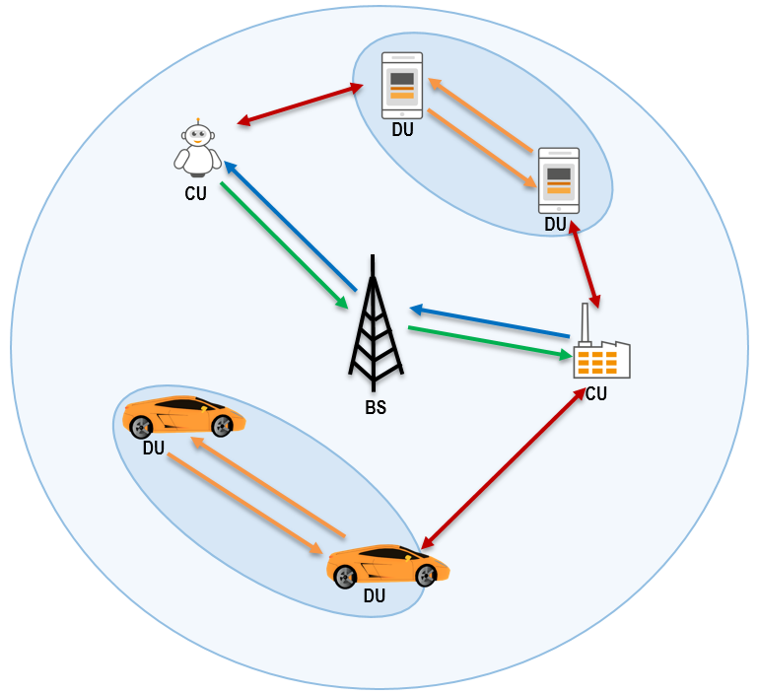
MARL in D2D
Movement of Devices
Information of neighbors
Up- & Downlink
Traffic Priorities
Redundancy
Choosing multiple RBs
Problem: Reliable Communication without regulation of BS
Aim: Optimization of Communication with Multi-Agent Reinforcement Learning

