Slide 1
Automatic Setup of Controlled Longitudinal Emittance Blow-Up
>> Considerations on RL Feasibility <<
N. Bruchon

Slide 2
Outline
Introduction to blow-up
Importance for longitudinal stability
Blow-up settings
Purpose of RL application
Definition of State, Actions, Reward
Critical issues
Solutions with other approaches
Discussion
Conclusions

Slide 3
Outline
Introduction to blow-up
Importance for longitudinal stability
Blow-up settings
Purpose of RL application
Definition of State, Actions, Reward
Critical issues
Solutions with other approaches
Discussion
Conclusions

Slide 4
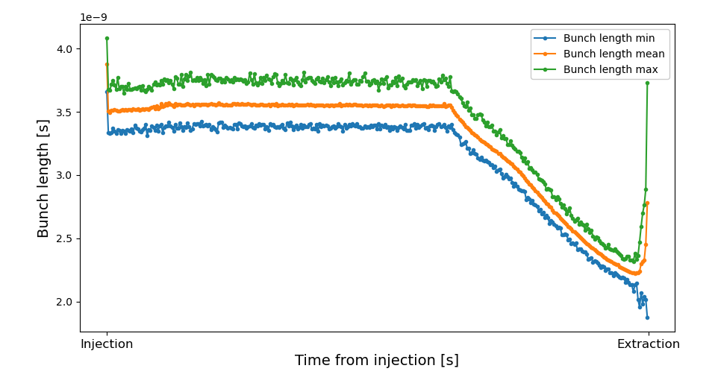
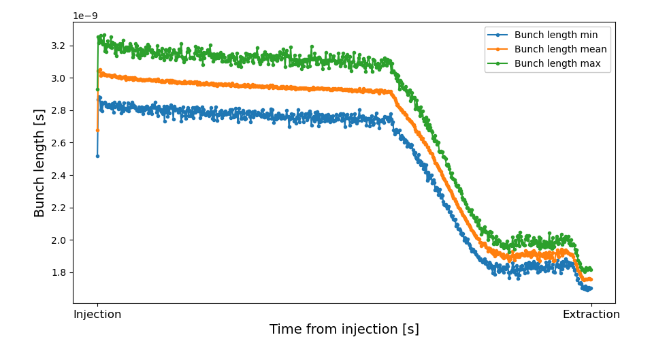
Introduction
Bunch length shrinks during acceleration
Smaller bunch length may result in unstable beam at extraction
Injection of bandwidth limited noise into the phase loop
Purpose: diffuse particles in the bunch core, without touching the tails
Effect: improve beam stability

Slide 5
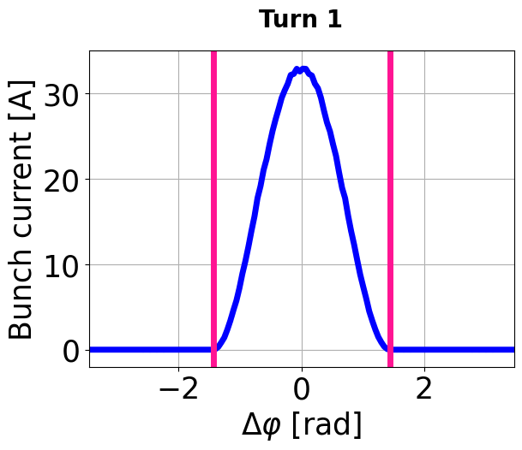
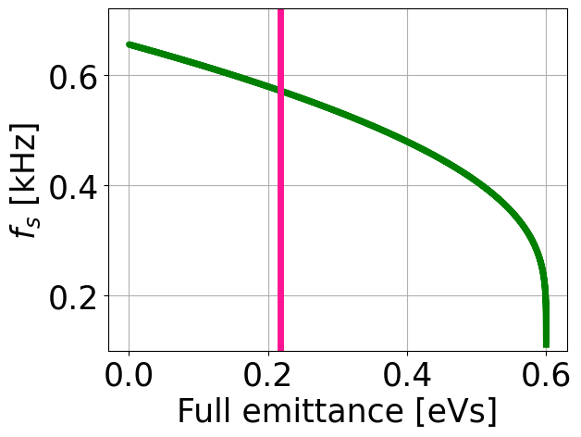
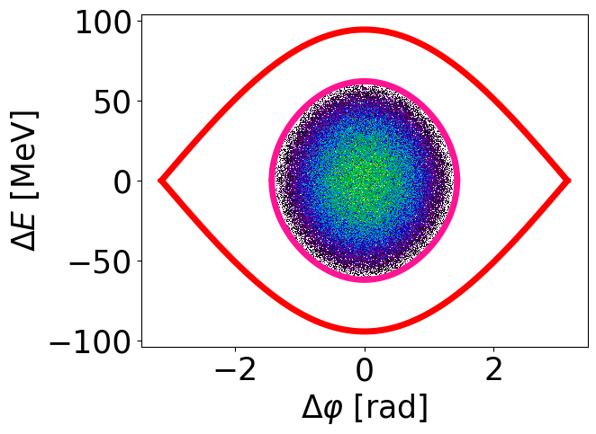
Blow-Up in a Nutshell
Profile
Synchrotron frequency
Emittance
Noise bandwidth
Longitudinal
Phase Space
Particles diffuse in the bunch to increase longitudinal emittance:
Reduced line density peak current
Increased bunch length
Courtesy of D. Quartullo
Notes:
Maybe in back up

Slide 6
Blow-Up Functions to Optimize
Amplitude, $a$:
Defined in rms degrees of the 200 MHz RF system
Too low-amplitude noise signal may be ineffective
Too high amplitude can negatively affect the bunch distribution
Zero amplitude means that no blow-up is applied
Frequency band:
Defined by cutoff frequencies that follow variation of small-amplitude synchrotron frequency, $f_{s0}$
Ratios called margins defined by normalizing those values with respect to $f_{s0}$
Margin low, $m_{low}={f_{low}}/{f_{s0}}$
Margin low, $m_{high}={f_{high}}/{f_{s0}}$
The aim of the blow-up is to impact the bunch core exclusively, without increasing the tail population of the particle distribution, which would risk generating losses

Slide 7
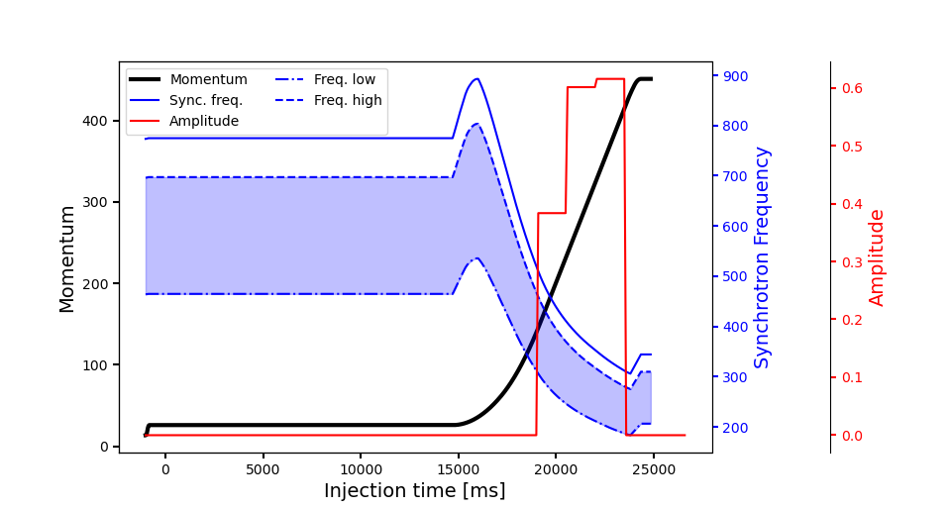
Blow-Up Functions to Optimize
Blow-up interval:
Time interval along the cycle during which the blow-up is applied
Defined when RF voltages and synchronous phase are nearly constant
Limited also by other manipulations

Slide 8
Outline
Introduction to blow-up
Importance for longitudinal stability
Blow-up settings
Purpose of RL application
Definition of State, Actions, Reward
Critical issues
Solutions with other approaches
Discussion
Conclusions

Slide 9
Purpose
Optimal blow-up settings are essential to ensure longitudinal stability
Automatize the Setup!
Replace the manual procedure
Reduce required beam time for optimization
Results comparability thanks to objective function
Why Reinforcement Learning?
A trained agent should efficiently solve the problem

Slide 10
Schematic View
LHC Software Architecture
Raw Data Analysis
Blow-up Noise Generator
Beam Measurements
Environment
State
Action
RL Agent
Reward

Slide 11
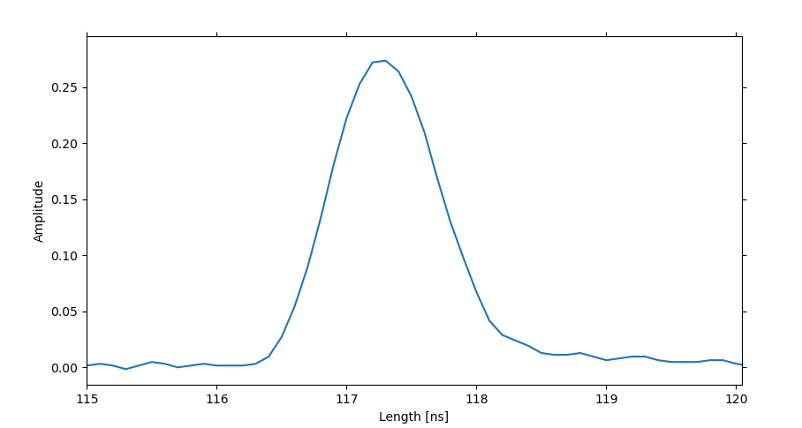
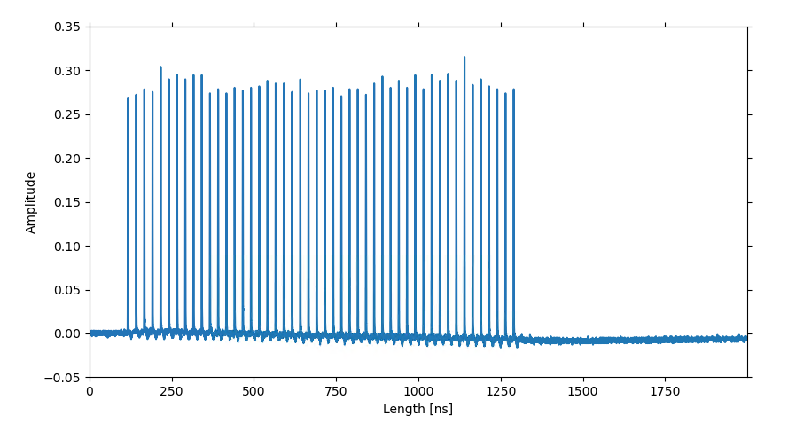
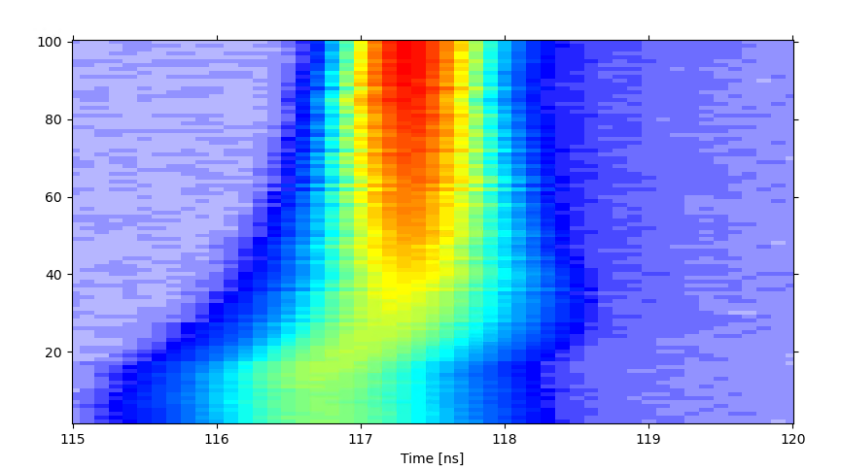
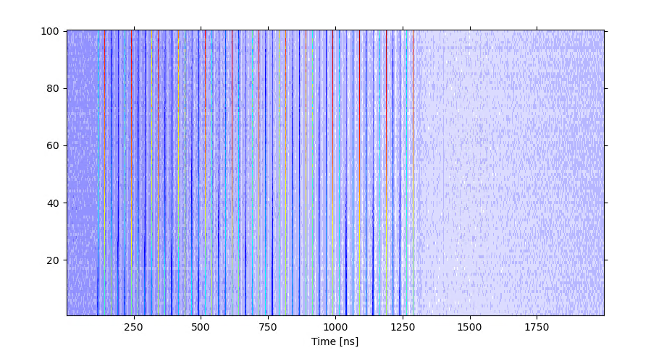
Measurements/Observations
Longitudinal profiles from detectors installed in the SPS
Multi turn acquisitions:
Data refresh every 20ms
Single bunch
Analysis software to extract features:
Peak, Width, FWHM, μ, σ, bunch length, …
Multiple bunches → extract features for each bunch
LHC-beam type consists of $4×72=288$ bunches
Uniform features are desired across all bunches
Multi bunch
Single bunch
Multi bunch

Slide 12
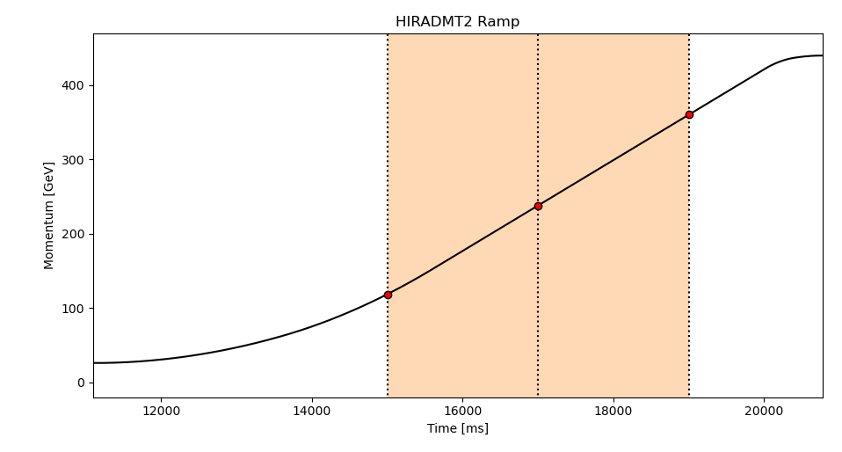
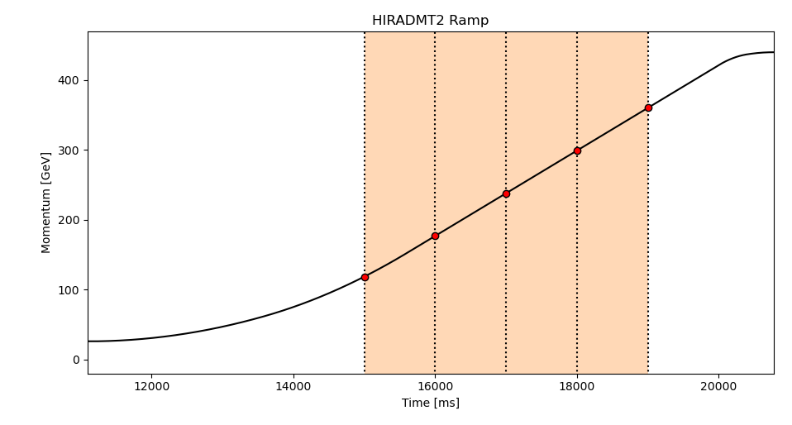
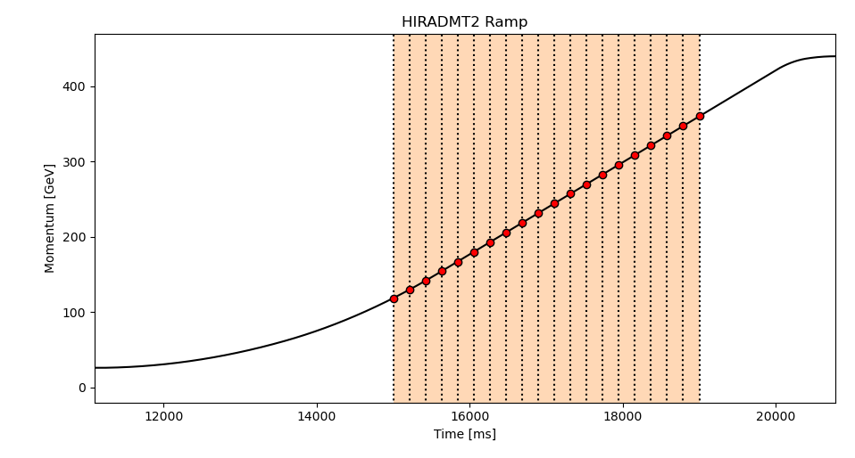
State
Represent environment: raw data and/or extracted features
Bunch length is the most critical one
Additional information about bunches may be useful (shape, intensity, …)
Multi turn acquisitions: when observation must be taken?
Few observations are sufficient but…
information during blow-up is missing
What about adding intermediate points?
Better knowledge and control of the beam aspects taken into account!
WARNING: do not exaggerate with the state dimensions → the problem will become unmanageable soon!

Slide 13
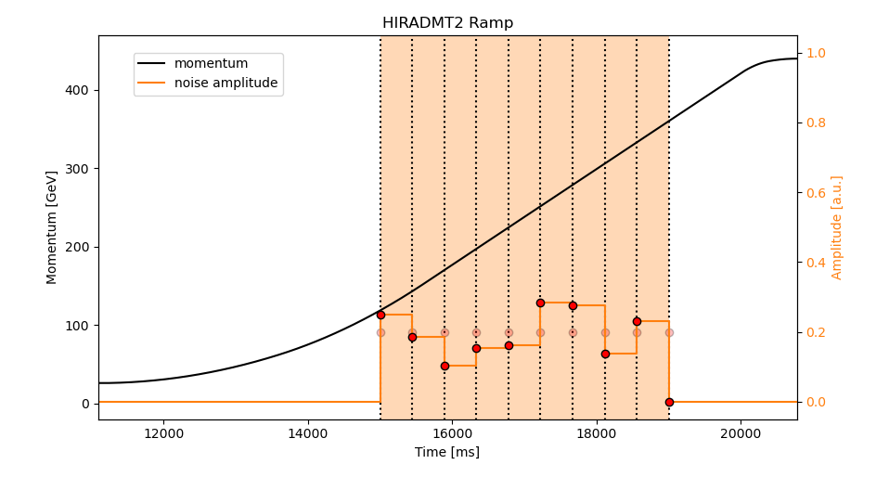
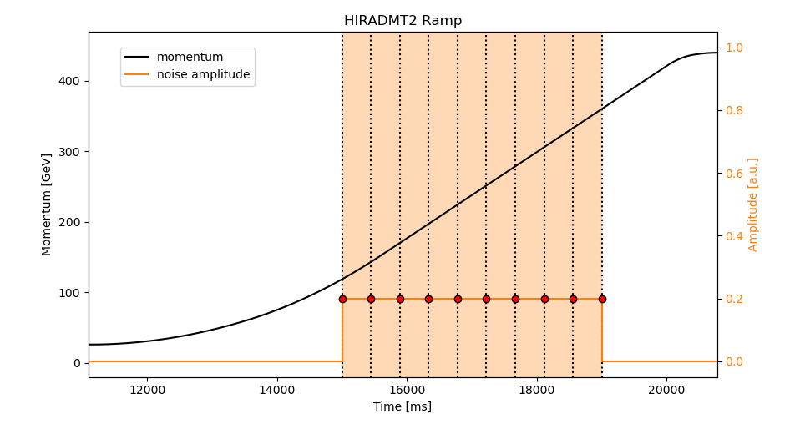
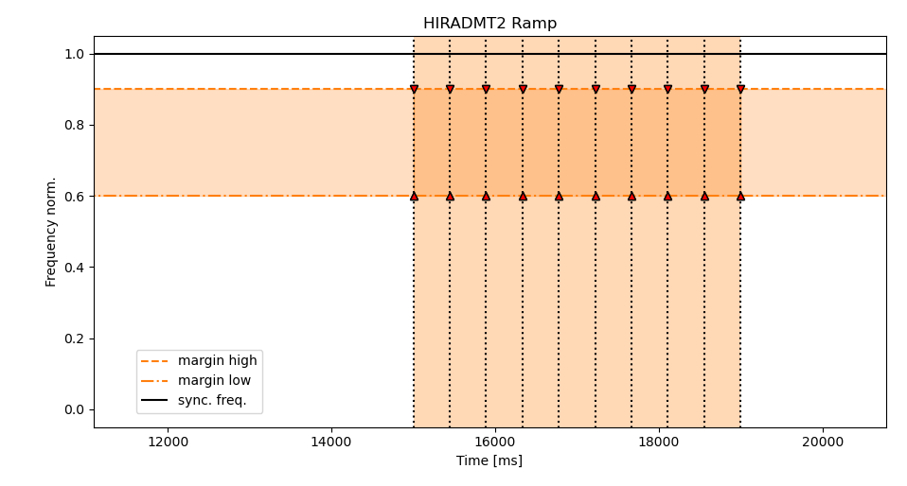
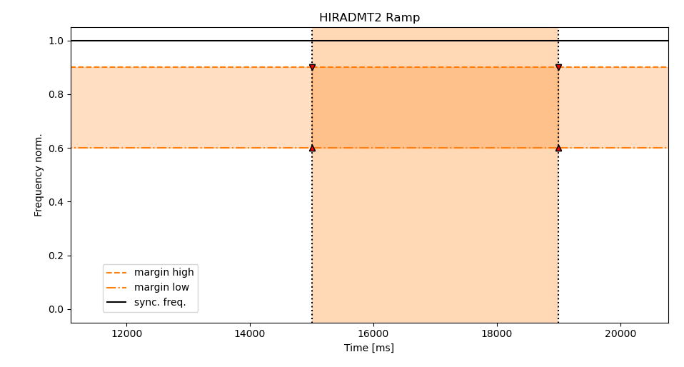
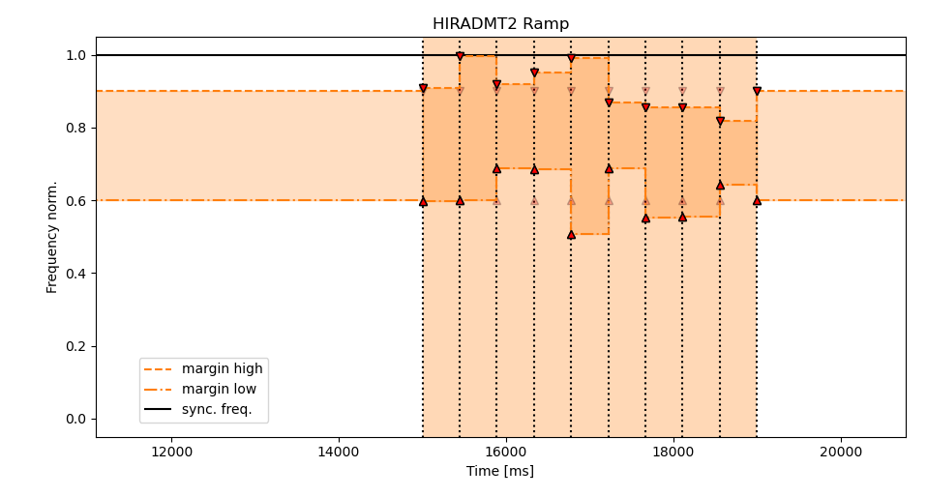
Action
Variation of settings value
Manually: constant settings
Over multiple points:
Adapt settings to each interval independently
More accurate time dependent setup:
Amplitude could go to zero in some intervals.
Freq. band could increase or reduce in intervals.
Better control leads to better results
Limit actions to avoid losses or ineffective blow-up
Variation of the AMPLITUDE
Variation of the MARGINS

Slide 14
Reward
The reward must be a scalar
Custom function to calculate it relying on observations
Define the most relevant features with which calculate the blow-up effects
…
General targets:
Reach desired bunch length
Guarantee longitudinal stability
Ensure uniform bunches
Control the bunch length evolution.
Avoid losses

Slide 15
Bunch Length RMSE – Reward example
Multi bunch beam → $n$ bunch lengths: $σ={\left[σ_{1},σ_{2}, …,σ_{n}\right]}^{T}$
Error vector: $ε={\left[σ_{i}−σ_{ }^{∗} ∀i∈\{1,…,n\}\right]}^{T}$
Desired bunch length: $σ_{ }^{∗}$, constant for all sub-interval observations
Filtered error vector: $ε_{FILTERED}=\left\{\begin{aligned}\begin{matrix}0 & if ε_{i}∈{tol}_{band}\end{matrix} \\ \begin{matrix}ε_{i} & otherwise \end{matrix}\end{aligned}\right.,$ $∀i∈\left\{1,…,n\right\}$
With tolerance band defined by $σ_{ }^{∗}∓{tol}_{\%}$ : ${tol}_{band}=\left[{ σ}_{ }^{∗}− {tol}_{\%},{ σ}_{ }^{∗}+ {tol}_{\%}\right]$
$$Root Mean Square Error (RMSE)= \sqrt{\sum_{i=1}^{n}{\frac{{\left(ε_{FILTERED}\right)}^{2}}{n}}}$$
$$Reward=−RMSE$$
$$σ$$
$$σ$$
$$\max\left(ε_{FILTERED}\right)$$
$$σ_{ }^{∗}$$
$$0$$

Slide 16
Critical Issues
Training an RL agent requires data:
from the real system
from a simulator
Data efficiency is mandatory:
Training should rely on as little data as possible
Data collection should not take long time:
Fast creation of dataset

Slide 17
Real World Data
Single LHC cycle ($\sim 23 s$) in the SPS super-cycle ($\sim 45 s$)
State is collected at the end of the cycle
Single sample every $\sim 45 s$
$100$ samples →$\sim 1.25$ hours
without considering eventual issues along the acceleration chain
Relying on real data requires too much machine time → Unfeasible!

Slide 18
Simulated Data
Beam Longitudinal Dynamics (BLonD):
CERN simulation suite for longitudinal particle tracking in synchrotrons.
It generates the blow-up effects on the longitudinal profiles:
“raw data” to analyse
It can replace the real machine and provide data according to blow-up settings
Issues on the calculation time!
Single cycle with uniform settings $>8$ hours
Grid search ($16065$simulations in parallel) with uniform settings $\sim 3$ days
BLonD

Slide 19
A dead end…
Too long time to collect enough data for training RL agent
Only uniform settings were considered, exponential growth of problem complexity with intermediate points…
Software for optimal blow-up was required as soon as possible
→ Generic optimizers to replace RL solutions

Slide 20
Outline
Introduction to blow-up
Importance for longitudinal stability
Blow-up settings
Purpose of RL application
Definition of State, Actions, Reward
Critical issues
Optimization loop
Alternative approaches
Discussion
Conclusions

Slide 21
LHC Software Architecture
Raw Data Analysis
Blow-up Noise Generator
Beam Measurements
Environment
SET
SPS blow-up optimization
GeOFF & COI
Blow-up parameters
sps-blowup
┣━ sps_blowup
┃ ┣━ __init__.py
┃ ┣━ _baseenv.py
┃ ┣━ _machine.py
┃ ┣━ _realprofiles.py
┃ ┗━ _analysis.py
┣━ setup.py
┗━ README.md
Beam info
GET

Slide 22
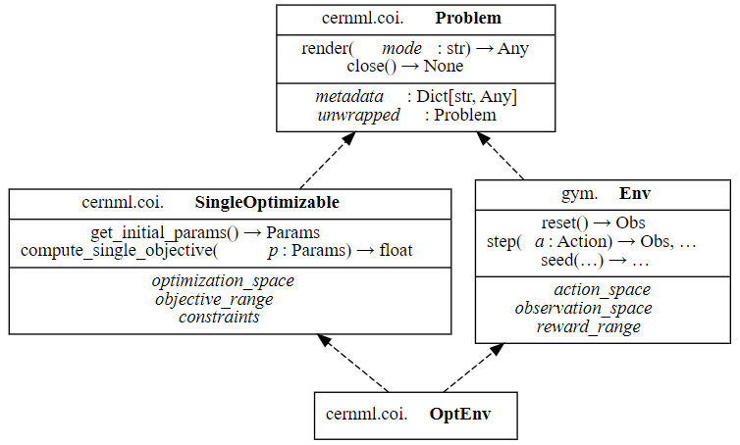
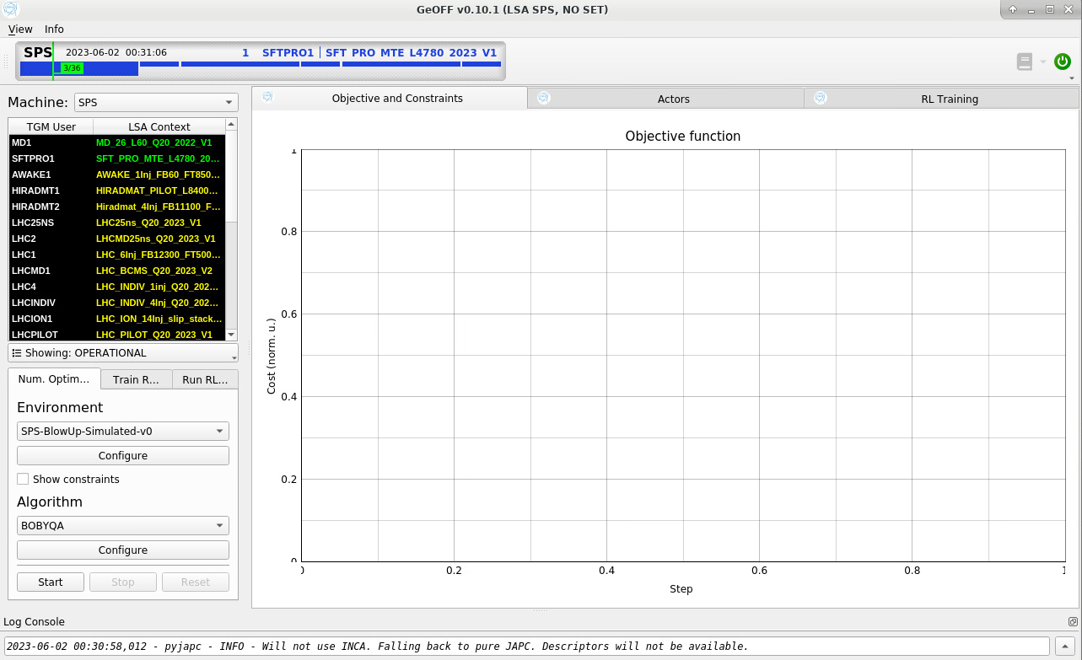
Integration in the CERN Optimization Framework
Generic Optimization Frontend
and Framework (GeOFF)
“… graphical application for generic numerical optimisation and reinforcement learning on CERN accelerators.
It bundles:
Interfaces to the machines and simulations thereof
Numerical optimisers and reinforcement learners that can use these interfaces.”
Common Optimization Interfaces (COI)
“… facilitate using numerical optimization and reinforcement learning (RL) on the same optimization problems. This makes it possible to unify both approaches into a generic optimization application in the CERN Control Center.”
Inheritance diagram of the core interfaces

Slide 23
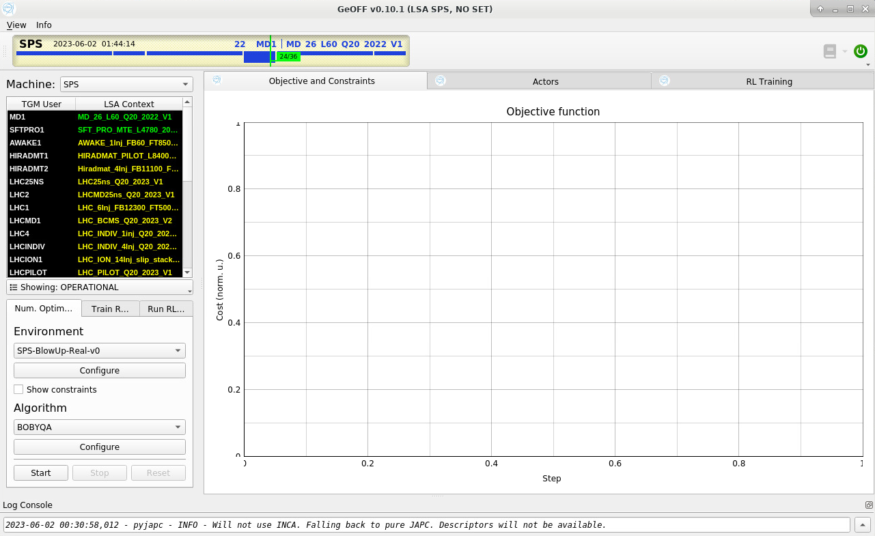
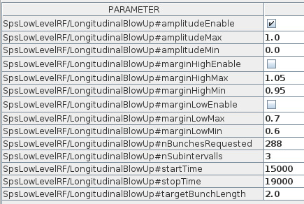
Configuring the Tool
Check parameters in LSA
Select the noise settings to optimize and set their min-max range
Amplitude, margin low, margin high
Set the number of sub-intervals, the start time and end time
Set the number of bunches in the circulating beam
Set the target bunch length
Run the optimization in GeOFF
Select the Machine: SPS
Select the User
Environment: SPS-BlowUp-Real-v0
Push Start and… sit back and relax!
Parameter Group: RF BEAM CONTROL Property: SpsLowLevelRF/LongitudinalBlowUp
Amplitude
Margin low
Margin high
Interval

Slide 24
Results
Scan of $a$, $m_{low}$ and $m_{high}$on two sub-intervals
Target bunch length: $2.$1 ns
Scan of $a$ and $m_{low}$ on three sub-intervals
Target bunch length: $2.0$ ns
Scan of $a$ and $m_{low}$ on two sub-intervals
Target bunch length: $2.0$ ns---
Generic optimization (BOBYQA)
Bayesian optimization
Intensity per bunch: $2.15∙{10}^{11}$ ppb - # bunches: $288$
Int. per bunch: $1.90∙{10}^{11}$ ppb - # bunches: $56$

Slide 25
Discussion
Trade-off: optimization time and bunch length constant
More sub-intervals mean more iterations
More sub-intervals ensure flatter bunch length
Acceptable results with two and three sub-intervals
Single sub-interval: faster, suitable if a constant bunch length is not required
Four sub-intervals: longer time required for limited improvement in bunch length
Bayesian optimization
Dataset for exploration by grid search
Fixed number of steps for optimization
Drawback: increased number of steps
Need of mitigation strategies (e.g., reuse previous data, define convergence criteria, …)

Slide 26
Outline
Introduction to blow-up
Importance for longitudinal stability
Blow-up settings
Purpose of RL application
Definition of State, Actions, Reward
Critical issues
Solutions with other approaches
Discussion
Conclusions

Slide 27
Conclusions
An operational tool to automatically setup the controlled longitudinal emittance blow-up for high-intensity multi-bunch LHC beams was developed
Integration in LSA and the CERN optimization framework
Simple objective function is based on RMSE
Sequential setup by splitting blow-up duration in sub-intervals
Blow-up setup successful for high intensity proton LHC beams
Promising results with Bayesian optimization, improve sample-efficiency
Released software supports the extension to RL methods
Faster way to simulate data
Improve sample-efficiency

Slide 28
Automatic Setup of Controlled Longitudinal Emittance Blow-Up
>> Considerations on RL Feasibility <<
N. Bruchon

Slide 29
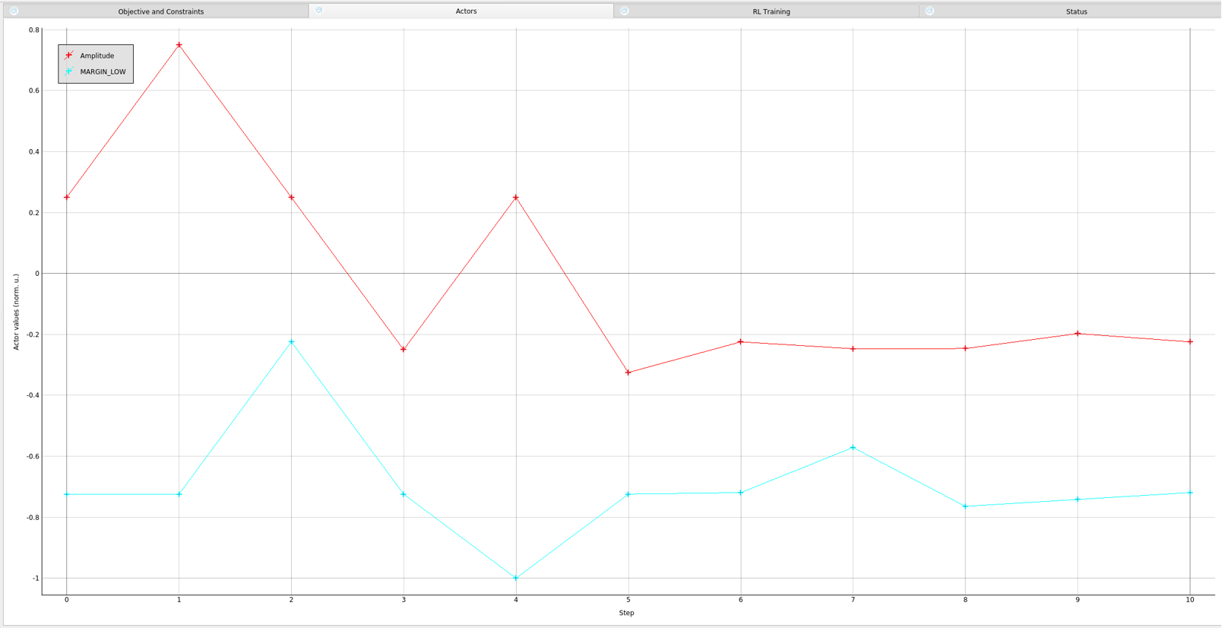
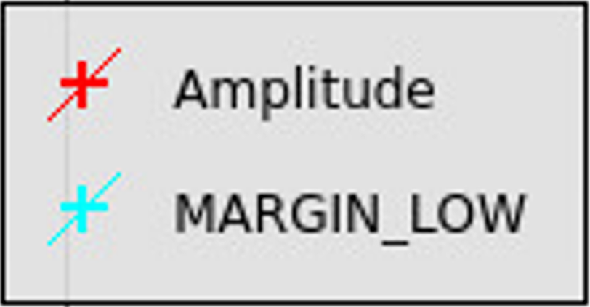
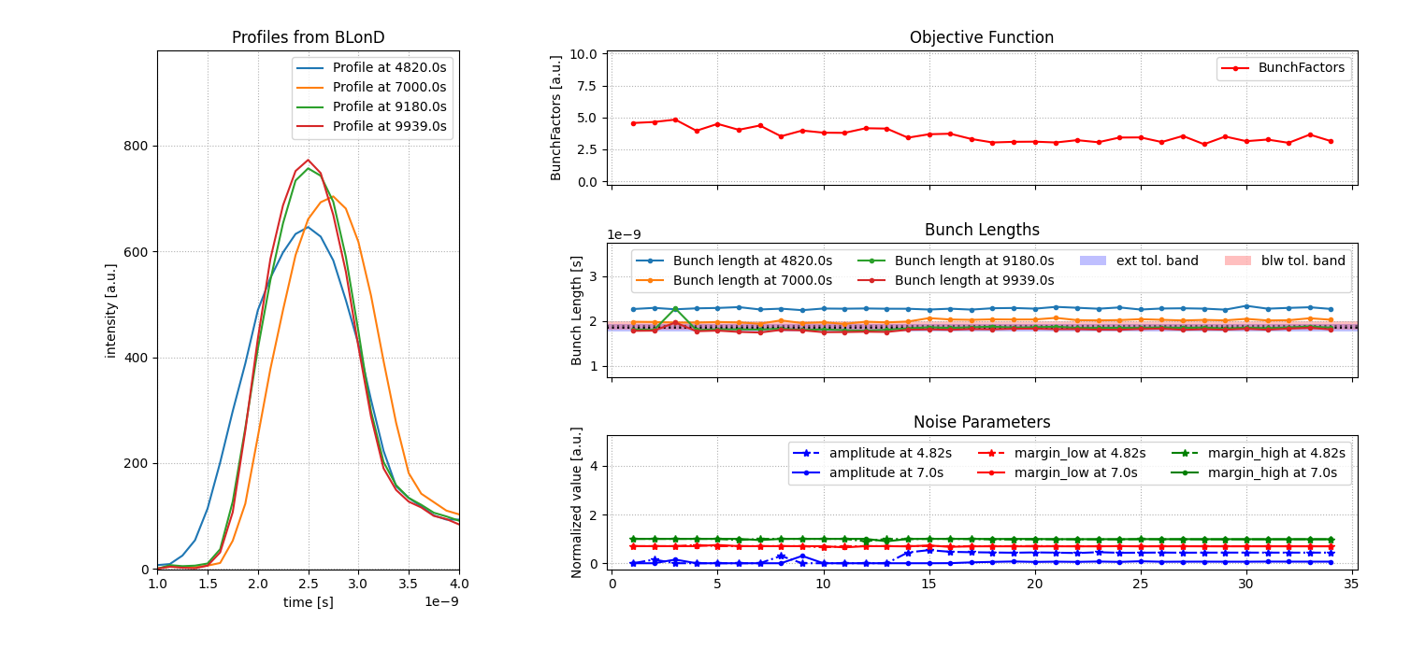
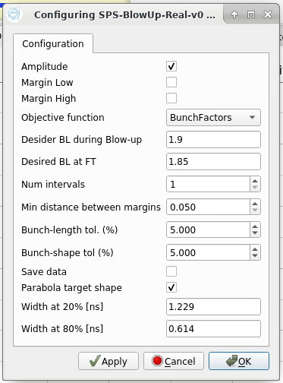
Blow-up Past Presentations/Publications
ML and data analysis discussions:
03/03/2022
ML Community Forum meetings:
29/04/2022
30/11/2022
IPAC 22:
TUPOST42 (proceedings)
09/06/2022 (poster)
SPS MPC:
06/06/2023
ICALEPCS 23:
07/12/2023 (flash presentation)
0.35
0.2551
Parameters:
Amplitude
Margin low
0.64
0.6375
02:56:36
03:06:17
Blow-Up parameters during the online optimization Beam process: HIRADMT2 Hiradmat_4Inj_FB11100_FT500_Q20_2021_V1
Nov. 2021
Configurations
ML: Machine Learning
Data on the LHCPILOT Cycle
Summer 2022

Slide 30
Common Optimization Interfaces
CERN ML Project:
Numerical Optimization - Machine Learning (ML) - Reinforcement Learning (RL)
for operations in the CERN accelerator complex.
CERNML-COI:
Common Optimization Interfaces (COI) to apply CERN ML solutions on the same problems.
Unification of all approaches into a generic optimization application in the CERN Control Center.
CERNML-COI-UTILS:
Provides utility functions and classes that make it easier to work with the COI.
Improvable keeping the COI stable.
Generic Optimisation Frontend and Framework (GeOFF):
This is the graphical application for generic numerical optimisation and reinforcement learning on CERN accelerators.
ENVIRONMENT:
Statement of the problem to be managed by the generic optimizers.
It should be encapsulated in an appropriate structure and follow some rules.

Slide 31
Some Existing Environments
Optimization of the steering for ISOLDE:
Problem of steering optimization for ISOLDE. The goal is to steer the ion beam via electrostatic elements such as to maximize the intensity measured by a downstream Faraday cup.
Optimization of the LEIR Transfer Line:
Problem of alignment in the ETL transfer line towards LEIR. The goal is to adjust the current over time of the BHN10 kicker so that the first injection in a cycle has maximum injection efficiency, and all subsequent injections in a cycle land in the same orbit as the first one.
Optimization of the Tune in the SPS:
Problem of tune optimization in the SPS. The goal is to manipulate the horizontal and vertical tune at two times within a cycle so that it maximizes the transmission. The transmission is defined as the beam intensity at the beginning of slow extraction divided by the beam intensity at the end of injection.
Optimization of the ZS Alignment in the SPS:
Problem of ZS alignment in the SPS. The goal is to move 9 anodes in such a manner that during slow extraction, the beam passes the electromagnetic septum and does not hit the beamline walls.
Optimization of the Blow-Up in the SPS:
Problem of Blow-Up setup in the SPS. The goal is to reach a desired longitudinal emittance by controlling the amplitude and the frequency margins of the noise injected in the phase.

Slide 32
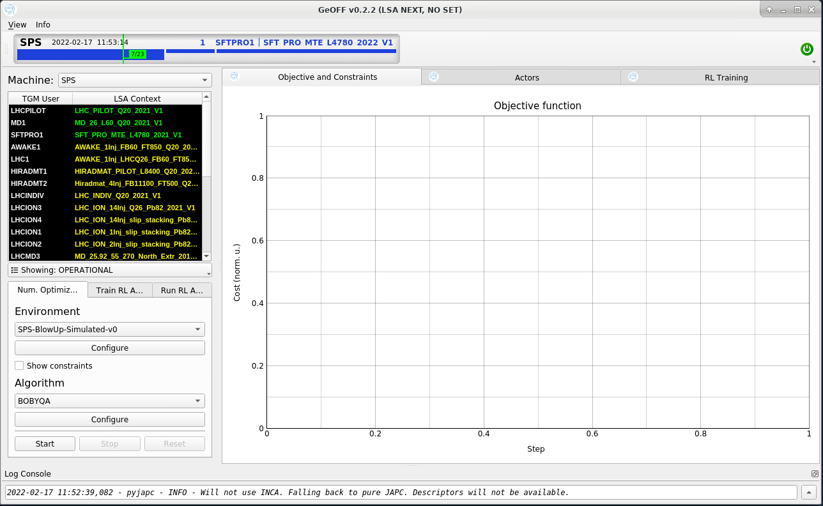
GeOFF
Supercycle
Machine
Cycles
Tabs
Optimization
Visualization
Num. Opt.
Train RL Agent
Run RL Agent
Environment
Algorithm

Slide 33
LSA Integration: Functions
Advantages of the LHC Software Architecture:
Keep in the database settings of all managed device/properties
Every change in control value (trim) is registered
Trim history and rollback
Use of LSA for all tools settings
Optimizable functions:
Amplitude
Margin Low
Margin High

Slide 34
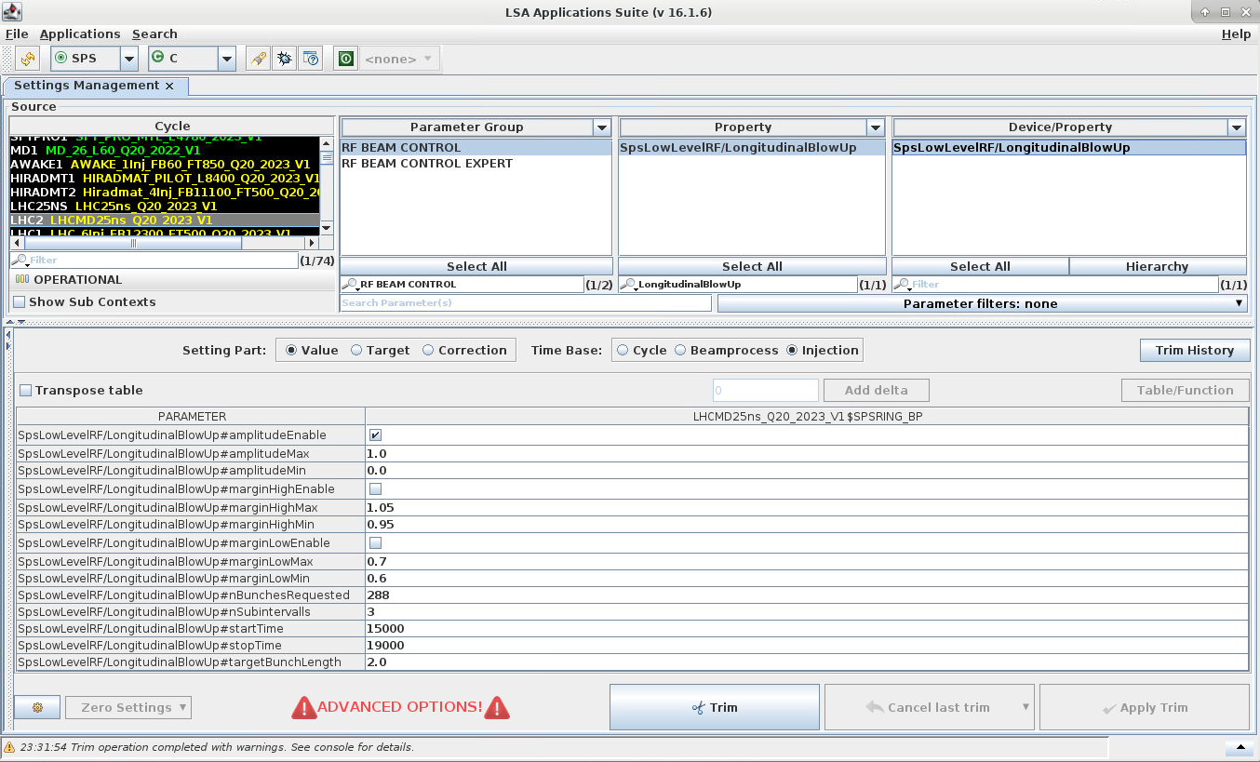
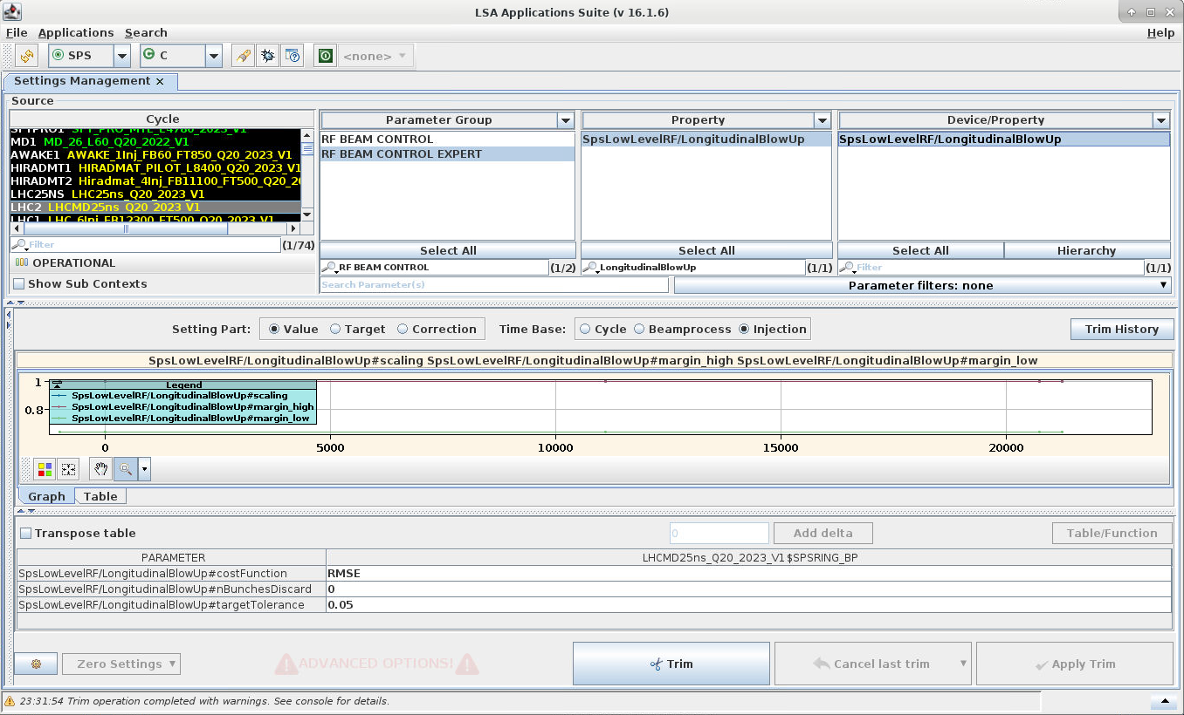
LSA Integration: Discrete Settings
Parameter Group: RF BEAM CONTROL Property: SpsLowLevelRF/LongitudinalBlowUp
Parameter Group: RF BEAM CONTROL EXPERT Property: SpsLowLevelRF/LongitudinalBlowUp
(*)
(*)
Amplitude
Margin low
Margin high
Interval
(*) Test parameters for user LHC2

Slide 35
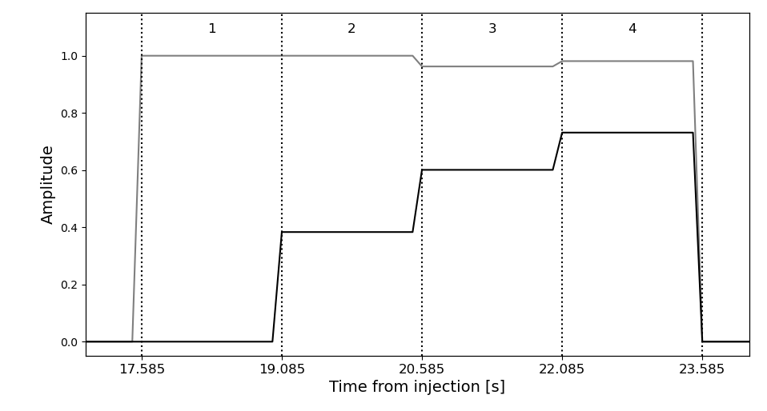
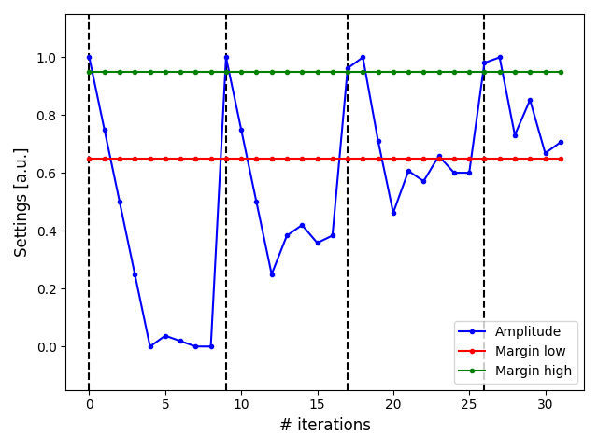
Amplitude Scan in the SPS
Blow-up interval: 19085 – 23585 [ms]; Num. sub-intervals: 4
Skeleton Points: 17585, 19085, 20585, 22085 [ms]
Observation Points: 19085, 20585, 22085, 23585 [ms]
Parameters: Amplitude
Amplitude Range: [0, 1]
Algorithm: BOBYQA
sub
sub
sub
sub
Scan ${sub}_{1}$
Scan ${sub}_{2}$
Scan ${sub}_{3}$
Scan ${sub}_{4}$

Slide 36
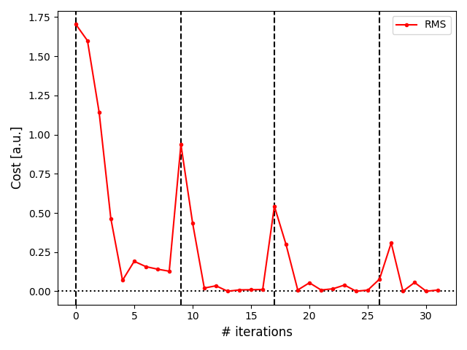
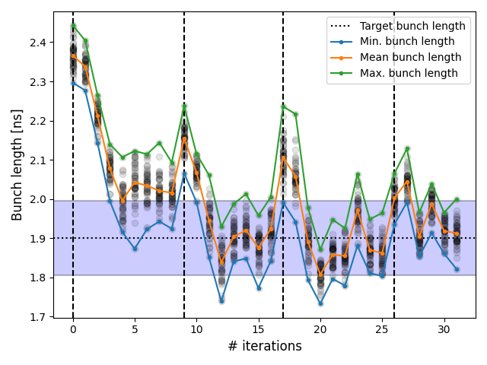
Results in the SPS
Target bunch length: $σ_{ }^{∗}=1.9 ns$
Tolerance: ${tol}_{\%}=$ ±5% → ${tol}_{band}=\left[\begin{matrix}1.805, & 1.995\end{matrix}\right] ns$
Problem solved in 31 iterations (Num. sub-intervals: 4).
Amplitude scan
Objective function
Bunch lengths
Scan ${sub}_{1}$
Scan ${sub}_{2}$
Scan ${sub}_{3}$
Scan ${sub}_{4}$
Scan ${sub}_{1}$
Scan ${sub}_{2}$
Scan ${sub}_{3}$
Scan ${sub}_{1}$
Scan ${sub}_{2}$
Scan ${sub}_{4}$
Scan ${sub}_{3}$
Scan ${sub}_{4}$
$$σ_{ }^{∗}$$
Iterations per sub-interval
Scan ${sub}_{1}$: 0, 8
Scan ${sub}_{2}$: 9, 16
Scan ${sub}_{3}$: 17, 26
Scan ${sub}_{4}$: 27, 31

Slide 37
Results Portability
Blow-up optimized for single batch, 06-10-2022.
Intensity per bunch: 1.2 e11 p/b
Average bunch length per extraction: 1.76 ns
Average bunch length at injection: 2.68 ns
Results on 5 batches without optimizing, 13-10-2022.
Intensity per bunch: 1.5 e11 p/b
Average bunch length per extraction: 1.81 ns
Average bunch length at injection: 2.82 ns
$$σ_{ }^{∗}$$
$$σ_{ }^{∗}$$
Scraping EXERCISE

Slide 38
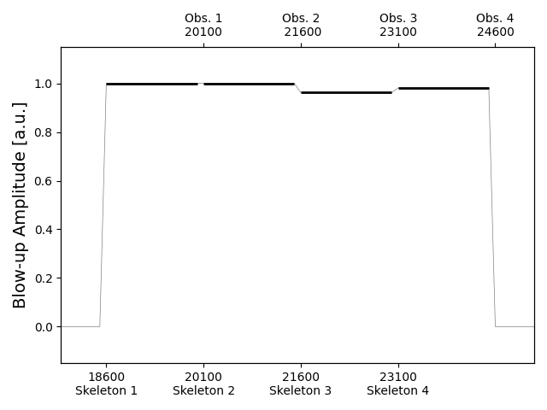
LSA Function Trim
Amplitude Optimization
Interval per interval research of the optimal amplitude to keep the bunch length constant.

