Slide 1
Adaptive X-ray Fluorescence Imaging
Daniel Ratner
February, 2024

Slide 2
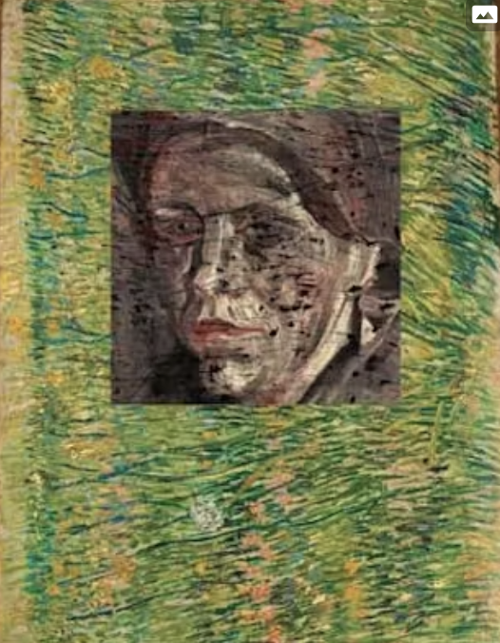
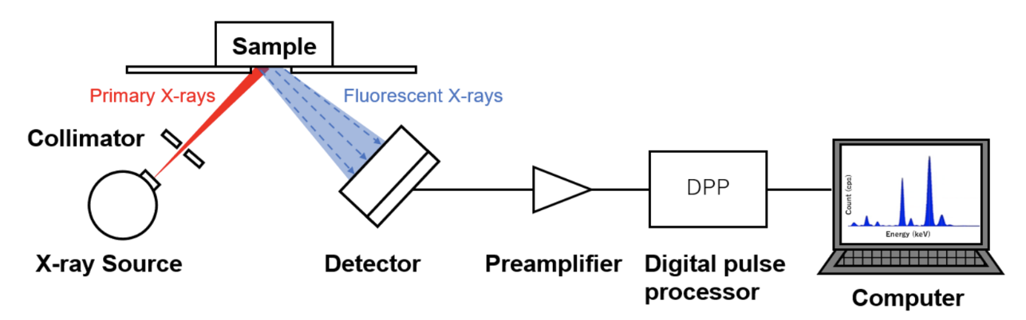
X-ray Fluorescence Imaging
X-ray Fluorescence Imaging (XRF):
Relatively new imaging method measures quantitative elemental maps
Scan x-ray probe (with variable resolution) around the sample
Fluorescence proportional to composition
Famous example #1: Van Gogh study of the potato-eaters
Map composition to pigment
Recover picture underneath in color!
Courtesy TU Delft et al
Image courtesy Horiba

Slide 3
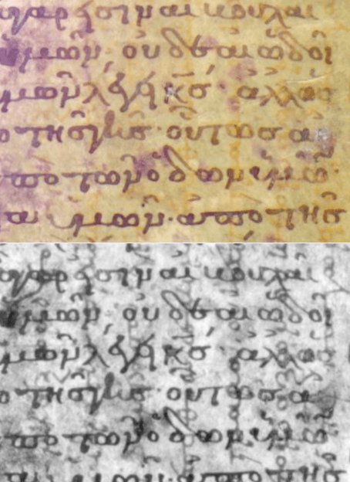
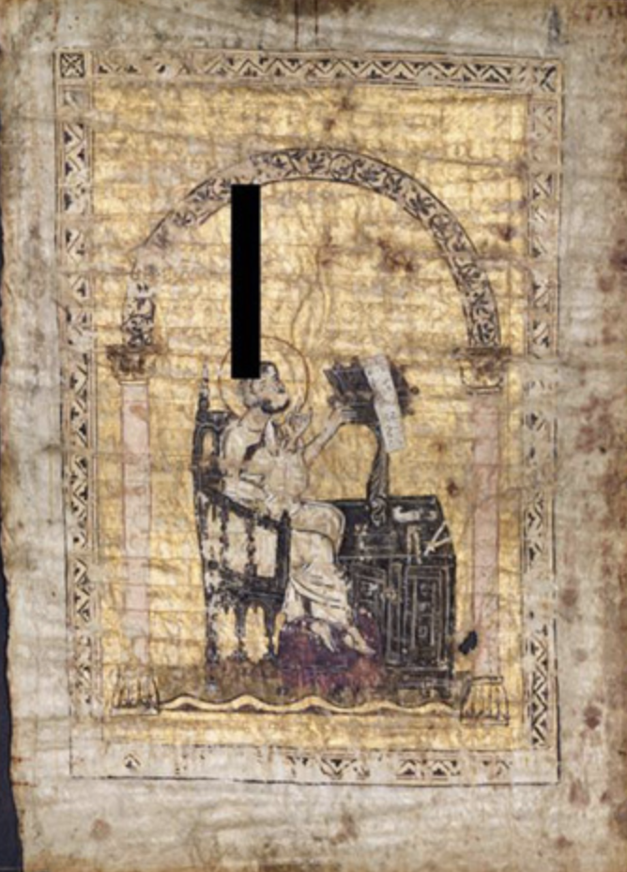
X-ray Fluorescence Imaging
Famous example #2: Archimedes Palimpsest
Archimedes text from the Medieval period was erased, copied over, and then further tampered in the 20th century
XRF identifies original writing by elemental composition
Recovered only example of a lost Archimedes text on “early calculus”!
Hall, Bergmann, Morton, et al.

Slide 4
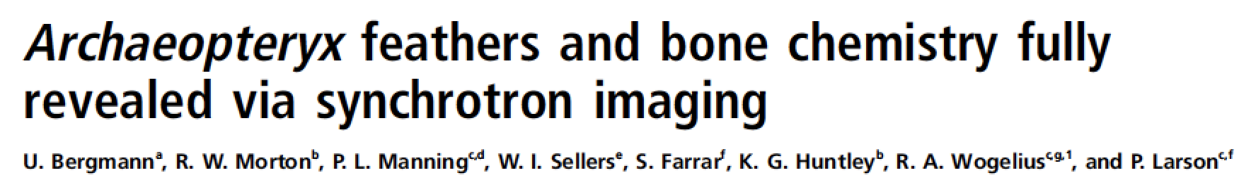
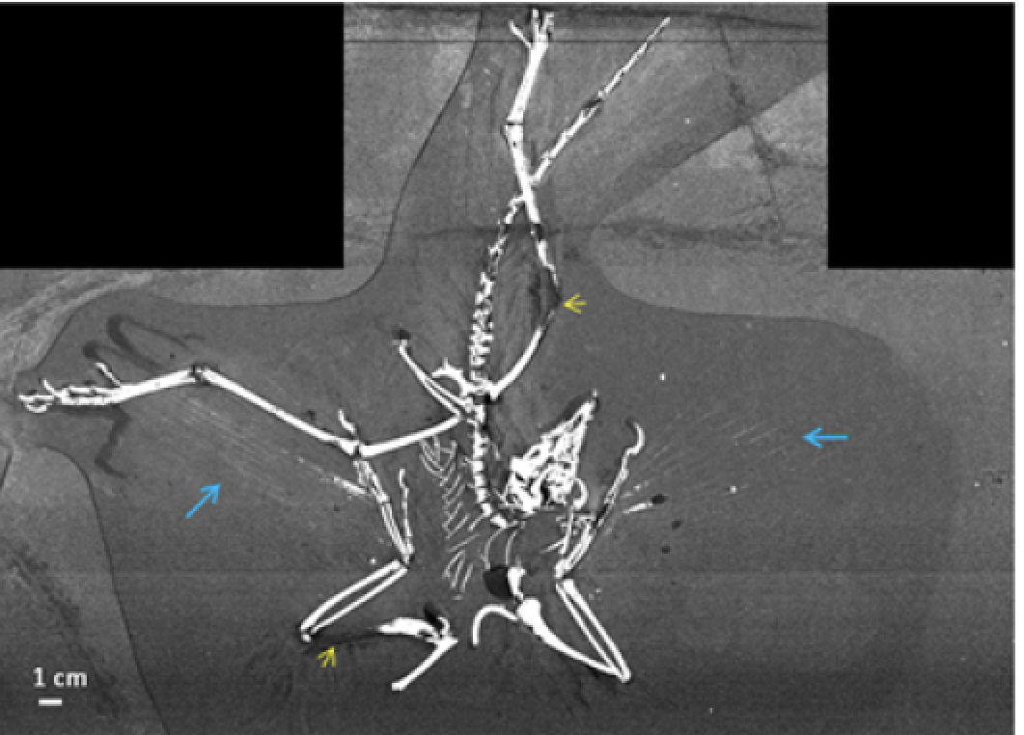
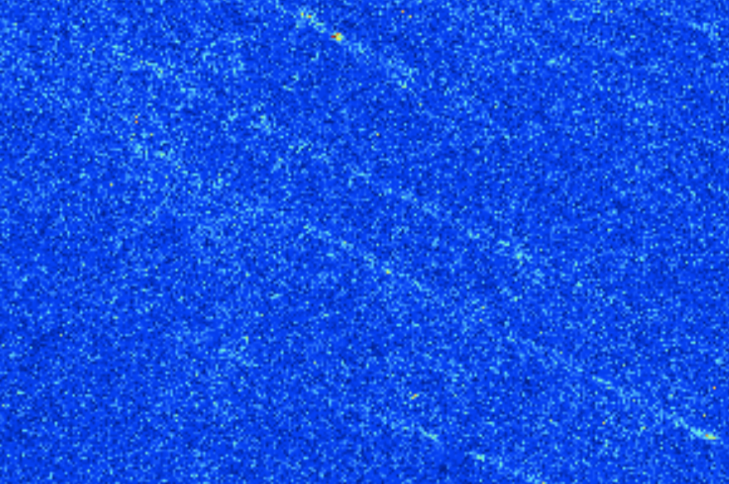
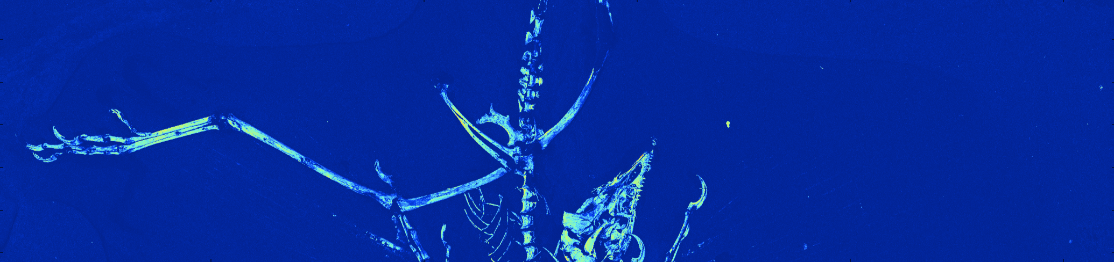
X-ray Fluorescence Imaging
Famous example #3: Thermopolis Archaeopteryx
Phosphorous scan reveals bone details, including first images of quills (albeit still at low resolution)
Close-up of quills
Uwe
Bergmann
Phosphorous scan

Slide 5
X-ray Fluorescence Imaging
Famous example #3: Thermopolis Archaeopteryx
Phosphorous scan reveals bone details, including first images of quills (albeit still at low resolution)
Image is VERY sparse… hours of scanning and less than 1% of pixels capture quill region!
Close-up of quills
Uwe
Bergmann
Phosphorous scan

Slide 6
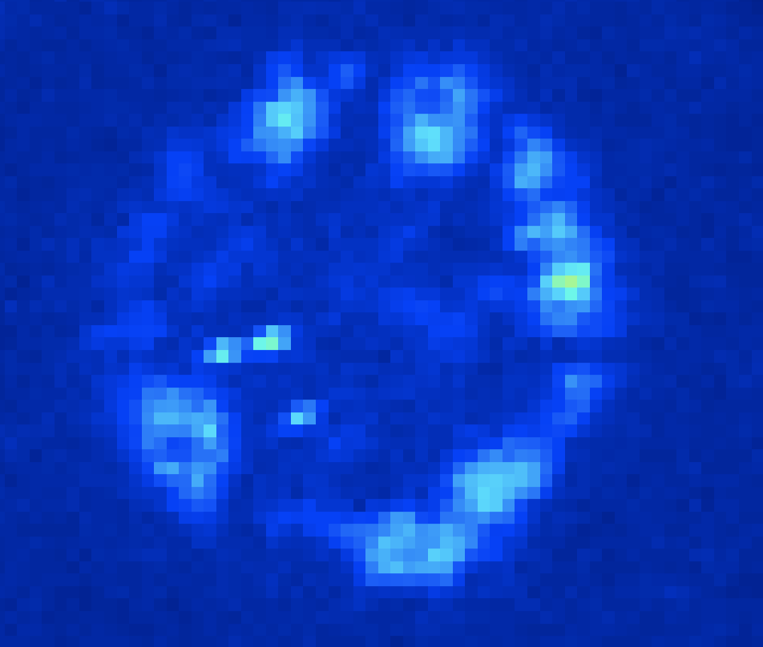
X-ray Fluorescence Imaging
Sign of early life?
Sparse structures appear in Zinc map
Possible early life signature?
Calcium
Zinc
Sam Webb

Slide 7
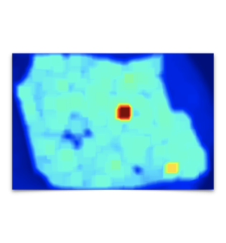
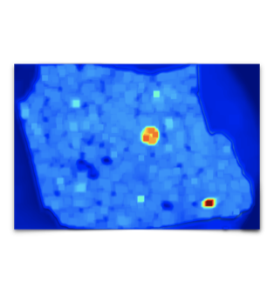
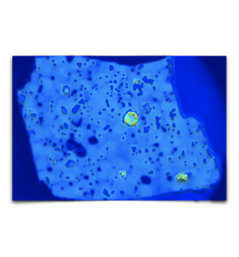
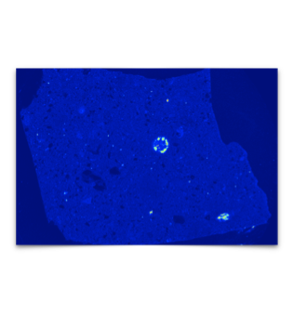
Adaptive XRF for Sparse Samples
Rough (human) approach for adaptive sampling:
Low resolution scans identify rough areas of interest
Increasing resolution focuses on most interesting/uncertain regions
Final reconstruction combines all measurements
Key in on high value regions
Ground truth
Sam Webb
Loop 1
Loop 2
Loop 3

Slide 8
RL or BO?
Reinforcement learning
Bayesian optimization (GP)
Advantages
Incorporate rich priors with pre-trained deep NN
Easy implementation of high-dimensional inputs and outputs
Fast executing at inference
Disadvantages
Very data hungry (effectively requires simulation)
Requires retraining when distribution changes
Expensive to train
Advantages
Can handle small data sets
Relatively robust to changing conditions
No need for pre-training in a simulation environment
Disadvantages
Expensive to operate at inference
Poor scaling with big data
Poor scaling to high dimensional inputs/outputs
Priors relatively weak
Caveat: BO with NNs blurs these distinctions

Slide 9
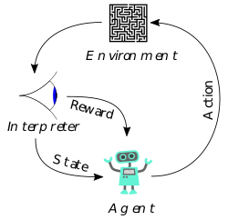
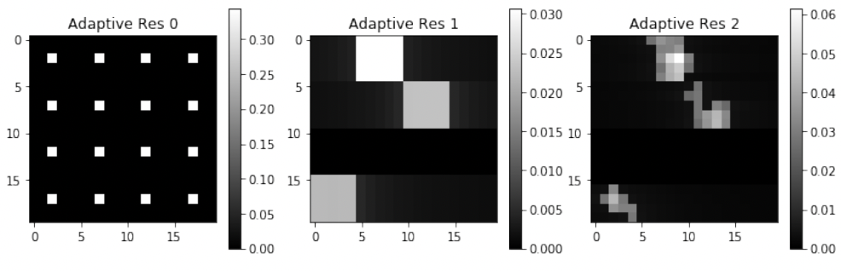
RL for XRF
Translating to an RL problem:
Action: Select aperture, position, exposure
Interaction with Environment: Acquire data
State: Acquisition parameters and data returned to agent
Reward: Final reconstruction quality (e.g. RMS error) and acquisition time penalty
Exposure map
Trajectory control
https://en.wikipedia.org/wiki/Reinforcement_learning
Two styles of actions:
Key in on high value regions
Ground truth
Sam Webb
Loop 1
Loop 2
Loop 3

Slide 10
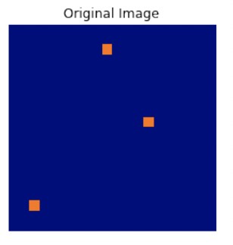
RL for XRF
Preliminary simulation studies of simple system
Simplify problem:
Force measurements to monotonically increase resolution
Force measurements to scan every pixel (no path planning)
  ➔ Policy chooses an exposure map
Loss function minimizes RMS error and total exposure time
Purely convolutional architecture ➔ allow arbitrary image shapes
Drawbacks:
Training constrained by image reconstruction (needed for reward)
Small network trained with a GA
Jean Betterton et al., ICRA, 2020

Slide 11
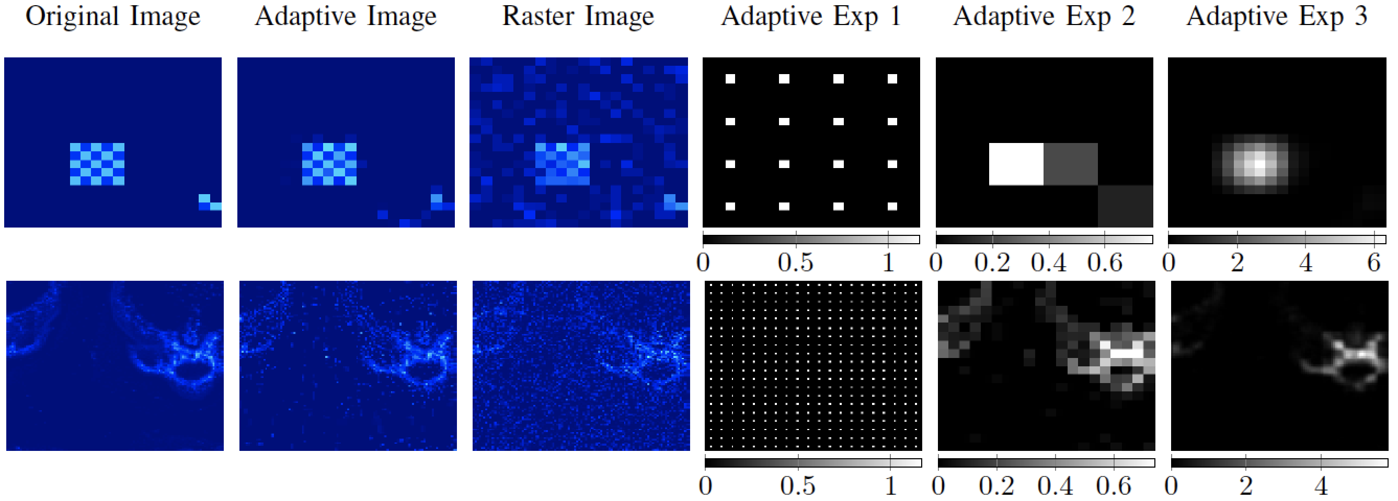
RL for XRF
First studies by Jean Betterton (Stanford):
Examples on a synthetic checkerboard pattern and real fossil data
(Both run in simulation environment)
Jean Betterton et al., ICRA, 2020

Slide 12
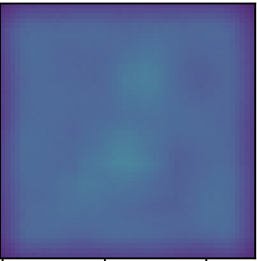
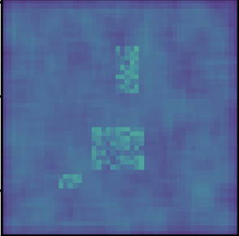
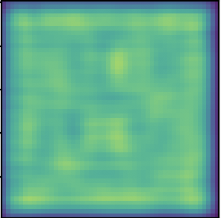
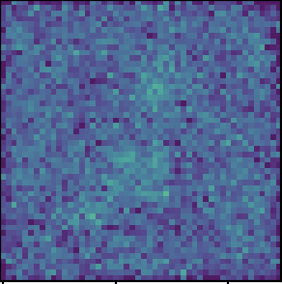
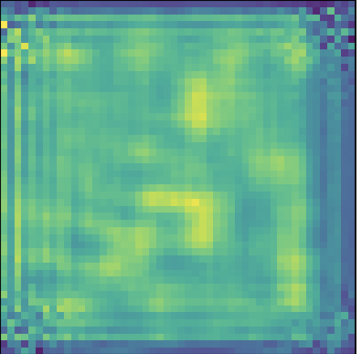
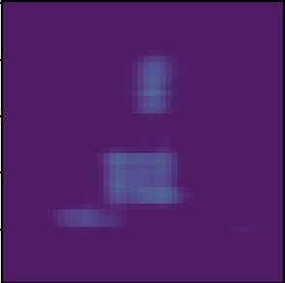
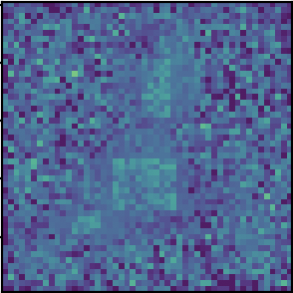
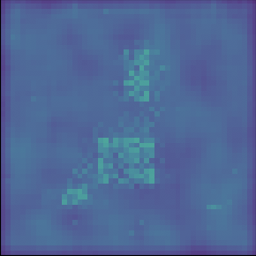
XRF Scanning schematic: Deep learning version
Exposure
Measurements
Sample
Uniform raster
Note: This is just a PINN!
Low resolution
Policy
Reconstruction
Mid resolution
NN
Policy
Loss
High resolution
NN

Slide 13
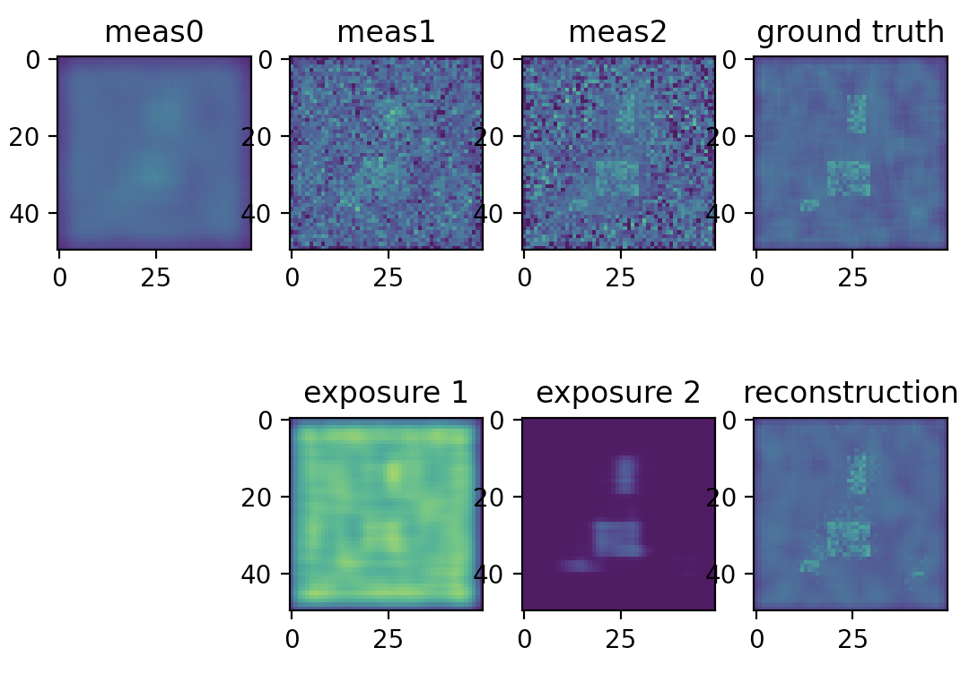
XRF Deep RL: Toy example
Adaptive policy, Avg exposure = 1, avg loss = 0.055
Sample #1

Slide 14
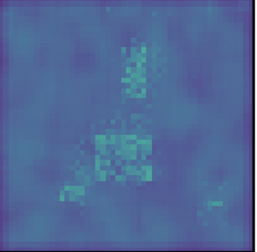
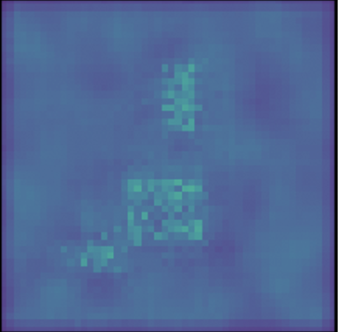
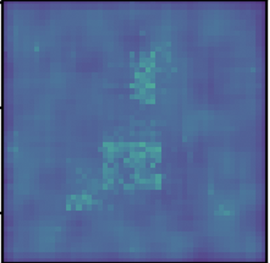
XRF Deep RL: Toy example
Ground truth
Upshot: better loss (0.19 vs. 0.22) with 8x shorter exposure (0.12 vs 1) compared to uniform sampling
Adaptive, Err=0.055
Exposure = 1
Adaptive, Err=0.19
Exposure = 0.12
Raster, Err=0.22
Exposure = 1

Slide 15
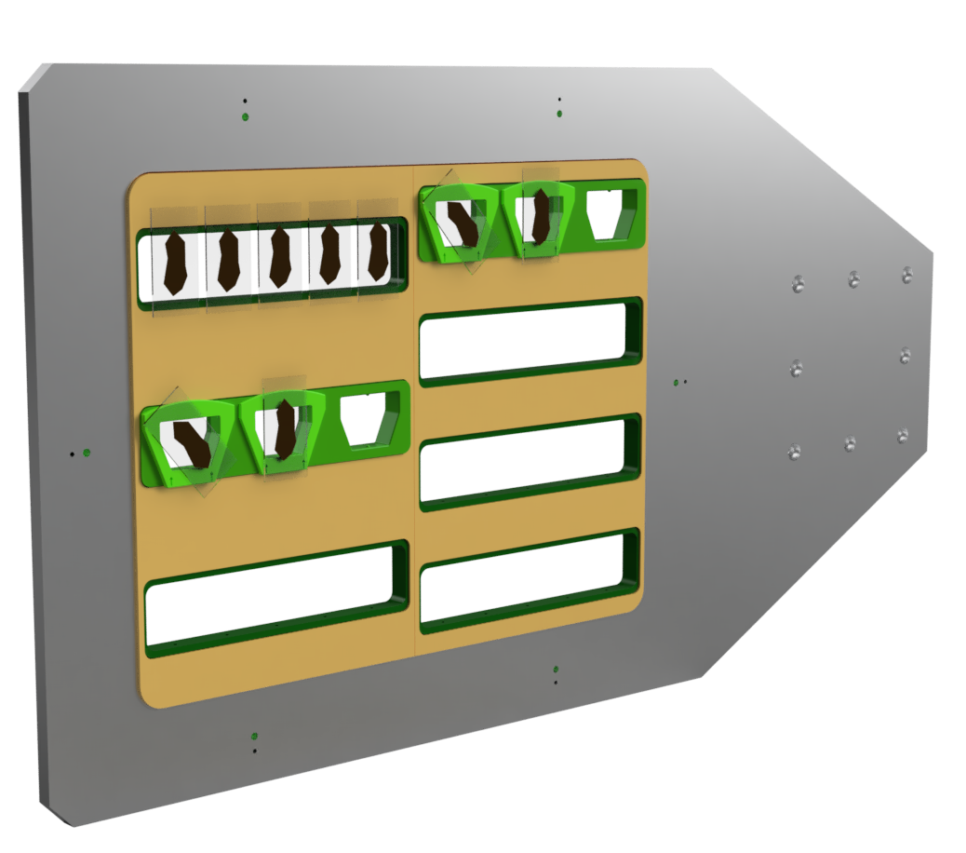
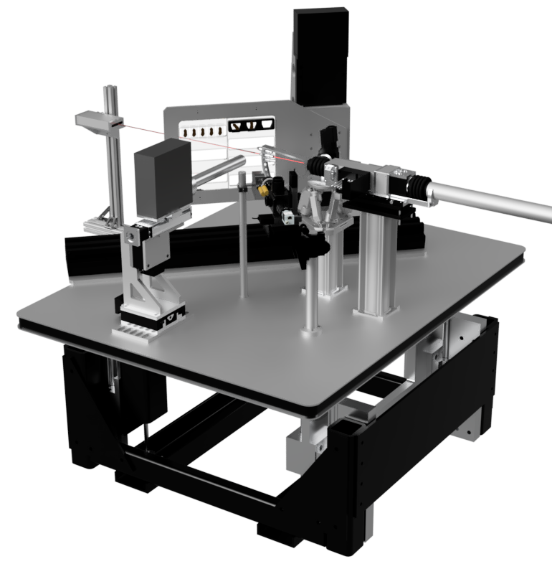
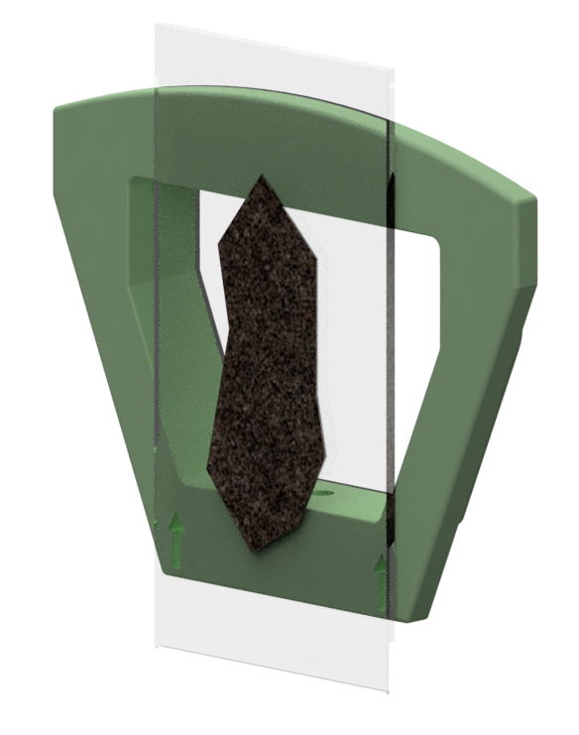
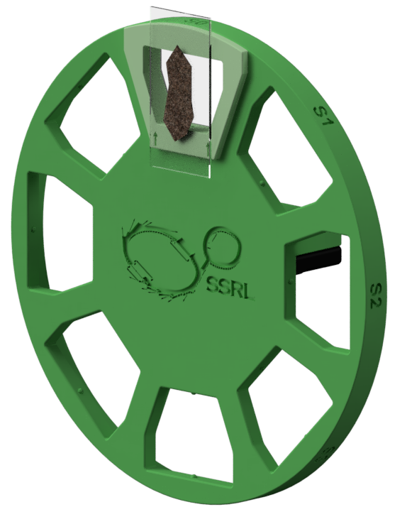
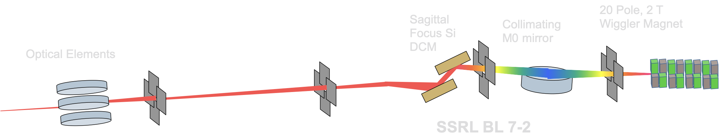
Experimental configuration
Experiments to happen at SSRL BL 7-2
SSRL hard x-ray, wiggler-based beam line
Sample size up to 300 mm x 1000 mm
Supports XRF/XAS techniques, as well as XRD
Hexapod optics platform for rapid encoded switching between beam sizes
Dedicated beam line allows expanded science program
  Rapid screening for remote access
  Large scale soil core pilot program
  Large scale animal tissue screening
Sam Webb

Slide 16
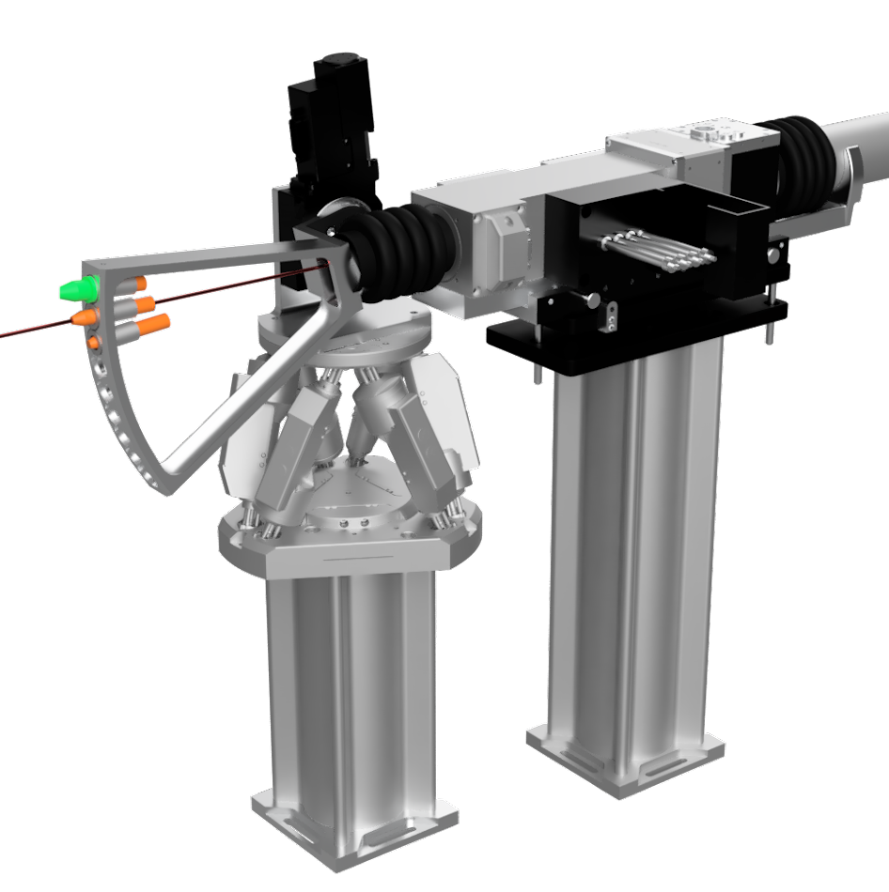
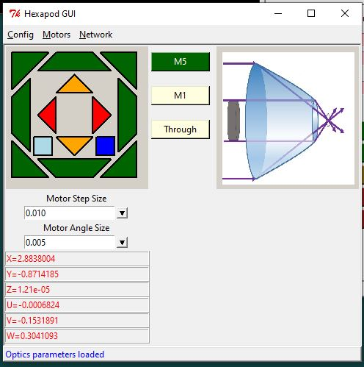
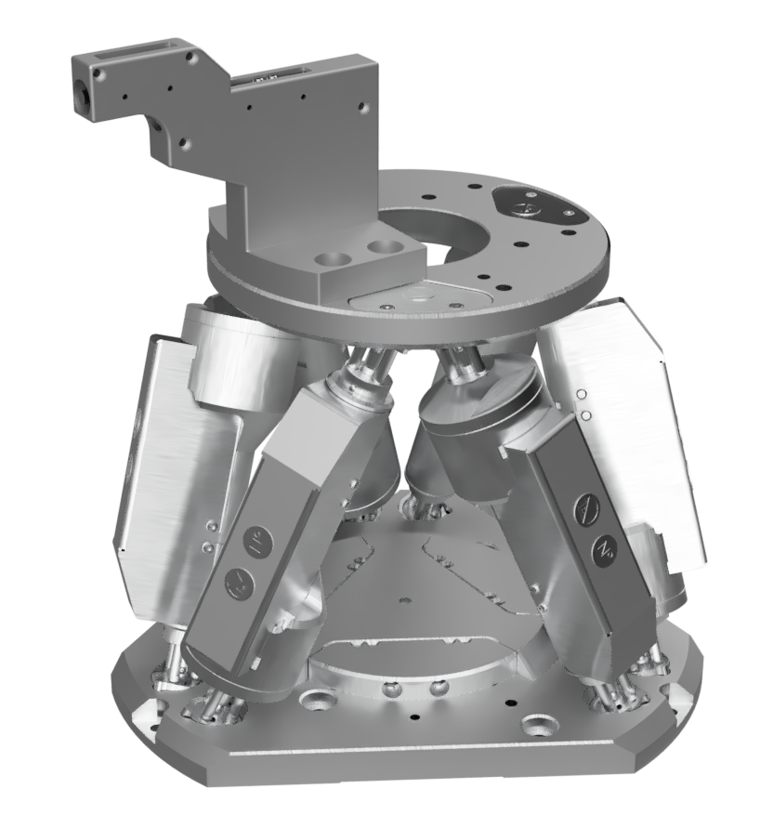
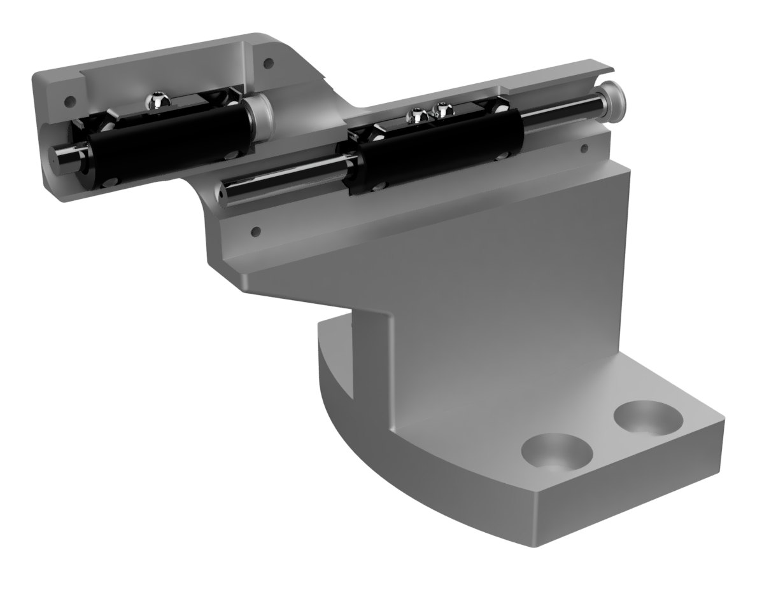
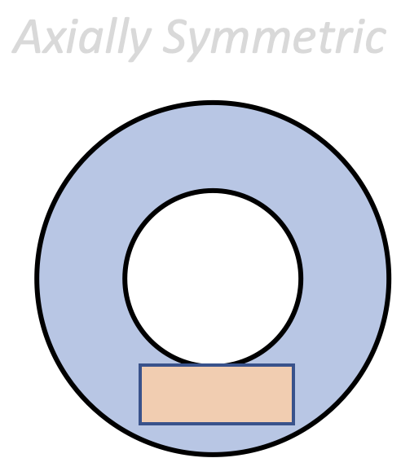
Experimental configuration
New optics allows automated, adaptive switching of focus
Custom optic holder & hexapod allows for the ability to easily change between optics
“Pie slice” for macro-imaging beam lines allows switching between several different types of optics – capillaries, pinholes, SIGRAYs
Critical capability to enable adaptive scanning methods with ability to change between encoded beam focus positions.
Sam Webb

Slide 17
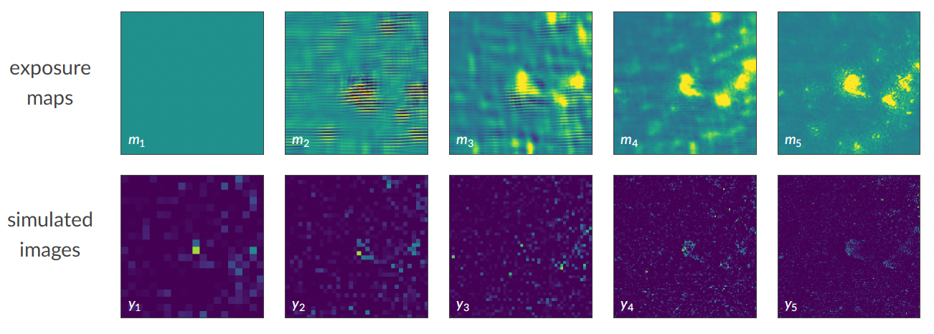
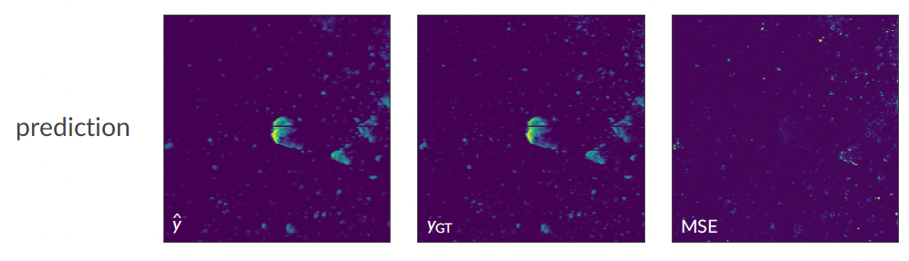
XRF Deep RL: Realistic samples
New project just funded for deep-learning RL on XRF
Example of realistic sample (still in simulation environment)
Tobias Boltz, Sam Webb

Slide 18
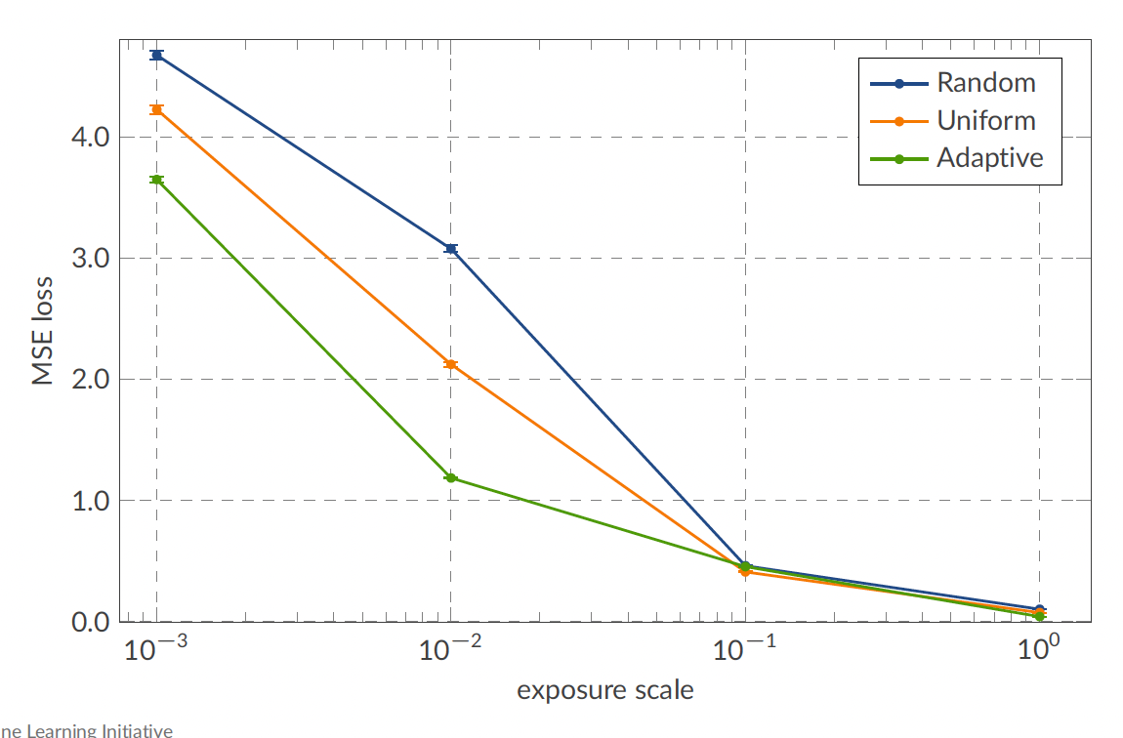
XRF Deep RL: Realistic samples
New project just funded for deep-learning RL on XRF
Factor of ~3-5 speed-up
To improve we will try:
Sparser samples
Stronger priors
More specific loss functions (ignore low-signal regions)
Trajectory control (instead of exposure map) may be necessary
Tobias Boltz, Sam Webb

Slide 19

XRF Deep RL: First experimental test
First experimental test failed. Some possible issues:
Zig-zag pattern highlights challenge of matching simulation to experiment
NN reconstruction seems to be bottleneck
➔ Next experiment (March) will use statistical reconstruction
Priors too weak. Networks should match specific tasks
Tobias Boltz, Sam Webb

Slide 20
RL vs. BO Comparison
Reinforcement learning
Bayesian optimization (GP)
Advantages
Incorporate rich priors with pre-trained deep NN
Easy implementation of high-dimensional inputs and outputs
Fast executing at inference
Disadvantages
Very data hungry (effectively requires simulation)
Requires retraining when distribution changes
Expensive to train
Advantages
Can handle small data sets
Relatively robust to changing conditions
No need for pre-training in a simulation environment
Disadvantages
Expensive to operate at inference
Poor scaling with big data
Poor scaling to high dimensional inputs/outputs
Priors relatively weak
Caveat: BO with NNs blurs these distinctions

Slide 21
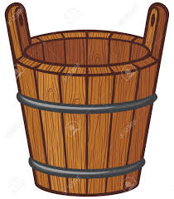
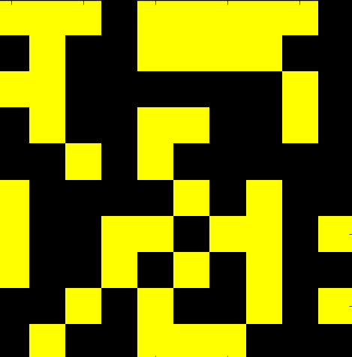
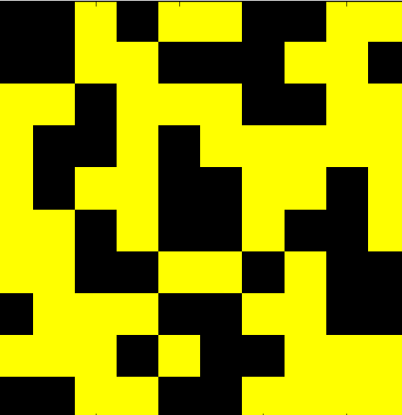
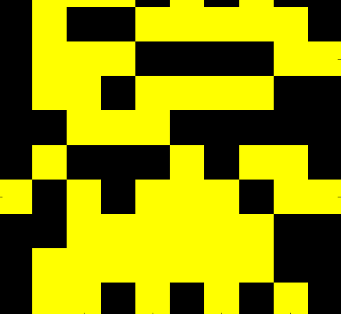
Ghost Imaging / Compressive Sensing for X-rays
Ghost imaging / single pixel camera / compressive sensing:
Non-adaptive approach
Random probe in sparse representation
b
=
a
x
Reconstructed Target, x*
Radiation, a
b = [ 5037,
4783,
4891, … ]
Bucket measures total transmission
Target, x

Slide 22
Random sampling vs. Adaptive Experiments
Toy problem: search for single sparse signal out of n pixels
Assume complete freedom to shape probe
Adaptive approach:
Binary search
➔ log₂(n) measurements

Slide 23
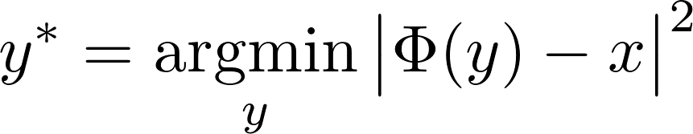
Random sampling vs. Adaptive Experiments
Toy problem: search for single sparse signal out of n pixels
Assume complete freedom to shape probe
Adaptive approach:
Compressive sensing/ Ghost imaging approach:
Randomly probe sample and solve by optimization
Binary search
➔ log₂(n) measurements
C log(n) measurements
With C ~ small number
In what situations can adaptive experiments outperform compressive sensing?

Slide 24
Conclusion
Conclusions so far:
RL promising for X-ray imaging of certain sparse use cases
Matching simulations to experimental setup is challenging
Benefits still not sufficient to justify effort… research into competing methods ongoing in parallel
Thanks to Jean Betterton, Tobias Boltz, Mykel Kochenderfer, Willie Neiswanger, and Sam Webb

