Slide 1
Batch System – Introduction
Andreas Baer, SCC, KIT

Slide 2
Batch System Introduction
Andreas Baer, KIT - SCC

Slide 3
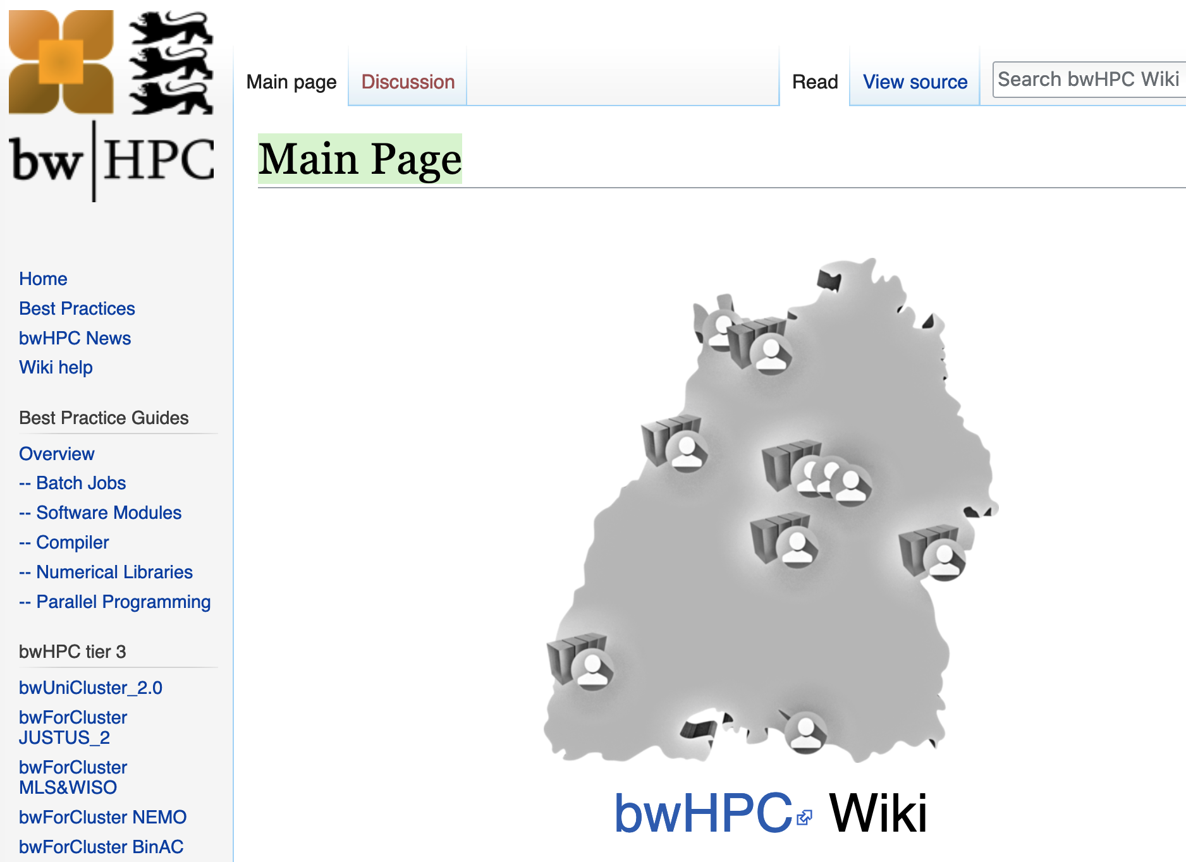
Reference: bwHPC Wiki
All information given in this talk can be found at wiki.bwhpc.de:
Batch Jobs

Slide 4
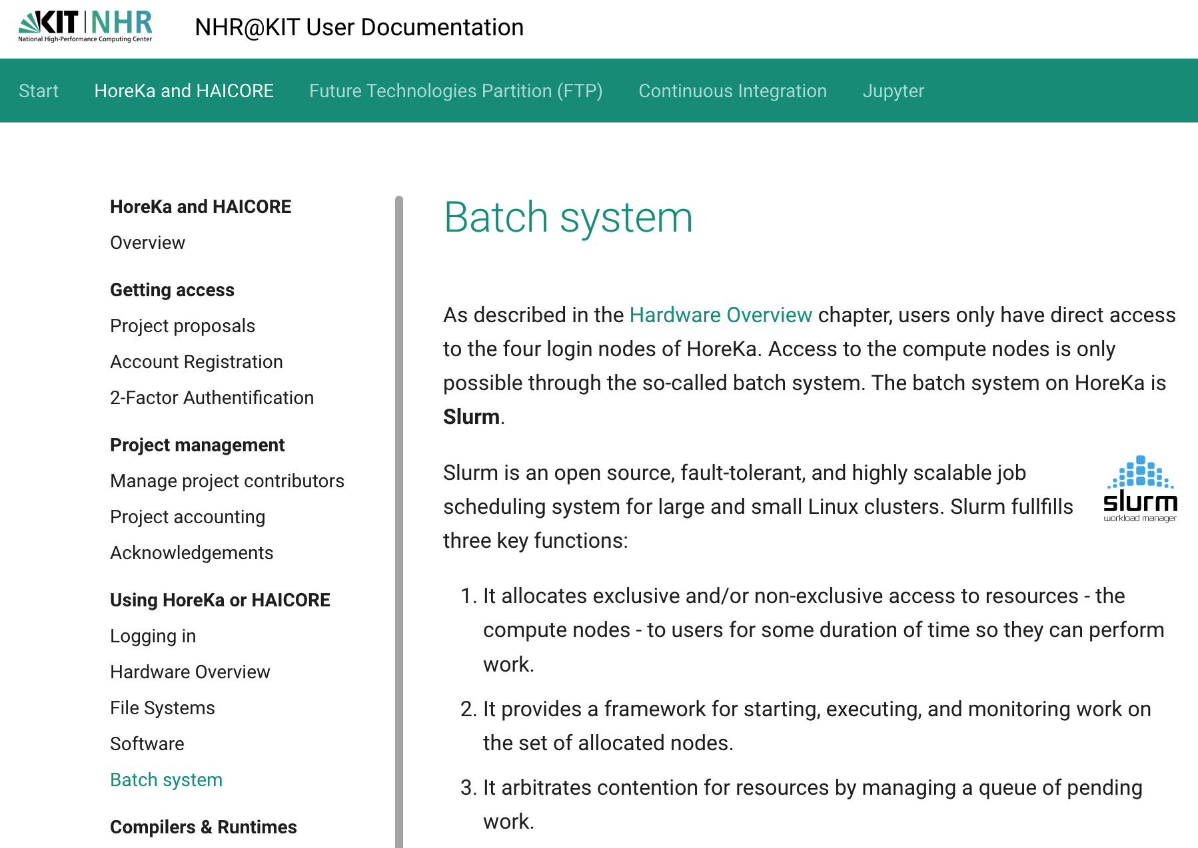
Reference: NHR@KIT User documentation
All information given in this talk can be found at https://www.nhr.kit.edu/userdocs/horeka/batch/:
Batch Jobs

Slide 5
Material: Slides & Scripts
https://indico.scc.kit.edu/e/hpc_course_2023-10-16
@bwUniCluster: /opt/bwhpc/common/workshops/2023-10-16
@HoreKa: /software/all/workshop/2023-10-16
How to read the following slides
Abbreviation/Colour code | Full meaning
$ command -option value | $ = prompt of the interactive shell The full prompt may look like: user@machine:path$ The command has been entered in the interactive shell session
<integer> <string> | <> = Placeholder for integer, string etc

Slide 6
Batch System

Slide 7
Resource management
Jobs are NOT executed by the user
Instead, there is a management system (Batch System)
workload manager (scheduler)
scheduling, managing, monitoring, reporting
SLURM (HoreKa, bwUniCluster 2.0, 2x bwForCluster)
MOAB (2x bwForCluster)
resource manager
control over jobs and distributed compute nodes
SLURM (HoreKa, bwUniCluster 2.0, 2x bwForCluster)
TORQUE (2x bwForCluster)

Slide 8
Resource and workload manager (1)
(2) Slurm parses the job script:
→ where & when to run job
(1) User creates a job script and submits it to Slurm via the “sbatch” command
Slurm (central management daemon)
#!/bin/bash
#SBATCH –p dev_cpuonly
#SBATCH –N 1 –n 1
#SBATCH –t 00:01:00
#SBATCH –mem-per-cpu=500
./your_simulation
(3) Job execution: delegated to resource manager on the node
compute resources:
Slurm compute node daemon
(4) The resource manager executes the job and communicates status information to nodes

Slide 9
Resource and workload manager (2)
All clusters:
compute job will only be processed by the batch system
Running jobs on login nodes not allowed
Waiting time:
depends on:
your job demands
your demand history
ONLY bwUniCluster 2.0: your university's share

Slide 10
Job's life cycle
1. Preprocessing: Setup job_script.sh:
2. Submit: ONLY with “sbatch” (for interactive jobs: “salloc”)
3. Processing:
4. Postprocessing: Job is finished → check output (default job name) bwUniCluster: slurm-<job_ID>.out HoreKa : slurm-<job_ID>.out
1) Options for the job
#!/bin/bash
#SBATCH –p dev_single
#SBATCH –N 1 –n 1
#SBATCH –t 00:01:00
#SBATCH –mem-per-cpu=500
./your_simulation
2) Actual work to be
exectuted on the cluster
$ sbatch job_script.sh
<job_ID>
$ squeue <job_ID> STATE: “PENDING” → “RUNNING” → “COMPLETED”

Slide 11
1./2. Job submit

Slide 12
1./2. Job Submit: Sbatch options
https://wiki.bwhpc.de/e/BwUniCluster_2.0_Slurm_common_Features#sbatch_Command_Parameters on bwUniCluster 2.0 and
https://www.nhr.kit.edu/userdocs/horeka/batch/ on HoreKa respectively.
sbatch options: command line or in your job script
Command line | Script | Purpose
-N nodes -n tasks | #SBATCH –-nodes=nodes #SBATCH –-ntasks=tasks | Number of nodes to be used. Number of tasks to be launched.
-J name | #SBATCH –-job-name=name | Gives a user specified name to the job.
-p queue | #SBATCH –-partition=queue | Defines the queue class
--mail-type=type | #SBATCH –-mail-type=type | Send email when job begins (BEGIN), ends (END), aborts (FAIL), at each event (ALL) …

Slide 13
1./2. Job Submit: Important Resource Parameters
Sbatch Resource Options
Command line | Script | Purpose
-t time | #SBATCH –-time=time | Wallclock time limit
-N nodes | #SBATCH –-node=nodes | Number of nodes to be used
-n tasks | #SBATCH –-ntasks=tasks | Number of tasks to be launched
-c count | #SBATCH –-cpus-per-task=count | Number of CPUs required per (MPI-)task
--ntasks-per-node=count | #SBATCH –-ntasks-per-node=count | Number of (MPI-)tasks per node
--mem=MB_value | #SBATCH –-mem=MB_value | Memory in MegaByte per node
--mem-per-cpu=MB_value | #SBATCH –-mem-per-cpu=MB_value | Memory required per allocated core
-p queue | #SBATCH –-partition=queue | Defines the queue class
Use these options in the job script:
#!/bin/bash
#SBATCH -N 1
#SBATCH –-ntasks=20
#SBATCH --time=00:02:00
#SBATCH --mem=500mb
...
Or use them with sbatch:
$ sbatch -N 1 -n 20 -t 2 --mem=500 <job_script>

Slide 14
1./2. Job Submit: Important Resource Parameters
Sbatch Resource Options
Command line | Script | Purpose
-t time | #SBATCH –-time=time | Wallclock time limit
-N nodes | #SBATCH –-node=nodes | Number of nodes to be used
-n tasks | #SBATCH –-ntasks=tasks | Number of tasks to be launched
-c count | #SBATCH –-cpus-per-task=count | Number of CPUs required per (MPI-)task
--ntasks-per-node=count | #SBATCH –-ntasks-per-node=count | Number of (MPI-)tasks per node
--mem=MB_value | #SBATCH –-mem=MB_value | Memory in MegaByte per node
--mem-per-cpu=MB_value | #SBATCH –-mem-per-cpu=MB_value | Memory required per allocated core
-p queue | #SBATCH –-partition=queue | Defines the queue class
https://wiki.bwhpc.de/e/BwUniCluster_2.0_Slurm_common_Features#sbatch_Command_Parameters on bwUniCluster 2.0 and
https://www.nhr.kit.edu/userdocs/horeka/batch/ on HoreKa respectively.

Slide 15
bwUniCluster 2.0
 | HPC nodes (“Thin” / “HPC” / “IceLake”) | Fat nodes | GPU nodes | IceLake + GPU x4
Number of nodes | 100 + 60 / 360 / 272 | 6 | 14 (4 GPUs each) 10 (8 GPUs each) | 15 (4 GPUs each)
Number of sockets | 2 / 2 / 2 | 4 | 2 | 2
Number of cores per node | 40 / 40 / 60 | 80 | 40 | 64
Main memory per node | 96 GB, 192 GB / 96 GB / 256 GB | 3 TB | 384 GB 768 GB | 512 GB
Local SSD | 960 GB SATA / 1,8 TB NVMe | 4.8 TB NVMe | 3.2 TB NVMe 6.4 TB NVMe | 6.4 TB NVMe
Interconnect (InfiniBand) | HDR 100 (blocking) / HDR 100 / HDR 200 | HDR | HDR | HDR
GPUs |  |  | NVIDIA Tesla V100 | NVIDIA A100 / NVIDIA H100
4 login nodes

Slide 16
HoreKa
 | Normal nodes | Extra-Large nodes | Accelerator nodes
Number of nodes | 570+32 | 8 | 167
Sockets per node | 2 | 2 | 2
Number of cores per node | 76 | 76 | 76
Main memory per node | 256/512 GB | 4096 GB | 512 GB
Interconnect (InfiniBand) | HDR | HDR | HDR
Local SSD | 960 GB NVMe | 7x 3.84 TB NVMe | 960 GB NVMe
4 login nodes
Accelerator nodes incorporate 4 NVIDIA A100-40 GPUs

Slide 17
sbatch -p queues (Important queues of bwUniCluster 2.0)
queue | default resources | MIN resources | MAX resources
dev_single | time=10, mem-per-cpu=1125mb |  | time=30, nodes=1, mem=180000mb, ntasks-per-node=40
single | time=30, mem-per-cpu=1125mb |  | time=72:00:00, nodes=1, mem=180000mb, ntasks-per-node=40
multiple | time=30, mem-per-cpu=1125mb | nodes=2 | time=72:00:00, nodes=128, mem=90000mb, ntasks-per-node=40
gpu_4 | time=10, mem-per-cpu=2178mb cpu-per-gpu=20 | nodes=2 | time=48:00:00, nodes=14, mem=376000, ntasks-per-node=40
fat | time=10, mem-per-cpu=18750mb |  | time=72:00:00, nodes=1, ntasks-per-node=80
https://wiki.bwhpc.de/e/BwUniCluster_2.0_Batch_Queues
Time and memory will be automatically chosen if not set

Slide 18
sbatch -p queues (All queues of HoreKa)
queue | default resources | MIN resources | MAX resources
dev_cpuonly | time=10, ntasks=1, mem-per-cpu=1600mb | nodes=1, ntasks=1 | time=60, nodes=2, mem=243200mb, ntasks=152
cpuonly | time=10, ntasks=152, mem-per-cpu=1600mb, mem=243200mb | nodes=1, ntasks=152 | time=72:00:00, nodes=192, mem=501600mb, ntasks=152
dev_accelerated | time=10, ntasks=1, grep=gpu:1, mem-per-cpu=3300mb, def-mem-per-gpu=125400mb, def-cpu-per-gpu=38 | nodes=1, ntasks=1, gres=gpu:1 | time=1:00:00, nodes=1, mem=501600mb, ntasks=152, gres=gpu:4
accelerated | time=10, ntasks=152, grep=gpu:4, mem=501600mb, mem-per-cpu=3300mb, def-mem-per-gpu=125400mb, def-cpu-per-gpu=38 | nodes=1, ntasks=152, gres=gpu:4 | time=48:00:00, nodes=56, ntasks=152, gres=gpu:4, mem=501600mb
https://www.nhr.kit.edu/userdocs/horeka/batch/
Time and memory will be automatically chosen if not set

Slide 19
Available Resources
Check available resources via
$ sinfo_t_idle
xy_ab1234@bwunicluster:~$ sinfo_t_idle
Partition dev_single : 6 nodes idle
Partition single : 0 nodes idle
Partition dev_multiple : 8 nodes idle
Partition multiple : 3 nodes idle
Partition fat : 0 nodes idle
Partition dev_multiple_e: 8 nodes idle
Partition multiple_e : 3 nodes idle
Partition dev_special : 2 nodes idle
Partition special : 0 nodes idle
Partition gpu_4 : 0 nodes idle
Partition dev_gpu_4 : 1 nodes idle
Partition gpu_8 : 0 nodes idle
xy_ab1234@horeka:~$ sinfo_t_idle
Partition dev_cpuonly : 1 nodes idle
Partition cpuonly : 101 nodes idle
Partition dev_accelerate : 1 nodes idle
Partition accelerate : 83 nodes idle

Slide 20
Tutorial 1a
Goal: Use the Batch System to execute “printenv“ on the cluster
1) Create a file „submit_script.sh“ and set the following options in the submit script:
1 task
500 MB memory
Time: 5 minutes
2) After defining these options, insert the command to be exectuted at the end of the jobscript (“printenv“)
3) Save the jobscript and submit it to the Batch System with
You can use “squeue“ to see the status of your job
4) Look in the output file of your job (slurm-<jobID>.out) for variables starting with „SLURM_“. These can be used to get information on how the job was started
#!/bin/bash
#SBATCH [???]
#SBATCH --time=00:05:00
#SBATCH --mem=500
[?????]
$ sbatch -p single –-reservation=ws submit_script.sh # bwunicluster
$ sbatch -p cpuonly --reservation=ws submit_script.sh # horeka

Slide 21
Tutorial 1a – Solution
Create a file named „submit_script.sh“ with the following content:
Save the file and submit it with („--reservation=ws” only for this workshop)
In the output file, you can find the SLURM variables:
For example: „SLURM_JOB_PARTITION=cpuonly“ means: In the job script, we have not defined a partition but the job was submitted to the „cpuonly“ partition with sbatch command
#!/bin/bash
#SBATCH -n 1
#SBATCH --time=00:05:00
#SBATCH --mem=500
printenv
$ sbatch -p single –-reservation=ws submit_script.sh # bwunicluster
$ sbatch -p cpuonly --reservation=ws submit_script.sh # horeka

Slide 22
Tutorial 1b
1) Modify your submit script so that instead of “printenv“ the value of „SLURM_NPROCS“ is printed (Hint: Use echo)
Submit your job again, but this time use sbatch to specify the number of processes:
2) Check in your output file if the number of processes is „1“ as specified in the submit script or „4“ as specified directly with sbatch
$ sbatch -p single –-reservation=ws -n 4 submit_script.sh # bwunicluster
$ sbatch -p cpuonly --reservation=ws -n 4 submit_script.sh # horeka

Slide 23
Tutorial 1b - Solution
Modify your submit script to print the variable SLURM_NPROCS
Save the file and submit it with
In the output file the number of processes is printed:
slurm-<job-ID>.out
The options given directly to sbatch take precedence over the options in the submit script
#!/bin/bash
#SBATCH -n 1
#SBATCH --time=00:01:00
#SBATCH --mem=500
echo $SLURM_NPROCS
$ sbatch -p single –-reservation=ws -n 4 submit_script.sh # bwunicluster
$ sbatch -p cpuonly --reservation=ws -n 4 submit_script.sh # horeka
4

Slide 24
3. Processing

Slide 25
3. Processing
After submit command: if successful it returns <job-ID>
„Monitoring“ via:
3.a.
scontrol show job <job-ID>
3.b.
squeue
3.c. Login to compute node:
srun --jobid=<id> --pty [--overlap] /usr/bin/bash
„Modifying“ via:
3.d Cancel your job
scancel <job-ID>
$ sbatch submit_script.sh
Submitted batch job 1487560
sacct

Slide 26
3.a. Processing – scontrol show job (1)
After submission of your script submit_script.sh
$ scontrol show job <job-ID>
JobId=1487569 JobName=submit_script.sh
UserId=ab1234(27049) GroupId=scc(12345) ...
Priority=4298 Nice=0 Account=kit QOS=normal
JobState=RUNNING Reason=Prolong Dependency=(null)
Requeue=1 Restarts=0 BatchFlag=1 Reboot=0 ExitCode=0:0
RunTime=00:00:19 TimeLimit=00:10:00 TimeMin=N/A
SubmitTime=2021-10-13T00:06:58 EligibleTime=2021-10-13...
AccrueTime=2021-10-13T00:06:59
StartTime=2021-10-13T00:06:59 EndTime=2021-10-13T00:16:59 ...
SuspendTime=None SecsPreSuspend=0 LastSchedEval=...
Partition=dev_single AllocNode:Sid=uc2n997:2170796
ReqNodeList=(null) ExcNodeList=(null)
NodeList=uc2n362
BatchHost=uc2n362
...
1) Consumed resources will be booked on your university / project
2) Your job state
3) Your time logging
4) Your selected partition
5) Your node list and
Node on which job
started

Slide 27
3.a. Processing – scontrol show job (2)
After submission of your script submit_script.sh
$ scontrol show job <job-ID>
JobId=1487569 JobName=submit_script.sh
...
NumNodes=1 NumCPUs=2 NumTasks=1 CPUs/Task=1 ...
TRES=cpu=2,mem=2250M,node=1,billing=2
Socks/Node=* NtasksPerN:B:S:C=0:0:*:1 CoreSpec=*
MinCPUsNode=1 MinMemoryCPU=1125M MinTmpDiskNode=0
Features=(null) DelayBoot=00:00:00
OverSubscribe=OK Contiguous=0 Licenses=(null) ...
Command=/pfs/data5/home/kit/scc/ab1234/submit_script.sh
WorkDir=/pfs/data5/home/kit/scc/ab1234
StdErr=/pfs/data5/home/kit/scc/ab1234/slurm-1487569.out
StdIn=/dev/null
StdOut=/pfs/data5/home/kit/scc/ab1234/slurm-1487569.out
Power=
NtasksPerTRES:0
1) Your requested nodes & CPU cores
2) Your job memory
3) Actual node policy
4) Your submit directory
& submit script
5) Your job standard output and error log file

Slide 28
3.b. Processing – squeue
After submission of your script submit_script.sh
$ squeue
JOBID PARTITION NAME USER ST TIME NODES NODELIST(REASON)
1487570 dev_cpuon submit_s ab1234 R 0:05 1 hkn0301
$ squeue --long
JOBID PARTITION NAME USER STATE TIME TIME_LIMI NODES NODELIST(REASON)
1487570 dev_cpuon submit_s ab1234 RUNNING 2:49 10:00 1 hkn0301
Job states:
PD = PENDING
R = RUNNING
CD = COMPLETED
...
F = FAILED
CA = CANCELLED
When job is pending: expected start time?
$ squeue --start
JOBID ... START_TIME SCHEDNODES
1487570 ... 2021-10-14T10:10:10 hkn0301

Slide 29
3.b. Processing – sacct
After submission of your script submit_script.sh
Display accounting data of your job and job steps?
$ sbatch submit_script.sh
Submitted batch job 1487652
$ sacct –j 1487652
JobID JobName Partition Account AllocCPUS State ExitCode
------------ ---------- ---------- ---------- ---------- ---------- --------
1487652 submit_sc+ dev_single kit 2 RUNNING 0:0
1487652.bat+ batch kit 2 RUNNING 0:0
1487652.ext+ extern kit 2 RUNNING 0:0
1487652.0 hostname kit 2 COMPLETED 0:0
1487652.1 bash kit 2 RUNNING 0:0

Slide 30
3.c. Processing – Compute node login
Once your job is running (state=R),
login to dededicated nodes is possible:
ab1234@hkn1990:~$ sbatch submit_script.sh
Submitted batch job 1487652
ab1234@hkn1990:~$ squeue
JOBID PARTITION NAME USER ST TIME NODES NODELIST(REASON)
1487652 dev_cpuon submit_s ab1234 R 2:42 1 hkn0301
ab1234@hkn1990:~$ srun --jobid=1487652 --pty [--overlap] /usr/bin/bash
ab1234@hkn0301:~$
The command srun adds another step to your job,
Once main jobs finishs, this job step is cancelled automatically:
ab1234@hkn0301:~$
slurmstepd: error: *** STEP 1487652.2 ON hkn0301 CANCELLED AT 2021-10-13T10:35:52 ***
exit
srun: Job step aborted: Waiting up to 32 seconds for job step to finish.
ab1234@hkn1990:~$

Slide 31
3.d. Processing – Change status of your job
Once your job is submitted (state=PD or R),
You can cancel your job
Check with sacct :
$ sbatch submit_script.sh
Submitted batch job 1487683
$ scancel 1487683
JOBID PARTITION NAME USER ST TIME NODES NODELIST(REASON)
1487683 dev_cpuon submit_s ab1234 R 2:42 1 hkn0301
$ sacct –j 1487683
JobID JobName Partition Account AllocCPUS State ExitCode
------------ ---------- ---------- ---------- ---------- ---------- --------
1487683 submit_sc+ dev_cpuon+ hk-projec+ 2 CANCELLED+ 0:0
1487683.bat+ batch hk-projec+ 2 CANCELLED
1487683.ext+ extern hk-projec+ 2 CANCELLED

Slide 32
Tutorial 2
Modify your submit script so that it executes a command to wait for 600 seconds (sleep 600)
Set walltime to 10 minutes and give your job a name
Submit your job script with sbatch
Use squeue to check the status of your job
Use scontrol show job to see from which directory you started your job
Use scancel <job-ID> to cancel your job

Slide 33
Tutorial 2 - Solution
Modify your submit script
Save the file and submit it with
Get your start directory of your jobs
Use scancel <job-ID> to cancel your job
#!/bin/bash
#SBATCH –N 1 –n 1
#SBATCH –t 00:10:00
#SBATCH –-mem-per-cpu=500
#SBATCH -J myJobName
sleep 600
$ sbatch -p single –-reservation=ws submit_script.sh # bwunicluster
$ sbatch -p cpuonly --reservation=ws submit_script.sh # horeka
$ scontrol show job 1487685 | grep WorkDir
WorkDir=/pfs/data5/home/kit/scc/ab1234/workshop

Slide 34
Interactive jobs
Jobs on login nodes are not permitted
Solution: interactive slurm jobs
Access compute nodes and work on them interactively
ab1234@hkn1990$ salloc -p cpuonly -n 1 -t 10 --mem=2000
salloc: Granted job allocation 1487738
salloc: Waiting for resource configuration
salloc: Nodes hkn0301 are ready for job
ab1234@hkn0301:~$ {Now you can work on the compute node}
salloc: Job 1487738 has exceeded its time limit and its allocation has been revoked.
srun: Job step aborted: Waiting up to 32 seconds for job step to finish.
slurmstepd: error: *** STEP 1487738.interactive ON hkn0301 CANCELLED AT 2021-10-13T13:02:41 DUE TO TIME LIMIT ***
exit
srun: error: hkn0301: task 0: Exited with exit code 127
ab1234@hkn1990:~$
Job is waiting to start, Do
Not interupt the command
Job running. You are
now on a compute node
Requested time for the
interactive job ran out
Back on the login node

Slide 35
Thank you for your attention!
Questions?

