Slide 1
First results of KIT 3D USCT III system crosstalk analysis
Michael Zapf, Simon Kraft

Slide 2
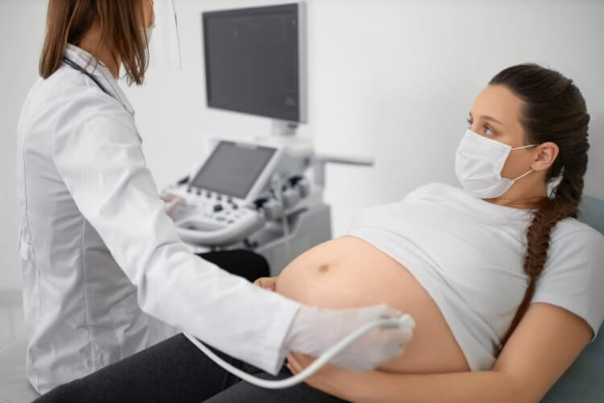
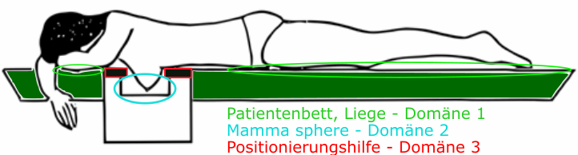


Medical Vision:
3D USCT for early Breast cancer detection
Wanted Technical properties
  Fixed and reproducible measurements
    Surround object with (unfocused) ultrasound transducers
  Milimeter to sub-mm resolution
    Water as imaging medium
    MHz ultrasound
  Multimodal
    Measure reflection and transmission signals
Object surrounding aperture
  Many ultrasound transducers surround the object hemisphere
Manual guided imaging setup
Breast imaging in fixed setup

Slide 3
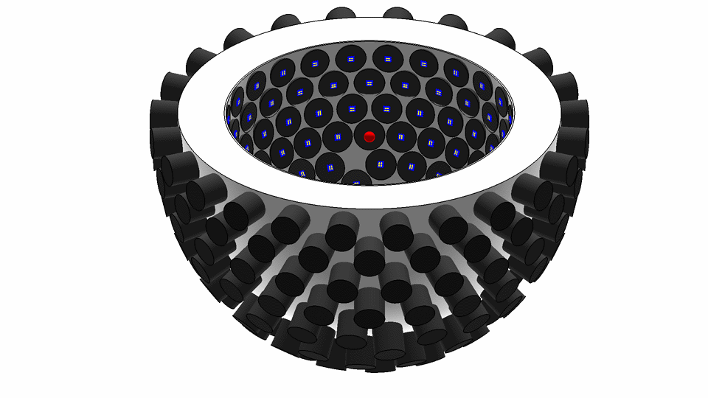
Operation principle: KIT 3D USCT
Operation principle
  3D phased array too slow
    shifting to software
  Synthetic aperture focussing technique (SAFT)
  One transducer emits only, many transducer receive
    Many DAQ channels (RX), a singular excitation channel (TX)
    Iterative, sequential excitation
    Focussing and imaging in software on raw data
    Not a real-time system
Receiver
Emitter

Slide 4
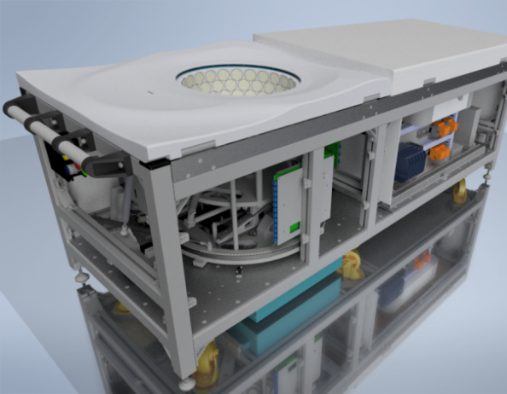
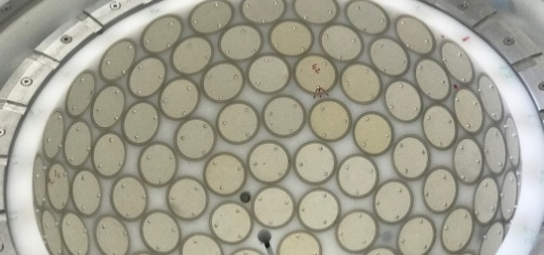
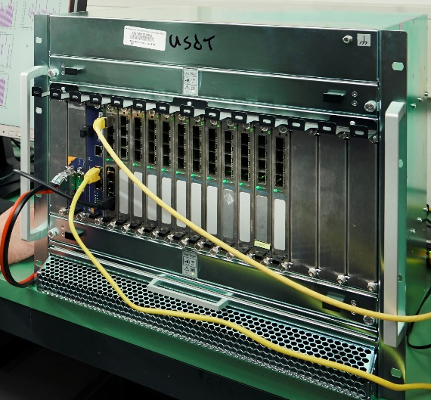
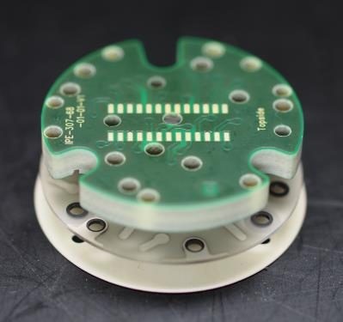

Realization: KIT 3D USCT III
Measuremen tcontainer
→ Larger ROI, better contrast, faster acquisition time, faster readout
KIT 3D USCT III patient bed
Transducer Array System
Detail view of DAQ system
3D hemisphere
Diameter: 35 cm
2304 US transducers (TX + RX), pseudo-random
2.6 MHz center freq (3.4 MHz bandwidth @ -10dB)
384 channels 20MHz sample rate
96 GB memory buffer
A complex device, many channels cables, muxes, hierarchical, sequential measurement procedure….

Slide 5
Challenge: A complex, hierarchical multi-channel system
The USCT system is designed around Synthetic Aperture Focusing Technique (SAFT)
  System emits with one element and receives with all others
In the 3D USCT III prototype:
  1 emitter, 2303 receivers
  Limitation of the number of ADC/DAC channels leads to use of multiplexer
=>Multiplexer and parallel channel are sources of crosstalk
Notes:
All or many others

Slide 6
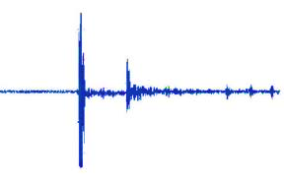
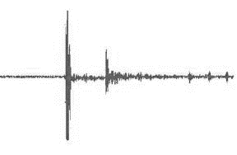
Challenge: Coherent “artifacts” leading to artifacts
The SAFT approach of USCT is built around the assumption of well behaving noise
  1D signals carrying all the information can be utilized to extract all the information
  System design theories like the the 1Bit ADC paradigma showing that coherent overlaying and extraction of information is possible
  Gauss formed well heaved noise chancels out -> system Design of USCT as proababilistic detection device
  Coherent noise/distortions, cancels not out!
  Coherent “Noise” in context of our system of many parallel measured pressure over time data is needed to be time coherent
  Such “coherent distortions” are created by classical signal crosstalk, capacitive and inductive coupling which is typically almost instantaneous
Signal
Signal with artifact
Medium with crosstalk!
Wire 1
Wire 2
Notes:
All or many others

Slide 7
Challenge: Crosstalk sources
many crosstalk mechanism:
  Component level crosstalk
  Capacitive coupling crosstalk
  Inductive coupling
  Mechanical crosstalk
  “Digital”/”Virtual” crosstalk
Notes:
Component level crosstalk
Analog multiplexers/switches have a characteristic crosstalk rejection (usually around -30 to -50 dB)
Capacitive coupling crosstalk
Created by two signal conductors being close to each other
Of particular concern inside close PCB Traces (-45dB for 10cm traces 0.2mm apart)
Inductive coupling
Coupling of the magnetic fields of the signal
Usually very low
Mechanical crosstalk
Unwanted mechanical propagation can happen around the sensor/emitter and reach other elements
“Digital”/”Virtual” crosstalk
Unexpected signal in the data due to an error in the system hardware of software
Potential to be extremely high (up to 0dB theoretically)

Slide 8
Motivation: 3D USCT III Receiver Chain Crosstalk sources
*128 Transducer Array system
Piezo element
384 ADC channel
Piezo element
ASIC :
Amplifier
&
MUX
Piezo element
Piezo element
3*128
channel
Piezo element
Multiplexer
Piezo element
Piezo element
Piezo element
Piezo element
9to3 MUX
Piezo element
Piezo element
ASIC :
Amplifier
&
MUX
Piezo element
Piezo element
Piezo element
Piezo element
6to3 MUX
Piezo element
Piezo element
Piezo element
9to3 MUX

Slide 9
Motivation: 3D USCT III Receiver Chain Crosstalk sources
*128 Transducer Array system
Piezo element
384 ADC channel
Piezo element
ASIC :
Amplifier
&
MUX
Piezo element
Piezo element
3*128
channel
Piezo element
Multiplexer
Piezo element
Piezo element
Piezo element
Piezo element
Piezo element
Piezo element
ASIC :
Amplifier
&
MUX
Piezo element
Piezo element
Piezo element
Piezo element
Traces and cables closes to each other can couple and induce crosstalk
Piezo element
Piezo element
Piezo element

Slide 10
Motivation: 3D USCT III Receiver chain Crosstalk sources
*128 Transducer Array system
Piezo element
384 ADC channel
Piezo element
ASIC :
Amplifier
&
MUX
Piezo element
Piezo element
3*128
channel
Piezo element
Multiplexer
Piezo element
Piezo element
Piezo element
Piezo element
Piezo element
Piezo element
ASIC :
Amplifier
&
MUX
Piezo element
Piezo element
Piezo element
Piezo element
Analog multiplexer have a specified rejection between channel were crosstalk can be measured
Piezo element
Piezo element
Piezo element

Slide 11
Motivation: 3D USCT III Receiver chain Crosstalk sources
*128 Transducer Array system
Piezo element
384 ADC channel
Piezo element
ASIC :
Amplifier
&
MUX
Piezo element
Piezo element
3*128
channel
Piezo element
Multiplexer
Piezo element
Piezo element
Piezo element
Piezo element
Piezo element
Piezo element
ASIC :
Amplifier
&
MUX
Piezo element
Piezo element
Piezo element
Piezo element
Miss-cabling (swapped cables) can create virtual crosstalk
Piezo element
Piezo element
Piezo element

Slide 12
Motivation: 3D USCT III emitter architecture
4*32 TAS
Piezo element
Piezo element
ASIC :
Amplifier
&
MUX
4 Distribution
board
Piezo element
Piezo element
Multiplexer
Piezo element
Multiplexer
Multiplexer
Multiplexer
Piezo element
4*32
ch
Multiplexer
*4
ch
Multiplexer
1
DAC
channel
Piezo element
Piezo element
1to9 MUX
Piezo element
Piezo element
Piezo element
ASIC :
Amplifier
&
MUX
Piezo element
Piezo element
Piezo element
1to4 MUX
Piezo element
1to2 MUX
1to32 MUX
Piezo element
Piezo element
Piezo element
1to9 MUX
Total emitter multiplexing : 1 to 2304

Slide 13
Motivation: 3D USCT III emitter architecture
Crosstalk source
*128 TAS
Piezo element
Piezo element
ASIC :
Amplifier
&
MUX
4 Distribution
board
Piezo element
Piezo element
Multiplexer
Piezo element
Multiplexer
Multiplexer
Multiplexer
Piezo element
4*32
ch
Multiplexer
*4
ch
Multiplexer
1
DAC
channel
Piezo element
Piezo element
Piezo element
Piezo element
Piezo element
ASIC :
Amplifier
&
MUX
Piezo element
Piezo element
Piezo element
Piezo element
Piezo element
As previously, parallel traces, cables and multiplexer can induce cross-talk
Piezo element
Piezo element

Slide 14
Motivation: 3D USCT III emitter architecture
Crosstalk source
128 TAS
Piezo element
Piezo element
ASIC :
Amplifier
&
MUX
4 Distribution
board
Piezo element
Piezo element
Multiplexer
Piezo element
Multiplexer
Multiplexer
Multiplexer
Piezo element
4*32
ch
Multiplexer
*4
ch
Multiplexer
1
DAC
channel
Piezo element
Piezo element
Piezo element
Piezo element
Piezo element
ASIC :
Amplifier
&
MUX
Piezo element
Piezo element
Piezo element
Piezo element
Piezo element
Misconfiguration of the multiplexer could lead to multiple element emitting => “virtual crosstalk”
Piezo element
Piezo element

Slide 15
3D USCT system analysis: Crosstalk

Slide 16
Research Theory
3D ultrasound computer tomograph have especially low signal SNR and higher probability of catching
Potentially significant source of signal disruption or falsification
Question: How much crosstalk do we have?
(„digital“ and analog…)

Slide 17
Challenge: side & local maxima
Crosstalk might be more general problem than „Geometry detection“
  Crosstalk might or might not be the global maximum….
Geometry detection: find global maximum
Crosstalk detection: find all maxima
Global maximum
Global maximum
local maximum: crosstalk?
Optimization domain
Optimization domain

Slide 18
Approach: Linear Projecting into the imaging domain
Needed: a methode which is robust and error tolerant and cover the full optimization domain
By utilizing the enormous AScan amount instead of single Ascans?
Approach:
  Projecting the 1D data into 3D the spatial domain and utilizing all the data
  Algorithm from Synthetic Aperture Focussing technique family
    Ellipsoide Backprojection -> reflectivity imaging
    Spherical Backprojection -> spatial projection of transmission info
Properties
  Propabilistic, brute force -> with our many signals error tolerant
  Linear projection: allows extraction of quantiative metrices
  Full domain coverage: unlike optimizer based methods which extract only one „optimum“

Slide 19

Method: Spherical Projection
Spherical projection of 1D time pressure 3D spatial domain
1D Time domain
Artifact + Real signal
2D (of 3D) Spatial projection domain
Projection
…
Ascan 1
…
Ascan n

Slide 20
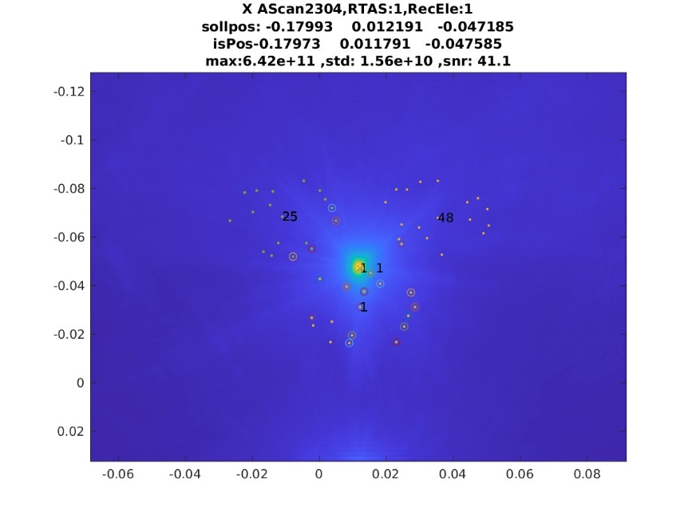
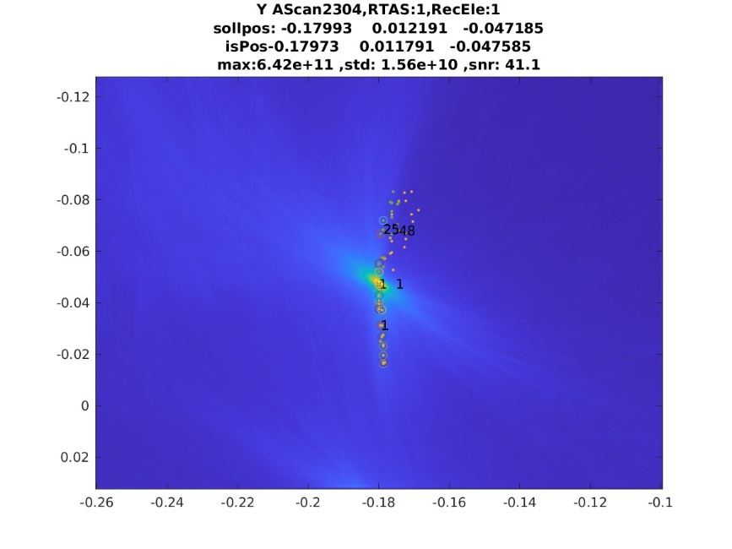
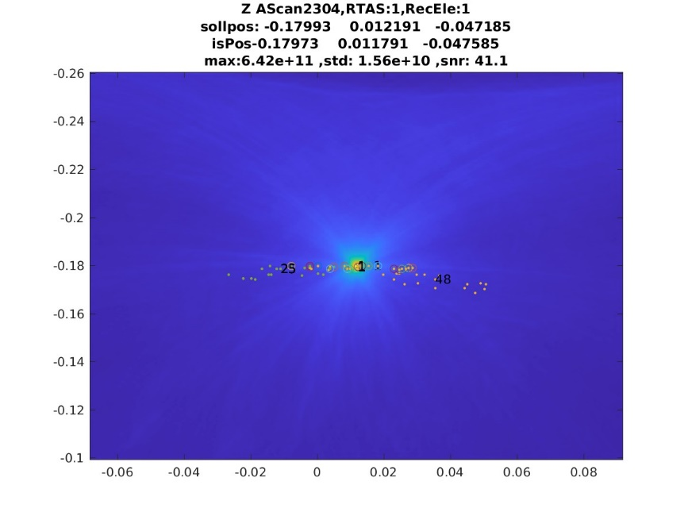
3 D projection space
X Projection
Y Projection
Z Projection

Slide 21
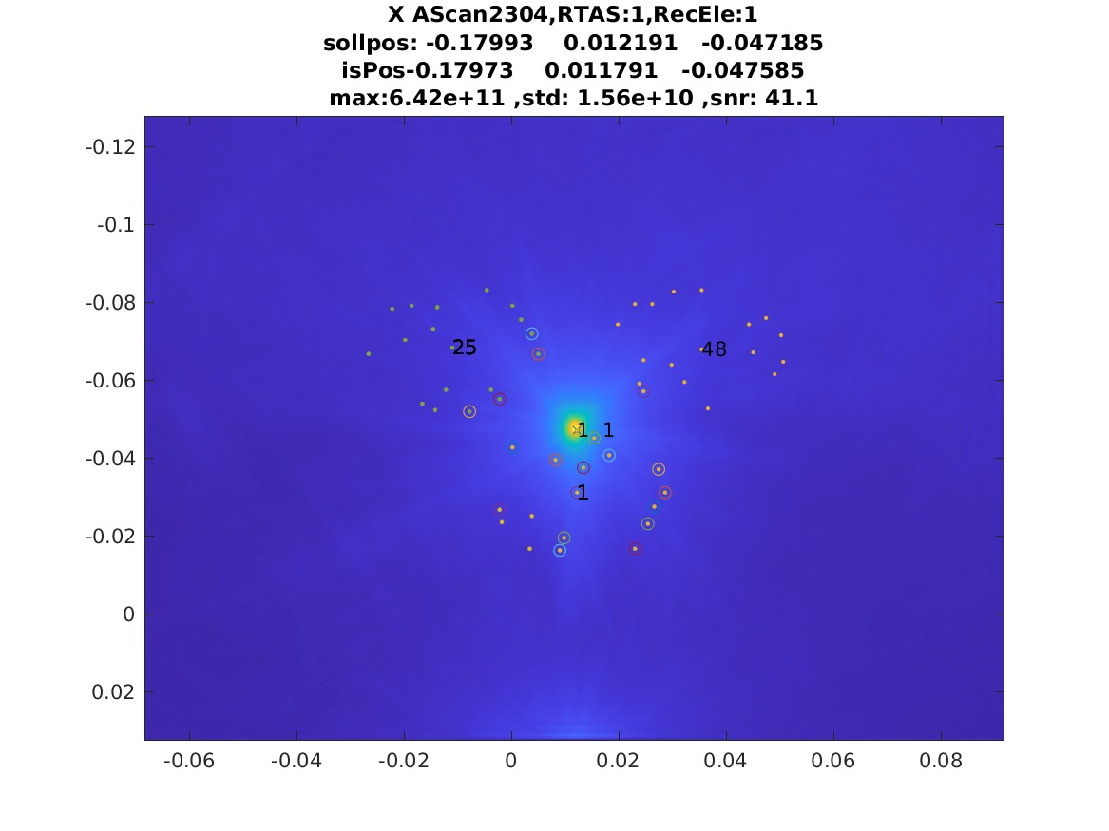
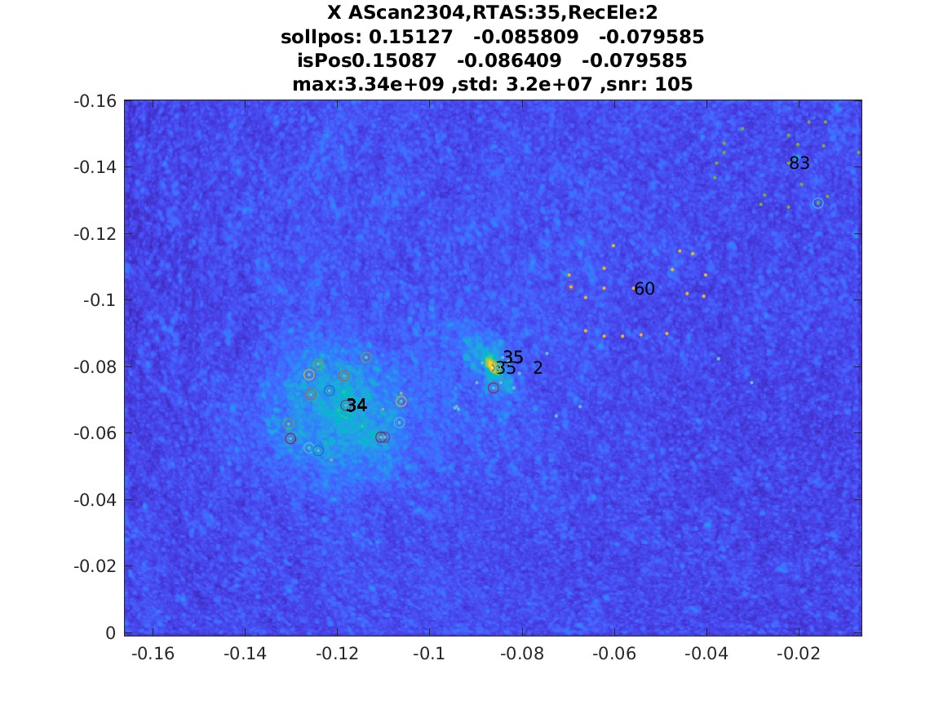
Results
2D projections
High-SNR
Low-SNR

Slide 22
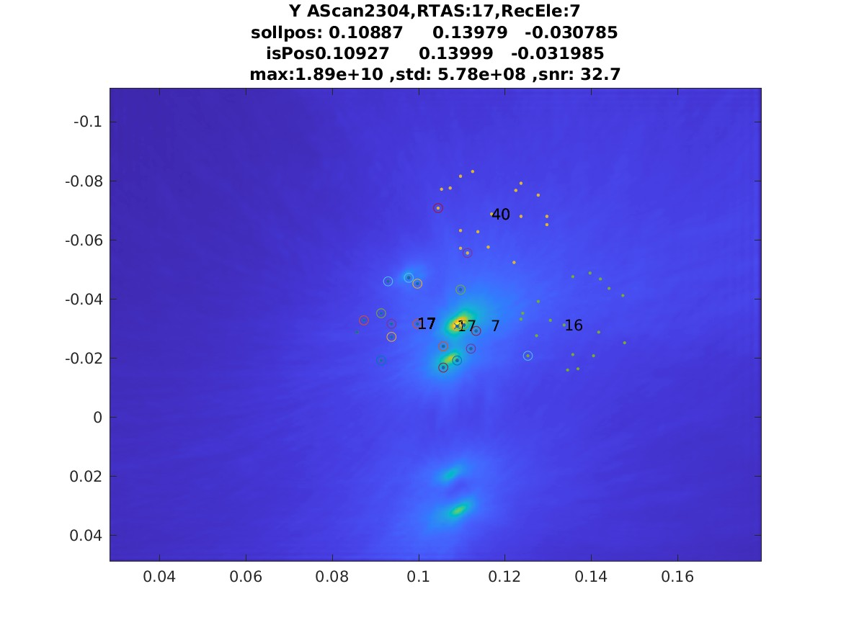
Results
2D projections
High-SNR
Crosstalk
"V:\Data\_USCT3Dv3\_exp807_FPGA v1.28 reference CIRS 28164.1-1 measurement EQ9_emptyMeasurement_try2\quick_const17\Receiverdetection MP01TAS017El07-Y.jpg"

Slide 23
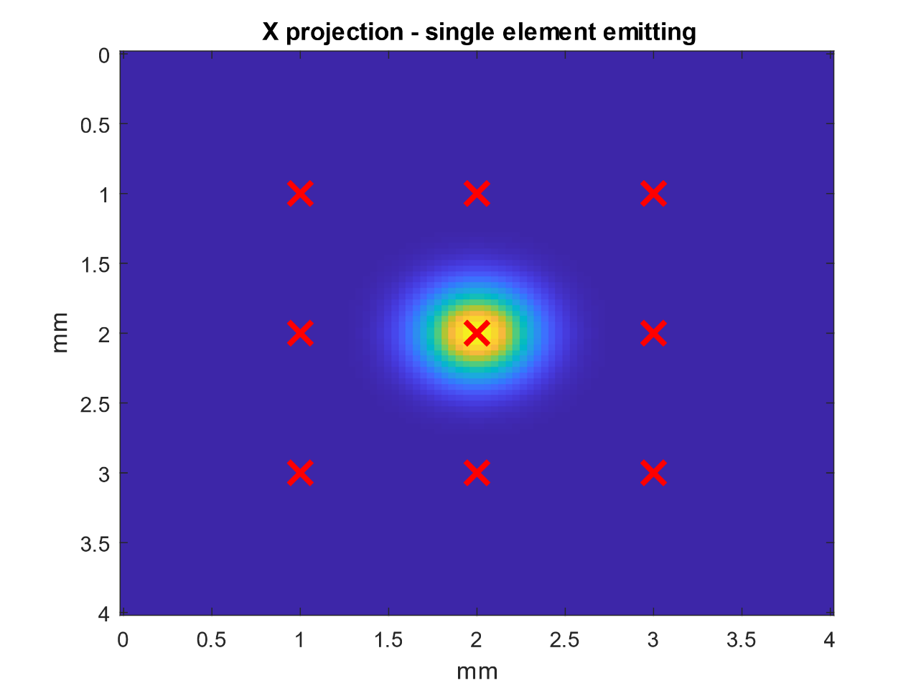
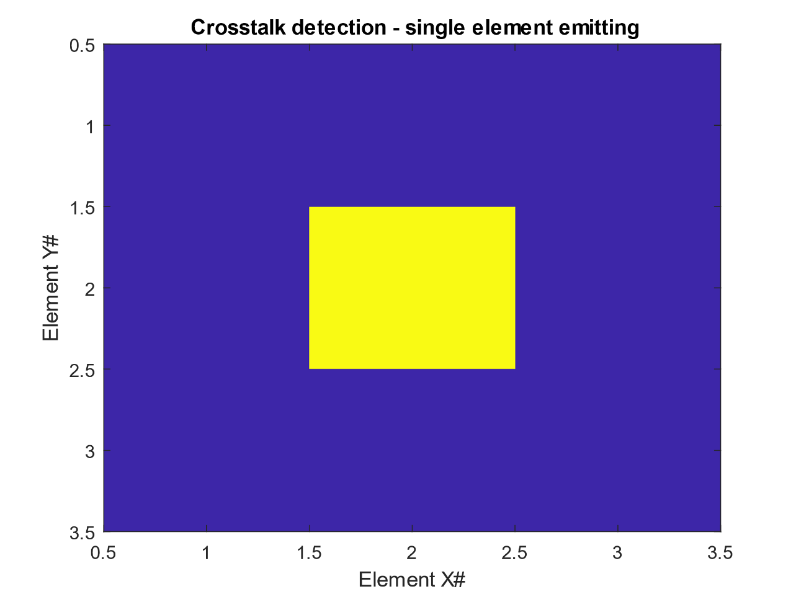
Association with positions

Slide 24
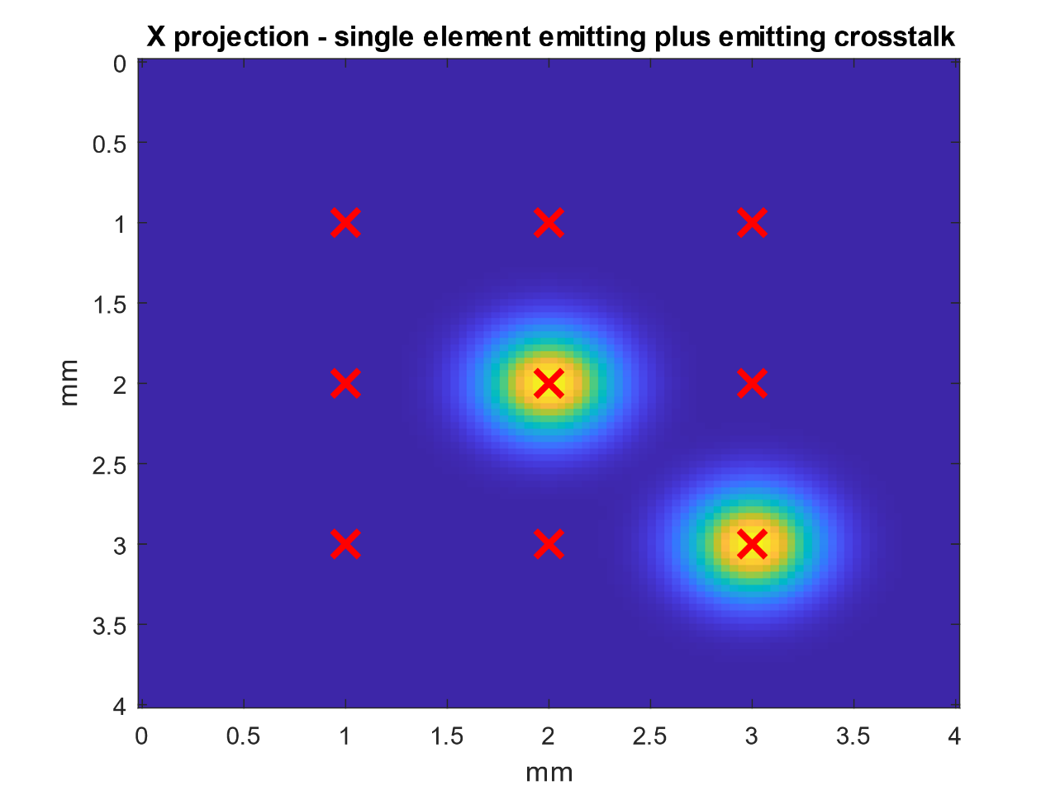
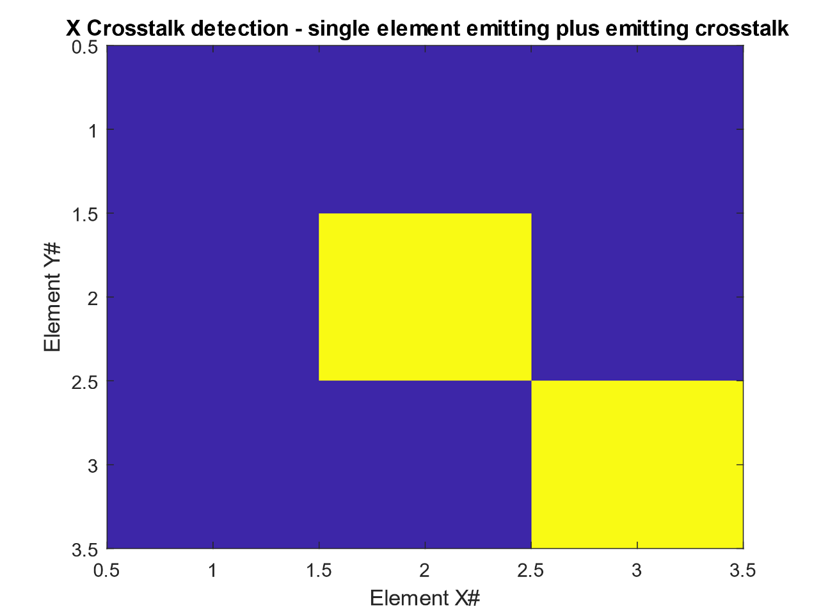
Association with positions

Slide 25
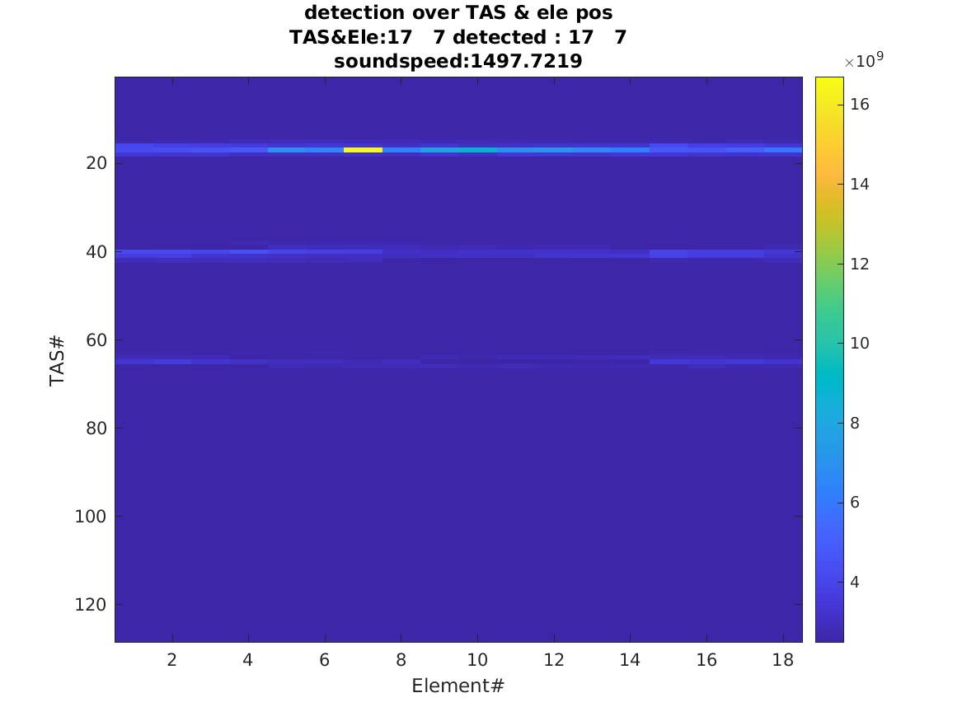
Results
2D projections
Crosstalk
Association
"V:\Data\_USCT3Dv3\_exp807_FPGA v1.28 reference CIRS 28164.1-1 measurement EQ9_emptyMeasurement_try2\quick_const17\Receiverdetection MP01TAS017El07-Y.jpg"

Slide 26
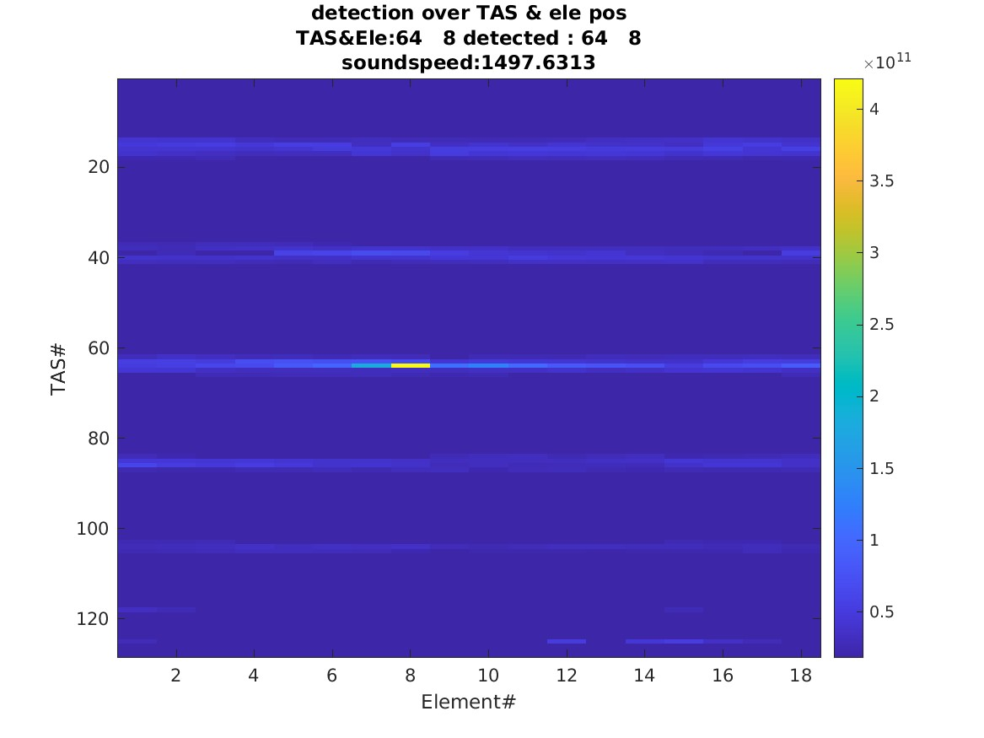
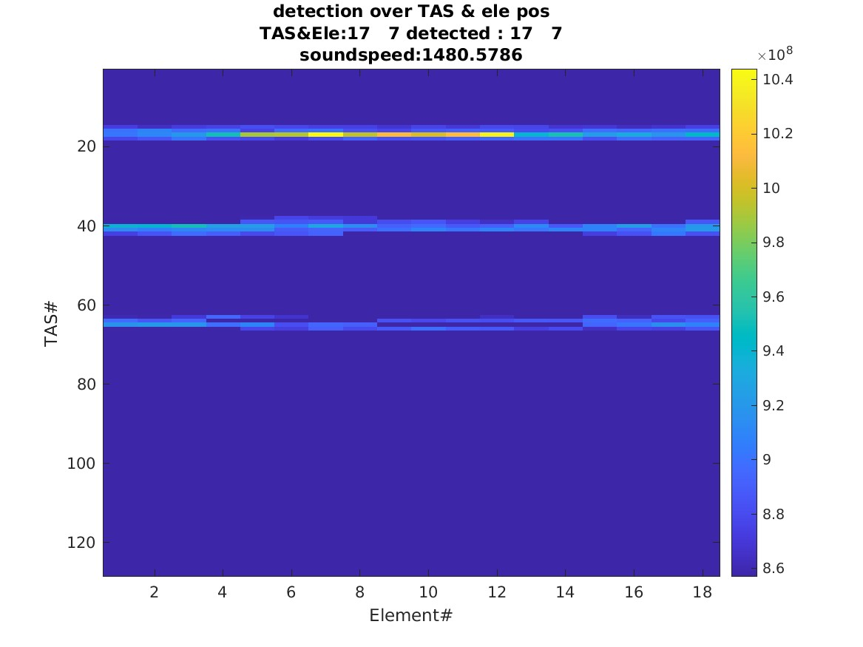
Results
Association examples
Good element
Element with crosstalk

Slide 27
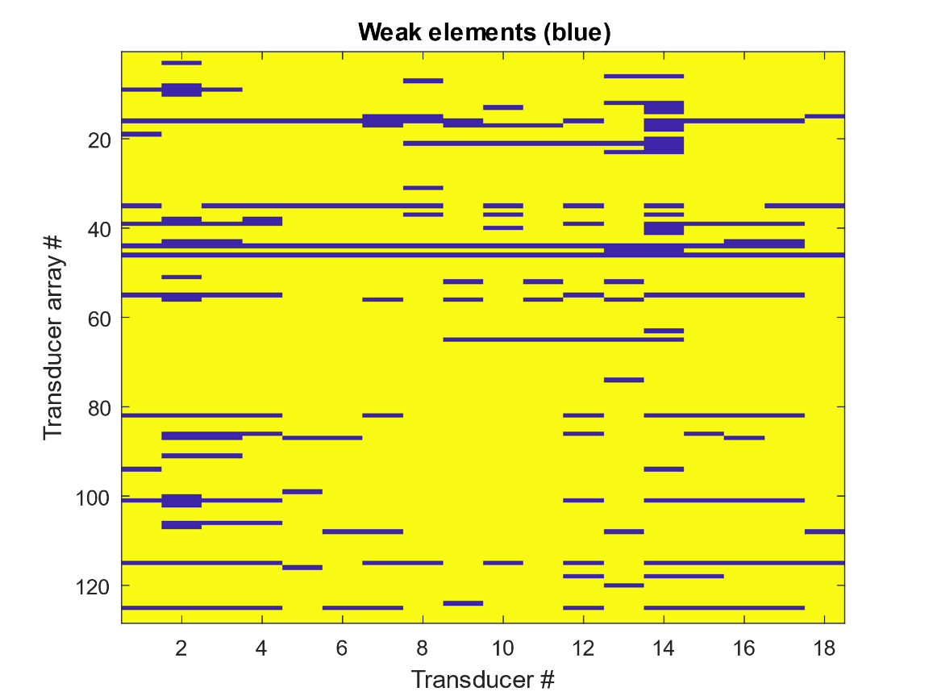
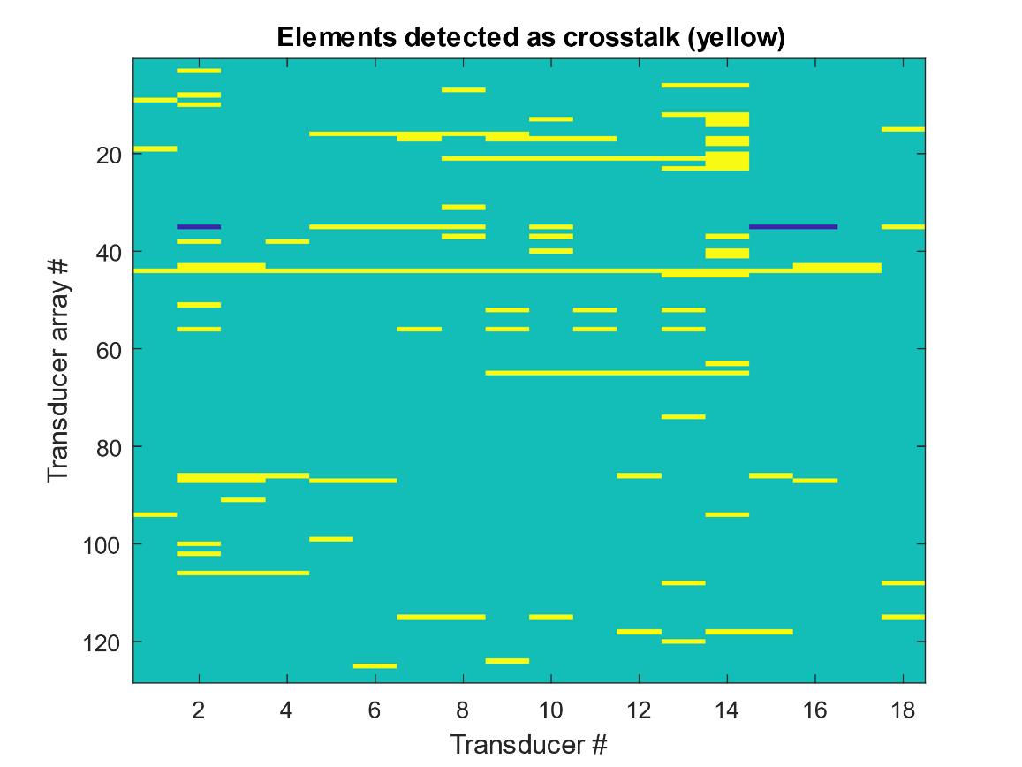
Results:
Classification
Weaker elements
Crosstalk

Slide 28
Results: Robustness and generality
Receiver Detection
Emitter detection
Consistent classification results
  Averaging, objects & empty measurements, temperature variation

Slide 29
Summary and conclusion
Method evaluation
  Works / converges when signal SNR is low or negative
  Modelable for TX, RX chains independently
  Robust (over parameters, medium and object etc)
  Overall, Spherical backprojection allows system analysis of crosstalk
Device evaluation
  3D USCT KIT has an upper bound ratio to signal to crosstalk of smaller 2 orders of magnitude
  Crosstalk can make weak and dead elements seem working and producing „false data“ -> can be filtered out now
  „Digital crosstalk“ could be ruled out
Future possibilities
  More system status classification classes, fine grained HW element association, geo. detection etc…

Slide 30
Discussion: Crosstalk sources mitigation
Component level crosstalk
  Selection of component with a higher rejection ratio
Capacitive coupling crosstalk
  Reduce parallel length/surface
  Shielding/ground traces around the signal
Inductive coupling
  Don’t coil your cable together with a ferrite core ?
Mechanical crosstalk
  Mechanical energy directed to your ROI and dampen if not ?
“Digital”/”Virtual” crosstalk
  Cable and configure correctly? Detect it ?!?

Slide 31
Summary
Experiment _USCT3Dv3_exp807_FPGA v1.28 reference CIRS 28164.1-1 measurement EQ9_emptyMeasurement_try2”
Good TAS:
  sum(~isnan(Q_val))= 1803
  mean(Q_val(~isnan(Q_val)))= 0.3641
Inside tAS crosstalk:
  sum(~isnan(iCQ_val)) = 87
  mean(iCQ_val(~isnan(iCQ_val)))= 0.0974
Between tAs crosstalk
  sum(~isnan(eCQ_val)) = 46
  mean(eCQ_val(~isnan(eCQ_val)))=0.0015

Slide 32
3D USCT: measurement principle and signals
Separation of measurement phase + imaging phase
Receiver
Pressure p(t)
Time t
Transmission
Reflection
Emitter
Pressure over time ultrasound signal, so called AScan
Multimodal imaging:
  Sound speed
  Attenuation
  Reflection

Slide 33
Motivation: Multichannel system
USCT system designed around Synthetic Aperture Focusing Technique (SAFT)
  System uses one emitter while receiving on all/many others
Theoretical 1 to 2304
  -> many parallel channel
In reality muxers: TX Mux, receiver mux

Slide 34

3D USCT III: Measurement time and data
3D USCT III system
Parallel data
Data sink (server)
Measurement process
  2304 emitters are excited individually and iteratively
  Measurement window: 400µs
  => 1 to 10 minutes (parameter dependend)
DAQ
  384 channels, 6x time muxing (2304 channels)
  10 MHz sample rate, 400µs window, 16 bit datatype
  => 80GByte
Measurement process:
  2304 Emitters are excited individually to 2304 Receivers, iterated…. 1 to 5min measurement time
  Resulting in 80GByte of Data (10 MHz sample rate, 400µs window)
=> Clinical applicable with ~ 10 min

Slide 35
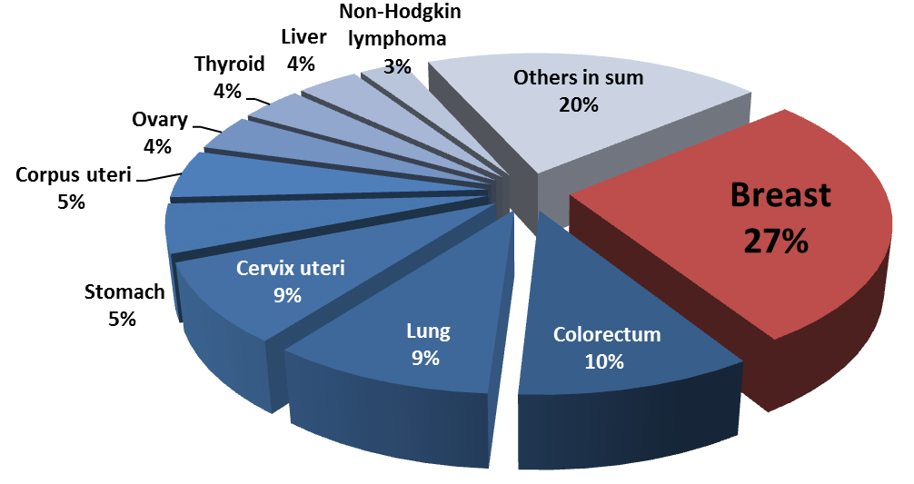

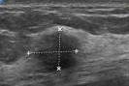

Background: Medical situation
Motivation: Breast cancer
  Most common cancer of women in western world (every 10th woman)
  Deadly, despite not being a non-vital organ due to metastasis
  Current methods have downsides and weaknesses…
Solution:
  Early diagnosis before metatasizing happens…
WHO cancer statistics 2012 (GLOBOCAN 2012)
Source: International Agency for research on cancer, https://gco.iarc.fr
Data source: WHO cancer statistics 2020, GLOBOCAN 2020
…
X-ray mammography
Sonography
MRI
Screening
Symptomatic patients
Notes:
NEED FOR NEW METHOD
---------------------------------------------
Most common cancer of women in western world (every 10th woman)
Most deadly cancer, 5 year survival rate of 76%.
Why do so many women die from breast cancer? → Metastases in vital organs ! Screening: find cancer before metas.
Current methods:
Palpation:
Self examination, >20a annually
Tumor size >20mm
Approx. 60% probability for metastases
Mammography:
If symptoms are present, >50a every 3a screening
Tumor size >10mm
Approx. 30% probability for metastases
Sonography:
For clarification (or young patients with small breasts)
Tumor size >5mm (if position of suspicious lesion is known)
Magnetic Resonance Imaging with contrast agent:
Additonal clarification (e.g. implants)
Tumor size >5mm (low specitivity)
Image guided biopsy and histological examination
Positron Electron Tomography (PET)
Evaluation of lymph node mestastases and metastases in other organs
Metastases size > 2cm
----------------------
Image sources: netdoctor.de, University Hospital Jena, University Hospital Mannheim

Slide 36
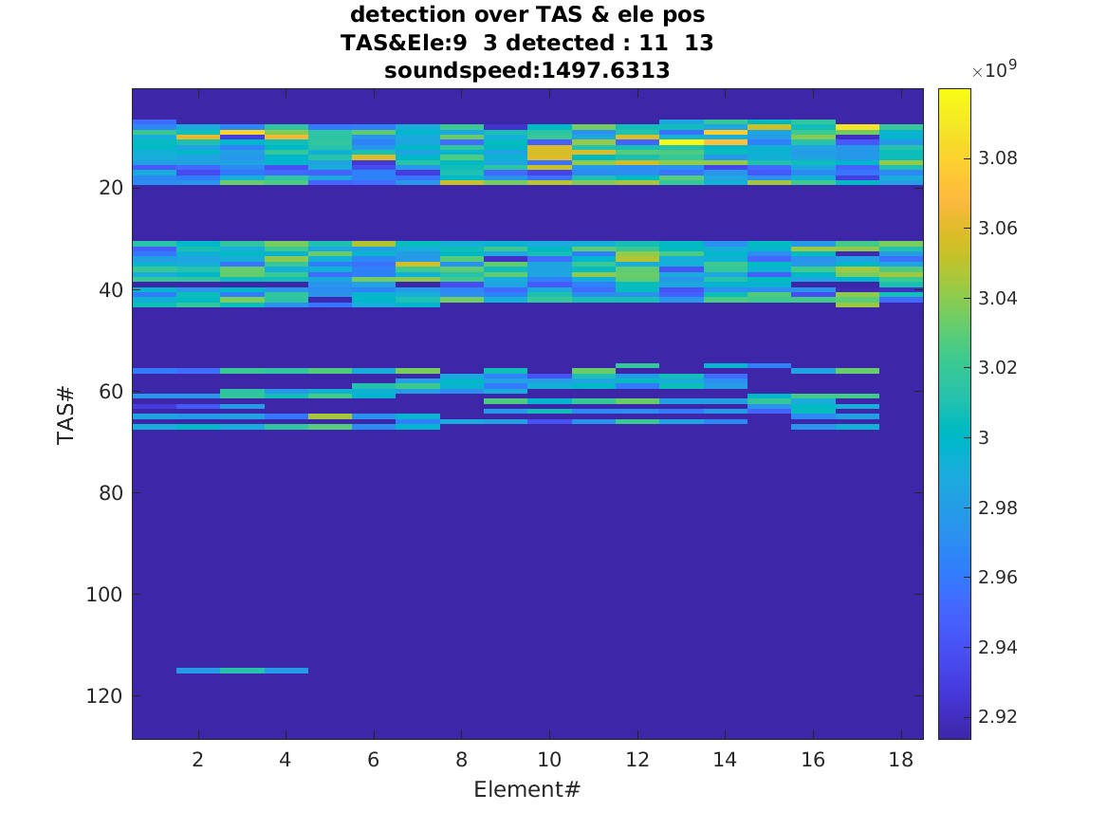
Results
Crosstalk view
Good element
Dead element

Slide 37
Geometry detection: Best fit between pos_detect & pos
Experiment _USCT3Dv3_exp807_FPGA v1.28 reference CIRS 28164.1-1 measurement EQ9_emptyMeasurement_try2

Slide 38
Example: Used dataset KIT
KIT exp1939 dataset
  Empty measurement with Aperture filled with water
  Averaging 16
  Emitter detection
  Soundspeed and delay detection closed
  10MHz sample rate
  Water temperature 25°C
  2024-02-03 12:55:55
  V:\Data\_USCT3Dv3\_exp1939_USCT before Barcelona study, EMPTY, new CE not compensated\USCTIII_geomdetectMeasurement_unified_phase_detection2

Slide 39
System analysis – Zewei’s guess (no numerical value guess possible)
Source | TX/RX | Level
PCB Traces before amplification | Receive | 4
Amplification and Multiplexing ASIC | Receive | 4
PCB Traces after amplification | Receive | 2
Multiplexer | Receive | 4
Parallel coaxial cables | Receive | 1
Parallel differential cables | Receive | 2
PCB Traces after Amplification (HV) | Transmit | 5
Amplification and Multiplexing ASIC | Transmit | 4
PCB Traces before Amplification | Transmit | 2
Multiplexer | Transmit | 4
Parallel coaxial cables | Transmit | 2
Parallel differential cables | Transmit | 2

Slide 40
Motivation
Crosstalk has a negative impact on image reconstruction
  Crosstalk is not a “classical” noise that can be filtered
  For most reconstruction it passes as a genuine signal
3D USCT III piezoelectric designed to have a large opening angle
  Results in low-pressure and small signals
  Sensitive to cross-talk
Complete electrical crosstalk analyses are complex
  Neglects mechanical effects
  Can miss other errors: miss-cabling or digital misconfiguration
=> Design a holistic analysis tool for crosstalk

Slide 41
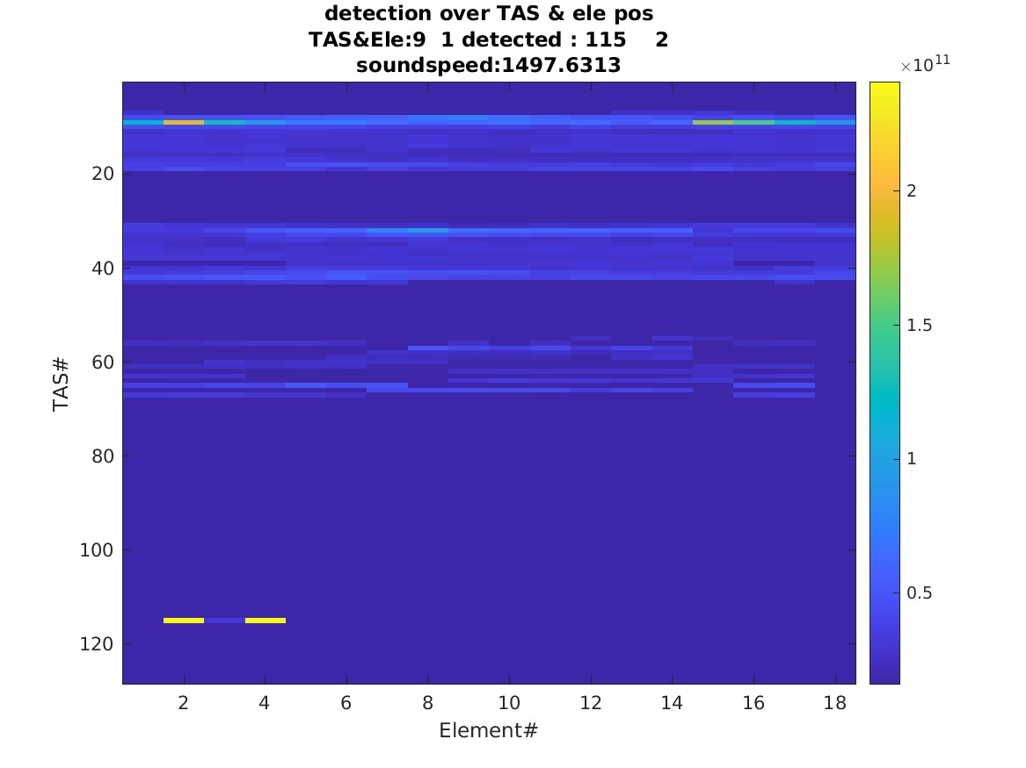

Slide 42
New slides

Slide 43
Challenge and Approach
Classical approach: Signal based cross talk detection
  USCT is built as SAFT system :Every ascan carries all information, therefore the Signal based SNR is low Separation of the many signal is problematic
  Also, physical effects like water temperature and soundspeed variation make the separation harder
  Further, HW variations and defects
To increase the SNR confidence of
  From the Transmissions signals the positions of the emitter and receivers can be extracted

Slide 44
Method 2D projections
Experiment
Receiver , emitter, degrees of freedom

Slide 45
exp2067

Slide 46
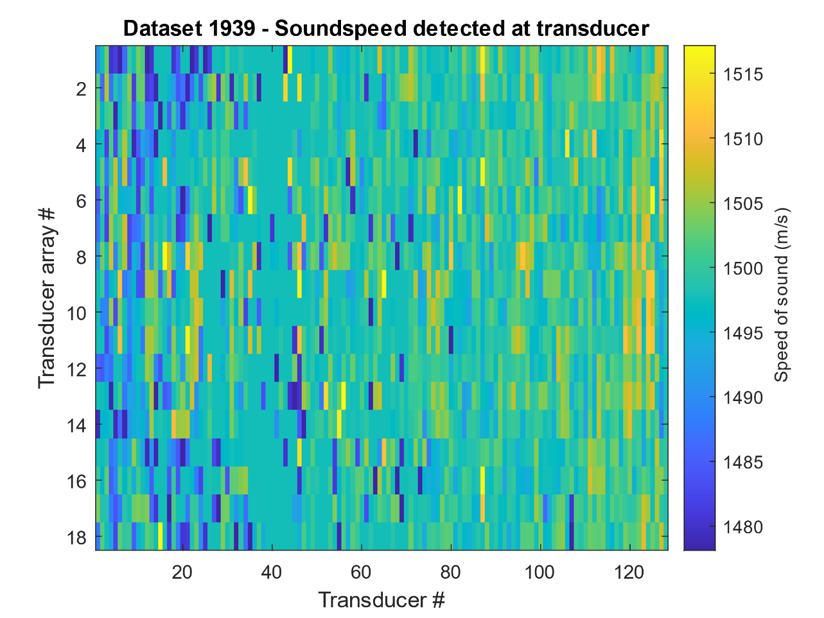
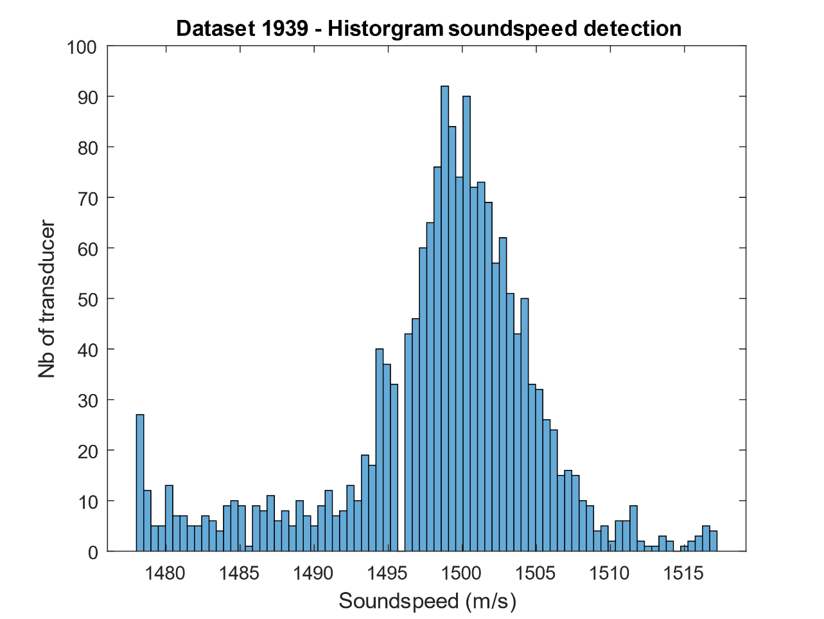
Results:
Soundspeed detection

