Slide 1
Gamma-ray emission in radio galaxies under the VLBI scope
R. Angioni (MPIfR-Bonn, U. Würzburg)
Monitoring the non-thermal universe 2018, Cochem
Collaborators:
Prof. E. Ros (MPIfR-Bonn)
Prof. M. Kadler (U. Würzburg)
Dr. R. Ojha (NASA/GSFC/UMBC)
et al., for the TANAMI and Fermi-LAT collaborations

Slide 2
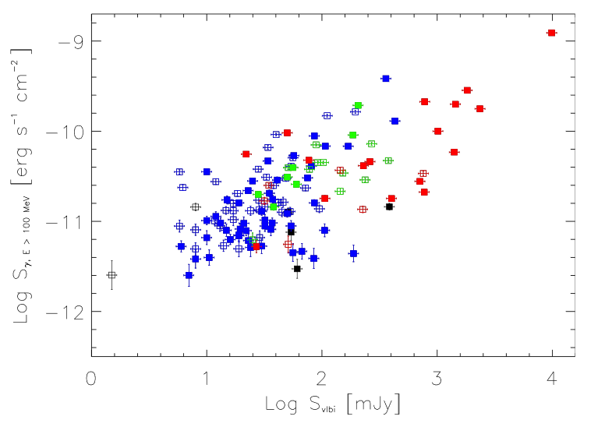
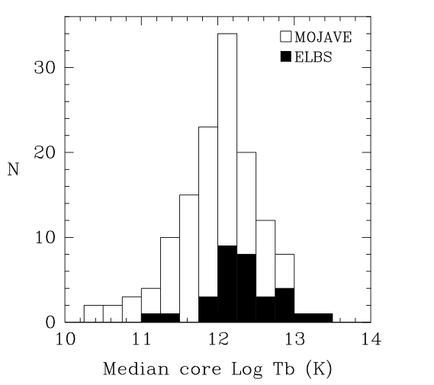
The radio-gamma connection in AGN
Lico et al. 2017
Kovalev et al. 2009
Strong connection between radio and $γ$-ray emission in large, blazar-dominated samples (e.g., Kovalev+09, Ackermann+11, Lico+17)
$γ$-ray sources in large radio samples show preferentially higher Doppler boosting markers (Kovalev+09)

Slide 3
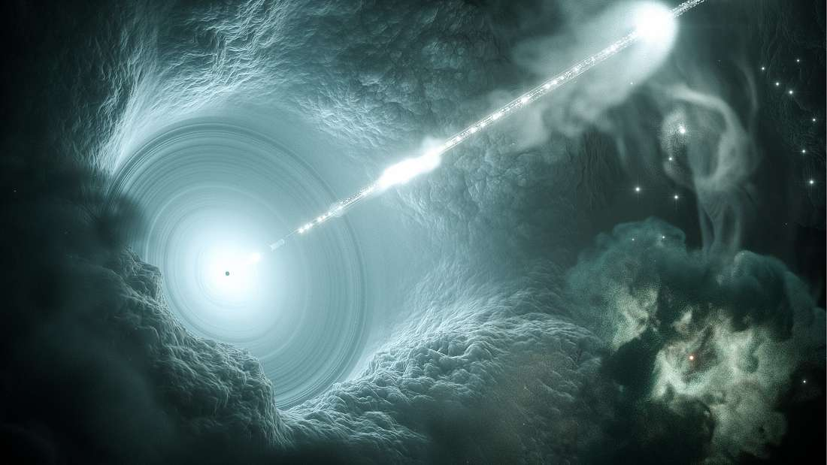
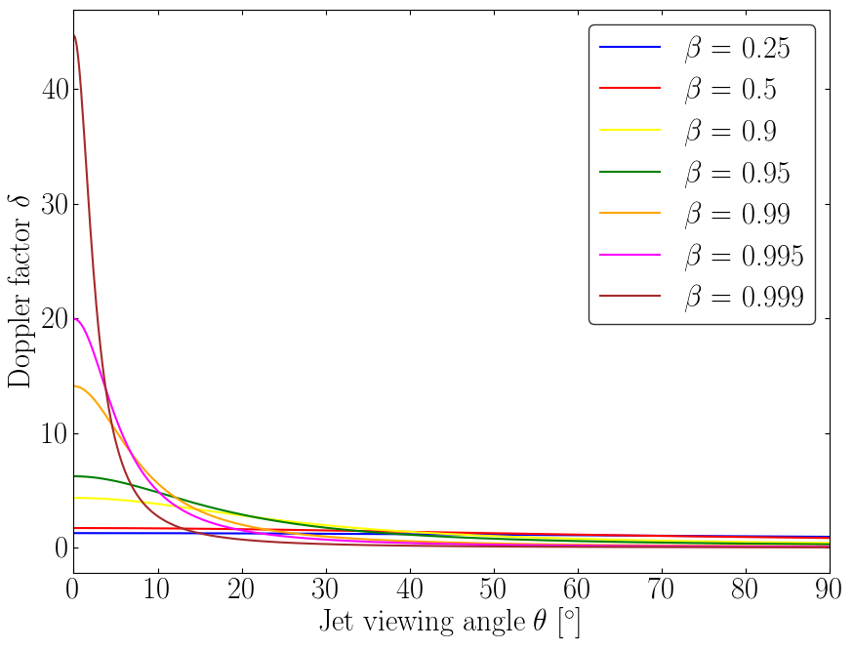
$$F_{obs}=δ^{4}F_{intr}$$
Image credit: DESY science communications

Slide 4
Radio and $γ$-ray properties of radio galaxies
Well-established relationship between pc-scale jet and $γ$-rays in blazars
Much less clear situation for radio galaxies
Mostly single-source studies (e.g. 3C 111, 3C 120, M 87, NGC 1275)
No systematic population study of VLBI-LAT properties of radio galaxies
VLBI monitoring (MOJAVE/TANAMI)
LAT monitoring
Do pc-scale jet properties drive $γ$-ray emission in radio galaxies? What is the role of Doppler boosting?

Slide 5
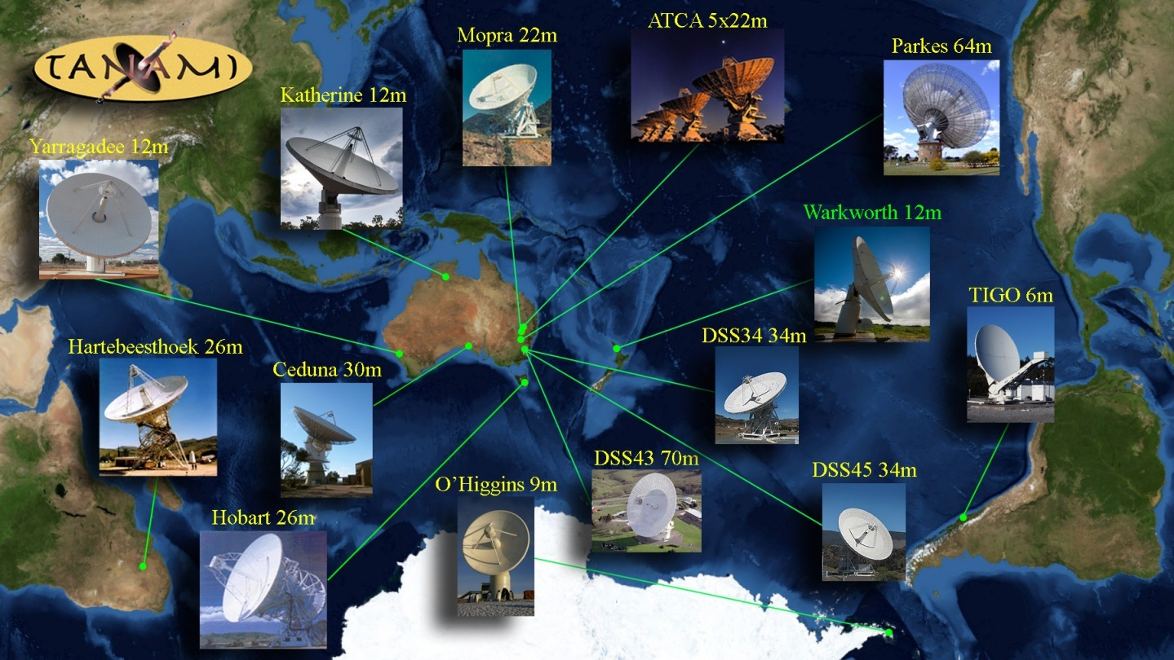
The TANAMI program
Tracking Active Nuclei with Austral Milliarcsecond Interferometry
~100 jets at $δ<−{30}^{°}$ declination at mas resolution since 2007
Dual frequency 8.4 GHz and 22.3 GHz, 3-4 epochs/yr

Slide 6
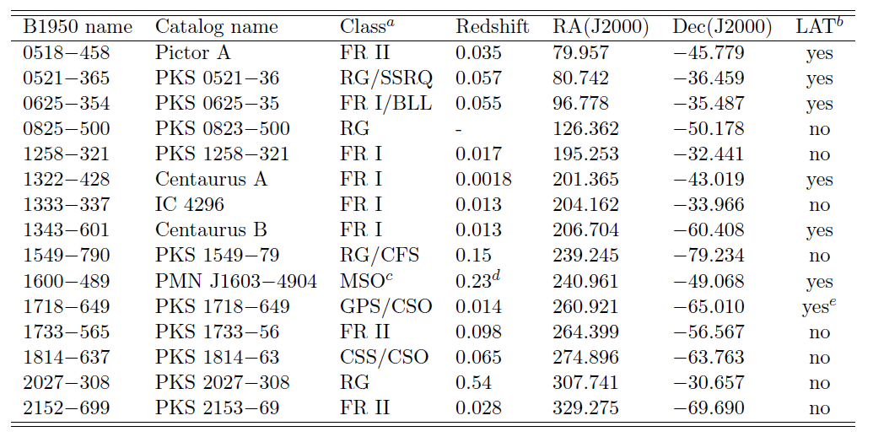
TANAMI radio galaxy sample

Slide 7
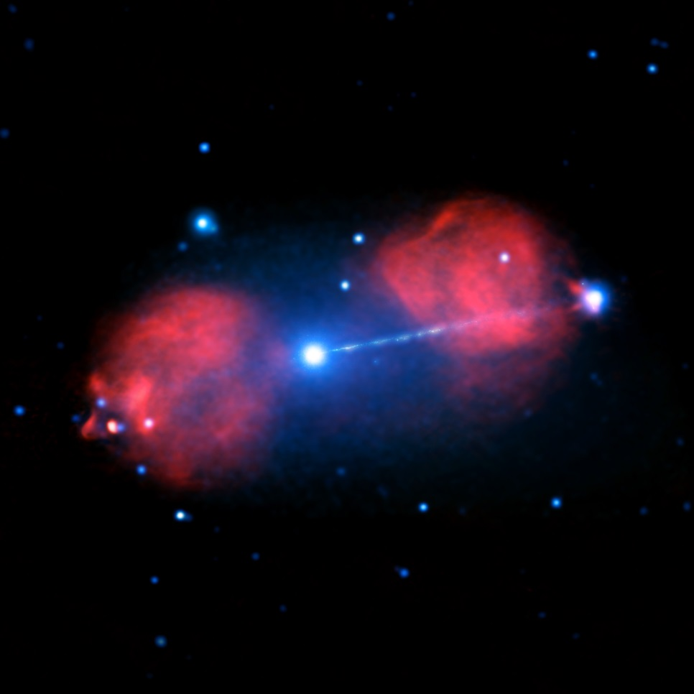
Pictor A
Classic FR II, $z=0.035$
Earlier VLBI study found jet viewing angle $θ<51°$ (Tingay+00)
Detected by Fermi-LAT in 2012 (Brown+12) flux underestimated by SED model of western hot-spot, probably jet origin/contribution
80 kpc
Image credit:
X-ray: NASA/CXC/Univ. of Hertfordshire/M. Hardcastle et al.
Radio: CSIRO/ATNF/ATCA

Slide 8
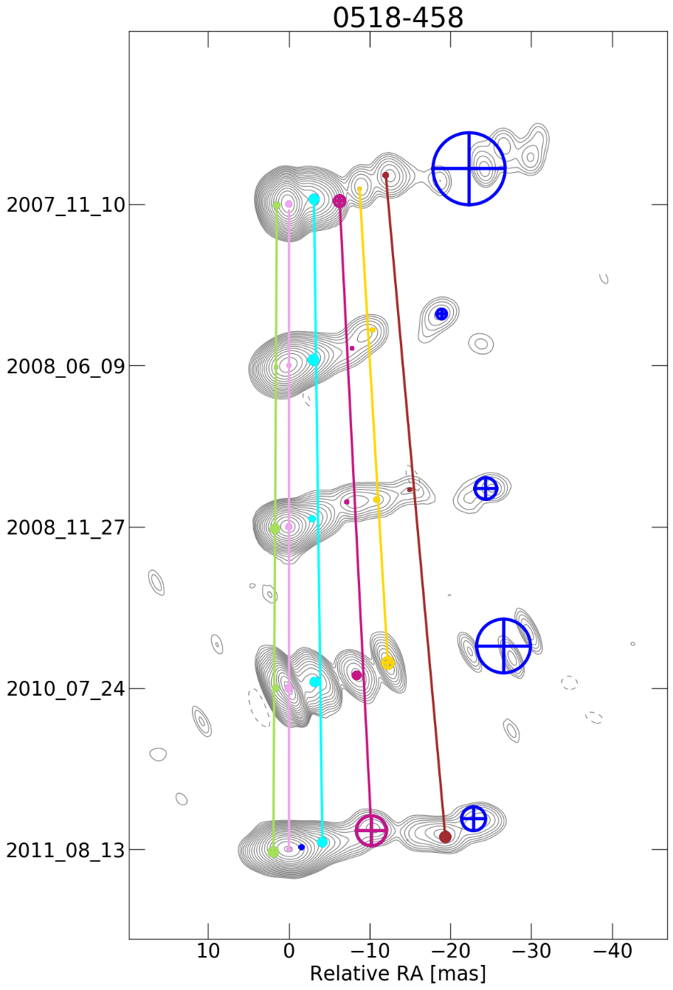
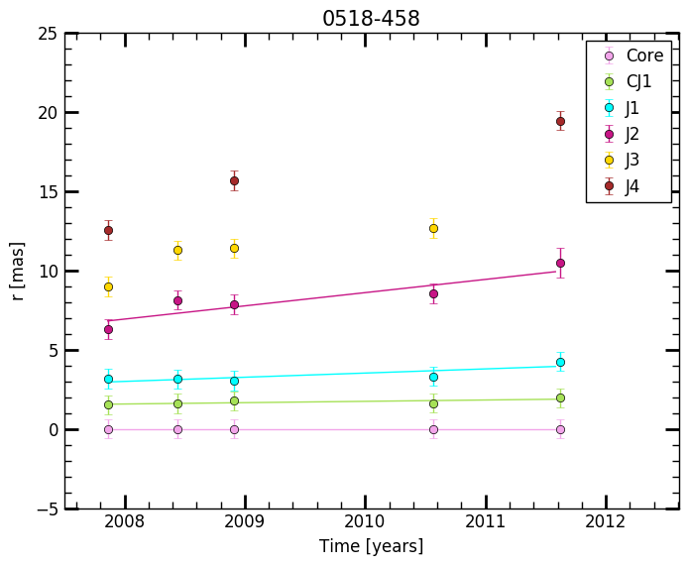
Kinematic analysis: Pictor A
1.9c
0.6c
Angioni+ in prep.

Slide 9
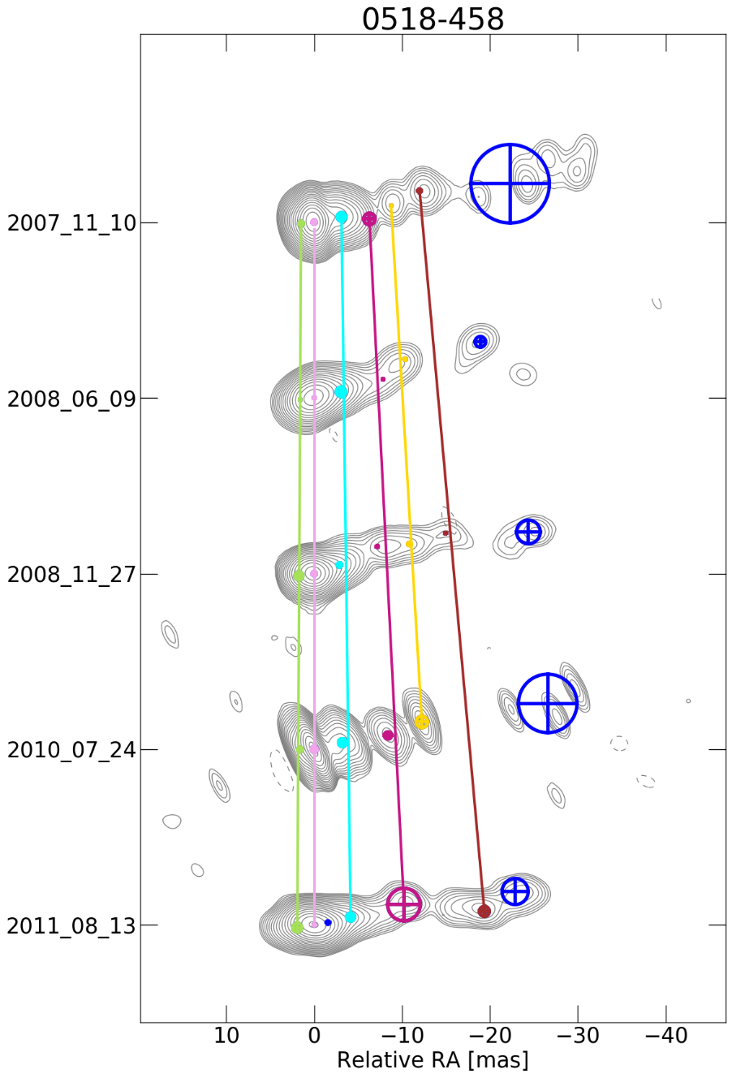
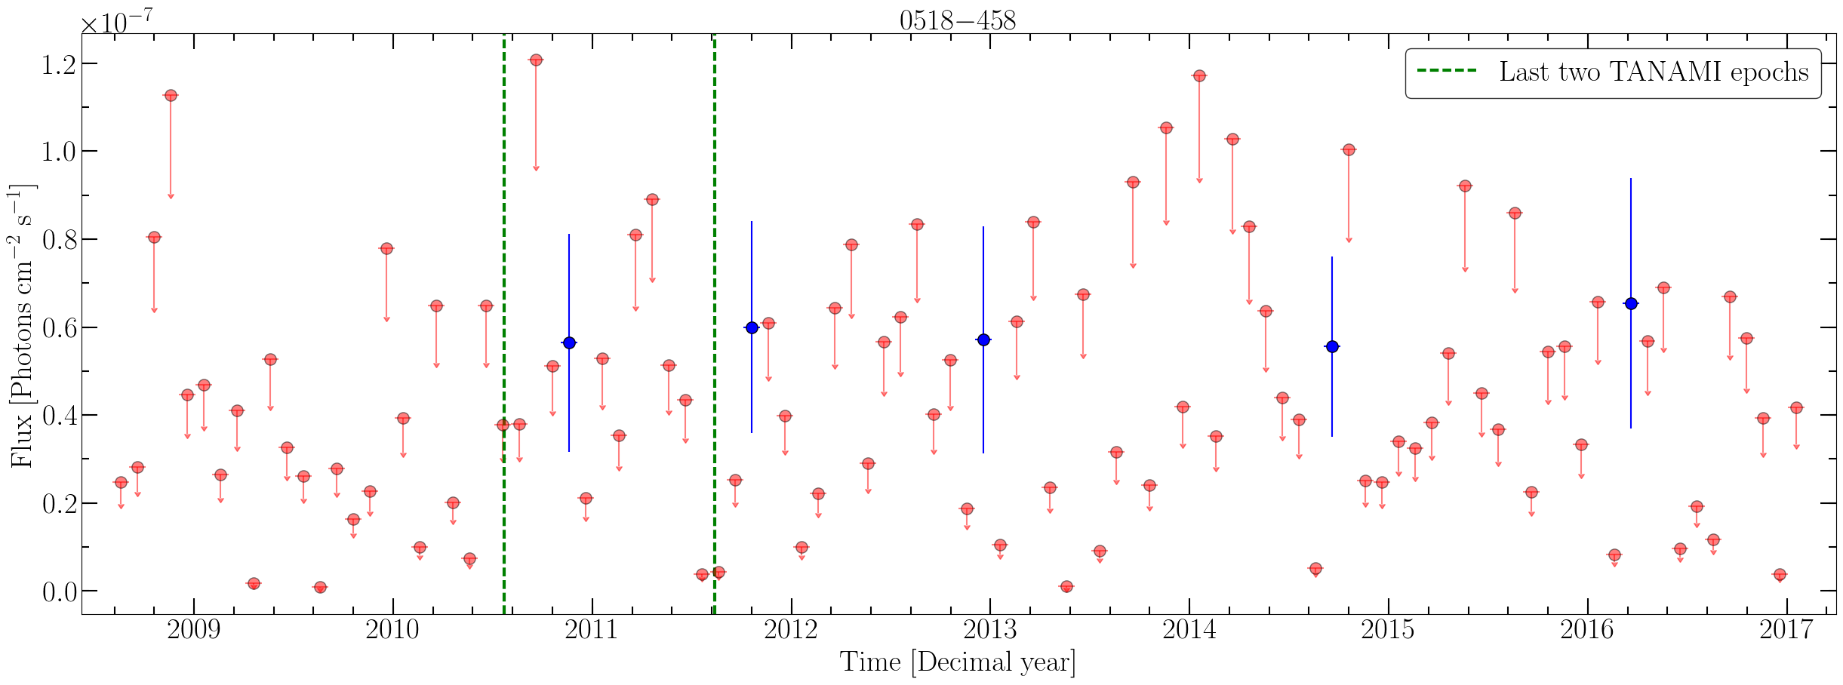
Pictor A: jet emission confirmed?
LAT monthly light curve
Angioni+ in prep.

Slide 10
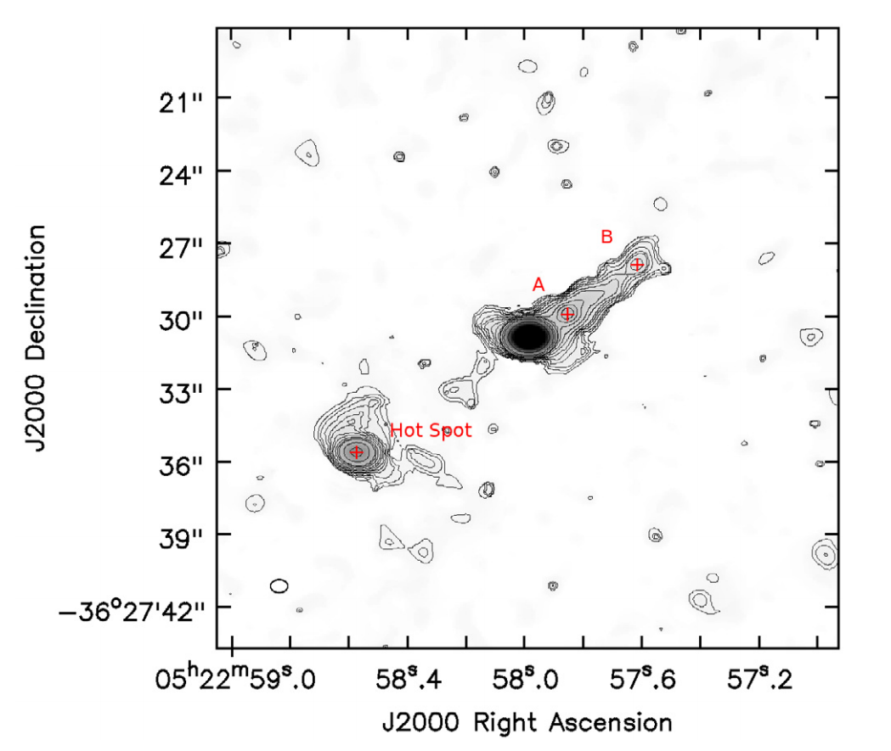
PKS 0521$−$36
Misclassified BL Lac,
likely misaligned jet, $z=0.055$
Small core dominance suggests weak boosting (Pian+96)
SED spine-sheath model suggests viewing angles $6°<θ<15°$ (D’Ammando+15)
ALMA view of large-scale structure supports small beaming and large angle (Leon+16)
Image credit:
ALMA Bands 3,6,7 ($ν_{eff}\sim 220$ GHz): Leon et al. 2016

Slide 11
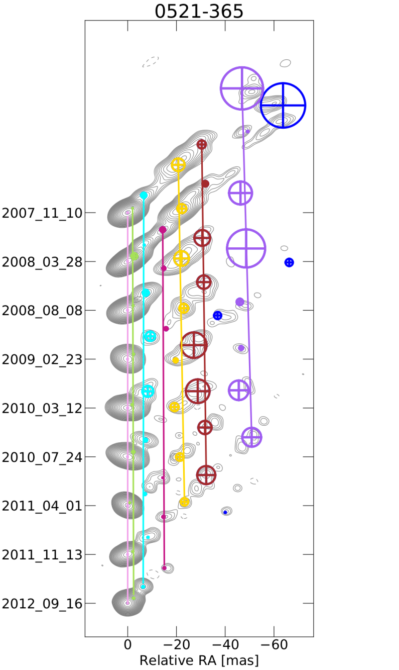
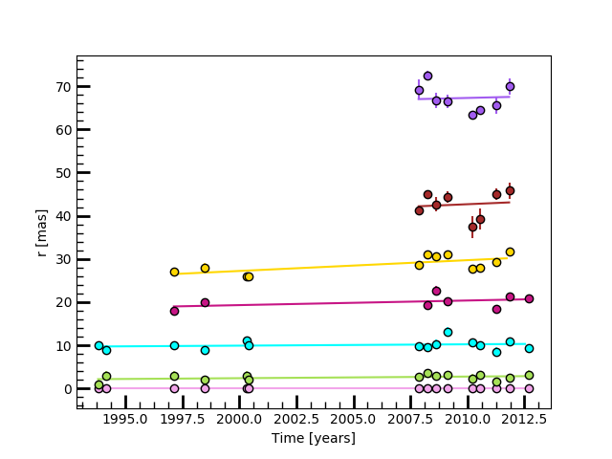
Kinematic analysis: PKS 0521$−$36
0.9c
0.4c
Angioni+ in prep.

Slide 12
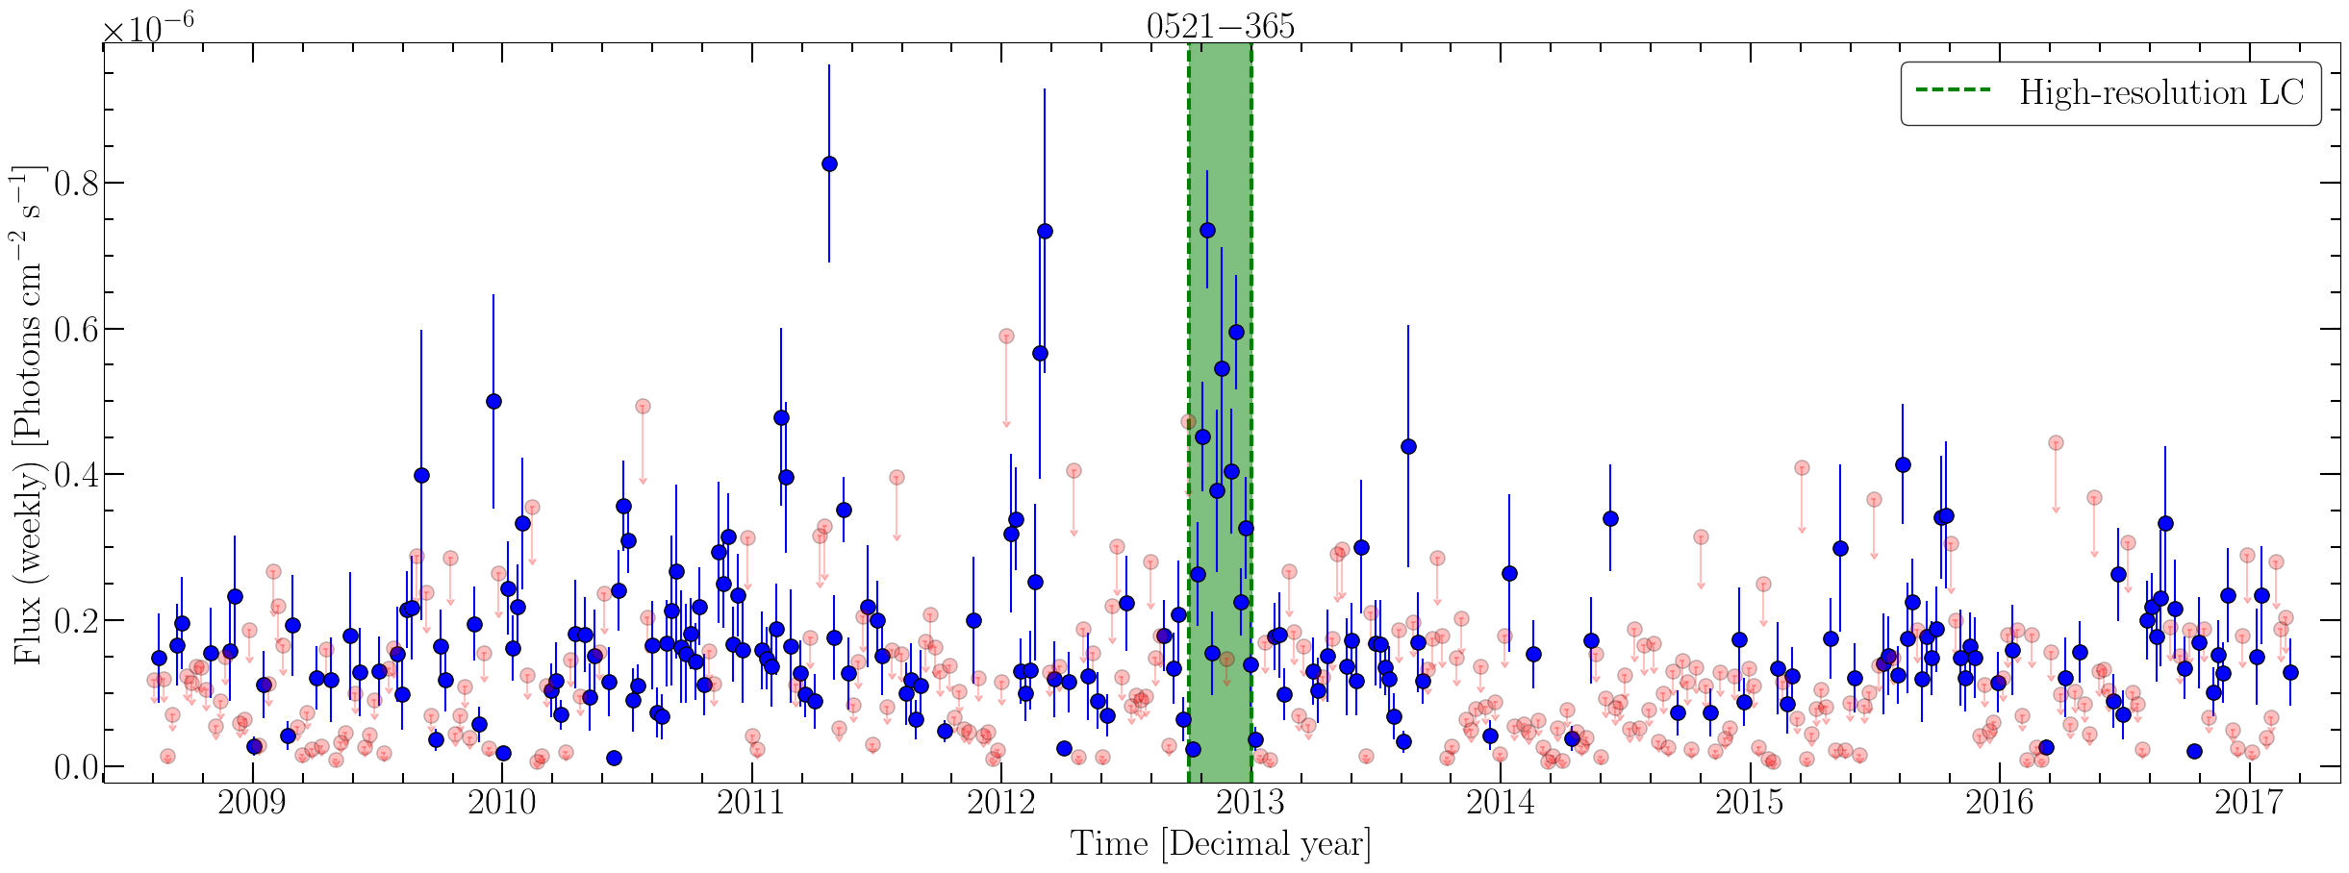
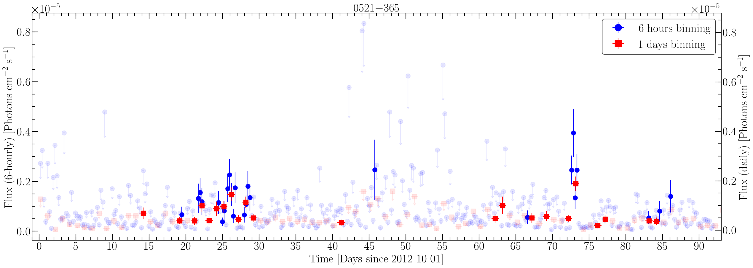
PKS 0521$−$36: fast flares, slow jet
LAT weekly light curve
Angioni+ in prep.

Slide 13
TANAMI radio galaxy sample

Slide 14
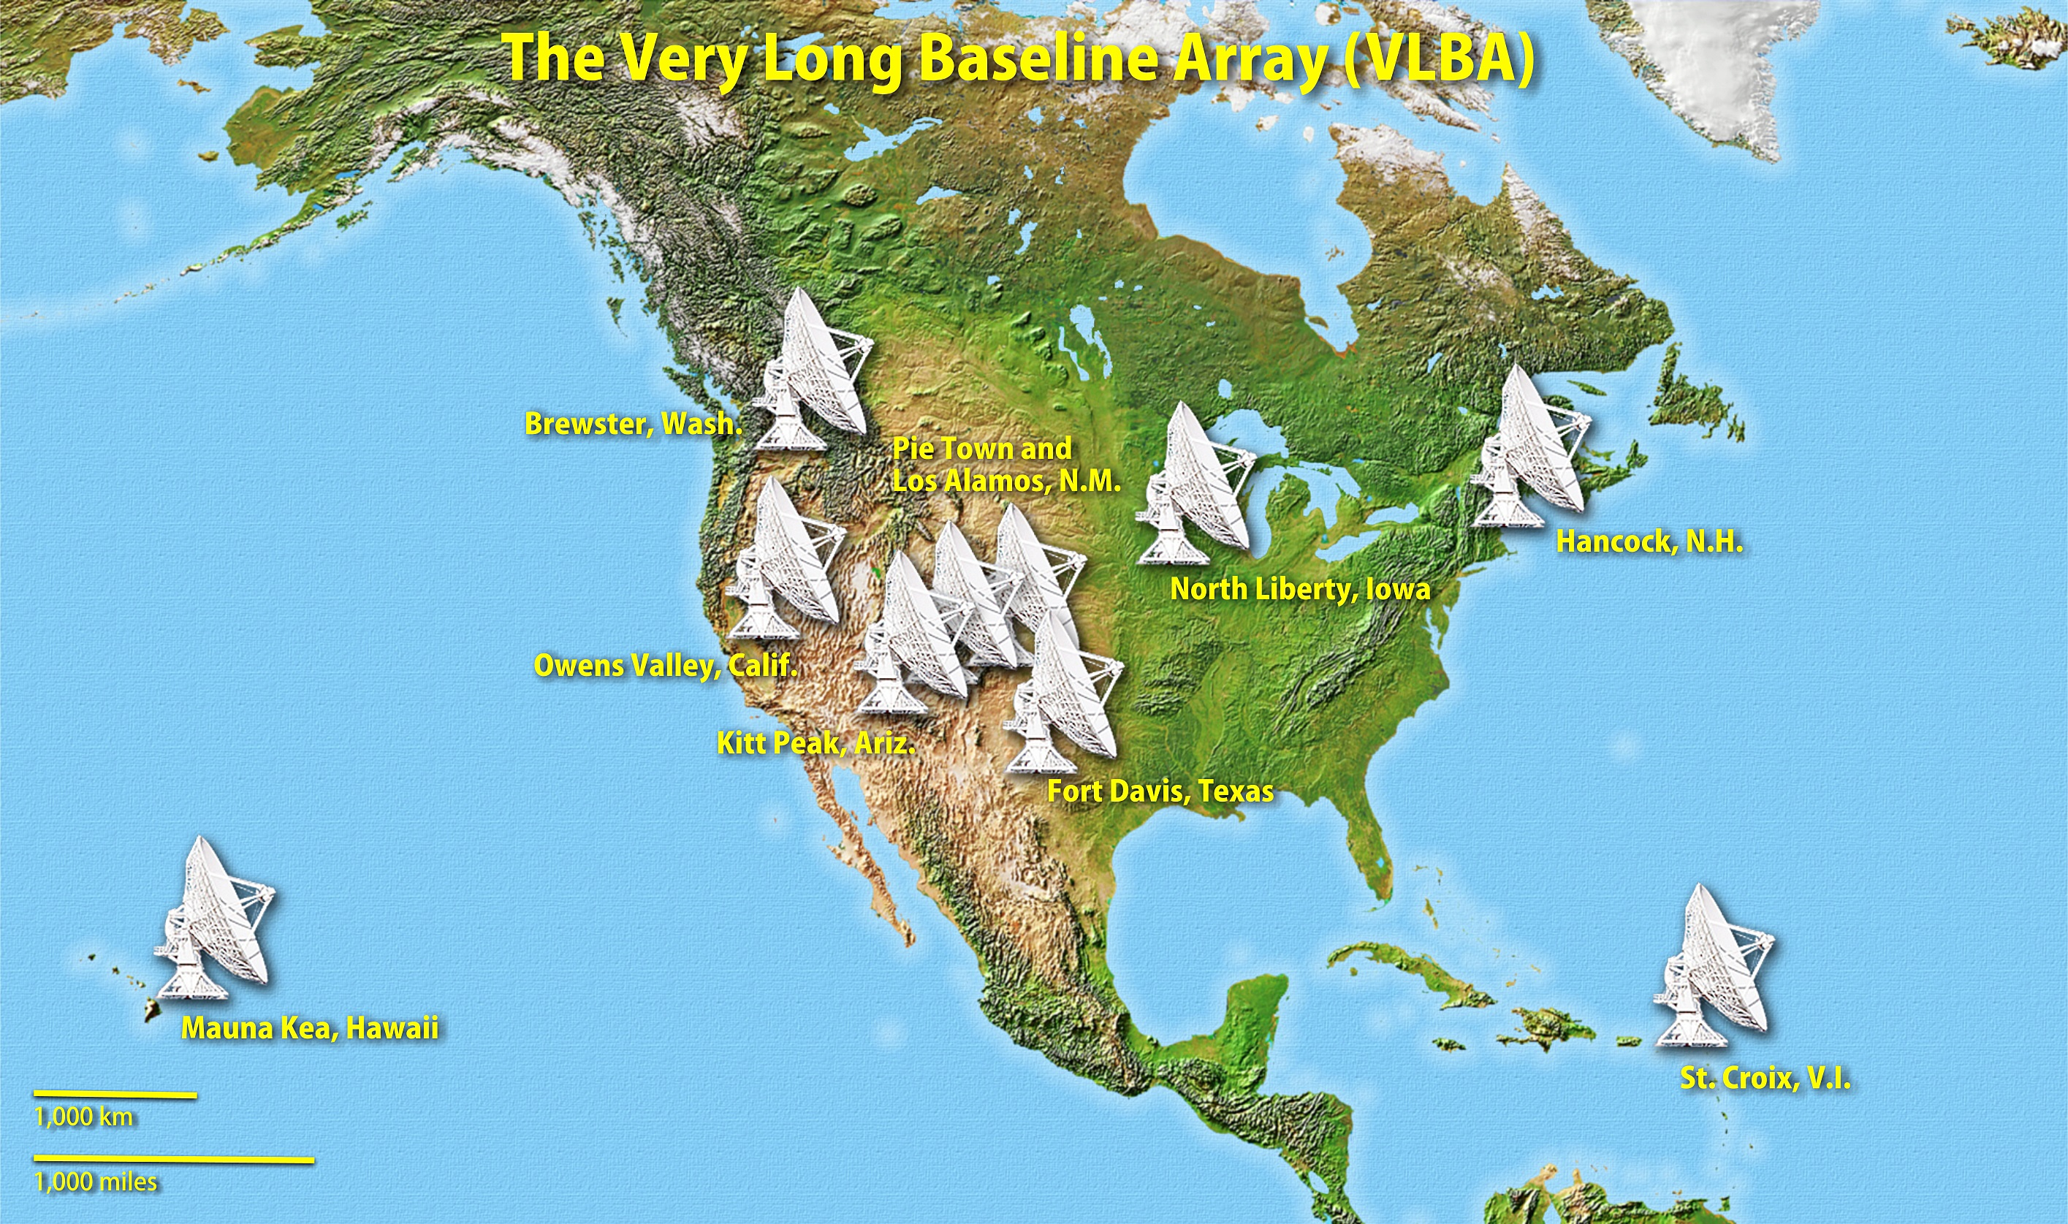
Sample properties: extension to MOJAVE

Slide 15
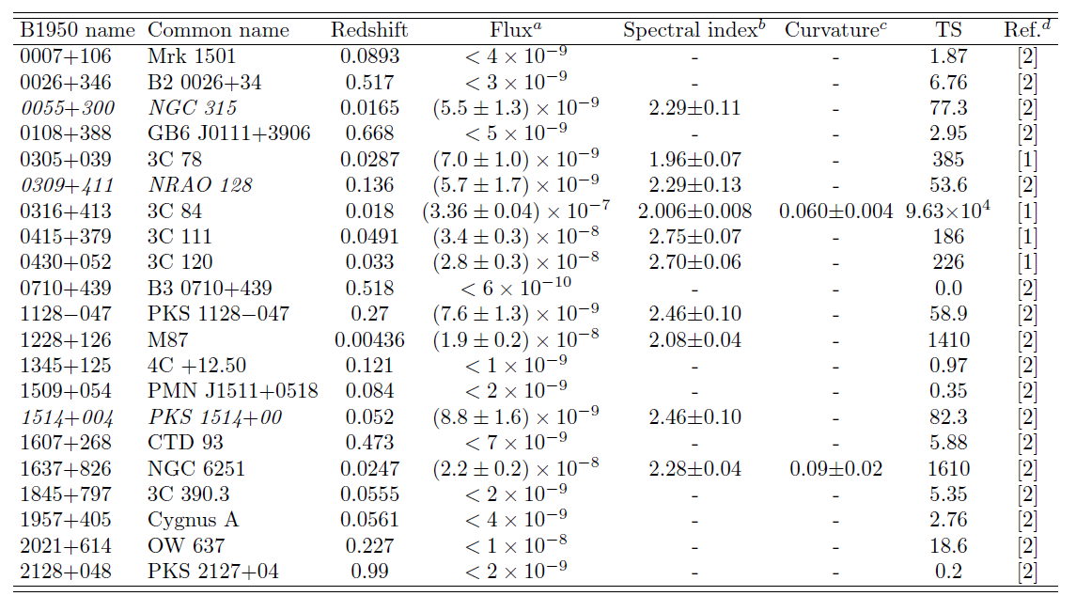
Radio galaxies in the MOJAVE sample

Slide 16
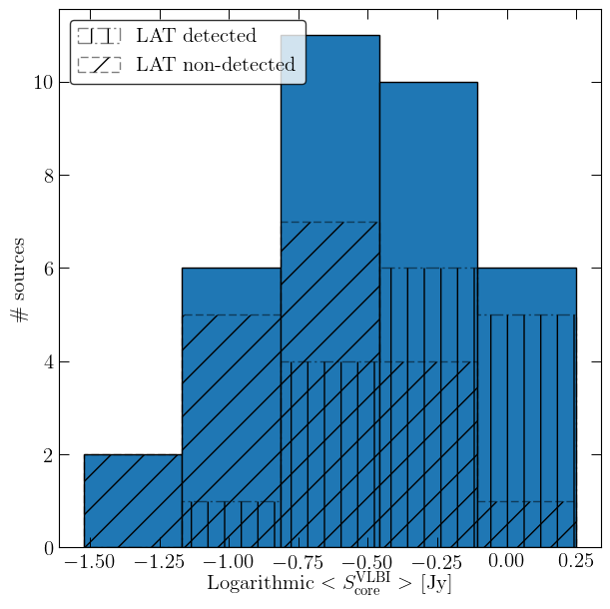
VLBI core flux
KS = 0.53
$p$-value = 0.009

Slide 17
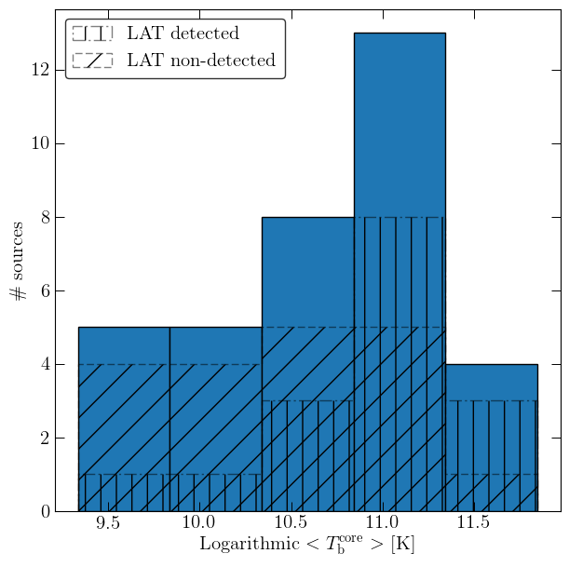
VLBI core brightness temperature
KS = 0.50
$p$-value = 0.017
$$T_{B}∝S/θ^{2}$$

Slide 18
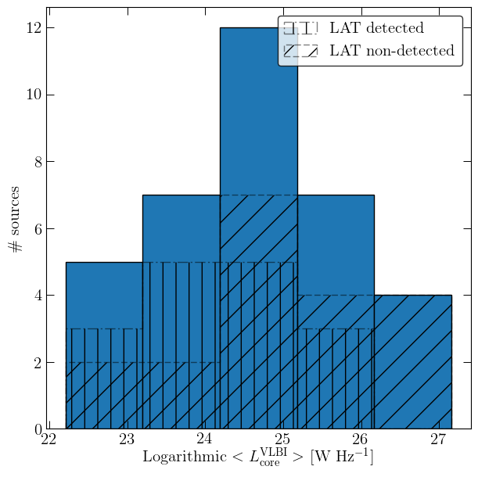
VLBI core luminosity
KS = 0.41
$p$-value = 0.073

Slide 19
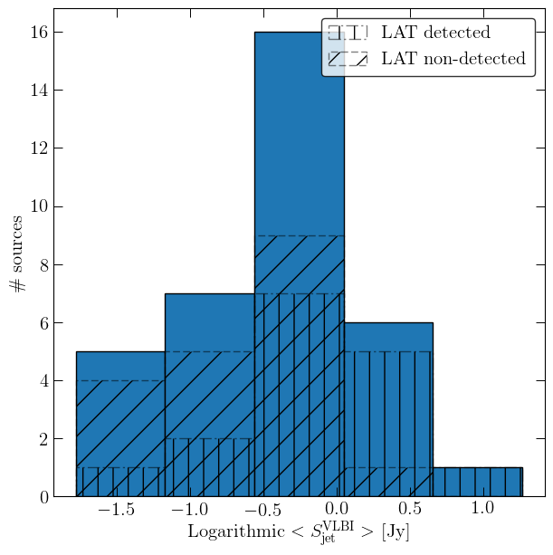
VLBI jet flux
KS = 0.38
$p$-value = 0.13
$$S_{jet}=S_{tot}−S_{core}$$

Slide 20
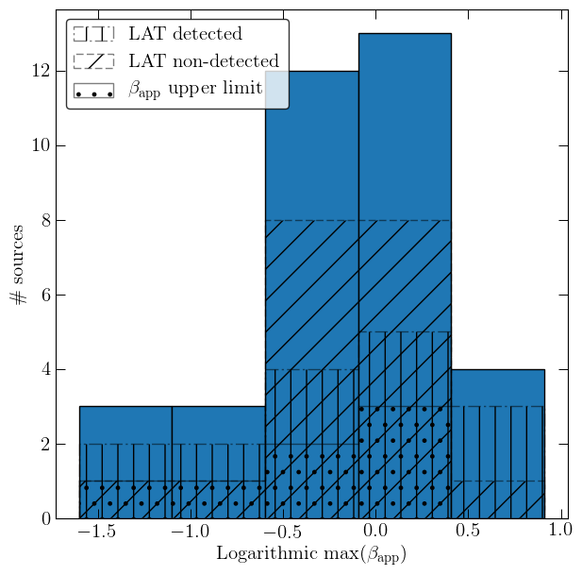
Maximum apparent speed
KS = 0.23
$p$-value = 0.70

Slide 21
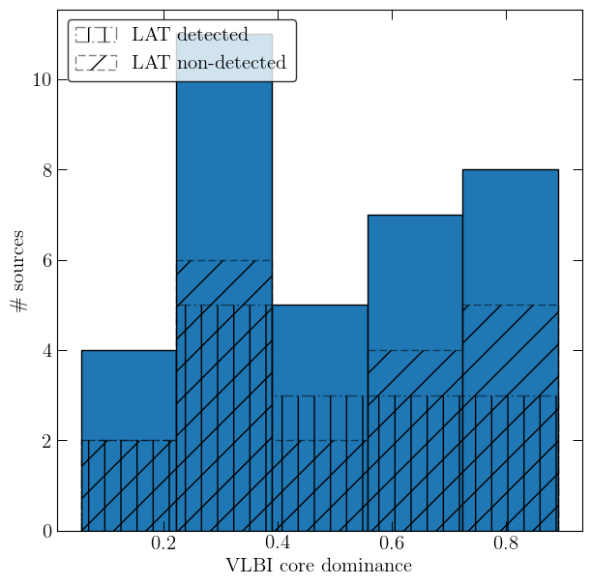
VLBI core dominance
KS = 0.18
$p$-value = 0.91
$$CD=S_{core}/S_{tot}$$

Slide 22
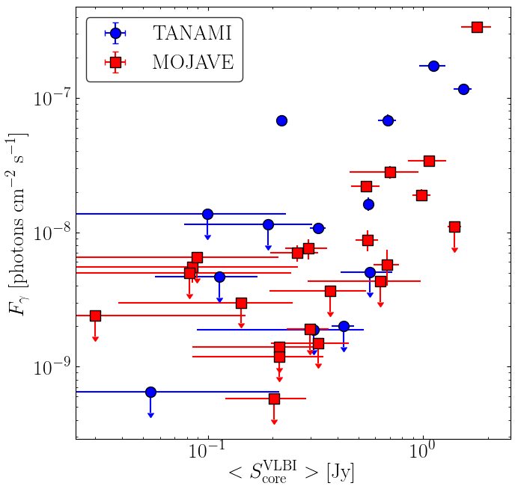
LAT flux vs. VLBI core flux
Kendall’s tau
$$τ=0.32$$
$p$-$value=0.006$
Compact radio emission is related to high-energy emission

Slide 23
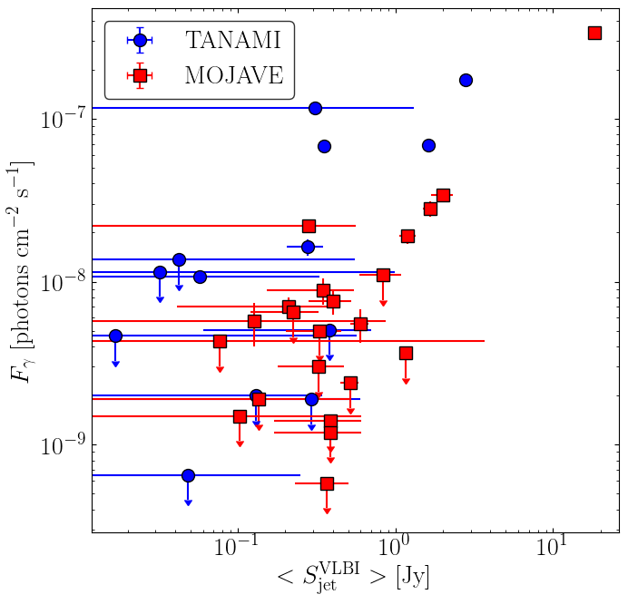
LAT flux vs. VLBI jet flux
Kendall’s tau
$$τ=0.19$$
$p$-$value=0.1$

Slide 24
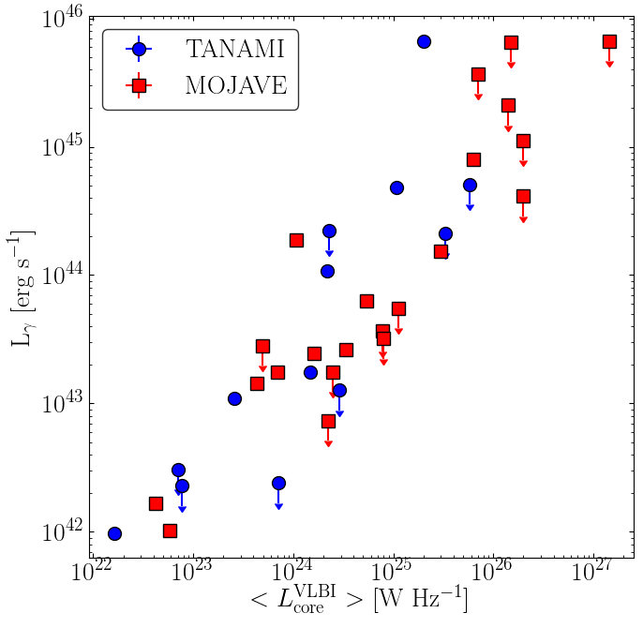
LAT luminosity vs. VLBI core luminosity
1:1 correlation induced by common redshift dependence

Slide 25
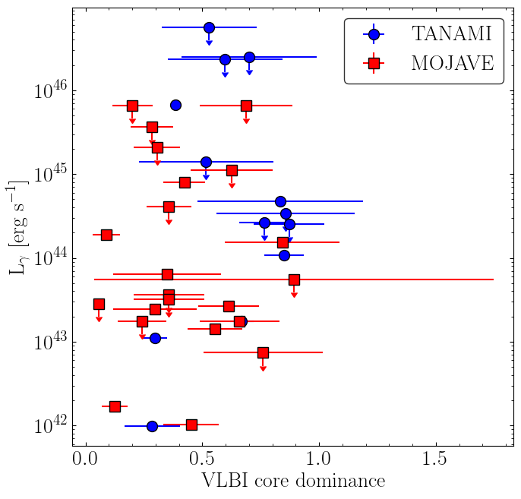
LAT luminosity vs. VLBI core dominance
Kendall’s tau
$$τ=0.16$$
$p$-$value=0.17$
High-energy emission unrelated to Doppler boosting markers

Slide 26
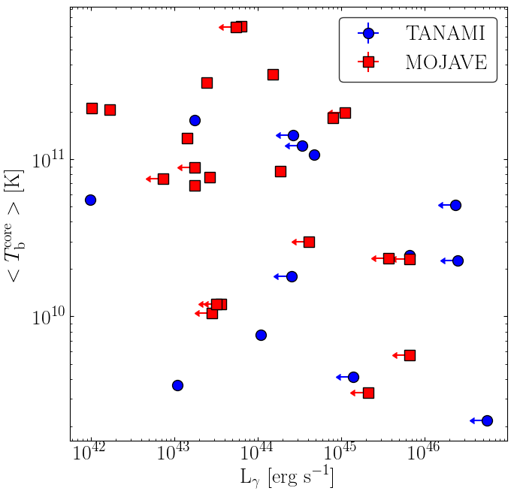
VLBI core $T_{b}$vs. LAT luminosity
Kendall’s tau
$$τ=0.08$$
$p$-$value=0.5$
High-energy emission unrelated to Doppler boosting markers

Slide 27
Conclusions
We have performed the first systematic study on the connection between pc-scale properties and high energy emission in misaligned jets
Selected individual source result: Pictor A
First counter-jet detection, improved intrinsic jet parameter estimates
Possible association between component ejection and gamma-ray activity
Selected individual source result: PKS 0521$−$36
Subluminal apparent speed
Fast gamma-ray variability corresponds to core brightening but no jet morphological changes
Gamma-ray emission in radio galaxies:
High-energy flux correlates with pc-scale radio core flux
No significant correlation with Doppler boosting markers
Thank you for the attention!

