Slide 1
Experiences with SIRIUS Booster
Fernando Henrique de Sá
On behalf of the LNLS Accelerator Physics Group
Injectors for Storage Ring Based Light Sources
Karlsruhe, 6-8 of March 2024

Slide 2
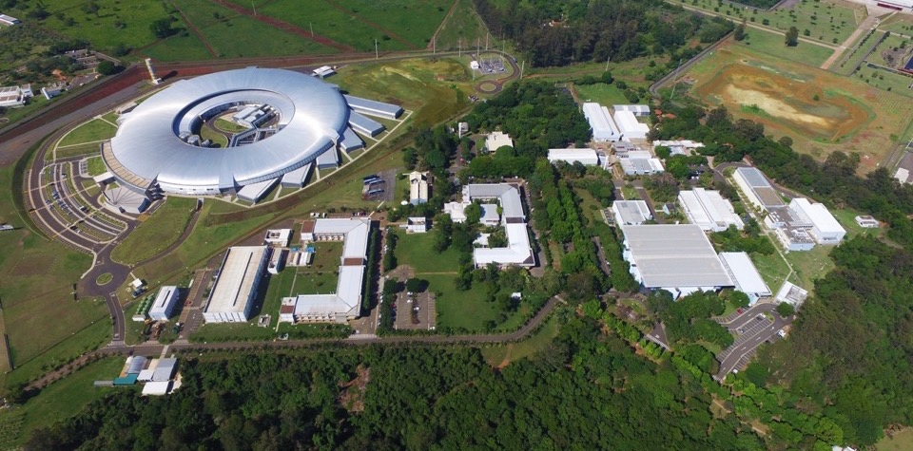
SIRIUS – 4GSR in Operation
SIRIUS design parameters
Energy 3.0 GeV
Circumference 518.4 m
Emittance 250 pm.rad
Current (top-up) 350 mA
Brazilian Center for Research in Energy and Materials (CNPEM)
CNPEM campus
Green-field facility
Construction: 2012 – 2020
Cost: US$ 500M (∼85% spent in Brazil)
1st regular users call: Nov. 2022
10 beamlines in operation
100 mA in top-mode mode, uniform fill
Phase-1 (end of 2024): 14 beamlines
Campinas
Brazil

Slide 3
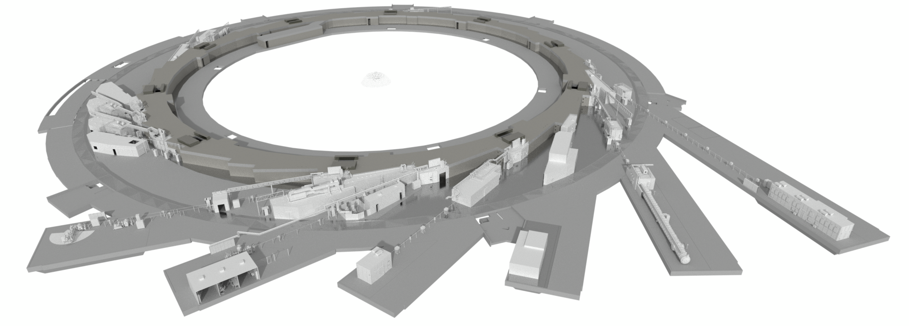
SIRIUS Beamlines – Phase 1
https://www.lnls.cnpem.br/beamlines/
Third Cycle of Proposals (1S 2024)
Total: 422 submitted / 225 approved
From Brazil: 376 submitted / 198 approved
Form abroad: 46 submitted / 27 approved
OPERATION
CEDRO
(SRCD)
SAPUCAIA
(SAXS)
INSTALLATION
PAINEIRA
(XPD)
JATOBÁ
(PDF)
Fast track
CONSTRUCTION
IMBUIA
(nano & μ FTIR)
46 submitted
36 approved
82 submitted
33 approved
QUATI
(XAFS)
SAPÊ
(ARPES)
IPÊ
(RIXS/ XPS)
45 submitted
26 approved
MOGNO
(μCT)
CARNAÚBA
(nanoprobe)
40 submitted
30 approved
CATERETÊ
(CDI/XPCS)
SABIÁ
(XMCD/PEEM)
MANACA
(MX)
EMA
(Extreme Cond.)
67 submitted
41 approved
41 submitted
24 approved
18 submitted
15 approved
Fast track
83 submitted
20 approved
Courtesy: Harry Westfahl

Slide 4
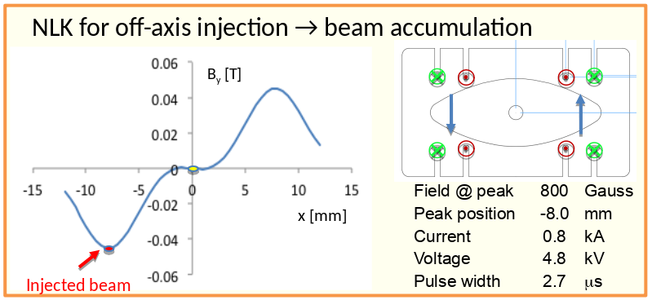
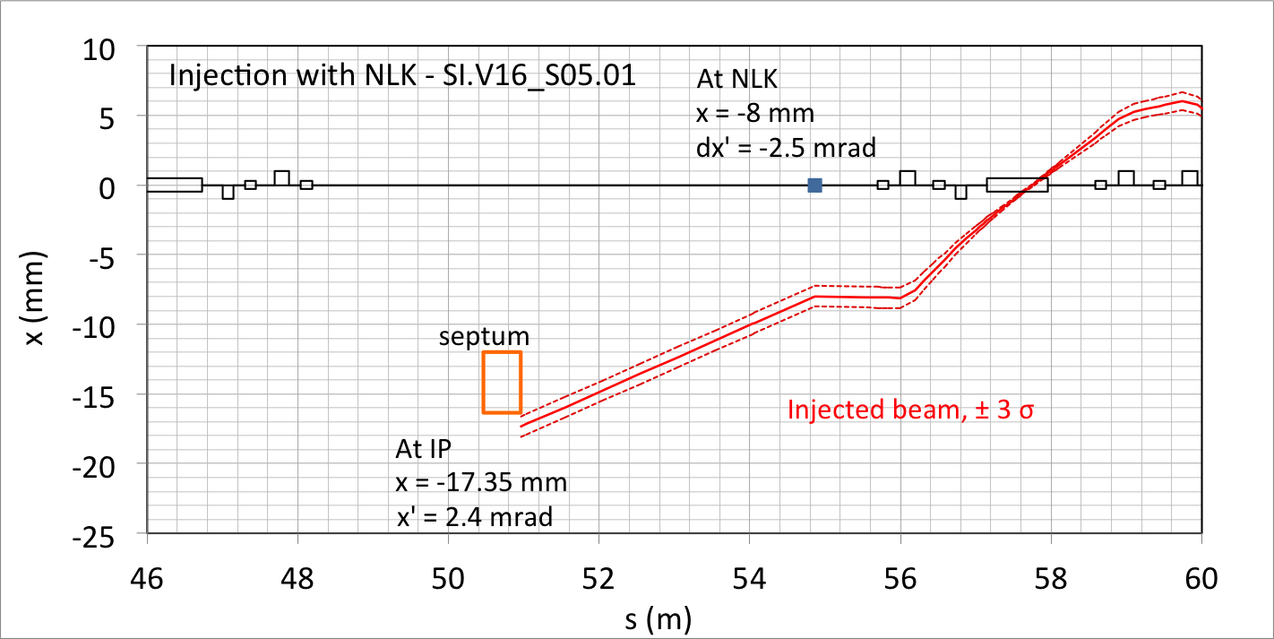
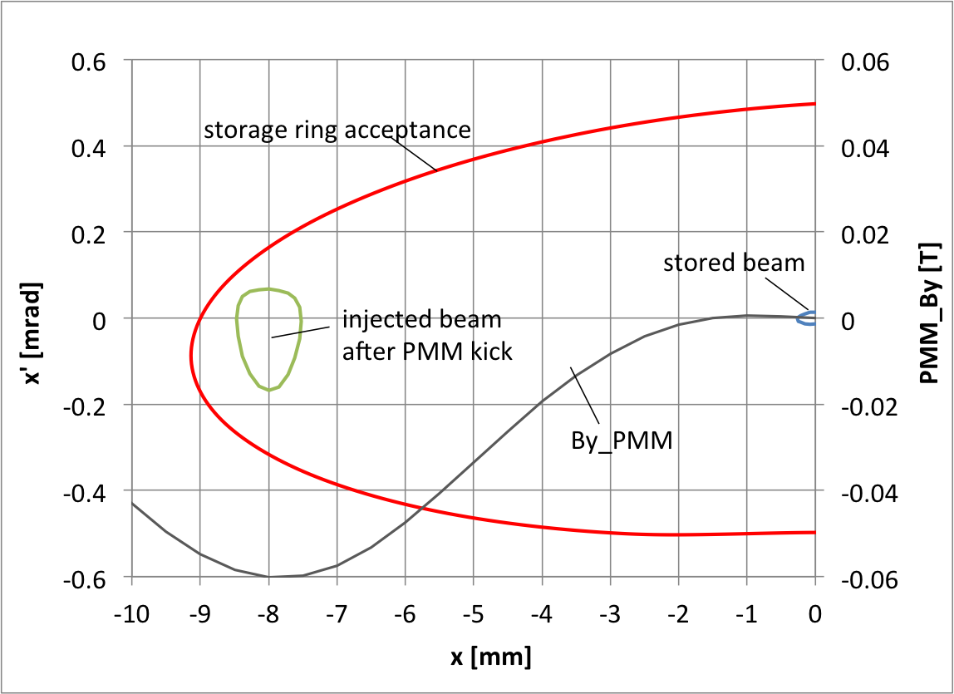
Storage Ring Injection
Low emittance booster required!

Slide 5
Booster Design

Slide 6
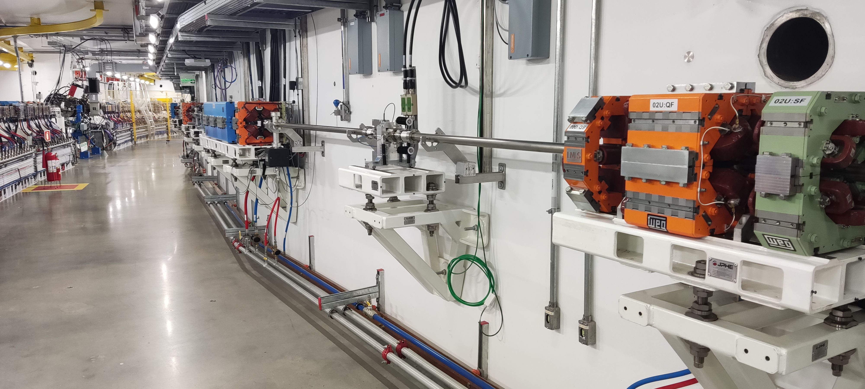
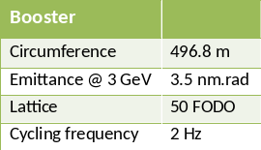
Lattice Design
Dipoles with defocusing quadrupole and sextupole components;
Large spaces between magnets:
enough room for RF cavity and injection/extraction systems;
Symmetric lattice, without non-dispersive straigth sections:
simpler, cheaper and with uniform distance to storage ring;
Compact magnets:
supported by girders attached to inner walls of tunnel;

Slide 7
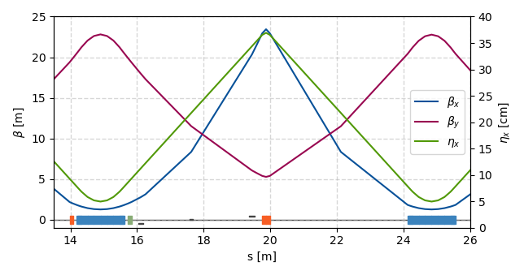
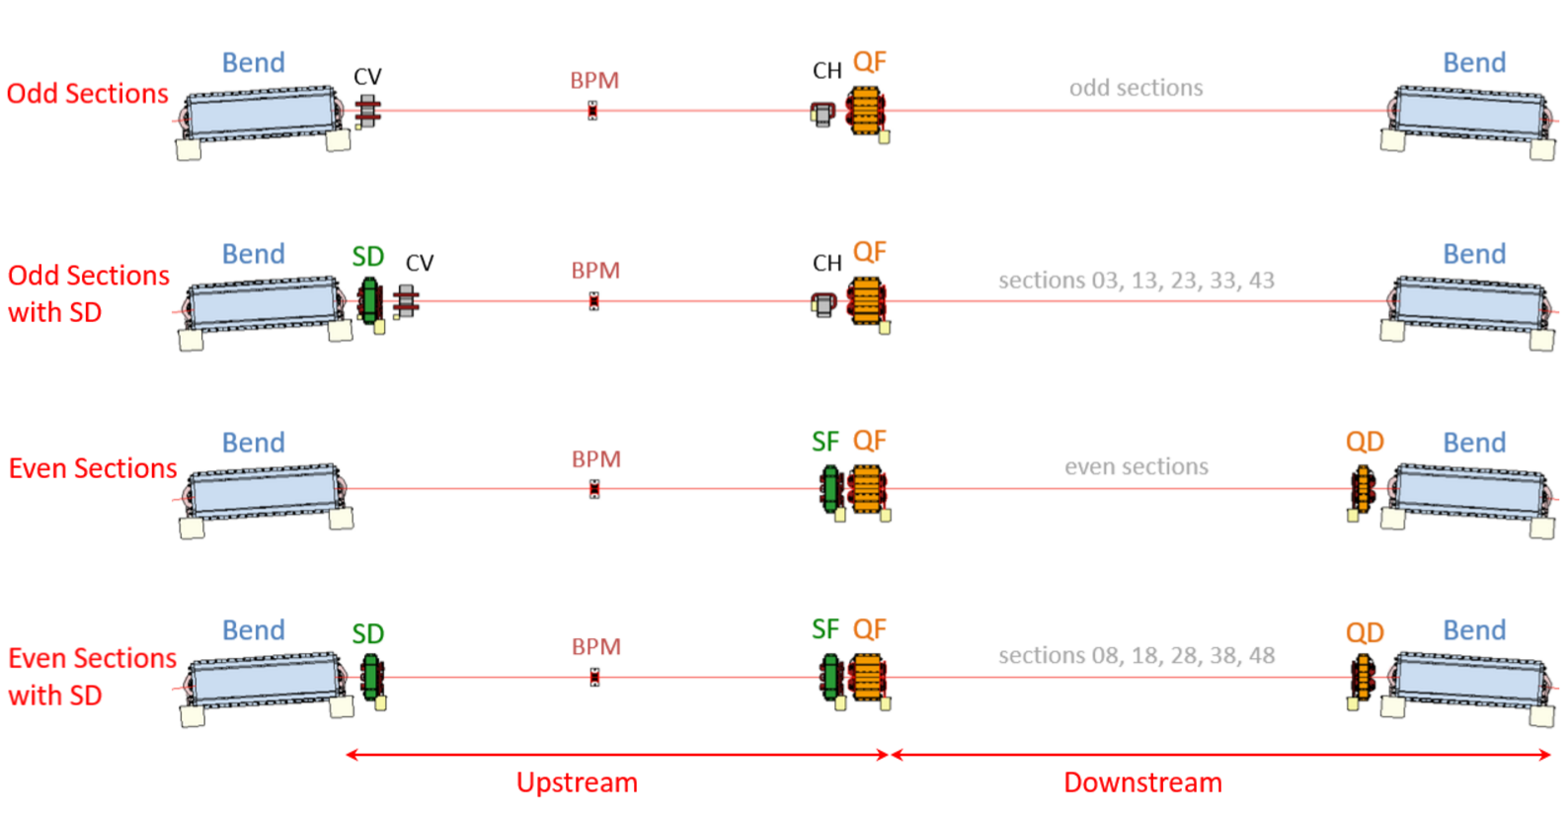
Linear Optics
Circumference | 496.8 m
Harm. Number | 828
Tunes | (19.20, 7.31)
Chromaticities | (0.5, 0.5)
Nat. Chrom. | (-33.7, -13.9)
Mom. Compaction | 7.2x10⁻⁴
Nat. Emitt.@3GeV | 3.5 nm.rad
Nat. En. Spread@3GeV | 0.09 %
Nat. Bun. Len.@3GeV | 11.2 mm
Optimized for low emittance → low momentum compaction;
Nominal linear optics with 50 dipoles and 50 QFs;
Nominal chromaticity adjusted to 0.5 with 25 SF sexts and dipoles;
Tune and chromaticity correction with 25 QD quads and 10 SD sexts;
Orbit Correction with 50 BPMs, 25 CH and 25 CV magnets;
BPMs are not placed close to peaks of optical funcions;

Slide 8
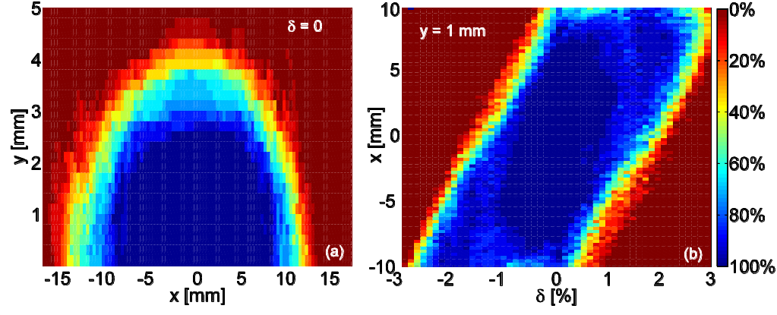
Orbit Correction and Dynamic Aperture
Error | Dipole | Quad. | Sext.
Alignment x, y | 160 um
Rotation Roll | 0.8 mrad
Excitation | 0.15 % (grad. 2.4 %) | 0.3 % | 0.3 %
Mult. Normal | ~4x10⁻⁴
Mult. Skew | ~1x10⁻⁴
Simulations with realistic errors;
Low residual orbit;
Good dynamic aperture and momentum aperture;

Slide 9
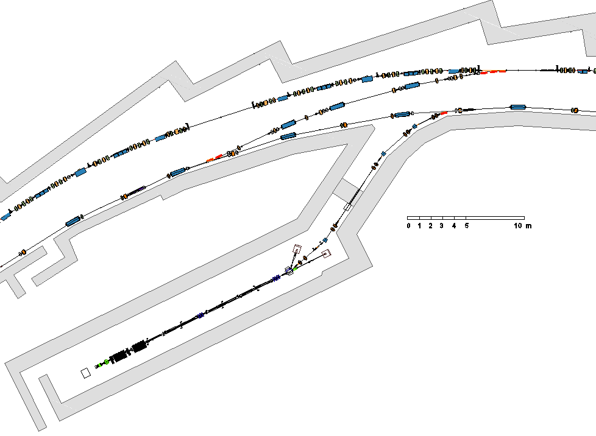
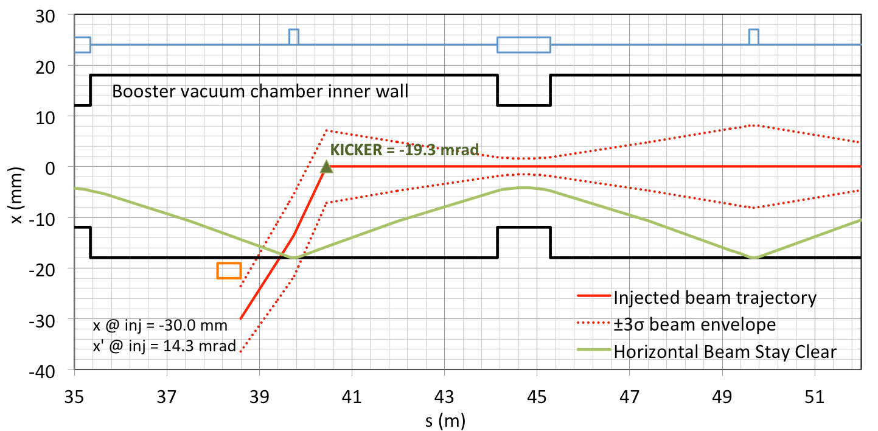
Injection System
Linac beam @ 150 MeV: ε_{x,y} = 170 nm.rad, σ_{δ} = 0.5%;
Geometry requires strong septum (21.5°) and kicker (19.3 mrad);
Optics (β, α, η, η’) at end of TL matched to booster optics;
Booster horizontal acceptance:
4-σ of beam size;
1 mm of orbit distortion;
4.5 mm of transverse oscillations
1.5% of energy oscillation;
Three screens were considered to help checking optics matching;
100% of ramp efficiency in commissioning simulations.

Slide 10
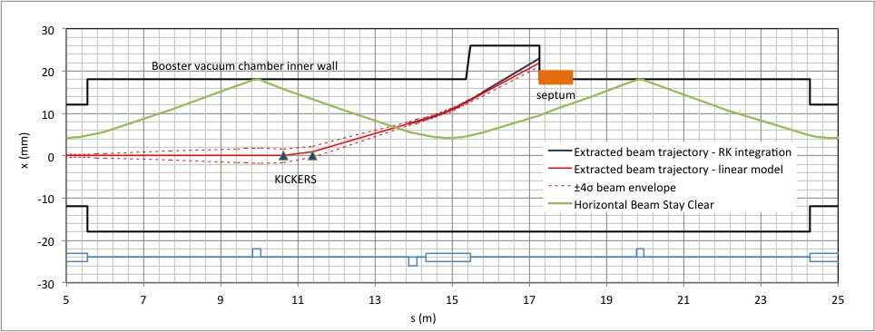
Ejection System
Optics at beggining of TL matched to optical functions of booster (including dispersion and its derivative);
Weaker ejection kicker (~2.1 mrad) and septa (~3.6°);

Slide 11
Commissioning

Slide 12
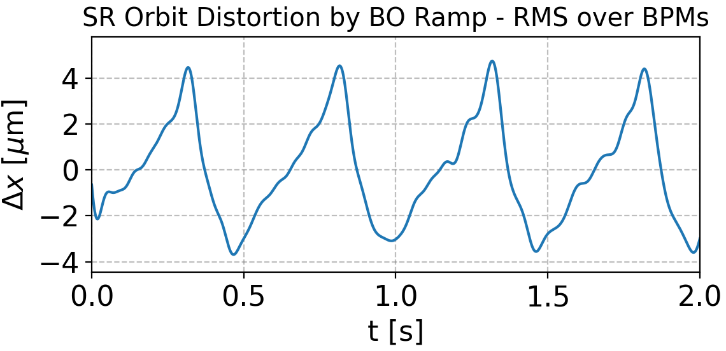
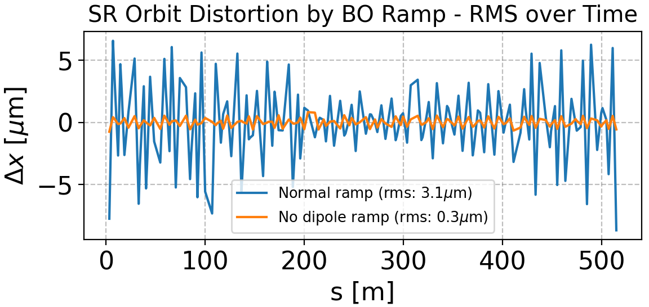
Booster and SR sharing same tunnel
Commissioning concurrently with the installation of the SR:
Intermitent commissioning schedules;
Facilities not well conditioned yet -> poor temperature stability;
Installation activities delaying commissioning:
Magnets and BPM cables inversion;
Mal-functioning power supplies;
SR permanent magnet temporarilly stored close to booster;
Interference of SR power supplies on booster and TLs orbit:
SR magnets cable positions optimized to minimize magnetic field on booster under nominal operation currents for all PSs;
Only few SR PSs on -> no beam on booster;
Even with all SR PSs on, the booster orbit changes in comparison to when they are off;
Interference of booster ramping on storage ring orbit:
Mainly on the horizontal plane;
Created by the dipoles;
Effectively attenuated by SR fast orbit feedback.

Slide 13
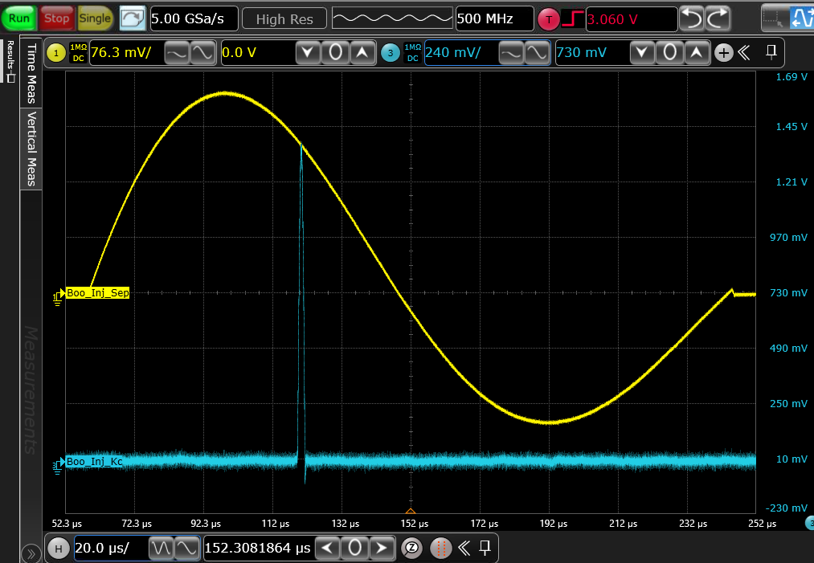
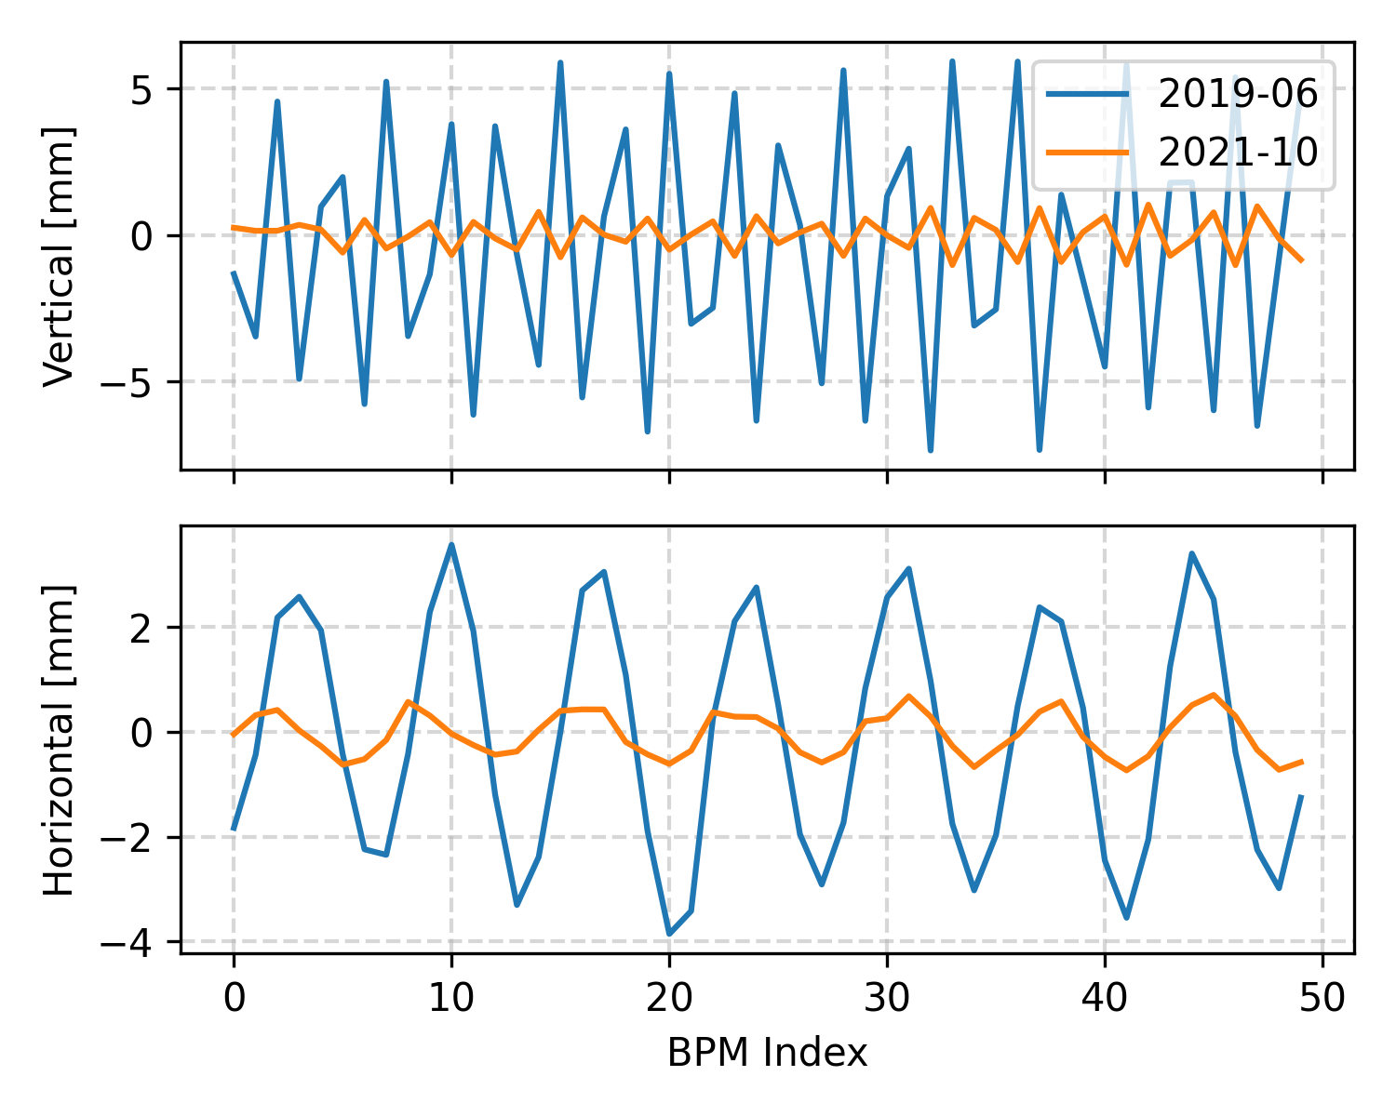
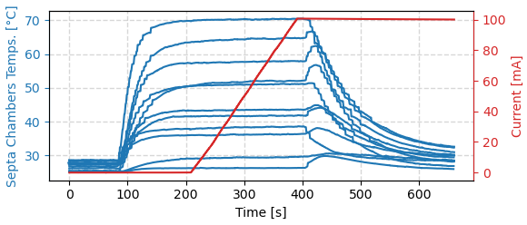
Septa Issues
Strong effect of eddy current:
Peak of magnetic field displaced in relation to peak of current;
Strong quadrupole at injection septum → re-matching of TL;
Injection at 1/3 Hz due to temperature rise when pulsing at 2 Hz;
Initially there was a large effect on orbit due to leak fields;
Max. Field
Injection

Slide 14
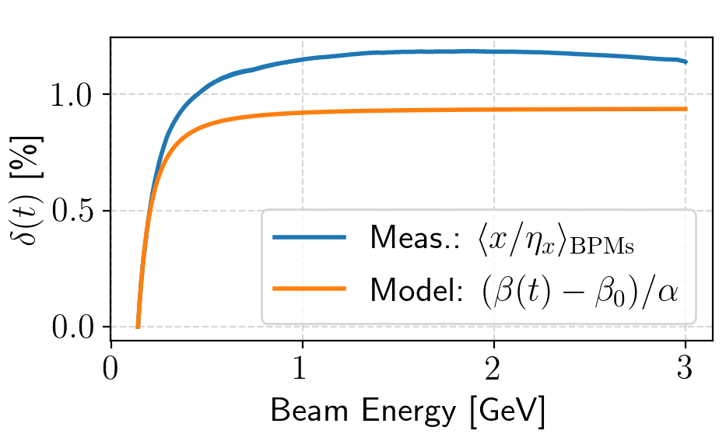
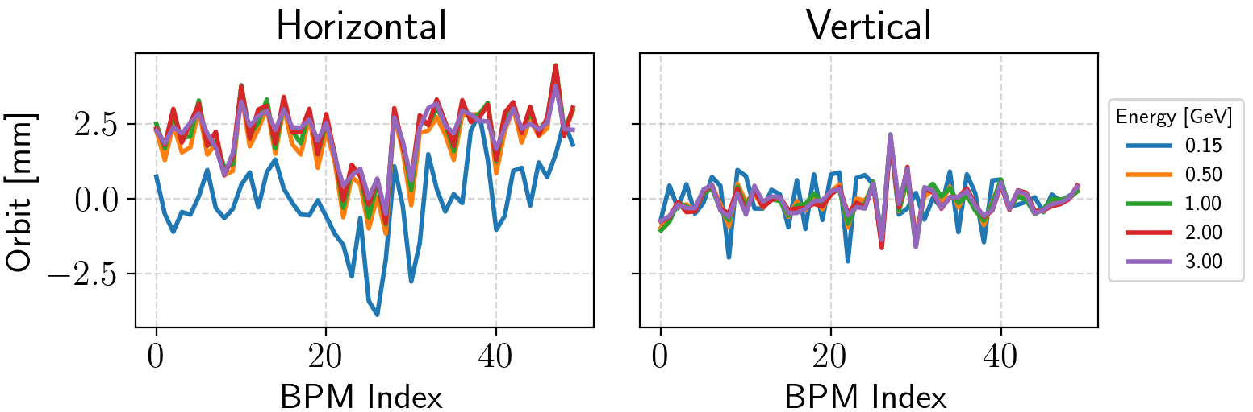
Orbit Issues
Energy deviation variation along ramp:
low momentum compaction + variation of velocity → energy deviation variation;
Easy to miss in design stage:
slippage factor ≈ momentum compaction even at low energies;
For the SIRIUS booster 1/γ² ~ 1.3x10⁻⁵ @150MeV, while α = 7.2×10⁻⁴
The orbit correction system ineffective:
booster and the SR have the same master RF oscillator;
Booster realigned to correct energy deviation at low energy: improve ramp eff.;
Large residual horizontal orbit due to small number of HCMs:
Not predicted by simulations from design stage;
Similar orbit signature along ramp;
Possibly related to sorting of magnets installation order (correlated errors);
Ongoing studies to add corrector magnets and/or realign some magnets.

Slide 15
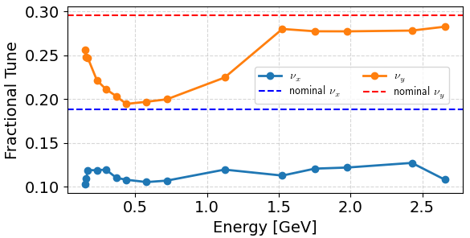
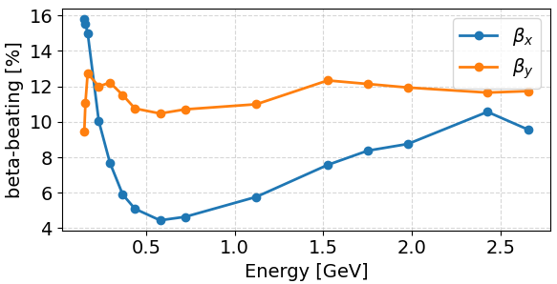
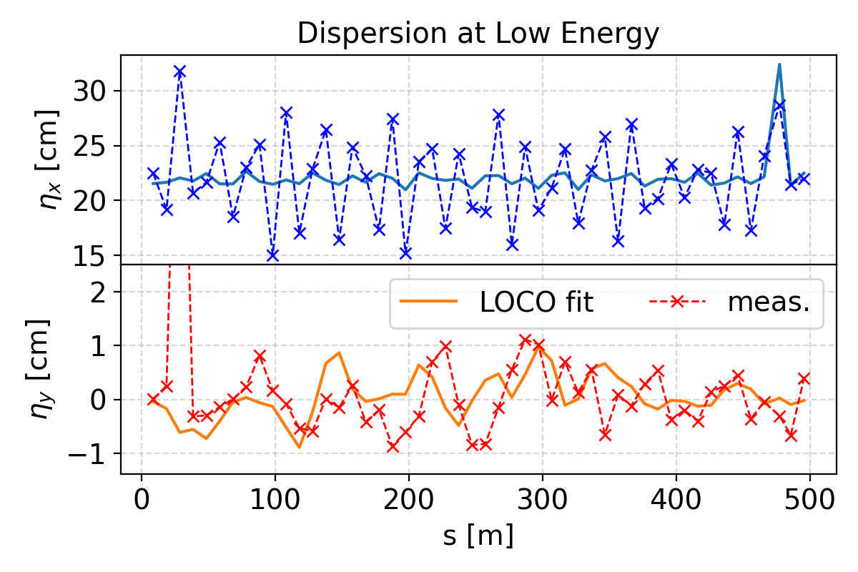
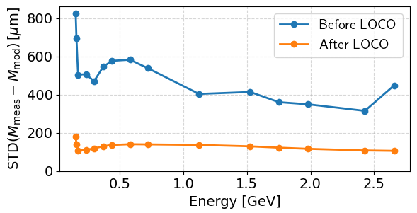
Optics Characterization
Orbit response matrix measured along all ramp;
LOCO fitting at some points (without using dispersion data);
Tunes and beta-beating predicted by model:
Large beta-beating, but results are ok for a booster;
Dispersion measured at low energies:
Difference to LOCO fitted model is not alarming;

Slide 16
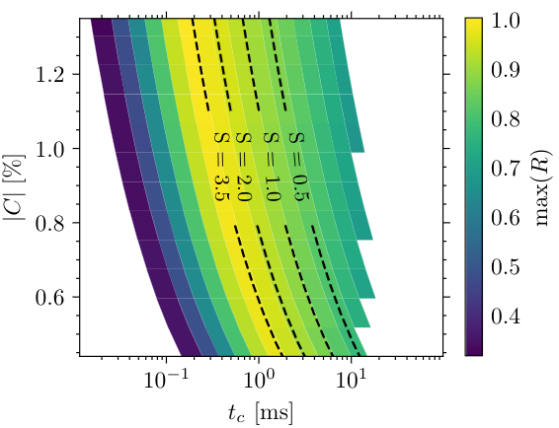
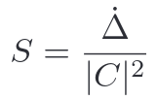
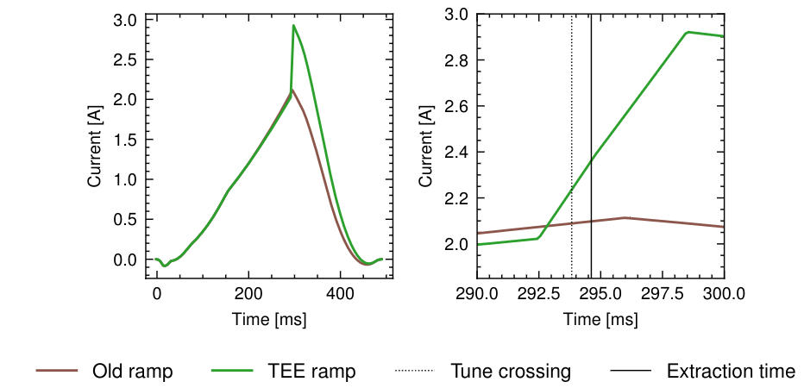
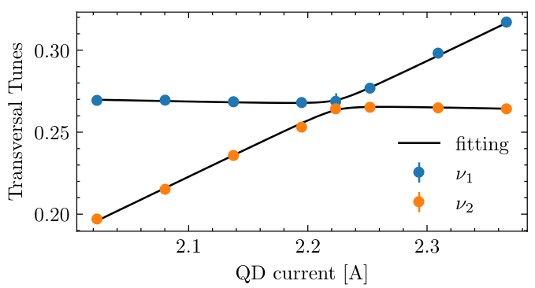
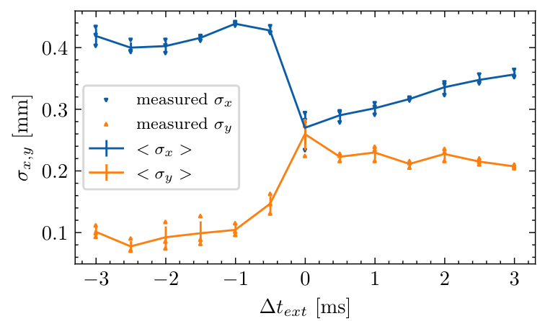
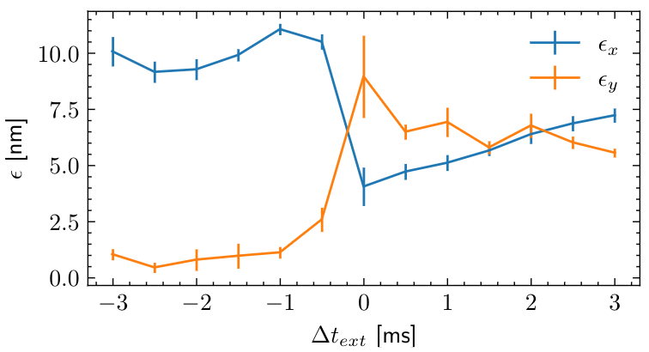
Transverse Emittance Exchange (TEE)
P. Kuske and F. Kramer, “Transverse Emittance Exchange for Improved Injection Efficiency”, in Proc. IPAC’16, Busan, Korea, May 2016, pp. 2028–2031. doi:10.18429/JACoW-IPAC2016-WEOAA01

Slide 17
Current and Future Operation

Slide 18
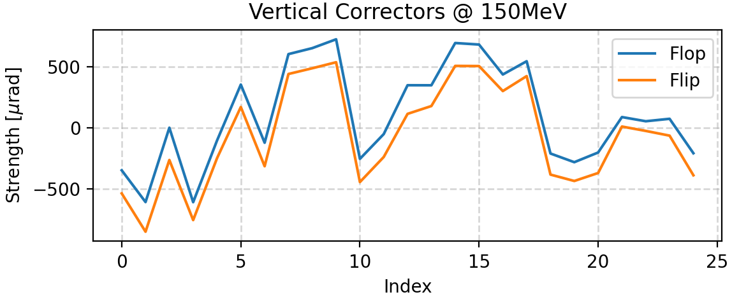
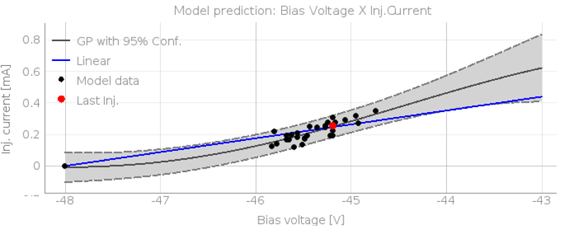
Current Operation in Top-up Mode
100.3
100.2
100.0 ± 0.3 mA
100.1
100.0
Current [mA]
99.9
99.8
99.7
99.6
07:00
09:00
11:00
13:00
15:00
17:00
19:00
Current operation performance:
Top-up mode: single-shot every 3 min;
Average injected current per pulse: 0.220 mA;
Control of injected current with Egun bias voltage.
Ocasionally BO vert. orbit changes between 2 states (flip-flop):
Correction signature imply field distributed along the ring;
Generally happens after machine maintenances;

Slide 19
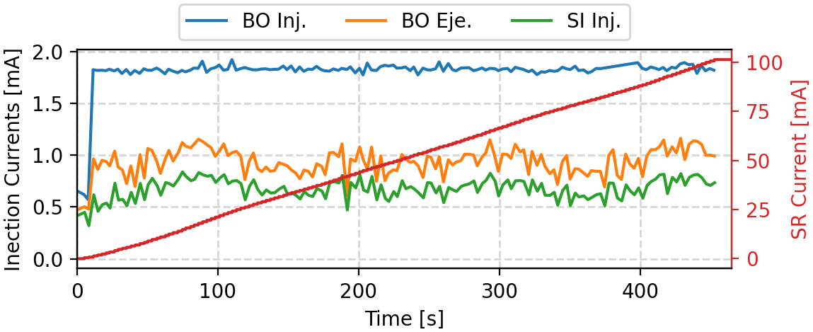
Future Requirements for Operation
In August 2024 SC RF cavities will be installed in the SR:
Stored current will probably increase to 200mA;
Lifetime is expected to be about half of present value;
Same injection scheme -> ~0.9mA per pulse;
Multi-bunch needs optimization at high currents:
Linac was specified so that BO would ramp 1.7mA;
Today, maximum current delivered is ~1.1mA;
Single-bunch injection:
Important to provide top-up operation with arbitrary fillings;
Not ready for operation. Very low efficiency (<10%);
Optimization also required for LINAC;

Slide 20
Summary
A low-cost small emittance booster was designed:
Symmetric lattice and small number of magnet families and PSs;
Simple scheme for tune and chromaticity correction;
The number of corrector magnets was too small;
Small momentum compaction is an issue.
In 2019 the booster commissioning was intervealed with the SR installation:
Intermitent scheduling. Main objective was to start SR commissioning ASAP;
Difficulty to perform detailed characterizations;
From 2020 to last year a large effort was applied to the SR:
Increase of operation current, top-up;
Orbit stability, "transparent SR Injection", IDs installation and commissioning;
Little time dedicated to booster optimization;
Booster performance meets current requirements;
Work required to reach future operation demands:
Improvement of orbit correction;
Optimization of single-bunch mode;
Improvement of multi-bunch ramp efficiency at high currents;
Investigation of solutions to septa heating issues;

Slide 21
Thank you for your attention!
Thanks to Murilo Alves and all my colleagues that helped putting this presentation together.

