Slide 1
Status of the HEPS booster commissioning
Yuemei Peng
HEPS AP group
07March,2024
I.FAST Workshop 2024 on Injectors for Storage Ring Based Light Sources (KIT)
Notes:
Good morning, my name is Yuemei Peng and I am pleased to be here today to present Status of the HEPS booster commissioning

Slide 2
Outline
Overview of the HEPS project
Physical design of the HEPS booster
Status of HEPS booster commissioning
Summary

Slide 3
Overview of the HEPS project

Slide 4
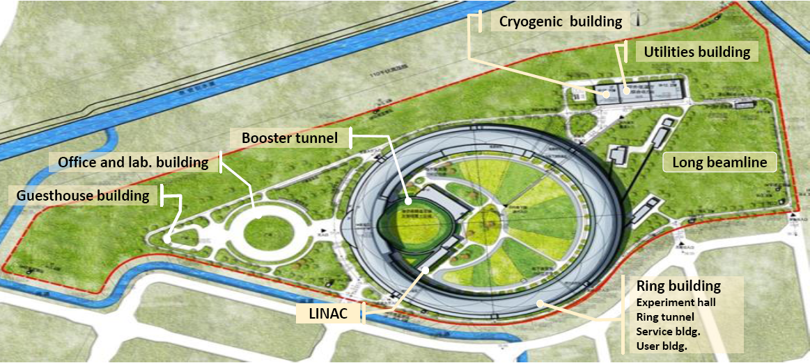
High Energy Photon Source (HEPS)
HEPS is a 4th generation, 6 GeV ultra-low emittance synchrotron light source, under construction in Beijing, China.
It is located in Huairou District, about 80 kilometers away from the IHEP
Main parameters | Unit | Value
Beam energy | GeV | 6
Circumference | m | 1360.4
Emittance | pm∙rad | < 60
Brightness | phs/s/mm²/mrad²/0.1%BW | >10²²
Beam current | mA | 200
Injection |  | Top-up
Notes:
HEPS is the first high-energy and diffraction-limited light source in China, it is located in Huairou District, about 80 kilometers away from IHEP. This picture is rendering of the HEPS, and its shape looks like a magnifying glass.

Slide 5
Timelines of HEPS construction
2010-the R&D of HEPS proposed to the government
Apr. 2016- Sept. 2018-HEPS-TF project. (verify the feasibility of some key equipment )
Jun.2019- HEPS construction started
Jun.2021- Installation of the first equipment of Linac
Jan.2023- The entire vacuum connection of booster completed
Feb.2023- The installation work of storage ring tunnel equipment started
Mar. 2023- Obtained permit of radiation protection , started commissioning of Linac
5th Jun. 2023- completed acceptance of Linac
25th Jul. 2023- started beam commissioning of the booster
17th Nov.2023- completed acceptance of booster
The beam commissioning of SR is planned start in July,2024

Slide 6
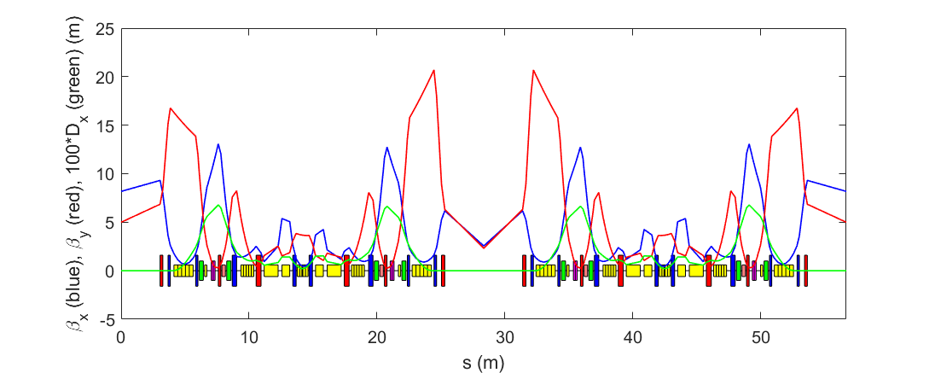
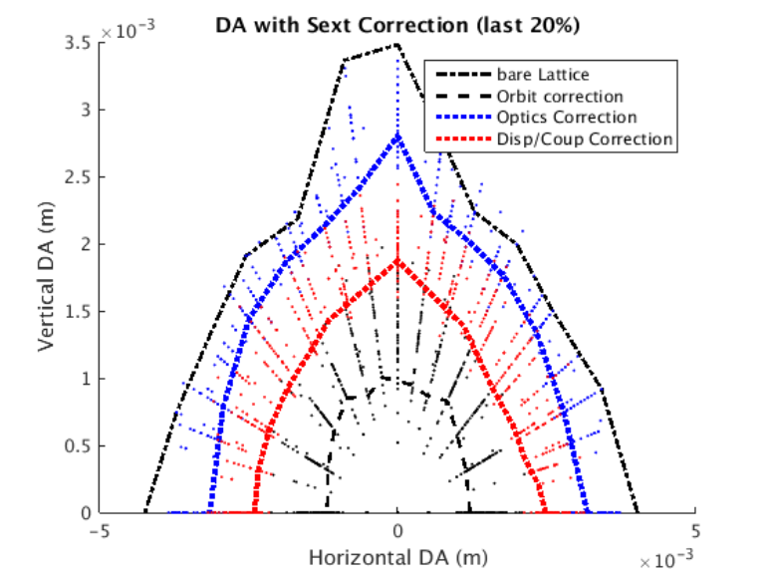
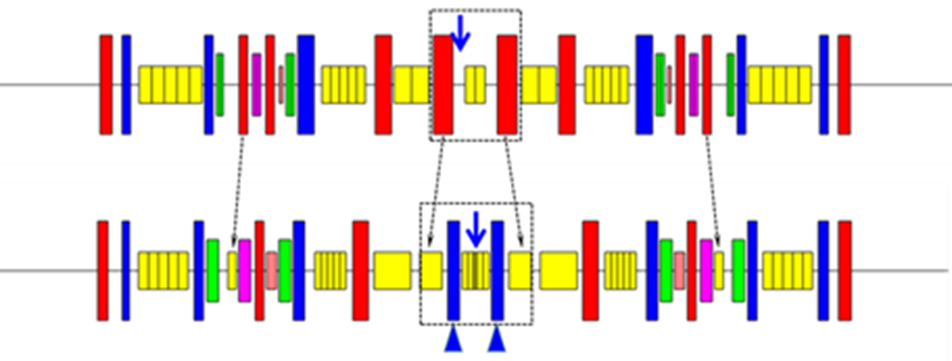
Final lattice design of the SR
Parameters | Values
Beam energy E₀ (GeV) | 6
Beam current I₀ (mA) | 200
Circumference (m) | 1360.4
Horizontal damping partition number \ | 1.90/1/1.10
Horizontal natural emittance (pm⋅rad) | 34.8
Working point (x/y) | 115.15/104.29
Natural chromaticity (x/y) | -209/-233
Corrected chromaticity (x/y) | +5/+5
Number/length of high-beta sections (—/m) | 24/6.086
Beta functions at the center of high-beta sections (x/y) (m) | 8.18/5.0
Number/length of low-beta sections (—/m) | 24/6.086
Beta functions at the center of low-beta sections (x/y) (m) | 2.56/2.31
Momentum compaction factor | 1.83×10⁻⁵
Damping times (x/y/z) (ms) | 10.8/20.6/18.7
Energy loss per turn, U₀ (MeV) | 2.64
Energy spread | 1.0×10⁻³
Two families of anti-bends
Super bend in the central unit cell for bending magnet beam lines
One more family of quads in the central unit cell
Y. Jiao, et al., RDTM (2020)
Notes:
This is the final lattice we used. With de modified 7BA, it can reach an emittance of about 35pm.
In long straight sections, the lattice was designed with alternating high- and low-beta functions to obtain highest possible brightness and get reasonable DA. This is the main parameter list.

Slide 7
The operation mode of HEPS storage ring
Injection
On-axis swap-out injection as the baseline scheme.
Injected in the vertical plane with 1 LSM+1kicker (pulse<10 ns )
RF system
5 fundamental RF cavities at 166.6 MHz
2 active harmonic RF cavities at 499.8 MHz (which keep on feasibility study of longitudinal accumulation injection in the future)
Filling Mode
High Brilliant Mode: 680 buckets are filled, 200mA, 1.33nC/bunch
High bunch charge mode: 63 buckets are filled, 200mA, 14.4nC/bunch
Main challenges to the injector
If without accumulation :
How does the Linac provide such a high bunch charge? ( super KEKB , BEPC 10nC/pulse )
How does the booster accept such a bunch with small beam loss?( beam collective effects at injection energy)
Notes:
The operating mode of the storage ring determines the requirements for the injector. In pursuit of the lowest possible emittance, there has been some sacrifice in the dynamic aperture. So the …was chosen as the …
The Lambertson type septum was chosen in the HEPS, in order to keep the tunnel of Linac, booster, and storage ring on the same horizontal plane, injection and extraction occured in the vertical plane
5 RF cavities at 166.6MHz planed to install in the SR to Providing sufficient longitudinal acceptance

Slide 8
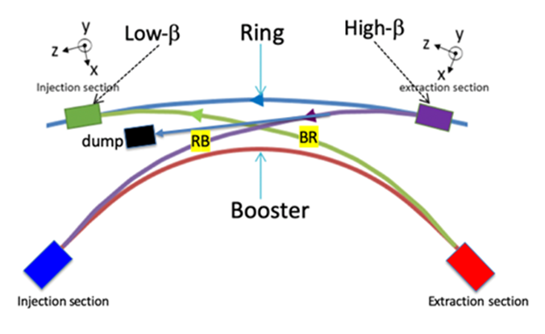
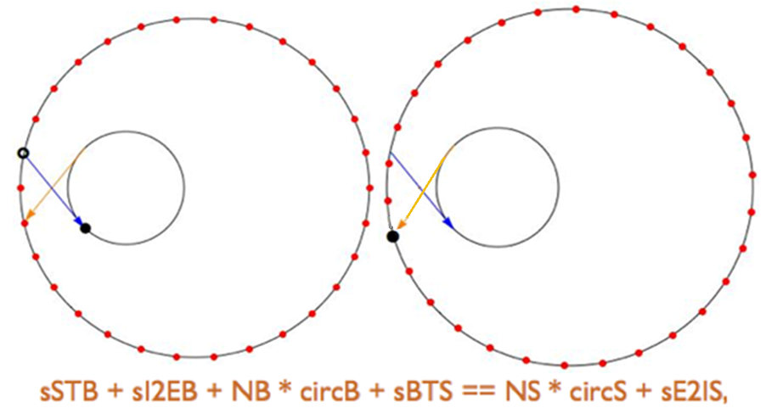
Booster high energy accumulation scheme
On-axis swap-out injection
APS-U^{[1]} ：Linac + AR + booster + SR
ALS-U^{[2]} ：Linac + booster + AR + SR
HEPS：Linac + booster (high energy accumulation) + SR
Booster high energy accumulation scheme
Adding a transport line from the storage ring to the booster
Enhancing the booster with a high-energy injection system
The beam should stay in the extraction energy more than 3 damping times
Strict circumference design, precise timing control
Ref:[1] Advanced Photon Source Upgrade Project, Preliminary Design Report
[2] S.DeSantis,et al. Progress on the Injection/Extraction Kicker for the ALS-U
Notes:
In addition to HEPS, APS-U and ALS-U also plan to adopt …
Addressing the issues caused by high bunch charge
The implementation of “high-energy accumulation” scheme requires adding a high-energy transport line that can transfer the beam from the storage ring to the booster and a high-energy injection system to support off-axis injection in the booster. When the electron beam in the storage ring needs to be refilled, the bunch with the lowest charge will be extracted and injected into the booster. Then, the bunch will merge with an existing bunch in the booster that has been injected from the linac and accelerated to 6 GeV. After more than 3 damping times, this merged bunch will be extracted from the booster and reinjected to the storage ring

Slide 9
Physical design of the HEPS booster

Slide 10
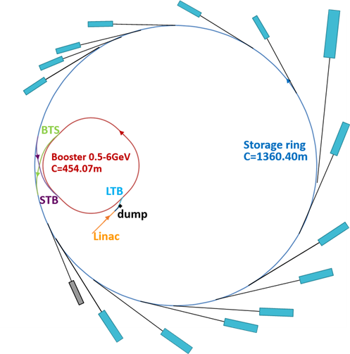
Requirements and design considerations
Energy at extraction: 6 GeV
Emittance: < 20 nm∙rad
Bunch charge: >5 nC
High transmission rate
Reliability: hardware based on mature and reliable technologies
Separate tunnels
Mitigate ramping induced impact on the beam in the storage ring
Avoid conflicts between storage rings 、booster and linac in construction, installation and commissioning
Mitigate bunch charge limitation at lower energy of booster
choose relaxed booster lattice with large momentum compaction factor
higher Linac energy
Hardware
Separated magnets
Lambertson septum magnets

Slide 11
Design of booster
Four-fold symmetric FODO lattice
14 standard FODO cells and 2 match cells
Dispersion free straight sections are used for RF cavity, inj. & ext. systems
A specially designed π section is used for injection using 2 kickers
parameters | Final lattice
Beam energy E₀ (GeV) | 0.5--6
Circumference (m) | 454.066
Natural emittance@6GeV (nm) | 16.3
tune(x/y) | 21.21/11.15
Natural chromaticity (x/y) | -27.4/-18.7
Corrected chromaticity (x/y) | +2/+2
Momentum compaction factor | 2.3×10⁻³
Damping times (x/y/z)@6GeV (ms) | 4.7/4.7/2.3
Energy loss per turn@6GeV, U0 (MeV) | 3.88
Energy spread @6GeV | 9.5×10⁻⁴
RF frequency (MHz) | 499.8
RF voltage@6GeV(MV) | 8
Bunch length w/ 8MV RF voltage@6GeV(mm) | 8.6
Harmonic number | 757

Slide 12
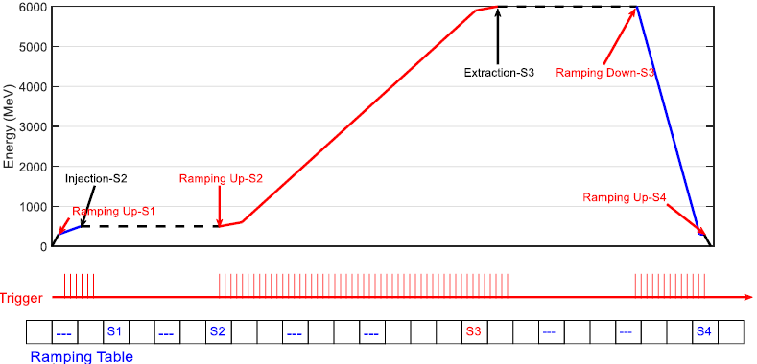
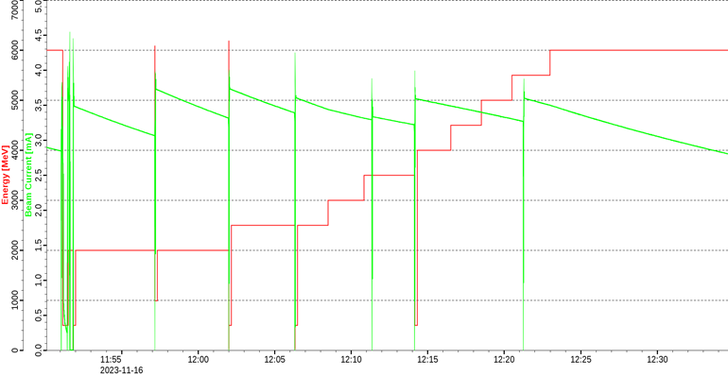
The energy ramping scheme
Flexible ramping scheme is used
The ramping curve is defined by pre-determined tables, which can be generated and optimized online
Injection and extraction energies can be easily determined and changed
match the energy with the storage ring：The dipoles of booster is electromagnets, while the storage ring use permanent magnets
The booster can operate like a storage ring at any energy between 0.5-6GeV ,can be used for beam and accelerator physics experiments

Slide 13
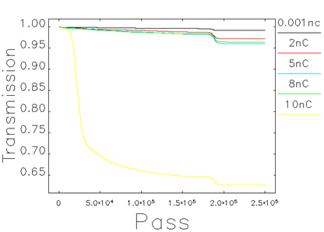
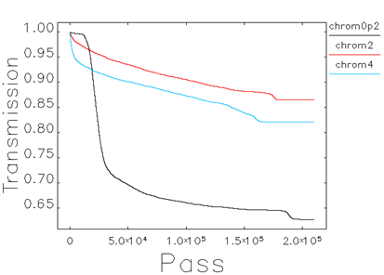
Bunch charge related
Simulation the transmission efficiency with errors and impedance
Simulation results suggest that it is feasible to achieve a transmission efficiency of higher than 80% when injecting a 8 nC bunch to booster
Improve transmission efficiency ways were studied
Reasonable chromaticity
Matched injection beam( optics, position, energy)
Reasonable RF voltage
Coupled-bunch instabilities
Through controlling the positions of the plug-in tuners and temperature of the cooling water, the resonant frequencies of HOMs can be varied differently
Notes:
the of coupled bunch instability is the most significant issue of uncertainty.

Slide 14
Status of HEPS booster commissioning

Slide 15
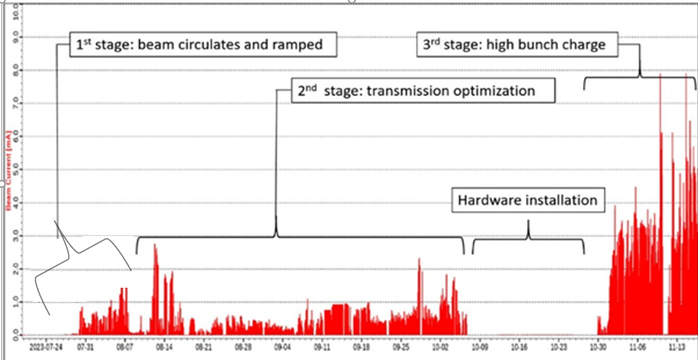
Beam commissioning
Notes:
The commissioning process can be roughly divided into three stages. In the following stage, which toke about 2 months, it is mainly focused on optimizing the beam transmission efficiency during injection and ramping processes. Equipment performance improvement was also performed in this stage. A bunch charge lower than 3 nC from the Linac is used to reduce radiation dose, During the ramping process at this stage, each RF cavity needs to provide a voltage greater than 1.6MV, and the power used is almost at its limit. This makes it prone to vacuum protection or open loop, thus imposing several restrictions on the energy ramping operation. After about 20 days of RF cavities installation, the high bunch charge was pursued in the 3 stage. Inthis stage ,the Linac is provide a bunch charge more than 7nC . Multi bunch mode was also tested in this stage.

Slide 16
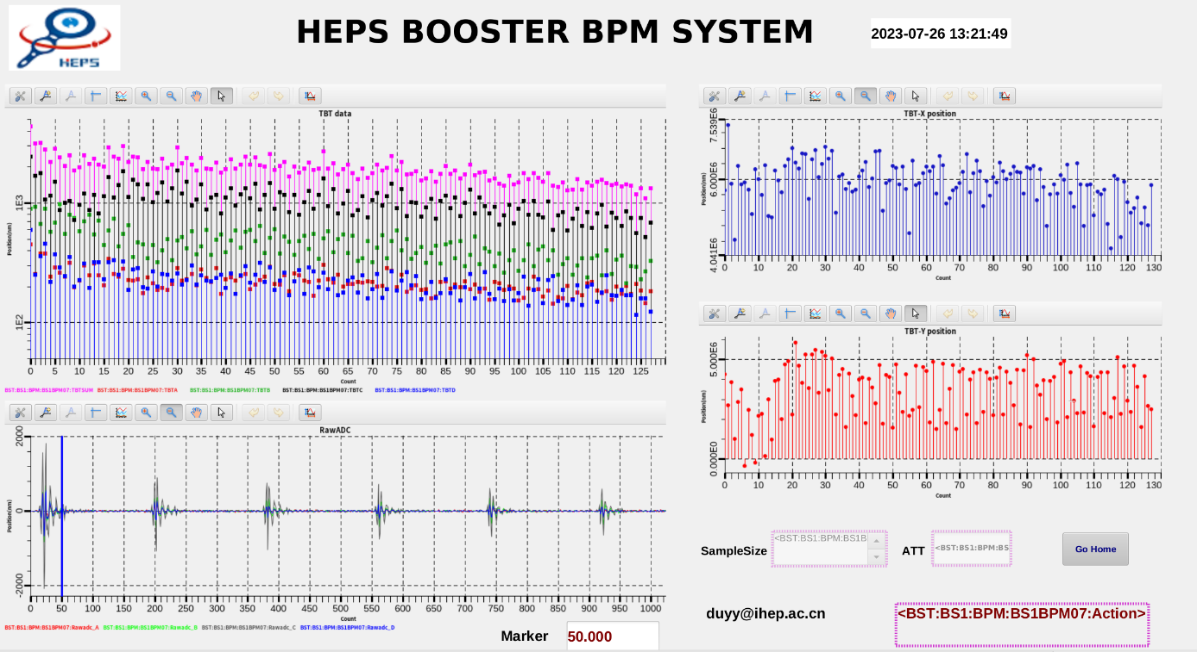
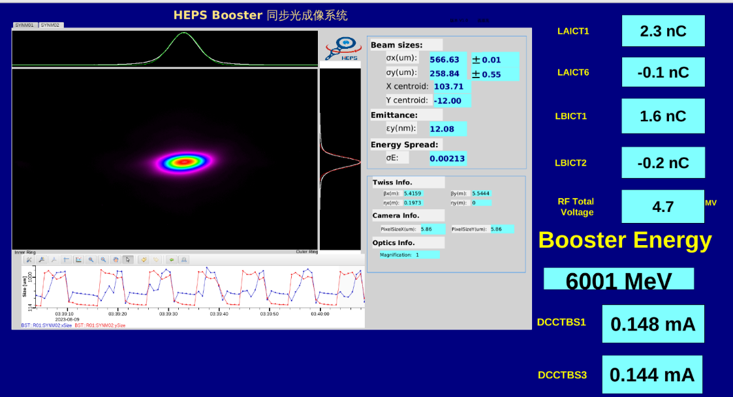
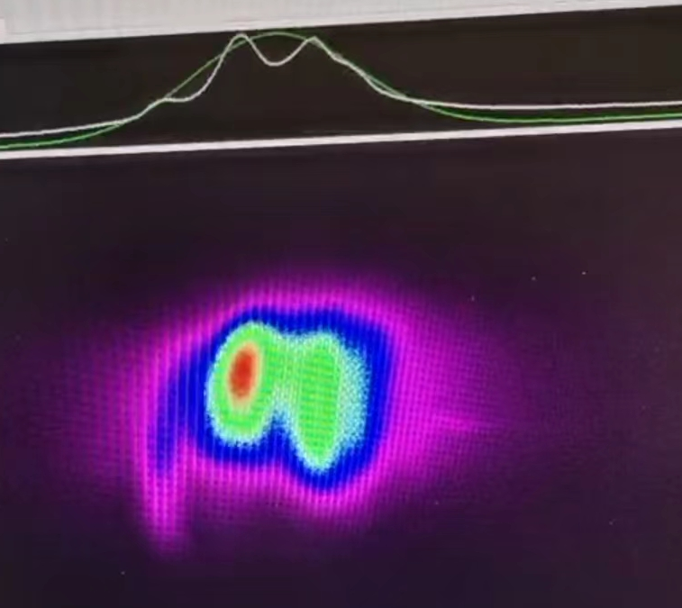
Milestones
25-7-2023, beam commissioning started
28-7-2023, beam accumulated at 500MeV
09-8-2023, ramped to 6GeV
06-11-2023, bunch charge >5 nC reached
17-11-2023, all the target values proposed by PDR has been reached
26-7-2023
9-8-2023
28-7-2023

Slide 17
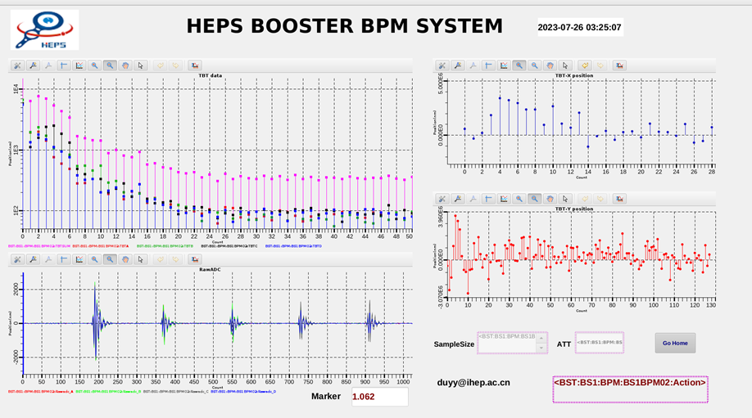
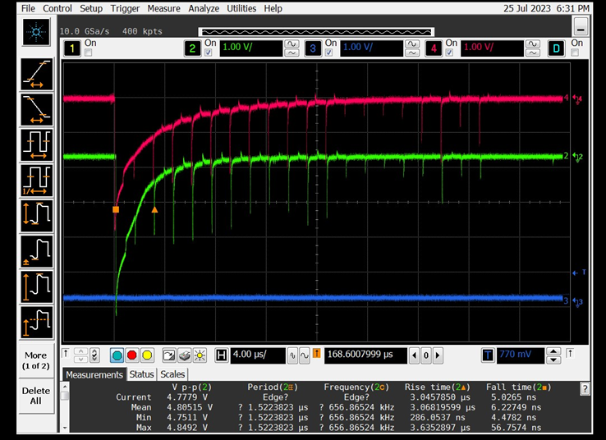
Beam accumulation
20 turns were achieved
Optimize the trajectory and angle of the injected beam
scanning the kicker strength
fine-tuning the correctors’ strength near injection point
Little changed the quadrupoles’ strength
X the RF powered on with 4MV voltage ( mistake)
The beam can stay more than 25 ms
Tuned off the RF
adjusting the set of injection energy in the booster
orbit was preliminary corrected
Theoretical response matrix and TBT data
The sextupole was powered on and RF cavity were turned on
Beam accumulated after adjusting RF Phase and frequency

Slide 18
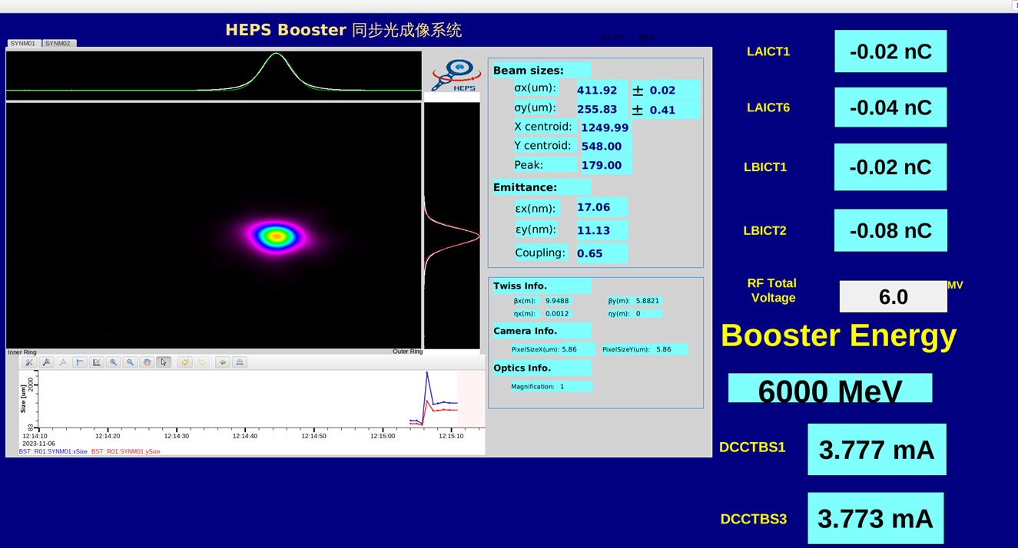
Energy ramping
The match of quadrupole to the dipole
The current starting point in the energy ramp-up curve is different from starting point for the magnetic field measurement.
change the starting point in the energy ramp-up curve same as the magnetic field measurement
Based on the physical quantities set at injection energy to generate the initial energy ramp-up curve
The magnetic measurement method used for the dipole magnet cannot detect the residual magnetism
Calculate the residual magnetism in the dipole through measurement and add it to the excitation curve
RF voltage ramping
RF voltage set as a constant in the first stage, Linear curve used in the second and third stage
3 RF cavities support 4.9MV in the second stage
5 RF cavities support 6MV in the third stage

Slide 19
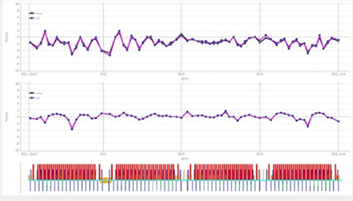
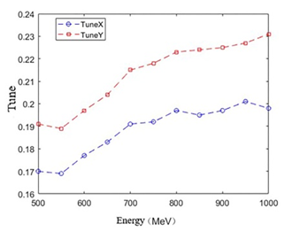
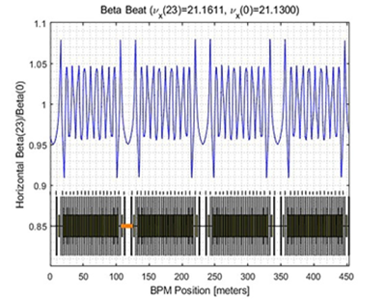
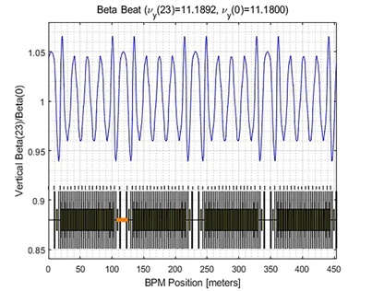
Optimize the transmission efficiency
The beam loss mainly occurred below 1GeV, many efforts have been made
The orbit at 500MeV is set as the reference orbit, and the orbits at other energy points are corrected to approach this reference orbit with LOCO
Measuring and Adjusting the tune to ensure it does not cross dangerous resonance lines
The optics are corrected at 6GeV to control the beta -beating

Slide 20
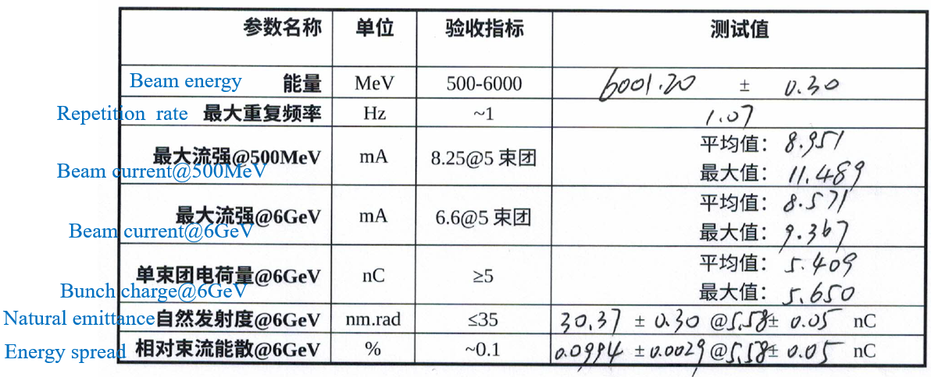
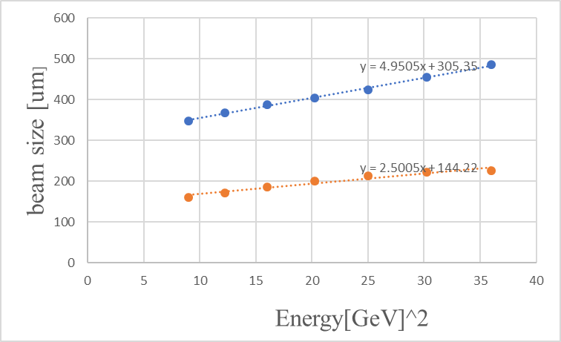
Beam performance
The measured value of the emittance (30.4nm)is much larger than the theoretical value(16.3nm)
Camera vibration and beam oscillations? The time dependence of the measured electron beam sizes has been investigated
Notes:
The constant term of the linear fit is the measurement error term, which we should deduct when calculating emittance. But in fact, only half of the measurement is missing. If all deductions are made, it is consistent with the theoretical calculation

Slide 21
Summary

Slide 22
Summary
The construction and beam commissioning of the HEPS booster have been completed basically on schedule
Due to the installation of the equipment in the BR and RB, the beam commissioning in the HEPS booster are stopped
The next step will involve the extraction commissioning of the booster and providing stable beam for commissioning the storage ring
Once the storage ring reaches its design specifications and have the conditions for extraction to the booster, the booster high-energy accumulation commissioning will be started
There are also many beam-related physical phenomena that require in-depth research, such as the emittance measurement, IBS, tune in the ramping process, eddy current effects, ……

Slide 23
Thanks for your attention!

Slide 24
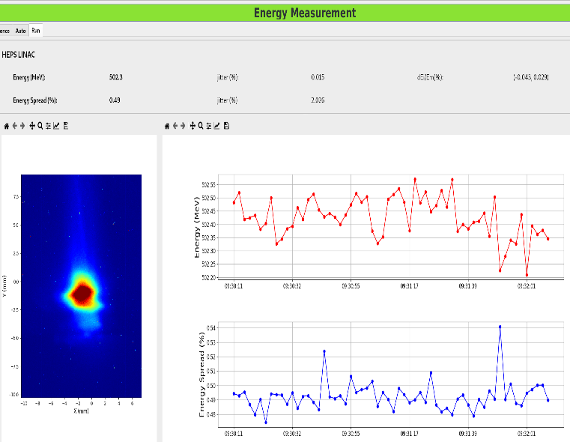
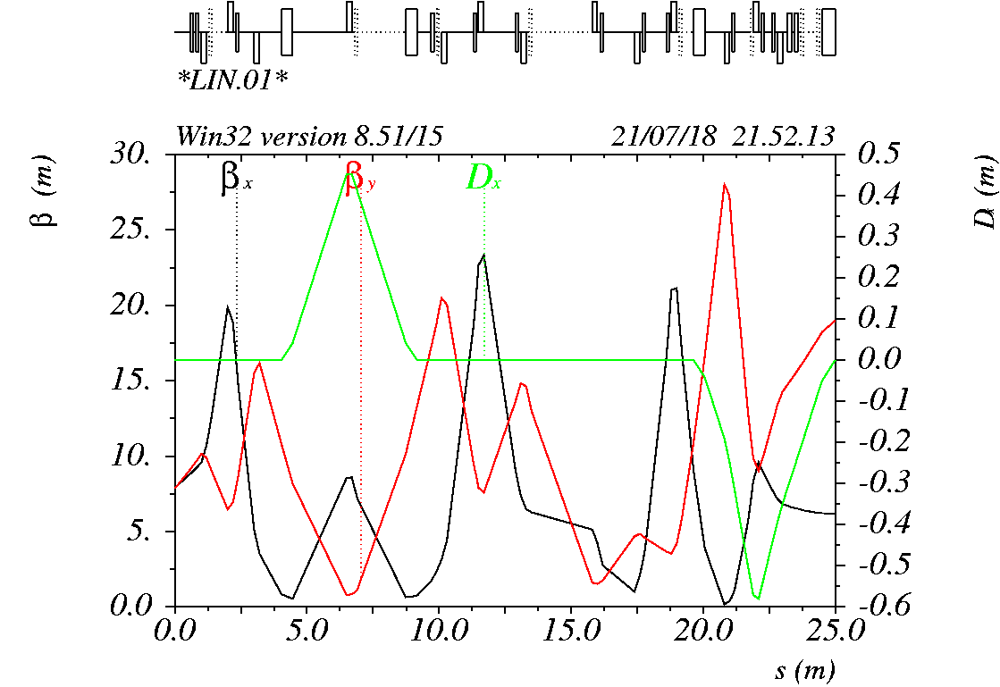
LB commissioning
8 BPM
2 ICT
2 PR
6 HC
6 VC

