Slide 1
Introduction: proposed and future injectors
Jonas Kallestrup :: Paul Scherrer Institute
I.FAST Workshop on Injectors for Storage Ring Based Light Sources
Karlsruhe, 7.-8. March 2024

Slide 2

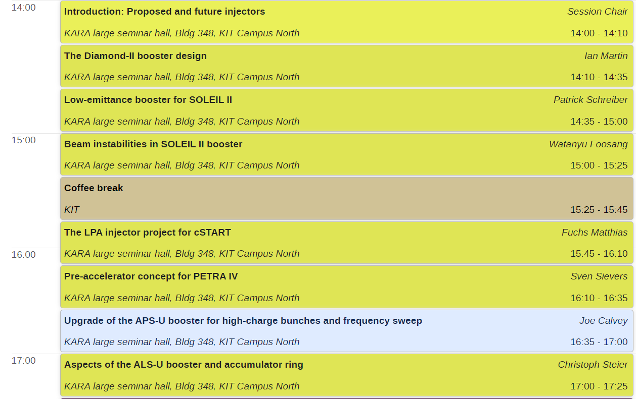


Slide 3
It’s all about the aperture…
3rd generation storage rings
Physical aperture
Ideal dynamic aperture
  Stable region of particle motion
  Limited by strong non-linear magnets
Dynamic aperture including machine errors
  Deteriorated stable region of particle motion due to magnet errors, misalignments etc.
Physical aperture
(vacuum chamber)
Injected beam
Stored electron beam
Ideal dynamic
aperture
Dynamic aperture
including machine errors

Slide 4
It’s all about the aperture…
3rd generation storage rings
Physical aperture
Ideal dynamic aperture
  Stable region of particle motion
  Limited by strong non-linear magnets
Dynamic aperture including machine errors
  Deteriorated stable region of particle motion due to magnet errors, misalignments etc.
What are current trends for new injectors?
Physical aperture
(vacuum chamber)
Stored electron beam
Injected beam
Ideal dynamic
aperture
Dynamic aperture
including machine errors

Slide 5
Booster synchrotrons for 4th generation storage rings

Slide 6
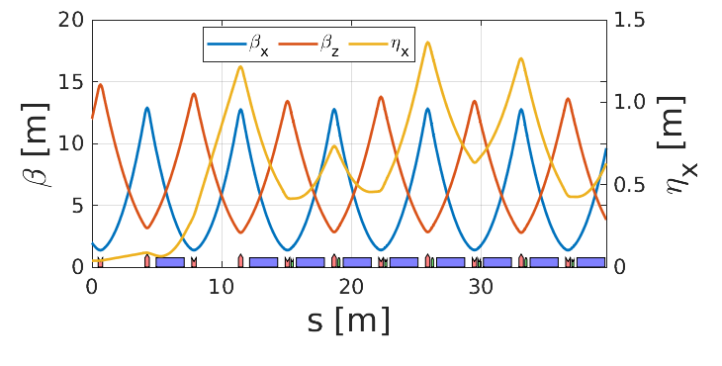
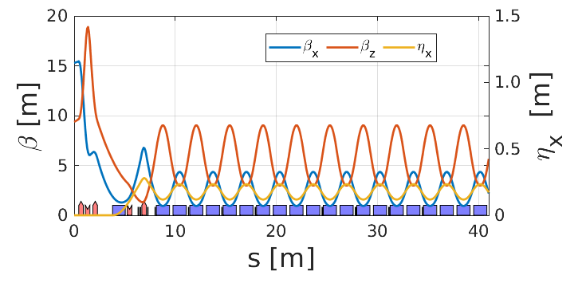
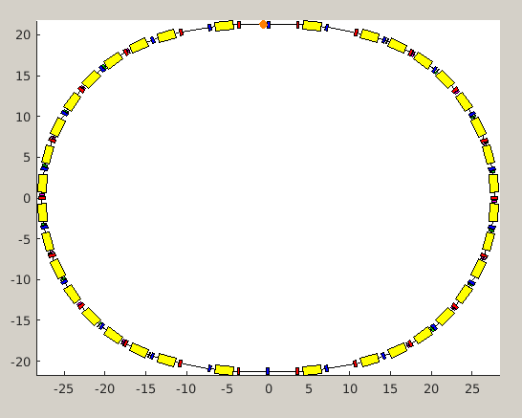
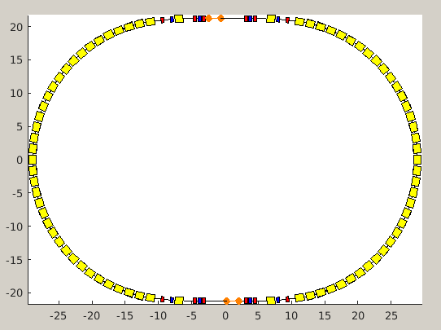
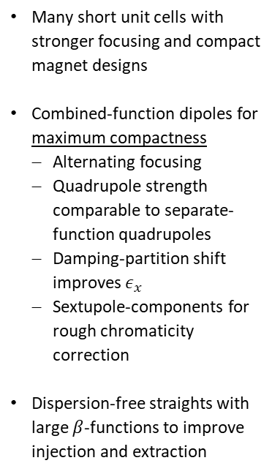
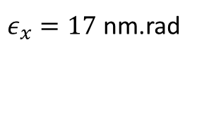
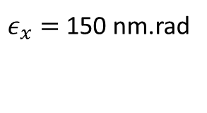
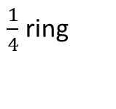
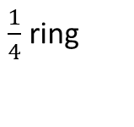
Booster upgrades: modern machines in old tunnels
$\frac{1}{4}$ ring
$\frac{1}{4}$ ring
Many short unit cells with stronger focusing and compact magnet designs
Combined-function dipoles for maximum compactness
  Alternating focusing
  Quadrupole strength comparable to separate-function quadrupoles
  Damping-partition shift improves $ε_{x}$
  Sextupole-components for rough chromaticity correction
Dispersion-free straights with large $β$-functions to improve injection and extraction
$ε_{x}=$150 nm.rad
$ε_{x}=17$ nm.rad
Old compact boosters
Modern boosters

Slide 7
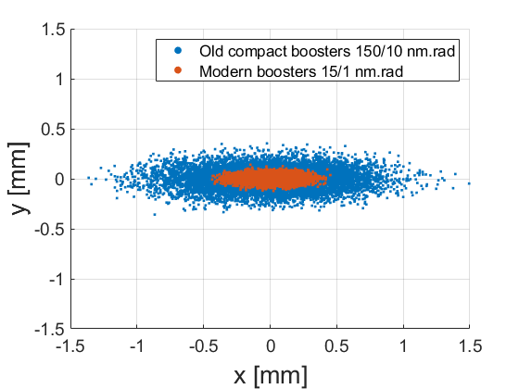

Slide 8
Full-energy linacs

Slide 9
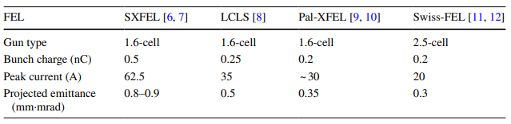
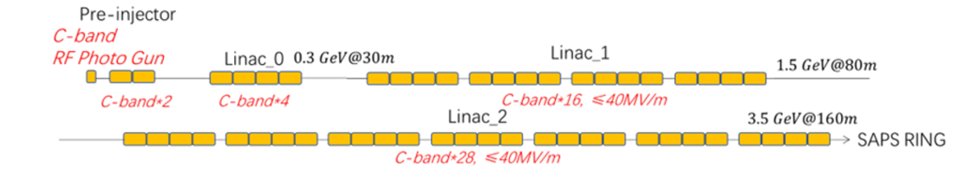
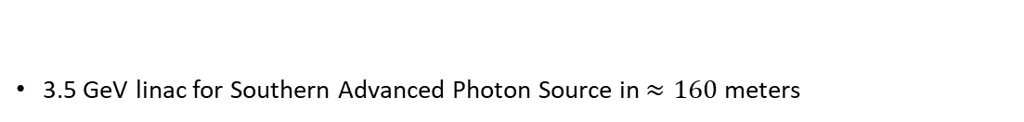
Full-energy linacs as the optimum injector for accumulation
Table borrowed from
https://doi.org/10.1007/s41365-023-01183-6
Photoinjector-based linacs can deliver outstanding beam quality
  Low emittance
  Short bunch length and low energy spread
  Appropriate bunch charge for top-up
  Slightly too low bunch charge for swap-out
Geometric emittance 0.14 0.09 0.06 0.05
at 3.0 GeV (nm.rad)
3.5 GeV linac for Southern Advanced Photon Source in $≈160$ meters
Figure borrowed from
https://doi.org/10.18429/JACoW-IPAC2023-TUPL111

Slide 10
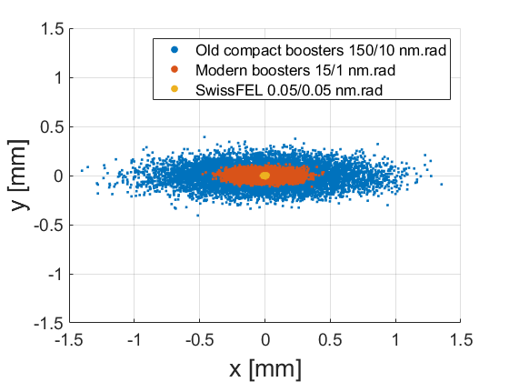

Slide 11
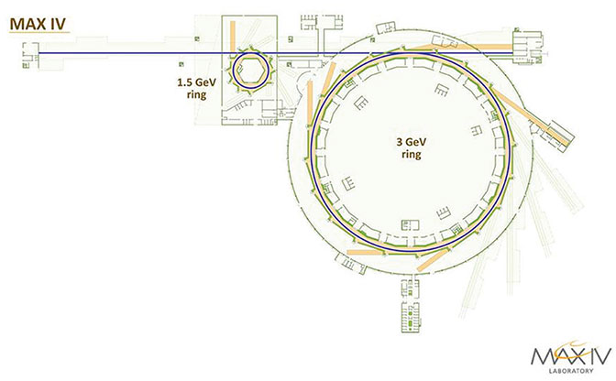
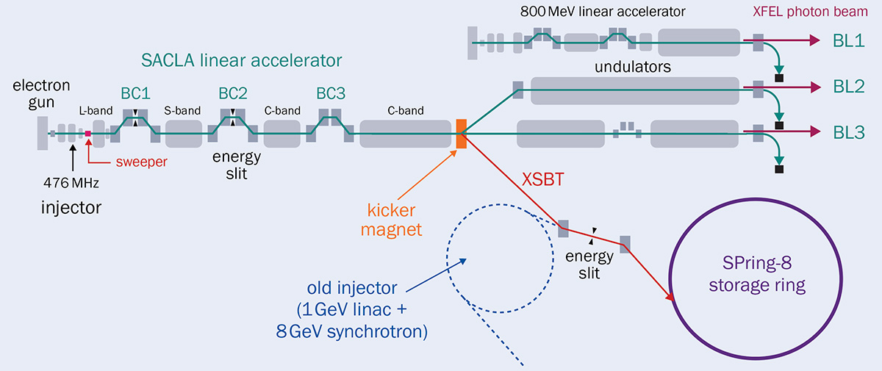


Full-energy linacs as the optimum injector for accumulation
Science-case can be expanded by utilizing injector as short-pulse facility or Free-Electron Lasers
$⇒$likely a win-win situation!
Short-pulse facility
$⇒$ Soft Xray FEL (?)

Slide 12
Plasma-based injectors

Slide 13
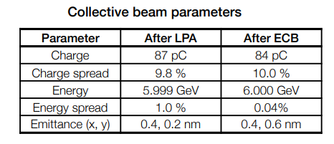
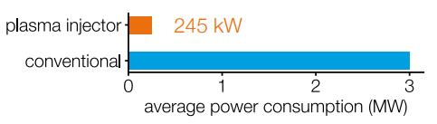
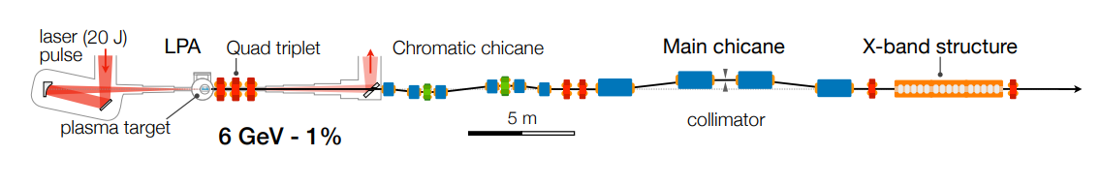
Plasma acceleration – the way for “green-field” injectors?
Performance of plasma-based accelerators is rapidly improving
  High energy (several GeV)
  Low emittance (< nm)
  Low energy spread (< 0.1%)
  Reasonable rep-rate (>10 Hz)
  Low bunch charge
  Low energy consumption
PETRA IV LPA-injector proposal
Figures borrowed from
https://doi.org/10.1103/PhysRevAccelBeams.24.111301
https://accelconf.web.cern.ch/fls2023/talks/mo4b2_talk.pdf

Slide 14
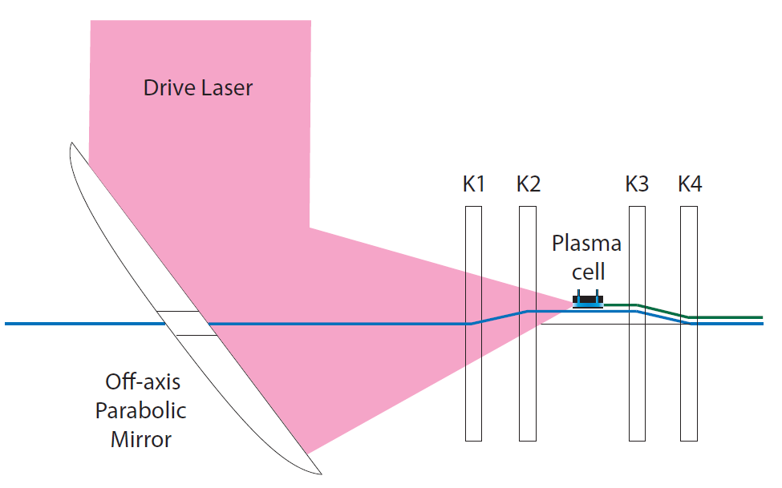
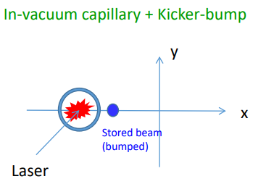
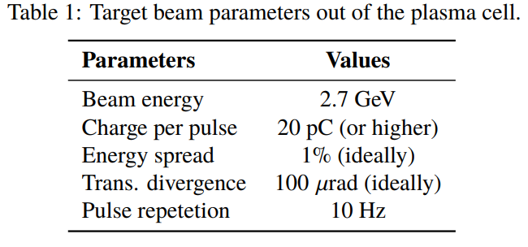
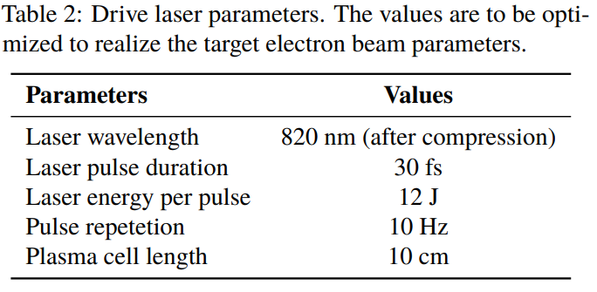
Plasma acceleration – injector inside the storage ring (?!?!)
Idea by Masamitsu Aiba:
Plasma cell instead of septum magnet
High-power drive laser couples in to plasma cell using parabolic mirror
High-energy electrons are accelerated and injected into storage ring using 4-kicker bump
SLS 2.0 example parameters:

Slide 15
References – all as clickable links!
Boosters and accumulators:
H.C. Chao, Design considerations of a high intensity booster for PETRA IV, IPAC’21, 2021
S. Liuzzo, A long booster option for the ESRF-EBS 6 GeV storage ring, IPAC’22, 2022
T. Chanwattana, Update on injector for the new synchrotron light source in Thailand, IPAC’22, 2022
A. Bukhtiyarov, Synchrotron Radiation Facility «Siberian Circular Photon Source» (SRF SKIF), Crystallography Reports, 2022
I. Martin, Beam dynamics studies for the Diamond-II injector, IPAC’23, 2023
M. Tordeux, Progress on the new booster for SOLEIL II, IPAC’23, 2023
Y. Lee, Beam dynamics in the booster synchrotron of Korea-4GSR project, NIM-A, 2024
L. Huang, Booster conceptual design of the Southern Advanced Photon Source, IPAC’23, 2023
Linacs:
MAX IV Detailed Design Report
L. Wang, Hefei Advanced Light Source: A future soft x-ray diffraction-limited storage ring at NSRL, IPAC’18, 2018
T. Hara, Low-emittance beam injection for a synchrotron radiation source using an X-ray free-electron laser linear accelerator, PRAB, 2021
R. Dowd, Conceptual design of a future Australian Light Source, IPAC’22, 2022
Z. Dai, Design of S-band photoinjector with high bunch charge and low emittance based on multi-objective genetic algorithm, Nuclear Science and Techniques, 2023
X. Liu, Start-to-end simulation of the full energy linac injector for the Southern Advanced Photon Source, IPAC’23, 2023
Plasma:
S. Antipov, Design of a prototype laser-plasma injector for an electron synchrotron, PRAB, 2021
S. Antipov, First Start-to-End simulations of the 6 GeV laser-plasma injector at DESY, IPAC’22, 2022
E. Panofski, Status report of the 50 MeV LPA-based injector at ATHENA for a compact storage ring, IPAC’22, 2022
A. M. De la Ossa, The Plasma Injector for PETRA IV: Conceptual Design Report, presented at FLS’23, 2023

Slide 16
Thank you for your attention!

