Slide 1

ALS-U Injector(s)
Christoph Steier
ALS-U Accelerator Physics and Commissioning Manager
iFAST Injector Workshop, March 7, 2024

Slide 2
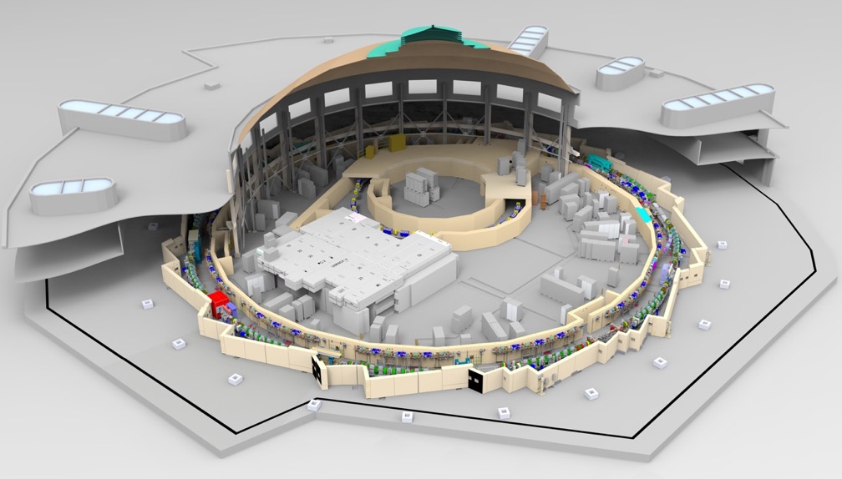
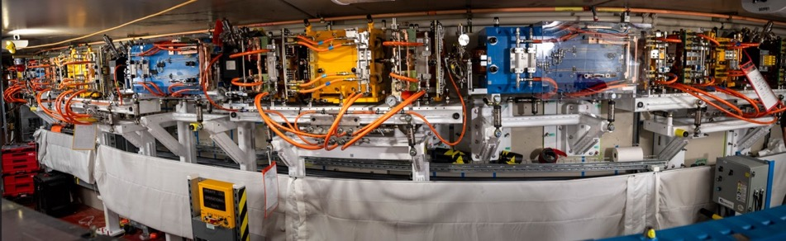
Outline
Introduction: ALS-U
Swap-Out Injection
New accumulator + booster modifications
R&D results on injection elements for swap-out
Accumulator status (installation in progress)
Summary

Slide 3
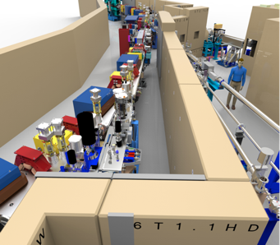
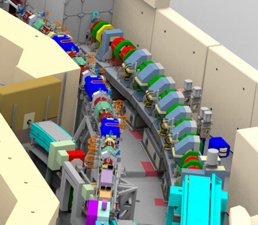
ALS-U Project
3BA
Electron Beam Profile
ALS-U will deliver a world-leading light source that provides users with bright, high-coherent-flux soft x-rays
  High-level Goals:
  Achieve an increase in brightness and coherent flux of soft x-rays (@1 keV) of at least 2 orders of magnitude beyond today’s ALS capabilities
  Develop a set of experimental capabilities that will enable leadership in soft x-ray science
  Provide infrared and hard x-ray capabilities comparable to present-day ALS
Today’s ALS
Future ALS
9BA

Slide 4


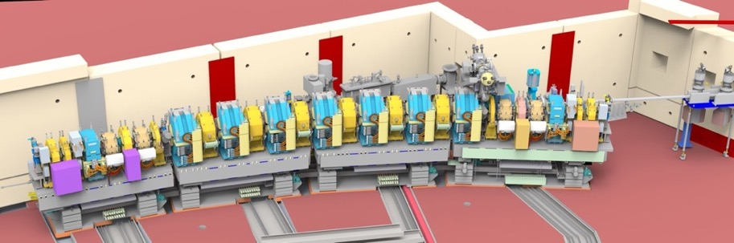
ALS-U Scope
  New 2.0 GeV Accumulator Ring for full energy swap-out injection and bunch train recovery
  New full-length undulators optimized for high coherent flux
  The Accumulator Ring is being installed and will be commissioned early in order to minimize the risk and duration of one-year dark period; Storage Ring, ATS+STA will be installed during dark period
Booster Ring
(existing)
ATS and STA
transfer lines
Linac
(existing)
BTA injection line
  New 2.0 GeV 9BA storage ring in existing cave optimized for low emittance and high soft x-ray brightness and coherent flux

Slide 5
More than two order of magnitude brightness improvement,
69 pm emittance, diffraction limited to ~ 1.5 keV
Storage Ring | Design
Energy | 2.0 GeV
ε_{x} (full coupling) | 69 pm
ε_{y} (full coupling) | 69 pm
Δp/p | 0.98 x 10⁻³
σ_{x/y} @ ID | 12 μm/14 μm
σ_{x/y} @ Bend sources | 7 μm/10 μm
Bunch Length (FWHM) | 110 ps
Current | 500 mA
Lifetime | ~1 h
C. Sun
9 Bend achromat lattice with reverse bends and high field Hbends in 3 sectors for hard x-rays
Small, optimized beta functions in straights
~2.5% dynamic momentum aperture in arcs
On-axis injection (swap-out) needed
Improvements: Emittance, undulator length, undulator technology+gap, smaller β_{x:} Overall: >100x @ 1 keV

Slide 6
Swap-Out Injection

Slide 7
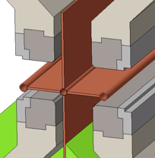
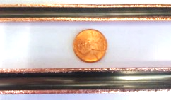
Performance enabling ALS-U feature – Bunch train swap-out
Off-axis injection + accumulation
On-axis swap-out injection
(initially proposed by M. Borland)
Stored Beam
Fast Kicker
Stored Beam
requires larger
apertures
can use smaller
apertures
Injected Beam
Injected Beam
  Swap-out enables:
  lattices with smaller dynamic apertures → higher brightness
  Small round apertures → improved undulator performance
Allows for small (~6mm) round apertures
Permits higher performance polarizing undulators
Delta/Apple-X undulator
Allows lattices with stronger focusing + higher brightness
E. Wallen
S. Omolayo

Slide 8
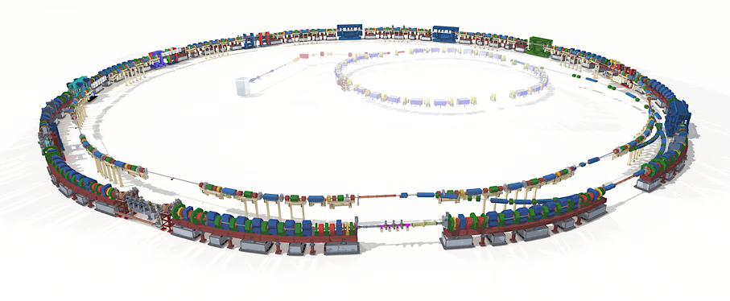
Injector Requirements for Swap-Out
Hard requirements:
  Sufficient charge per bunch
  Sufficiently small emittance
  Stable pulse to pulse (charge, position, angle, energy, …)
Desired
  Cost + space optimized
  Minimized beam losses – ALARA
  Minimum perturbations on user photon beams - transients
For ALS, booster is fairly small – hard to achieve sufficiently small emittance
Booster also makes charge recovery from SR difficult
Accumulator ring comes with inherent stability of a storage ring
Selected full energy accumulator with bunch-train swap out

Slide 9
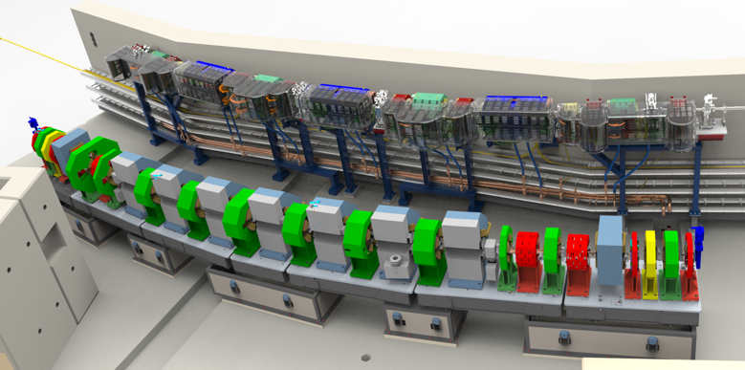
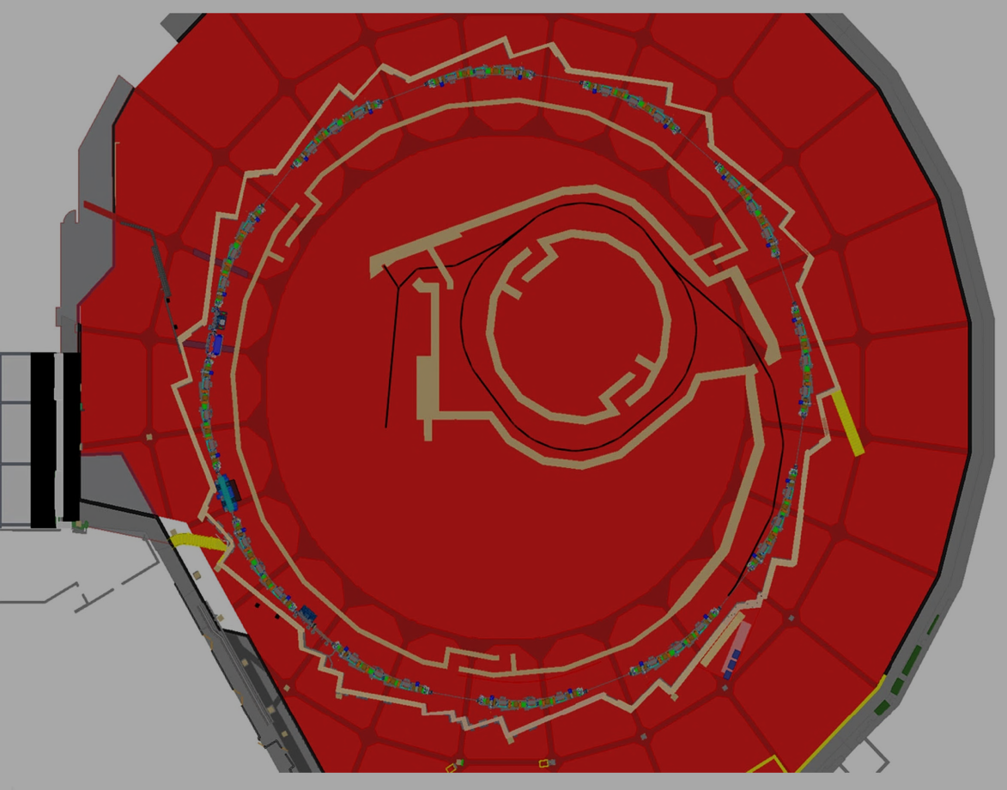
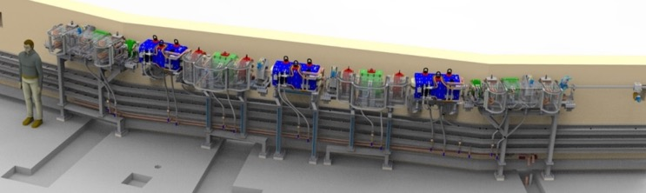
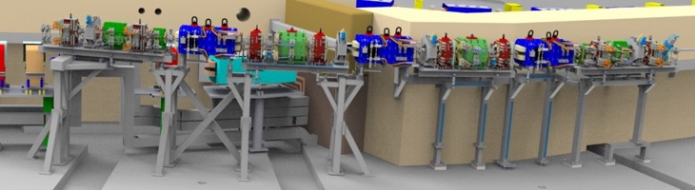
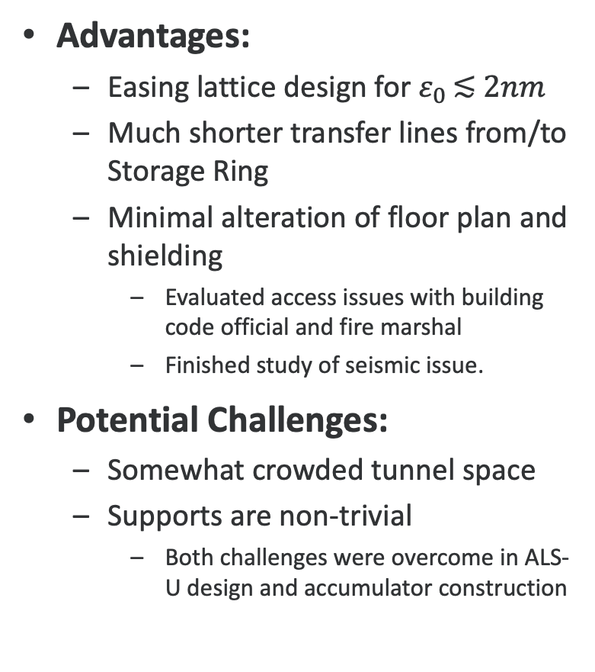
Accumulator location in SR tunnel is optimal solution
Advantages:
  Easing lattice design for $ε_{0 }\text{≲} 2nm$
  Much shorter transfer lines from/to Storage Ring
  Minimal alteration of floor plan and shielding
    Evaluated access issues with building code official and fire marshal
    Finished study of seismic issue.
Potential Challenges:
  Somewhat crowded tunnel space
  Supports are non-trivial
    Both challenges were overcome in ALS-U design and accumulator construction

Slide 10
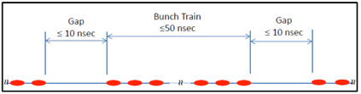
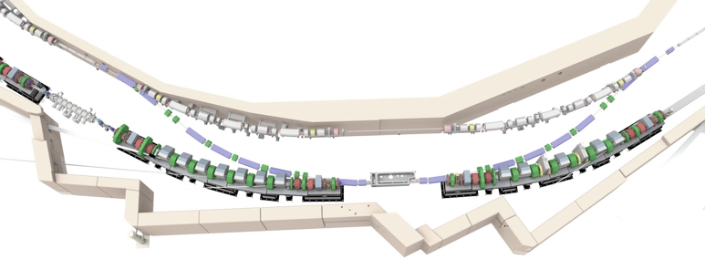
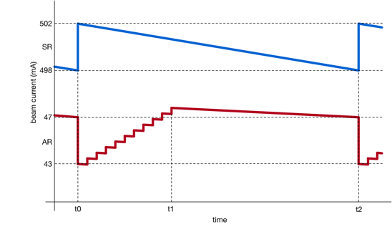
ALS-U Operation/Fill Modes
Storage-ring bunches transferred to accumulator
Accumulator bunches transferred to storage ring
Advantages of bunch train swap-out with recovery
  minimizes number of lost/dumped electrons
  reduces demands on injector
  made swap-out-kicker development easier
ALS-U expected lifetime ~1 h @ 500 mA
  Need to replace 0.09 nC/s
  Booster routinely delivers 1 nC/s
Planned Swap-out Timing:
  Between SR swap-out injections the AR train is filled from the BR in Top-Off mode.
  AR injection between 1 and 4 BR bunches per shot, at up to 1Hz.
  Do not need to top-off every bunch in single swap-out, could spread over multiple swap-out cycles if necessary
To achieve 1% current stability, swap-out would need to happen every 36 seconds (500 mA)
  User experience at ALS shows ALS minimum of 12 seconds between injections is acceptable
Can maintain bunch-to-bunch current variation around 10%, similar to ALS
Fast kicker magnets
New ALS storage ring
New accumulator ring

Slide 11
New Accumulator and Booster modifications

Slide 12
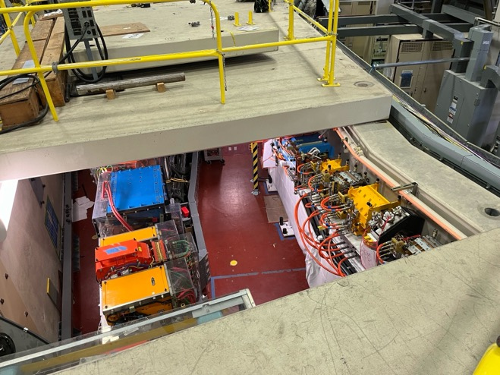
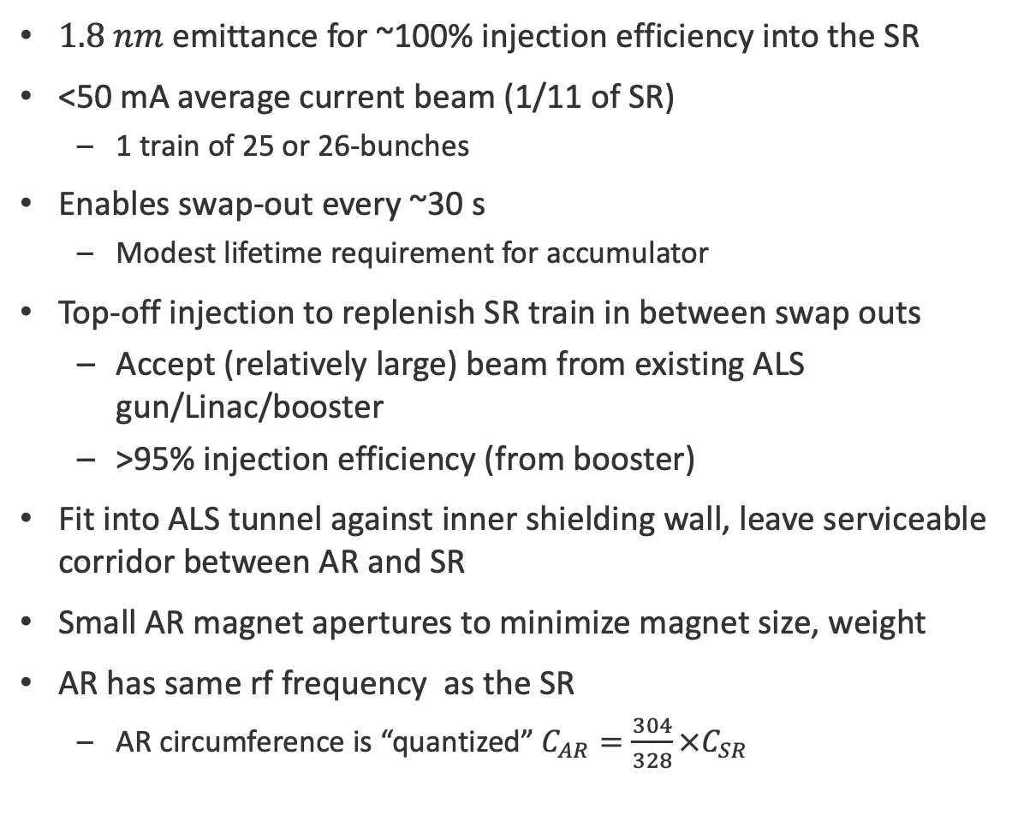
AR Parameters
$1.8 nm$ emittance for ~100% injection efficiency into the SR
<50 mA average current beam (1/11 of SR)
  1 train of 25 or 26-bunches
Enables swap-out every ~30 s
  Modest lifetime requirement for accumulator
Top-off injection to replenish SR train in between swap outs
  Accept (relatively large) beam from existing ALS gun/Linac/booster
  >95% injection efficiency (from booster)
Fit into ALS tunnel against inner shielding wall, leave serviceable corridor between AR and SR
Small AR magnet apertures to minimize magnet size, weight
AR has same rf frequency as the SR
  AR circumference is “quantized” $C_{AR}=\frac{304}{328}×C_{SR}$

Slide 13
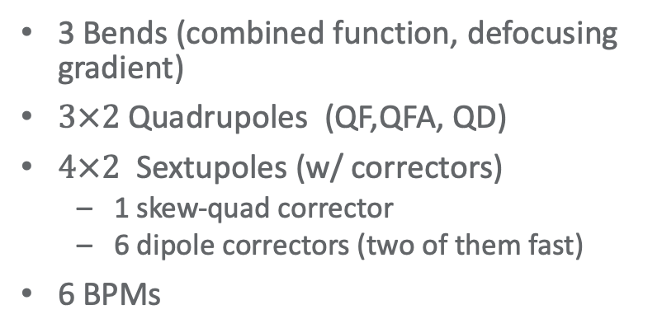
Accumulator uses Triple-Bend-Achromat lattice
Scaled-down and optimized version of ALS TBA (circumference ~14m shorter)
  12 sectors
Lattice optimization done w/ genetic algorithm (MOGA)
  1.8 nm emittance
  Finite dispersion in straights
Straight magnetic-axis, combined-function bends
Magnet apertures significantly narrower than in ALS
  Optimizing weight, power consumption and cost
C. Sun
3 Bends (combined function, defocusing gradient)
$3×2$ Quadrupoles (QF,QFA, QD)
$4×2$ Sextupoles (w/ correctors)
  1 skew-quad corrector
  6 dipole correctors (two of them fast)
6 BPMs

Slide 14
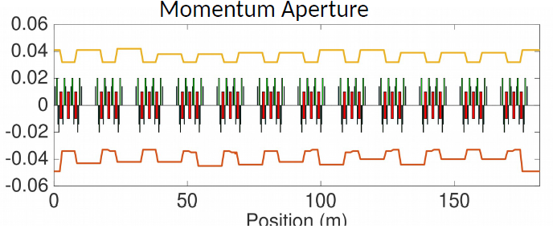
Extensive simulations determined magnet and other error tolerances
Error Sources considered (using simulated commissioning toolkit – SC):
  Systematic multipoles errors
  Random multipole errors
  Mechanical, assembly imperfections
  Magnet misalignments
Achieve dynamic and momentum aperture close to physical apertures – predict rapid commissioning
Impact of differential circumference variations (AR/SR) is small
Dynamic Momentum Aperture with errors is larger than RF acceptance
T. Hellert

Slide 15
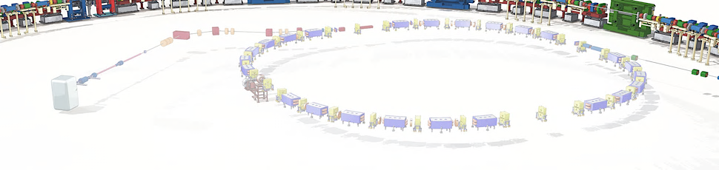
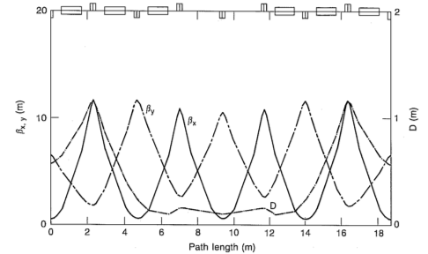
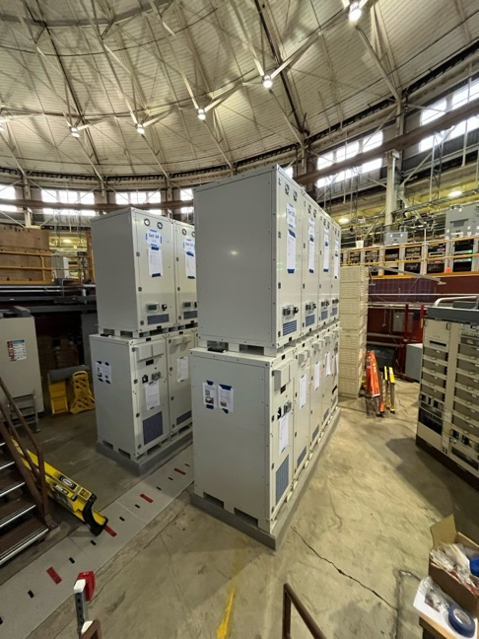
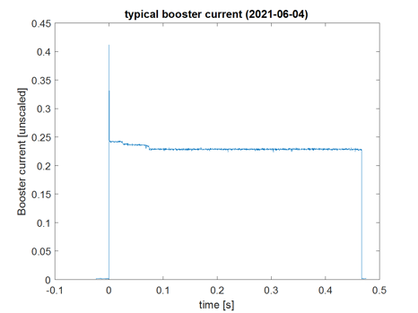
Booster Upgrades
Linac+Booster have previously been refurbished
  Power supplies, controls, timing, vacuum instrumentation, …
Accumulator (with bunch train recovery) relaxes requirements on injector
Charge and emittance from Booster sufficient for ALS-U
ALS-U upgrades are limited to expanding booster energy to 2.0 GeV
  Dipole power supply
  RF cavity power coupler

Slide 16
R&D results

Slide 17
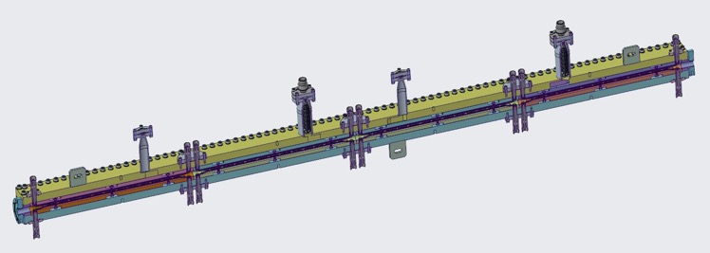
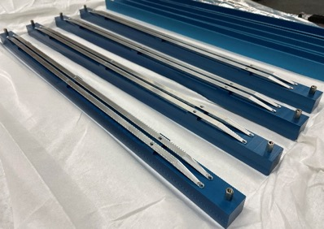
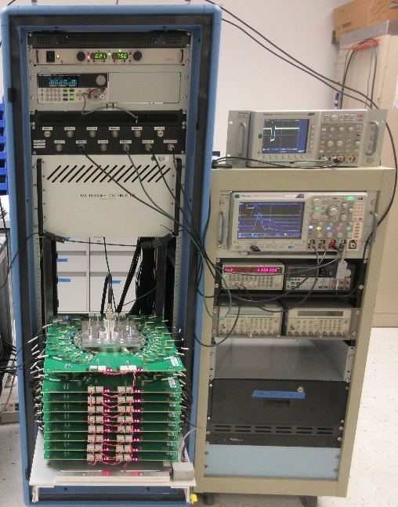
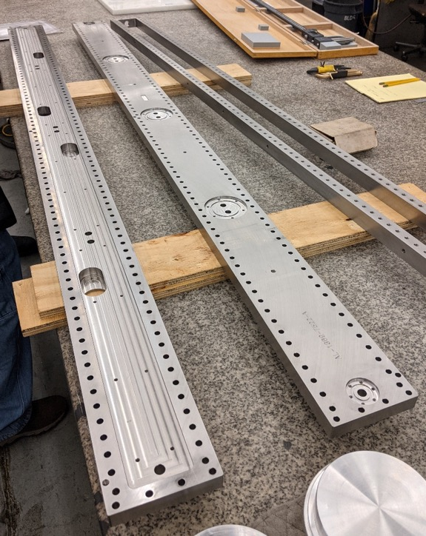
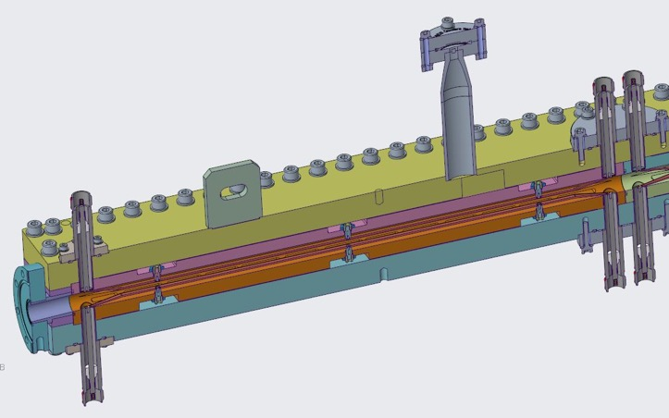
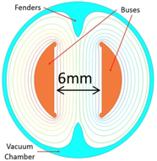
Swap-out kicker concept was demonstrated at ALS with beam, full-scale prototype is currently in fabrication
W. Waldron
2m long

Slide 18
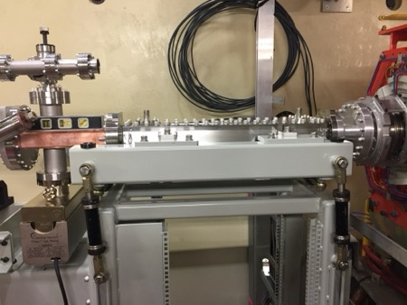
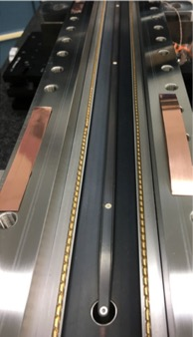
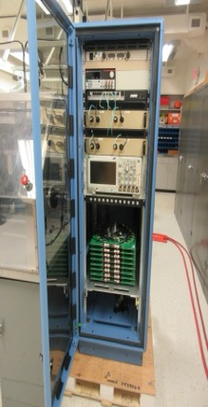
R&D pulser and stripline kicker beam tested over full year in ALS
On-axis swap-out injection
(initially proposed by M. Borland)
C. Swenson, C. Pappas, S. De Santis, C. Steier
Stored Beam
Fast Kicker
W. Waldron
can use smaller
apertures
Injected Beam
In house design for kicker and pulser
Beam based characterization of rise/fall-time and reproducibility
  Successful swap-out technology demonstration on ALS:
  6 mm full (vertical) gap stripline kicker installed in ALS in 2017
    In user operations for several years
  Verified impedance and thermal design
  Kicked single bunch, mapping the time structure and reproducibility of pulser

Slide 19
Accumulator progress

Slide 20
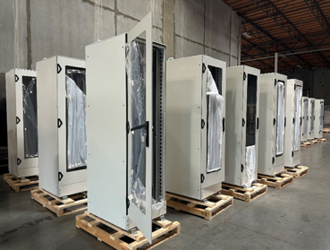
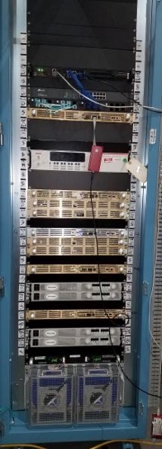
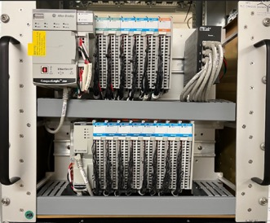
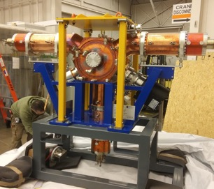
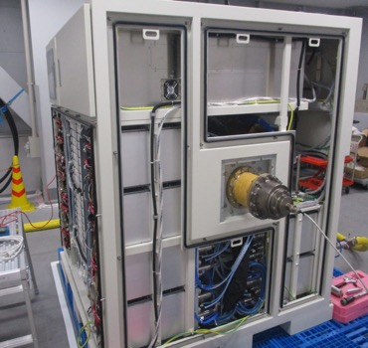

Accumulator Manufacturing and Installation
Design work is complete, integration and installation plan are mature
Received majority of mechanical hardware (for example vacuum, magnets, supports fully received)
Prestaging output close to target rate, handoffs to removal and installation work well, good collaboration for installation support
Starting electrical installations (rack baseplates, RF HPA); AR AC distribution was previously installed
Completed full project cycle: Design, Integration, Manufacturing, Testing, Assembly, Installation Support -> basis of SR plan
Integrated testing and commissioning planned for 2025
PS Rack
Electronics racks at off-site storage
MPS chassis
Accumulator rafts, dipoles, vacuum chambers, and straight: installed several full sectors and started vacuum integration
RF HPA
RF Cavities

Slide 21
Summary
ALS-U will reach diffraction limit for soft x-rays (69 pm emittance)
Lattice optimization aided by choice of on-axis swap-out injection
Swap-out needed injector upgrades – optimum choice was full energy accumulator with bunch train swap-out
Accumulator manufacturing and installation is well advanced, commissioning in 2025
ALS-U upgrade will be complete afterwards during one year darktime starting in 2026

Slide 22
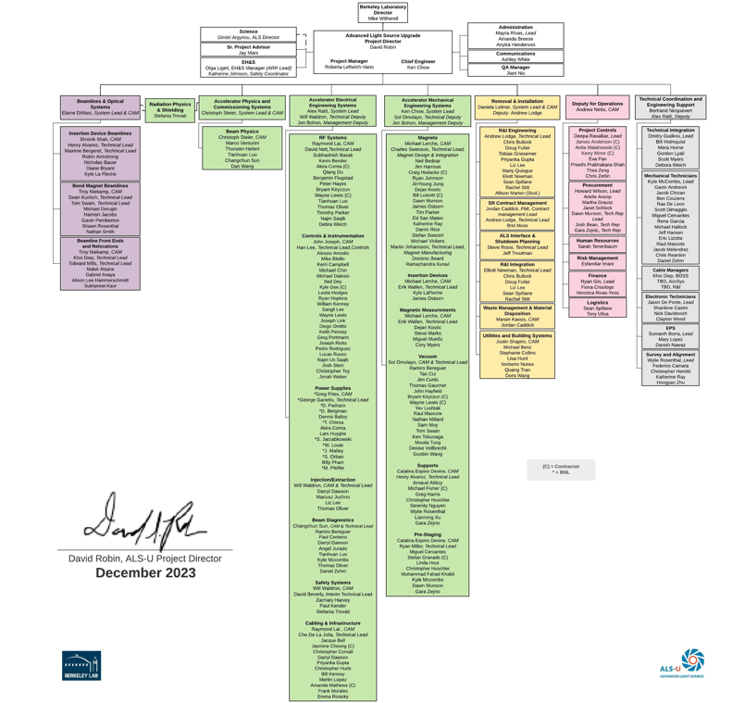
Acknowledgements
ALS-U is very large project, but for the topics of this talk:
Leads for swap-out R&D:
  Will Waldron, Stefano de Santis, Chuck Swenson, Christoph Steier
Accumulator Design:
  Physics Lead(s): Marco Venturini, Christoph Steier
  Mechanical: Steve Virostek
  Electrical: Will Waldron

Slide 23
Backup Slides

Slide 24
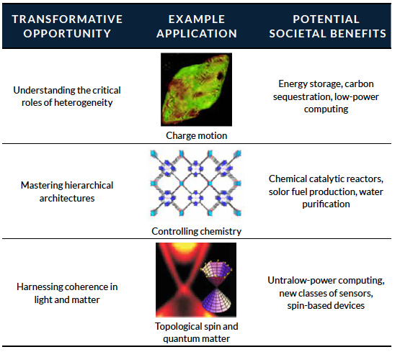
Science Case for ALS-U
Soft x-ray light, which has the appropriate energy to interact strongly with the electrons that determine the chemical, electronic, and magnetic properties of materials, and
High coherent flux delivered in a nearly continuous wave, which is necessary to resolve nanometer-scale features and interactions and which allows real-time observation of chemical processes as they evolve and materials as they function.

Slide 25
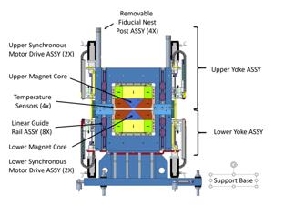
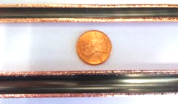
Baseline is mature and stable, and reaches soft x-ray diffraction limit up to 1.5 keV
Major design choices have remained throughout R&D and design phases – 9 bend achromat, bunch trains swap out, accumulator, HBends
Bunch train swap-out using demonstrated kicker/pulser technology
Small aperture NEG coating
High Field PM bend magnets

Slide 26
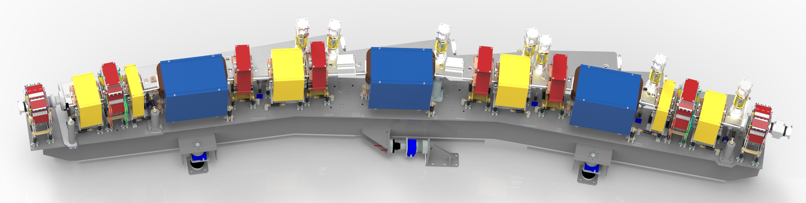
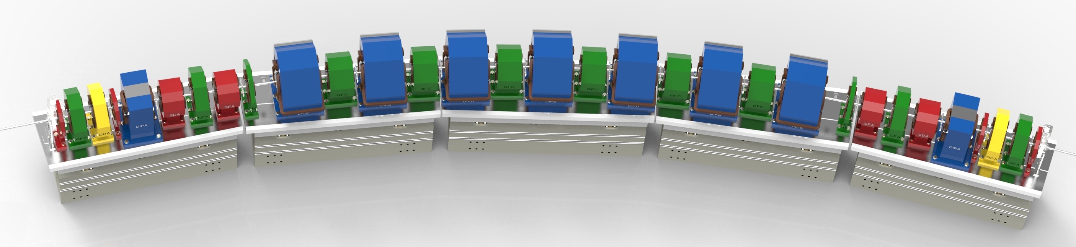
Nine-bend achromat lattice reaches the soft
x-ray diffraction limit up to 1.5 keV
ALS-U: nine-bend achromat with
reverse bends
ALS today: triple-bend achromat
75
Large increase in coherent fraction due to lower emittance and smaller β-functions

Slide 27
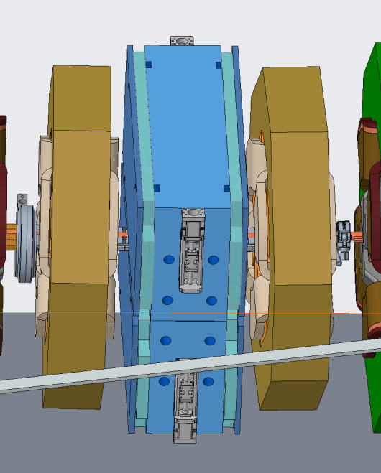
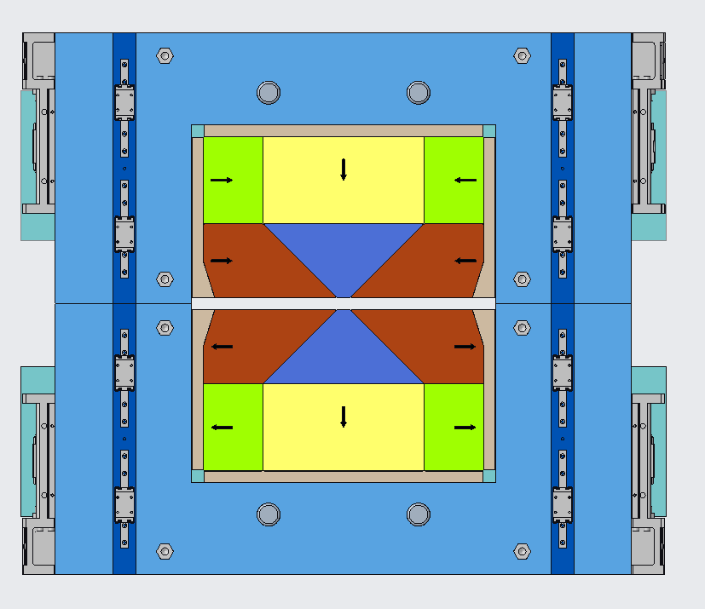
Performance enhancing lattice features: Reverse bends & high-field bend magnets
Reverse Bends
High Field Bend Magnets
10 focusing quadrupoles per sector radially offset (~1 mm)
3 of 12 Sectors
high field bend
Reverse bends further reduce emittance
  ~1 mm offset of 10 QF per sector
High Field Bend Magnets allow generation of hard x-rays on intermediate energy ring
  3.2 T Permanent Magnet dipoles
2 magnets each

Slide 28
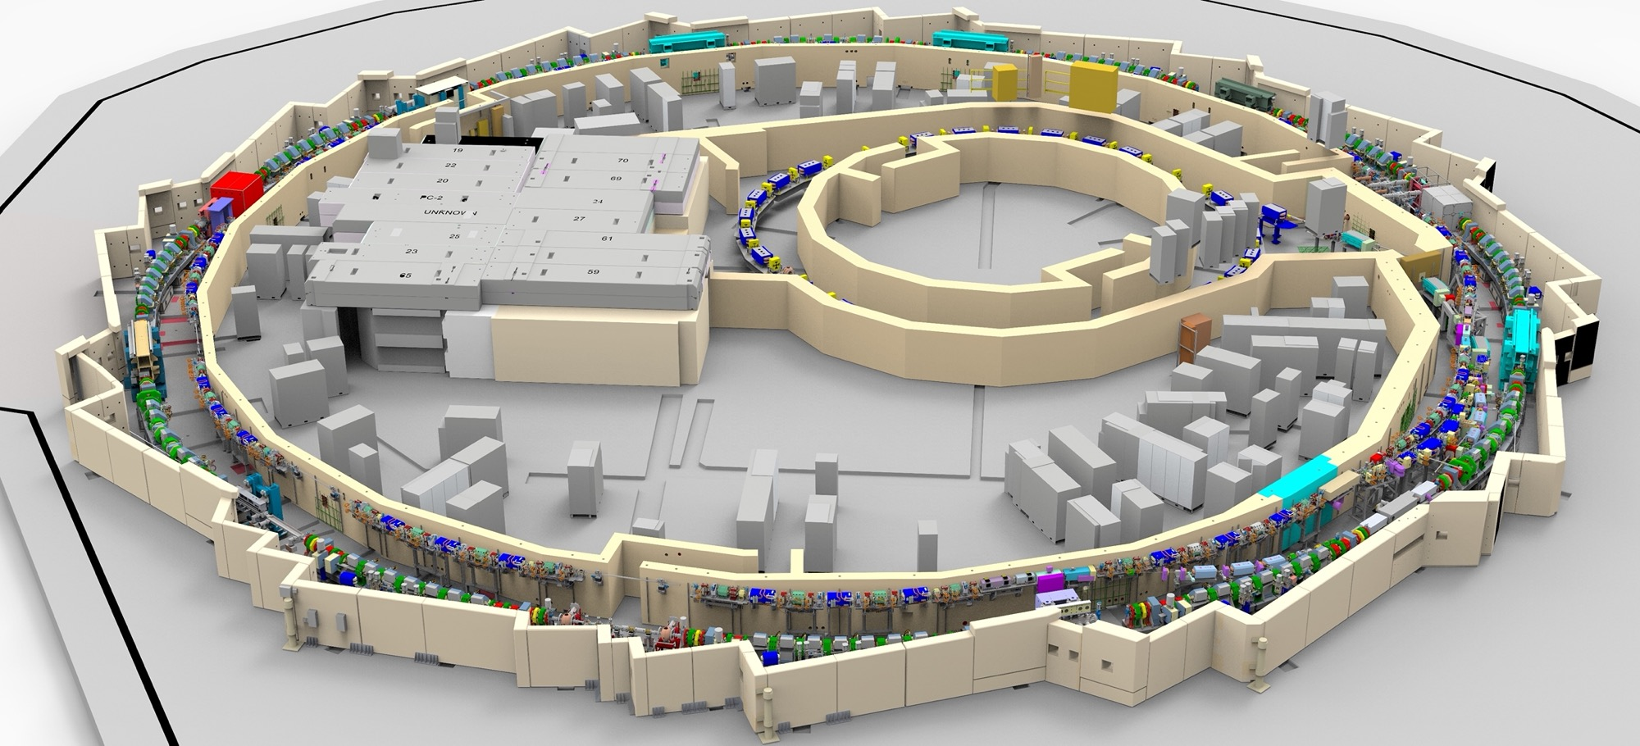
ALS-U Integrated CAD model includes all mechanical scope of Project

Slide 29
Injection / Extraction
AR
(commissioning)
SR

Slide 30
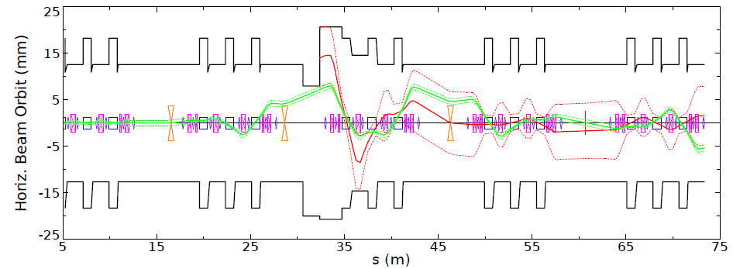
Injection from the Booster (top-off) is based on a three pulsed-dipole kicker (3DK) scheme
Kickers are placed in three separate sectors (12, 1, and 2)
  1st and 2nd pre-kickers only affect the stored beam. The main kicker deflects both stored and injected beam.
  Pulsed thin + thick septum in sector 1 straight
For best injection efficiency the stored beam is left with a small, finite oscillation-amplitude past the main kicker
Sector-12 straight
Sector-1 straight
Sector-2 straight
Injected beam (from booster)
SEPTUM
stored beam
1st pre-kicker
Main kicker
2nd pre-kicker

Slide 31
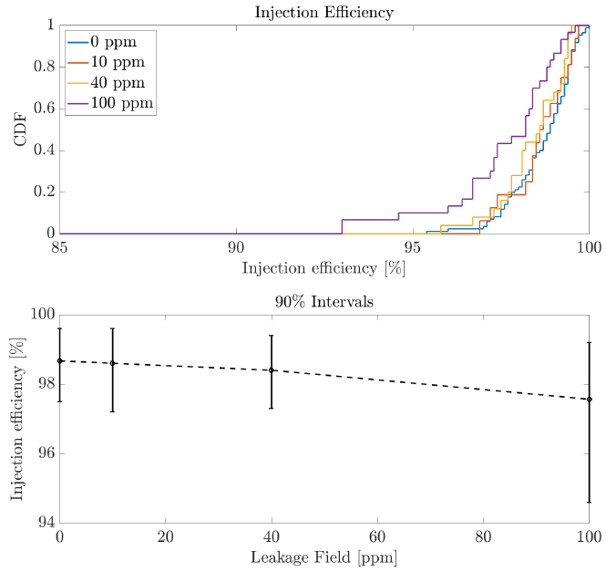
Simulations show injection efficiency > 95% over all lattice error realizations
Study of tolerance to thin-septum leakage fields
(on top of all other error sources)
3DK optimally set (by scan) based on lattice error realization
  No losses on the stored beam
These simulation do not include 3-4% possible additional degradation due to collective effects
  Likely to be less once wakes are included in full 3DK setting optimization
With additional losses through BTA (BTA magnet errors, beam jitter) injection efficiency estimated to above 90% for the largest majority of error realizations
specified tolerance
for leakage fields

Slide 32
ALS-U Summary
Cost:
TPC of $590M (CD-2 approval 4/2021)
Schedule:
CD-3A approved 12/2019 for the early installation and commissioning of the accumulator ring and BTA prior to dark time
CD-2 approved 4/2021
CD-3 approved 11/2022
AR commissioning starts late 2025
Dark Period is FY26 (start 6/2026)
Early finish is early FY28 , >1 year of float to late finish
Scope:
New 2-GeV, high-brightness storage ring fed by a new full-energy accumulator ring and transfer lines in the existing ALS storage-ring tunnel
2 new full-length undulators
Suite of 2 new and 2 upgraded world-leading undulator beamlines
High-field bends and realignment of bend-magnet beamlines
Seismic and shielding upgrades of SR tunnel
CD-0
CD-1
CD-3A
CD-2
CD-3
CD-4 (Early Finish)
9/2016
9/2018
12/2019
4/2021
FY23
FY28
dark
time
Today

