Slide 1
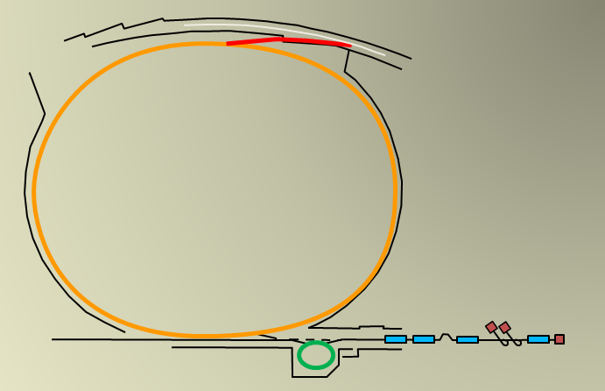
Upgrade of the APS-U Booster for High-charge Bunches and Frequency Sweep
Joseph Calvey
Physicist
Argonne National Laboratory
I.FAST Workshop 2024 on Injectors for Storage Ring Based Light Sources
March 7, 2024
Notes:
Univ of Chicago Review, Aug. 30, 2010
1

Slide 2
Outline
APS-Upgrade introduction
Particle accumulator ring (PAR) and Booster status
High charge issues:
  Booster injection efficiency
  PAR longitudinal instability
Injector charge stability
Injection / extraction timing and synchronization system
Plan for achieving higher charge
Injector commissioning status

Slide 3
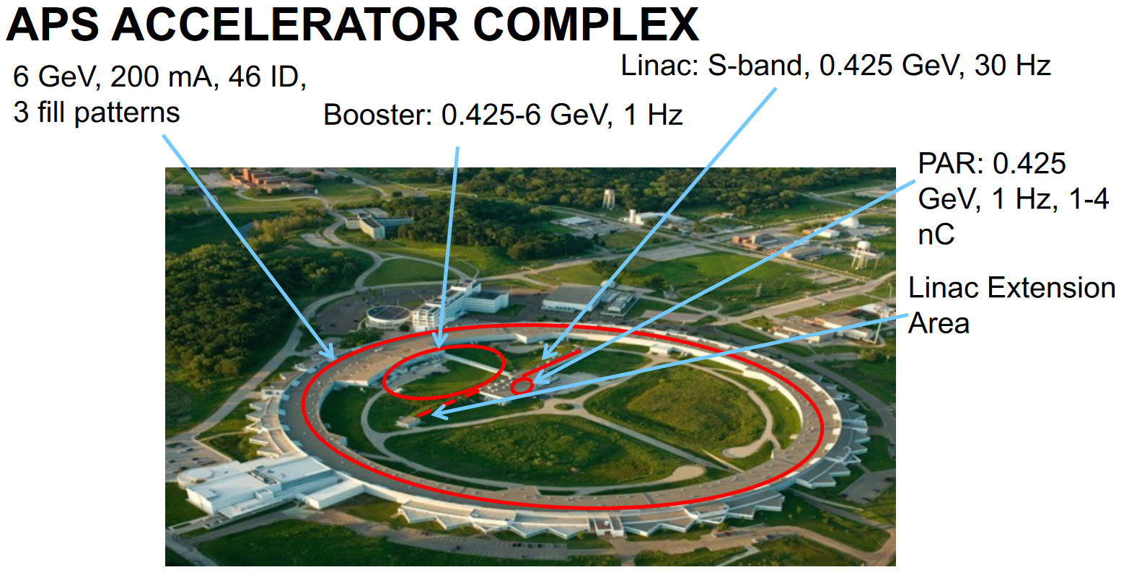
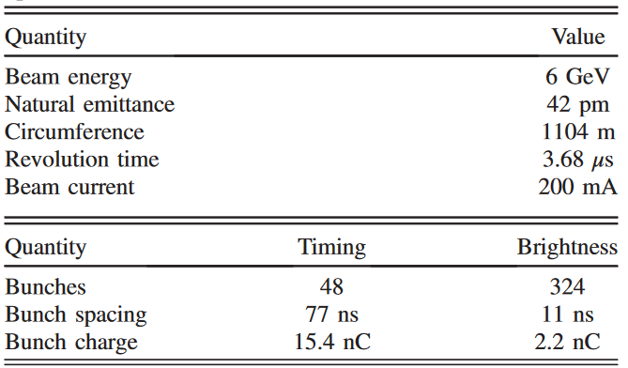
Advanced Photon Source Upgrade¹ (APS-U)
New storage ring: 42-pm emittance @ 6 GeV, 200 mA
Seven-bend hybrid multibend achromat² (MBA) with reverse bending magnets
New and updated insertion devices, including superconducting undulators (SCUs)
Combined result in brightness increases of up to 500x
Two operational modes: 48 and 324 bunches
Uses swap-out injection: full bunch replacement
[1] https://aps.anl.gov/APS-Upgrade/Documents
[2] L. Farvacque et al., PAC-2013, pp. 79–81.

Slide 4
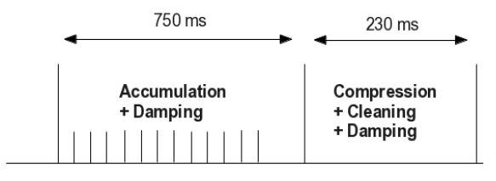
APS → APS-U injector chain
For the APS-Upgrade, it was decided to leave the present APS injector chain in place and make individual improvements where needed.
Challenges include:
  Operating the booster synchrotron and storage ring at different rf frequencies
  Much higher charge per bunch (up to 17 nC)
  Stricter requirement for charge stability (±5% rms)
Booster-to-storage ring transport line (BTS)
Booster (7 → 6 GeV)
2→ 1 Hz rep rate
Magnet ramp linear; RF ramp ~E⁴ (352 MHz)
Momentum offset -0.6% → variable
Charge: 1-3 → 2-17 nC
RG2 RG1 PCG
Particle accumulator ring (PAR) (425 → 450+ MeV)
Single bunch; 2 → 1-Hz rep rate
Captures linac pulses in RF1 (9.8 MHz); compresses damped beam in RF12 (117 MHz)
Linac (425 → 450+ MeV)
1 nC/pulse; 30 Hz rep rate
Thermionic RF guns: RG1, RG2 (1 hot spare)
RF1
RF1 + RF12
PAR cycle

Slide 5
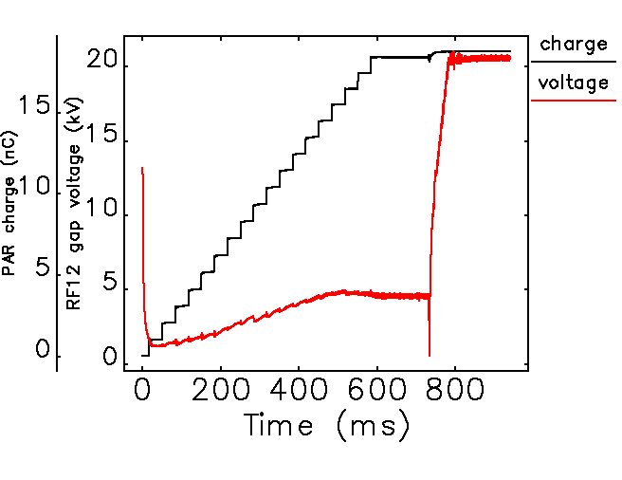
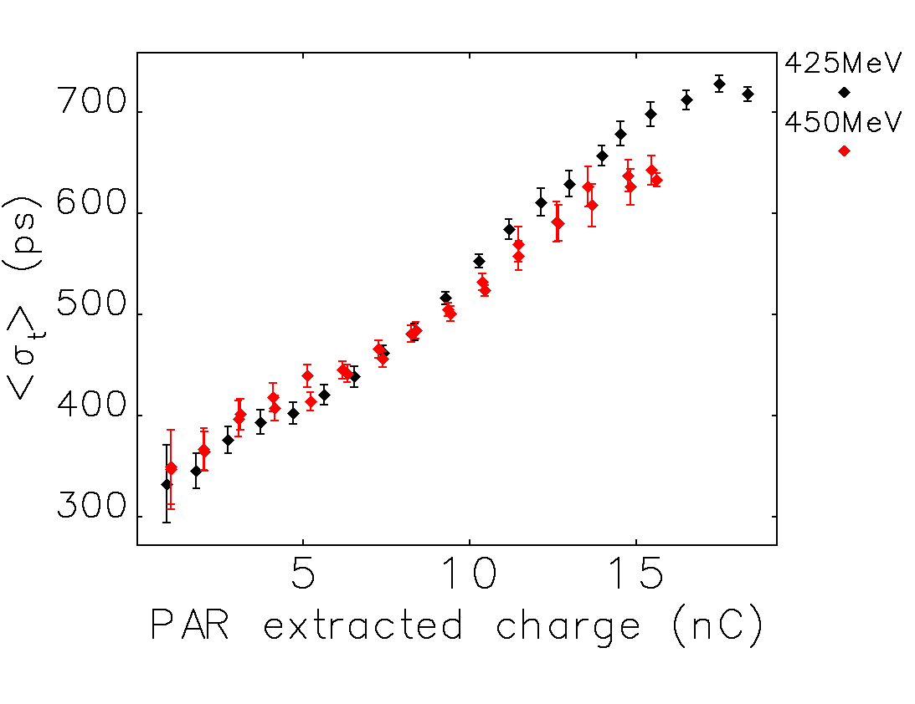
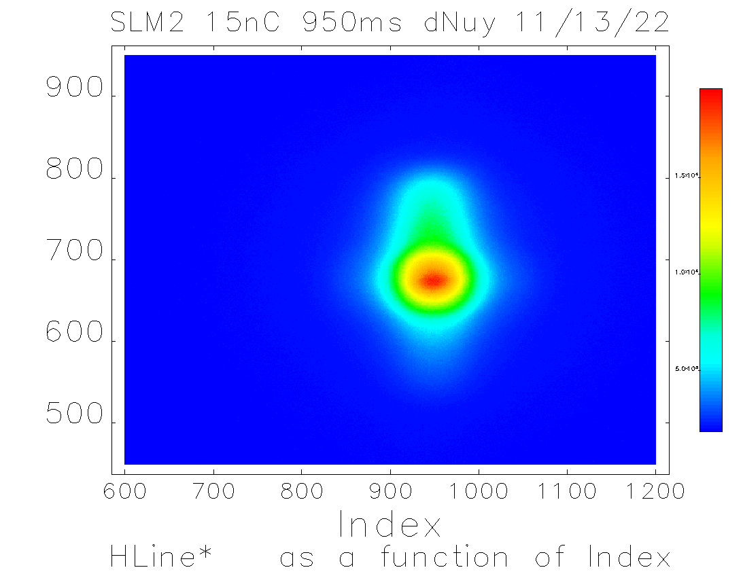
PAR status^{1,2}
Achieved high-charge goal of 20 nC extraction in 1-Hz operations.
PAR bunch length more than doubles from 1 – 20 nC.
  Large reduction in booster injection efficiency.
Plan to mitigate:
  High power 12th harmonic amplifier (compress bunch)
  Higher energy from linac (stabilize bunch)
Also observe ion-induced
vertical beam size blowup³
[1] K. Harkay et al., MOPLM21, NAPAC19
[2] K. Harkay et al., THYYPLM3, IPAC19
[3] J. Calvey et al., THPOA14, NAPAC16.

Slide 6
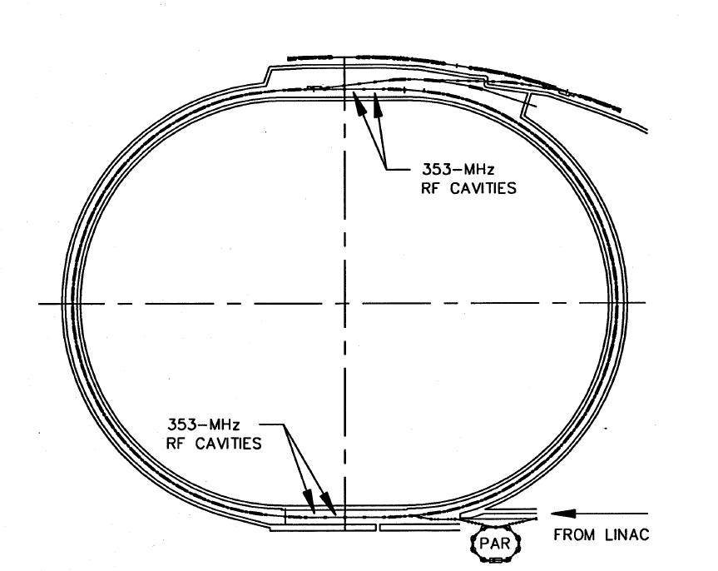
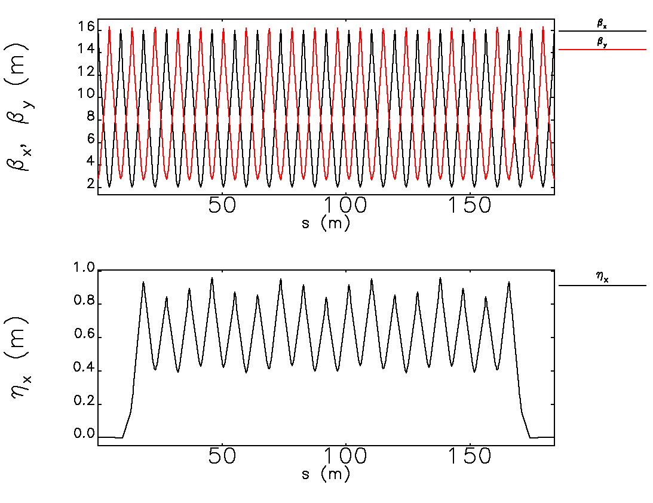
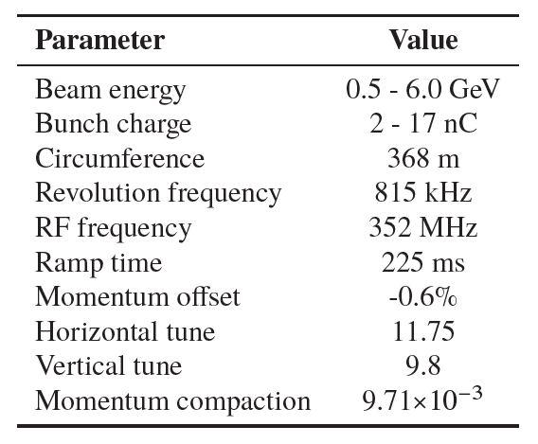
Booster parameters
Racetrack shape
FODO lattice with missing dipoles in straight section
Lattice functions for one half of booster shown
Operated off-momentum

Slide 7
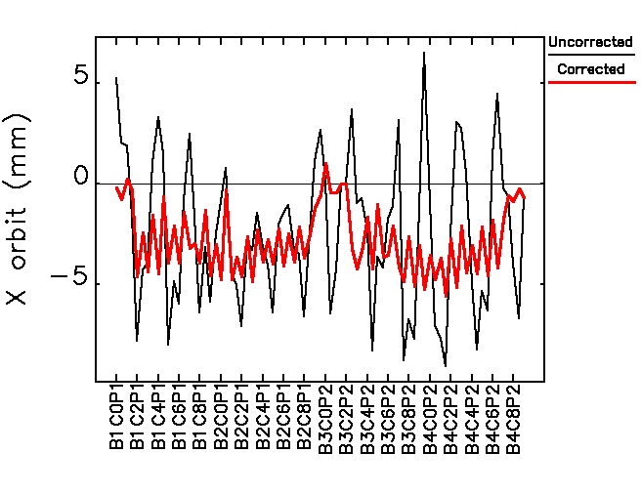
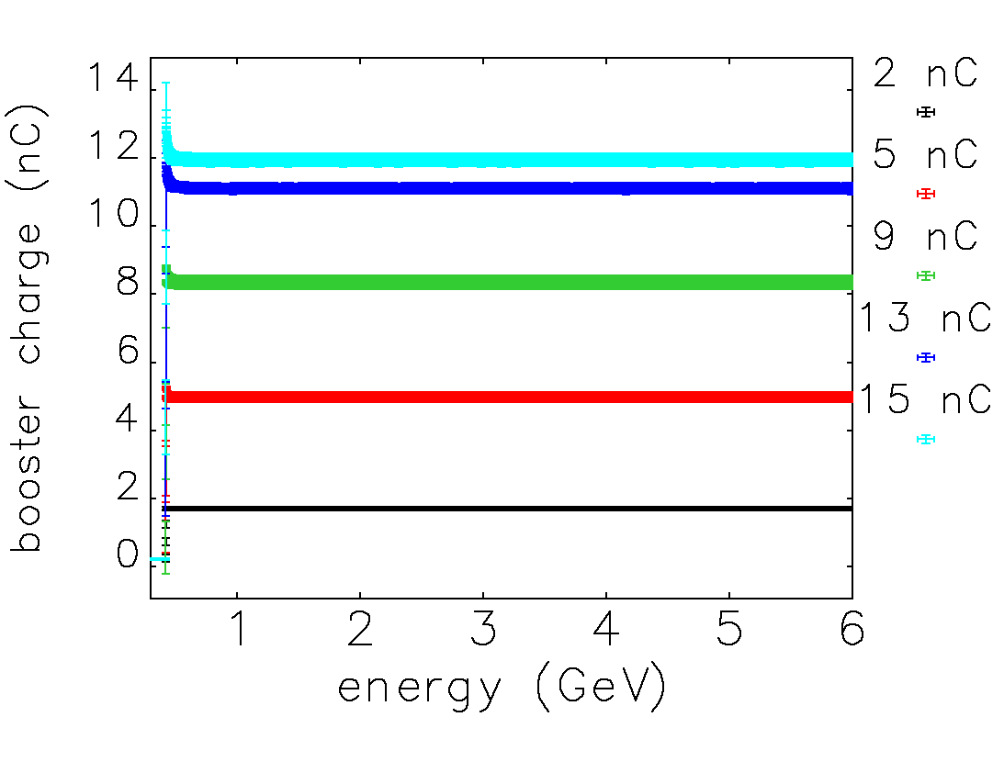
Booster status
Achieved 12 nC booster charge (70% of goal)
Progress and improvements:
  Switching from a “low emittance” lattice to one with zero dispersion in the straight sections¹
  Orbit correction over the booster ramp.
  Current-controlled sextupole power supplies
  New and re-commissioned diagnostics: synchrotron light monitors (SLMs)², photodiode bunch duration monitor (BDM)³ and turn-by-turn BPMs.
  Improvements to control of injection trajectory⁴
  Optimizing RF cavity voltage at injection vs charge
Efficiency drops above 10 nC injected charge⁵.
Good short-term charge stability (<5% rms)
[1] J. Calvey et al., NAPAC16, pp. 647-650.
[2] K. Wootton et al., proc. IBIC23.
[3] J. Dooling et al., IPAC18, pp. 1819-1822.
[4] C-Y. Yao et al., IPAC21, pp. 419-421.
[5] J. Calvey et al., IPAC21, pp. 197-199.

Slide 8
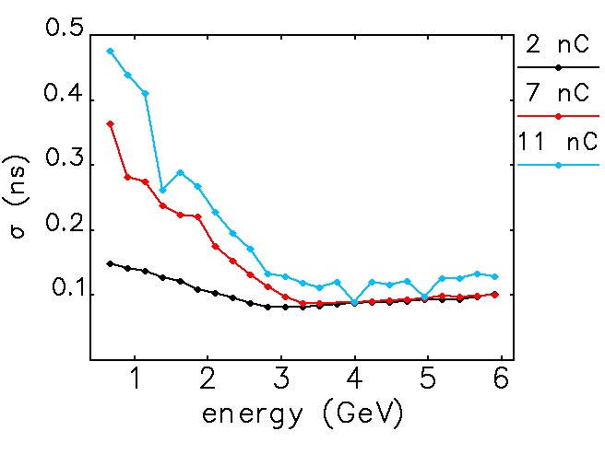
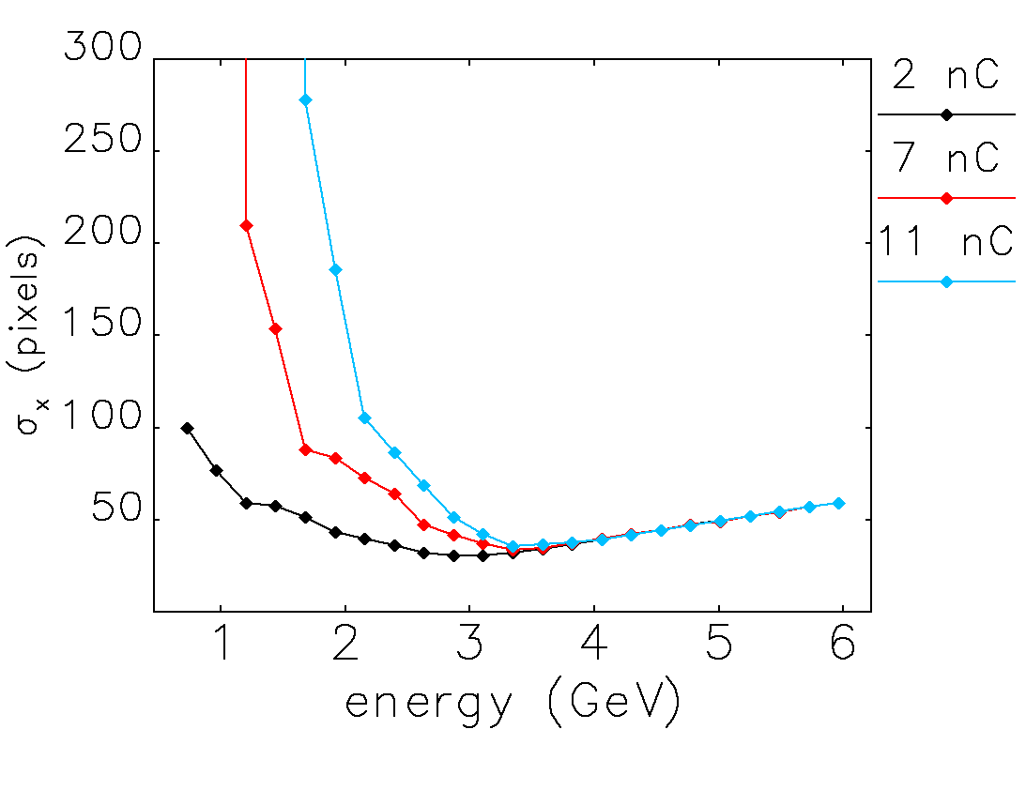
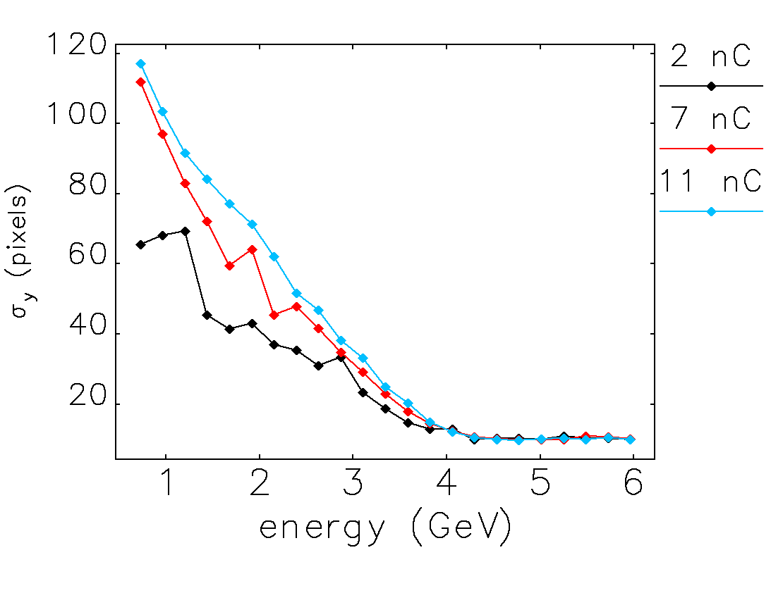
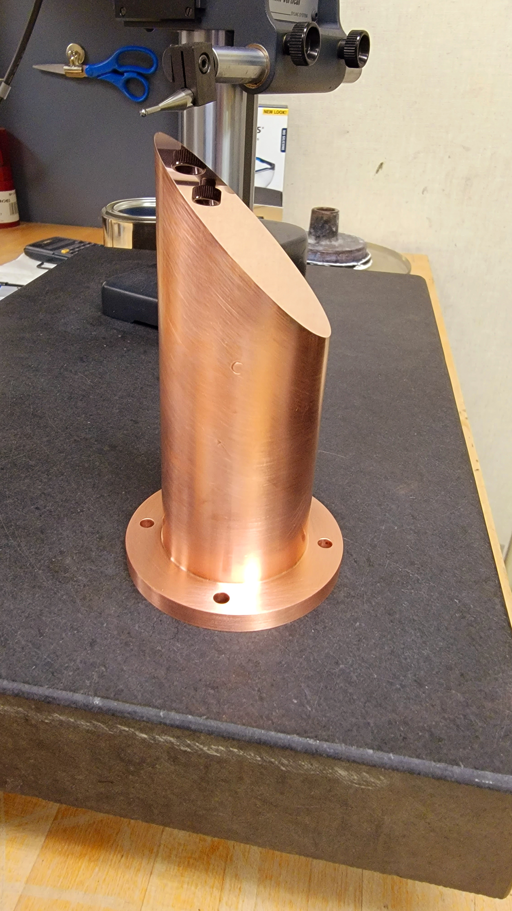
Measurements along the ramp
Beam size measurements from synchrotron light monitors (SLMs), bunch length from fast photodiode
Initial beam size blowup damps away by end of ramp
Suggestion of bunch length blowup at 11 nC
Observed thermal drift in photon diagnostics due to mirror heating, more stable mirrors are being installed
Bunch length
Horizontal beam size
Vertical beam size

Slide 9
Available charge for swap-out
Reliable injector charge limit is ~10 nC. More than sufficient for APS-U commissioning & KPPs.
Higher charge was de-emphasized by APS-U project. Achieved ≥ 12nC in studies but more work is needed after APS-U commissioning to achieve sufficient reliability.
Possible APS-U bunch patterns are highlighted in green.
  Table assumes 5% swap-out overfill and 95% injection efficiency.
  E.g., 48 bunches require 15.3 nC stored per bunch. Swap-out bunch charge is (15.3 x 1.05) / 0.95 = 17 nC.
# bunches/ total current | 48 | 54 | 72 | 81 | 108 | 144 | 162 | 324
200 mA | 17.0 | 15.1 | 11.3 | 10.0 | 7.5 | 5.7 | 5.0 | 2.5
175 mA | 14.8 | 13.2 | 9.9 | 8.8 | 6.6
160 mA | 13.6 | 12.1 | 9.0 | 8.0 | 6.0
130 mA | 11.0 | 9.8 | 7.3 | 6.5
120 mA | 10.2 | 9.0 | 6.8 | 6.0
nC bunch charge

Slide 10
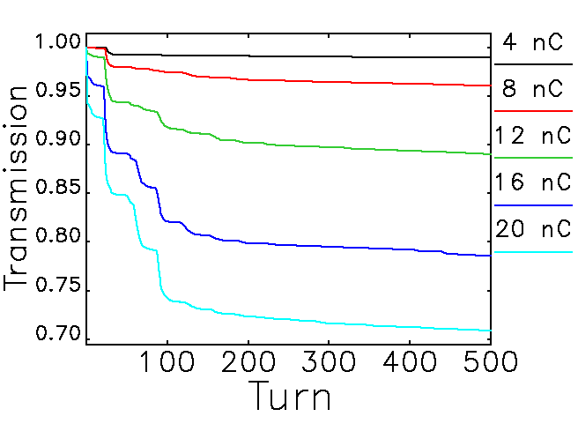
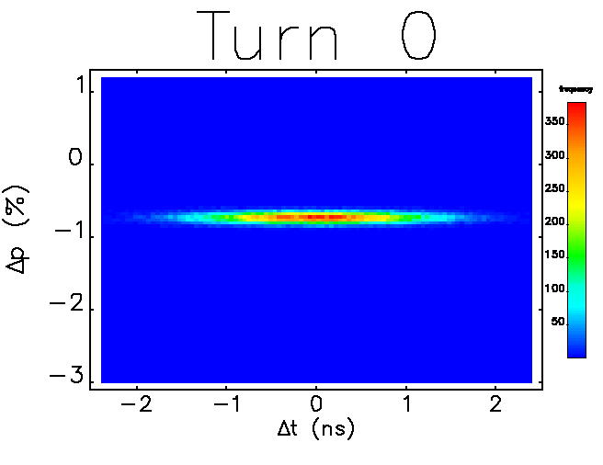
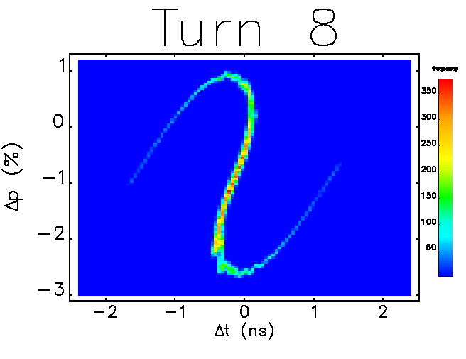
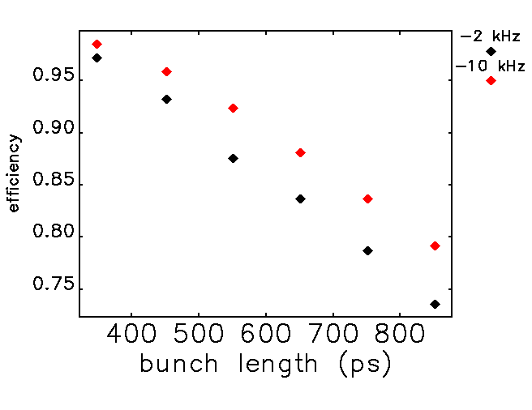
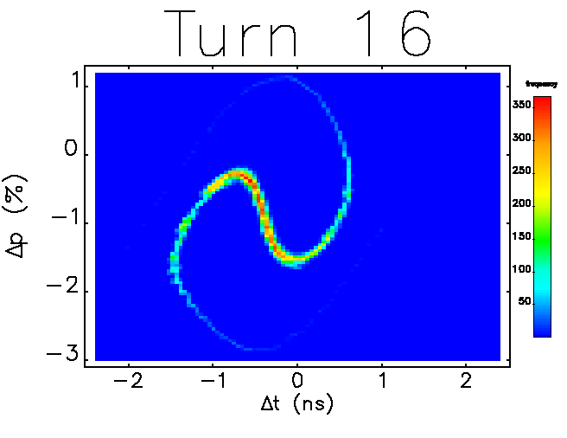
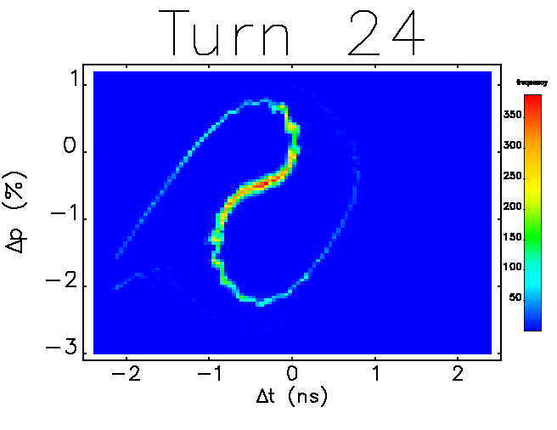

Comprehensive injection model
Using elegant [1], tracked 3000 booster turns (3.5 ms), where most losses occur.
Model includes momentum offset (-0.6%), transverse and longitudinal impedance [2], beam loading in rf cavities, and incoming beam parameters (e.g., beam size and bunch length vs charge) derived from measurements.
Good agreement with measured efficiency.
Main source of losses: PAR bunch length, beam loading.
Efficiency can be improved with shorter bunch length (PAR improvements) and detuning cavities³.
[1] M. Borland. ANL/APS LS-287, (2000). Y. Wang et al. Proc. of PAC 2007, 3444–3446 (2007).
[2] R. R. Lindberg et al. Proc. IPAC 2015. TUPJE078.
[3] ] J. Calvey et al., Proc. IPAC21, pp. 197-199
10

Slide 11
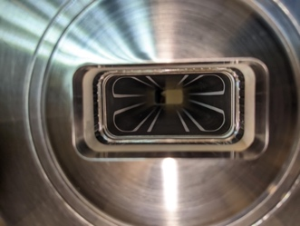
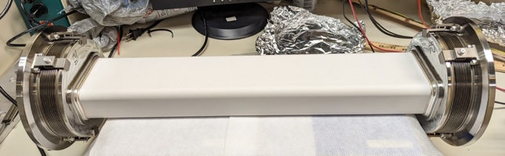
PAR longitudinal instability
Large bunch length blowup vs charge, caused by potential well distortion and microwave instability¹
Limiting factor for high charge booster injection²
Simulate with elegant^{3,4}. Model includes longitudinal impedance⁵ and beam loading in the rf cavities
Simulated bunch length agrees
well with measurement (but a bit lower)⁶
Installed new kicker chambers with patterned Ti coating for reduced impedance
PAR kicker chamber with innovative Ti coating
[1] K. C. Harkay et al., Proc. NAPAC’19, pp. 151–154.
[2] J. Calvey et al., Proc. IPAC’21, pp. 197–200.
[3] M. Borland, Rep. LS-287, APS, Sep. 2000.
[4] Y. Wang and M. Borland, Proc. AAC 877, p. 241, 2006.
[5] C. Yao et al., Proc. NAPAC’19, pp. 140--143.
[6] J. Calvey, Proc. NAPAC’22, pp. 859 – 862.

Slide 12
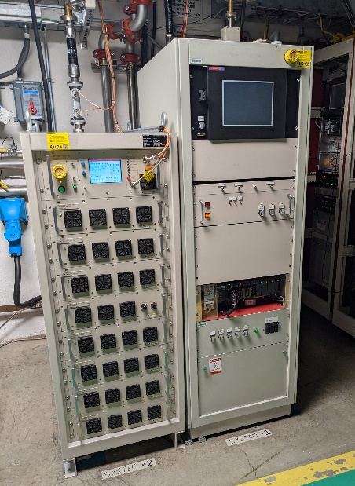
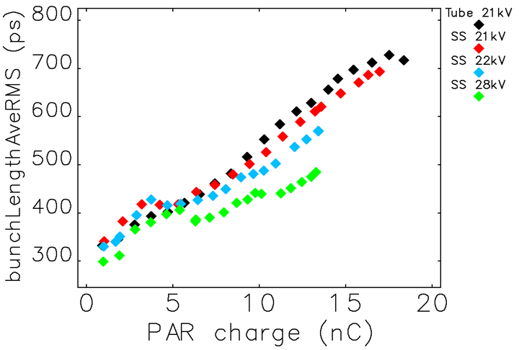
Shorter bunch length with new RF12 amplifier
10-kW harmonic rf solid-state amplifier (SSA) installed and operating reliably
Shorter bunch length even above microwave instability at ~10 nC.
Further optimization is planned to achieve higher bunch charge.
Further studies with >425 MeV and injecting into booster also planned.
Simulations predict bunch length can be kept below 600ps up to 19 nC with high voltage and higher energy
10-kW SSA 3-kW tube
Measurement
K. Harkay et al., Proc. NAPAC’22, TUPA23.
Simulation

Slide 13
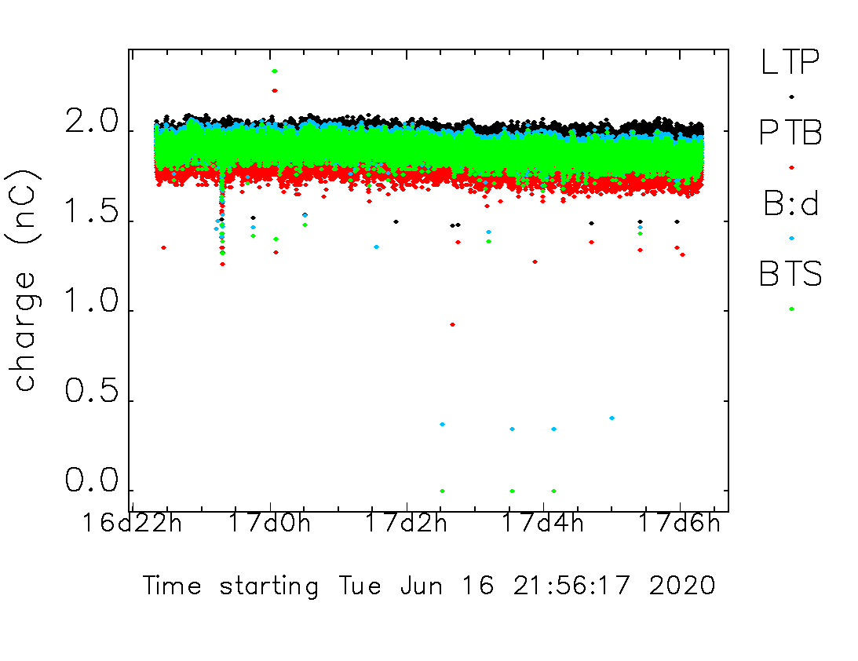
Injector charge stability
APS-U requires 5% rms charge stability from the injectors
APS-U will require frequent injection: 9 – 30 sec
Injector charge stability over several hours studied with 2 – 10 nC
Continuous and intermittent injection
Most cases have ≥ 90% efficiency, < 5% rms charge stability
Diagnose cases with low stability/efficiency by monitoring relevant process variables, looking for correlations with booster charge
Continuous
Intermittent

Slide 14
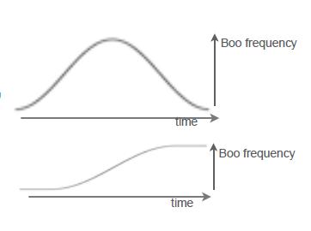
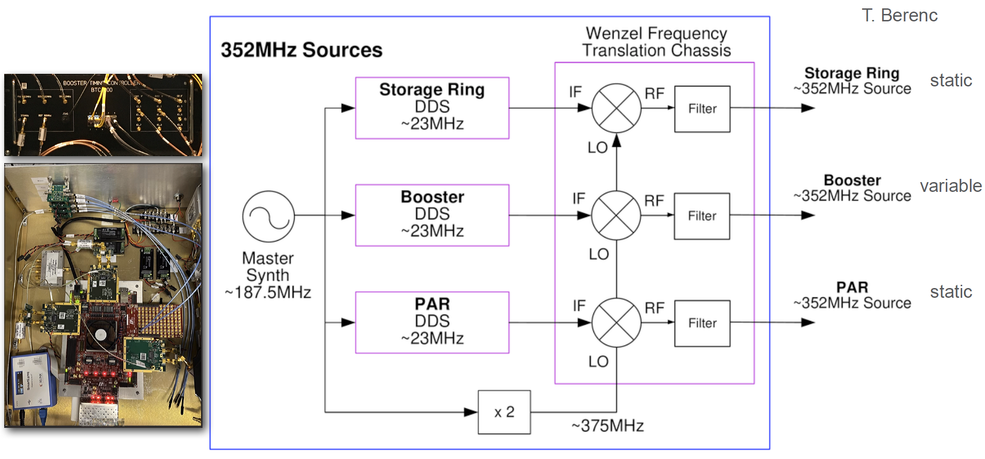
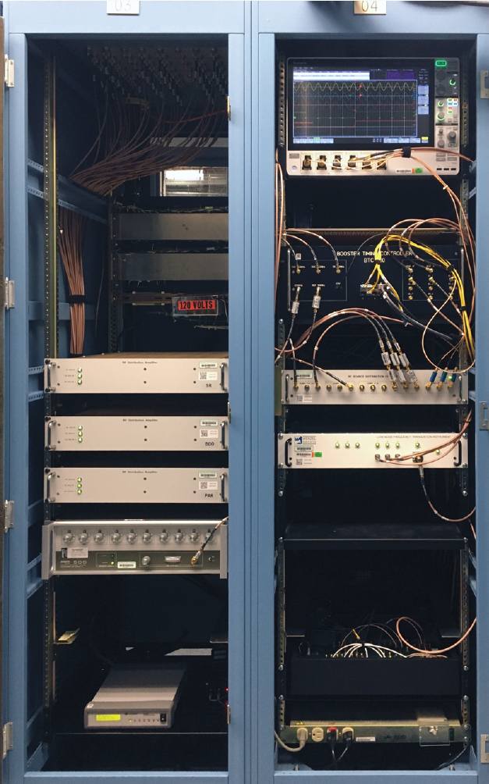
Injection/extraction timing & synchronization (IETS)
APS-U storage ring (SR) will have higher frequency than old one
SR, booster, and PAR rf frequencies will be decoupled
Booster frequency can be adjusted along the energy ramp
  Bucket targeting with frequency bump- changes time beam spends in the booster
  Overall frequency ramp - optimize both injection efficiency and extracted emittance
U. Wienands

Slide 15
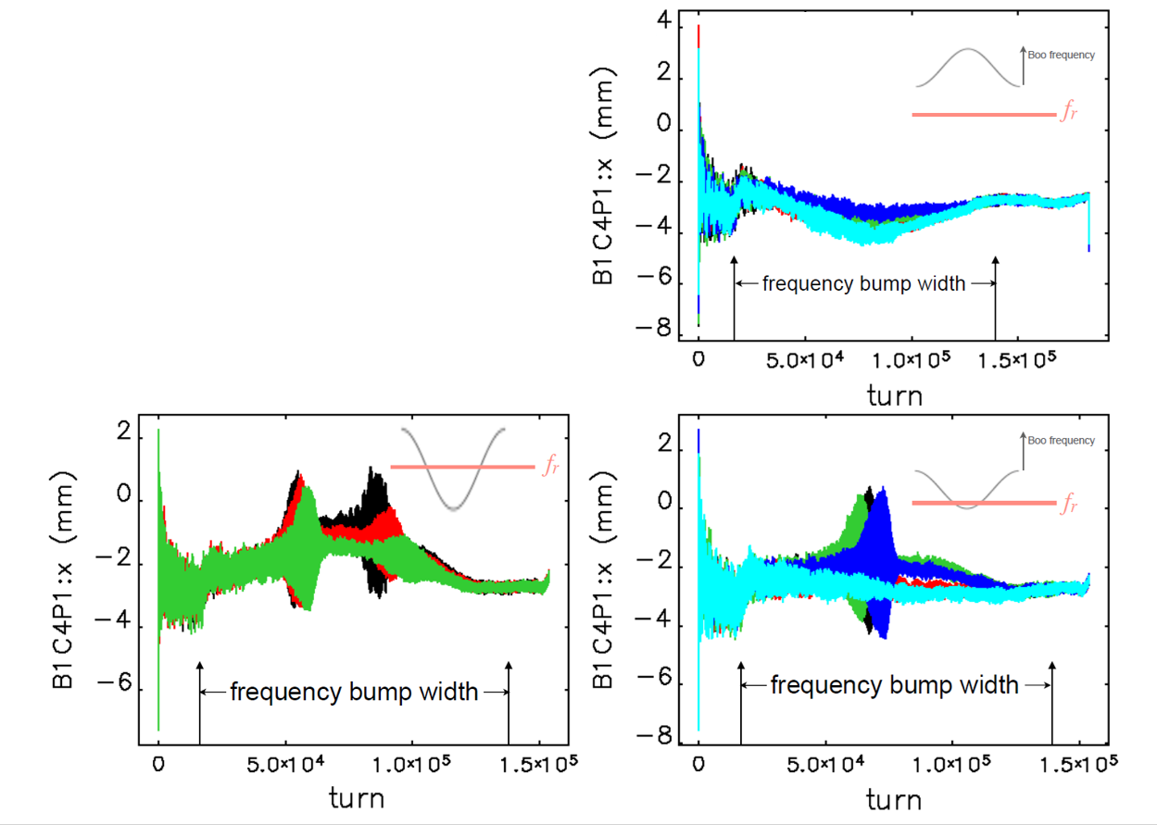
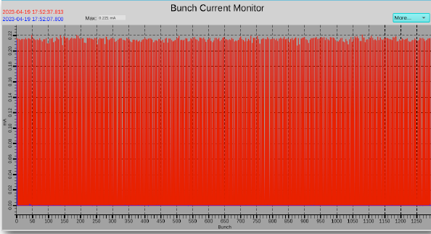
Targeting bumps
X position in dispersive BPM
Positive frequency bump -> negative X bump
Bump height different for each shot
Instability seen for negative frequency bump from crossing cavity resonance
Confirmed that bumps put the beam in the right SR bucket
Ring filled with IETS system

Slide 16
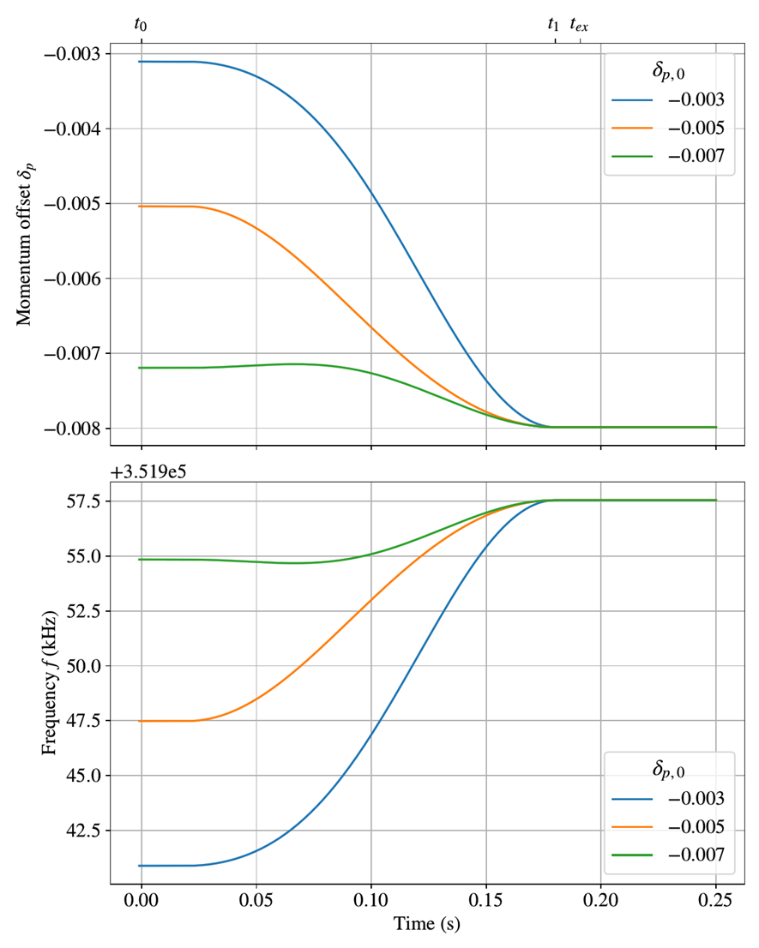
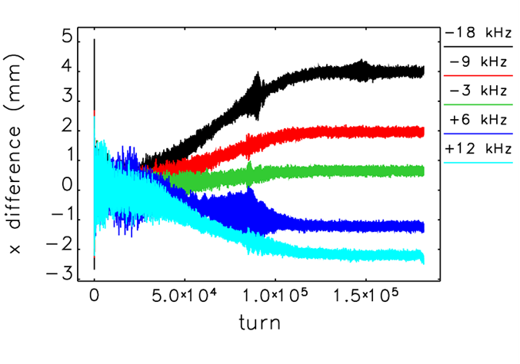
Frequency ramp
Want good booster injection efficiency (85+%) up to 20 nC
  Favors on-momentum injection.
Small emittance (preferably < 60 nm) at extraction
  Favors off-momentum extraction.
Achieve both with a frequency ramp
Each ramp shown has a different initial momentum offset, but a final offset of -0.8%.
Negative momentum sweep → positive frequency sweep
Results in large detuning at extraction

Slide 17
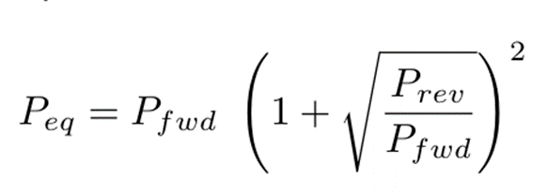
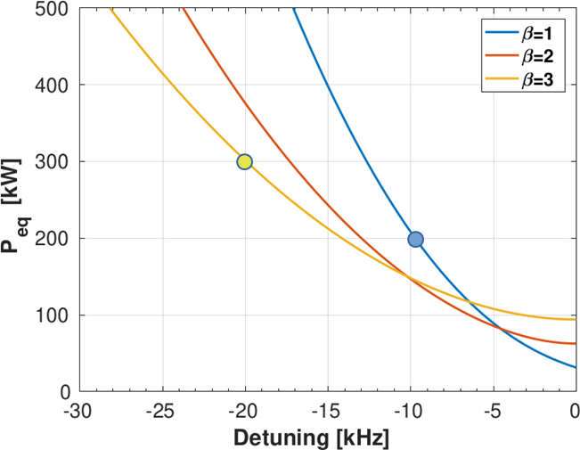
Achieving higher charge
High power couplers (HPCs) needed in the booster cavities to needed to handle high equivalent power at extraction
Total detuning = (detuning at injection) + (frequency ramp)
Over-couple the cavities to reduce beam loading and P_{eq}
Simulations showed good injection efficiency up to 20 nC with this scheme
HPC prototype was designed, installed and tested in the booster
  Rated for 500 kW, planned to run at 300 kW.
  No operational issues.
  Design had undesirable water-vacuum joints,
  had to be modified.
  HPC project was descoped by APS-U project.
  Renewed interest recently, working with CERN
  on a new 500 kW design.

Slide 18
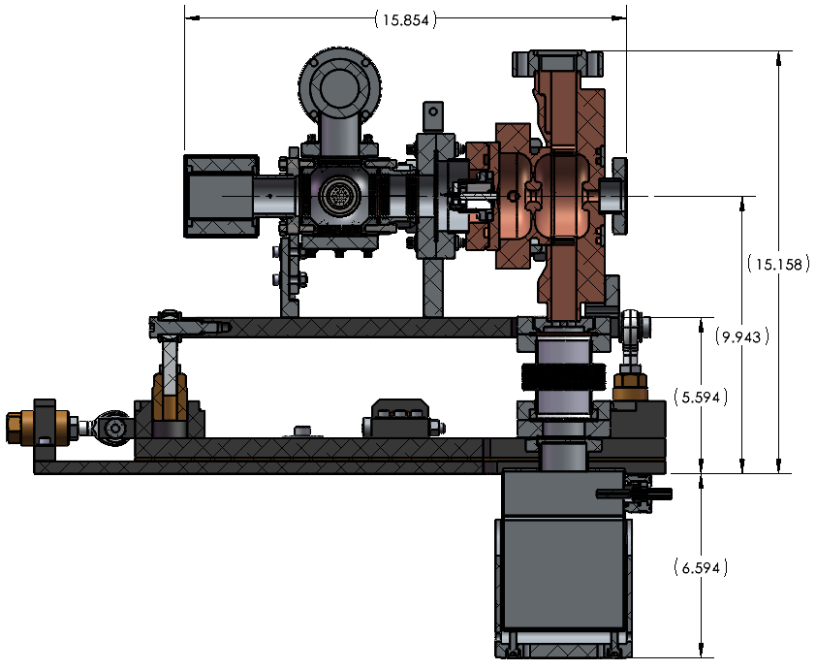
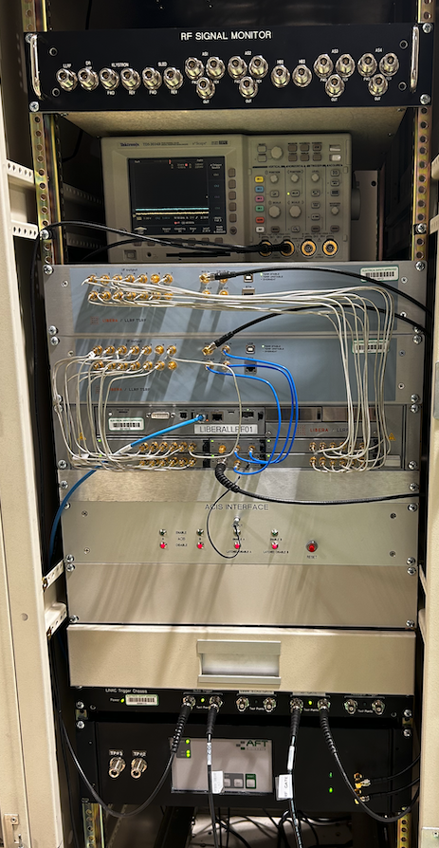
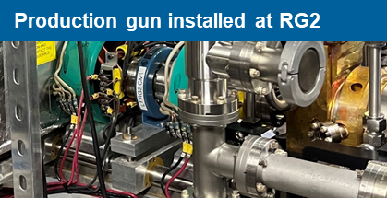
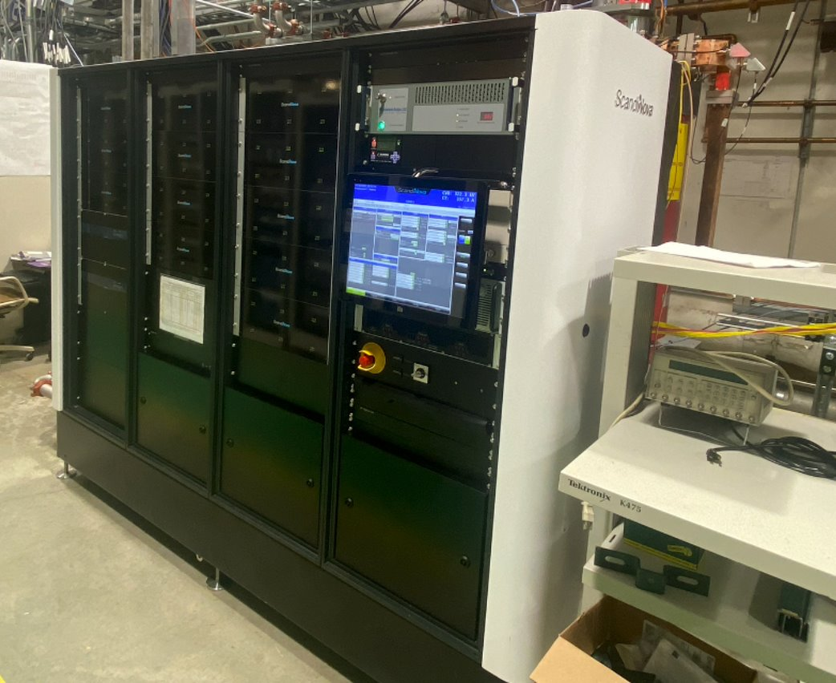
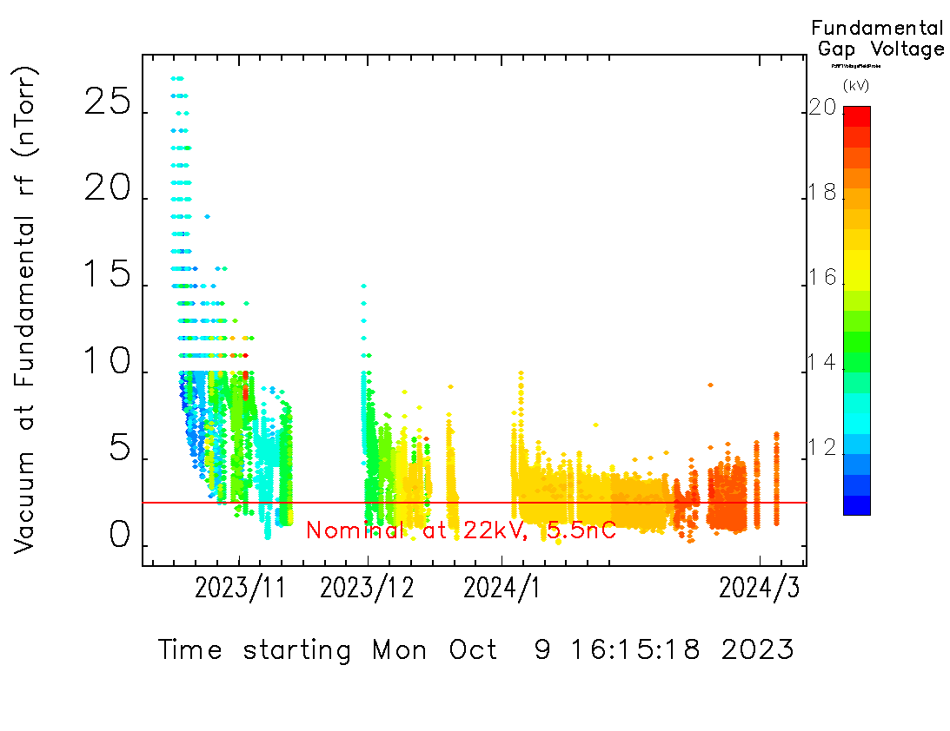
Injector re-commissioning: linac and PAR
Linac and PAR restarted last fall
Linac upgrades
  New timing system
  Higher power (50 MW) klystron
  in 1/3 stations
  New thermionic RF guns
  Faster corrector power supplies
  Recovered 1 nC/pulse, good PAR injection efficiency
New kicker chambers in PAR
PAR vacuum initially very poor, limited fundamental RF gap voltage
  Slowly improving with beam scrubbing
Radiabeam Gun
Version 2
Libera DLLRF at K2
50-MW K2 klystron and modulator

Slide 19
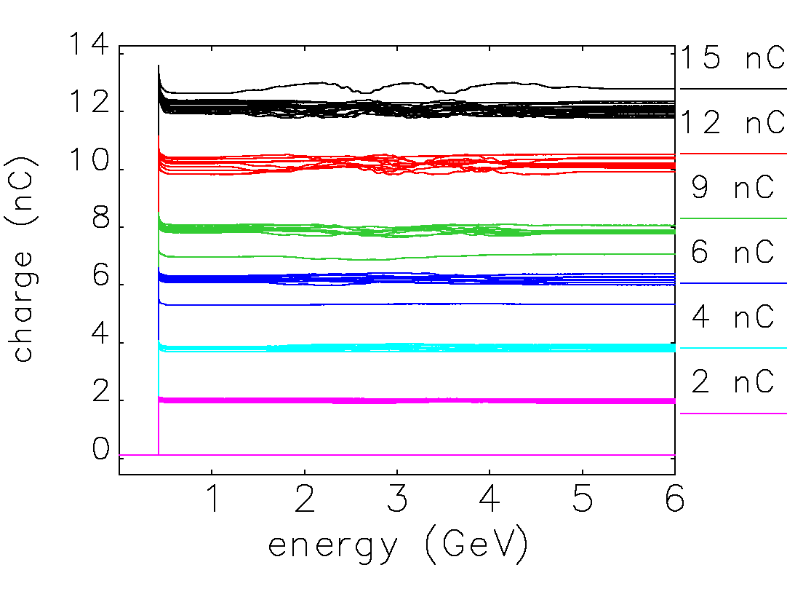
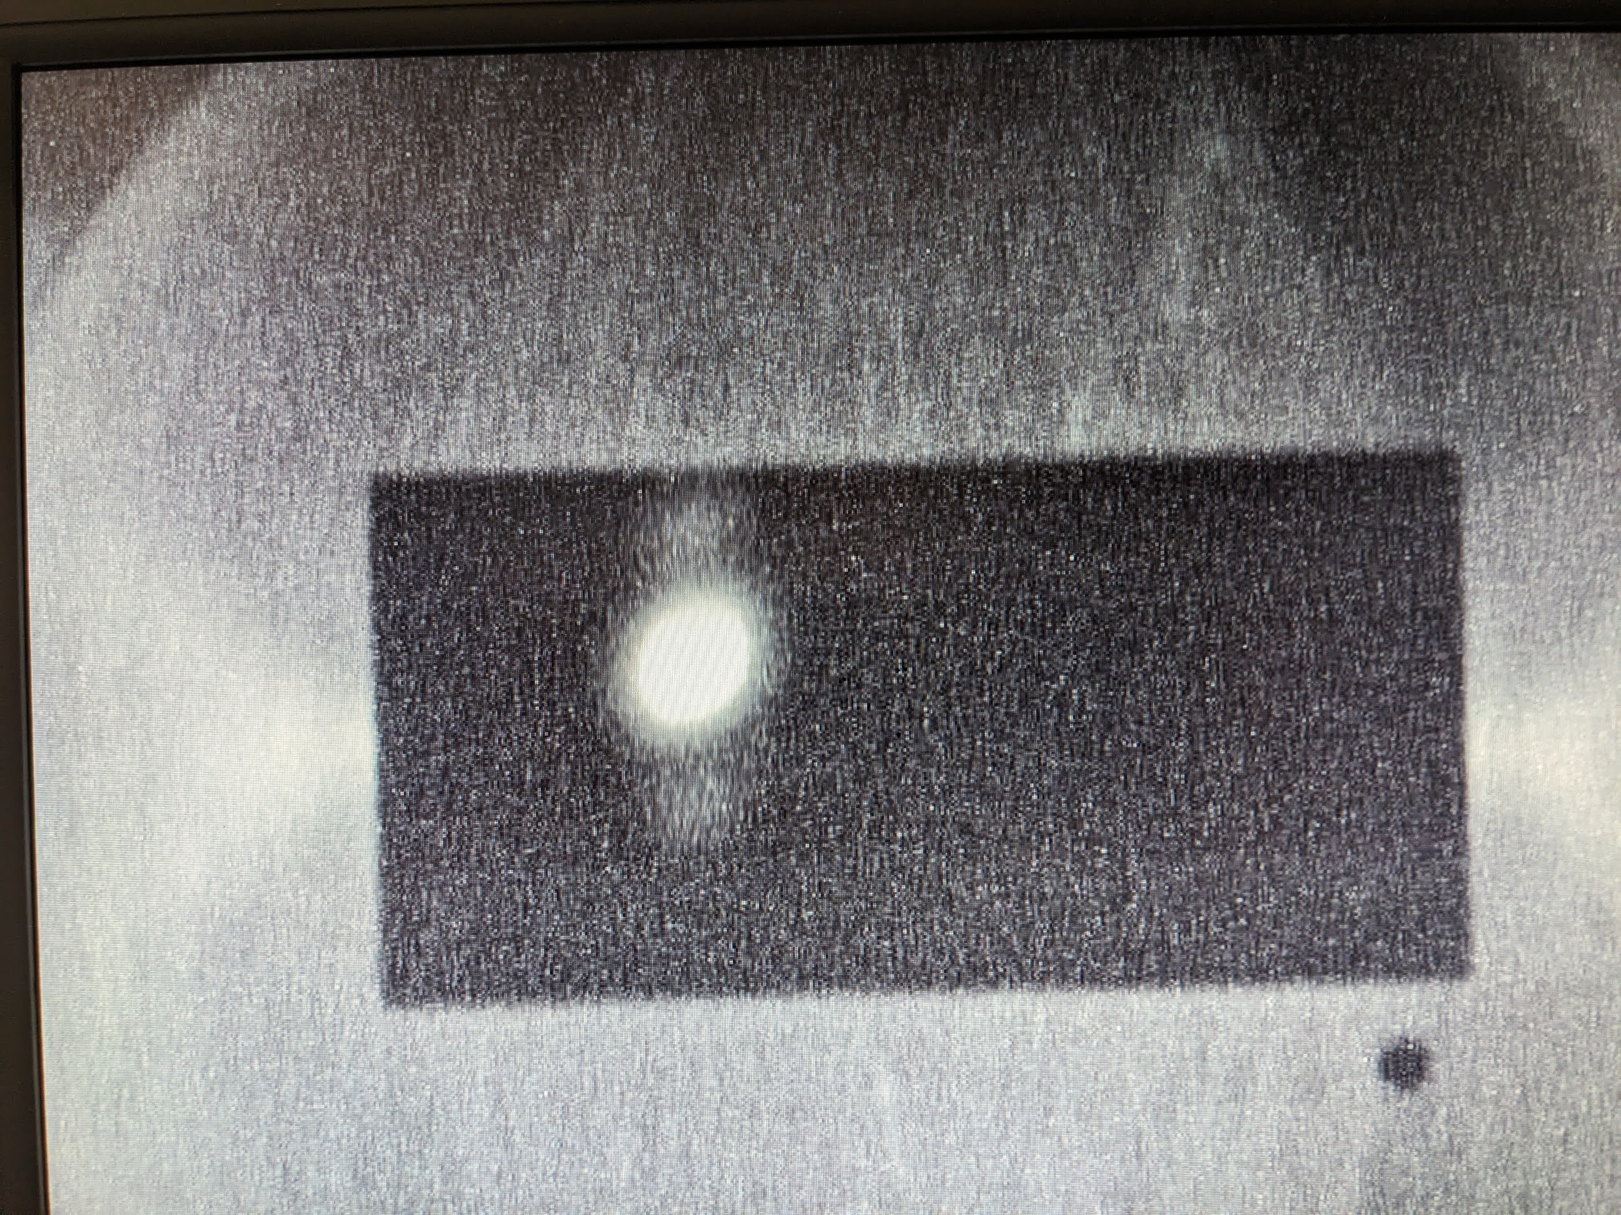
Injector re-commissioning: booster
Booster re-started in February
Demonstrated injection and acceleration to 6 GeV
  Tuned for good injection efficiency, charge stability
  Ran with IETS frequency bumps and ramps
  High charge: 9 nC with frequency ramps,
  12 nC without
Demonstrated booster extraction to BTS dump
Injected charge
Beam image on BTS dump flag

Slide 20
Conclusions
Upgrades and intensive studies have raised the APS injector charge limit from ~4nC to 12 nC
Injector charge stability has been characterized up to 10 nC
Booster is run with separate, variable rf source
  Frequency bumps for bucket targeting
  Overall frequency ramp for optimizing injection/extraction
To achieve higher charge:
  Finish commissioning new RF12 amplifier, for shorter PAR bunch length
  Raise linac energy, for more stable PAR beam
  Install high power couplers in the booster cavities, to allow for large detuning and over-coupling
Injector re-commissioning is essentially complete
APS-U storage ring commissioning starting soon!

Slide 21
Acknowledgements: Injector Working Group
K. Harkay – PAR Machine Manager
G. Fystro – Injector Chief of Operations
M. Borland¹, J. Dooling, L. Emery, D. Hui, N. Kuklev, R. Lindberg, I. Lobach, A. Lumpkin², B. Micklich⁴, A. Nassiri³, V. Sajaev¹, N. Sereno³, Yine Sun³, Yipeng Sun, A. Xiao⁶, U. Wienands⁴, K. Wootton, B-x. Yang, C-Y. Yao²; A. Blednykh⁵; J. Steinmann⁶
I. Abid, R. Agner, N. Arnold², K. Belcher, T. Berenc, D. Bromberek, A. Brill, G. Bruno, H. Bui, J. Carter, C. Doose, S. Farrell, R. Flood, T. Fors, A. Goel, M. Henry, E. Heyeck, A. Hillman, R. Hong, D. Horan, R. Keane, R. Laird, F. Lenkszus², T. Madden, L. Morrison³, S. Pasky, A. Pietryla, T. Puttkammer, F. Rafael⁴, P. Rossi, H. Shang, S. Shoaf, T. Smith, R. Soliday, J. Stevens, J. Vacca, G. Waldschmidt, J. Wang³, F. Westferro, S. Xiang, S. Xu, Y. Yang, W. Yoder, B. Berg
¹ Associate Division Director; ² Argonne Associate or Retired; ³ Group leader; ⁴ APS-U; ⁵ BNL; ⁶ Formerly at ANL
21
Notes:
3/6/2024
Go to ”Insert (View) | Header and Footer" to add your organization, sponsor, meeting name here; then, click "Apply to All"
21

Slide 22
Thanks for your attention!

Slide 23
Backup slides

Slide 24
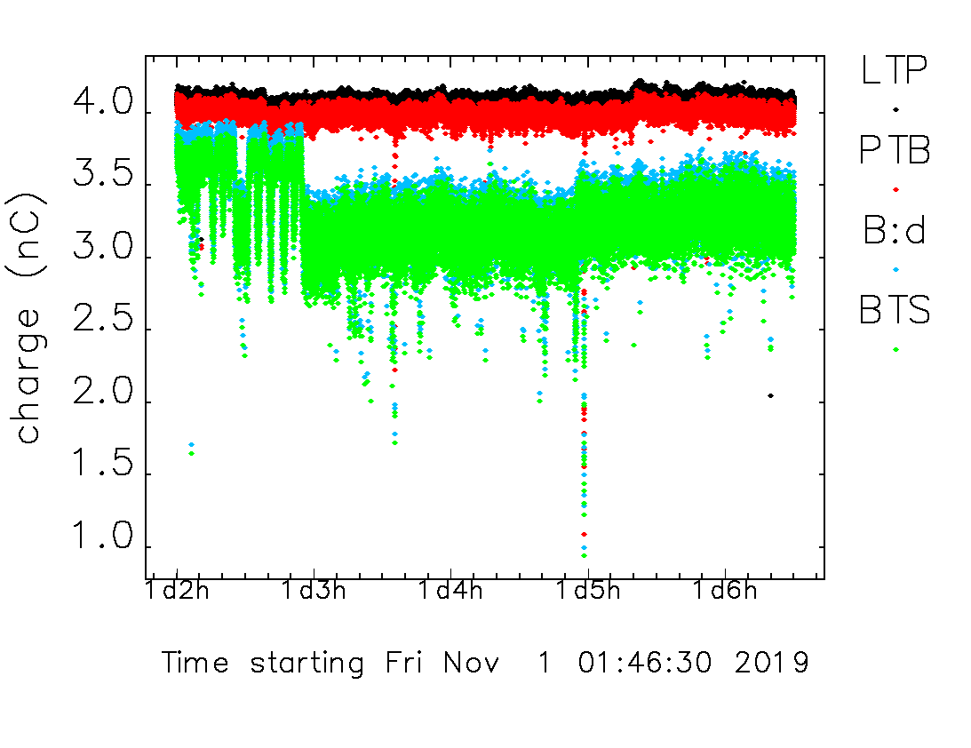
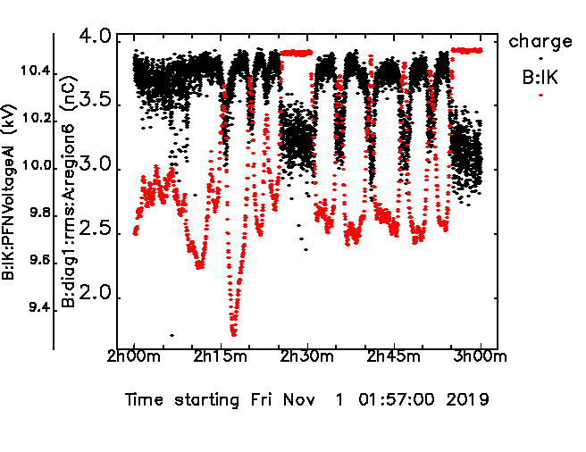
Identifying source of bad
efficiency / stability
Ex: 4 nC, 80% efficiency, 7.5% rms
Monitor relevant process variables (PVs) at a 2 Hz rate
Look for correlation between booster charge and each PV
Clearly related to injection kicker voltage
  Process for correcting booster injection trajectory was misbehaving
  Has since been improved, works well consistently¹
[1] C. Yao et al., Proc. IPAC’21, pp. 449–450.
24

Slide 25
Time to stabilize
After beam is enabled, how many shots does it take to get stable beam through the injector?
Special PVs developed to track a bunch through the injector chain
Study injector issues on a shot-by-shot basis
Look at many (~100) cycles, take average and standard deviation
Time to stabilize
  2 nC: 1 shot (0.5 sec) for PTB, 4 for BTS
  5 nC: 1 shot for PTB, 6-8 for BTS (3-4 sec)
  High charge: 9+ seconds
Fix by locking booster cavity tuners in place. After this, 3-4 sec for stable high charge beam

Slide 26
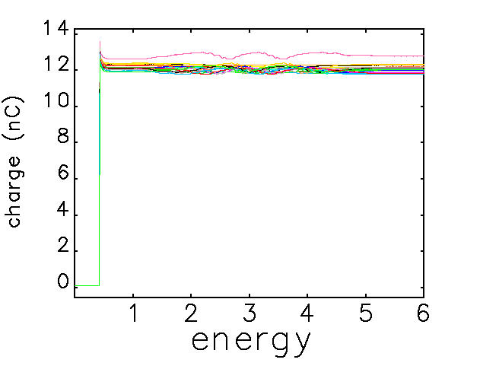
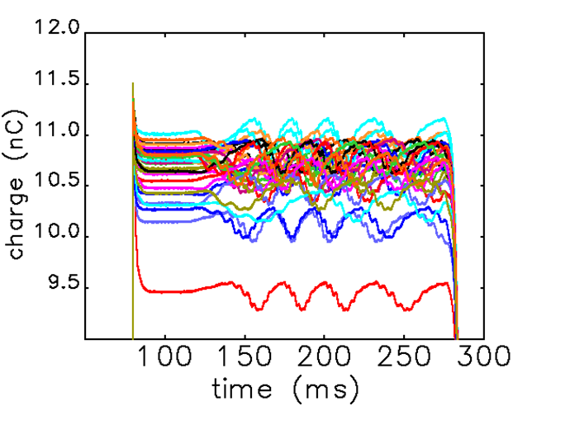
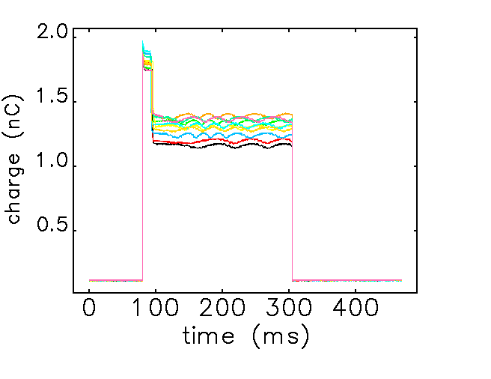
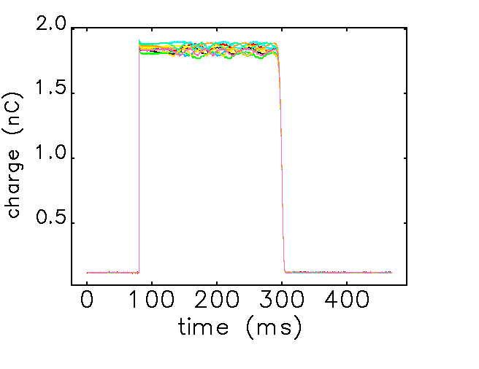
High charge with IETS
Achieved 12nC with frequency bumps only, 10.5nC with bumps+ramp
With frequency ramp, need to detune cavities to prevent charge loss
Current monitor wavy because it is not (yet) synchronized to new booster rf
Bump only
Ramp + bump
No detuning
Detuning

Slide 27
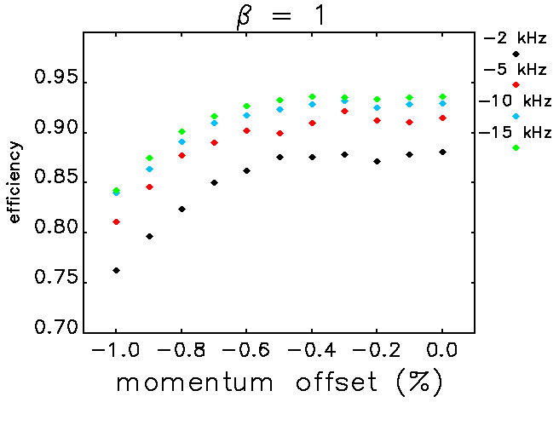


Booster injection efficiency vs rf parameters
Simulations with 20 nC, 600 ps bunch length
Injecting off momentum reduces injection efficiency
Detuning the cavity reduces beam loading, increases efficiency
Over-coupling reduces sensitivity to detuning
Scheme is flexible, provides range of possible options
For -0.8% extraction offset

Slide 28
Development plans for post-commissioning APS-U needs
Booster digital LLRF system (started, but deferred)
  Needed to measure/maintain constant detuning
  Option for direct feedback and/or feedforward
More synchronized PVs
Booster photon diagnostics: glidcop mirrors for other photon ports
Injector current monitor upgrades, using BTS BESOCM electronics
High power couplers for high charge operation
Re-deploying old SR DCCT in the booster
Long term:
  Upgraded ramping power supplies for the booster
  Comb filter LLRF feedback could allow for positive detuning
28

