Slide 1
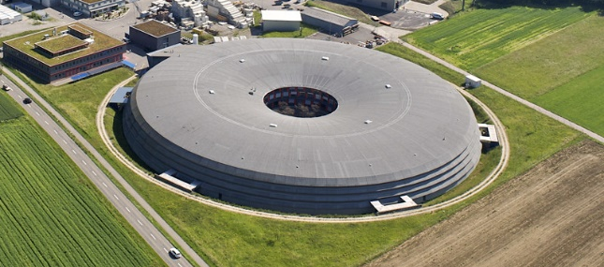
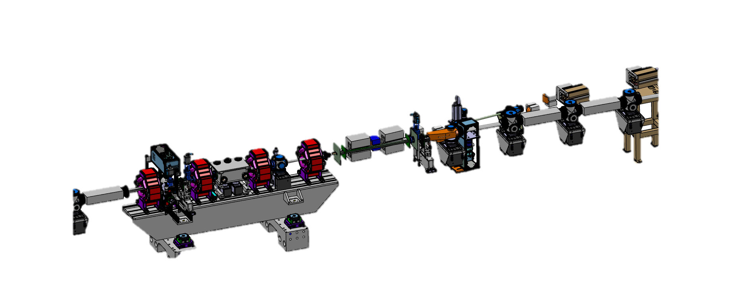
Permanent and pulsed septa for SLS 2.0
M. Paraliev
Transfer line
Swiss Light Source (SLS) part of
Paul Scherrer Institute,
Switzerland
Storage ring
Beam dump
Thick septum
Thin septum
Injection straight

Slide 2
Motivation
Injection in small dynamic aperture
Due to the new SLS 2.0 low emittance lattice the beam acceptance of the machine is reduced. A thin septum should make the conventional 4-kicker bump injection possible [1].
Top-up injection transparency
Advanced injection modes like fast injection and on-axis injection will improve further top-up injection transparency [2].
Beam dump
Due to the much smaller dispersion in the arcs (compared to SLS 1) an RF phase inversion-based beam dump might not be acceptable, causing beam loss and irradiation of sensitive devices like superconducting superbends and in-vacuum undulators. To avoid deterioration or damage, a dedicated beam dump magnet should deflect the beam towards well shielded beam dump.
Improved septa
Fast injection elements
Dedicated beam dump

Slide 3
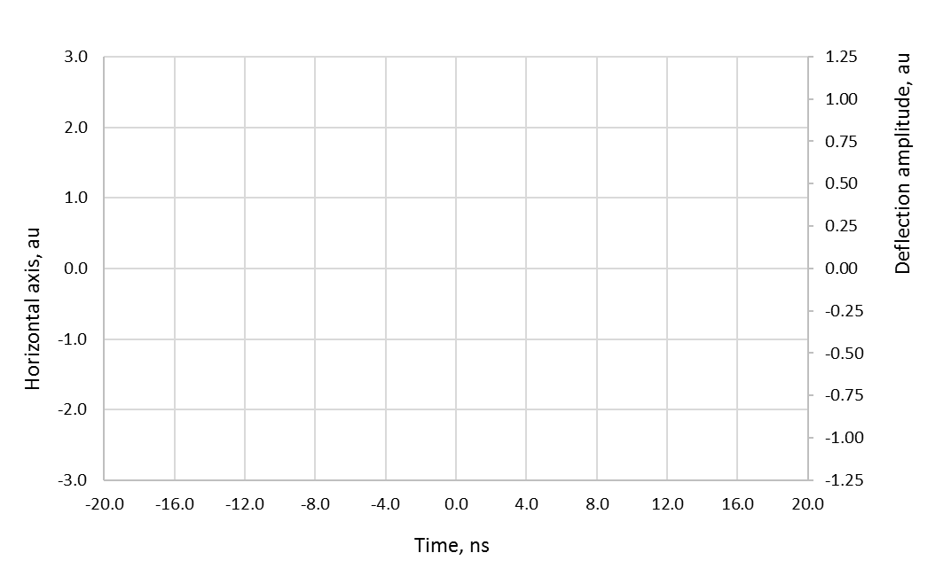
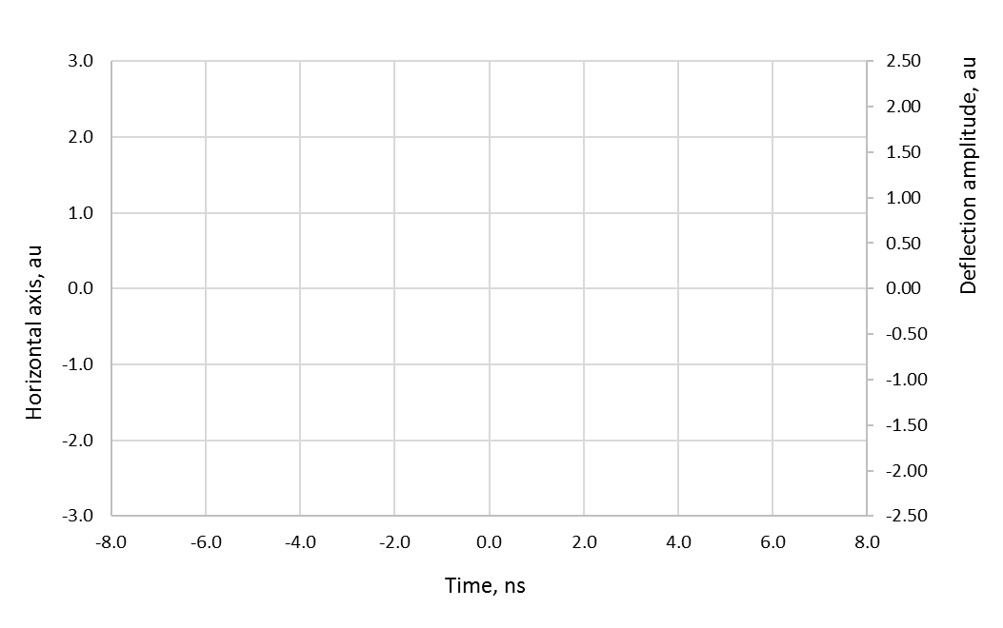


SLS 2.0 Advanced Injection Schemes
“Fast” injection scheme, aperture sharing
“Super-fast” injection scheme, on-axis
A portion of the stored beam (15 bunches in the illustration) and the injected bunch are deflected with a short kicker pulse (20..30 ns) to fit in the machine aperture. With decaying Betatron oscillation they come back on axis.
A very short kicker pulse (<2 ns) puts an off-momentum injected bunch on-axis without significantly disturbing the adjacent stored bunches. With decaying Synchrotron oscillation the injected bunch joins a stored one.
Injected bunch
Fast Pulse
Injected bunch
Super-fast Pulse
Septum
Septum
Stored beam on-axis
Injected bunch joins the stored bunch
Stored beam on-axis
Injected bunch joins the stored bunch
Simplified illustration of “Fast” injection scheme with aperture sharing (off-axis injection)
Simplified illustration of “Super-fast” on-axis injection scheme

Slide 4
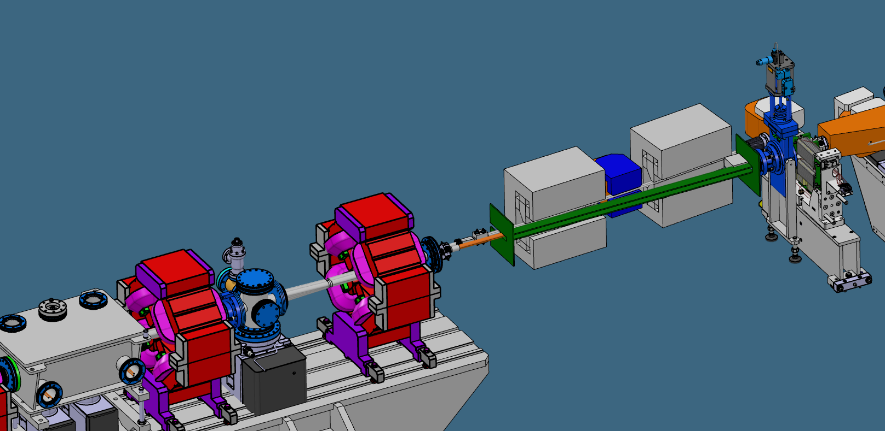
SLS 2.0 Permanent Magnet-based Thick Septum
Permanent magnet-based septum will ensure the necessary deflection and stability of the injected beam benefiting from practically maintenance-free operation. Advance magnetic materials like CoFe high magnetic saturation alloys make possible to screen the dipole field in the stored beam region.
Split septum design with and electrical corrector in the middle
Soft magnetic material sandwich-shielding for the stored beam
  Thick Septum Specification
Parameter | Thick Septum
Gap, mm | 10
Magnet length, m | 2x 0.35
Bending angle, mrad | 120@2.7 GeV
Field integral, T.m | 1.1
Gap field. T | 1.57
Permanent magnets’ type | Sm₂Co₁₇
Target zero-field integral, μT.m | 50
Shielding coefficient, - | >20000
Stability, ppt | ±0.1
  Thick septum 3D model

Slide 5
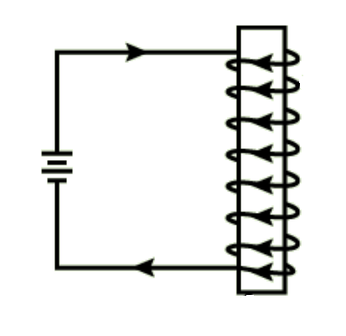
Field strength
The development of strong rare-earth magnets makes possible to create more compact and consumption-free magnetic devices.
Good understanding of magnetic circuits behavior is essential for the design of permanent magnet-based accelerator components.
Remanence limits of the more common strong permanent magnets:
NdFeB – up to 1.5 T
Sm₂Co₁₇ – up to 1.2 T
Magnet material has practically free space permeability (is an additional “gap” in the magnetic circuit)
Using “flux concentration” technique the gap field can be made higher than the maximum magnet field (in the expense of massive increase of the necessary magnet volume)
S
  Magnetic “gap”
N
  Magnetic gap
Electrically driven magnetic device
Permanent magnet driven magnetic device

Slide 6
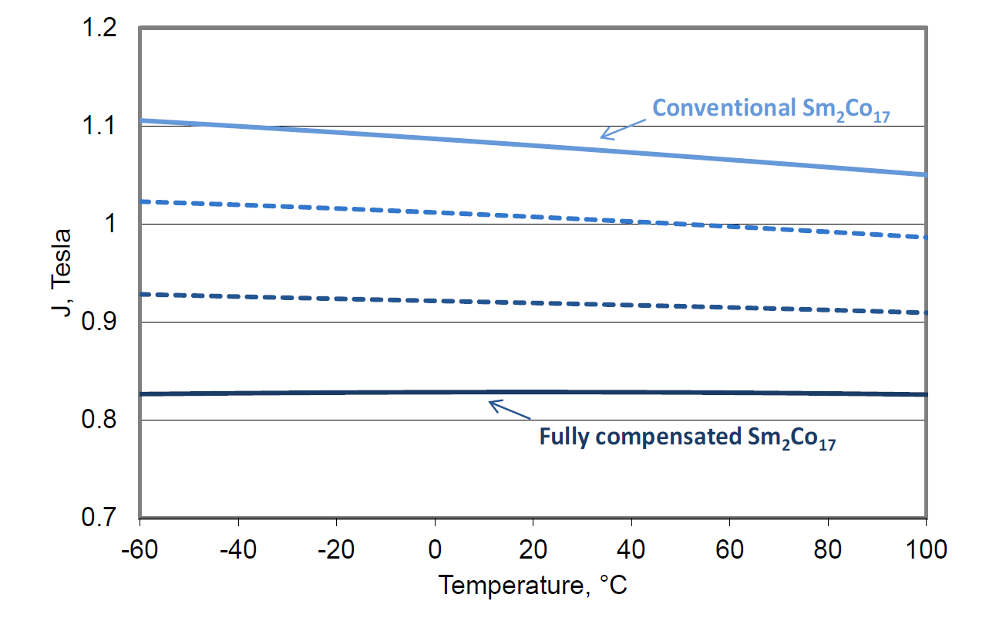
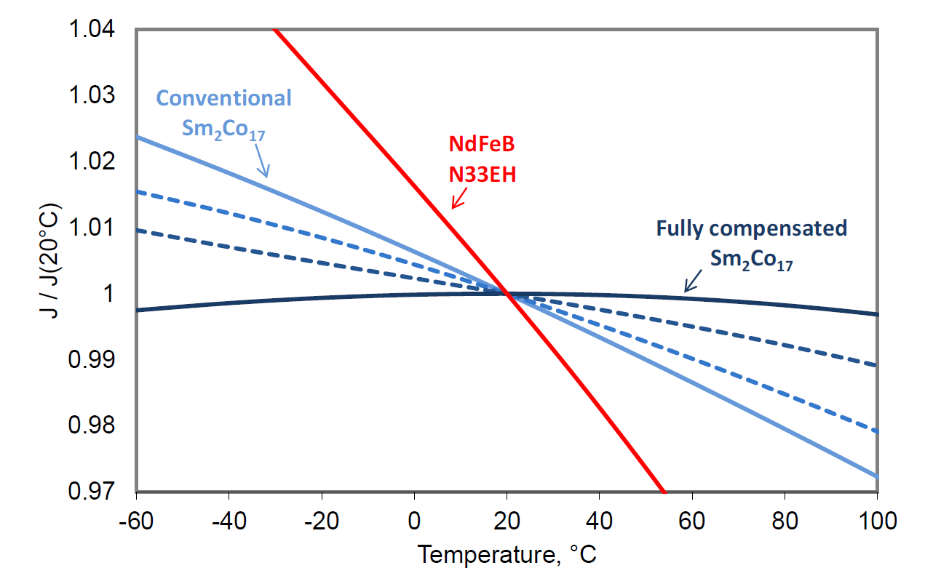
Reversable field change
(Is permanent magnet really “permanent”)
Temperature sensitivity
NdFeB – 0.9-1.2 ppt/K
Sm2Co17 – 0.3-0.5 ppt/K
Permanent magnets lose their strength with increasing temperature and gain strength with reducing the temperature (within their operation temperature range)
  Absolute field vs temperature of different Sm₂Co₁₇ alloys [3]
  Relative field temperature sensitivity of NdFeB and different Sm₂Co₁₇ alloys [3]

Slide 7
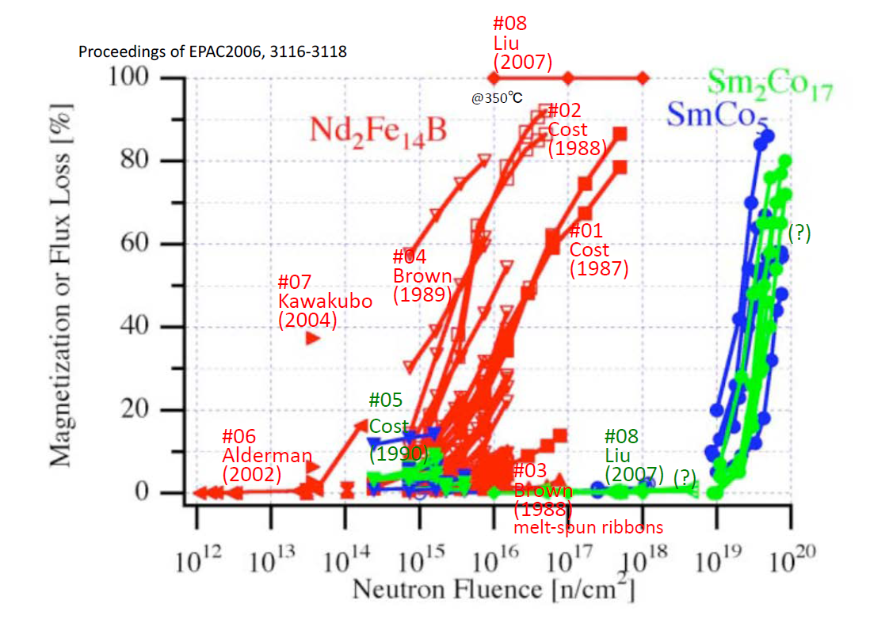
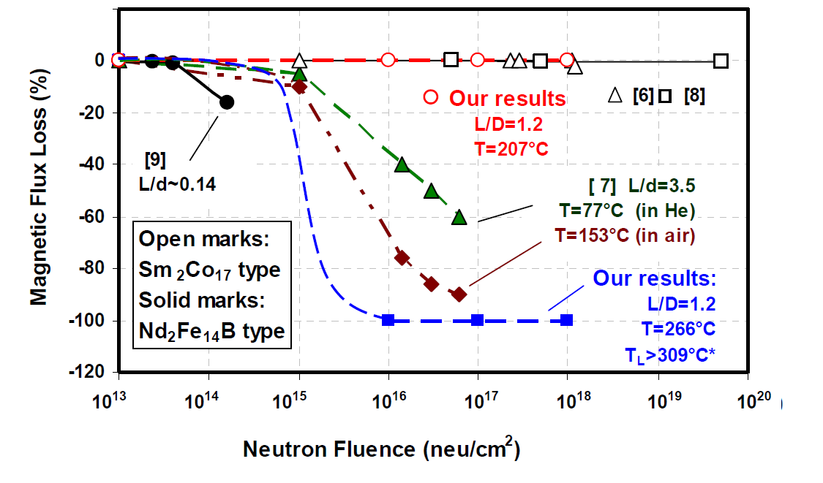
Irreversible field change
(Radiation degradation)
Permanent magnets irreversibly degrade under irradiation with high energy photons and particles.
There are different attempts to evaluate their degradation. Nevertheless, a high confidence assessment is difficult due to poorly defined conditions and difficulty to recreate realistic configurations.
  Magnetic field degradation under neutron exposure for different magnet types [4]
  Reduction of magnetic field under neutron exposure for different magnet types [5]

Slide 8
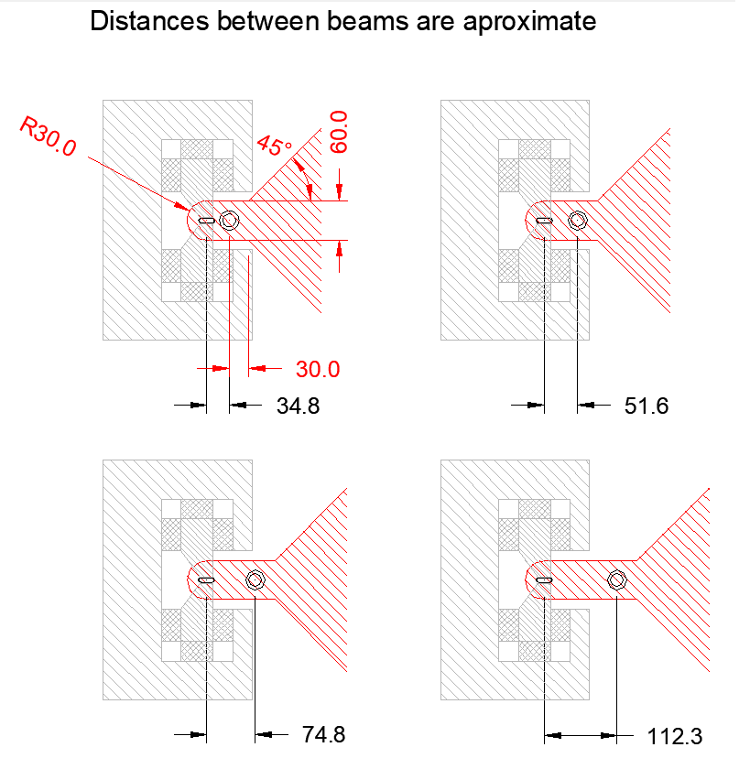
Radiation damage considerations
Careful radiation analysis should be done to define the radiation dosage.
Local shielding can improve (or worsen) the situation.
Place permanent magnets blocks as much as possible away from the beams.
Design constrains for dipoles construction – magnets should not be placed in red hatched areas

Slide 9
Beam dump related radiation (horizontal plane)
Radiation levels should not cause permanent magnets’ magnetic field degradation.
Neutron fluence at first (upper graph) and second (lower graph) permanent magnet-based septum dipole
  Courtesy of I. Besana

Slide 10
Shielding with soft magnetic material
Two-stage shielding of Armco iron and Permenorm5000 (FeNi) reduces B down to a few micro Tesla.
The thick septum is ordered
at Arnold Magnetic Technologies
  Shield construction
6 µT
2 T
0 T
0 T
  Field on the shield outer layer
  Field inside the shield
  Dipole – shield configuration
  Courtesy of G. Martinek (Arnold Magnetic Technologies)

Slide 11
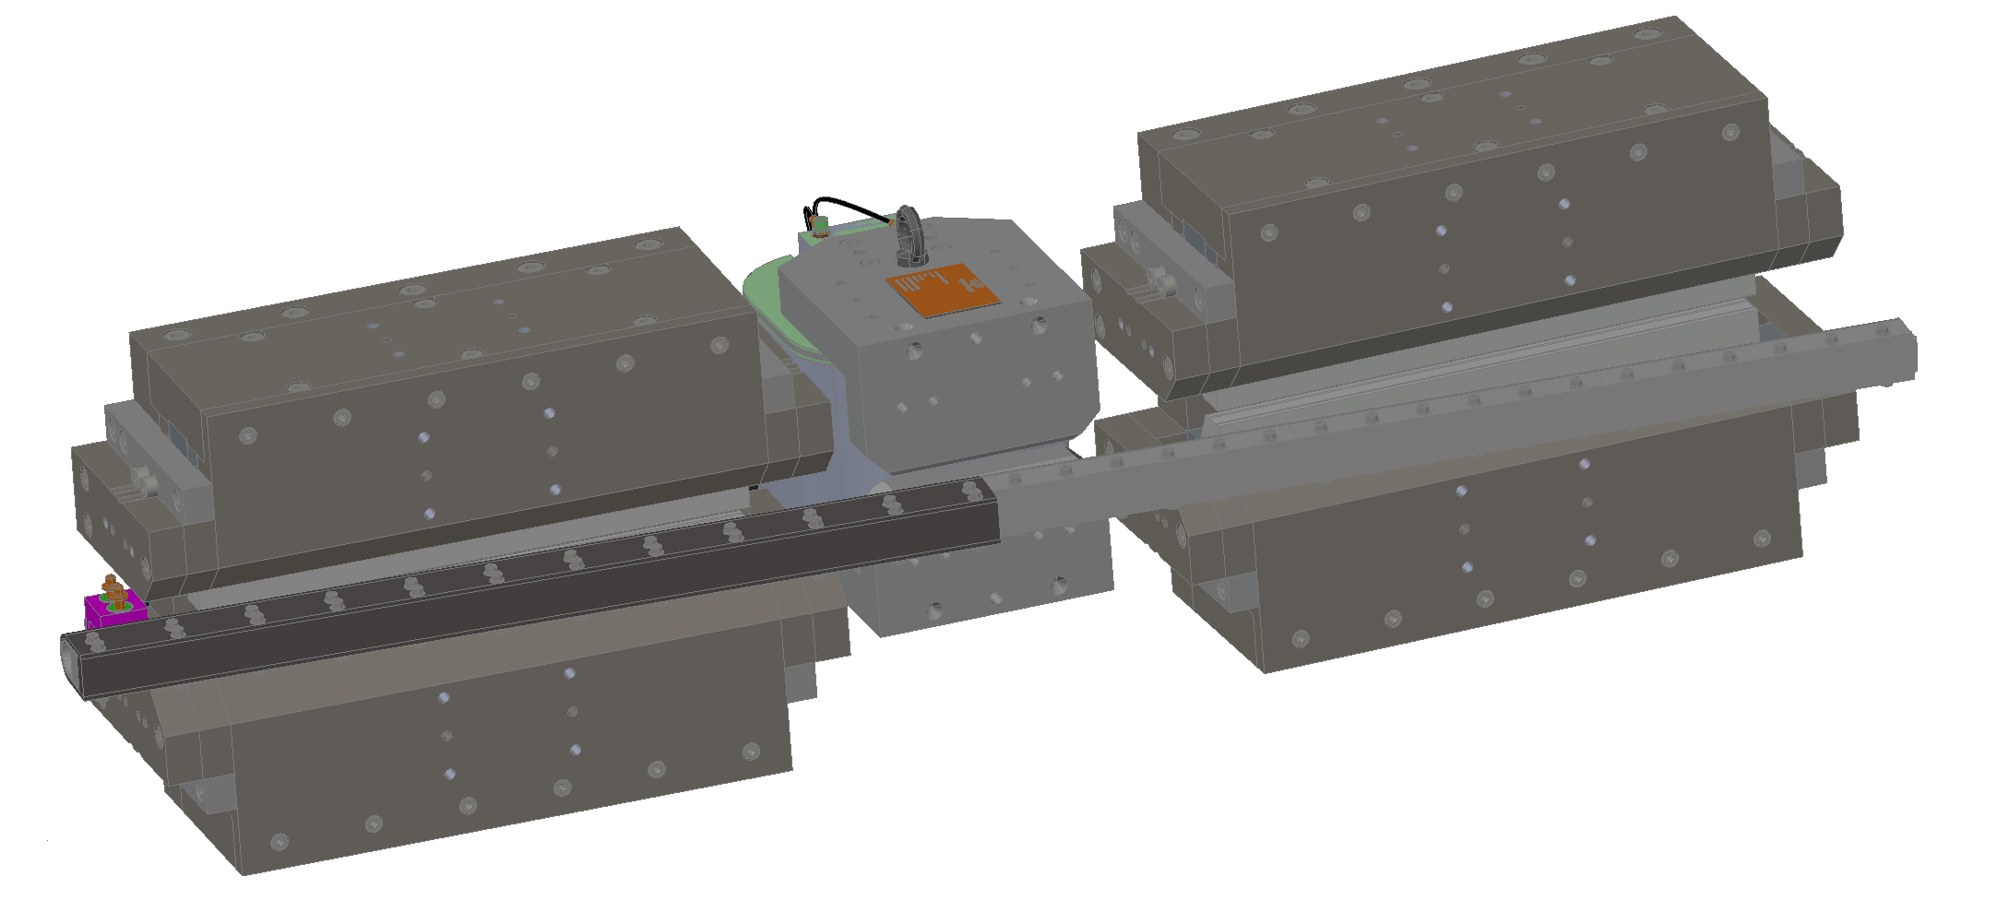
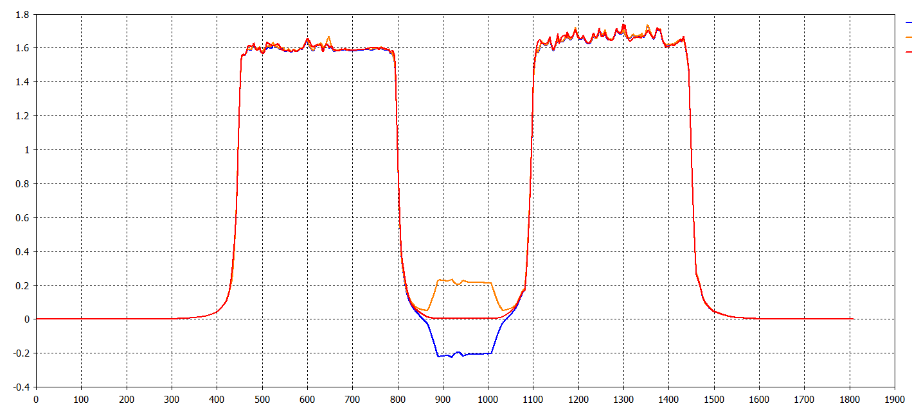
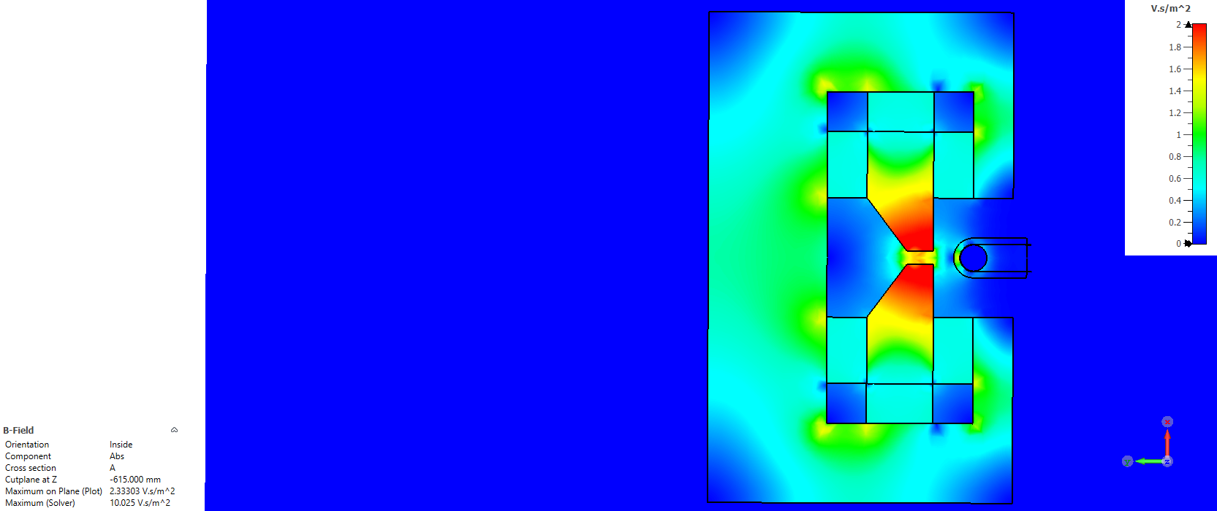
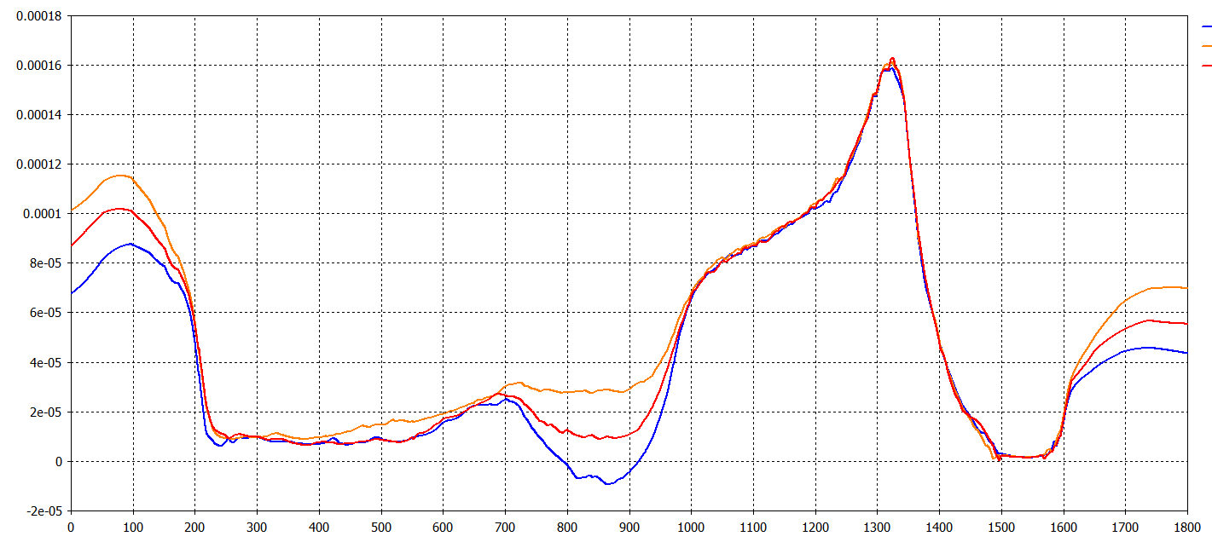
SLS 2.0 PM-based Thick Septum
Combine magnetic performance
  Main field
Field Integral
(for given corrector setting):
+5 A: 1.22 T.m (2.7%)
0 A: 1.19 T.m
-5 A: 1.15 T.m (-3.1%)
  B, T
+5A
0A
-5A
  Z, mm
  Leakage field
Leakage field Integral
(for given corrector setting):
+5 A: 94 μT.m
0 A: 84 μT.m
-5 A: 76 μT.m
Bmax = 2.2 T
  B, T
Earth magnetic field
+5A
0A
-5A
  Magnetic simulation
  Smallest distance between beams ~35 mm.
  Air gap is important.
  Z, mm

Slide 12
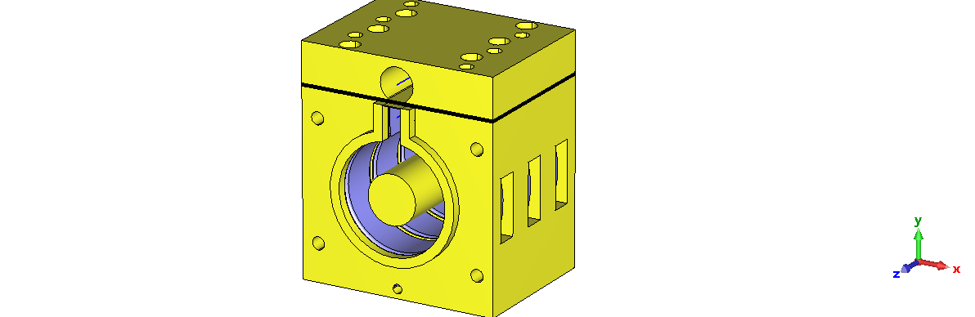
SLS 2.0 Thin Septum
Very thin eddy current septum should ensure inserting the injected beam very close to the stored beam with preferably no disturbance.
Distance between injected and stored beam only 3 mm.
Very thin septum wall - 1 mm
Good magnetic screening
  Thin Septum Specification
Parameter | Thin Septum
Septum thickness, mm | 1.0
Magnet length, m | 0.3
Gap, mm | 6.0
Magnet length, m | 0.3
Bending angle, mrad | 15@2.7 GeV
Field integral, T.m | 0.135
Gap field. T | 0.45@2.7 kA
Pulse length (period), μs | 12.5 (full sine)
Maximum zero-field integral, μT.m | 2.37
Shielding coefficient, - | >50000
Stability, ppt | 1.2
Stored beam
(Line 1)
  Cu
Septum wall
Injected beam
(Line 2)
  Cu
  Three sections of SLS 2 thin septum prototype 3D CST® magnetic model

Slide 13

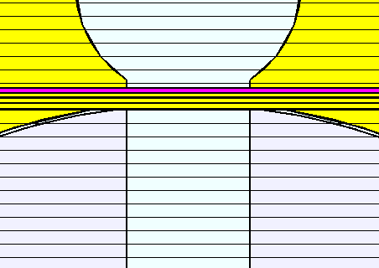
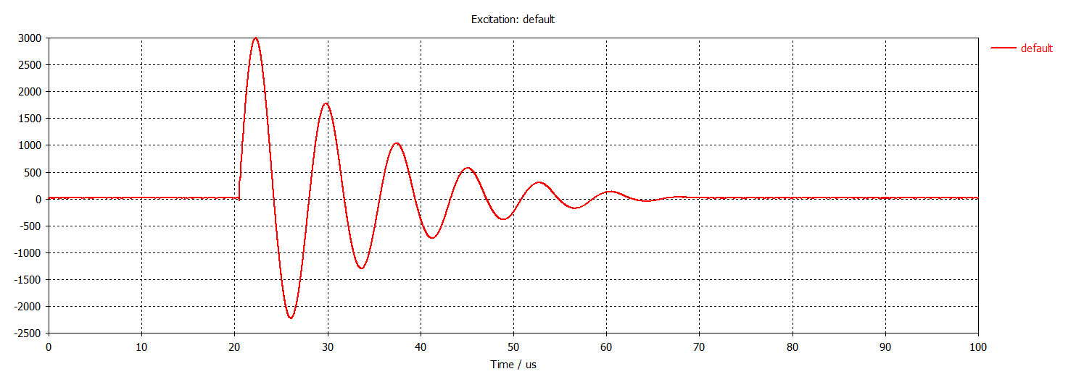
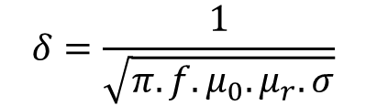
Eddy current septum numerical simulations
  Legend:
  Septum’s 4-layers
Skin depth
Powder cores are chosen for the magnetic circuit to cover the frequency and the filed strength requirements.
3D electromagnetic numerical simulations were used to optimize the screening of the thin septum.
The credibility of the simulation results depends a lot on the correct material model. Choosing the proper material model parameters proved itself difficult since this information is usually not readily available.
$$δ=\frac{1}{\sqrt{π.f.μ_{0}.μ_{r}.σ}}$$
  “0”-field
  Septum
  Main field
  Fe-powder core
  Fe-powder core
  Gap 6 mm
  Cu
  Electromagnetic model of the thin septum
  Courtesy of S. Dordevic
  Excitation pulse
  Cu
Ip = 3 kA

Slide 14
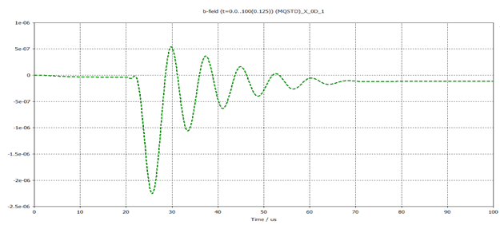
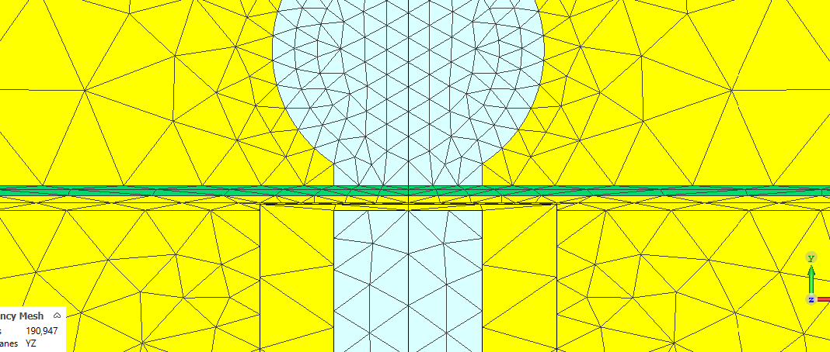
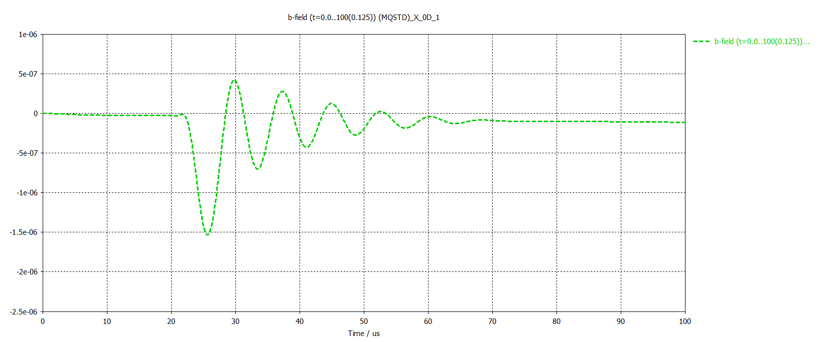
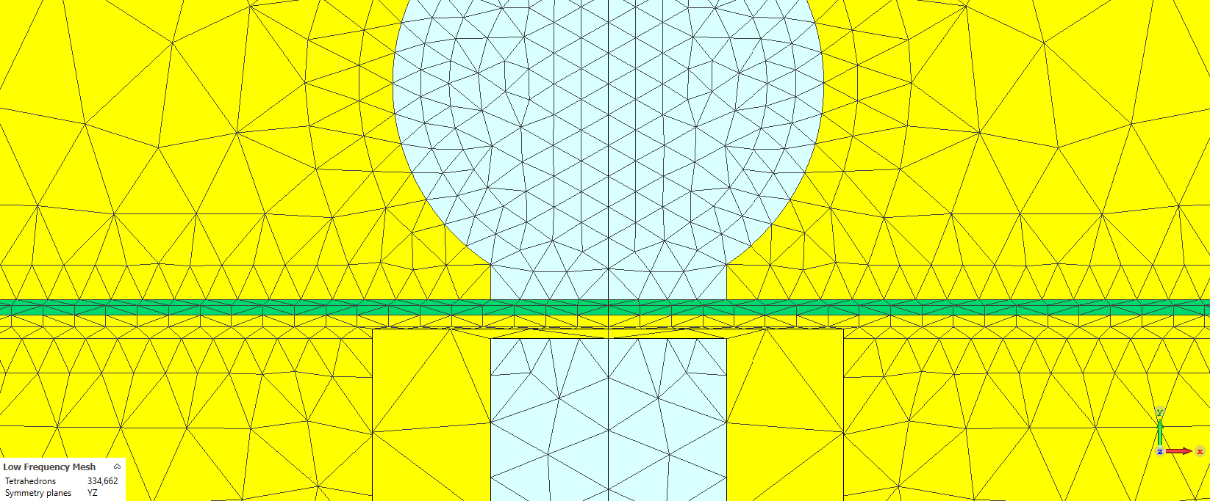
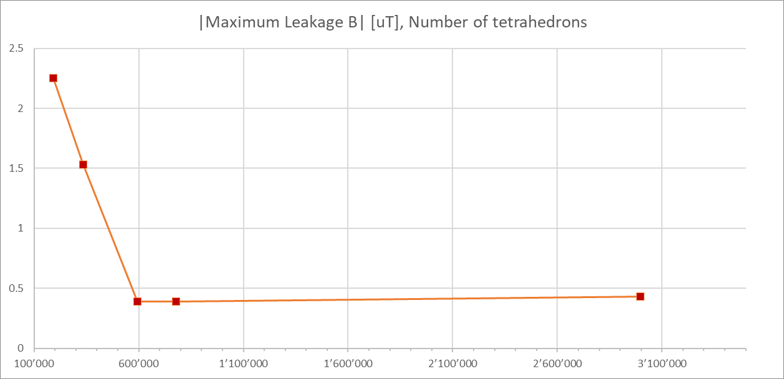
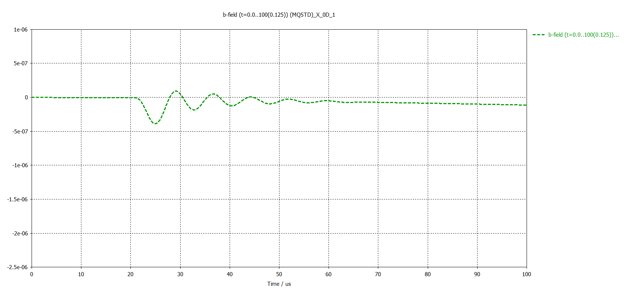
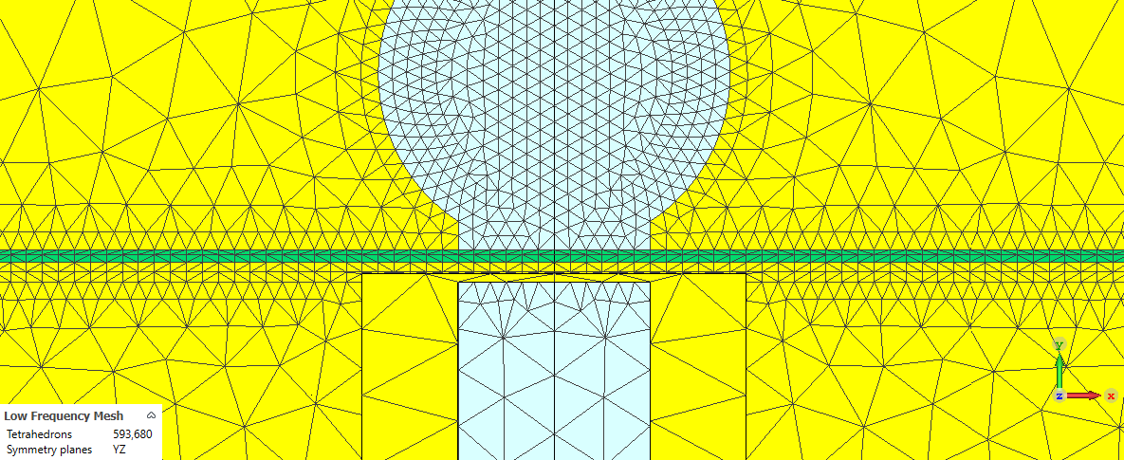
Meshing matters
[T]
Proper meshing is crucial to get consistent results.
Tetrahedrons 190’947
Influence of mesh on CST results
[T]
[uT]
Tetrahedrons 334’662
[T]
Tetrahedrons 593’680
Leakage field amplitude vs number of mesh cells
Leakage field results for different mesh density (same other conditions)
  Courtesy of S. Dordevic

Slide 15

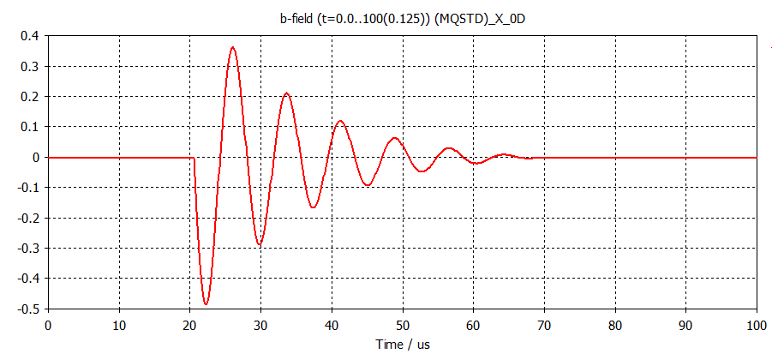
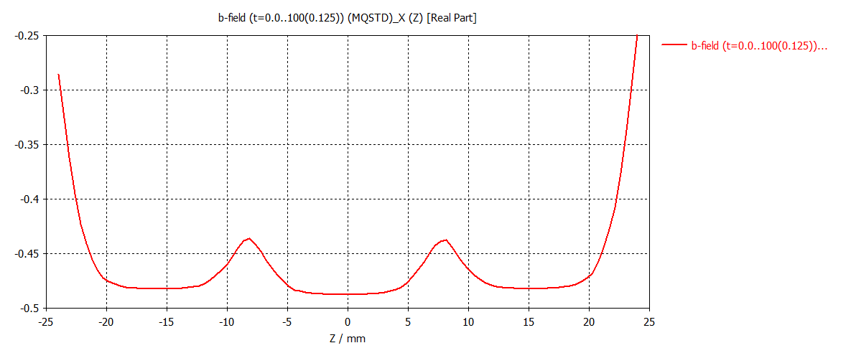
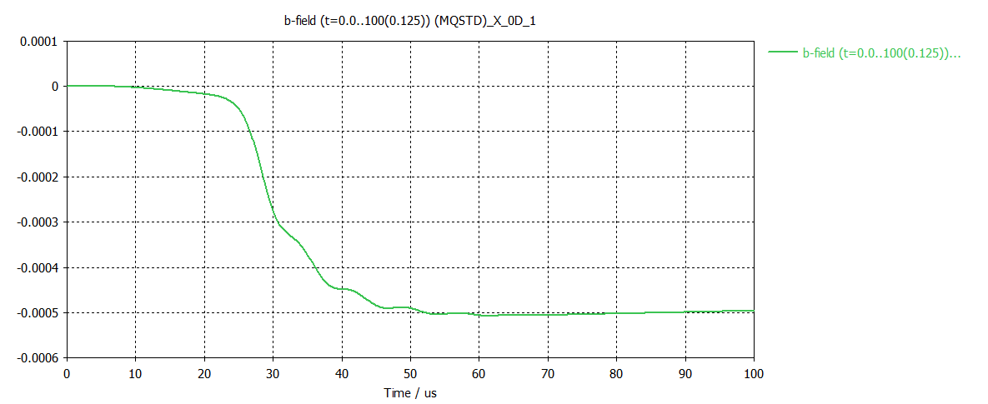
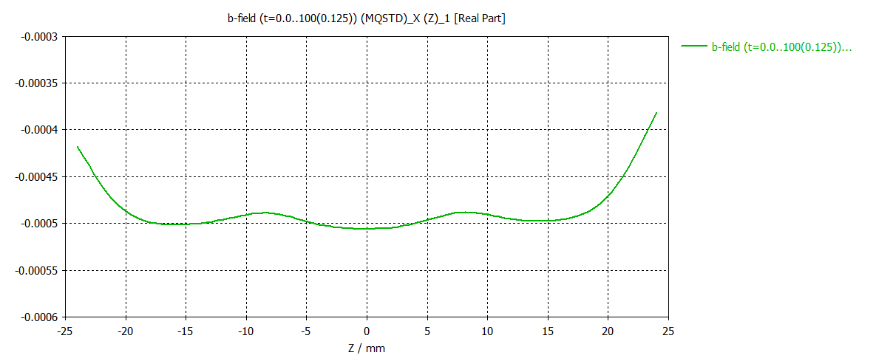
Conductivity limitation
  Legend
One mm of cooper does not provide the required screening. No other engineering material (at room temperature) could provide much better conductivity. (Silver is only ~6% more conductive and will not give significant skin depth reduction.)
Excitation
Copper, thickness 1mm
Main Field in (0/-10/0)
Main Field along curve 2 @ 22.25us
Leakage Field in (0/0/0)
Leakage Field along curve 1 @ 60us
0.5 mT or 150 µT.m

Slide 16
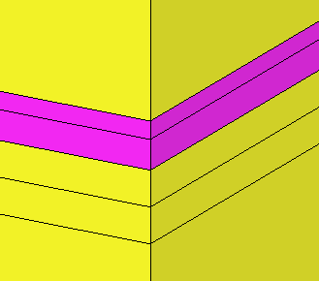
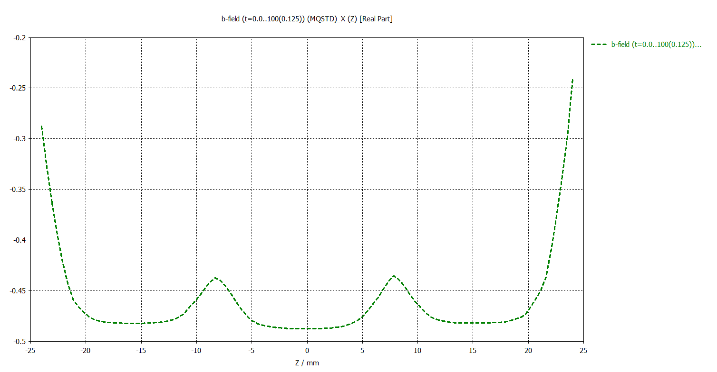
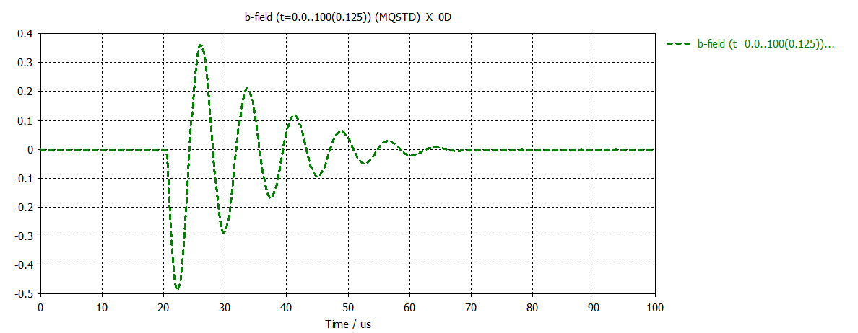
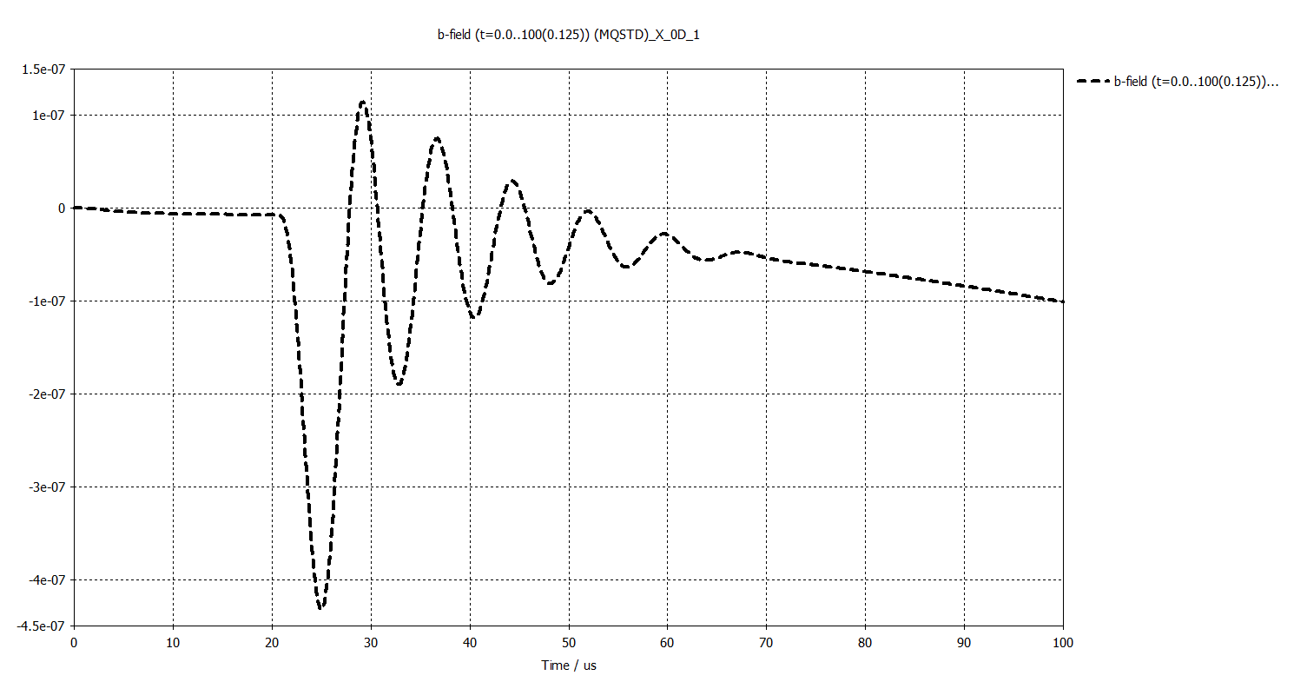
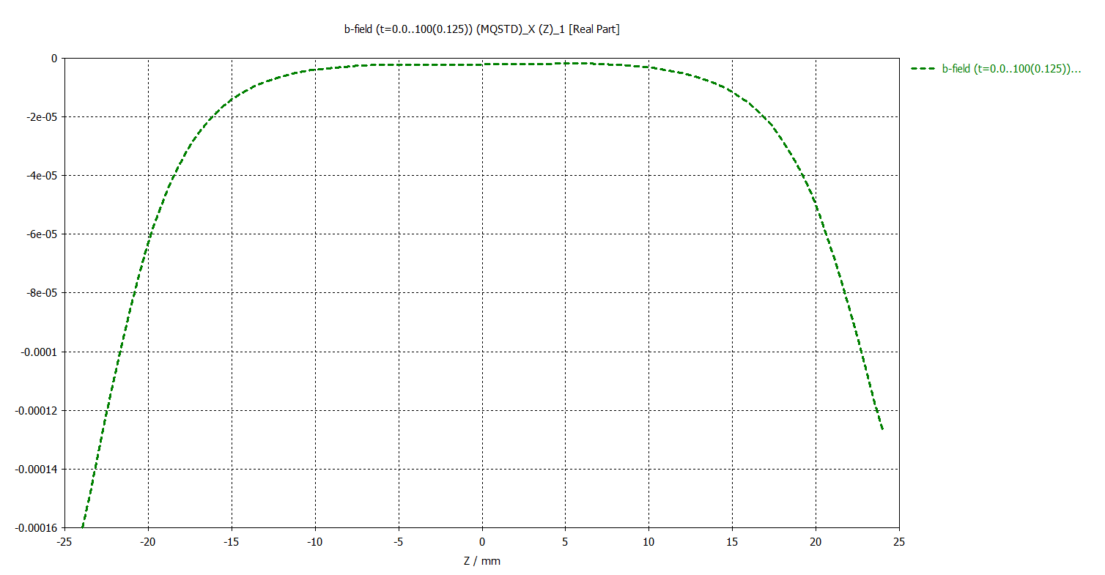
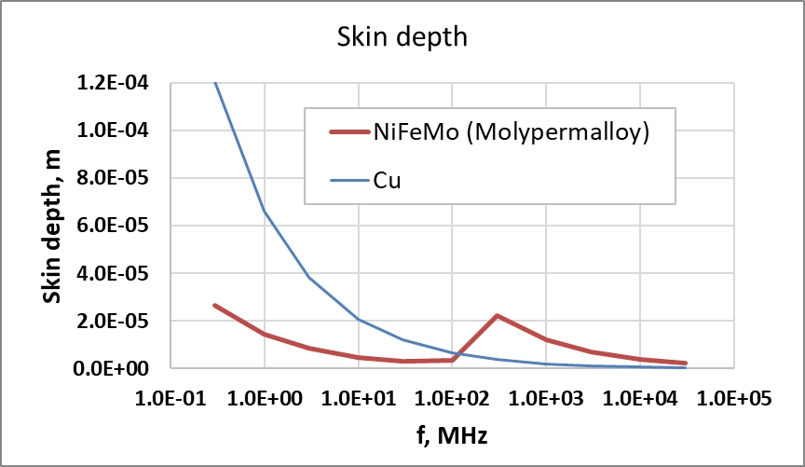
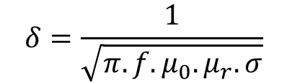
Going beyond cooper
  Legend
Cooper sheet screens the majority of the field. Adding high-µ soft magnetic material we can beat copper in the frequency range where it has available significantly large relative permeability. This compensates its lower conductivity and overall reduces the skin depth.
Excitation
µ-metal, thickness 0.15mm
µ-metal, thickness 0.25mm
Copper, thickness 0.3mm
Copper, thickness 0.3mm
Main Field in (0/-10/0)
Main Field along curve 2 @ 22.25us
Skin depth
$$δ=\frac{1}{\sqrt{π.f.μ_{0}.μ_{r}.σ}}$$
Leakage Field in (0/0/0)
Leakage Field along curve 1 @ 25.625us
0.7 µT or 0.21 µT.m

Slide 17
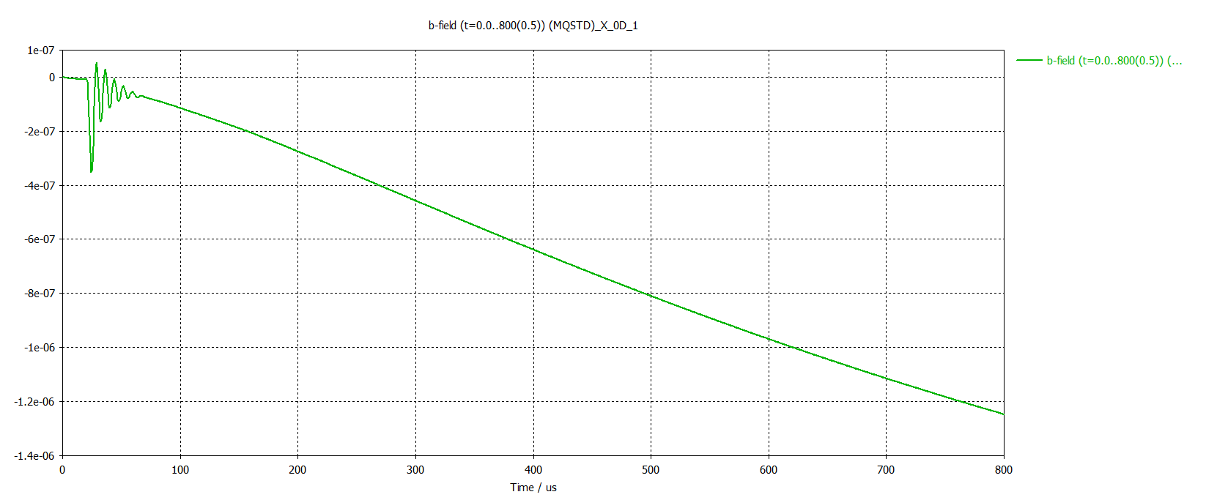
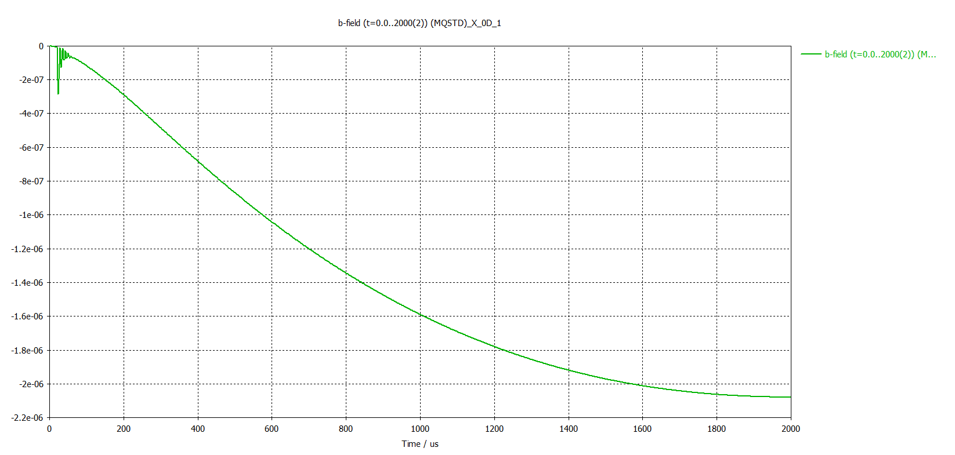
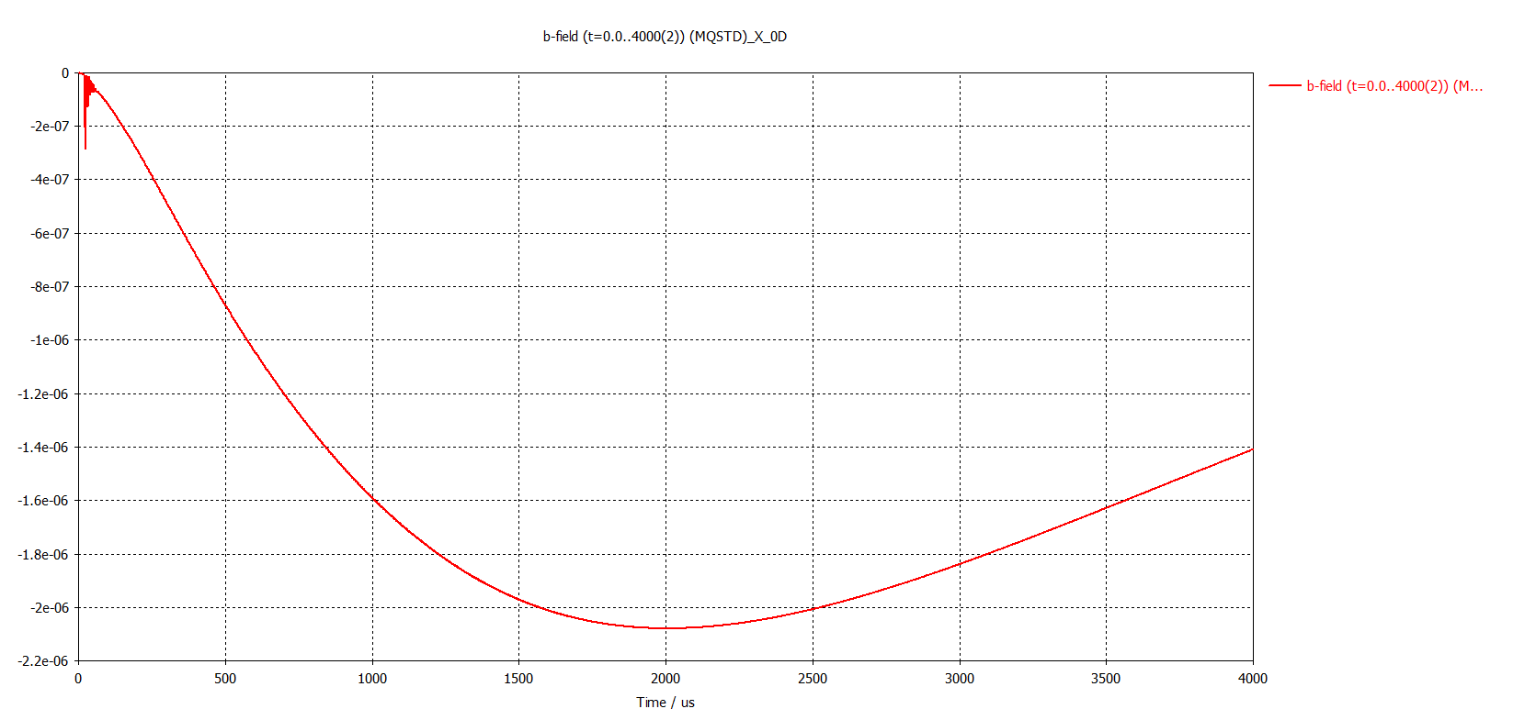
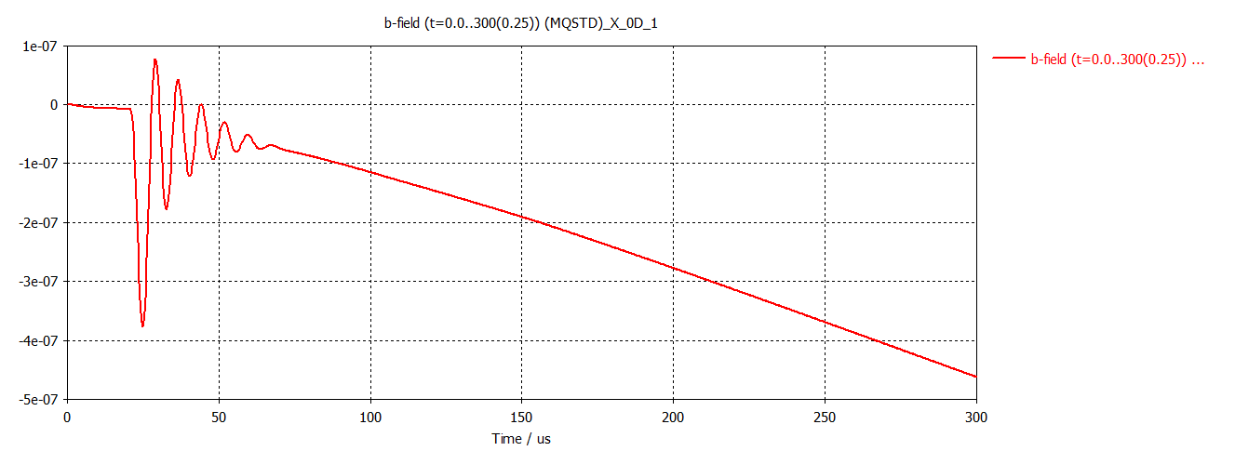
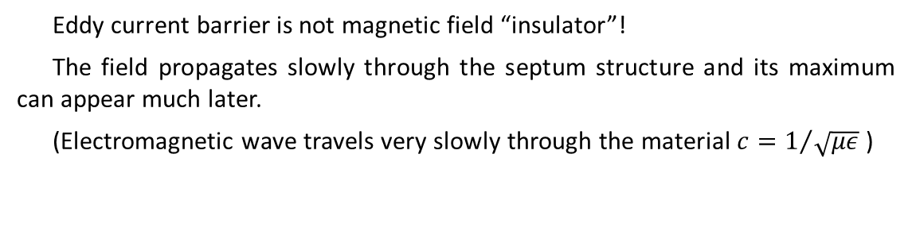
Story is a bit more complicated
  Legend
Eddy current barrier is not magnetic field “insulator”!
The field propagates slowly through the septum structure and its maximum can appear much later.
(Electromagnetic wave travels very slowly through the material $c=1/{\sqrt{με}}$ )
µ-metal, thickness 0.15mm
µ-metal, thickness 0.25mm
Copper, thickness 0.3mm
Copper, thickness 0.3mm
Leakage Field in (0/0/0)
Work in progress
2.3 µT or 0.69 µT.m
0 ms 1 ms 2 ms

Slide 18
Conclusions and discussion
Thick septum (permanent magnet based)
Rare-earth permanent magnets dipoles combined with high-saturation soft magnetic screen give a good alternative to pulsed septa.
Nevertheless, the magnetic screening requires larger beam separation.
Thin septum (pulsed)
Combination of copper and µ-metal sheets can provide very good eddy current screening with total septum thickness down to 1.0 mm and respective beam separation of 3.0 mm.
Eddy current screen is not a magnetic “insulator”. Leakage field maximum could appear after ms.
Simulation and measurement of the leakage field is challenging.

Slide 19
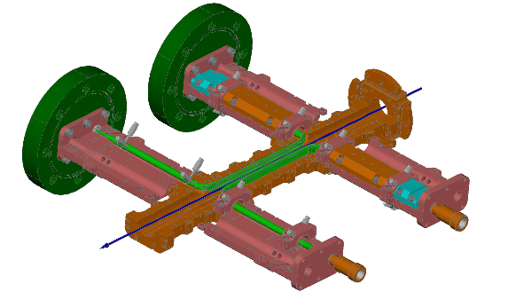
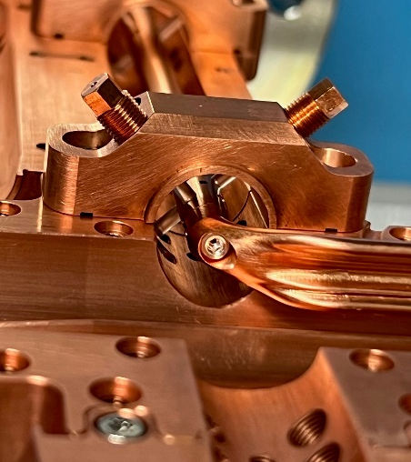
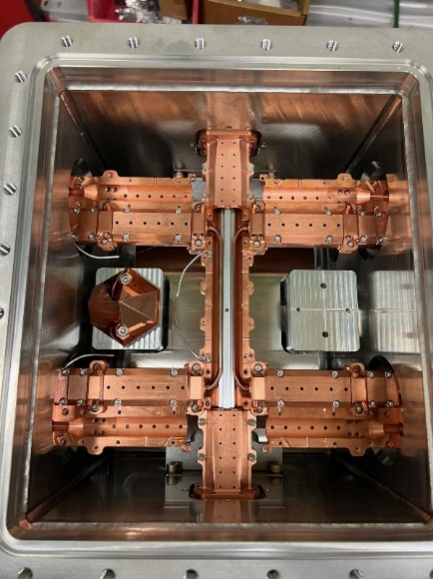
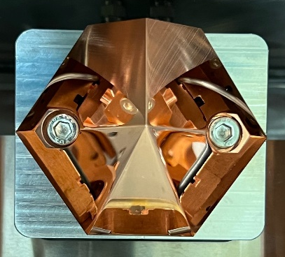
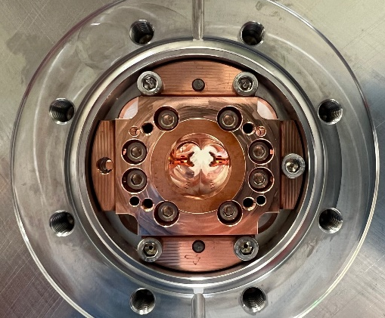
Thank you for your attention

Slide 20
[1] A. Streun, “SLS-2 Conceptual Design Report”, 2017
[2] A. Streun, “SLS 2.0, The Upgrade of the Swiss Light Source”, IPAC2022, Bangkok, Thailand, 2022
[3] Temperature Compensated Rare Earth Magnets, Arnold Magnetic Technologies
[4] H. Chen et al., “The Effect of Neutron Irradiation on Nd–Fe–B and Sm2Co17-Based High-Temperature Magnets”, IEEE Transactions on Magnetics, Volume: 41, Issue: 10, 2005
[5] B. Shepherd, “Radiation damage to permanent magnet materials: A survey of experimental results”, CERN-ACC-2018-0029 ; CLIC-Note-1079
[]

