Slide 1
Volker Schlott, Paul Scherrer Institut
Diagnostics for LESR Injectors
IFAST Workshop on Injectors for Storage Ring based Light Sources
KIT, Karlsruhe, Germany, March 6th – 8th 2024

Slide 2
Overview
Introduction
Injector Diagnostics Requirements
Diagnostics Systems
  … Overview
  … Beam Position Monitors
  … Profile Monitors – Screens and Synchrotron Light
  … Loss Monitors
  … Current, Charge and Bunch Pattern Monitors
Conclusions
Page 2
Notes:
2

Slide 3


Acknowledgements
This presentation is based on discussions and
information material provided by many dear colleagues!
Special thanks go to…:
  … Cigdem Ozkan-Loch
  … Jonas Kallestrup
  … Boris Keil
  … and PSI mechanical engineering for CAD drawings
Page 3
Notes:
3

Slide 4
Some General Remarks on LESR Injectors
Typical storage ring based light source injectors consist of…
→ a low energy (up to some hundred MeV) LINAC
→ a LINAC to booster transfer line (LBTL)
→ a (full energy) booster synchrotron
→ a booster to storage ring transfer line (BRTL)
SRLS injectors are typically operated at a few Hz for…
→ storage ring filling
(as fast as possible from scratch up to full current)
→ ”top up” operation
(frequent filling to keep the current dead band of
a few mA → ~ 10 shots every 5 minutes)
Page 4
Notes:
4

Slide 5
Requirements for SRLS Injector Diagnostics
LINAC and Transfer Lines
→ single-shot and shot-to-shot measurements of single bunches and bunch trains
→ provide input for beam dynamics applications to set-up and optimize LINAC
(e.g. cathode and gun characterization, emittance and energy spread measurements)
→ monitoring of transmission, energy stability and injection points / angles
→ allow for beam-based feedbacks to compensate drifts and minimize losses
Booster Synchrotron
→ measurement of orbit along the ramp to allow for orbit correction
→ provide tune information along the ramp
(tune kicker and turn-by-turn BPM mode or multi-bunch feedback system)
→ measurement and monitoring of losses and transmission
Page 5
Notes:
5

Slide 6
Overview of SRLS Injector Diagnostics Systems
LINAC and Transfer Lines (LBTL and BRTL)
Parameters | Devices | Measurement Mode(s)
Bunch Pattern | - coaxial Faraday cup - wall current monitor - fast current transformer - broadband pick-up | - single bunches and bunch trains at a few Hz - tens of ps to a few µs resolution - read-out of waveforms by (ultra) fast digitizers and/or oscilloscopes
Bunch Charge Beam Current Transmission | - ICT and BCM - BPM sum signal | - single bunches and bunch trains at a few Hz - absolute and relative charge measurement
Beam Position | - (resonant) stripline and button type BPMs | - single-shot at a few Hz for single bunches - average position for bunch trains
Transverse Profile | - screen monitors - synchrotron radiation monitors | - single shot image acquisition at a few Hz - tens of mm AoI for beam finding / threading - few tens of µm to a few µm spatial resolution for ε-measurement in LINAC and BRTL
Beam Loss | - scintillators & PMs - Cerenkov fibers & PMs | - beam loss detection and monitoring at selected locations - monitoring of beam loss pattern along transfer lines and injection areas
Page 6
Notes:
6

Slide 7
Overview of SRLS Injector Diagnostics Systems
Booster Synchrotron
Parameters | Devices | Measurement Mode(s)
Beam Current Transmission | - NPCT (MPCT) - BPM sum signal | - sub-ms absolute beam current measurement along the ramp - relative current measurement (e.g. turn-by-turn)
Beam Position | - button type pick ups | - turn-by-turn beam position for commissioning - averaged beam positions along the ramp (lower BW / higher resolution “ramp modes”) - BPM readings can be used for orbit correction
Tune | - dedicated tune pick up - tune (stripline kicker) | - tune measurements along the ramp
Transverse Profile | - screen monitors - synchrotron radiation monitors | - screens (2) at the injection for position and angle control (30 mm AoI, 100 µm resolution) - a few more screens and/or synchrotron radiation monitors for observing beam profiles (in case of trouble shooting)
Beam Loss | - scintillator BLMs - longitudinal LMs | - beam loss detection and monitoring at selected locations - monitoring of beam loss pattern at injection areas
Page 7
Notes:
7

Slide 8
BPMs – LESR LINAC and Transfer Lines
Requirements, Boundary Conditions and Evaluation
→ single-shot and shot-to-shot measurements of single bunches and bunch trains
→ spatial resolution requirements are moderate (~ 100 µm) in LINAC and LBTL but
much more challenging (~ 10 µm for low charges (≤ 150 pC) during top -up) in BRTL
→ if possible, make use of the same BPM electronics in the injector as for the storage ring
Options | Pros | Cons
Button-type | make use of similar BPM pick-up HW from booster and storage ring | low signal levels & limited resolution for single bunches in top-up mode
Cavity-type | highest signal levels and potentially best resolution (especially for low charge single bunches in top-up mode) | different type of BPM pick-up as in booster and storage ring different type of BPM electronics only limited (linear) meas. range
Matched Stripline | high signal levels (up to 10 x button-type) large measurement range same BPM electronics in whole facility (but energy / signal level lost in input ringing filter) | different type of BPM pick-up as in booster and storage ring
Resonant Stripline | higher signal levels than MS (10+ x button-type) large measurement range same BPM electronics in whole facility (pick-up res. frequency matches input ringing filter) | different type of BPM pick-up as in booster and storage ring
Page 8
Notes:
8

Slide 9
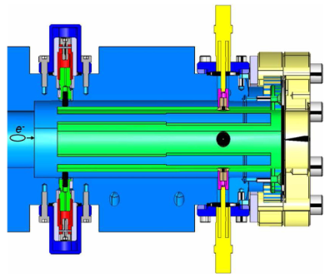
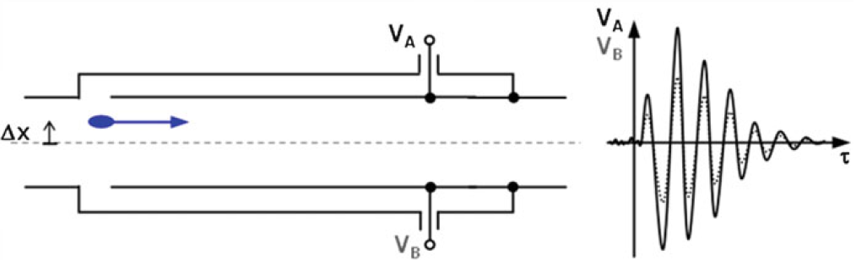
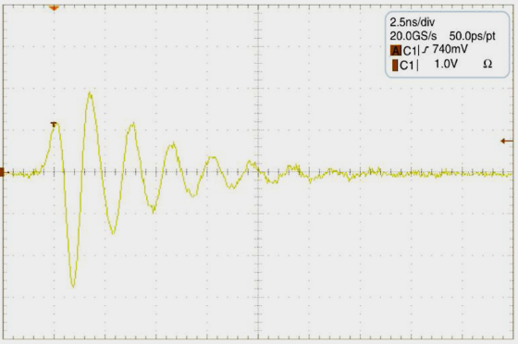
Transfer Line BPMs – Resonant Striplines *
* A. Citterio et al., Proc. DIPAC’09, Basel, Switzerland, MOPD12, p. 71
Mechanical Design
Schematic and Signal Waveform (one plane)
500 MHz resonance
tuning pin
striplines
N-type feedthrough
resonant frequencies f_{M} and f_{D} @ 500 MHz (< 1 MHz BW)
loaded Q ≈ 7, measured sensitivity ≈ 1.5 dB/mm
crosstalk (for orthogonal dipole modes) ≈ 0.1%
beam aperture 38 mm, stripline length tuned to 138.4 mm
low-pass filtered electrode voltage
behind RF cable
For SLS 2.0 BRTL single bunch / single shot position resolution using the turn-by-turn mode of the “DBPM3” BPM electronics and the 500 MHz resonant striplines is in the order of 10 µm RMS for typical top-up charges of 150 pC
Page 9
Notes:
9

Slide 10
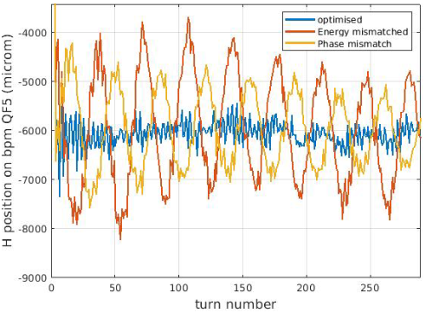
BPMs – LESR Booster Synchrotron
→ sufficient number of button-type BPMs to be placed in the booster synchrotron
for orbit and tune measurement and correction
→ booster BPM system should provide turn-by-turn and “ramped-mode” position data for injection studies and beam orbit measurements / corrections along the ramp
→ spatial resolution requirements are moderate: O (100 µm) for “turn-by-turn” data and O (10 µm) for orbit measurements along the ramp (for top-up currents)
→ BPM sum signals can be used as a ”turn-by-turn” current / transmission monitor
→ tune measurement is provided by a stripline kicker and a dedicated “turn-by-turn” BPM
Some Examples (from the upgraded ESRF EBS booster*)
* M. Cargnelutti et al., Proc. IPAC’15, Richmond, VA, USA, MOAB3, p.24
N. Carmignani et al., Proc. IPAC’21, Campinas, SP, Brazil, MOPAB051, p. 221
“turn-by-turn” BPM data for injection optimization
→ synchrotron oscillations of the beam entering the
booster for three different cases:
blue: optimized
yellow: phase mismatch
brown: energy mismatch
Page 10
Notes:
10

Slide 11
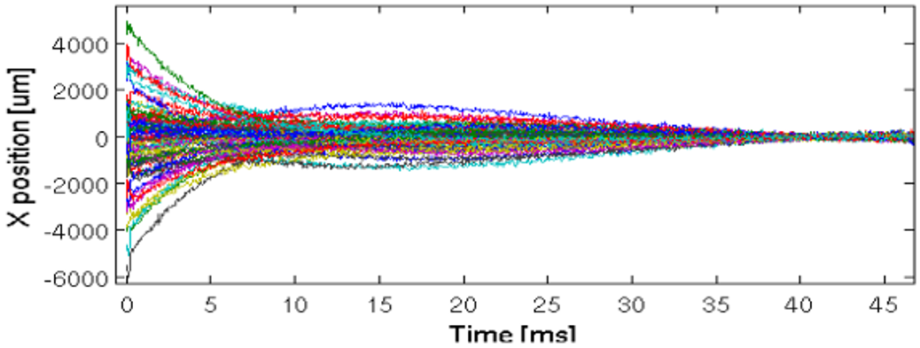
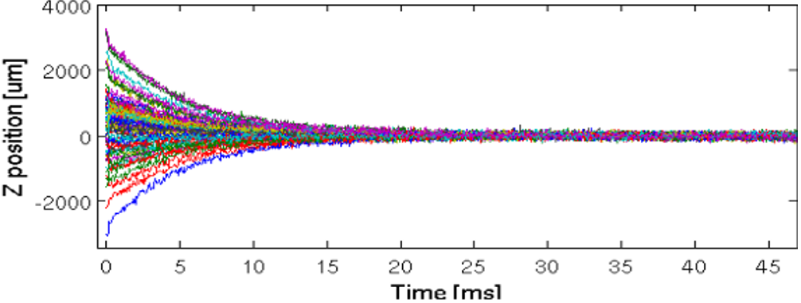
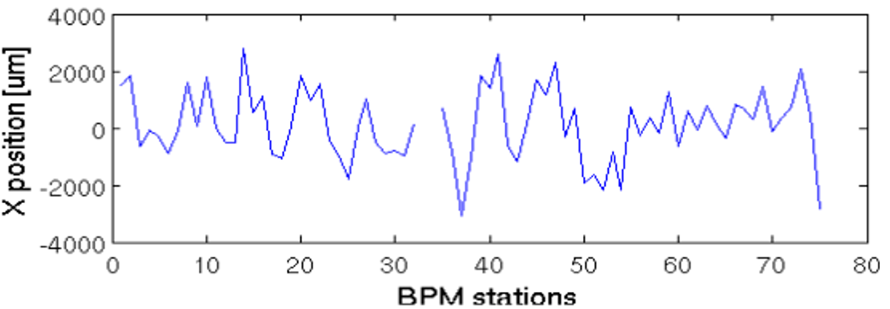
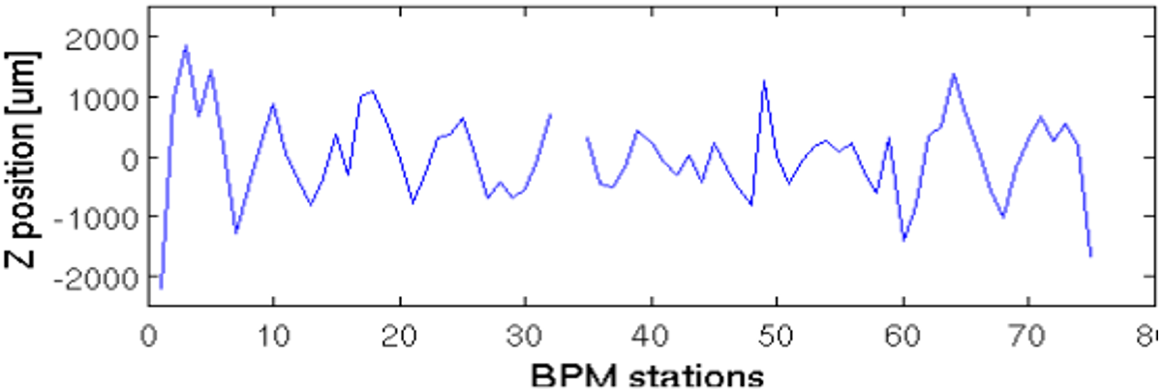
BPMs – LESR Booster Synchrotron
Some More Examples (from the upgraded ESRF EBS booster*)
beam position from all booster BPMs
(position offset of each BPM has been removed)
→ lower bandwidth (increased decimation) provides
higher resolution (here x 64 for covering the booster ramp)
booster beam orbit measurement
(beam positions have been taken 20 ms after injection)
* M. Cargnelutti et al., Proc. IPAC’15, Richmond, VA, USA, MOAB3, p.24
N. Carmignani et al., Proc. IPAC’21, Campinas, SP, Brazil, MOPAB051, p. 221
Page 11
Notes:
11

Slide 12
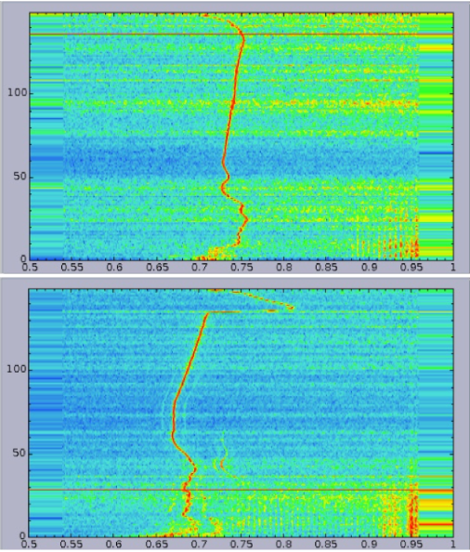
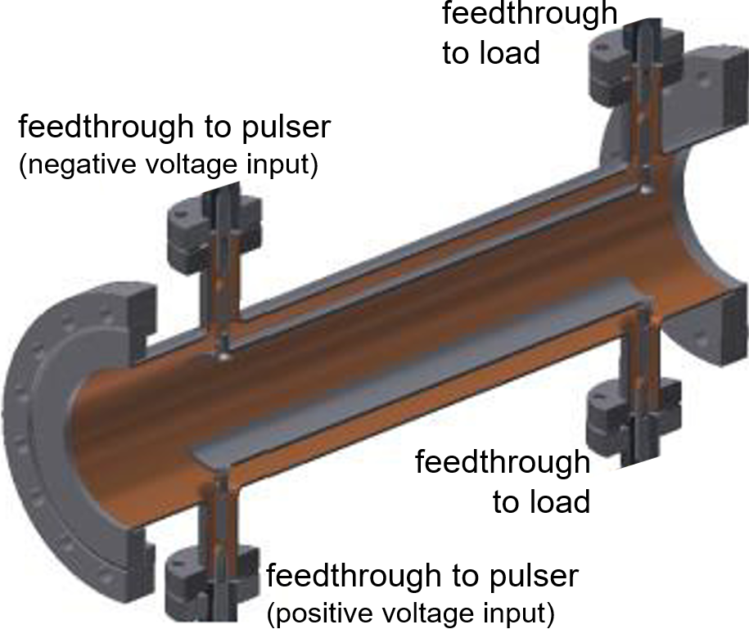
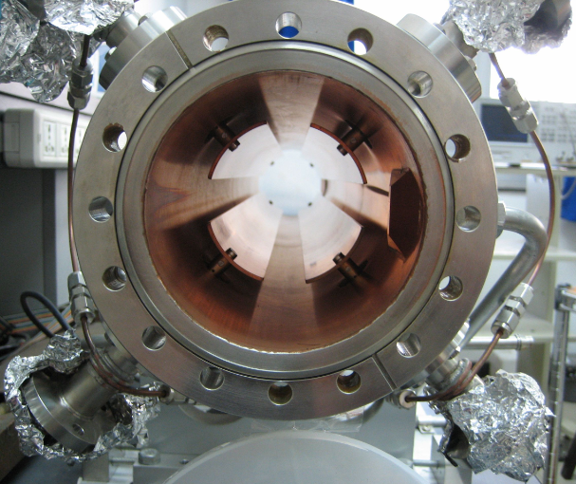
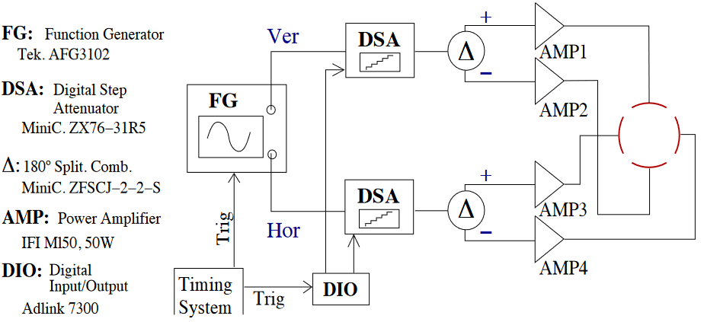
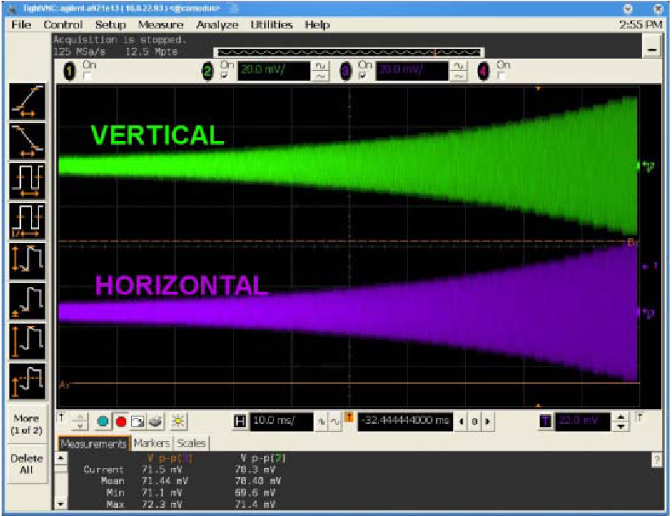
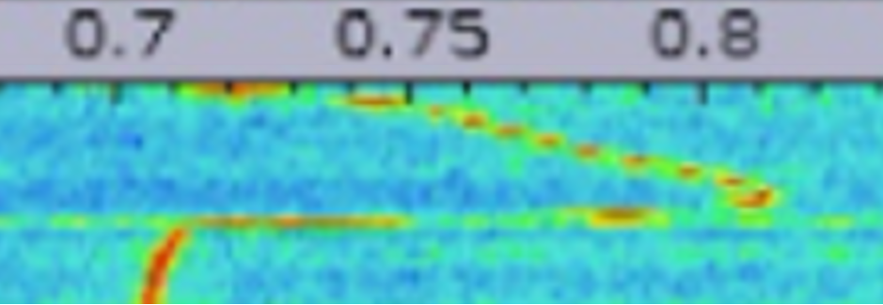
LESR Booster Tune Measurement
Stripline Kicker *
Measurement Example
from the upgraded ESRF EBS booster***
schematic of SL kicker (one plane) and image (two planes)
ramping time (ms)
fractional tune
(horizontal plane)
* From J. Byrd, Stripline Pickups and Kickers, USPAS June 2009
fractional tune
(vertical plane)
ramping time (ms)
Beam Excitation **
using white noise and increasing kick strength
synchronized with beam energy on the ramp
*** N. Carmignani et al., Proc. IPAC’21,
Campinas, SP, Brazil, MOPAB051, p. 221
emittance exchange
vertical tune change
by ≈ 0.1 within 0.7 ms at
extraction time of ≈ 140 ms
** U. Iriso et al., Proc. BIW’10, Santa Fe, NM, USA, TUPSM073, p. 350
Page 12
Notes:
12

Slide 13
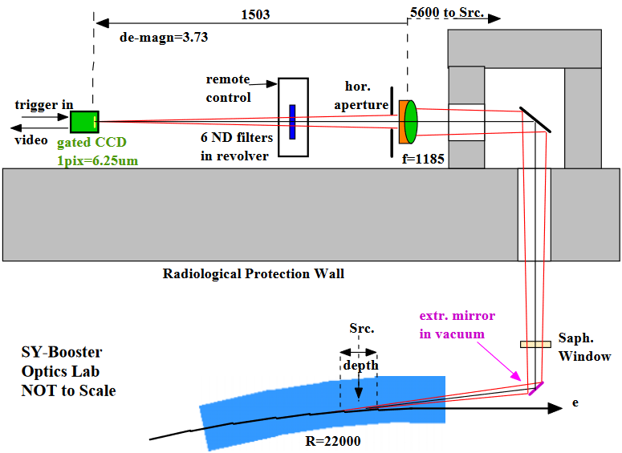
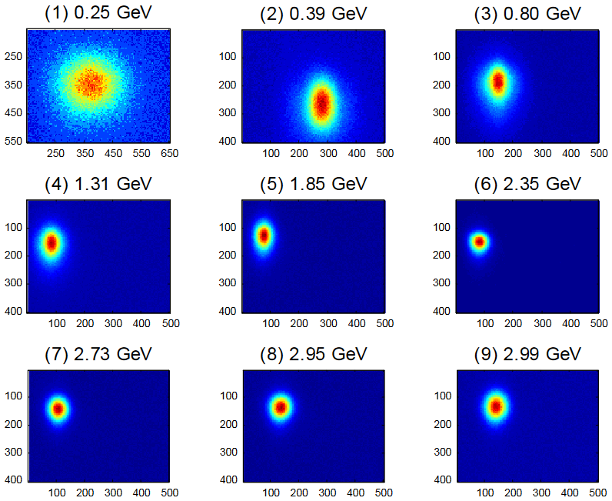
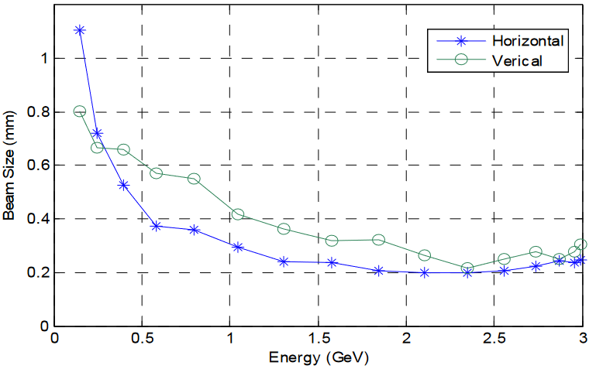
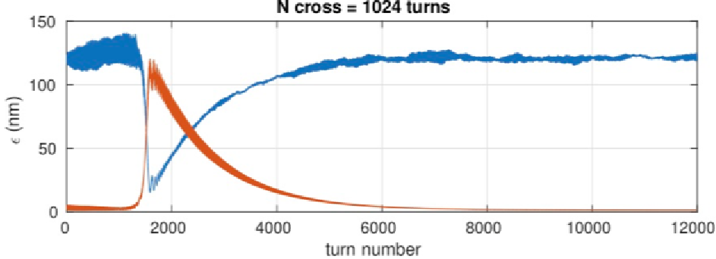
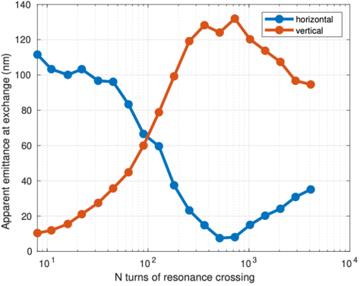
LESR Booster – Beam Profile Measurements
Synchrotron Light Extraction
top view from the ESRF EBS booster *
Synchrotron Light Profiles
from TPS booster along the ramp (9 µm / pixel) **
* B.K. Scheidt, Proc. DIPAC’05, Lyon, France, POM002, p. 24
Emittance Exchange
on the ESRF EBS booster ramp observed by SL profile monitor ***
extraction time at
85% reduced horizontal beam size
** P.C. Chiu et al., Proc. IBIC’15, Melbourne, Australia, MOBLA01, p. 1
*** N. Carmignani et al., Proc. IPAC’21, Campinas, SP, Brazil, MOPAB051, p. 221
Page 13

Slide 14
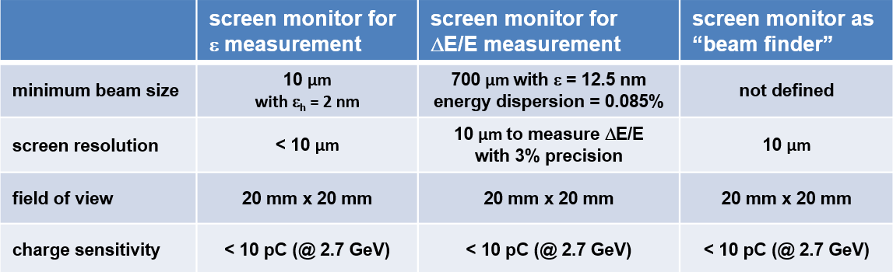
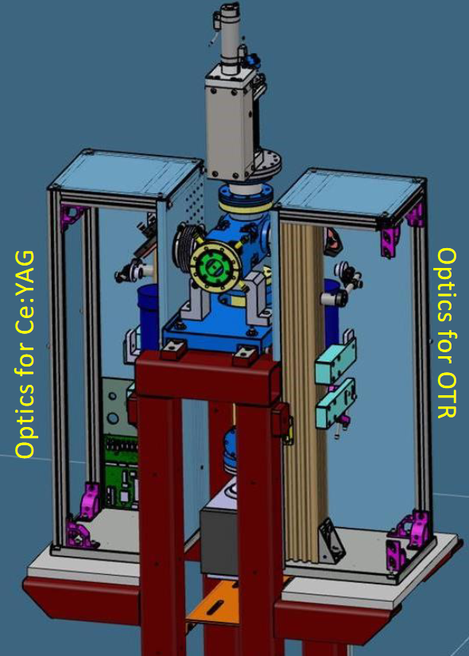
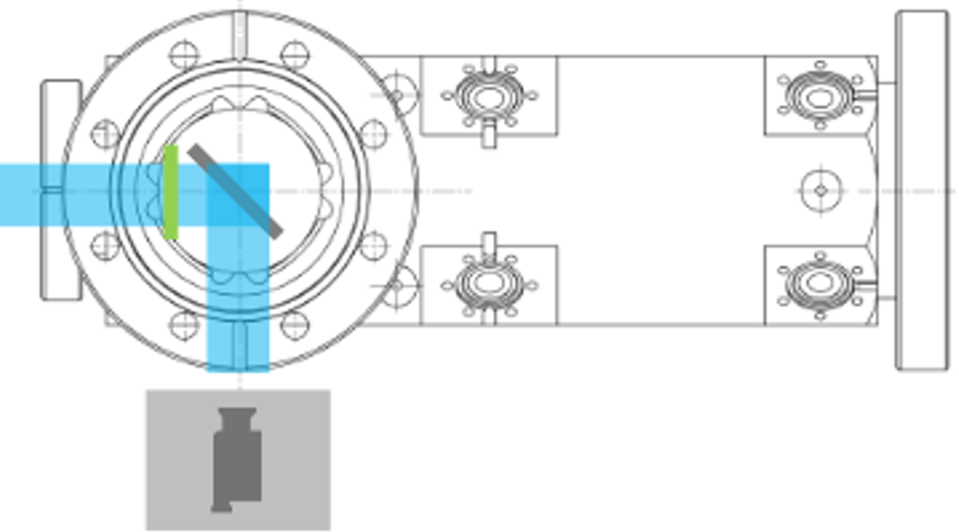
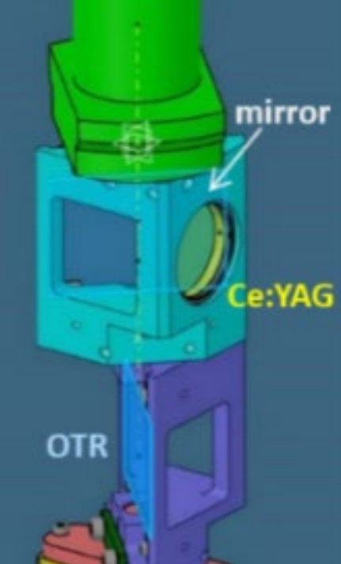
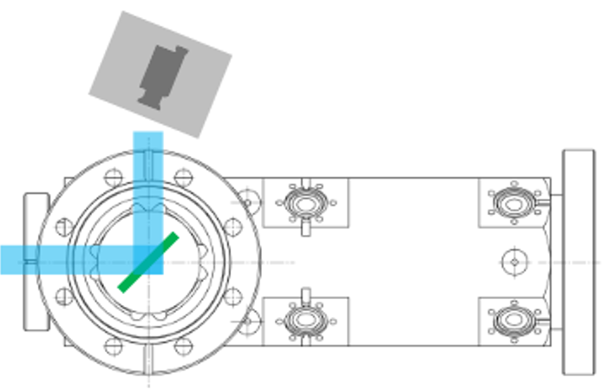
LESR Transfer Lines – Screen Monitors
Screen Monitors for SLS 2.0 BRTL
a dispersion-free beam path has been integrated in the SLS 2.0 BRTL for ε measurement
courtesy of Cigdem Ozkan-Loch
→ Ce:YAG screens as beam finder
for low charge beams with limited
spatial resolution
→ OTR screens for high resolution /
precision measurements (ε and ΔE/E)
→ separate optics boxes at ε and ΔE/E
measurement station for high resolution
and high sensitivity
→ camera mounted in Scheimpflug
geometry to correct for focal plane of
OTR screen (@ 45° to beam and camera)
Optics Set-up for “BRTL ε-Screen”
Light Out-coupling for Ce:YAG
Screen Holder with Ce:YAG and OTR
Light Out-coupling for OTR
(Scheimpflug geometry)
Page 14

Slide 15
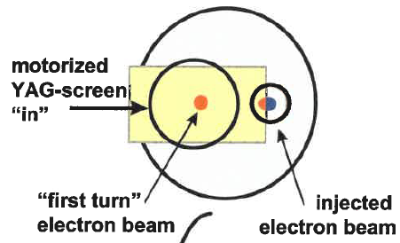
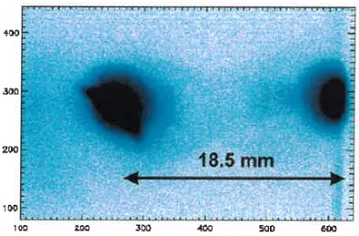
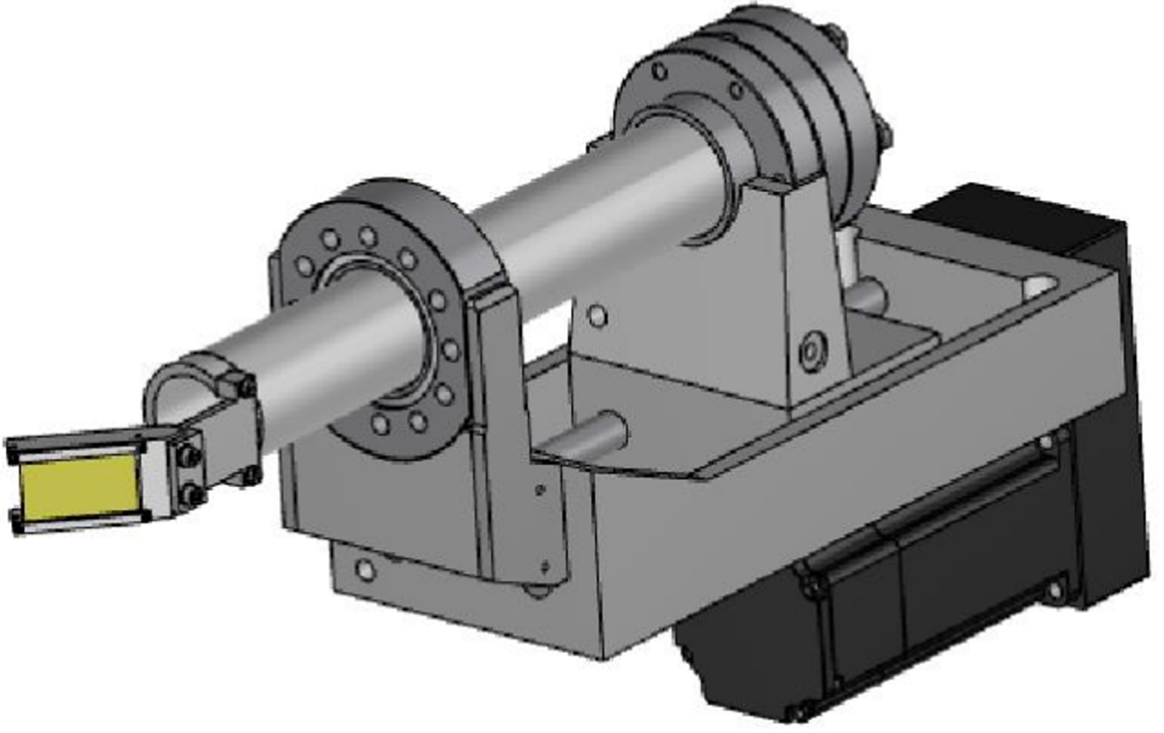
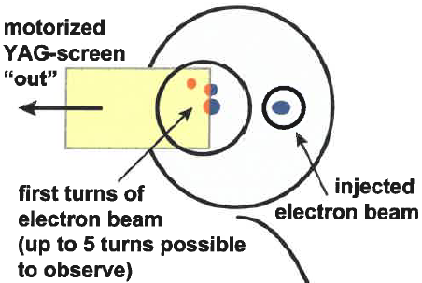
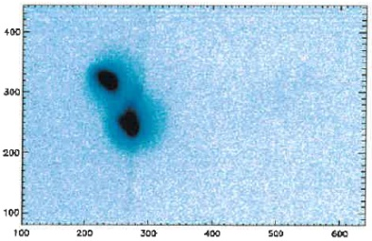
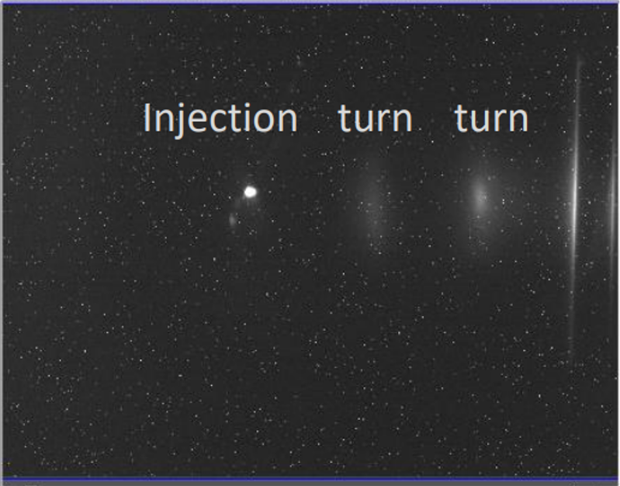
LESR Screens for Injection and 1st Turn(s)
screens are not popular nor widely used in storage rings (impedance, heat load…)
first turn(s) during commissioning can be considered as transfer line diagnostics
→ one screen directly behind injection septum can be helpful for observing
beam position (relative to septum), beam matching and injection point
→ a second screen in injection straight to adjust the kick / injection angle
First Turns in SLS Booster
images taken during booster commissioning in 2000
SLS Storage Ring Injection
screen monitor to observe injection and 1st turn(s)
camera
observation
1st turn
beam
injected
beam
motorized
UHV-feedthrough
courtesy of Cigdem Ozkan-Loch
screen(s) can be helpful for “trouble shooting” but turn-by-turn BPMs are the working horses…!!!
Page 15

Slide 16
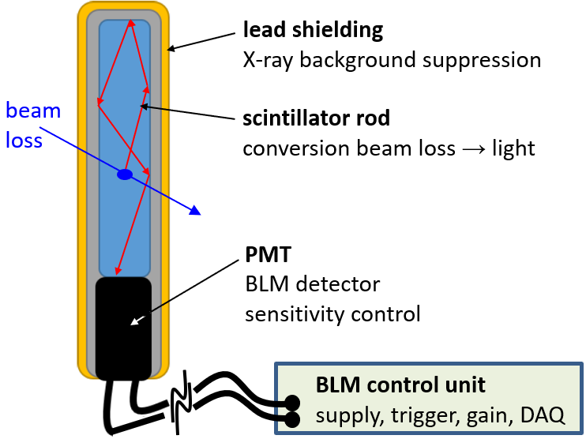
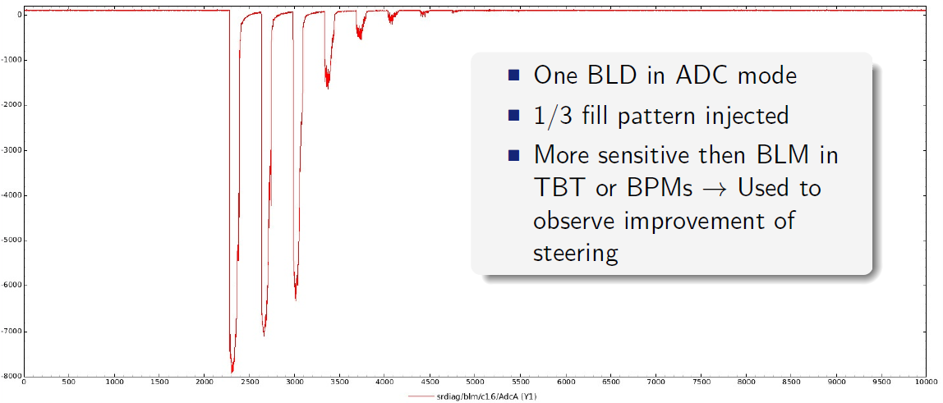
LESR Injector Diagnostics – Loss Monitors
Localized Loss Monitors – Scintillators and PMT
courtesy of E. Buratin, Kees Scheidt (ESRF-EBS) and L. Torino (ALBA)
BLM sensitivity & calibration
PMT: blue light
gain: PMT voltage
DAQ: ADC calibration
system: Ce137 source in-situ
Commissioning: First Turn(s)
BLM in most sensitive “ADC mode"
over first turns
BLM operation modes
fast ADC and sufficient buffer provides
turn-by-turn (even bunch-by-bunch) options
integration mode provides loss pattern
along accelerator and allows “sanity-check”
in reference to pre-defined loss rates
(e.g. “BLM drift control” in injector and transfer lines can be helpful for stable and reliable “top-up” operation)
Page 16

Slide 17
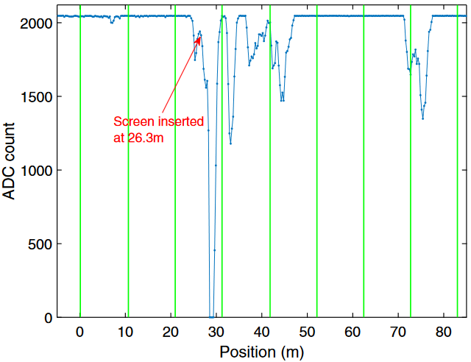
LESR Injector Diagnostics – Loss Monitors
Longitudinal Loss Monitors – Cerenkov Fibers and PMT
courtesy of C. Ozkan-Loch (PSI)
→ similar to undulator lines in FELs, a long Cerenkov (quartz) fiber can be placed along the
LINAC, transfer lines and booster / storage ring injection regions
→ beam losses generate light pulses in the quartz fiber, which are detected by a PMT
at one end of the fiber.
→ multiple loss locations generate multiple light pulses (O 10s of ns) per injection trigger
→ a fast ADC (> 500 MS/s) digitizes the loss signal as a waveform corresponding to the
fiber length or the beam path, which is covered by the LLM
→ the LLM spatial resolution is in the order of 0.5 – 1 m.
loss locations can be “calibrated” by inserting screens
valves at known locations along the beam path
→ LLMs will be installed in SLS 2.0…:
LINAC – LBTL – booster injection
BRTL – storage ring injection
→ LLMs will be used for “injector drift control” in SLS 2.0
Example of LLM Calibration from SwissFEL
from C. Ozkan-Loch et al., PRSTAB 23, 102804 (2020)
Page 17

Slide 18
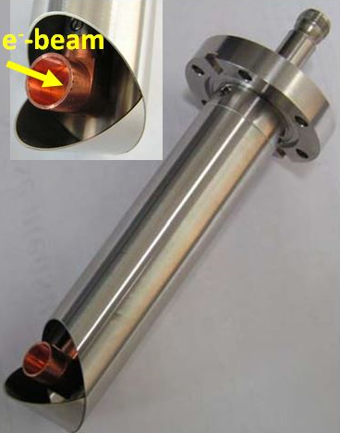
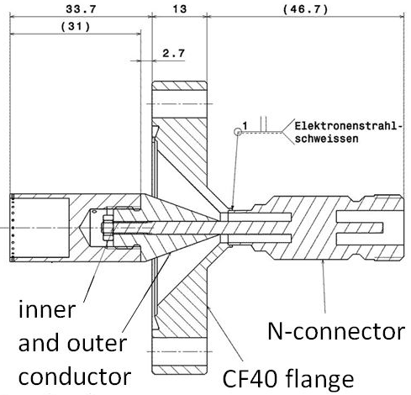
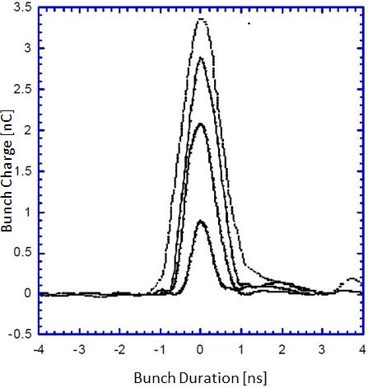
LESR Injector: Charge and Current Monitors
integrating current transformers are absolutely calibrated standard devices for
beam charge measurements in LINACs and transfer lines:
→ e.g. ICT / BCM-IHR < 10 pC – 1 nC (single bunches and bunch trains)
parametric current transformers are standard devices for circulating beam current measurements in booster and storage rings:
→ e.g. NPCT 5 (1) µA / √Hz from DC (storage ring) to 10 kHz (booster ramps)
real-time determination of transmission efficiency through injector complex provides
important information of injector stability during commissioning and to-up operation
coaxial Faraday cups, wall current monitors and fast current transformers provide time-resolved information of electron bunches and bunch patterns on a ps to ms scale
SLS LINAC Coaxial F-Cup
90° insertable version
Coaxial Faraday Cup
integrated in a CF flange as
low energy beam stop
SLS LINAC Gun Emission
bunch length and charge as
function of gun bias settings
Page 18

Slide 19
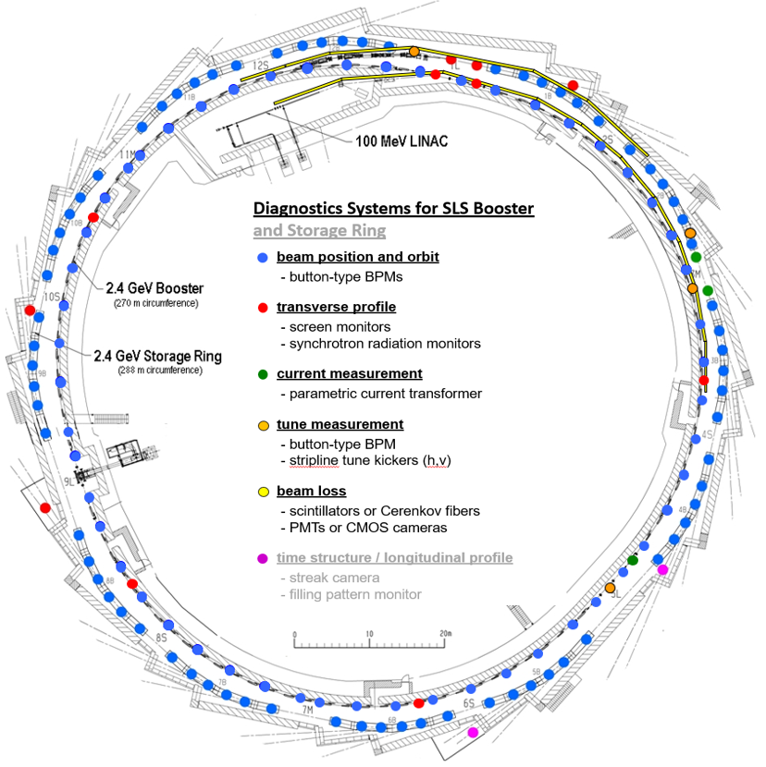
LESR SLS Booster Diagnostics – Overview
54 button-type BPMs
1 current transformer
1 tune kicker (diagonal)
1 tune BPM
2 screen monitors
(at injection)
3 screen monitors
(around ring)
3 synchrotron light ports
BLMs and LLM at injection
Page 19

Slide 20
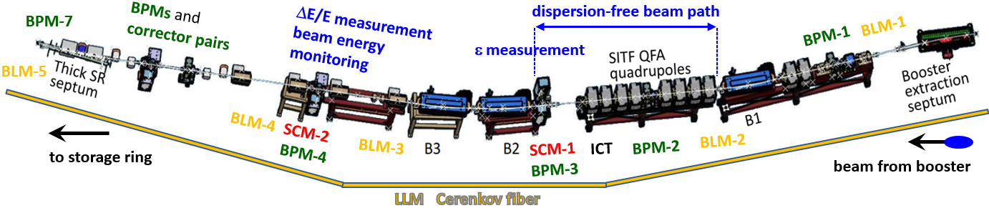
LESR Transfer Line Diagnostics
Example: SLS 2.0 BRTL aiming for good SR injection control
→ matching from booster synchrotron to storage ring
→ dispersion-free beam path allows for ε and Twiss parameter measurement
(strong SITF QFA quadrupoles and SCM-1 in front of B2)
→ high dispersion at location of SCM-2 / BPM-3 allows for ΔE/E measurement and
monitoring of energy stability
→ BPM and corrector pairs in front of thick septum allow for good control of injection
point and angle supported by high resolution “witness BPM” (BPM-7) behind thick septum
→ beam loss monitors at selected locations and longitudinal loss monitor along BRTL
and storage ring injection region to monitor and optimize beam losses and loss pattern
Page 20

Slide 21
Conclusions
Injectors are often “re-used”, and they are much less challenging than the
new or upgraded generation of low emittance storage rings ☺ ☺ ☺
However, …
→ existing diagnostics systems should be improved and/or refurbished
→ new or adequate diagnostics systems should be introduced
if and where necessary
High resolution Profile Monitors and BPMs in combination with BLMs are required to…
→ determine beam parameters (e.g. in case of emittance exchange)
→ tune and monitor position and angle of injected beams
→ monitor drifts in LINAC and transfer lines
(especially during “top-up operation)
Page 21
Notes:
21

Slide 22
Thank You !!!
… for your patience and
attention ☺ ☺ ☺
Page 22
Notes:
22

