Slide 1
Emittance exchange options for injectors
Jonas Kallestrup :: Paul Scherrer Institute
I.FAST Workshop on Injectors for Storage Ring Based Light Sources
Karlsruhe, 7.-8. March 2024

Slide 2
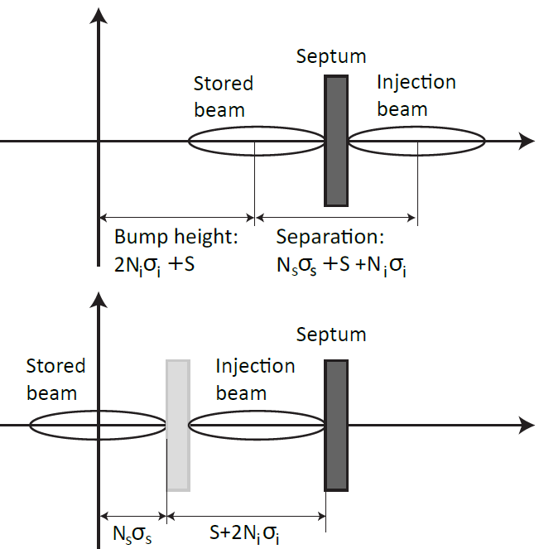
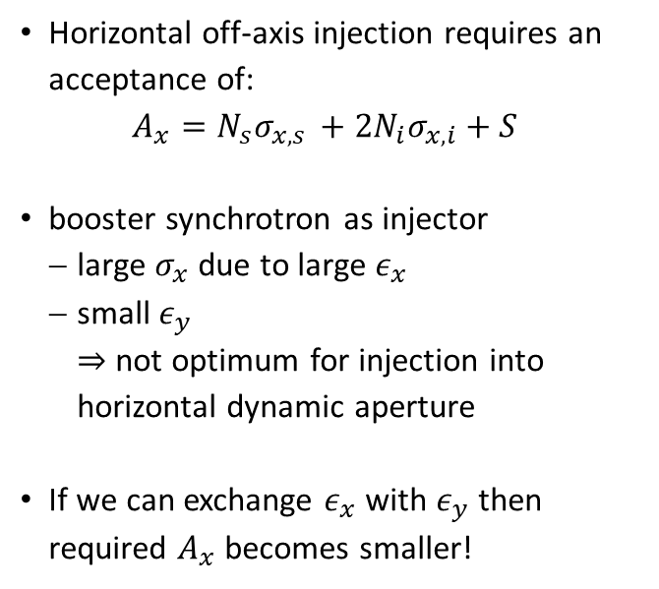
Why emittance exchange?
Horizontal off-axis injection requires an acceptance of:
  $$A_{x}=N_{s}σ_{x,s }+2N_{i}σ_{x,i}+S$$
booster synchrotron as injector
  large $σ_{x}$ due to large $ε_{x}$
  small $ε_{y}$
  $⇒$not optimum for injection into horizontal dynamic aperture
If we can exchange $ε_{x}$ with $ε_{y}$ then required $A_{x}$ becomes smaller!

Slide 3
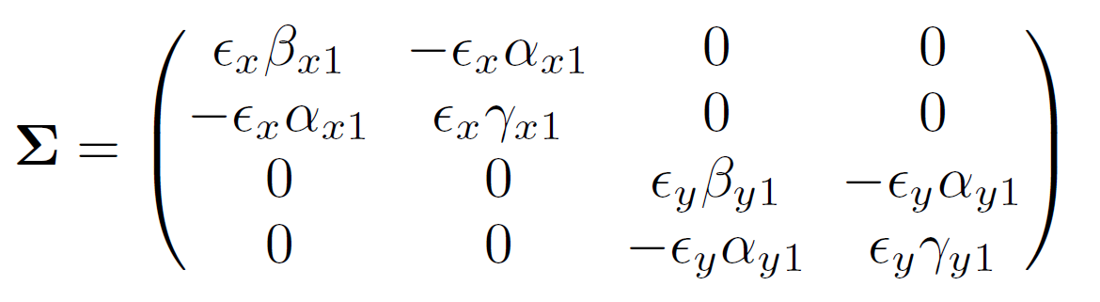
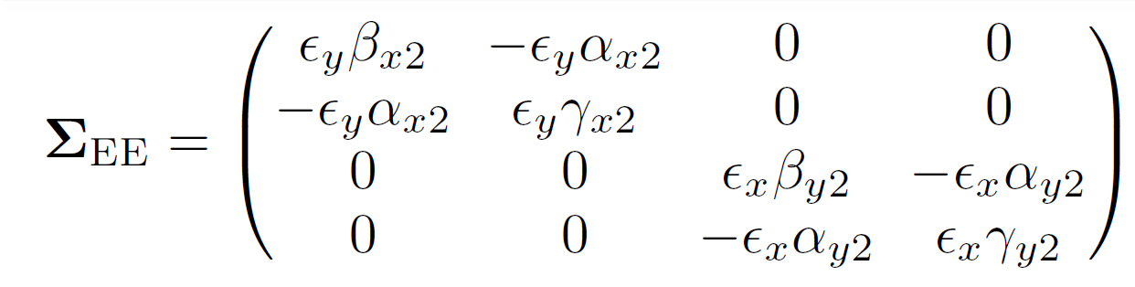
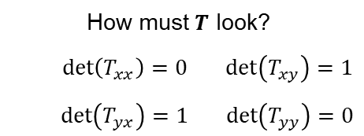




Generalized emittance exchange
Objective: create system with transfer matrix $T$ such that transverse emittances of the beam are perfectly exchanged:
$$TΣT^{′}$$
$$ε_{x}= \sqrt{\det{Σ_{xx′}}}$$
$$ε_{y}= \sqrt{\det{Σ_{yy′}}}$$
How must $T$ look?
  $\det\left(T_{xx}\right)=0$ $\det\left(T_{xy}\right)=1$
  $\det\left(T_{yx}\right)=1$ $\det\left(T_{yy}\right)=0$

Slide 4
Ways of doing emittance exchange
Transfer lines

Slide 5
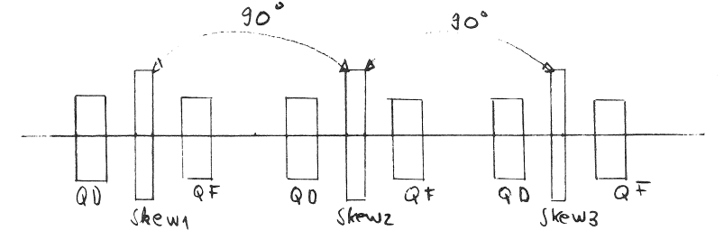
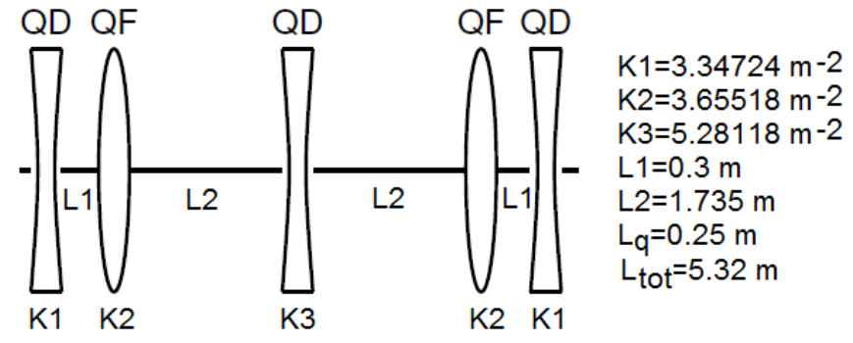
Emittance exchange transfer line exchange
Clever arrangement of skew quadrupoles will exchange emittances
  Maybe the oldest method: proposed in 1970!
Simple. Clean. Stable.
Must be kept dispersion-free to avoid vertical dispersion after exchange.
CERN proposal:
3 skew quads + interleaved normal quads
90° phase advance.
BESSY proposal:
5 skew quads

Slide 6
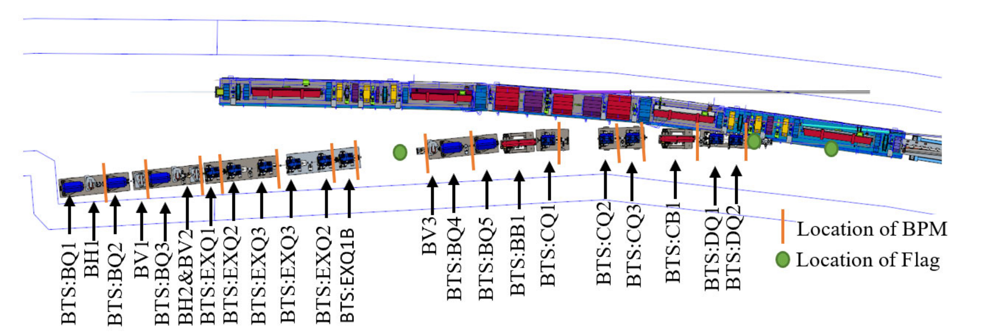
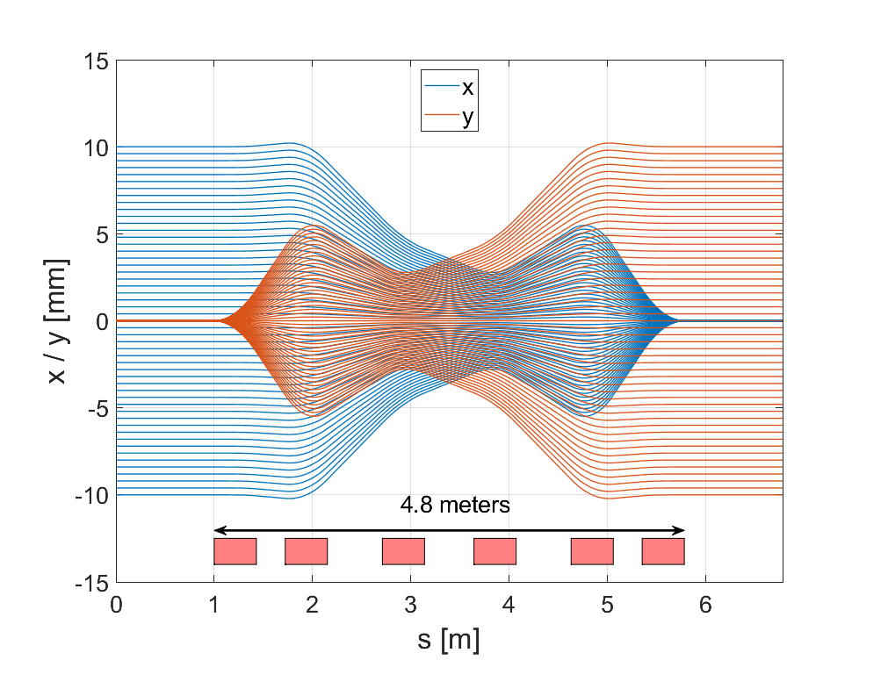
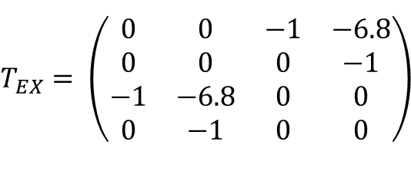
Emittance exchange
APS-U BTS transfer line exchange
$$T_{EX}= \left(\begin{matrix}0 & 0 & −1 & −6.8 \\ 0 & 0 & 0 & −1 \\ −1 & −6.8 & 0 & 0 \\ 0 & −1 & 0 & 0\end{matrix}\right)$$
Thanks to Michael Borland for the lattice

Slide 7
Ways of doing emittance exchange
Resonances in boosters

Slide 8
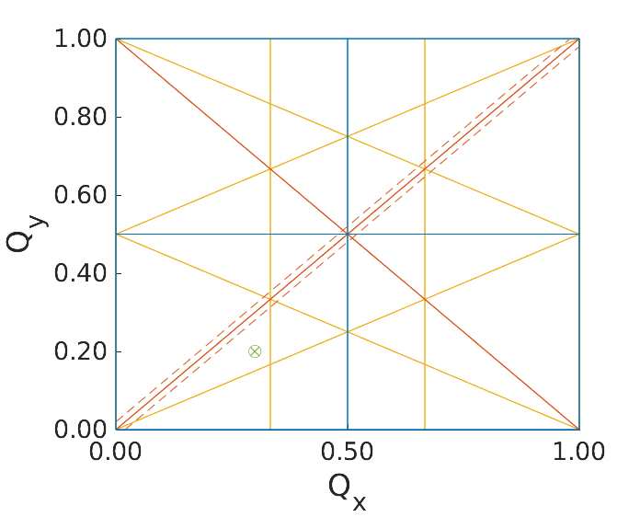
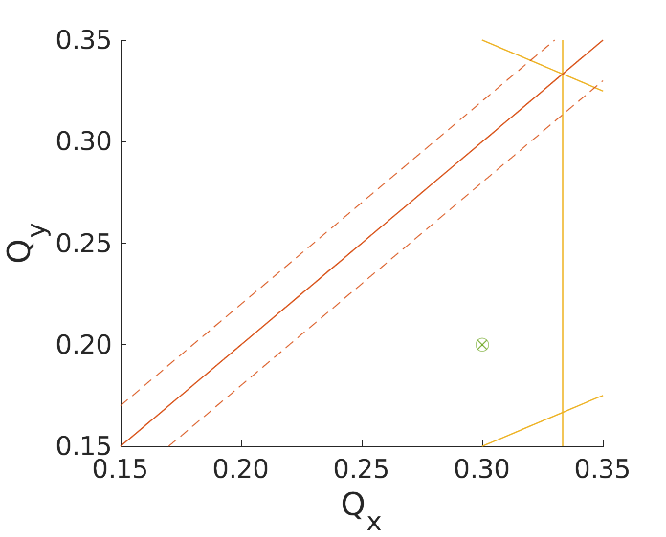
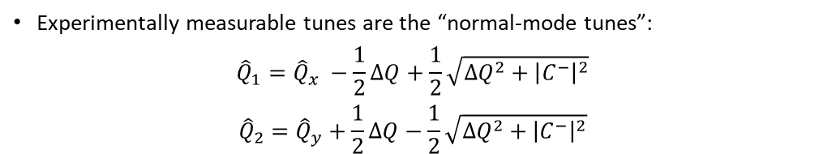
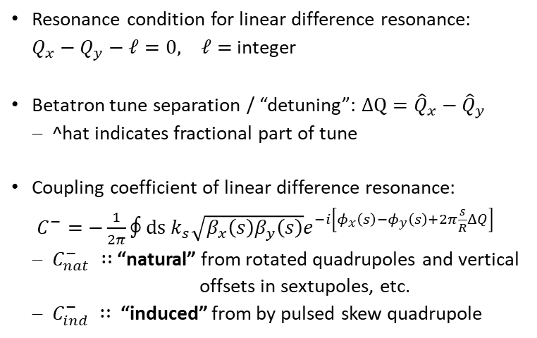


Emittance exchange using resonances
Terminology
Resonance condition for linear difference resonance:
$Q_{x}−Q_{y}−ℓ=0, ℓ=$integer
Betatron tune separation / “detuning”: $ΔQ={\hat{Q}}_{x}−{\hat{Q}}_{y}$
  ^hat indicates fractional part of tune
Coupling coefficient of linear difference resonance:
$C^{−}=−\frac{1}{2π}∮ds k_{s}\sqrt{β_{x}\left(s\right)β_{y}\left(s\right)}e^{−i\left[φ_{x}\left(s\right)−φ_{y}\left(s\right)+2π\frac{s}{R}ΔQ\right]}$
  $C_{nat}^{−} ∷$“natural” from rotated quadrupoles and vertical offsets in sextupoles, etc.
  $C_{ind}^{−} ∷$“induced” from by pulsed skew quadrupole
$$\sqrt{2}|C^{−}|$$
Experimentally measurable tunes are the “normal-mode tunes”:
  $${\hat{Q}}_{1}={\hat{Q}}_{x} −\frac{1}{2}ΔQ+\frac{1}{2}\sqrt{ΔQ^{2}+{\left|C^{−}\right|}^{2}}$$
  $${\hat{Q}}_{2}={\hat{Q}}_{y}+\frac{1}{2}ΔQ−\frac{1}{2}\sqrt{ΔQ^{2}+{\left|C^{−}\right|}^{2}}$$
Dotted lines act as “stop-band” for $Q_{1}$ and $Q_{2}$

Slide 9
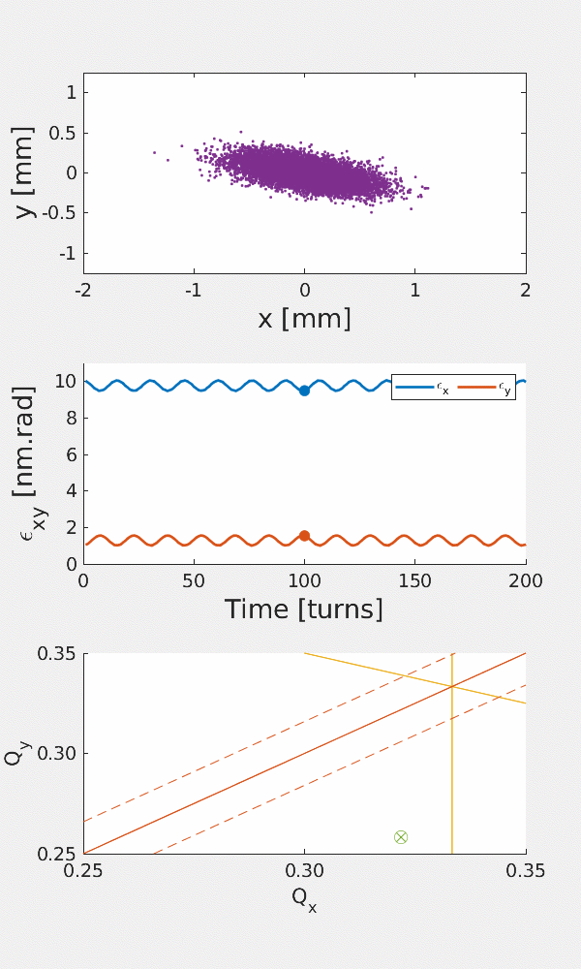
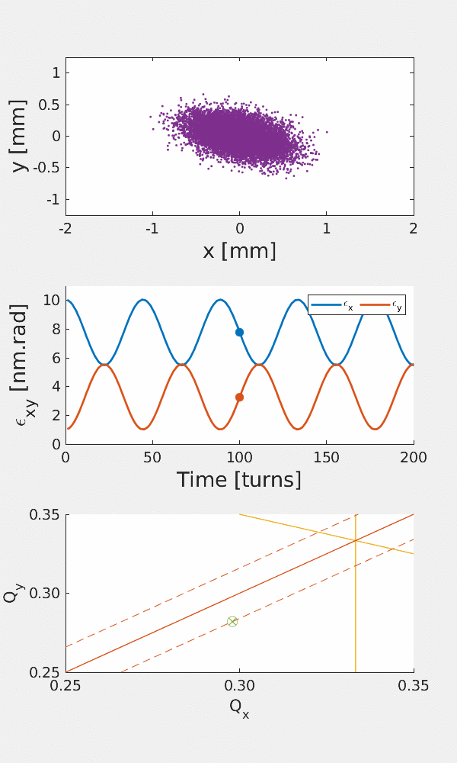
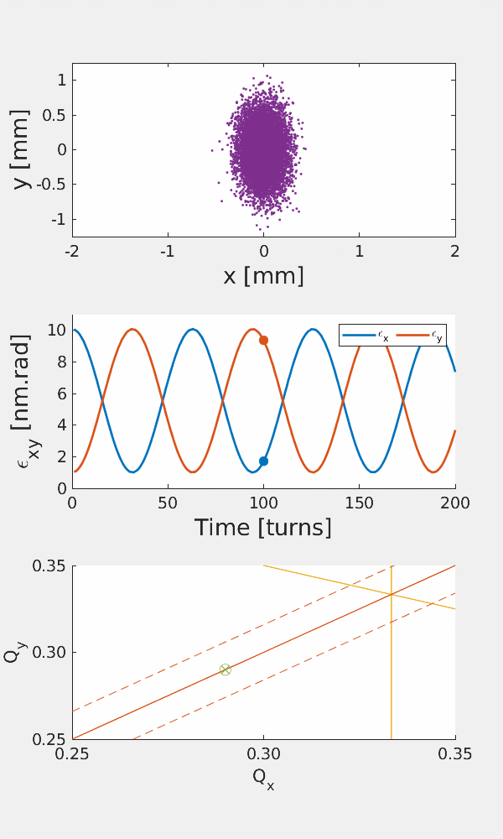





Emittance oscillations due to linear difference resonance
$ΔQ=0$.064
$$\left|C^{−}\right|=0.016$$
$ΔQ=0$.016
$$\left|C^{−}\right|=0.016$$
$$ΔQ=0 \\ \left|C^{−}\right|=0.016$$
No damping!
$$ε_{x,min}=ε_{x0}+\frac{{\left|C^{−}\right|}^{2}}{{\left|C^{−}\right|}^{2}+{ΔQ}^{2}}\frac{\left(ε_{y0}−ε_{x0}\right)}{2}$$
$$ε_{y,max}=ε_{y0}−\frac{{\left|C^{−}\right|}^{2}}{{\left|C^{−}\right|}^{2}+{ΔQ}^{2}}\frac{\left(ε_{y0}−ε_{x0}\right)}{2}$$

Slide 10
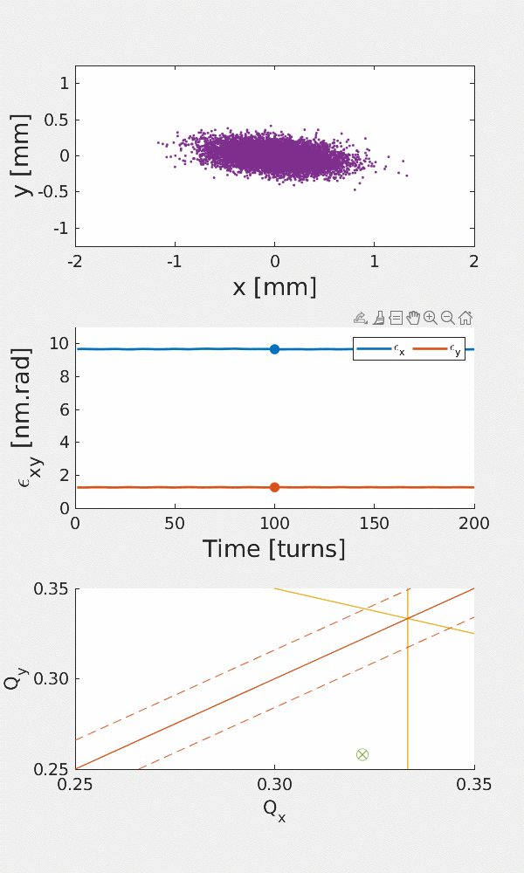
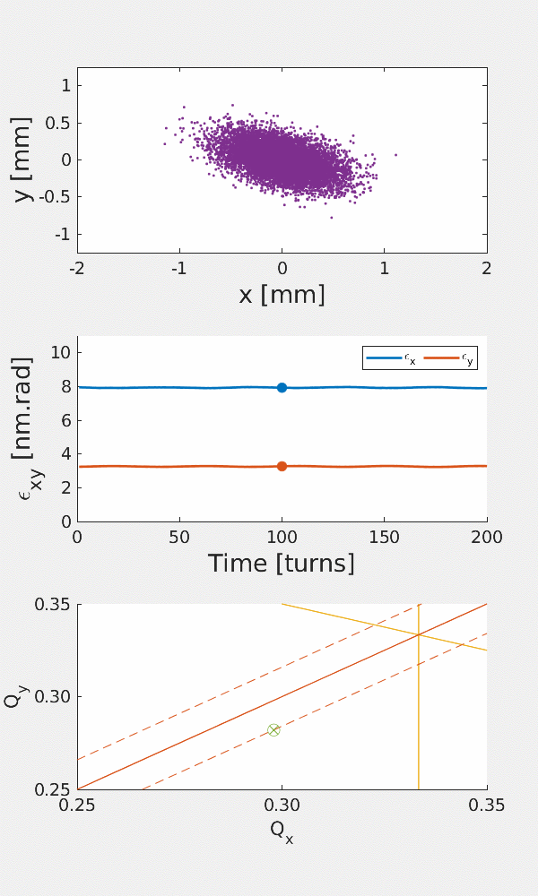
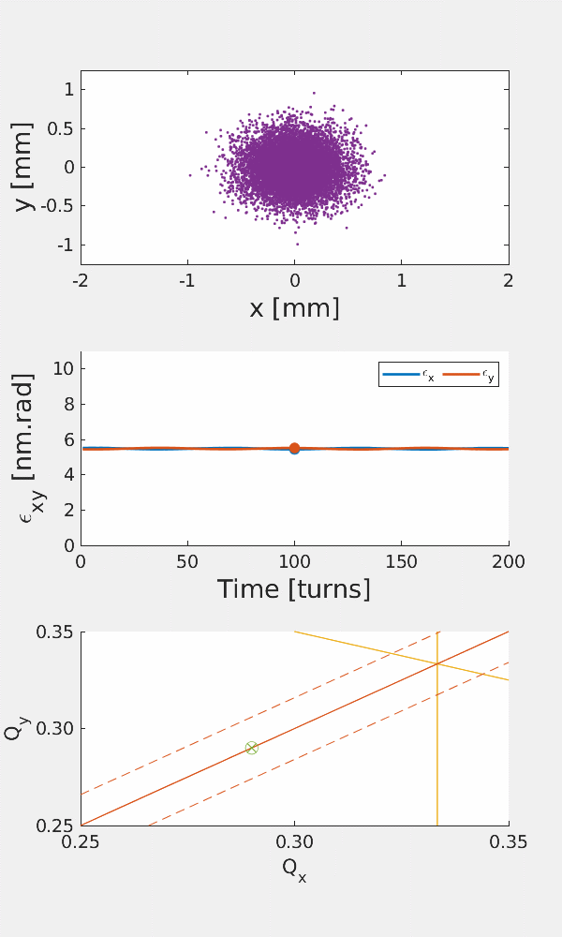
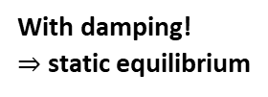




Emittance oscillations due to linear difference resonance
$ΔQ=0$.064
$$\left|C^{−}\right|=0.016$$
$ΔQ=0$.016
$$\left|C^{−}\right|=0.016$$
$$ΔQ=0 \\ \left|C^{−}\right|=0.016$$
With damping!
$⇒$ static equilibrium
$$ε_{x}=ε_{x0}+\frac{{\left|C^{−}\right|}^{2}}{{\left|C^{−}\right|}^{2}+{ΔQ}^{2}}\frac{\left(ε_{y0}−ε_{x0}\right)}{2}$$
$$ε_{y}=ε_{y0}−\frac{{\left|C^{−}\right|}^{2}}{{\left|C^{−}\right|}^{2}+{ΔQ}^{2}}\frac{\left(ε_{y0}−ε_{x0}\right)}{2}$$

Slide 11
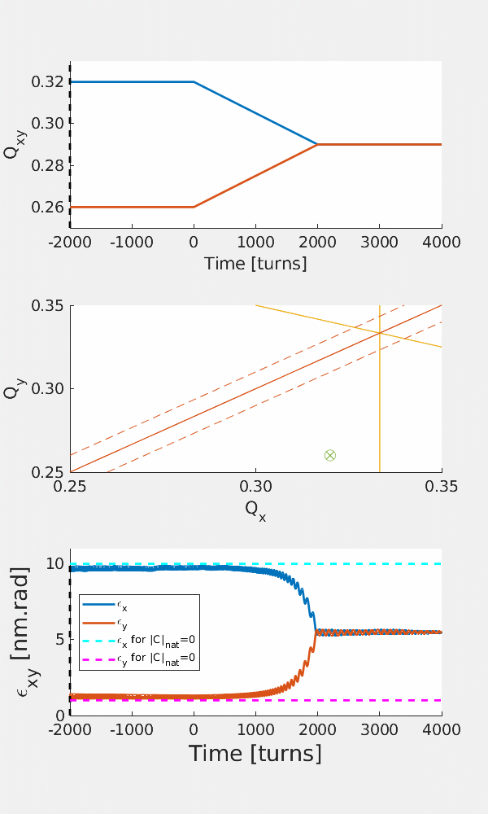

Emittance sharing the easy choice
${\hat{Q}}_{x}=$0.32 $⇒$ 0.29
${\hat{Q}}_{y}=0.26$ $⇒$ 0.29
${\left|C\right|}_{nat}=0.01$
Nice and slow – easy for power supplies
But this is just equalizing the emittances!
How to improve the situation??

Slide 12
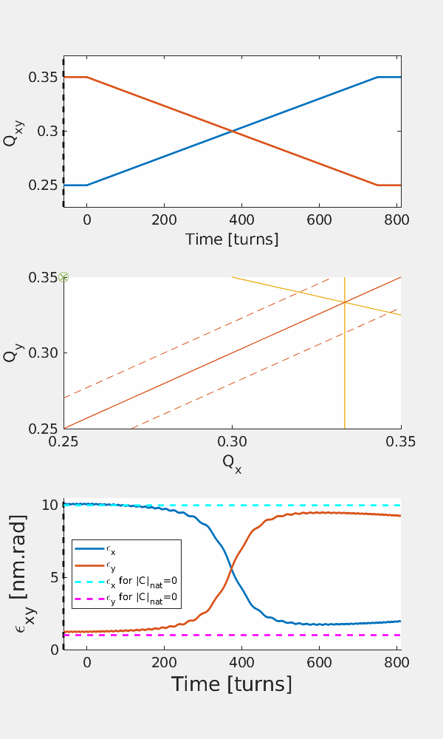

Emittance exchange coupling resonance crossing
Crossing the resonance can lead to emittance exchange
  Only spend time within the stopband when you need it!
    Example
${\hat{Q}}_{x}=$0.25 $⇒$ 0.35 ${\hat{Q}}_{y}=0.35$ $⇒$ 0.25 ${\left|C\right|}_{nat}=0.02$
“Free” if the coupling in the machine is non-zero and quadrupole power supplies are capable of ramping with the required speed
Damping deteriorates the exchange
  Works best for machines with long $τ_{x}$

Slide 13
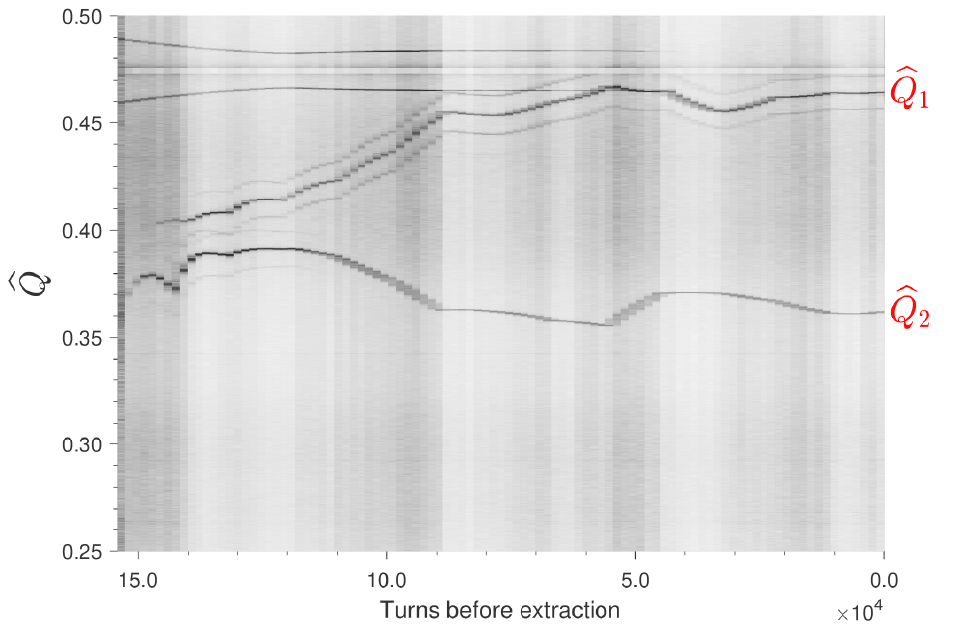
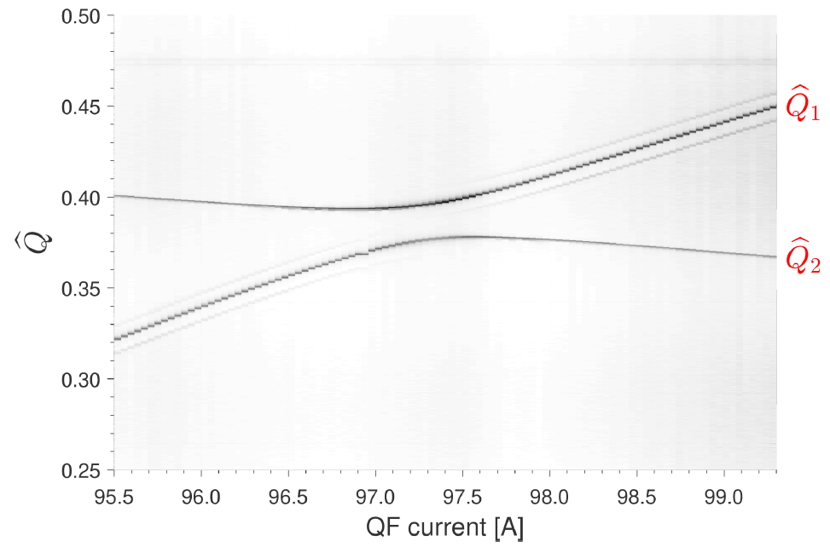
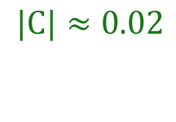
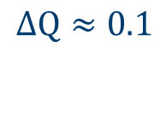
Emittance exchange
SLS booster coupling resonance crossing
Preparations for resonance crossing: investigate the state of the SLS booster
  Measure tunes along ramp
  Coupling coefficient measured by closest tune approach by scanning QF family current
Resonance crossing possible by decreasing QF-family current before extraction
$$ΔQ≈0.1$$
$$|C|≈0.02$$
Page 13

Slide 14
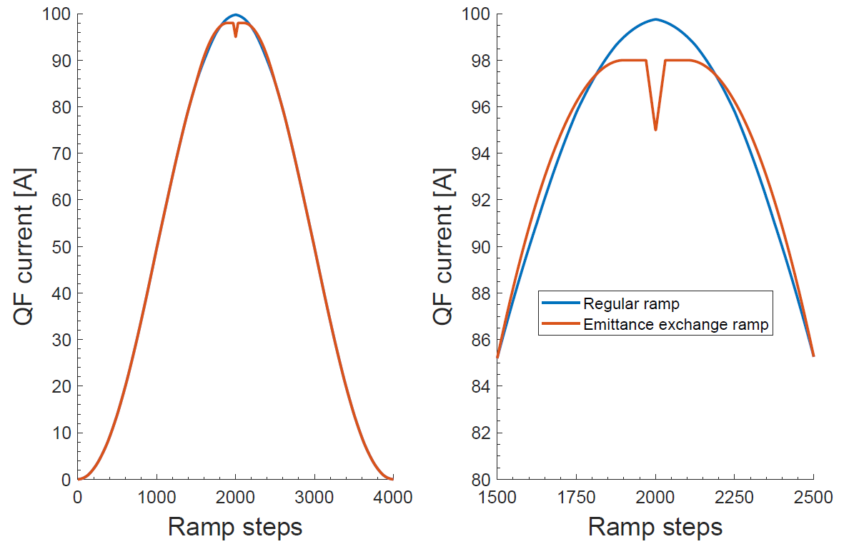
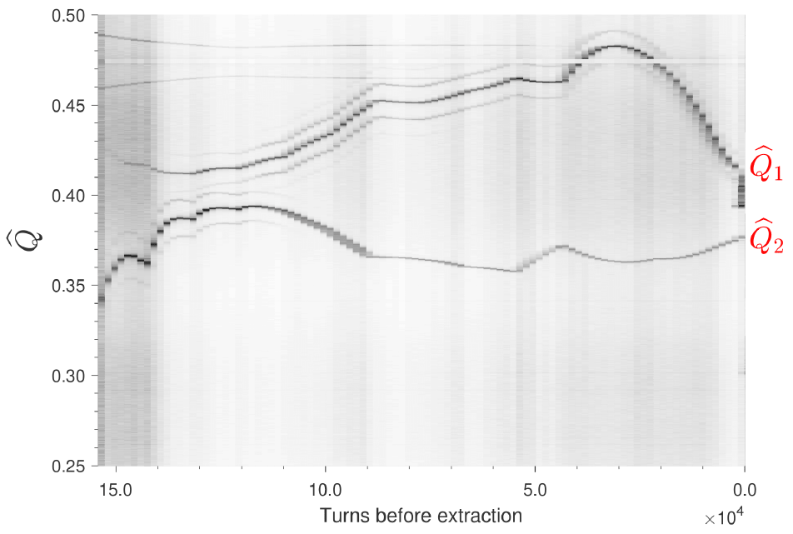

Emittance exchange
SLS booster coupling resonance crossing
$ΔQ$ is reduced to ease resonance crossing
Rapid tune-shift within last 2.4 ms before extraction
Page 14

Slide 15
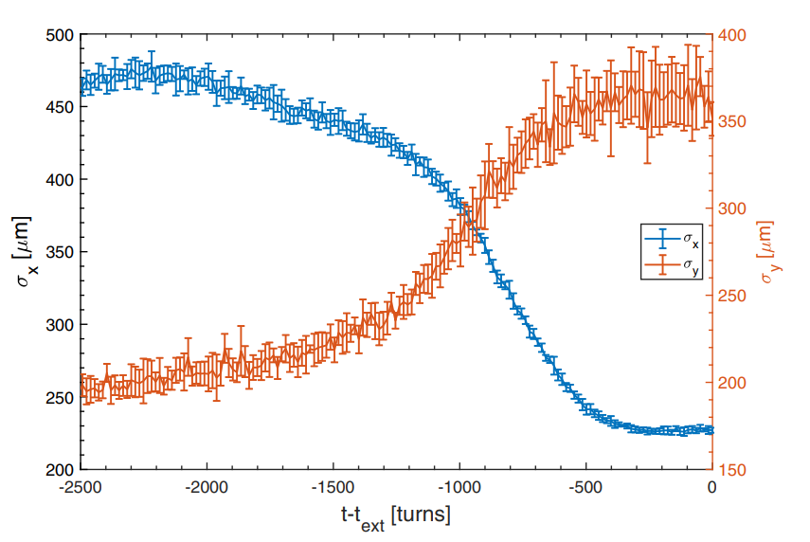
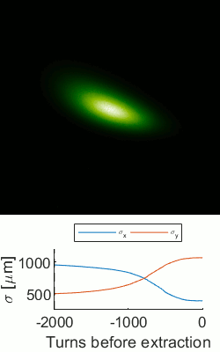


Emittance exchange
SLS booster coupling resonance crossing
From quadrupole scans: $ε_{x}≈10 nmrad⇒ ≈2.5 nmrad$
Limited by $ε_{y}$

Slide 16
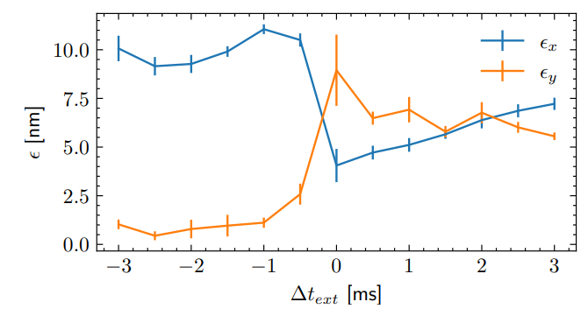
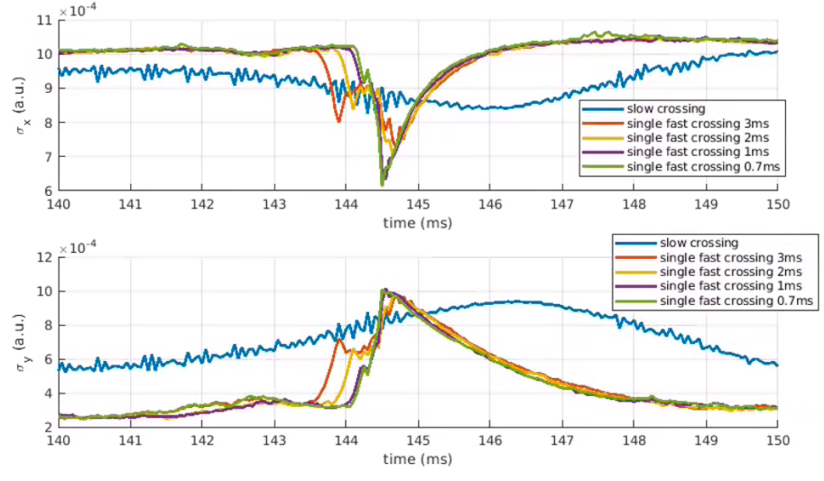
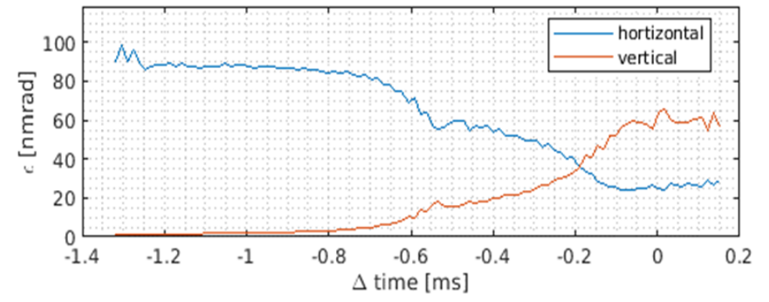
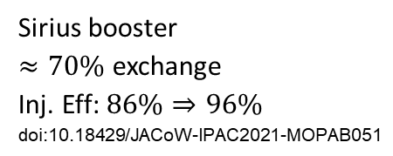
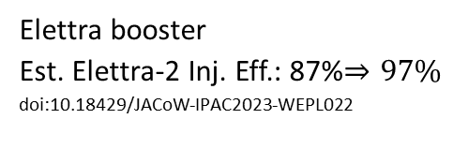
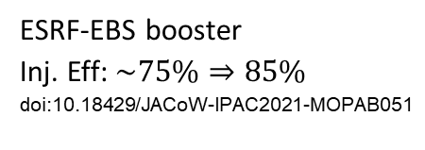
Emittance exchange
Resonance crossing elsewhere
Sirius booster
$≈70\%$ exchange
Inj. Eff: $86\%⇒96\%$
doi:10.18429/JACoW-IPAC2021-MOPAB051
ESRF-EBS booster
Inj. Eff: $\sim 75\%⇒85\%$
doi:10.18429/JACoW-IPAC2021-MOPAB051
Elettra booster
Est. Elettra-2 Inj. Eff.: 87%$⇒97\%$
doi:10.18429/JACoW-IPAC2023-WEPL022

Slide 17
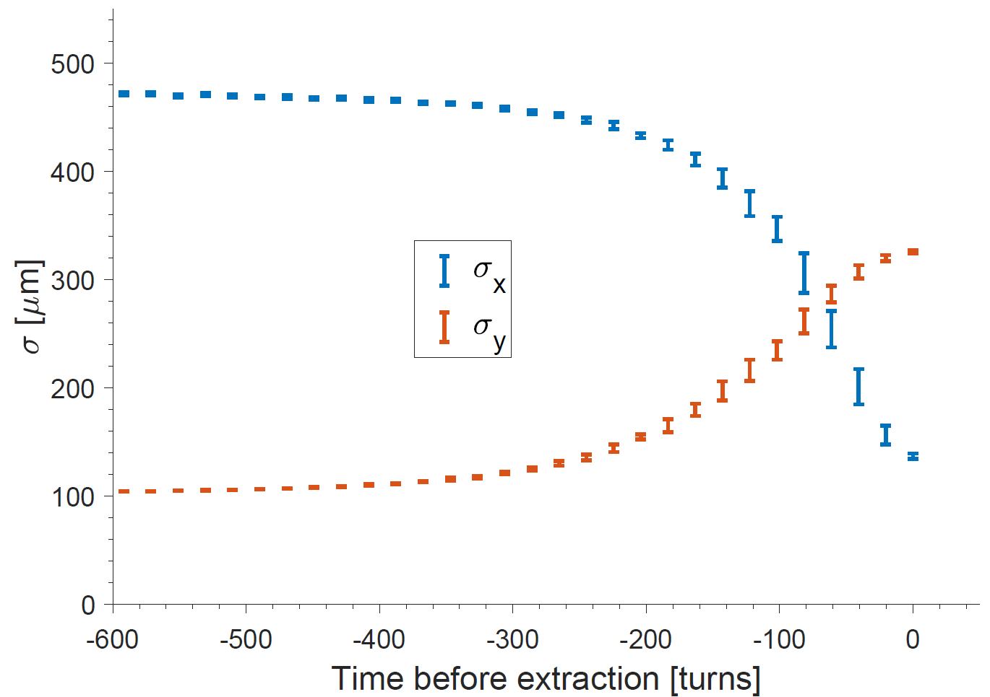
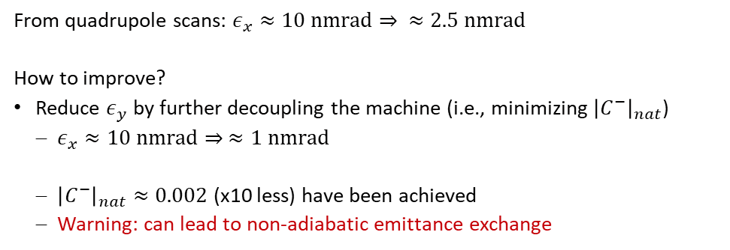
Emittance exchange
SLS booster coupling resonance crossing
From quadrupole scans: $ε_{x}≈10 nmrad⇒ ≈2.5 nmrad$
How to improve?
Reduce $ε_{y}$ by further decoupling the machine (i.e., minimizing ${\left|C^{−}\right|}_{nat}$)
  $ε_{x}≈10 nmrad⇒ ≈1 nmrad$
  ${\left|C^{−}\right|}_{nat}≈0.002$ (x10 less) have been achieved
  Warning: can lead to non-adiabatic emittance exchange
Limited by $ε_{y}$

Slide 18
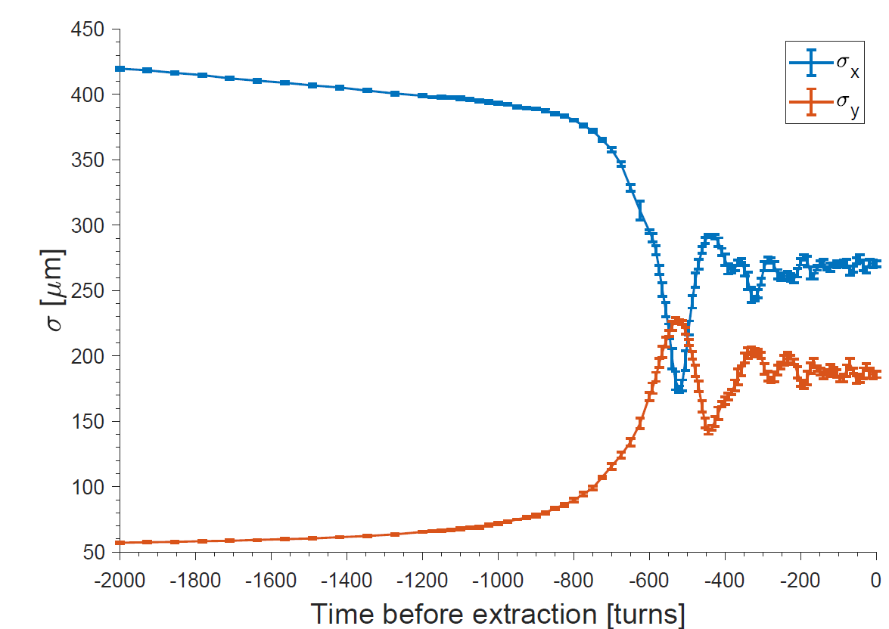
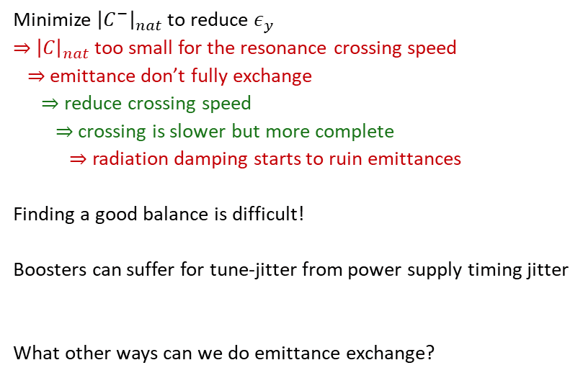
Emittance exchange
SLS booster coupling resonance crossing
Minimize ${\left|C^{−}\right|}_{nat}$ to reduce $ε_{y}$
$⇒$ ${\left|C\right|}_{nat}$ too small for the resonance crossing speed
$⇒$ emittance don’t fully exchange
$⇒$ reduce crossing speed
$⇒$ crossing is slower but more complete
$⇒$ radiation damping starts to ruin emittances
Finding a good balance is difficult!
Boosters can suffer for tune-jitter from power supply timing jitter
What other ways can we do emittance exchange?

Slide 19
Ways of doing emittance exchange
Resonances in boosters
+ induced coupling

Slide 20
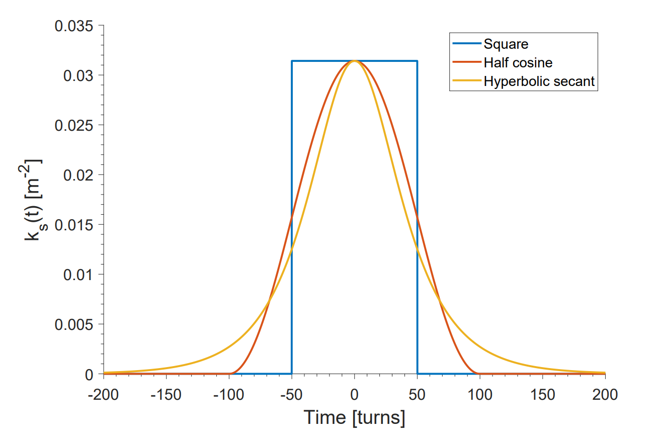
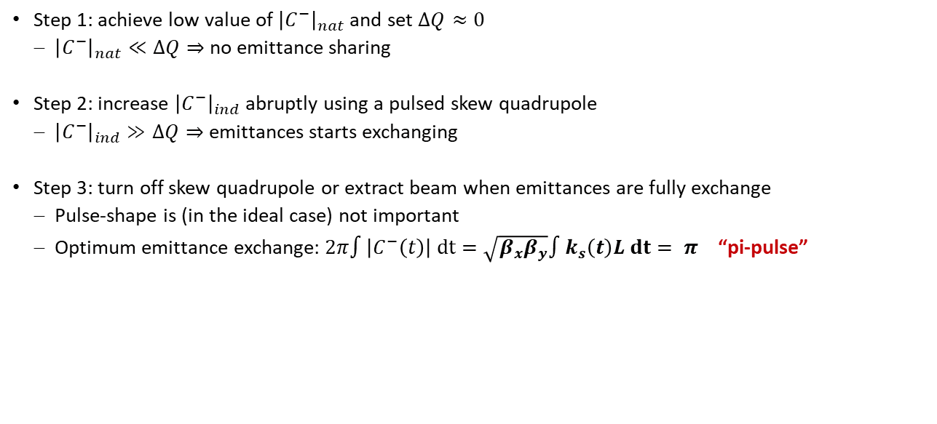
Emittance exchange pulsed skew quadrupole
Step 1: achieve low value of ${\left|C^{−}\right|}_{nat}$ and set $ΔQ≈0$
  ${\left|C^{−}\right|}_{nat}≪ΔQ⇒$ no emittance sharing
Step 2: increase ${\left|C^{−}\right|}_{ind}$ abruptly using a pulsed skew quadrupole
  ${\left|C^{−}\right|}_{ind}≫ΔQ⇒$ emittances starts exchanging
Step 3: turn off skew quadrupole or extract beam when emittances are fully exchange
  Pulse-shape is (in the ideal case) not important
  Optimum emittance exchange: $2π∫\left|C^{−}\left(t\right)\right| dt=\sqrt{β_{x}β_{y}}∫k_{s}\left(t\right)L dt= π$ “pi-pulse”

Slide 21
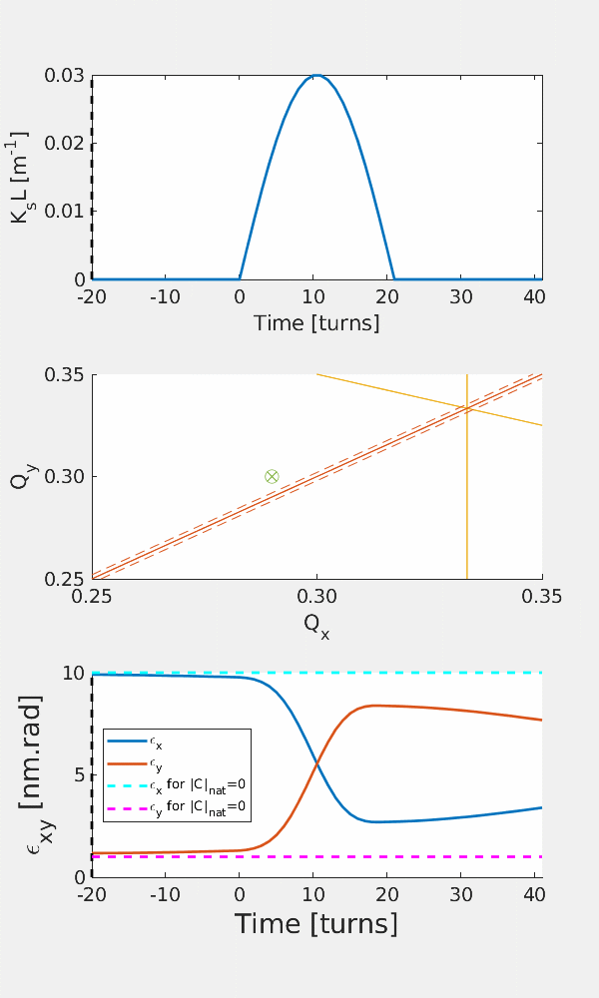



Emittance exchange pulsed skew quadrupole
${\hat{Q}}_{x}=$0.29, ${\hat{Q}}_{y}=0.30$ $⇒ΔQ=0.0$1
${\left|C\right|}_{nat}=0.0$02
${\left|C\right|}_{ind}=0.03$
The detuning ($ΔQ>0)$ makes a perfect exchange impossible
  But detuning needed because ${\left|C\right|}_{nat}>0$
How to improve?
  Smaller ${\left|C\right|}_{nat}$ and smaller $ΔQ$
  Larger ${\left|C\right|}_{ind}$
Square-pulse for $\left|Δ\right|>0$

Slide 22



Emittance exchange pulsed semi-skew quadrupole
Idea by Peter Kuske: combine tune shift from pulsed quadrupole with coupling from pulsed skew quadrupole
Tune shift and most coupling is controlled by only one power supply
Only a modest quadrupole strength is needed (w.r.t. pure-skew quad)
The natural $|C^{−}|$ can be basically zero
$⇒$ small $ε_{y}$ before exchange gives small $ε_{x}$ after exchange
+
=
Normal quadrupole
Skew-quadrupole
45° rotation
Semi-skew-quadrupole
22.5° rotation
Effect of quadrupole rotated $\frac{π}{8}$ rad = 22.5°:
$$δQ_{xy}=±\frac{1}{\sqrt{2}}\frac{Δk}{4π}β_{xy}$$
$\left|C^{−}\right|=\frac{1}{2π}∮\sqrt{\frac{β_{x}β_{y}}{2}}k_{s}ℓ ds$ (for $ΔQ=0$)

Slide 23



Emittance exchange pulsed semi-skew quadrupole
${\hat{Q}}_{x}=$0.29 + $δQ_{x} =0.273$
${\hat{Q}}_{y}=0.$29 + $δQ_{y}=0.297$
${\left|C\right|}_{nat}=0.002$
${\left|C\right|}_{ind}=0.021$
Note: same magnet strength as pulsed skew quadrupole example but smaller ${\left|C\right|}_{ind}$ due to magnet rotation
Perfect exchange possible despite large detuning ($\left|ΔQ\right|≫0)$
$⇒|Δ|=0.0$24

Slide 24


Emittance exchange
AC skew quadrupole
Emittance exchange through resonance crossing and the pulsed skew-quadrupole schemes requires $ΔQ$ to be small
Oscillating (“AC”) skew quadrupole can be used to excite the resonance with $\left|ΔQ\right|≫0$
  Condition: $Q_{x}−Q_{y}−Q_{AC}=p ⇒ Q_{AC}=\left|{\hat{Q}}_{x}−{\hat{Q}}_{y}\right|=ΔQ$
Example:
  $T_{rev}=1 μs⇒f_{rev}=1 MHz$
  $\left[{\hat{Q}}_{x}, {\hat{Q}}_{y}\right]=\left[0.42, 0.27\right] ⇒ΔQ=Q_{AC}=0.15=150 kHz$
  ${\left|C\right|}_{nat}=0.002 {\left|C\right|}_{ind}=0.01$
Important observations
Arbitrary selection of tunes!
  best booster performance by picking optimum working point
  only affects frequency of AC skew quad
“Arbitrary” selection of $k_{s}$
  small $k_{s}⇒$ slow exchange $⇒$ larger effect of damping

Slide 25

Conclusions
Emittance exchange is a way of improving horizontal off-axis injection from booster synchrotrons into low-dynamic aperture machines
The reduced $ε_{x}$ may allow the re-use of existing boosters: saves dark time and money
Many exciting options!
  Transfer line exchange
  Coupling resonance crossing
  Pulsed- and AC-skew quadrupole
 | Emittance sharing | Coupling resonance crossing | Pulsed skew quadrupole | AC skew quadrupole | Transfer line exchange
Emittance exchange quality | 50% | 80-100% | 80-100% | 95-100% | 95-100%
Price tag | - | - | 💲 | 💲 | 💲💲
Space requirement | - | - | ⌂ | ⌂ | ⌂⌂
Operational stability | ☺☺ | (☹) | ☺☺ | ☺ | ☺☺☺
Technological requirements | - | (⚒) | ⚒⚒ | ⚒⚒⚒ | ⚒

Slide 26
Thank you for your attention!

Slide 27

Emittance exchange
APS-U transfer line
Projected emittances tracked through APS-U transfer line with emittance exchange after skew quadrupoles 1-6.
0
1
2
3
4
5
6
6
1
2
4
5
3

Slide 28


Emittance exchange
Transfer line exchange errors
Warning:
Not totally scientifically sound.
Use with caution!
Calibration errors lead to non-perfect emittance exchange
Example: APS-U BTS exchange section
  Apply random relative error $Δk/k_{0}$ to quadrupoles of varying RMS value
  Calculate $σ_{x}/σ_{x0}$ at end of exchange section
    $σ_{x}/σ_{x0}$ = 0 $⇒$ perfect exchange
    $σ_{x}/σ_{x0}$ = 1 $⇒$no exchange
Results:
5% RMS calibration error on skew quadrupole strengths
gives on average ~20% deterioration of emittance exchange

Slide 29



Resonance crossing: adiabaticity
Resonance crossing must be slow to allow for the emittance exchange: “adiabatic”
Crossing too quickly will lead to incomplete exchange: “non-adiabatic”
What is the impact of non-adiabaticity?
Define quality of emittance exchange:
$$R=1−\frac{ε_{x,end}−ε_{y,0}}{ε_{x,0}−ε_{y,0}}$$
Scaling parameter describing adiabaticity
  $$S=\left(\frac{\frac{d}{dt}\left({\hat{Q}}_{x}−{\hat{Q}}_{y}\right)}{{\left|C\right|}^{2}}\right)= \frac{\dot{ΔQ}}{{\left|C\right|}^{2}}$$
$$C=−\frac{1}{2π}∮ds k_{s}\sqrt{β_{x}\left(s\right)β_{y}\left(s\right)}e^{−i\left[φ_{x}\left(s\right)−φ_{y}\left(s\right)+2π\frac{s}{R}Δ\right]}$$
Page 29

Slide 30



Emittance exchange: adiabaticity
Simulation emittance exchange in the SLS booster lattice with different $\left|C\right|$ and $\dot{Δ}:$
  $S$ is indeed a good scaling parameter for adiabaticity
  $S<3$ gives good exchange
Landau-Zener formula from QM describes the scaling
  $$R=1−P_{na}=1−\exp\left(−\frac{π^{2}}{S}\right)$$
adiabatic
non-adiabatic

Slide 31



Emittance exchange: damping
Radiation deteriorates the emittance exchange when beam is out of equilibrium
Effect of radiation in SLS booster:
extracting after $Δ_{ext}=2.1\left|C\right|$ with $τ=11.4ms$
  Beam must be extracted early, but working point must be far away from resonance

Slide 32

SLS booster decoupling
Vertical beam offsets in sextupoles lead to x-y coupling
$$C=−\frac{1}{2π}∮dsk_{2}y\left(s\right)\sqrt{β_{x}\left(s\right)β_{y}\left(s\right)}e^{\left(−i\left[φ_{x}\left(s\right)−φ_{y}\left(s\right)\right]+2π\frac{s}{R}Δ\right)}{}$$
Orbit in SLS booster is not corrected due to lack of available BPMs
  $⇒$ coupling may stem from vertical offsets, leading to vertical dispersion and emittance sharing
  $$σ_{y}=\sqrt{β_{y}ε_{y}+ η_{y}^{2}σ_{δ}^{2}}$$
Minimizing $σ_{y}$ in transfer line can lead to decoupling
  Closed orbit bumps
  Single-corrector optimization

Slide 33




SLS booster decoupling
Works very well!
  Factor 2 reduction in $σ_{y}$
  Suppression of $η_{y}$ at BRTL cameras
  Factor 10 reduction in $|C|$
$⇒$better $ε_{x}$ after emittance exchange

