Slide 1
Transverse beam instabilities in the SOLEIL II booster
Watanyu Foosang
Accelerator physics group
Synchrotron SOLEIL
watanyu.foosang@synchrotron-soleil.fr
I.FAST Workshop on Injectors for Storage Ring Based Light Sources
6-8 March 2024, KIT, Karlsruhe

Slide 2
Outline
Introduction
Why study collective effects in the new booster
Booster model
Ramp model
Case study from the present booster
SOLEIL II booster model
SOLEIL II impedance model
Energy-dependent collective effects study
Transverse Single-Bunch Instabilities (TSBI)
Transverse Coupled-Bunch Instability (TCBI)
Conclusion and outlook
Design of the SOLEIL II booster
Previous talk of P. Schreiber

Slide 3
Introduction

Slide 4
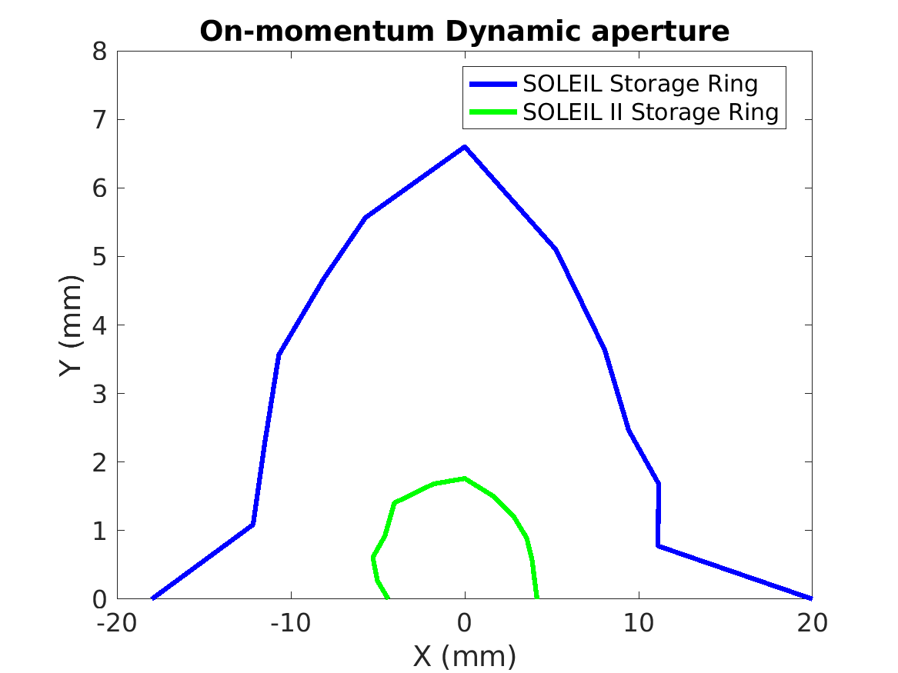
Why study collective effects in the new booster
The new 7BA-4BA lattice of the SOLEIL II storage ring results in a much smaller dynamic aperture (DA) compared to the present ring.
The booster which serves as an injector to the SR also needs an upgrade to produce low emittance beam to be injected into the new DA.
The lattice design has evolved from simple FODO cells to 16BA lattice with stronger dipole field, quadrupole and sextupole gradients.
Present booster
SOLEIL II booster
Emittance at extraction
140 nm rad
5.2 nm rad
27 times smaller
Close to the natural emittance of the present storage ring
(3.9 nm rad)

Slide 5

Why study collective effects in the new booster
Present SOLEIL booster
SOLEIL II booster
To allow for the stronger magnets, the average vaccum chamber dimension will be reduced.
This immediately raised concern over the impedance, especially the resistive-wall (RW) type since
18 mm
22 mm
52 mm
$$τ_{RW}∝b^{3}$$
RW instability (RWI) growth time
Vaccum chamber radius
32 mm
48 mm
52 mm
Standard vacuum chamber sizes (to scale)

Slide 6
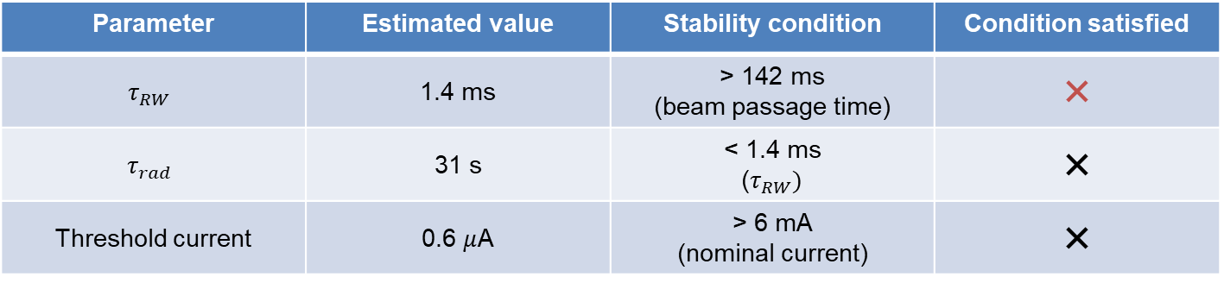

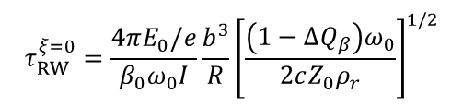


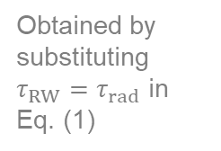


Why study collective effects in the new booster
To asses the importance of the resistive-wall instability (RWI), we calculated its growth time at the injection enegy and compared it to the synchrotron radiation damping time.
$$τ_{RW}^{ξ=0}=\frac{4πE_{0}/e}{β_{0}ω_{0}I}\frac{b^{3}}{R}{\left[\frac{\left(1−ΔQ_{β}\right)ω_{0}}{2cZ_{0}ρ_{r}}\right]}^{1/2}$$
RWI growth time ^{[1]} :
(1)
$$τ_{RW}∝E_{0}b^{3}$$
Stable beam when $τ_{RW}>τ_{rad}$
$$τ_{rad}=\frac{2}{j}\frac{E_{0}}{U_{0}}T_{0}$$
(2)
$$τ_{rad}∝E_{0}^{−3}$$
Synchrotron radiation damping time :
Where $E_{0}$ is beam energy
Parameter | Estimated value | Stability condition | Condition satisfied
$$τ_{RW}$$ | 1.4 ms | > 142 ms (beam passage time) | ❌
$$τ_{rad}$$ | 31 s | < 1.4 ms ($τ_{RW})$ | ❌
Threshold current | 0.6 $μ$A | > 6 mA (nominal current) | ❌
Obtained by substituting $τ_{RW}=τ_{rad}$ in Eq. (1)
^{[1]} R. Nagaoka and K. L. F. Bane, J Synchrotron Rad 21, 937–960 (2014), https://doi.org/10.1107/S1600577514015215

Slide 7
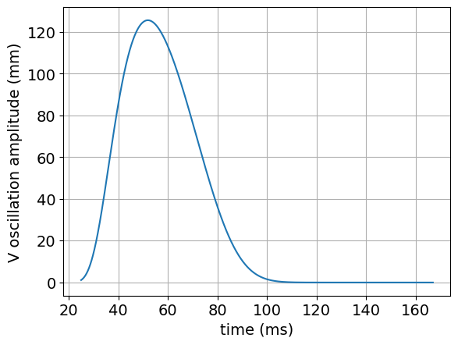
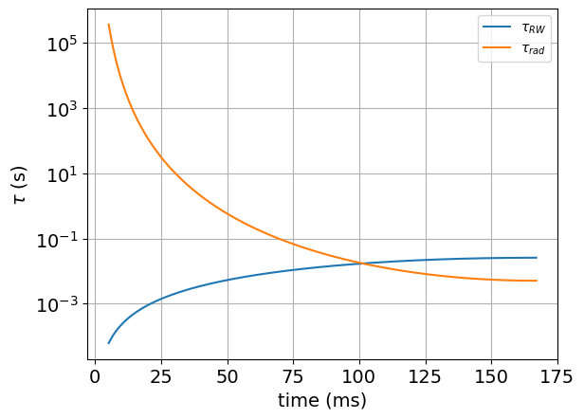

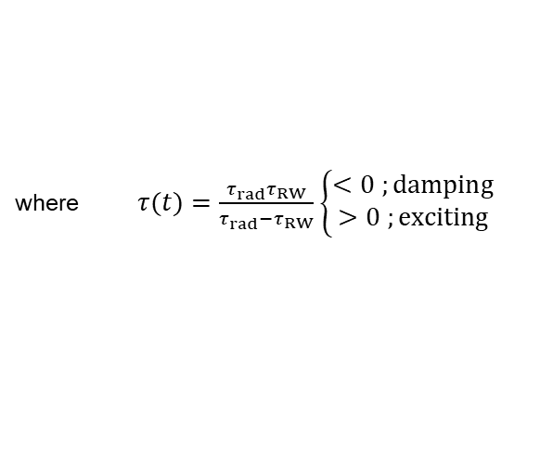

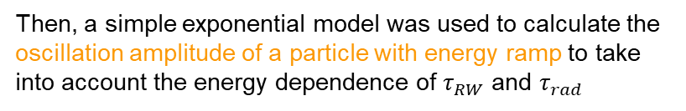

Why study collective effects in the new booster
Then, a simple exponential model was used to calculate the oscillation amplitude of a particle with energy ramp to take into account the energy dependence of $τ_{RW}$ and $τ_{rad}$
where $τ(t)=\frac{τ_{rad}τ_{RW}}{τ_{rad}−τ_{RW}}\left\{\begin{aligned}<0 ;damping \\ >0 ;exciting\end{aligned}\right.$
$$y\left(t\right)={y_{0}e}^{t/τ(t)}$$
It was found that the particle oscillation amplitude exhibited a large inflation along the ramp due to a competition between $τ_{RW}$ and $τ_{rad}$.
This worrying result had brought us to a more sophisticated model by doing particle tracking simulation with energy ramp.
Particle vertical oscillation amplitude along the SOLEIL II booster ramp
Analytical RWI growth time and SR damping time along the ramp
Excited beam
Damped beam
$$τ_{rad}$$
$$τ_{RW}$$
150 MeV
2.75 GeV
150 MeV
2.75 GeV

Slide 8
Booster model

Slide 9
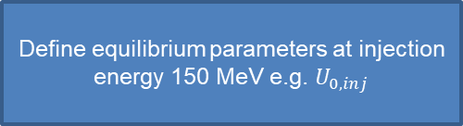



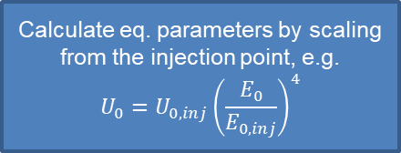


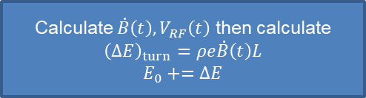

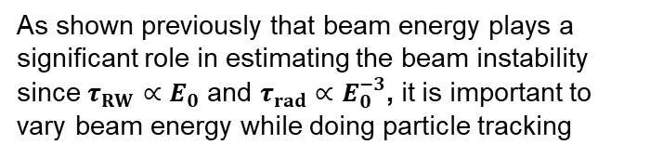




Ramp model
Start
Equilibrium parameters variation along the ramp
Define equilibrium parameters at injection energy 150 MeV e.g. $U_{0,inj}$
As shown previously that beam energy plays a significant role in estimating the beam instability since $τ_{RW}∝E_{0}$ and $τ_{rad}∝E_{0}^{−3}$, it is important to vary beam energy while doing particle tracking
Set $t=0$ and $E_{0}=0$
Energy gain per turn
Energy loss per turn
Synchronous phase
Radiation damping time
Natural energy spread
Natural emittance
$${\left(ΔE\right)}_{turn}=ρe\dot{B}L$$
$$i=0, N=320,000$$
No
$$i<N$$
$$U_{0}∝E_{0}^{4}$$
End
$$φ_{s}=\arccos\left(\frac{{\left(ΔE\right)}_{turn}+U_{0}}{V_{RF}}\right)$$
Yes
$$t+=T_{0}$$
$$i+=1$$
$$τ_{rad}∝1/E_{0}^{3}$$
Calculate $\dot{B}\left(t\right), V_{RF}\left(t\right)$ then calculate
$${\left(ΔE\right)}_{turn}=ρe\dot{B}\left(t\right)L$$
$$E_{0}+=ΔE$$
$$σ_{δ}∝E_{0}$$
$$ε_{0}∝E_{0}^{2}$$
Calculate eq. parameters by scaling from the injection point, e.g.
$$U_{0}=U_{0,inj}{\left(\frac{E_{0}}{E_{0,inj}}\right)}^{4}$$
Track particles with collective effects

Slide 10
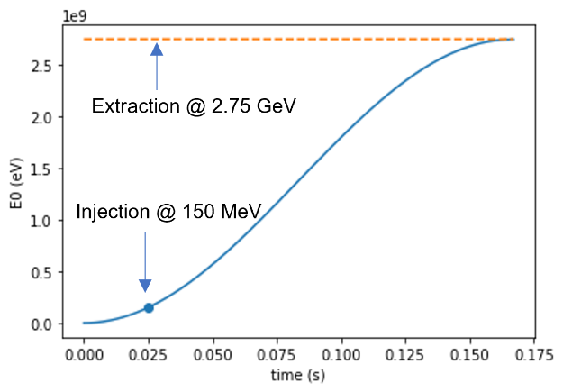
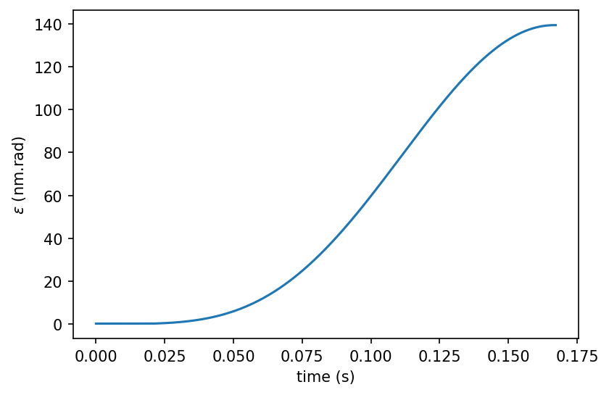
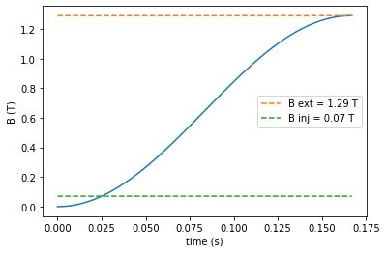
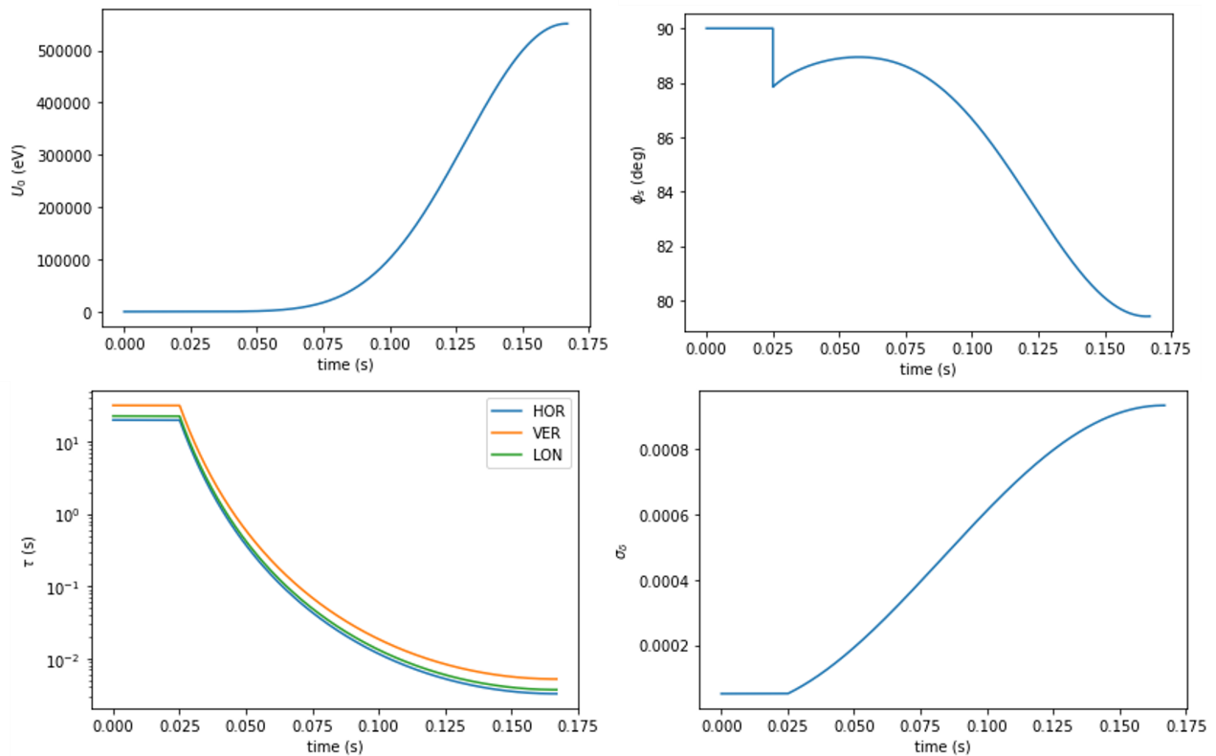
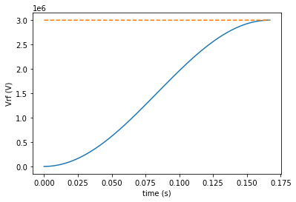








Ramp model
Dipole field and RF voltage ramp in SOLEIL II booster
Equilibrium parameters along the ramp in SOLEIL II booster
$$E_{0}$$
$$ε_{0}$$
$$B$$
$$U_{0}$$
$$φ_{s}$$
Vrf max = 3 MV
Vrf inj = 164 keV
$$V_{RF}$$
$$τ_{rad}$$
$$σ_{δ}$$

Slide 11
Case of the present booster
What else do I need to correctly model the booster?
Notes:
To see which element is important to add in the booster model, we step back to take a look at the present booster.
However, we did not know much about how the present booster can work without instabilities even though its impedance is not at all optimized.
So we wanted to gather its data and use it the previously shown tracking model with energy ramp that I designed.
By doing this, I would know if there was something missing in my model if the results did not correspond the reality.
And also, this would help us know which element in the booster is crucial for fighting instabilities.

Slide 12
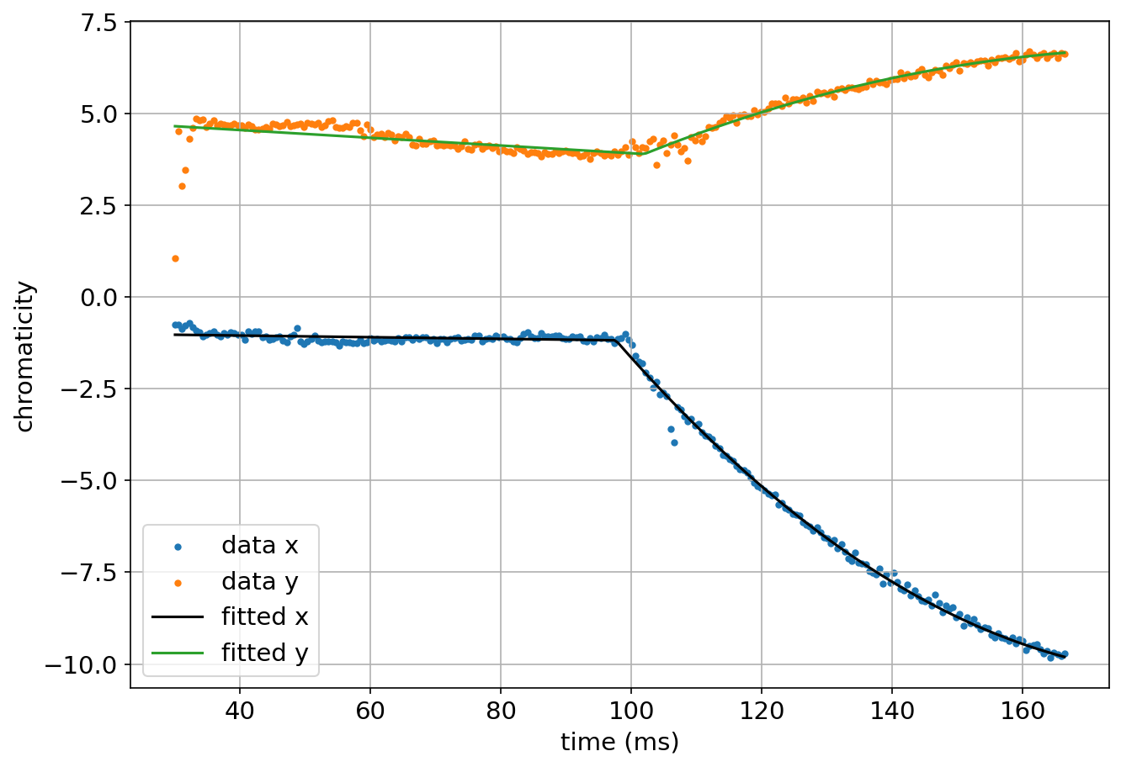
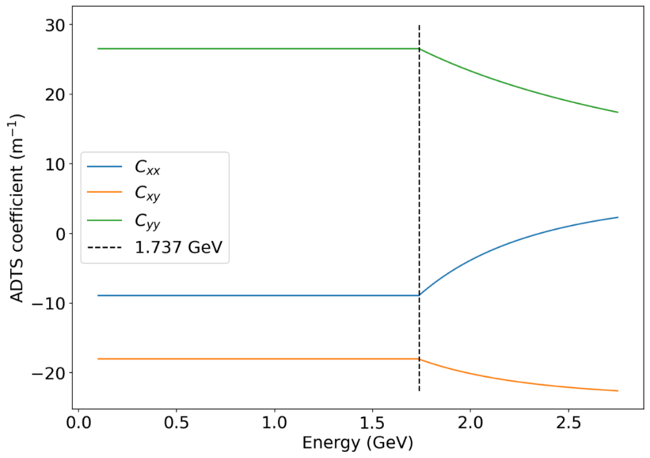









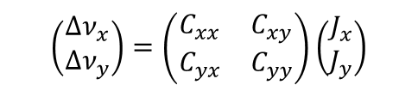



Present booster model
Chromaticity
Re[$Z_{⊥}$]
Amplitude-Dependent Tune Shift (ADTS)
$$Z_{RW}$$
Positive chromaticity can:
Induce ‘head-tail damping’ which is favorable for coupled-bunch instabilities.
Decrease head-tail instability growth rate
ADTS can prevent instabilities to build up since it induces incoherent tune spread in the beam which breaks the coherent behavior of the particles.
$$h$$
$$Z_{BB}$$
$$f$$
$$\left(\begin{matrix}Δν_{x} \\ Δν_{y}\end{matrix}\right)=\left(\begin{matrix}C_{xx} & C_{xy} \\ C_{yx} & C_{yy}\end{matrix}\right)\left(\begin{matrix}J_{x} \\ J_{y}\end{matrix}\right)$$
$$f_{ξ}$$
2nd order ADTS equation :
$$f_{ξ}=\frac{ξ}{η}ν_{β}f_{0}$$
ADTS coefficients
Particle amplitude or Courant-Snyder (CS) invariant
Measured chromaticity along the ramp
ADTS coefficients along the ramp obtained from AT code
$$C_{yy}$$
$$ξ_{y}$$
$$C_{xx}$$
$$ξ_{x}$$
$$C_{xy}$$

Slide 13
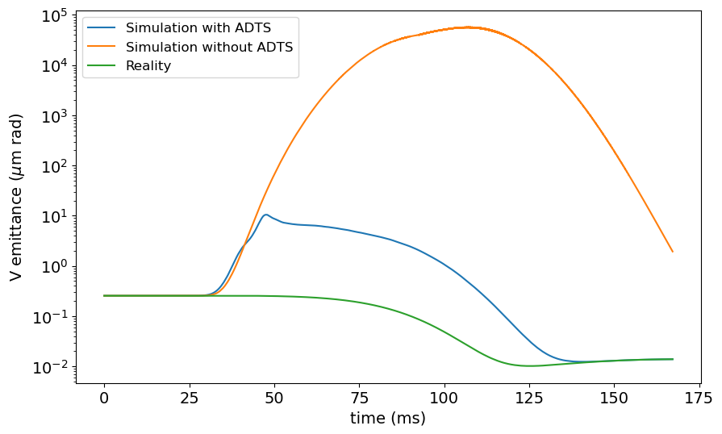
Present booster model
TCBI simulation results
* All tracking simulations in this talk were by mbtrack2 ^{[1,2]}
Model component
Energy ramp
Chromaticity variation
ADTS
RW impedance
Vertical emittance along the ramp
It was found that the beam can indeed exhibit a large emittance blow-up along the ramp (blue line), but this behavior does not match the reality (green line)
Without ADTS, the blow-up gets even worse (orange line). So, the ADTS is necessary for the model.
This shows that the model was incomplete.
^{[1]} A. Gamelin, W. Foosang, and R. Nagaoka, Proc. IPAC’21 (2021), pp. 282–285,
https://doi.org/10.18429/JACoW-IPAC2021-MOPAB070
^{[2]} mbtrack2, https://gitlab.synchrotron-soleil.fr/PA/collective-effects/mbtrack2
Total charge = 3 nC (nominal multibunch charge)

Slide 14
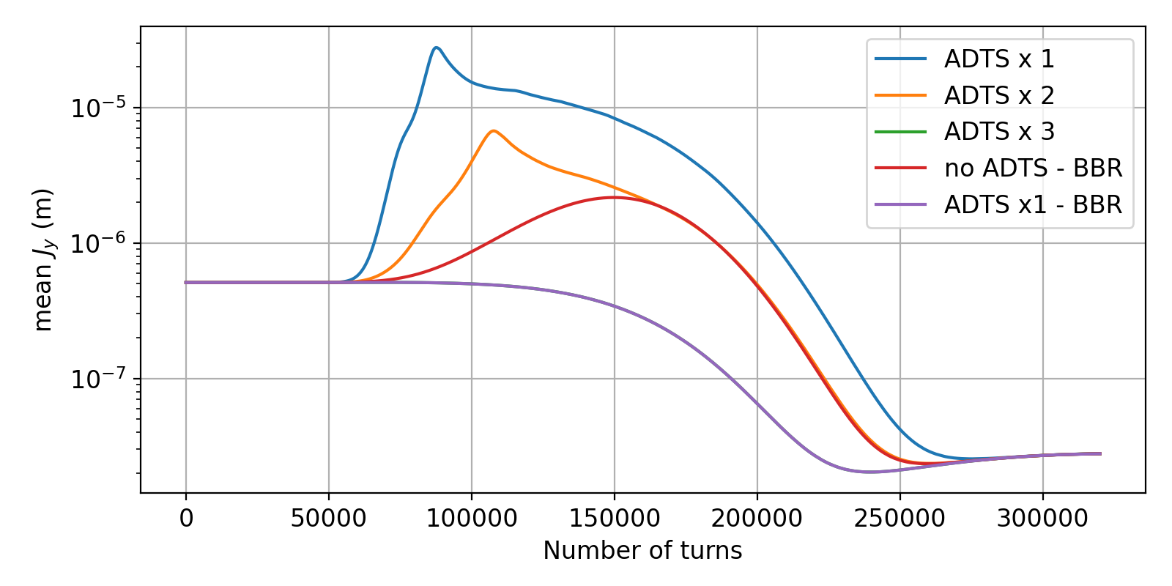
Present booster model
TCBI simulation results
Vertical amplitude along the ramp with different combinations of ADTS and broadband resonator (BBR)
To investigate this results, the ADTS was increased by a factor of 2 and 3 since it is possible that the ADTS in the model is underestimated.
A mock-up BBR was also added as an approximate impedance of all the special chambers whose model does not exist, so they were not taken into account in the model.
Only at ADTSx3 or when the nominal ADTS is present simultaneously with the BBR, the instability can be suppressed completely.
Broadband resonator parameters: $R_{s}=5 MΩ/m, { f}_{r}=2 GHz, Q=2$
Case study conclusion: essential elements for collective effect modeling
Energy ramp
Chromaticity variation
ADTS
RW impedance
Broadband impedance

Slide 15
Moving back to the SOLEIL II booster

Slide 16
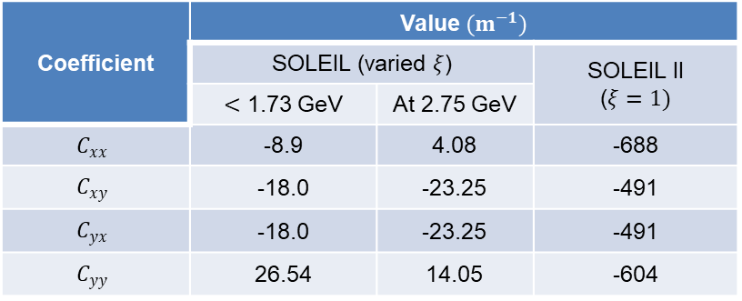
SOLEIL II booster model
Chromaticity
Constant throughout the ramp due to constant sextupole strength.
ADTS
Also constant ADTS (for a given chromaticity*).
* In reality, ADTS coefficients are different for each chromaticity since the sextupole strength is not equal. However, in this work, every chromaticity was estimated to have identical ADTS coefficients.
Comparison of the ADTS coefficients in the two boosters computed from the AT code
Coefficient | Value$(m^{−1})$ |  | C
 | SOLEIL (varied $ξ$) |  | SOLEIL II ($ξ=1)$
 | $<$ 1.73 GeV | At 2.75 GeV
$$C_{xx}$$ | -8.9 | 4.08 | -688
$$C_{xy}$$ | -18.0 | -23.25 | -491
$$C_{yx}$$ | -18.0 | -23.25 | -491
$$C_{yy}$$ | 26.54 | 14.05 | -604
ADTS is much stronger in the new booster due to the stronger chromaticity correction.

Slide 17
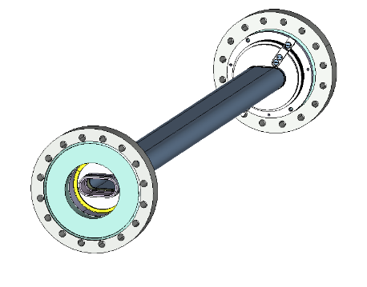
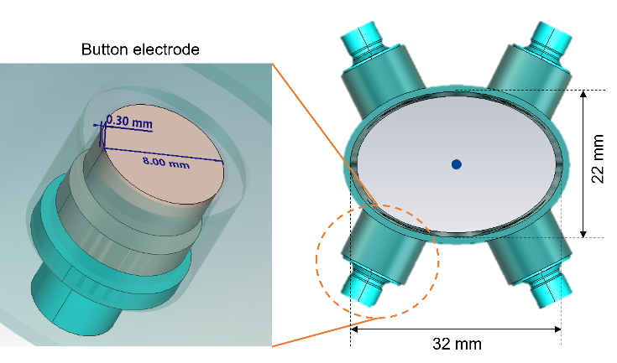
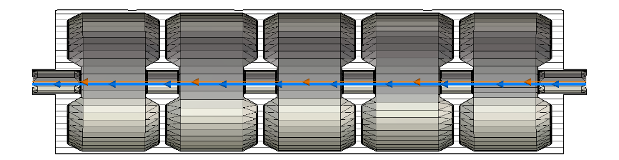
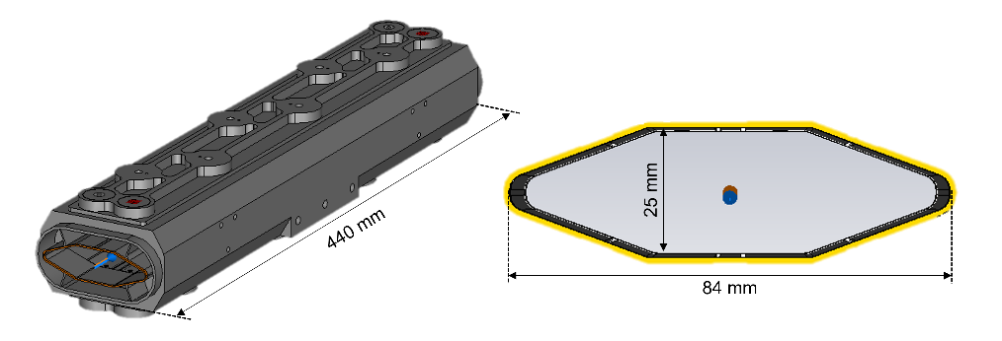
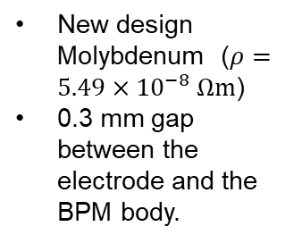
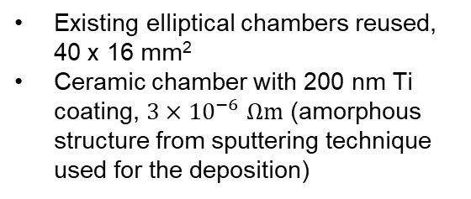
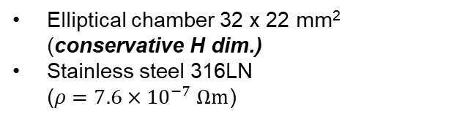
SOLEIL II booster model
Preliminary impedance model
Kicker chamber (3)
BPM (42)
Existing elliptical chambers reused, 40 x 16 mm²
Ceramic chamber with 200 nm Ti coating, $3×{10}^{−6}$ $Ωm$ (amorphous structure from sputtering technique used for the deposition)
New design Molybdenum ($ρ=5.49×{10}^{−8} Ωm$)
0.3 mm gap between the electrode and the BPM body.
RF cavity (2)
Present RF cavity reused.
Taper modeled as a frustum of a right cone, 300 mm long with an angle of 7.41°
Tapers
Standard chambers
Stripline (2)
Standard chamber
22 mm
32 mm
Elliptical chamber 32 x 22 mm² (conservative H dim.)
Stainless steel 316LN
($ρ=7.6×{10}^{−7} Ωm$)
Present storage ring striplines reused

Slide 18
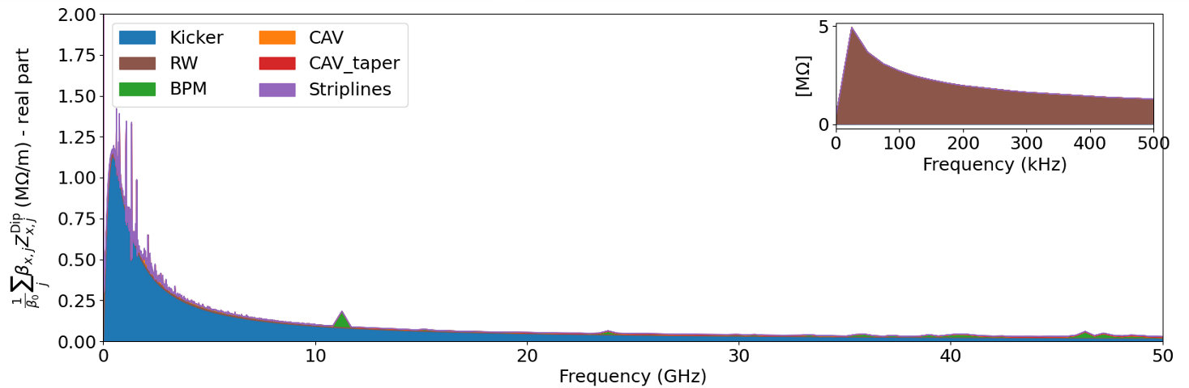
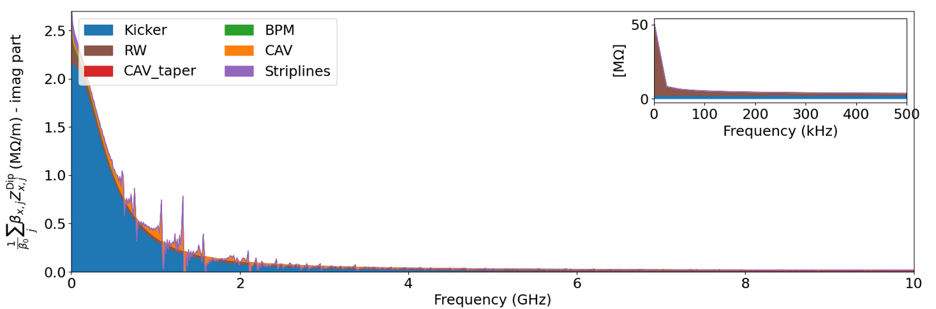
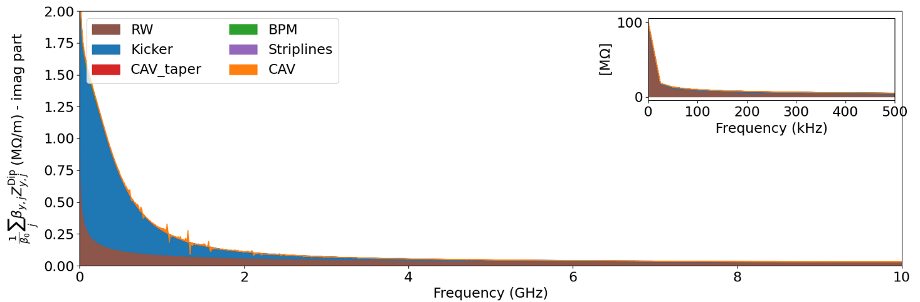
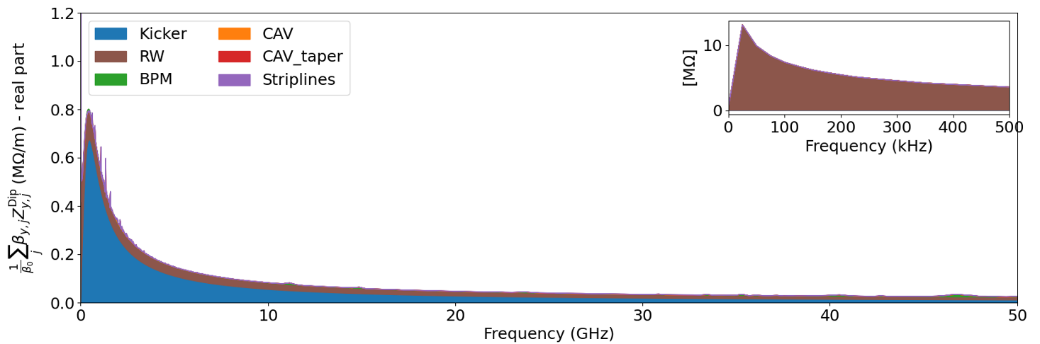
SOLEIL II booster model
Total transverse impedance
Horizontal dipolar impedance (real part)
Horizontal dipolar impedance (imaginary part)
Sorted by max to min contribution (downward and L to R)
Zoom-in at low frequency part
Vertical dipolar impedance (real part)
Vertical dipolar impedance (imaginary part)
Conclusion:
Overall, the kicker chambers contribute the most to the budget, but the resistive wall dominates the low frequency part which is important for multibunch instability.
The kicker chambers add a significant broadband impedance at around 450 MHz.

Slide 19
Energy-dependent collective effect study

Slide 20
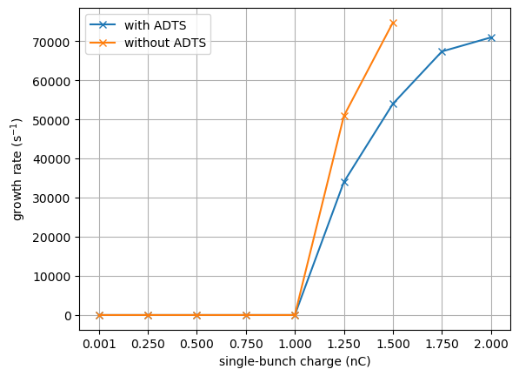
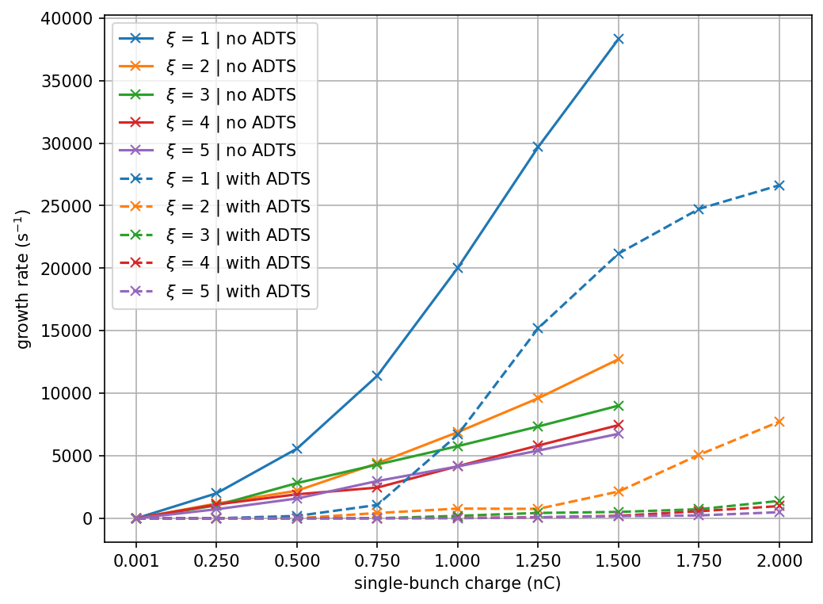
Single-bunch regime (without energy ramp)
Transverse mode-coupling instability (TMCI)
Head-tail Instability (HTI)
TMCI Growth rate at 150 MeV at $ξ=0$
HTI Growth rate at 150 MeV at $ξ>0$
Growth rate (s⁻¹)
Growth rate (s⁻¹)
Bunch charge (nC)
Bunch charge (nC)
ADTS does not have an impact on the threshold but does significatly reduce the growth rate
Growth rate reduces at higher chromaticity
ADTS also greatly reduce the growth rate.
This shows Landau damping effect in the booster

Slide 21
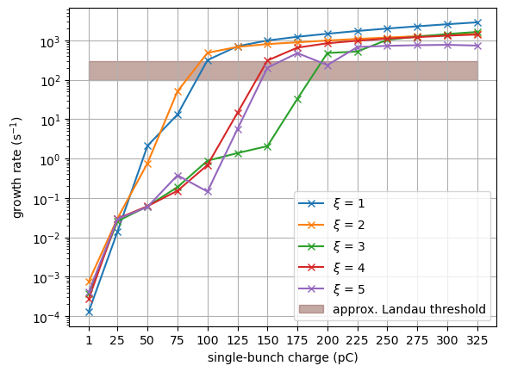
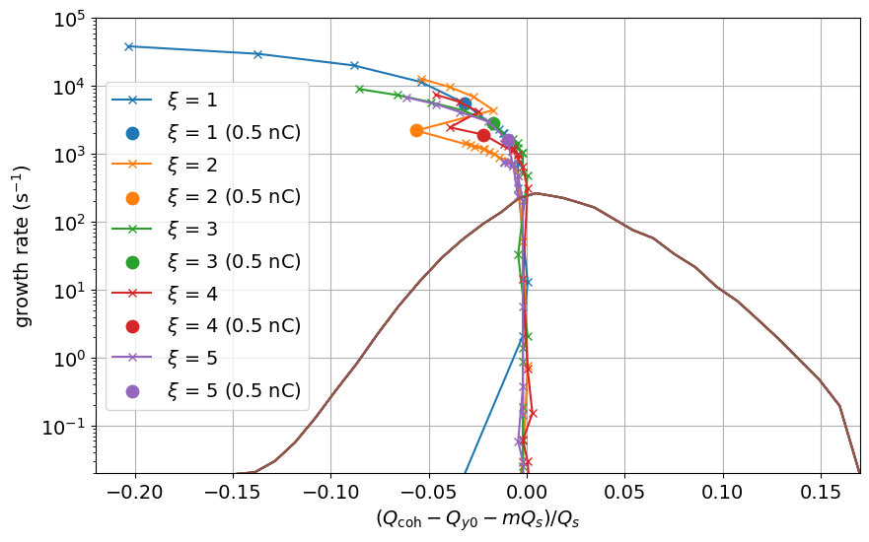

Single-bunch regime (without energy ramp)
Stability diagram
Emittance at injection : $ε_{x}=ε_{y}=0.17 μm rad$
Growth rates in the low charge regime
Stability diagram of the SOLEIl II booster at 150 MeV
Nominal charge
Landau damping limit
75 – 200 pC
Growth rate (s⁻¹)
Growth rate (s⁻¹)
Coherent tune shift ($Q_{s}$)
Bunch charge (pC)
The stability limit is approximately 75 – 200 pC which is lower than 500 pC (nominal charge) at every chromaticity.
Landau damping cannot stabilize the beam with the nominal charge at the injection.
However, it cannot be concluded immediately if the beam will be stable throughout the ramp. Simulations with an energy ramp then needs to be pursued.

Slide 22
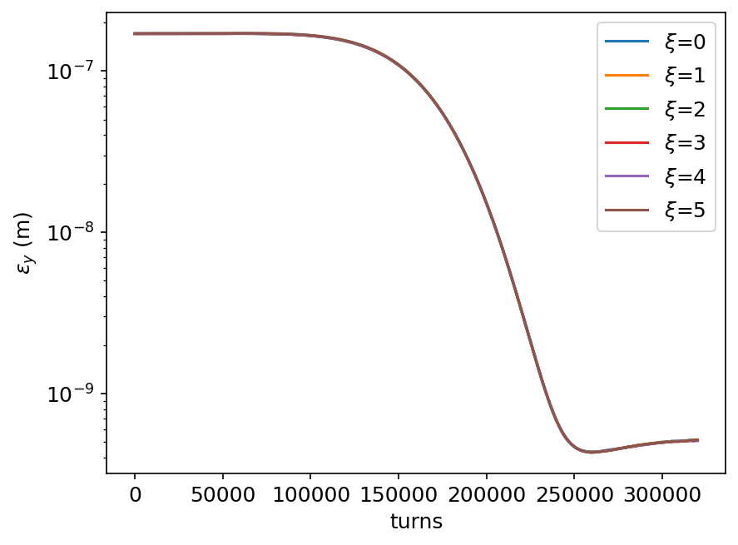
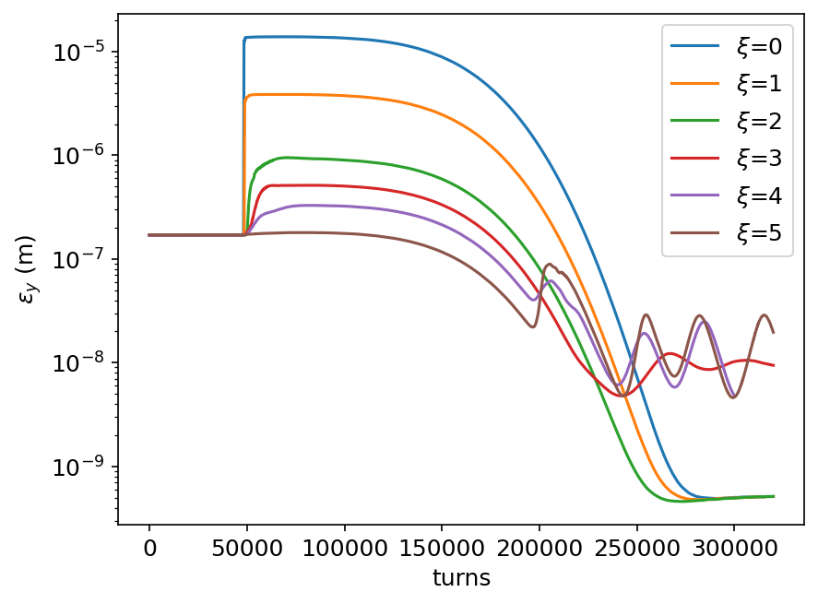
Single-bunch regime (with energy ramp)
Transverse single-bunch instabilities (TSBI) along the ramp
0.5 nC (nominal single-bunch charge) with ADTS
1.5 nC (maximum single-bunch charge) with ADTS
V emittance (m.rad)
V emittance (m.rad)
Turns
Turns
Conclusion:
A beam with the nominal charge is in fact stable throughout the ramp.
For the maximum charge, only chromaticity 5 can suppress the instability at low energy.
An unexpected sawtooth feature at high energy was discovered for chromaticities 3-5.
Could be the loss of Landau damping due to the beam size reduction (reducing the tune spread for the same ADTS coefficients)
To be investigated

Slide 23
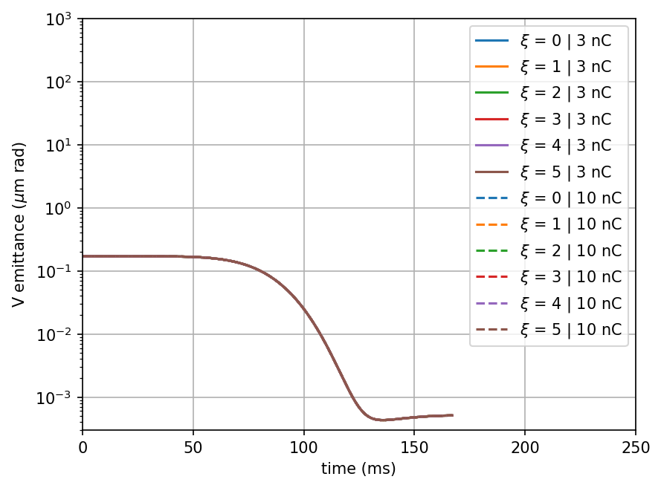
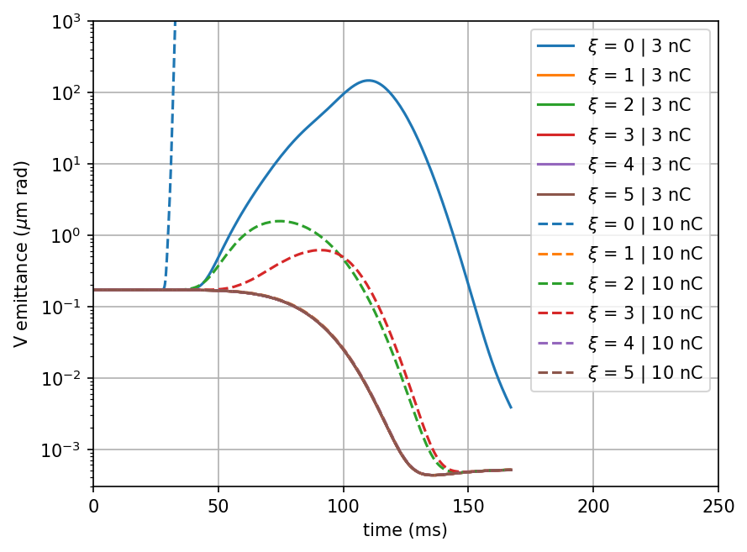
Multibunch regime (with energy ramp)
Transverse coupled-bunch instability (TCBI) driven by RW impedance ^{[1]}
3 nC (nominal multibunch charge)
10 nC (maximum achievable charge)
Simulations with energy ramp were also performed for TCBI to confirm the stability throughout the ramp at
Vertical emittance with ADTS
Vertical emittance without ADTS
Conclusion:
  The beam at both charges are indeed stable all along the ramp when ADTS is present.
  On the contrary, the beam withtout ADTS would not be stable at low chromaticity: $ξ≥1$ for 3 nC and either $ξ=1$ or $ξ≥4$ for 10 nC to be stable.
^{[1]} More about this topic: W. Foosang et al, J. Phys.: Conf. Ser. 2687 062017 (2024), https://doi.org/10.1088/1742-6596/2687/6/062017

Slide 24
Conclusion

Slide 25
Conclusion
It has been shown that
ADTS and broadband impedance are key elements for accurate modeling of collective effects in boosters.
Tracking with energy ramp is important to determine beam’s stability throughout the ramp.
Conclusion from the SOLEIL II project’s aspect
Single-bunch regime
  The beam is stable throughout the ramp at nominal charge (0.5 nC) for positive chromaticity.
  Possible stability issue for maximum charge (1.5 nC), to be investigated.
Multibunch regime
  The beam is stable up to 10 nC (maximum charge) for positive chromaticity.
Bottom line:
SOLEIL II booster is safe from TMCI, HTI, and RW instability at the nominal charge.
Cost optimization: collective effect study can help optimize the construction cost of the machine by neglecting unneccessary impedance optimization (tapers, RF fingers, pumping grid etc.).

Slide 26
Thank you for your attention

Slide 27
Back-up slides

Slide 28
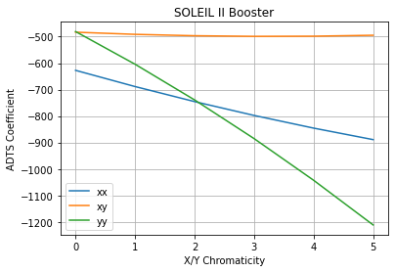
Outlook
Next steps
New impedance model following the advance of mechanical design.
Use of different ADTS coefficients according to the chromaticity​.
Investigate the sawtooth feature at the end of the ramp of the single-bunch simulation.
Add physical aperture in tracking.

Slide 29
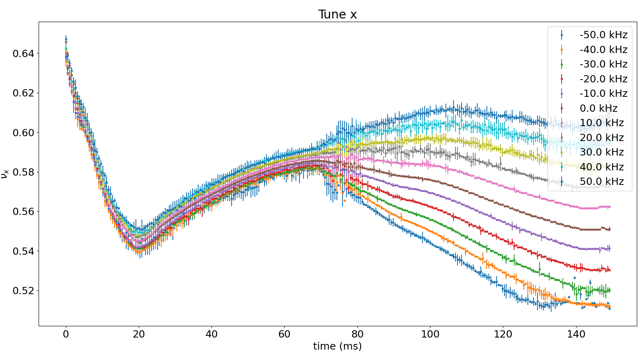
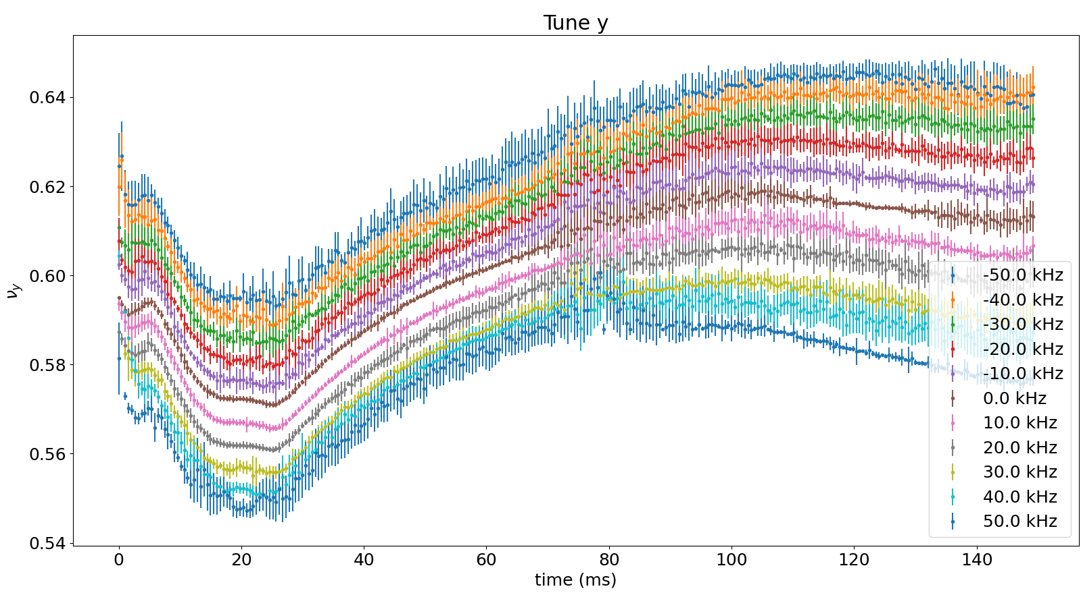
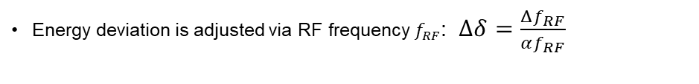
In the present booster
Chromaticity
To obtain the chromaticity along the ramp in the present booster, a measurement of the betatron tune along the ramp at various energy deviation $δ$ was conducted.
Energy deviation is adjusted via RF frequency $f_{RF}$: $Δδ=\frac{Δf_{RF}}{αf_{RF}}$
Betatron tunes along the present booster’s ramp at various energy deviation
Horizontal tune
Vertical tune

Slide 30




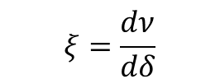
In the present booster
Chromaticity & ADTS
$$ν$$
$$ξ=\frac{dν}{dδ}$$
$$ξ_{y}$$
$$ξ_{x}$$
$$δ$$
Between 0-100 ms, the sextupole strength in both planes ramps up accordingly to the beam energy resulting in a constant normalized sextupole force $K_{f}$ and thus fairely constant chromaticities.
However, due to the inconstant $K_{f}$ in the horizontal plane after 100 ms, the chromaticities vary by a large amount from this point until extraction.

Slide 31

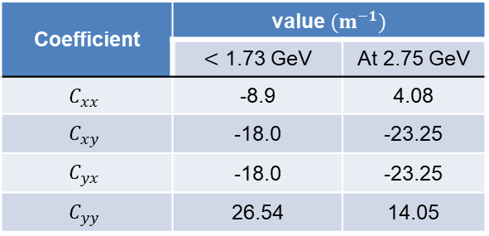
In the present booster
ADTS
Present booster’s ADTS coefficients along the ramp calculated using the real chromaticity variation
Coefficient | value$(m^{−1})$
 | $<$ 1.73 GeV | At 2.75 GeV
$$C_{xx}$$ | -8.9 | 4.08
$$C_{xy}$$ | -18.0 | -23.25
$$C_{yx}$$ | -18.0 | -23.25
$$C_{yy}$$ | 26.54 | 14.05
$$\left(\begin{matrix}Δν_{x} \\ Δν_{y}\end{matrix}\right)=\left(\begin{matrix}C_{xx} & C_{xy} \\ C_{yx} & C_{yy}\end{matrix}\right)\left(\begin{matrix}J_{x} \\ J_{y}\end{matrix}\right)$$
The ADTS coefficients were then determined from element-by-element tracking in Accelerator Toolbox (AT) code.
As a consequence of the inconstant $K_{f}$, the ADTS coefficients vary after 100 ms (1.73 GeV) in the present booster.

