Slide 1
Bunch-by-Bunch Feedback in the BESSY II booster
Meghan McAteer, Bessy II Machine Group
I.FAST Workshop 2024 on Injectors for Storage Ring Based Light Sources
07.03.2024

Slide 2
overview
  Why do we want/need bunch-by-bunch feedback in the BESSY II Booster?
  A quick look at the results
  A longer look at the difficulties along the way

Slide 3
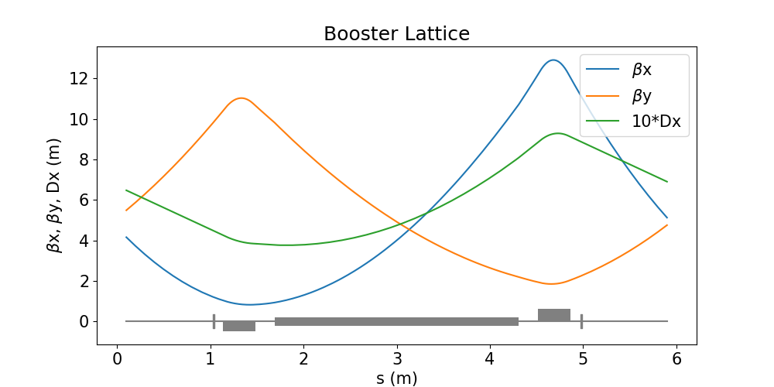
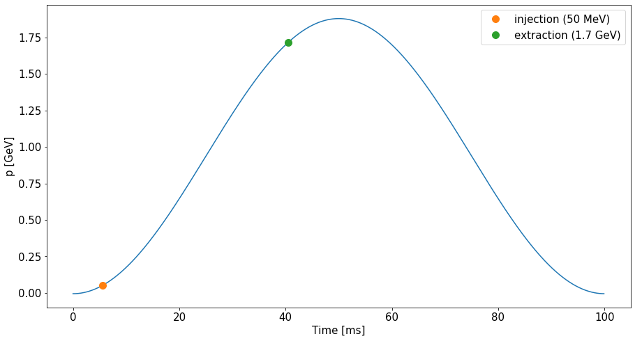
The BESSYII Booster
Large energy range →
field errors at low energy
Injection while ramping → transient beam loading effects
Energy | 50 MeV–1.9 GeV
Circumference | 96 m
# cells | 16
RF frequency | 500 MHz
H | 160
Qx, Qy | 5.88, 3.69
ξx, ξy | 2, 2
Ramping time | 100 ms
Max. current | 6 mA
Booster energy ramp.

Slide 4
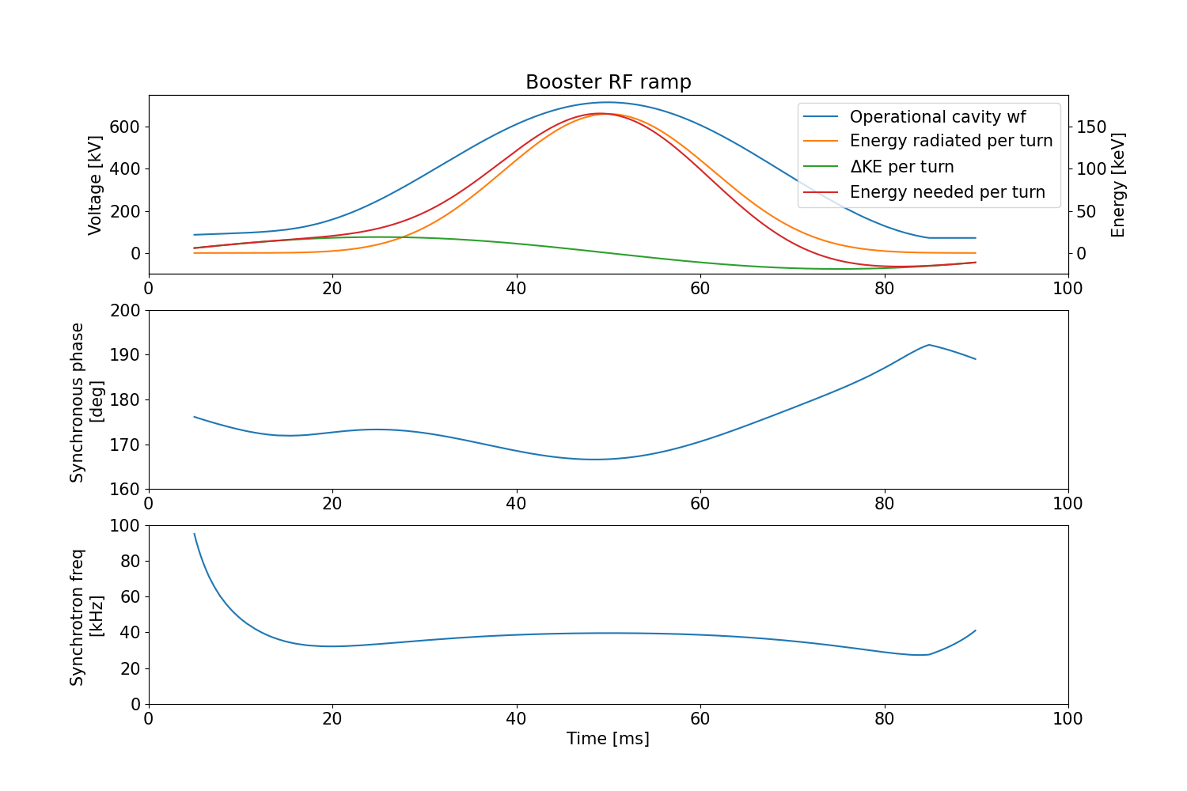
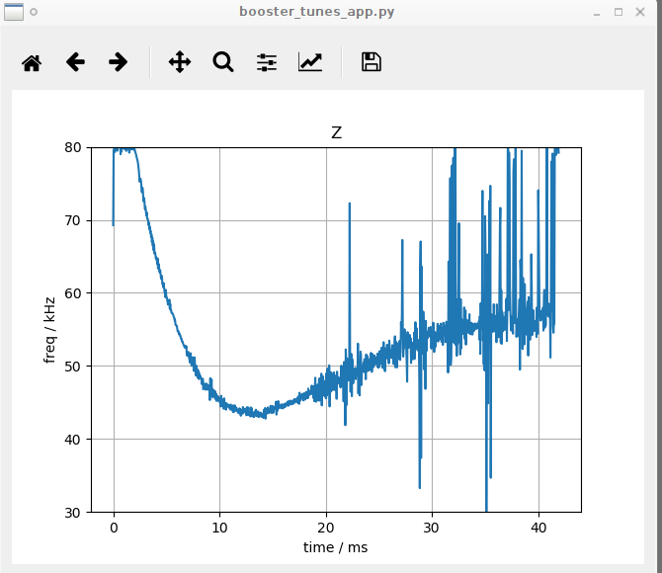
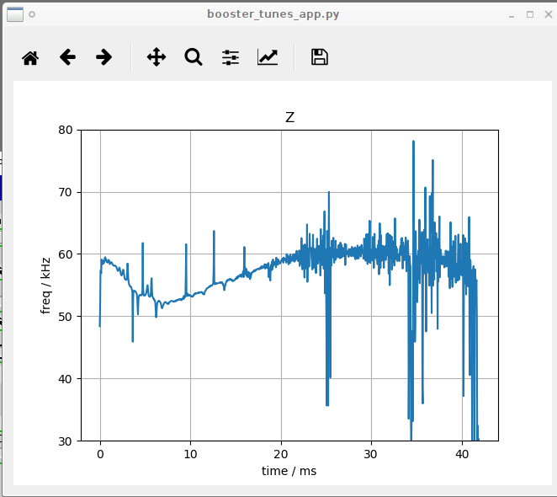
RF ramp
RF waveform is shaped such that synchronous phase, synchrotron tune, and energy acceptance are not constant through acceleration ramp
RF ramp shape seems to have been empirically tuned to increase acceptance at injection
  Flattening the synchrotron tune at injection resulted in beamloss for multi-bunch shots
  Flattening the synchronous phase, without reducing acceptance at injection, would require more rf power than currently available
Booster RF waveform, and corresponding calculated synchronous phase and synchrotron tune during ramp.
Measured synchrotron frequency.

Slide 5
Why BBFB?
Implementation of bbfb system was motivated by plan to reduce booster bunch length
  shorter bunches + increased impedance would reduce instability threshold
At the moment we can operate without bbfb, but injection efficiency is much better with longitudinal fb (98-99% with fb, ~90% without)

Slide 6
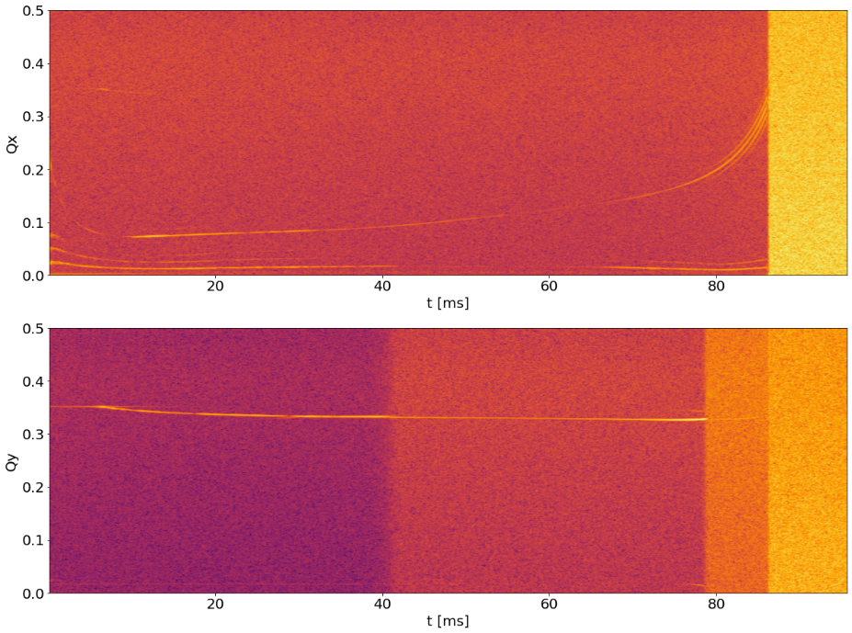
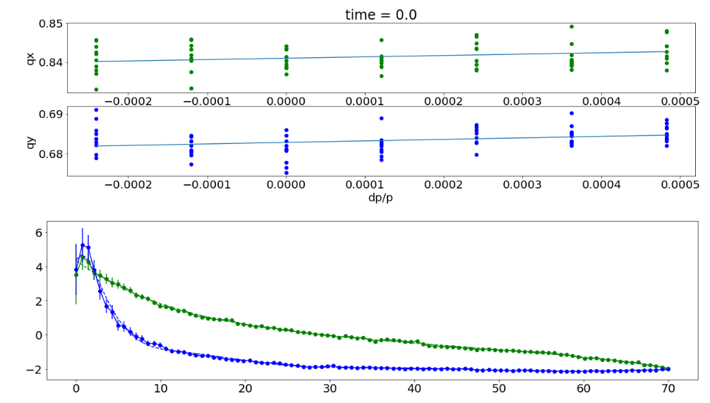
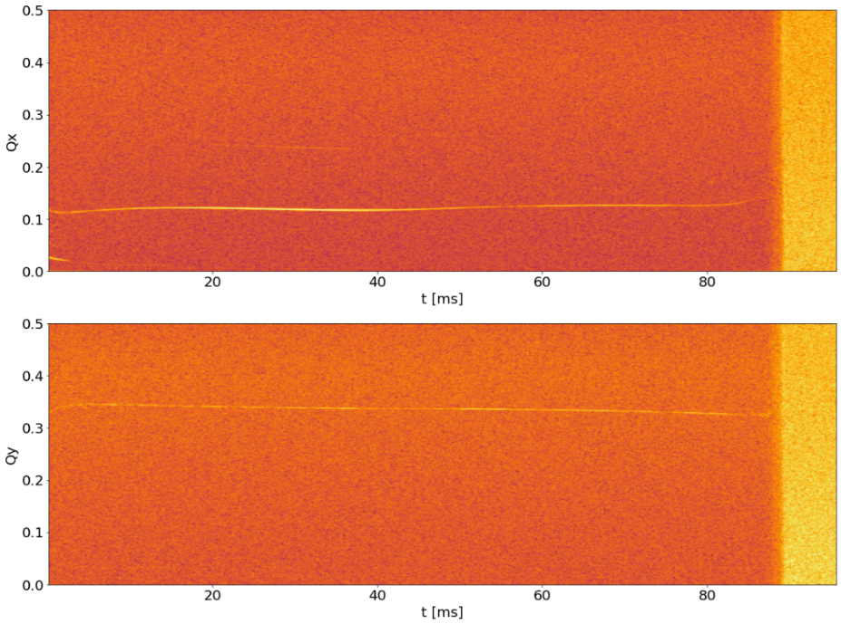
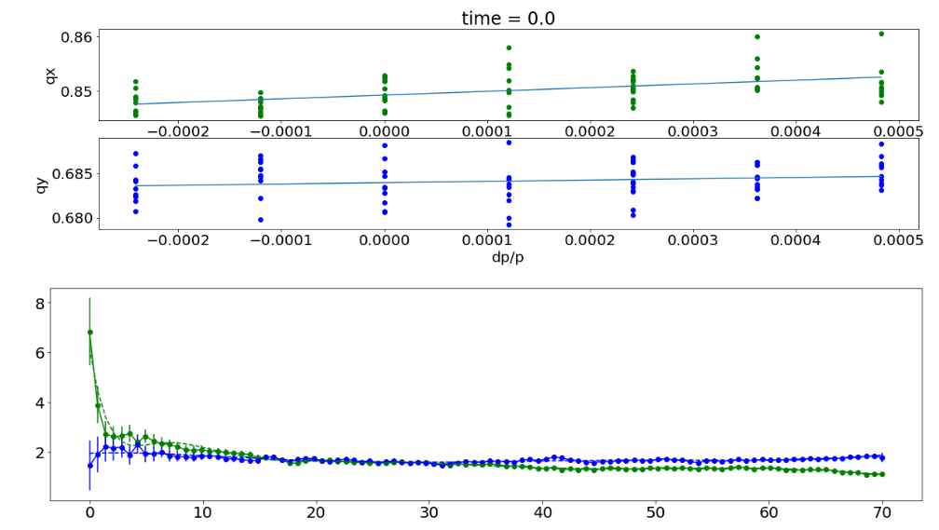
Why bbfb? (Transverse dynamics)
Uncorrected tunes throughout acceleration ramp
When possible, fixing sources of instability is best
Correction of optics has stabilized transverse motion, while also allowing for ~50% more current to be accelerated in the Booster
Transverse bbfb is not currently needed but may become important after upgrading to ‘flexi-gun’ (with variable bunch spacing)
Uncorrected chromaticity
(green is horizontal, blue is vertical)
Corrected tunes throughout acceleration ramp
Corrected chromaticity

Slide 7
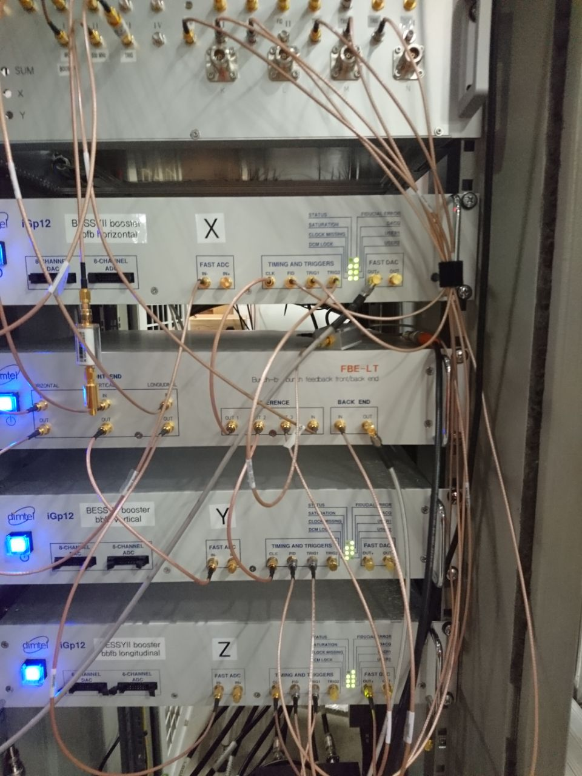
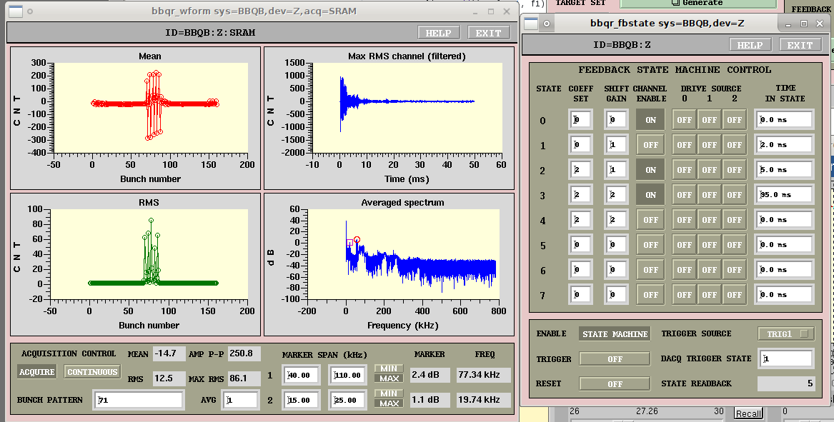
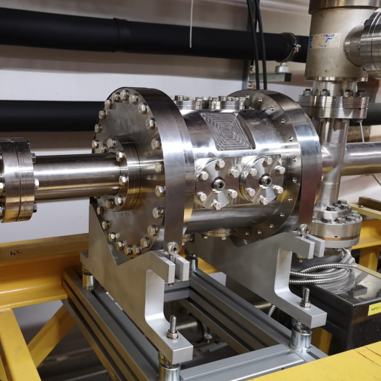
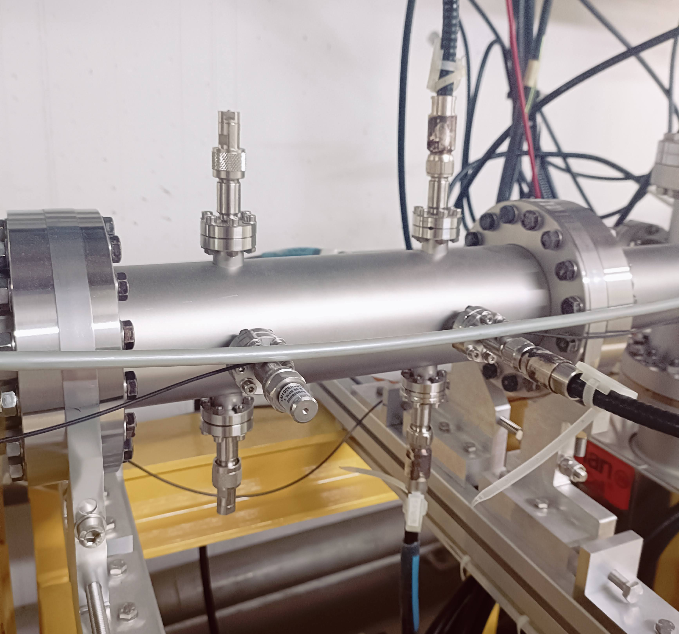
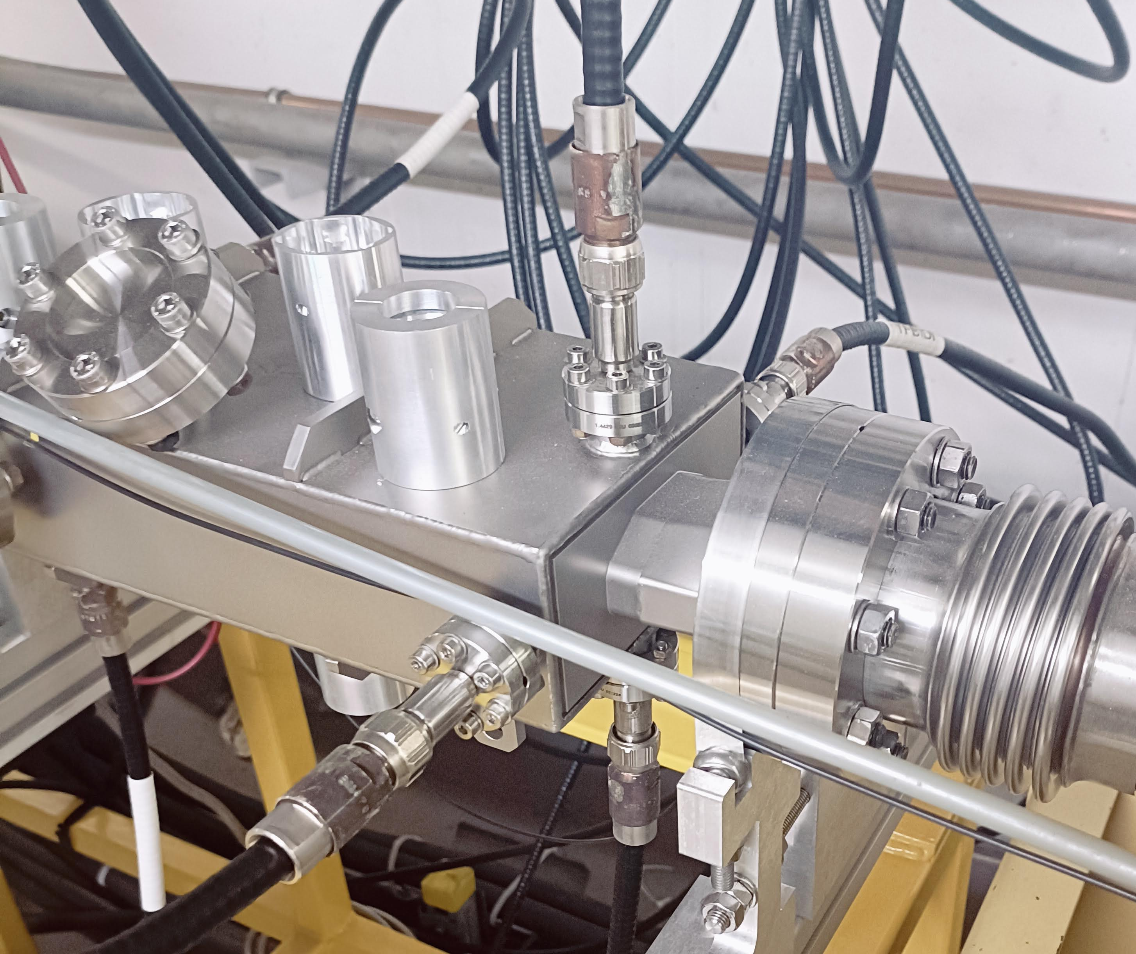
BBFB setup
Dimtel system: FBE-LT front/back end, three iGP-12 processors w/ state machine firmware
Longitudinal kicker cavity based on DLS design (1.625 GHz, 300 V max kick), stripline pickup andtransverse kicker
Sum and difference signals from stripline are pre-processed in FE, then sampled and processed in iGP processors (one for each plane)

Slide 8
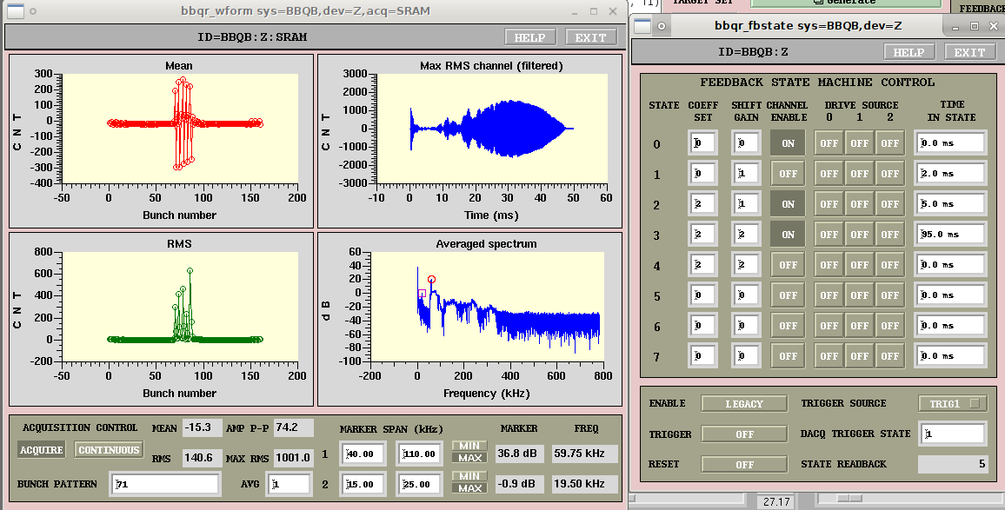
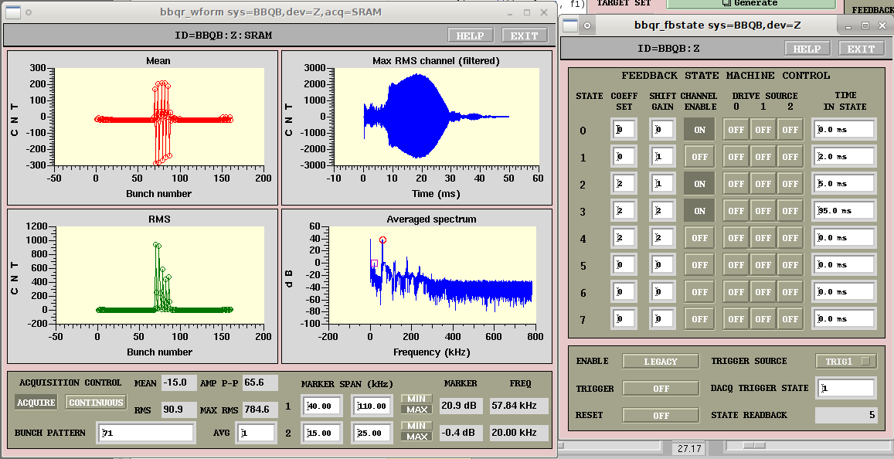
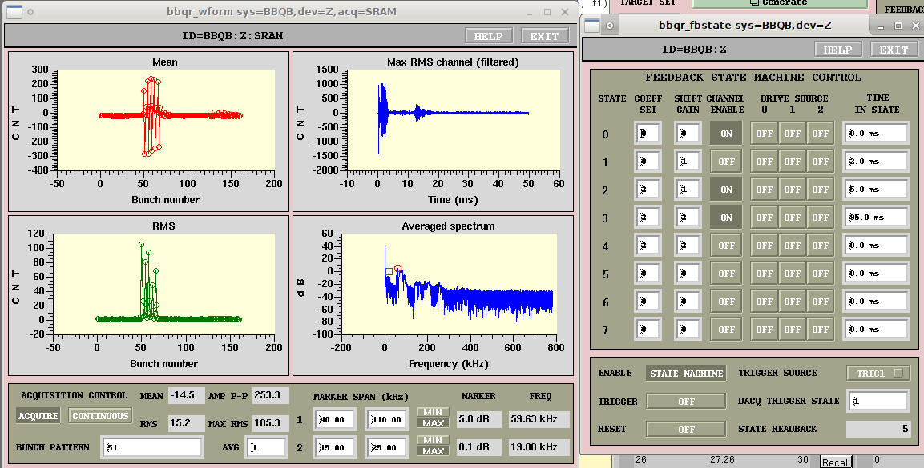
Results
Without bbfb, longitudinal instabilities impact efficiency of injection into storage ring
Longitudinal feedback is very effective at suppressing instabilities and keeping injection efficiency high (~99%), even with highest booster current
Without Damping:
With Longitudinal Damping:

Slide 9
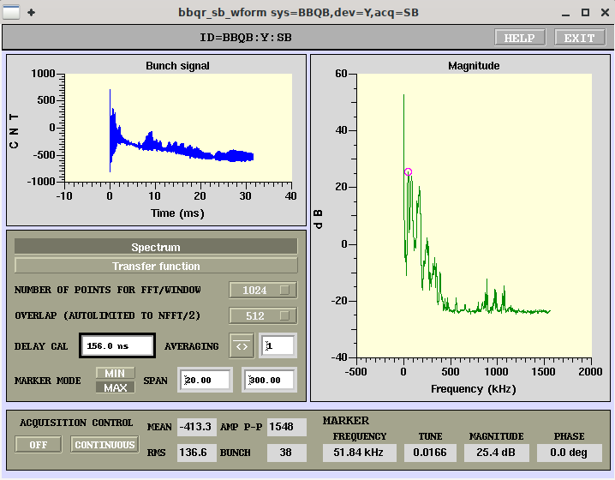
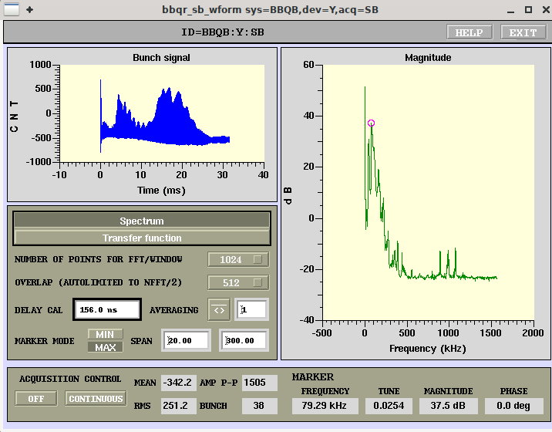
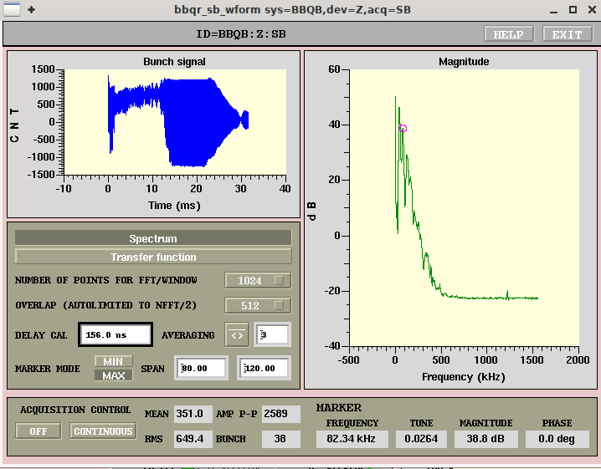
But…
Initial results were erratic and unreliable (worked well on some shots, ineffective or even destructive on other shots)
There was a lot of unexpected behavior to be understood before performance was reliable! (particularly, about the Front End phasing throughout the acceleration ramp)

Slide 10
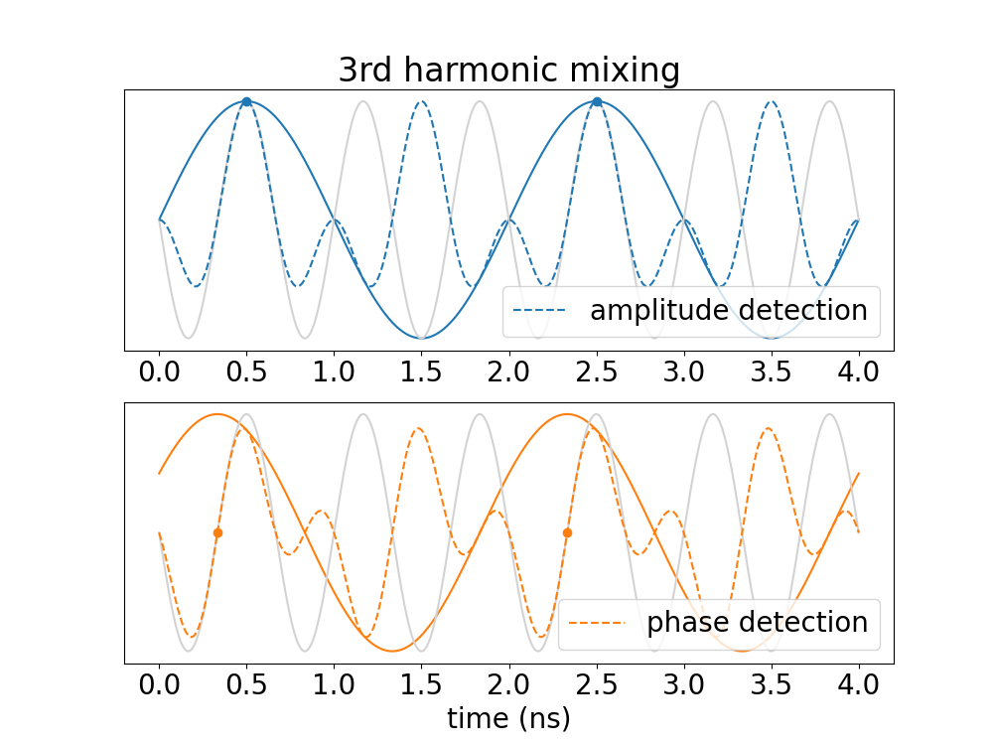
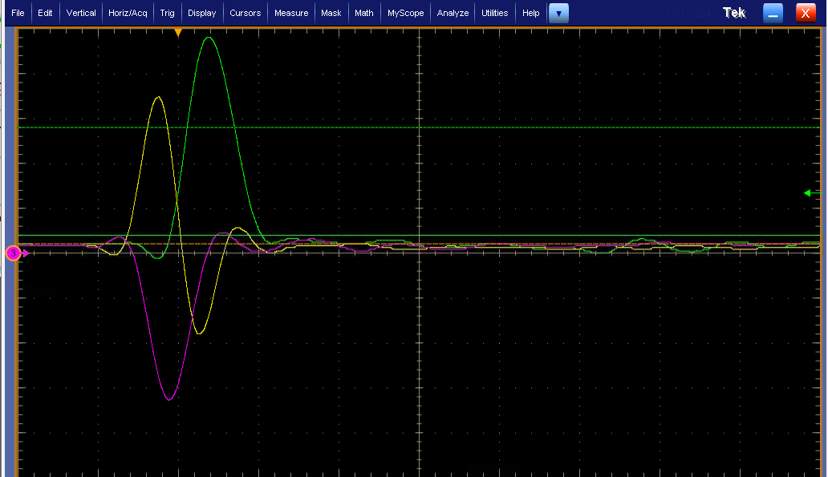
Front End Phase setup
Sum and difference signal are mixed with 3rd harmonic (1.5 GHz) in the front end
  30º shift in 500 MHz signal becomes 90º shift in FE output
Setting FE delay so that phases are correct at injection leads to erratic and incorrect signals later in ramp

Slide 11
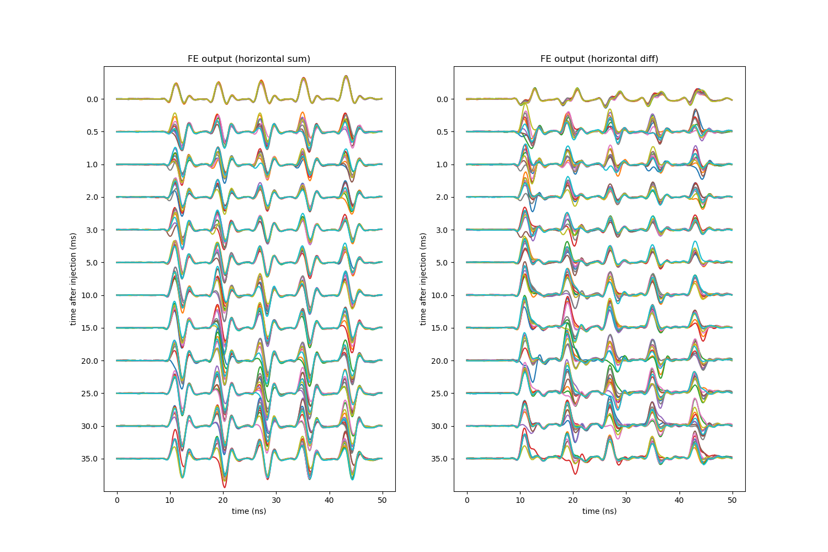
Front End Phase setup
Setting FE delay so that phases are correct at injection leads to erratic and incorrect signal later in ramp
Beam arrival phase changes enough from (during the acceleration ramp, and also shot to shot) that the FE mixing phase is often totally wrong
FE output on multiple shots, at various time points during the acceleration ramp, without feedback.

Slide 12
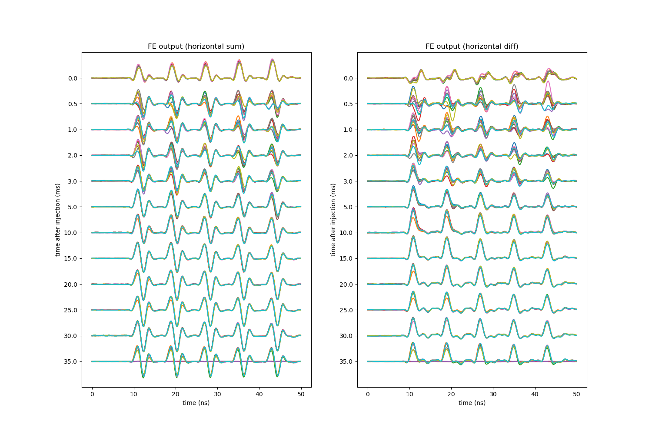
Front End Phase SEtup
(Once longitudinal feedback was set up correctly, the arrival phase stabilized a few ms after injection.)
FE output on multiple shots, at various time points during the acceleration ramp, with longitudinal feedback.

Slide 13
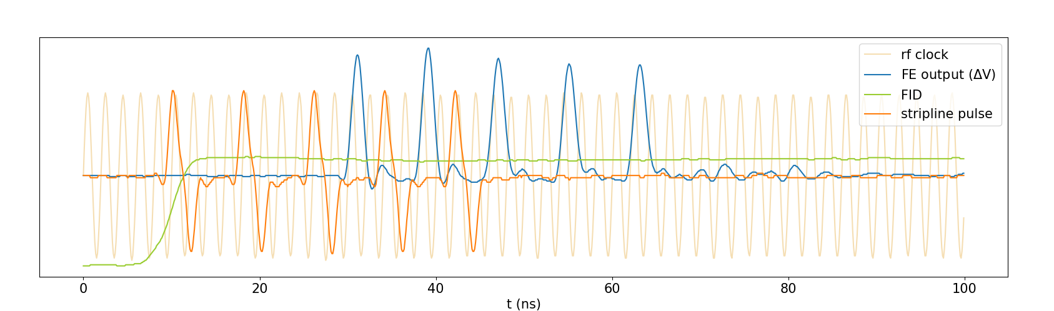
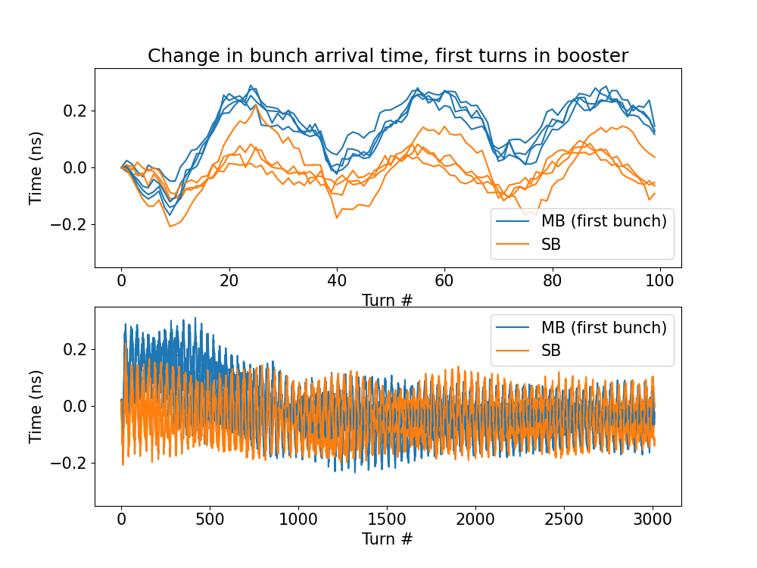
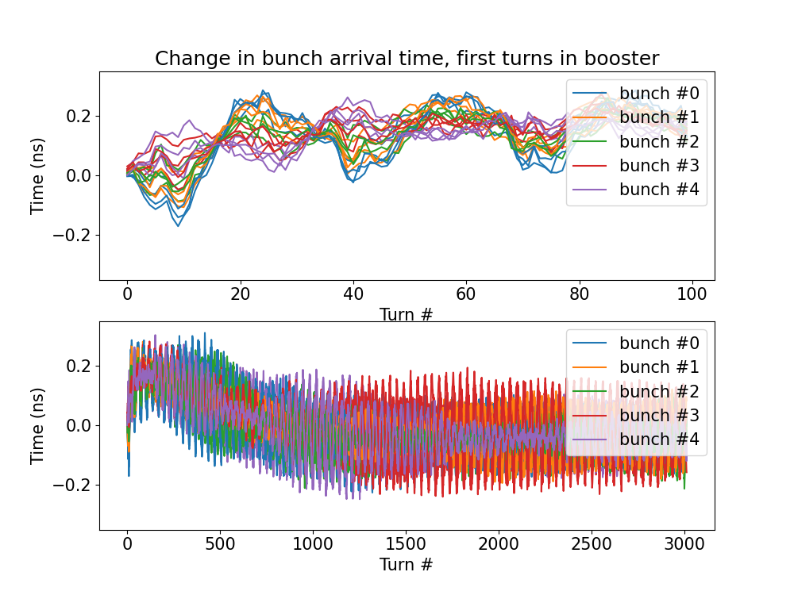
Measurement of Bunch arrival time jitter
Arrival time of beam pulse relative to RF was measured by recording stripline and RF clock signals with scope, and fitting peaks
Beam arrival time fluctuates by ~0.5 ns in the first tens of turns after injection
Amplitude of arrival-time oscillation is current-dependent
Seems to be caused by transient beam loading at injection
Synchrotron period =~35 turns

Slide 14
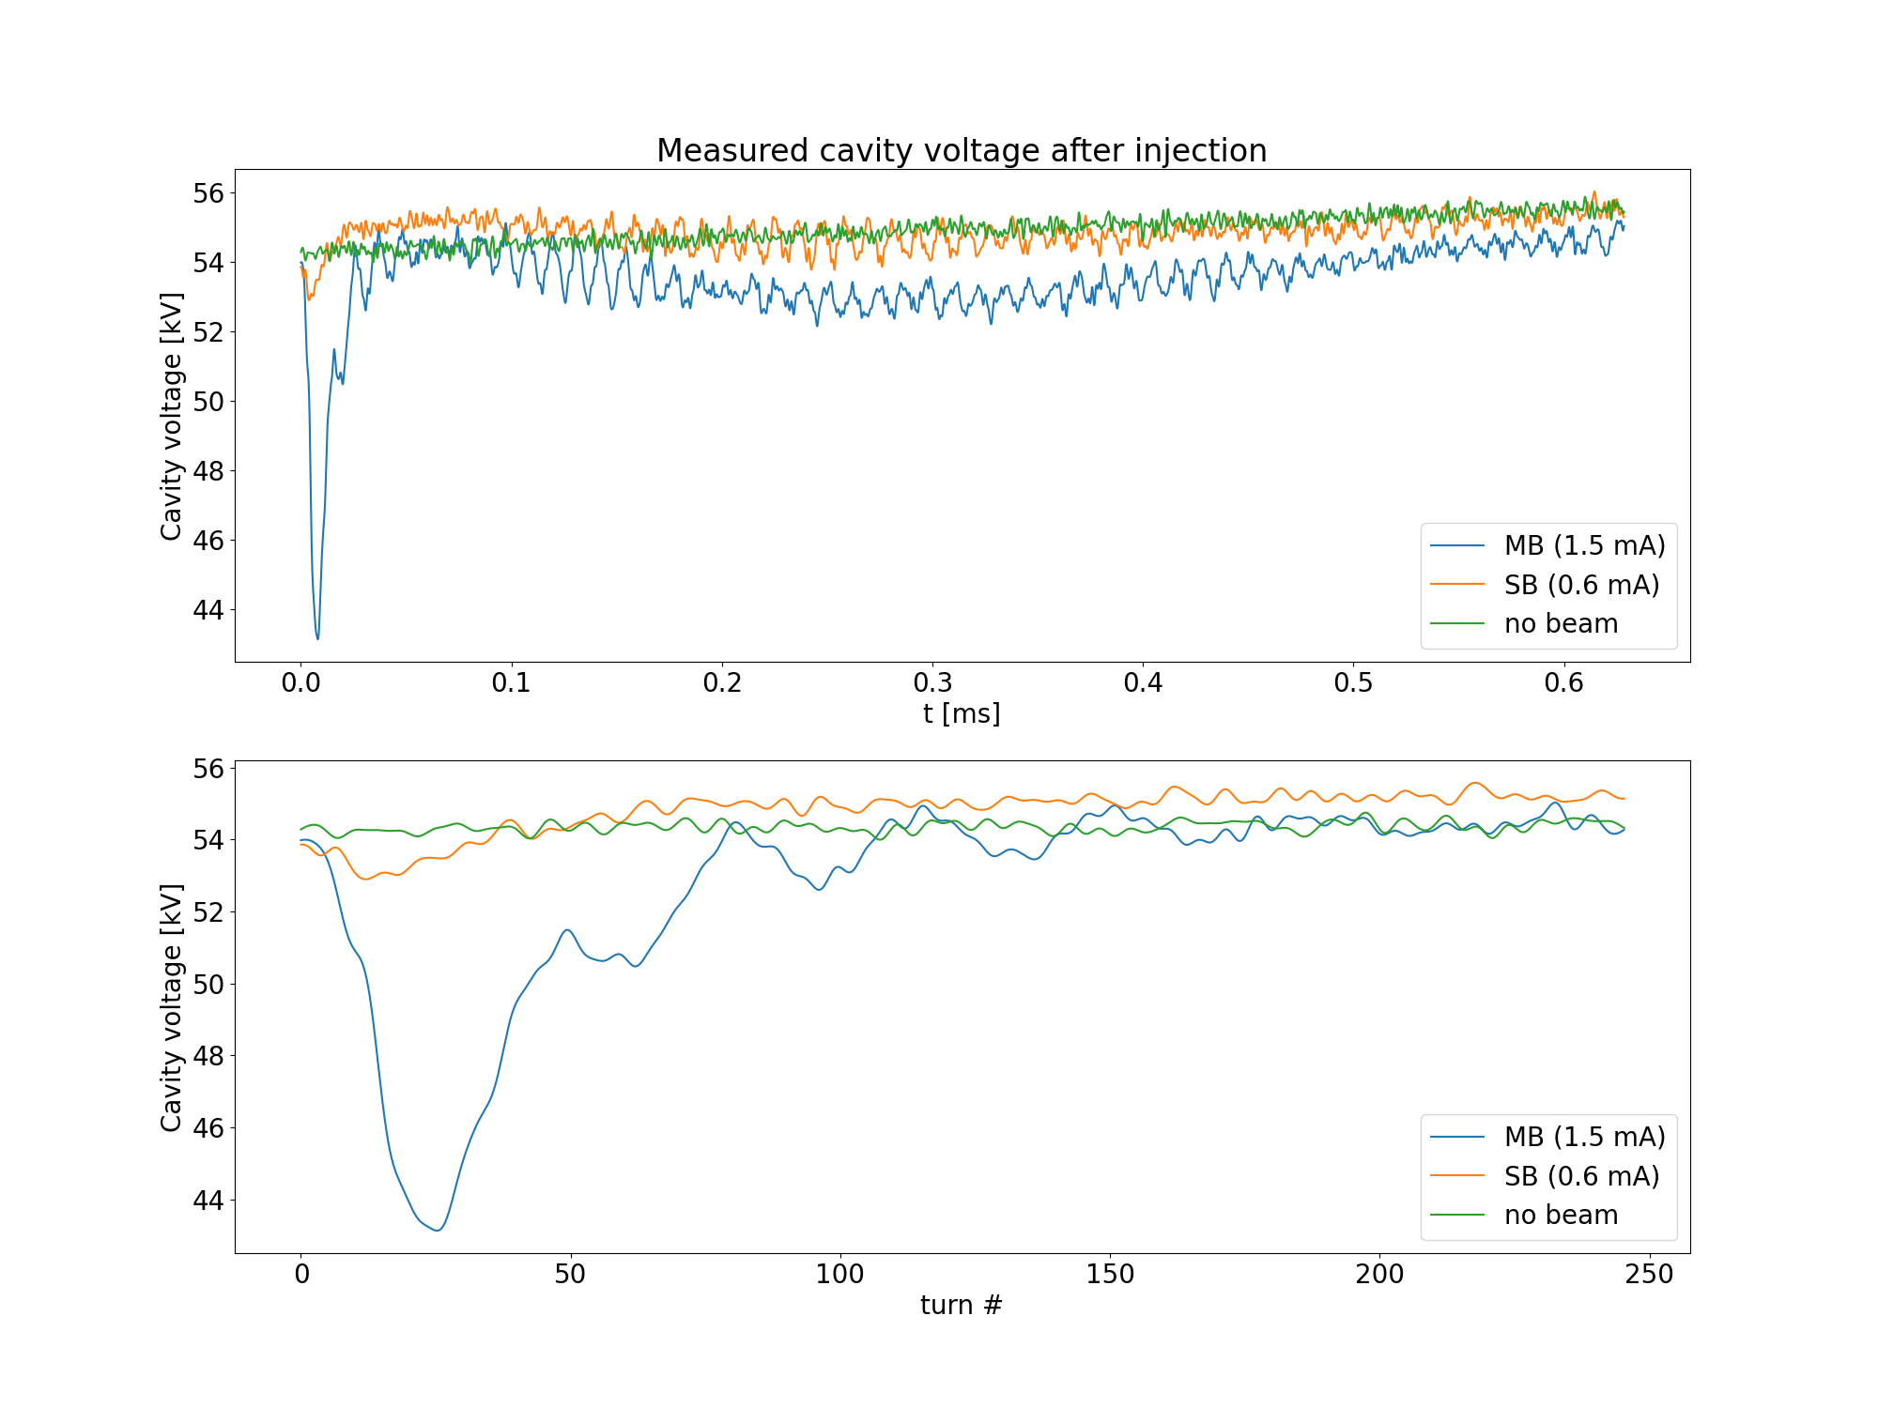
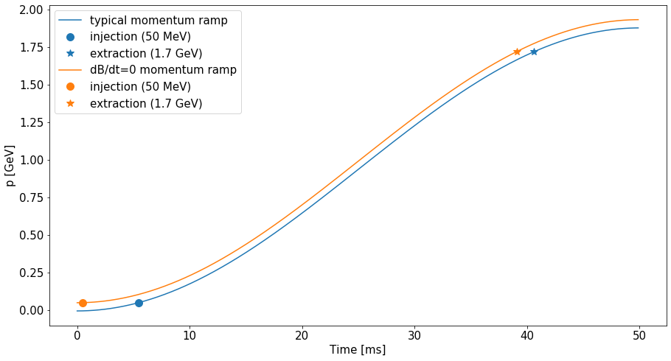
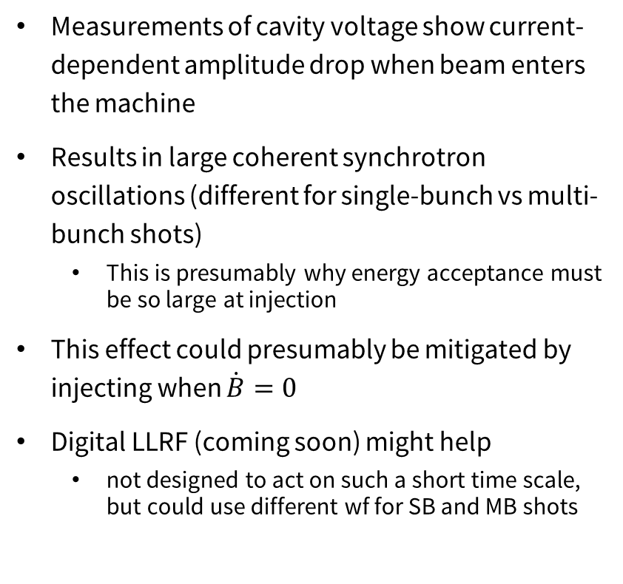
Transient beam loading
Measurements of cavity voltage show current-dependent amplitude drop when beam enters the machine
Results in large coherent synchrotron oscillations (different for single-bunch vs multi-bunch shots)
  This is presumably why energy acceptance must be so large at injection
This effect could presumably be mitigated by injecting when $\dot{B}=0$
Digital LLRF (coming soon) might help
  not designed to act on such a short time scale, but could use different wf for SB and MB shots

Slide 15
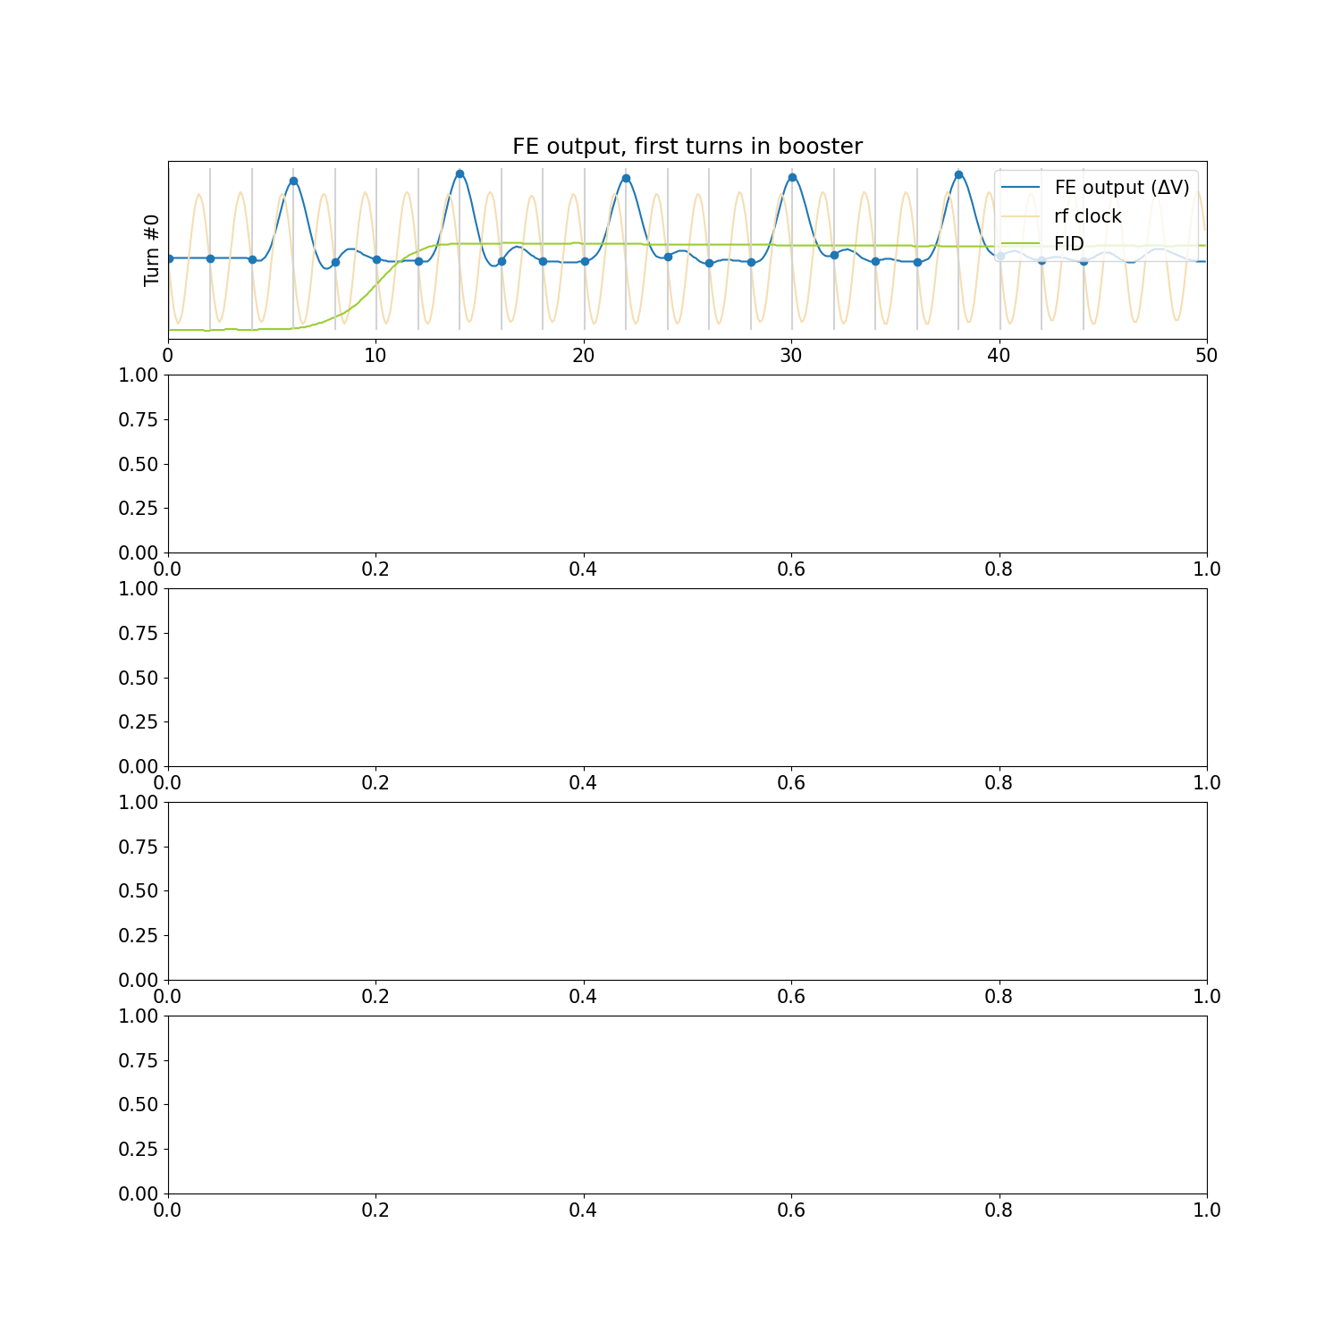
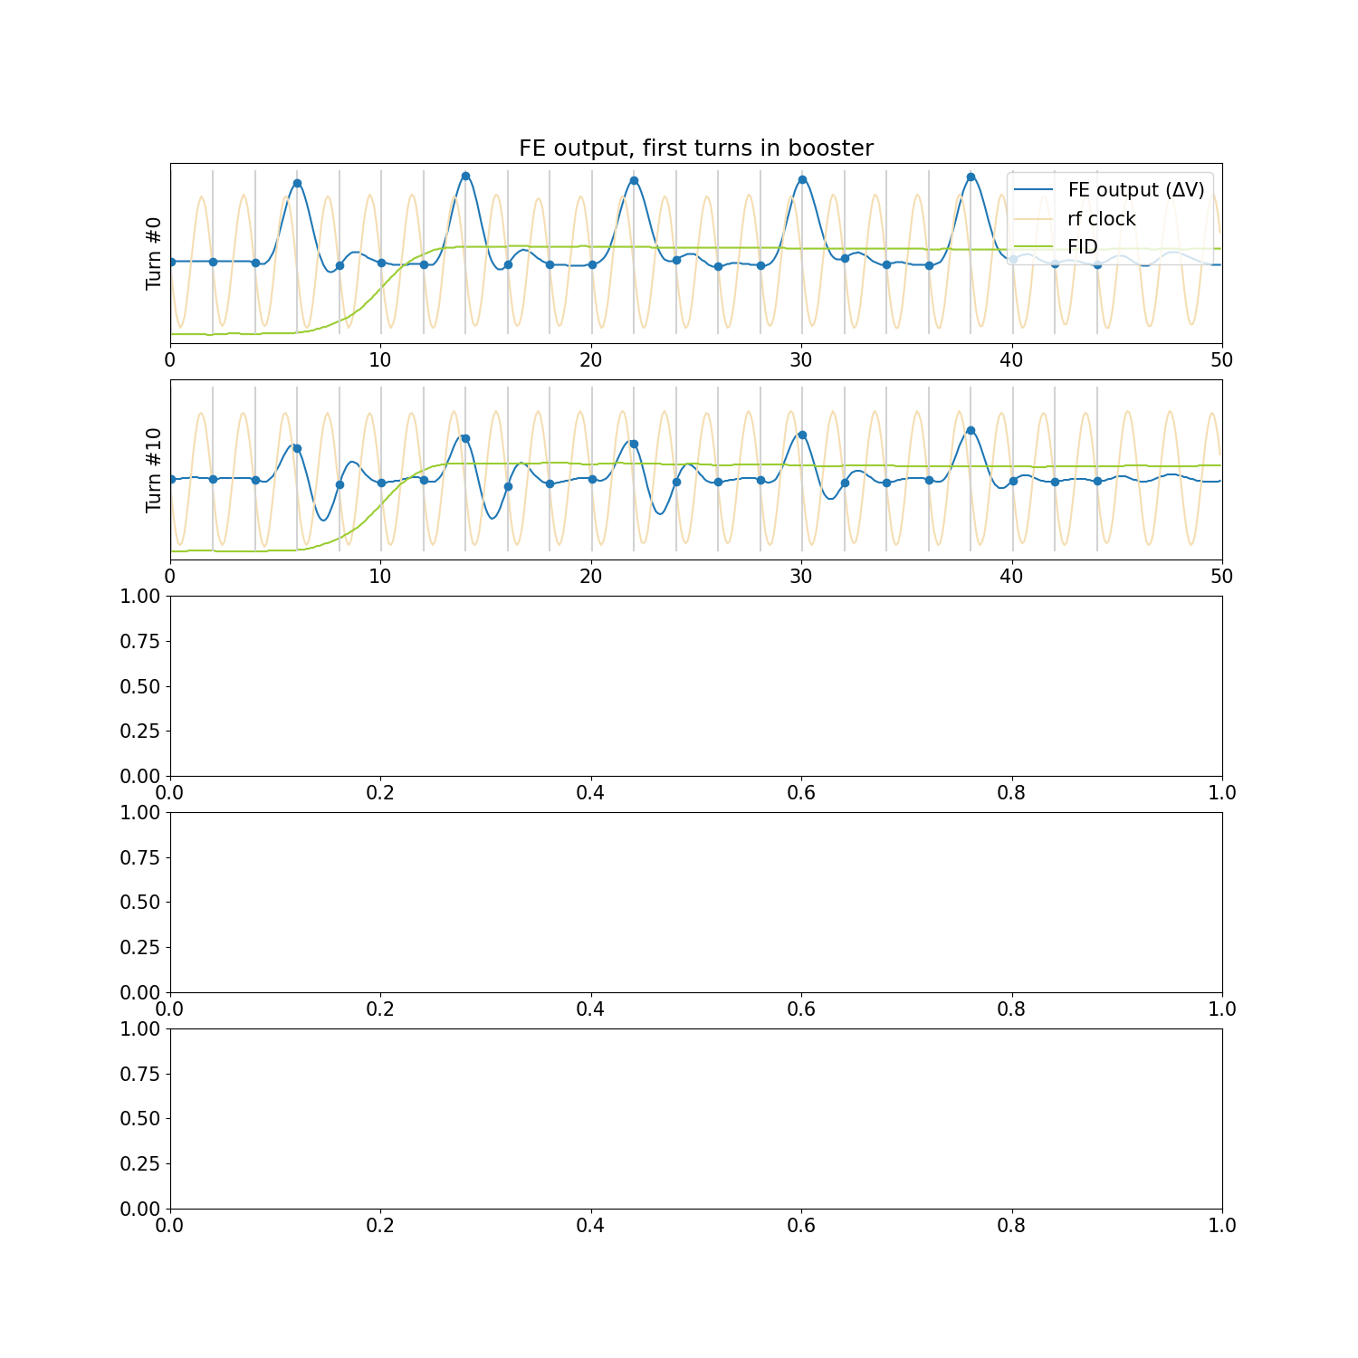
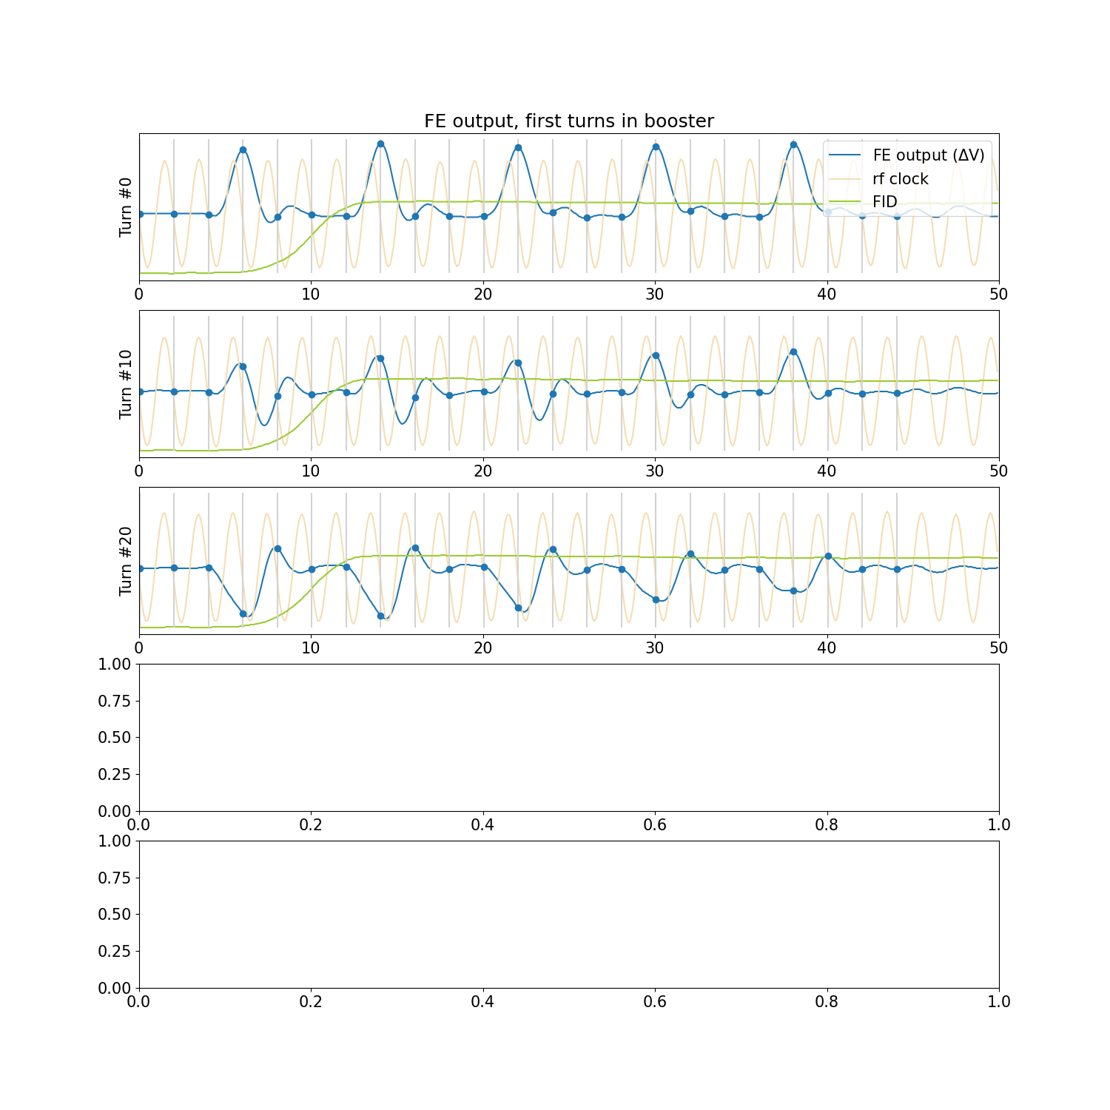
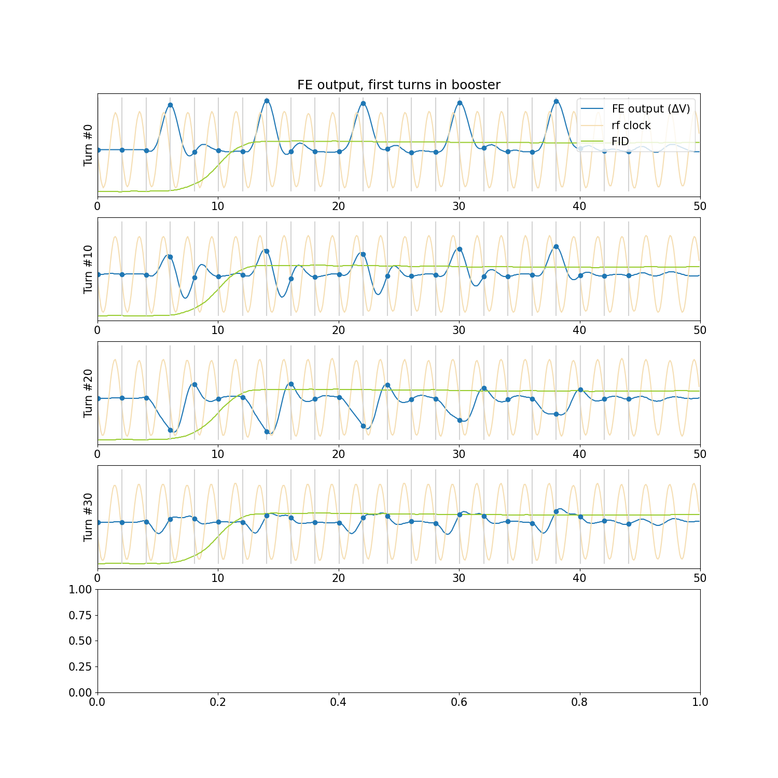
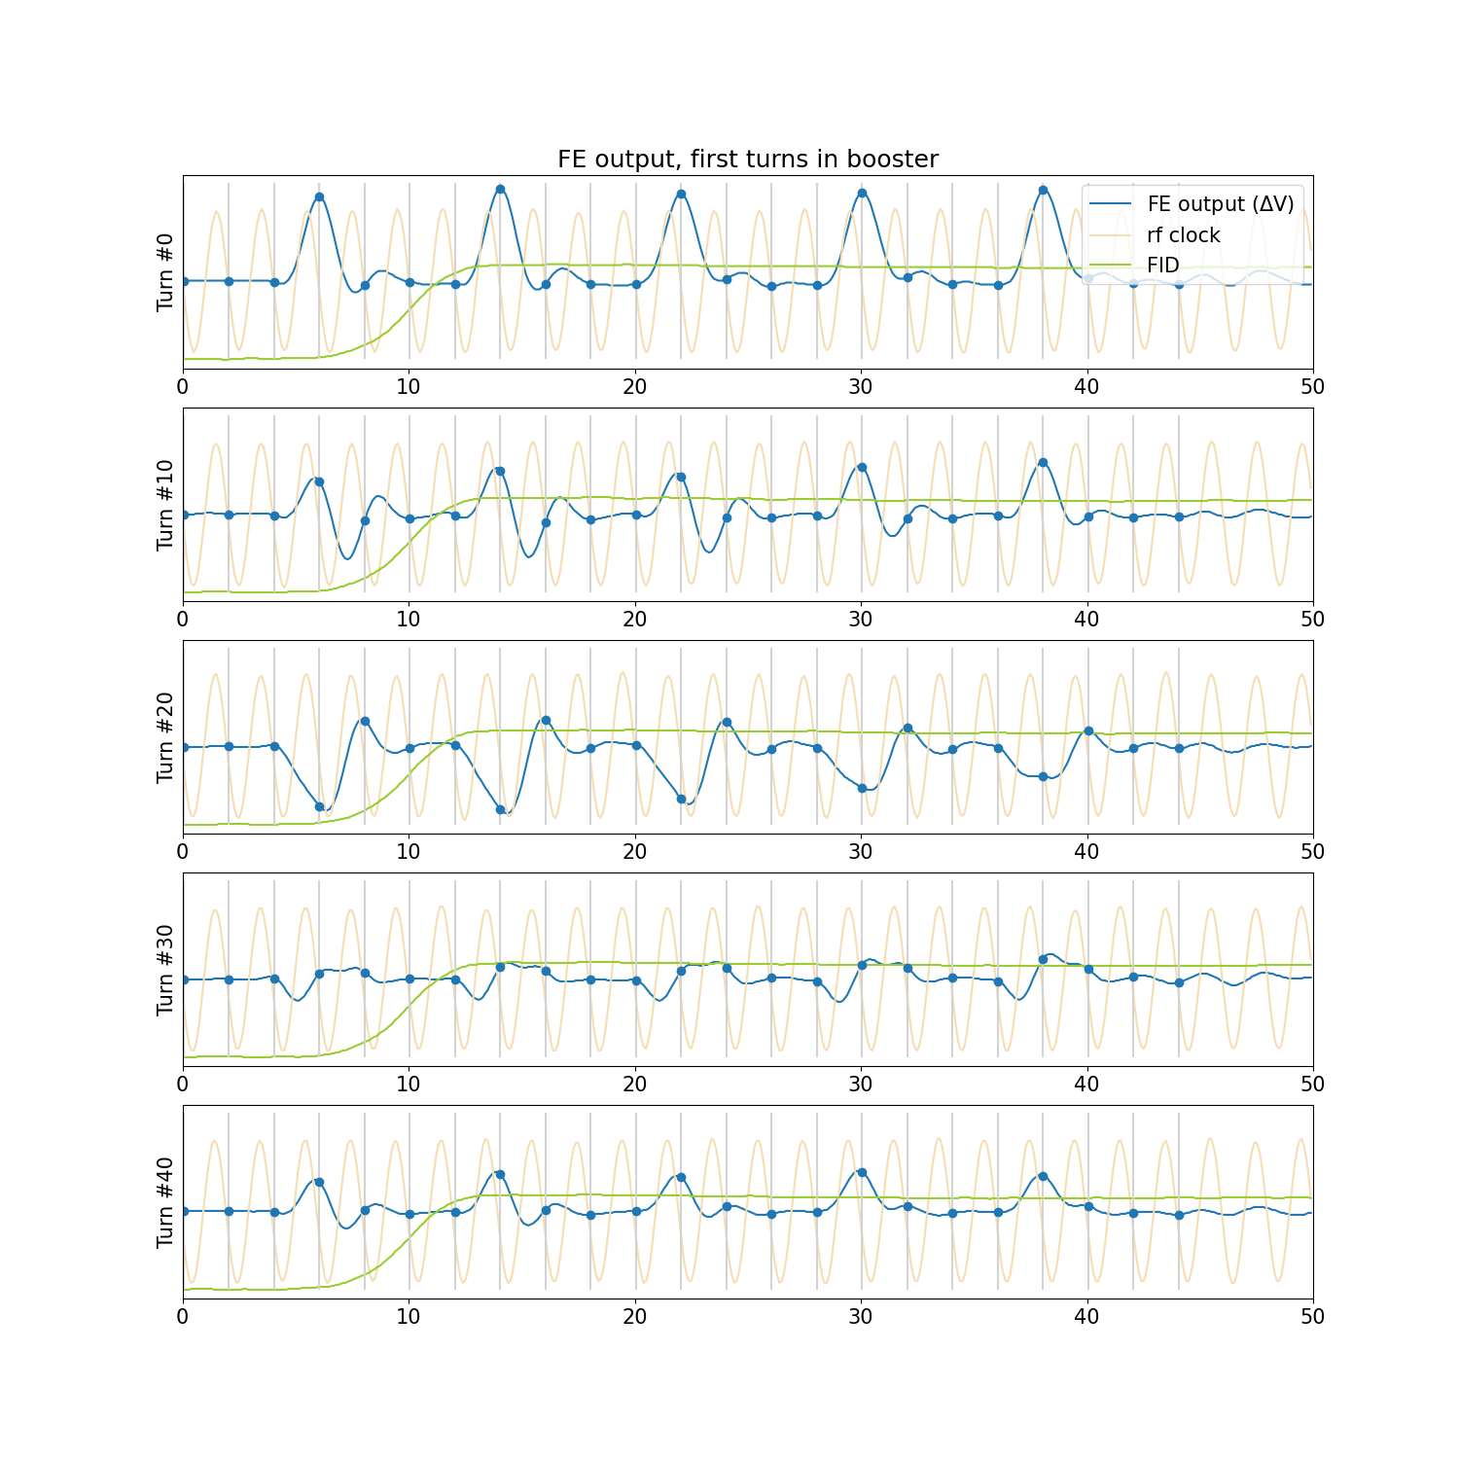
Effect of arrival time jitter on sampled waveform

Slide 16
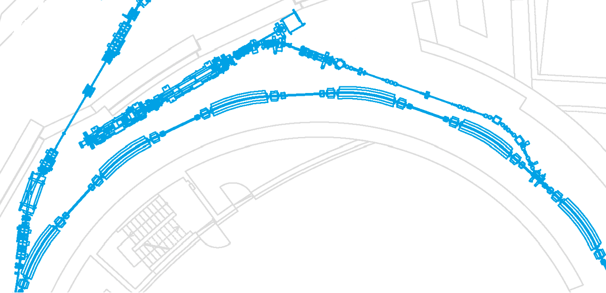
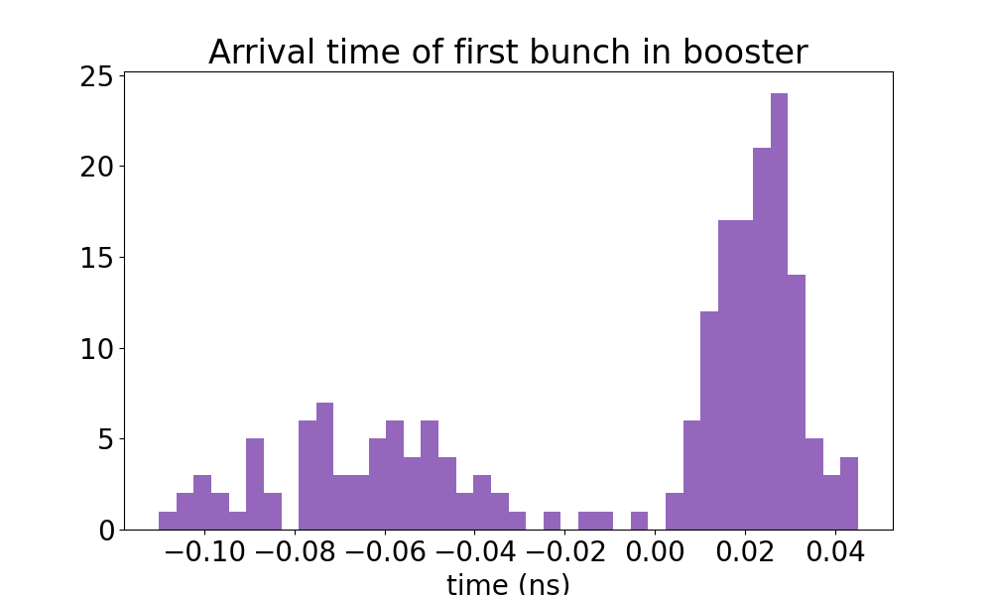
Arrival time Jitter caused by Linac
Measured output voltage of the linac klystron tends to jump between two states (well within specified tolerances, but enough to produce noticeable change in energy and arrival time from shot to shot)
With ‘correct’ state, the arrival time only fluctuates by a few degrees
Mean arrival time difference between the two klystron states is about 0.1 ns (which can be enough to cause erratic feedback results)

Slide 17
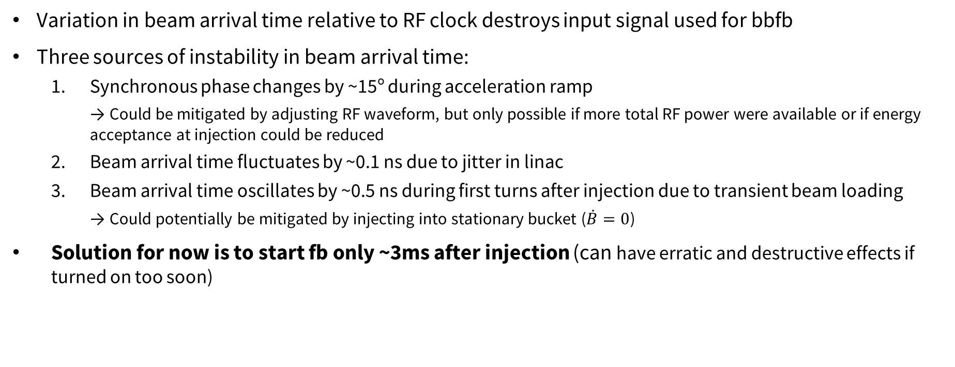
Summary – arrival time jitter
Variation in beam arrival time relative to RF clock destroys input signal used for bbfb
Three sources of instability in beam arrival time:
  Synchronous phase changes by ~15º during acceleration ramp
    → Could be mitigated by adjusting RF waveform, but only possible if more total RF power were available or if energy acceptance at injection could be reduced
  Beam arrival time fluctuates by ~0.1 ns due to jitter in linac
  Beam arrival time oscillates by ~0.5 ns during first turns after injection due to transient beam loading
    → Could potentially be mitigated by injecting into stationary bucket ($\dot{B}=0$)
Solution for now is to start fb only ~3ms after injection (can have erratic and destructive effects if turned on too soon)
Longitudinal beam motion without feedback.
Longitudinal beam motion with longitudinal feedback.

Slide 18
Summary and outlook
Longitudinal bbfb is very effective at controlling beam instabilities despite complications due to beam arrival time jitter
  Allows consistently high injection efficiencies even with highest beam current
  Transverse feedback is currently not needed, but may become important after gun upgrades
Possibilities for improving bbfb:
  Reduce transient beam loading effects (which have significant impact on longitudinal dynamics at injection)
  Change pre-processing scheme for bbfb signal (skip 3rd harmonic mixing to reduce sensitivity of bbfb to bunch arrival time jitter)

Slide 19
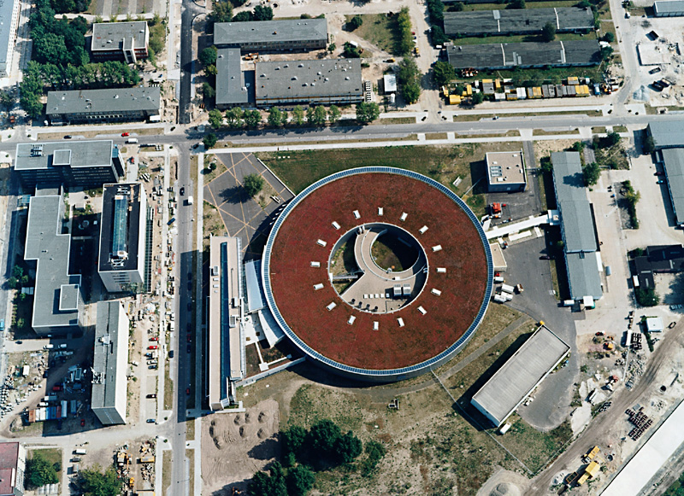
Questions? Comments?
Thanks to
T. Atkinson, M. Dirsat, F. Falkenstern, T. Flisgen, H. Glass, P. Goslawski, T. Löwner, P. Kuske, A. Matveenko, R. Müller, G. Rehm, M. Ries, M. Ruprecht, A. Schälicke, T. Schneegans, B. Schriefer, D. Schüler, Y. Tamashevich, D. Teytelman
and many others in the BII machine group who have contributed to this project in numerous ways.

