Slide 1
The new SOLEIL II MIK design
P. Alexandre
Pulsed Magnet and Power Supply Engineer
Injector Technical Coordinator for SOLEIL II Project
I.FAST 2024 Injectors
Karlsruhe
6-8 March 2024

Slide 2
Outline
The SOLEIL II project & Top-Up injection scheme.
New MIK design constraints.
New MIK engineering features and challenges.
Future perspectives and work.

Slide 3
The SOLEIL II project
Upgrade project to a 4th generation light source, in the same tunnels :
New storage ring.
New booster.
Refurbished or upgraded transfer lines & LINAC.
Upgraded beamlines in several phases.
Projected electron beam performances :
Reduced emittance : 82 pm.rad (vs 3.9 nm.rad today).
500 mA stored / 416 bunches / 2.75 GeV.
Transparent Top-Up injection.
Time frame as of today :
TDR phase : up to end 2024.
Construction : 2025 to end 2030 including :
Dark-time : late 2028 – early 2030.
User beam availability : mid-2030.
Preliminary view of a multi-bend achromat cell (7BA) foreseen for the storage ring, with dipoles (bends), reverse bends, quadrupoles, sextupôles, octupoles & correctors.
Over 1500 main magnets are expected with a third being permanent magnet based.
The current storage ring has 312 main magnets.

Slide 4
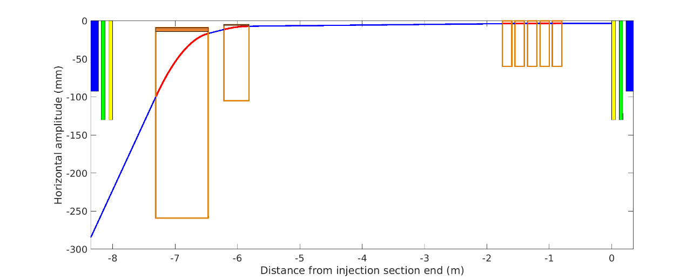
Storage ring Top-Up injection scheme
X_{inj} = -7 mm
X’_{inj} = 1 mrad
X_{inj} = -3,6 mm
X’_{inj} = 1 mrad
X_{inj} = -3,5 mm
X’_{inj} = 0 mrad
MIK modules (x5)
~1 mrad total
150 mm per module
Thin Septum
20 - 25 mrad
1 mm thick septum blade & 5 mm from stored beam.
EM design
MIK core ideas
Uniform deflection of injected beam to kick it within the dynamic aperture.
Zero magnetic field at center to avoid perturbations on stored beam.
Injected beam from booster
Thick septum
156 mrad
638 mm
1.7 T
Thick septum
150 - 160 mrad
Perm. Mag. (pref)
EM (back-up)
Off-axis on-momentum main Top-Up injection scheme

Slide 5
MIK specifications
In red : what beam dynamics group dream of…
In green : what engineering can offer so far :
A peak field at 3.5 mm with quadratic-like distribution.
A zero-field region at center with octupole distribution
With defect small dipole component and small quadrupole component.
Small Bx (horizontal) component for a well aligned magnet.
Negligeable Bs component.
Aperture large enough for beams, in both planes.
By
3.5 mm
x
Short summary of specifications
Peak field value at 3.5 mm | 10 mT / kA | 9.2 mTm field integral needed
Magnetic length | 150 mm / mag. | limit inductance to allow pulsed operation
Number of magnets | 5 | including redundancy for reliable operation
Residual dipole at center | ~ 2 µT | define the transparency of Top-Up injection, including eddy-current induced effects
Residual quadrupole at center | < 0.1 T/m

Slide 6
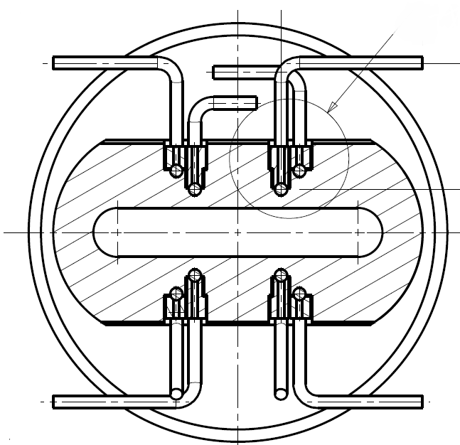
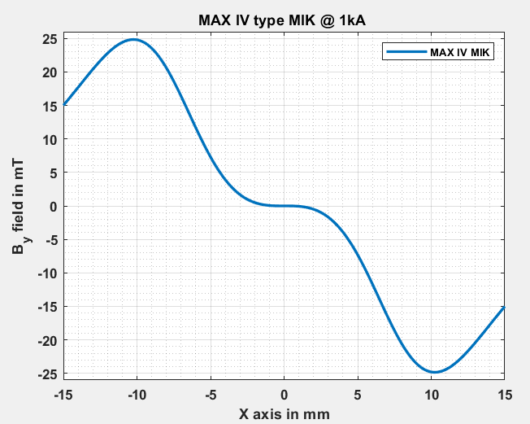
Reusing a MAXIV MIK
Re-using the MAX IV type MIK
11.5 kA & 2.4 µs pulse to achieve Top-Up injection @ 3.5 mm kick
Local 25 T/m gradient.
Working voltage above spec (40 kV).
Gradient detrimental : non-uniform kick to injected beam.
Shrinking the MAX IV type MIK design
Moves the peak field location from 10.3 mm to 3.5 mm.
Peak magnetic field at 3.5 mm.
Mechanical aperture : ~ 1 mm (V) : not feasible.
MAX IV type MIK not usable for Top-Up injection in SOLEIL II
Need to create new topologies.
ideal
optimal
location
injected beam
SOLEIL II
8 conductor topology
Inner conductors (red) : 14 mm square
Outer conductors (green) : 20 mm square
Aperture : 7.8 mm (V) x 46 mm (H)
Length: 304 mm (magn.) / 400 mm (mech.)

Slide 7
Brainstorming new ideas…
To achieve specifications presented earlier:
Maintain a large aperture:
6 mm minimum in vertical aperture:
to preserve beam lifetime.
to maintain reasonable levels of beam induced heating in the titanium coating.
30 mm minimum in horizontal aperture:
to avoid synchrotron radiation from upstream dipole intercepting a ceramic chamber or a conductor.
Conductors:
Location to achieve desired magnetic field distribution.
no conductor in the mid-plane.
Maximum of 20 conductors.
more conductors could improve field distribution at the expense of inductance.
All connected electrically in series.
to avoid dealing with several pulsers & current pulse identity.
Magnet mechanical design:
Dissociate conductor assembly from titanium coated liners.
easier manufacturing process vs assembly tolerances.
In vacuum or in air.
the more compact the conductors, the more efficient.
Careful thermal design.
constant challenge with ceramic parts in kicker design.
Conductor
Assembly
y
x
s
Thin ceramic liners with Ti coating
Conductor
Assembly
Transverse cross-section
Green dot : stored beam
Red dot : injected beam
Orange : ceramic plates
Dark blue : titanium coating

Slide 8
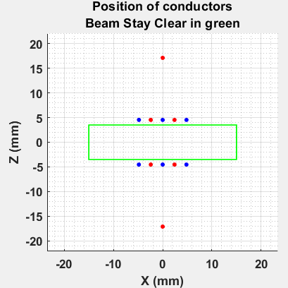
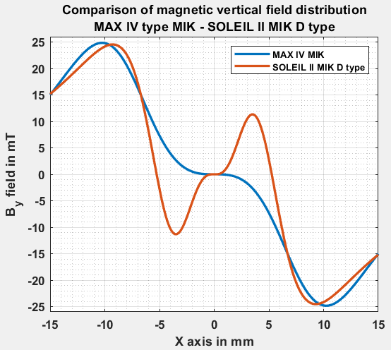
MIK topology D
7 new ideas to form MIK topology : A to G.
3 of which are patented in Europe (and worldwide extension pending).
A lot of other topologies did not work….
The most suitable for our needs is topology D:
12 conductors in series electrically.
Aperture : 7 mm (V) x 30 mm (H) (minimum),
With no main physical constraint in horizontal plane (advantageous for synchrotron radiation issues.
B_{y} field : 11.5 mT / kA.
Zero field region at center : octupole shaped.
No dipole component with mechanically perfect magnet.
Quadrupole component below 0.1 T/m with mechanically perfect magnet.
Other features :
Liners with Ti coating mechanically decoupled from the conductor assembly.
The zero-field region can be tuned by moving the two outer conductors located at Z = +/- 17 mm, to compensate for some field errors due to magnet mechanical errors.

Slide 9
MIK topology D challenges
From colored dots on paper to a fully functional magnet….
Challenges :
Mechanical and thermal design
How to manufacture the magnet ?
How to cope with the beam induced heat load on an in-vacuum magnet ?
Field tunability
Quality of the correction of defect field at center and accurately moving an electrical conductor.
Liners and eddy currents
Liner with coating separate from conductor assembly.
Transient magnetic simulation to assess effect on the magnetic field distribution.
Voltage withstand
High voltage pulsed magnet in vacuum.
Paschen law.

Slide 10
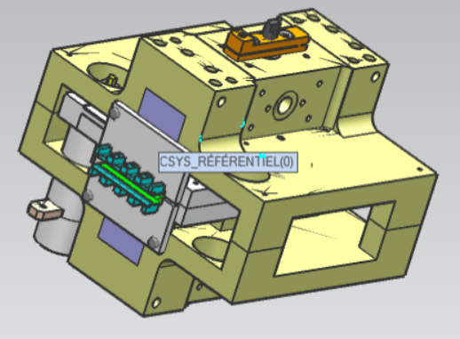
Mechanical and thermal design
Magnet: 3 sub-components:
Conductor assembly.
Liners : 0.5 mm thin ceramic plate with coating.
General mechanics.
Holding everything together.
Moving the tuning conductors (flexors).
Conductor assembly
Brazed / bonded wires or deposited (PCB) on alumina or aluminum nitride parts.
Accurate machining to position conductors.
Liners
Standard parts : 43 mm x 178 mm x 0.5 mm.
Decent flatness : 0.1 to 0.2 mm (or better).
Alumina or aluminum nitride with brazed transition parts.
Advantage : simple parts to manufacture in large number & coat separately.
Tuning
Conductor
Conductor assembly
Coated liner
Cross-section of half a MIK type D concept
Preliminary mechanical design

Slide 11
Field tunability
The MIK topology D has no magnetic yoke: magnetic field distribution is only related to the conductor position.
The zero-field region at center for the stored beam is degraded by:
Mechanical errors of positioning of the conductors.
Dipole & quadrupole component synchronous with current in conductors.
Eddy currents in the titanium coating.
Mainly an induced quadrupole.
Induced dipole possible for some coating errors.
Alignment of the magnet is equally critical…

Slide 12
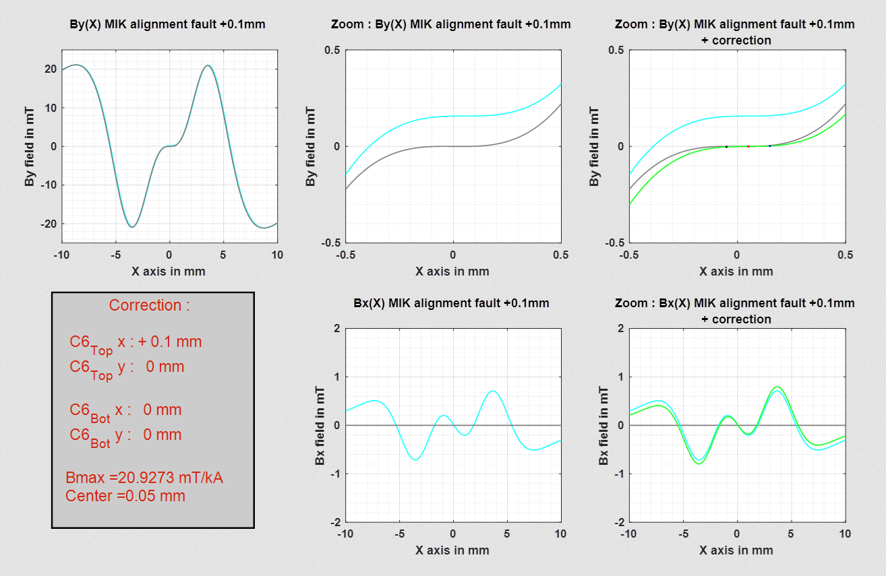
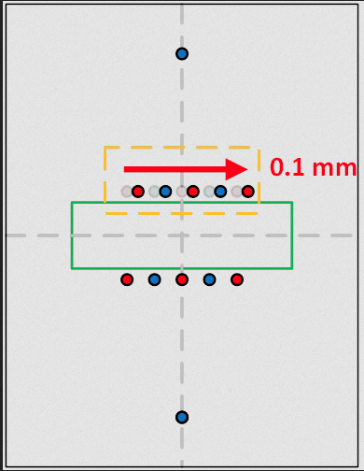
Field tunability
Corrected By(x) at center.
Corrected dBy(x)/dx at center.
Bx(x) zero at center.
dBx(x)/dx not well corrected and remains around - 0.3 T/m
Correction step: 10 µm (x & y) for each tuning conductor
Color code:
Grey: ideal MIK
Blue: MIK with error
Green: MIK with error corrected
Calculations of sensitivity to errors help justify machining tolerances

Slide 13
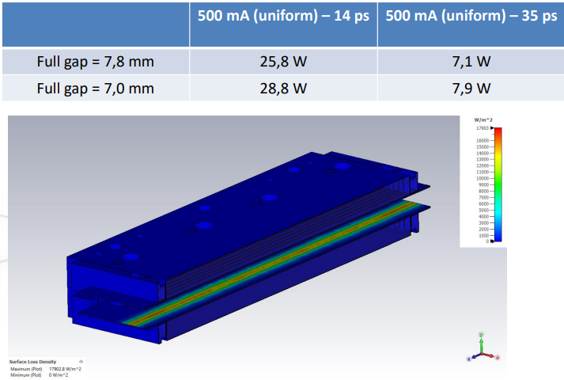
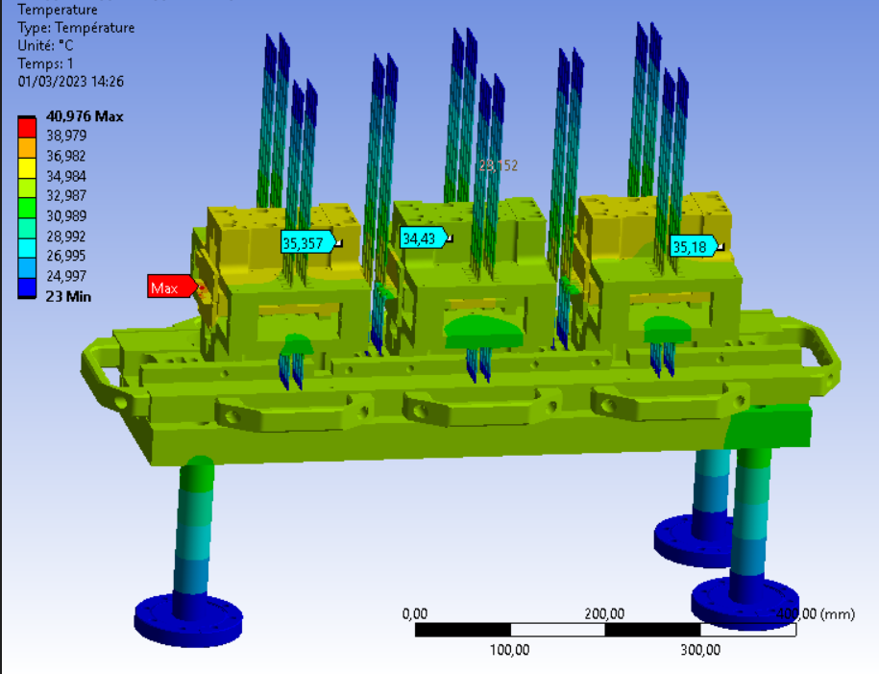
Mechanical and thermal design
Advantage of aluminum nitride over alumina:
Thermal conductivity Al₂O₃: 10 – 30 W/m/K
Thermal conductivity AlN: 150 – 180 W/m/K
Both exhibit good dielectric rigidity.
15 to 20 kV/mm, depending on quality & test norm.
Both compatible with vacuum constraints.
Using aluminum nitride for conductor support & liners leads to acceptable temperature on the magnets (with pessimistic heat load):
500 mA – 14 ps leads to a max heating of ~41°C.

Slide 14
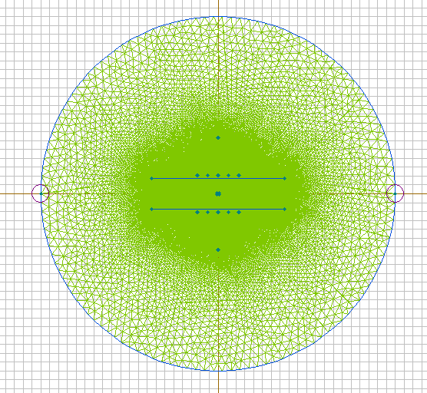
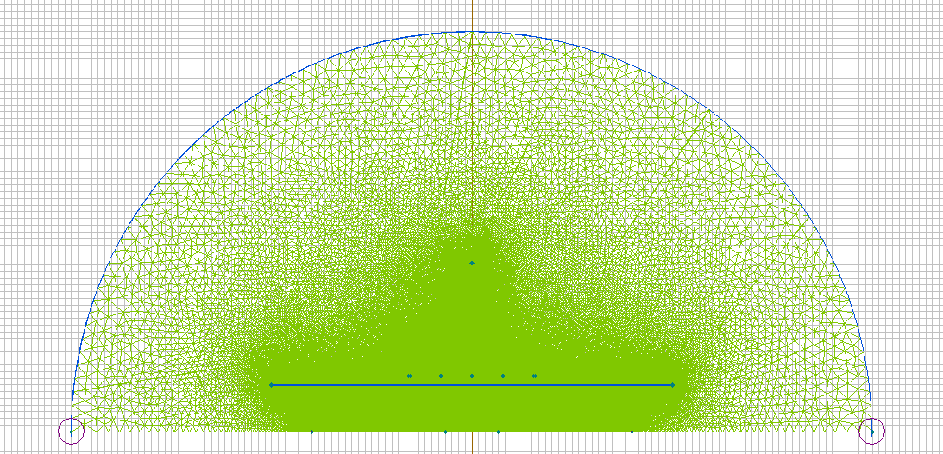
Liners & eddy currents
Transient magnetic simulation using QuickField 2D
Use of a full model & a half model, with only functional elements.
Conductors, w/o mechanical errors.
Coatings (0 – 5 – 10 – 20 µm), all uniform.
Various conductivities of titanium.
Transient field is mainly a pulsed quadrupole at center.
Target is to get this quadrupole below 0.1 T/m at any time, to minimize beam size oscillations.
Target residual dipole field shall be in the range of few µT.
Thickness, resistivity & homogeneity are critical.

Slide 15
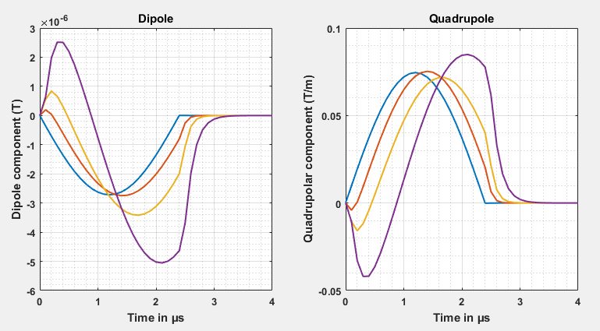
Liners & eddy currents
Harmonic decomposition at center for a MIK topology D with 4 cases calculated:
Sputtered titanium conductivity (based on experience).
Thicknesses of 5 – 10 – 20 µm (and no liner & coating modelled as comparison).
Promising results!
Delicate simulations : feedback & discussion welcome!
Prototype coatings and perform pulsed magnetic measurements to validate simulations.

Slide 16
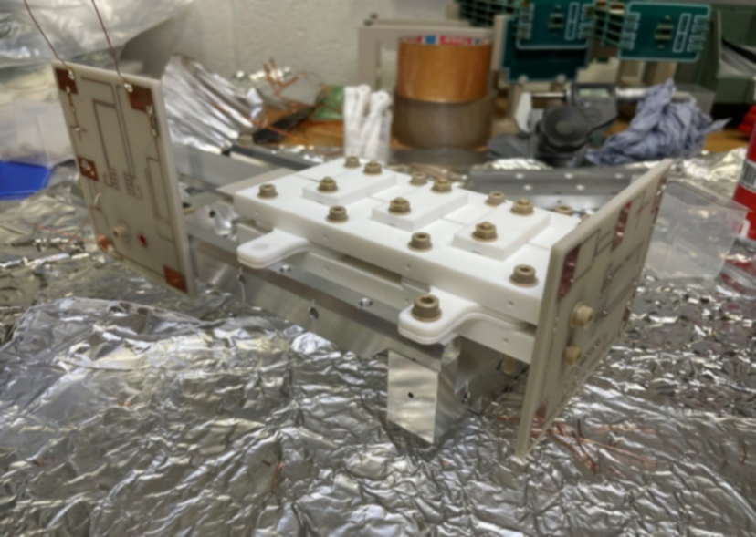
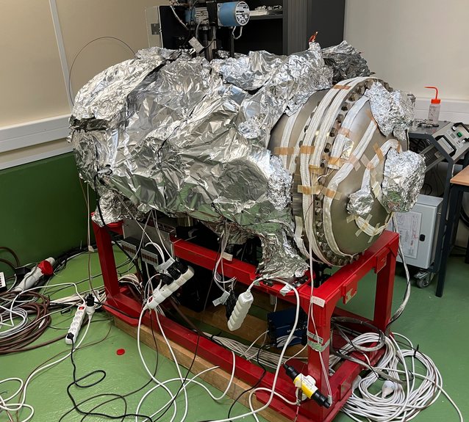
Voltage withstand
Compact design
Conductors ~ 2 mm apart & complex connections.
Sandwich of parts in vacuum
Various outgassing levels.
Small conductance.
What is the pressure surrounding the conductors?
Paschen law
Arcing voltage depends on pressure and gas type.
Existence of a minimum in voltage withstand.
To add: shapes of conductors, smoothness of surfaces, manufacturing errors in ceramics on a very small object.
Not straightforward to calculate voltage withstand to access maximum performance of the magnet.
Prototyping !
So far, the magnet prototypes held ~ 9 to 10 kV in pulsed mode with simulated Ti coated liners.
Vessel pressure between low 10⁻⁶ and high 10⁻⁹ mbar (baked or unbaked)

Slide 17
Pulser development
How to provide pulsed current with minimal voltage on magnet ?
trans. line
Traditional topology
Capacitive discharge
short transmission line to load
(~ 20 m max.)
C, U₀
s₁
matching
matching
MIK mag.
trans. line
TX Capacitor topology
Capacitive discharge
long transmission line to load
(~ 200 m min.)
C, U₀
s₁
matching
matching
MIK mag.
U₀
PFL
s₁
trans. line
TX PFL topology
PFL discharge
long transmission line to load
(~ 200 m min.) & 2 switches
s₂
matching
MIK mag.
match

Slide 18
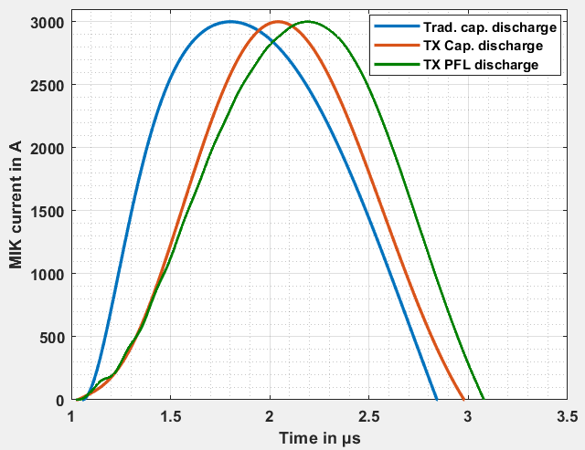
Pulser development: pulsed current waveforms in MIK
I_{MIK} @ 3 kA | Trad. Cap. | TX Cap. | TX PFL
charging voltage (U₀) | 12.8 kV | 11.1 kV | 18.8 kV
MIK magnet max. voltage | 9 kV | 5.9 kV | 5.4 kV
rise time (0 – peak) | 0.734 µs | 1.005 µs | 1.173 µs
fall time (peak – 0) | 1.036 µs | 0.942 µs | 0.884 µs
Pulse waveform main characteristic,
for a target peak 3 kA in MIK magnet.
Note: injection with MIK is planned on one turn, so fall time should be less than 1 revolution (1.18 µs) - pulse duration of 2.4 µs maximum. Required current per MIK for nominal betatron injection is ~ 1 to 1.5 kA, depending on septum blade location. Parasitic components such as stray resistance and inductance as well as losses in cables considered. Voltage margin required for reliable operation.
TX capacitor discharge pulser topology seems the most suitable.

Slide 19
Conclusions
Extensive engineering to bring the design up to life to injection in SOLEIL II storage ring!
Early 2024 : ceramic manufacturer prospection.
No big NO on magnet part feasibility !
Several good recommendations to improve magnet design.
Next steps
Continue prototypes to measure pulsed magnetic field distortion due to eddy current in liners with several Ti coating thicknesses.
Continue pulser design (mechanical integration).
Produce a first of series magnet and test on beam to validate heating simulations.

Slide 20
Acknowledgments
Thank you for your attention !
Special thanks to the SOLEIL MIK engineering team for bearing with me :
R. Ben El Fekih, J. Dasilvacastro, Z. Fan, A. Gamelin, A. Letresor, S. Thoraud,
M.-A. Tordeux
~
Review on non-linear kicker designs throughout time & space.
I.FAST 9th Low Emittance Ring Workshop – CERN 13th-16th Feb. 2024
https://indi.to/FvCZT

