Slide 1
Closing Remarks:
The IFAST Workshop 2024 on
Injectors for Storage Ring Based Light Sources
KARA Large Seminar Hall, 8. March 2024
Akira Mochihashi, KIT - IBPT

Slide 2
Statistics
Number of registered onsite participants: 41
Number of registered online participants: 13
Number of scientific presentations: 24 (inc. summary)
Participants´ affiliations: 14
ANL, ALBA, CERN, DESY, DLS, Elettra, ESRF, HZB, KEK, KIT, LBL, LNLS, PSI, SOLEIL

Slide 3
The purpose of the workshop
Networking
  With different institutes worldwide
  With different types of injectors
  With different R&D fields
  With different generations
  With another workshop, i.e., BbB feedback workshop
We have reached a goal of the workshop: through the networking, we could recognise again the significance of injectors for present and future accelerators, especially for storage ring-based light sources.

Slide 4
Aiming at synergy
Two workshops + one experiment
  Injectors for storage ring based light sources
  Bunch-by-Bunch feedback systems and related beam dynamics
  Three experimental topics concerning BbB feedback system
We have discussed several applications of BbB feedback systems and related technologies to injector operation and R&D possibilities.

Slide 5
Information
Abstract
  Please submit abstracts for the presentation by the end of March 2024.
  The abstract will be summarized as an official IFAST project report and be submitted to the IFAST project office.
  The abstract booklet will be published on the Indico website.
  You can submit the abstract on the Indico website. The abstract submission is open now.
We appreciate your understanding and cooperation!

Slide 6
Information
@ IPAC‘24
  The network activities of the IFAST project (including the injector workshop, the BbB feedback workshop and the joint experimental session) will be summarized and presented at the IPAC‘24.

Slide 7
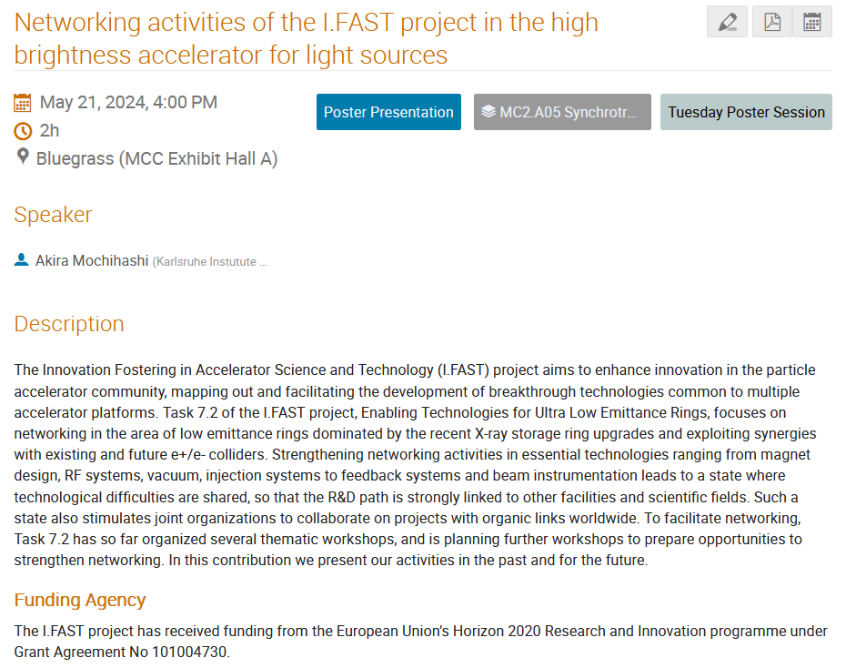
Networking activities of the I.FAST project in the high brightness accelerator for light sources (poster presentation)

Slide 8
Acknowledgement
Workshop Joint Organizing Committee
Jonas Kallestrup | PSI
Michael Boege | PSI
Patrick Schreiber | SOLEIL
Ryutaro Nagaoka | SOLEIL
Robert Ruprecht | KIT
Akira Mochihashi | KIT

Slide 9
Acknowledgement
Local Organization
Deniz Bilri | KIT
Katharina Mayer | KIT
Leyla Johim | KIT
Robert Ruprecht | KIT
Akira Mochihashi | KIT

Slide 10
Announcement
Site Tour
  Please come back to the large seminar hall by 14:35.
  We will make three tour groups.
  You can leave your luggage in the seminar hall.
Workshop Shuttle Bus
  Departure at 15:35 from the workshop venue.

