Slide 1
Classification algorithms Logistic regression and neural networks
HAF Workshop, 22.3 – 23.3.2018, KIT
Martin Siggel
German Aerospace Center

Slide 2
Outline
Basics
Supervised learning: regression and classification
Math theory
Training
Optimization: gradient descent, gradient checking
Over- and underfitting, regularization
Logistic Regression:
Linear regression vs logistic regression
Formalism
Cost vs. Loss
One-vs-All for multi-class classification
Neural Networks
History
Neurons
Formalism
Loss + Back-propagation
Advanced topics

Slide 3
Basics

Slide 4
Big picture: supervised learning Regression

Slide 5
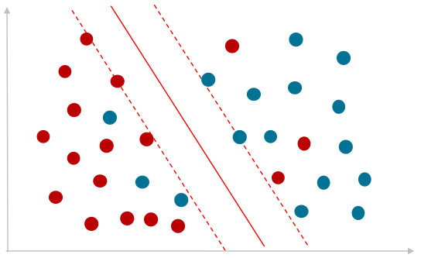
Big picture: supervised learning Classification
Malignant
Benign
Age
Tumor size
Classification = choose between discrete options

Slide 6
Big picture: supervised learning Mathematical model
Given a set of input data and correct answers
Goal: find a model that fits to these data
E.g. Given house size and number of rooms, predict house price
Notation:
$x^{(i)}∈R^{n}$ is the i-th input for the algorithm (House size, room number)
$y^{(i)}$ is the ground truth answer (actual house price given features $x^{(i)}$)
$m$ number of training samples
Training Set: $\{\left(x^{\left(1\right)},y^{\left(1\right)}\right),\left(x^{\left(2\right)},y^{\left(2\right)}\right),…,\left(x^{\left(m\right)},y^{\left(m\right)}\right)\}$
Regression: Fit continuous data (house price)
Classification: Predict for discrete classes (cancer, no cancer)
House size (x) | Price (y)
80 | 220
85 | 390
120 | 368
122 | 371
137 | 427
180 | 553
183 | 546
192 | 511

Slide 7
Big picture: supervised learning The hypothesis
Training set
Learning Algorithm
x (House size)
h
y (estimated house price)
hypothesis

Slide 8
Training the hypothesis Loss function
The model $h(x)$ depends on some model parameters $θ$
Training requires measure for quality of the model $h_{θ}\left(x\right)$
The loss function J compares predicted value $h_{θ}(x^{(i)})$ with true value $y^{(i)}$, e.g.
$$J=\frac{1}{2m}\sum_{i=1}^{m}{{\left(h_{θ}\left(x^{\left(i\right)}\right) −y^{\left(i\right)}\right)}^{2}}$$
Training = Find parameters $θ$ such that loss function J is minimal
Optimization problem

Slide 9
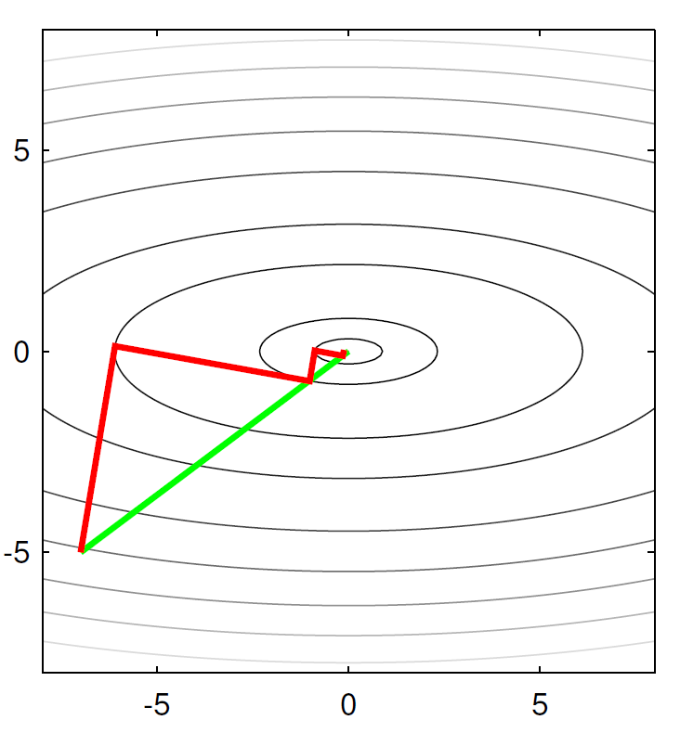
Training the hypothesis Gradient descent optimization
Mathematical formalism to minimize functions J$(θ)$, $θ∈R^{n}$
Gradient based methods can handle millions of variables
Iterative approach
Start with some initial guess $θ_{0}$
Iterate until convergence
$$θ_{i+1}=θ_{i} −α\vec{∇}J(θ_{i})$$
$$θ_{2}$$
$$θ_{1}$$
Learning Rate
Derivative of J w.r.t $θ$ must be computed!

Slide 10
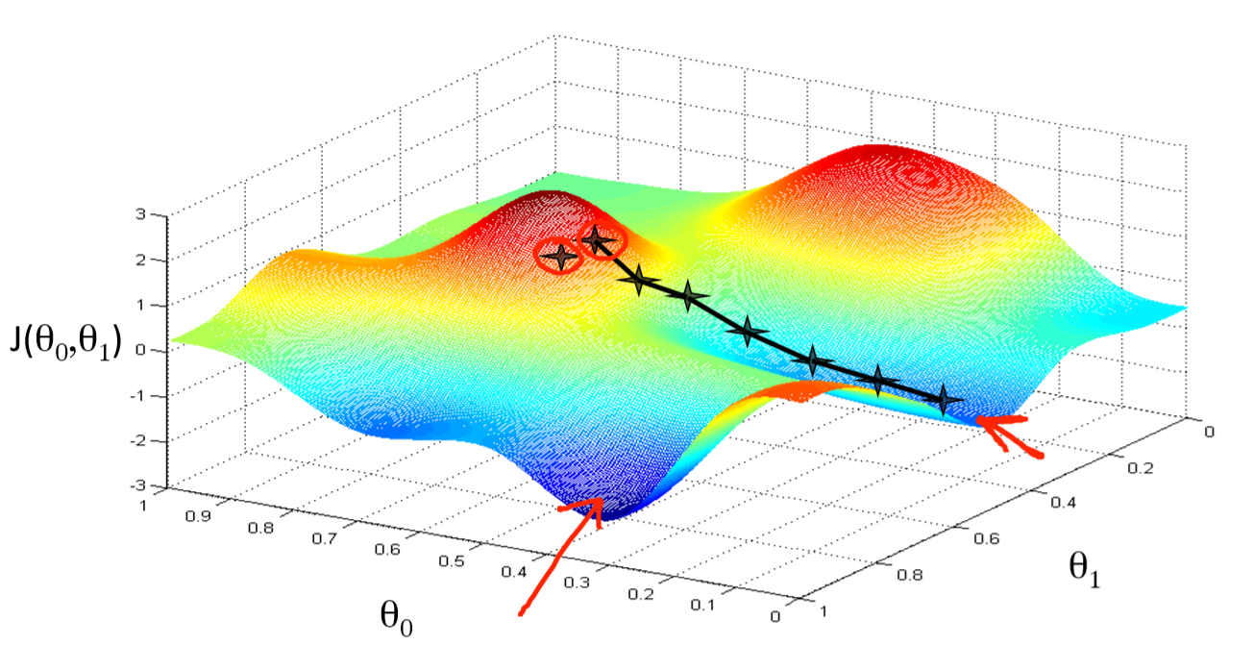
Training the hypothesis Gradient descent optimization

Slide 11
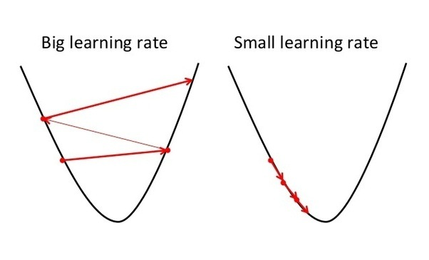
Training the hypothesis Gradient descent optimization
$$J$$
$$θ$$
$$θ$$

Slide 12
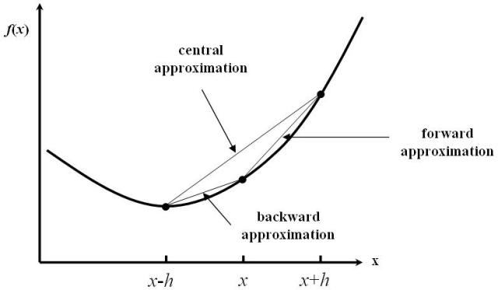
Training the hypothesis Gradient Checking
Implementing gradients $\frac{d}{dθ}J(θ)$ is difficult and error prone
Simple (but slow) method, to check accuracy: Finite central differences
$$\frac{dJ}{dθ_{i}}\left(θ\right)≈ \frac{J\left(θ+{\vec{e}}_{i}⋅h\right)−J\left(θ −{\vec{e}}_{i}⋅h\right)}{2h}$$
Should always be done before training!

Slide 13
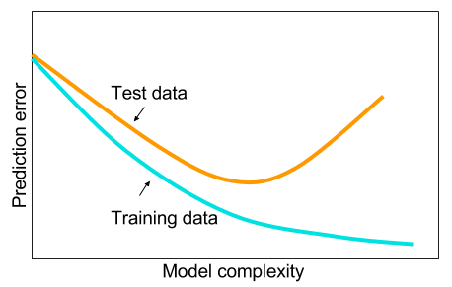
Training the hypothesis Over- / underfitting
Underfitting
Just right
Overfitting
Underfitting
Just right
Overfitting

Slide 14
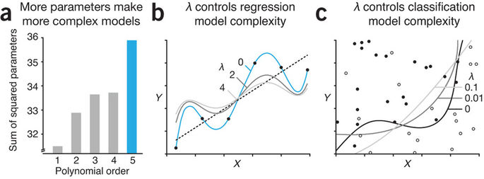
Training the hypothesis Regularization
Regularization tries to avoid overfitting by penalizing parameters
Technically, add a regularization term to the loss function
$$J=\frac{1}{2m}\sum_{i=1}^{m}{{\left(h_{θ}\left(x^{\left(i\right)}\right) −y^{\left(i\right)}\right)}^{2}+ \frac{λ}{2m}\sum_{j=1}^{n}{θ_{j}}}$$
Note: The bias term $θ_{0}$ should not be included!

Slide 15
Logistic Regression

Slide 16
Simple linear regression
1
Miss-classification
Malignant?
0.5
$$h_{θ}\left(x\right)=θ_{1}x+θ_{0}$$
0
Tumor size (x)
Classify:
Malignant, if $h\left(x\right)≥0.5$
Benign, if $h\left(x\right)<0.5$

Slide 17
Logistic regression
1
Less prone to extreme values
Malignant?
0.5
$$h_{θ}\left(x\right)={σ(θ}_{1}x+θ_{0})$$
$σ\left(z\right)≔ \frac{1}{1+e^{−z}}$ (sigmoid function)
0
Tumor size (x)

Slide 18
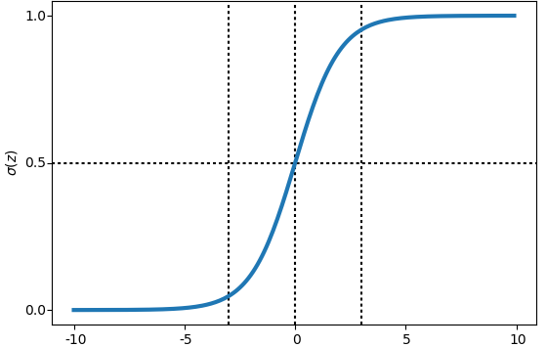
Sigmoid function (Logistic curve)
$$σ\left(z\right)= \frac{1}{1+e^{−z}}$$
$$z$$
→ Measure of classification probabilty

Slide 19
Logistic Regression Formalism
Let $x∈R^{n}$be the n-dim input feature vector, then
$$h_{θ}\left(x\right)=σ( \sum_{j=1}^{n}{θ_{j}x_{j}+θ_{0})}$$
Constant bias trick:
Define $x_{0}=1$
Then $h_{θ}\left(x\right)=σ( \sum_{j=0}^{n}{θ_{j}x_{j})}=σ(θ^{T}x)$
$$h_{θ}\left(x\right)= \frac{1}{1+e^{{−θ}^{T}x}}$$
Can be used for binary classification problems

Slide 20
Cost function
Problem: standard mean squared loss is not convex in LR!
$$J=\frac{1}{2m}\sum_{i=1}^{m}{{\left(h_{θ}\left(x^{\left(i\right)}\right) −y^{\left(i\right)}\right)}^{2}= }\frac{1}{2m}\sum_{i=1}^{m}{Cost(h_{θ}\left(x^{\left(i\right)}\right), y^{\left(i\right)})}$$
Optimizers get stuck in local minima
Non-convex
nonvex
Desired
$$J$$
$$J$$
$$θ$$
$$θ$$

Slide 21
Cost function
$$Cost\left(h_{θ}\left(x\right), y\right)= \left\{\begin{aligned}−\log\left(h_{θ}\left(x\right)\right), if y=1 \\ −\log\left(1 −h_{θ}\left(x\right)\right), if y=0\end{aligned}\right.$$
$$∞$$
$$∞$$
$${Cost(h}_{θ}\left(x\right), y)$$
$$h_{θ}(x)$$

Slide 22
Simplified Cost Function
$$Cost\left(h_{θ}\left(x\right), y\right)= \left\{\begin{aligned}−\log\left(h_{θ}\left(x\right)\right), if y=1 \\ −\log\left(1 −h_{θ}\left(x\right)\right), if y=0\end{aligned}\right.$$
Can be simpified / unified to:
$$Cost\left(h_{θ}\left(x\right), y\right)=−\left(1−y\right)⋅log\left(1 −h_{θ}\left(x\right)\right)−y⋅log\left(h_{θ}\left(x\right)\right)$$
y=0
y=1

Slide 23
Loss function regularized Logistic Regression
The complete loss function of logistic regression + regularization is:
$$J\left(θ\right)≔ −\frac{1}{m}\sum_{i=1}^{m}{y^{i}\log\left(h_{θ}\left(x^{(i)}\right)\right)+\left(1−y^{(i)}\right)\log\left(1 −h_{θ}\left(x^{(i)}\right)\right)} +\frac{λ}{2m} \sum_{j=1}^{n}{θ_{j}^{2}}$$
We can compute the derivatives as follows:
$$\frac{d}{dθ_{j}}J\left(θ\right)= \frac{1}{m}\sum_{i}^{m}{\left(h_{θ}\left(x^{(i)}\right)−y^{(i)}\right)⋅x_{j}^{(i)}}+ \frac{λ}{m}θ_{j}$$

Slide 24
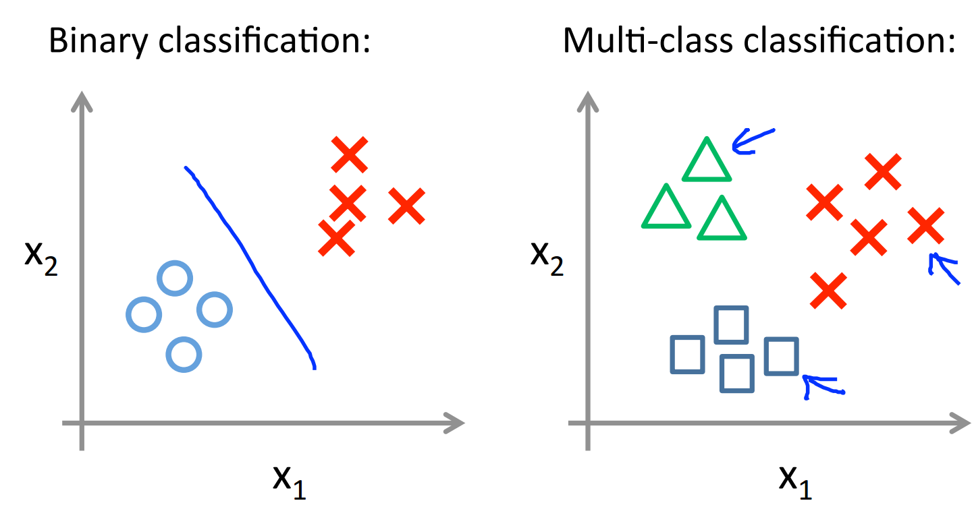
Multi-class classification with Logistic Regression

Slide 25
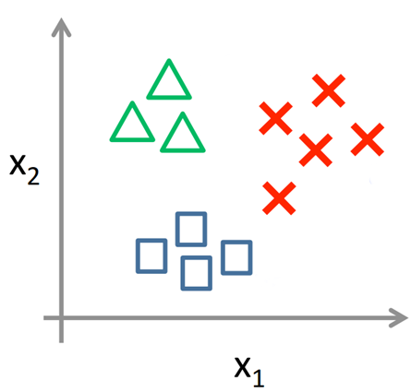
Multi-class classification with Logistic Regression One-vs-all
red or not
3 Classifiers
blue or not
green or not

Slide 26
Multi-class classification with Logistic Regression One-vs-all
Train a logistic regression classifier $h_{θ}^{i}(x)$ for each class i
Predict class i which has the highest probability $h_{θ}^{i}(x)$ , i.e.
$i= argmax_{i}\left(h_{θ}^{i}\left(x\right)\right)$

Slide 27
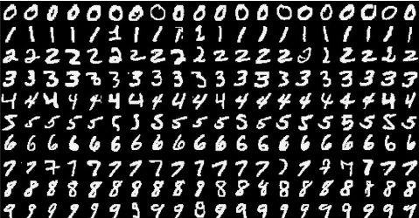
Excercise
Classify hand-written digits (MNIST)
TODO:
Get a feeling for the data
Implement and check the loss function of the LR method
Classify images from a test data set and compute accuracy of our method.
Figure out, how test set accuracy and training set accuracy depend on the number of samples.
30 min

Slide 28
Neural Networks

Slide 29
History
Originally invented to mimic brain
Hyped due to many successful applications in the 80s / early 90s
Recognition of hand-written text (Yan LeCun)
Winter of neural networks: networks were not as good as hoped
Lately revival of large scale deep neural networks due to better hardware, better network architectures

Slide 30
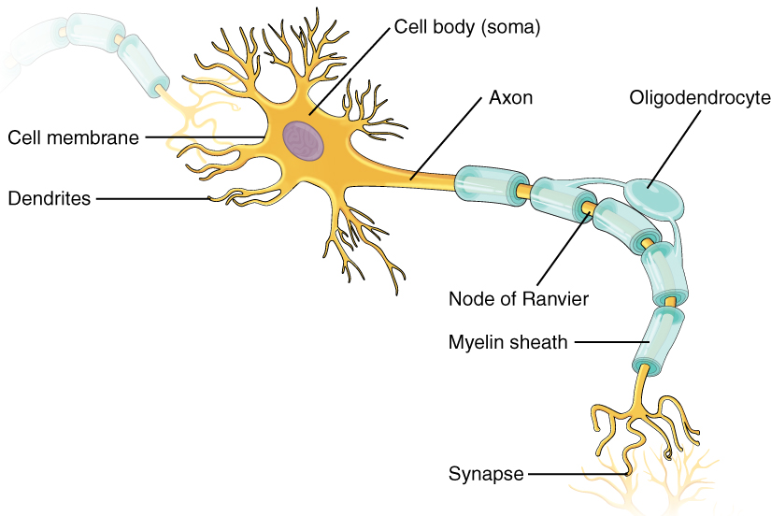
The Neuron

Slide 31
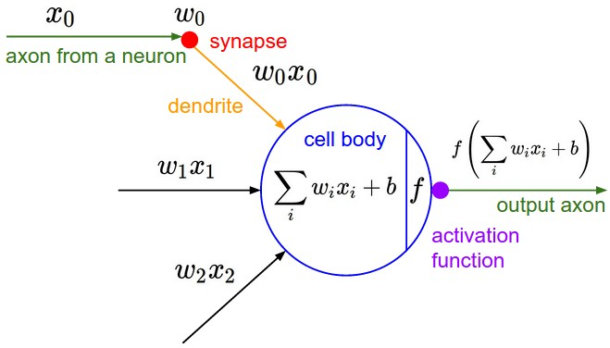
The Neuron Mathematical analogon
1 Neuron = Logistic Regressor

Slide 32
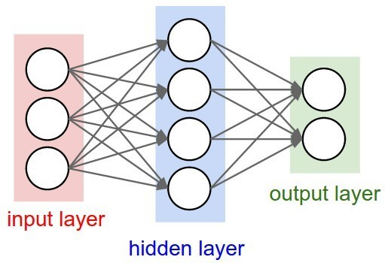
Neural Network
$$a_{1}^{(1)}$$
$$z_{1}^{(2)}$$
$$a_{1}^{(2)}$$
$$a_{1}^{(3)}$$
$$z_{2}^{(2)}$$
$$z_{1}^{(3)}$$
$$h$$
$$a_{2}^{(3)}$$
$$z_{3}^{(2)}$$
$$z_{2}^{(3)}$$
$$a_{3}^{(1)}$$
$$z_{4}^{(2)}$$
$$a_{4}^{(1)}$$
Learns abstract features

Slide 33
Neural Network
$$1$$
$$1$$
$$a_{1}^{(1)}$$
$$a_{1}^{(2)}$$
$$z_{1}^{(2)}$$
$$a_{i}^{(1)}=x_{i}$$
$$x_{1}$$
$$a_{1}^{(3)}$$
$$z_{2}^{(2)}$$
$$z_{1}^{(3)}$$
$$z_{i}^{(l+1)}=\sum_{j=1}^{n_{l}}{Θ_{ij}^{(l)}a_{j}^{(l)}+θ_{i0}^{(l)}}$$
$$x_{2}$$
$$h$$
$$a_{2}^{(3)}$$
$$z_{3}^{(2)}$$
$$z_{2}^{(3)}$$
$$x_{3}$$
$a_{i}^{l+1}=σ\left(z_{i}^{\left(l+1\right)}\right)$
$$a_{3}^{(1)}$$
$$z_{4}^{(2)}$$
$$a_{4}^{(1)}$$
$a^{(l+1)}=σ\left(Θ^{(l)}a^{(l)}\right)$
Sigmoid function $σ\left(z\right)= 1/{1+e^{−z}}$

Slide 34
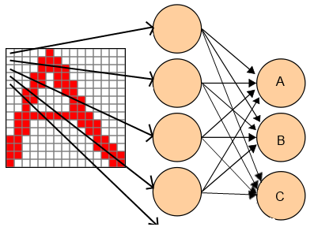
Multi-Class classification
Neural network has K output neurons
Each output neuron represents a different class e.g.
The neuron that fires most (has highest probabilty) wins
…

Slide 35
Multi-Class classification One-hot encoding
The true values have to be encoded to match output topology, i.e.
This encoding is called one-hot
A $≜\left(\begin{matrix}1 \\ 0 \\ 0\end{matrix}\right)$
B $≜\left(\begin{matrix}0 \\ 1 \\ 0\end{matrix}\right)$
C $≜\left(\begin{matrix}0 \\ 0 \\ 1\end{matrix}\right)$
…

Slide 36
Training Loss function
Loss function similar to logistic regress, but with K outputs
$$J\left(θ\right)=−\frac{1}{m}\sum_{i}^{m}{\sum_{k}^{K}{\left[y^{(i)}\log\left(h_{θ}\left(x^{(i)}\right)\right)+\left(1 −y^{(i)}\right)\log\left(1 −h_{θ}\left(x^{(i)}\right)\right) \right] }}$$
$$+\frac{λ}{2m}\sum_{l=1}^{L}{\sum_{k=1}^{n_{l}}{\sum_{j=1}^{n_{l+1} }{Θ_{jk}^{(l)}}}}$$
Sum over all parameters, except bias

Slide 37
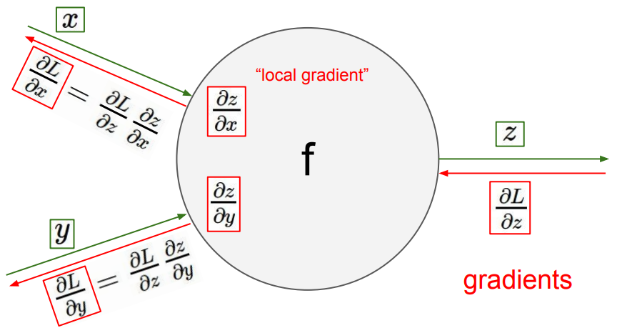
Training Back-propagation
Application of chain rule:

Slide 38
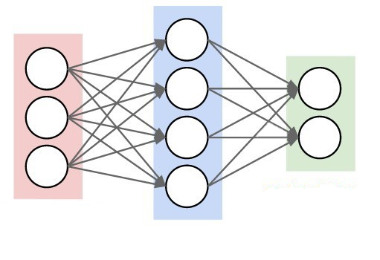
Training Back-propagation
$$θ_{}^{(1)}$$
$$θ_{}^{(2)}$$
$$a_{i}^{(1)}$$
forward activation flow
$$z_{i}^{(2)}$$
$$a_{i}^{(2)}$$
$$a_{i}^{(3)}$$
$$z_{i}^{(3)}$$
$$J$$
$$\frac{∂J}{∂a_{i}^{\left(3\right)}}$$
$$\frac{∂J}{∂z_{i}^{\left(3\right)}}$$
$$\frac{∂J}{∂a_{i}^{\left(1\right)}}$$
$$\frac{∂J}{∂a_{i}^{\left(2\right)}}$$
$$\frac{∂J}{∂z_{i}^{\left(2\right)}}$$
$$\frac{∂J}{∂θ_{}^{\left(1\right)}}$$
$$\frac{∂J}{∂θ_{}^{\left(2\right)}}$$
Backwards gradient propagation

Slide 39
Training Back-propagation, Example
Back-propagate: $f\left(3,−4, 2, 1\right)$ for $f\left(x,y,z,w\right)={\left(xy+\max\left(z,w\right)\right) }^{2}$
X
3
80
*
-4
-12
y
-60
-20
-10
100
+
^2
z
2
-20
1
2
-20
max
-20
1
w
0

Slide 40
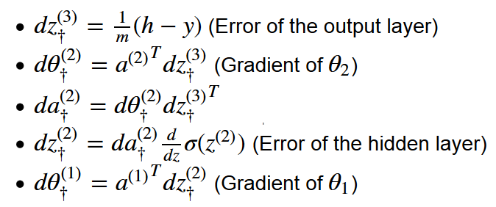
Training Back-propagation, Layers
Just believe me ;)
Add regularization part

Slide 41
Training Setting initial parameters $θ$
Bad: all zero values
Lead to same gradients and same updates.
Bad: large values
Activation is saturated
Gradients become zero
Optimization can‘t process
Good: small random numbers
Keeps the activation in the dynamic region of the sigmoid function
Gradients usable
Breaks symmetry

Slide 42
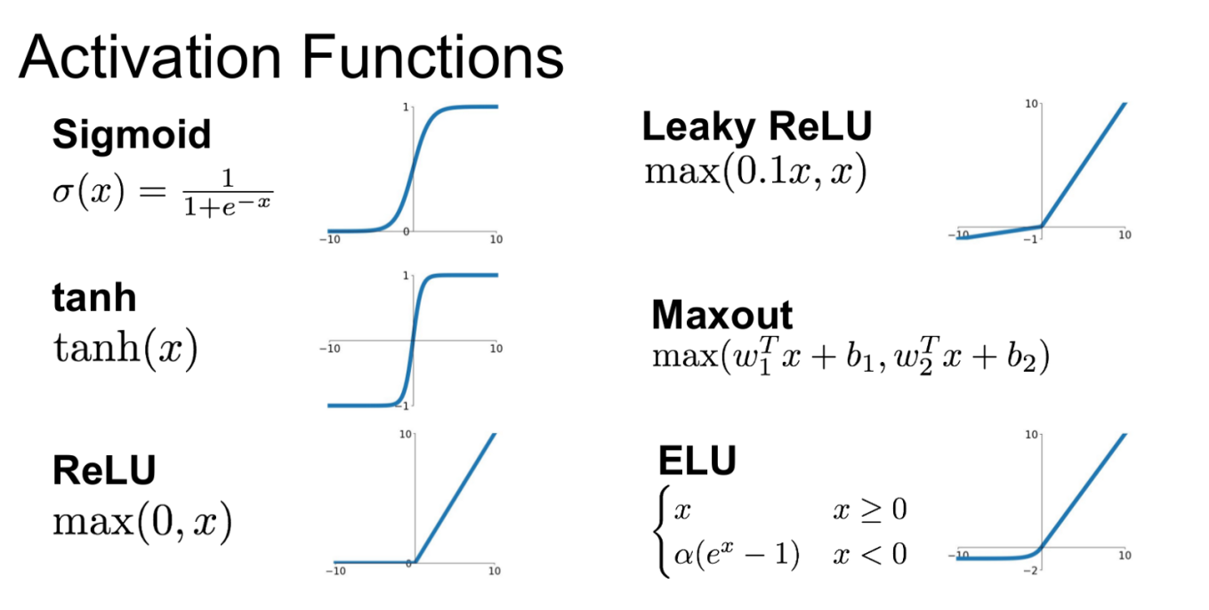
Advanced Topics Other activation functions
Add non-linearity, make networks more flexible
Different in training convergence
ReLU seems to work best for large networks!

Slide 43
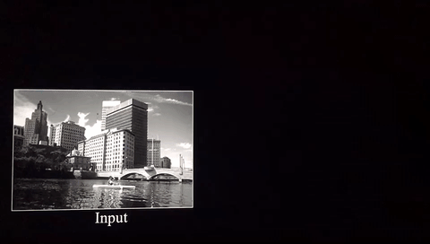
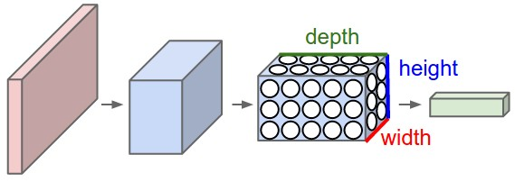
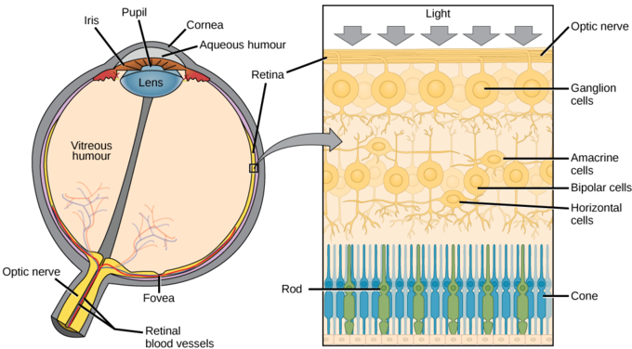
Advanced Topics Convolutional Networks
Image
Filters
Filtered images
Good for image classification
Similar to the receptive field of the eye

Slide 44
Advanced Topics Deep Networks
Currently very successful in image classification
Many layers, often combined with convolution

Slide 45
Advaned Topics Tensor Frameworks
Build to create large scale deep networks
Often GPU acceleration
Automatic gradient computation / back-propagation!
Specialized optimization algorithms (mini-batch mode, stochastic gradients)
Pre-configured networks …

Slide 46
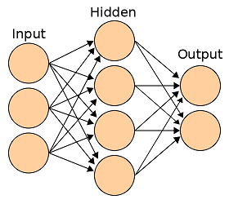
Excercise
Classify hand-written digits with a 3-layer network
TODO:
Implement and check the cost function of the Neural Network
Classify images from a test data set and compute the accuracy.
Figure out, how test set accuracy and training set accuracy depend on the number of samples.
Try to improve the accuracy by changing the number of neurons in the hidden layer or by changing the regularization.
30 min

Slide 47
Further reading
https://www.coursera.org/learn/machine-learning (Great introduction)
http://cs231n.github.io/ (Stanford course for Conv. Networks)
http://www.subsubroutine.com/sub-subroutine/2016/11/12/painting-like-van-gogh-with-convolutional-neural-networks (making art with neural networks)
https://www.youtube.com/watch?v=AgkfIQ4IGaM (Amazing video, how neurons get specialized tasks)
http://ruder.io/optimizing-gradient-descent/ (Overview on optimization algorithms for neural networks)

Slide 48
Questions
martin.siggel@dlr.de

