Slide 1
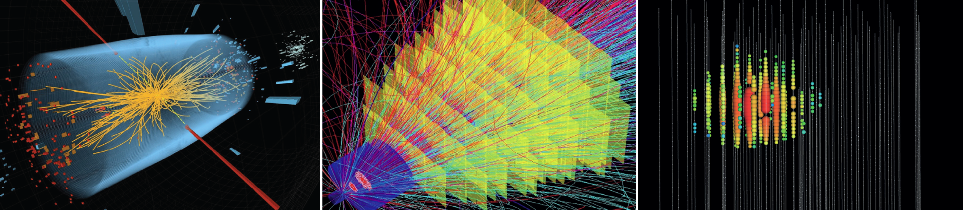

Matter and the Universe
Matter and Radiation from the Universe
Christian Stegmann – DESY

Slide 2

What is the role of
high-energy particles
dark matter
neutrinos
in the evolution of the Universe

Slide 3
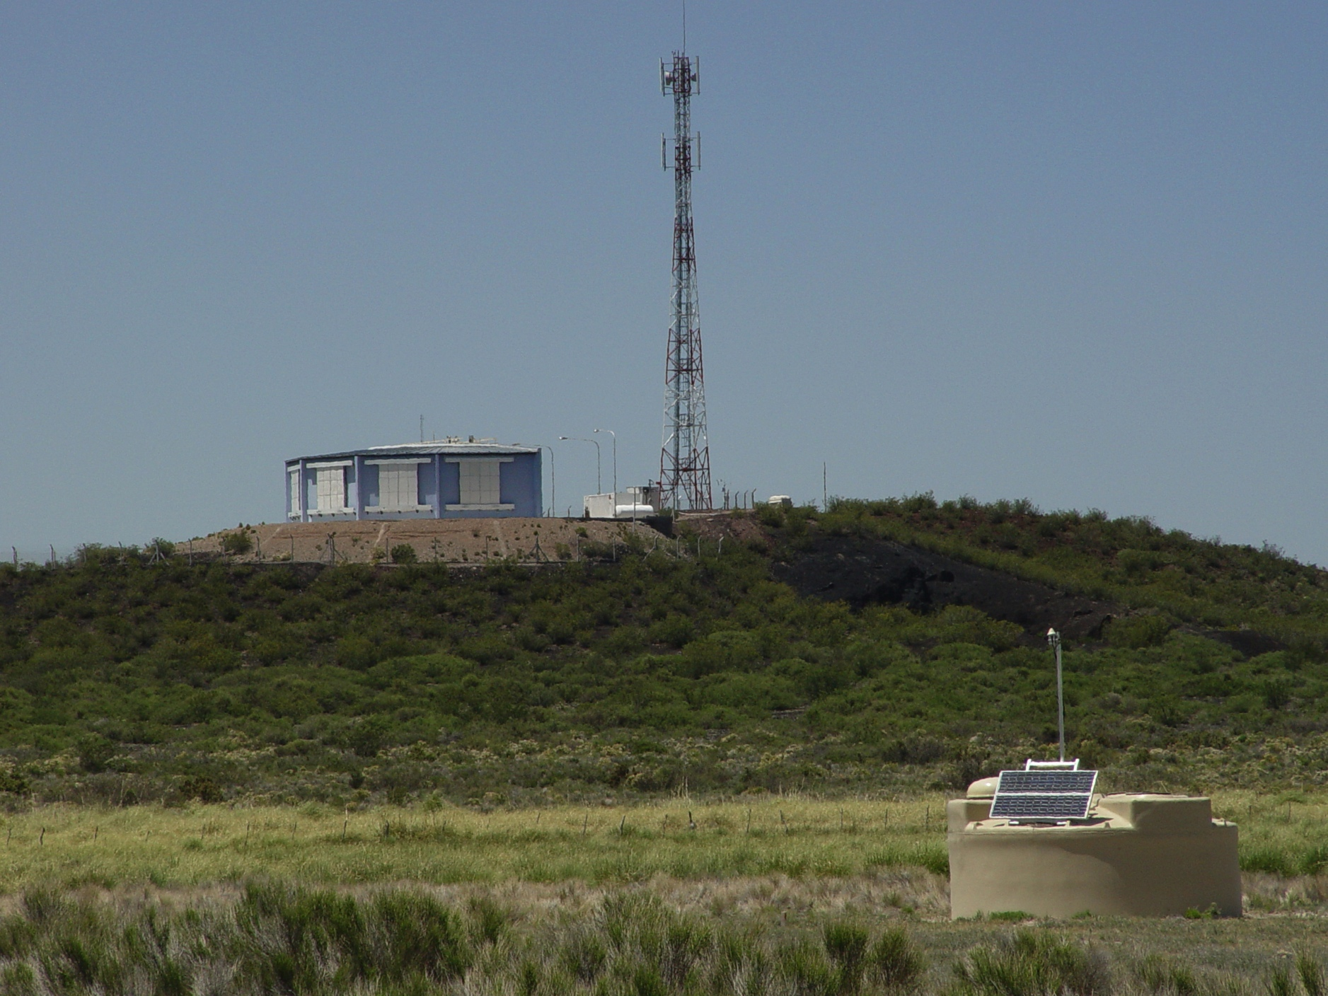
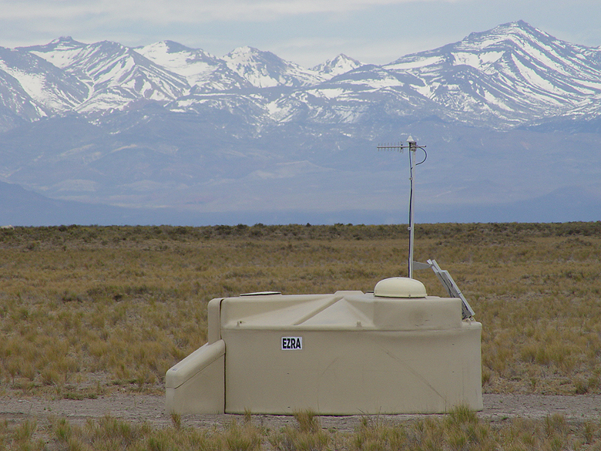
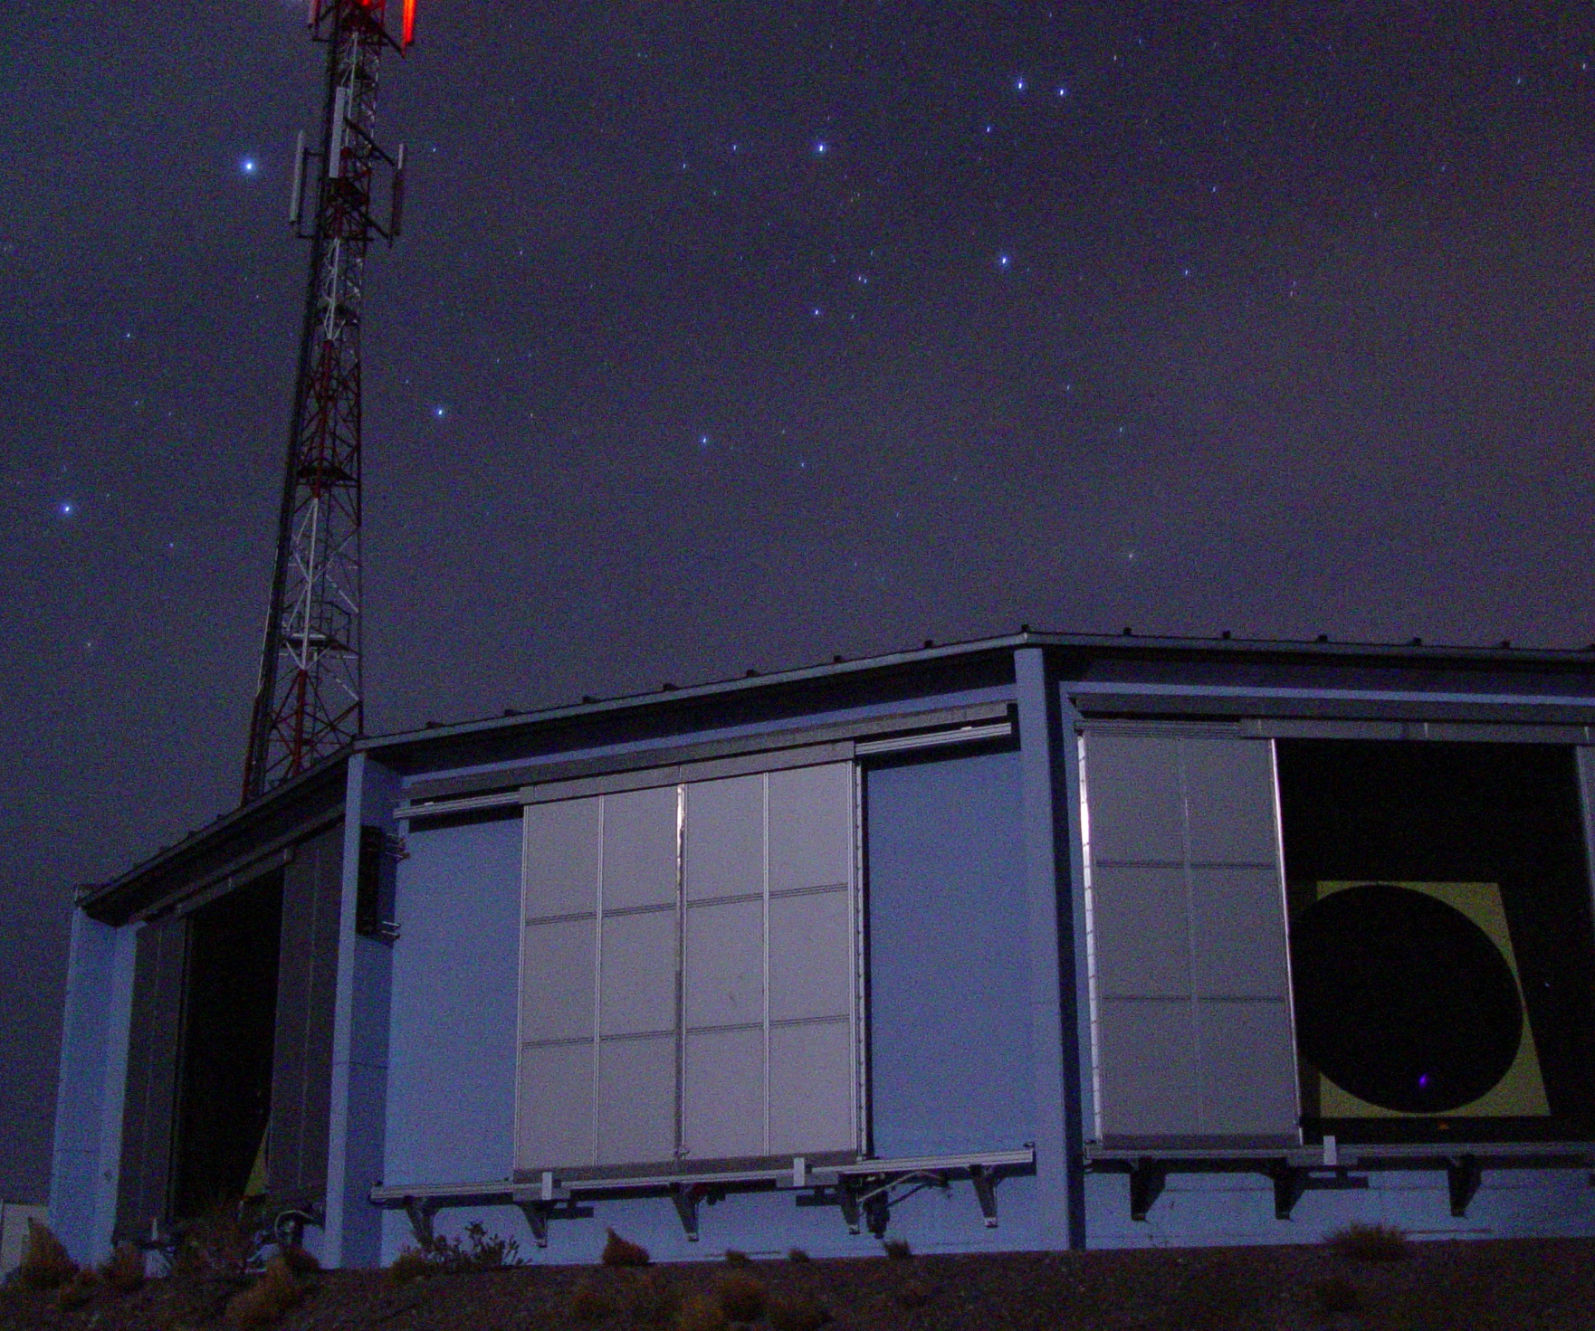
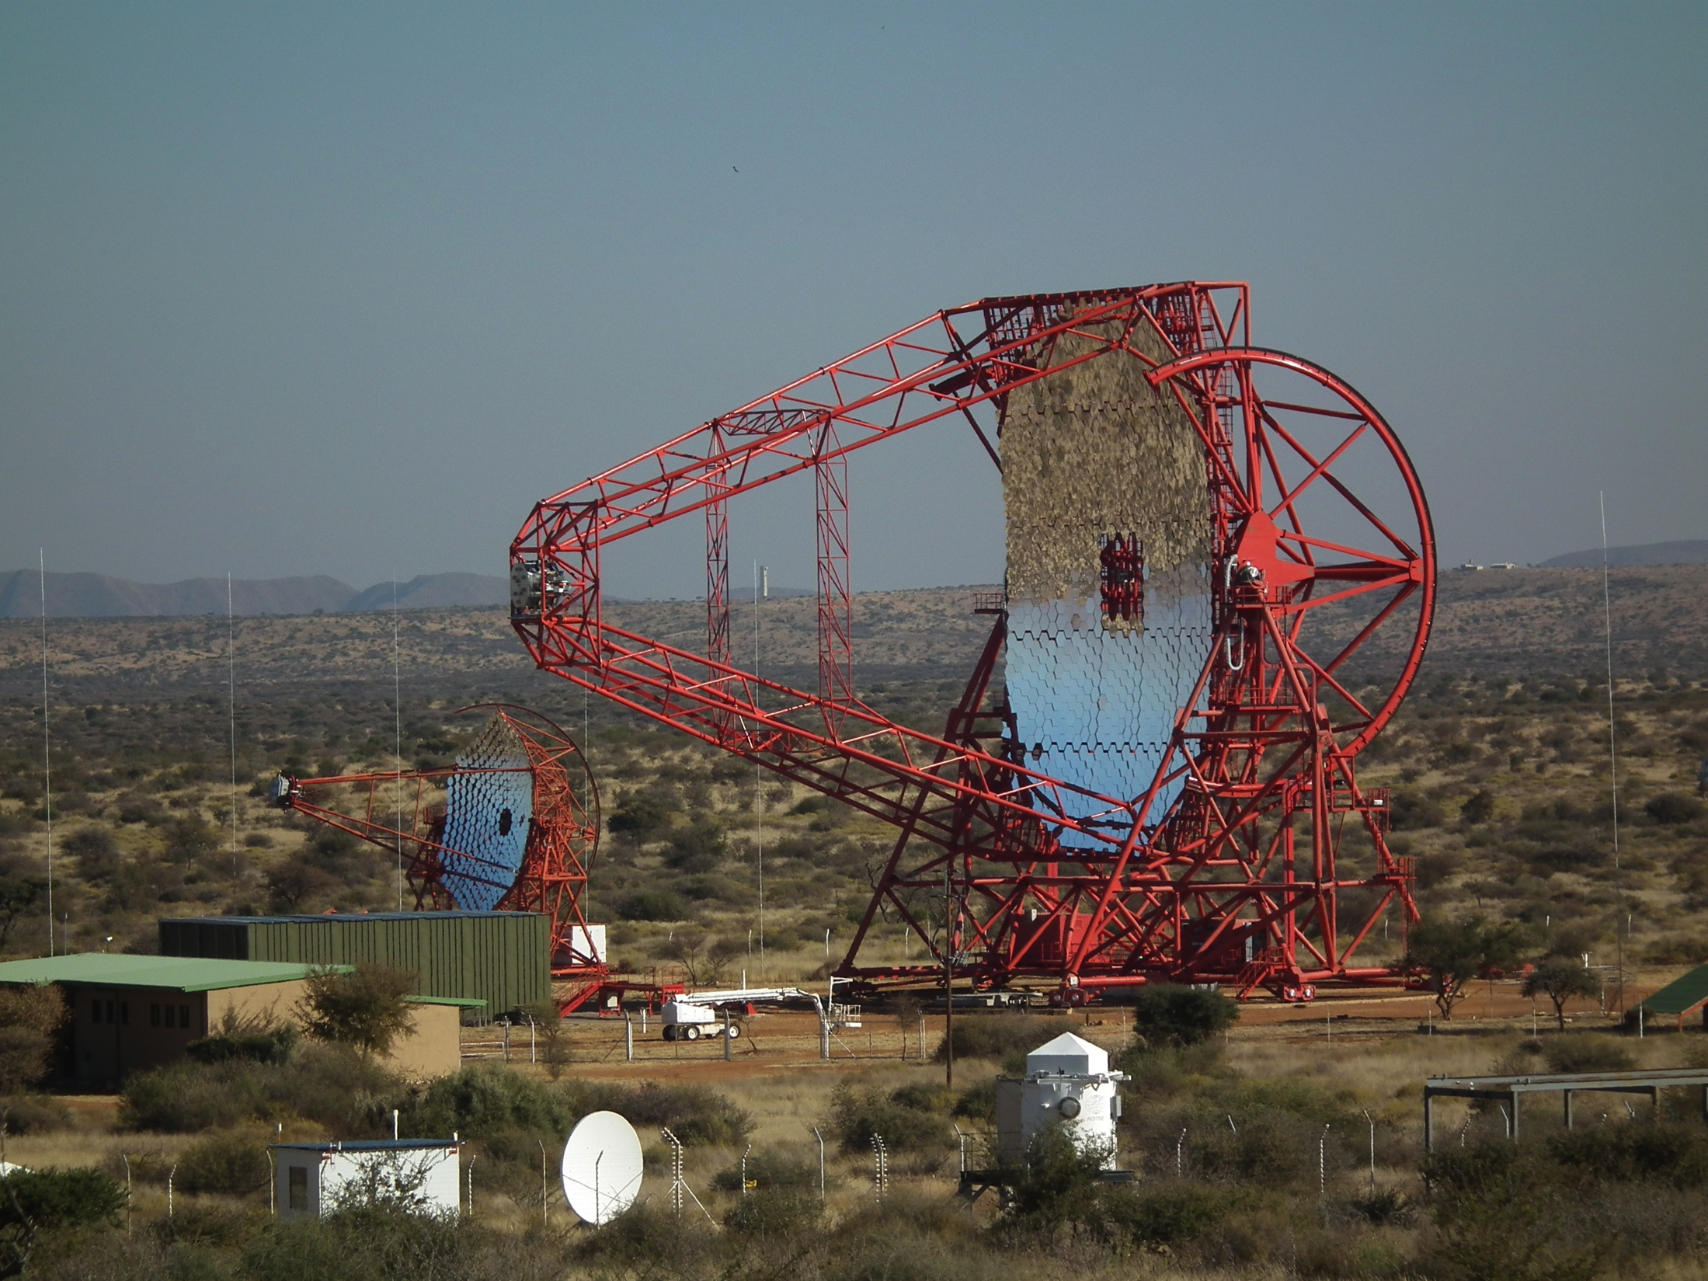
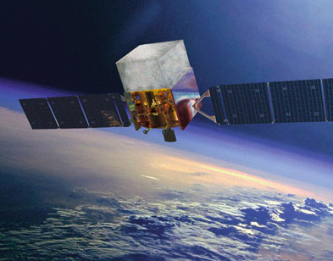
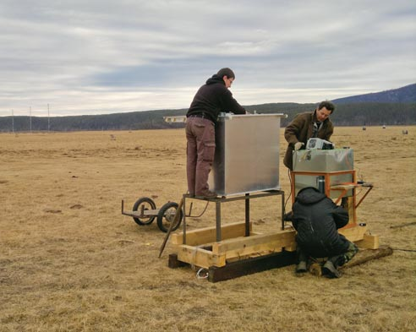
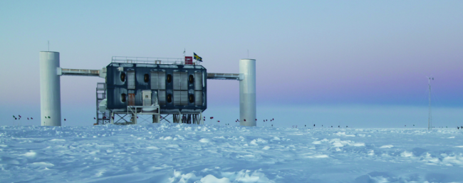
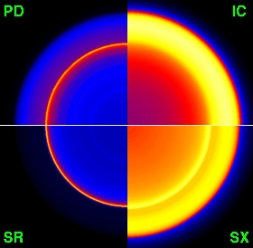
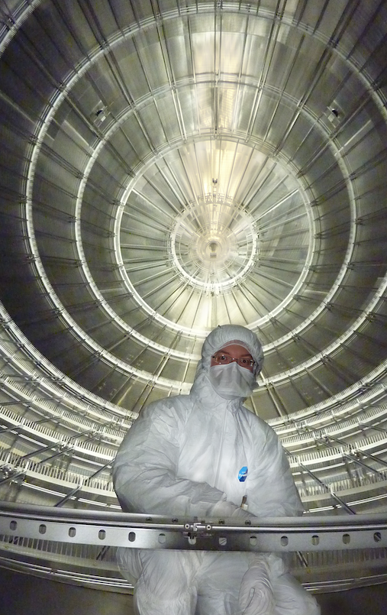
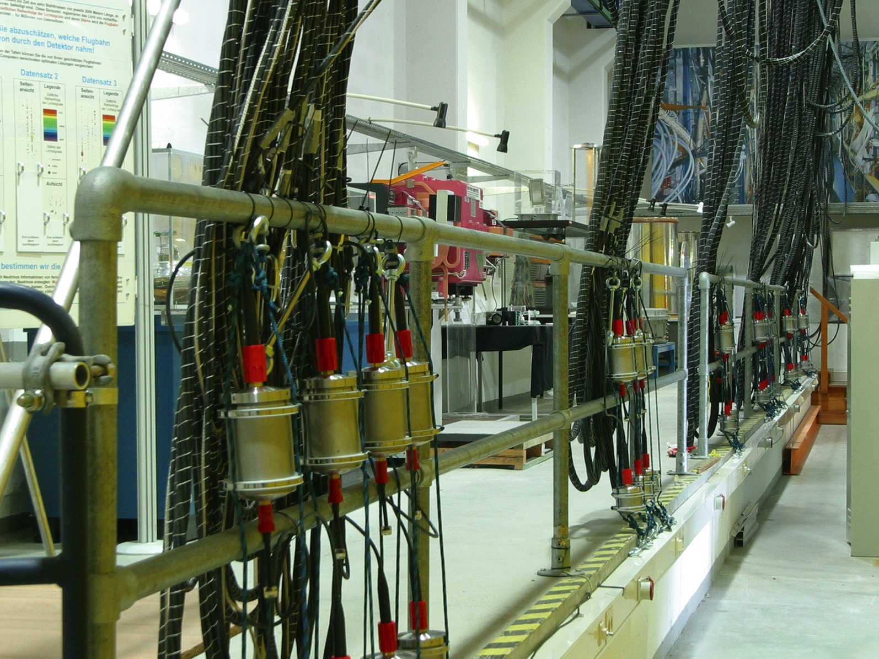
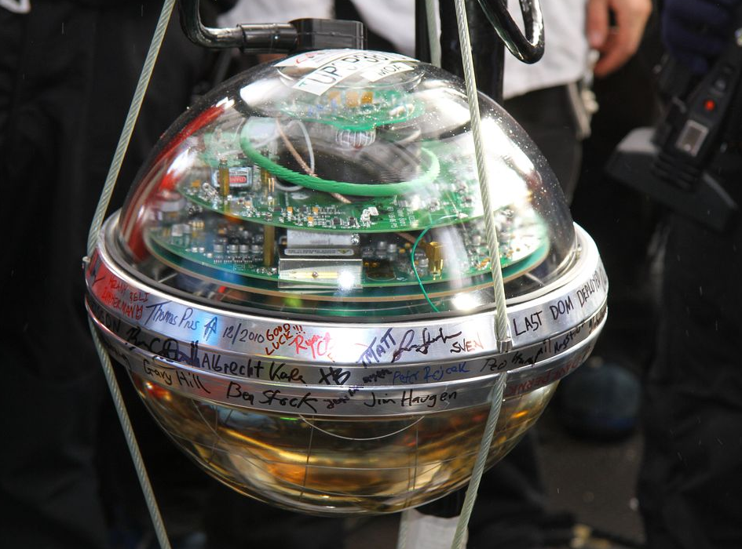
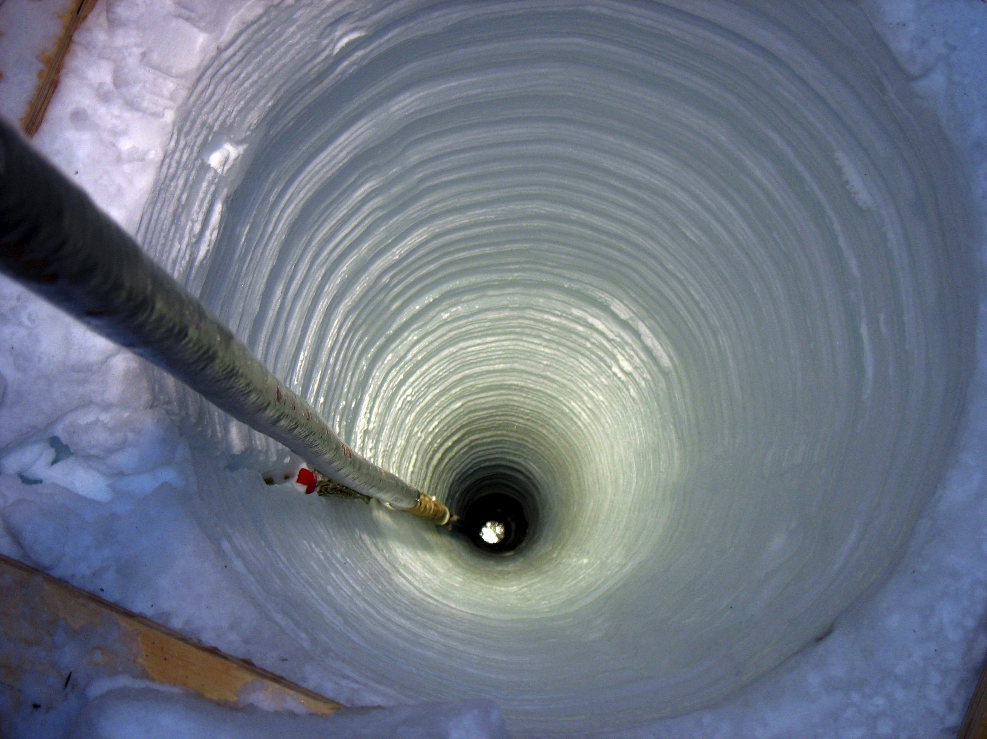
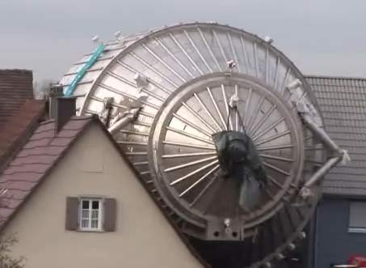
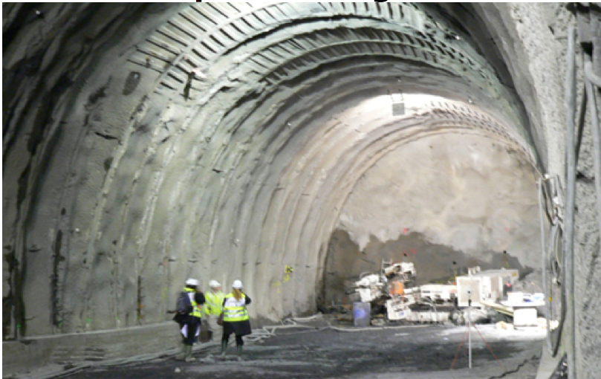
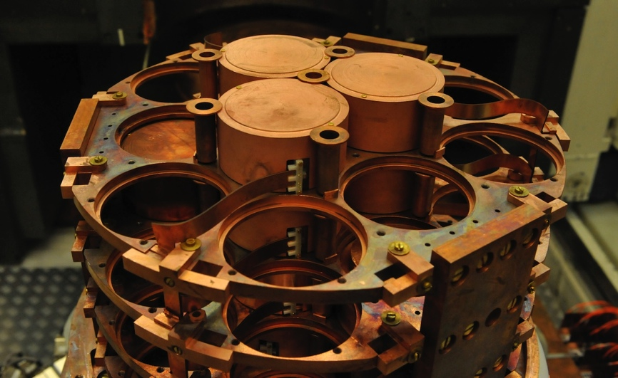
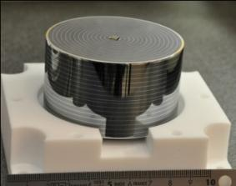
A Diverse Field of Activity
Notes:
We use instruments
ranging from a few cm³ to 3000 km²
from bolometers to radio antennas
placed in the laboratories and the weirdest places on Earth
in collaborations of a few groups to more than 1000 members

Slide 4
Messengers from the Non-thermal Universe

Slide 5
Messengers from the Non-thermal Universe
direct protons
via photons
via neutrinos
Notes:
Non-thermal Universe
to understand the origin and properties of the most energetic cosmic particles,
the establishment of multi-messenger astroparticle physics using high-energy neutrinos, photons and particles,

Slide 6
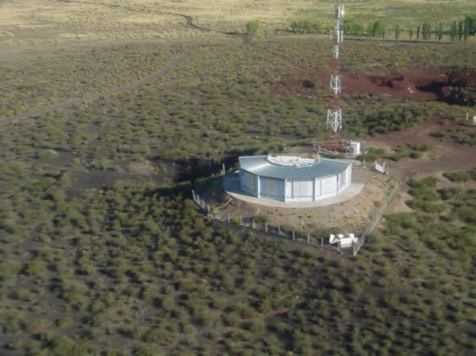
Cosmic Rays
Auger2023
What is the origin of the highest energy cosmic rays?
We are driving the field from KASCADE to the Auger Observatory
Notes:
Flux suppression for
E > 5.5×10¹⁹ eV
Limits on “top-down” models
Indication of an anisotropy
for E > 5.5×10¹⁹ eV
GZK scenario but …
… improved understanding of the observed flux suppression is indicating the upper-limit of the power of the accelerator.

Slide 7
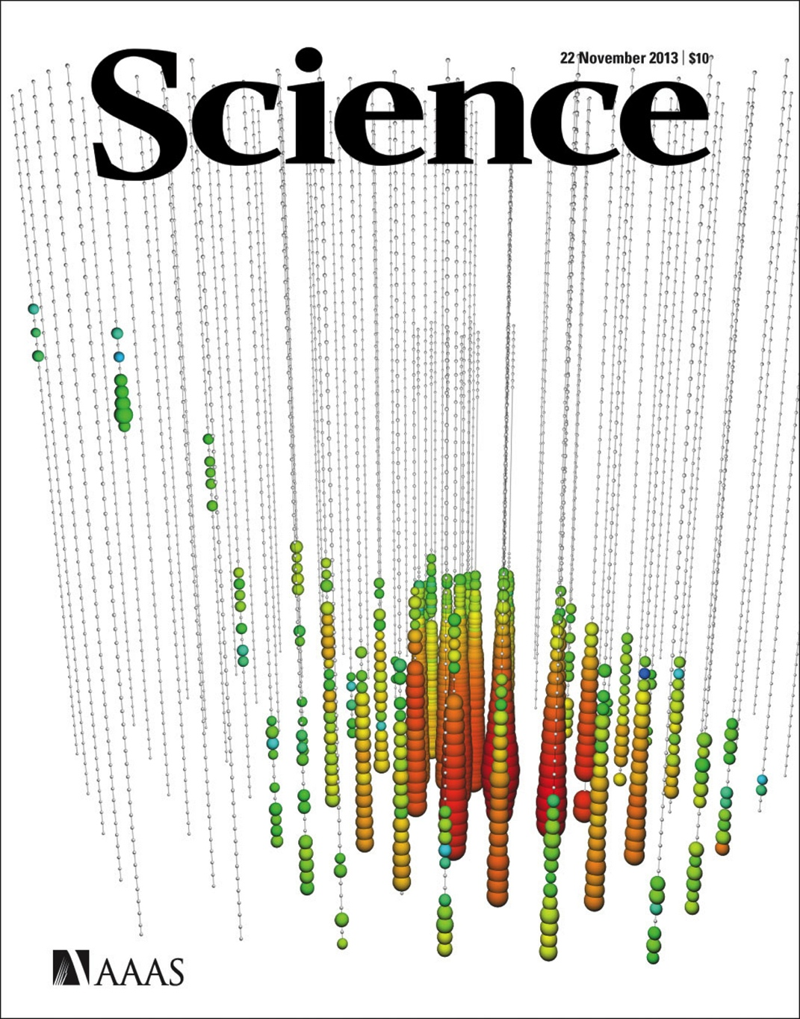
Neutrino Astronomy
First cosmic high-energy neutrinos
A new window to the non-thermal Universe.
We are pioneers in neutrino astronomy from Lake Baikal to IceCube

Slide 8
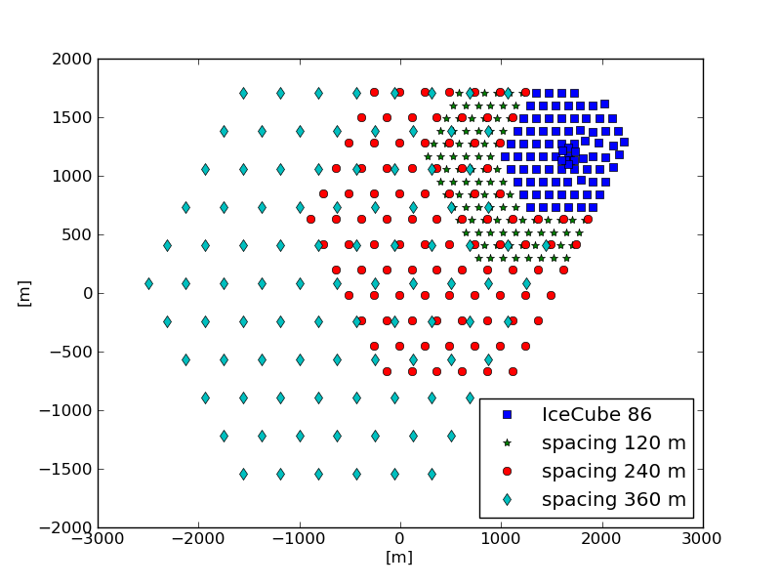
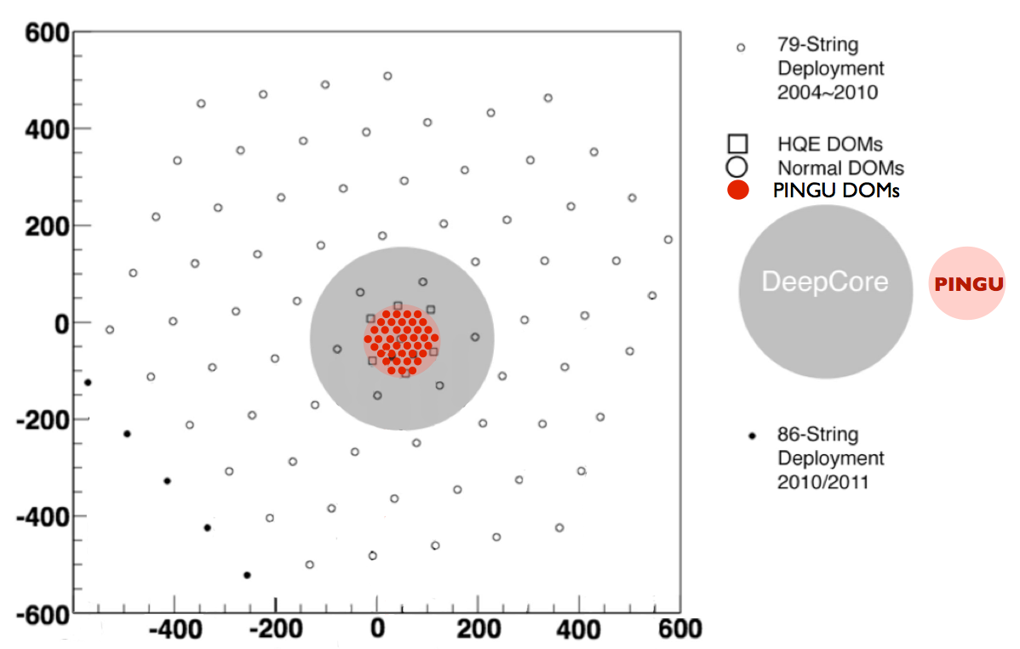
Future Options
IceCube++: a multi-km³ extension up to 12 km³
→ Future of neutrino astronomy
PINGU: 40 additional strings within DeepCore
→ Neutrino Physics
IceCube
IceCube
PINGU
Notes:
South Pole is a neutrino infrastructure

Slide 9
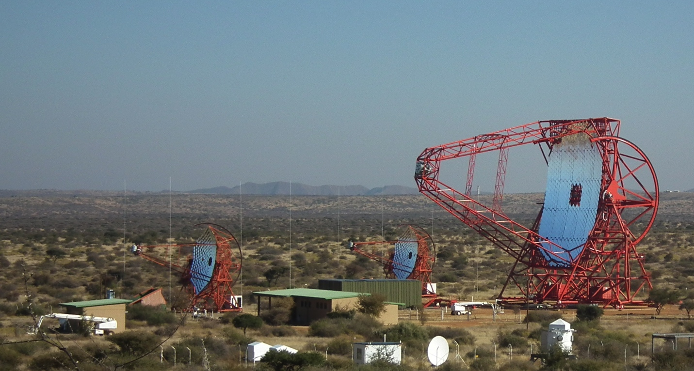
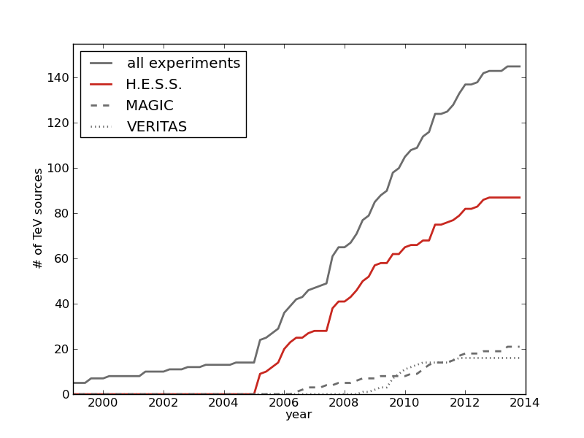
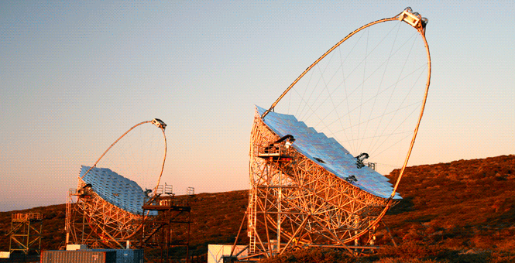
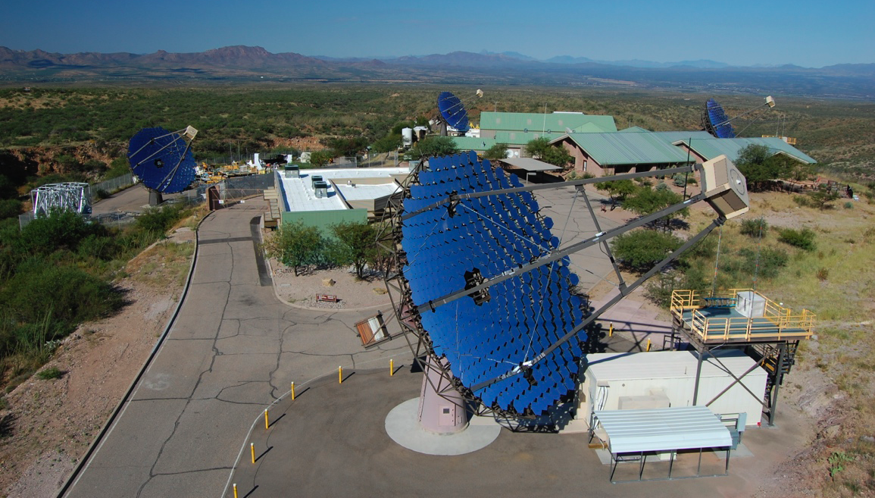
Gamma Ray Astronomy
H.E.S.S. in Namibia
H.E.S.S. in Namibia
MAGIC in La Palma
# of TeV sources
VERITAS in USA
VERITAS in USA
year
The Universe is full of gamma-ray sources.
We are able to design, construct and operate an observatory.

Slide 10
The Cherenkov Telescope Array
Helmholtz Mission:
“We research systems of great complexity with our large-scale facilities and scientific infrastructure, cooperating closely with national and international partners.”

Slide 11
Non-thermal Universe in PoF III
Keep or achieve the leadership in all fields
Cosmic Rays
  Improved operation and upgrade of the Pierre Auger Observatory (Auger2023)
  Explorative studies of new and optimized shower detection techniques
Neutrino Astronomy
  Continue operation and exploitation of IceCube
  Preparation and eventual construction and operation of PINGU
  R&D, design studies and preparation for a multi-gigaton extension
Gamma-ray astronomy
  Exploitation of H.E.S.S., MAGIC, VERITAS
  Construction of CTA
Notes:
Beyond the non-thermal Universe: Indirect Dark Matter searches and neutrino physics

Slide 12
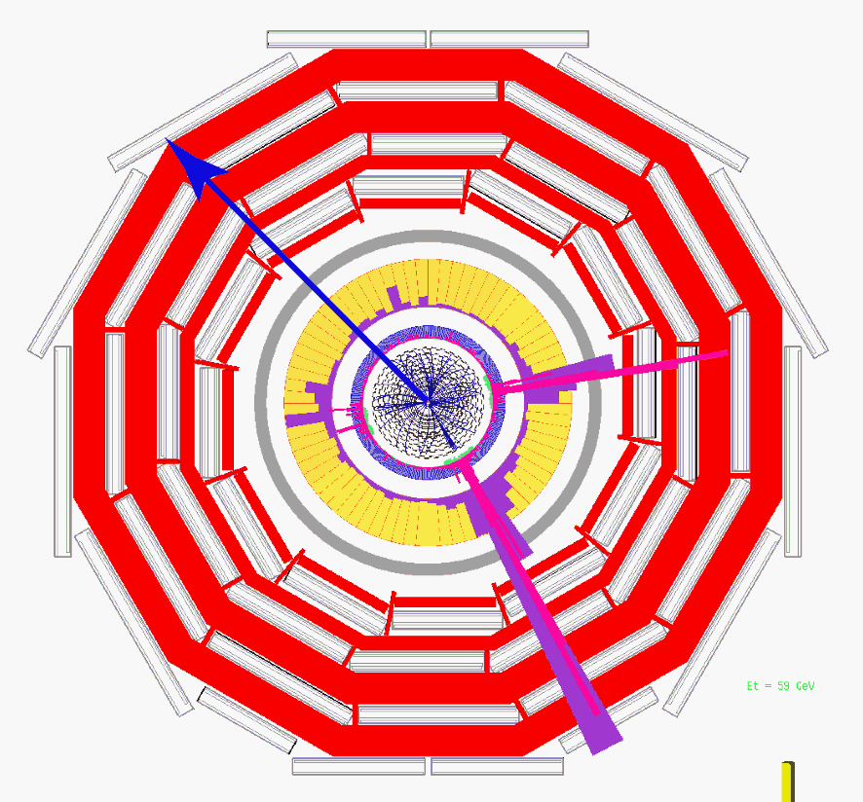
Dark Matter
indirect searches
direct searches
What is Dark Matter made of?
We couple indirect and direct measurements

Slide 13
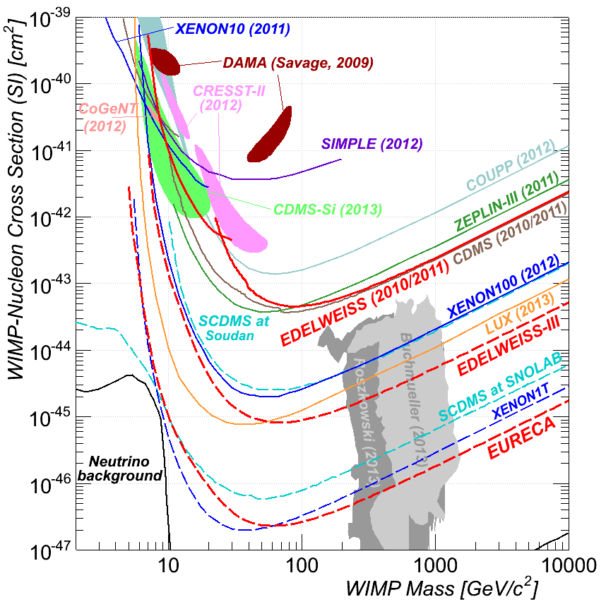
Our Path in Direct Dark Matter Searches
Direct searches
from EDELWEISS III to EURECA
stable and timely acquisition of WIMP search data with the EDELWEISS setup
develop key elements for the EURECA programme
Indirect searches
exploitation of existing data from neutrino, gamma-ray and CR instruments
Edelweiss II
Edelweiss III
Xenon100
EURECA
Xenon1T

Slide 14
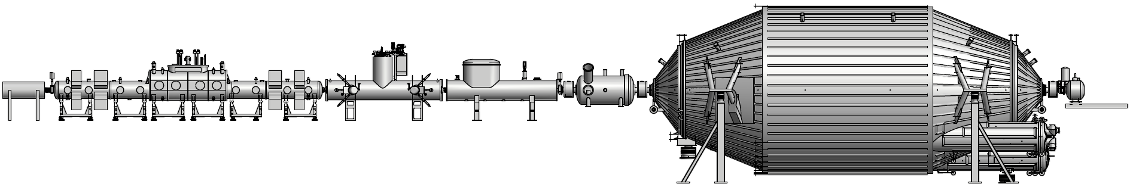
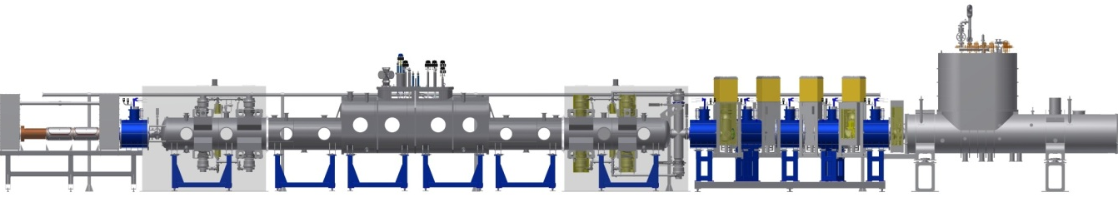
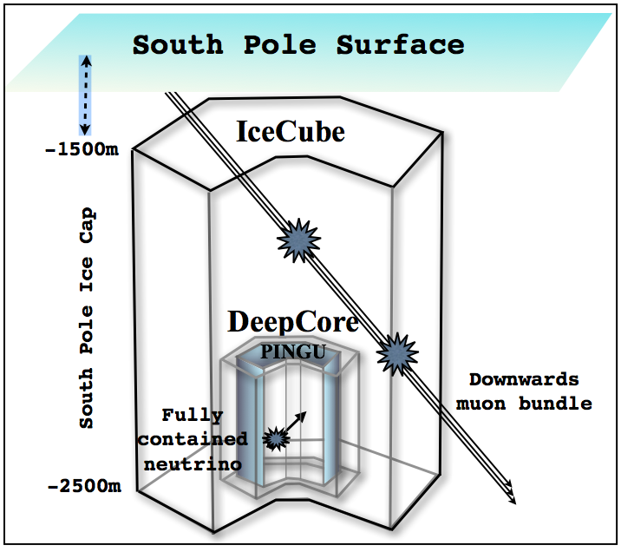
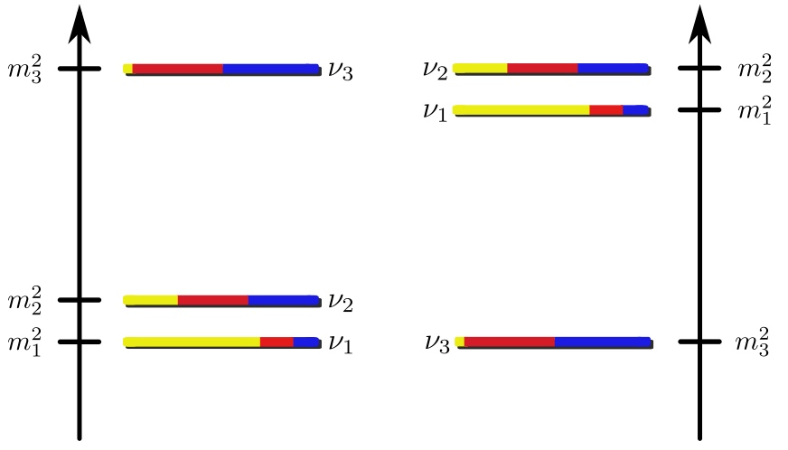
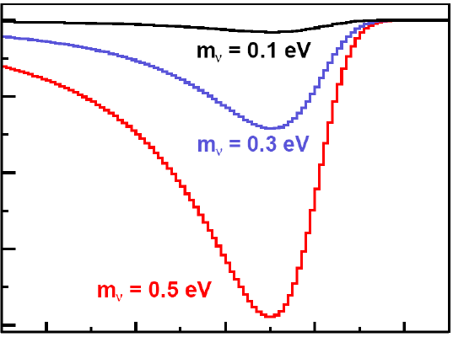
Neutrino Physics
m_{ν} = ?
normal
inverted
What is the mass and the mass hierarchy of neutrinos?
We are a unique place in the world for the mass measurement

Slide 15
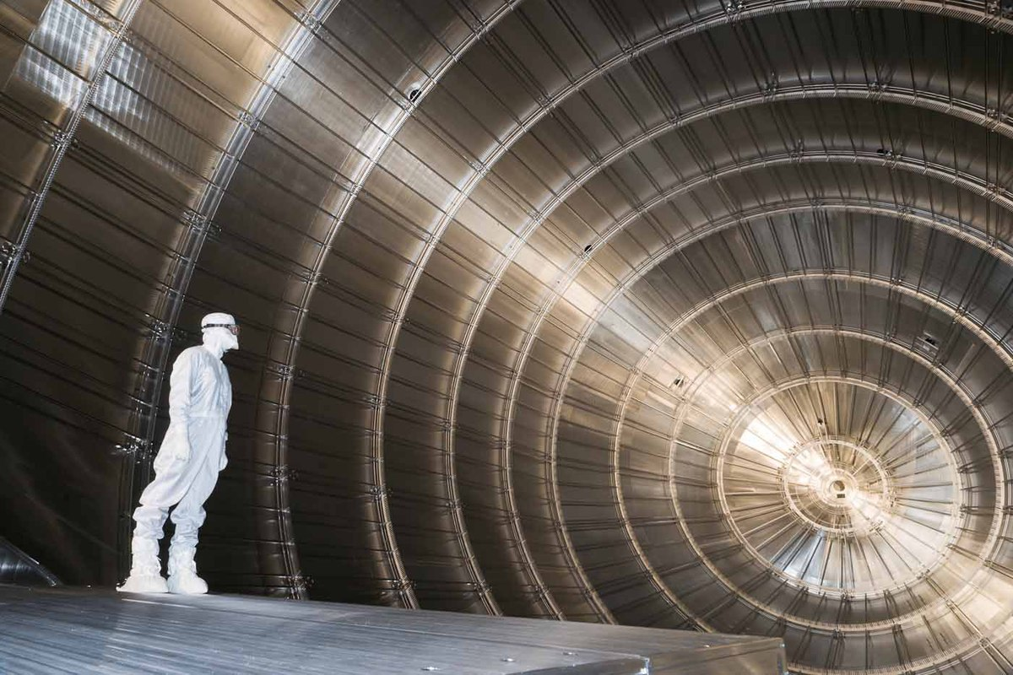
The Karlsruhe Tritium Neutrino Experiment
Helmholtz Mission:
“We research systems of great complexity with our large-scale facilities and scientific infrastructure, cooperating closely with national and international partners.”

Slide 16
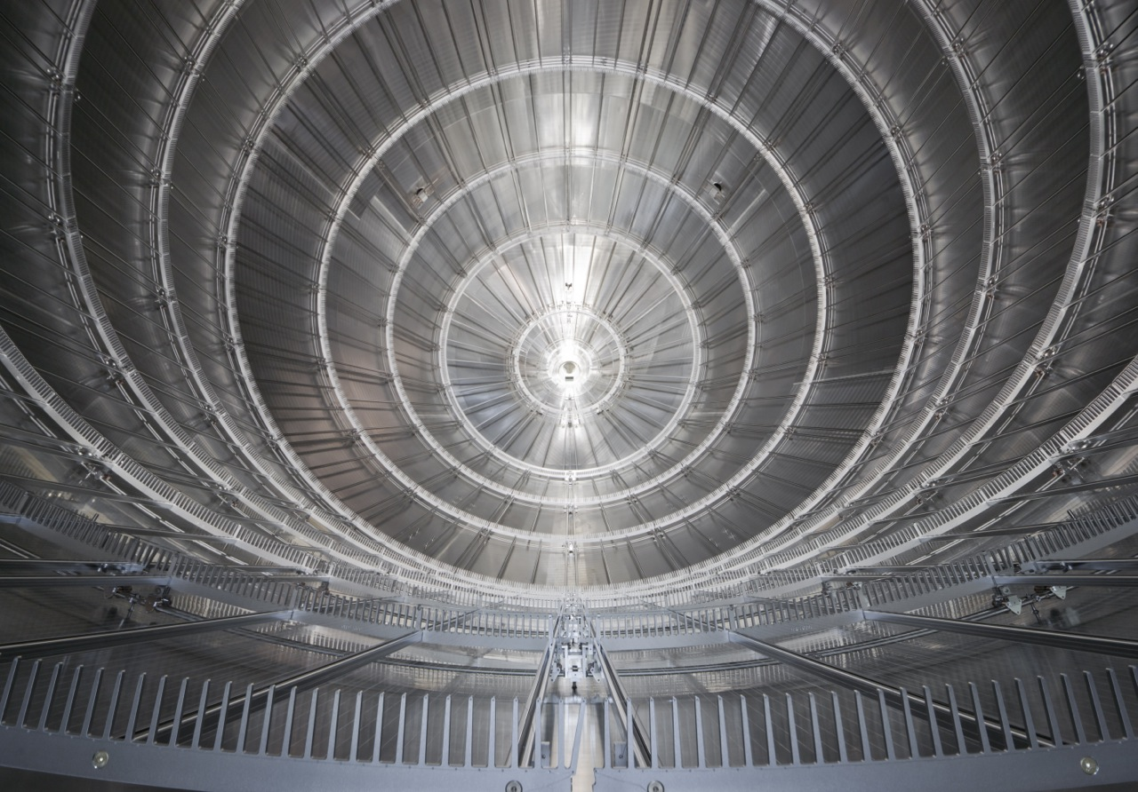
The Karlsruhe Tritium Neutrino Experiment
Helmholtz Mission:
“We research systems of great complexity with our large-scale facilities and scientific infrastructure, cooperating closely with national and international partners.”

Slide 17
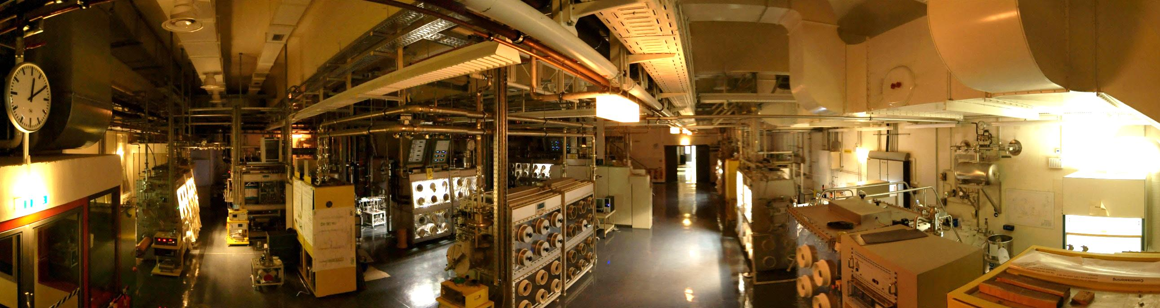
The Karlsruhe Tritium Neutrino Experiment
Tritium Laboratory Karlsruhe
  unique large research facility at KIT for KATRIN and fusion (ITER)
  20 years of experience in tritium handling and processing
  prepared for largest ever tritium throughput of 10 kg/a

Slide 18
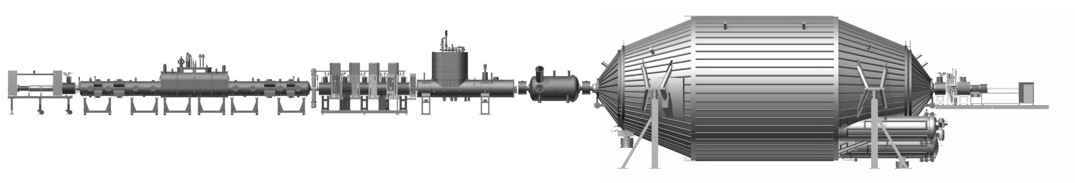
KATRIN Schedule
2014
spectrometer commissioning phase 1
background levels ~0.1 cps
manufacture of source components
end of 2015
Tritium retention operational
background level ~0.01 cps
mid 2016
System ready for tritium runs
sensitivity m(ν) = 200 meV (90% CL)
350 meV (5σ)
Notes:
largest ever UHV recipient (<10⁻¹¹ mbar)
tritium source: 10¹¹ ß-decays/s
total background: 10⁻² cps

Slide 19
A Topic with Multiple Connections
CTA
Auger
What is the role of
EURECA
high-energy particles
dark matter
neutrinos
IceCube
in the evolution of the Universe
and connecting theory
KATRIN

Slide 20
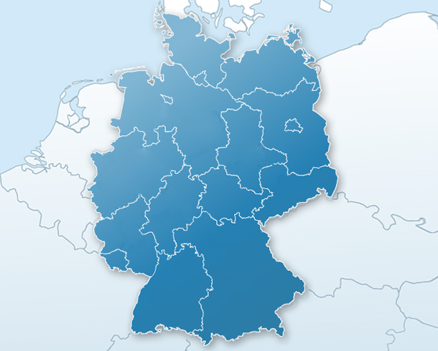
Cooperations
Hamburg
Berlin
Potsdam
DESY
Münster
Bochum
Dortmund
Bonn
Wuppertal
Dresden
Aachen
Siegen
DESY/KIT: shaping the field in Germany
Helmholtz Alliance for Astroparticle Physics HAP
Mainz
Würzburg
Erlangen
Heidelberg
KIT
Tübingen
München

Slide 21
Astroparticle Physics Strategy in PoF 3
Standing
leading participation in world leading experiments and infrastructures
shaping the field in Germany and Europe and beyond
Balance
concentrate and advance established competences in astroparticle physics
combine research areas to maximize synergies
Potential
young and rapidly developing field of research
at the step to large infrastructures
driving technology developments

Slide 23
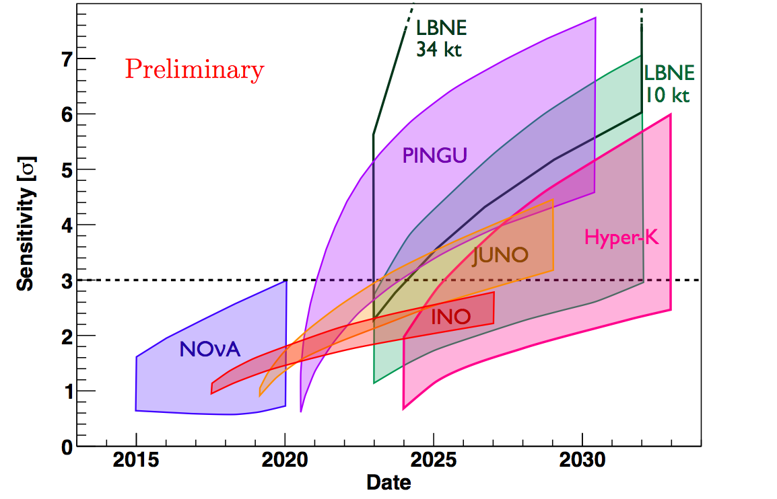
PINGU: Mass Hierarchy Sensitivity

